Slide 1
Muon Collider R&D
J. Scott Berg
Brookhaven National Laboratory
Fermilab ACE Science Workshop
June 14, 2023

Slide 2
Muon Collider Motivation
Recent strengthening of interest in physics at the 10 TeV scale
Would require ≈100 TeV CoM with protons
Electrons
  Would radiate too much in a ring
  A linear collider is long and expensive, plus beamstrahlung challenges
So instead use muons
  Fundamental particles, all energy goes to interaction
  Higher mass then electrons, so no radiation issues
  But they’re unstable and difficult to make...

Slide 3
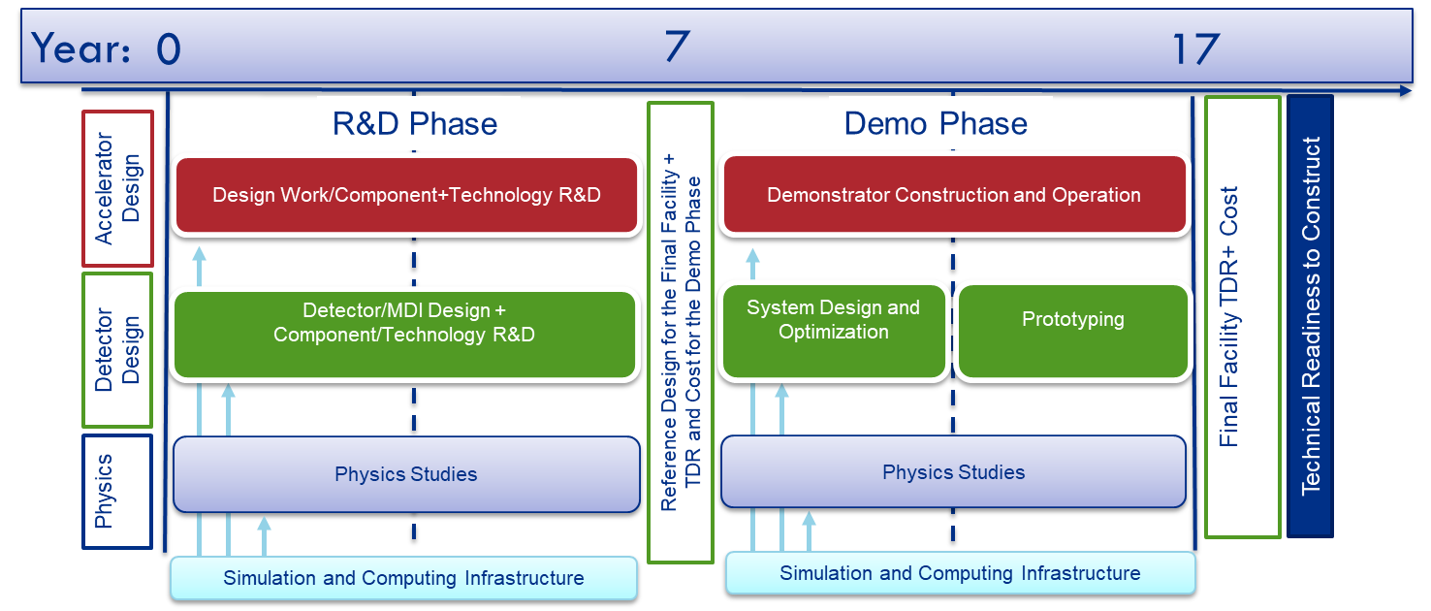
US Near-Term Plan
1st phase: key R&D, facility design, TDR(s) for demonstration(s)
2nd phase: prototypes, demos, muon collider facility TDR
Partner with IMCC throughout, but also study US-specific aspects

Slide 4

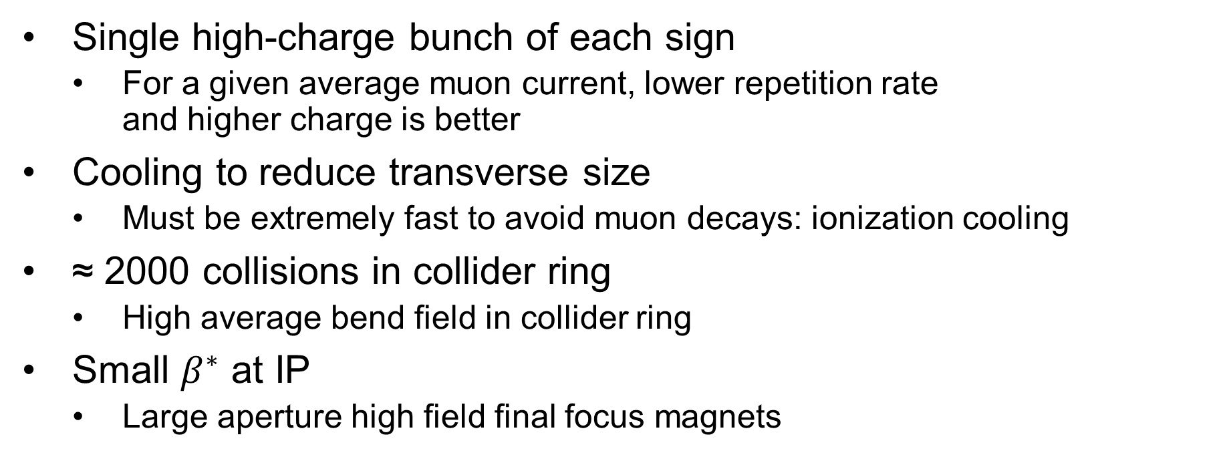
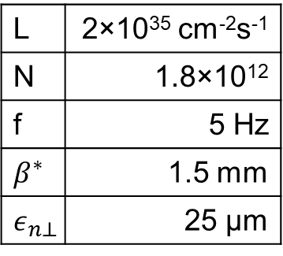
Luminosity in a Muon Collider
Single high-charge bunch of each sign
  For a given average muon current, lower repetition rate
  and higher charge is better
Cooling to reduce transverse size
  Must be extremely fast to avoid muon decays: ionization cooling
≈ 2000 collisions in collider ring
  High average bend field in collider ring
Small $β^{∗}$ at IP
  Large aperture high field final focus magnets
$$\frac{N_{+}N_{−}n_{C}f}{4πσ_{x}σ_{y}}$$
L | 2×10³⁵ cm⁻²s⁻¹
N | 1.8×10¹²
f | 5 Hz
$$β^{∗}$$ | 1.5 mm
$$ε_{n⊥}$$ | 25 µm

Slide 5
Muon Collider Facility Overview
Proton driver creating high-power proton beam
Front end: create pions at target, capture muons, convert to bunch train
Cooling: reduce emittance, combine into one bunch
Acceleration: increase energy
Collider ring

Slide 6
Target and Initial Capture
Proton beam (1–4 MW) hits target, producing pions, decay to muons
Pions produced with a large angular and energy spread but a small spot size
Target is in a high field solenoid
(15–20 T), which tapers down to a
lower field to capture a large angular divergence
Very challenging engineering in target station

Slide 7
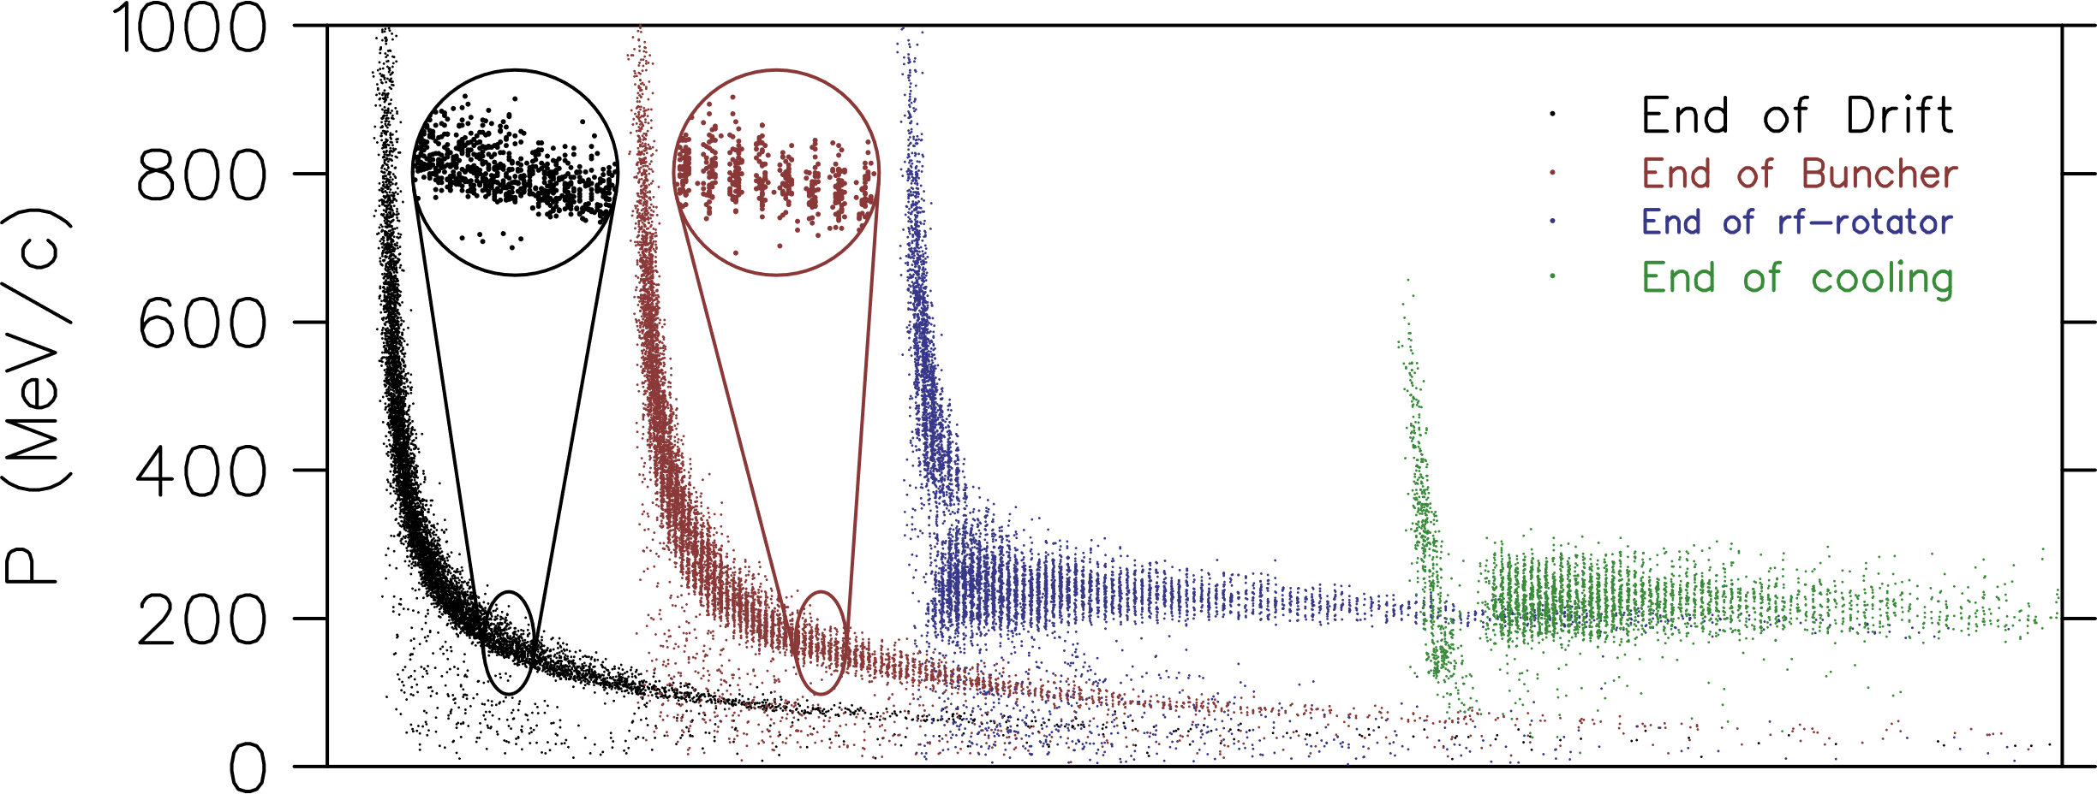
Capture of Bunch Train
Beam develops a time-energy correlation
RF cavities form bunches
Adjust RF frequencies to give bunches similar energies
Works for both
muon signs
Short proton
bunches needed

Slide 8
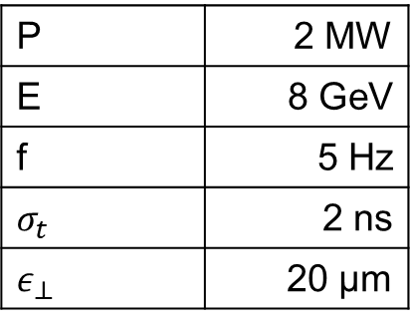
Proton Driver Requirements
High power, 2–4 MW
Moderate energies: 4–20 GeV
High charge, so low repetition rate
Short bunches (capture efficiency): 1–3 ns
Small transverse emittance
  Size and divergence matter at target
Best parameters depend on target material
ACE plan parameters should not preclude an upgrade to this
Sample Parameters
P | 2 MW
E | 8 GeV
f | 5 Hz
$$σ_{t}$$ | 2 ns
$$ε_{⊥}$$ | 20 µm

Slide 9
Proton Driver, Target R&D Topics
Proton driver
  Determine how Fermilab could supply protons
  for a muon collider (ACE plan should be compatible)
  Design and simulate accumulation & compression
  Experiments at existing facilities (IOTA, SNS, ...)
Target
  Study target material choices
  Perform material studies
  Design a target station: proton beam delivery, solenoids, shielding with its cooling, beam dump, particle selection chicane, ...
Sample Parameters
P | 2 MW
E | 8 GeV
f | 5 Hz
$$σ_{t}$$ | 2 ns
$$ε_{⊥}$$ | 20 µm

Slide 10
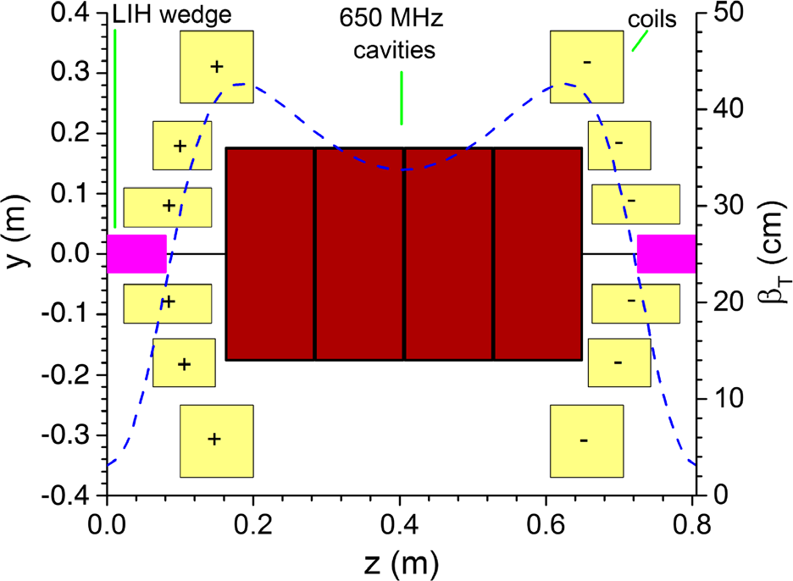
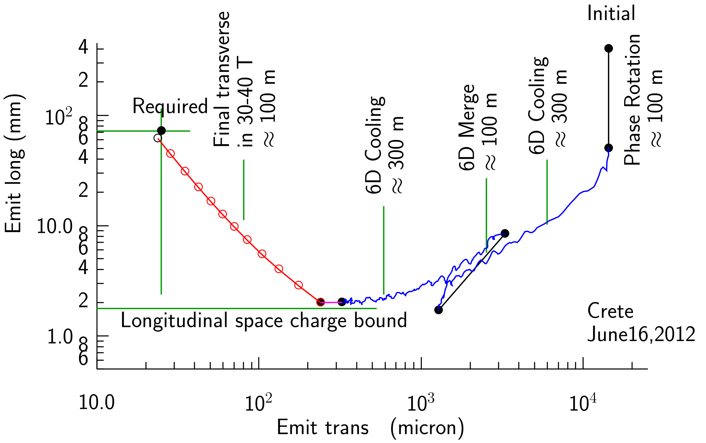
Ionization Cooling
Lose transverse and longitudinal momentum in absorber
  Large angular divergence in absorber relative to multiple scattering: strong focusing, high field
Restore longitudinal momentum in RF cavity
Dipole field and triangular absorber couple transverse to longitudinal, cool longitudinally
Cool bunch train, then merge to single bunch and cool more

Slide 11
Ionization Cooling
Late stages very challenging
  High fields
  Proximity of magnets to each other and to RF cavities
Reaches a performance limit
  Achievable magnetic field
  Energy acceptance (energy straggling)
  Transverse acceptance falling faster than emittance
  Intensity-dependent effects

Slide 12
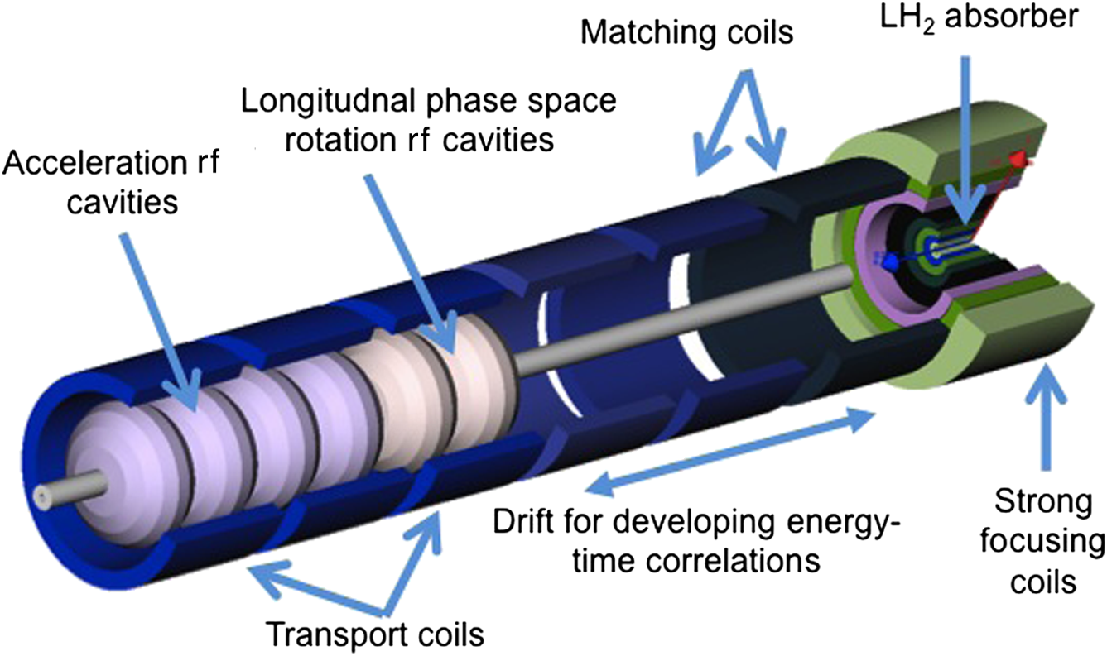
Final Cooling (Palmer)
Cool in a uniform, very high field solenoid
Non-adiabatic: significant amount of cooling
before reacceleration
  Difficult beam dynamics
Energy drops, solenoid effectively stronger
  Longitudinal emittance growth from slope of
  Bethe-Bloch curve
Forced to lower RF frequencies
Simulated performance currently worse
than we would like

Slide 13
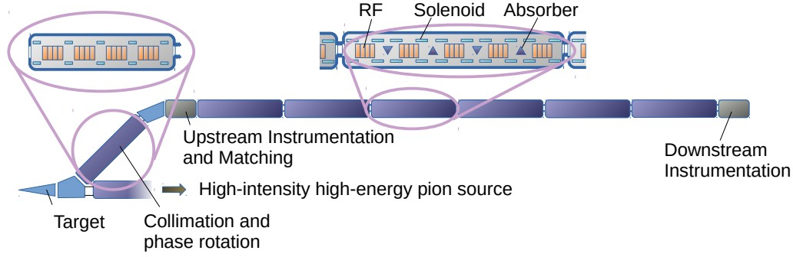
Cooling Demonstrator Facility
Demonstrate significant cooling in sequence of cells
Face engineering, operational challenges of muon collider cooling

Slide 14
Cooling Demonstrator Facility
Sufficient beam intensity required for good measurements
Few GeV protons, ns long, maximize pions around 200 MeV/c

Slide 15
Cooling R&D Topics
Improve performance of the rectilinear 6-D cooling channel
  Better technology: HTS, higher RF gradients, cold copper
  Incorporate engineering input
  Better lattice configurations, find limits from collective effects
Improve design of cooling to final transverse emittance
Prepare proposal for RF test facility
  Expand test plan beyond MAP (e.g., other materials, liquid N₂, magnet configurations, lower frequency)
Propose power source for rectilinear channel RF, make R&D plan
Design, possibly construct, cooling prototype cell

Slide 16
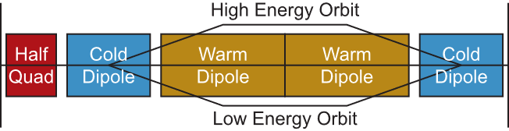
Acceleration
High average RF gradient to avoid decays (few MV/m)
Low energy: linacs, recirculating linear acclerators
High energy: synchrotron, ms pulse time
  Interleave SC fixed and iron bipolar pulsed dipoles: high average field
  Acceleration is largest ring: limits energy reach of given footprint

Slide 17
Acceleration R&D Plan
Design of acceleration just after cooling
Design of acceleration chain, including transport between stages
Find and design highest energy acceleration that will fit on Fermilab site
Prototyping of pulsed magnets
  Characterization of performance of smaller magnet at short pulse rates
  Design of the power supply
  Test full-scale magnet with power supply

Slide 18
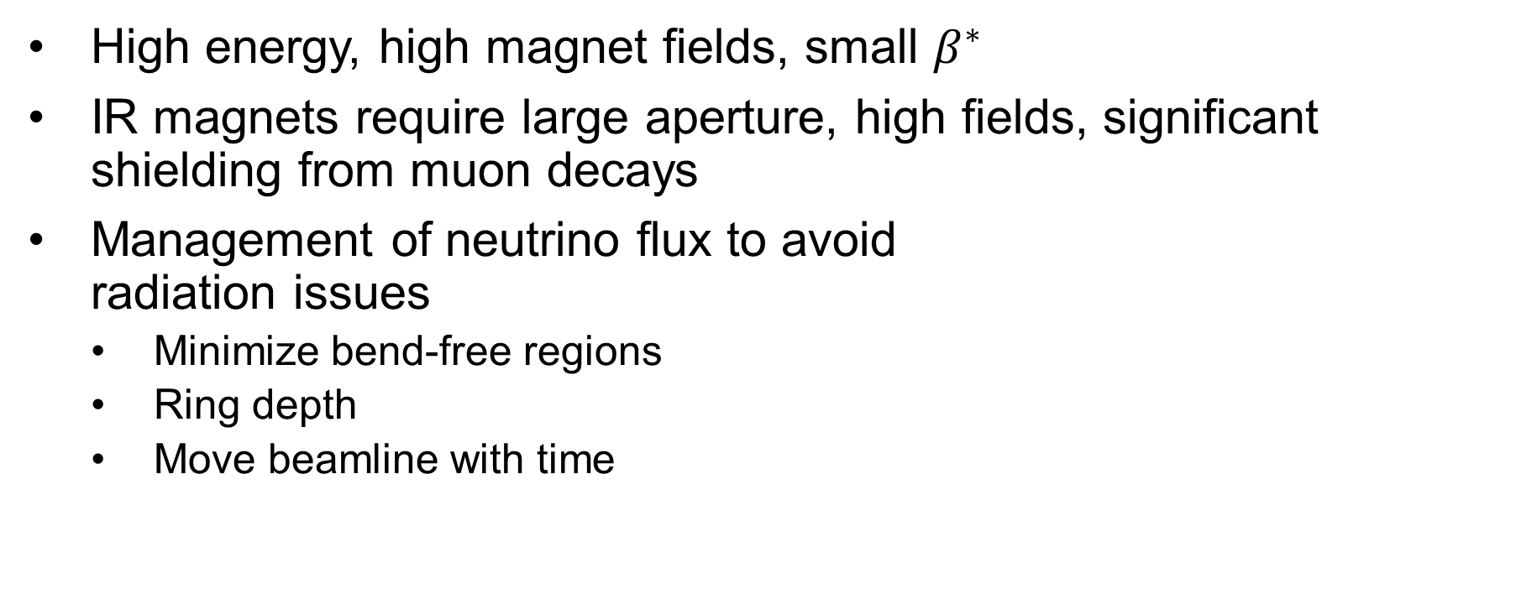
Collider Ring Challenges
High energy, high magnet fields, small $β^{∗}$
IR magnets require large aperture, high fields, significant shielding from muon decays
Management of neutrino flux to avoid
radiation issues
  Minimize bend-free regions
  Ring depth
  Move beamline with time

Slide 19
Collider Ring R&D Plan
Design a collider ring compatible with maximum acceleration energy on Fermilab site
  Consider shielding with its cooling, magnet technology limitations, management of neutrino radiation
Detail plan for mitigating neutrino radiation
Design most challenging magnets in the collider ring
Choose magnets to prototype, create designs and prepare prototyping program

Slide 20
Summary
There is a strong interest in physics at a ≈10 TeV muon collider
We understand how to make such a collider
  There are nonetheless significant engineering and design challenges
  Much design work remains
We have proposed a near-term R&D plan to P5
  To create a design report for a muon collider facility
  To do the needed R&D to answer major technical questions, prepare and begin component prototyping, and design a demonstrator facility
We could have a muon collider at Fermilab
  The ACE plan should ensure compatibility with a muon collider
  Cooling demonstrator: muon beams with sufficient intensity for measurements

