Slide 1
DAMSA Experiment
@ Fermilab PIP-II and Beyond
ACE Science Workshop
June 14 – 15, 2023
Fermilab
Jaehoon Yu
University of Texas at Arlington
For the DAMSA Collaboration

Slide 2
What is DAMSA?
Dark sector particle (DSP) search and discovery experiment at low E, high intensity proton beam facility
Stands for Dump produced Aboriginal Matter Search at an Accelerator (DAMSA)
  담사 (潭思) = 깊은생각 – Rumination or Reflection
    Jang et al., PRD 107, L031901 (2023)
Aims to discover DSP’s in the low mass regime at an accelerator ➔ ideally E_{beam} below the pion threshold
  Originally developed for 600MeV proton beams at a nuclear rare isotope facility
The 800MeV PIP-II and the ACE beams fit the bill
  The goal is to build the experiment by 2029 in time for PIP-II

Slide 3
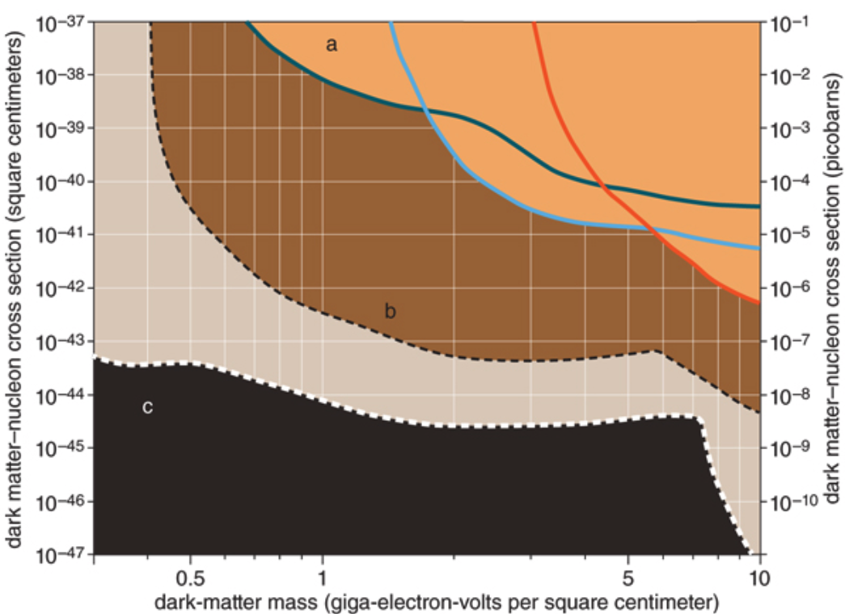
Physics Motivation For DSP
The SM describes the visible ~5% of the matter in the universe ➔ becoming more solidly established, while the neutrinos sector requires modifications
Dark matter (Dark Sector Particle, DSP) makes up about 25% of the universe ➔must be explored better
Direct searches have limitations in kinematic reach, leaving low mass range un-explored
Strategy:
  Search for rare particles in unexplored kinematic regime
  Make and discover DSPs in an accelerator
  Establish human infra on DM production
Focus
here
No DM
Future: SuperCDMS SNOLAB
Solar Neutrino Background
See Gordon K’s talk

Slide 4
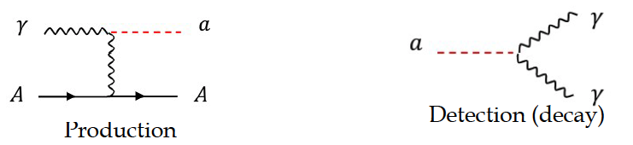
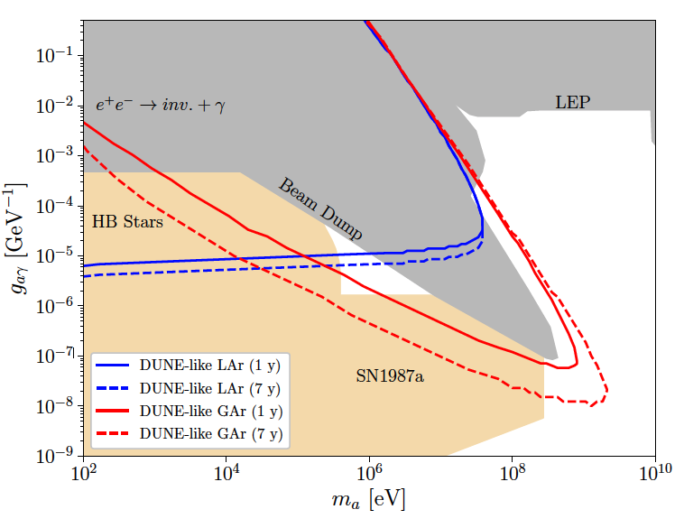
DAMSA Physics Strategy
Focus on Axion-like particles (ALP) in their two-photon final state via the Primakoff process as the use case
Produce as many photons as possible in the beam source, namely the dump
Capture as many ALPs as possible in as wide a mass range as possible
  Shorten the distance from the source to the detector
  Increase the detector angular coverage
Minimize the backgrounds from neutral particles
  Neutron spallation
  ν QE, RES, and NC interactions
This edge constrained by the distance from the source to the detector
Oppo
  Brdar, Yu et al., PRL126, 201801 (2021)

Slide 5
DAMSA Exp. Concept
Inject and absorb as many low-E (1GeV or less) protons and produce as large number of γ in the dump as possible
Allow higher mass ALP’s to decay with as small a number of neutrons escaping the dump as possible
Place the detector as close to the dump as possible on axis to expand the mass reach to higher mass region
Vacuum Decay Volume
L=10m
Detector
Proton beam
W Dump
L=1m
Absorber

Slide 6
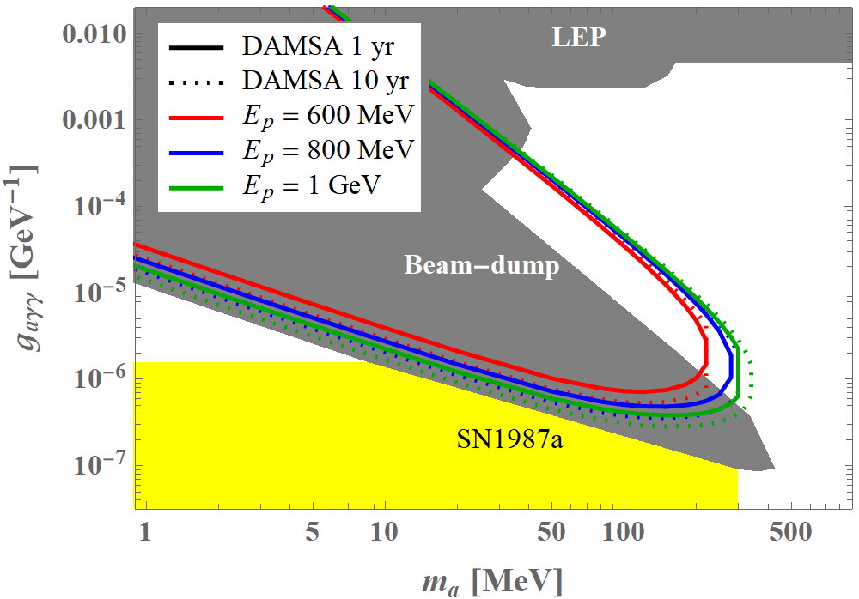
DAMSA Sensitivity Reach
Short lived! ➔ Capture decay products b4 det.
Long lived! ➔ Capture decays in the detector

Slide 7
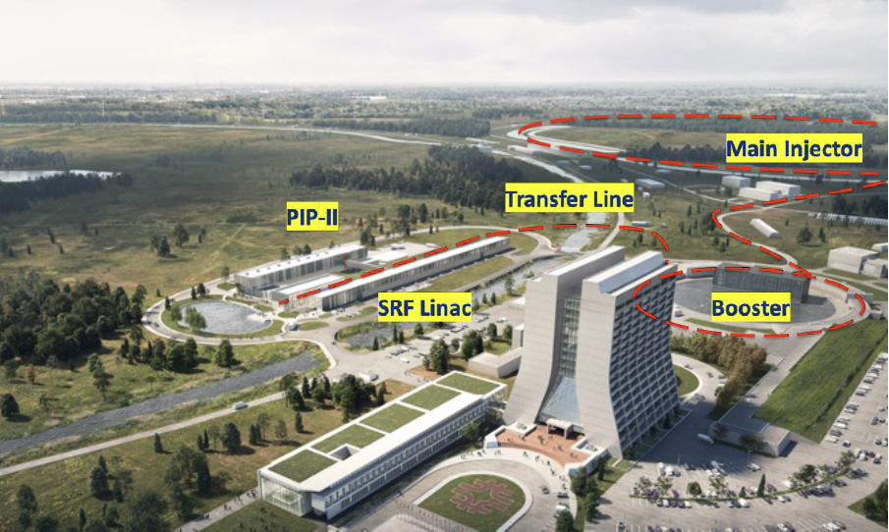
DAMSA Experiment Strategy
Overarching strategic goal: Get the detector ready to take data in time for PIP-II LINAC completion in 2029
Design and build the detector to meet the requirements with minimal R&D
  Fast timing (~0.1ns or better)
  High position resolution (~0.1mm or better)
  Excellent energy and invariant mass resolution
  Low threshold energy
Discover Dark Sector Particles in the beam and produce the beam of them
DAMSA

Slide 8
Conclusions
DAMSA is a DSP search and discovery experiment that leverages high intensity, low energy proton beams
  ALP and other physics topics will be explored
Detailed GEANT based studies performed for detector parameter requirements ➔ Optimization in progress
  Neutron background consideration
DAMSA collaboration building (6 US, 5 SK, 1 EU) w/ the goal to submit a proposal to Fermilab PAC Jan. 2024
DAMSA presents an excellent opportunity for transforming Fermilab’s PIP-II and ACE to a world-class DSP facility & to train the next generation physicists to lead dark matters in accelerators

Slide 9
Back Up Slides

Slide 10
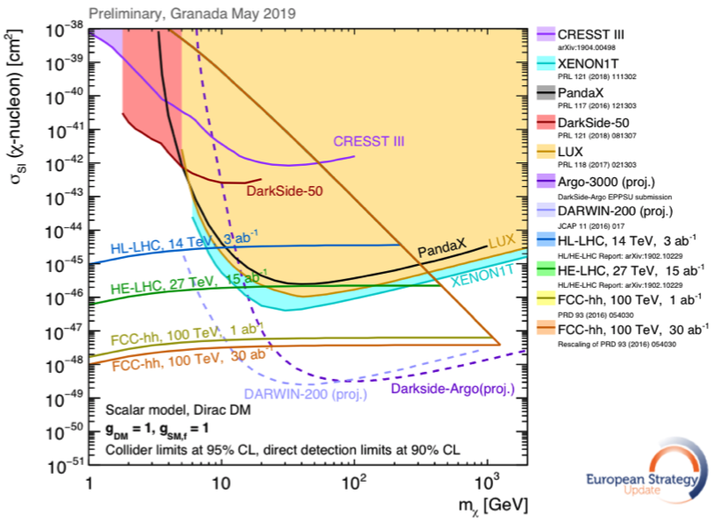
Physics Motivation For DSP
SM describes the visible ~5% of the matter in the universe ➔ becoming more solidly established, while the neutrinos sector requires modifications
Dark matter (Dark Sector Particle, DSP) makes up about 25% of the universe ➔must be explored better
Direct searches have limitations in kinematic reach, leaving low mass range un-explored
Strategy:
  Search for rare particles in unexplored kinematic regime
  Make and discover DSPs in accelerators
  Establish human infra on DM production
Focus
here
No DM

Slide 11
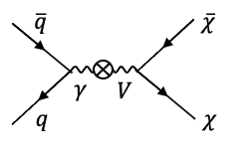
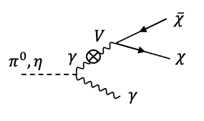
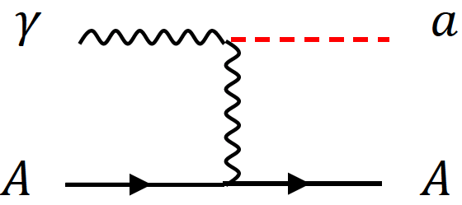
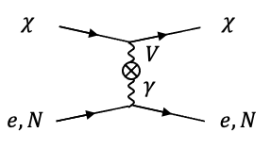
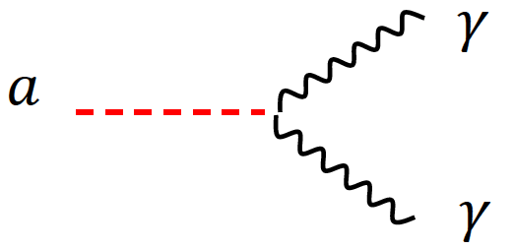
DSP’s? How do we make & see them?
Set of new particles which do not experience the known forces
DSPs can be weakly coupled to visible sector thru a mediator or “portal”
High intensity proton beams produce large number of photons from brem, DY and neutral mesons decays ➔ Make it possible to contemplate couplings of new U(1) gauge to SM γ
Detection through an electron scattering, N(n) recoil or 1, 2 γ final states

Slide 12
What’s needed to discover a DSP?
Direct Observation Signatures
  Requires high beam flux
  Large mass, high density detector for scattering
  Large volume, low density detector for decay
Inferred Observation Signatures from both beam and cosmogenic sources
  Leverage oscillatory behaviors
  Large mass detectors for interactions
What do we need to know?
  Signal flux and realistic behaviors in the detector
  Neutrino flux and their interactions in the detector as bck

Slide 13
DAMSA Requirements – The Beam
PIP-II LINAC’s 800MeV beam energy enables access to the tangible ALP mass range
Need to have as much beam as possible
  ~1x10²³ POT/yr was assumed in the PRD 600MeV physics study
  ~1x10²³ POT/yr for PIP-II 800MeV and 1GeV physics study
PIP-II CW beam characteristics (total proton current: 2mA)
  Bunch length: 1ns
  N_{p}/bunch : 8x10⁷ p/bunch
  Bunch spacing: 6.2ns
PIP-II CW Chopping possibility?
  micro-pulses w/ two 14x10⁷ p-bunches separated by 6.2ns and the next pair separated by 16.2ns, repeating every 22.4ns
  Each micro−pulse lasts for 0.6ms spaced every 50ms ➔ I=2mA/micro−pulse

Slide 14
DAMSA Requirements – The Dump
What material on what depth would be most optimal?
  Produce most photons per unit length
  Produce least number of neutrons out the dump
  Absorb most particles per unit length
GEANT4 based study shows 1m diameter, 1m long cylindrical shape tungsten dump (~10 nuclear interaction lengths) produces most photons and absorb ~99.995% 600MeV protons
  Neutrons produce additional photons in the dump, providing additional source for ALP

Slide 15
DAMSA Requirements – The Detector 1
What detector capabilities are needed to
  Capture as many ALP’s as possible in as wide a mass range as possible
    High mass ALP’s have shorter lifetime ➔ Need to be able to capture two photons from the ALP decays upstream of the detector
    Low mass ALP’s live longer ➔ Allow them to decay and interact in the detector and capture decay products upstream of the detector as much as possible
  Reject accidental backgrounds from neutron spallation in the detector
    Reduce the materials upstream of the detector for neutron to interact
Place a large decay volume in vacuum to fill the gap between the dump and the detector ➔ Extends detecting volume
  Vacuum decay chamber w/ 0.6cm SS wall thickness assumed ➔ this may have to be thicker
  Allows high mass ALPs to decay ➔ giving clear vertices where the two final state photons originate from
  Neutron interactions confined to the decay chamber walls

Slide 16
DAMSA Requirements – The Detector 2
What are other possible ways to further reduce the background from neutron spallation? ➔ Aim to reduce by order >=10¹⁰
  Leverage the speed of the neutrons ➔ Neutrons are 10 – 1000 times heavier than the ALPs, thus for the given momentum, the arrival time of the neutron induced photon accidentals would be slower than that of the ALP’s
  Leverage the distance of the closest approach of the two photon traces
  Require the traceback of the overlapping two photon momentum sum to point the dump
  Invariant mass of the two photon momenta be within the interested mass range
  Arrival time difference between two photons
A large number of neutrons have low kinetic energy ➔ Require the photon energy to be greater than 5 MeV (detector threshold ~1MeV)

Slide 17
DAMSA Detector Characteristics
Based on the concept studies using GEANT4 and neutron background rejection studies ➔ The detector must be
  Capable of measuring up to 500 MeV photons with a MeV or better mass resolution
  Fine granularity for superb shower position (1cm or better) and angular resolutions
  Fast timing capability, ideally at the sub-ns (100ps or better) level resolution

Slide 18
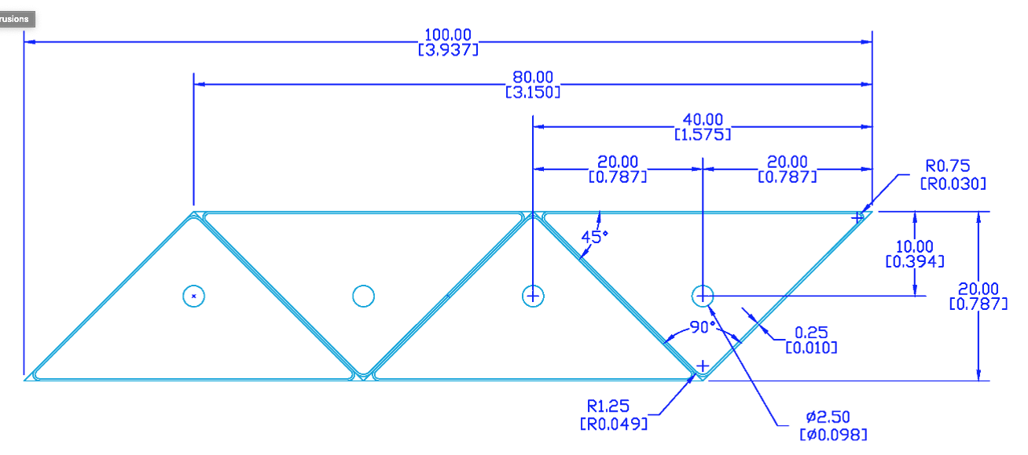
Potential DAMSA Detector Technology
A total absorption EM calorimeter
  Sufficient depth to absorb photons up to 500MeV
  Need further optimization for low mass ALP decays
Crystal or plastic scintillation counter with fine lateral and longitudinal granularity (M~160t)
  A thin (<5cm) triangular pixels with a fast photon detector attached to the pixel
    Lateral and longitudinal granularity
  SPAD, MCP, Hybrid SiPM, etc
A study to develop the most optimal detector for the physics has begun

Slide 19
Potential DAMSA Experiment Timeline
May – Dec. 23 : Form a team and prepare a proposal to Fermilab PAC
  Physics goals and sensitivity reach
  Detector design and rough cost estimates
Jan. 2024: Submit the DAMSA proposal to PAC
2024 – 2025/2026: experiment approval and project establishment
2025/2026 – 2028: experiment construction
2029: Complete the detector construction and start commissioning for data taking
Internationality would be important – Korean and European colleagues

Slide 20
DAMSA Experiment Team
DAMSA has been introduced to the community throughout the past 2 years, more intensely in 2023
  Multiple presentations made at conferences and workshops
  The concept was included in a few Snowmass2021 white papers
  At the physics opportunities at PIP-II BD and beyond at Fermilab 5/10 – 5/13/23, the discussion on DAMSA experiment occurred 5/12 – 5/12/23
  Introduced to Fermilab leadership April and May 2023
The team consists of
  Lead Investigators: Jae Yu and Juan Estrada (FNAL)
  Institutions expressed interests thus far:
    US (6+2): FNAL, OU, TAMU, UCR, UCI, U. of Kansas (TBC), LANL (TBC), UTA
    SK (5+3): SNU, Yeonsei U. (TBC), U. of Seoul, Chungnam U. (TBC), Jeonbuk U. (TBC), KNU-CHEP, Korea U., Korea U. - Chochiwon Campus
    Portugal: LIP (TBC)

Slide 21
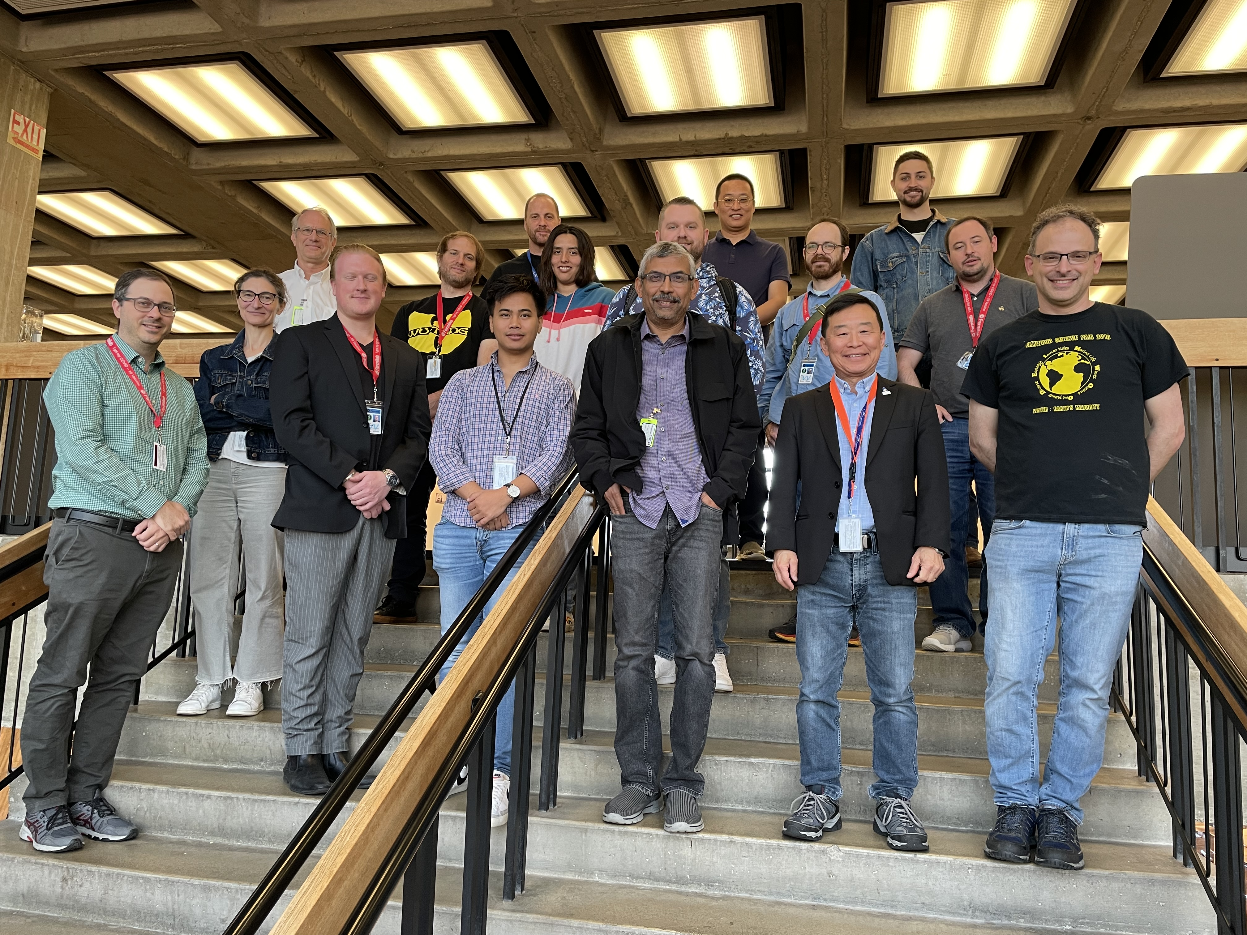
1st Workshop on Physics Opportunities at PIP-II
May 10 – May 13, 2023
Juan Estrada
Matt Toups

Slide 22
Parting Questions to this crowd
What other physics can we do with the DAMSA experiment configuration?
What modifications to DAMSA experimental configuration to dramatically expand the physics reach?
What are the tools necessary for DAMSA physics reach in a timely manner?

