Slide 1
High-Power Targetry R&D for Next-Generation Accelerator Facilities
Frederique Pellemoine
Fermilab ACE Science Workshop
14-15 June 2023

Slide 2
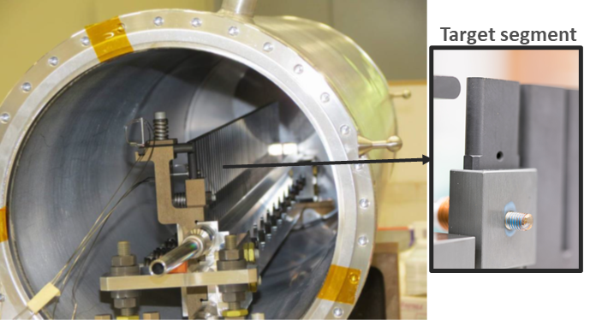
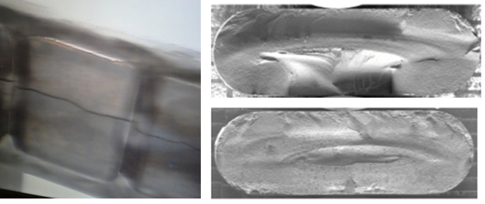
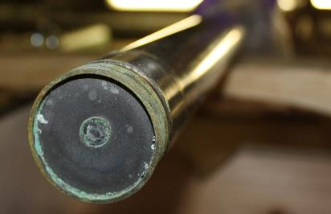
Critical Need for Robust High-Power Targets
Recently, major accelerator facilities have been limited in beam power not by their accelerators, but by target survivability concerns
Timely HPT R&D research is essential to optimize the performance, the reliability and operation lifetimes of target components as beam power and intensity increase
High Power Targetry includes all beam intercepting devices (targets, beam windows, beam absorbers, collimators, …)
Graphite neutrino target (NOvA MET series)
The Leading Material Challenges to Address…
MINOS NT-02 target failure: radiation-induced swelling (FNAL)
Radiation Damage: affects material properties and target lifetime by disrupting the lattice structure
Thermal Shock: Sudden energy deposition from pulsed beam generates dynamic stress waves that leads to target failure
Thermal Fatigue: Cyclic loading progressively damages the material’s microstructure that leads to premature target failure
Beryllium window embrittlement (FNAL)

Slide 3
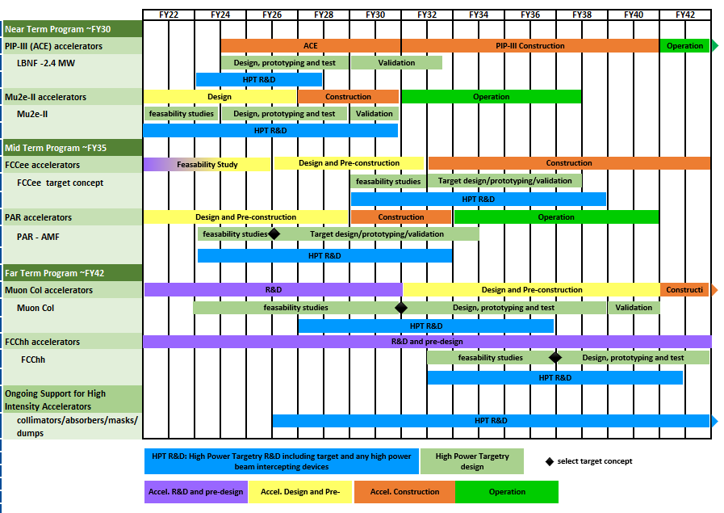
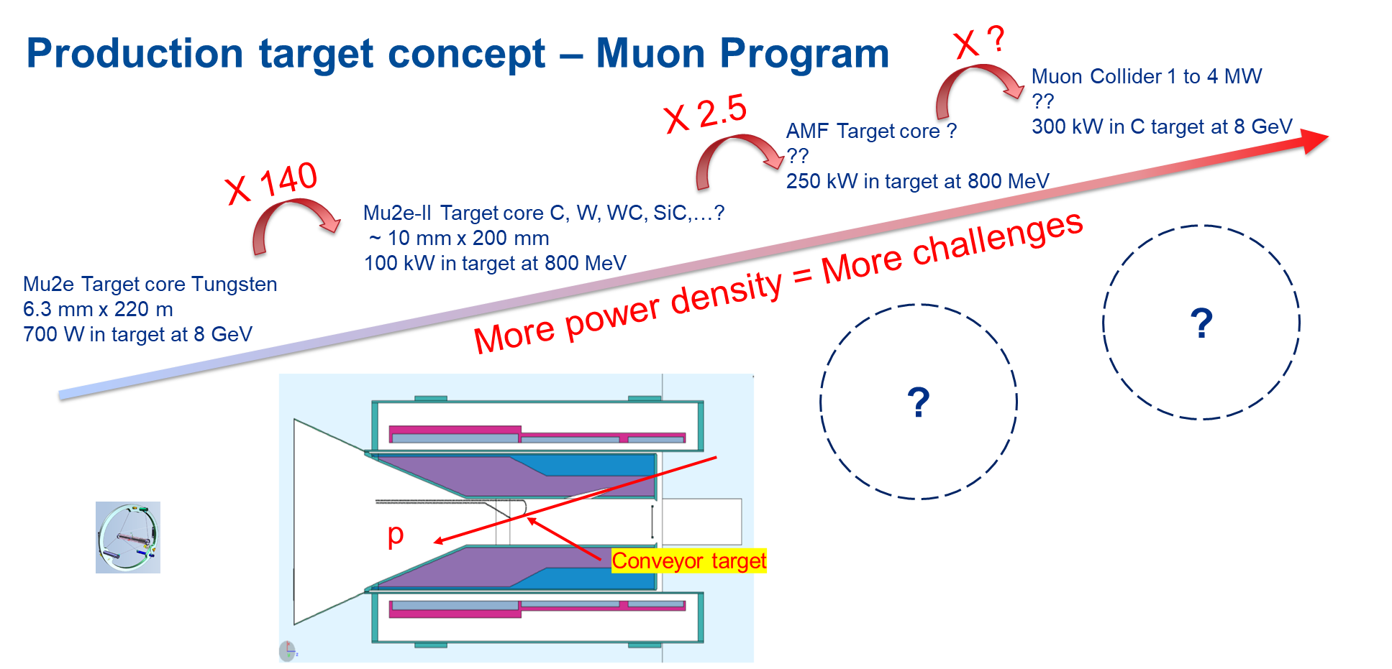
High Power Targetry R&D Roadmap (draft)
Target can’t be directly transferred from one application to another
Need specific and significant R&D for each target components
HPT R&D cycle up to 10 years based on current supports
HPT R&D needs to start now with more resources to enable and support future HEP experiments
Workshop – April 11-12 2023

Slide 4
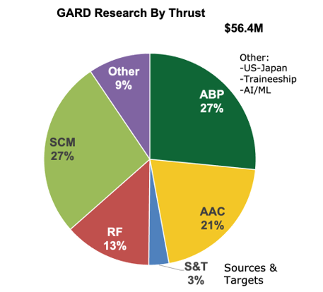
High Power Targetry Needs
Current HPT R&D approach based on 4 topics
Directed R&D to be applied for each projects
In-Beam irradiation
Irradiation time can be very expensive (~$1M for 4 weeks of irradiation at BNL-BLIP, not enough to replicate radiation dose relevant for future accelerator)
Long-term generic R&D that will also benefit other applications
Alternative Methods to emulate high energy proton irradiations for accelerated and cost-effective material screening
Explore new materials with enhanced thermal shock and radiation damage resistance
Modeling to predict fundamental response of various materials to extreme environment and irradiation
GARD (including US-JP) = $1.7M (to FNAL: 2.25 FTE + ~$270k M&S) - 3% of the budget only
Currently supports only Neutrino Program
Need more support for each project
We need to ramp up activities to fully respond to the needs for next generation accelerators
Recommendations to P5 to fully respond to the needs for next generation accelerators
More resources to fully support R&D: directed (In-beam studies) and generic R&D (alternative methods, novel materials and modeling)
Develop more capabilities to support HPT R&D: Post Irradiation Examination (PIE) and irradiation station
Strengthen the high-power target community through the RaDIATE collaboration and High-Power Targetry workshop.
Develop Synergy with other communities facing similar challenges: Accelerator Driven Systems and nuclear Energy and Nuclear Physics communities

