Slide 1
2 GeV Linac + RCS ACE Configuration
Jeffrey Eldred, special thanks to Sergei Nagaitsev, Valeri Lebedev
ACE Science Workshop
June 15, 2023

Slide 2
2
Upgrade Design History & Process
In 2003, Proton Driver Study II (PD2): 0.6 GeV Linac, New 0.6-8 GeV RCS
In 2010, Project X ICD-2: 2 GeV Linac, New 2-8 GeV RCS.
In 2018, S. Nagaitsev and V. Lebedev: updated version of ICD-2.
In 2019, J. Eldred, V. Lebedev, A. Valishev: parametric study of RCS design.
In 2021, Committee for Fermilab Booster Upgrade an integrated design effort:
Science Working Group chaired by R. Harnik
“Physics Opportunities for the Fermilab Booster Replacement”
Accelerator Working Group chaired by M. Syphers
“An Upgrade Path for the Fermilab Accelerator Complex”
In 2022, ACE Central Design Group Accelerators
Bottom Line:
Technical considerations are well understood at this point.
We know how to build a new RCS with beam intensity four times greater intensity than the Fermilab Booster.
2
Jeffrey Eldred | Snowmass 2.4 MW Upgrade with RCS
Notes:
2
2
2

Slide 3
3
RCS Design vs Booster Design
1. RCS lattice design avoids transition-crossing.
2. RCS injection accommodates a higher injection energy.
3. RCS features a larger aperture and better orbit control.
4. RCS has beampipes inside dipoles, avoid impedance from laminations.
5. RCS has more shielding from surface and a wider tunnel.
6. RCS has new components with greater reliability, precision, controls.
7. RCS has better designed injection straight with downstream collimators.
There are many different parameter variations we can consider for the RCS design, but the basic argument for performance is quite straightforward.
3
Jeffrey Eldred | Snowmass 2.4 MW Upgrade with RCS
Notes:
3
3
3

Slide 4
4
Some Parameter Variations We Considered
- Harmonic RF for suppression of space-charge at injection.
- Correlated instead of anti-correlated injection painting.
- Using an asymmetric injection chicane to save space.
- Larger transverse emittance, higher/lower injection energy.
- Highly periodic RCS (4-8 superperiods) vs racetrack RCS (2 superperiods)
- Use of nonlinear integrable optics or electron lenses
- Slip-stacking beams as much higher than PIP-II intensity.
- Use/avoidance/upgrade of Fermilab Recycler
- RCS extraction at greater than 8 GeV.
But I won’t go into detail on these topics today.
4
Jeffrey Eldred | Snowmass 2.4 MW Upgrade with RCS
Notes:
4
4
4

Slide 5
5
Updated ICD-2 used as baseline RCS scenario
In 2003, Proton Driver Study II (PD2): 0.6 GeV Linac, New 0.6-8 GeV RCS
In 2010, Project X ICD-2: 2 GeV Linac, New 2-8 GeV RCS.
In 2018, S. Nagaitsev and V. Lebedev: updated version of ICD-2.
In 2019, J. Eldred, V. Lebedev, A. Valishev: parametric study of RCS design.
In 2021, Committee for Fermilab Booster Upgrade an integrated design effort:
Science Working Group chaired by R. Harnik
“Physics Opportunities for the Fermilab Booster Replacement”
Accelerator Working Group chaired by M. Syphers
“An Upgrade Path for the Fermilab Accelerator Complex”
In 2022, ACE Central Design Group Accelerator Working Group
Bottom Line:
Technical considerations are well understood at this point.
We know how to build a new RCS with beam intensity four times greater intensity than the Fermilab Booster.
5
Jeffrey Eldred | Snowmass 2.4 MW Upgrade with RCS
Notes:
5
5
5

Slide 6
6
ACE RCS Configurations
ACS RCS v1: 10Hz RCS
ACS RCS v2: 20Hz RCS + 2GeV AR to facilitate injection.
ACS RCS v3: 20Hz RCS + Current upgrade to 5mA
Assume all scenarios inject 6x25e12 particles into the Recycler at 8 GeV.
Used ICD-2 / Nagaitsev-Lebedev ring as baseline for 10Hz RCS.
For 20Hz considered ceramic rather than metallic beampipe, greater RF and magnet power supplies, more challenging to flatten injection.
6
Jeffrey Eldred | Snowmass 2.4 MW Upgrade with RCS
Notes:
6
6
6

Slide 7
7
7
Updated ICD-2
10 Hz RCS Configuration
7
Jeffrey Eldred | Snowmass 2.4 MW Upgrade with RCS

Slide 8
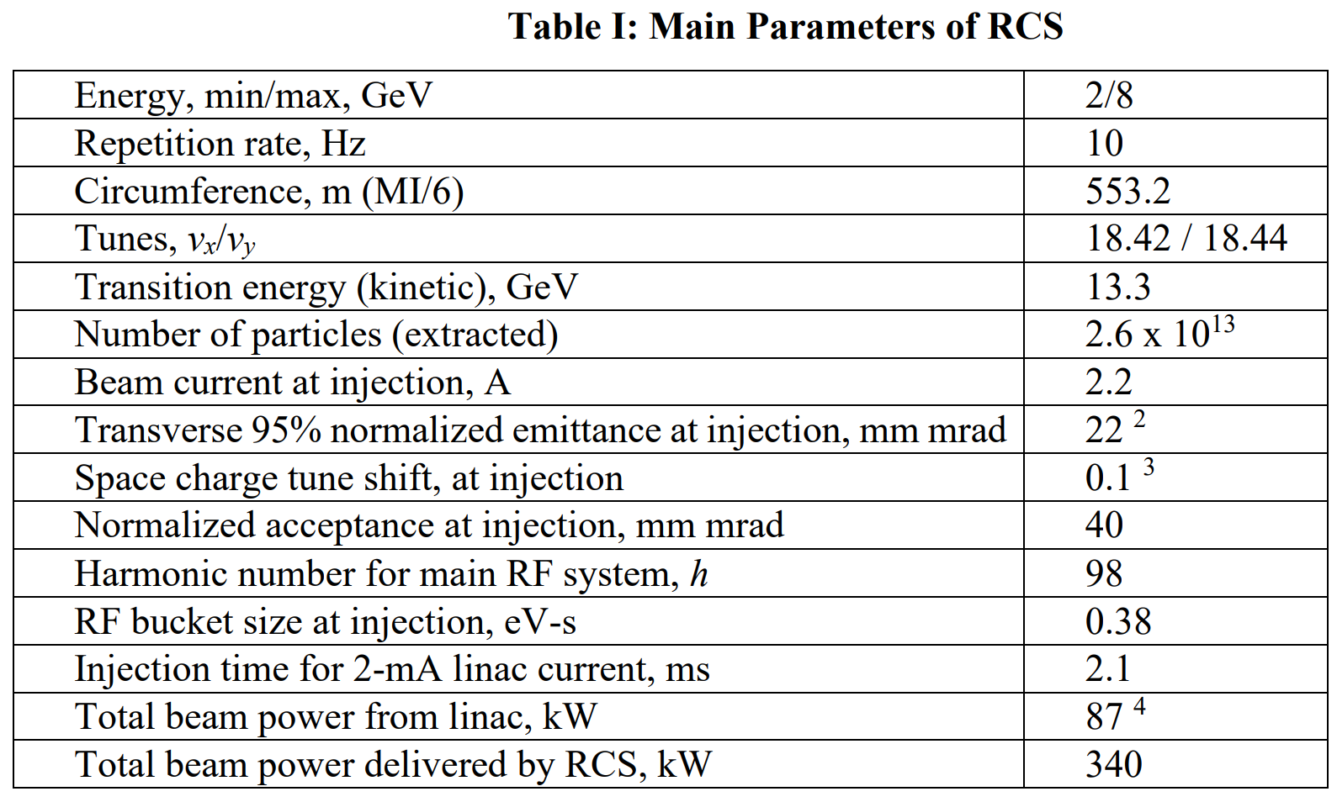
8
High-level Parameters
8
Jeffrey Eldred | Snowmass 2.4 MW Upgrade with RCS
Notes:
8
8
8

Slide 9
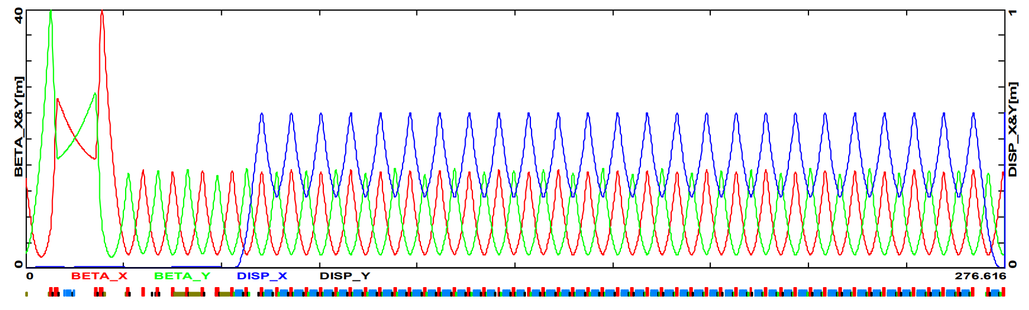
9
Racetrack Architecture
Long dispersion-free straights sections for injection, collimation, RF, extraction..
Simple FODO bending arcs with small max betas (16m) and small max dispersion (0.6m).
9
Jeffrey Eldred | Snowmass 2.4 MW Upgrade with RCS
Notes:
9
9
9

Slide 10
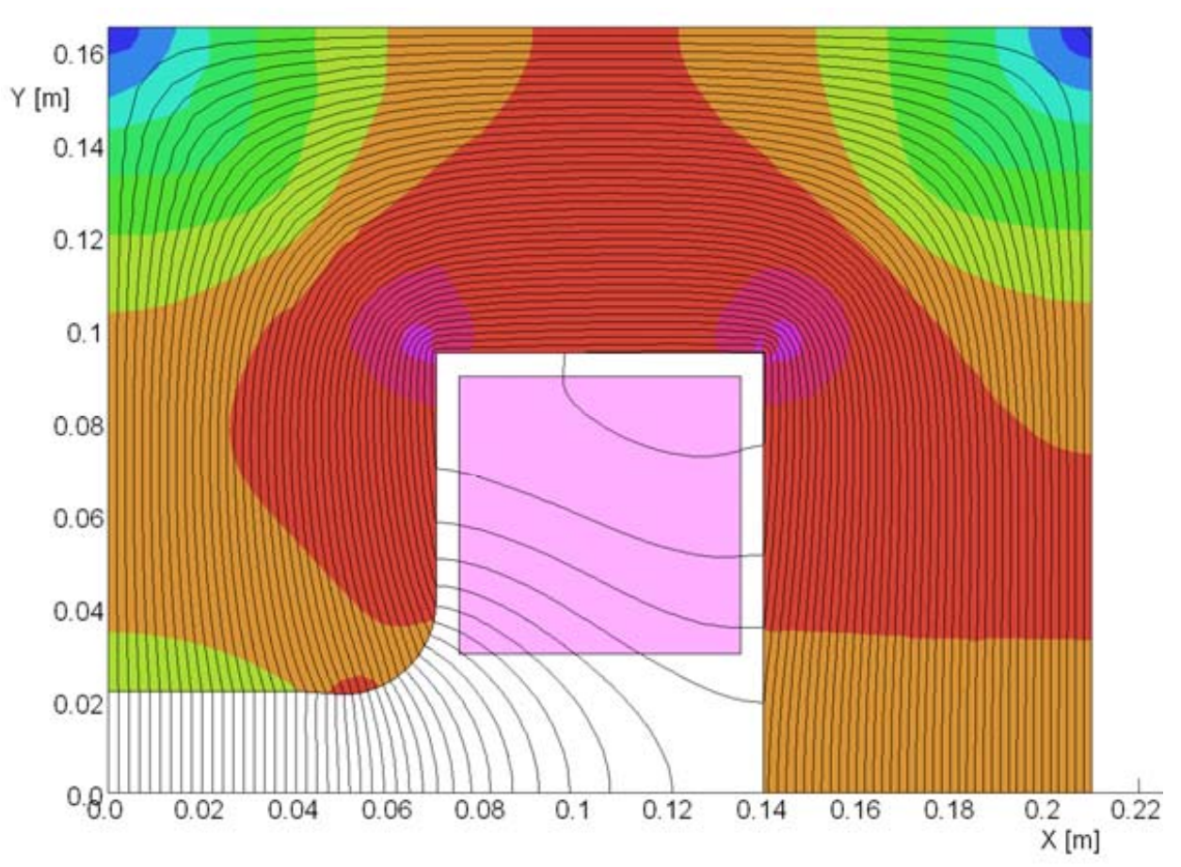
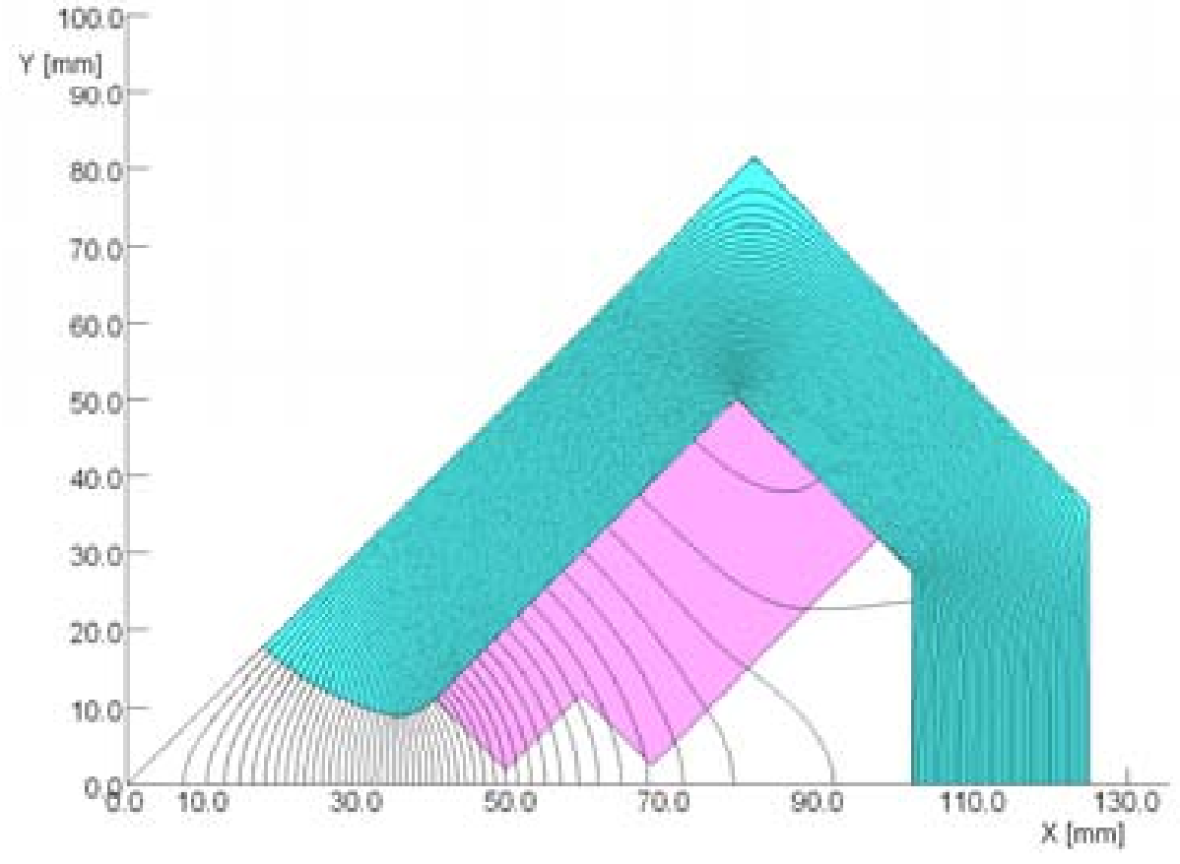
10
Dipole and Quad Magnet Designs
0.87 T
17.4 T/m
2D calculations of conductor currents, field uniformity, saturation effects.
Similar calculations made for corrector magnets.
10
Jeffrey Eldred | Snowmass 2.4 MW Upgrade with RCS
Notes:
10
10
10

Slide 11
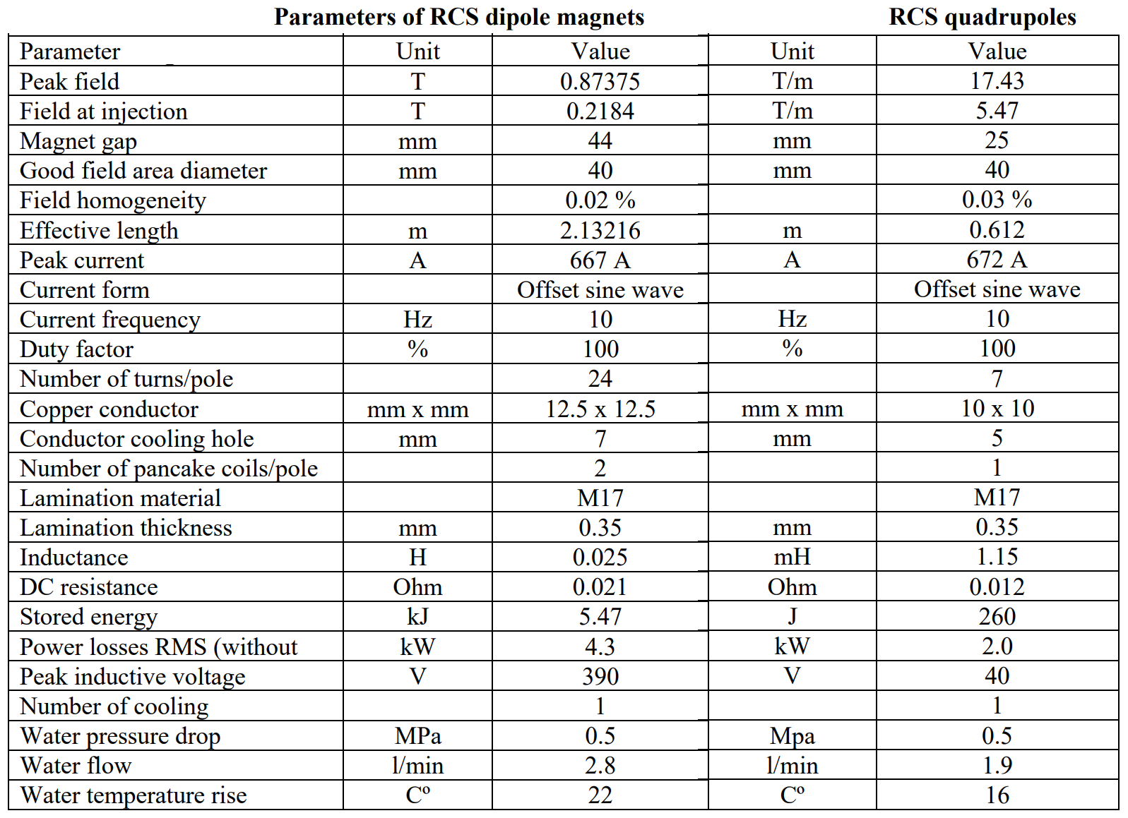
11
Dipole and Quad Magnet Designs
11
Jeffrey Eldred | Snowmass 2.4 MW Upgrade with RCS
Notes:
11
11
11

Slide 12
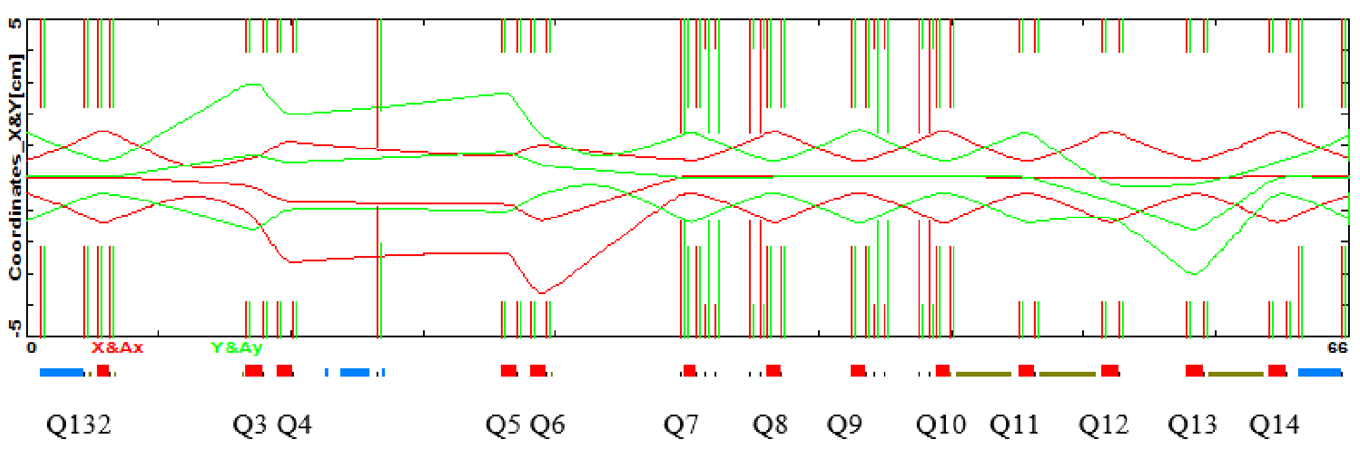
12
Injection / Collimation
Injection Foil
Collimators
Collimation region downstream of injection foil to collect particles scattering off the injection foil before the first bending arc.
Adequate phase-advance to get good collimation efficiency.
12
Jeffrey Eldred | Snowmass 2.4 MW Upgrade with RCS
Notes:
12
12
12

Slide 13
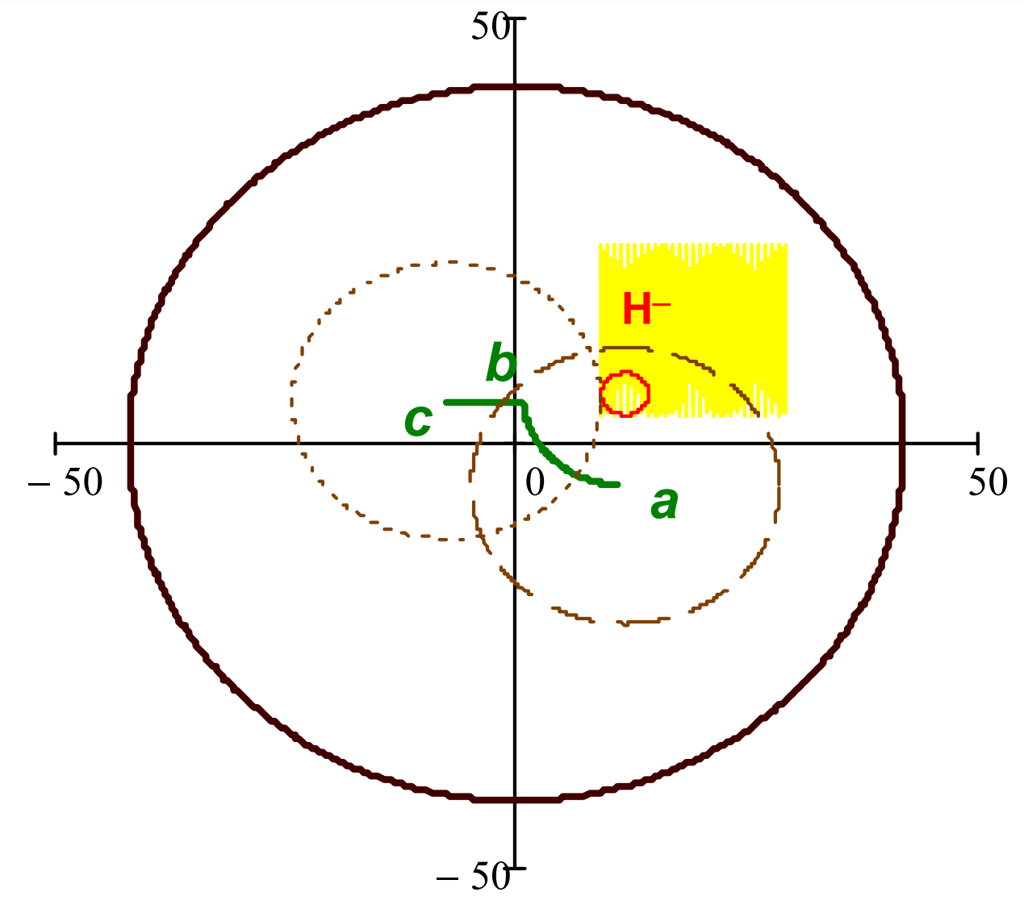
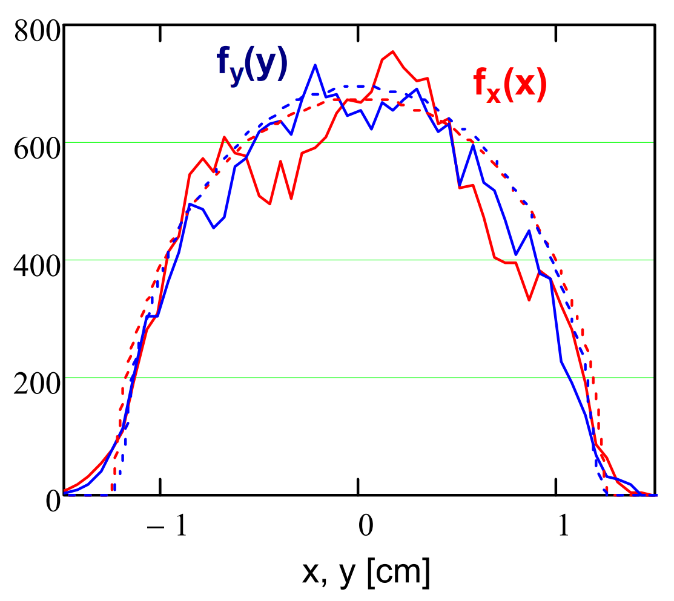
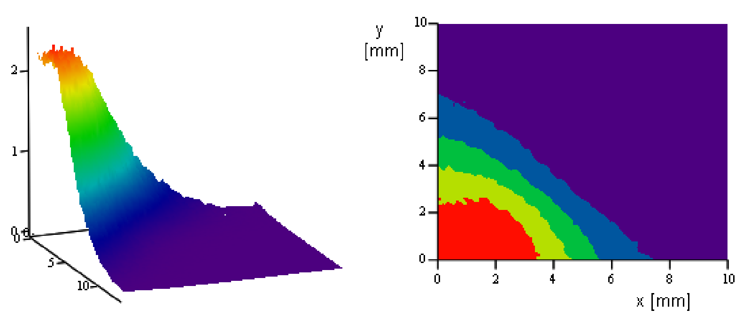
13
Injection Painting
Anti-Correlated
Injection
Painting
Near-KV Injected Distribution
Peak foil hit density of
22 hits / mm² per inj. particle
13
Jeffrey Eldred | Snowmass 2.4 MW Upgrade with RCS
Notes:
13
13
13

Slide 14
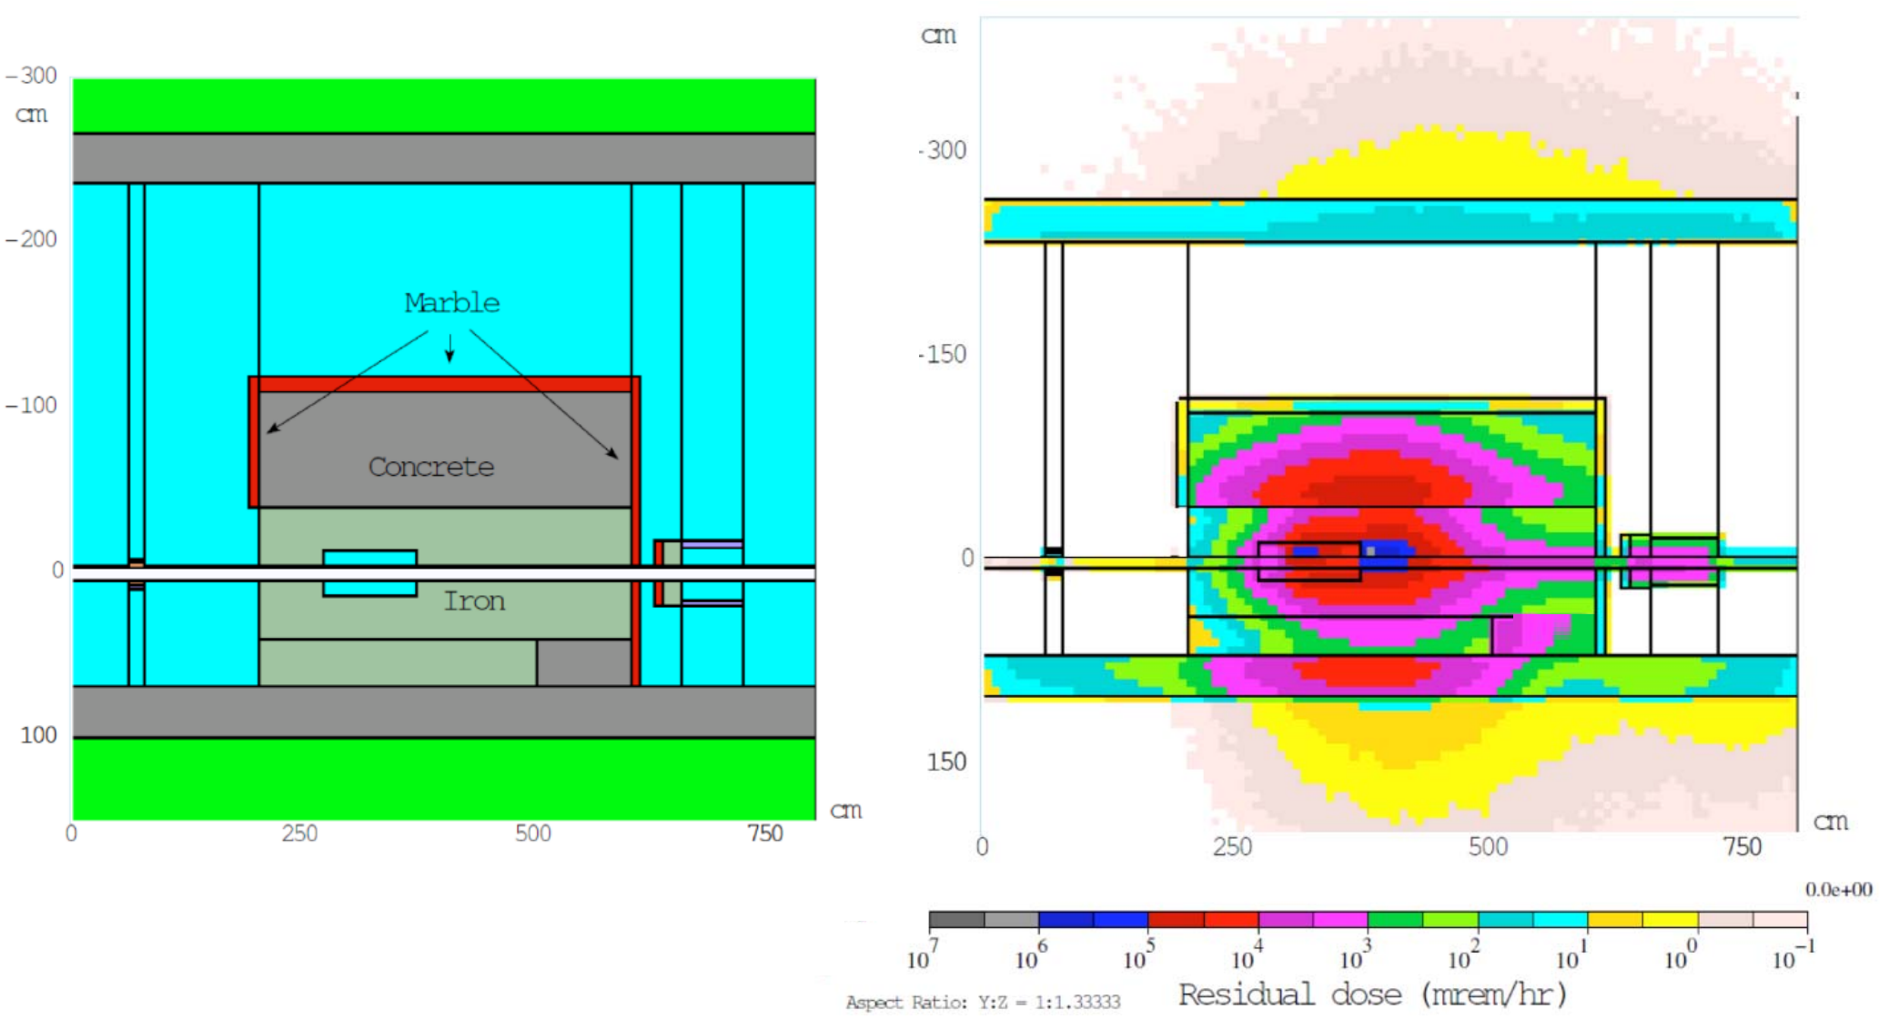
14
Collimators MARS Calculations
14
Jeffrey Eldred | Snowmass 2.4 MW Upgrade with RCS
Notes:
14
14
14

Slide 15
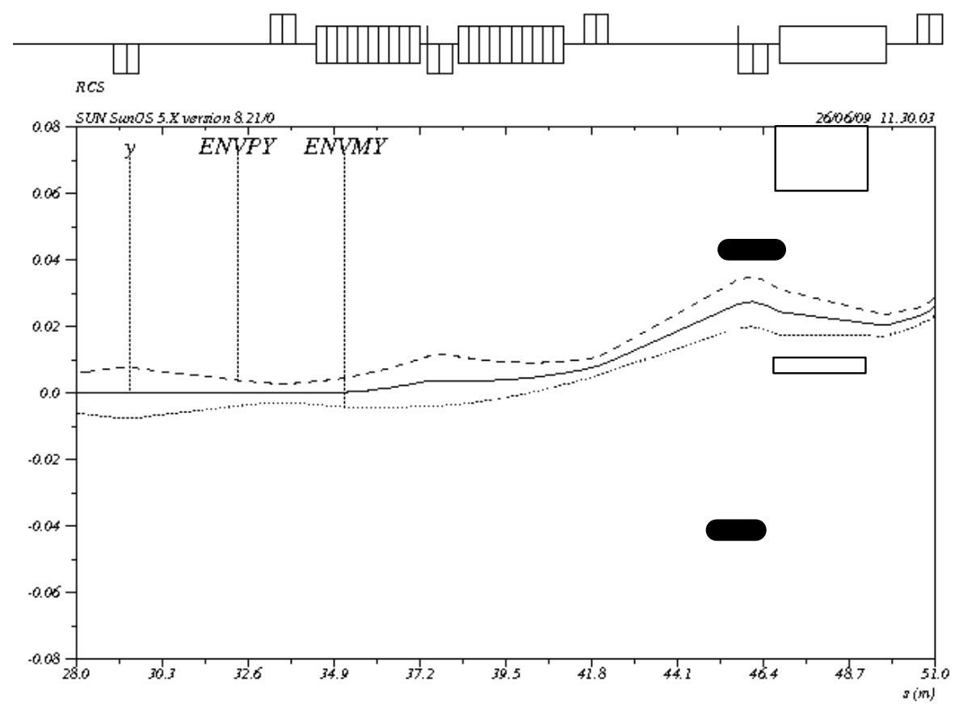
15
Extraction Trajectory
15
Jeffrey Eldred | Snowmass 2.4 MW Upgrade with RCS
Notes:
15
15
15

Slide 16
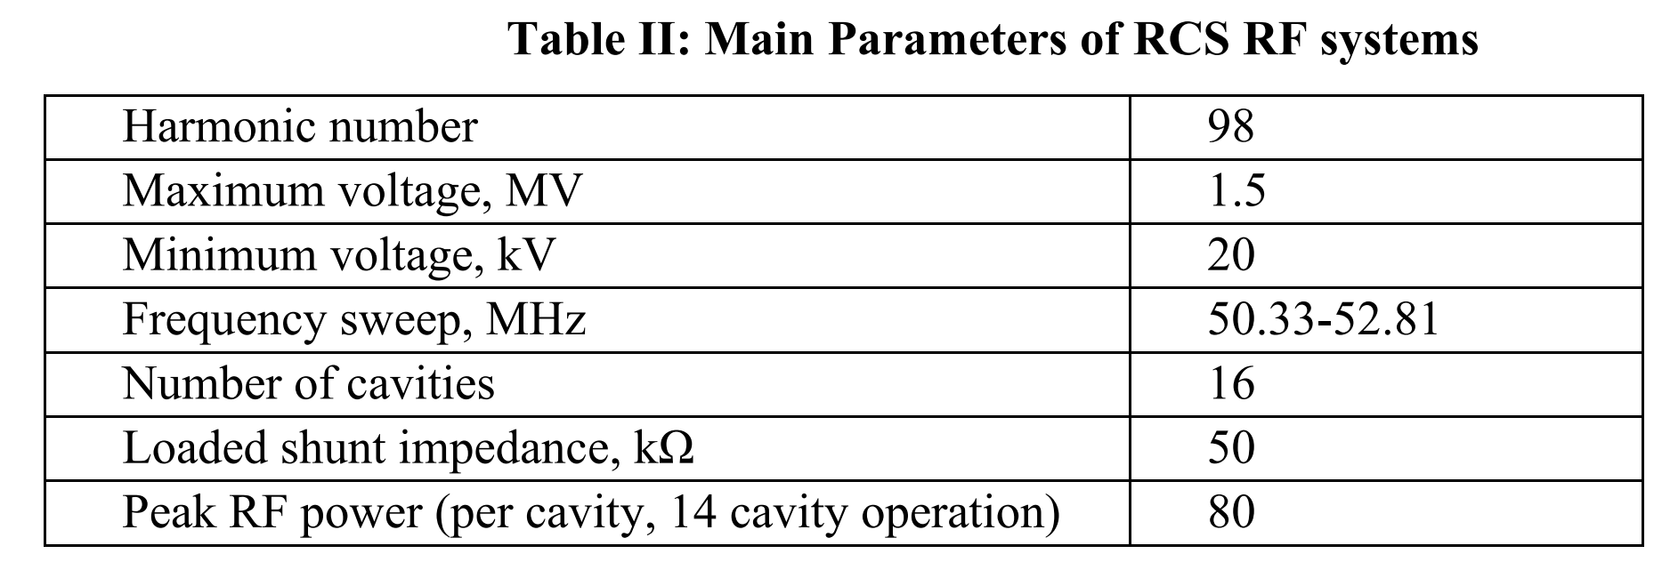
16
RF Cavities
Perpendicular-bias quarter-wave RF cavity design.
Additional details about cavity design and RF modulators etc in ICD-2 report.
16
Jeffrey Eldred | Snowmass 2.4 MW Upgrade with RCS
Notes:
16
16
16

Slide 17
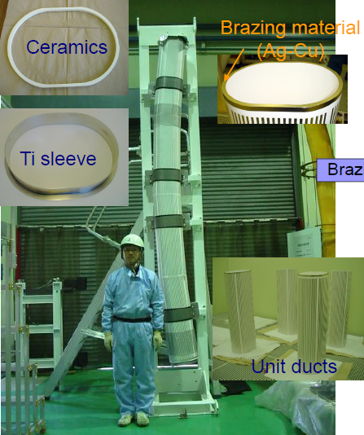
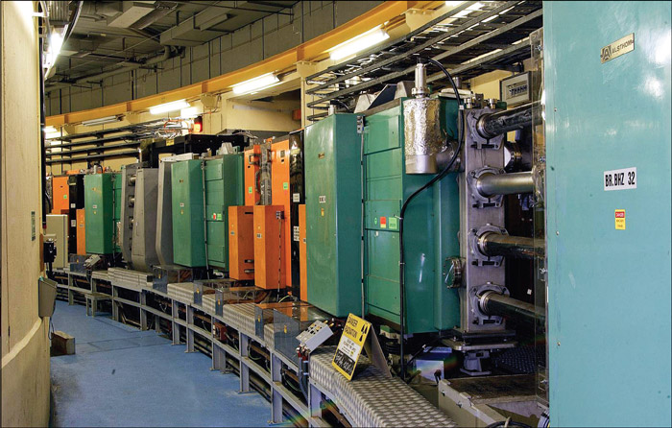
Boosters and RCSs at present (examples)
CERN PS Booster
1 Hz rate (non-resonant)
Metallic vacuum
chamber
Fermilab Booster
15 Hz (resonant)
No vacuum chamber
(this is what we are
trying to correct)
J-PARC RCS
25 Hz (resonant)
Ceramic vacuum
chamber
The transition from ceramic to metallic (and from resonant to
non-resonant) occurs at about 15 Hz

Slide 18
18
18
10Hz vs. 20Hz
Eddy Current Heating Effects
18
Jeffrey Eldred | Snowmass 2.4 MW Upgrade with RCS

Slide 19
Vacuum chamber
The competing effects are:
  shielding and distortion of the dipole bend field by eddy currents, excited in the vacuum chamber;
  vacuum chamber mechanical integrity under the atmospheric pressure;
  vacuum chamber heating by eddy currents;
  transverse beam impedance due to the wall resistivity;
  geometric ring acceptance.
Eddy current heating (per unit length)
Field distortions (time-dependent):
  Require corrections during ramping

Slide 20
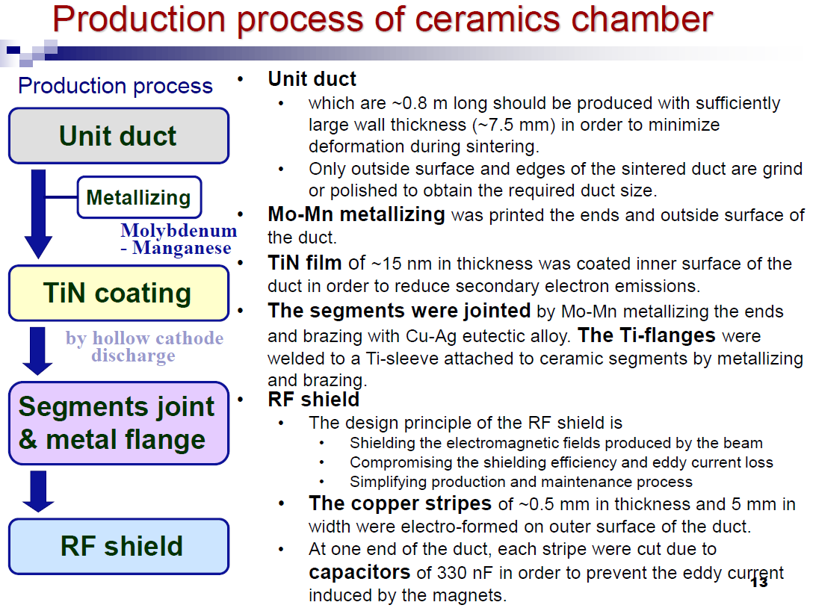
Ceramic vacuum chambers at J-PARC
From: M. Kinsho (JAEA), 2005

Slide 21
21
Implications of Ceramic Beampipe
J-PARC provides a clear precedent that ceramic vacuum ducts can be constructed and performance well in an accelerator environment.
However we would need to do this for different parameters, and relying on different vendors. Not R&D exactly, but certainly development.
- Although R&D could improve the design or manufacturing.
J-PARC uses a 170mm aperture whereas that 10 Hz RCS uses a 44mm aperture. Will the 20 Hz RCS need a large aperture to avoid resistive wall instability? For our 20 Hz cost analysis we used 100mm aperture.
- On the other hand, if we can manage the impedance effect and take advantage of that larger aperture a x5 overdesign!
- This is the main cost-driver for 20Hz vs 10Hz in our analysis.
21
Jeffrey Eldred | Snowmass 2.4 MW Upgrade with RCS
Notes:
21
21
21

Slide 22
22
22
Flat Injection for a
20Hz-Resonant RCS
22
Jeffrey Eldred | Snowmass 2.4 MW Upgrade with RCS

Slide 23
23
Flat Injection for 20Hz-Resonant RCS
To inject 25e12 with 2mA current, takes 2ms.
For a 20 Hz sinusoidal ramp between 2 GeV and 8 GeV, the beam momentum changes 3.3% over 2ms.
For 0.6m dispersion, this is 20mm of orbit movement that has to be compensated carefully.
At 5mA its only 0.8mm of orbit movement.
Using an AR also solves this problem.
Maybe we can compensate without current upgrade or AR, but we’ll see it also helps with a foil. Don’t want to build an RCS starting with bottleneck.
23
Jeffrey Eldred | Snowmass 2.4 MW Upgrade with RCS
Notes:
23
23
23

Slide 24
24
24
Foil-Injection Considerations
24
Jeffrey Eldred | Snowmass 2.4 MW Upgrade with RCS

Slide 25
25
Updated ICD-2 used as baseline RCS scenario
In 2003, Proton Driver Study II (PD2): 0.6 GeV Linac, New 0.6-8 GeV RCS
In 2010, Project X ICD-2: 2 GeV Linac, New 2-8 GeV RCS.
In 2018, S. Nagaitsev and V. Lebedev: updated version of ICD-2.
In 2019, J. Eldred, V. Lebedev, A. Valishev: parametric study of RCS design.
In 2021, Committee for Fermilab Booster Upgrade an integrated design effort:
Science Working Group chaired by R. Harnik
“Physics Opportunities for the Fermilab Booster Replacement”
Accelerator Working Group chaired by M. Syphers
“An Upgrade Path for the Fermilab Accelerator Complex”
In 2022, ACE Central Design Group Accelerator Working Group
Bottom Line:
Technical considerations are well understood at this point.
We know how to build a new RCS with beam intensity four times greater intensity than the Fermilab Booster.
25
Jeffrey Eldred | Snowmass 2.4 MW Upgrade with RCS
Notes:
25
25
25

Slide 26
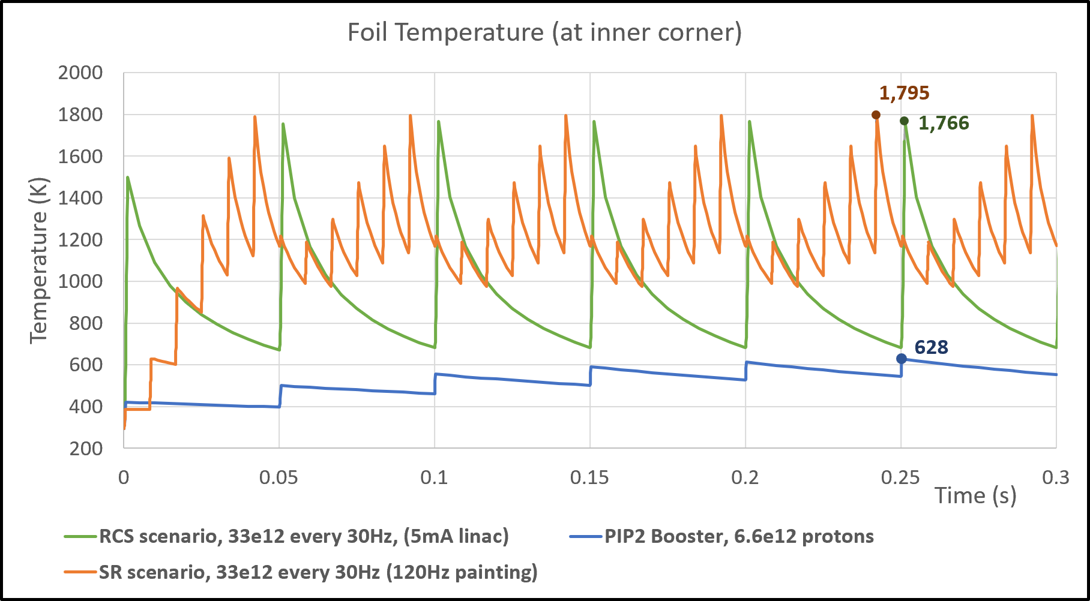
26
Foil-Heating effects, for 33e12 every 20 Hz
Scenario 1: Upgrade PIP-II linac to 5mA pulsed.
Scenario 2: Use six 120 Hz painting cycles to accumulate beam in 2- GeV AR every 20 Hz.
26
Jeffrey Eldred | Snowmass 2.4 MW Upgrade with RCS
Notes:
26
26
26

Slide 27
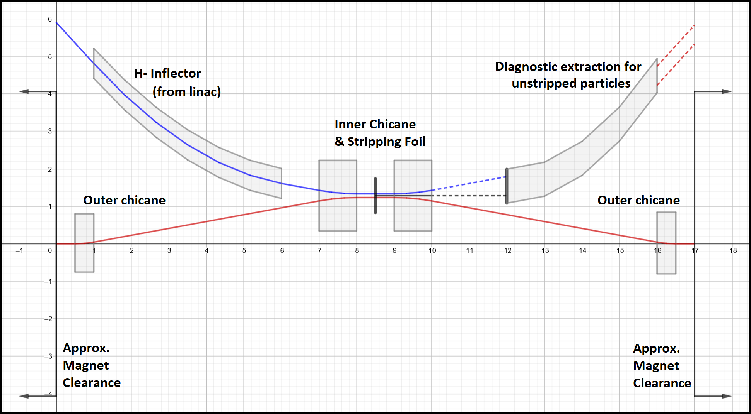
27
Generous 17m Injection Straight for 2-GeV H⁻
H- Foil Stripping Injection
17 m straight.
27
Jeffrey Eldred | Snowmass 2.4 MW Upgrade with RCS
Notes:
27
27
27

Slide 28
28
28
RCS for MuC Proton Driver
28
Jeffrey Eldred | Snowmass 2.4 MW Upgrade with RCS

Slide 29
29
How to get from ACE RCS to MuC PD?
Consider ACE RCS that provides 37e12 at 8 GeV every 20Hz = 950 kW.
What can I change at that point?
- I can change the injection energy / intensity (maybe).
- I can change the extraction energy (maybe) or reaccelerate.
- I can’t easily change the aperture.
- I definitely can’t change the circumference.
The best ACE RCS to MuC PD scenario would be to design for a subsequent upgrade or overdesign, for a MuC proton driver later.
- Using similar designs/costs to what I presented already, consider an RCS that provides 100e12 at 12 GeV every 10 Hz for 2MW
- Then add a bunch compressor ring and combiner line.
29
Jeffrey Eldred | Snowmass 2.4 MW Upgrade with RCS
Notes:
29
29
29

Slide 30
30
Idea: Fast-Ramping HTS Proton RCS
Recall that the muon collider design already requires fast-ramping HTS magnets for the muon RCS accelerator.
- Could similar technology be applied to proton RCS?
The parameters are a little different, proton RCS application needs:
aperture (5-20 cm), dipole field (1-4 T), ramping (60-600 T/s)
Larger aperture at same circumference and extraction energy
-> greater line density, better field uniformity.
Shorter circumference at same extraction energy and aperture
-> greater line density, more efficient RF acceleration.
Greater energy at same circumference and aperture.
-> more beam power at intensity.
Consider 250m RCS, 12 GeV, 10 Hz, 2x100e12 = 4 MW.
30
Jeffrey Eldred | Snowmass 2.4 MW Upgrade with RCS
Notes:
30
30
30

Slide 31
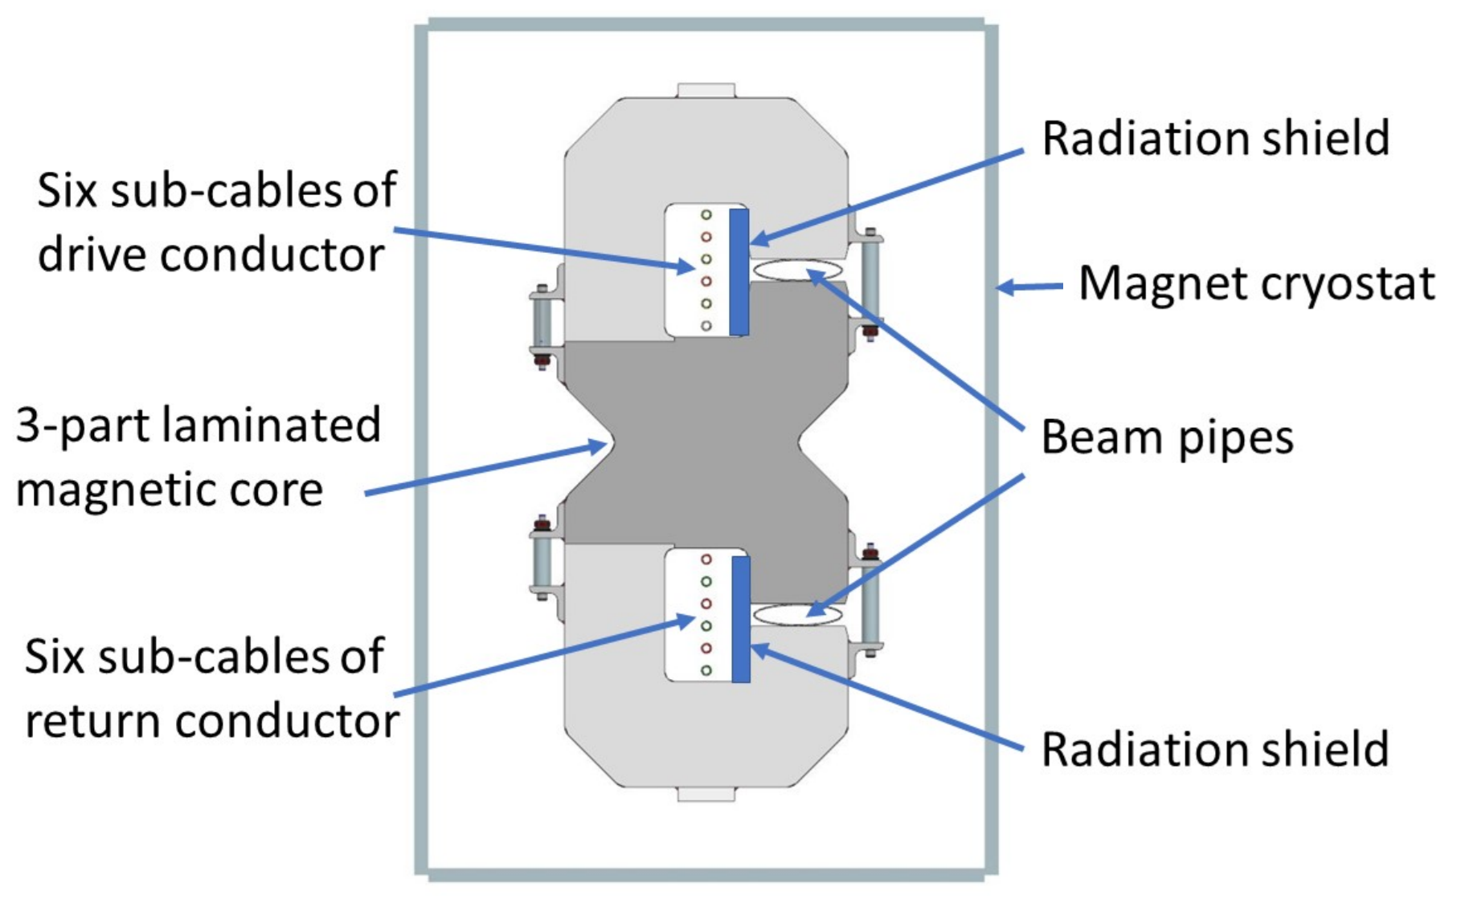
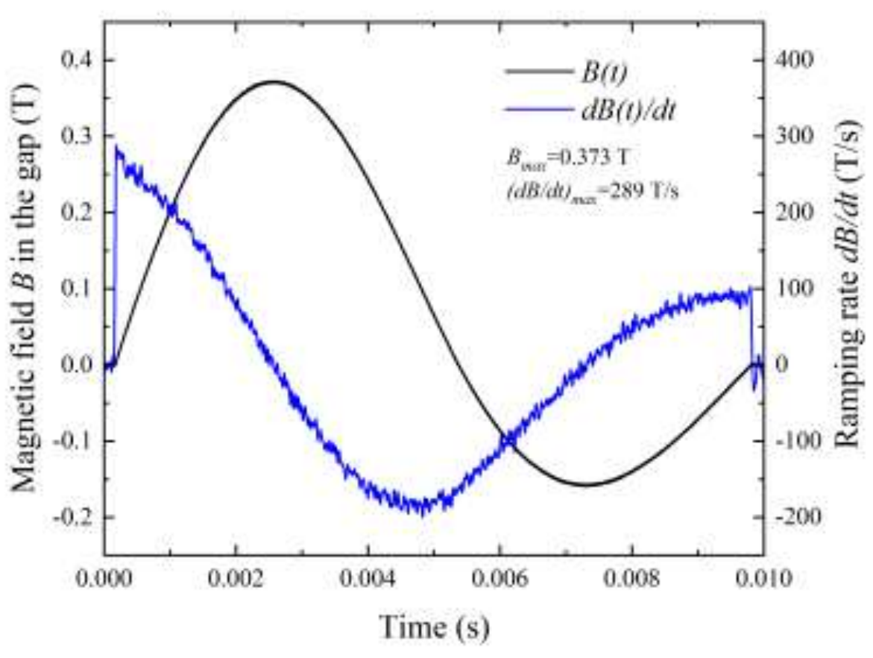
31
Idea: Fast-Ramping HTS Proton RCS
YBCO-based HTS super-ferric dipole demonstrated >300 T/s. paper.
Still some ways to go to desired proton RCS parameters.
31
Jeffrey Eldred | Snowmass 2.4 MW Upgrade with RCS
Notes:
31
31
31

Slide 32
Three Questions Slide
How will your system/development address the BR goals of DUNE/LBNF, New Physics, MuC?
  DUNE/LBNF: 10Hz RCS may be the lowest cost, lowest risk configuration.
  New Physics: Spigots yesterday, CW up to 2 GeV
  MuC: There’s a viable path, but advantage goes to Linac option.
    RCS gets more interesting with higher energies.
2. What are the biggest technical/performance risks of your system/development?
  H- Foil Injection, Laser stripping R&D. Looks okay, but biggest risk/limit.
  Ceramic/Dielectric Beampipe. Barrier to 20+ Hz ramp rate.
  MuC R&D, proton compression, HTS, muon production, cooling.
3. What are the most sensible first steps to enable progress in your system/ development? What can be done before the next ACE event (Fall’23 workshop)?
  Start prototype RCS ceramic beampipes.
  Create decision tree/timeline for choosing RCS vs Linac upgrade.
  Resolve MuC R&D plan, role for Fermilab proton complex.
32
Jeffrey Eldred | Snowmass 2.4 MW Upgrade with RCS

