Slide 1
ACEACE Workshop
W Pellico
PIP-II Accumulator Ring (PAR)

Slide 2
Purpose of This Talk
To inform people of an opportunity that exists, for a modest cost and within this decade, a storage ring option that will utilize the PIP-II capabilities, help DUNE power ramp up, and jump start FNAL DS beam-based FNAL physics program.
  What is presented here is summarized in Snowmass paper …..
    arXiv paper: https://arxiv.org/abs/2203.07339

Slide 3
PAR People
Bill Pellico: Lead Proponent, RF Systems, Hardware
Cheng-yang Tan: Head of Proton Source Department
John Johnstone: Lattice Design
Dave Johnson: Injection Design
Meiqin Xiao: BTL Interface to PAR
Chandra Bhat: Longitudinal Capture, RF Systems
Ben Simons: Space-charge & Nonlinearity
Jeff Eldred: Intensity Upgrades
Phillipe Piot: Physics Consultant
Carol Johnstone: Lattice Consultant
Kiyomi Seiya: Injection Consultant
Matt Toups: Dark Sector Experiment
Dave Harding: Magnets
Steve Dixon/Ernesto Alcaraz: Civil Logistics
Matt Toups/Jacob Zettlemoyer: DS Physics requirements
Curtis Baffes/Marina Simon: PIP-II

Slide 4
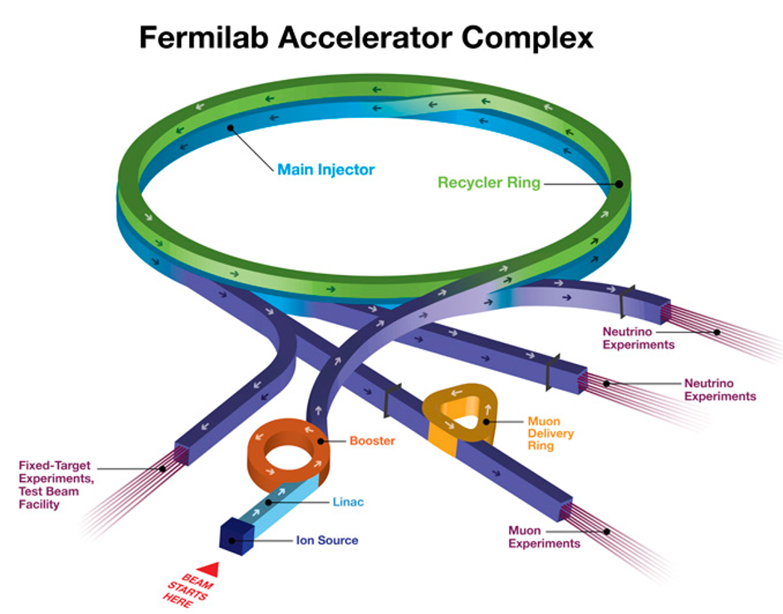
Present Complex
Linac:
15 Hz
30 ma
Booster:
8 GeV,
15 Hz
MI:
150,120, 60 GeV
1.2 sec cycle
Muon Campus, 8 GeV
Fixed Target (Test Beams), 120 GeV
Physics:
G-2
Neutrino –
NoVA:
Short Baseline: ICARUS and SBND
Long Baseline: NOvA
Fixed Target - Misc
Dark Matter & Dark Energy

Slide 5
PIP-II Complex & PAR
SRF PIPII: 800 MeV:
2.5 ma
High Cycle Rate
Upgradable
PAR:
100Hz (Upgradable)
800 MeV (Upgradable)
Booster:
8 GeV
20 Hz
MI: 150, 120, 60 GeV
Muon Campus, 8 GeV
Fixed Target, 120 GeV
Physics:
Mu2E
Neutrino - DUNE
Fixed Target - Test Beams
Dark Search
…….TBD…….
New
Transfer Line
PAR
PIP II Complex

Slide 6
Accumulator Rings
Serve as the middle layer between rapid cycling machines for delivery of higher flux to downstream slower ramping machines or target systems.
  We have had two+ at FNAL
    Pbar Accumulator Ring, Recycler and a test accumulator ring (prior to Pbar).
  Both were essential to our HEP program
  No acceleration is typically done is an accumulator ring (Pbar did test deacceleration)
Having an accumulator ring allows functions impossible in cycling machines or difficult to achieve.
  Complex beam manipulations (PAR has multiple RF systems – harmonics #)
  Accumulation of multiple cycles (PAR could do this if necessary)
  Accommodate long injection loading
    Produce higher intensity bunches
  Cleansing of beams (scrapping or notching)
  Cooling of beams
PAR does not plan to hold beam any longer than it needs to collect and manipulate
  This is not intended to be a storage ring
  Unlike storage rings – there is no cooling or damping systems
Cost is between 200,000 to 250,000 $ per meter for a standard accumulator ring.
  Cost of civil, magnets, RF, standard diagnostics

Slide 7
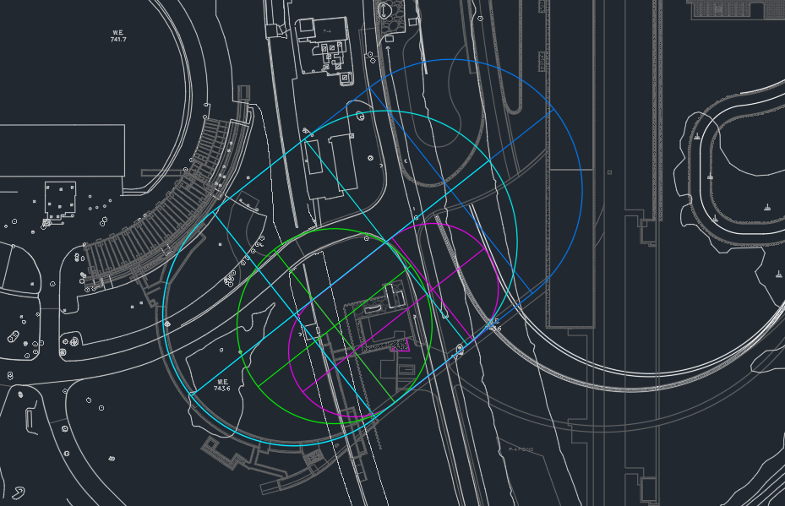
PAR
Early Effort to locate
With PIP-II civil support
Priorities
Minimize impact to PIPII
Allow design flexibility
Meet timeline goals
HEP flexibility
Reduced cost
Too Big
Max Size
Half Booster Options

Slide 8
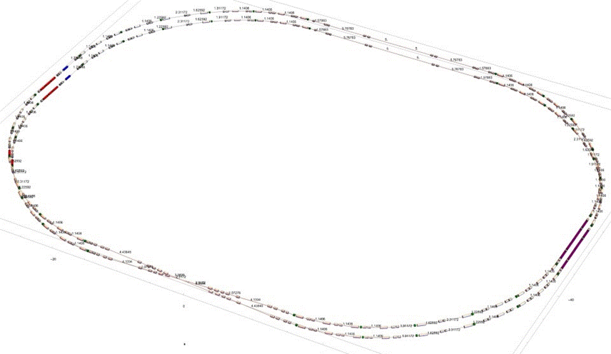
PAR Lattice Feature Locations
Phase Trombone
Injection Chicane
Extraction Sections
Collimation
RF Sections
Cross-over region
*CY Tan

Slide 9
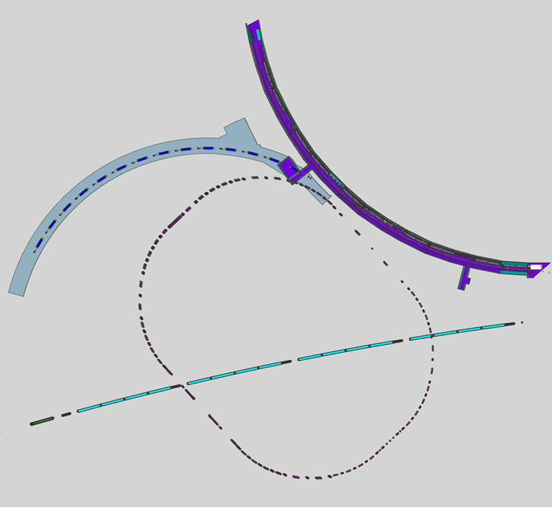
Present PAR Civil
PAR Civil Overview:
2 MI crossing – no interference
Injection Beam Dump – outside
Two rings: Top/Bottom Ring straights utilized
RF is located on one location
Extraction in one location
Rings are offset in both V & H for connivence
~ 10-meter injection region
PAR
Ext
DS
Target
PAR
Inj
DS
Det
PAR
BD
Beam Dump Line Overview:
Water cooled
~20-meter transfer line with tunable optics
100 Hz pulsed extraction with DC line elements
Shared service building with extraction elements?
3.25 aperture beam pipe to window
Detector is shown 17 meters downstream of dump
A detector perpendicular to dump (TBD)
A detector just upstream of dump (TBD)
MI X2
MI X1

Slide 10
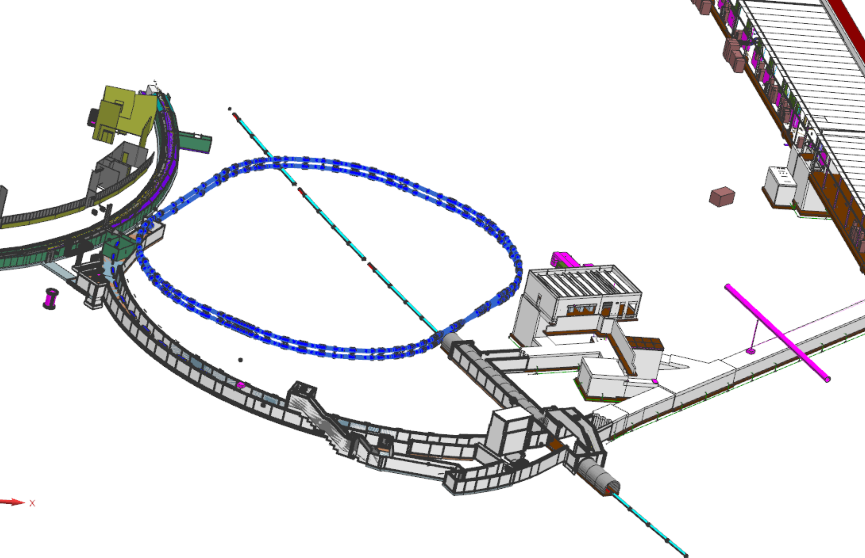
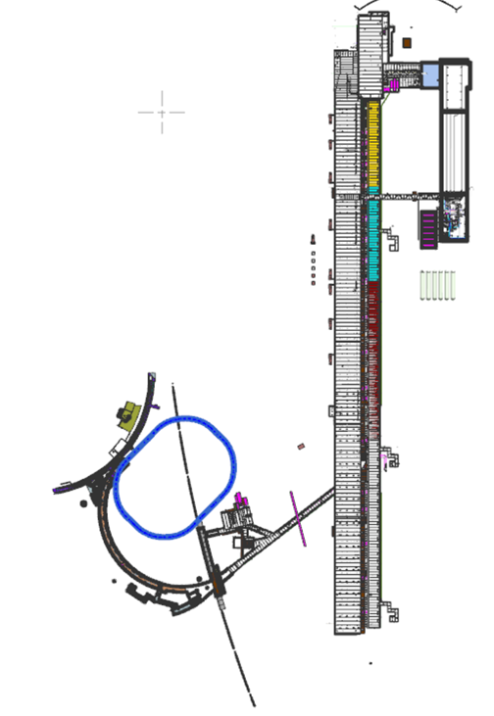
Civil Views – PAR with PIP-II for Booster Injection
Notice the folded ring topology!
This is fairly unique – not sure of another one?
This same space and costs!
Fold Point
PAR Beam
Direct PIP-II

Slide 11
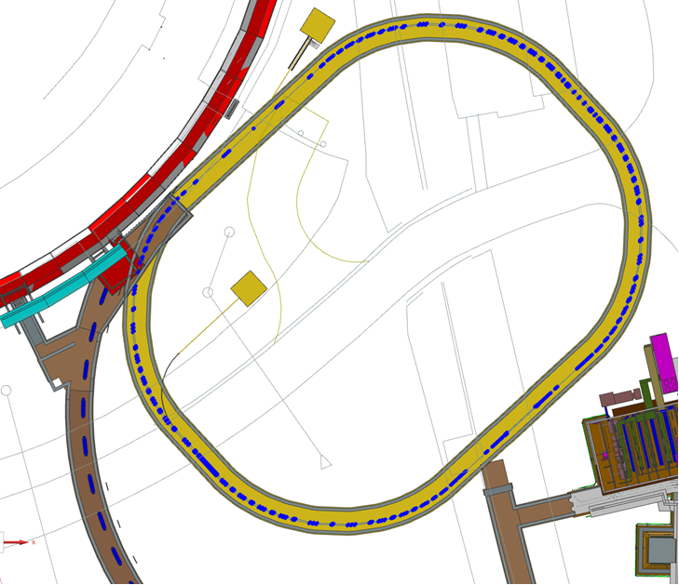
PAR with DS dump
PAR Injection Beam Dump
PAR DS Beam Dump

Slide 12
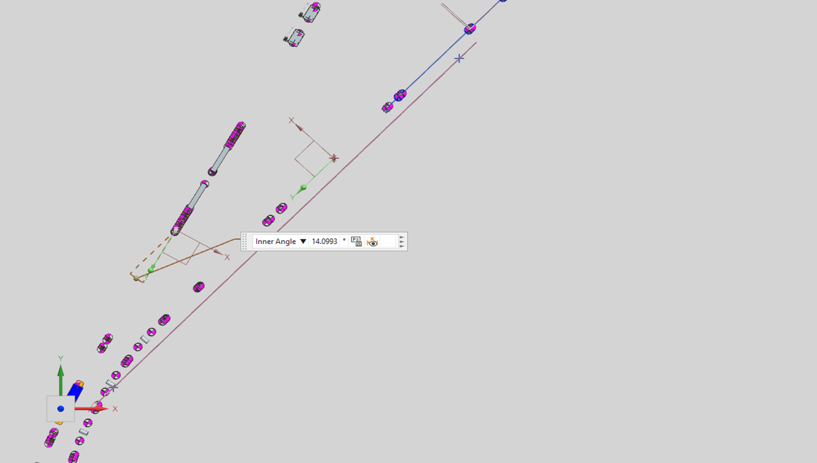
Not Used BTL magnets
When PAR is commissioned and ready to deliver to Booster
Two DC magnets in the BTL line will be used to divert beam:
Blue dipole magnet - Beam from BTL to PAR
Red dipole magnet - Beam from PAR to BTL

Slide 13
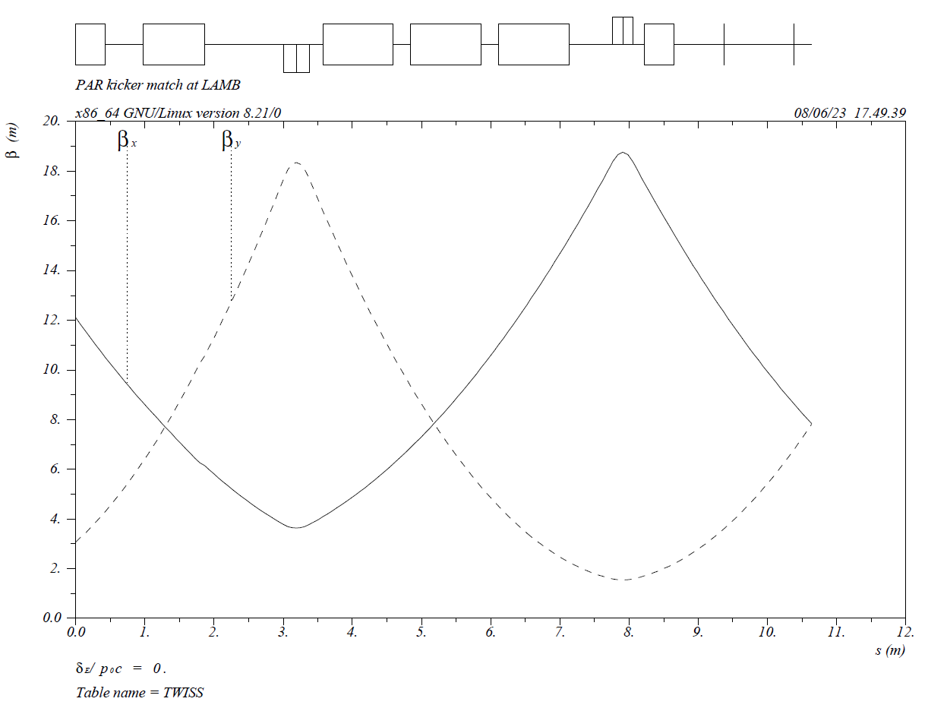
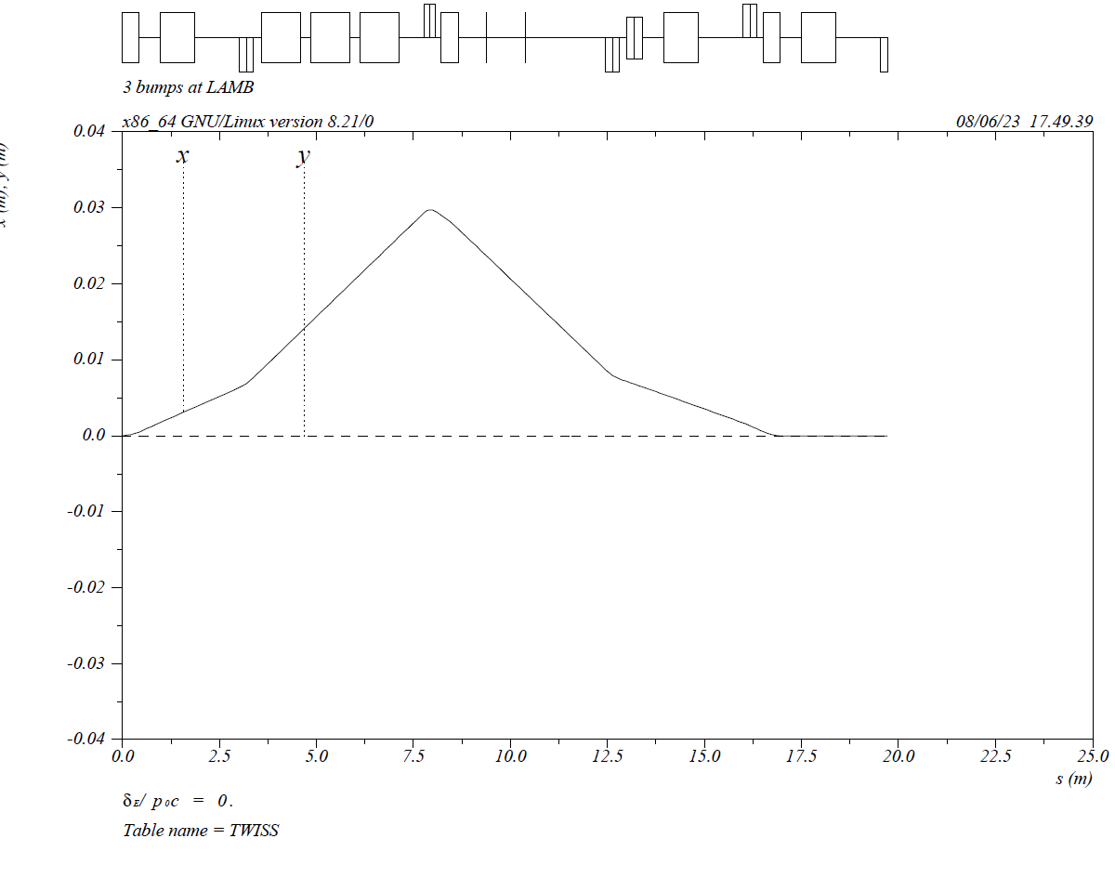
Injection and Extraction
Want to have clean injection and extraction – good to have plenty of space to accommodate hardware.
Needed for high flux DS and DUNE use.

Slide 14
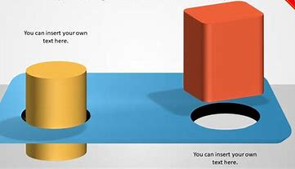
PAR – Design Parameter Considerations
Needed to start with a concept – to allow lattice work to start…….
Booster circumference ring ~478m so half Booster circumference ring ~239m
Beam will take the same time to fill the wrapped ring as it does the Booster: ~600us:
A bunch will pass the foil/injection girder in a similar number/time. ~7 (parasitic hits)
Harmonic number will be basically the same (fill about 81 buckets).
Aperture needed for Booster load is like Booster ~5.5125 cm
Aperture for DS program is constrained by cost – but ideally larger is better. ~7.62 cm
Accommodate a large injection region to handle the flux: ~10 meters
Accommodate two extraction areas:
Booster 20 Hz extraction rate
DS 100+ Hz extraction rate
Accommodate Two RF systems:
Booster designated beam needs 44 MHz capture
DS desires high intensity short bunches – Sub 10 MHz planned
Room for DS and waste beam dumps
Room for PAR injection from BTL line, extraction line to BTL, Extraction line to DS
Fit all of this inside an ‘open’ area that can match BTL, Booster and DS needs……
PIPII-PAR- BTL-Booster

Slide 15
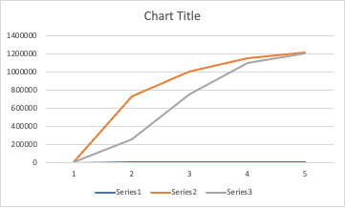
PAR Benefits for DUNE
The PAR concept offers significant improvements to planned PIPII Booster injection.
  PAR would allow for single turn injection – no flattening of Booter bend field
  PAR would remove from Booster RF needs of flat to ramp transition
PAR could reduce DUNE power ramp up times.
PAR offers a path to quickly utilize the capability of PIPII.
PAR will reduce Booster losses
  Can accommodate a robust injection and beam dump
  Easier beam painting
  Better injection capture and synchronization to Booster ramp and PIP-II
PAR could have an upgrade path to 1 GeV
PAR allows for a more direct method of RF transfer between PIP-II and Booster (Simpler Locking System)
PAR will allow accelerator scientist and engineers to test concepts needed for future storage rings/ RCS.
  A future RCS will require a storage ring to effectively collect high energy H- beams.
  Design and operation of Booster sized storage rings will be challenging at DUNE intensities.
DUNE Power Ramp UP
With PAR Present DUNE
Years

Slide 16
PAR Benefits for DUNE
Two categories: Ramp Up Flux & Viability/Reliability
Ramp Up Flux
  Reduces complexity of Injection
    Injection girder
    Injection beam dump
  Reduces complexity of RF capture
  Reduces complexity of Ramp process
  Reduces complexity of flat orbit
  Reduces complexity of orbit control/painting
  Reduces complexity of collimation
  (Higher injection opportunity)
  PAR lattice zero RF dispersion
Viability/Reliability
  Booster shielding is limited –
    TLM are tightly set to be safe
    Collimators are under towers
  Booster Injection Dump limited space
    Injection girder is under BWG
  Less stress on Booster correctors to flatten orbit
    Voltage gradient removed
  Loses at RF and Collimators reduced
  Booster RF systems – cogging, feedback are much simpler to maintain

Slide 17
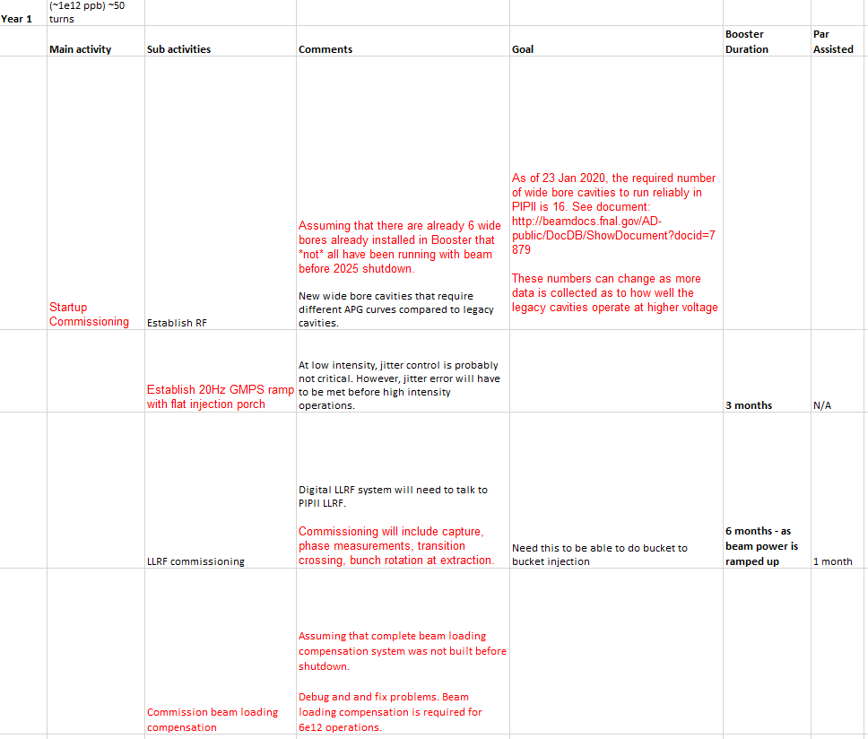
PAR TASK – Show PAR
Benefits to DUNE
The PAR working group has started to go through each required task and quantity the savings. This is straight forward for initial effort/time. However, long term or to quantify viability is more challenging.
We are taking the same approach as we did with PIP and put a risk on items. Then will look at PAR impact on those risks as well as what risks PAR adds.

Slide 18
PAR For DS – Parameters
Initial goal is 800 MeV 1E13 ppp at 20 Hz
  130kW
Operating in parallel with DUNE/Booster – no impact
Operating as high a rep rate as hardware can achieve – 100 Hz
Separate extraction systems but in same region
Separate RF system – Different Machine Harmonic Number (2 verses 84)
Higher intensity capability – use entire PAR aperture for DS
One injection region – must handle both DUNE and DS loading of PAR

Slide 19
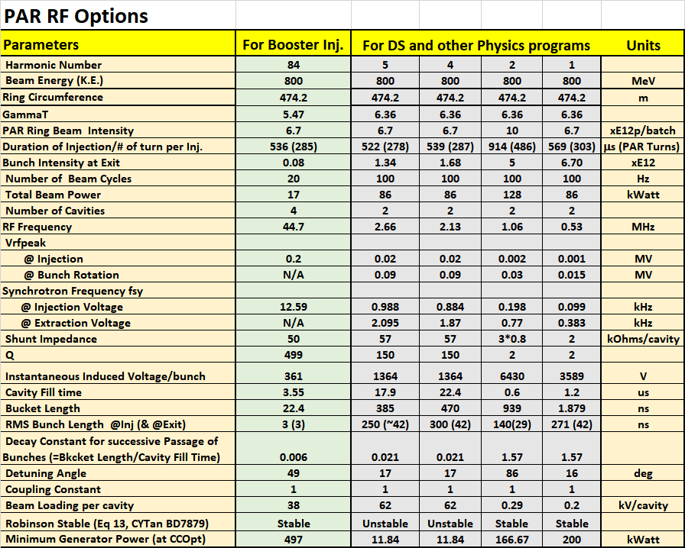
Possible RF Systems for the PAR Ring &
Beam Loading and RF Power Issues
2 bunches @ 5E12
Could go higher
w/o overhead
Good rotation
Short Bunches
Need beam loading compensation

Slide 20
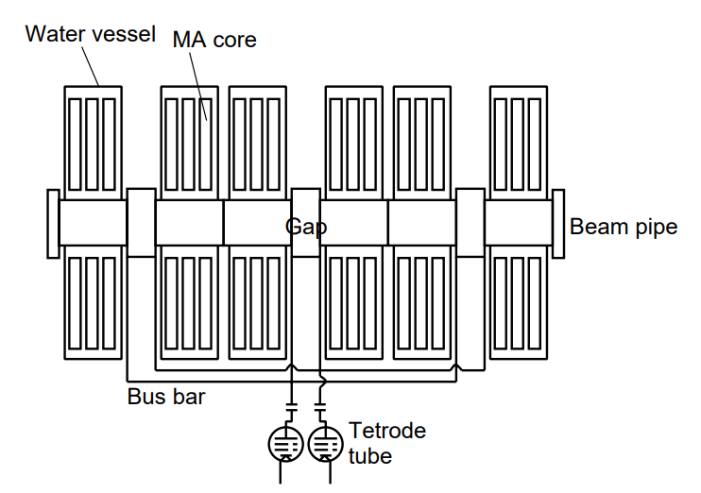
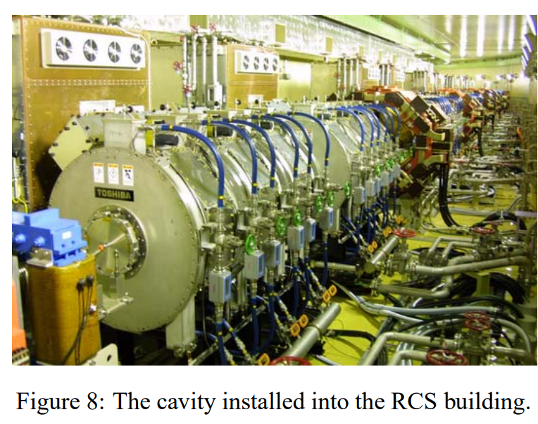
Possible h=2 RF System
We have started a collaboration with J-PARC
This is a straightforward path for DS needs.
h=2
frf=1.06MHz
Vrf =45kV/cavity (JPARC)
Rs= 2.4kΩ, Q~2, ~1m dia
Need to run full CW
Average Power Dissipation=120kW/Cavity
# of cavity=2
Beam pipe
# of gaps=3
Ref: PAC07 p1532
J-PARC

Slide 21
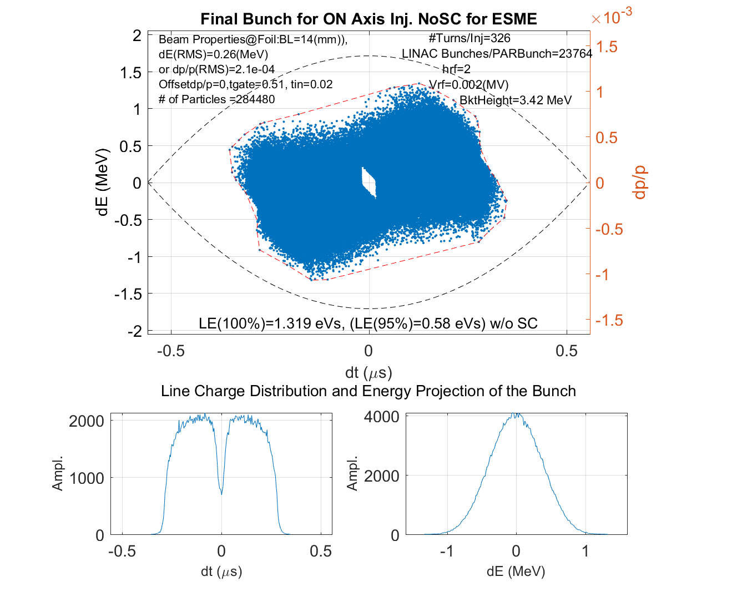
Bunch population with h=2 for
DSP program w/o SC effects at Injection
fsy= 0.2kHz
@0.002 MV
RF simulations have progressed:
No showstoppers
Affordable
Could go higher voltage –>higher Ibeam
½ PAR Circumference
ON axis injection is preferable

Slide 22
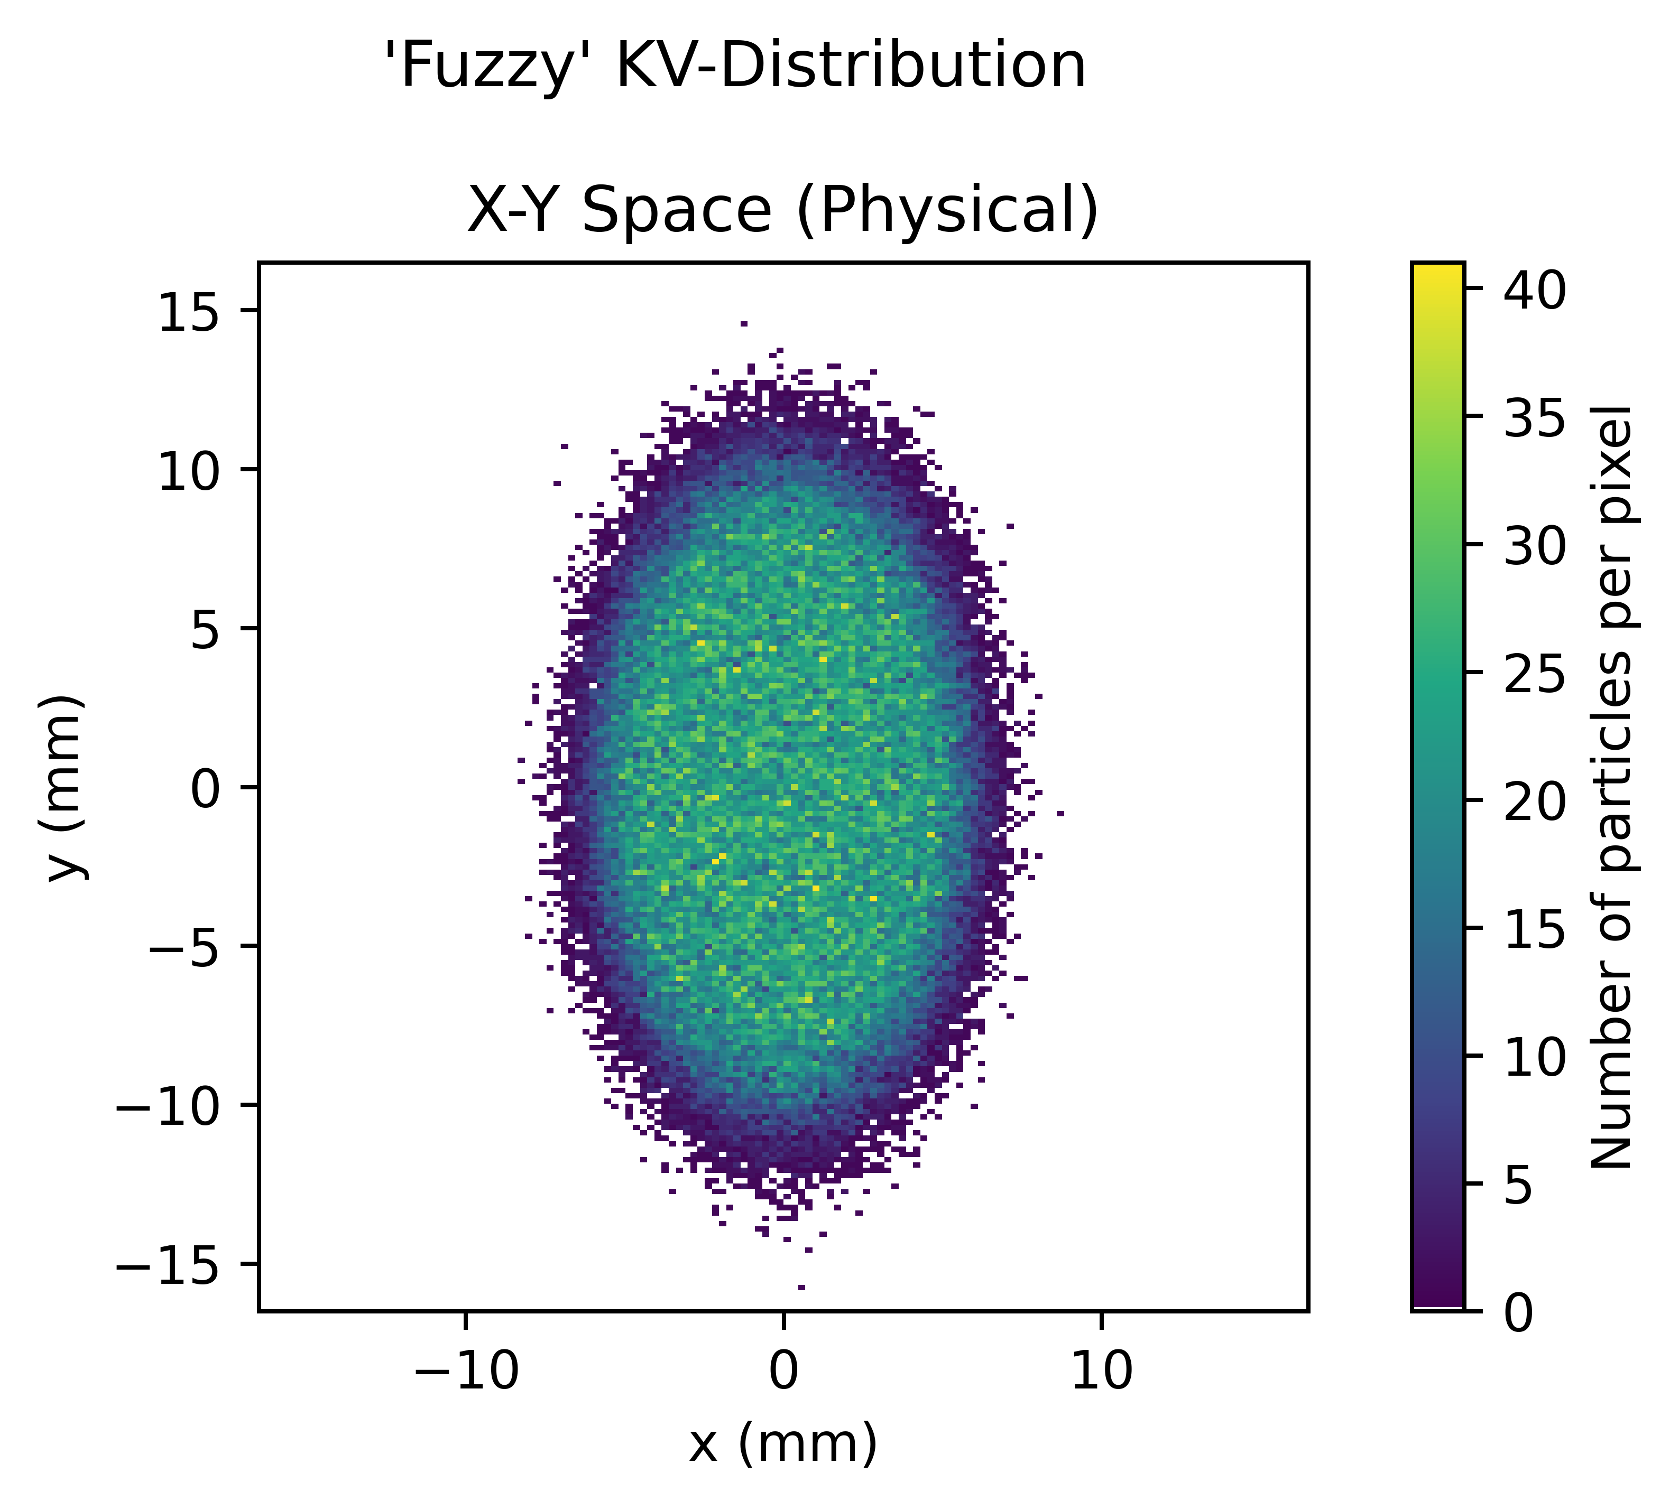
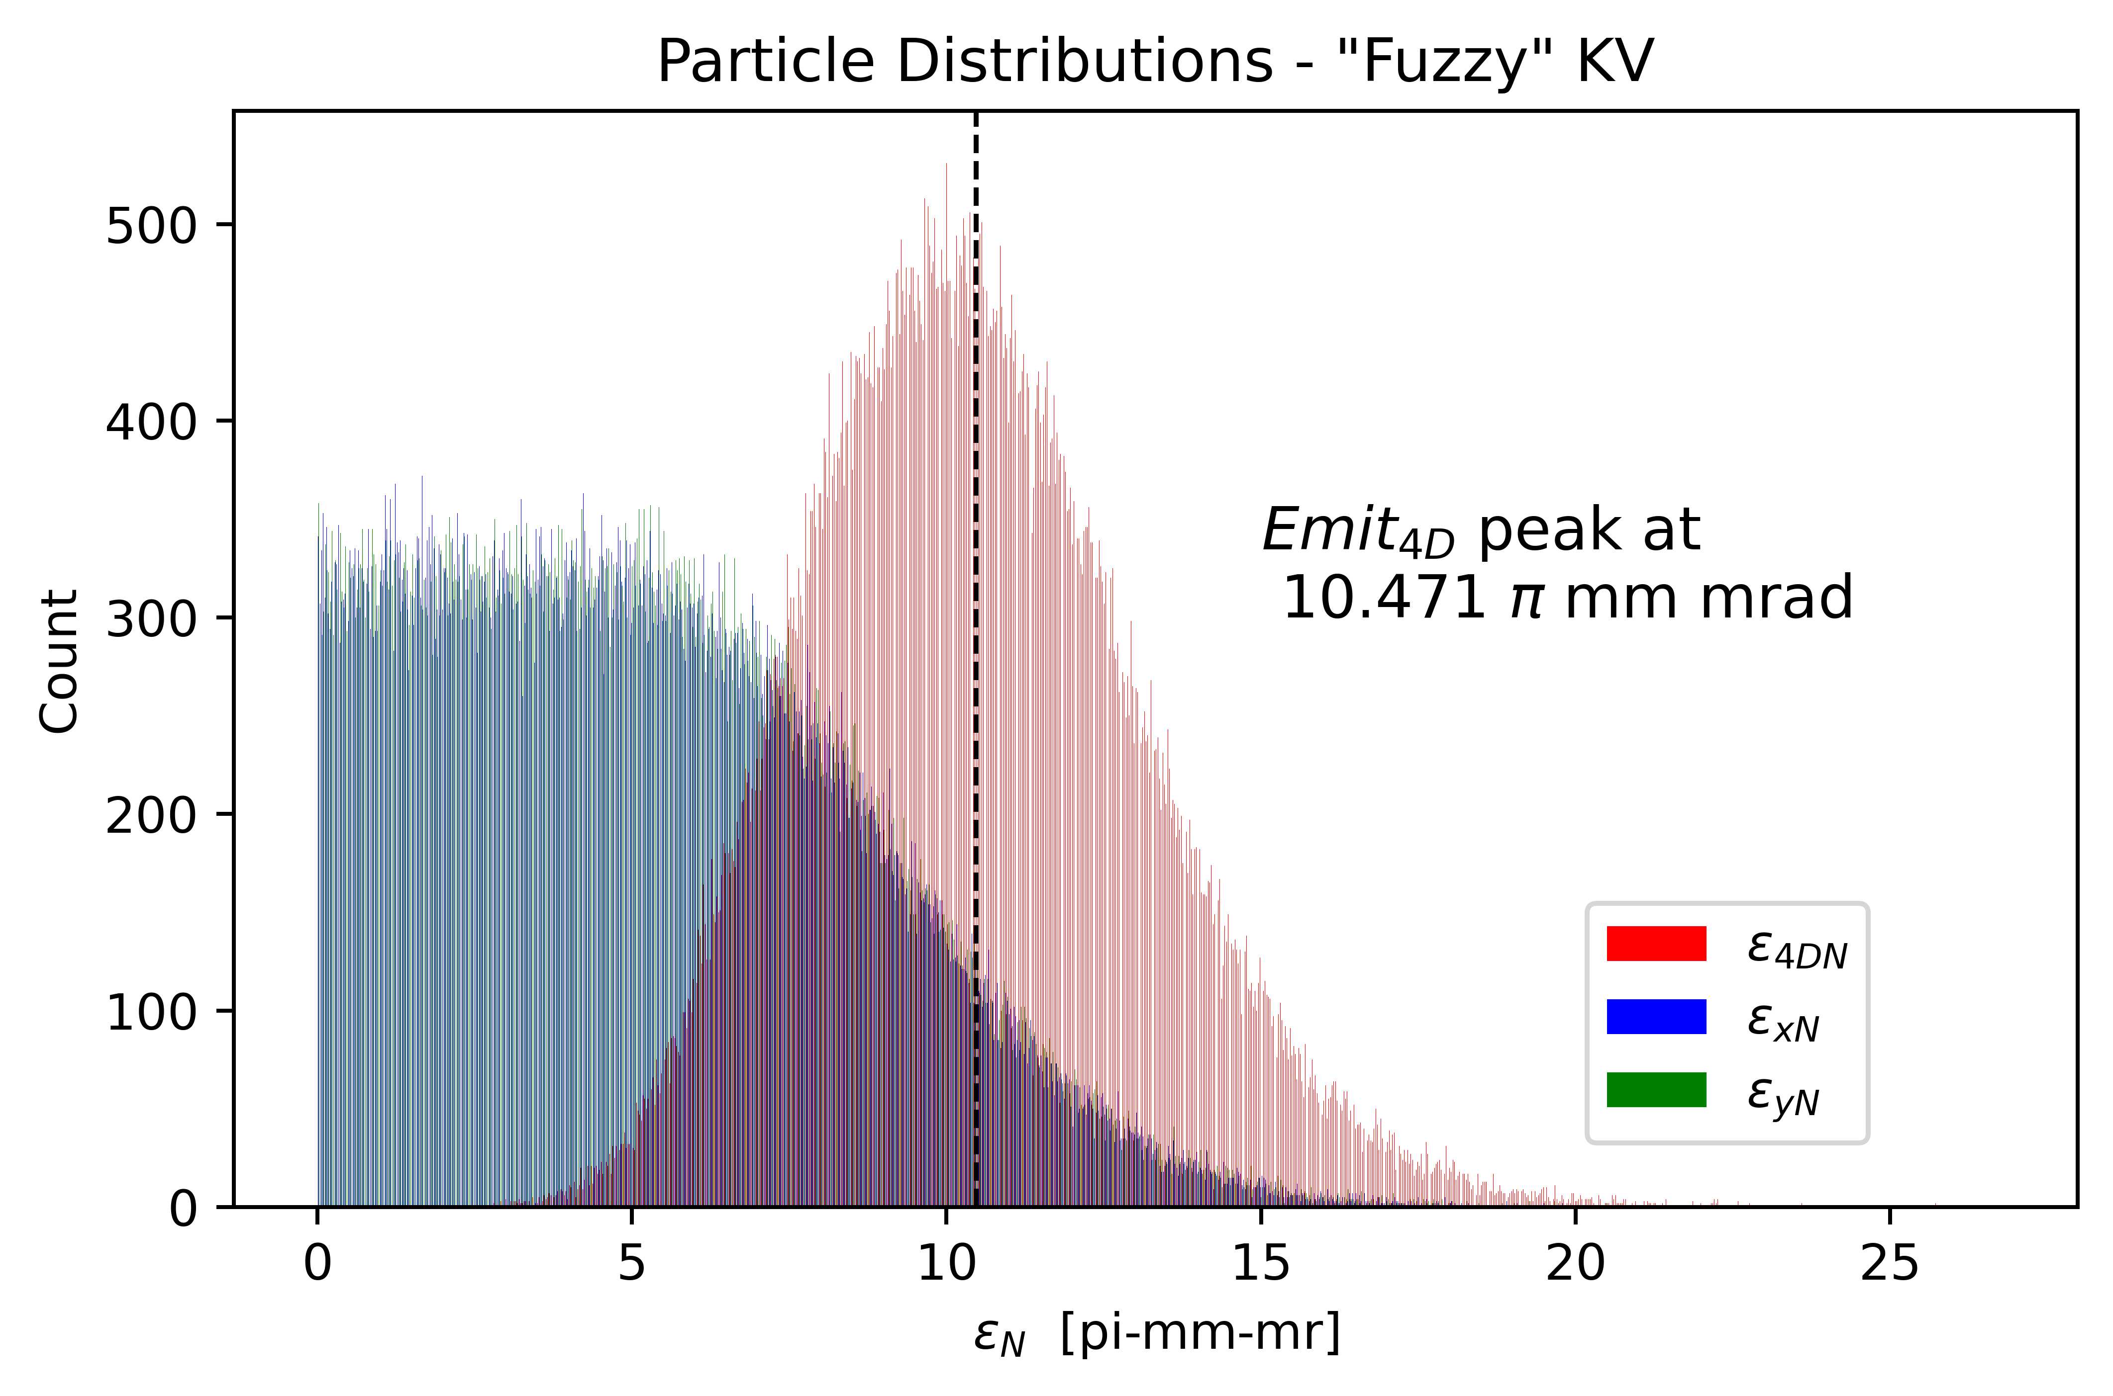
Beam Distribution – Painted Injection
Initial beam distribution is within the +/- 40mm apertures
  Nonlinear tracking with full machine apertures shows good stability within a large range of tunes
  DS mode will have a beam at least 50% larger
Notes:
Beam distribution AFTER painted injection into PAR.

Slide 23
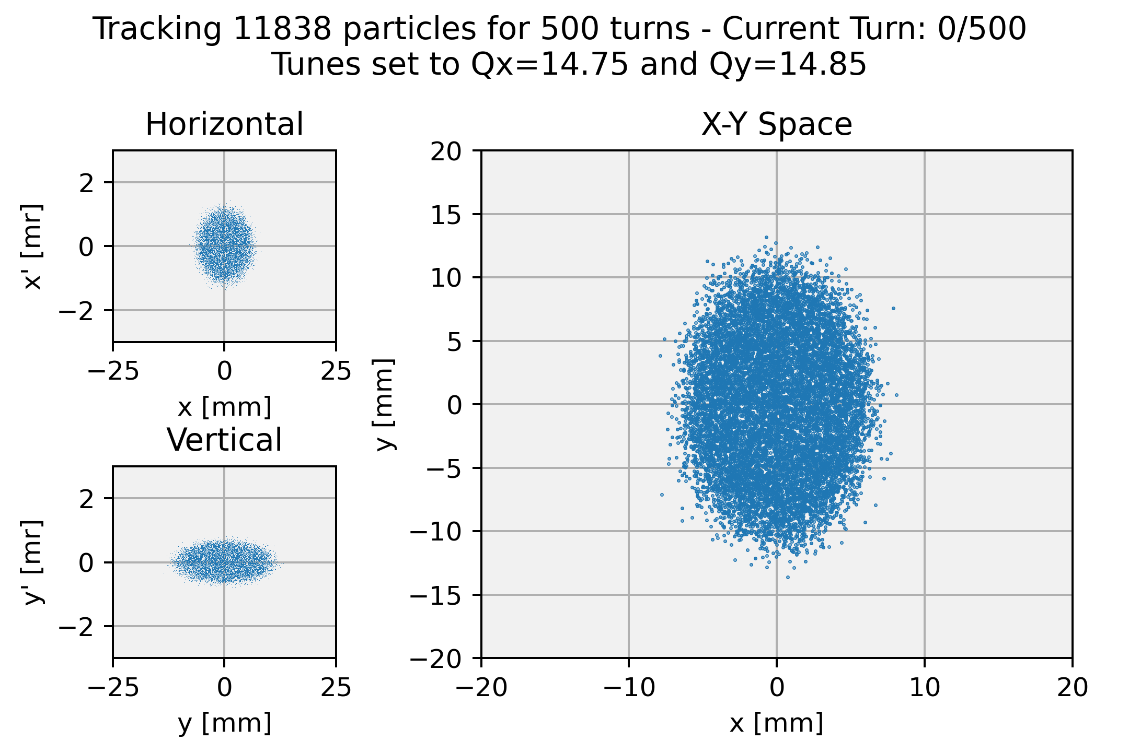
Initial Tracking is Stable

Slide 24
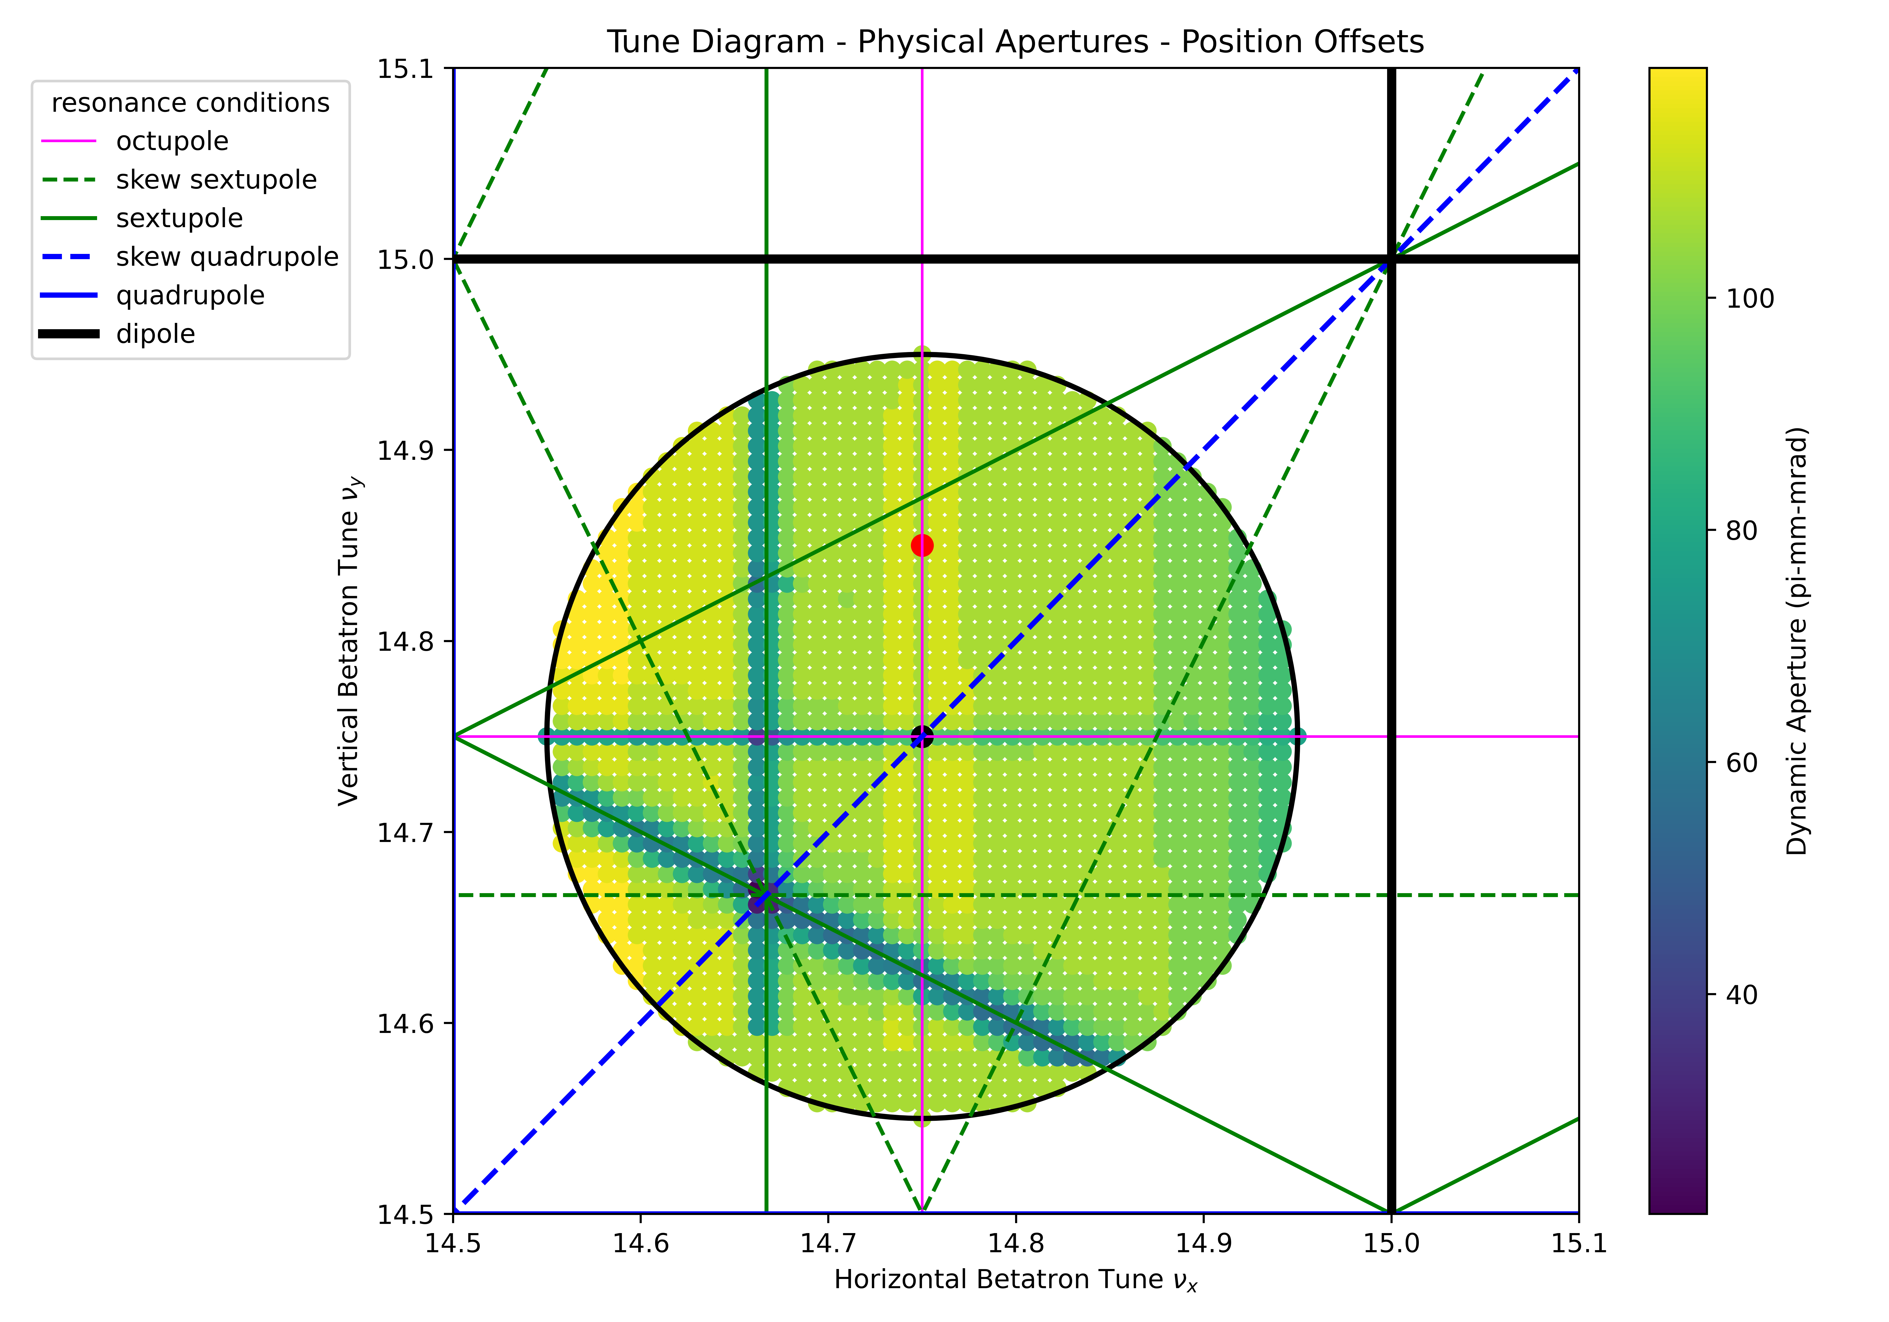
PAR Tune Diagram
Preliminary tracking provides a large region of stable tunes within the range of the phase trombone
The current working point (red dot)
  Avoids the most dangerous resonances from quadrupoles and dipoles
  Avoids the sextupole resonances

Slide 25
PAR Status
The effort for PAR started almost two years ago
  Originally located in the Booster Tunnel was called BAR
Opted to move adjacent to the Booster near the PIP-II injection line BTL
  Civil cost higher
  Reduced impact to Booster
  No impact to present PIP-II Booster plan
Regular meetings
  Proton Source/Beam Physics Group
  Civil Construction – with PIP-II civil engineers
  Division Management
Finishing up lattice and beam physics in 2023
Cost estimates will be provided in 2023
Complete interface of PAR with BTL civil plans 2023
  Alternate options such as C-PAR listed in PIP2-BD physics paper
    C-PAR (compact PAR) option will be more fully explored following PAR

Slide 26
PAR Operations
Designed around some initial base numbers but with upgrades in mind:
Opportunity to minimize hardware rate and radiation limitations
Booster Delivery – 20 Hz @ 5E12 ppp x 2 @800 MeV (20 Hz 1 GEV being explored as part of design)
DS Delivery 100 Hz @ 800 MeV initial goal
Goal to be upgradable to 1 GeV
> 100 Hz options

Slide 27
PAR Operation
PIP-II - Booster – Recycler – MI cycles
v
T= .6 sec for 12 Booster cycles –> time to load of Recycler
MI Ramping
1.2 sec MI cycle
1 Sec
Beam to BNB
Additional Booster
cycles
T= 50msc
Load Recycler

Slide 28
Beam Cycles
.6 sec/12 Booster Cycles
Booster Beam
Booster
Beam
50 ms
Booster Cycles
20 Hz
PAR
Booster Load
PAR
Booster Load
100 Hz Option
PAR
DS Load
10ms
PAR
DS Cycles
Cycle rate for filling PAR will depend upon hardware limitations and injection region capability

Slide 29
PAR Beam to DS program
(Matt Toups Talk)
Assuming 100 Hz hardware limitations and Space Charge like PIP-II
100 Hz* 1E13 ppp*800 MeV*1.6E-19 = 128 kW
More pulses and or higher intensity may be possible
Future option: PIP-II increases injection beam energy to 1 GeV.
  The SC is reduced, and you can scale up the beam intensity:
100 Hz*1.5E13 ppp*1E9*1.6E-19 = 240 kW
Limitations for these intensities need to be examined – such as shielding, painting, injection foil, extraction, RF needs…..

Slide 30
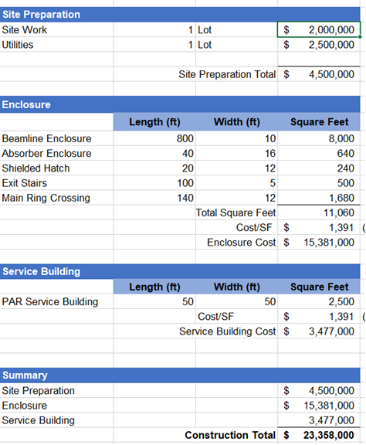
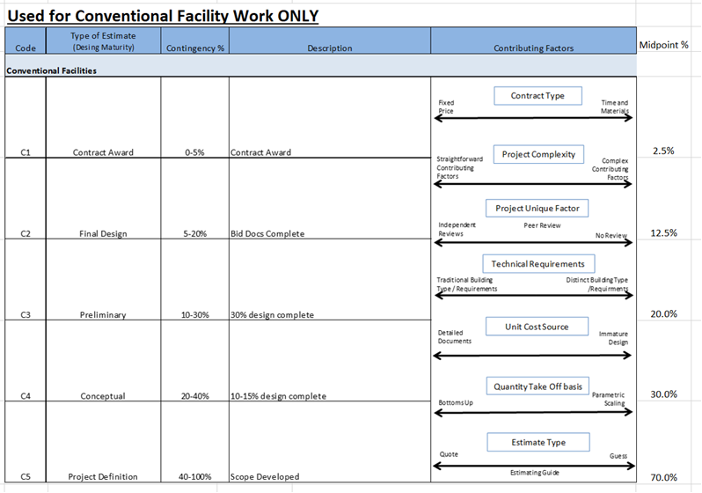
Why Not PAR - Funding Reality
Funding at an opportune time is the challenge. Meeting the timeline to help PIP-II/DUNE is important to PAR becoming reality. As PAR progresses – cost tables will be completed as shown for civil below.

Slide 31
PAR is path to a faster DUNE ramp up, use of the PIP-II capability and nearly a decade faster path to a DS physics program.
PAR
Build BTL Tie-In
The above timeline provides some idea of DUNE and DS power delivery. This may be overly optimistic or pessimistic – it all depends upon funding profile.
PAR is not an attempt to change the DUNE 2.4 MW timeline directly. However, it does offer a faster ramp-up. If one wants three years at full power before shutting down for 2.4 MW and the opportunity to examine some of the challenges of 2.4 MW delivery.
One may also consider 1 GeV PIP-II as a staged upgrade that will further improve staging of power upgrades. This also reduces the stress on the Booster magnets from reduced voltage radient 1 GeV injection from PIP-II into Booster is not possible without PAR.
PAR occurs before Booster replacement – This is the only option/talk on the next decade plus opportunities at FNAL.

Slide 32
Three ACE Booster Replacement (BR) Questions:
a) help LBNF/DUNE Phase II and improve reliability of the accelerator complex;
  To achieve Phase II – you have to be successful in phase one! Success requires operating the Booster for the initial power ramp up during the critical commissioning and at least 5 years of running at required power. PAR is capable of helping the Booster deliver the necessary beam by reducing losses in the Booster and significantly reducing the complexity of the Booster operations.
  Taking the Booster Injection out of the Booster has several benefits that can’t be underestimated:
  More space for a robust beam dump – will be a HRA in Booster!
  Single turn injection into a rapid cycling Booster – still uncertain how to do this without PAR
  Simplify the Booster RF locking to PIP-II
  Does not require Booster correctors to flatten orbit – removing risks associated with pushing correctors
  Simple acceleration process in the Booster – no longer need to transition from flat to ramping GMPS
b) enable new physics “spigots” (RPF, etc);
  The only way to achieve a DS or any other beam based new physics program within a decade is PAR!
  Every other plan is 20 years away – unless you leave Fermilab (the nations' HEP lab)
c) layout foundation for the future MuColl R&D and facility
  If an accumulation ring is required for MuColl – this will be a testing ground.
  We have not built an accumulator ring in decades – PARs unique design and potential training is important to helping us ensure success at the next stage.

Slide 33
Questions 2 & 3
2 What are the biggest technical/performance risks of your system/development?
  I see no significant technical risks, but I do see timing challenges – given approval – how quickly can you manufacture required magnet systems – fully tested.
  Placement ands design of service building requires site planning outside the PAR immediate group and may delay deployment of PAR.
  Performance risk – Should be thought of as Flux limit(s) .
    Pulse systems – 60to 80 Hz been shown – how much is 100 Hz going to stress design
    Beam extraction loss,
    Beam Injection Loss
. What are the most sensible first steps to enable progress in your system/ development? What can be done before the next ACE event (Fall’23 workshop)? With technical hurdles crossed the work on fundamental Civil & Mechanical required…..
  The PAR beam dump needs to be designed (Could be done by fall)
  Actual mechanical stands and supports
    It would take two years to complete ME designs and drawings
  Civil work on building, penetrations, and cable runs all to be done

Slide 34
Summary
PAR offers solutions an upgrade of PIP-II to Booster operations, an immediate extended use of the PIP-II capability, a stage to upgrade power, an opportunity for FNAL to make a significant contribution to DS HEP and an exciting area of accelerator development.
This option, by using the upgrades and facilities that exist or soon to exist, is cost effective and achievable on a short time scale. To achieve this capability before the end of this decade is possible but needs to start now.
Cost is the only reason not to proceed –
Therefore, if we can get the cost to a reasonable number – PAR will be done!
Had we started this earlier - I believe PAR would have been part of PIP-II plan.
  PIPII will work without PAR, but with PAR, PIPII operations is improved and simplified.

Slide 35
PAR Costs (Fill In Numbers Over the Next year)
Tunnel Enclosure 24 M
Permanent magnets (Two recent examples with labor) 7 M
Stands/supports 1.4 M
Correctors – reuse .1 M
Power Supplies
RF: Retro Fit Spare Booster Cavities Like PIP II (may power from upstairs: fixed freq) 4 M
Vacuum estimates: Pumps and plumbing (24 sector system). 2.5 M
  Can we share Booster Roughing system?
  Controls .8 M
Diagnostics – Use Booster BPM design (4 inch ID)
  BPM unit cost 24 k (with flanges) .65 M
  Use Booster or Linac fixed frequency BPM digitizer design ( 4k per board) .1 M
  Extraction Kickers – larger aperture, use SS PS – 2.2 M
  Toroids
Injection – similar to PIP II cost ??
Extraction Dump Magnets: (Unless we reuse 8 GeV magnets and PS) 1.2 M
Work In Progress

Slide 36
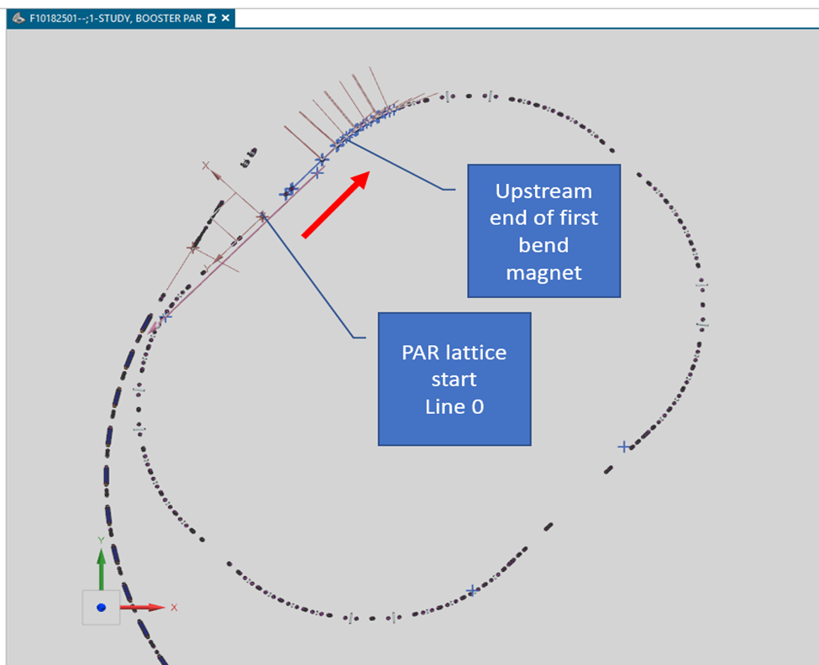
Planning DS placement is underway
Early thoughts each had pro/cons
Extract from PAR in the same region as extraction to Booster.
Have a switching magnet that switches between BTL/Booster and Booster Dump/DS region.
Benefits:
Use same kickers,
Use only one short straight
Issues:
Faster kickers 120 Hz vs 100/20 Hz
Potentially hotter area
Adding a fast pulser magnet
Separate
Using Btm ring for BTL, top for DS:
Separate operations
Easier of Pulsed systems
Det
DS RF section
>18 Meters
Tunable
Detector
Flux
Dump
Det B
Det C
PAR RF
Service
Building
PAR RF
BTL
Service
Building

Slide 37
PAR: Timeline of Development:
Lattice: (FNAL)
  Develop a list of constraints (use rough parameter boundaries)
    RF footprint (capture and maybe unique DS bunching needs)
    Injection Area
    Extraction (kickers, septa)
    Meet PIP-II injection and BTL physical and lattice constraints
    Comfortable tune and chromaticity for 600 us accumulation
    Minimize dispersion in RF area –
Hardware: (FNAL, BNL, US-Japan)
  Lattice will drive magnet design
    Edge Focusing
    Reasonable strength
      Permanent magnet
      Combined Function
  RF – reuse Booster cavities (shell)
  Use Booster style short kickers
Injection (FNAL)
  System to handle Booster needs but also DS needs -
  This is probably the most challenging aspect of a 100+ Hz capable machine –
Generate Rough Cost Estimate – In One Year

