Slide 1
Muon Collider R&D with the FNAL Accelerator Complex Evolution (ACE) plan
Katsuya Yonehara
Fermilab ACE Science Workshop
June 15 2023

Slide 2
Muon Collider design parameter
The goal is to get to 10 TeV center-of-mass energy
Consider proton driver based Muon Collider
  Low EMittance Muon Accelerator (LEMMA) use e⁺e⁻ → mu⁺mu⁻ though production rate is extremely low
Staging at 3 TeV is the current baseline
Aim to have two detectors but only experiment assumed now

Slide 3
Questions and Answers (I)
Experiments:
  How does the experiment make use of the ACE beam?
    ACE phase I is utilize for MuC R&D
    And ACE phase II (Booster Replacement) is useful for MuC cooling demo
  Is the experiment uniquely enabled by The ACE upgrades?
    Yes
  Can this experiments be performed elsewhere?
    ACE BR is needed to demonstrate muon collider system which is the last stage to construct real muon colliders
  What particular accelerator components or capabilities are necessary?
    What proton energies are needed?
    5-15 GeV
    What proton quantities are needed?
    > 10¹² protons per bunch
    What time structure is needed? (bunch length, train structure)
    Bunch length something in the ns scale, Repetition rate is not so important for the demo facility
    Can the demonstrator be performed with 800 MeV protons from PIP-II or 8 GeV protons from the Booster with PIP-II?
    Yes for 8 GeV, No for 800 MeV

Slide 4
Questions and Answers (II)
How might an eventual Muon Collider benefit from ACE?
  What particular accelerator components or capabilities are necessary for the experiment?
    What proton energies are needed?
5-15 GeV approximately
What proton quantities are needed?
10^14 approximately
What time structure is needed? (bunch length, train structure
1-3 ns bunches, ideally at 5-10 Hz

Slide 5
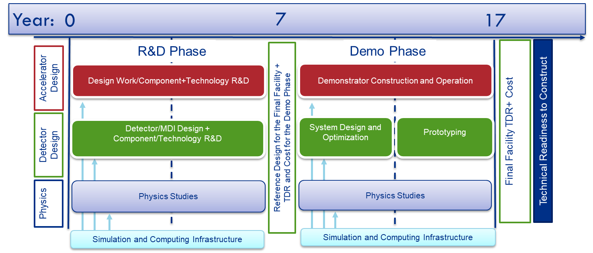
US Muon Collider timeline
ACE
Booster Replacement
ACE + Booster Replacement will be expected around the year 17 where the Muon Collider facility design will be done

Slide 6
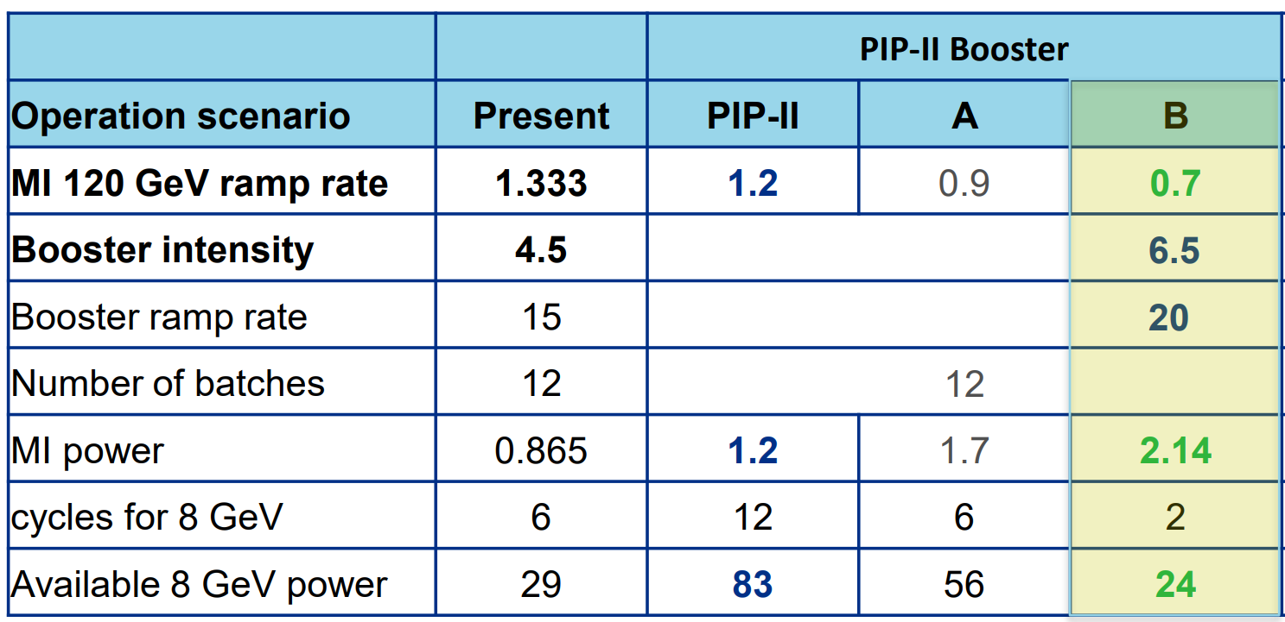
6
S0D: 8 GeV Booster Experiments
Example: Current BNB Program.
Booster provides 1.8μs pulses every 20 Hz of 6.5e12 protns at 8 GeV.
Impacted by MI cycle rate, but at least as high as present.
6
Jeffrey Eldred | ACE Science Workshop
Notes:
6
6
6

Slide 7
Evaluate ACE beam parameter for MuC R&D scenario
Scenario A
  Capable to deliver 8 GeV ACE beam to Recycler Ring
  AP0 could be potential to utilize for Target R&D and Muon Cooling demo
Scenario B
  Share 8 GeV ACE beam with SBN

Slide 8
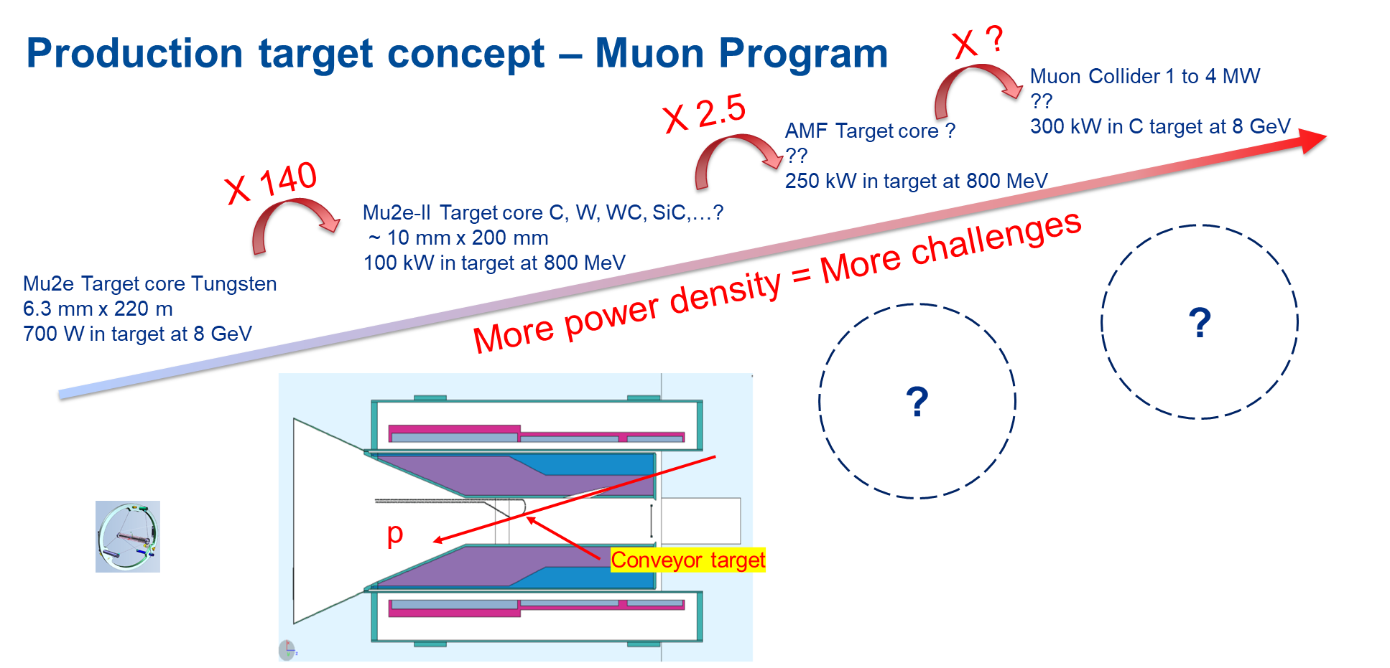
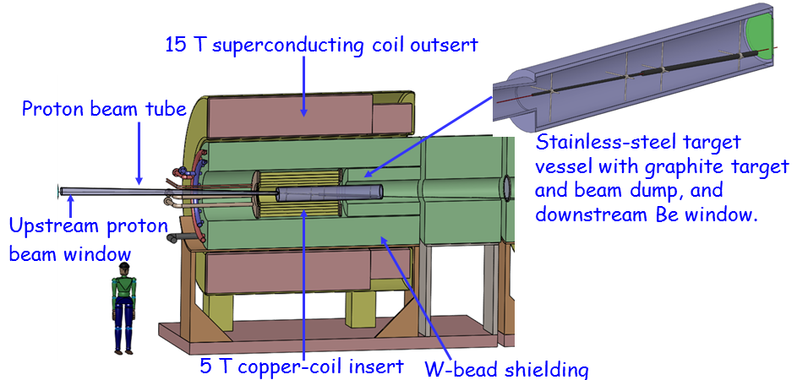
R&D of Targetry for Fermilab accelerator program
High Power Target technology has been developed for neutrino program
  Established 1.2 MW graphite target for LBNF
  ACE plan pushes the target R&D to produce 2+ MW target
ACE plan opens more high power target applications
  Target R&D roadmap to support Mu2e+, AMF and MuC
MAP + IMCC design

Slide 9
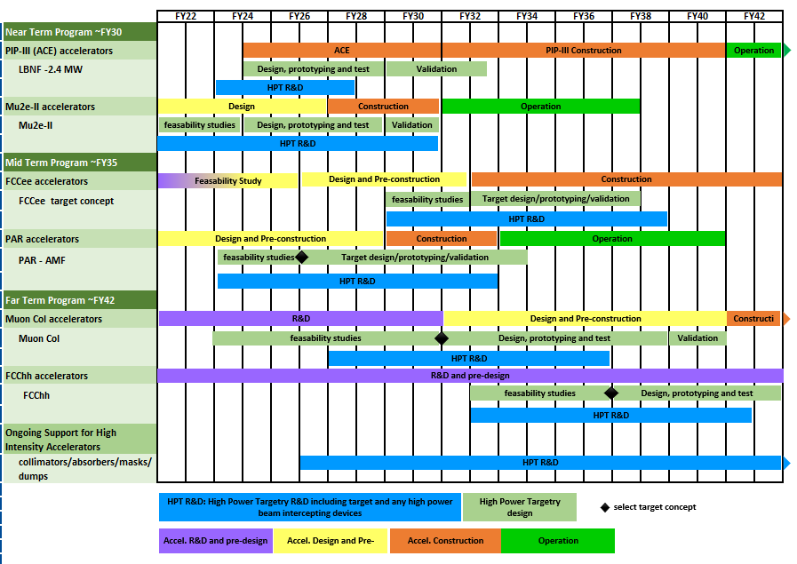
Proposed Roadmap of Targetry R&D
Workshop – April 11-12 2023

Slide 10
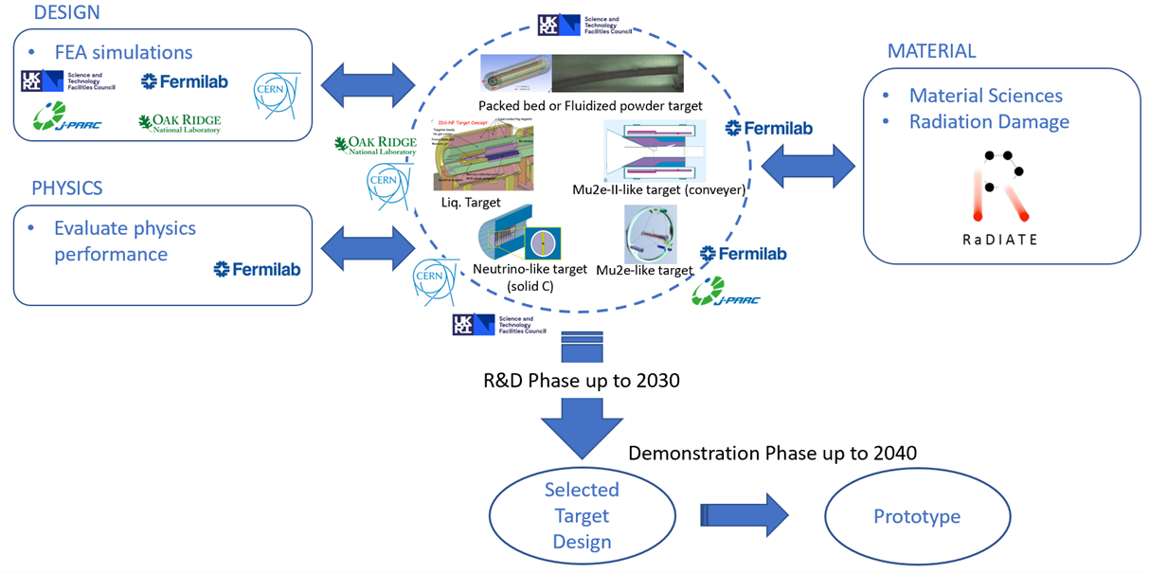
Collaborate Targetry R&D for MuC target study
MuC targetry is included in the proposed GARD High Power Targetry Roadmap with a plan to have a prototype in the late 2030s
R&D
should start now!

Slide 11
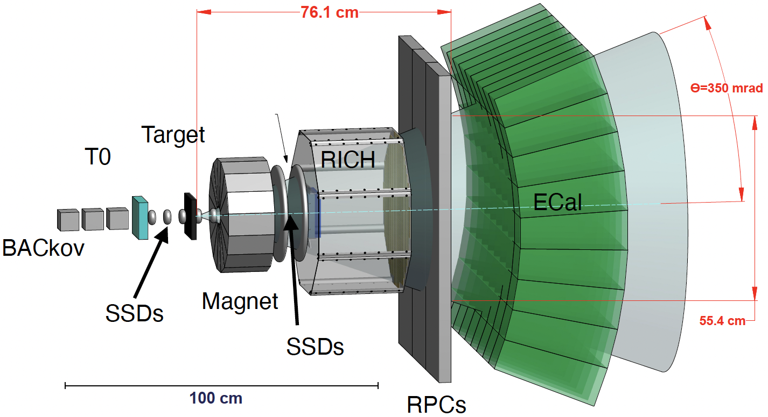
Optimize MuC Target performance
Select the building material including shielding block, beam window based on the material study
  Study radiation & thermal stresses of building materials (RaDIATE)
Design dimensions of target system from engineering and physics point views
  Pion yield study
    Angular distribution
    Target Z dependence
    Energy dependence
    Hadronic shower
EMPHATIC
for yield study

Slide 12
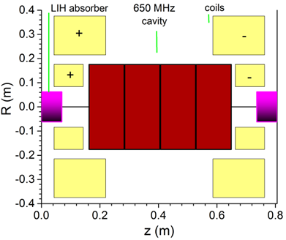
MuC Hardware R&D (A couple of examples)
High gradient RF cavity in strong magnetic fields
  Study cold RF cavity with various wall materials (Cu, Be, Al)
  Beam window
  Power coupler
  High power RF source
  Gas-plasma process in gas-filled cavities (beam needed)
Prototype cooling cell
  Integrate high field magnet coils
  Infrastructure
    LN2
    RF waveguide
    Beam instrumentation
Example cooling cell

Slide 13
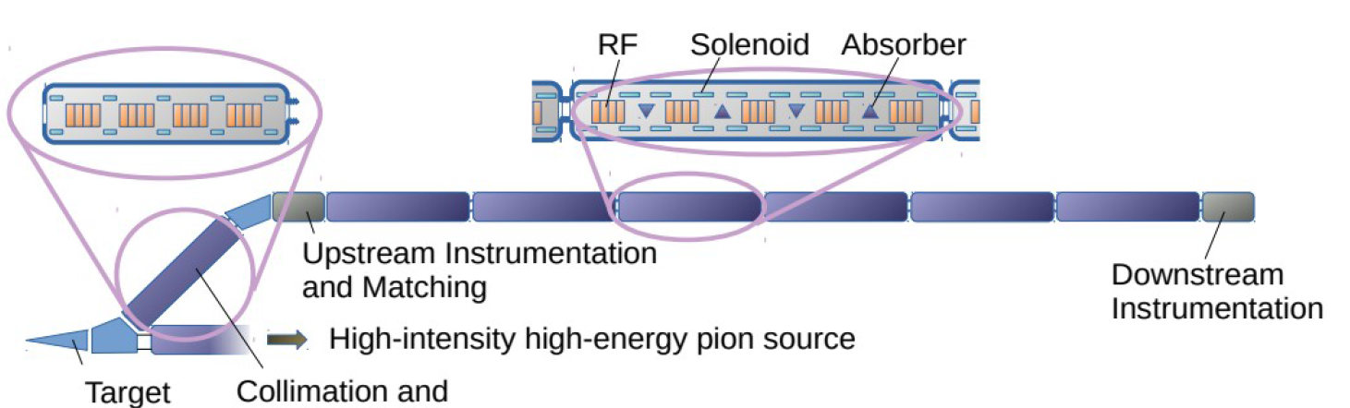
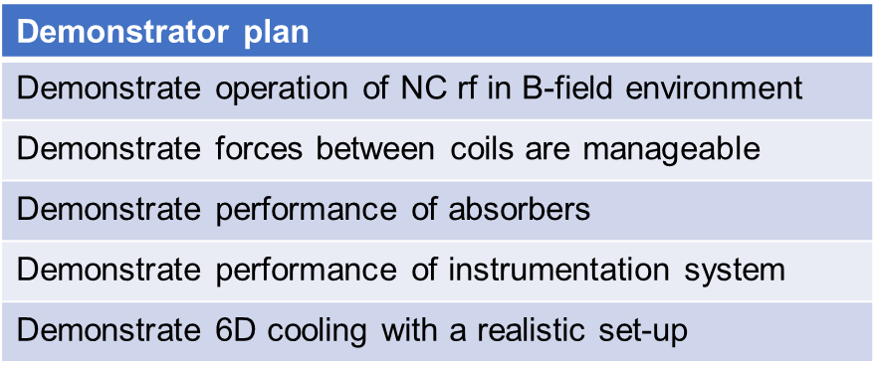
Muon Collider cooling: Path forward (demonstrator)
While the physics of ionization cooling has been shown [ref] it is critical to benchmark a realistic MuC cooling lattice
  This will give us the input, knowledge, and experience to design a real, buildable cooling channel for a MuC
  Next 5 years: (1) A conceptual design of a demonstrator facility that allows testing the technology for cooling (2) Site exploration & cost estimate of a demo facility (3) Engineering design & start fabrication of a 1.5 prototype cooling cell
Many cells
x10

Slide 14
Summary
ACE booster upgrade should be designed to be compatible with the requirements for a muon collider proton driver
Muon collider target R&D will utilize 8 and 120 GeV ACE beam in synergy with the Fermilab physics program
In ACE scenario A, the AP0 campus can be used for muon collider R&D
In ACE scenario B and beyond, 8 GeV from the booster will have to be extracted for muon collider R&D and shared with the SBN program

Slide 15
Questions and Answers (I)
Experiments:
  How does the experiment make use of the ACE beam?
    Muon collider demo facility
  Is the experiment uniquely enabled by The ACE upgrades?
    Yes
  Can this experiments be performed elsewhere?
    ACE BR is needed to demonstrate muon collider system which is the last stage to construct real muon colliders
  What particular accelerator components or capabilities are necessary?
    What proton energies are needed?
    5-15 GeV
    What proton quantities are needed?
    > 10¹² protons per bunch
    What time structure is needed? (bunch length, train structure)
    Bunch length something in the ns scale, Repetition rate is not so important for the demo facility
    Can the demonstrator be performed with 800 MeV protons from PIP-II or 8 GeV protons from the Booster with PIP-II?
    Yes for 8 GeV, No for 800 MeV

Slide 16
Questions and Answers (II)
How might an eventual Muon Collider benefit from ACE?
  What particular accelerator components or capabilities are necessary for the experiment?
    What proton energies are needed?
5-15 GeV approximately
What proton quantities are needed?
10^14 approximately
What time structure is needed? (bunch length, train structure
1-3 ns bunches, ideally at 5-10 Hz

Slide 17
Questions and Answers (III)
ACE Booster Replacement (BR) has potential for: a) help LBNF/DUNE Phase II and improve reliability of the accelerator complex; b) enable new physics “spigots” (RPF, etc); c) layout foundation for the future MuColl R&D and facility
Three Questions (to accelerator session speakers):
How will your system/development address the above three BR goals?
  Answers are given in the previous slides
2. What are the biggest technical/performance risks of your system/development?
  Lower than nominal luminosity due to performance of target/capture and ionization cooling systems
3. What are the most sensible first steps to enable progress in your system/ development? What can be done before the next ACE event (Fall’23 workshop)?
  Initiate design work towards a self consistent set of parameters for the demo and the final facility hosted at Fermilab

