Slide 1
Tianlai Cylinder Array FRB backend
Beamforming Map Making
Zijie Yu

Slide 2
0.1 ms
1024 channels
655.36 MB/s
Disk
FRB Raw data
0.4 ms
256 channels
40.96 MB/s
RAM
Beamformer
Hashpipe
FRB Down-sampled data
0.10066 s
1024 channels
Disk
Survey data (.fil)
10.066 s
1024 channels
Disk
Survey data (.hdf5)

Slide 3
Beam 0
Az 0°
Alt 44.15°
Beam 1
Az 0°
Alt 45.15°
Beam 2
Az 0°
Alt 46.14°
Beam 95
Az 180°
Alt 40.00°
$$⋯⋯⋯$$
Dec 90°
Dec 89°
Dec 88°
Dec -5°

Slide 4
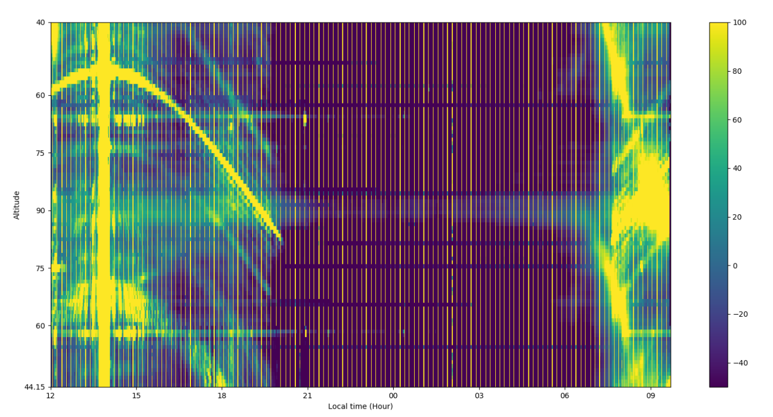

Slide 5
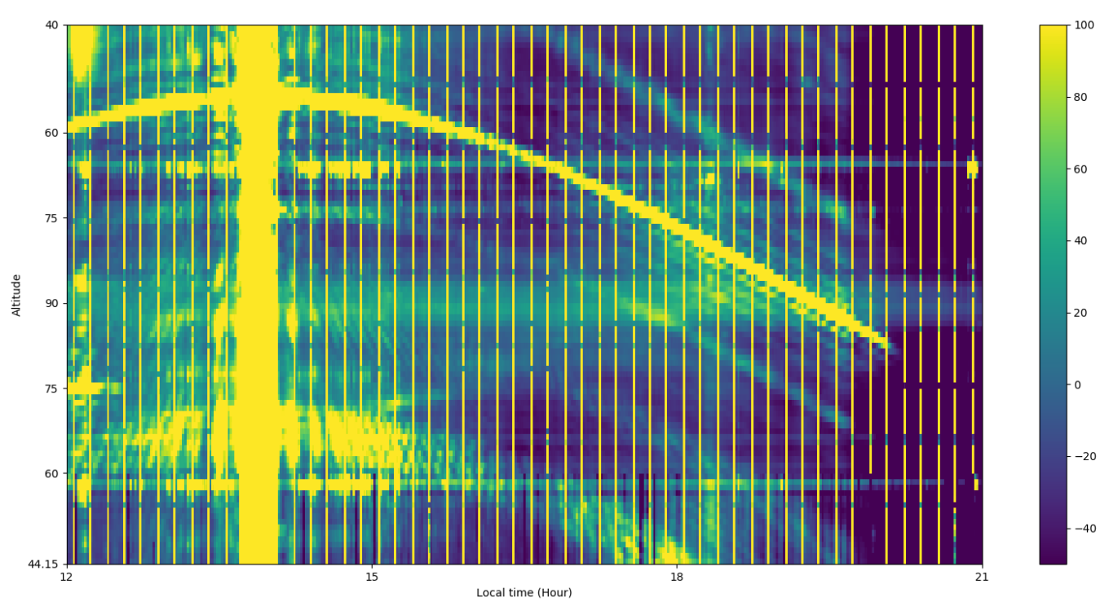
M1
CasA?

Slide 6
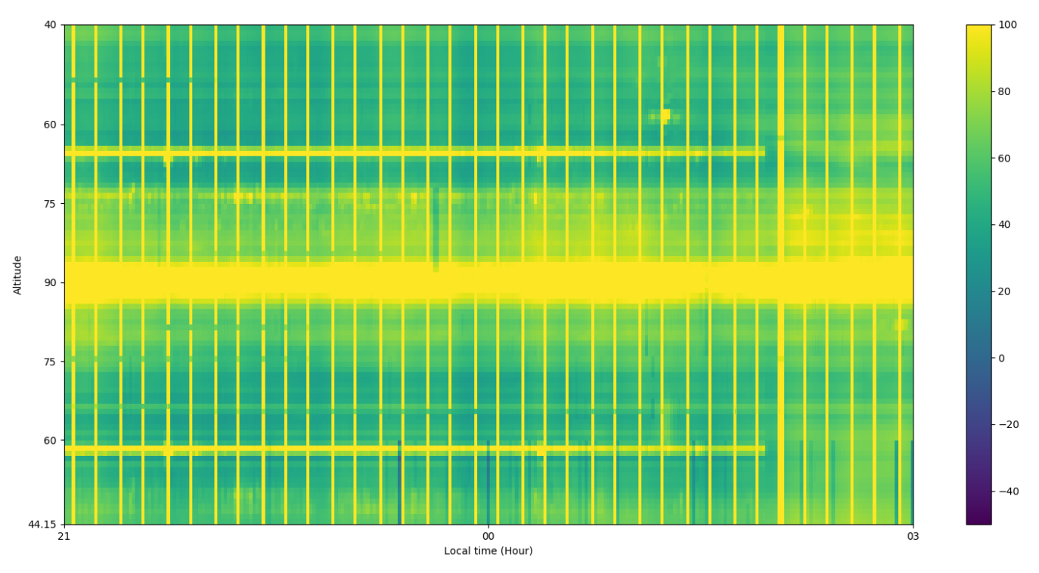
M87

Slide 7
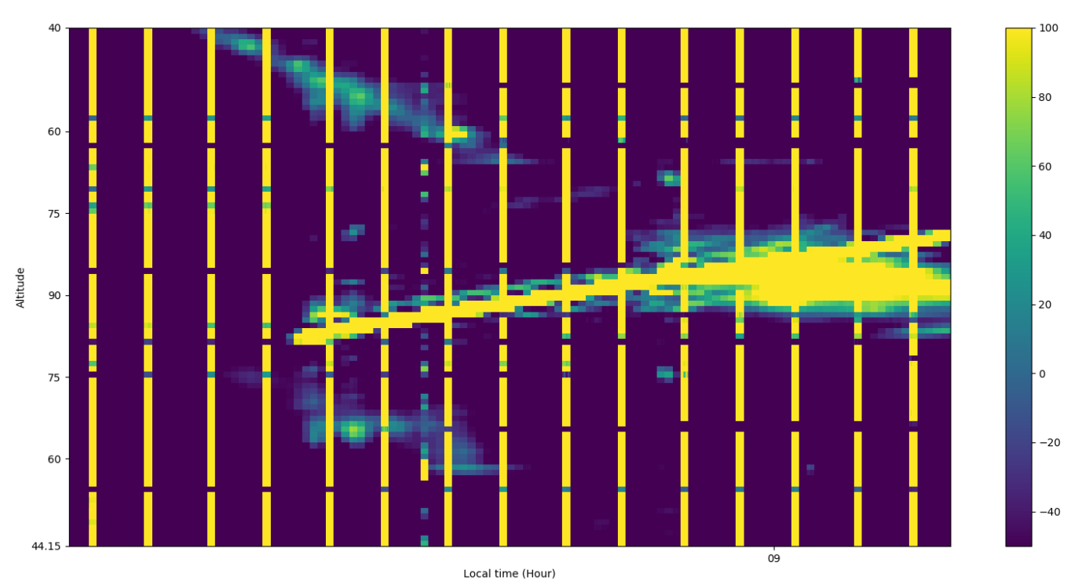
CygA?

Slide 8
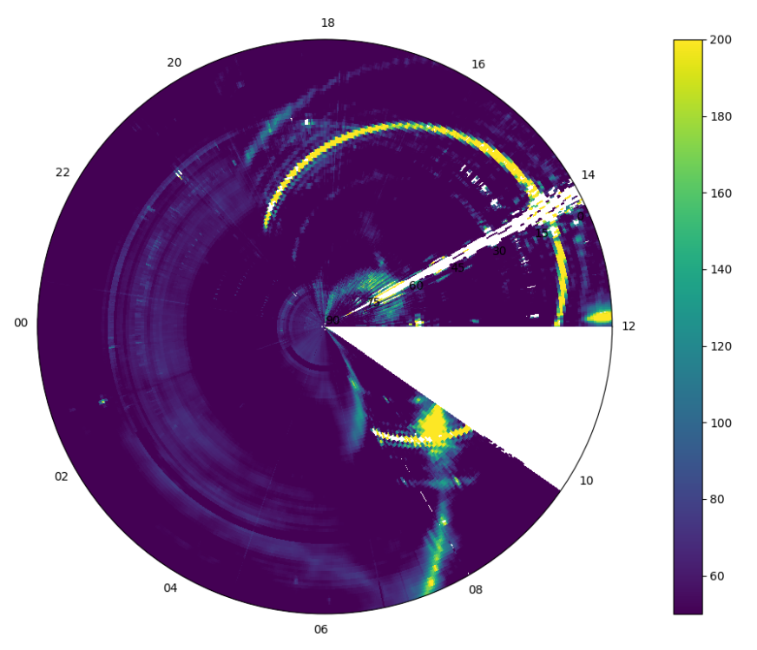
M1
CasA
M87
Cygnus

Slide 9
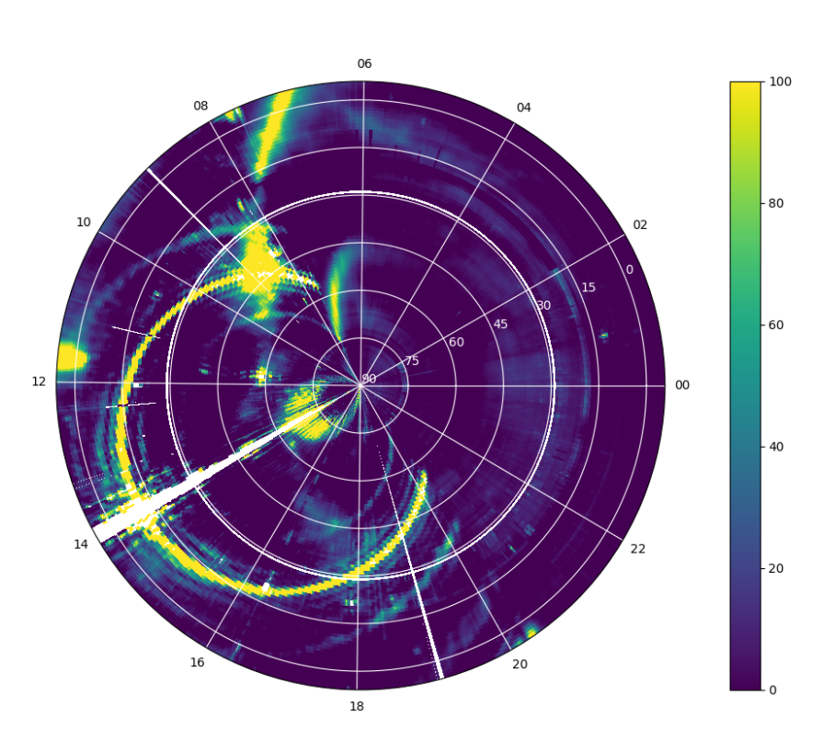
Cygnus
M87
CasA
M1

Slide 10
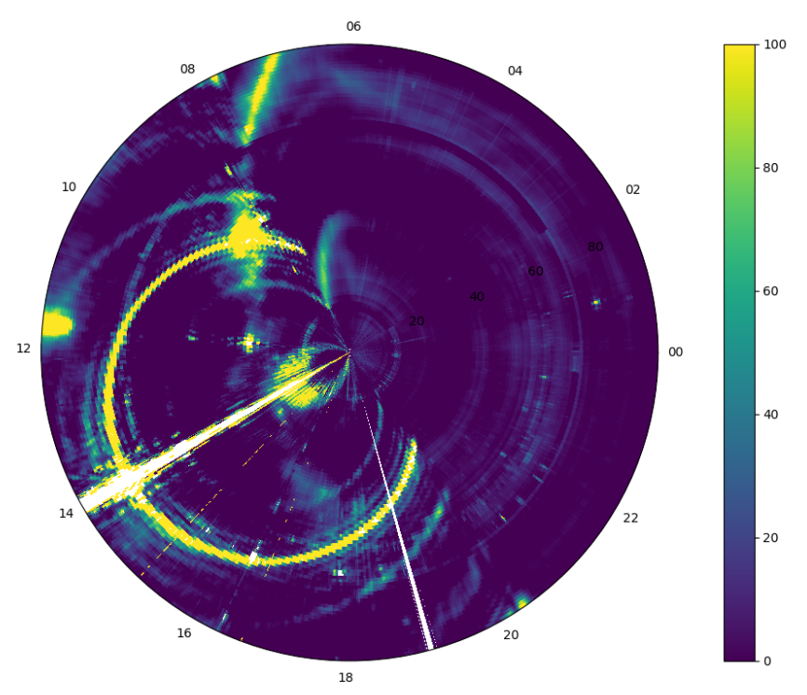
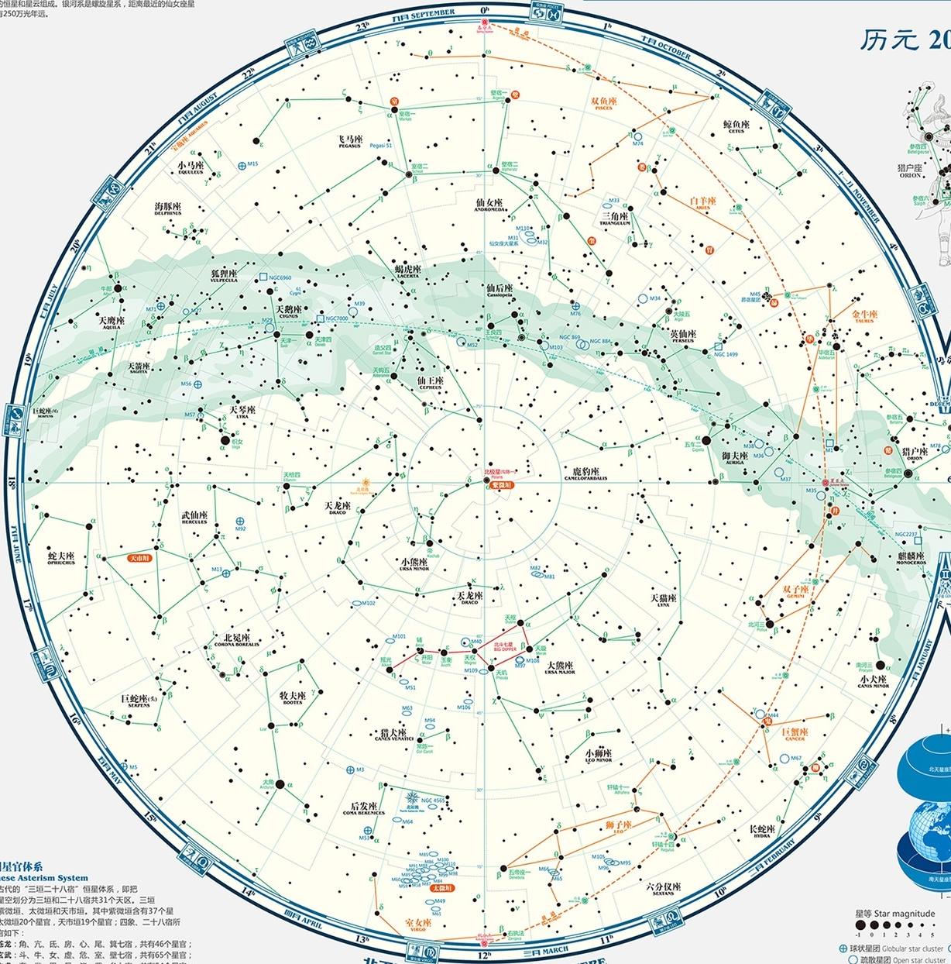

Slide 11
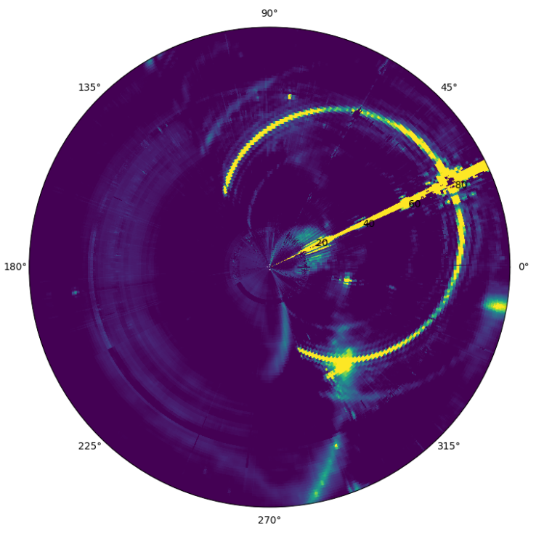
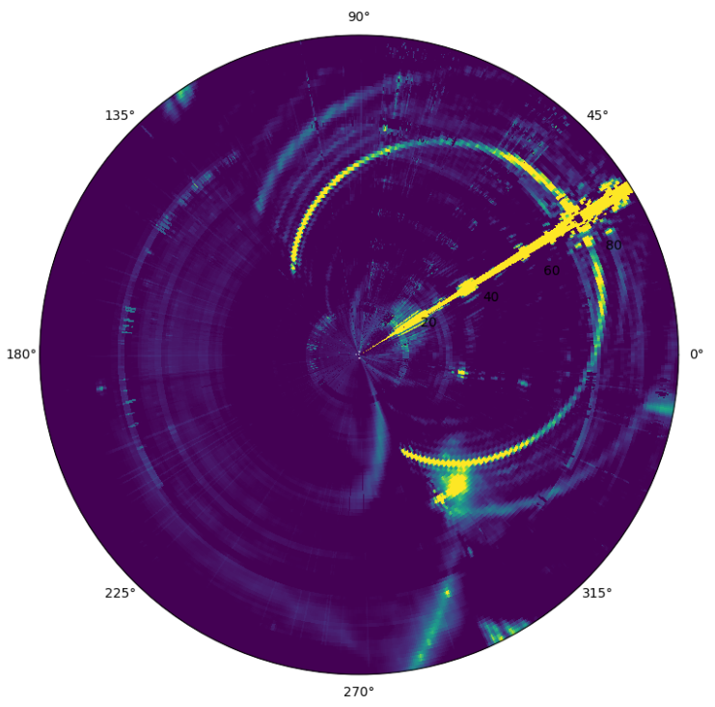
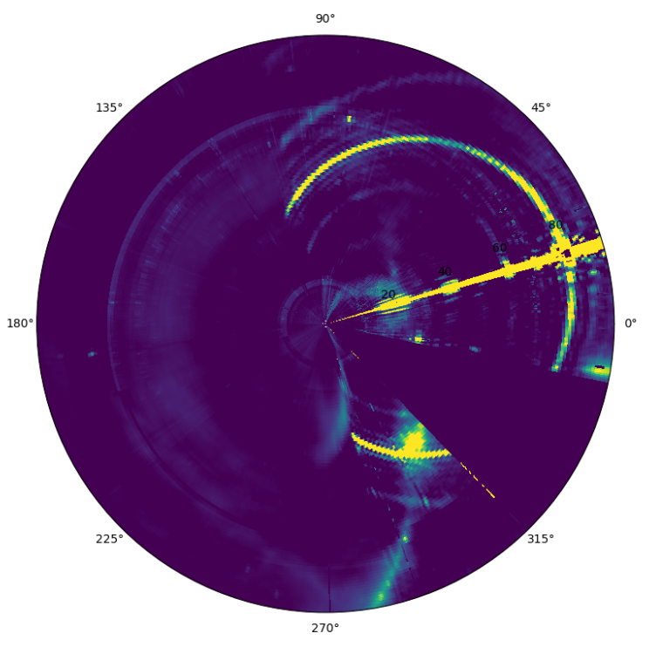
Map 1
2023-04-17
Map 2
2023-04-24
Map 3
2023-04-08

Slide 12
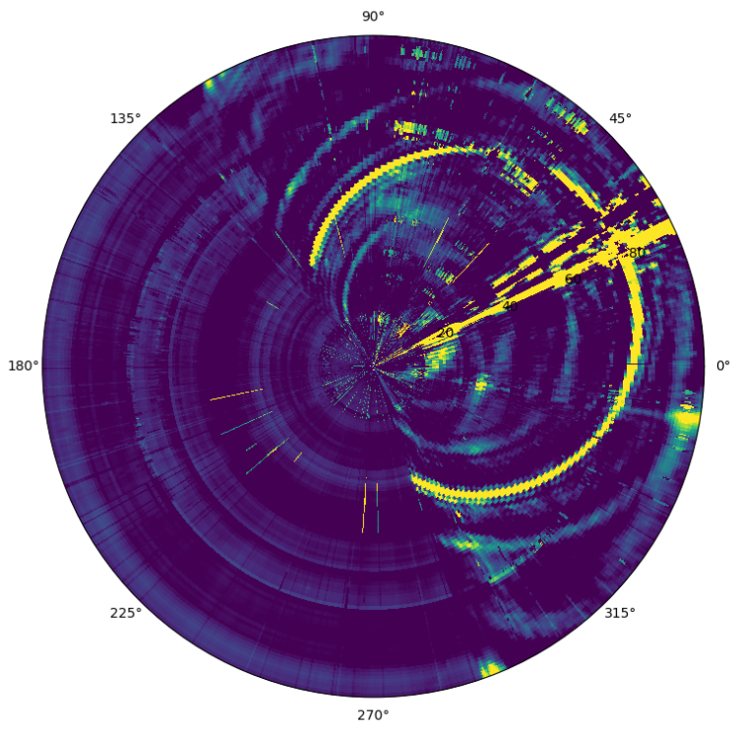
Map 1
2023-04-17
Map 2
2023-04-24
diff
Map 1 – Map 2
Map1[diff>10] = ma.masked
Map2[diff<-10] = ma.masked

Slide 13
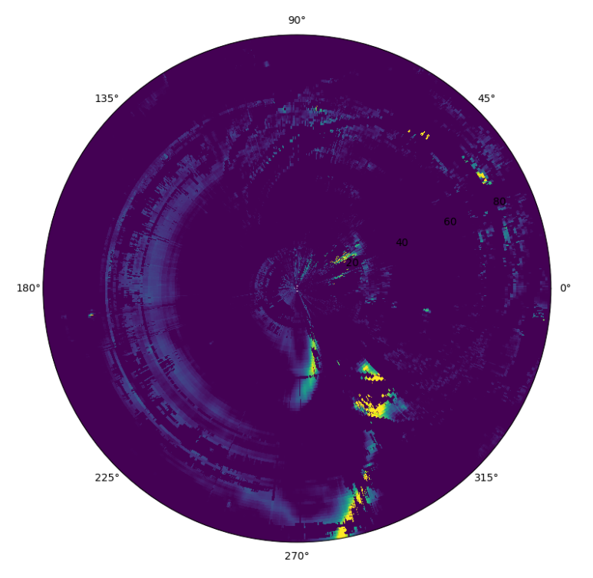
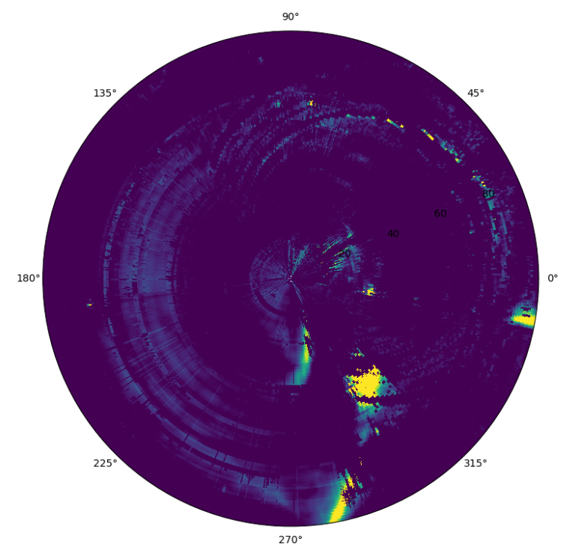
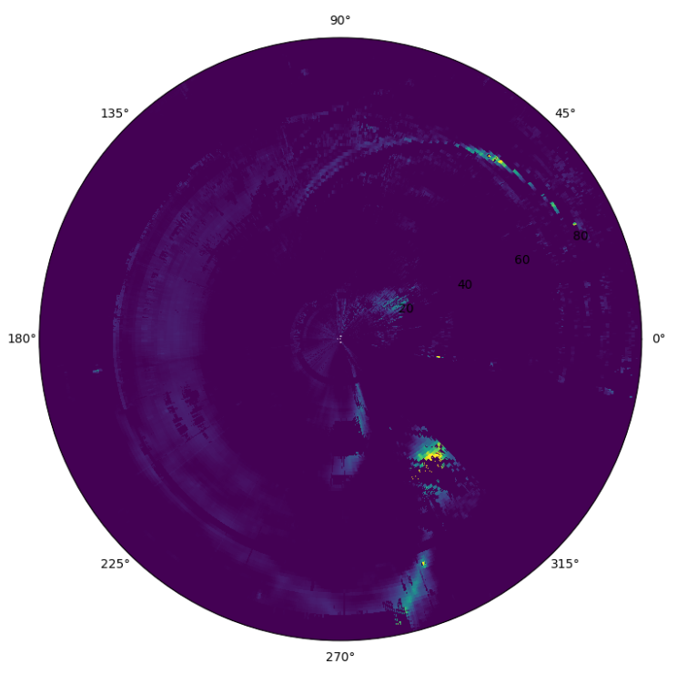
Map 1
2023-04-17
Map 2
2023-04-24
Map 3
2023-04-08

Slide 14
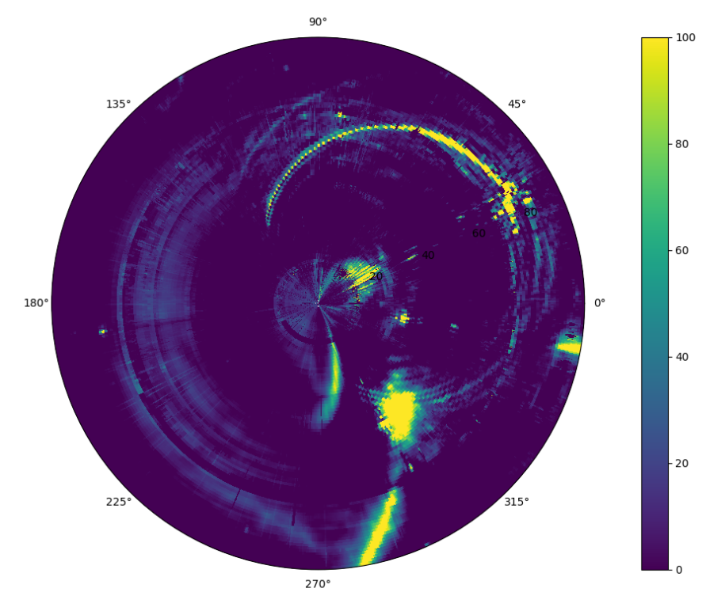
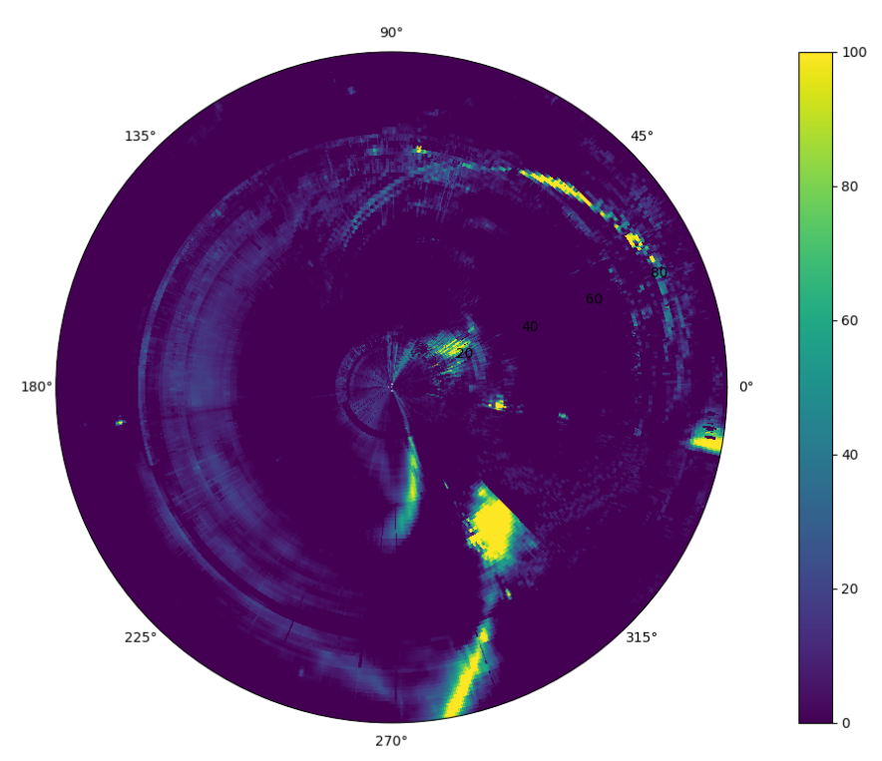
Map 1+2
Map 1+2+3

Slide 15
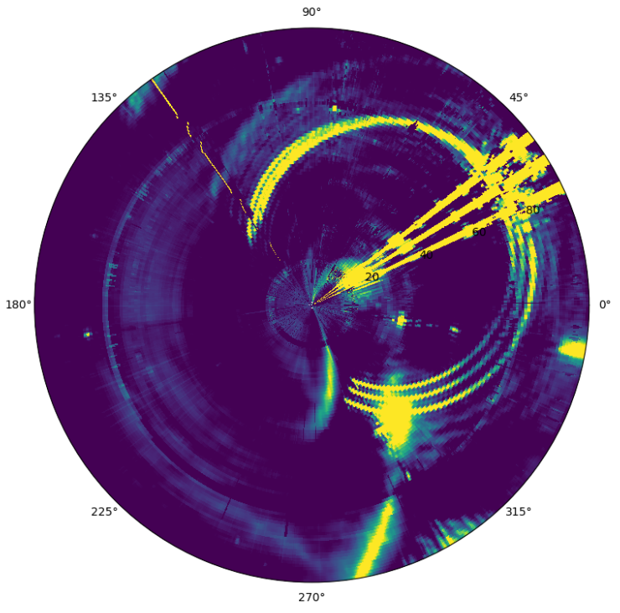
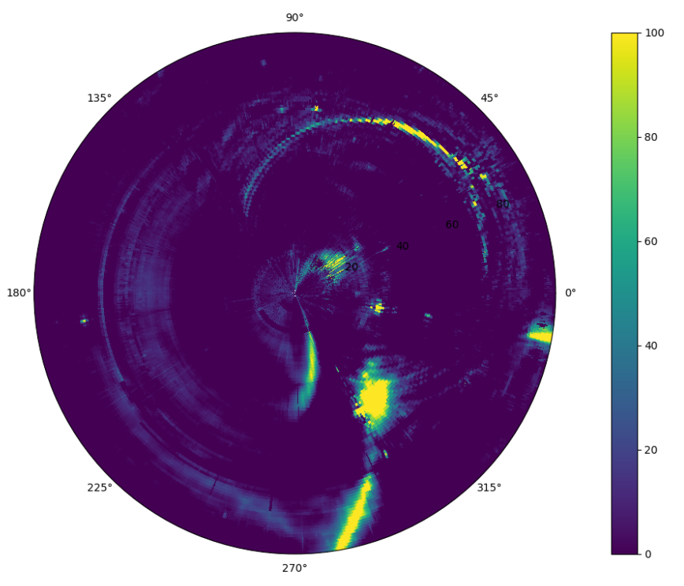
2023-04-17、24、30

