Slide 1
Summer Shutdown 2023
Cons Gattuso
May 5th, 2023

Slide 2
Shutdown Parameters (Tentative)
Start Shutdown
We will determine if the need intensity reduction intensity as the work list evolves.
Duration
10-12 Weeks (duration may change depending on the major tasks undertaken )
Beam Off
Sunday July 9th @0001 hrs.
Configuration Control
Open surveys would take place Monday 10th -Wednesday 12th
Go over order this next week
Specialty access would be from Wednesday-Friday
Lighting Assessment, Phone Assessments, Fire protection testing, WiFi installation … *
Go over order this next week
General tunnel access would commence Monday July 17th
Start of tunnel work
Monday July 17th
End of tunnel work
Week of Monday October 9th
HEP
Monday October 16th
Calendar Days: 67
Working Days: 48

Slide 3
Shutdown 2023 Timeline
Milestone 0
Commence ISD Job Collections
Milestone 5
Milestone 7
Milestone 1
Milestone 3
Complete shutdown.
Define Shutdown Coordinators.
Completed
Refine Shutdown Parameters
Completed
First pass resource level Schedule.
Final resource level Schedule.
Milestone 4A
Milestone 8
Underway
Complete
Startup.
Milestone 1A
Completed
Milestone 4
Commence Major Job collection
Completed
Second pass resource level Schedule.
Milestone 6
Milestone 9
Milestone 2
Start Shutdown.
Return HEP
ID Jobs to the 90% level.
Completed
Completed
DEC
JAN
FEB
MAR
APR
MAY
JUN
JULY
AUG
SEP
OCT
NOV
DEC
Define Scope
Plan
Execute
Close out
HEP
Plan phase 1:Determine Jobs and Define schedule
Plan phase 2: Finalize Schedule
Plan Phase 3:Execute Shutdown
Close out
Progress Indicator
Crew Marching orders
Planned
Achieved
Activities planned
Work Planning
HA’s
Dose Plan
Permits
Etc..
Class Zero
Expectations
General Task Approval process
Work In HRA
Shutdown Boot Camp
AD All Hands

Slide 4
Planning Stages
Planning Milestones
Kick off meeting (completed)
Set Major Jobs (completed)
Get T&M/Fixed price packets out by early March (completed)
Setup up Prep-work for given areas (Underway)
Booster West Gallery
Set Alignment Tasks ~90% complete
Input into their system (end of April)
Finalizing ISD work in and around Tunnel Enclosures 85% Complete
Finalize Service Building Outages (early May) (completed)
Set Maintenance tasks (mid of May)75% Complete
FESS and Machine activities
Fit tasks with our Manpower (mid May) 80% Complete
Resource leveled schedule 65%Complete
Primary (mid April)
Final (mid/end May)
Please label jobs in the work list “Summer shutdown 2023:…”

Slide 5
Culvert Replacement
https://admd.fnal.gov/Culvert%20road%20work/index.html
Before
Road
After
Culvert
Culvert Inside
Concrete Box
* Artist rendition not to scale
Done
Underway
On Schedule

Slide 6
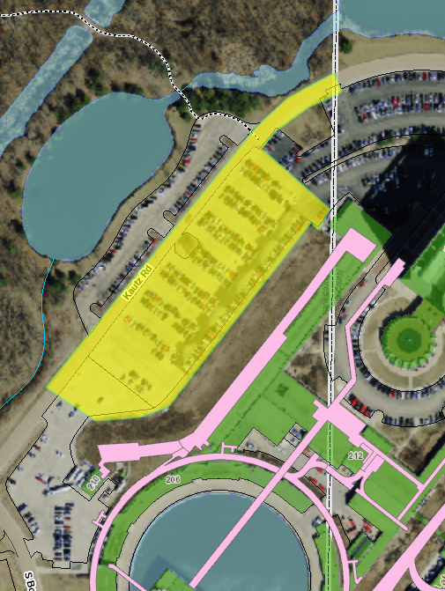
Road and New Gate Work….
Roadway and Parking lot work
To start work in the fall/Late Fall, covering Kautz road and the Wilson Hall west parking lot roughly as indicated in the screen shot below.
Traffic patterns are still being worked out
Gate installation
To start ASAP
Impact to AD
New Traffic patterns
Impacts to AD
Magnet loads
We should plan on Moving Magnets to staging area in Accelerator Complex prior to this work starting.

Slide 7
New Gate
Removal Fencing
New Guard House/gate
Power distribution modification
Tie into Electrical Panel
Shipping Container
Staging are for Booster RF work

Slide 8
ISD Activities
Power Outage
This week
Wednesday May 3rd
NL LABS A-C-D-CDX
Thursday May 4th
PAB, TPL, Site 50 & 52
Saturday May 6th
Village PM
07:30-16:00 hrs
Entire Village, All village labs and residences.
Next week
Wednesday May 10th
PS4, PC4, PS2, PW2,3,4
All day
Tevatron A-E (all week)
P&M on Tunnel Sumps and Dehumidifies
Completed
Completed
Scheduled

Slide 9
Schedule
Releases
Electrical should start coming in in the next week
Schedule
~ 800 jobs have been posted to the Shutdown worklist
Next Phase of our planning
Meeting with each Machine Coordinator/system Coordinator
Review the current schedule
Task order and when in the shutdown they occur
Review general scope
Review critical activities than may need to be detail out further
Review schedule Pivot Points
Revise Schedule
Resource level schedule
Post schedule

Slide 10
That’s all for this week…….
Next Week
Switching over to Weekly Shutdown planning meetings
Tuesday at 11:00 in the huddle and Via Zoom

