Slide 1
Radiation Safety – Weekly Update
ES&H RPO Department
05/05/2023 9am Ops Meeting

Slide 2
Enclosure Briefings
Enclosures with local High Radiation Areas and/or Contamination Areas continue to require enclosure access briefings, for either Controlled Access or Supervised Access.
Contact RSO is you are unable to attend scheduled briefing.
Daily briefings for non-AD available on access days.
+ means Contamination Area
* means High Radiation Area
% means only when shield blocks removed
Current List:
MTA +
Booster *+
8 GeV *+
BNB *
MI-20—MI-62 *+
NuMI Pre-Target / Target Hall *+%
NuMI Absorber Hall *+
Muon Campus US/DS +
Looking to schedule May/June briefings the week of the 15th – Stay tuned!

Slide 3
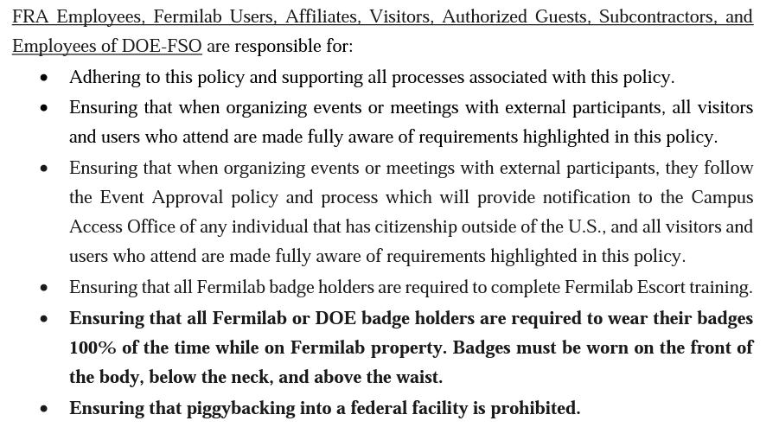
Other Information – Close Doors and Wear Badges!
https://directorate-docdb.fnal.gov/cgi-bin/sso/RetrieveFile?docid=108&filename=Policy%20on%20Access%20to%20Fermilab%2020230321.pdf&version=12

Slide 4
Contacting your RSO!
If you’re unsure which RSO is responsible for your area, or need to reach a wider audience of RSOs, we have a group email.
ESH_RSO@FNAL.GOV
If you’re curious who your assigned RSO is, please use the link below or go to the ESH website, click on Radiological Protection, then click RSO Coverage and Contact Info on the right hand column:
https://esh-docdb.fnal.gov:440/cgibin/ShowDocument?docid=3846

