Slide 1
72 Hour Summary
Spencer Schiefelbein
May 8th, 2023

Slide 2
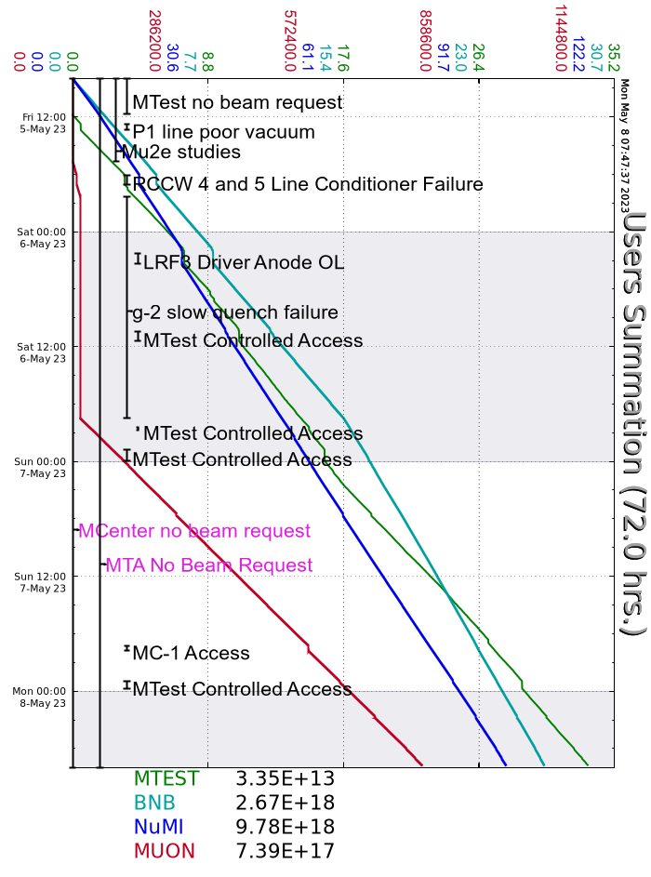
Summary
Friday
Mtest secured and began taking beam
Recovered from P150 vacuum burst
Glitch in Booster RCC West rack PS – moved loads to adjacent racks
g-2 magnet slow dump
Saturday
Linac QPS305 and QPS417 Regulation troubles over the weekend
Power outage at Fermi Village for maintenance complete
g-2 beam re-established ~2000h
Sunday
High temps
Neutralization tank drained
Muon M1 BPM issue resolved with help of experts
MS2 LCW system filled
RRLLRF rebooted
Monday
B:MP03 current drop instances from weekend being investigated by EE Support
Mu2e studies to begin 1000h
Current Conditions:
NuMI: 53E12 POT / 770kW
BNB: 3.61E12 p/hr
Muon 1.01E12 POT
Mtest: -10GeV LE Pion Mode

