Slide 1
An Introduction to Cosmology
Dan Hooper – Fermilab
Undergraduate Lecture Series
June 8, 2023

Slide 2
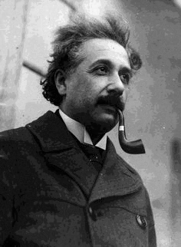

Slide 3

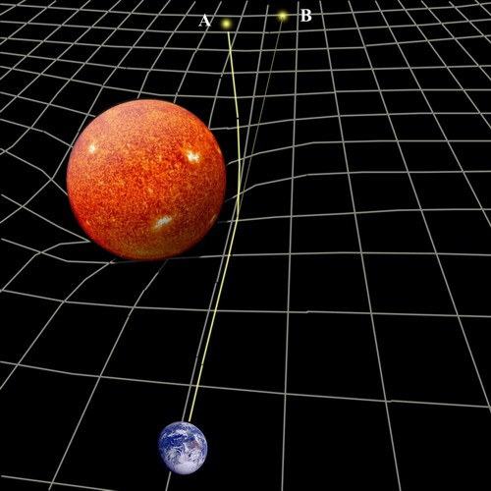

Slide 4
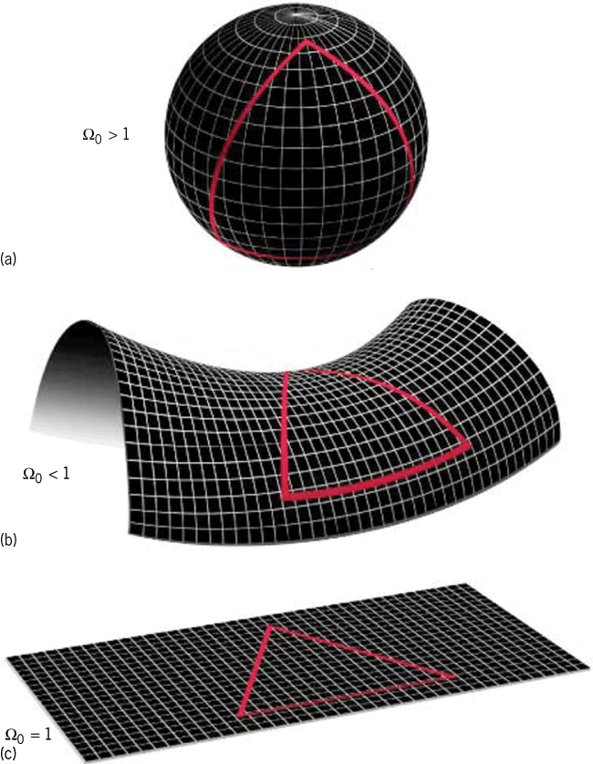


Cosmological Solution
k=1
k=-1
AND
k=0

Slide 5
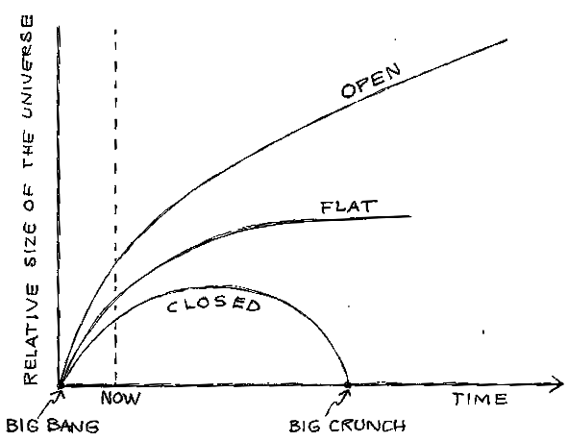
Cosmological Solution
k=1
k=-1
k=0

Slide 6
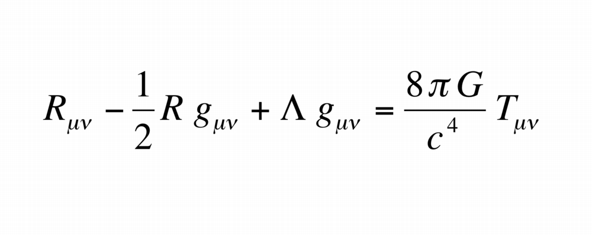

Slide 7
Solution with a “Cosmological Term”
k=1
k=-1
AND
k=0

Slide 8
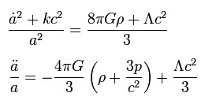
“Einstein’s World”
Einstein showed that for the choice of Λ=4πGρ/c², a static solution could be found (with positive curvature, k=1)
But this solution was unstable

Slide 9
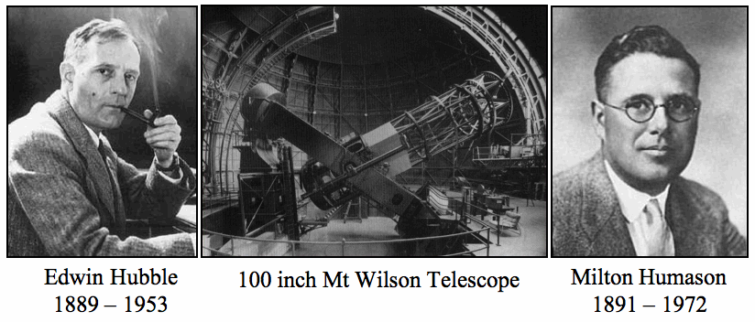

Slide 10
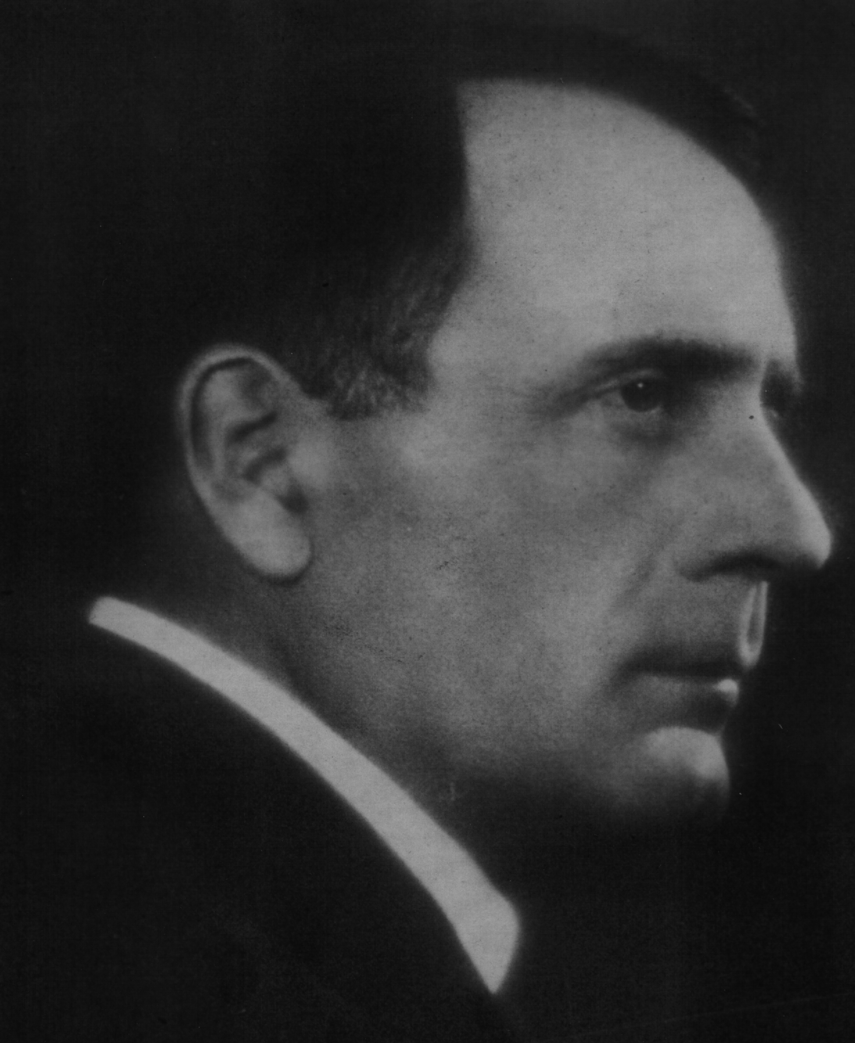
Notes:
Edwin Hubble

Slide 11
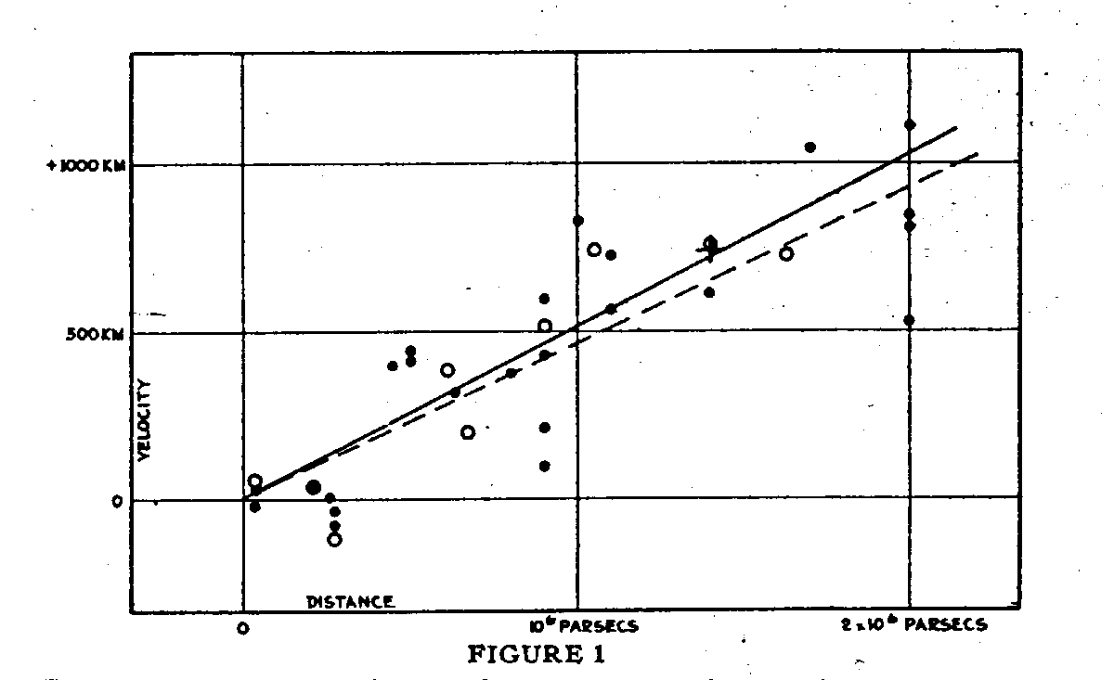

Slide 14
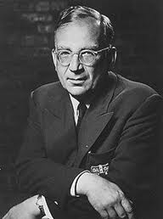
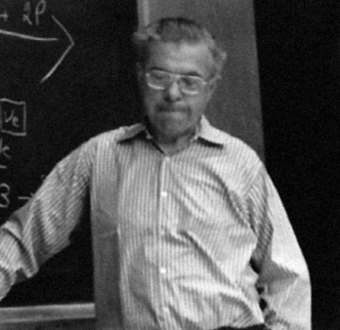
Notes:
George Gamow, Fred Hoyle

Slide 16
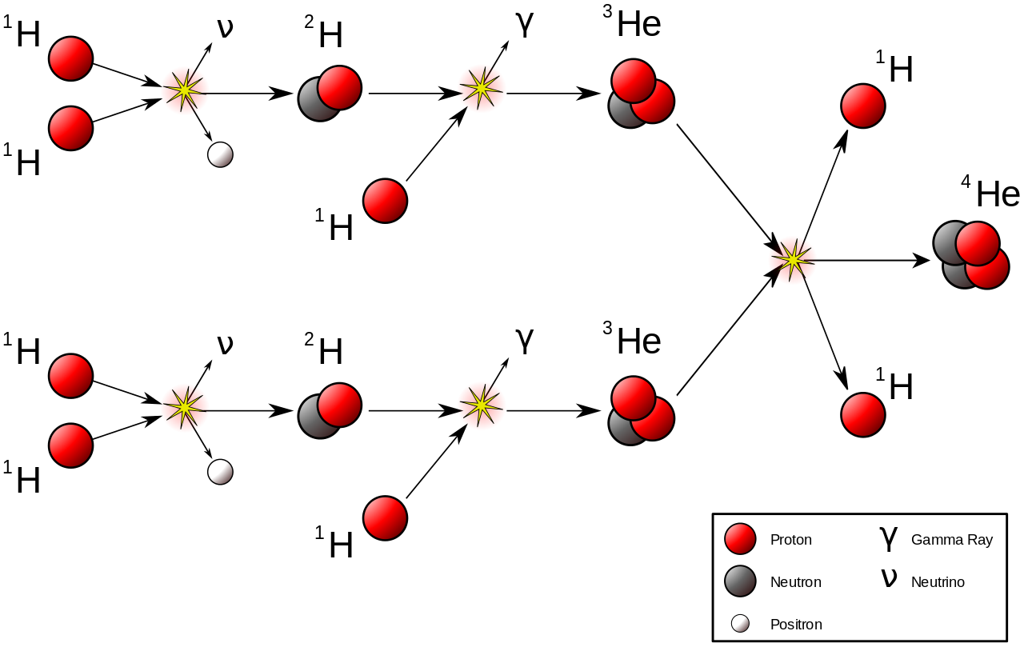
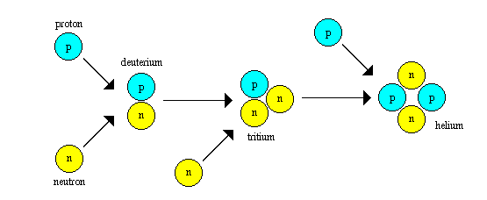

Slide 17
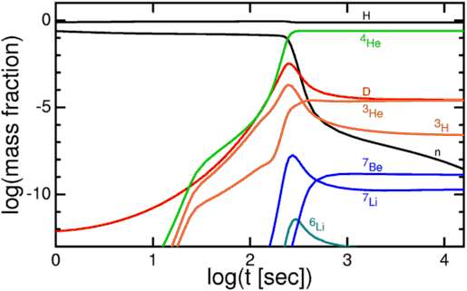

Slide 18

Notes:
Relative abundances in our solar system

Slide 20
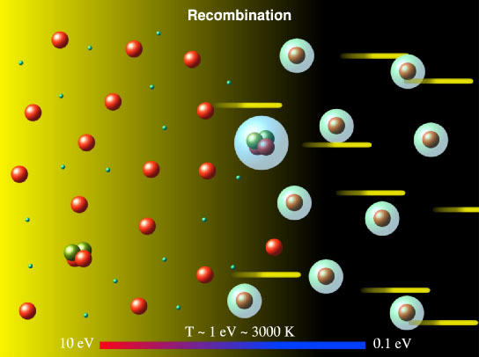

Slide 21
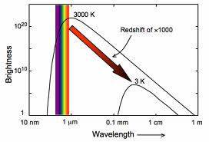

Slide 22
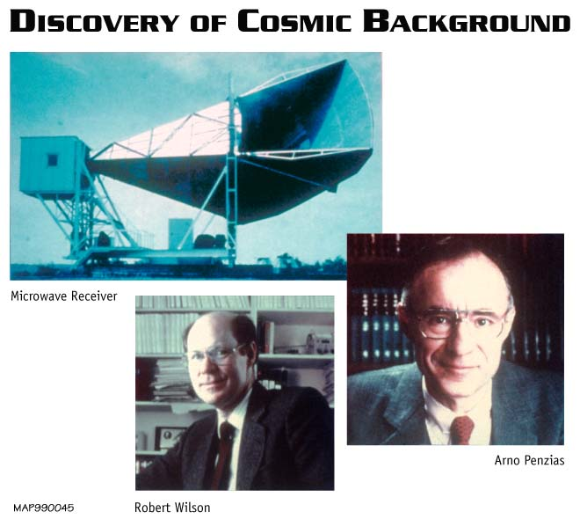

Slide 23
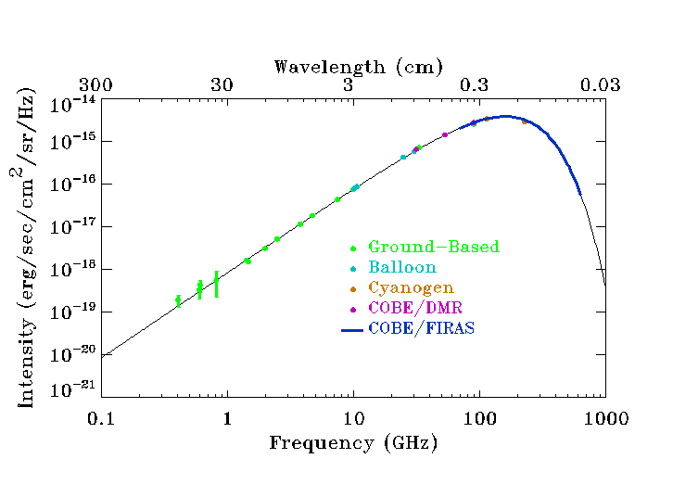

Slide 24
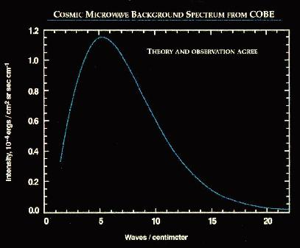
Notes:
WITH ERROR BARS!, 2.726 K

Slide 25
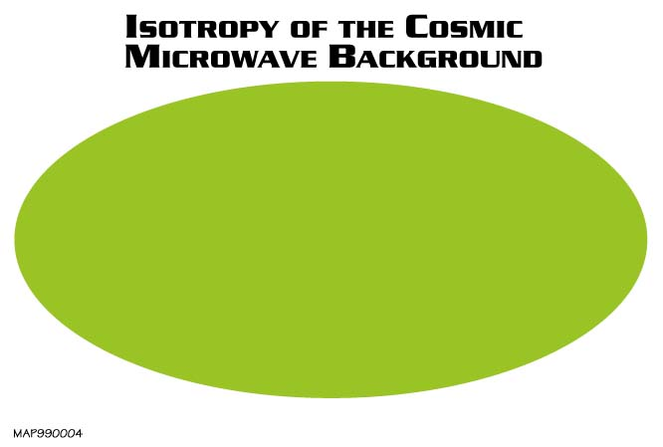

Slide 26
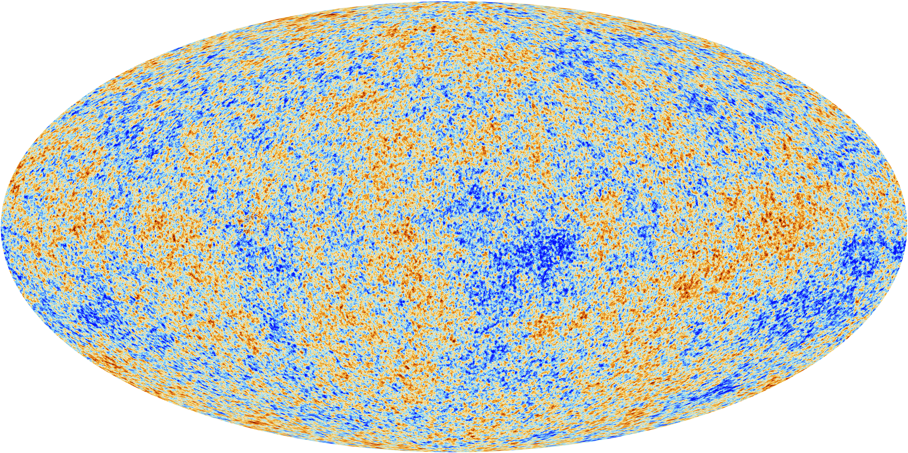

Slide 27
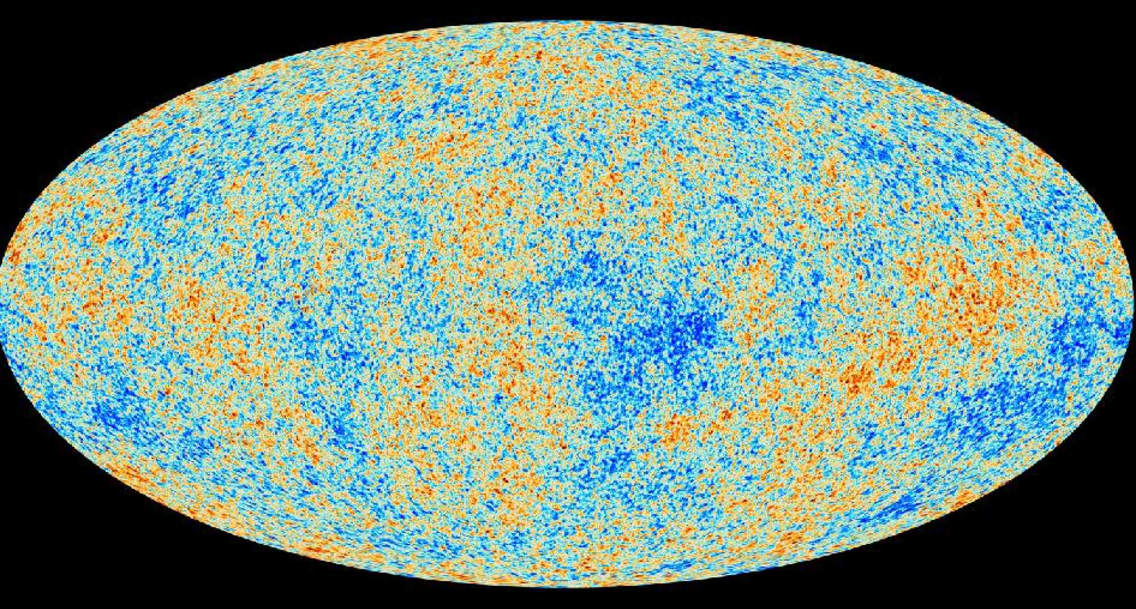
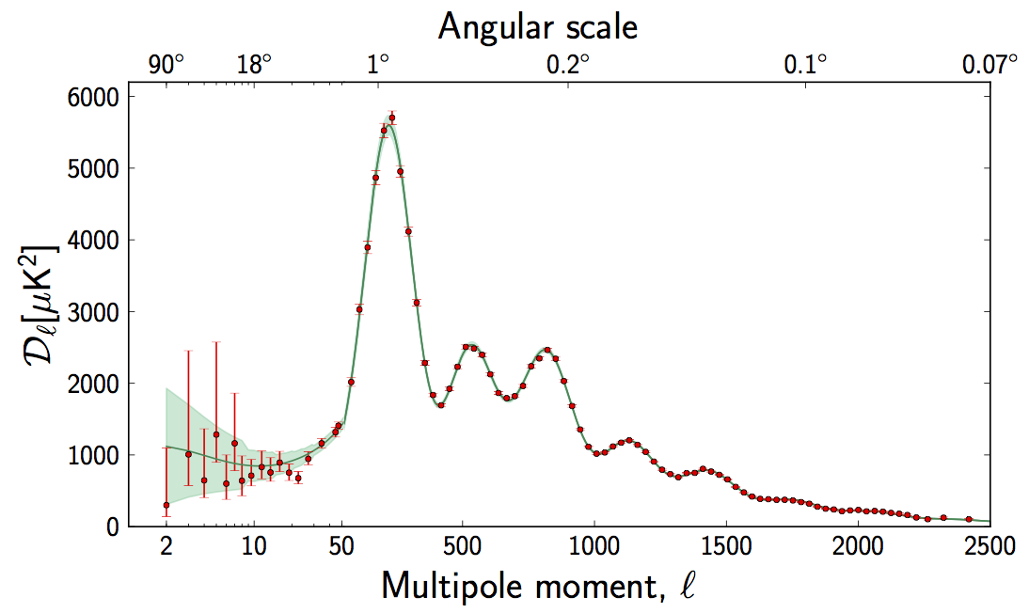

Slide 29
k
𝚹_{Flat} ≃ 1∘

Slide 30
k
𝚹_{Flat} ≃ 1∘
k = 0
k = +1
k = -1
𝚹 > 𝚹_{Flat}
𝚹 < 𝚹_{Flat}

Slide 31
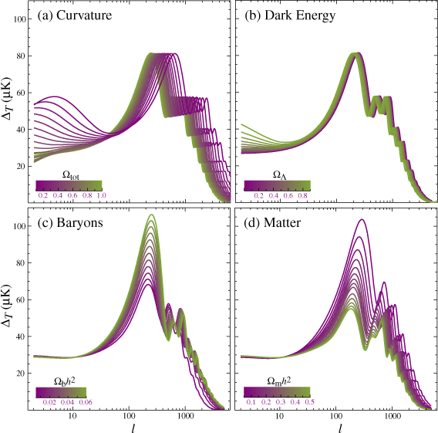
k

Slide 32
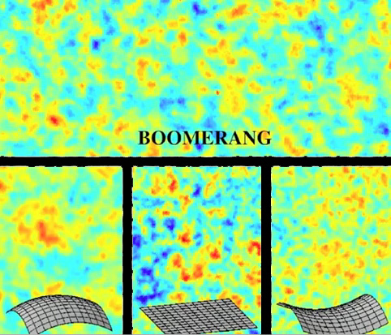

Slide 36
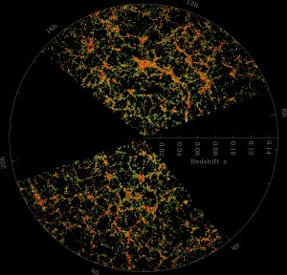

Slide 37
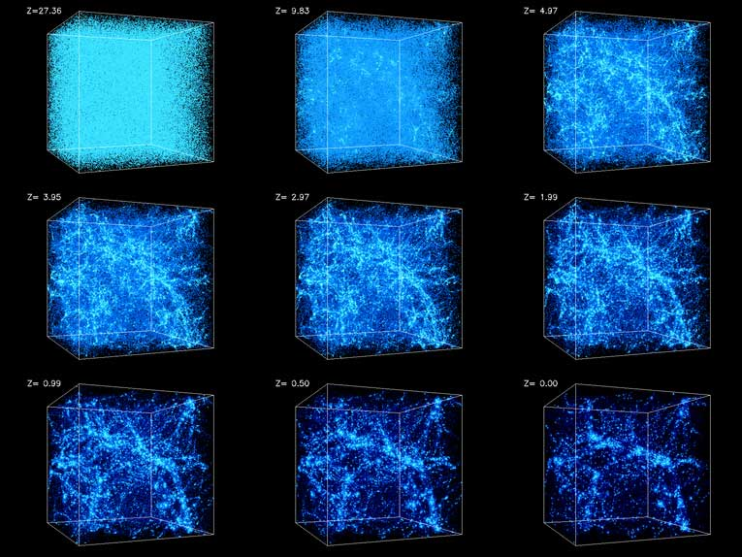

Slide 38
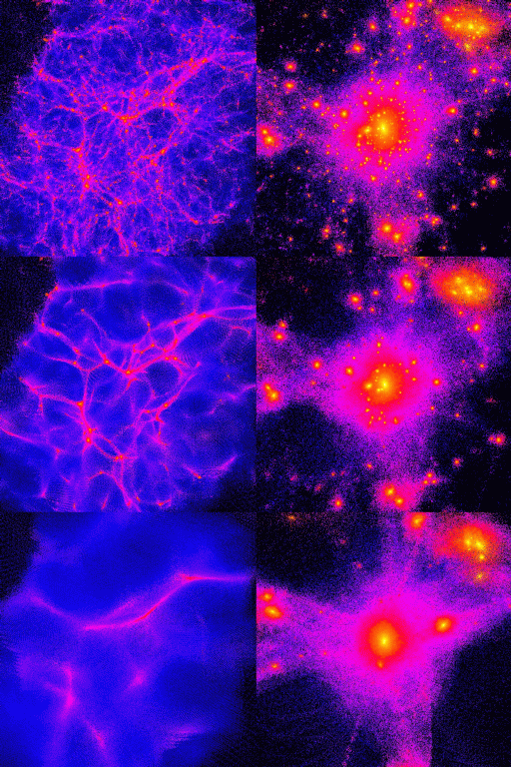
Notes:
Simulation, cold, warm, hot

Slide 39
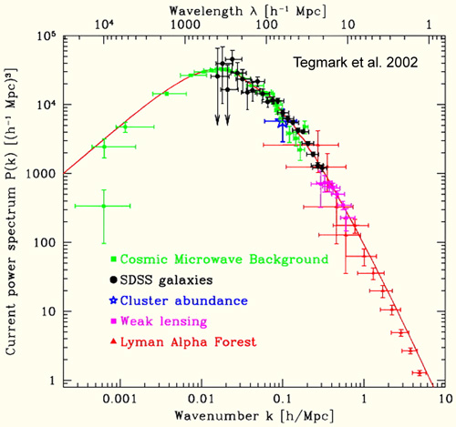

Slide 40
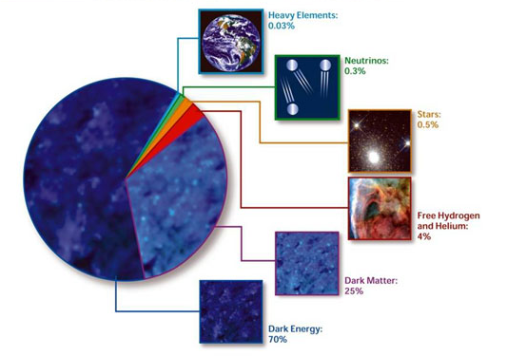

Slide 43
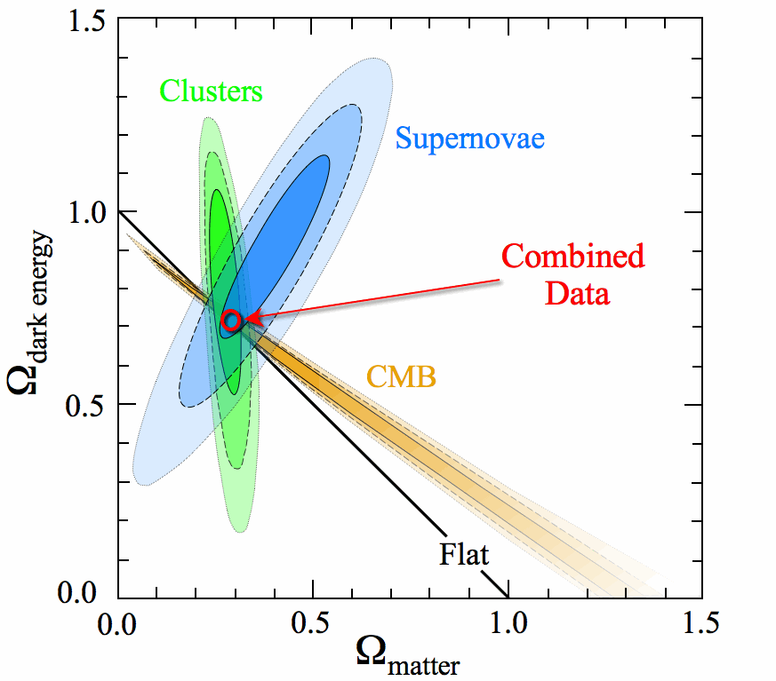

Slide 44
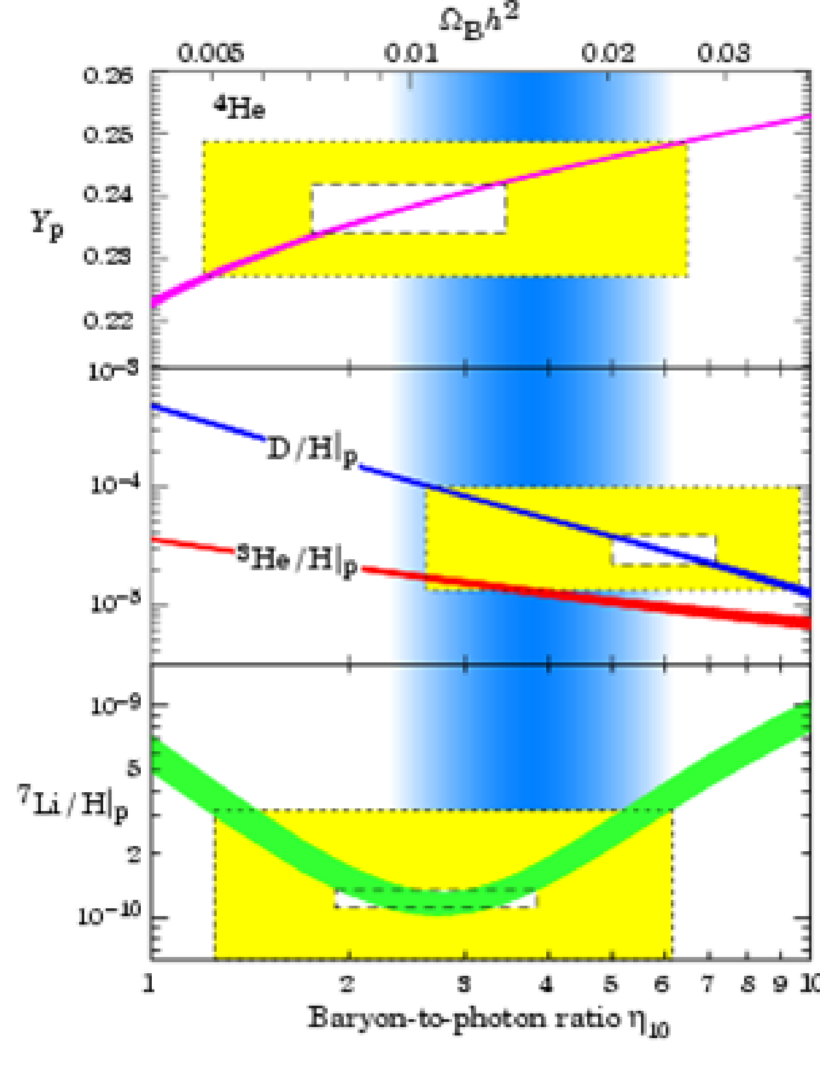
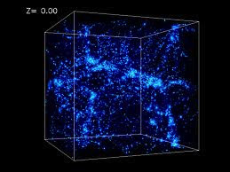
The Pillars Of Physical Cosmology
Hubble Expansion
The Light Element Abundances
The Cosmic Microwave Background
Large Scale Structure
The Big Bang Theory, although remarkably successful, requires us to introduce:
1) Something that drives accelerated expansion in the early universe (inflation)
2) Non-baryonic dark matter
3) Something that drives accelerated expansion in the current era (dark energy)

Slide 45
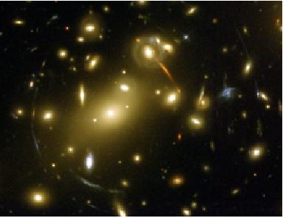
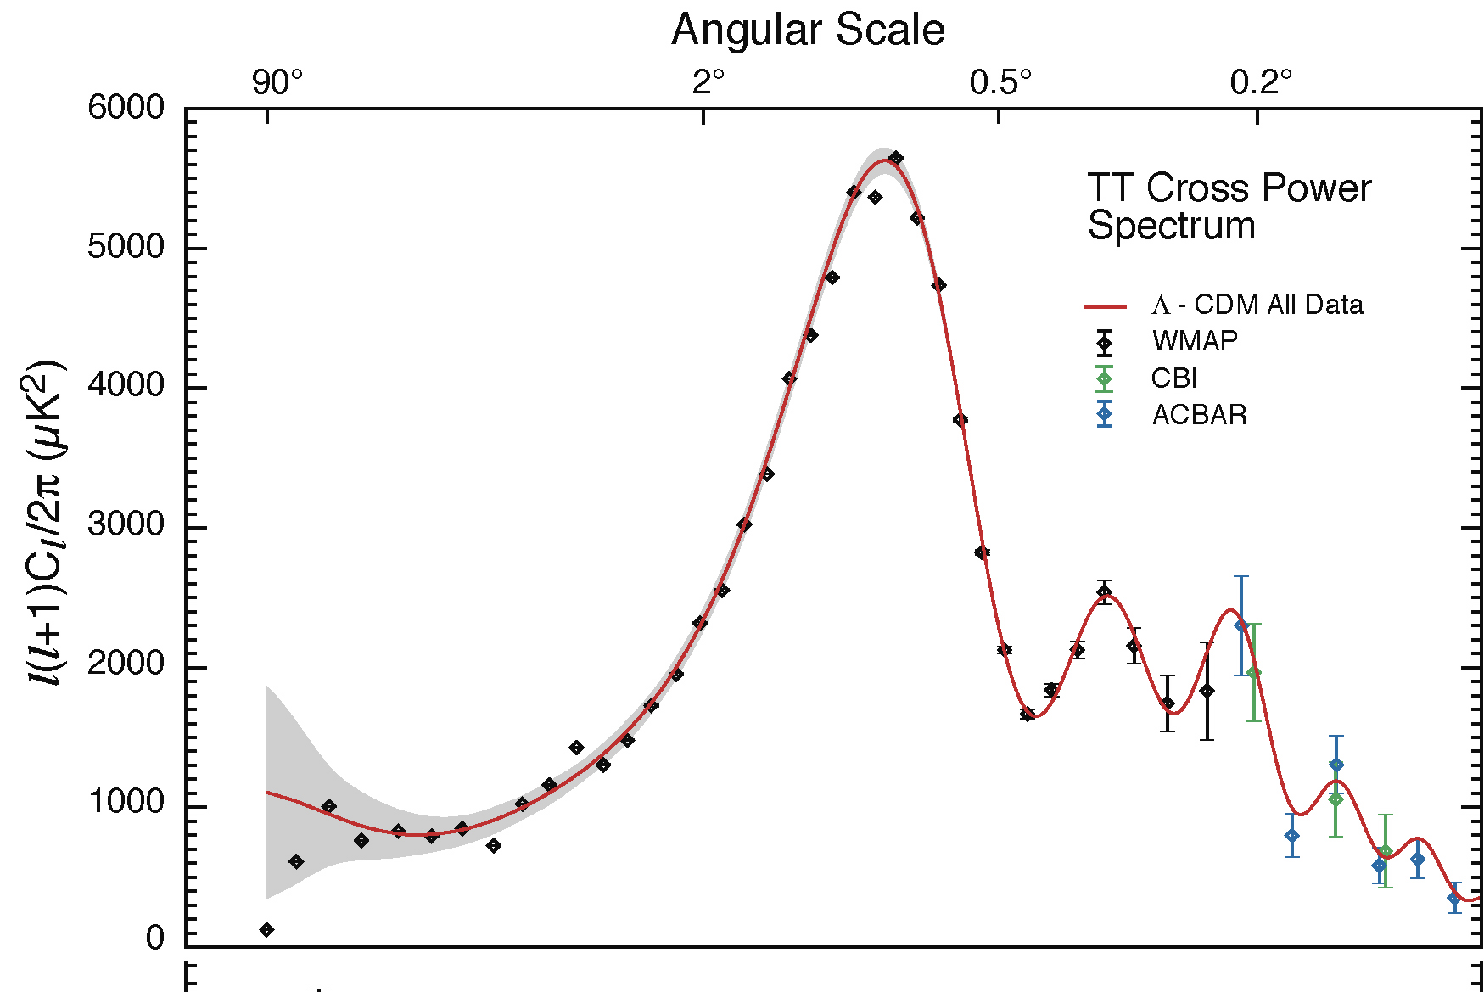
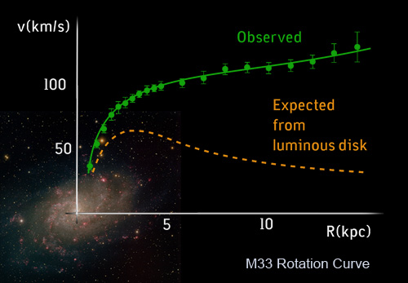
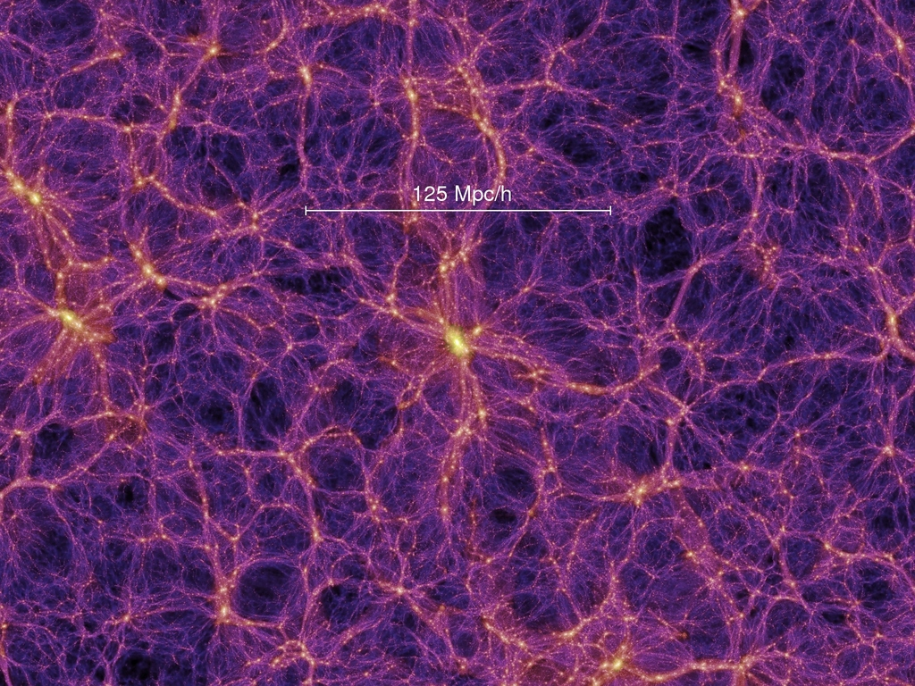
Evidence for Dark Matter

Slide 46
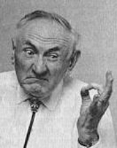
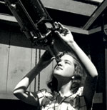
Early Pioneers
Fritz Zwicky
Vera Rubin

Slide 47
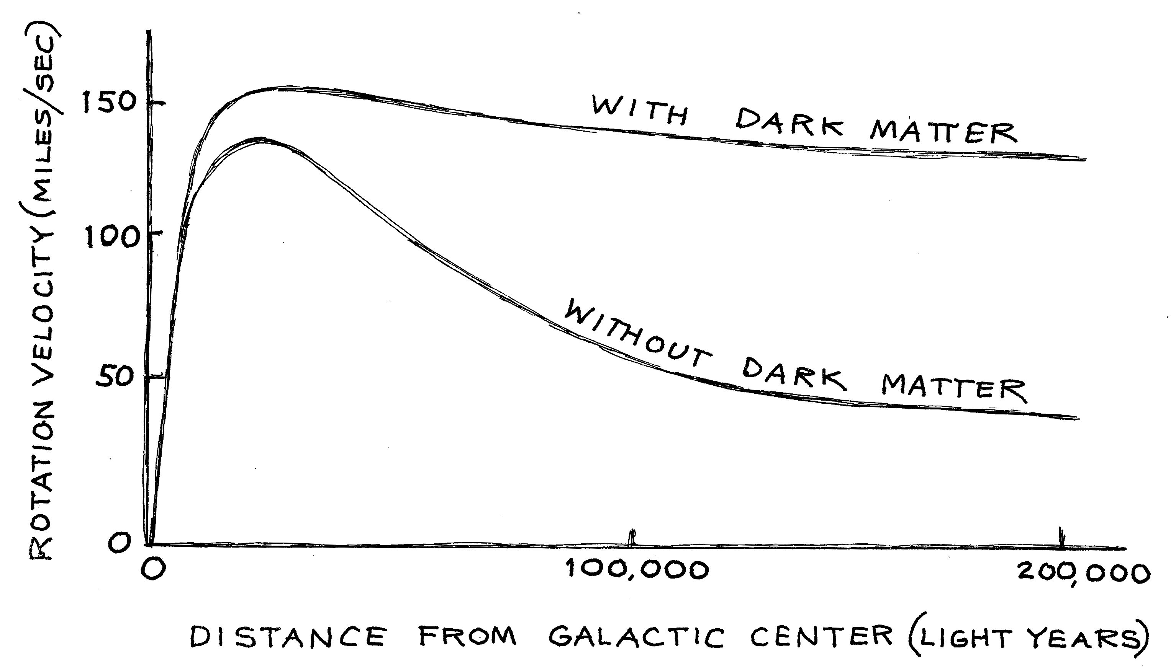

Slide 49
Most of the mass is invisible

Slide 50
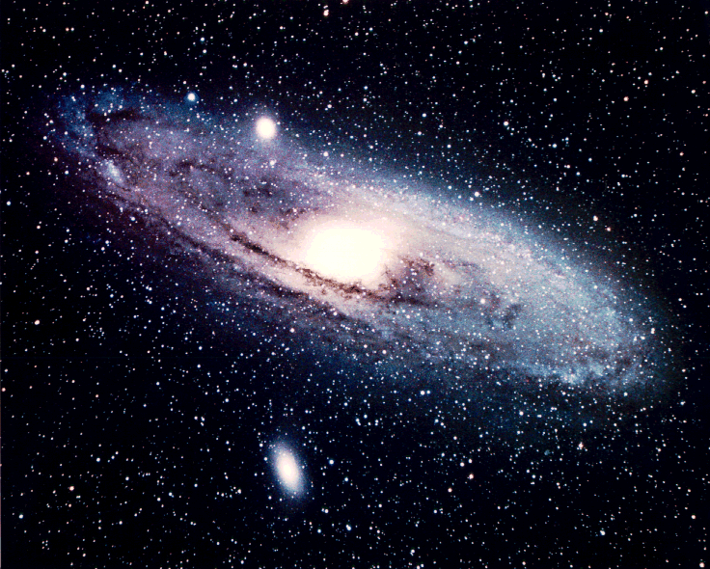
v² G M_{Sun}
R R²
=
R
v
v² G M_{GALAXY} (<R)
R R²
=
Measure the speeds ⇒ Determine the mass of stars of their galaxy

Slide 51
Three Possibilities
1) Galaxies are mostly made up of very non-luminous objects (black holes, neutron stars, white dwarf stars, large planets, etc.)

Slide 52
Three Possibilities
1) Galaxies are mostly made up of very non-luminous objects (black holes, neutron stars, white dwarf stars, large planets, etc.)
2) Gravity does not work in galaxies or clusters the way it does on Earth or in our Solar System

Slide 53
Three Possibilities
1) Galaxies are mostly made up of very non-luminous objects (black holes, neutron stars, white dwarf stars, large planets, etc.)
2) Gravity does not work in galaxies or clusters the way it does on Earth or in our Solar System
3) The missing mass consists of some other form of matter

Slide 54
What Is Dark Matter?
MACHOs
Massive Compact Halo Objects
Faint stars or planets (or rocks, baseballs, automobiles…)
As most of the visible matter in our universe is made up of baryons (protons and neutrons), a first good guess is non-luminous or faint baryonic objects
WIMPs
Weakly Interacting Massive Particles
A gas of subatomic particles, interacting only through the weak force and gravity

Slide 55
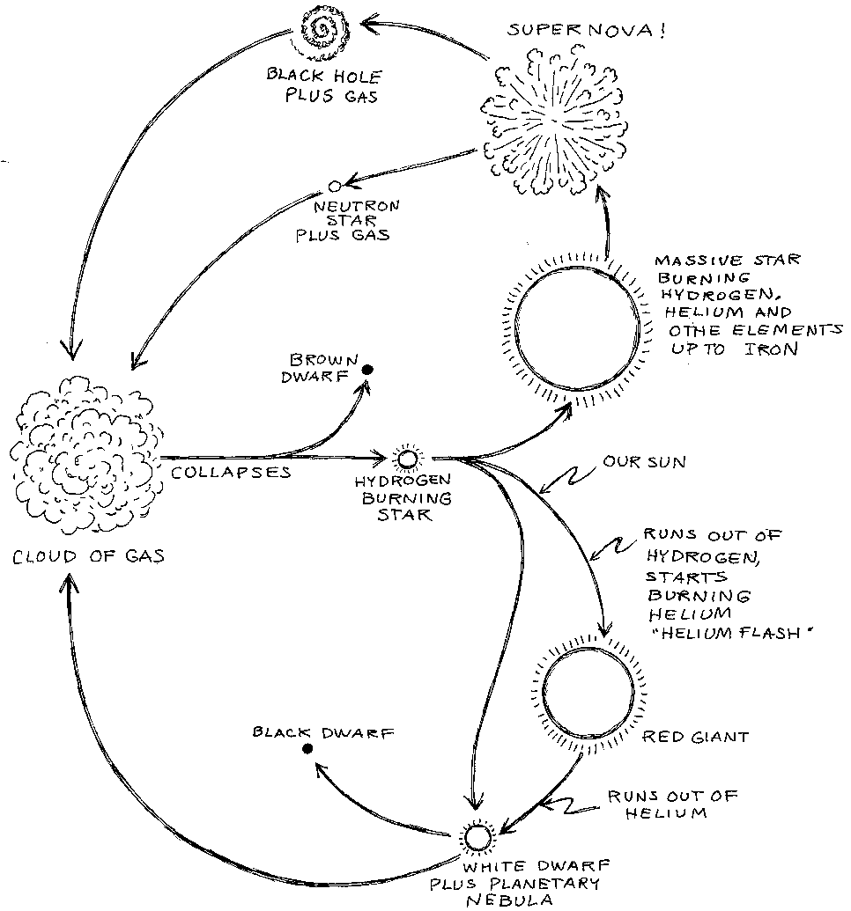

Slide 57
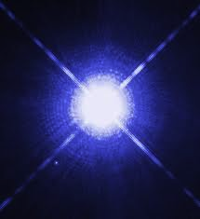
Faint Stars
When most (~97%, including the Sun) stars run out of nuclear fuel, they compress into objects about the size of the Earth - white dwarfs
White dwarfs become fainter as they age; most are 20% to 0.03% as luminous as the Sun
When massive stars (~3%) run out of fuel, they explode as supernovae, leaving behind either a neutron star or a black hole
Neutron stars are objects made up almost entirely of neutrons (few protons, electrons); they consist of a solar mass worth of material within a radius of ~10 kilometers
Black holes are remnants of stars so massive that they collapse to a single point of space, with infinite density; nothing (including light) can escape their gravitational pull

Slide 58
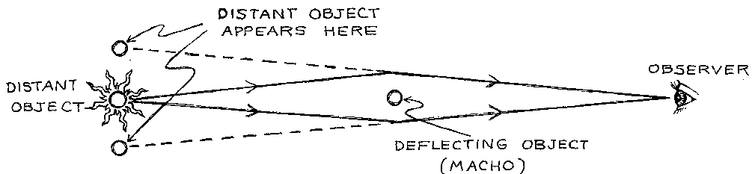
“Seeing” Black Holes
Massive objects can be detected as gravitational lenses, even if they are themselves non-luminous

Slide 59
Caused by a black hole six times more massive than the Sun

Slide 60
Searches For Dark Matter With Gravitational Microlensing
Although microlensing searches have found some faint and compact objects, they seem to be far too rare to make up much of the missing matter
Whatever the dark matter is, it does not consist of compact objects with masses between about 3x10⁻⁸ and 50 solar masses
MACHO dark matter also conflicts with the successful predictions of Big Bang nucleosynthesis, the cosmic microwave background, and large scale structure (primordial black holes being an exception)

Slide 61
Three Possibilities
1) Galaxies are mostly made up of very non-luminous objects (black holes, neutron stars, white dwarf stars, large planets, etc.)
2) Gravity does not work in galaxies or clusters the way it does on Earth or in our Solar System
3) The missing mass consists of some other form of matter

Slide 62



Modified Newtonian Dynamics (MOND)
Begin by modifying Newtonian dynamics as follows:
where μ≈1, except for small at acceleration, at which μ=a/a₀
For a circular orbit,
which in the low-acceleration limit yields
Rotational velocity independent of galactic radius (flat rotation curve)

Slide 63
Modified Newtonian Dynamics (MOND)
MOND has been quite successful in explaining the dynamics of galaxies, and provides an explanation for the Tully-Fisher relationship
Galaxy clusters are not well described by MOND
MOND is not consistent with cosmological measurements
Dark matter suppresses the impact of baryon acoustic oscillations, explaining the observed matter power spectrum – MOND does not

Slide 64
Properties of Dark Matter
1) Not made of baryons (protons, neutrons)
2) Comes in “small” pieces (relative to stars, planets)
3) Does not significantly emit, reflect, or absorb light (electrically neutral)
4) Stable (or at least cosmologically long-lived)
5) Massive

Slide 67
Cosmic Background Neutrinos
Neutrinos were very abundant in the early universe, and some of them survived as a thermal relic
Thermal decoupling and annihilation freeze-out happens at approximately the same time/temperature (t~2 sec, T~MeV)
Assuming that neutrinos are stable, this should lead to a cosmic background of neutrinos with a similar density and temperature as the CMB (1.95 K vs 2.73 K)
Indirect evidence of this background is observed in the anisotropies CMB

Slide 68
Could Neutrinos Be The Dark Matter?
The only weakly interacting massive particles in the Standard Model are neutrinos – might they make up the dark matter?
Neutrinos decouple at ~MeV temperatures, and were thus relativistic when gravity began to bind dark matter into large scale structure
Neutrinos therefore act as “hot” dark matter

Slide 69
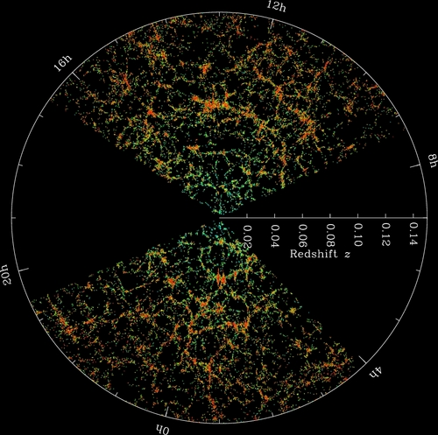
Hot and Cold Dark Matter
Cosmologists use simulations to predict how dark matter will form structures under the influence of gravity
The hotter the dark matter is, the less small scale structure forms, and the more “puffy” halos are
When compared to observations, it is clear that dark matter is not hot – dark matter is not neutrinos
HOT COLD

Slide 70
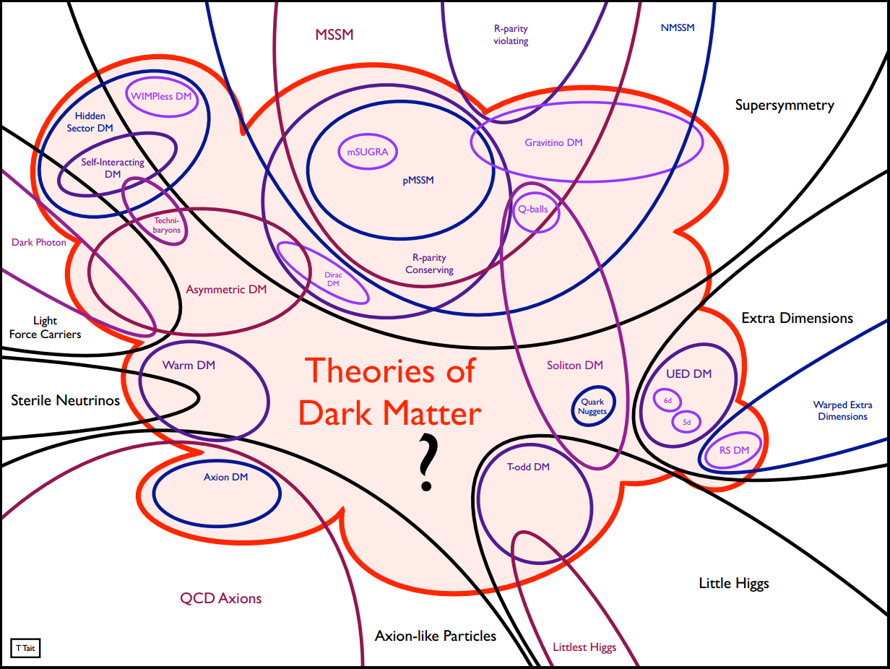
The Dark Matter Candidate Zoo

Slide 71
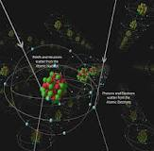
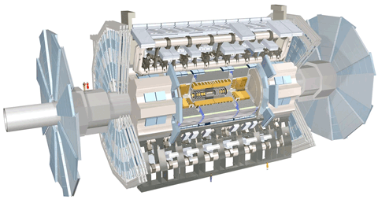
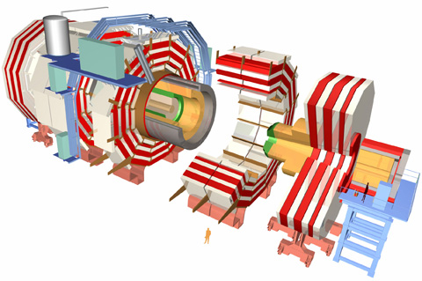
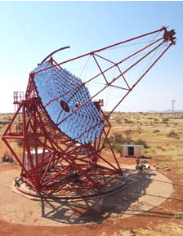

Putting the WIMP Hypothesis to the Test

Slide 72


Slide 73



