Slide 1
IOTA/FAST Research and Facility
“5 year” Plan
D.Broemmelsiek, J.Jarvis, V.Shiltsev
April, 2023

Slide 2
IOTA/FAST Long-Term Strategy
IOTA/FAST is the US leading ABP research test facility, centerpiece of the US CAP:
3-5(?) experiments per year; ~50(?) users; (Users’ Facility?)
Accelerator & Beam Physics research with electrons:
now-Fall 2024, ~50% after 2024
Accelerator & Beam Physics research with protons:
Starting ~Fall 2024
Electron lens ~Fall 2025
50% or more after
VTS (Virtual Test Stand) AI/ML control system:
First elements and test ~Fall 2026
Accelerator Operations and Upgrades:
6-9 mos/year
3 upgrades: proton injector (2024); e-lens (2025); VTS (2026)

Slide 3
Expected IOTA/FAST Schedule: CY23-28
2023
2024
2025
2026
2027
2028
p⁺ source commissioning
RFQ+MEBT installation
2.5-MeV p⁺ from RFQ
IOTA p⁺ commissioning
Run 8 (p⁺)
IOTA Run-5 (p⁺)
NIO+
IOTA Run-7 (p⁺)
NIO & SC
TBD
IOTA/FAST Run-6 (e)
OSC+
Run 8 (e)
IOTA/FAST Run-5 (e)
GREENS+
Run-7 (e)
TBD
TBD
E-lens development
E-lens in IOTA
AI/ML controls integration
Shutdowns

Slide 4
Global View on FAST/IOTA: FY24-28
Area | Type | FY23 | FY24 | FY25 | FY26 | FY27 | FY28
Headcount |  | 13 (18-5) | 18 | 18 | 19 | 19 | 19
KA24 AI/ML | Total $M | 1.74 | 1.67 | 1.77 | 2.24 | 2.24 | 2.03
 | M&S $M | 0.150 | 0.11 | 0.16 | 0.43 | 0.43 | 0.22
 | SWF $M | 1.59 | 1.563 | 1.612 | 1.814 | 1.814 | 1.814
KA25 Research | Total $M | 2.89 | 2.86 | 2.91 | 2.96 | 2.96 | 2.96
 | M&S $M | 0.72 | 0.65 | 0.61 | 0.30 | 0.30 | 0.50
 | SWF $M | 2.17 | 2.21 | 2.30 | 2.66 | 2.66 | 2.66
KA25 Operations | Total $M | 2.28 | 2.37 | 2.32 | 2.23 | 2.23 | 2.23
 | M&S $M | 0.515 | 0.55 | 0.44 | 0.31 | 0.31 | 0.31
 | SWF $M | 1.77 | 1.82 | 1.88 | 1.92 | 1.92 | 1.92
KA25 EQU | Total $M | *0.308 | 0 | 0 | 0 | 0 | 0
TOTAL $M |  | 7.212 | 6.904 | 6.996 | 7.428 | 7.428 | 7.413
Incl M&S |  | 1.69 | 1.31 | 1.21 | 1.04 | 1.04 | 1.03

Slide 5
Back up slides

Slide 6
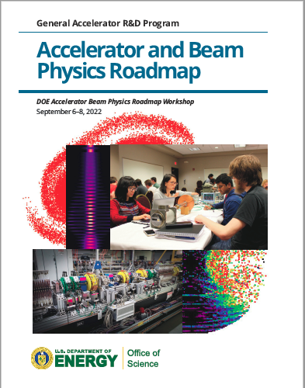
High level – GARD ABP
Roadmap approved 03/31/23
It is:
On one hand – “all inclusive”
On another – “focused”
DOE will follow up with changes in the GARD planning
After the P5 (Q1 FY24 or later)
IOTA/FAST research program is central in several aspects:
Grand challenges 1, 2, 3, and 4
The only ABP facility; 1st VTS

Slide 7
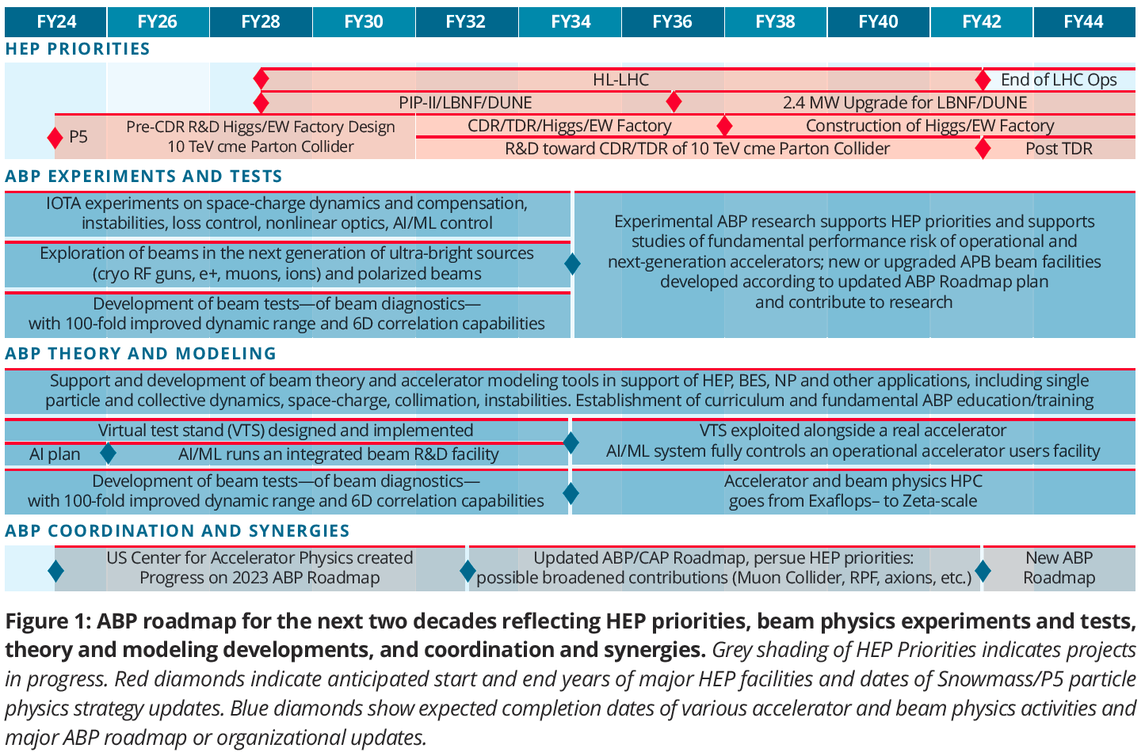
GARD ABP Roadmap

