Slide 1
Rare Events and their Optimization
Vishwas Rao
vhebbur@anl.gov
Collaborators: Shanyin Tong (NYU), Anirudh Subramanyam (ANL), Mihai Anitescu (ANL & UChicago), Emil Constantinescu (ANL), and Romit Maulik (ANL)
HEP (05/18/2023)

Slide 2



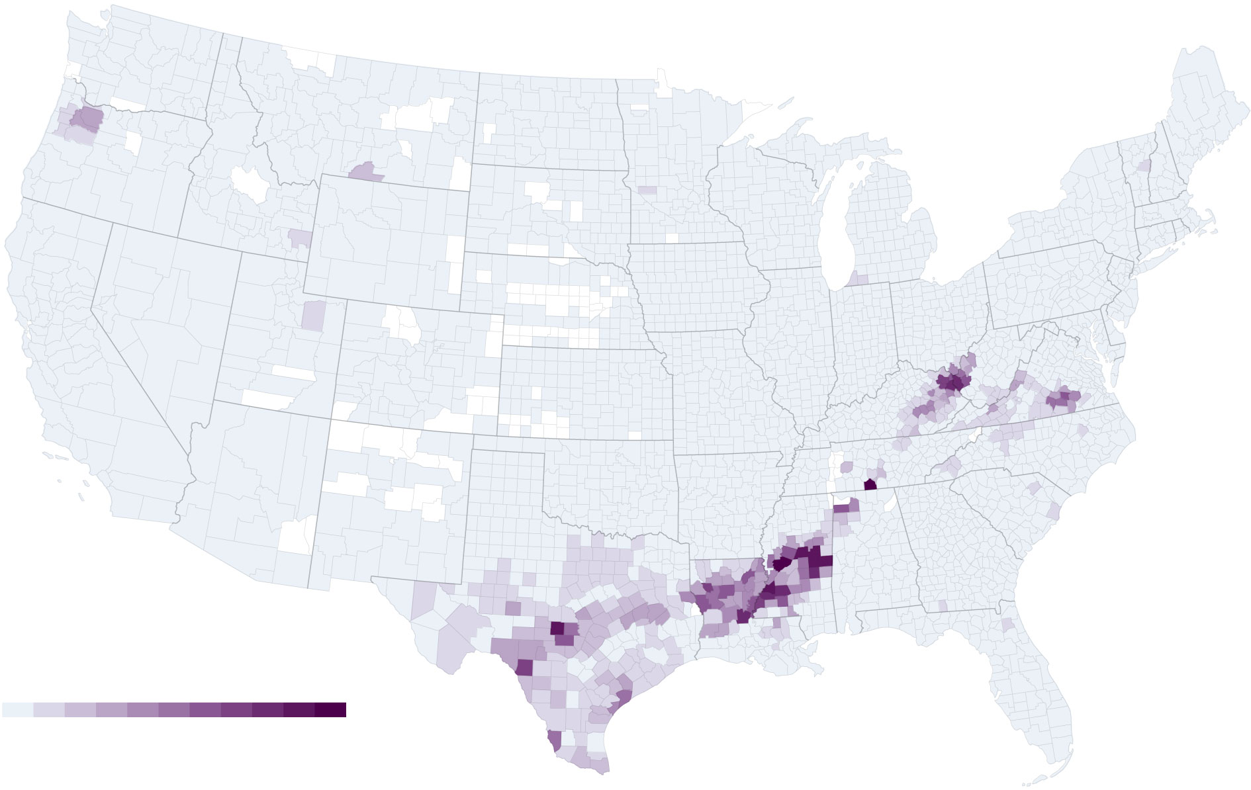
Motivation
Extreme weather events
  Flooding
  Earthquakes
  Tornadoes
Cascading power failures
  2003 in USA
  2012 in India
  2012 in NoVA region
  2021 in Texas
Huge costs incurred (US only)
  2017 – 174 Billion
  2018 – 155 Billion
Hurricane Harvey caused extreme flooding in parts of Houston, TX - 2017
Image credit: AICHE, CERC investigation report

Slide 3
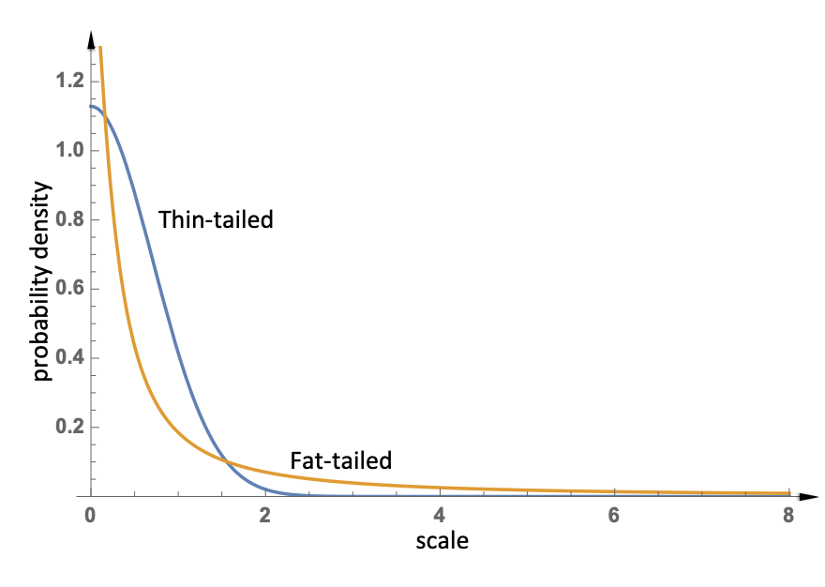
A thought experiment
Components of a system are independent from one another (above a certain scale)
  At much larger scales the magnitude of fluctuations of the system follows a normal distribution (loosely follows from the central limit theorem)
  Probabilities of the events many std deviations from the mean are astronomically improbable.
  For example: Consider 100 independent ladders each with 1/10 probability of falling.
Components of a system are interdependent
  Interdependencies can lead to a distribution of fluctuations in which the probability of an extreme event, while still small is not astronomically small.
  If we tie all the ladders together, while the probability of an individual ladder falling is smaller – but we would have significantly increased the probability of all the ladders collapsing.
Concept and Figure borrowed from An Introduction to Complex Systems Science and its Applications

Slide 4


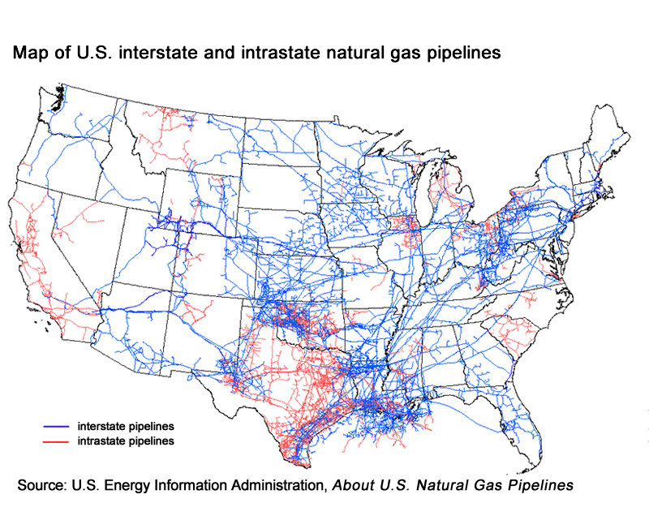
Examples of Complex Systems

Slide 5
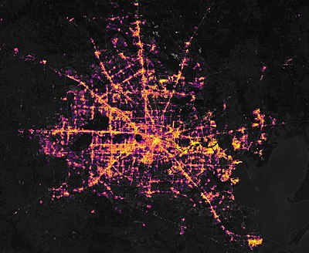
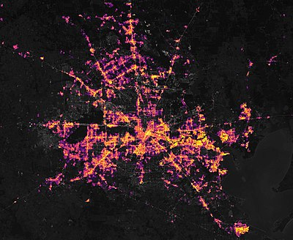
Texas Blackout: Before
Texas Blackout: After. About 4.4 Million people were affected
Blackout in India: 2012. About 620 Million people were affected.
Causes for disruption
Weather events
  Texas 2021, California 2020
Poor planning
  Texas 2021,
  NE US 2003 (A software bug in the alarm system)
  California 2020.
Terrorist attacks
  Ukraine Cyberattack (2015)
Common Themes
Rare
  O(100) Power outages per year in US
  O(1000) large floods in the last 35 years
High-Impact
  Costs O($1B)
  Huge societal costs
Questions
  Risk Quantification
  Risk Mitigation

Slide 6
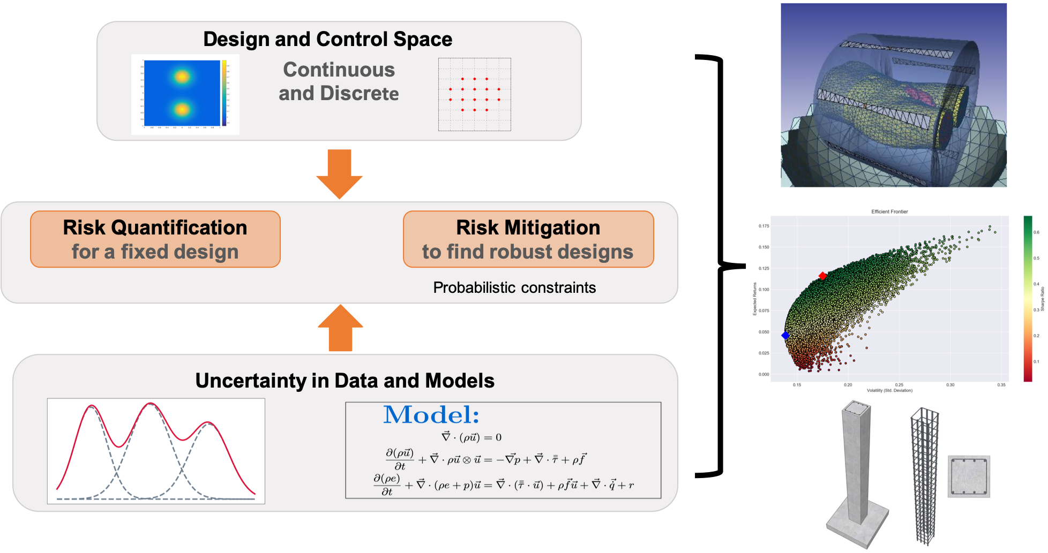

Slide 7

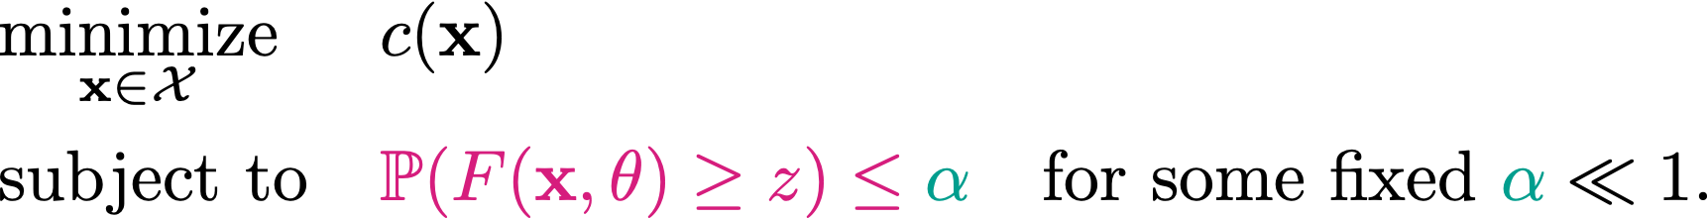
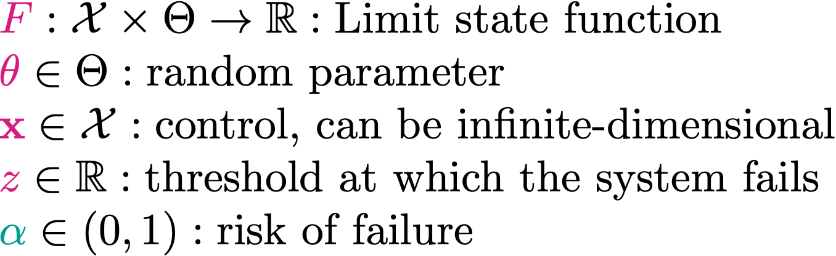
Rare event problem formulation
Estimating the probability of rare events:
Optimization under rare events:
Risk Mitigation
Risk Quantification
Notes:
Some of the challenges involved with estimating the probabilities of such events are the lack of data pertinent to these events. An obvious approach to estimating the probabilities of such events is to use a Monte Carlo approach. However, this is computationally very expensive. For example: estimating the odds of an event whose probability is ~ 1e-3, for an underlying simulation that requires 10 minutes per simulation, requires two years of serial computation for a std. dev of 10%. Estimating the probabilities is akin to characterizing the tails of the distribution, which is again difficult in practice. To add to this, nonlinearity of the models makes things worse. Our approach in addressing this problem has shown considerable promise. For example, with O(10) samples for small systems we obtain accurate estimates of the probability. These methods are extensible to larger systems. We have seen that it addresses the nonlinearity issues. Also, the methods give theoretical guarantees under some assumptions.

Slide 8
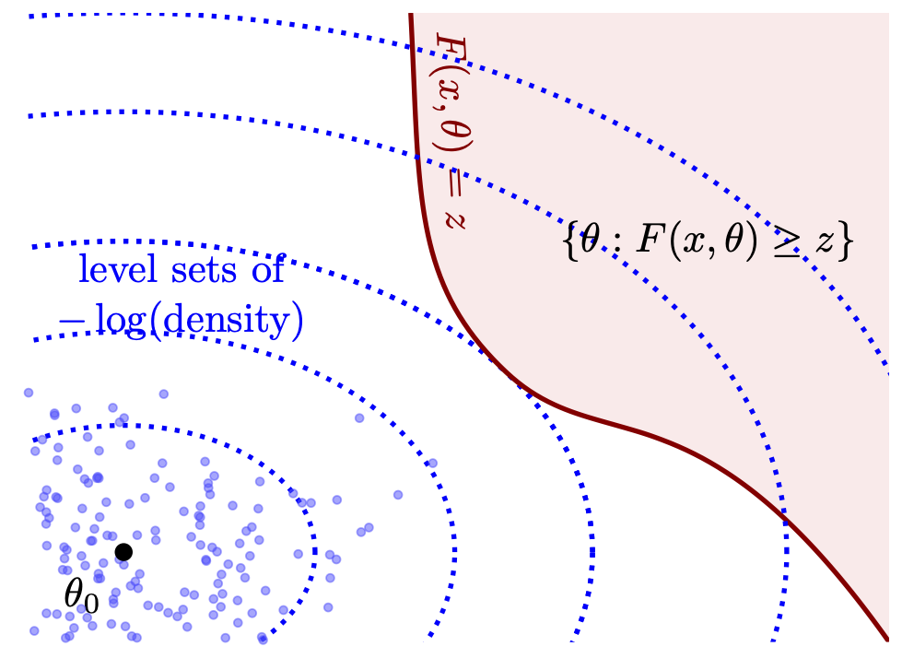

Challenges
Not enough data that corresponds to the rare events
Computationally expensive
  For example: estimating the odds of an event whose probability is ~ 1e-3, for an underlying simulation that requires 10 minutes per simulation, requires two years of serial computation for a std. dev of 10%.
Mitigation is even more harder
  Sampling-based methods require samples
  Optimization problem size grows linearly with samples
Notes:
Some of the challenges involved with estimating the probabilities of such events are the lack of data pertinent to these events. An obvious approach to estimating the probabilities of such events is to use a Monte Carlo approach. However, this is computationally very expensive. For example: estimating the odds of an event whose probability is ~ 1e-3, for an underlying simulation that requires 10 minutes per simulation, requires two years of serial computation for a std. dev of 10%. Estimating the probabilities is akin to characterizing the tails of the distribution, which is again difficult in practice. To add to this, nonlinearity of the models makes things worse. Our approach in addressing this problem has shown considerable promise. For example, with O(10) samples for small systems we obtain accurate estimates of the probability. These methods are extensible to larger systems. We have seen that it addresses the nonlinearity issues. Also, the methods give theoretical guarantees under some assumptions.

Slide 9
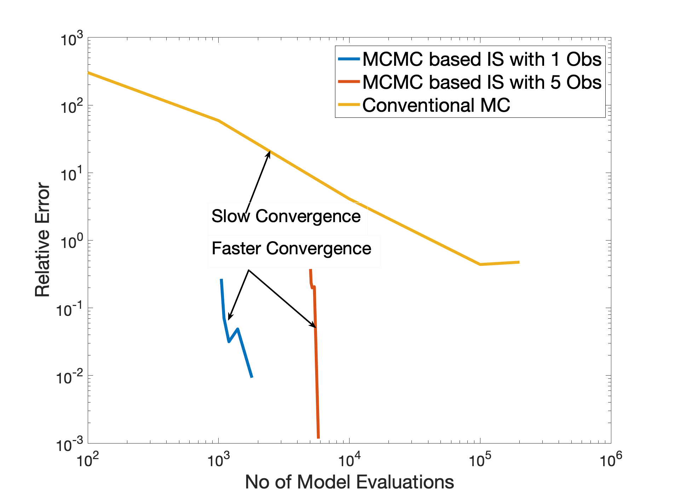
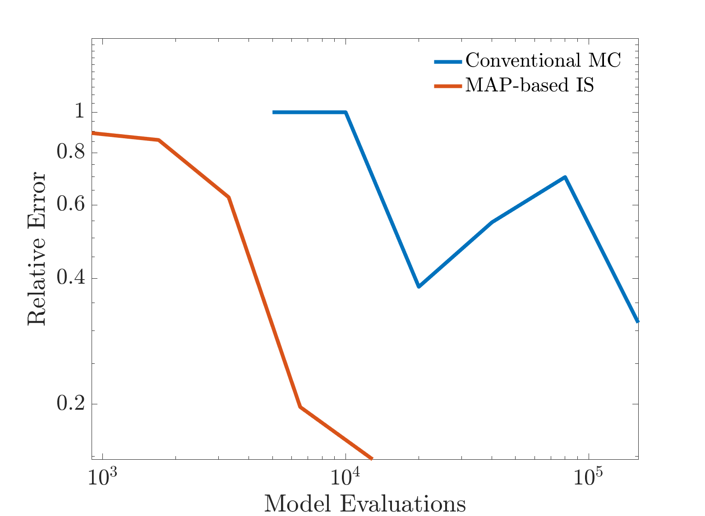
Overview of results: Risk Quantification
2D Problem (LV)
100D Problem (Lorenz 96)
Accurate results with O(1000) samples for small systems
Uses Rice’s formula + Bayesian Inference
Extensible to larger systems
Notes:
Some of the challenges involved with estimating the probabilities of such events are the lack of data pertinent to these events. An obvious approach to estimating the probabilities of such events is to use a Monte Carlo approach. However, this is computationally very expensive. For example: estimating the odds of an event whose probability is ~ 1e-3, for an underlying simulation that requires 10 minutes per simulation, requires two years of serial computation for a std. dev of 10%. Estimating the probabilities is akin to characterizing the tails of the distribution, which is again difficult in practice. To add to this, nonlinearity of the models makes things worse. Our approach in addressing this problem has shown considerable promise. For example, with O(10) samples for small systems we obtain accurate estimates of the probability. These methods are extensible to larger systems. We have seen that it addresses the nonlinearity issues. Also, the methods give theoretical guarantees under some assumptions.

Slide 10
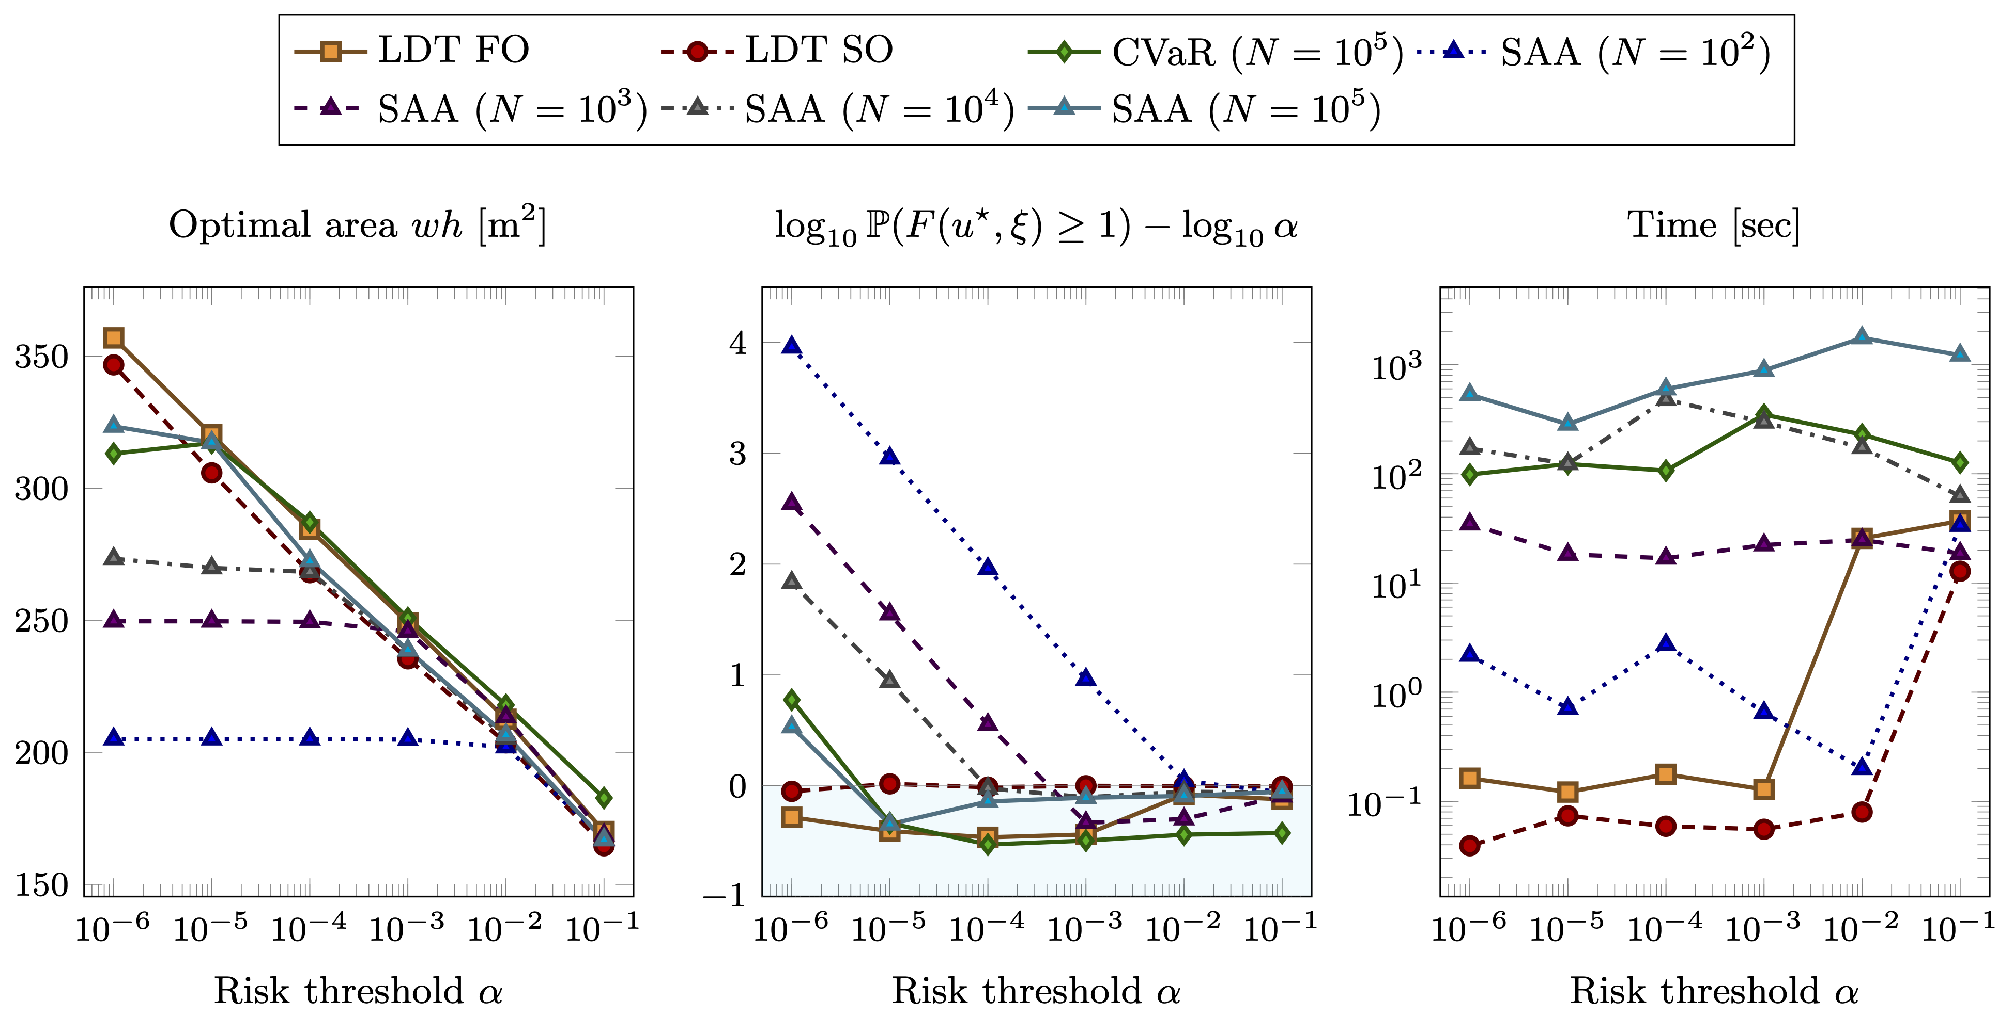
Overview of results: Risk Mitigation
“SAFE” Region
Sampling free methods (LDT + Bilevel optimization)
Scalable for ``Extremely rare events”
Works for Gaussian and Gaussian mixtures
Notes:
Some of the challenges involved with estimating the probabilities of such events are the lack of data pertinent to these events. An obvious approach to estimating the probabilities of such events is to use a Monte Carlo approach. However, this is computationally very expensive. For example: estimating the odds of an event whose probability is ~ 1e-3, for an underlying simulation that requires 10 minutes per simulation, requires two years of serial computation for a std. dev of 10%. Estimating the probabilities is akin to characterizing the tails of the distribution, which is again difficult in practice. To add to this, nonlinearity of the models makes things worse. Our approach in addressing this problem has shown considerable promise. For example, with O(10) samples for small systems we obtain accurate estimates of the probability. These methods are extensible to larger systems. We have seen that it addresses the nonlinearity issues. Also, the methods give theoretical guarantees under some assumptions.

Slide 11

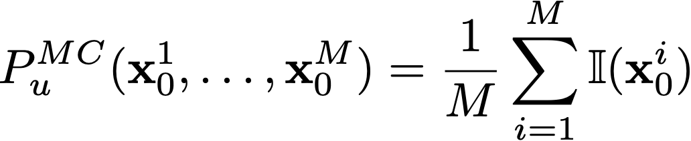
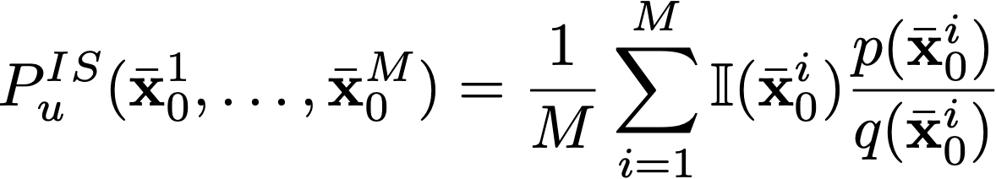
Existing approaches
Monte Carlo simulation
  Draw random samples from
  Simulate the dynamics with each random sample
  Compute the fraction of the samples that exceed the threshold
Importance sampling:
  Construct a ``suitable” biasing distribution
  Draw random samples from the biasing distribution
  Sum the “importance weights” for the samples that exceed threshold

Slide 12
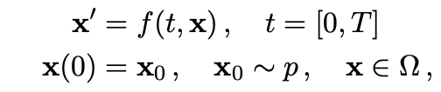
Problem formulation
Consider the following dynamical system
We are interested in estimating
The initial state of the system has the PDF `p’. When f is linear and p is Gaussian, the evolution of x is analytically tractable. However, when f is nonlinear, the evolution of x is not analytically tractable.

Slide 13

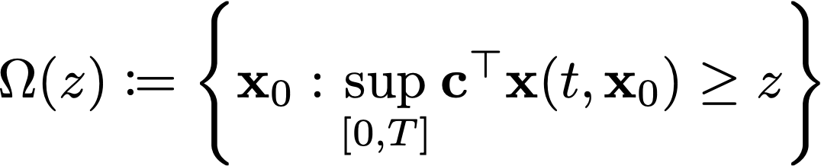



Sketch of our Approach
Let denote the set of all initial conditions that cause an excursion. That is:
Then is the
We use Rice’s formula to gain insights about

Slide 14
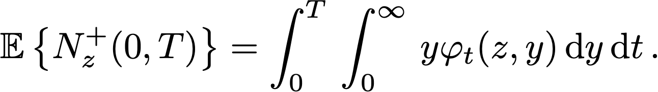
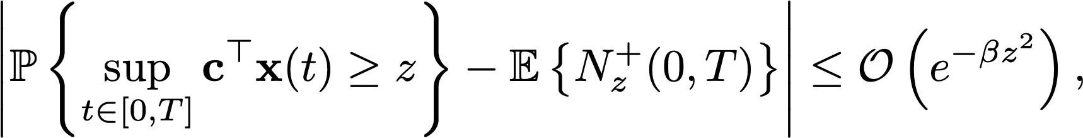


Our Approach: Rice’s formula + Bayesian Inference
Rice’s formula:
For Gaussian processes:
Unfortunately, is analytically computable only for Gaussian processes
The key idea is that values 't’ and `y’ at which is large contribute the most to integral in Rice’s formula. We use this idea to construct a biasing distribution.
Expected # of excursions
Derivative of the SP
Joint PDF
Faster than exponential convergence

Slide 15


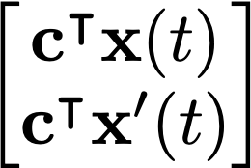

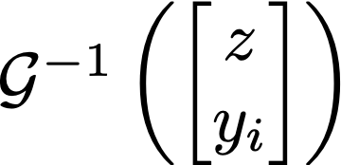

Ideas for constructing Biasing distribution
Consider the forward map that evaluates using the dynamics for a given initial conditions and at a specified time t.
can be approximated by
This is ill-posed; there are multiple x_0’s that map to a given .
Biasing distribution is II U III
Notes:
Evaluating the yphi for different values of y and t gives us an intuition about the times and slopes at which the

Slide 16
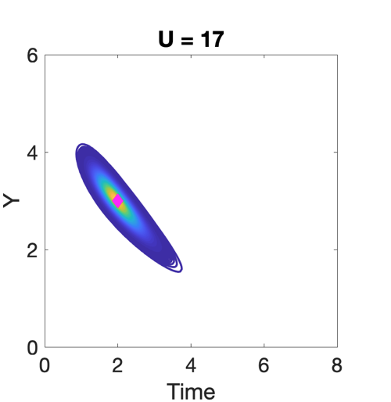



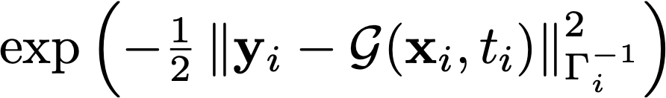
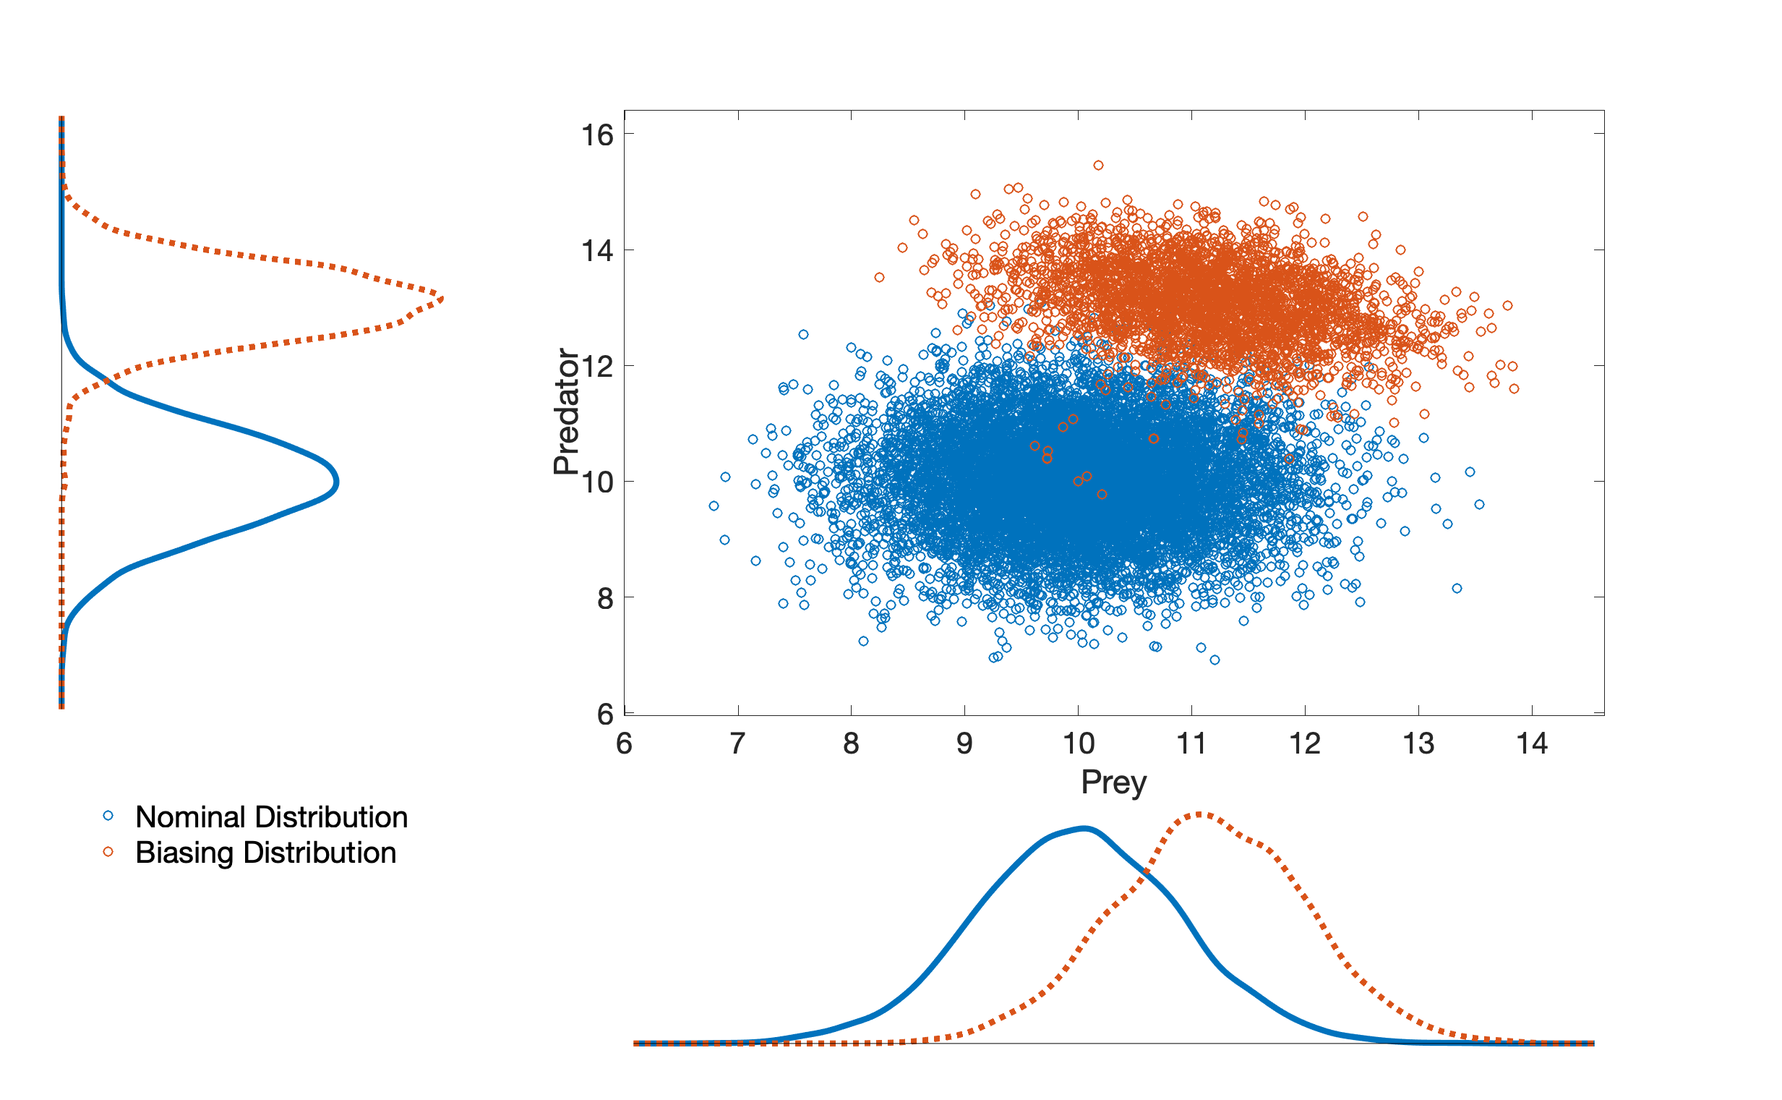
Overview of our approach
Prior
Nonlinear Dynamical systems
Linearization + Rice’s formula
Gaussian Uncertainties
Non-Gaussian Processes
Likelihood
MAP/MCMC or ML-based methods
Excursion Probability Estimates
Posterior/
IBD
Importance Sampling

Slide 17
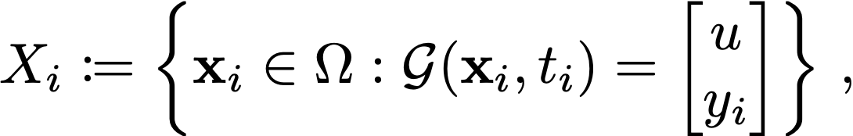

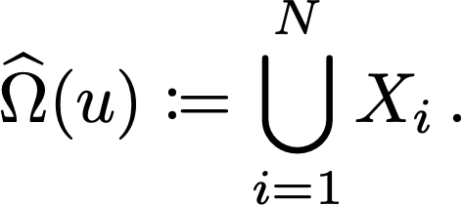

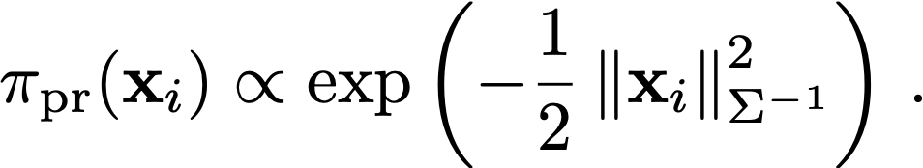

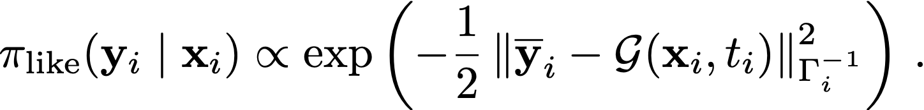
Overview of our approach – Bayesian approach
Define then an approximation can be constructed as
It is obvious that approximates better as we increase N
We find X_i’s using Bayesian approach.
Assuming p to be Gaussian, we have the following prior
We obtain the likelihood by using samples from unnormalized :

Slide 18
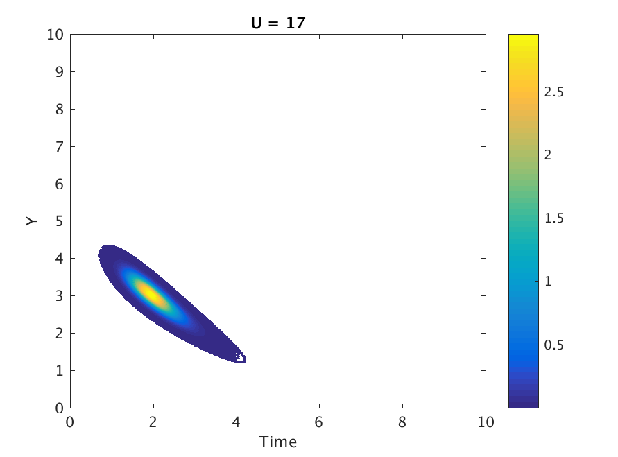
Bayesian approach (cont.)
Posterior PDF:
To construct y_i, we sample from unnormalized
This requires evaluating
Notes:
17

Slide 19
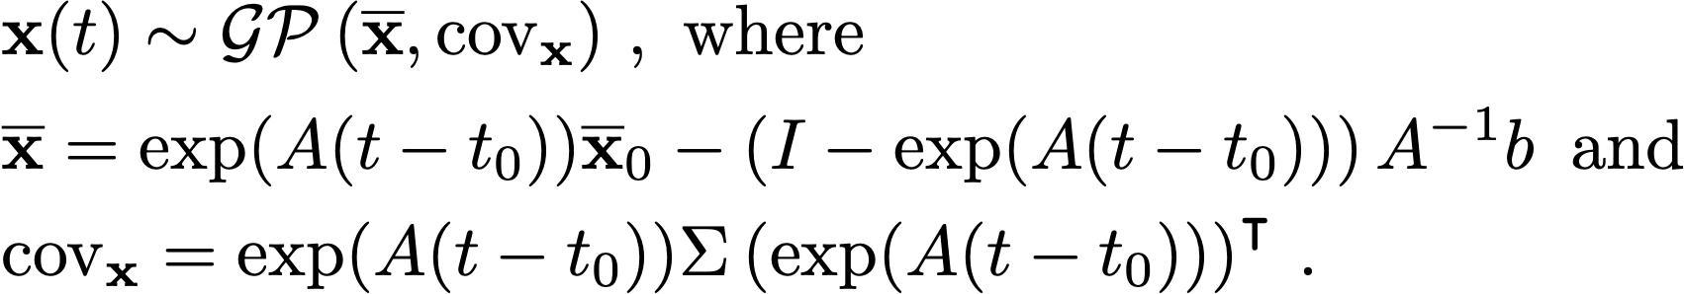
Evaluating
When p is linear and the dynamics is linear:
The time evolution of x can be written as
Since x_0 is normally distributed, we can write x(t) as a GP:
Notes:
18

Slide 20
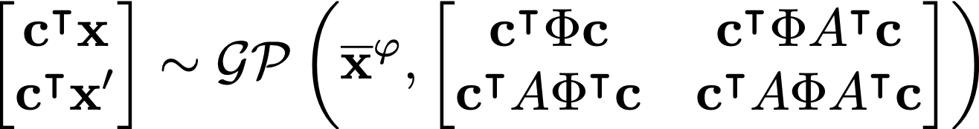
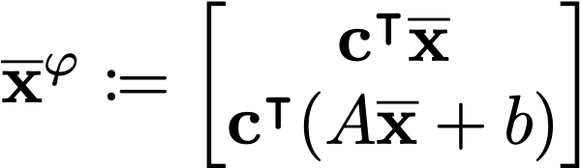
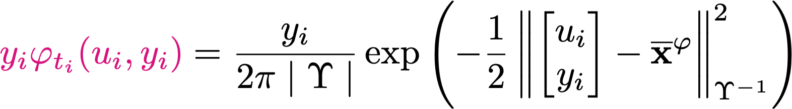
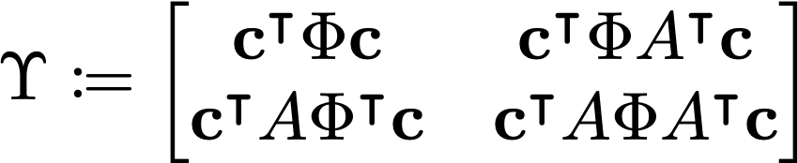
Evaluating (Cont.)
The joint PDF of the process and its derivative is given by:
Where and
Since x_0 is normally distributed, we can write x(t) as a GP:
For nonlinear use the method of moments by linearizing around the mean
Notes:
19

Slide 21
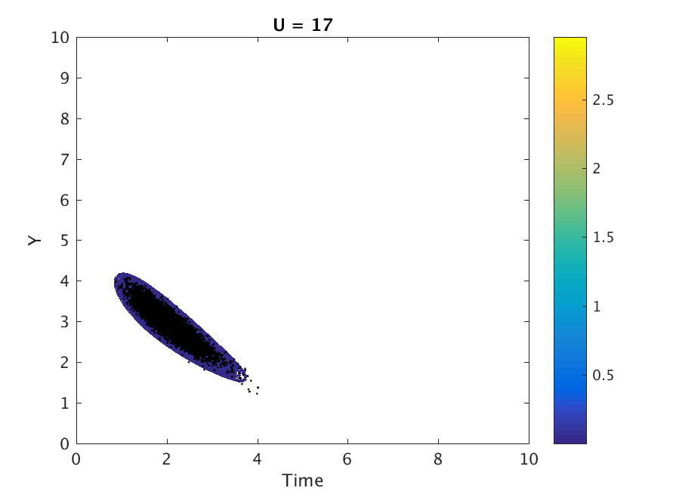
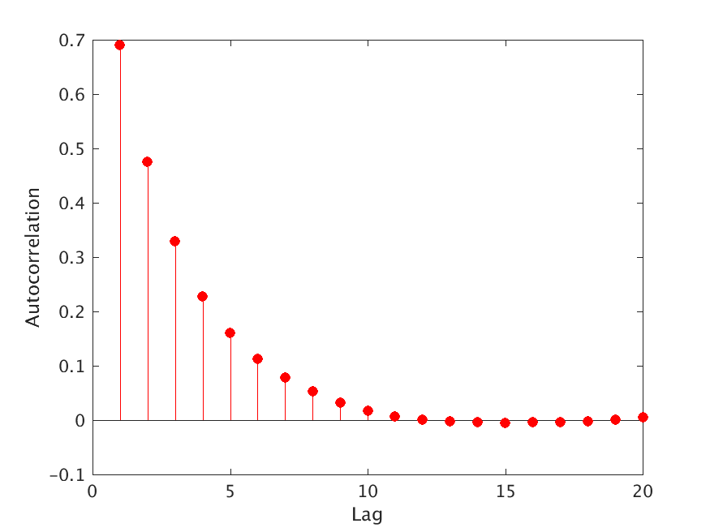
Sampling from
Left: The product of the derivative and the joint PDF of the state and its derivative for u=17. Center: Samples drawn from using DRAM MCMC. These samples will be used to construct the likelihood. Right: Autocorrelation between the samples. Picking every tenth sample will “ensure” independence
Notes:
20

Slide 22

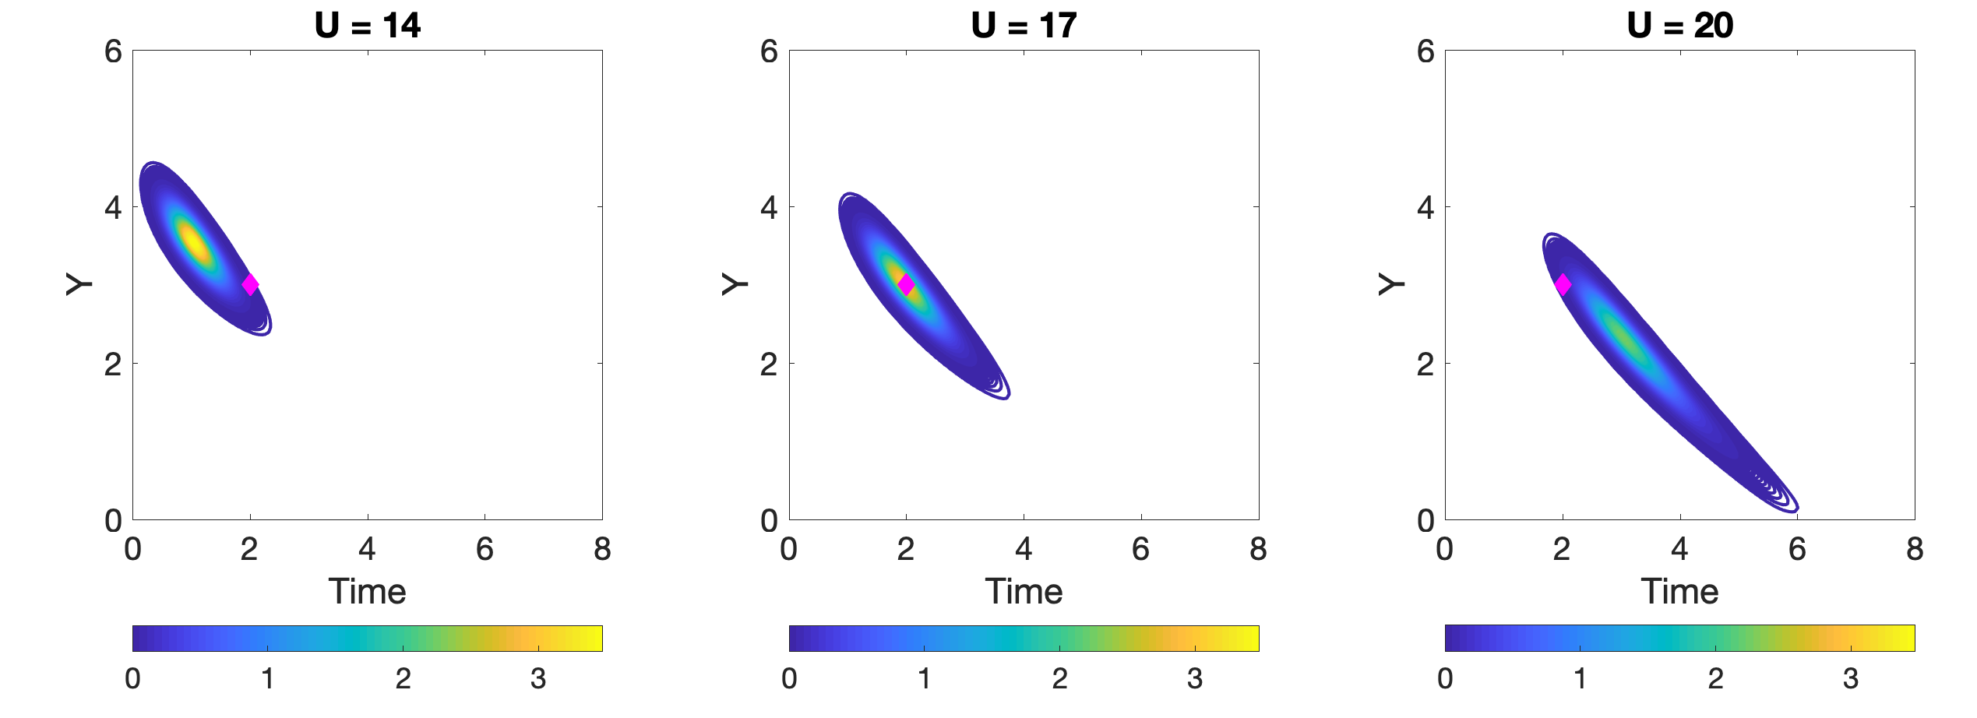
Choice of mean and covariance of likelihood
Sampling from gives us the likely time at which there is an excursion. So to determine the mean and covariance of the likelihood, we look at
Use Laplace approximation to estimate mean and covariance

Slide 23
Approaches to solve Bayesian inverse problems
Laplace approximation at MAP (MAP-based IS) → [R, Anitescu, In Press, SIAM JUQ]
  Solve the inverse problem using the negative log likelihood as cost function
  Use the Hessian inverse at the MAP point to approximate the covariance of the posterior
  Use LBFGS to solve the optimization problem (Poblano toolbox)
  Adjoints to obtain the gradient
MCMC-based IS → [R, Anitescu, In Press, SIAM JUQ]
  Sample directly from the posterior
  DRAM algorithm
Machine Learning based approach to find the inverse maps →[MLDADS (2020)]

Slide 24
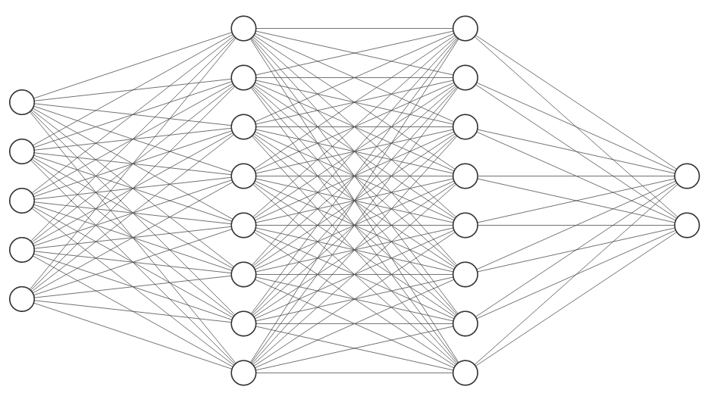
Inverse map using neural networks
The inverse map may be expensive to obtain
  Solving Bayesian inverse problems is expensive
  Can we build data-driven surrogates for approximating pre-images?
  We may utilize a fully connected neural network to approximate
  this map.
Learning
  We train our map given multiple examples of forward simulations.
  The input to the map is the outcome of the simulation and the initial condition is the output.
  Our neural network training is a non-convex optimization – we use the ADAM Stochastic Gradient optimizer with a learning rate of 0.001. Consistently reducing accuracy on a held out data-set is used to terminate optimization (i.e., the prevention of overfitting)
A fully connected artificial neural network
Notes:
23

Slide 25
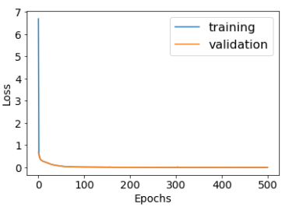
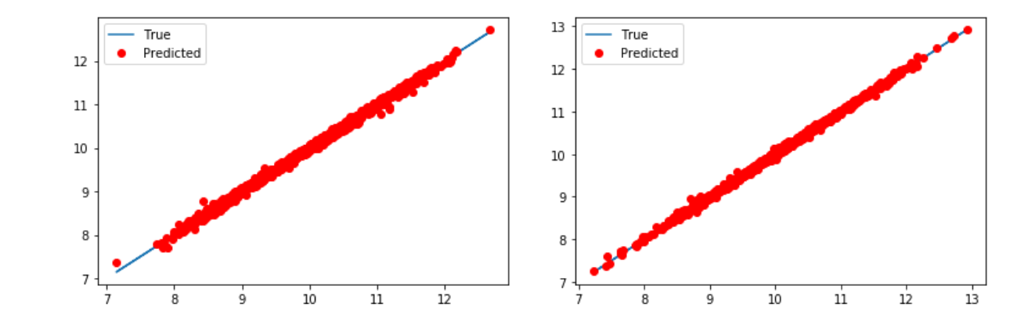
Inverse map using neural networks
Quantifying map fidelity
  We track the reducing objective function until improvement
  has stalled
  The held-out (validation) data is used to select the best
  model
  Scatter plots on the ‘test’ data (i.e., data completely unused
  till this point) show quality of predictions
Two plots for each dimension of outcome
Map evaluation in <1e-3 seconds
Notes:
24

Slide 26
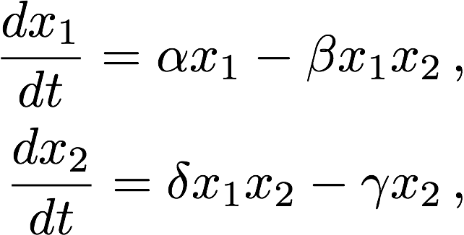
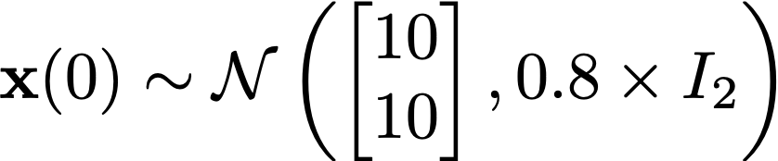
Nonlinear Example
We consider the Lotka Volterra example:
We are interested in estimating x2 exceeding 17
We also look at Lorenz96 system (100D)

Slide 27
Nominal and biasing distributions
Samples from Nominal and Biasing distributions. The Biasing distributions mainly picks samples from the tails. This is obtained using the MCMC based IS approach.

Slide 28
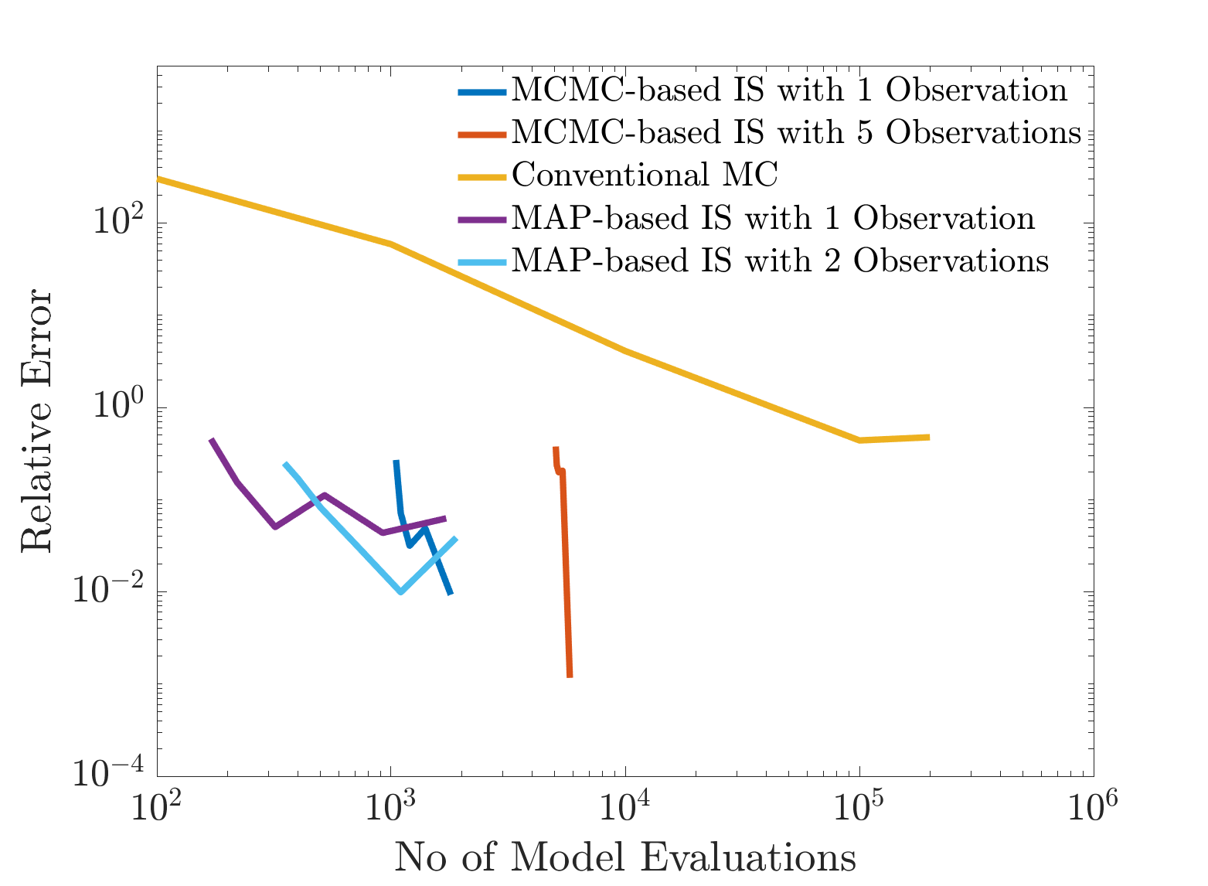
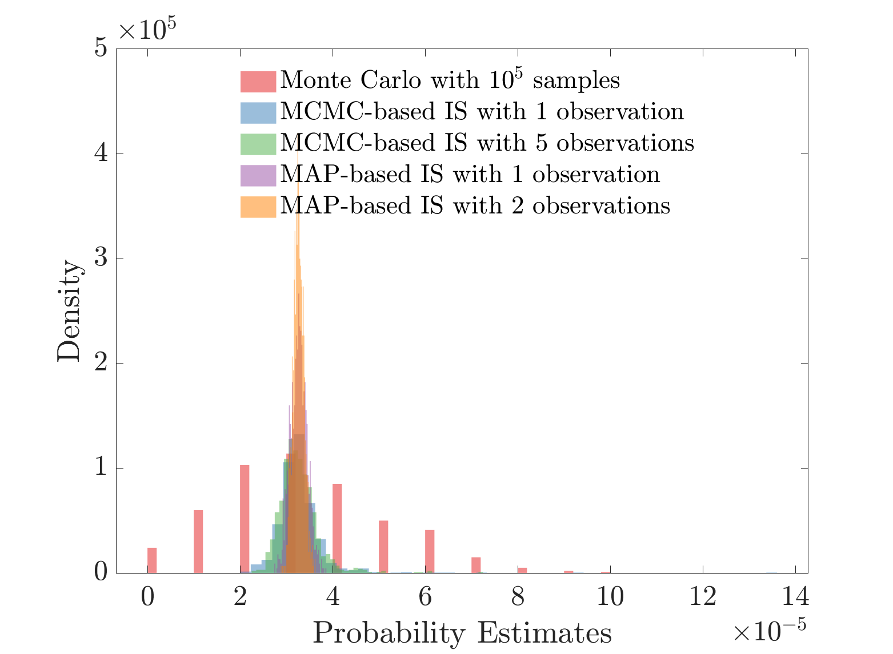
Results (Gaussian Uncertainties)
``True” probability is 3.28e-5 (Obtained with 10 Million samples of MC)
Both MCMC and MAP based IS yield comparable results for similar amount of “work”

Slide 29
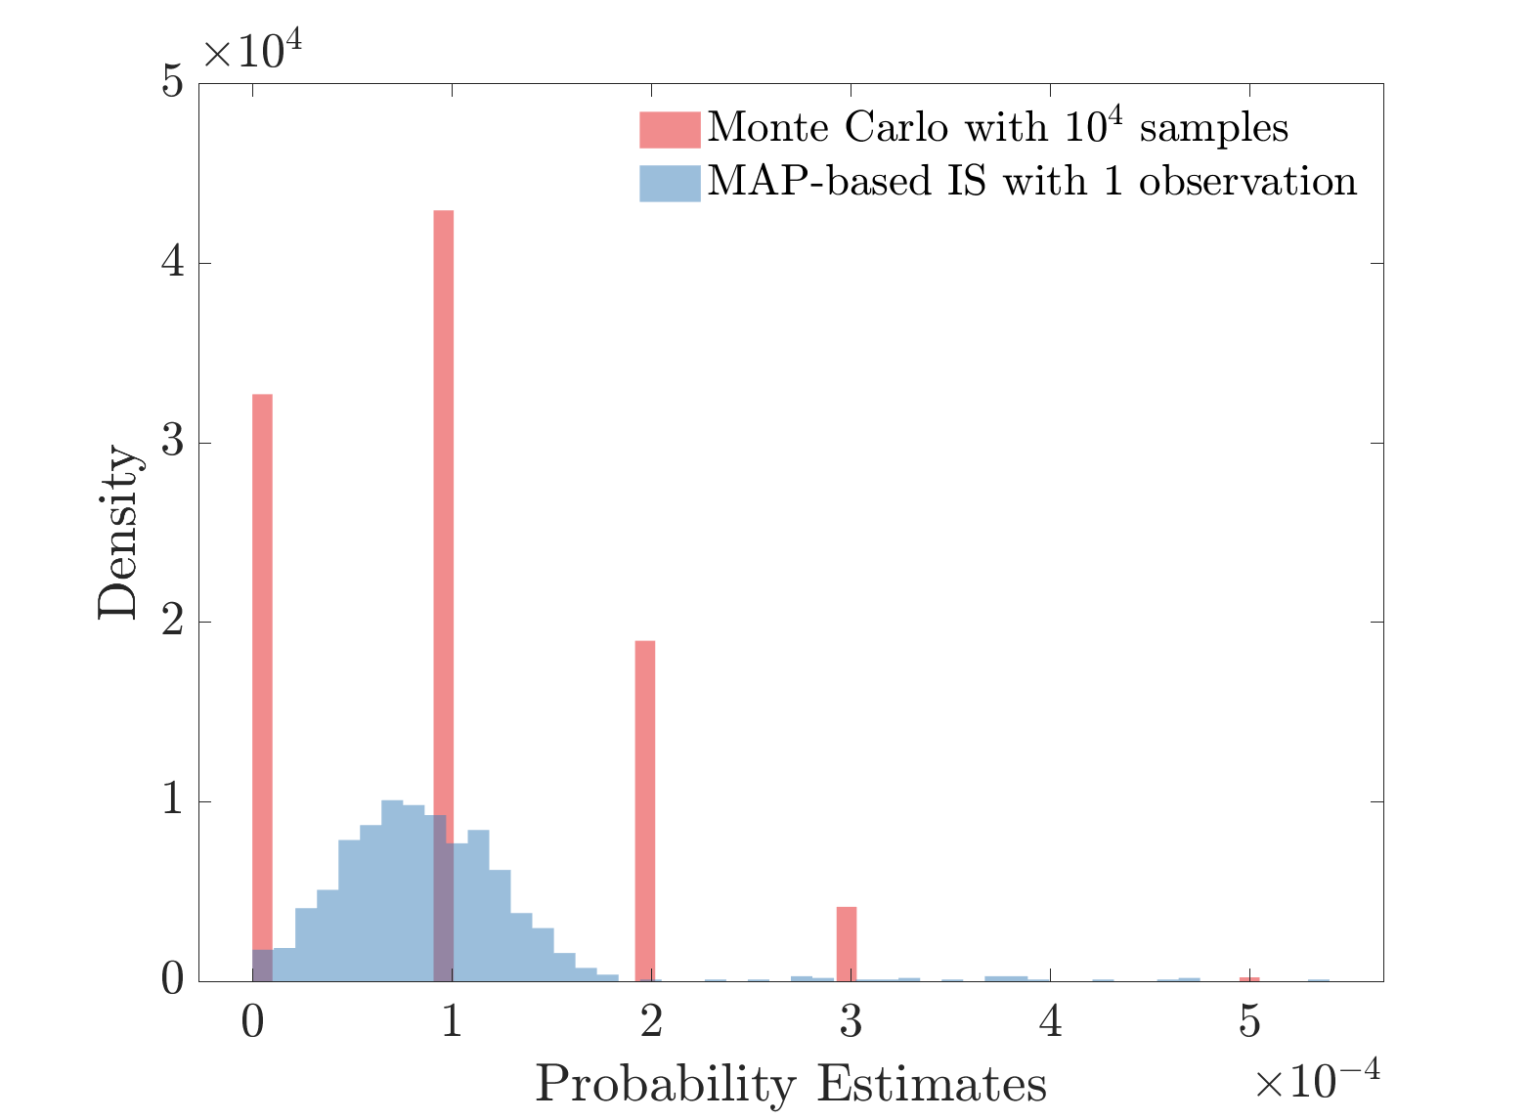
Results (Gaussian Uncertainties)
``True” probability is 8.09e-5 (Obtained with 10 Million samples of MC)

Slide 30
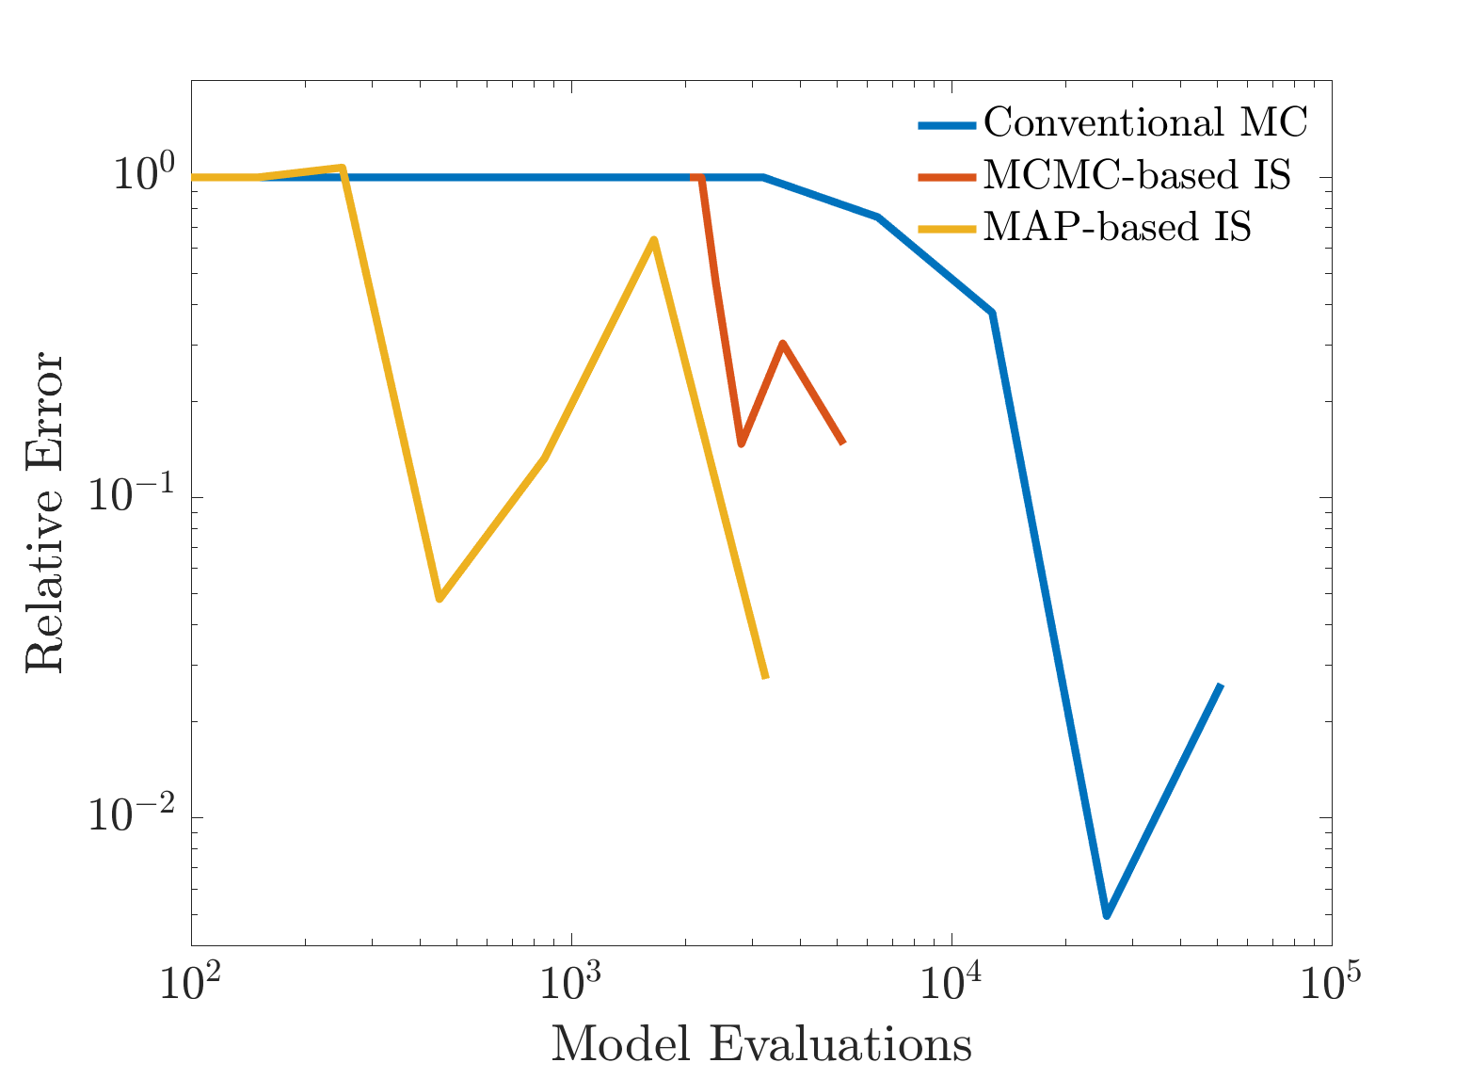
Results (non-Gaussian Uncertainties)
The true probability here is 6.281 ｘ 10⁻⁴.
Convergence of different approaches with an uniform initial distribution of the state.
The convergence is not as smooth as it is for a Gaussian initial distribution, and we attribute the cause to the edge effects of a uniform distribution.

Slide 31
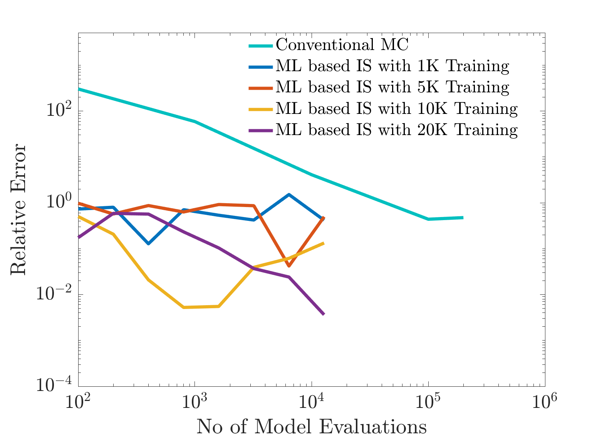
Results
Comparison between Conventional MCS and ML-based IS. We observe even with small number training data, we obtain fairly accurate estimates and as we increase the training data, the accuracy improves dramatically.

Slide 32
Computational Cost
Generating 20K training data points cost approximately equivalent to 400 Model evaluations
Training the dataset required 180 seconds on an 8th generation Intel Core I7 with python 3.6.8 (this is equivalent to about 50 model evaluations).
Inference costs were negligible.

Slide 33
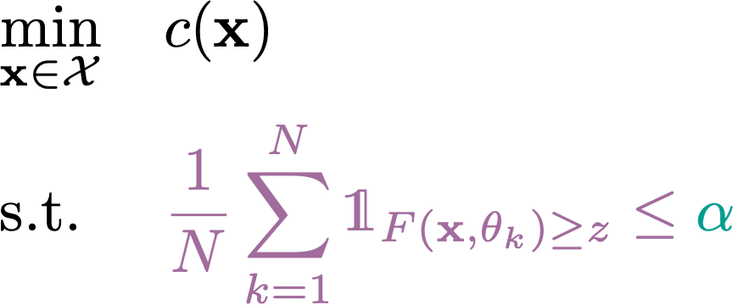
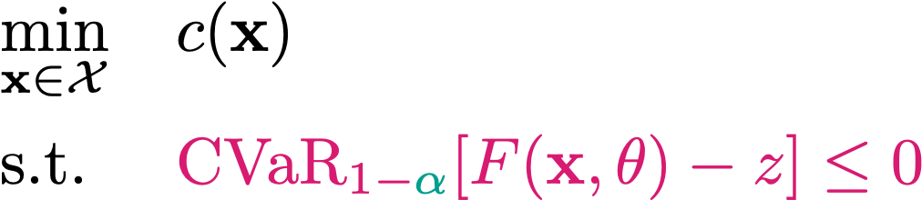
Approaches to approximate probabilistic constraints
Sample average approximation
CVaR: Convex approximation of constraint

Slide 34
Large Deviation Theory - A quick introduction
LDT is concerned with the asymptotic behavior of tails of probability distributions – specifically the rates of exponential decay of probabilistic measures of extreme events.
It uses the rate functions to characterize the asymptotic behavior of rare probabilities.
Recently Grafke, Vanden Eijnden, and Dematteis (2018, 2019) and later Tong, Stadler, and Vanden Eijnden (2020) adapted the classical LDT and sharp asymptotics to study the behavior of rare events.
The key idea is to find a dominating point in the rare event set by solving an optimization problem and estimate probabilities solely based on this.

Slide 35
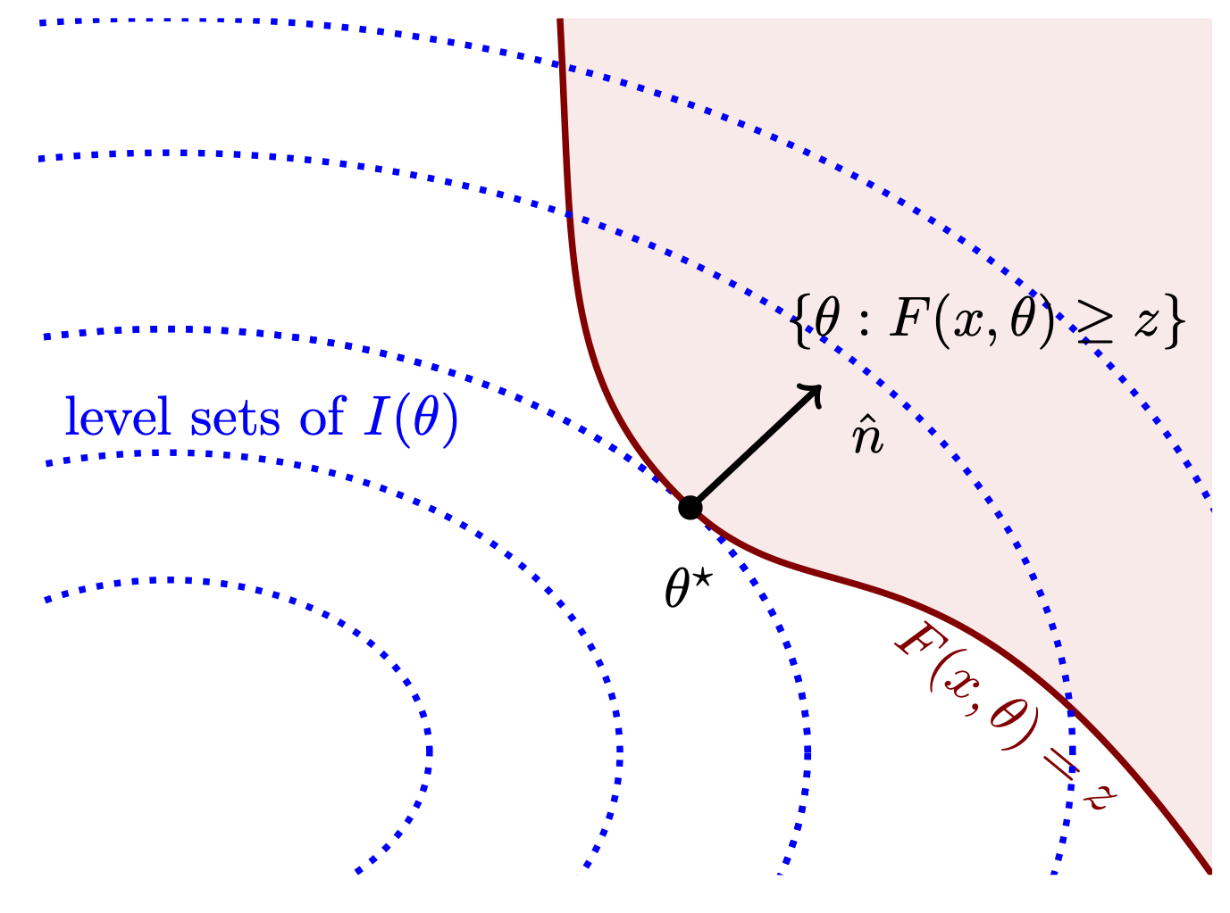



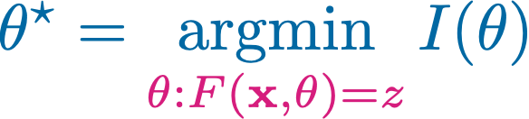


Large Deviation Theory
is the Legendre-Fenchel transform of cumulant generating functions. Example:
Probability computation requires optimization:
Regularity Conditions:
F is concave w.r.t
is Lipschitz continuous

Slide 36




Explicit formulae for chance constraints

Slide 37



Probability estimation with Gaussian Mixtures
First order approximation:
Second order approximation:

Slide 38



Chance Constraints to Bilevel optimization
LDT approximation
Optimization under Rare Chance constraints
Sampling free
Works for Gaussian mixtures
Bilevel optimization
Accurate if: Regularity conditions hold or
``Good” if F is close to concave and z is “large”
KKT Reformulation

Slide 39



Optimal boundary control for steady state advection diffusion problem
}
PDE
Chance Constraints
Notes:
Evaluating the yphi for different values of y and t gives us an intuition about the times and slopes at which the

Slide 40



Optimal boundary control for steady state advection diffusion problem
The optimal boundary conditions for different using SORM
The objective values and feasibilities of the boundary control problem for different using SORM
Notes:
Evaluating the yphi for different values of y and t gives us an intuition about the times and slopes at which the

Slide 41


Concluding Remarks and References
  Rice’s formula + Bayesian Inference for risk quantification
    Can be extended to Gaussian mixtures and by controlling the variance of mixture components, this can be used in optimization under rare chance constraints
  LDT + Bilevel optimization holds a lot of promise
    Works well for Concave or nearly concave limit state functions

Slide 42
Other approaches
Large Deviation Principles
Nested subset methods: Subsets generated by intermediate thresholds
Nested subset methods are inherently serial and the process of constructing biasing distribution cannot be performed in parallel
Nested Subsets

Slide 43

Problem formulation
Consider the following dynamical system
We are interested in estimating c is the canonical basis vector.
The initial state of the system has the PDF `p’. When f is linear and p is Gaussian, the evolution of x is analytically tractable. However, when f is nonlinear, the evolution of x is not analytically tractable.

Slide 44





Problem formulation
Let denote the set of all initial conditions that cause an excursion. That is:
Then Where, represents the probability measure associated with the random initial conditions.
Finding amounts to finding .
We use Rice’s formula to gain insights about

Slide 45

Overview of our approach: Rice’s formula and excursion probability theory
We have the following relation for the excursion probability (Adler and Taylor (2009))
Where, X is a centered unit-variance smooth Gaussian random field. is the Euler characteristic of the excursion set .
For 1D, Euler Characteristic of A is basically the number of disjoint intervals in A.
Rice’s formula, which computes the expected number of upcrossings of level u, and Euler Characteristic are similar and hence has been used to approximate the excursion probability

Slide 46


Overview of our approach: Rice’s formula and excursion probability theory
Rice’s formula is given by
Left hand side denotes the expected number of excursions of level u
y is the derivative of the stochastic process in a mean square sense
is the joint PDF of the process and its derivative
The key insight for our method is that values of the time t and slope y at which is large contribute the most to this integral.
We use this to construct an approximation to

Slide 47


Overview of our approach: Rice’s formula and excursion probability theory
Consider the forward map that evaluates using the dynamics for a given initial conditions and at a specified time t.
can be approximated by
This is ill-posed; there are multiple x_0’s that map to a given .
Biasing distribution is II U III
Notes:
Evaluating the yphi for different values of y and t gives us an intuition about the times and slopes at which the

Slide 48
Overview of our approach – Bayesian approach
Define then an approximation can be constructed as
It is obvious that approximates better as we increase N
We find X_i’s using Bayesian approach.
Assuming p to be Gaussian, we have the following prior
We obtain the likelihood by using samples from unnormalized :

Slide 49
Bayesian approach (cont.)
Posterior PDF:
To construct y_i, we sample from unnormalized
This requires evaluating

Slide 50
Evaluating
When p is linear and the dynamics is linear:
The time evolution of x can be written as
Since x_0 is normally distributed, we can write x(t) as a GP:

Slide 51
Evaluating (Cont.)
The joint PDF of the process and its derivative is given by:
Where and
Since x_0 is normally distributed, we can write x(t) as a GP:
For nonlinear use the method of moments by linearizing around the mean

Slide 52
Sampling from
Left: The product of the derivative and the joint PDF of the state and its derivative for u=17. Center: Samples drawn from using DRAM MCMC. These samples will be used to construct the likelihood. Right: Autocorrelation between the samples. Picking every tenth sample will “ensure” independence

Slide 53
Choice of mean and covariance of likelihood
Sampling from gives us the likely time at which there is an excursion. So to determine the mean and covariance of the likelihood, we look at
Use Gaussian approximation to estimate mean and covariance

Slide 54
Approaches to solve Bayesian inverse problems
Laplace approximation at MAP (MAP-based IS)
  Solve the inverse problem using the negative log likelihood as cost function
  Use the Hessian inverse at the MAP point to approximate the covariance of the posterior
  Use LBFGS to solve the optimization problem (Poblano toolbox)
  Adjoints to obtain the gradient
MCMC-based IS
  Sample directly from the posterior
  DRAM algorithm
We demonstrate both approaches

