Slide 1
RF-Mechanical design of the 650 MHz buncher
I. Gonin, T. Khabiboulline, G. Romanov, V Yakovlev

Slide 2
Why separate feeding of the cavity cells is better than use of a coupled-cell resonator:
No coupling cells and coupling slots, which also improves Rsh by ~20% compared to pi-structure
The separate cells are shorter, that allows further improvement transit time factor and shunt impedance;
No power combiner in the amplifier, which provides 1.5-2 dB loss and additional cost.
One needs not a big coaxial line, but a number of thinner coaxial cables. The cables may have higher loss than a coaxial line, but because of (1-3) the total input power from the grid may be even smaller than for a coupled cell cavity.
No high-power coupler, which is expensive, may be unreliable (big ceramic window) and needs long time for design and tests;
The separate cell cavity needs individual phase control, which is not a problem.
Separate feeding cavity design was completed on 09/13/2021

Slide 3
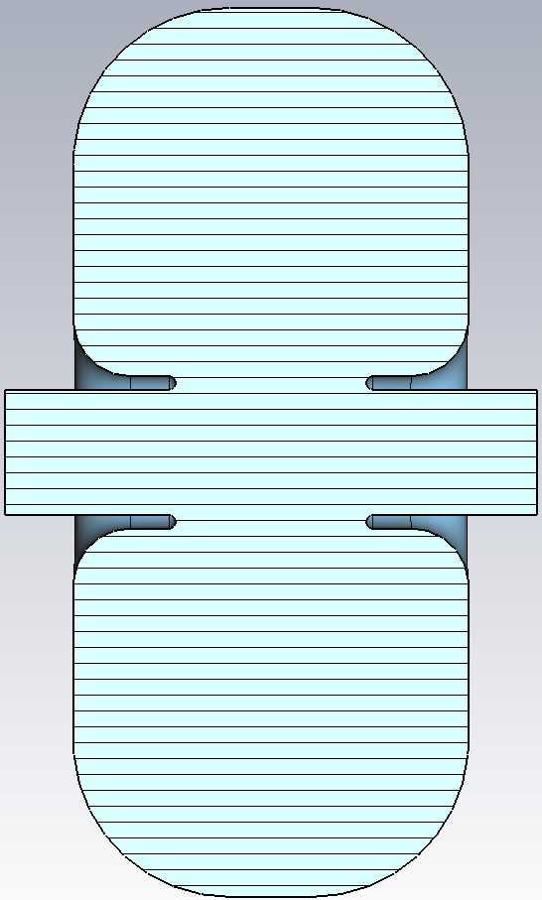
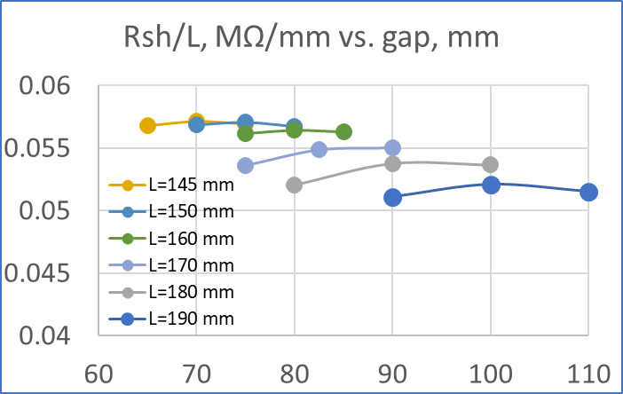
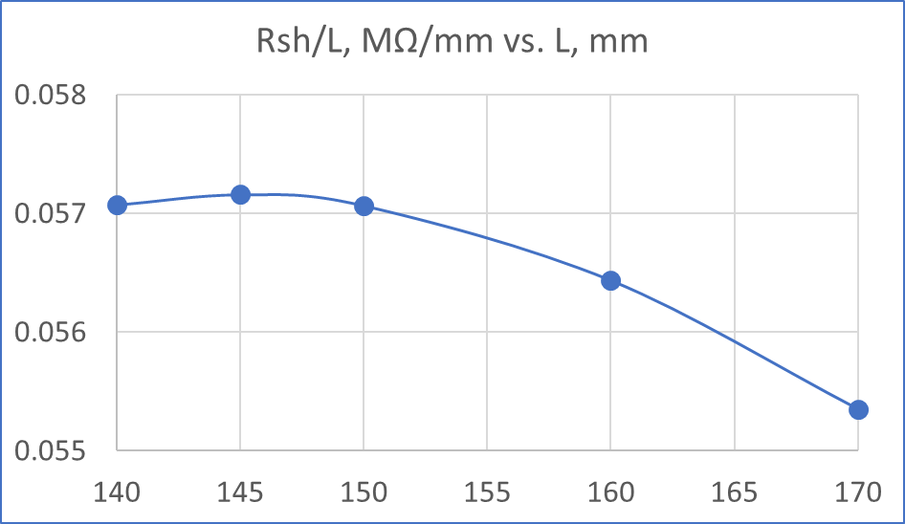
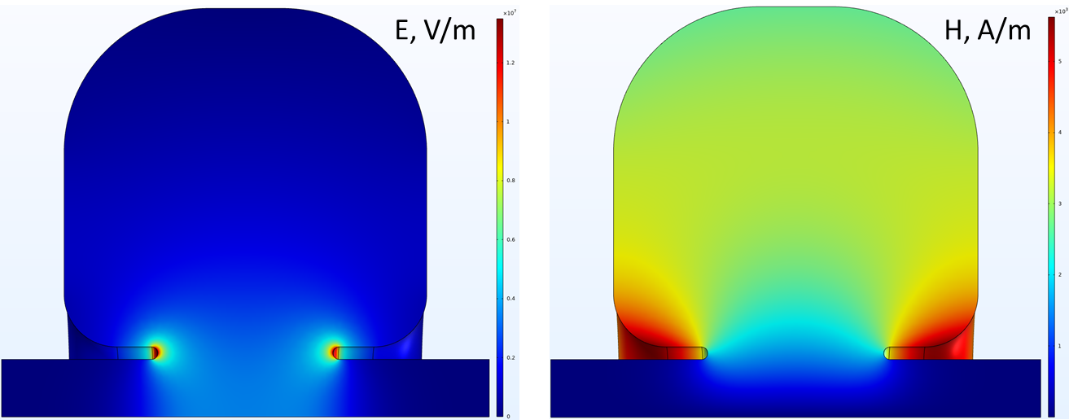
RF design
All parameters in mm
R4
Parameter | Value
$${\text{Ø}}_{aperture}$$ | 46
$${\text{Ø}}_{cavity}$$ | 323.4/326.74/329.82
L | 140/145/150
gap | 65/70/75
t | 5
R1 | 2.5
R2 | 2.5
R3 | 21
R4 | 55/57.5/60
L
R3
gap
t
$R_{sh }/L$ vs. gap length
$Maximum of R_{sh }/L$ vs. cavity length
V = 300 kV
β = 0.841 (800 MeV)
Parameter | L = 140 mm | L = 145 mm | L = 150 mm
${\text{V}}_{eff}$, kV | 272.5 | 269.8 | 267.0
R/Q ,Ω | 277.5 | 280.8 | 283.2
Q | 28790 | 29520 | 30220
$R_{sh}$/L ,MΩ/m | 57.07 | 57.16 | 57.05
Losses, kW | 9.29 | 8.78 | 8.33
$E_{max}$, MV/m | 13.9 | 13.25 | 12.7

Slide 4
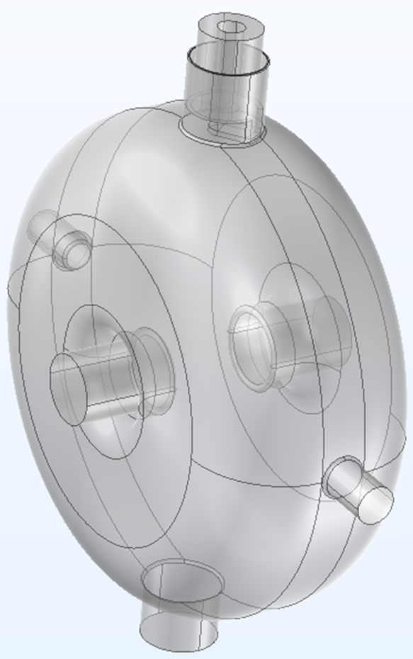
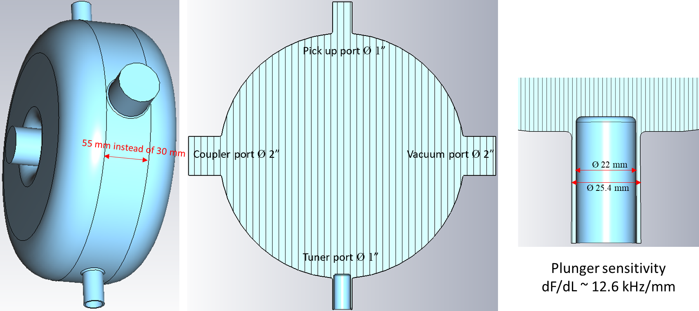
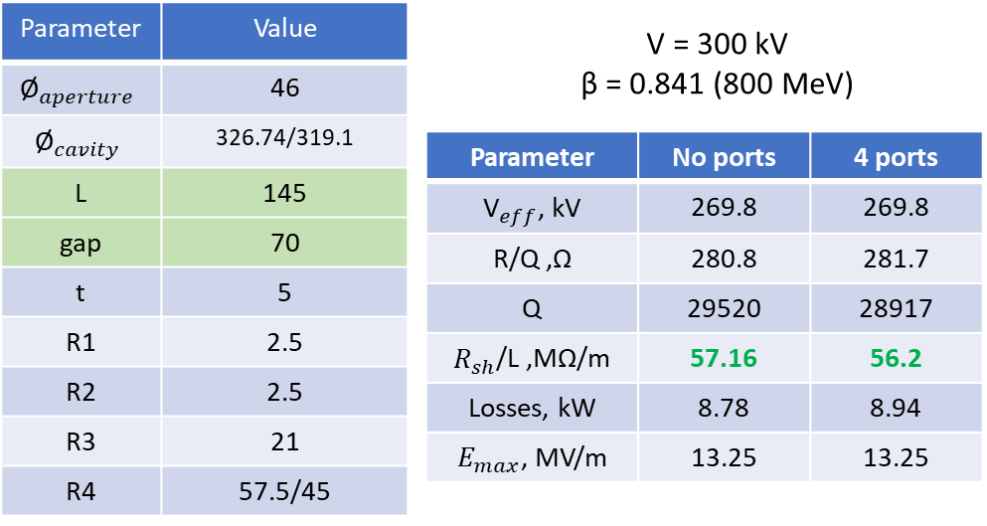
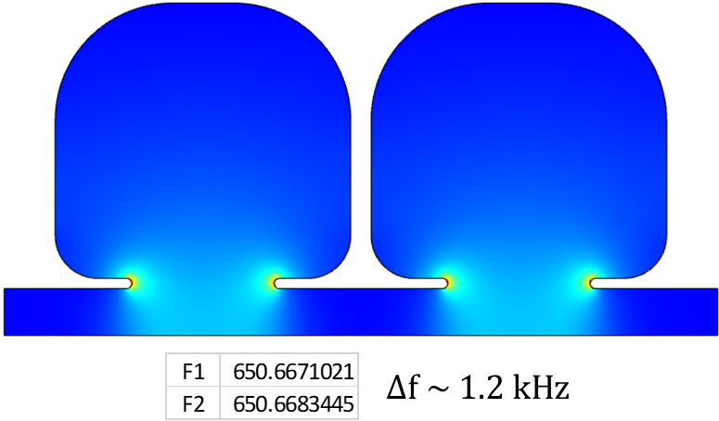
RF design
Cell to cell coupling

Slide 5
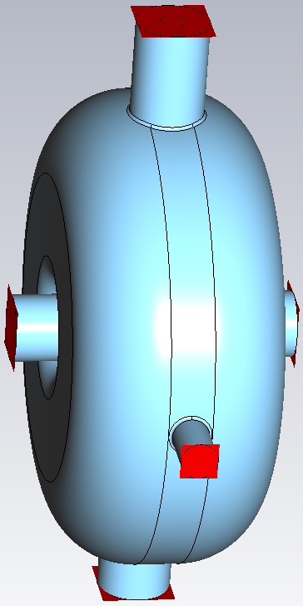
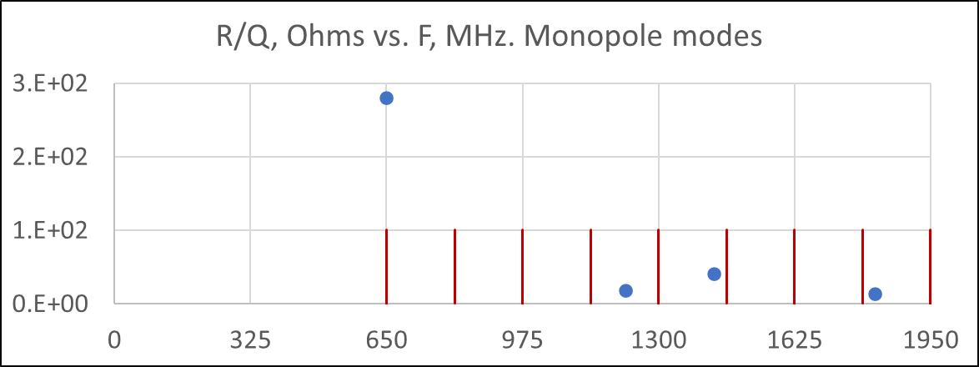
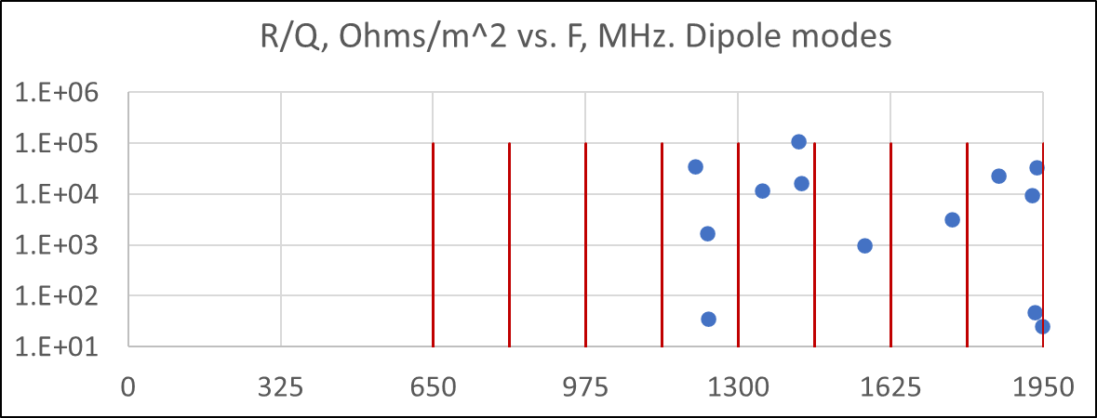
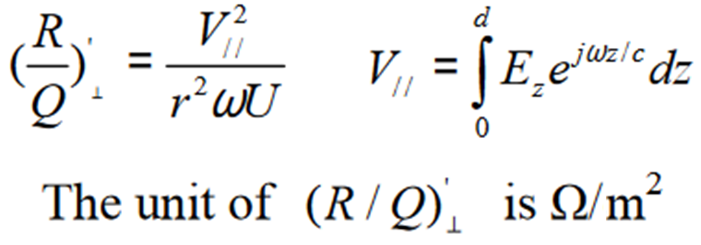





RF design, HOM’s up to 2 GHz
Monopole, m = 0
F, MHz
R/Q, Ω
$$Q_{ext}$$
$$Q_{cavity}$$
Port’s BC applied
650.000 | 2.81E+02 | 2.5E+04 | 2.92E+04
1221.607 | 1.88E+01 | 1.89E+06 | 3.73E+04
1431.673 | 4.12E+01 | 1.02E+04 | 2.72E+04
1817.310 | 1.32E+01 | 2.33E+04 | 1.13E+04
m ≥ 1
${\text{(}\text{R}\text{/}\text{Q}\text{)}}_{⫠}^{′}$
Ω/$m^{2}$
$$Q_{ext}$$
$$Q_{cavity}$$
F, MHz
162.5 MHz
1203.069 | 7.93E+00 | 6313 | 4.61E+03
1207.507 | 3.51E+04 | 1.89E+06 | 3.70E+04
1233.400 | 1.71E+03 | 1.12E+05 | 2.56E+04
1236.031 | 3.55E+01 | 1.14E+04 | 3.21E+04
1350.614 | 1.19E+04 | 6.04E+04 | 3.24E+04
1429.210 | 1.11E+05 | 5714 | 4.02E+04
1434.044 | 1.67E+04 | 2.49E+04 | 4.05E+04
1569.860 | 2.01E+03 | 7175 | 4.57E+04
1576.470 | 8.41E-05 | 3.53E+07 | 4.82E+04
1578.802 | 2.88E-02 | 1.29E+04 | 5.28E+04
1677.496 | 6.17E+01 | 3937 | 3.38E+04
1689.249 | 1.02E+00 | 1.37E+04 | 4.43E+04
1755.785 | 3.22E+03 | 5.64E+04 | 2.94E+04
1758.544 | 5.10E+03 | 2.97E+04 | 3.67E+04
1854.736 | 3.00E+04 | 9.86E+04 | 1.24E+03
1916.479 | 1.05E+04 | 4876 | 3.83E+04
1926.444 | 9.52E+03 | 1.07E+04 | 2.35E+04
1931.249 | 4.86E+01 | 4.40E+06 | 4.22E+04
1931.531 | 8.99E+03 | 2.13E+04 | 5.19E+04
1934.704 | 2.37E+04 | 1.18E+06 | 3.85E+04
1936.059 | 3.41E+04 | 7.20E+05 | 3.38E+04
1947.611 | 2.59E+01 | 3449 | 3.22E+04
1966.735 | 3.78E+02 | 9300 | 2.02E+04

Slide 6
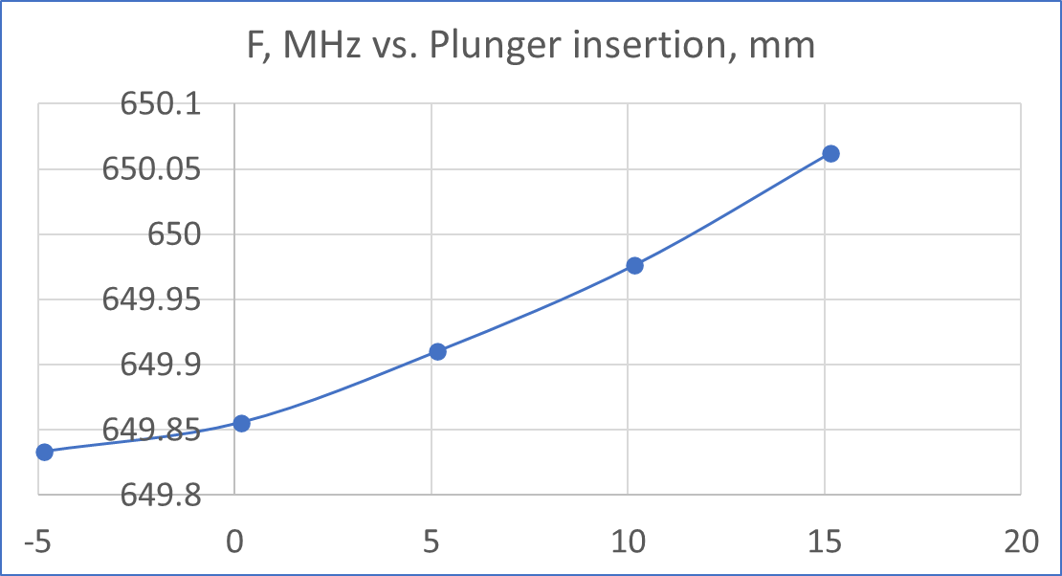
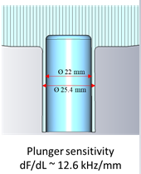
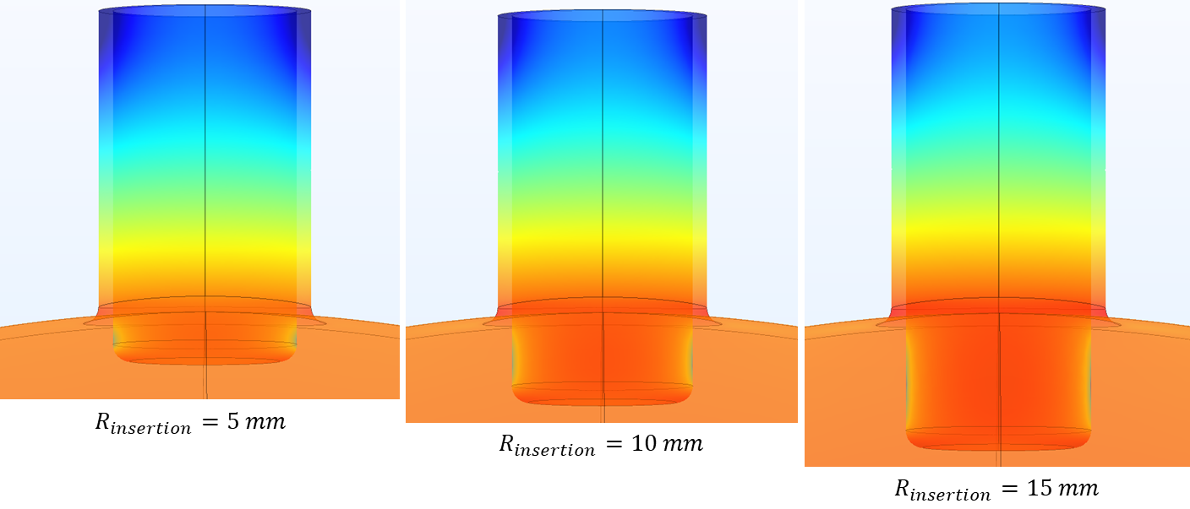
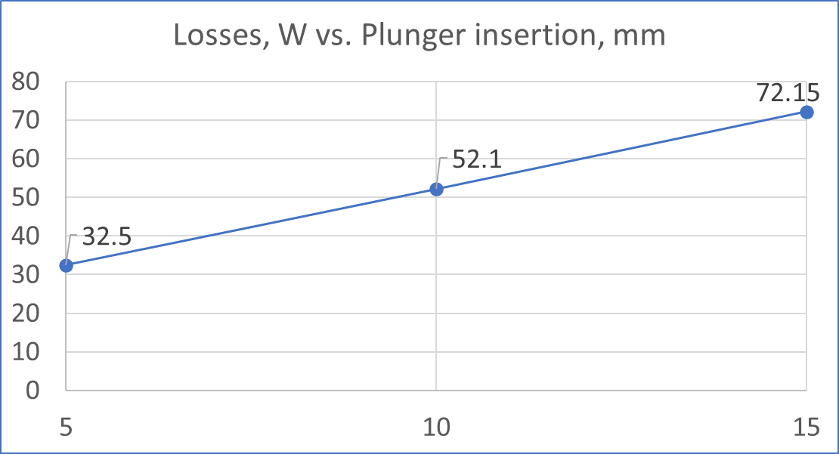
RF design, plunger tuner
dF/dL ~ 17.1 kHz/mm
dF/dL ~ 13.3 kHz/mm
dF/dL ~ 10.9 kHz/mm

Slide 7
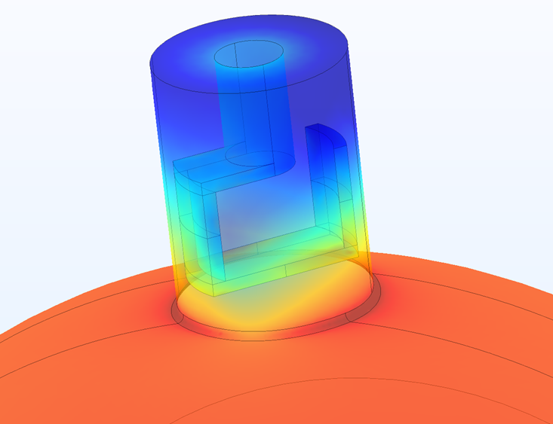
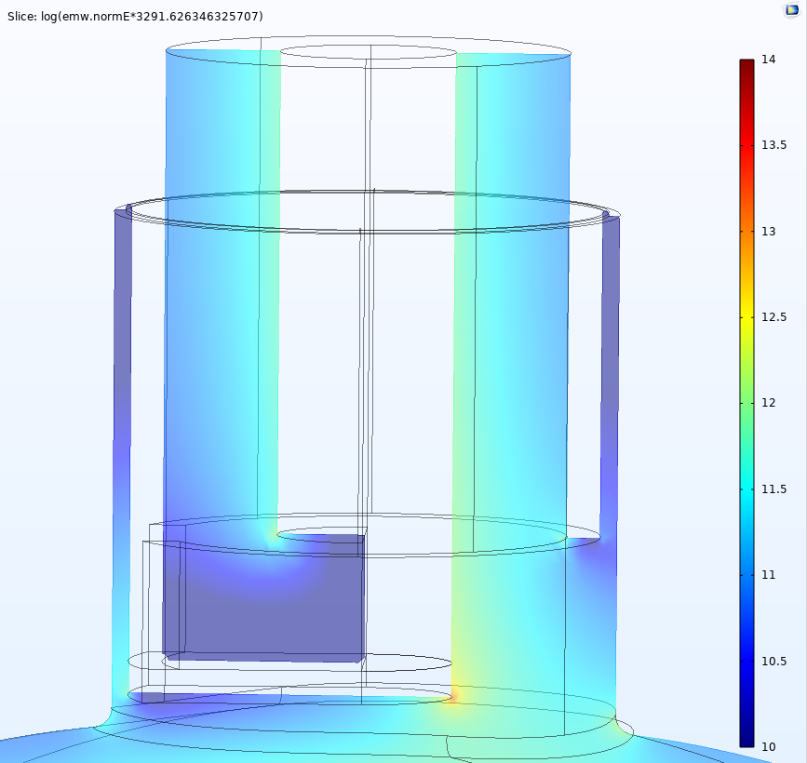
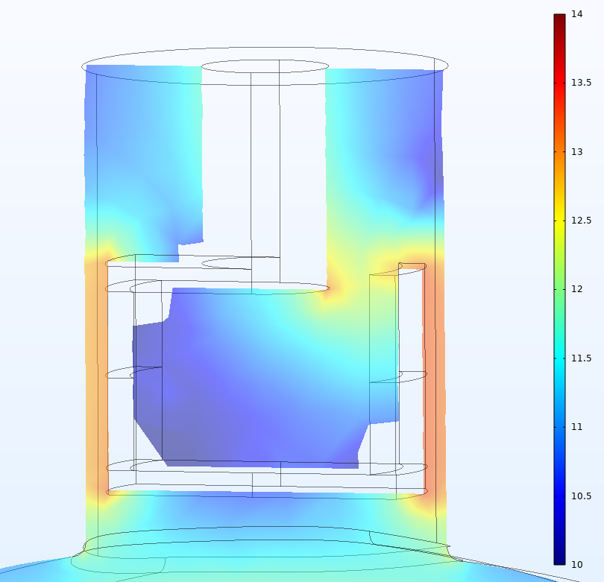
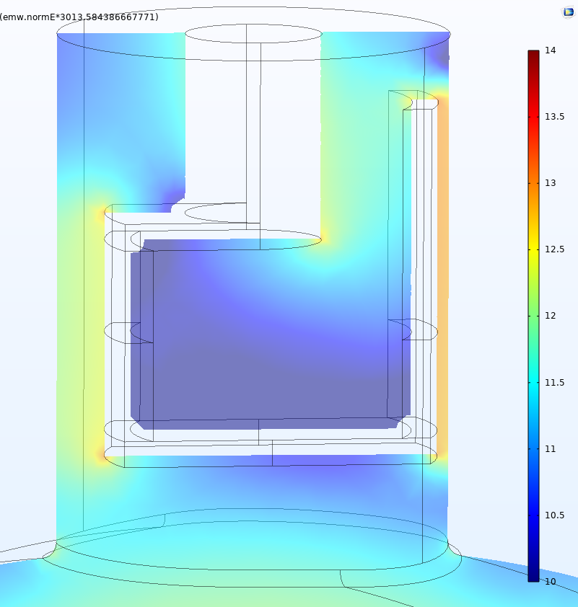

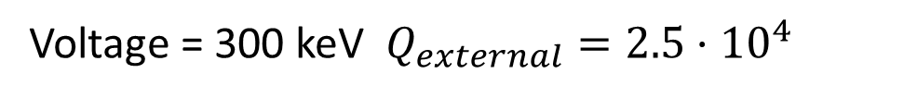
RF design, power coupler
Voltage = 300 keV $Q_{external}={2.5·10}^{4}$
$$P_{antenna}\sim 16 W$$
Log scale of E-fields in the same range
CH structure coupler
Loop coupler 1
Loop coupler 2
gap ~ 3.2 mm
gap ~ 3.2 mm
gap ~ 6.2 mm
gap ~ 1.5 mm

Slide 8
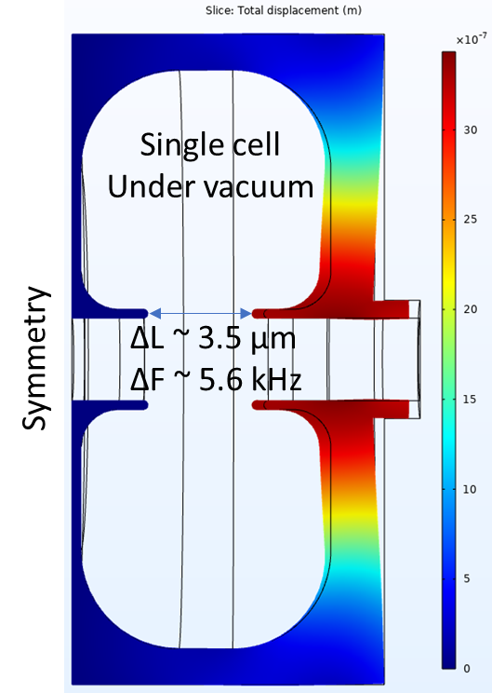
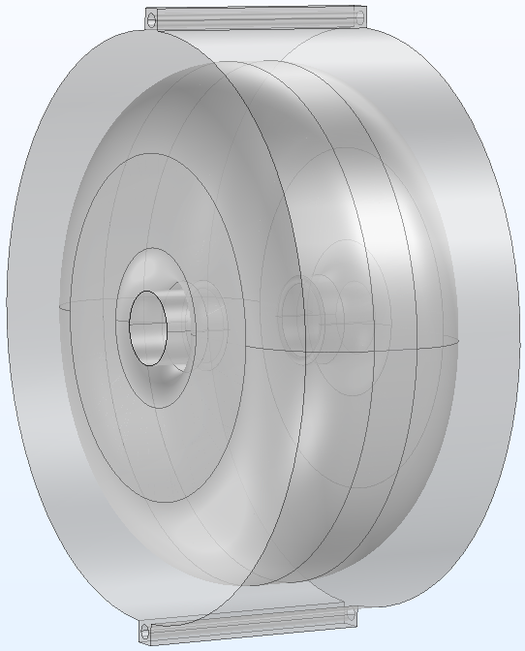
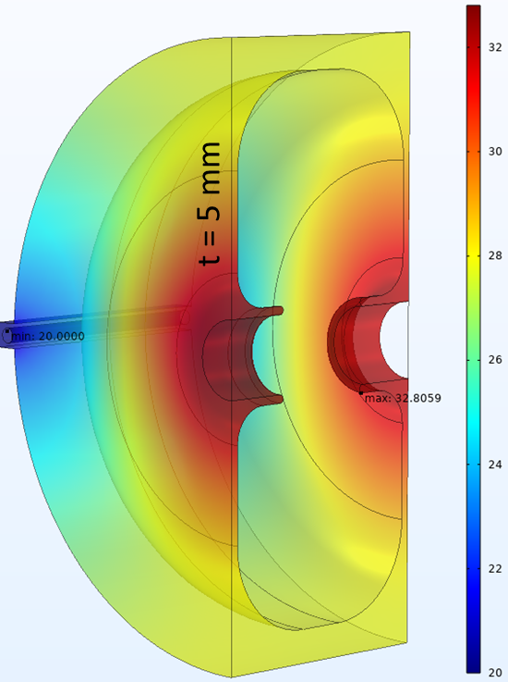
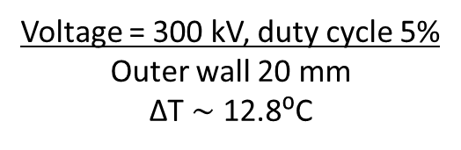
RF design, water cooling, vacuum
Voltage = 300 kV, duty cycle 5%
Outer wall 20 mm
ΔT $\sim$ 12.8⁰C
2 water channels, Ø 9 mm
30 mm

Slide 9
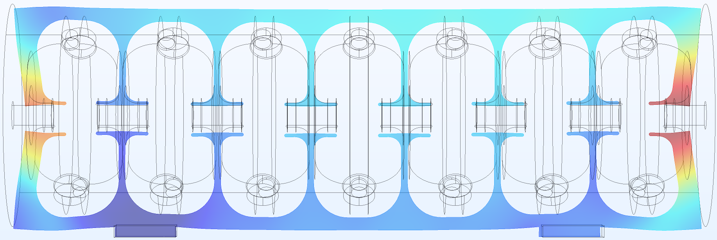
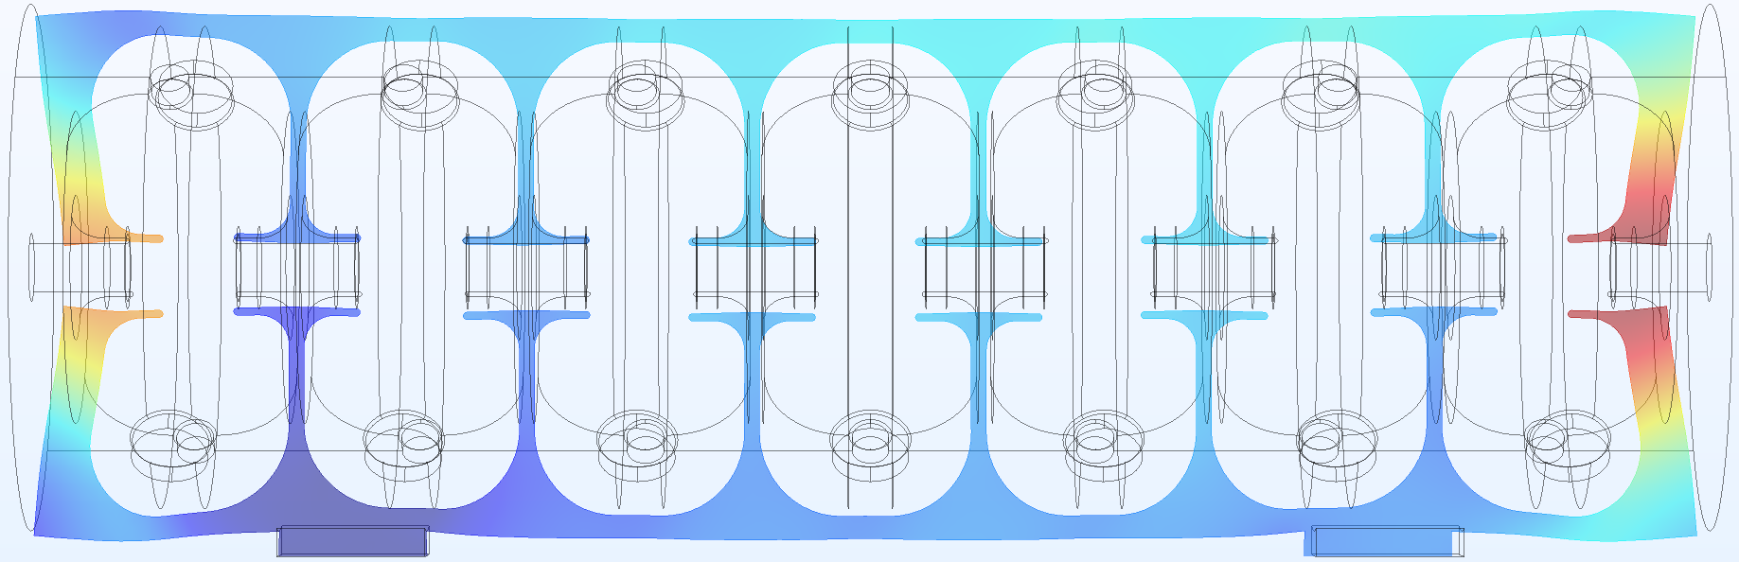
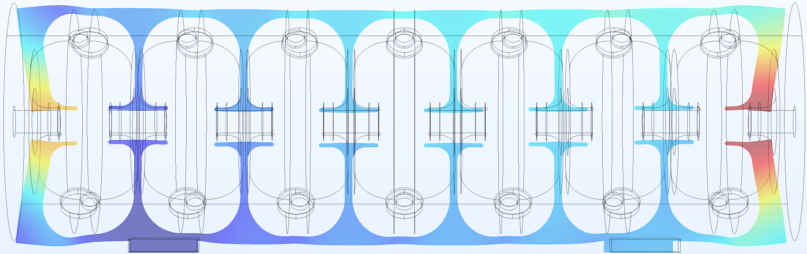
Mechanical design, deformation due to gravity + vacuum
Outer wall thickness 20 mm Weight ~ 394 kg
Outer wall thickness 15 mm Weight ~ 337 kg
Outer wall thickness 10 mm Weight ~ 283 kg

Slide 10
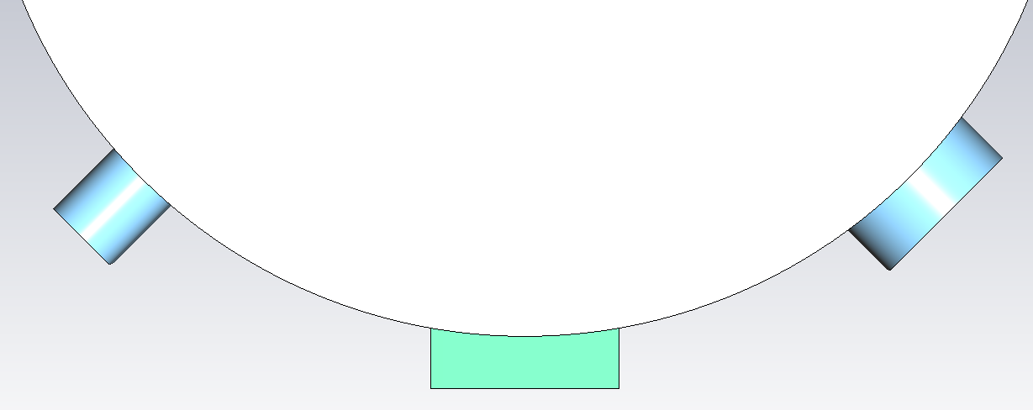
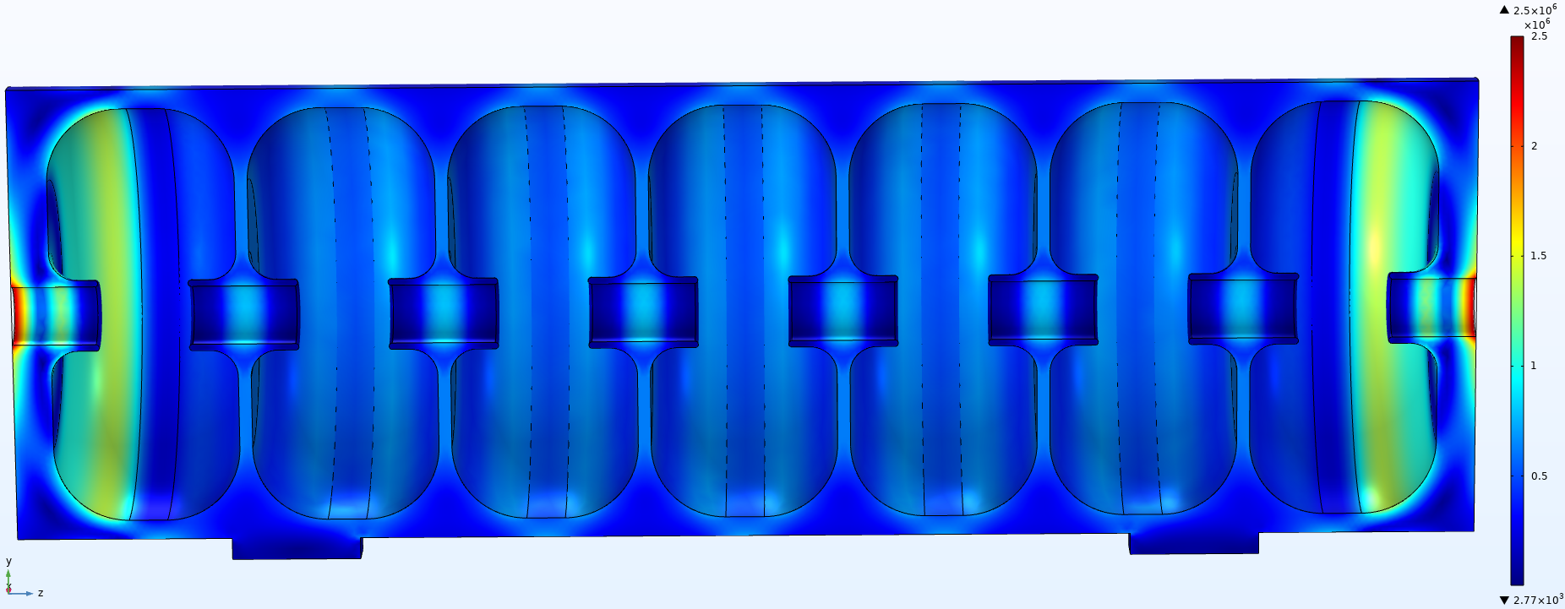
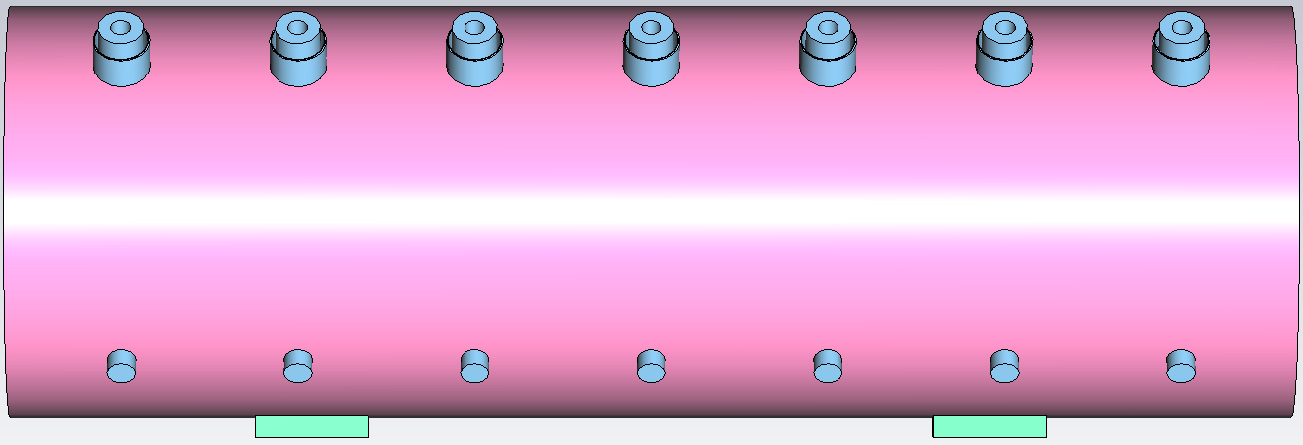
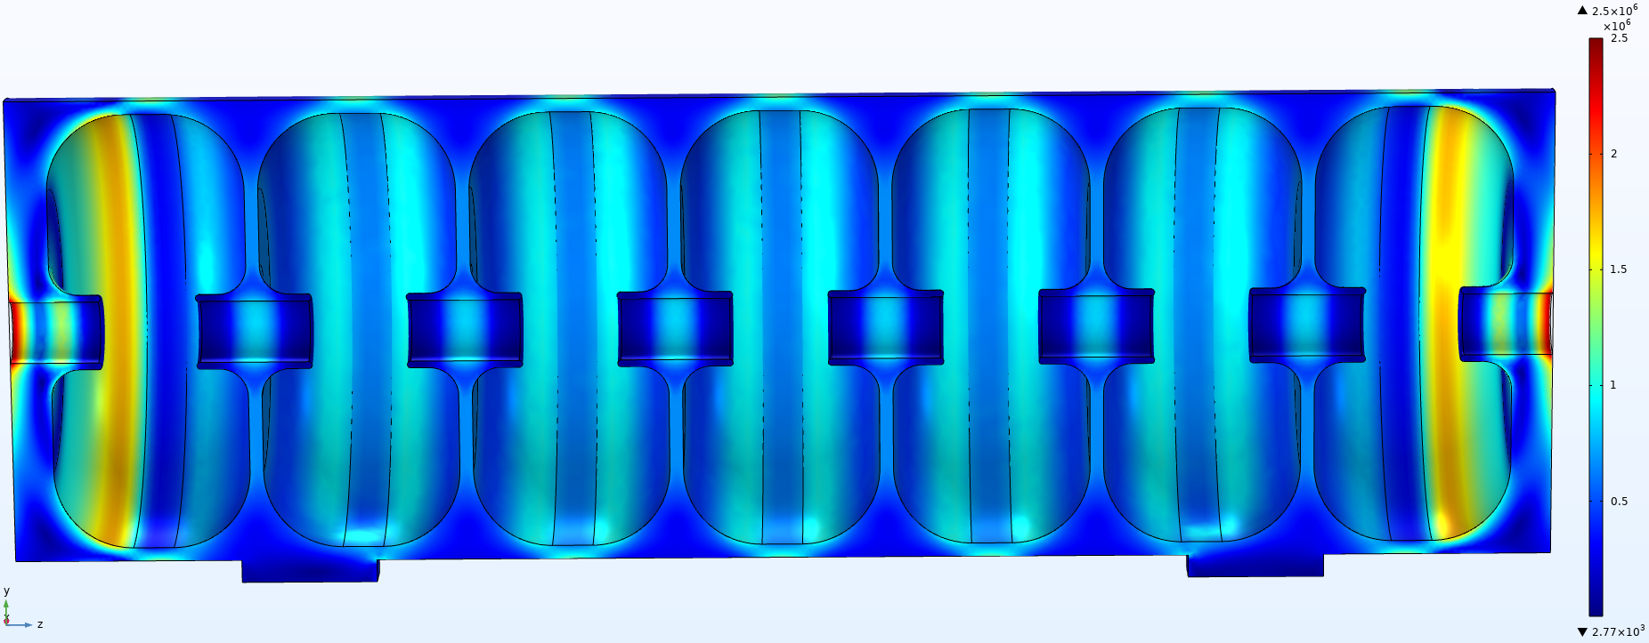
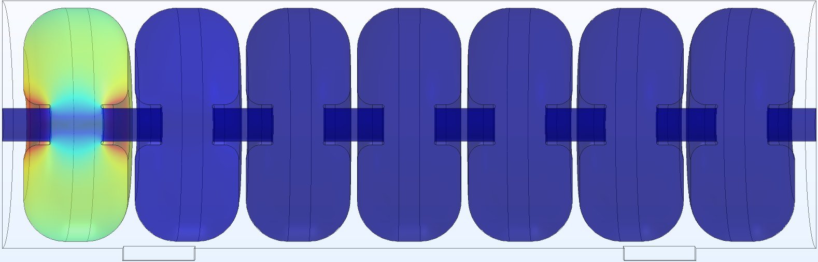
Mechanical design, deformation due to gravity + vacuum
Outer wall thickness 15 mm
2 supports lags
Outer wall thickness 10 mm
Thickness, mm | Δ F, kHz
10 | -5.9
15 | -5.45
Von Mises stresses in 7-cells cavity under vacuum are < 2MPa
Frequency change due to vacuum

Slide 11
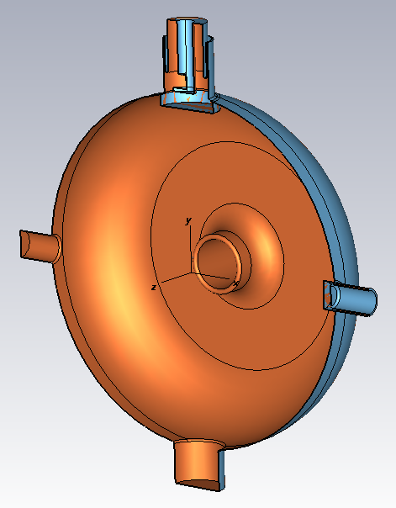
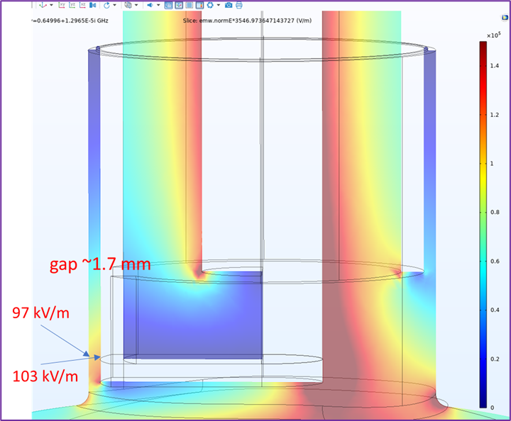
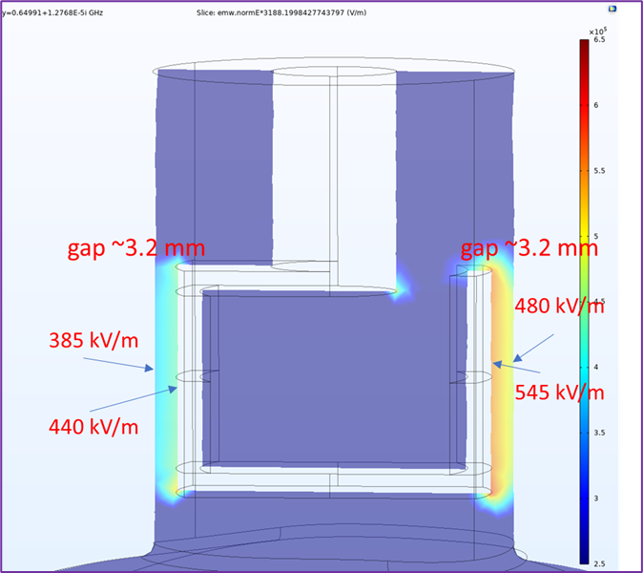
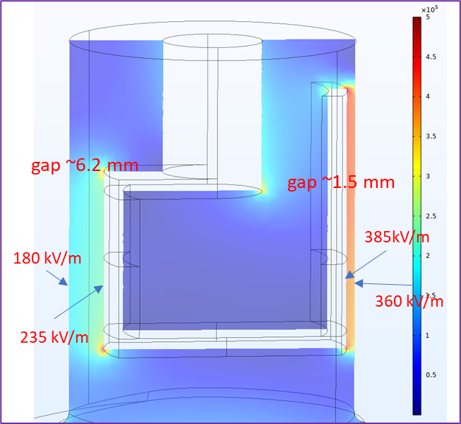
Multipacting simulations
Total design voltage of the multicavity PIP-II 650 MHz re-buncher is U_{nom} = 2.5 MV (without transit time factor).
Chosen number of cavities N = 14, so design voltage per cavity U_{14 nom} = 2500/14 ≈ 179 kV.
Magnetic boundary
Coupler 2
Coupler 1 (old)
Electric field in the gaps of the coupler
designs at U₁₄ = 300 kV.
Coupler 3
Model for eigen mode field simulation,
i.e., there is SW in the coupler.
Planes of symmetry are not used.

Slide 12
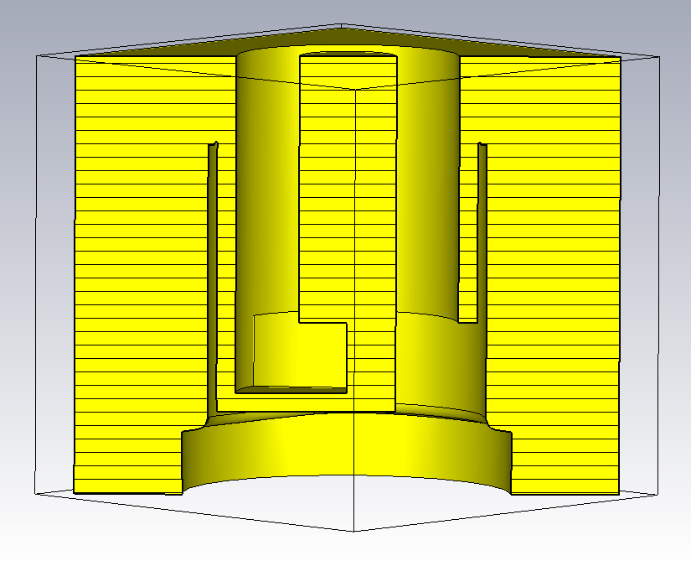
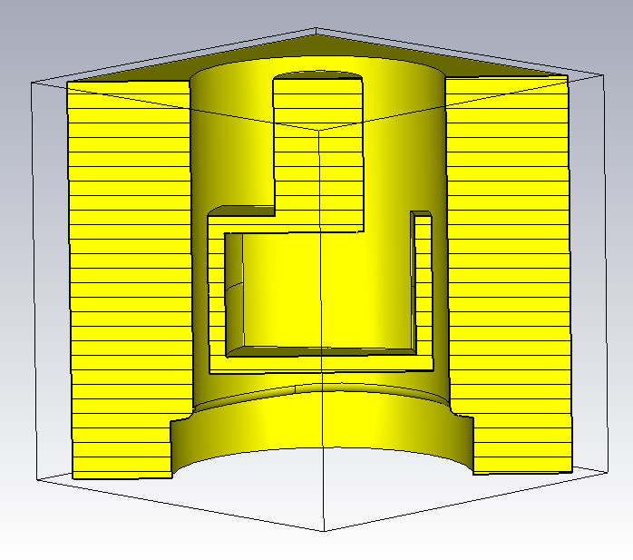
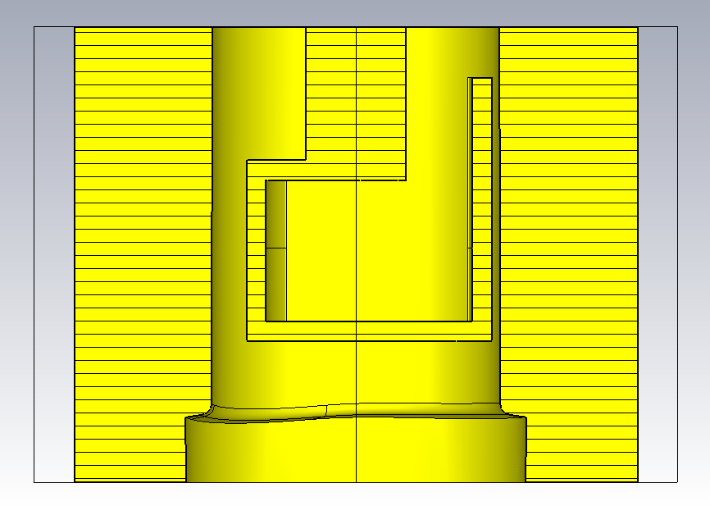
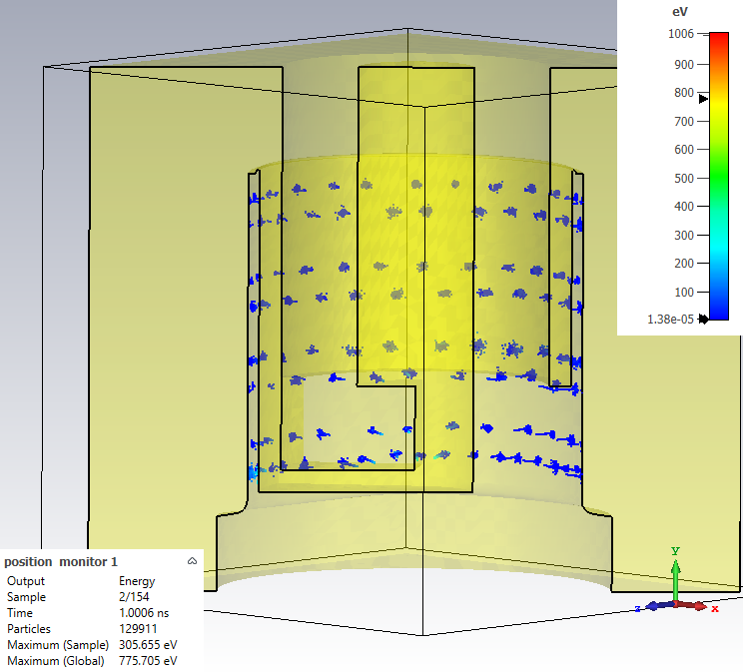
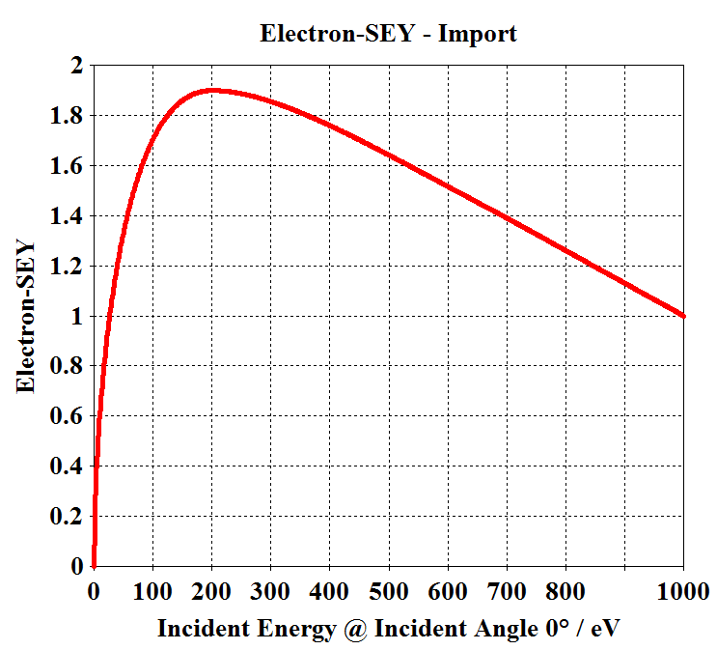
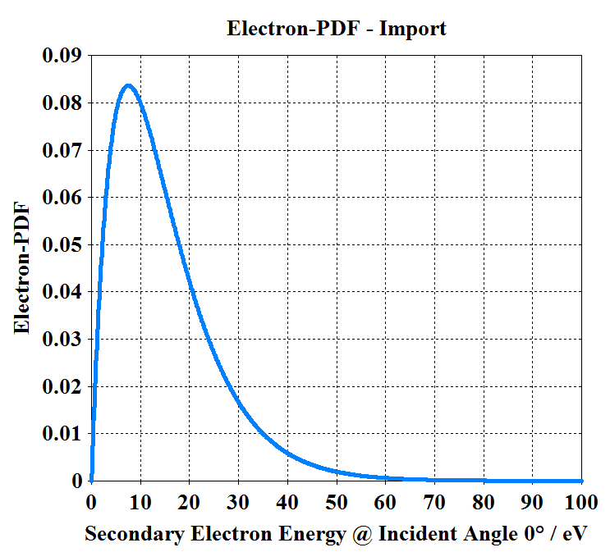
Multipacting simulations, PIC models
Coupler 1 (old)
Coupler 3
Coupler 2
Initial energy distribution,
same for all models
SEY, same for all
models

Slide 13
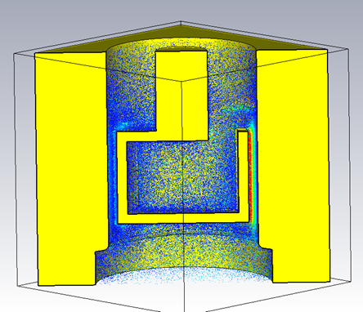
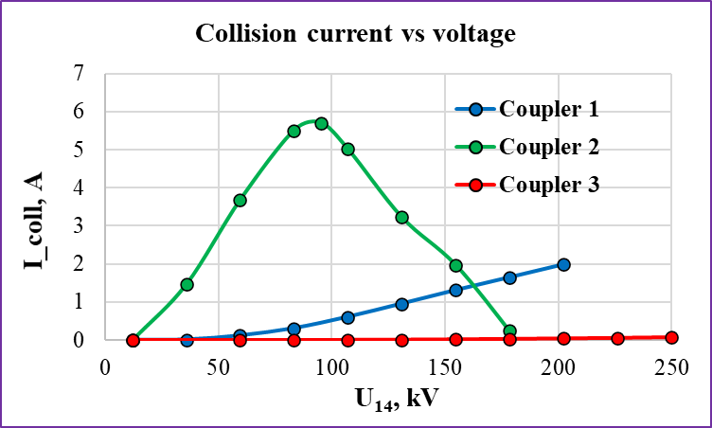
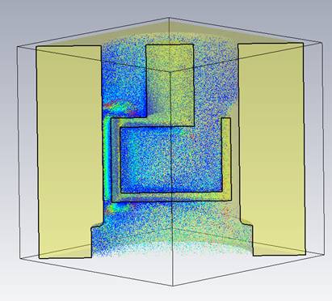
Multipacting simulations, PIC models
Coupler 2, U=83 kV
The coupler #3 is free of MP in the voltage range
that corresponds to 14 cavities variant.
Coupler 2, U=130 kV

Slide 14
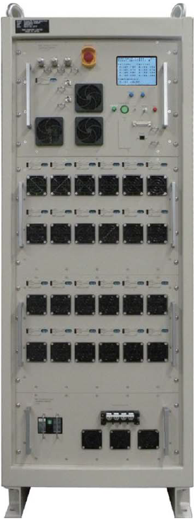
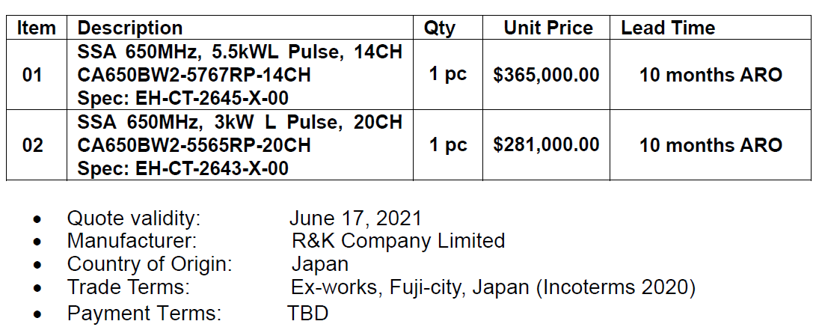
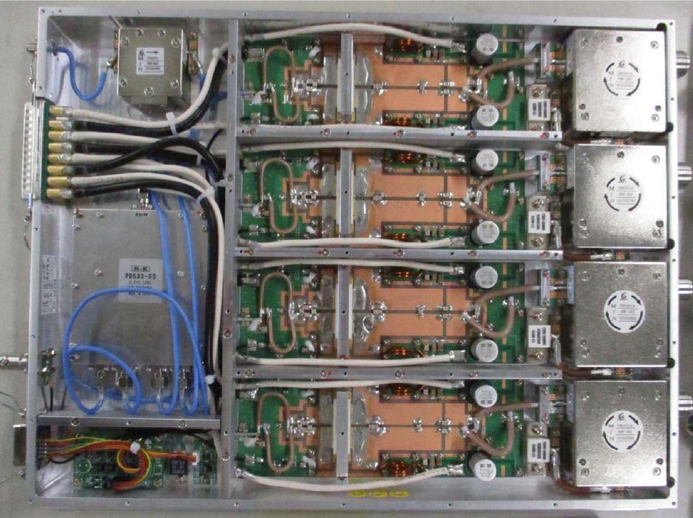
RF amplifiers, R&K

Slide 15
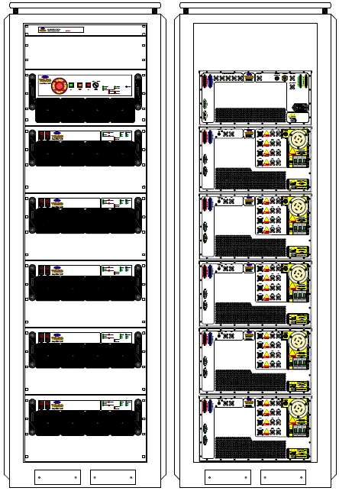

RF amplifiers, TOMPCO

Slide 16

Summary
RF design completed
  Accelerating cell optimized for maximum $R_{sh }/L$
  14 independent accelerating cells combined in 2 cavities
    7 cell in each cavity, length <1.2m each
  200 kHz range tuning plunger proposed
  Cavity MP free up to 300 kV
Power coupler design optimized for minimizing MP
  FPC MP free up to 300 kV
Power amplifier bids received
  300-400 k$ for 14 channel, 5.5 kW each
Next steps:
  Production drawings for cavities
  Cavity procurement
  Purchase FPC and PickUp parts
  LLRF development

