Slide 1
Buncher Interfaces
Eduard Pozdeyev
May 12, 2023

Slide 2
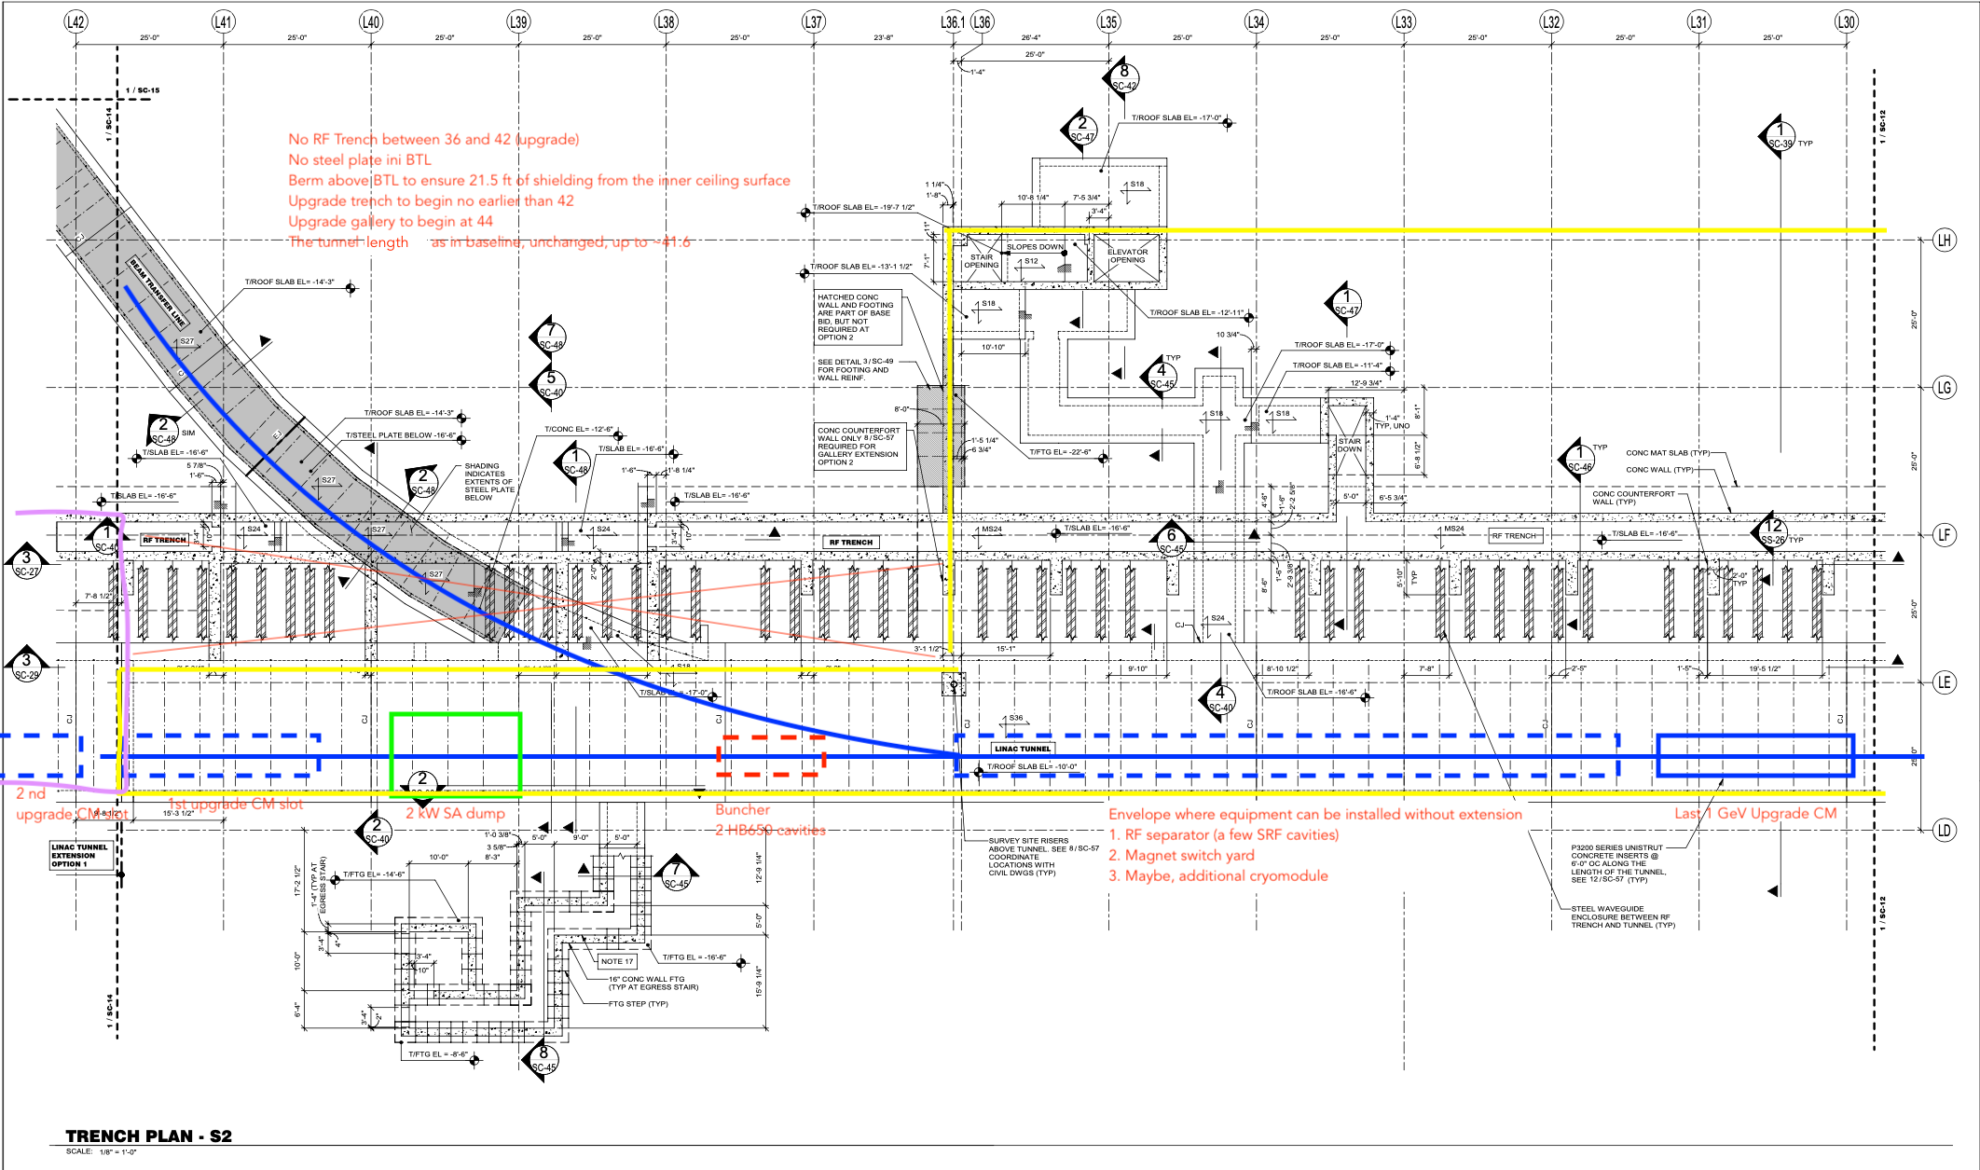
SRF Buncher Interfaces: CF
Buncher most likely can be accommodated without modifications to CF

Slide 3
SRF Buncher Interfaces: Accelerator Systems
RF:
One SSA amplifier P < 10 kW for both 650 MHz and 1.3 GHz
Nominal power to maintain 20 MV without beam is ~25 kW at the cavity
LLRF
Two channel
Cryogenics:
Need the cryogenic distribution line to be extended
Can the cavity be operated at 4K?
20W at 2K, 20MV, CW - > 1.25W at 2k, 5MV, CW - > 0.13W at 2k, 5MV, 10% DF - > 0.26W at 4K, 5MV, 10% DF
Timing:
650 MHz timing is available nearby
Vacuum:
Not a clean/particulate free area

Slide 4
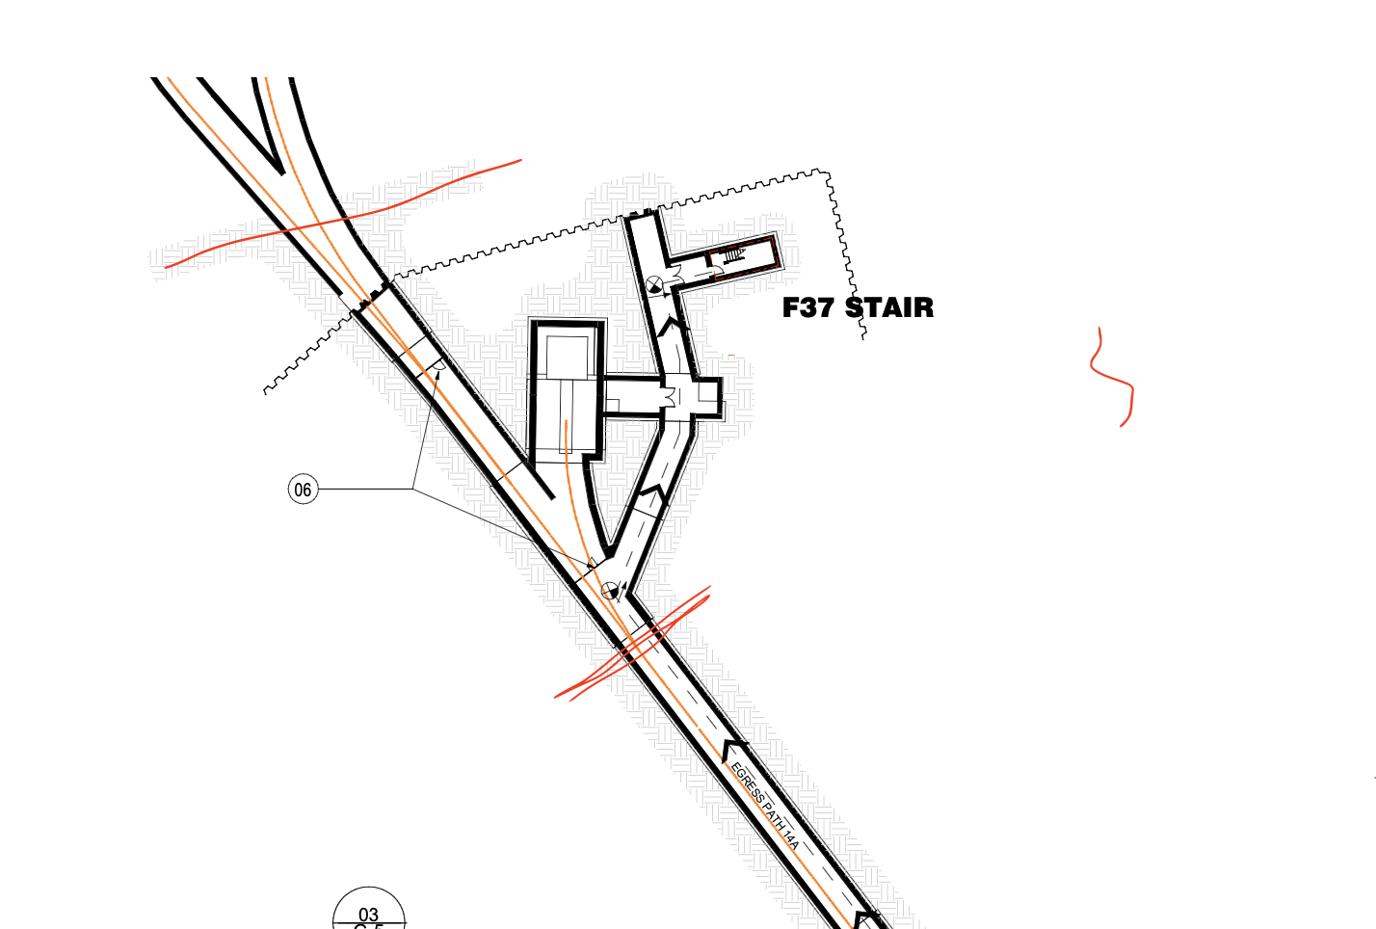
RT Buncher Interfaces: CF
Presently interfaces with CF were not defined, requirements need to be developed and provided
No space in F37?
Possible space in the tunnel
Maybe different location in MR crossing
Additional room

Slide 5
RT Buncher Interfaces: Accelerator Systems
RF
CCL: Two 50 kW amplifiers, 2% DF, 2 to 4 rack space
Decoupled Cell Cavity (DCC): 14 5-6 kW amplifiers, 2% DF, 2-4 rack space
Cables:
CCL: two 3 1/8 coaxial + 6 LLRF
DCC: 14 0.75 coaxial + 42 LLRF cables
LLRF
CCL: two channels
DCC: 14 channels
Temperature control
Two chillers ~ a few kW, small devices
Timing distribution line – requirements should not be very stringent (~0.5 deg.)
Vacuum: 2 ion pumps, two permanent TMPs or a cart
Total rack space: 5 – 8 racks
Power:
~150 kW pulsed
20-30 (?) kW average

Slide 6
Conclusion
Designs need to be evaluated and preferred options selected
Specifications need to be developed and provided to stakeholders

