Slide 1
BTL WORKSHOP
SiMULATIONS OF ENERGY SPREAD IN BTL AND BUNCHER REQUIREMENTS
Abhishek Pathak, Eduard Pozdeyev
12th May 2023
SLIDE #
1/17

Slide 2
1
Key Concerns
2
BTL & Energy Spread Growth
Outline
Compensation Strategies
3
4
Comparison
SLIDE #
1/17
2/17

Slide 3
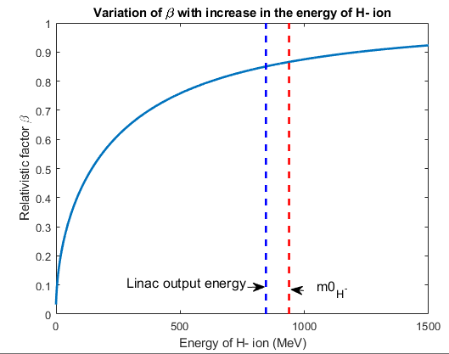
Key Concerns
Present PIP-II linac configuration lacks longitudinal focusing elements beyond the fourth cryomodule in the HB-650 section.
Beam is not yet relativistic (at 800 MeV), making space charge forces a significant factor in determining beam parameters like beam emittances and energy spread.
Study focuses on:
Analyzing the evolution of beam energy spread due to space charge forces in the Beam Transport Line (BTL)
Exploring potential approaches to minimize energy spread at BTL exit.
SLIDE #
3/17

Slide 4
Critical Locations For Energy Spread Optimization
Here we have marked the location of the critical point that will be considered throughout this energy spread minimization study.
ARC-1
STRAIGHT SECTION
ARC-2
HB-650
CM-3
LINAC END
BTL
CELL-6
BTL END
HB-650
CM-4
SLIDE #
4/17

Slide 5
Cases Under Consideration
REF: Estimate beam energy spread growth along the SC section of the PIP-II linac and in the Beam Transport Line (BTL) section for the current design.
Case 1: Optimize cavities in the third and fourth cryomodules of HB-650 to reduce energy spread, using the configuration from step 1.
Case 2 (A): Implement a 650 MHz single buncher cavity at the end of the linac, optimizing its gap voltage to minimize energy spread.
Case 2 (B): Refine synchronous phases in the fourth cryomodules of HB-650, along with the buncher cavity voltage, to maintain minimal energy spread and buncher cavity gap voltage requirements.
Case 3: Positioned the buncher cavity in the 6th cell of BTL and optimized its gap voltage to obtain the minimum energy spread at the exit of the BTL.
SLIDE #
5/17

Slide 6
REFERENCE
energy spread growth along the BTL section
First case performed using the current linac design.
Served as a reference for energy spread growth along
the SC section of the linac and BTL.
No attempts were made to minimize energy spread growth in this
case.
SLIDE #
6/17

Slide 7
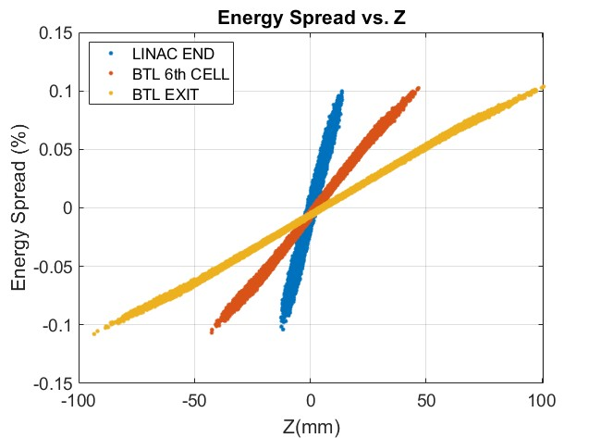
REFERENCE : energy spread growth along the PIP-II Linac & BTL section Without Correction
The Evolution of the Longitudinal Beam Envelope and Percentage Energy Spread is depicted in this figure.
Parameters | Values
RMS energy spread | 0.042%
Maximum energy spread | 0.108%
The figure illustrates the Output Longitudinal Phase Space Distribution.
Energy spread at the output of BTL
Linac Output Energy=845 MeV
SLIDE #
7/17

Slide 8
Case-1
O$ptimized φ_{s}$ for the cavities in the 3rd & 4th cryomodules of HB-650 to minimize energy spread. Here we use the last cavity of CM-4 with $φ_{s}=−90^{o}$.
(NO BUNCHER CAVITY WAS USED)
Adjusted synchronous phases of cavities in the 3rd and 4th cryomodules of HB-650 while keeping the $φ_{s}$ for the last cavity in HB-650 CM-4 equal to -90 deg.
Here we did not use any buncher cavity for energy spread minimization.
Examined distribution at BTL exit for rms and maximum energy spread growth calculation.
SLIDE #
8/17

Slide 9
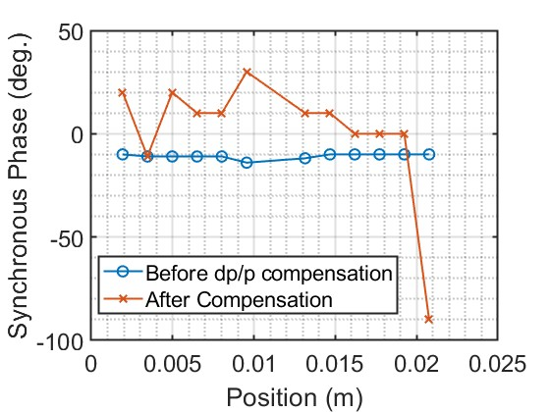
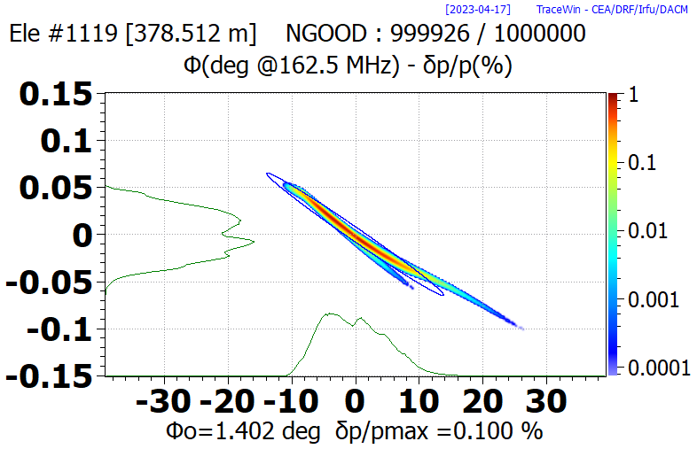
Case-1 Results: Optimized synchronous phase for the cavities in the third and fourth cryomodules of HB-650 to minimize energy spread. Here we use the last cavity of CM-4 with $φ_{s}=−90^{o}$.
(NO BUNCHER CAVITY WAS USED)
Refine synchronous phase for the cavities in the third and fourth cryomodules of HB-650 to minimize energy spread. Here we use the last cavity of CM-4 with $φ_{s}=−90^{o}$.
The Evolution of the Longitudinal Beam Envelope and Percentage Energy Spread is depicted in this figure.
Parameters | Values
RMS energy spread | 0.023%
Maximum energy spread | 0.1%
$φ_{s}$ for the cavities in the third and fourth cryomodule of HB-650 before and after compensation for the energy spread.
The figure illustrates the Output Longitudinal Phase Space Distribution.
Final Energy=825 MeV
Energy spread at the output of BTL
Linac Output Energy=825 MeV
SLIDE #
9/17

Slide 10
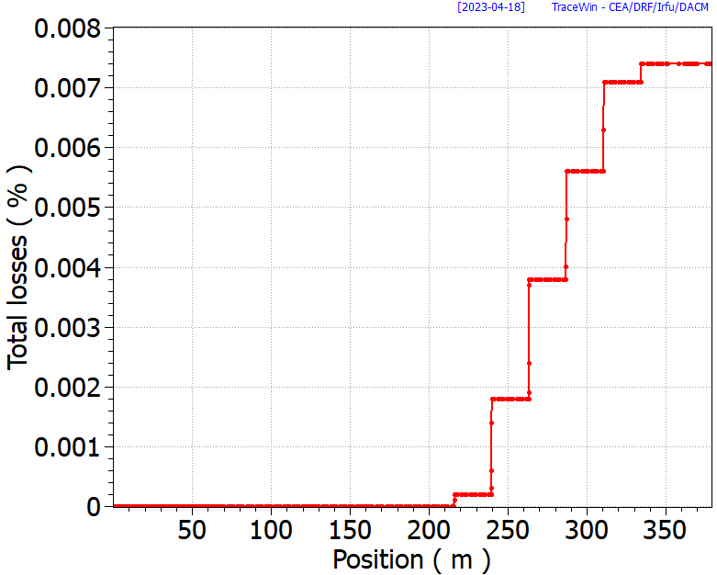
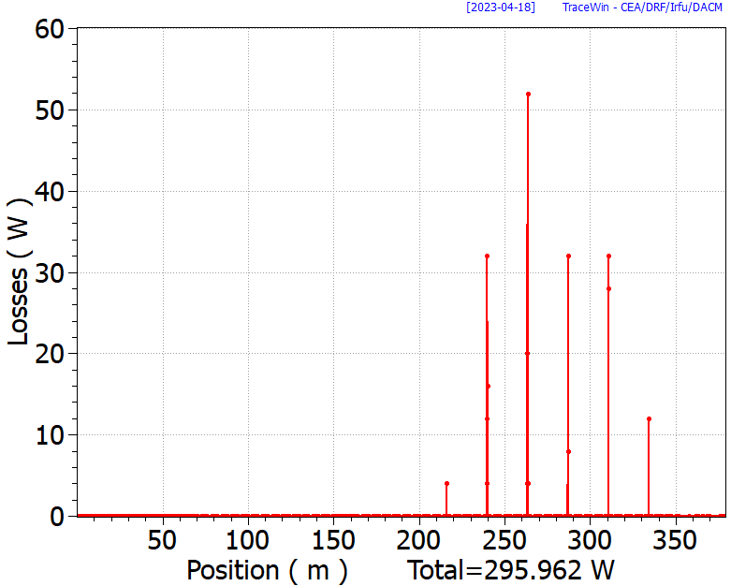
Case-1: Transmission Loss In BTL
We observed beam transmission loss while performing ca to minimize the energy spread.
(a)
(b)
SLIDE #
10/17

Slide 11
Case-2(A)
Implement a single buncher cavity at the end of the linac, optimizing its gap voltage to minimize energy spread.
(NO tuning was performed with HB-650 cavities)
Positioned a single 650 MHz cavity at the end of the linac and varied its gap voltage to minimize energy spread at BTL exit,
We did not change the parameters for the cavities in the HB-650 cryomodules
SLIDE #
11/17

Slide 12
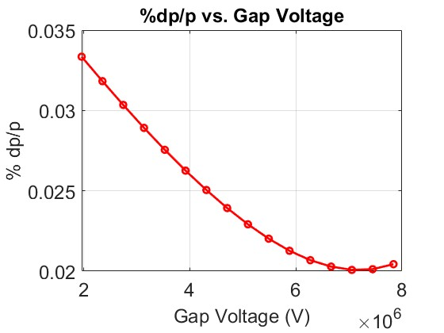
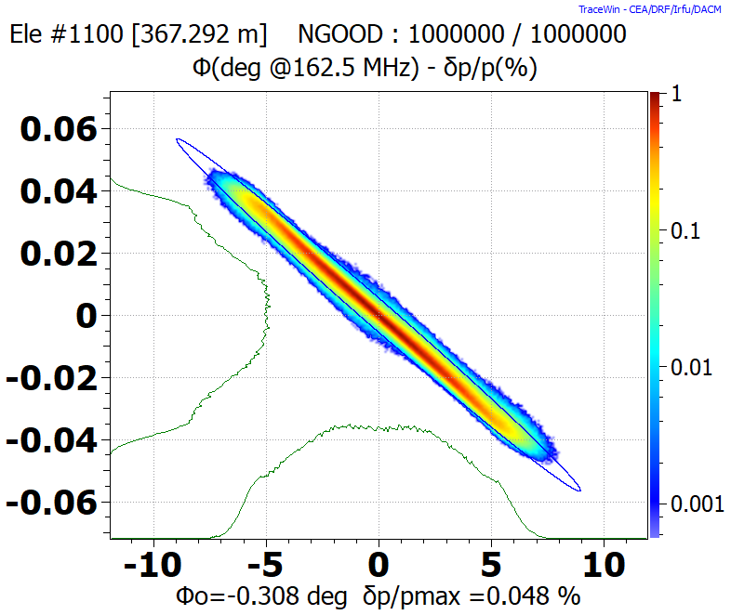
Case-2(a) Results: Implement a single buncher cavity at the end of the linac, optimizing its gap voltage to minimize energy spread.
(NO tuning was performed with HB-650 cavities)
Refine synchronous phase for the cavities in the third and fourth cryomodules of HB-650 to minimize energy spread. Here we use the last cavity of CM-4 with $φ_{s}=−90^{o}$.
Buncher cavity
Variation in energy spread at BTL exit as a function of buncher cavity gap voltage,
The figure illustrates the Output Longitudinal Phase Space Distribution.
Parameters | Values
RMS energy spread | 0.014%
Maximum energy spread | 0.048%
(6.6 MV,0.014%)
Energy spread at the output of BTL
SLIDE #
12/17

Slide 13
Case-2(b)
Optimized $φ_{s}$ In the fourth cryomodules of HB-650, along with the buncher cavity voltage, to maintain minimal energy spread and buncher cavity gap voltage requirements.
(We did not use the third cryomodule of the hb-650 section)
Altered synchronous phases for cavities in the fourth cryomodule of HB-650 to increase the longitudinal size at the buncher cavity location (end of linac).
Optimized gap voltage of buncher cavity for each phase change in HB-650 CM-4 cavity to achieve minimum energy spread at BTL exit.
Here we did not change the cavity parameters in the third cryomodule of HB-650.
SLIDE #
13/17

Slide 14
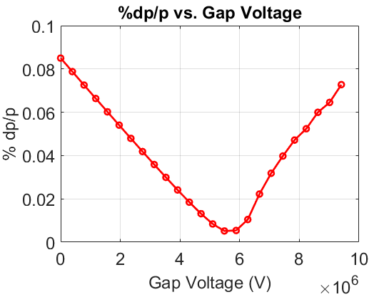
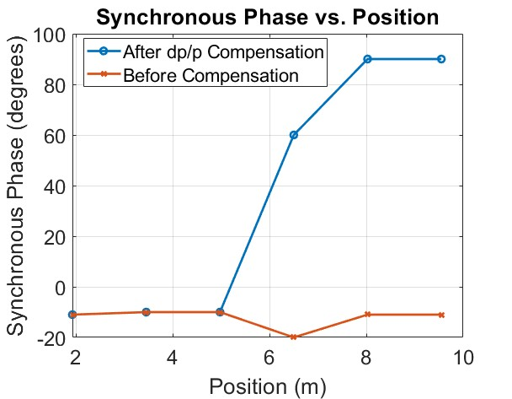
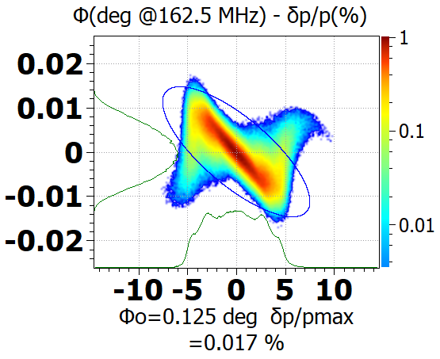
Case-2(b): Optimized synchronous phases In the fourth cryomodules of HB-650, along with the buncher cavity voltage, to maintain minimal energy spread and buncher cavity gap voltage requirements.
(We did not use the third cryomodule of HB-650)
Refine synchronous phases In the fourth cryomodules of HB-650, along with the buncher cavity voltage, to maintain minimal energy spread and buncher cavity gap voltage requirements.
(5.48 MV,0.0051%)
Parameters | Values
RMS energy spread | 0.0051%
Maximum energy spread | 0.017%
Energy spread at the output of BTL
Variation in energy spread at BTL exit as a function of buncher cavity gap voltage for the optimized $φ_{s}$ shown in the next figure,
$φ_{s}$ for the cavities in all six cavities of the fourth cryomodule of HB-650 before and after compensation for the energy spread.
Linac Output Energy=818 MeV
SLIDE #
14/17

Slide 15
Case-3
Positioned the buncher cavity in the 6th cell of BTL and optimized its gap voltage to obtain the minimum energy spread at the exit of the BTL.
(We did not use the third & fourth cryomodules of HB-650)
Positioned buncher cavity in the sixth cell of BTL and optimized its voltage for minimum energy spread at BTL exit.
Here we did not change the cavity parameters in the third and fourth cryomodule of HB-650.
SLIDE #
15/17

Slide 16
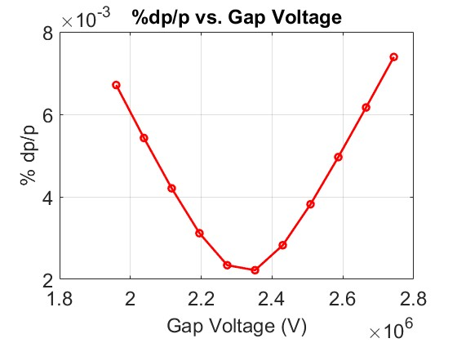
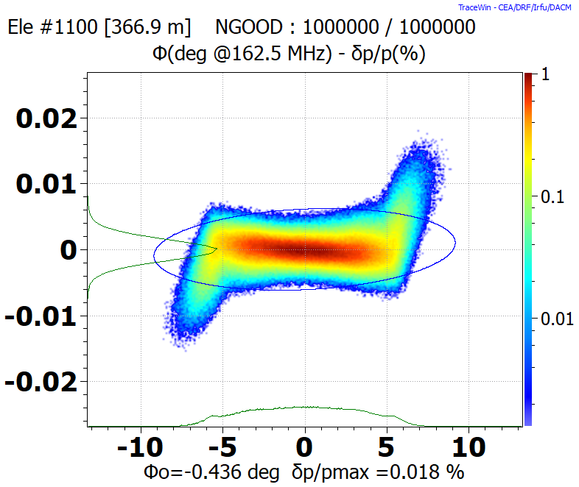
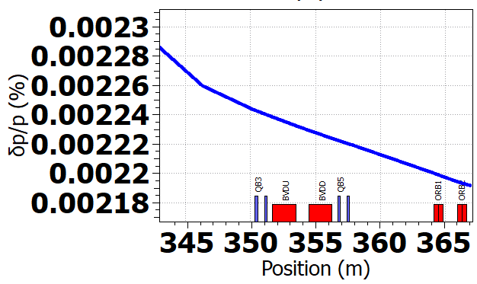
Case-3 Results: Positioned the buncher cavity in the 6th cell of BTL and optimized its gap voltage to obtain the minimum energy spread at the exit of the BTL.
(We did not use the third & fourth cryomodules of HB-650)
(2.35 MV,0.0022%)
Parameters | Values
RMS energy spread | 0.0022%
Maximum energy spread | 0.018%
Energy spread at the output of BTL
Variation in energy spread at BTL exit as a function of buncher cavity gap,
SLIDE #
16/17

Slide 17
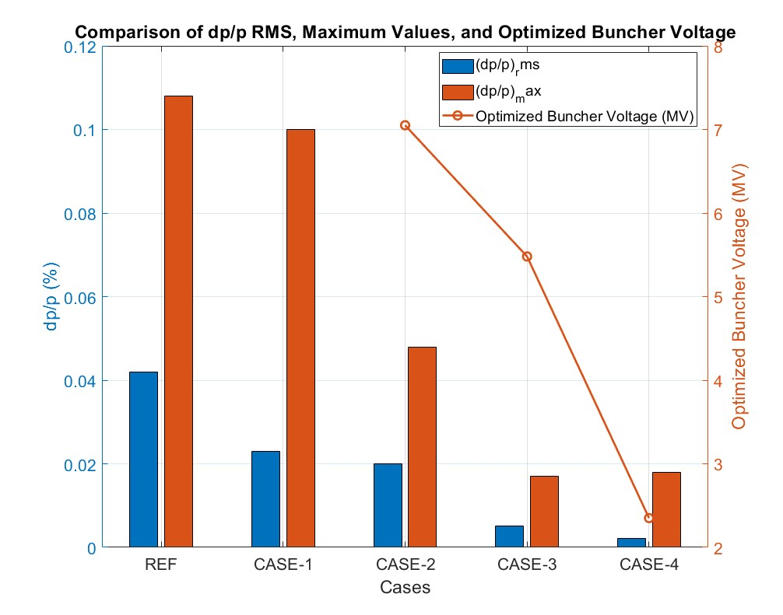
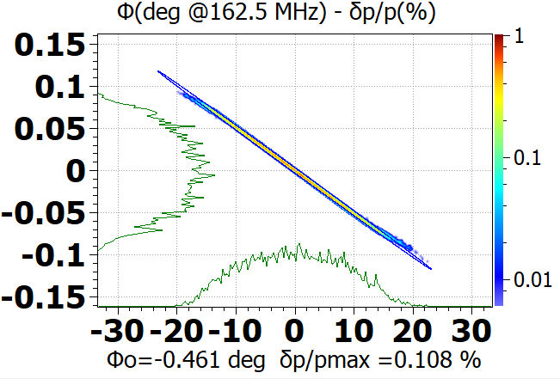
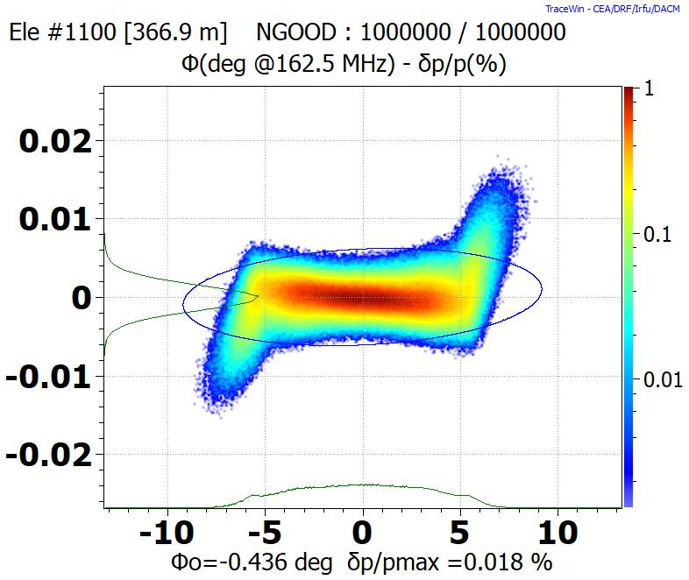
Comparison
 | $${\left(\frac{dp}{p}\%\right)}_{rms}$$ | $${\left(\frac{dp}{p}\%\right)}_{max}$$ | Optimized buncher voltage (MV)
REF | 0.042 | 0.108 | -
CASE-1 | 0.023 | 0.1 | -
CASE-2(A) | 0.02 | 0.048 | 7.05
CASE-2(B) | 0.0051 | 0.017 | 5.48
CASE-3 | 0.0022 | 0.018 | 2.35
REF CASE-1 CASE-2(A) CASE-2(B) CASE-3
CASES
REF
CASE-1
CASE-2(A)
CASE-2(B)
CASE-3
SLIDE #
17/17

Slide 18
Thank you

