Slide 1
Dept. Business

Slide 2
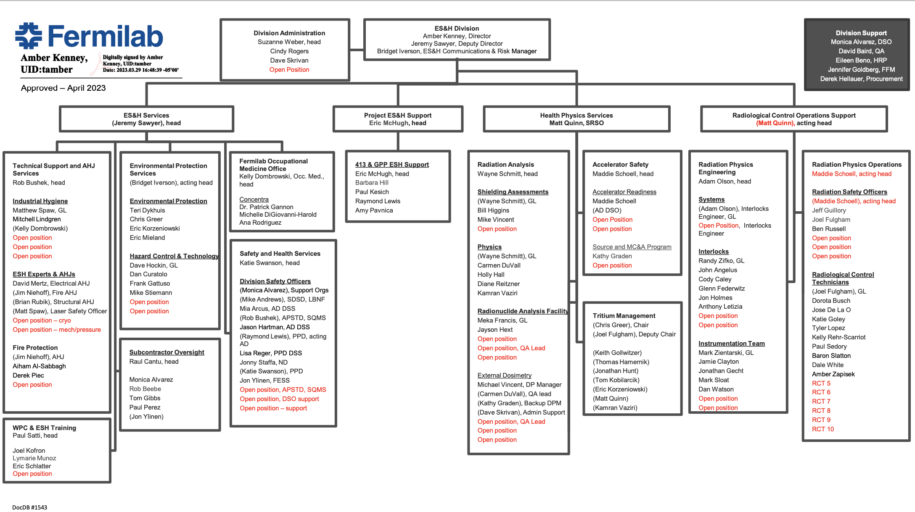
ESH ORGANIZATIONAL CHANGES
CHARLES ENGLAND
BOB AITKEN, AD DSO

Slide 3
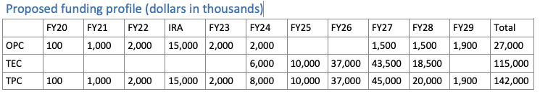
Project Timeline and Funding Profile (with CD-3a)
Start R&D
Conceptual Design
Preliminary Design
Final
Design
1.25 years
1 year
1 year
3 years
FY20 Q4
FY23 Q1
FY24 Q2
FY25 Q2
FY26 Q2
Construction
FY29 Q2
CD-0:
Approve Mission Need
CD-4: Project Complete
CD-1 Review: Approve Alternative Selection and Cost Range
CD-4 Review: Project Completion
We are here
CD-3 Review: Approve Start of Construction
CD-2/3a Review: Approve Performance Baseline

Slide 4
HCM Current Projects:
  Eligible for Rehire indicator for Recruiting
  Exit Interview reporting enhancements
  Disciplinary document categories (once in place, we will be fully electronic for personnel file documents)
  Updated Progressive Discipline Policy in final review

Slide 5

Rodeo Roundup May 24th

