Slide 1
PIP-II Report
PIP-II Team
Project Management Group
21 June 2023

Slide 2
Project Management
The serious fall injury of a contractor at PIP-II Linac construction site on 05.25 has shaken the whole PIP-II team. While except for the linac Complex construction, normal operations have resumed for the rest of the project, a higher scrutiny in planning and attention to safety are being observed at all levels.
We continue to work on rebuilding the management team:
  Project Director search continues
  Project Scientist position being posted
Extremely successful P2PEB15 on June 7-8 at CEA/IJCLab.
SRF conference on 24-29 June (over 45 PIP-II publications)
Ongoing actions after IPR:
  Schedule recovery plan has been presented to IPT on June 15:
    Aiming to reach an SPI value >0.97 by August/September and maintain performance
    New procurement tracking tool implemented in last turn around
    Restructured procurement meetings with action lists
    New resources tracking tool implemented in June
    Schedule improvements in several areas have been implemented -> still lots to do
2

Slide 3
Financials
SPI 0.92 0.00, CPI 0.98 0.00
Data are not fully correct due to the start of the schedule recovery process.
Current Period Negative Red Variances:
SRF CV is related to CP FDR-2 effort and Invoicing issues
AccS SV is related to HPRF, MagPS, and Controls
CF SV is related to delay in Linac complex Subcontract
3

Slide 4
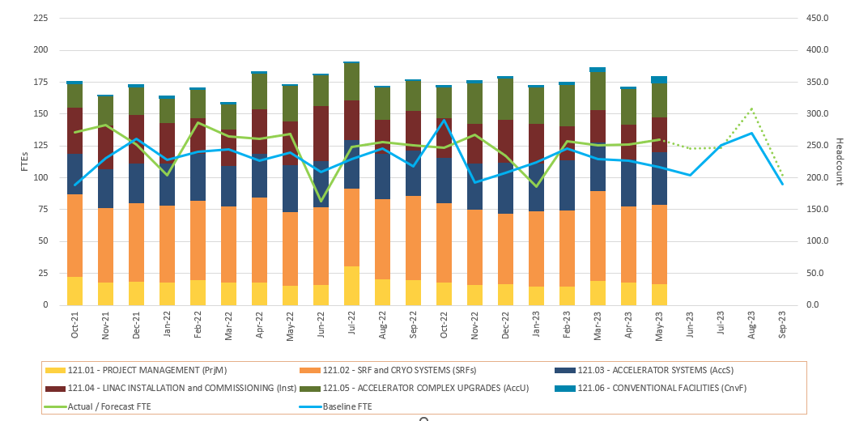
RLS Development Status
Contingency stable at 26.8% (-0.2%) -> mistake in CF
Critical path still though SRF systems (SSR and 650)
BCRs for $1.32k include 1st schedule recovery plan
4

Slide 5
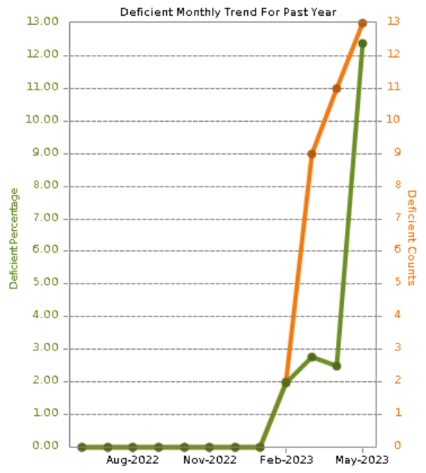
ESH
Fall event at the PIP II Linac site – multiple investigations occurring concurrently.
Cryo Plant - No deficiencies noted since last report.​
Linac Construction (graph) – (3) Housekeeping, material in pathway, (1) safety glasses not worn, (1) company truck blocking fire hydrant, (1) scaffolding not tagged, ladder removed to prevent usage.
COVID level - Low​​​
Reaching out to managers to flesh out the PIP II IT Safety Assessment Document (SAD). This is a new document aligning with the updated DOE O 420.2D Safety of Accelerators. This will nicely fold into the required SAD for the PIP II Linac proper. Need to complete before the end of August.
5

Slide 6
QA
Assessments/Reviews
  Concluded the Project Self-Assessment on Training – Shared final report and OFI’s/BP’s entered into iTrack.
  All Recommendations from the DOE IPR have been added to iTrack and responsible parties assigned.
Recurring monthly meetings with Partner quality counterparts setup with CEA, UKRI, and IN2P3.
  Working to set these up with DAE, INFN, and WUST
  Worked with IN2P3 to share nonconformance reports and completed travelers via their Atrium system.
QC Planning
  SSR1 QC Plan near release
  Draft of production HB650 QC Plan started
  Linac Installation QC Plan released
  Controls QC plan is under review by Tracy Sims, a DOE Software Quality Assurance resource
Developed and rolled out a new work instruction – “Completing a Traveler in Vector”, an action that came out of a Project Self-Assessment.
Discrepancy Report style template developed for Partners if they do not have a method to formally share nonconformances with FNAL.
6

Slide 7
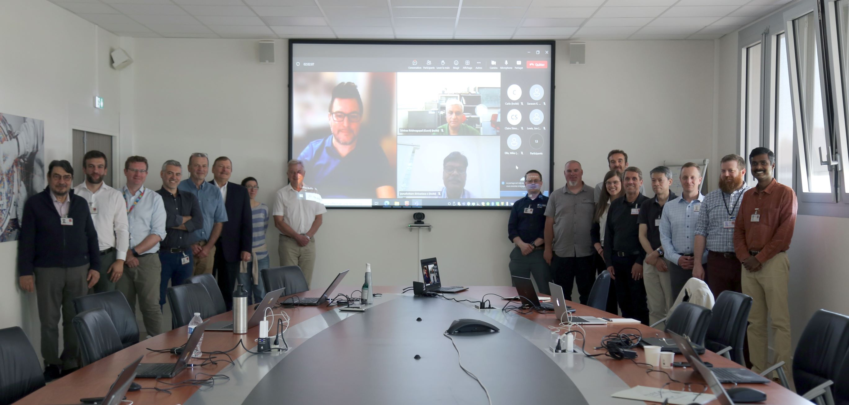
International
15th PIP-II Executive Board Meeting held at CEA with in-person participation from several Partner Technical Coordinators & Project Managers
  Primary agenda items:
    IPR outcomes and action items
    Risk register updates
    Integration planning (acceptance criteria, QC planning, etc.)
    https://indico.fnal.gov/event/59845/
Held satellite meetings with CEA, IJCLab, & UKRI
New INFN Technical Coordinator announced: Daniele Sertore
  Carlo Pagani retiring
New UKRI Project Manager announced: Mike Ellis – experienced ESS Project Manager
  Jon Lewis departing
DAE LLRF/RFPI system used on RRCAT horizontal cryostat delivered to Fermilab for verification testing. DAE colleagues will visit to participate in testing in the next few months
  R&D deliverable from IIFC and Addendum 1
DAE SSR CM SC solenoid testing ongoing at IB1
CEA have started PRRs, and hence procurement processes for LB650 PPCM
7

Slide 8
Procurements
Red= Behind schedule; actively working major issues
Green= On-Schedule; No major issues identified
Yellow= On-Schedule; Potential issues identified
Item | Status | Req # | Est SubK Value | Status Notes | Expected Award/Delivery Date
SSR2 Resonator Cavities (RI) |  | 305165 | $960K | RI has provided updated status report on the mfg. on June 6 complete with schedule and specifications that FRA requested. Delivery expected Feb 2024. FRA performing site visit July 10th/11th | Est. delivery Feb 2024
SSR2 Production Cavities – 33 total |  | TBD | $6.270M | Acquisition Procurement Plan - drafted and under review by Acquisition team prior to sending draft to FSO. Possible dual award due to quantity | TBD
SSR2 Resonator Cavities (Zanon) |  | 328365 | $567K | Second Subcontract No. 686389 awarded to Zanon due to RI issues for 3 cavities. Electron Beam welding has been completed on the cavities. Continued progress is being made from Zanon. Delivery on prior Subcontract No. 673794 has been completed. | Est delivery early 2024
Niobium for SSR1 Cavities |  | 328256 | $1.03M | Awarded PO 698536 ( Ningxia) May 31st, 2023 - Delivery date estimated July 2024 | July 2024
SSR 2 Niobium Material for Production Cavities |  | 337264 | $7.06M | FRA has received back two proposals on RFP337264-SC Ningxia (Foreign) on going negotiations with Ningxia for cost reductions. FSO approval of subcontract award is needed prior to award | Est Award July 2023
HB 650 Vacuum Vessel |  | 316651 | $584K | PHPK has completed the Vessel – In negotiations regarding cleaning charges | July 2023 Delivery
Helium Vessels |  | 309207 | $386K | Late on delivery dates per the Cure Notice. Update: Daily communications with Roark are occurring. PO # 673026. | Delivery - TBD
IDIQ Construction Phase Support |  | 333740/345127 | $4.9m | Engineering support IDIQ with first Task Order award for first 12 months of support. PoP start date is September 1, 2023. Burns and McDonnel – In Mgmt/Compliance/OCG review | July 2023
Thermal Cycling Upgrade Hardware |  | 341977 | $4.18M | Negotiations with ALaT still in process. Awaiting updated pricing proposal eta June 22 | May 2023

Slide 9
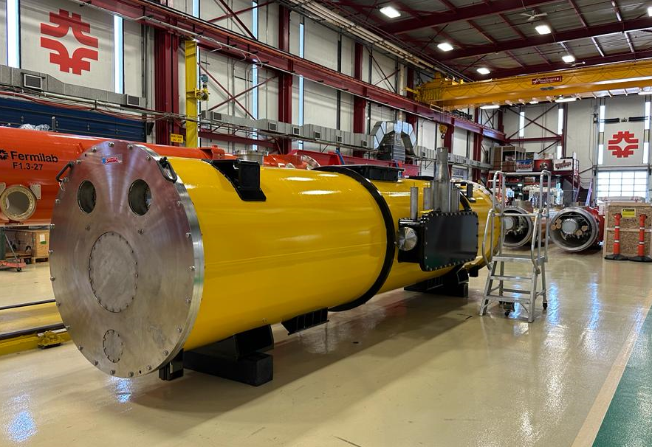
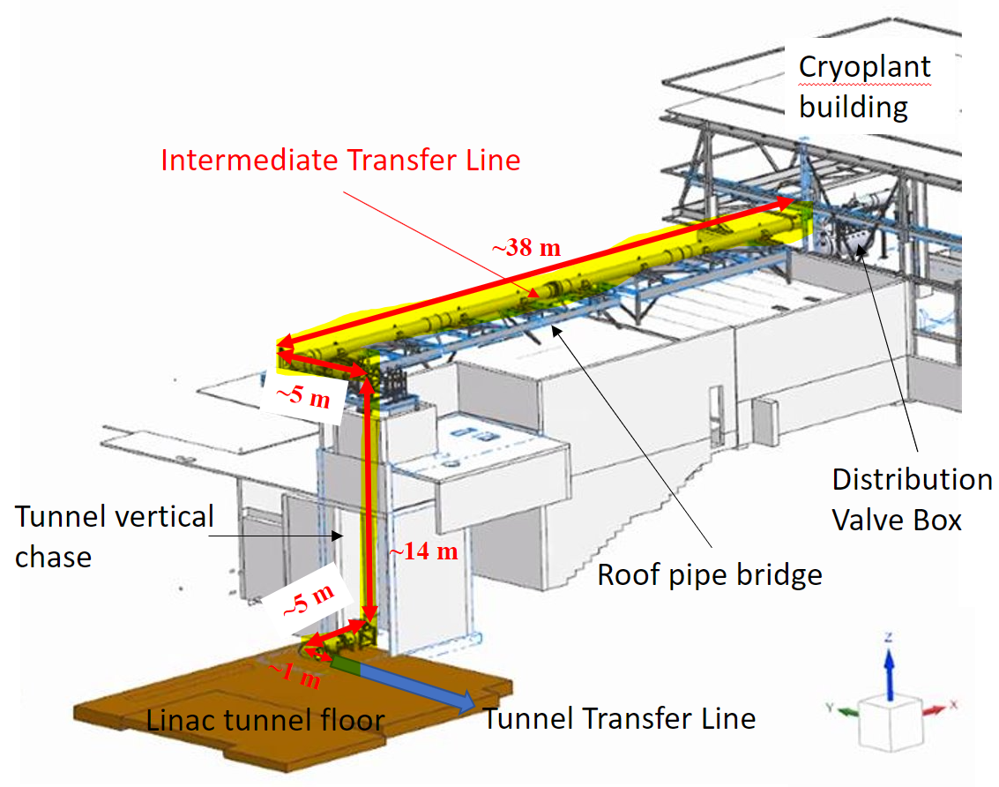
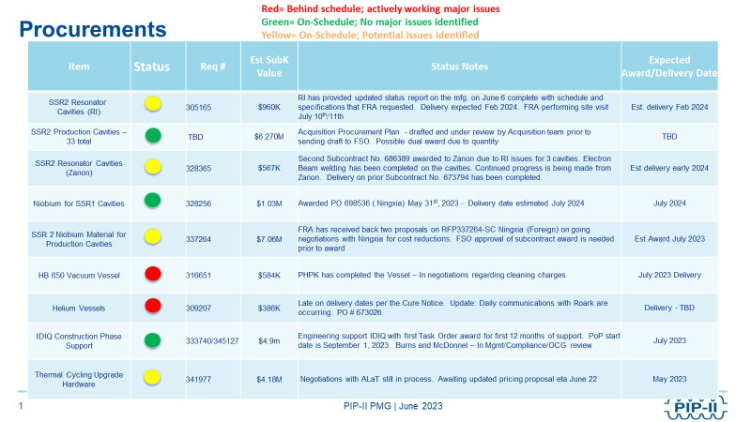
SRF Cryo
SSR cavities and cryomodules
  Still working on resolving the field emission limiting the performance of prod SSR2 cavities by improving the internal rinsing (HPR) of the cavities.
    In May we asked the support of MSU/FRIB to deploy their robotic HPR on SSR2 cavities ​
  Completing cost evaluation and negotiation of Nb for 33 SSR2 cavities.
  Finalizing APP for procurement of 33 SSR2 cavities.
  Received vacuum vessel, magnetic shield, strongback and support posts for ppSSR2 CM
650 cavities and cryomodules​
  Completed HB650 pCM Phase-I cold testing. Planned and executing Phase-II to be concluded in August 2023.​
  Continue preparing LB650 cavities for ppLB650 CM. First jacketed installed for cold testing to take place in June.
  Finalize procurement of tuner parts, motors, piezos, couplers for LB650 cavities.
  Working with partners (UKRI, RRCAT, CEA) to define procurement specifications.
Cryoplant ​
  Cryoplant ALaT FDR-2 Review held the week of May 22nd at BARC​.
  Cryoplant Transportation and Rigging procurement underway.​
    Warm Compressor System to be shipped in spring of 2024
    Coldbox to be shipped in late 2024
Cryogenics Distribution System: ​
  CDS DVB-TTL PDR-2 with WUST completed.
  TTL 3D models and FEA are complete.​
  ITL award in process.
SSR2 vacuum vessel
CDS Intermediate TL
9

Slide 10
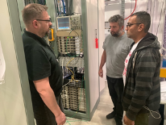
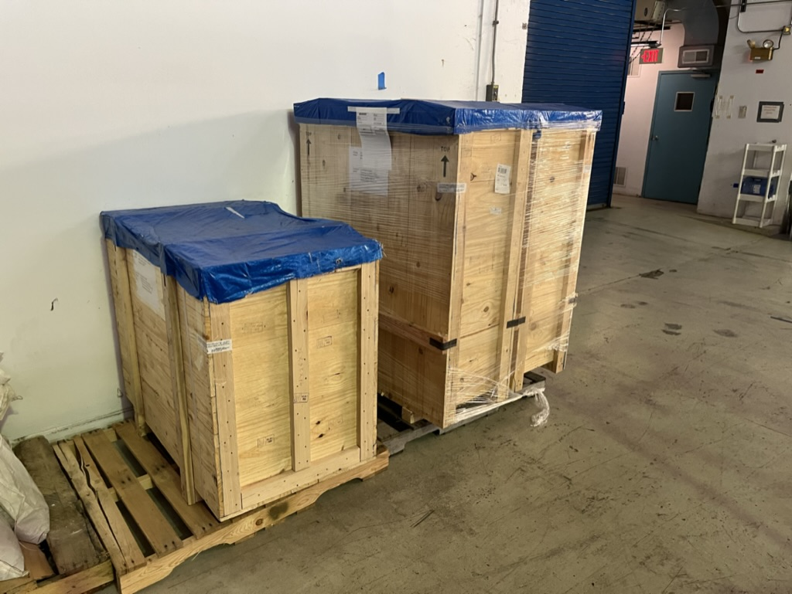
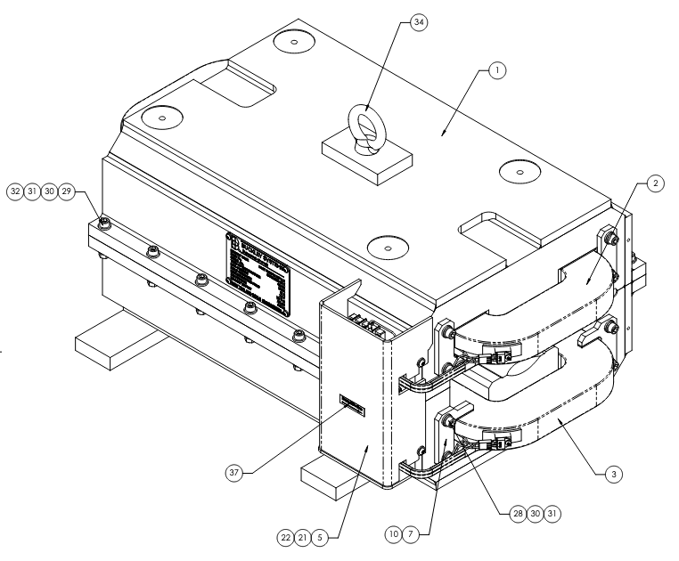
Accelerator Systems
HPRF
  650 MHz circulator unit #2 test continues
LLRF
  TUL visit to install/checkout 'Proof of Concept' RFPI chassis
  WUT IKC funding request denied, looking at alternative paths
  LLRF/RFPI from BARC delivered to Fermilab
Magnets/Power supplies
  2nd BARC quadrupole/corrector readied for testing
  BTL quadrupole vendor proposals under evaluation
  Vendor-design of BTL dipoles advancing
Controls
  Front End systems FDR conducted on 8 June
Instrumentation
  Invasive profile monitor FDR conducted on 25 May
TUL Proof of Concept chassis installed at PIP2IT
LLRF/RFPI hardware from BARC
BTL dipole mechanical design
10

Slide 11
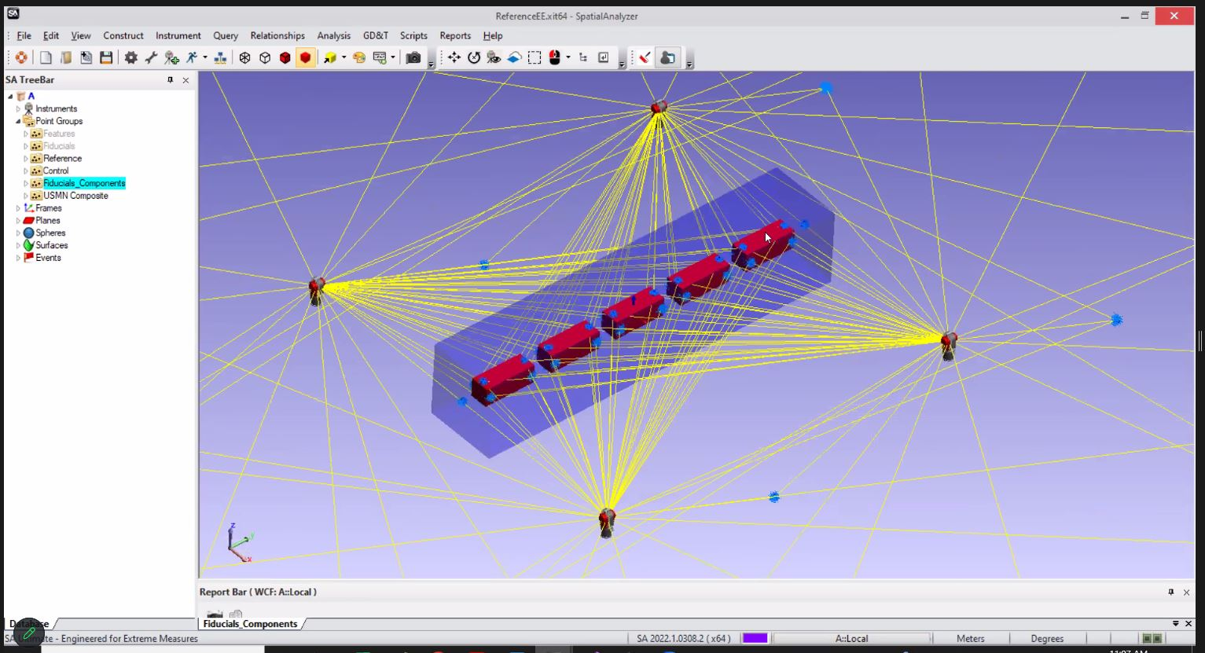
Installation and Commissioning
Project Management
  All L3 areas spent significant effort on schedule recovery plan in response to IPR recommendation
Warm Front End
  Preparation for Ion Source Final Design Review (FDR) underway
Building Infrastructure
  Requisition approved for Utility Plant pump room mechanical equipment
Linac Installation
  Cryomodule Stand FDR held May 23rd
  Preparing for Installation Plan FDR on June 21st
  Alignment Network calculations wrapping up
Commissioning & Accelerator Physics
  L3 for AP named – Sasha Shemyakin
  Shielding Assessment studies for BTL continued
Mathematical model for component alignment error budget
11

Slide 12
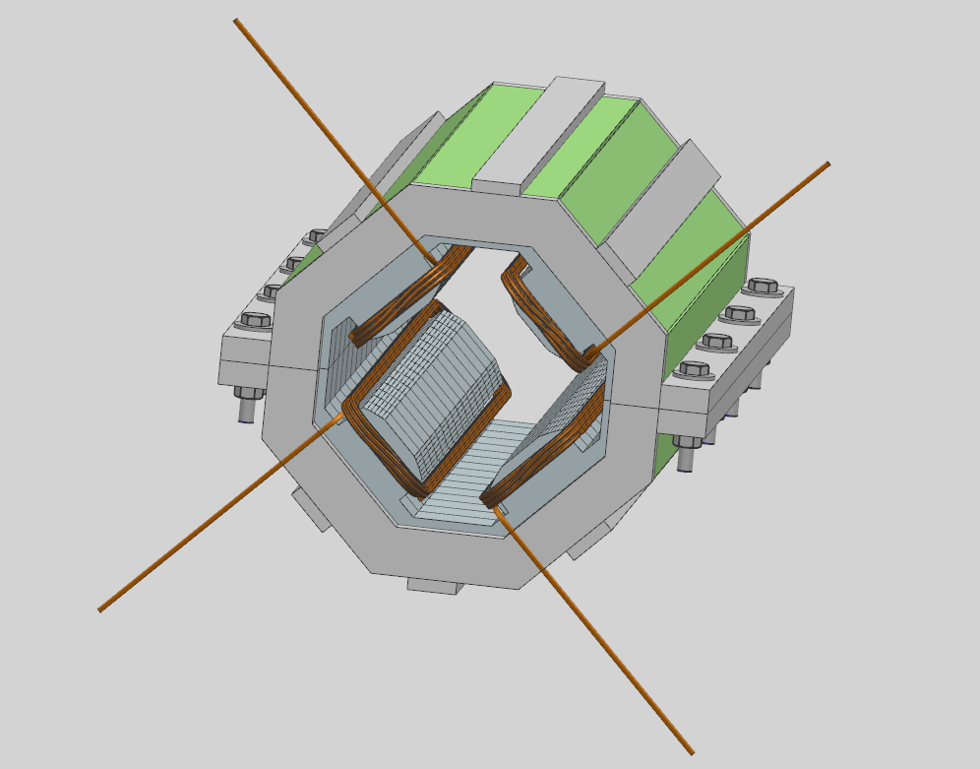
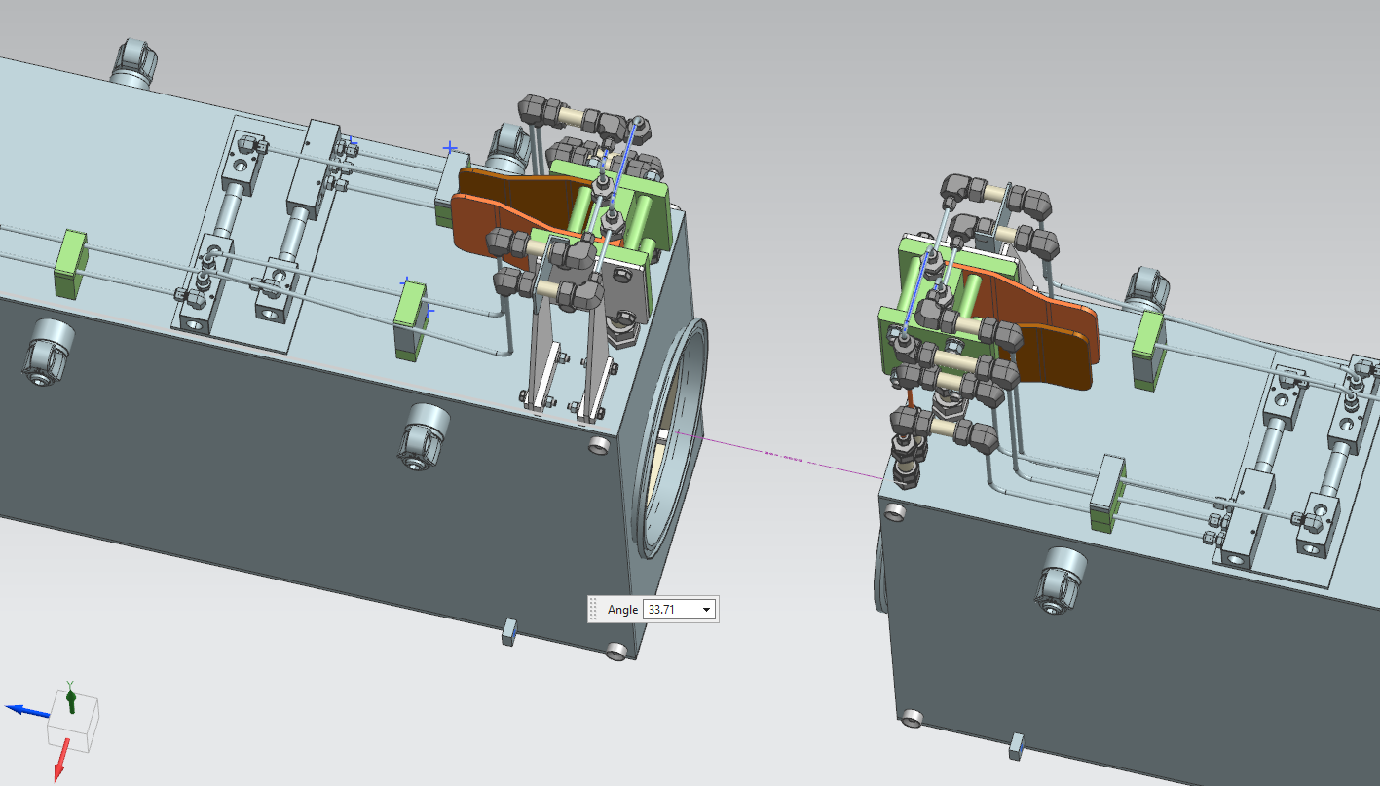
Accelerator Complex
Beam Transfer/Absorber Line
  Started the PRR effort for the BTL Collimators.
  Working on the 2KW portable absorber drawings and beam windows design.
  Preparing for the Gamma-T MI quads PDR review. Finalizing the mechanical model.
Booster
  Working on finalizing the ORBUMP magnet and the injection girder design. Preparing for the PRR review.
  Ordered most of the Booster collimator parts. Have received ~180K worth of parts.
  Preparing for Booster Gradient magnet testing (15 Hz) in E4R.We are currently addressing issues with the Power supply.
  Magnetic simulations of the shorter Booster Gradient magnets continue. Started working on the mechanical model.
  The new Booster DCCT is being commissioned.
MI/RR/Booster RF
  Preparing to upgrade one more MI RF station during the summer shutdown.
  Receiving 200 KW PA parts($843K/$1,100K). CPI is ahead of schedule for delivering power tubes (24/40).
  Making progress addressing the RR/RF PDR review recommendations.
  Started ordering parts for the Booster RF cavities.
Model of the MI Gamma-T quad magnet
Detail of the ORBUMP magnets manifold
12

Slide 13
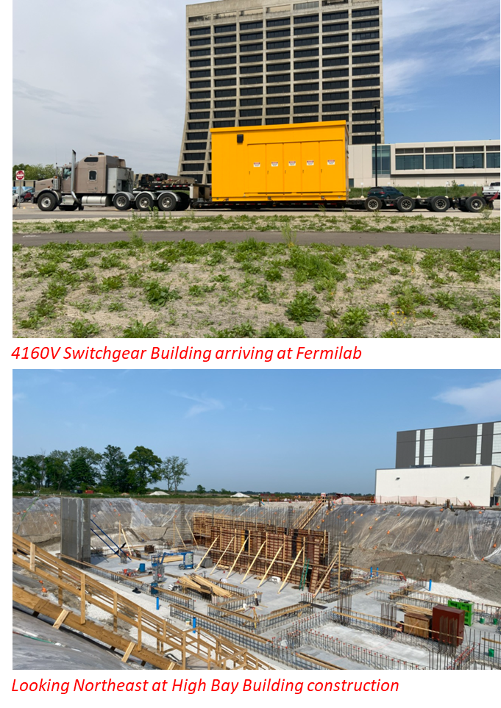
Conventional Facilities
WBS 121.06.07.02 - Cryogenic Plant Building (99% complete)
Authorization for Use and Possession (AUP) achieved January 5, 2023
Commissioning and punchlist items continue
Switchgear Building arrived at Fermilab on May 25, 2023
Installation impacted by safety stand down – Rescheduling with subcontractor
Project completion scheduled for late August 2023 – impact expected
WBS 121.06.07.03 - Isolated Cooling Loop
Notice to Proceed issued on April 28, 2023
Scheduled for completion in December 2023
Utilization of spare/existing equipment is being incorporated due to continued new electrical equipment long lead times
Installation impacted by safety stand down.
WBS 121.06.05 - Linac Complex (8% complete)
Last High Bay Building concrete slab pour (3 of 3) on May 17, 2023
First foundation wall section poured in northeast corner of HBB
Stop work order in effect since May 25, 2023
Working with investigations to provide information and details.
13

Slide 14
Technical Integration
Design Reviews:
  4 Design reviews completed in May
  6 PDRs & 50 FDRs remaining
Requirements, Interfaces, and Acceptance Criteria:
  HPRF Requirements revised:
    ED0004290 Rev F – 325 MHz 7kW RFPA TRS
    ED0010994 Rev C – PIP-II 325MHz 20kW RF Power Amplifier TRS
  ED0010433 Rev AG PIP-II Master ICD: Minor updates to interface names and references
    ED0022346 Rev- – WFE MEBT ISD initial release
  Acceptance Criteria Documentation development continues as primary focus prior to IPR
    40+ Acceptance Criteria documents are currently actively being drafted by L3/L4 systems with IKC deliverables. (55% development progress)
    100+ Acceptance Criteria documents identified for other PIP-II Installation/Upgrade deliverables (19% development progress)
Design Change Requests (DCRs) : No new DCR’s this reporting period
14

Slide 15
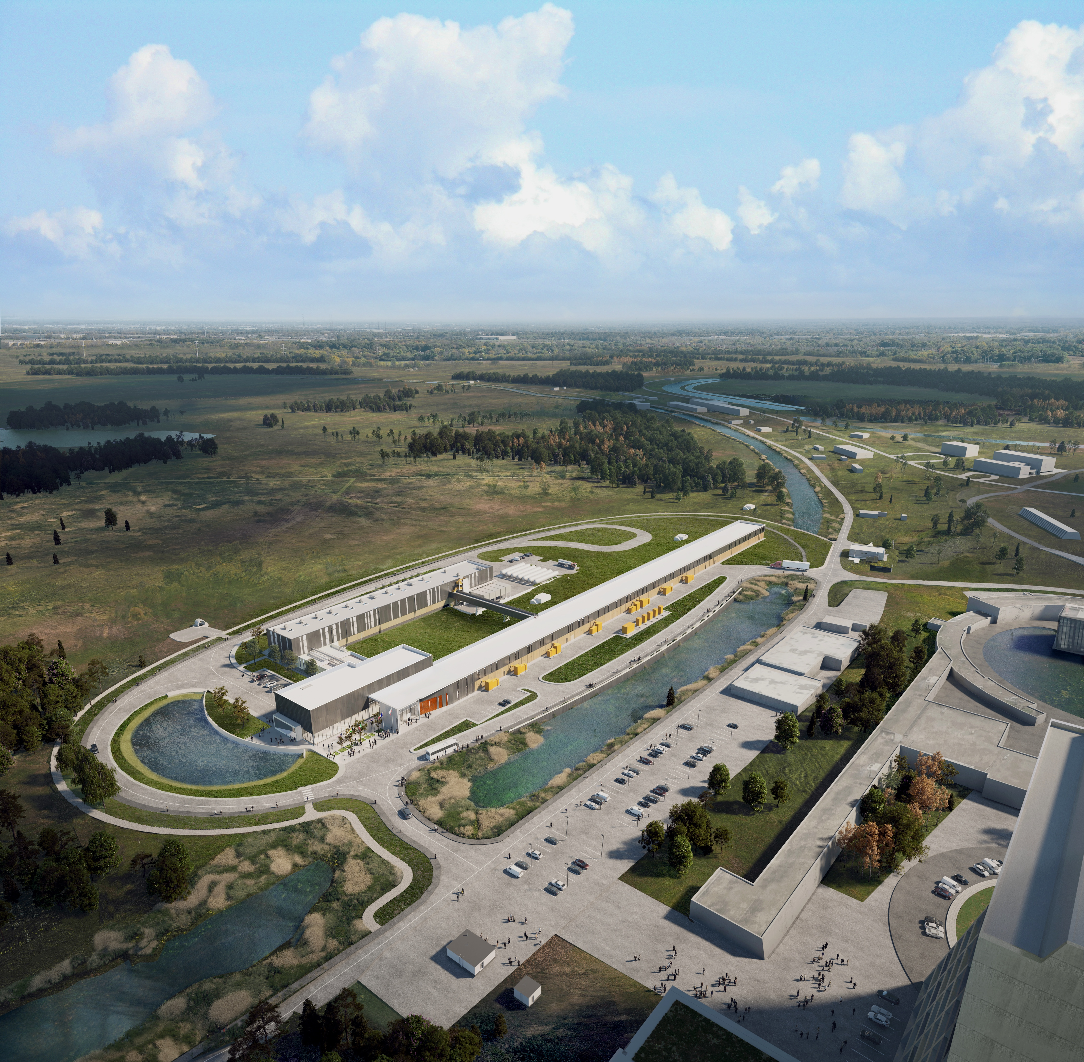



THE FUTURE OF FERMILAB
Follow us:
www.pip2.fnal.gov
@PIP2accelerator
/showcase/pip-ii/

