Slide 1
PIP-II Report
PIP-II Team
Project Management Group
19 July 2023

Slide 2
Project Management
With the internal investigation completed, a phased restart plan for the linac complex construction has been formulated and socialized with Senior Lab Management. The plan will be presented to FSO and IPT this Thursday.
We continue to work on rebuilding the management team:
  Project Director search continues – a very promising candidate will interview next week
  Project Scientist position being posted
  Project Engineer position will be posted (L. Kokoska joined LBNF/DUNE Near Detector as PM)
Ongoing actions after IPR:
  Schedule recovery plan has been presented to IPT on June 15
  First two BCRs allowed to reach an SPI of 0.96 (+0.04)
  Replanning continues and updated partner schedules are being analyzed (UKRI, DAE)
  Contingency is stable, but longer-term cost “offloading” discussion continues
  FY24 resources negotiation is critical (+50 FTEs)
2

Slide 3
Financials
SPI 0.96 +0.04, CPI 0.98 0.00
Schedule recovery reduced the schedule variance by 50%
Current Period Red Variances:
Analysis not possible due to large changes as part of the ongoing effort to establish a realistically achievable schedule
3

Slide 4
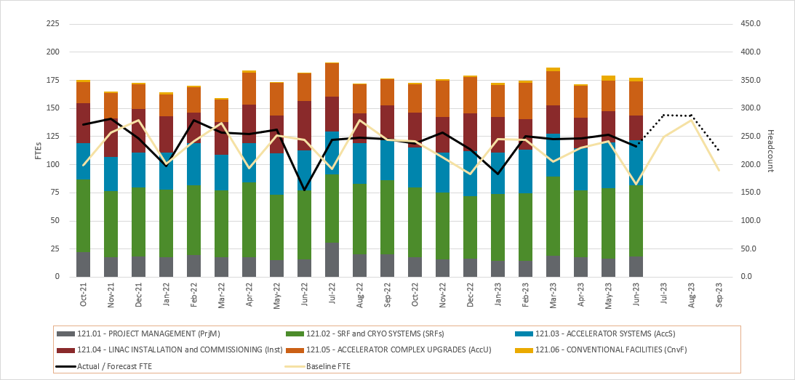
RLS Development Status
Contingency recovered to 27.6% (+0.8% +$1.5M)
Critical path still though SRF systems (SSR and 650)
BCRs for $403k include second schedule recovery plan
CF at -1 day from critical path
4

Slide 5
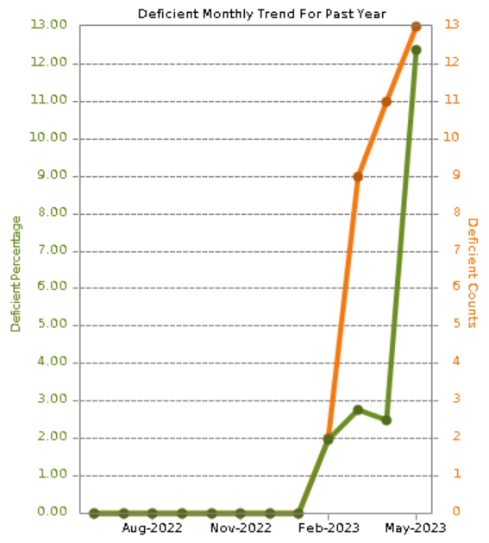
ESH
Fall event at the PIP II Linac site –
  Internal causal analysis complete – Corrective Action Plan (CAP) drafted
  DOE AIB investigation ongoing – factual accuracy review this week
  Phased restart plan includes CAP
COVID level - Low​​​
420.2D implementation – new Safety Assessment Document (SAD) template, SME meeting last week. Need to complete before the end of August. Lab-wide ARR scheduled for week of August 14.
5

Slide 6
QA
QC Planning
  SSR1 Production CM QC Plan drafted and under review by L3M
  HB650 Production CM QC Plan drafted and reviewed by L3M
  Worked with LLRF and Instrumentation to identify needed Travelers for each system
  Approved Bellows Incoming Inspection Traveler
  Initial draft of Ion Source Power Cabinets developed, reviewed, and feedback provided.
Acceptance Criteria Lists
  HB650 Coupler Approved in TC
  Updating HB650 Cryomodule, Bare, and Jacketed Cavity ACLs based on feedback from STFC
SRF/Cryo Quality Engineer is following Lab 2 cavity processing efforts closely for cavity -202 and -203
STC Maintenance and Improvement Items were identified and added to iTrack
Nonconformance Summary Report for HB/LB Quad Dipole Corrector Magnet developed and shared with BARC
Working with the assigned responsible parties to identify Corrective Action Plans for the IPR Recommendations
Supported STFC visit, introducing Mike Ellis to our QA/QC program for PIP-II
6

Slide 7
International
India-US joint statement issued on India’s $140M contribution to PIP-II, reaffirming commitment
UKRI’s Mid-Term Review concluded – scope retained; schedule extended
  UK’s schedule will be approved by their funding agency in a Nov-23 meeting
  Impacts to FNAL plans to be examined with UK counterparts, and mutually acceptable option to be chosen for the schedule
Srinivas Krishnagopal has retired from BARC, and replacement TC yet to be named (DAE has two TCs)
  Srinivas was the longest serving TC, since beginning of the Indian Institutions & Fermilab Collaboration (IIFC) in ~2009
  Purushottam Shrivastava, DAE TC from RRCAT, is sole TC for DAE scope in the interim
Guillaume Devanz named the CEA PIP-II Project Technical Director; reporting to Nicolas Bazin (CEA TC)
Mike Ellis takes over as UKRI PIP-II Project Manager, effective 24-Jul-23
  Jon Lewis established current project plan since 2018; and a valuable member of the team
20 kW SSA DAE internal review completed & FNAL FDR scheduled for early Aug-23
40 kW SSA DAE internal review ongoing, with expected completion in Aug-23
SSR pre-series solenoid (-007) departure from BARC for FNAL is imminent
SSR prototype solenoid from BARC continues to be tested (See SRF-Cryo updates)
LLRF/RFPI modules received from BARC have undergone initial inspections, and are undamaged
Warm magnets from BARC continue to be tested
Partner schedule integration continues, with some Partner schedules yet to be agreed (SSA, solenoids)
7

Slide 8
Procurements
Red= Behind schedule; actively working major issues
Green= On-Schedule; No major issues identified
Yellow= On-Schedule; Potential issues identified
Item | Status | Req # | Est SubK Value | Status Notes | Expected Award/Delivery Date
SSR2 Resonator Cavities (RI) |  | 305165 | $960K | RI has provided updated status report on the mfg. on June 6 complete with schedule and specifications that FRA requested. Delivery expected Feb 2024. | Feb 2024
SSR2 Production Cavities – 33 total |  | TBD | $9.88m | Acquisition Procurement Plan - drafted and under review by Acquisition team prior to sending draft to FSO. Final internal review comments due July 17. | TBD
SSR2 Resonator Cavities (Zanon) |  | 328365 | $567K | Second Subcontract No. 686389 awarded to Zanon due to RI issues for 3 cavities. Electron Beam welding has been completed on the cavities. Continued progress is being made from Zanon. FRA desires to exercise the processing option. | Est delivery early 2024
Niobium for SSR1 Cavities |  | 328256 | $1.03m | Awarded PO 698536 ( Ningxia) May 31st, 2023 - Delivery date estimated July 2024 – just received a milestone payment. | July 2024
SSR 2 Niobium Material for Production Cavities |  | 337264 | $7.2m | FRA has received back two proposals on RFP337264-SC Ningxia (Foreign) on going negotiations with Ningxia for cost reductions. FSO approval of subcontract award is needed prior to award. Expecting answer on price reduction request 7/17/23. | Est Award July 2023
HB 650 Vacuum Vessel |  | 316651 | $584K | PHPK has completed the Vessel – Ship date is 7/17/23 – Delivery 7/18/23 | July 18 - Delivery
Helium Vessels |  | 309207 | $386K | Daily communications with Roark are occurring. PO # 673026. Work is progressing on vessel 4 and 5. | Delivery - TBD
IDIQ Construction Phase Support |  | 333740/345127 | $4.9m | Engineering support IDIQ with first Task Order award for first 12 months of support. PoP start date is September 1, 2023. Burns and McDonnel – In Mgmt/Compliance/OCG review. Revision sent to compliance on July 13th. Current Task Order expires end of August – Current IDIQ needs a modification for additional funding. | July 2023
Thermal Cycling Upgrade Hardware |  | 341977 | $3.6m | In compliance and OCG review week of July 17th. Target award is July 24th – Significant savings realized through negotiations. | July 2023

Slide 9
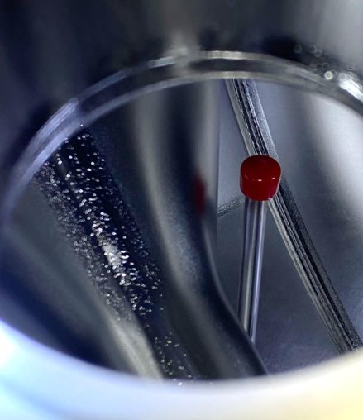
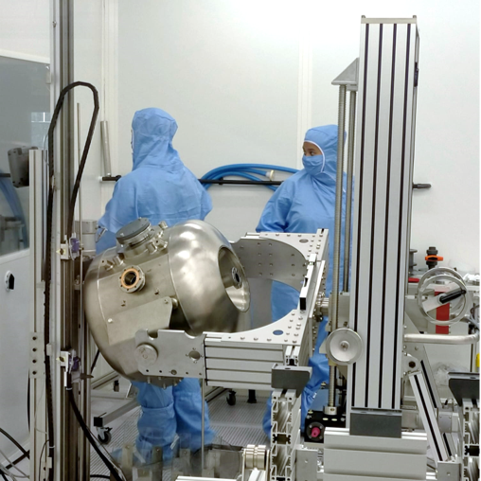
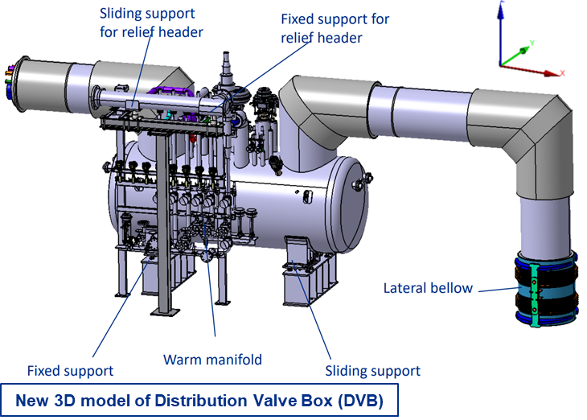
SRF Cryo
SSR cavities and cryomodules
  Working to improve the internal rinsing (HPR) of the cavities at IJCLab, ANL/FNAL, and MSU. Performed tilted HPR for rinsing hard-to-reach high electric field areas.​ Testing scheduled by the end of July.
  Prod SSR2 cavities: finalizing contract for Nb, completed APP for cavities procurement.
650 cavities and cryomodules​
  Performed thermal improvements to proto HB650 CM. Starting Phase-II testing in July.
  Tested HB650 RI-203. Next: jacketing and pressure test. Cavities will be shipped to UKRI for facilities verification.​
  Three out of five cavities at FNAL jacketed. First cold test of third jacketed cavity in July.
  Finalize procurement of tuner parts, motors, piezos, couplers for LB650 cavities.
  Completed review and approvals of UKRI’s (partner) procurement specifications.
Cryoplant ​
  Cryoplant ALaT PRR for Warm Compressor System and Coldbox scheduled for July 31st through August 1st. This authorizes vendor fabrication to commence.
  Cryoplant Integration and Installation Review scheduled for week of August 14th
  Cryoplant Transportation and Rigging procurement underway.
    Warm Compressor System to be shipped in spring of 2024
    Coldbox to be shipped in late 2024
Cryogenics Distribution System: ​
  Completing tunnel warm piping design
  DVB/TTL 3D models complete
  Intermediate Transfer Line award in process
SSR2 tilted HPR at IJCLab (France)
9

Slide 10
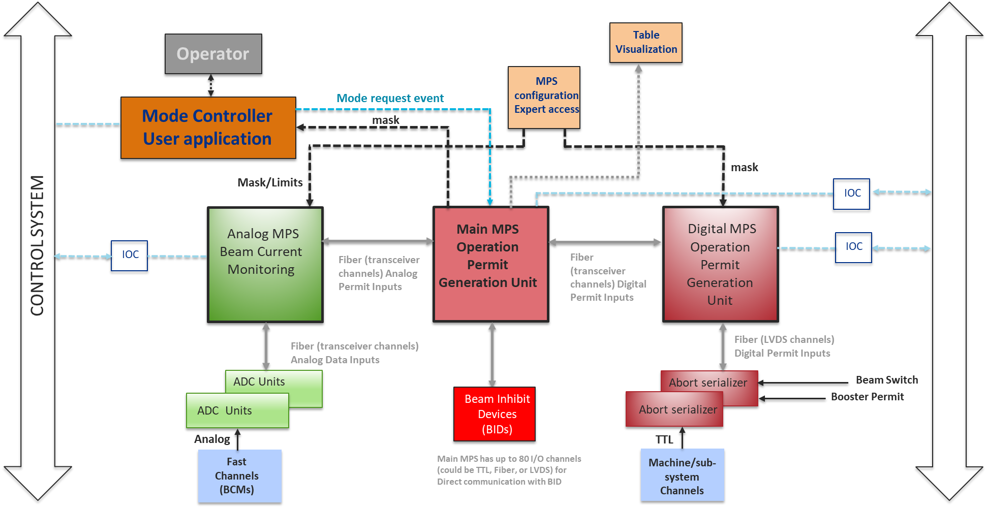
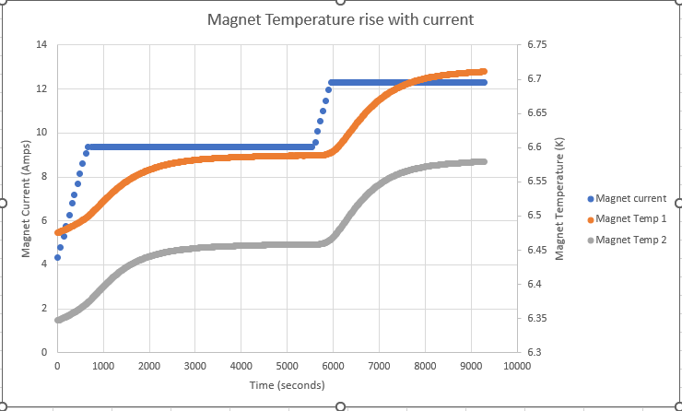
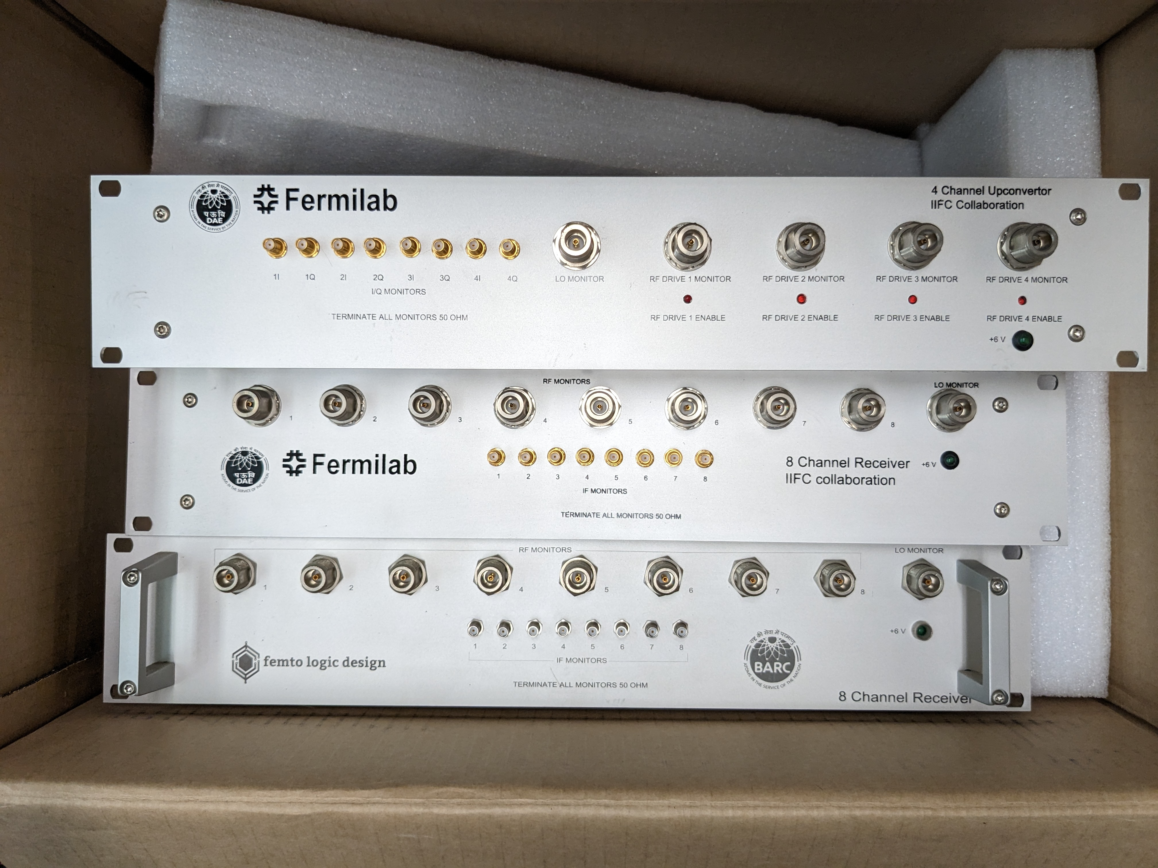
Accelerator Systems
MPS
  Final Design Review conducted on 12 July
HPRF
  650 MHz circulator unit #3 testing begun
  20 kW SSA FDR planned for 8-9 August, reviewers identified
LLRF
  Beam Pattern Generator mini-review conducted
  LLRF/RFPI from BARC system checkout beginning; software shared
Magnets/Power supplies
  2nd BARC quadrupole/corrector testing
  Solenoid Power supply/Quench protection monitor testing in progress
Controls
  Front End systems FDR conducted on 8 June
Instrumentation
  New CAM: Sherese Humphrey
MPS Architecture
Solenoid Current & Temperatures during testing
LLRF/RFPI hardware from BARC
10

Slide 11
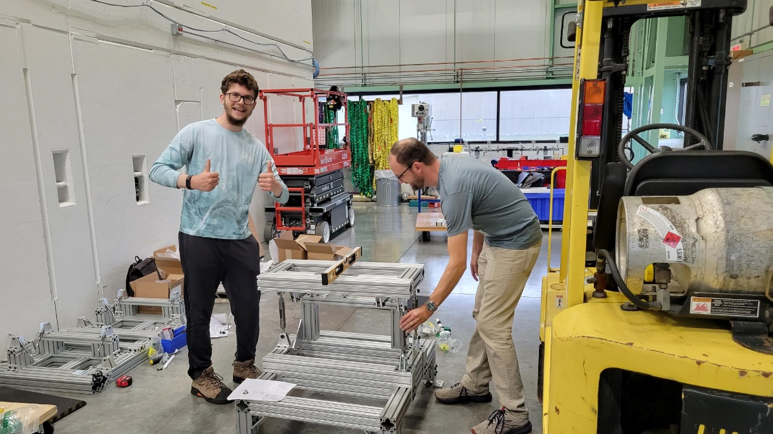
Installation and Commissioning
Warm Front End
  Preparation for Ion Source Final Design Review (FDR) continued
  MEBT scraper and bunching cavity fabrication in progress
Building Infrastructure
  Requisitions for Utility Plant pump room mechanical equipment and electrical racks in procurement
  Procurement Readiness Review (PRR) for cable procurements completed
Linac Installation
  Cryomodule stand FDR review recommendations being addressed
  Installation Plan FDR final report received
  PO awarded for Cryomodule Tunnel Transport System (CTTS)
  Warm Unit prototypes being assembled by NIU Engineering students
Commissioning & Accelerator Physics
  Design of moveable instrumentation cart for commissioning
  Shielding Assessment studies
  High Level Application plan development
NIU Engineering students finishing assembly of 325MHz Warm Unit Prototype

Slide 12
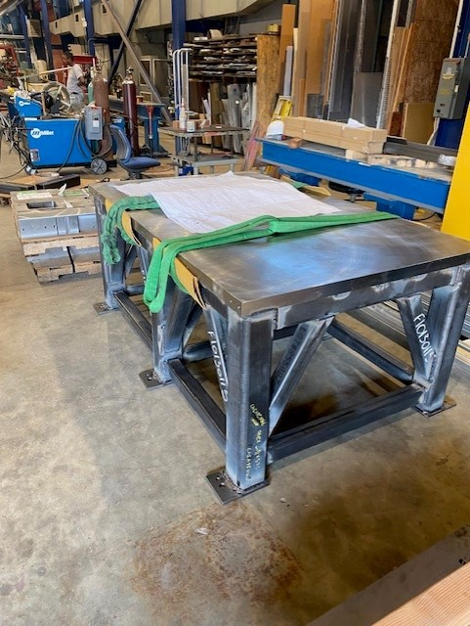
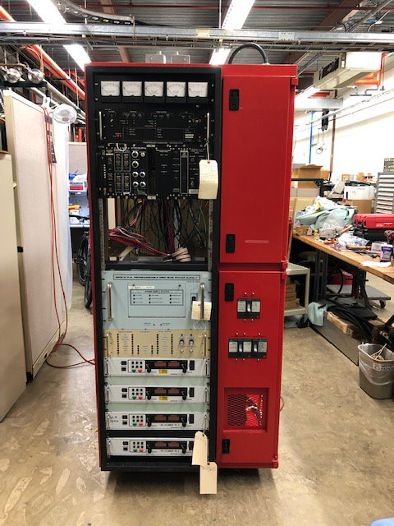
Accelerator Complex
Beam Transfer/Absorber Line
  Preparing for the BTL Collimators PRR review.
  Working on the 2KW portable absorber drawings and beam windows design.
  Preparing for the Gamma-t MI quads PDR review in August. Finalizing the magnet design and optimizing the PS design.
Booster
  Working on finalizing the ORBUMP magnet and the injection girder design. Preparing for the PRR review.
  Ordered most of the Booster collimator parts. Have received ~250K worth of parts. Have started assembly.
  Booster Gradient magnet testing (15 Hz) in E4R has been delayed because of PS issues. We are ready to order the capacitors for the 20 Hz testing (two vendors).
MI/RR/Booster RF
  Moving along with upgrading another MI RF station. Modulator is ready to be tested.
  Receiving 200 KW PA parts($900K/$1,100K). CPI is ahead of schedule for delivering power tubes (25/40).
  Have received 4 bids for the MI Solid state drivers.
  Making progress addressing the RR/RF PDR review recommendations. Tuner simulations almost finished.
  Continuing with the ordering of parts for Booster cavities. Have 80% of PR complete and have received $150K worth of parts.
Support table for the Booster Collimators
MI Upgraded modulator
12

Slide 13
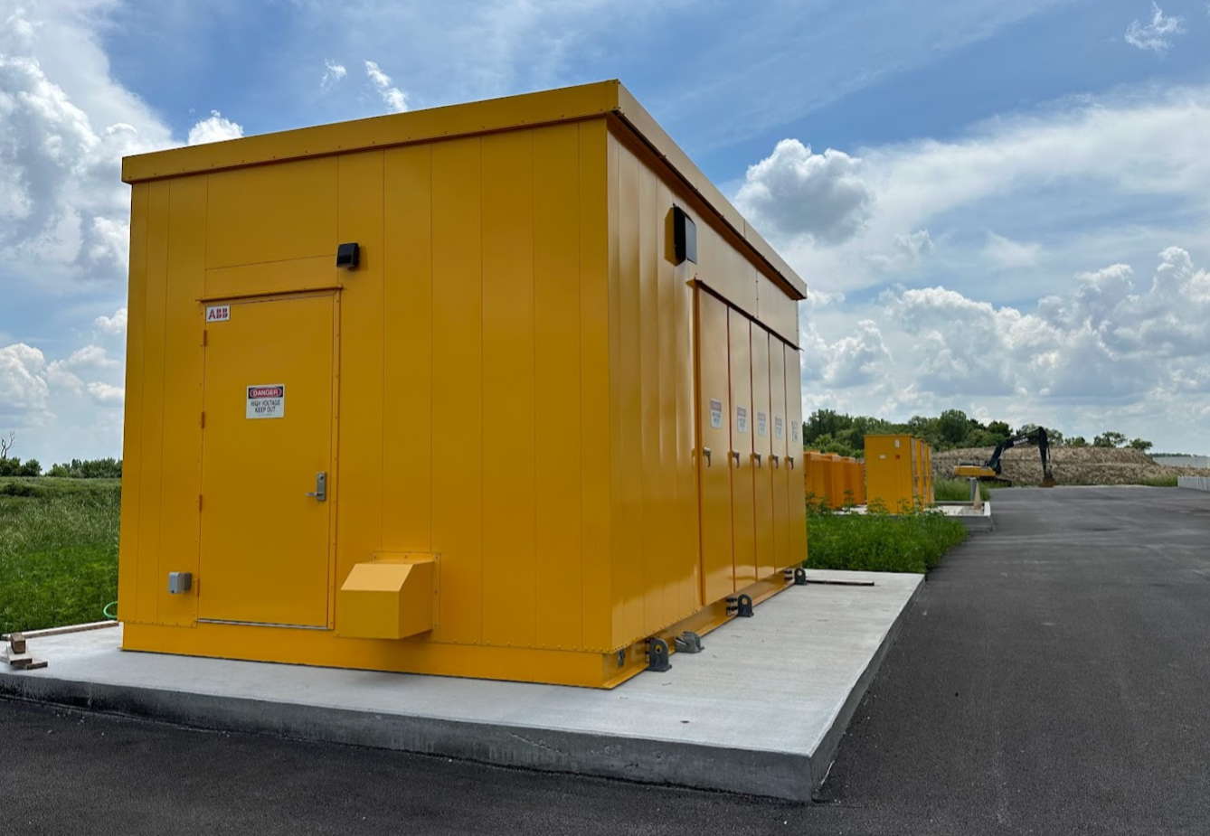
Conventional Facilities
WBS 121.06.07.02 - Cryogenic Plant Building ​(99% complete)
4160V Switchgear hut arrived in late May 2023
Installation delayed by safety pause
Set on pad June 30th
Project Complete scheduled for August 2023 (will be delayed)
WBS 121.06.07 – CPB Outfitting Packages
Isolated Cooling Loop construction underway
Process Power Transformer design underway
Long Lead time items identified, and procurement started
WBS 121.06.05 – Linac Complex ​(9% complete)
Fall Incident on May 25, 2023
Restart Plan:
  Corrective action plans identified
  Phased construction resumption plan in progress
  Updated schedule in progress
  Goal: restart letter issued in July 2023
Looking northwest towards 4160V switchgear hut
13

Slide 14
Technical Integration
Design Reviews
  SPI improvement re-plan modified review dates
  2 Design reviews completed in June
Requirements, Interfaces, Acceptance Criteria
  ED0010433 Master Interface Control Document revisions occurred in Beam Instrumentation, Vacuum, Linac Complex, Linac Installation, Controls, LLRF, and with Partners RRCAT and BARC
  Acceptance Criteria Documentation maturity continues to be ~55-60% complete.
    Renewed emphasis on finalizing and releasing Version 1 of all ACLs is required.
Design Change Requests (DCRs): No new DCRs approved
  Three being considered:
    Linac tunnel Heat Load and cooling requirements
    Bunching cavity type and location finalization
    BTL transition area steel shielding replacement with dirt shielding
Device naming convention strategy is maturing. (device type, name, location, serial number). Needed to support some procurements, installation, storage, servicing, replacement, etc.
14

Slide 15
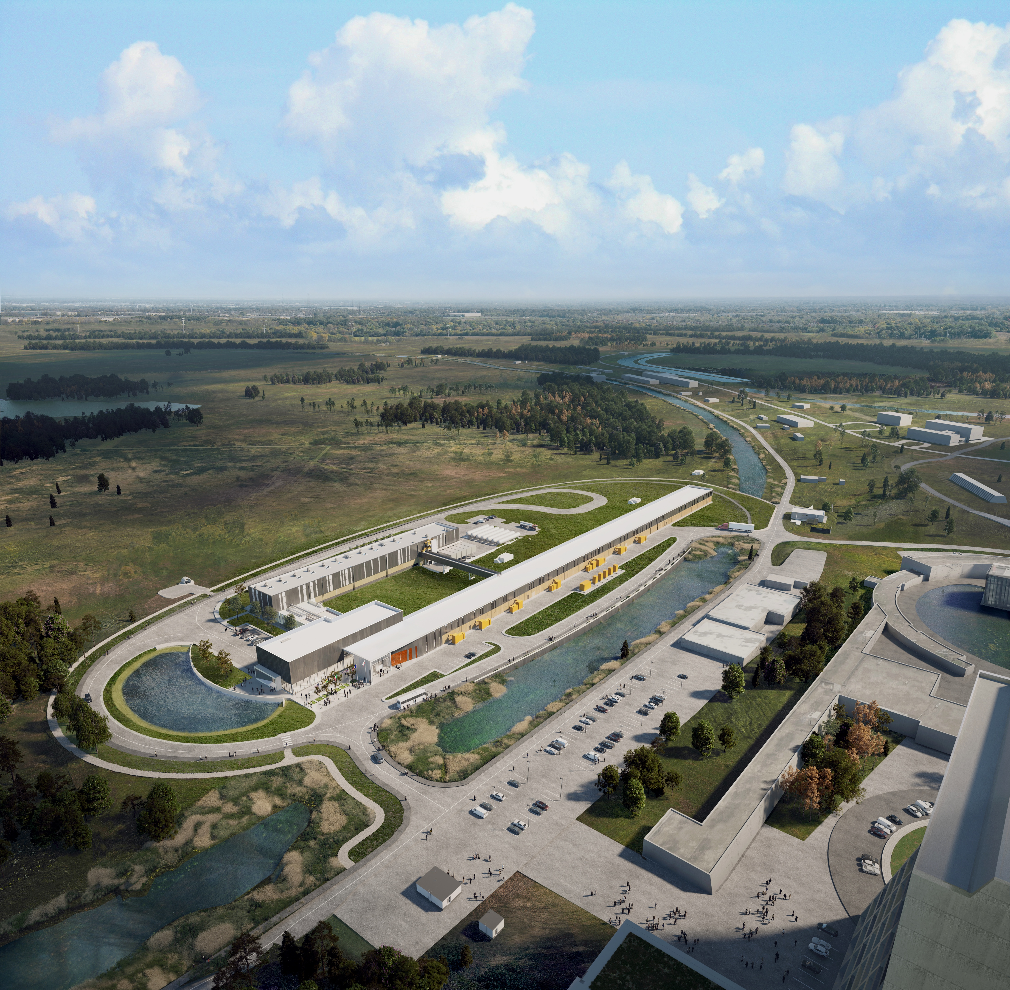



THE FUTURE OF FERMILAB
Follow us:
www.pip2.fnal.gov
@PIP2accelerator
/showcase/pip-ii/

