Slide 1
PIP-II Report
PIP-II Team
Project Management Group
16 August 2023

Slide 2
Project Management
The project together with ESH is finalizing a phased restart plan and seek FSO concurrence. Work at heigh will not resume before potential AIB recommendations have been addressed. The AIB report should be available at the beginning of September.
We continue to work on rebuilding the management team:
  Project Director search is in the final stages
  Project Scientist position is being posted
  Project Engineer position is being prepared
  Ongoing internal audit
  Successful EVMS Surveillance review
Ongoing actions after IPR:
  Schedule recovery plan will continue through August and September
  First three BCRs allowed to reach our goal of an SPI of 0.97 (+0.05), additional potential activities are planned in August
  A BCR is being prepared to cover the procurement of 6 40kW SSAs for PIP2IT testing of HB650/LB650 cryomodules
  Contingency is stable, but efforts toward improvement continue
  FY24 resources negotiation jamboree with APS-TD is completed, later this week will address PPD and most important AD where we have the most critical resource increases (+35 FTEs)
2

Slide 3
Financials
SPI 0.97 +0.01, CPI 0.98 0.00
Schedule recovery reduced the schedule variance by 63%
Current Period Red Variances:
AccS SV mostly related to delays in SSAs started activities that cannot be replanned
3

Slide 4
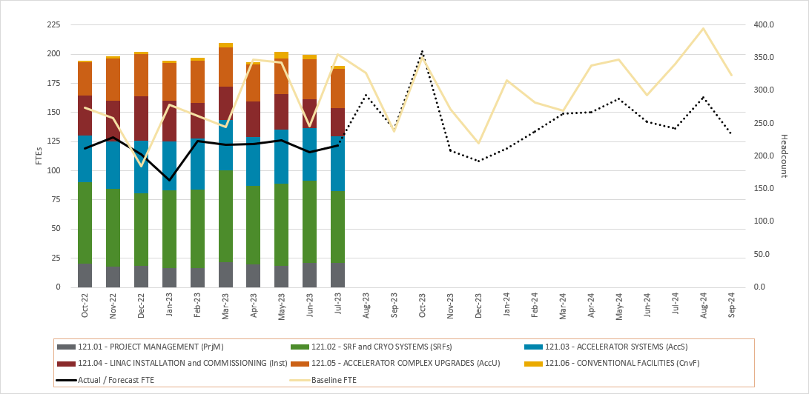
RLS Development Status
Contingency stable at 27.4% (-0.2%)
Significant reduction of EU thanks to optimization
Critical path still though SRF systems (SSR and 650)
BCRs for $1.3M include third schedule recovery plan
CF at -1 day from critical path
4

Slide 5
ESH
Fall event at the PIP II Linac site –
  Phased restart letter to the contractor submitted to senior leadership for review
  Increased rigor and more detailed format required for HA and work plan submission, being added to the contractor communication documents
  Relevant work planning and contractor guidance FESHM chapters being updated to capture corrective action plan language.
  Project is monitoring site conditions
COVID level - Low​​​
420.2D implementation –
  Big thank you to all who participated in the SAD and ASE updating exercise, especially to our PIP-II participation. Finalizing the new SAD and ASE for PIP2IT.
5

Slide 6
QA
QC Planning
  HB650 Production Cryomodule QC Plan shared with SPMs and SMEs for review and comment
  Cryoplant Installation QC Plan reviewed and feedback/questions shared with L3M
  Linac Installation QC Plan released in Teamcenter in preparation for the associated Final Design Review (FDR)
  Beam Instrumentation QC Plan updated with list of needed Travelers and released in preparation for FDR
  MPS QC Plan reviewed, and feedback provided to L3M in order to finalized.
Acceptance Criteria List (ACL) for HB650 Cryomodule phase 1-3 approved by Partner and TeamCenter workflows started
Procurement Readiness Review documents from BARC for couplers were reviewed.
PIP-II Nonconformance Handling Procedure was updated to include the QCR process.
New Lessons Learned (#97) entered for Components with sealing surfaces to utilize protective covers.
Held our monthly one-on-one quality meetings with Partners. Planning a quality visit to STFC/CEA/IN2P3 upon delivery of the pHB650CM
Began drafting the Internal Assessment Plan for our next project self-assessment – “SAR Document Planning and Development”
6

Slide 7
International
UKRI Procurements are proceeding (RF Couplers are the latest critical order to advance)
New UKRI PM Mike Ellis fully up-to-speed and returning to Fermilab for the 2nd time since starting the position
Replacement TC for DAR/BARC yet to be named (DAE has two TCs)
  Technical and administrative decisions are slowed without a named BARC TC
  Purushottam Shrivastava, DAE TC from RRCAT, is sole TC for DAE scope in the interim
20 kW SSA DAE Final Design Review occurred 08/09-10.
  Incorporated feedback from internal review committee which was engaged with the design team for ~6 months
  Expect review report draft within a week
40 kW SSA DAE internal review ongoing, with expected completion in Aug-23
SSR pre-series solenoid (-007) arrived at Fermilab
SSR prototype solenoid from BARC continues to be tested (See SRF-Cryo updates)
  Aligning testing procedures with BARC and Fermilab to the extent possible.
LLRF/RFPI modules received from BARC have undergone initial inspections, and are undamaged
First DAE software delivered as part of LLRF/RFPI scope. Code to be evaluated
Warm magnets from BARC continue to be tested
Partner schedule integration continues, with some Partner schedules yet to be agreed (SSA, solenoids)
Uncertainty with Polish IKC scope continues (WUST, WUT, TUL)
7

Slide 8
Procurement
SSR2 Cavities Acquisition Plan – submission to FSO
SSR2 Niobium Subcontract – Internal review by 8/18
Ongoing Internal Audit
Relay Rack Requisition
Barton Mallow needs to provide information

Slide 9
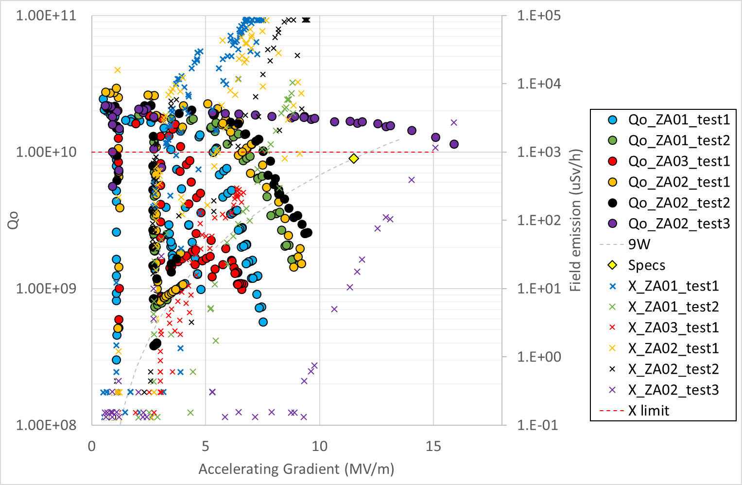
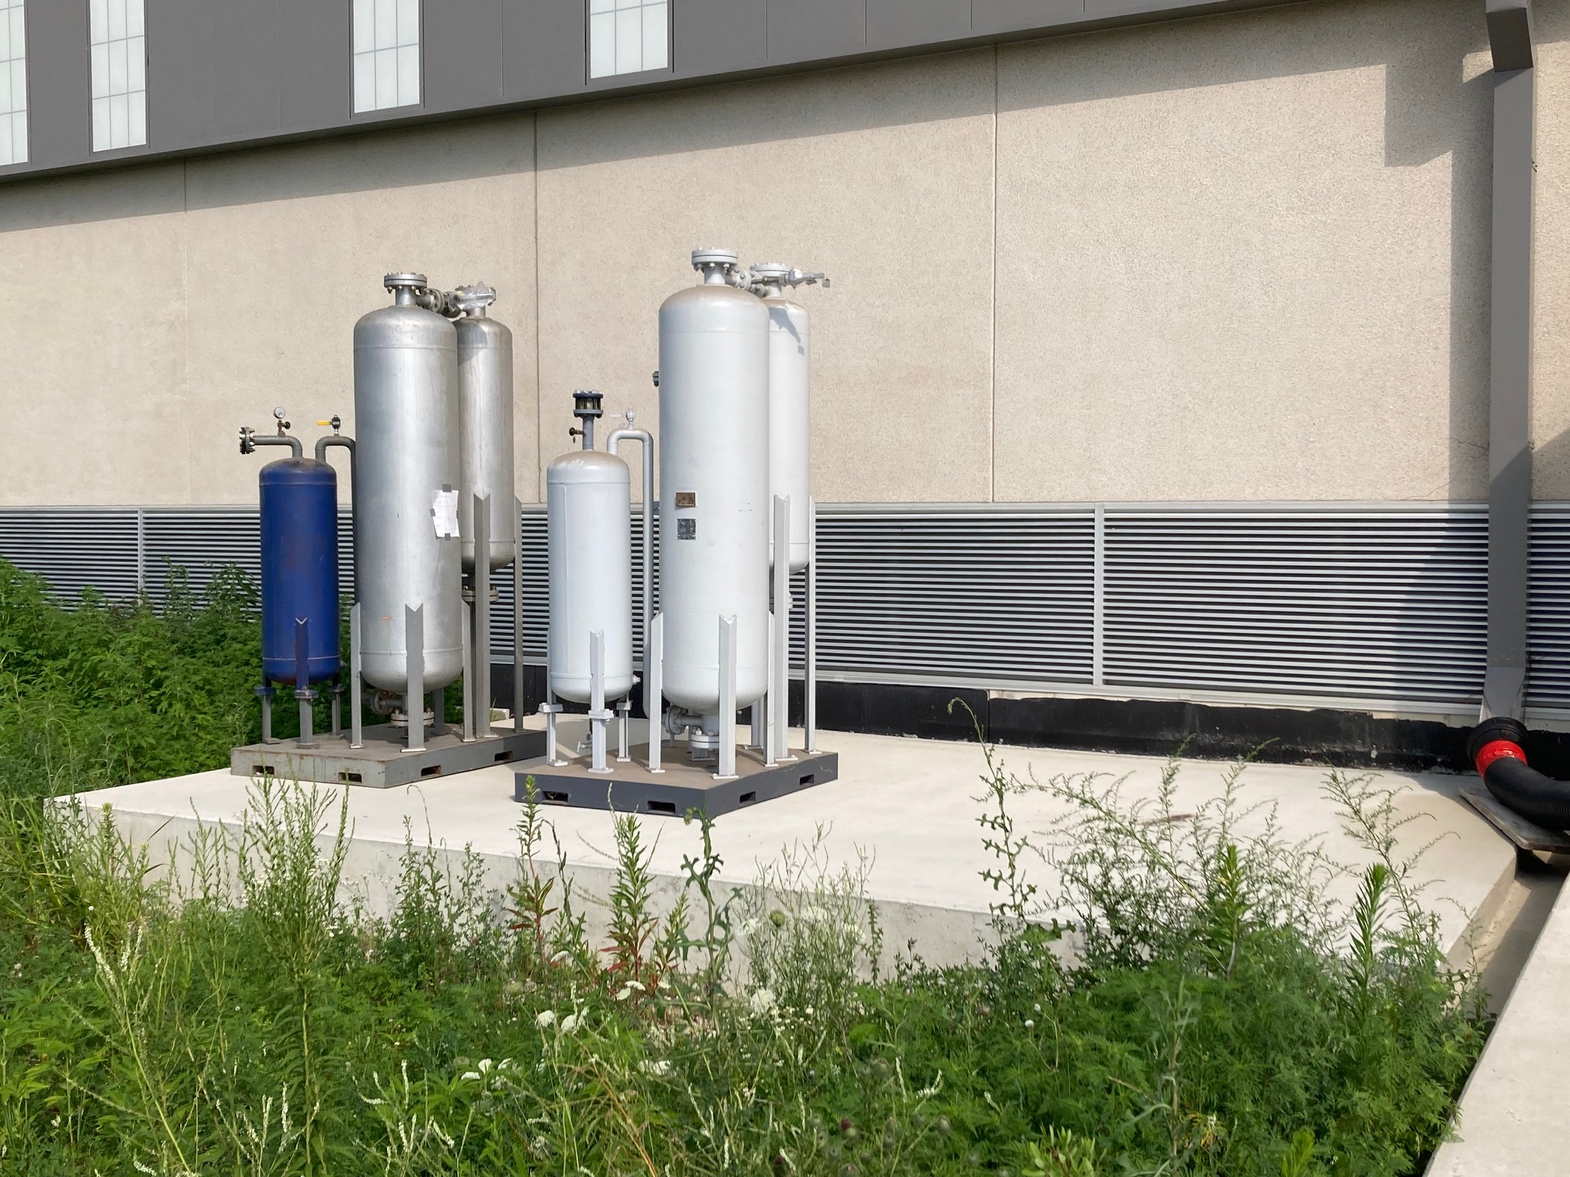
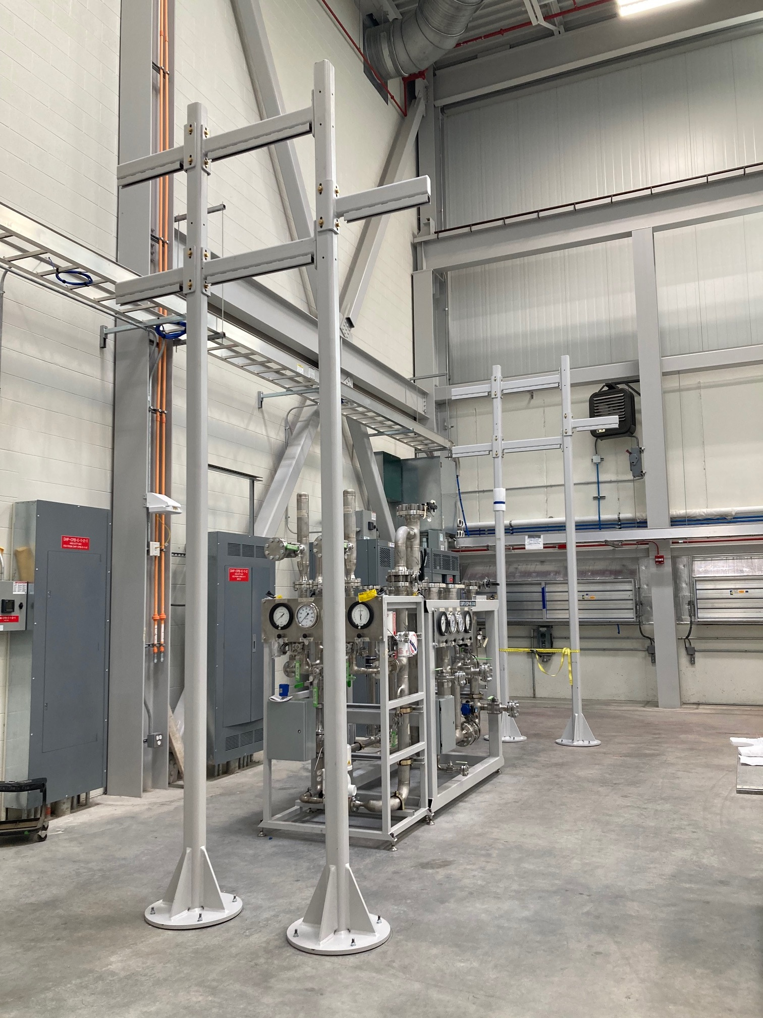
SRF Cryo
SSR2 cavity #2 meets PIP-II specification (ZA02_test3)
SSR cavities and cryomodules
  First SSR2 was cold tested and qualified per PIP-II requirements. This is the result of teamwork with our partners, mainly with IJCLab (France).
  Magnet 007 from BARC (India) arrived at FNAL. Next: cold testing in the CoCoLoCo.
  Prod SSR2 cavities: finalizing contract for Nb, reviewing APP for cavities procurement.
650 cavities and cryomodules​
  Performed thermal improvements to proto HB650 CM and completed Phase-II cold testing. Data analysis is in progress. Some reduction in heat load at 2K observed.
  HB Cavity 203 completed jacketing and successful pressure test – validates 900C heat treatment. Next: Cavity will be shipped to UKRI for facilities verification.​
  LB Cavities 101 & 104 received mid-T bake, awaiting VTS preparation & test, then jacketing
Cryoplant ​
  Cryoplant Integration and Installation Review scheduled for week of August 14th
  Cryoplant Transportation and Rigging procurement underway.
    Warm Compressor System to be shipped in spring of 2024
    Coldbox to be shipped in late 2024
  Working in compressor room in preparation for upcoming installation contracts
Cryogenics Distribution System: ​
  DVB/TTL: Modifying the DVB – Coldbox interconnection to facilitate alignment during installation and assembly
  ITL: PO paperwork under review with Procurement; review with legal/compliance to follow
Installation work in compressor room
9

Slide 10
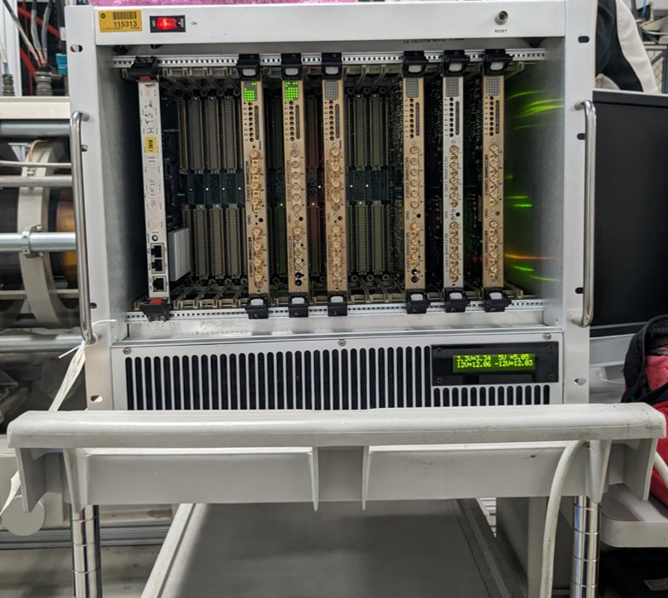
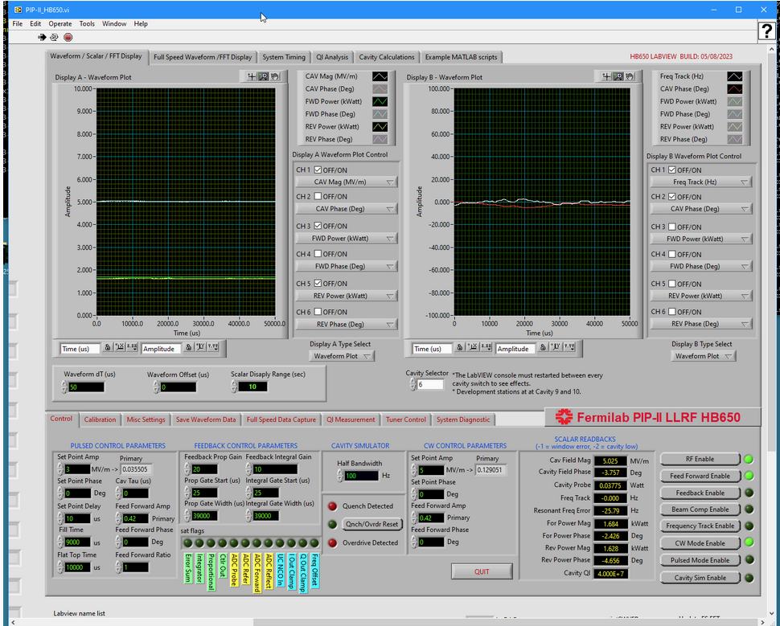
Accelerator Systems
HPRF
  20 kW SSA Final Design Review conducted 8-9 August; awaiting closeout
LLRF
  LLRF/RFPI from BARC system checkout in progress; executable software shared
  PHB650 cavity #6 GDR operation demonstrated; much work remains
Magnets/Power supplies
  2nd BARC quadrupole/corrector testing wrapping up
Controls
  Recent Conversation with Argonne APS/U regarding available resources beginning in FY24
Instrumentation
  Beam Pickup hardware Final Design Review conducted on 1 August; final report received
BARC LLRF hardware
powered up at PIP-II test stand
PHB650 cavity #6 – GDR mode
10

Slide 11
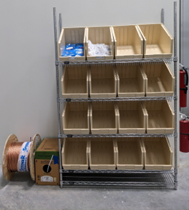
Installation and Commissioning
Project Management
  New full-time engineer joined the group Aug 7th (former ASPIRE Intern)
Warm Front End
  Kicker Driver, MEBT scraper and bunching cavity fabrication continued
Building Infrastructure
  Generating several requisitions - Utility Plant electrical/mechanical installation, relay racks, and cables
  Some of the cable prices have dropped to pre-COVID levels
Linac Installation
  Warm Unit prototype assemblies nearly complete
  Cryomodule Tunnel Transport System (CTTS) PO awarded and kickoff meeting held. Preliminary design review planned for late August
Commissioning & Accelerator Physics
  Booster simulation studies continue
  Finalizing placement of beam diagnostics in BTL
  High Level Application plan development
Utility Plant Cable "Store"

Slide 12
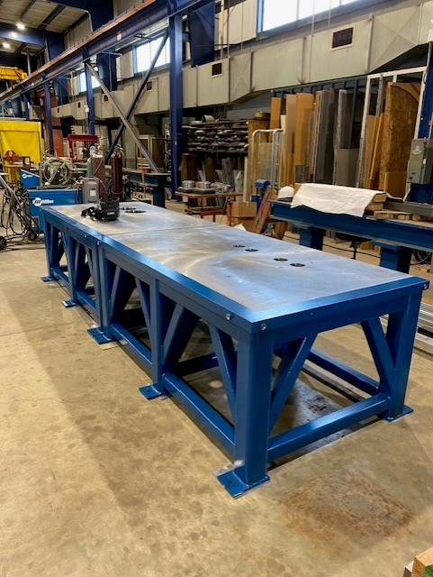
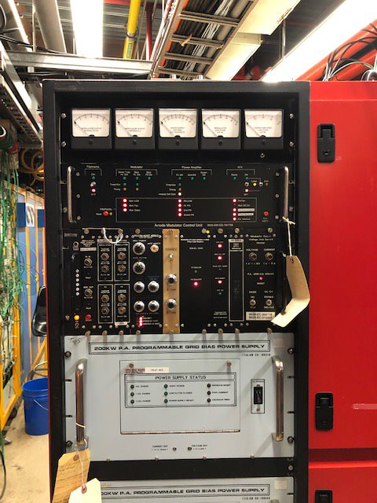
Accelerator Complex
Beam Transfer/Absorber Line
  Preparing for the BTL Collimators PRR review.
  Working on the 2KW portable absorber drawings and beam windows design.
  Preparing for the Gamma-T MI quads PDR review at the end of August. Finalizing the magnet design and optimizing the PS design.
Booster
  Working on finalizing the ORBUMP magnet and the injection girder design. Preparing for the PRR review.
  Ordered most of the Booster collimator parts. Have received ~350K worth of parts and have started assembly.
  Booster Gradient magnet testing (15 Hz) in E4R has been delayed because of PS issues. Ordering parts for a PS filter. Ordered the capacitors for the 20 Hz testing (two vendors).
  The new Booster DCCT has been commissioned.
MI/RR/Booster RF
  Moving along with upgrading another MI RF station. Second upgraded Modulator is under testing.
  Receiving 200 KW PA parts($900K/$1,100K). Last Aluminum parts expected in August. No power tubes received in July. CPI is ahead of schedule for delivering power tubes (25/40).
  Have received 4 bids for the MI Solid state drivers. Evaluating the proposals.
  Making progress addressing the RR/RF PDR review recommendations.
  Continuing with the ordering of parts for Booster cavities. Have 80% of PR complete and have received $150K worth of parts.
Support tables for the Booster Collimators
MI Upgraded modulator under testing
12

Slide 13
Conventional Facilities
WBS 121.06.07.02 - Cryogenic Plant Building ​(99% complete)
Change in Procurement Administrator
Electrical outfitting of 4160V hut underway
Commissioning and Punchlist remain (~65% complete)
Project Complete scheduled for October 2023
WBS 121.06.07 – CPB Outfitting Packages
Isolated Cooling Loop construction underway. Electrical work starting while awaiting mechanical equipment.
Process Power Transformer pad and relocation issued for lab-wide review – comments due in late August. Next step is to issue for proposal in September 2023.
5 KVA long lead time transformer proposals received. Evaluation underway. Goal: Issue PO in late August. 145 week lead time.
WBS 121.06.05 – Linac Complex ​(9% complete)
Fall Incident on May 25, 2023
Restart Plan:
  Phase 1 (planning) developed and submitted for internal and DOE review
13

Slide 14
Technical Integration
Design Reviews
  SPI improvement re-plan modified review dates
  1 reviews completed in July (MPS Systems FDR)
  4 reviews planned for August
  Closed 12 reviews in July (closeouts incorporate all final committee reports, comments, recommendations, responses and iTrack entries)
Design Change Requests (DCRs): No new DCRs approved
  Four CF-focused being considered:
    Linac tunnel Heat Load and cooling requirements – still waiting on final inputs from key stakeholders
    Bulletin 1 (mostly due to removal of linac gallery and tunnel extension options)
    Bulletin 2 (13 individual changes within the linac complex)
    BTL transition area steel shielding replacement with dirt shielding
  BTL power supply change
  Nitrogen supply to the tunnel change
Device storage and logistics planning underway and aligned with procurement timelines
  Significant temporary space is required to house the accelerator components prior to final integration
  To the extent possible, existing space is preferred to renting offsite or temporary onsite options
14

Slide 15
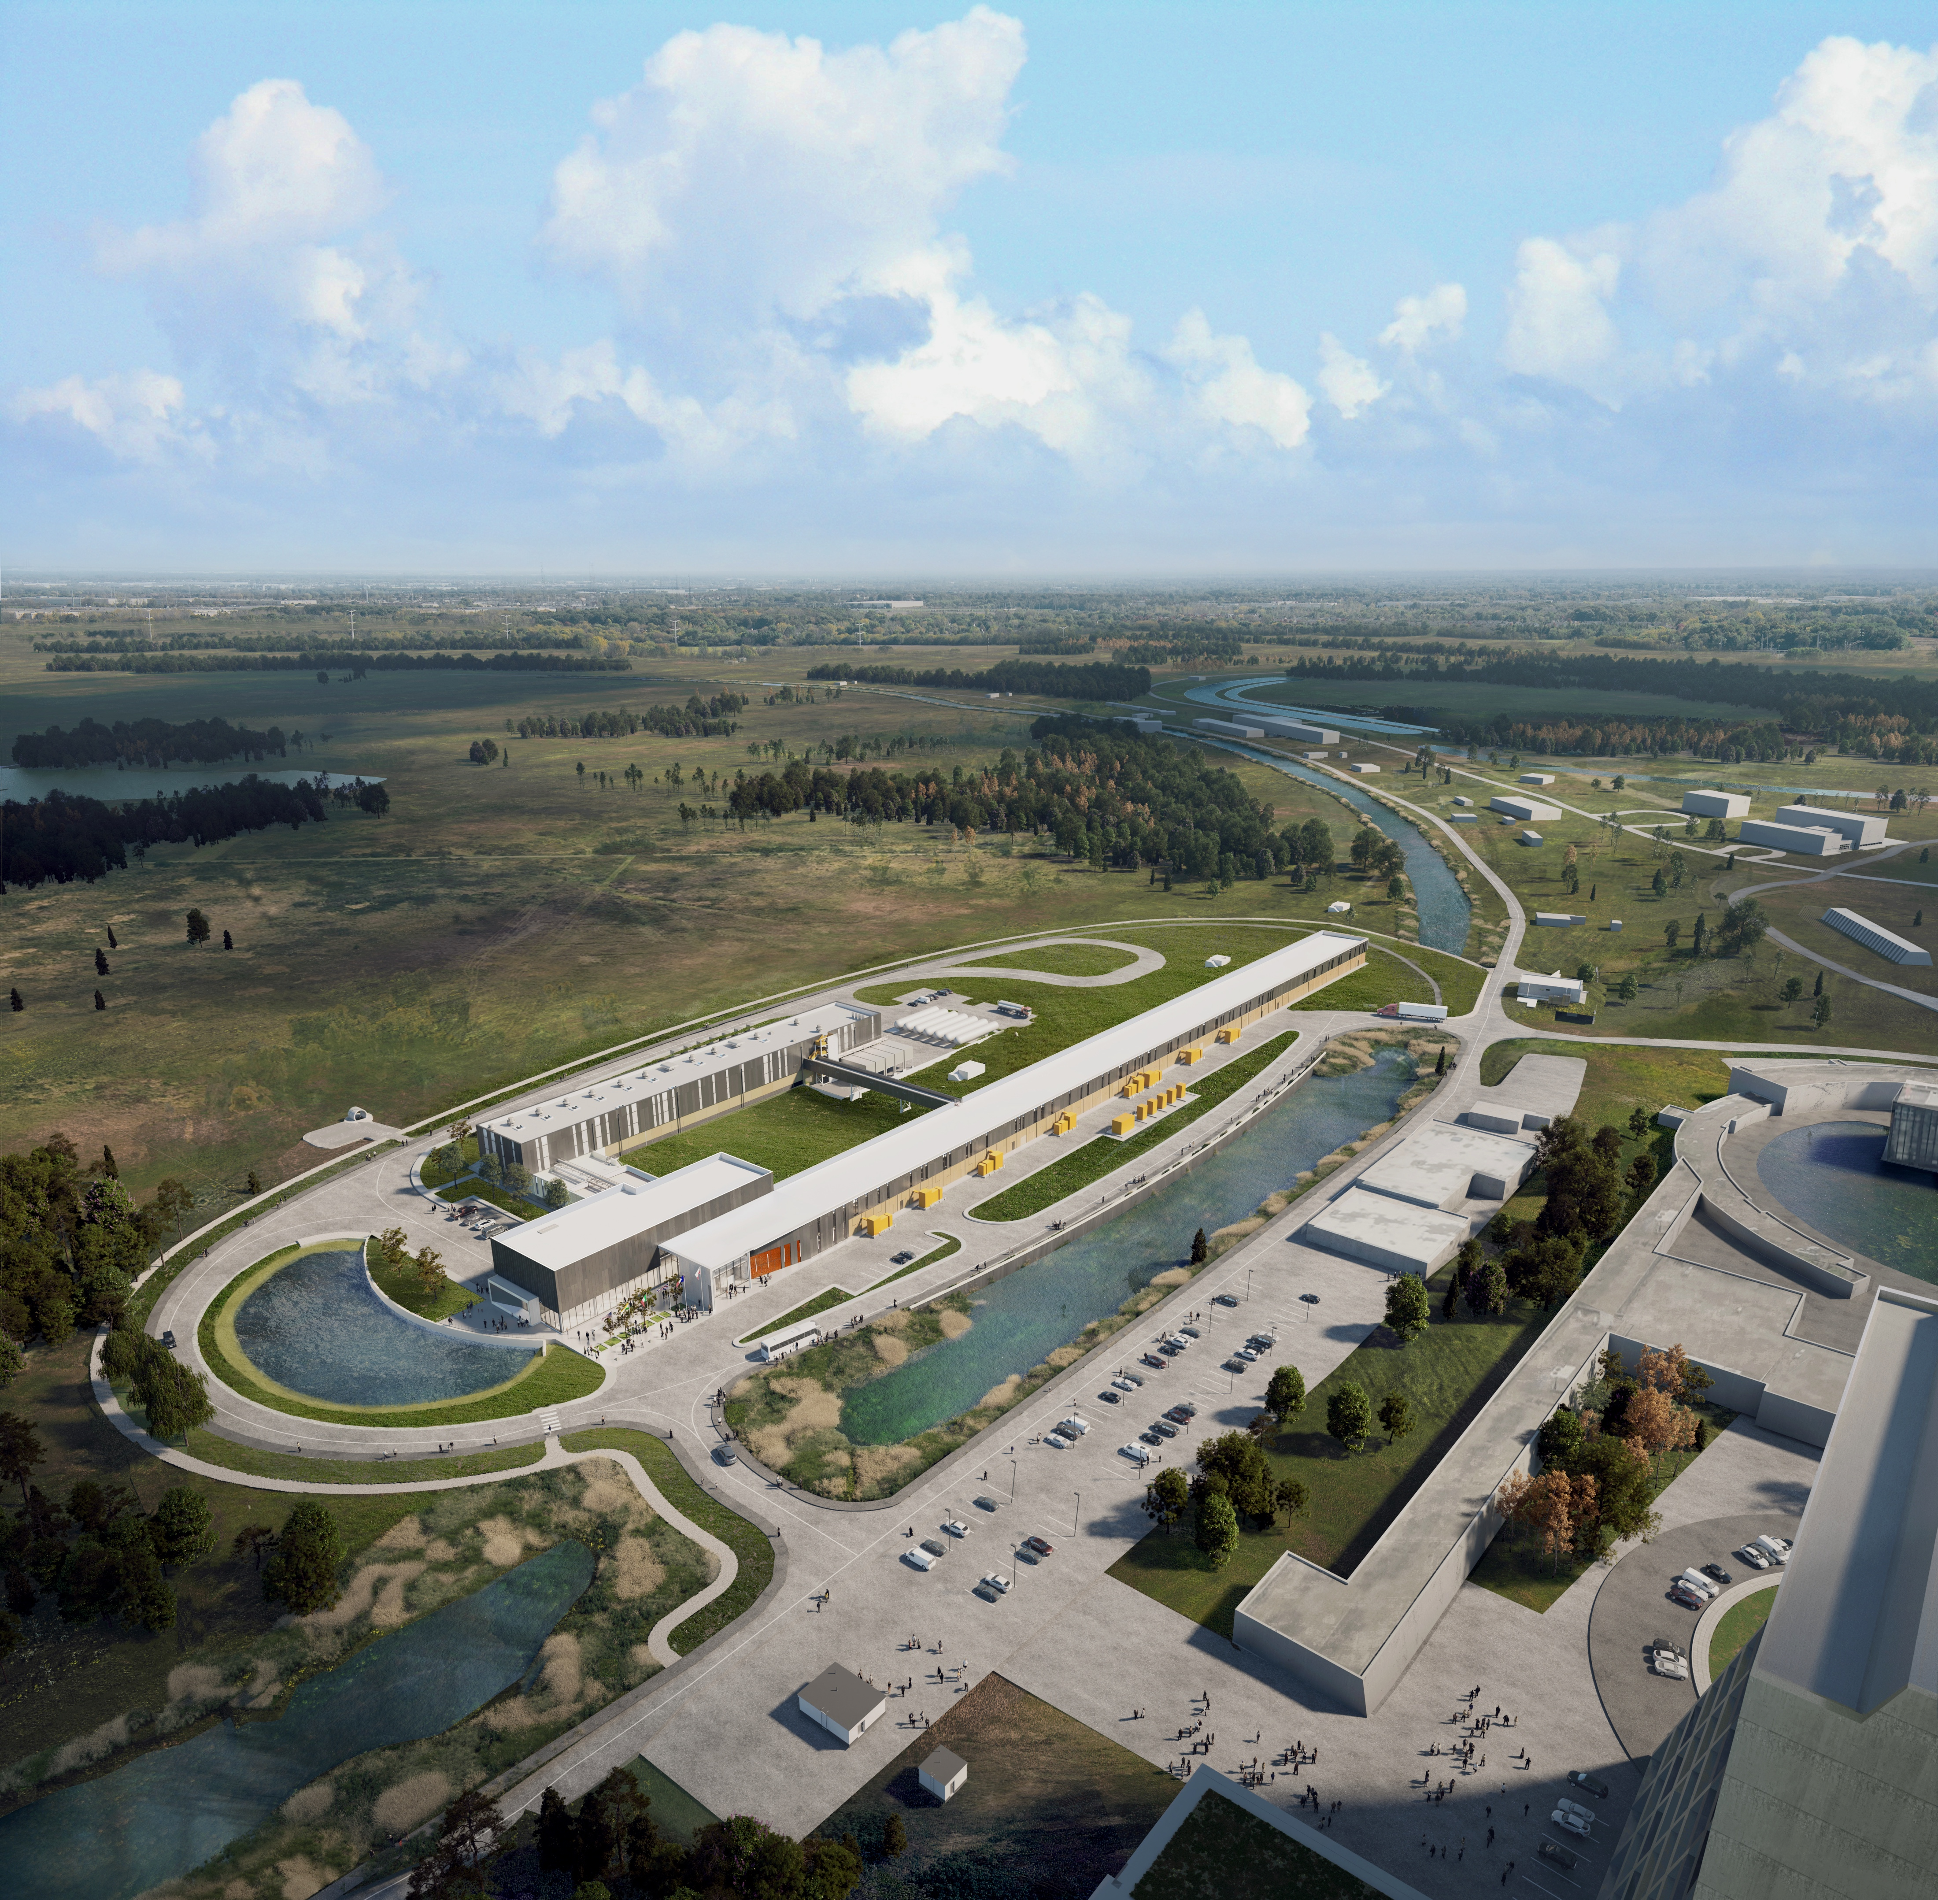



THE FUTURE OF FERMILAB
Follow us:
www.pip2.fnal.gov
@PIP2accelerator
/showcase/pip-ii/

