Slide 1
Innovation Discovery Event
Fermi National Accelerator Laboratory
May 25, 2023
9:00AM – 1:00 PM CDT
Virtual Event

Slide 2
What is an Innovation Discovery Event (IDE)?
The IDE is a one-day event consisting of two or three 75-minute sessions in which Fermilab researchers present technologies to a panel of four-six individuals with strong technical, business, and/or creative backgrounds. After the presentations, the panel is led in brainstorming sessions to identify opportunities for further development or commercialization.
This is not a Public Event and does not constitute a public disclosure of information.

Slide 3
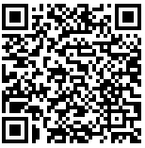
Why is Fermilab hosting an IDE?
To educate the Principal Investigators (Scientists and Engineers) on how to incorporate entrepreneurial thinking earlier in the research process
What problem are they trying to solve?
Does it have real world application?
Is it a viable option for industry?
What will be needed to identify and attract a transition partner?
Ex. Previous Event – Air Force Research Lab, Doolittle Institute
https://doolittleinstitute.org/artists-entrepreneurs-and-engineers-collaborate-at-ide/

Slide 4
Schedule
Central Daylight Time
8:55 AM | Virtual Event Link Opens
9:00 AM | Welcome & Introduction
9:15 AM | PI and Panel Orientation, Dr. Mike Reilly, TechLink
10:00 AM | Technology Round 1: Guillermo Fernandez Moroni Skipper CCD
11:15 AM | Break
11:25 AM | Technology Round 2: Jovan Pavle Mitrevski AI on the Edge
12:40 PM | Wrap up & Closing Remarks

Slide 5
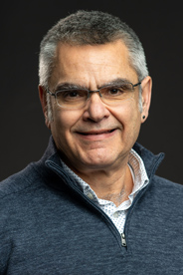
Your Host: Panagiotis Spentzouris Associate Laboratory Director, Emerging Technologies
Panagiotis Spentzouris is the Associate Lab Director for the Emerging Technologies Directorate, which oversees and conducts highly integrated basic and applied research programs across the laboratory that deliver new science and technology capabilities in support of Fermilab’s mission. Spentzouris is a senior scientist at the laboratory, former head of Quantum Science at the Fermilab Quantum Institute and former head of the Fermilab Scientific Computing Division. His prior research includes quantum information science, neutrino physics and computational accelerator physics. Spentzouris received his Ph.D. in 1994 from Northwestern University, is a fellow of the American Physical Society, and joined Fermilab as an associate scientist in 1998.

Slide 6
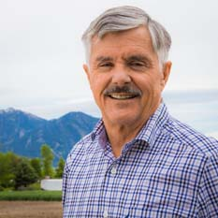
Your Facilitator: Mike Reilly Senior Commercialization Advisor, TechLink
Mike provides facilitation for creative group thinking. He has conducted over 60 brainstorm-based workshops to explore intellectual property development and expansion and identify commercial opportunities for innovative technologies. The emphasis is finding the right market opportunity where the technology solves a problem that is valuable to a well-defined segment of the market.

Slide 7
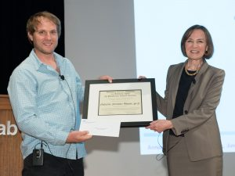
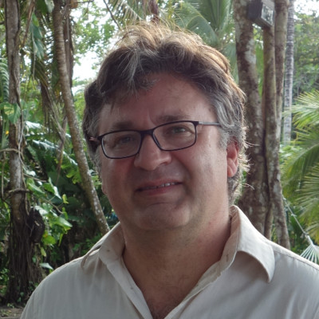
Principal Investigators
Guillermo Fernandez Moroni
Associate Scientist
Skipper CCDs
Jovan Pavle Mitrevski
Application Physicist II
AI on the Edge

Slide 8
Technology
Guillermo Fernandez Moroni
Associate Scientist
Skipper CCDs
The Skipper CCD concept was proposed in the early 1990's,but has only recently been realized. We can now precisely count each individual electron in each pixel of a large CCD consisting of millions of pixels. This is irrespective off whether the pixel contains only zero or one electron, or if it contains more than 1000 electrons.

Slide 9
Technology
Jovan Pavle Mitrevski
Application Physicist II
AI on the Edge
Edge computing is often needed for energy-efficient data reduction in high data rates use-cases, and AI-on-the-edge is often a high-performance solution for these many applications. Our work on the open-source tool flow, hls4ml, provides an accessible, user-driven way to deploy AI on efficient computing platforms such as FPGAs and ASICs on the edge, where the performance and power efficiency of such technology is especially desirable. The hls4ml software package takes networks in common formats, like Keras, ONNX, or PyTorch, and produces synthesizable C++, which can then be placed on the devices. It has been deployed in a broad range of applications in science and industry demonstrating its ease-of-use and performance.

Slide 10
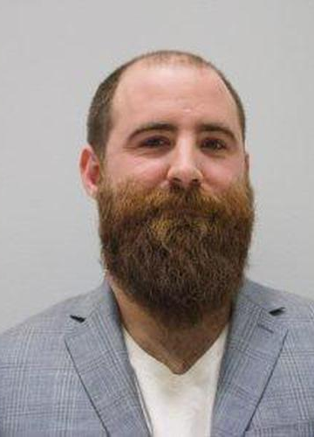
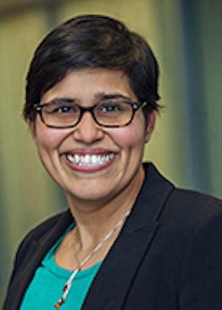
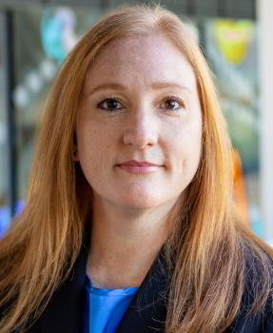
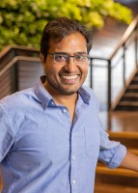
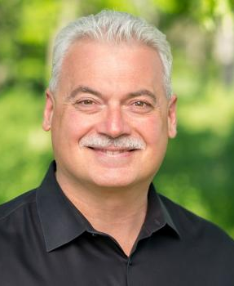
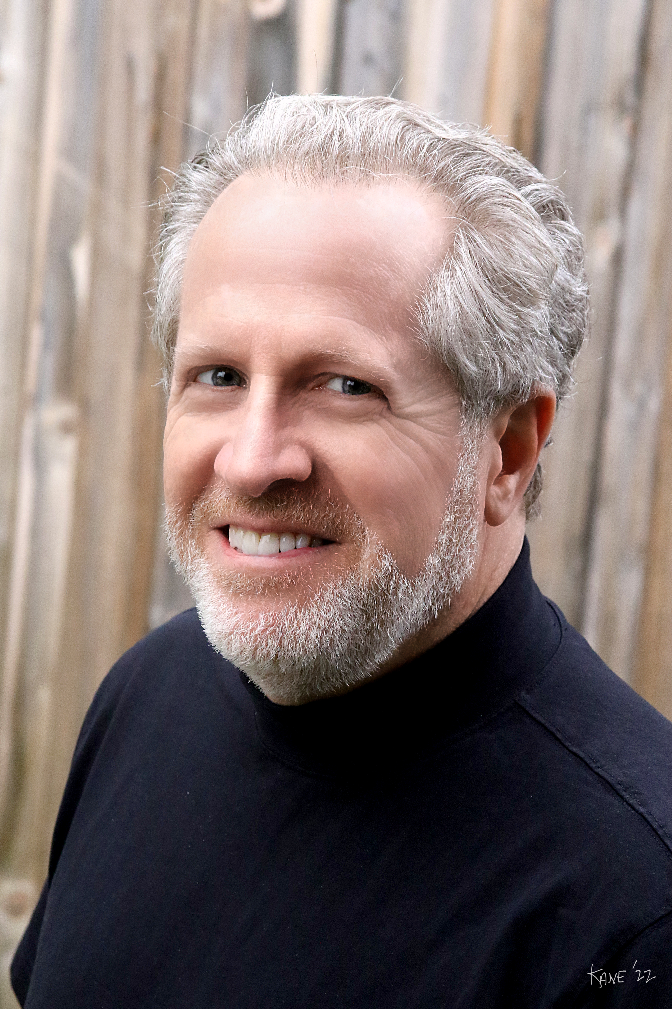
Panelists
Alex Gorsuch, Co-founder and CTO, Ascent Integrated Tech
Anne Juggernauth, Assistant Dir., Business Development and Licensing, University of Chicago
Deena Wright, Fellowship & Program Manager at Argonne National Laboratory
Gaurav Bansal, Sr Director of Engineering, Autonomy at Blue River Technology
John Carlisle, former Director of Chain Reaction Innovations, Argonne National Laboratory
Neil Kane, Director of Curriculum and Capstone Advising in the ESTEEM Program at the University of Notre Dame
Non-Disclosure Agreements (NDA) are required for all
non-Fermi Research Alliance, LLC (FRA)
No technical background or preparation required; panel will receive orientation on day of event.

Slide 11
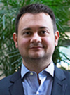
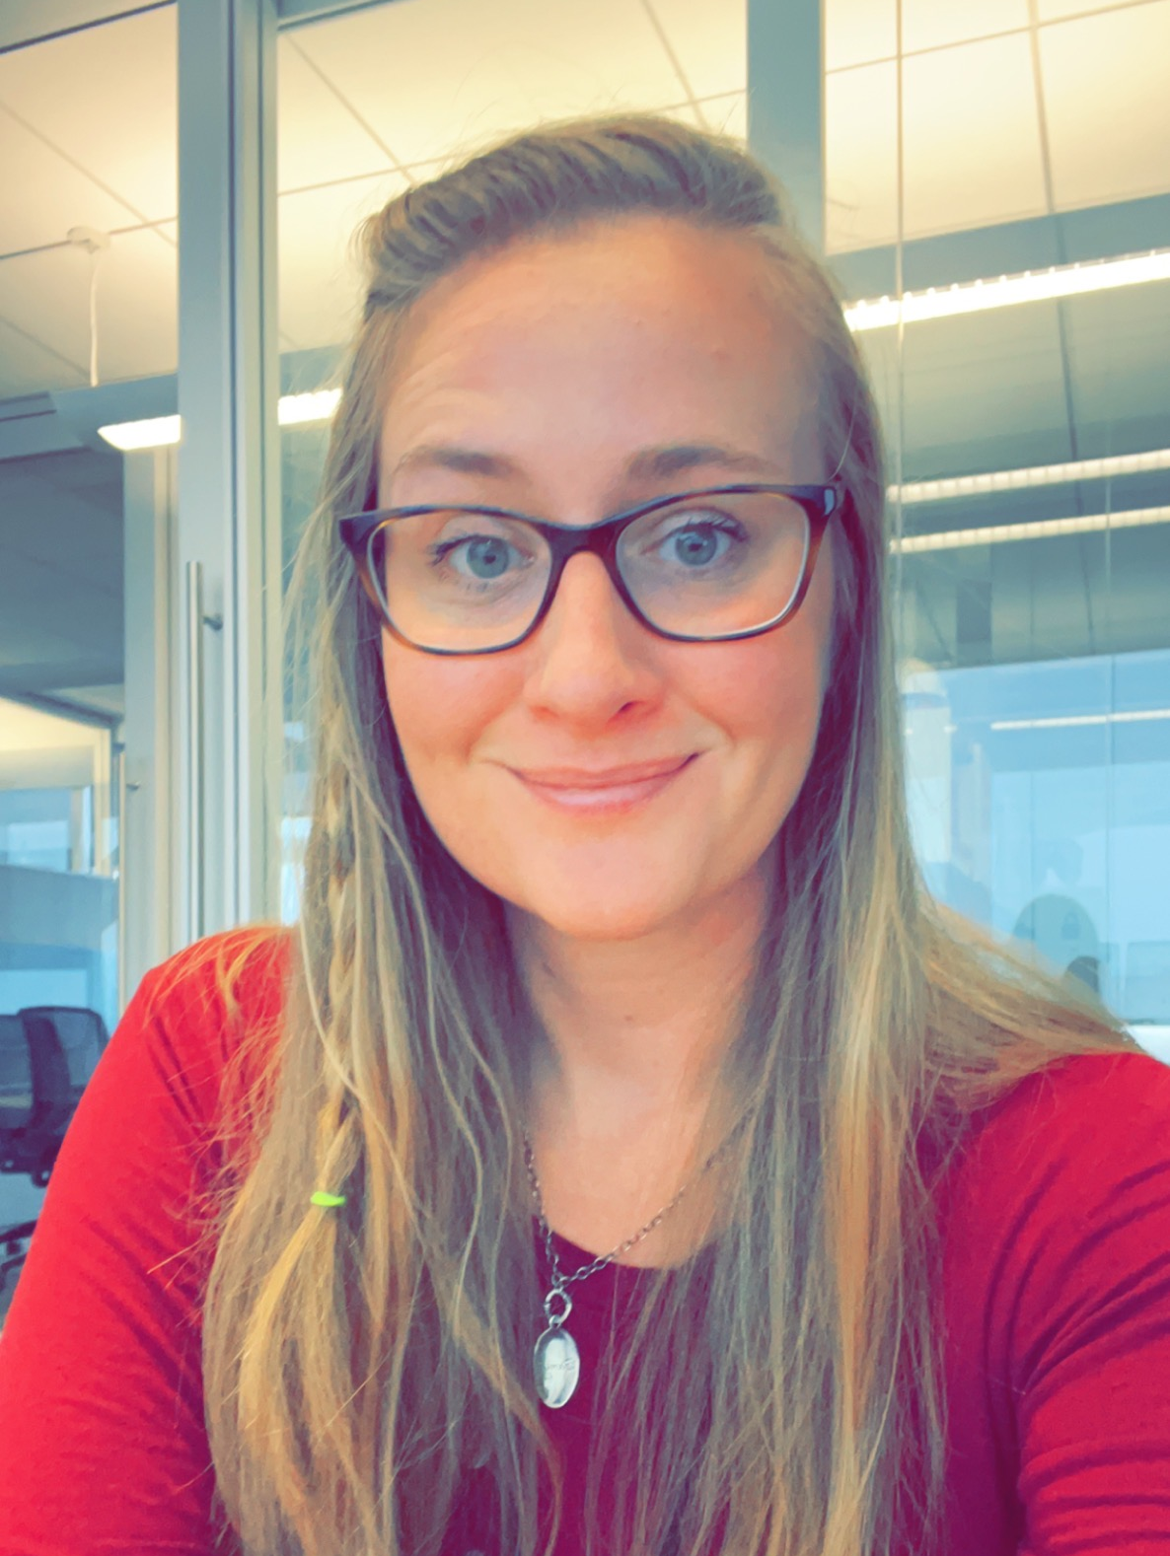
Coordinators
Aaron Sauers, Senior Patent & Licensing Executive, Fermilab
Leanna DeMarre, Partnership Coordinator, Office of Partnerships & Technology Transfer, Fermilab

Slide 12
Closed Event
Fermilab Senior Management Team and Legal Office
Fermilab Principal Investigator Project Teams
Fermilab Technology Engagements Team
Department of Energy, Office of Technology Transfer, PACT Program Manager
Department of Energy, Fermi Site Office
Princeton Plasma Physics Lab, Technology Transfer Chief
Jefferson Lab, Technology Transfer Chief
SLAC, Technology Transfer Chief
This is not a Public Event.

Slide 13
Previous TechLink Discovery Events
Army Research Lab
https://techlinkcenter.org/news/army-first-innovation-discovery-event/
Princeton Plasma Physics Lab
https://w3.pppl.gov/communications/weekly/WEEKLY.05.02.16.pdf
Naval Surface Warfare Center
https://www.navy.mil/DesktopModules/ArticleCS/Print.aspx?PortalId=1&ModuleId=523&Article=2260217

