Slide 1
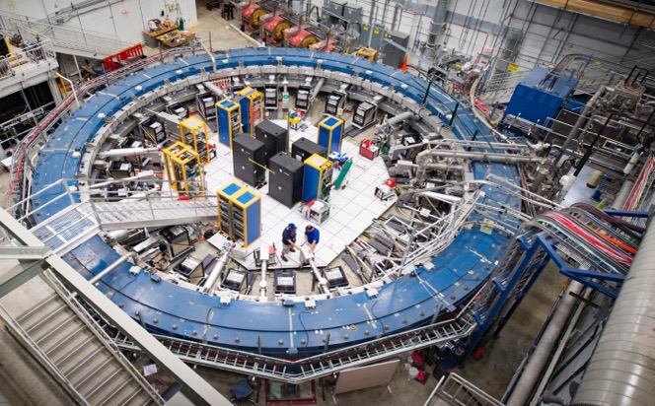
Fermilab Muon g-2 and other topics
Chris Polly
Fermi National Accelerator Laboratory
Muons in Minneapolis Workshop
December 6, 2023

Slide 2
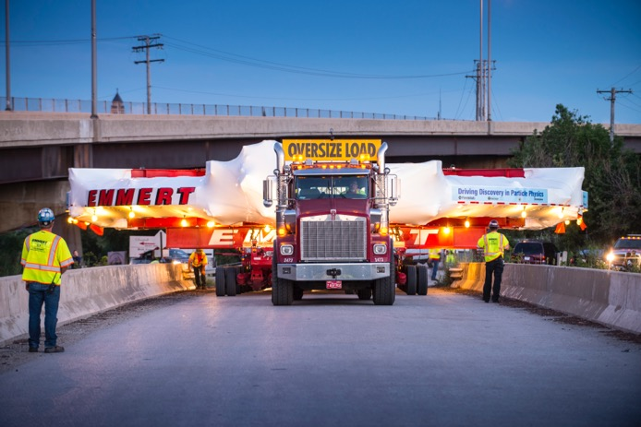


Original goal of Fermilab Muon g-2
Bring the container used to hold the muons from BNL and couple it to Fermilab’s powerful accelerator beam
Reduce the overall error by a factor of 4 to 140 ppb
  20x the muons → reduce statistical error from 460 to 100 ppb
Control systematics at the same 100 ppb level (3x better)
  Need to know ω_{a} and B( or ω_{p}) to better than 70 ppb each

Slide 3
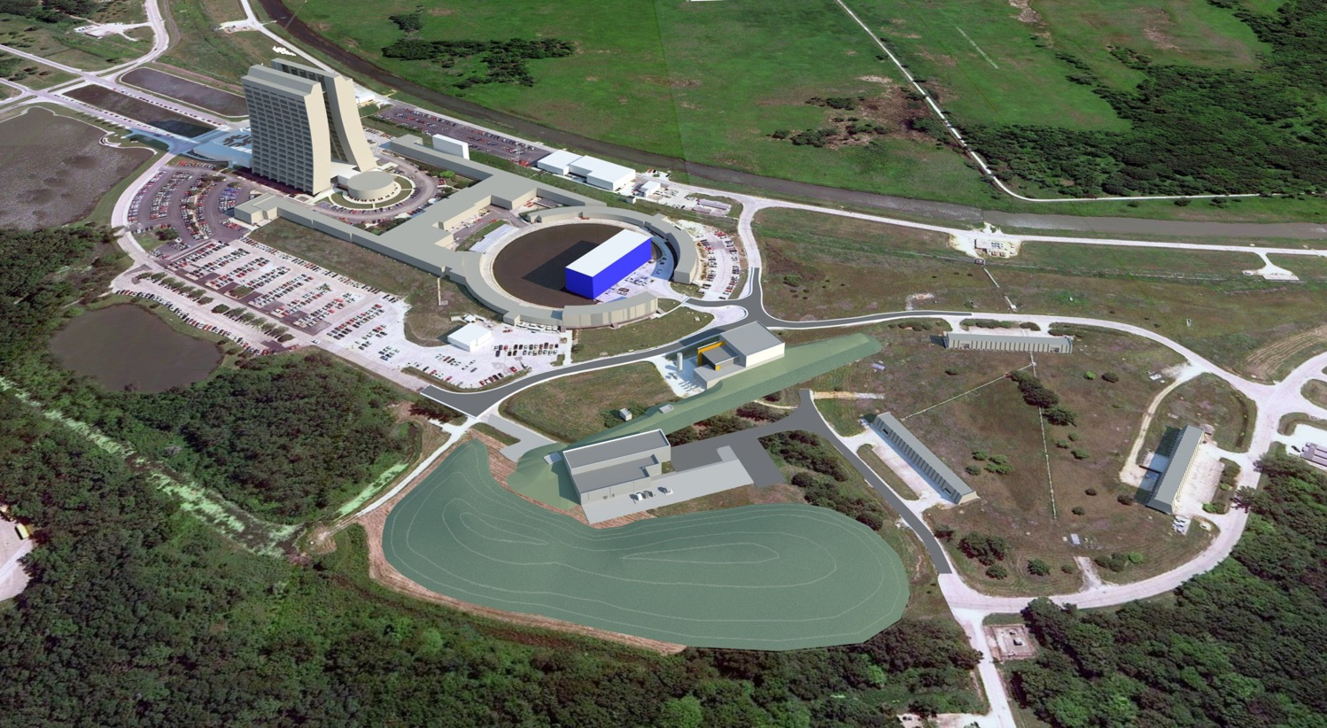
Fermilab Muon Campus Vision, circa 2012

Slide 4
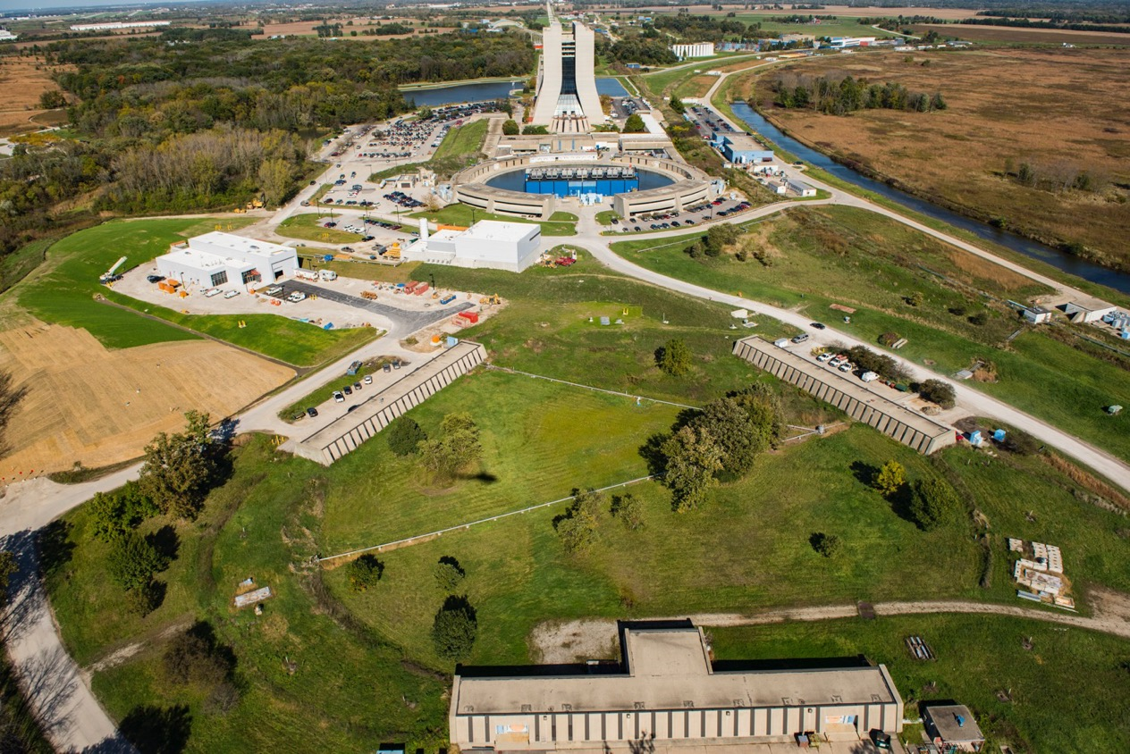
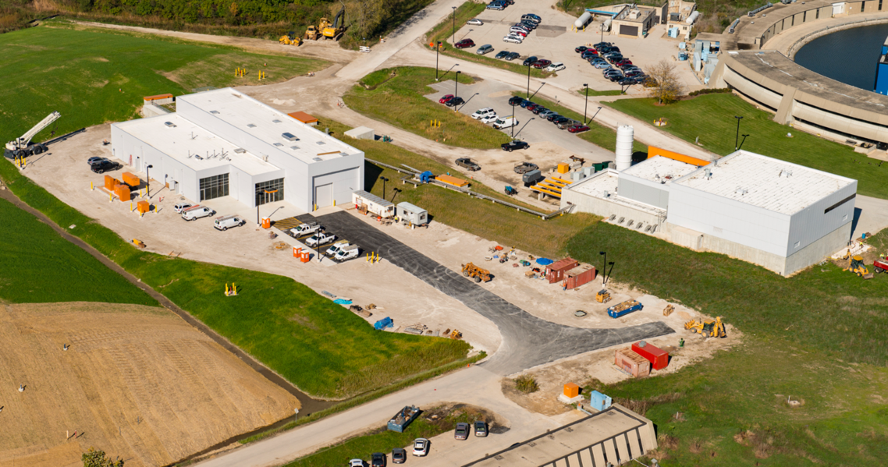
Muon Campus Today

Slide 5
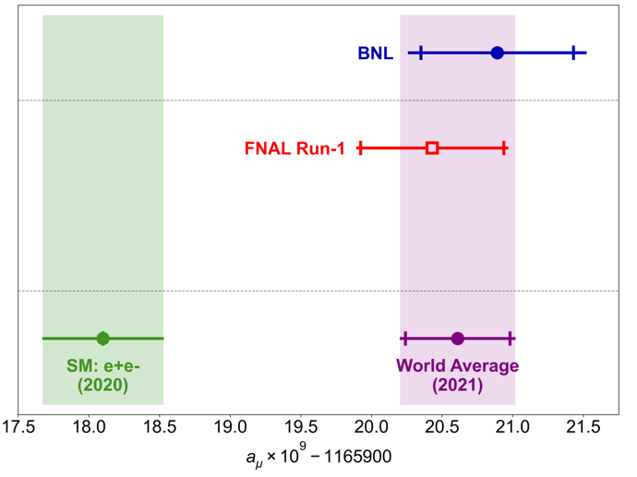
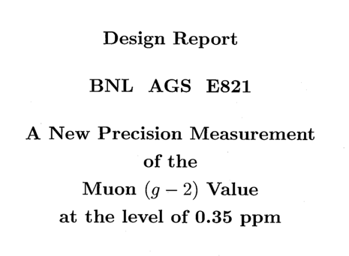
First Fermilab results from 2021
Excitingly confirmed the BNL result!
Increased tension with SM Theory to 4.7σ
Most precise determination at 463 ppb
Combined exp. precision of 350 ppb
a_{μ}(FNAL; Run-1) = 0.00 116 592 040(54) [463 ppb]
a_{μ}(Exp) = 0.00 116 592 061(41) [350 ppb]
*Muon g – 2 Theory Initiative white paper (WP) value
https://doi.org/10.1016/j.physrep.2020.07.006

Slide 6
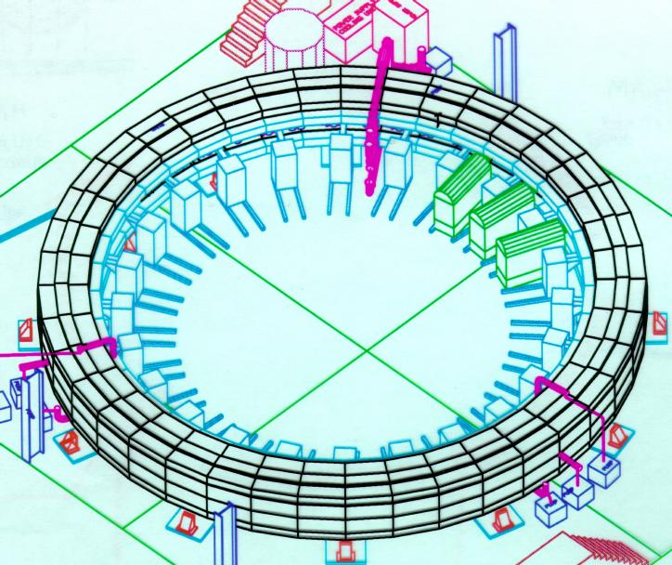
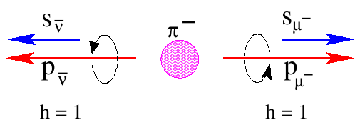

Experiment principles: Polarized muons & the magic γ
1) Inject polarized muon source
2) Choose γ = 29.3 muons allow E-field vert. focusing
~ 0

Slide 7
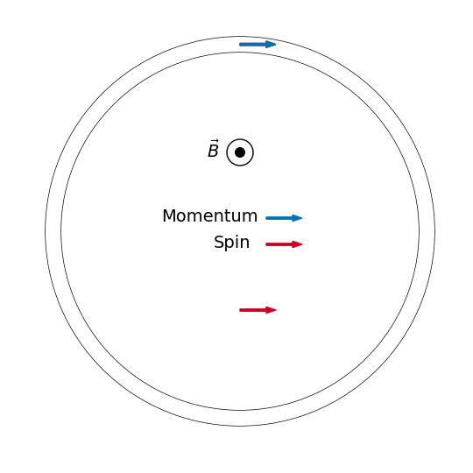
Experiment principles: Spin precession proportion to aμ
3) Muon spin precession relative to momentum in cyclotron is directly proportional to a_{μ}
800x more precise than muons at rest
→ ‘Only’ need to know ω_{a} and B to < 100 ppb!

Slide 8
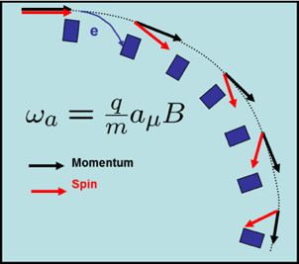
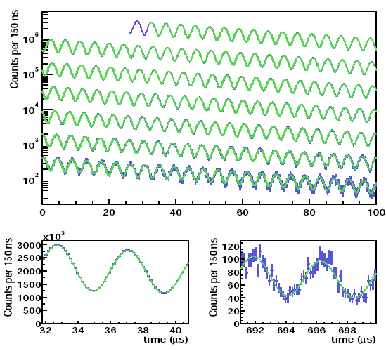
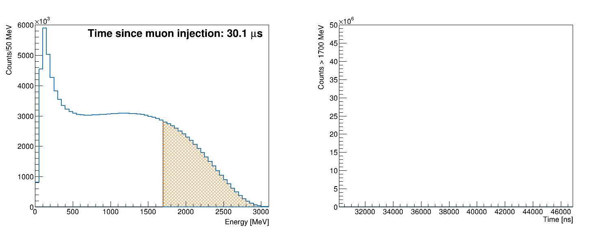
Experiment principles: PV in muon decay → natural polarimeter
4) Highest energy decay electrons emitted when spin and momentum vectors parallel
Energy Spectrum
Time Spectrum
Threshold Energy

Slide 9
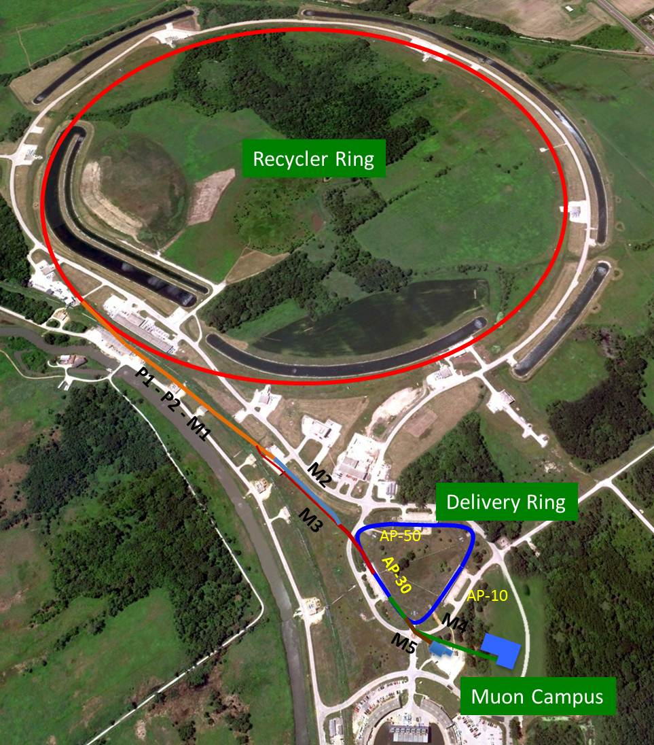
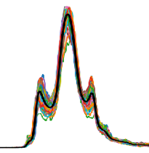

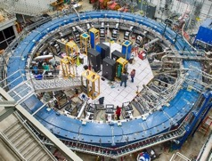
Beam delivery
Inject 8 GeV protons into Main Injector
intensity
Use RF to create bunches
Create pions on a target
150 ns
Transfer and decay π ◊ μν, creating a polarized muon beam
Delivery Ring kicks out remaining protons, muons are extracted
~5000 stored muons per pulse
16 shots / 1.4 s
Repeat! (~10Hz for ~40 mos)

Slide 10
Major improvements in beam delivery relative to BNL
21 x statistics of BNL but at similar instantaneous rate
  Injected muon bunches 3x faster and run 7x longer
  Run 7x longer
Pion decay channel increased from 80 m to nearly 2000 km by circulating around Delivery Ring (DR)
  All pions decay to muon vs 50% → reduces hadronic flash which creates a large background in ring
Circulating in DR also gives time for protons to separated by time-of-flight and cleaned from muon beam → also reduces flash

Slide 11
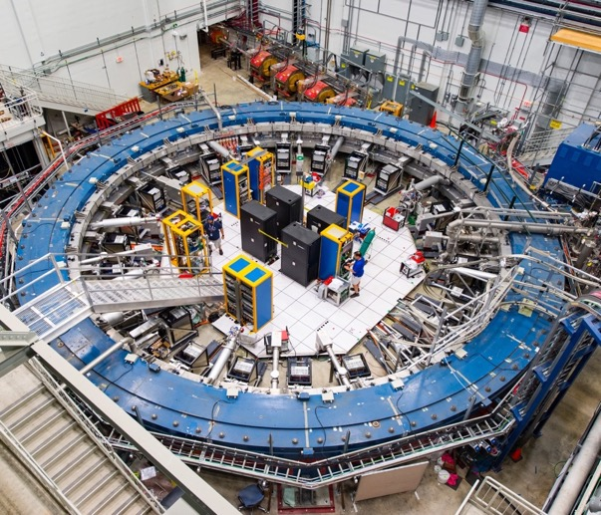
Inject nearly pure muon beam into the storage ring
μ⁺
Muons are injected through a hole in the back of the magnet
Superconducting magnet (inflector) nulls the B-field to allow muons to pass
Muon emerge from inflector and start to bend in the B field

Slide 12
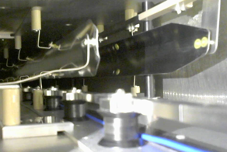
Kick muons onto a stored central orbit
μ⁺
μ⁺
Kicker
B
Kickers 3 x faster than BNL

Slide 13
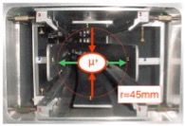
Electrostatic quad provide vertical focusing
μ⁺
Quadrupole Plates
B
Quad electrode cover 41% of ring circumference
Keeps beam confined but generates coherent betatron oscillation (CBO)

Slide 14
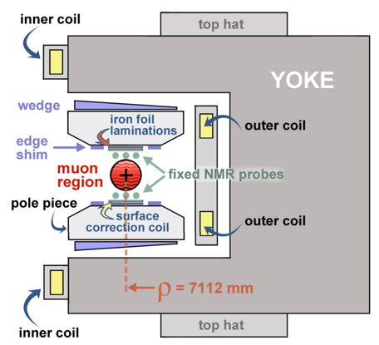
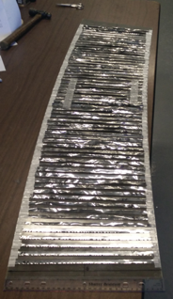
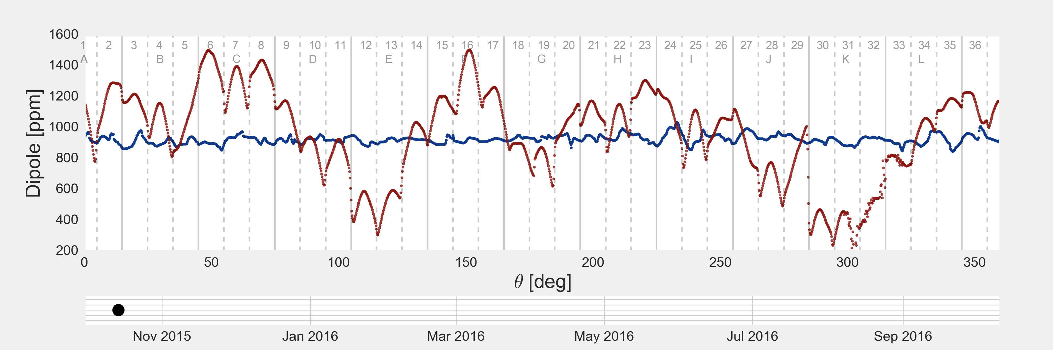
Same storage ring, but…
Much more stable floor and hall temperature
Most field systematics scales with field non-uniformities
  Spent a year shimming, added 9000 custom cut pieces of shim stock
Fermilab: ~15 ppm RMS (~75 ppm peak-to-peak)
BNL E821: ~35 ppm RMS (~200 ppm peak-to-peak)

Slide 15

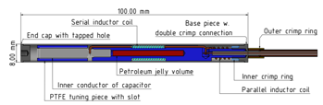
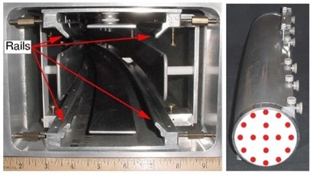
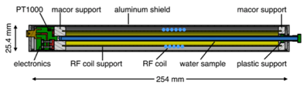
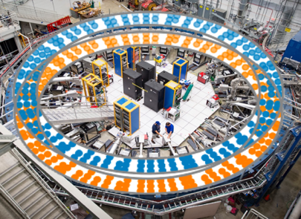
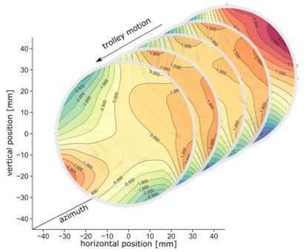
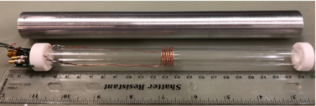
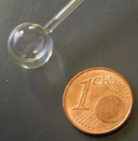
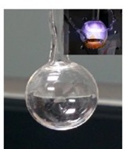
Field systems used to determine B to < 100 ppb
NMR trolley maps field every 3 days
Use NMR to find B-field in terms of proton precession frequency ω_{p} (comagnetometer)
378 fixed probes monitor 24/7
Trolley cross-calibrated to absolute probes
Doubled the number of useful fixed probes

Slide 16


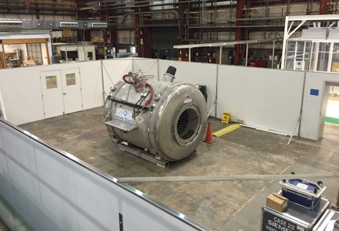

Improvements to field systematics – absolute calibration
At BNL one historical H₂O probe was used
  Same probe used in LANL muonium hyperfine
  26 ppm correction
Developed new cylindrical probe
  Holder has less magnetic impurities
Developed He3 as new standard (T. Chupp)
Built a facility at ANL for cross-calibration
  Probes consistent to better than 5 ppb
Original H₂O probe
New cylindrical H₂O probe
He3 as a new standard (no diamagnetism)

Slide 17
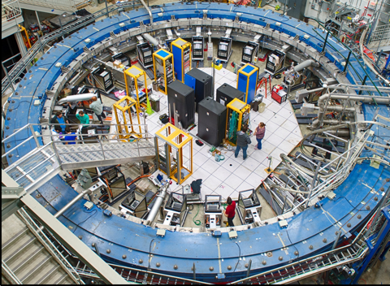
New calorimeters
PbF₂ xtals
e⁺
Major upgrades from BNL:
  6x9 array to PbF2 crystals allows us to spatially separate pileup with better Cerenkov timing relative to the PbSciFi monolithic BNL calorimeters
  800 MHz waveform digitizers sample at twice the rate
  Modern computing bandwidth allows us to keep data down to 0 threshold (1 GeV at BNL)
  Sophisticated laser systems allows us to monitors gain changes at 1 part in 10⁴

Slide 18
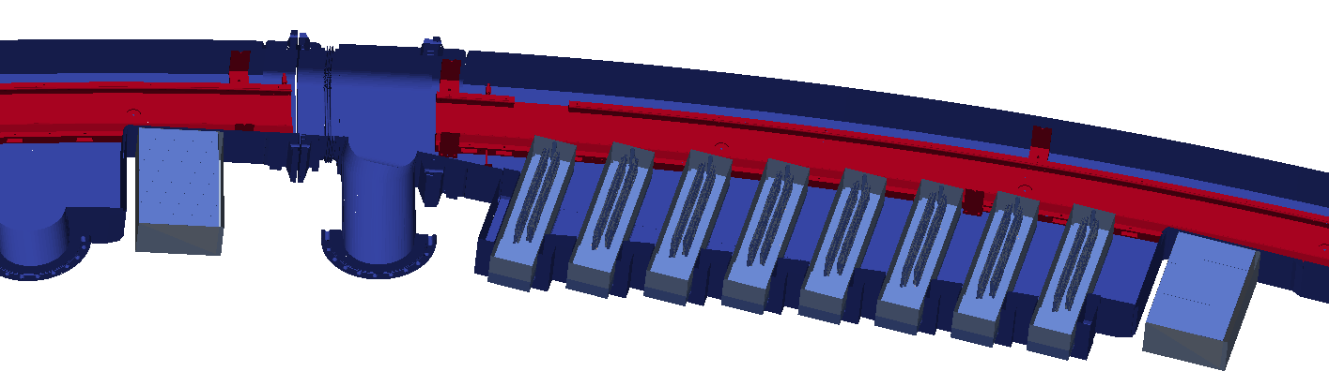
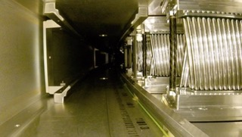
Straw trackers track decay positrons → muon distribution
Section through storage ring
Vacuum Chamber
Decay e⁺
Calorimeter
Tracker
Calorimeter
Two in vacuo straw tracker stations tell us the spatial distribution and many other critical muon beam properties (vertical/horizontal mean/width, CBO, p-distribution)
  Another major addition compared with BNL that had one tracker outside the vacuum

Slide 19
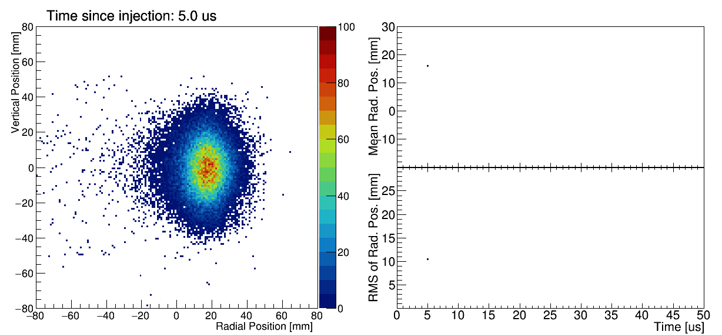
Tracker data invaluable for seeing muon beam dynamics

Slide 20
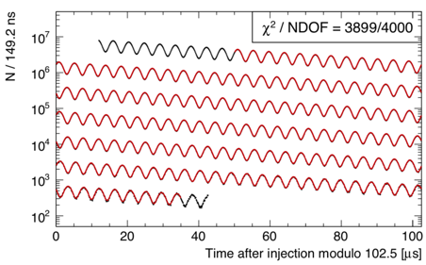
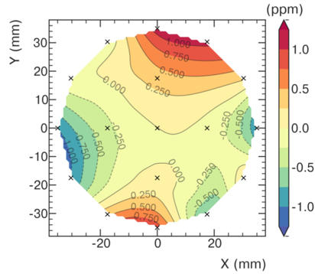
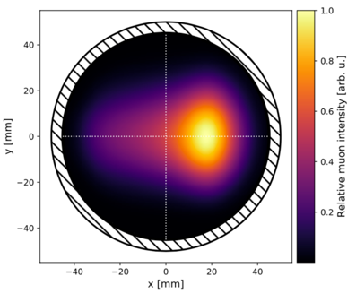
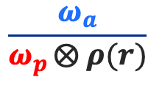
The analysis ‘big picture’
⇓
$$\frac{ω_{a}}{ω_{p }⨂ ρ(r)}$$
⊗
*All plots actual Run 1 data

Slide 21
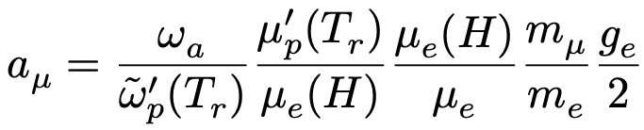
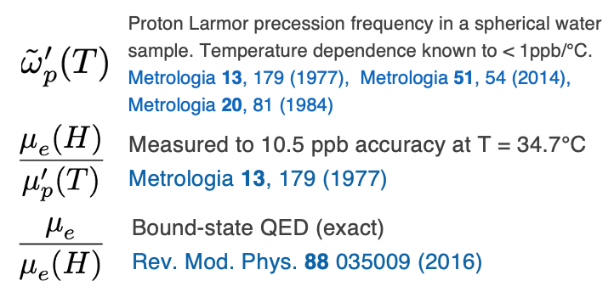


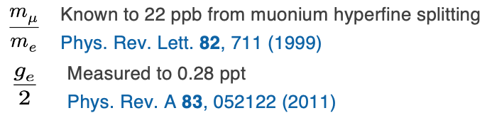
We rely on CODATA for some constants
Them
Us
: the muon spin precession frequency
: precession of protons in water sample mapping the field and weighted by the muon distribution
Goal: 140 ppb =
100 ppb (stat) ⊕ 100 ppb (syst)
All < 22 ppb

Slide 22
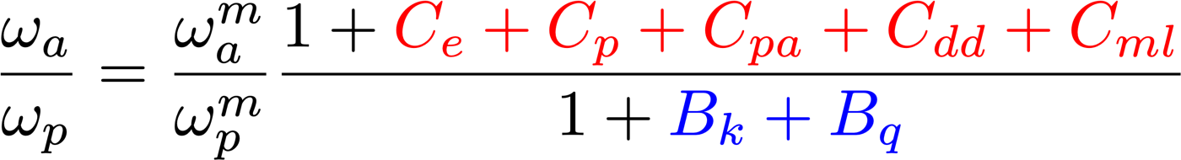
But wait, there’s more…
E-field & Up/Down motion: Spin precesses slower than in basic equation
Phase changes over each fill:
Phase-Acceptance, Differential Decay, Muon Losses
Transient Magnetic Fields:
Quad Vibrations,
Kicker Eddy Current,
Measured Values

Slide 23
Systematic summary from Run 1
ω_{a} systematics
ω_{p} systematics
 | BNL actual [ppb] | FNAL TDR [ppb] | FNAL Run 1 [ppb]
Trolley calibration | 90 | 30 | 32
Trolley B meas | 50 | 30 | 25
Fixed probe tracking | 70 | 30 | 23
Muon weighting | 30 | 10 | 20
Absolute calibration | 50 | 35 | 19
Configuration | ‘Other’ | ‘Other’ | 23
Kicker transients | ‘Other’ | ‘Other’ | 37
Quad transients | ‘Other’ | ‘Other’ | 92
Other | 100 | 50 | negligible
Total | 170 | 70 | 114
 | BNL actual [ppb] | FNAL TDR [ppb] | FNAL Run 1 [ppb]
Gain + residuals | 120 | 20 | 19
Pileup | 80 | 40 | 37
Lost muons | 90 | 20 | 5
CBO | 70 | 30 | 40
E-field/pitch | 50 | 30 | 55
Phase acceptance | N/A | N/A | 75
Total | 180 | 70 | 108
Total systematic = δω_{p} ⊕ δω_{p} ⊕ δ(PDG) = 114 ⊕ 108 ⊕ 25 ppb
= 159 ppb
Much better than BNL in Run 1, but at 159 ppb…not quite to 100 ppb goal
Dominated by a couple of specific systematics addressed by Run 2 & 3

Slide 24
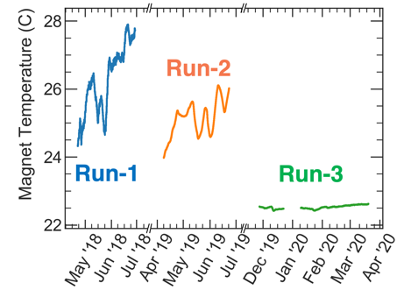
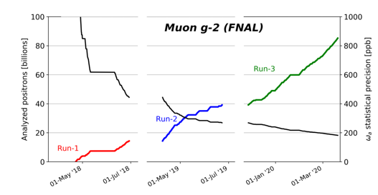
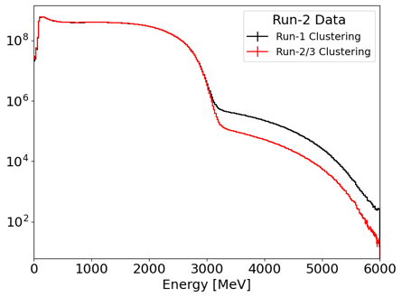
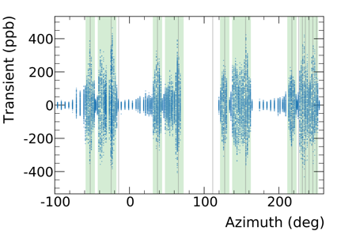
Improvements for Run 2/3
Statistics
Running Conditions
Systematic Measurements & Studies
Analysis Improvements

Slide 25
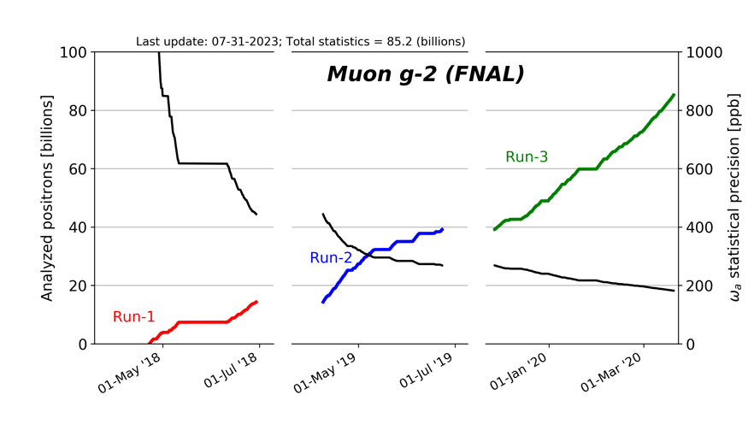
Run 2/3 Improvements: Statistics
Weighted e⁺ in our final fit after quality control
E > 1 GeV
t > 30 us
Dataset | Statistical Error [ppb]
Run-1 | 434
Run-2/3 | 201
Run-1 + Run-2/3 | 185
Factor 4.7 more data in Run-2/3 than Run-1

Slide 26
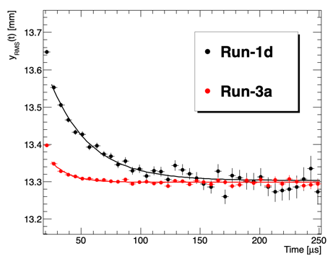
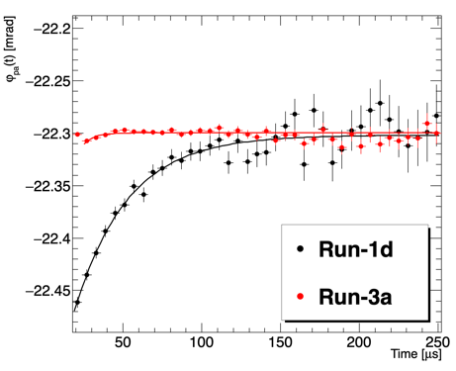
Run 2/3 Improvements: Run conditions – phase acceptance
Run-1 had damaged resistors in 2/32 quad plates leading to unstable beam storage → resistors re-designed & replaced before Run-2
C_{pa} uncertainty is reduced (75 ppb → 13 ppb) & more stable n-value
ω_{a} phase change
Vertical beam width change

Slide 27



Run 2/3 Improvements: Run conditions – hall temperature
Run-2
Run-1
Run-3
Added thermal insulation after Run 1 → nearly eliminates diurnal variations
Augmented hall HVAC with additional cooling (using liquid nitrogen)

Slide 28


Ring before and after

Slide 29


Run 2/3 Improvements: Run conditions – kick strength
Major kicker upgrades implement throughout Run 2/3 to increase the kick strength
  Momentum distribution better centered → smaller C_{e} correction
  Better phase space matching to ring → smaller betatron oscillations
Some improvements at start of Run 2, but optimal only for last 18% of Run 2/3

Slide 30



Run 2/3 Improvements: Measured quad transients
Pulsing quads vibrate $⇒$oscillating magnetic fields
Measured with a new NMR probe housed in insulator
For Run-1 analysis, we had limited measurement positions → largest Run-1 systematic: 92 ppb
ESQ4
ESQ1
ESQ2
ESQ3
Run-1 Measurement Locations at Black Lines
Field Change [ppb]
Muon fills

Slide 31


Run 2/3 Improvements: Measured quad transients
Measurement probe mounted on trolley rail train
For Run-2/3 analysis, probe runs on the trolley rails → allows full mapping of all quad stations → uncertainty reduced to 20 ppb

Slide 32


Run 2/3 Improvements: Measured kicker transients
Run-1 Measurement
Run-2/3 Measurement
Kicker creates eddy currents → transient magnetic field
Improved Faraday magnetometer to have less vibrational noise for Run-2/3
Uncertainty reduces from 37 ppb to 13 ppb

Slide 33

Uncertainty improvement from Run 1 to Run 2/3
Analysis Improvements
Running Conditions
Improved Measurements
Substantial improvements in all leading systematics

Slide 34

Run 2/3 Final Uncertainties
Total uncertainty is 215 ppb
[ppb] | Run-1 | Run-2/3 | Ratio
Stat. | 434
Syst. | 157
[ppb] | Run-1 | Run-2/3 | Ratio
Stat. | 434 | 201
Syst. | 157
[ppb] | Run-1 | Run-2/3 | Ratio
Stat. | 434 | 201
Syst. | 157 | 70
[ppb] | Run-1 | Run-2/3 | Ratio
Stat. | 434 | 201 | 2.2
Syst. | 157 | 70 | 2.2
Near-equal improvement: We’re still statistically dominated
Systematic uncertainty of 70 ppb surpasses our proposal goal of 100 ppb!

Slide 35

Run-2/3 Result: FNAL + BNL Combination
a_{μ}(FNAL) = 0.00 116 592 055(24) [203 ppb]
Unblinded Run 2/3 July 24, 2023
Excellent agreement with BNL and FNAL Run 1
Stat error still vastly dominates
World average now dominated by FNAL
a_{μ}(Exp) = 0.00 116 592 059(22) [190 ppb]

Slide 36


New RF system deployed in Run 5
First time in history of CERN/BNL/FNAL storage ring g-2’s
Turns on for first few microseconds to damp CBO
Greatly reduces CBO amplitudes and muon losses

Slide 37

Experiment Outlook
Data collection is done!
  Integrated statistics reached the TDR goal of 21 x BNL
  (actual = 21.9 x BNL)
  Systematic uncertainty (~70ppb) will already better than the ~100 ppb TDR goal
Aiming for publishing a final result in 2025 with uncertainty reduced by ~2
2023 pub (in progress)
2021 pub
~2025 pub

Slide 38

Parasitic measurement…Muon EDM
Signal is a rotation of the muon spin precession out of the plane and oscillating out of phase with g-2
Observe the pitch angle of decay e+ in the trackers
Key systematics
  Residual Br
  Tracker alignment and acceptance
Run 1/2/3 analysis nearing completion (still blind)
  Stat error dominated
  Anticipated sensitivity |d_{μ}| ~ 5 ✕ 10⁻²⁰ e·cm
  ~4x better than current BNL limit of |d_{μ}| < 1.9 ✕ 10⁻²⁰ e·cm
At least 4x statistics on tape (more with improvements in tracker ε) → ~2 ✕ 10⁻²⁰ e·cm ultimate limit

Slide 39



Parasitic measurement…CPT/LV Tests
Signals
  Sideral oscillation in ω_{a} (T = 23hr 56min)
  a(μ+) – a(μ-)
  Global fits to BNL/FNAL
Improvements/complementarity to BNL
  >20 x statistics w/ reduced systematics
  Longer lever arm (ran for ~36 mos over 6 years compared to ~9 mos over 3 at BNL)
  Different latitude
Expecting > 4x improvement

Slide 40





Parasitic measurement…DM Search
Coherent DM interactions can exert a spin torque and cause an oscillation in a_{μ} or the EDM signal
Similar to sidereal variation analysis but the period now depends on the m_{DM}
Stacked plots are sensitive to overall shift in ω_{a}, but time-resolved analysis needed for ultimate sensitivity
Analysis in progress…
Pseudoscalar example

Slide 41
What’s next for the storage ring?
More μ+ running?
  Anticipate a systematic floor of ~60 ppb and a final stat error of ~100 ppb → 3x more statistics would reduce total error by 25%
Complications
  Doubling time → 9 more years
  Can’t run with Mu2e → 2030 start
  Something upstream is degrading (20% less flux)
  Straw trackers are developing leaks
Aim high for 20x statistics (again) with full overhaul of beam delivery
  Pulsed devices (Li lens, DR kickers, g-2 kickers) are already maxed
  Need another factor of 2 reduction in systematic → many now comparable → many more upgrades

Slide 42
What’s next for the storage ring?
μ− running?
  Provides a CPT test
  π- production 2x lower → 6 years to match μ+
Ideas for using the ring for other experiments
  300 MeV frozen spin demonstrator
    Hard to deliver significant flux, not EDM competitive
  Use the ring as a spectrometer for muon mass
    Much work by P. Cushman in the past, not competitive with current limits
  Use the large, uniform field volume for an array of detectors
    Briefly explored array of Project 8-like detector, but ring not a good geometry
We would welcome new ideas!

Slide 43


M^3 at Fermilab
Impinge ~15 GeV muons on target and look for DM missing momentum
  Phase 1 10¹⁰ muons on target, Phase 2 10¹³ MOT
  Similar to NA64μ, but much lower beam energy
Interesting primarily in the context of muon-phillic forces
Working group currently developing proposal following Snowmass LOI
https://arxiv.org/abs/1804.03144

