Slide 1
Field Cage Configurations with Integrated PD Modules
Bo Yu
Brookhaven National Lab
June 27, 2023

Slide 2
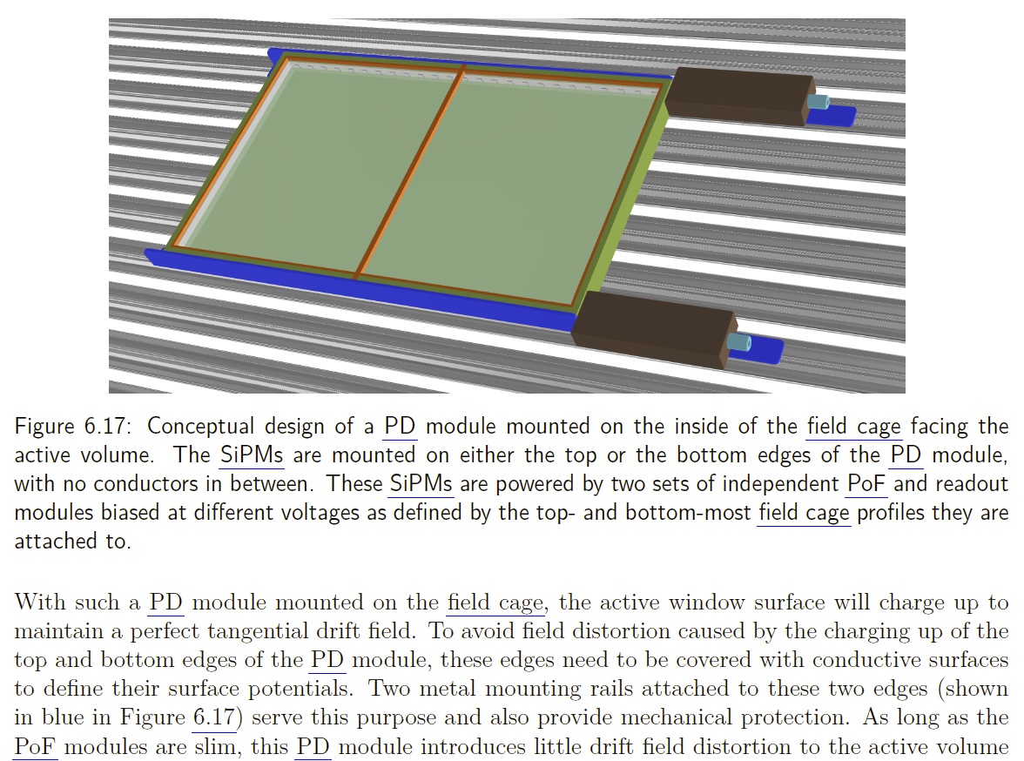
The original FC mounted PD concept
⬅ Excerpt from the DUNE VD CDR
The original goal was to improve the light response uniformity by supplementing the cathode mounted PD configuration with additional PD modules on the inside of the field cage without altering the transparency of the field cage itself.

Slide 3
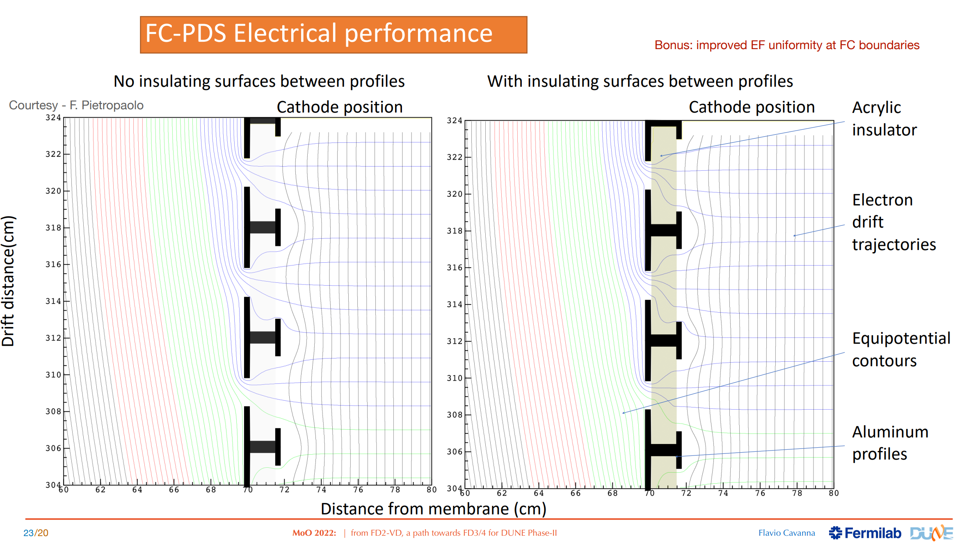

Slide 4
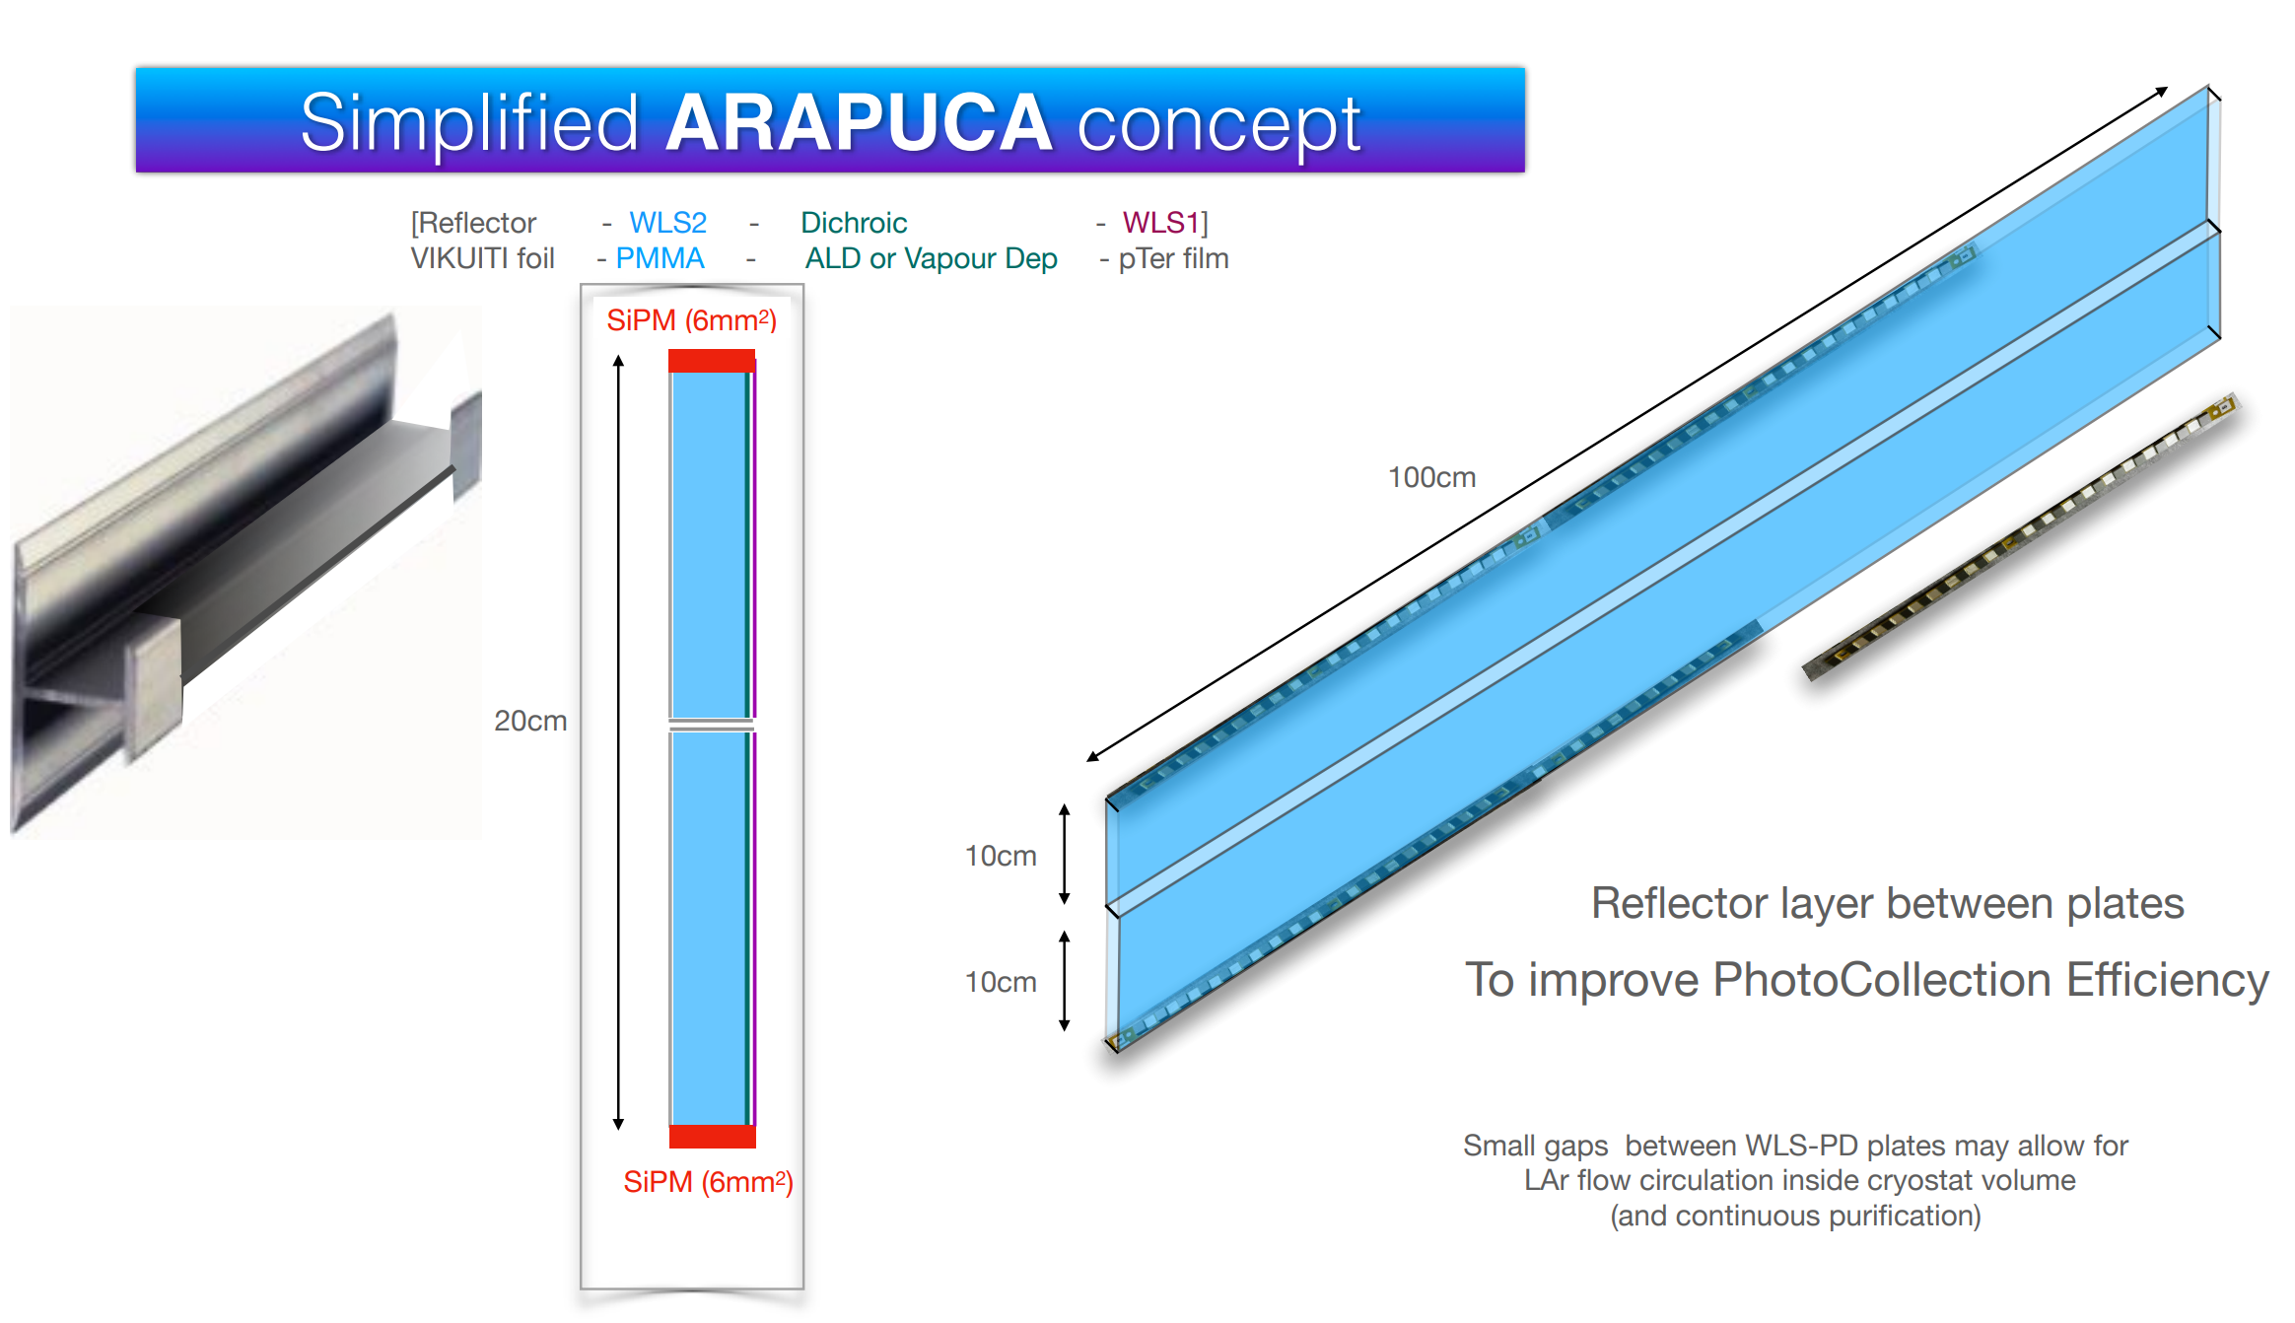

Slide 5
T shaped FC profiles based on FD1/2 FC profiles
The sharp edges of the “H” profile facing the cryostat wall will have very high E field, therefore must be rounded.
A wide strip facing the TPC active volume will cause distortion to the drift field.
The following “T” shape is used as the initial FC profile in some E field calculations.

Slide 6
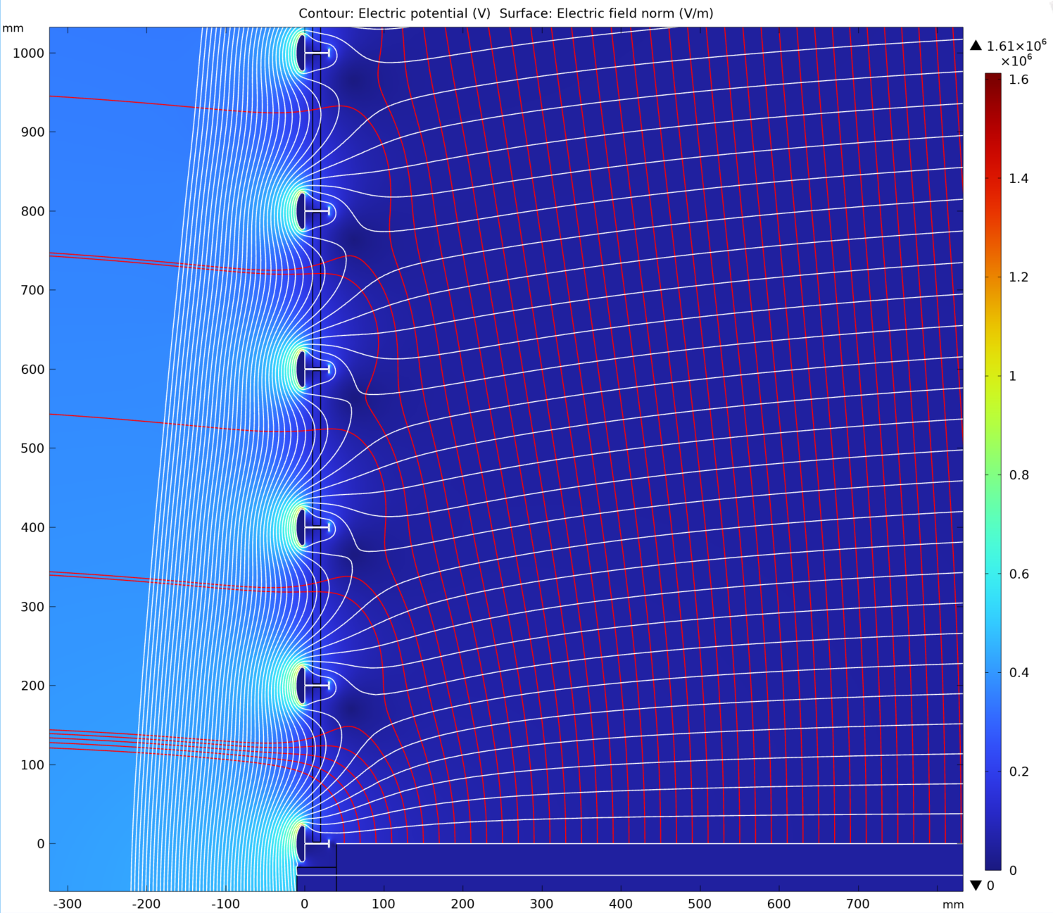
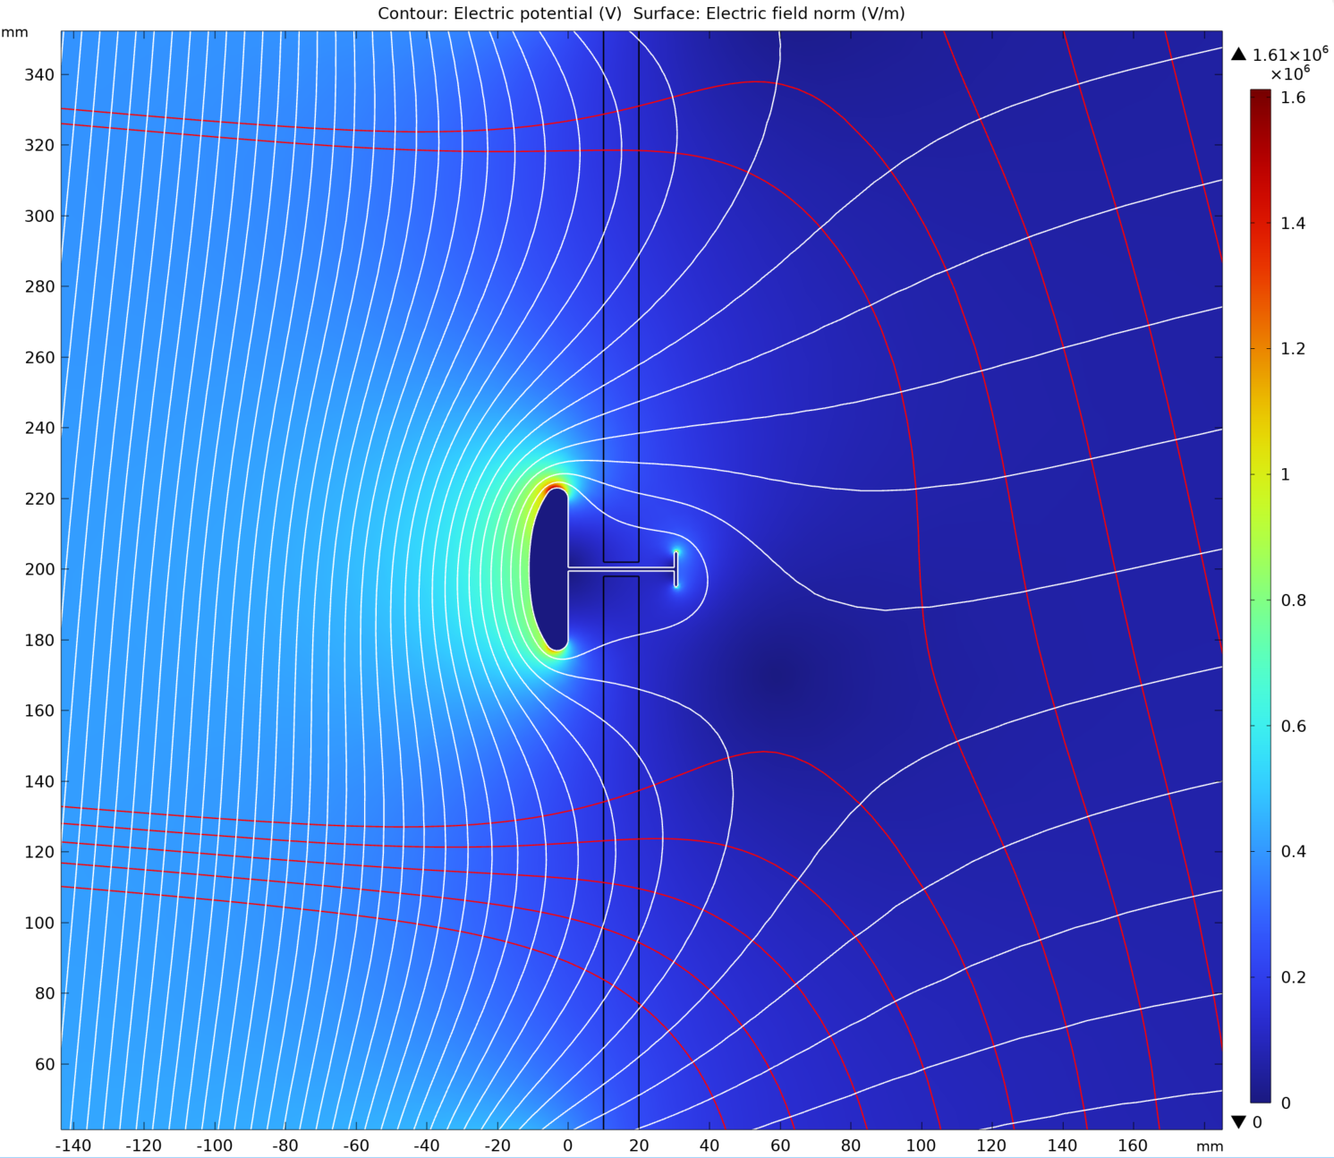
T shaped FC profiles at 20cm pitch, no charge build up
Max E field: 16kV/cm
Cathode

Slide 7
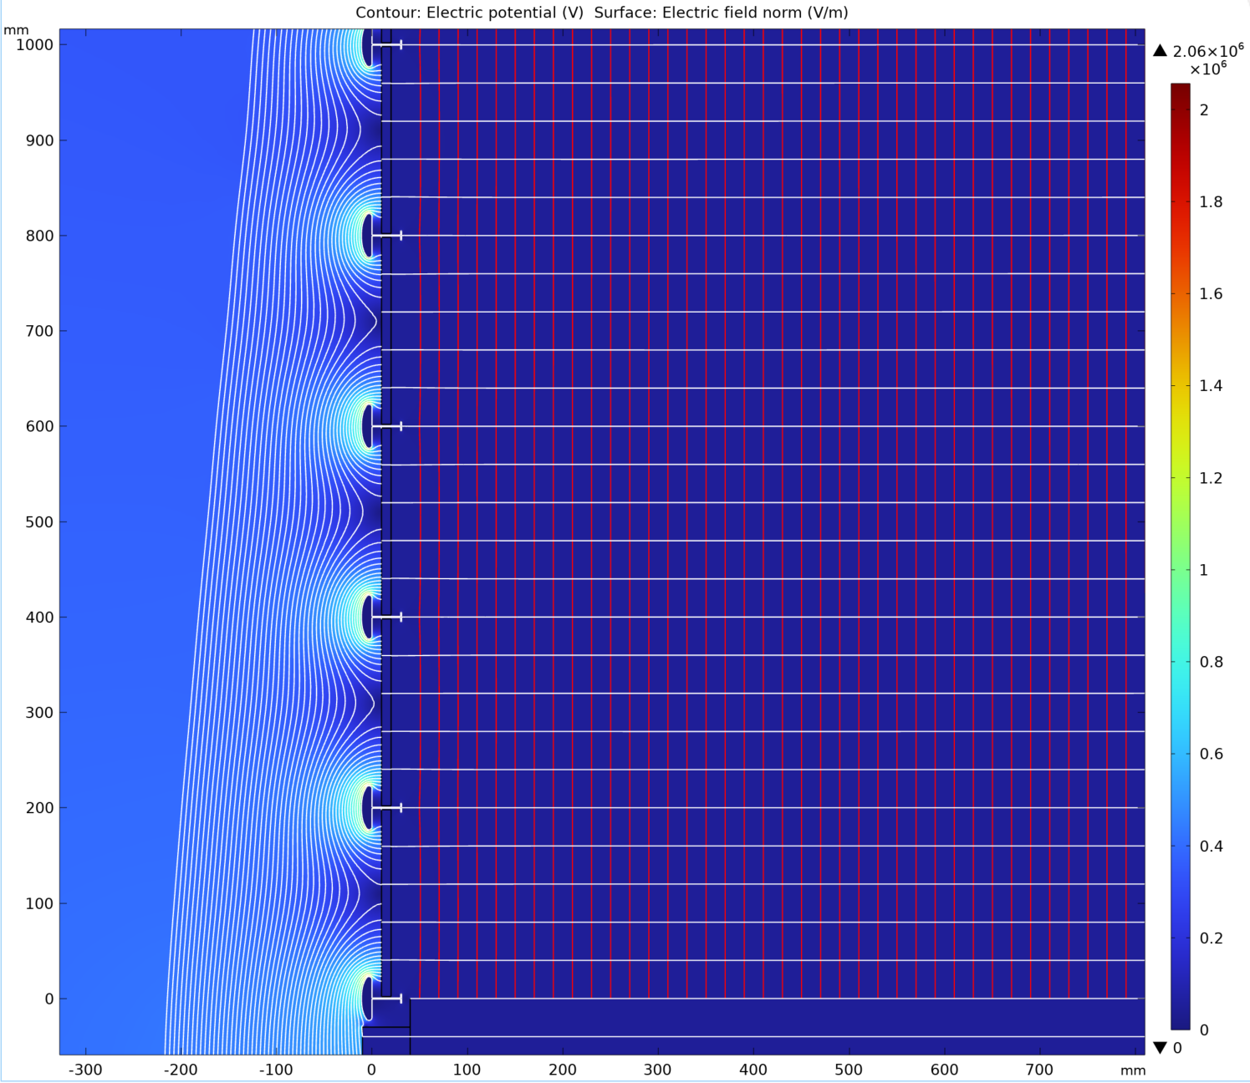
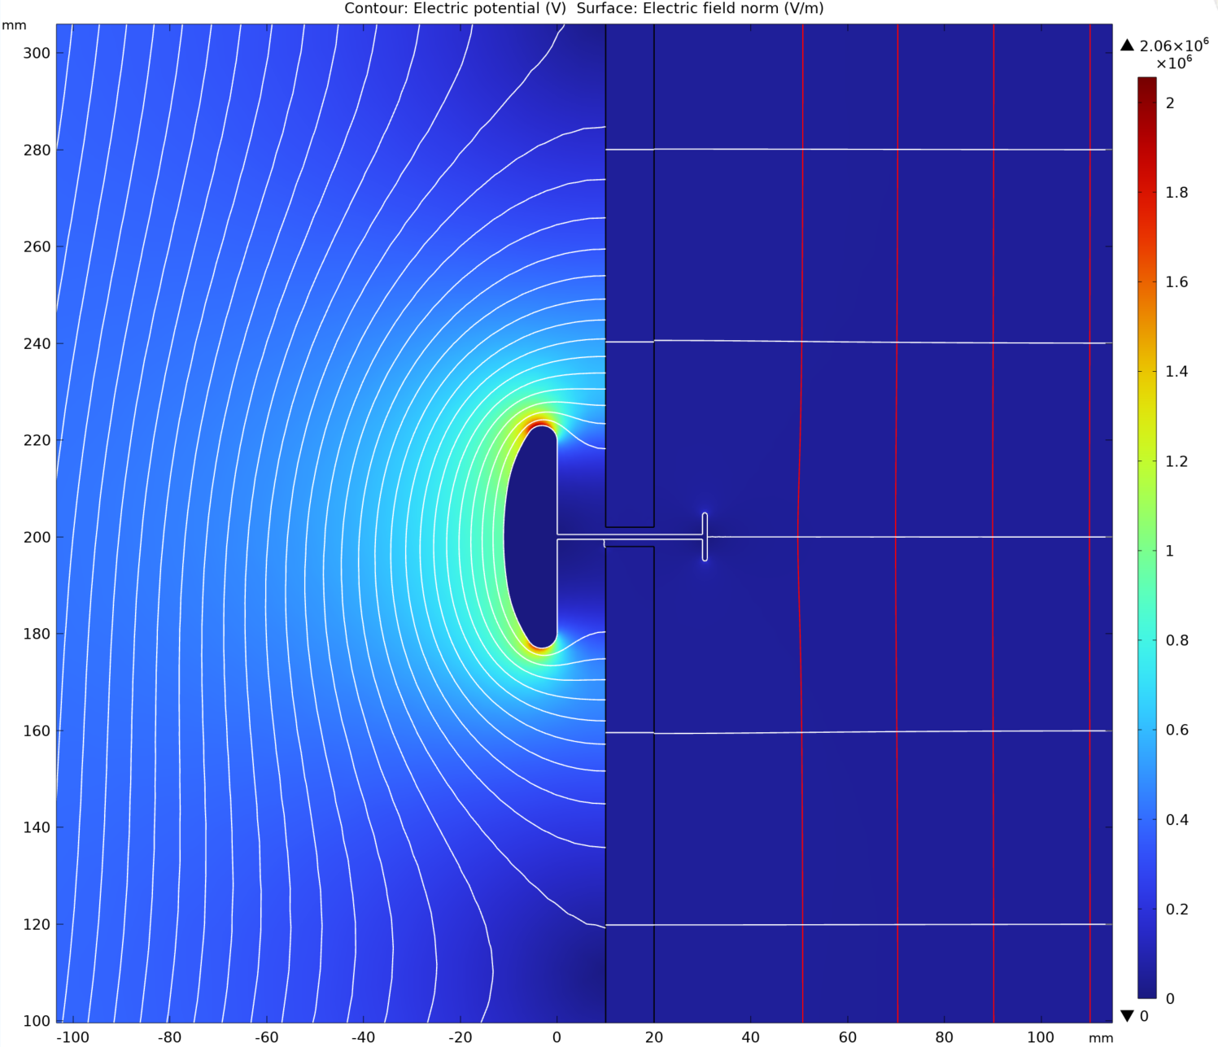
T shaped FC profiles at 20cm pitch, PD surface charged up
Max E field: 20kV/cm

Slide 8
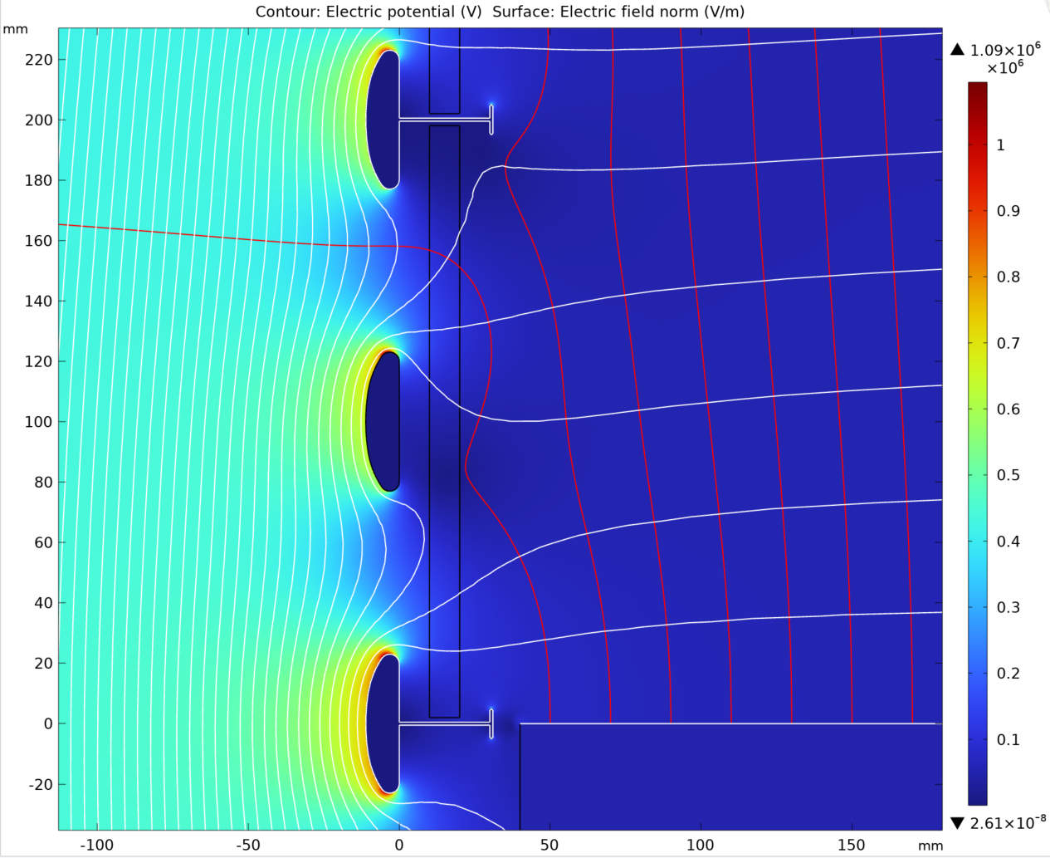
T shaped FC profiles at 10cm pitch, no charge build up
Max E field: 11kV/cm

Slide 9
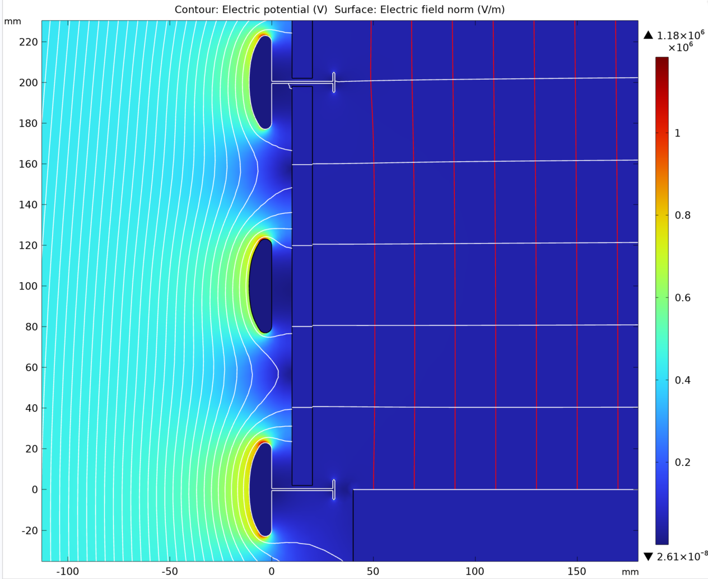
T shaped FC profiles at 10cm pitch, PD surface charged up
Max E field: 12kV/cm

Slide 10
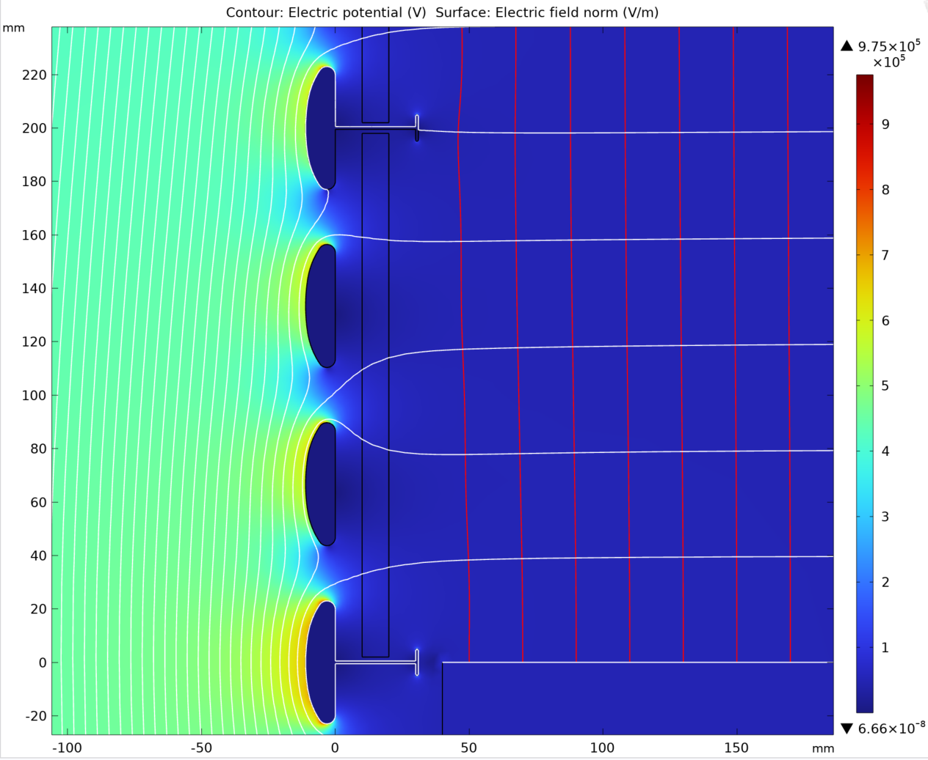
T shaped FC profiles at 6.7cm pitch, no charge build up
Max E field: 8kV/cm

Slide 11
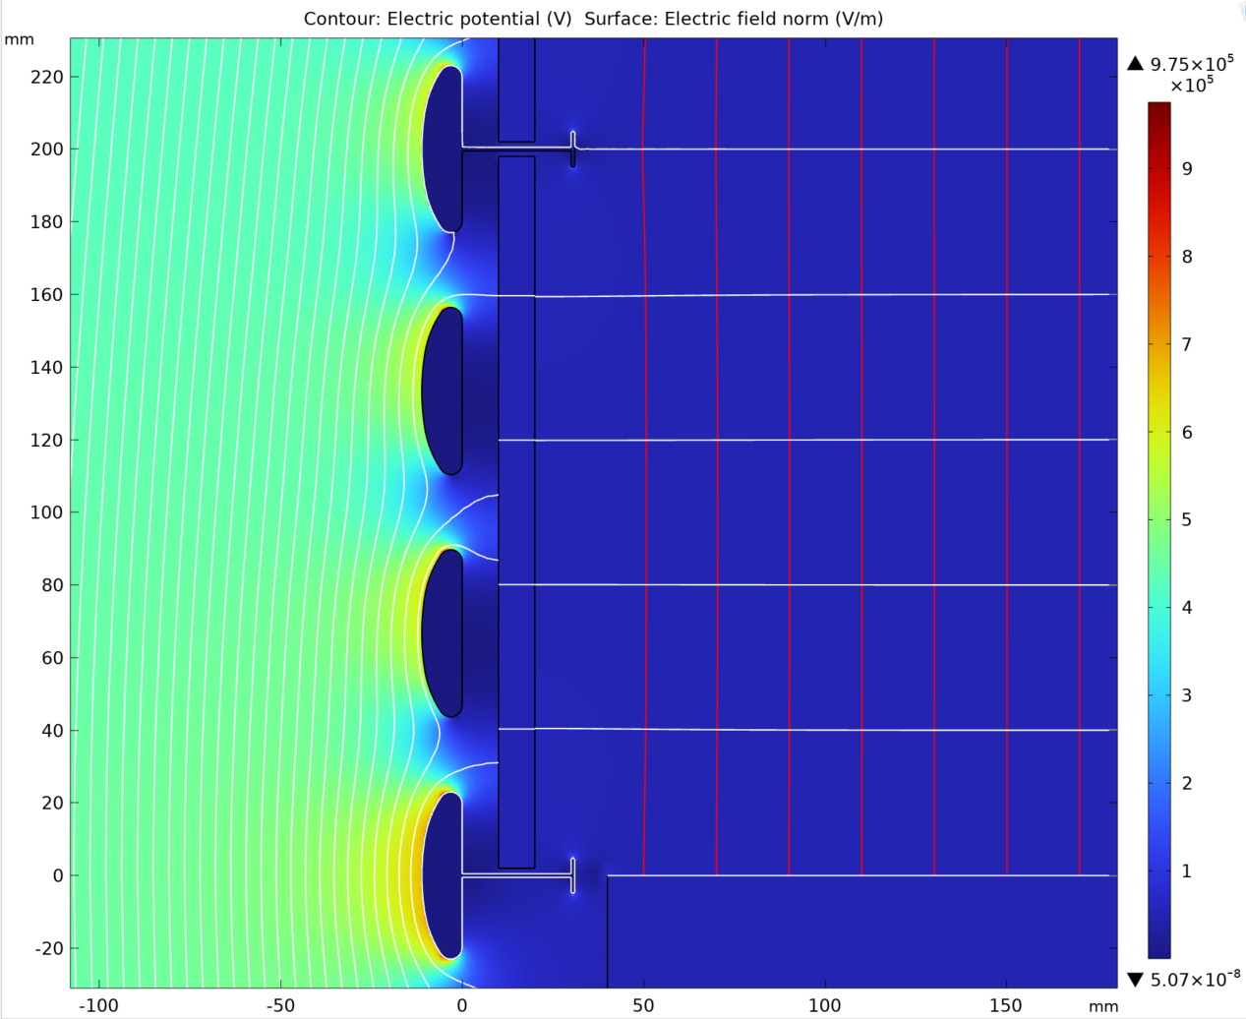
T shaped FC profiles at 6.7cm pitch, PD surface charged up
Max E field: 8kV/cm
The FD1/2 style FC profiles can be easily bent into 90 degree elbows to give smooth low E field FC corners.

Slide 12
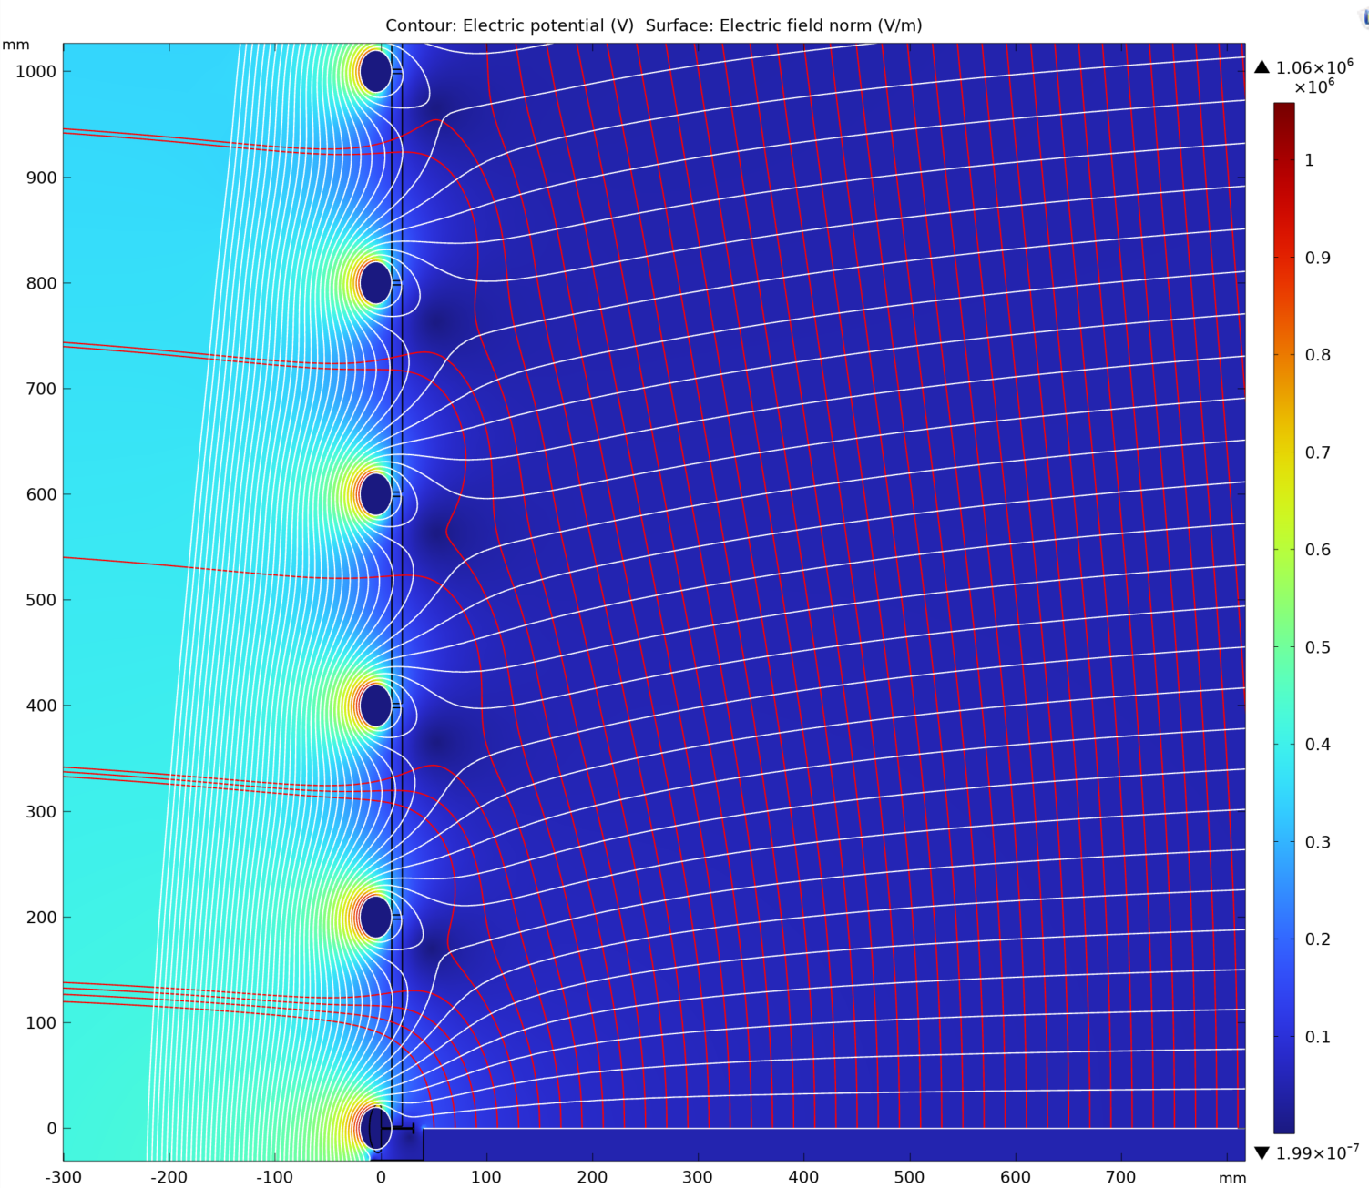
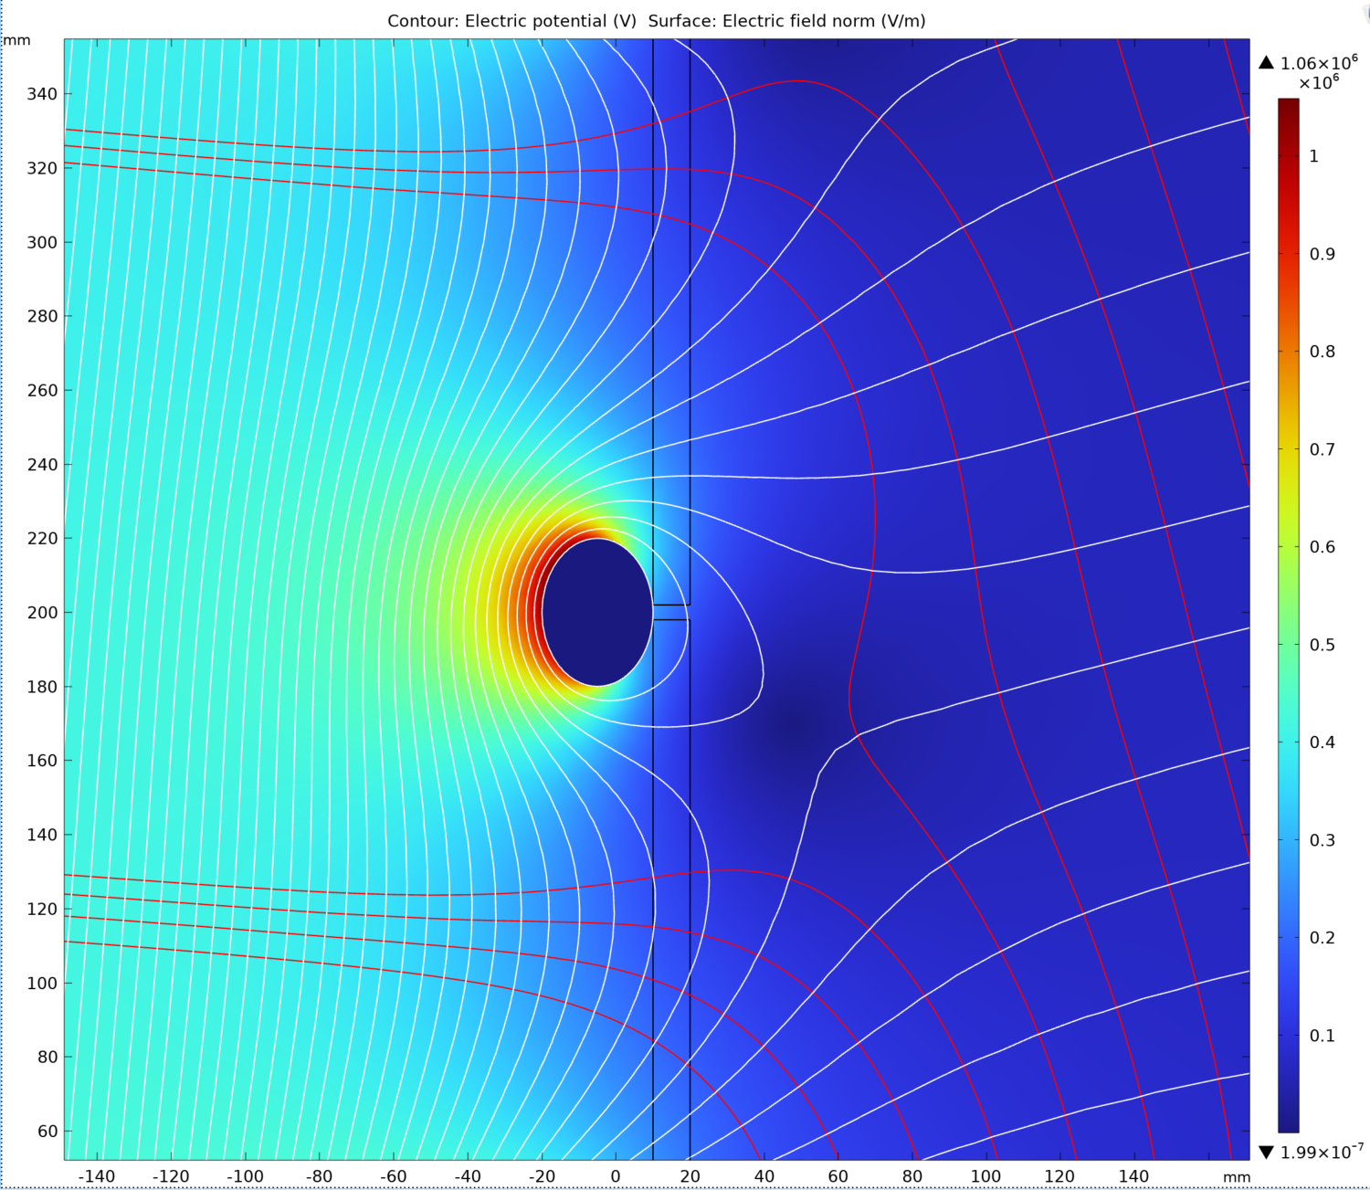
Oval shaped FC profiles at 20cm pitch, no charge build up
If we want larger FC profile pitch (reduce weight/cost), we should improve the profile shape: elliptical shape with 3/2 aspect ratio.
Width of oval profile: 40mm
Max E field: 10.4kV/cm

Slide 13
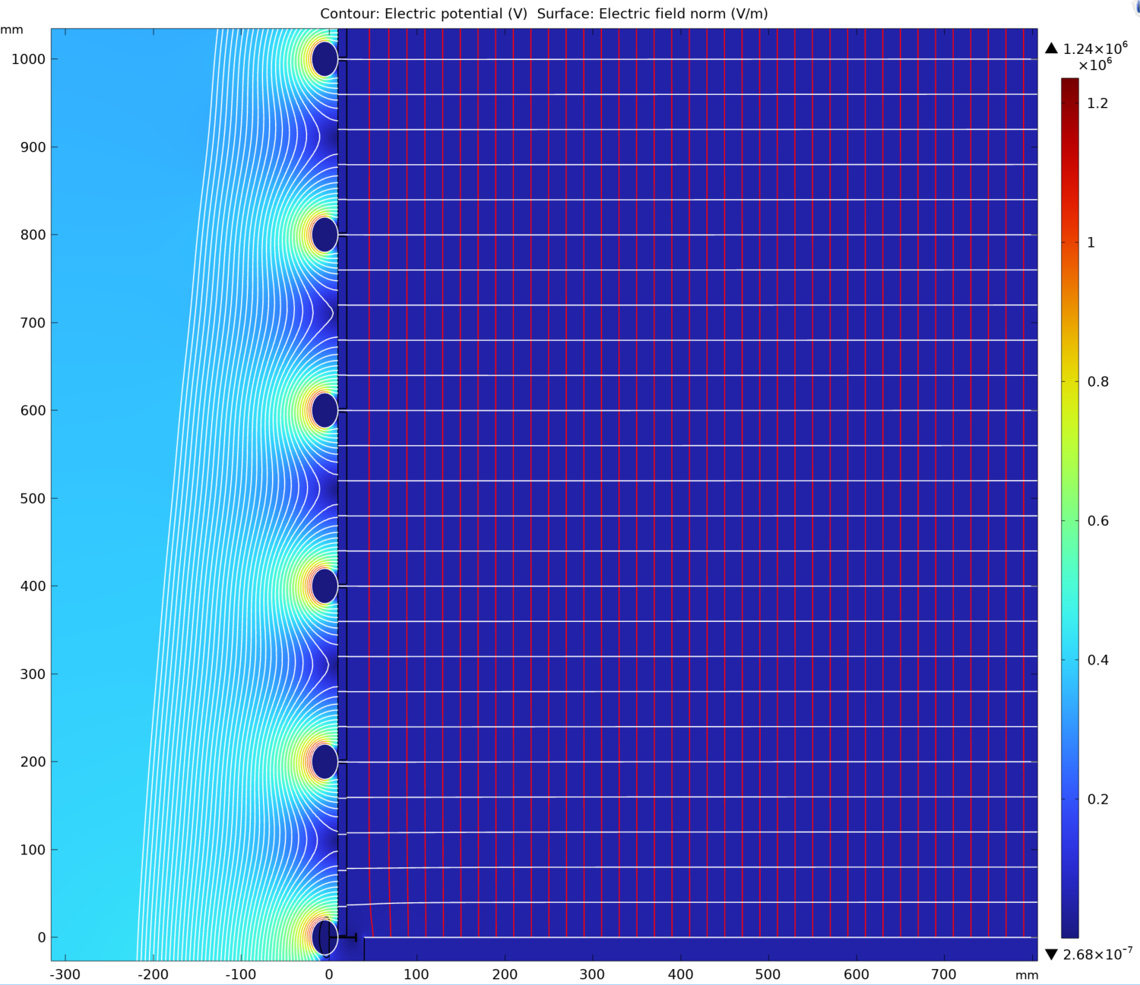
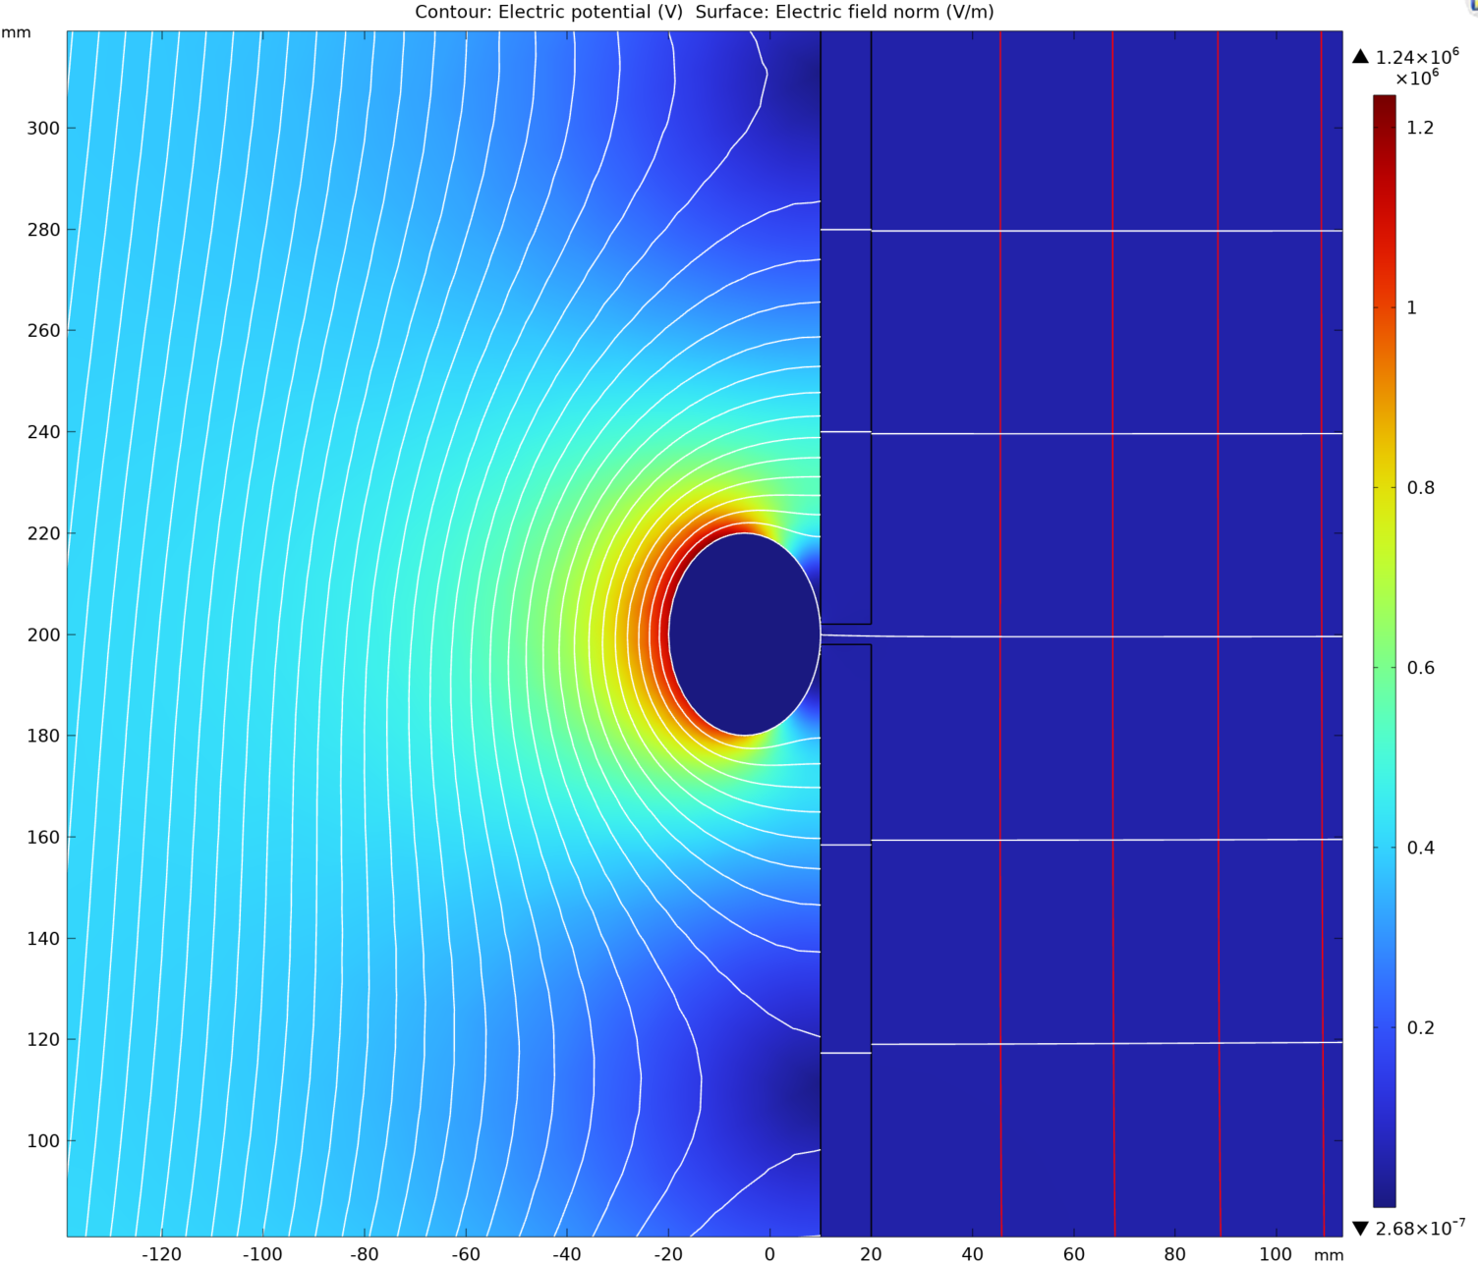
Oval shaped FC profiles at 20cm pitch: PD surface charged up
Width of oval profile: 40mm
Max E field: 12kV/cm

Slide 14
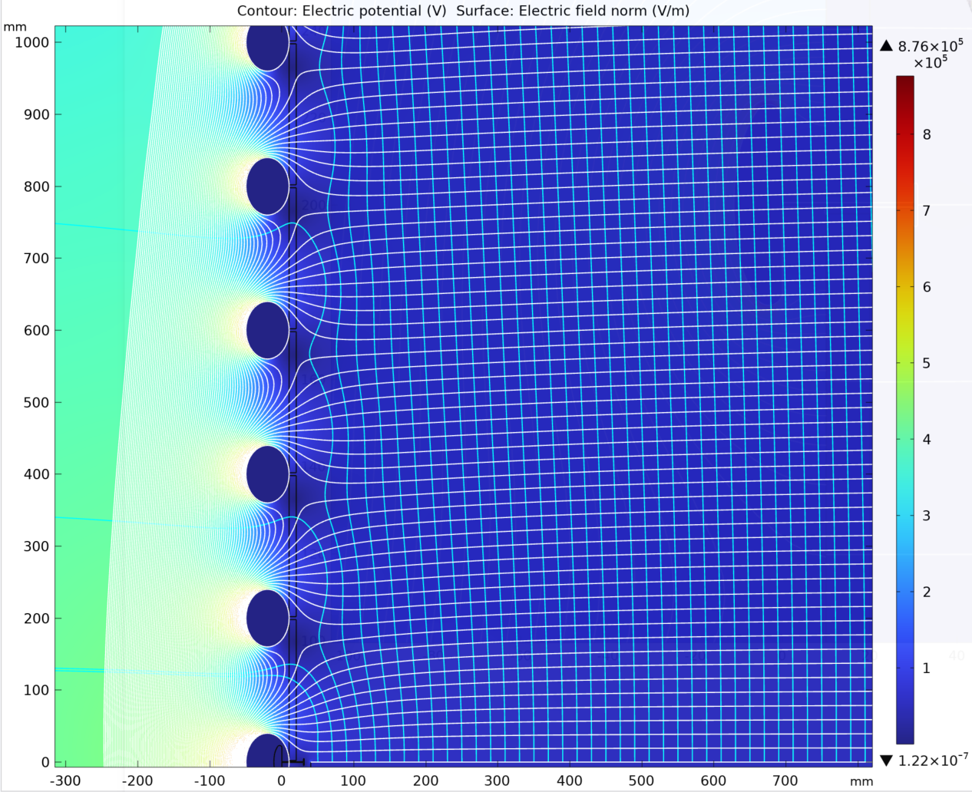
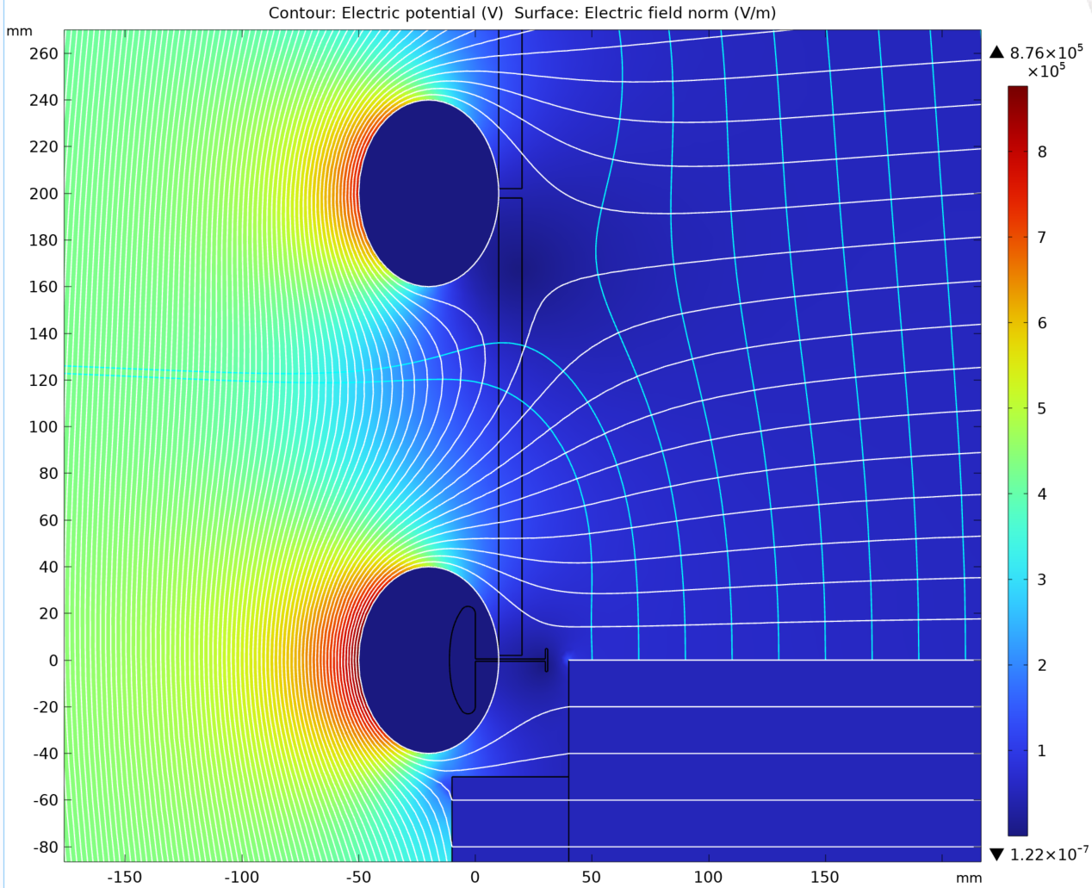
Larger oval shaped FC profiles at 20cm pitch, no charge build up
Width of oval profile: 80mm
Max E field: 8.7kV/cm

Slide 15
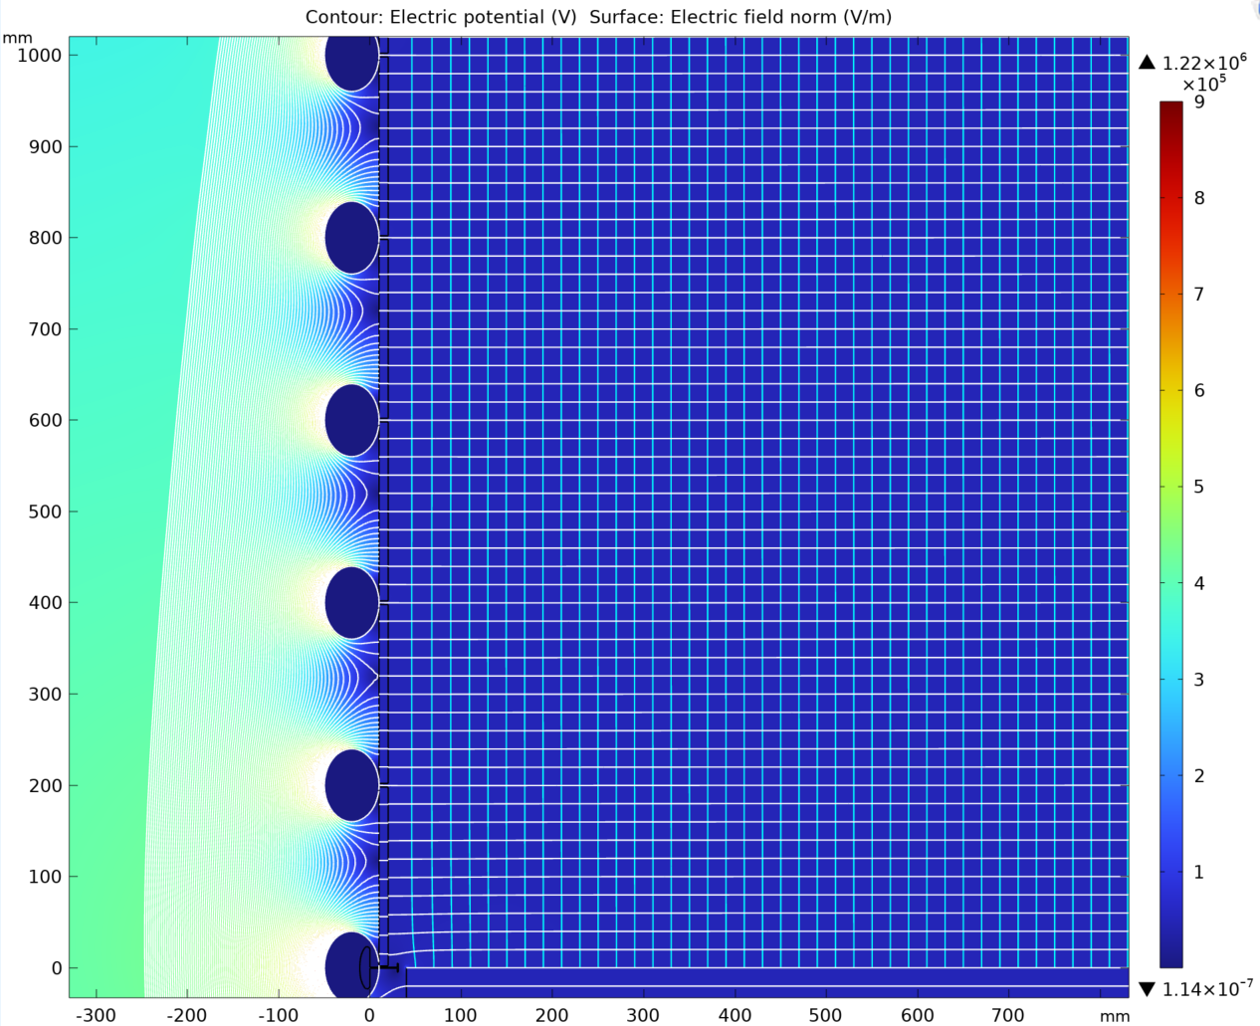
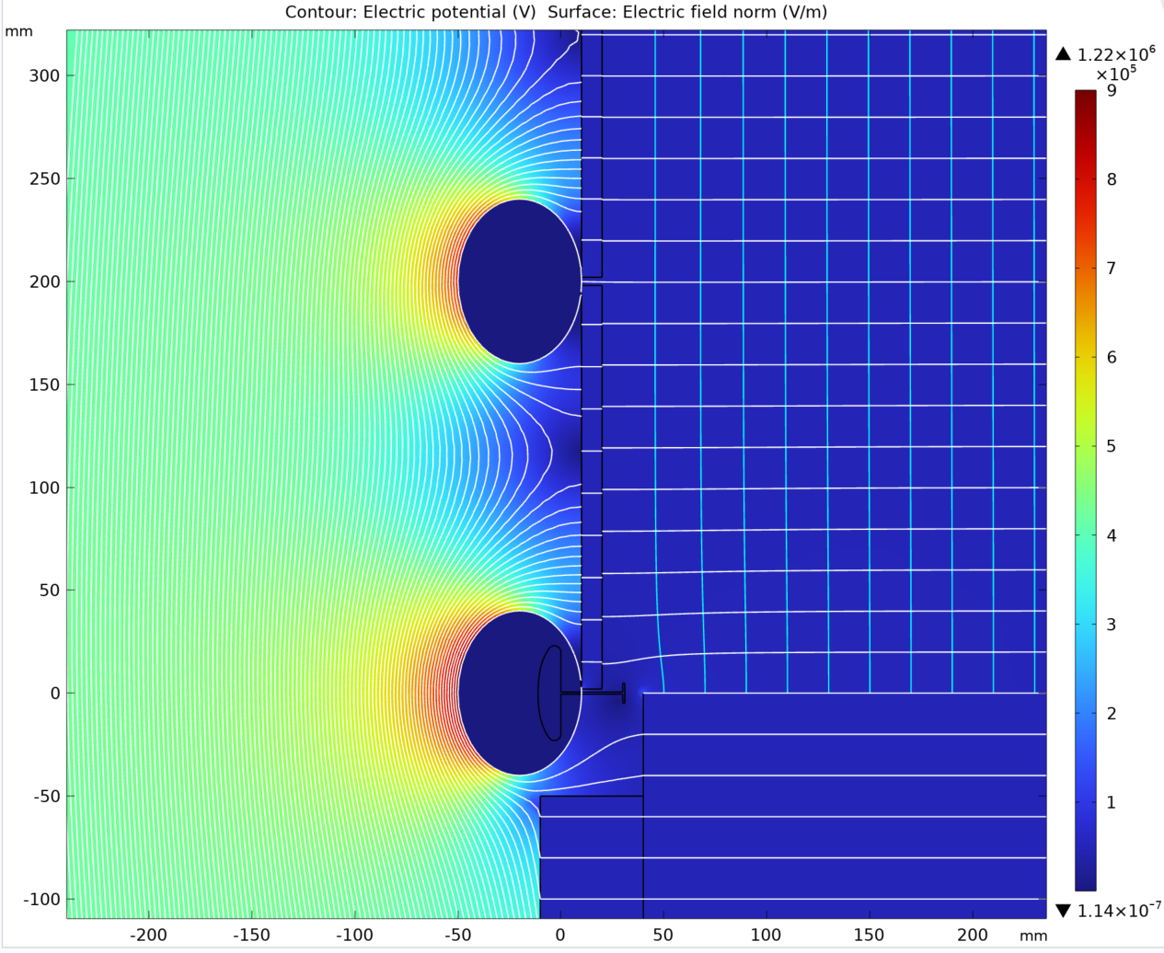
Larger oval shaped FC profiles at 20cm pitch: PD surface charged up
Width of oval profile: 80mm
Max E field: 8.8kV/cm

Slide 16
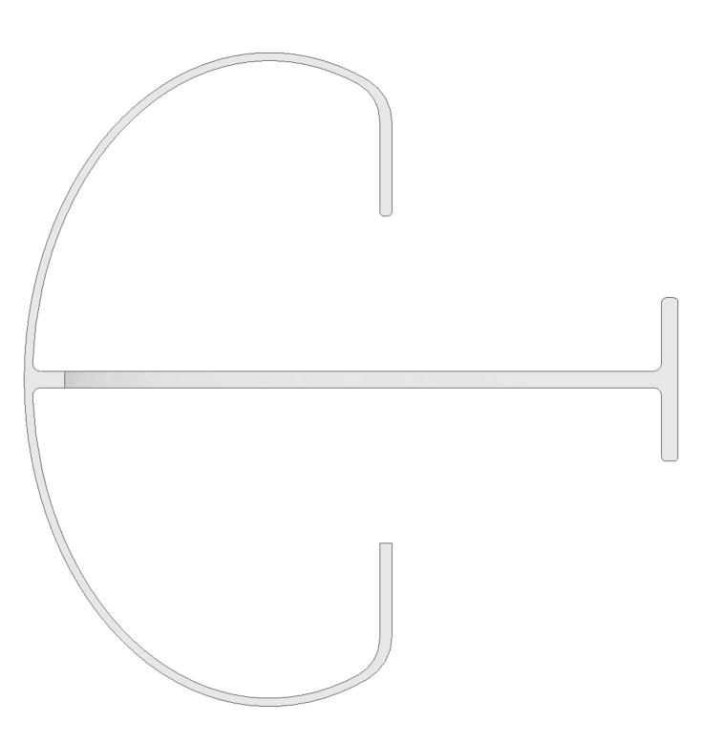
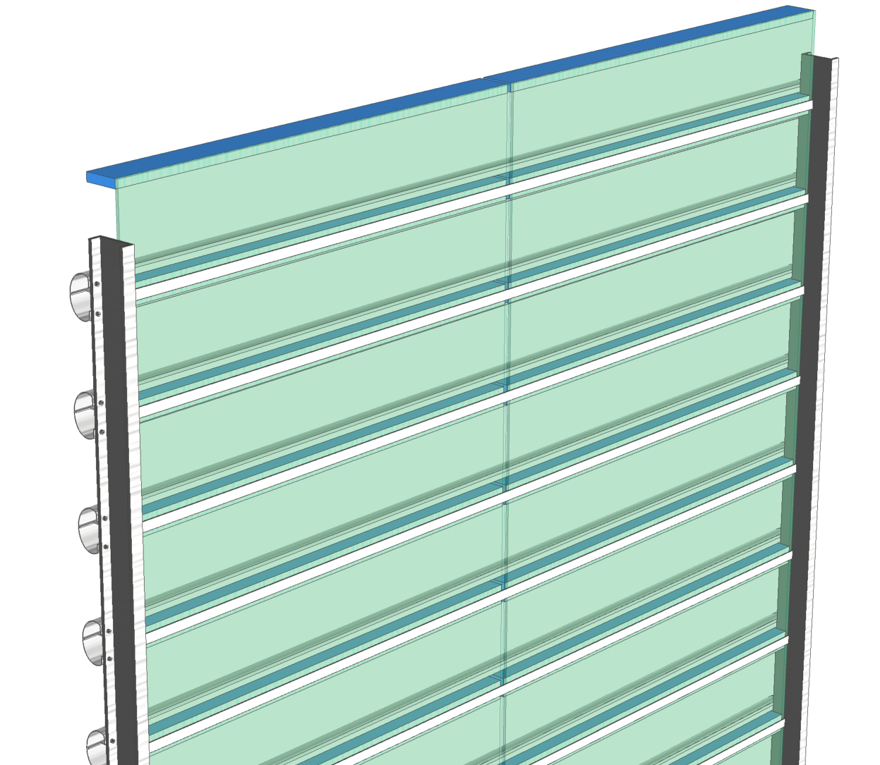
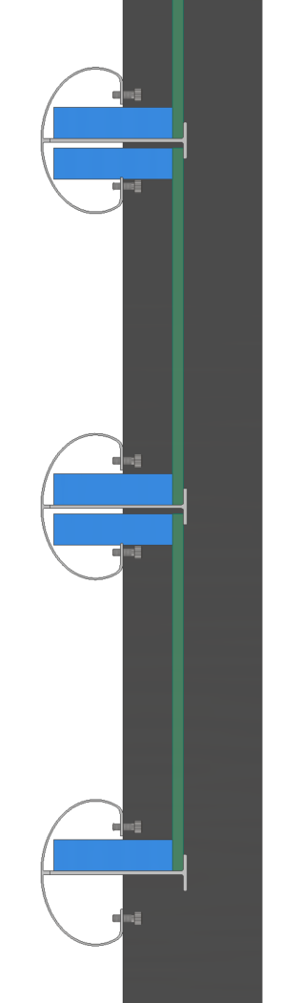
Larger oval shaped FC profiles at 20cm pitch: Configuration 1
1m x 0.2m PD module with SiPM/SoF/PoF bars along top and bottom edges.
They could be tucked into the oval FC profiles if necessary.
A pair of adjacent readout bars could share a common PoF module, can also share a common output fiber.
FRP C channels serve as structural support and fiber conduits.
Do we need a gap in the WLS plate?

Slide 17
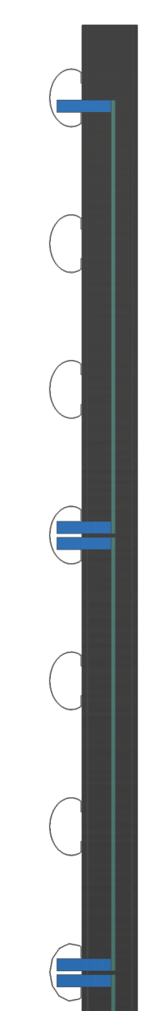
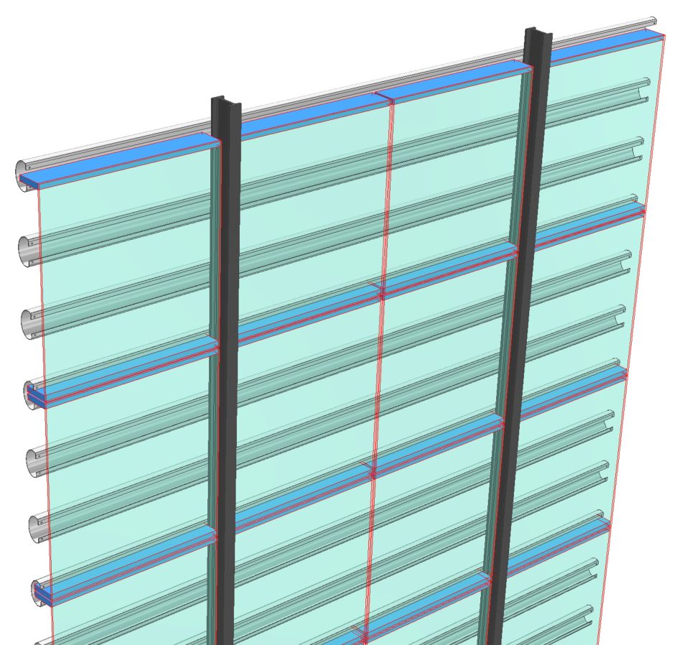
Larger oval shaped FC profiles at 20cm pitch: Configuration 2
0.6m x 0.6m PD module with SiPM/SoF/PoF bars along top and bottom edges.
FC profiles at 20cm pitch to keep the max E field low.
A pair of adjacent readout bars could share a common PoF module, can also share a common output fiber.
FRP I-beams serve as structural support and fiber conduits.
We could add a gap (w/ reflectors) in the WLS plate if finer position resolution is needed.

Slide 18
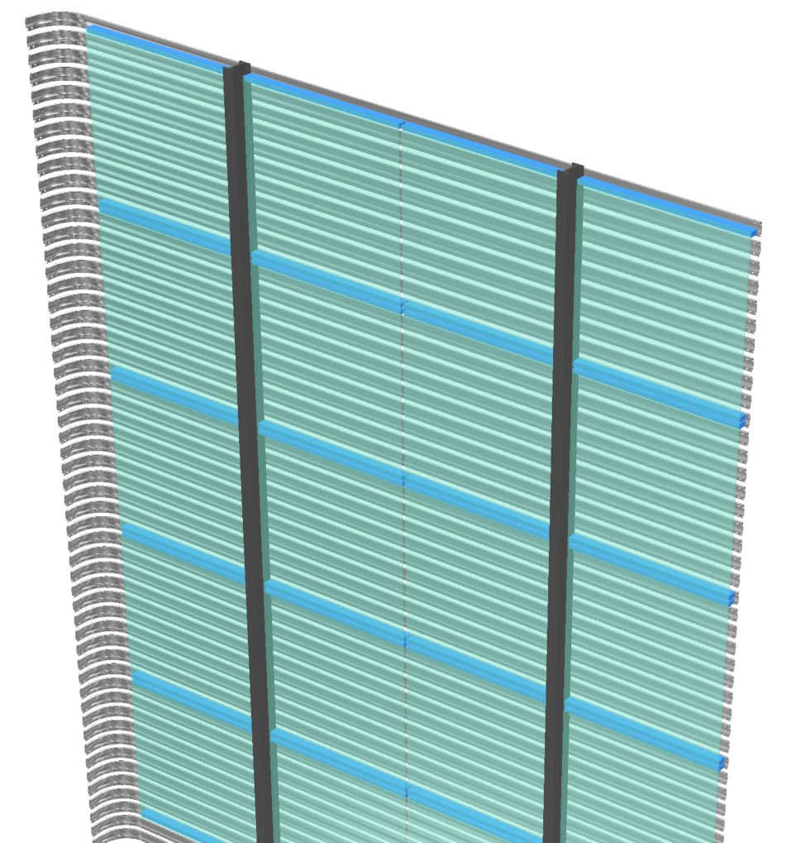
Classic FC profiles at 6cm pitch: Configuration 3
0.6m x 0.6m PD module with SiPM/SoF/PoF bars along top and bottom edges.
FD1/2 style “wide” FC profiles at 6cm pitch to keep the max E field low.
Use existing technique to bend profiles at corners.
Require slimmer FEE bars.
FRP I-beams serve as structural support and fiber conduits.

Slide 19
Summary
For an “APEX” style FC module with large profile spacing, the E field on the FC profiles are higher, requires optimized profile shape (rounder, wider)
  Higher load bearing capacity
  How to deal with the FC corners.
Surface charging is expected to improve drift field uniformity with fewer FC profiles. But a sparse FC profile configuration will lead to higher E field on profiles, and greater drift field non-uniformity before surface charging reaches equilibrium.
The PoF/FEE modules must be slimmed down to be comparable in size to a FC profile.
The dimensions/aspect ratio of the X-Arapuca module need to be optimized for best coverage/cost ratio.
Fiber routing (fiber bending radius) needs to be carefully planned.

