Slide 1




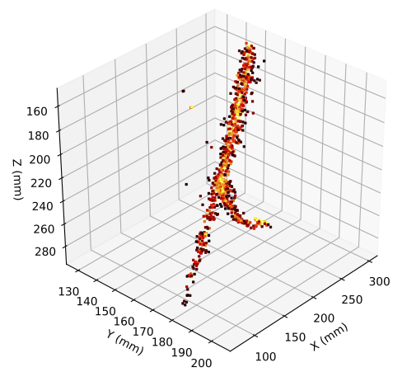
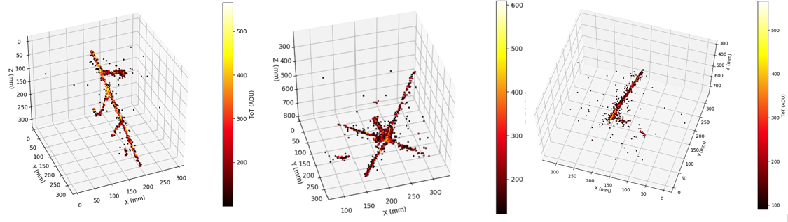
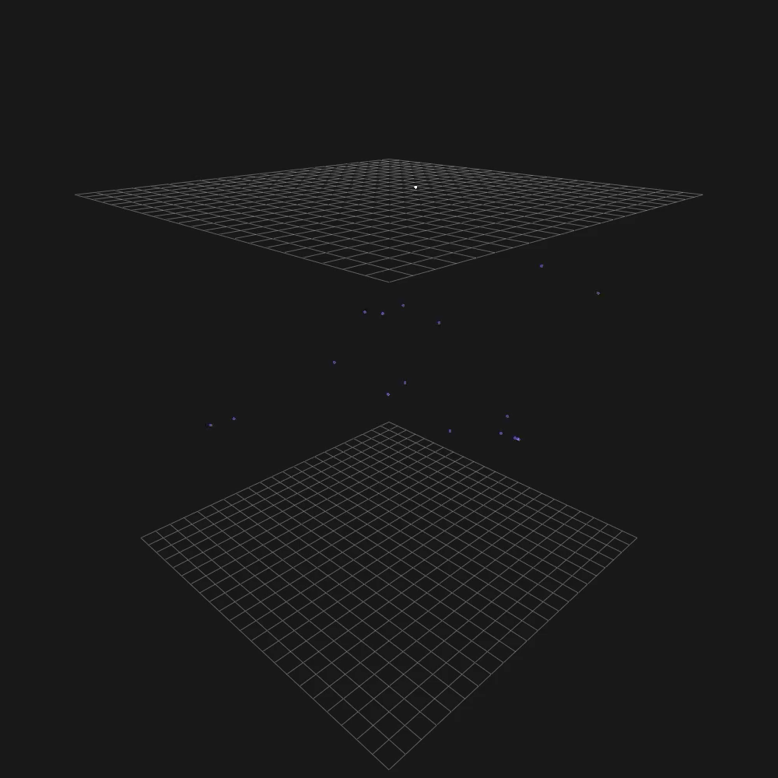

ARIADNE⁺ Results &
Future Optical ProtoDUNE Run
+
http://hep.ph.liv.ac.uk/ariadne
Kostas Mavrokoridis
(on behalf of the ARIADNE+ collaboration)
k.mavrokoridis@liv.ac.uk
DUNE FD3 workshop, Stony Brook, June 2023

Slide 2
Talk Outline
Background to the ARIADNE program
  TPX3Cam results taken with the ARIADNE 1-ton dual phase LAr detector
ARIADNE⁺: Larger scale demonstration using the CERN “Cold Box” at the Neutrino Platform
  Results and informing next steps
Dual phase Optical protoDUNE run proposal
  Design progress and technical coordination
  Preparing the LoI to SPSC

Slide 3
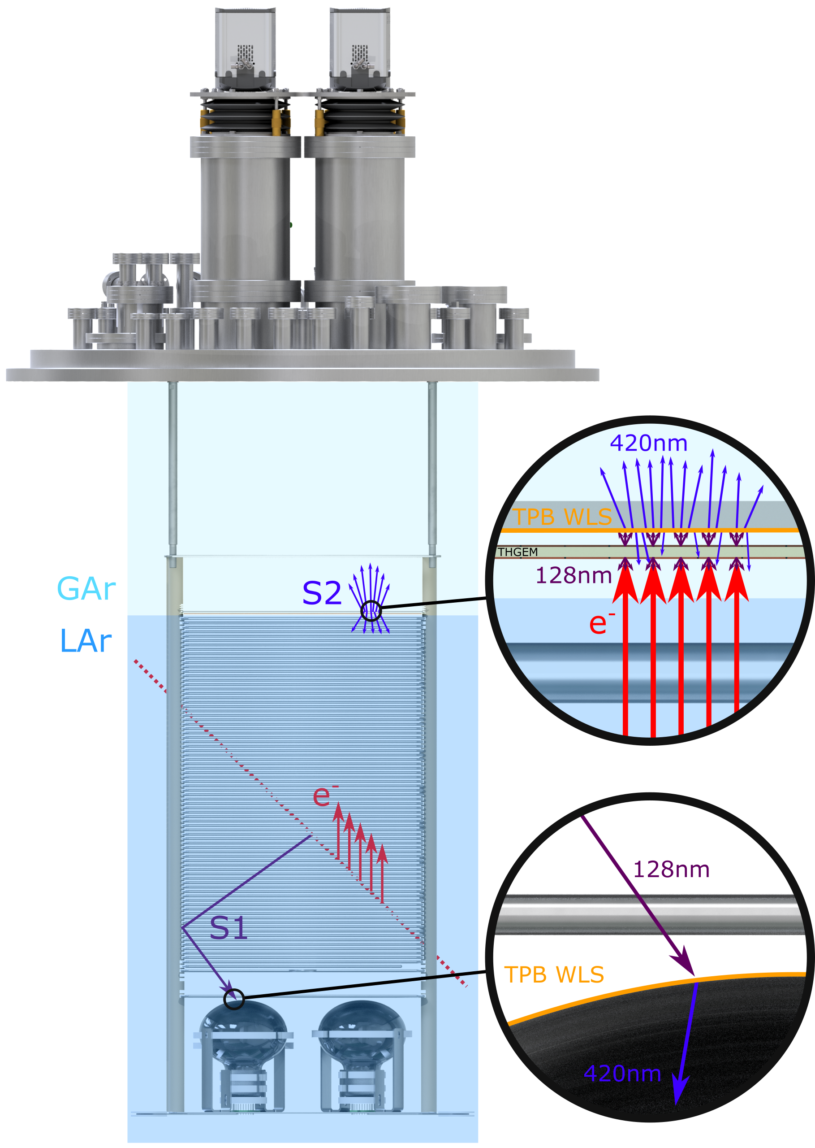
ARIADNE Detection Principle
Cameras
ARIADNE has demonstrated light readout as a viable alternative to charge in dual-phase TPC neutrino experiments
Incoming particles ionise LAr and create prompt scintillation light (S1)
Electrons drift towards the extraction grid situated below the liquid level
A THGEM (THick-Gaseous Electron Multiplier) amplifies drift charge (capable of >30 kV/cm in LAr) generating secondary scintillation light (S2)
WLS (Wavelength Shifting) before imaging with Timepix3 camera
ARIADNE (ARgon ImAging DetectioN chambEr)

Slide 4
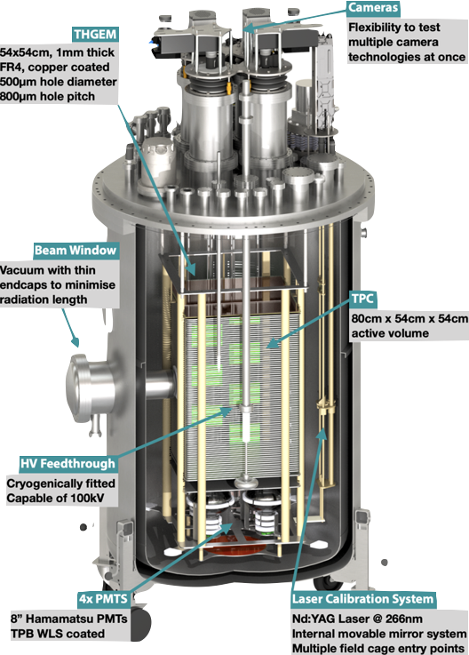
The ARIADNE Advantage - Optical TPCs
    High Resolution: For e.g. TPX3 camera has 256 x 256 pixels, imaging 35 x 35 cm area, as on ARIADNE, gives ≈1 mm resolution
    Sensitivity to low energies: Gain is generated by the THGEM; a THGEM accelerated electron can generate upwards of 100 photons, cameras can be sensitive to single photons
    Very low Noise: Externally mounted cameras are decoupled from TPC electronic noise sources/acoustics
    Ease of Access: Technology can be swapped in and out even with TPC operating
    Cost Efficient: No need for thousands of internal charge TPC readout channels, pre-amps etc.
    Available NOW
  Benefits over previous charge readout methods:
Dual phase TPCs can enable low energy physics hence it is the established technology for direct dark matter detection!
TDR: https://iopscience.iop.org/article/10.1088/1748-0221/15/03/P03003
ARIADNE 1-ton detector

Slide 5
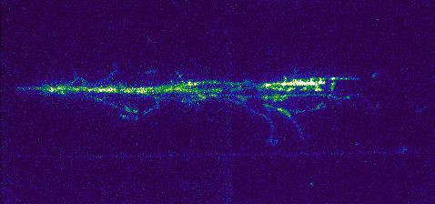
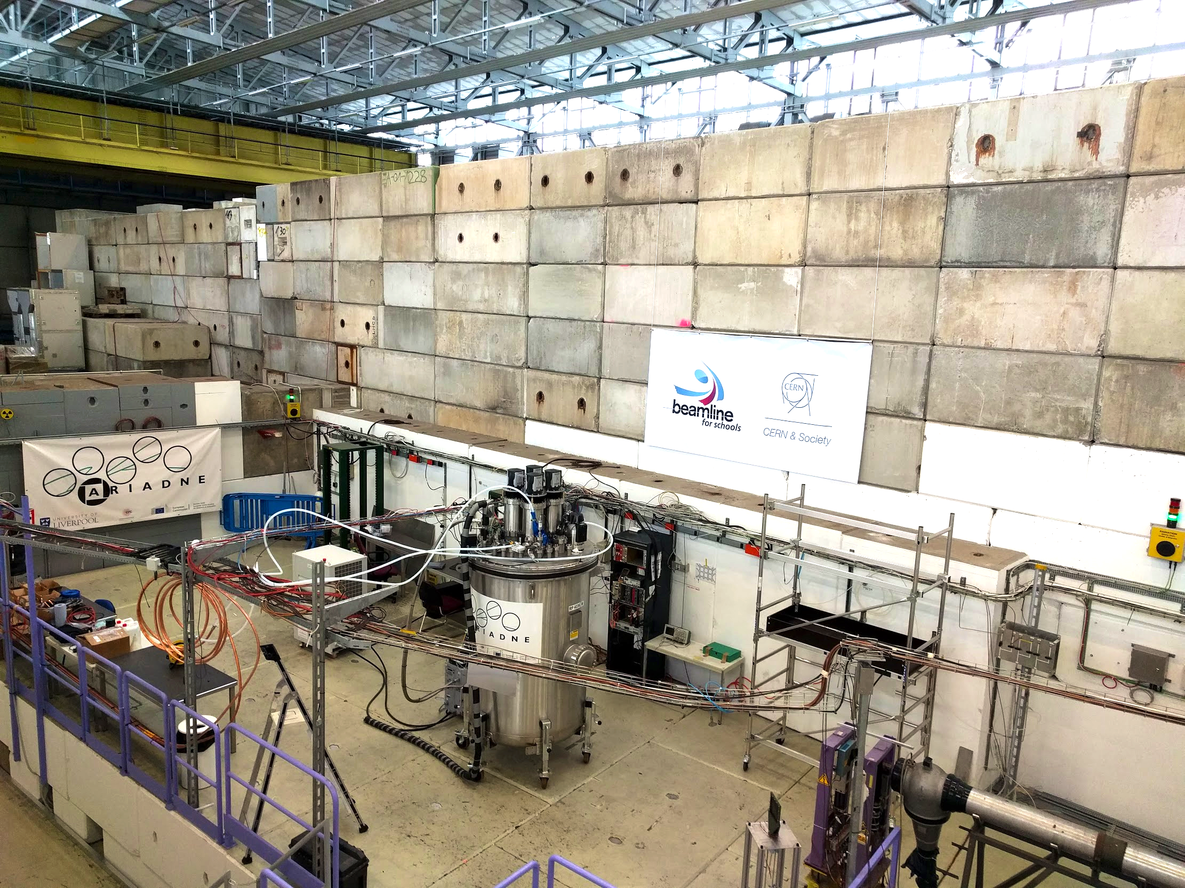
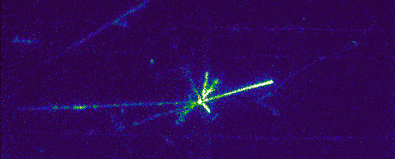
ARIADNE at CERN T9
EMCCD data taking 3 weeks April 2018.
T9 Beamline, East Area, CERN.
Mix of particles: e ±, μ ±, π ±, p±. (0.5 – 8 GeV/c.)
43 cm
35 cm

Slide 6
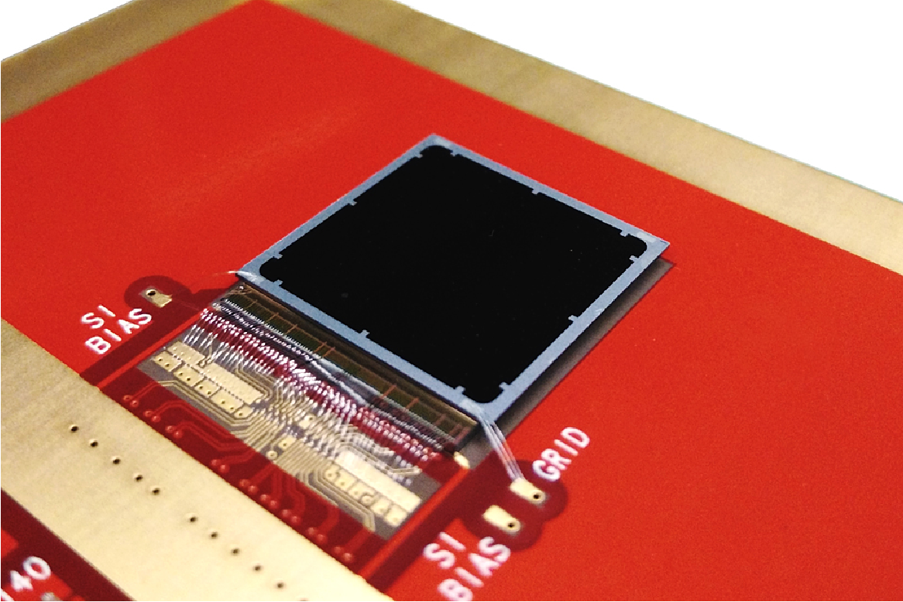
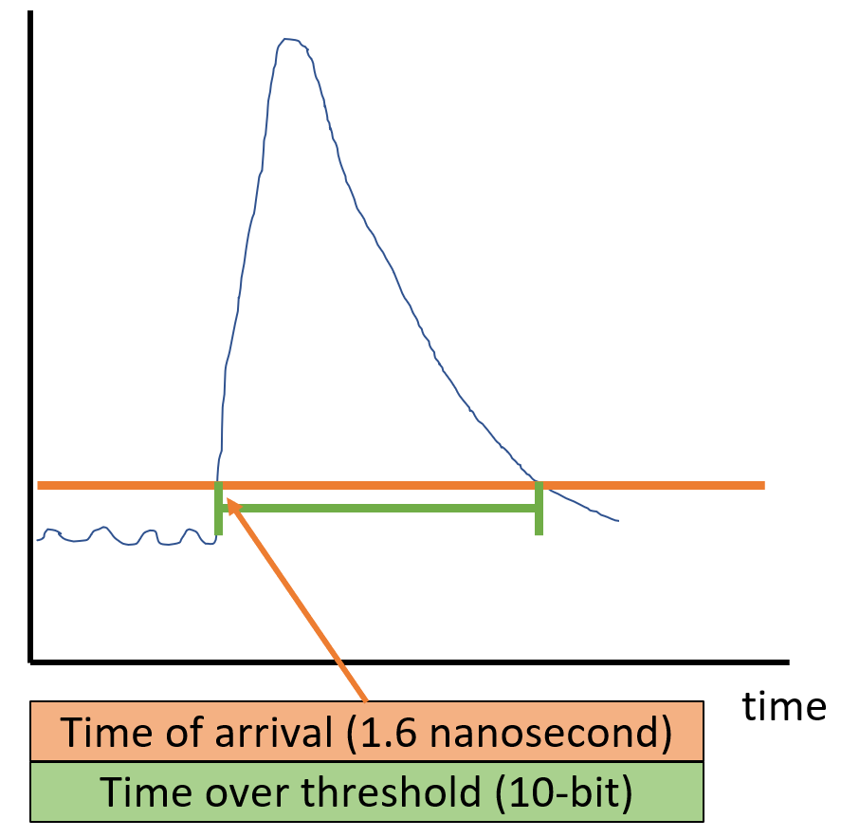
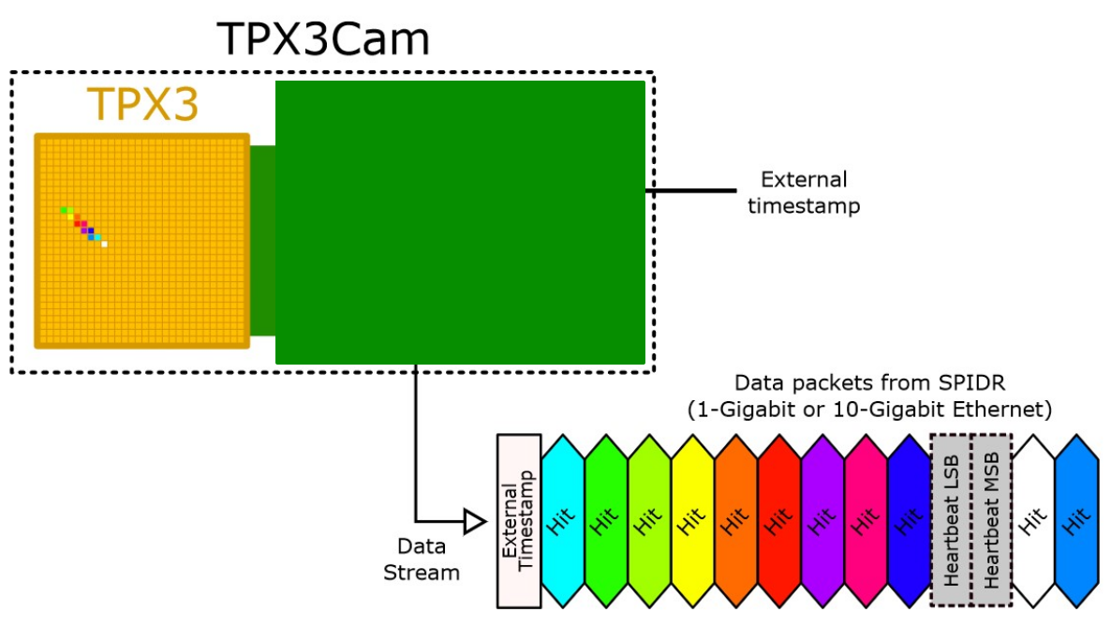
2D-> Full 3D Optical Readout
Silicon pixel readout chip developed by the Medipix collaboration. Very well established technology at CERN.
TPX3 ASIC bonded to optical sensor
TPX3 provides simultaneous time-over-threshold (ToT) and time-of-arrival (ToA). Complete (x,y,z,E) event reconstruction using a single device.
Time over threshold provides intensity / energy measurement ->10-bit resolution.
Time of arrival provides z (drift) axis position information -> 1.6 nanosecond resolution.
Data driven readout -> Event streaming with native zero suppression.
Efficient raw data storage. Triggerless operation.
Sensor resolution | 256x256 pixels
Pixel size | 55µm x 55µm
Max readout rate | 40Mhits•cm⁻² •sec⁻¹
Time resolution | 1.6 ns

Slide 7
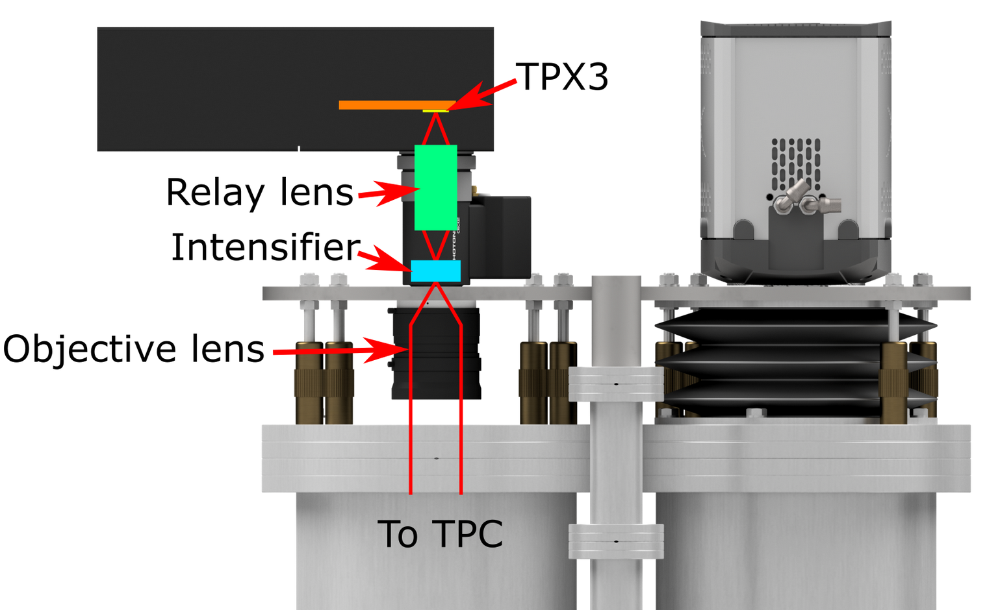
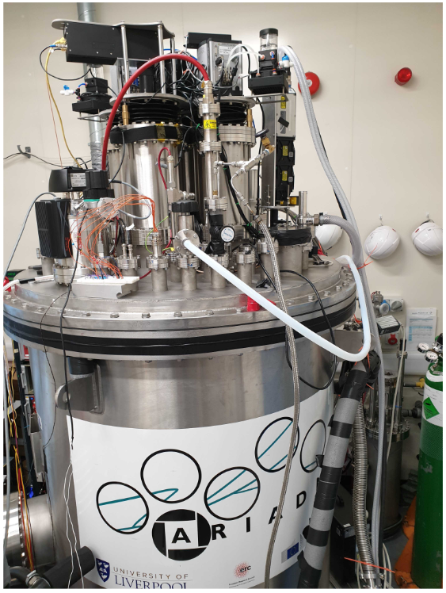
TPX3Cam Optical Readout
Single photon sensitivity when combined with image intensifier.
Intensifier gain ~1E6 photons/photon.
Relay lens couples intensified image onto light sensitive
sensor which is bump bonded onto TPX3 ASIC.
Intensifier provides flexibility -> Many photocathode options are available to customise spectral sensitivity.
– Now also Direct VUV!
Timepix3 camera installed in place of an EMCCD camera.
~ 30cm x 30cm field of view
Photonis Cricket image intensifier with Hi-QE green photocathode.
30% quantum efficiency at 430nm (TPB peak emission)
Coldbox Intensifier
ARIADNE results
TPB emission

Slide 8
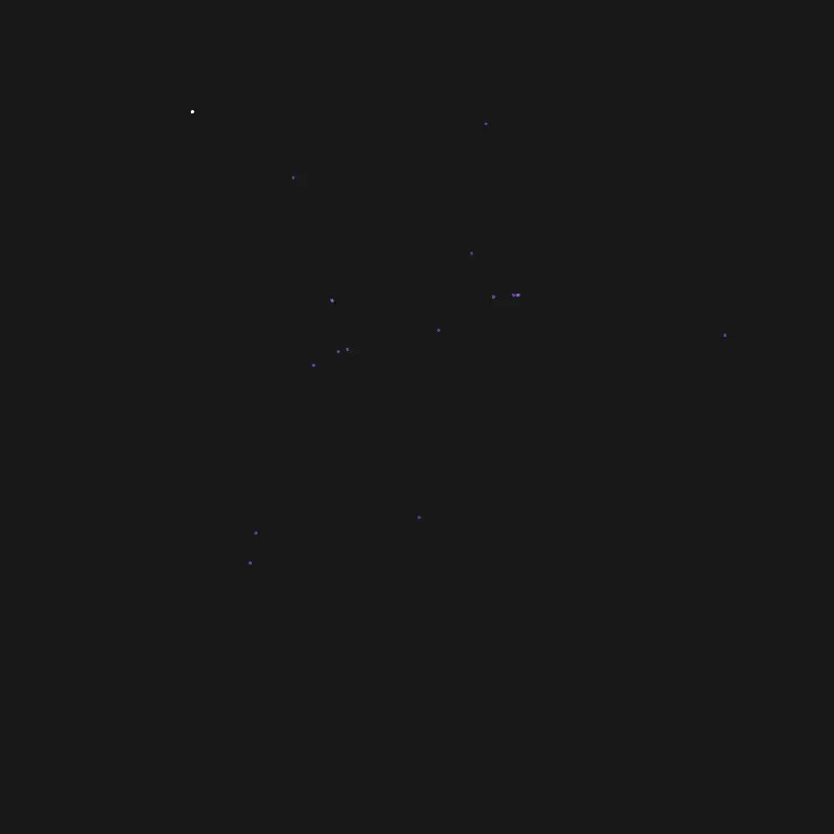
TPX3Cam 3D Cosmics LAr
Continuous streaming, 10 msec slice (playing 1ms jump per frame)
Side View
Top View

Slide 9
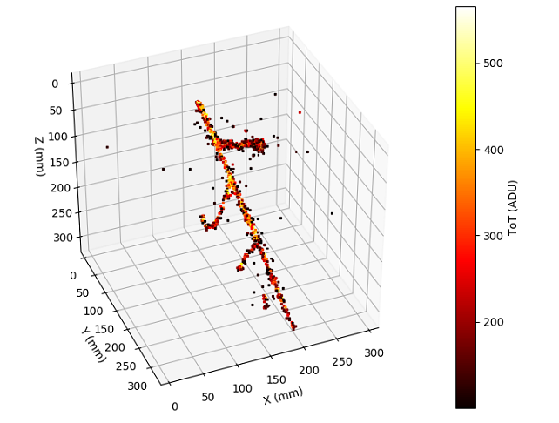
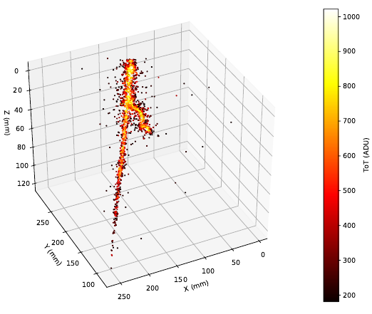
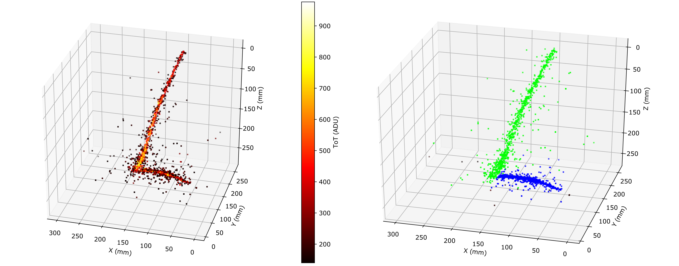
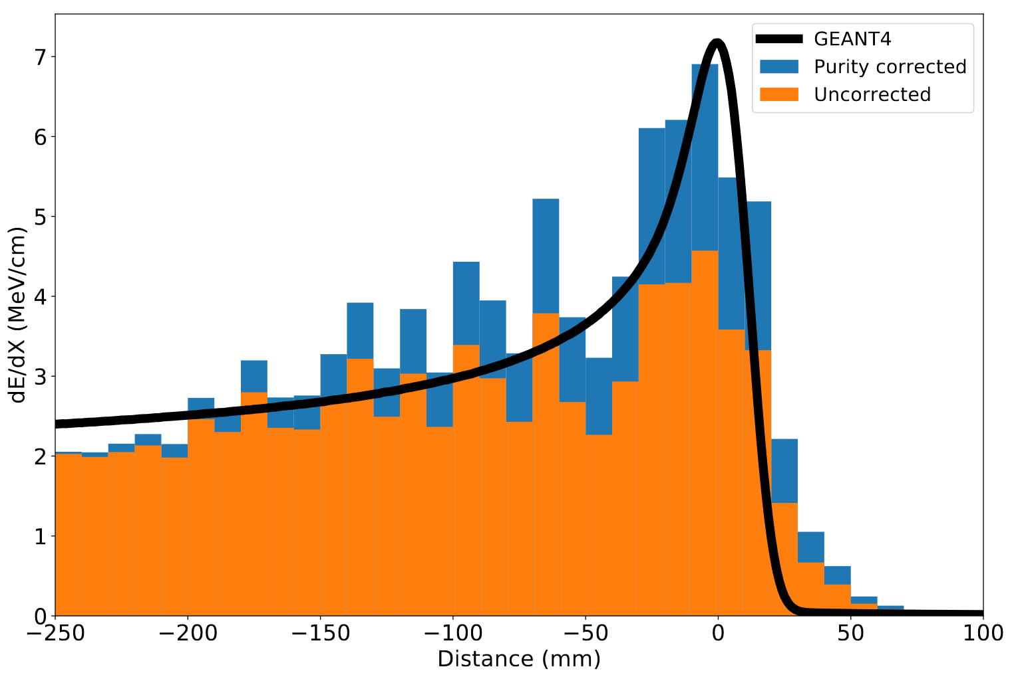
ARIADNE TPX3 Results
https://www.mdpi.com/2410-390X/4/4/35
Stopping Muon
MIP Energy Calibration
ADU (ToT) vs. THGEM Bias
11% energy resolution
Cameras are sensitive to the linear light production regime

Slide 10
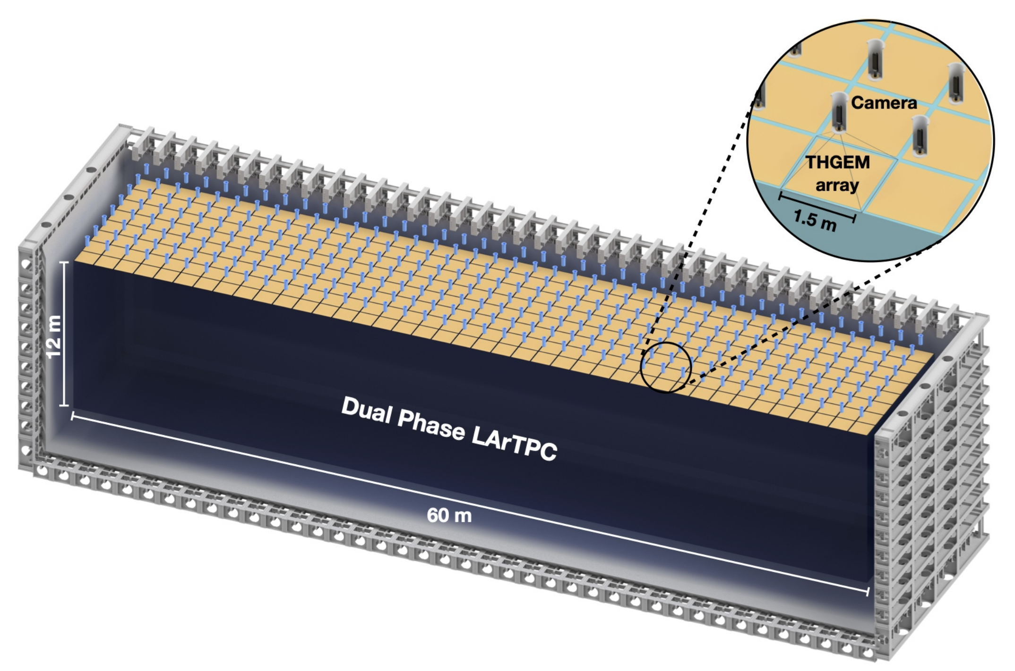
1st Module of Opportunity Workshop
@ Brookhaven
Conceptual DUNE Dual Phase with Optical Readout
320 TPX4Cams within the cryostat chimneys
Each camera images 1.5mx1.5m with 3mm/pixel resolution
Total camera commercial cost with optics ~3M Euro
Table: As an example, demonstration figures for use of TimePix within Dune - 720m², 60m x 12m
Camera type | Sen. Size (pixels) | Cameras to cover 1m² | Resolution (mm/pix) | Total cameras (to cover 720m²) | Total cost (assuming €5k /camera*)
TPX3 | 256x256 | 9 | 1.3 (~ARIADNE) | 6480 | 32.4M
TPX3 | 256x256 | 4 | 2 | 2880 | 14.4M
TPX3 | 256x256 | 1 | 4 (~ARIADNE⁺) | 720 | 3.6M
TPX4 | 512x448 | 4 | 1 | 2880 | 14.4M
TPX4 | 512x448 | 1 | 2 | 720 | 3.6M
TPX4 | 512x448 | 0.66 (1.5m/cam) | 3 | 320 | 1.6M
* Cost is a place holder based on discussions with ASI, assumes large production. Intensifiers and optics will double total cost

Slide 11


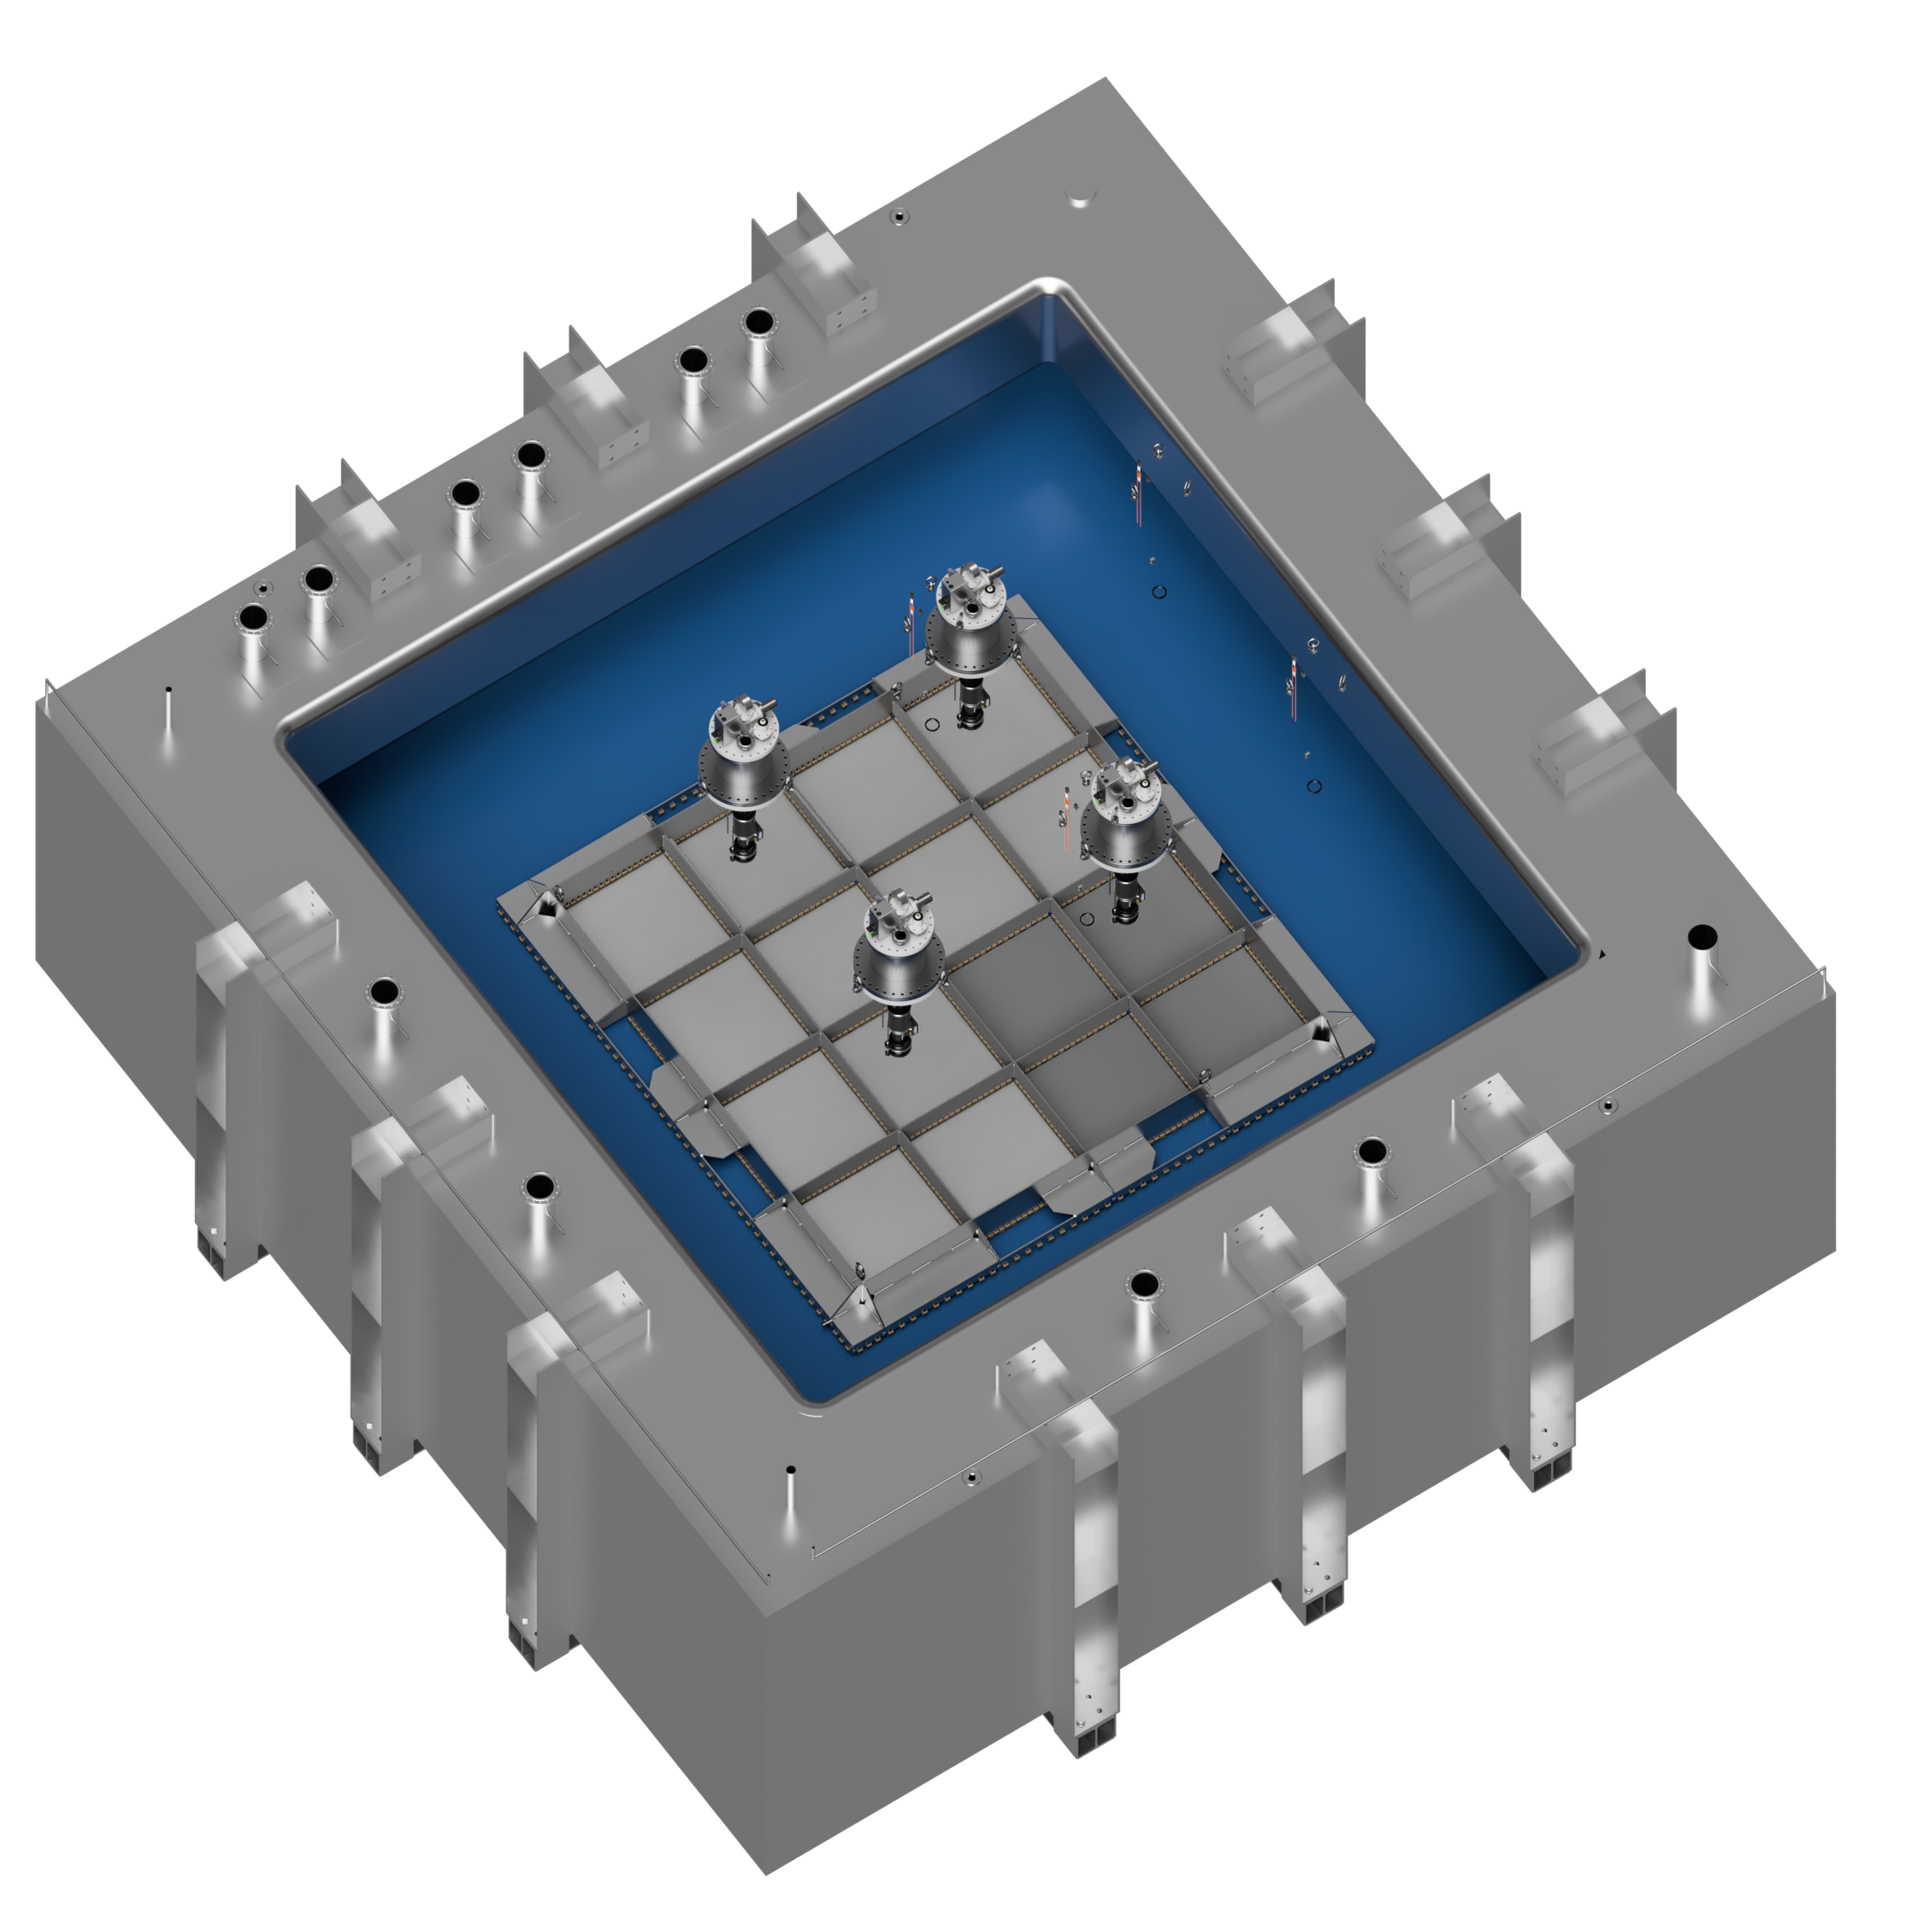
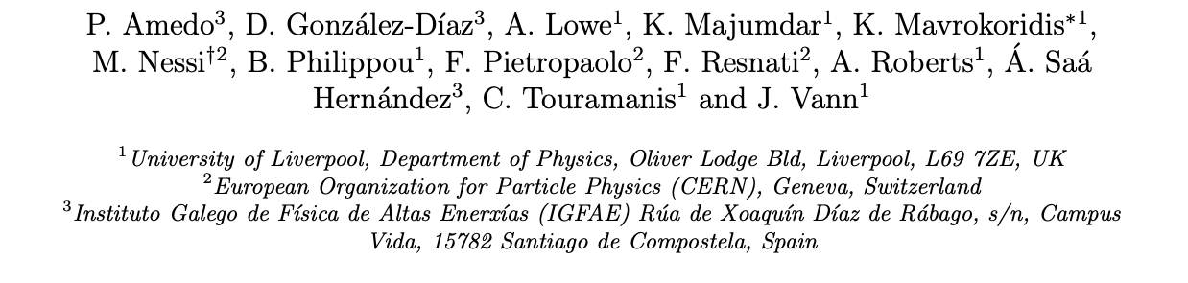
Larger Scale Demonstration at the CERN Neutrino Platform
Operation March/April 2022
Test optical readout on a scale relevant for DUNE using the existing cold box
CERN LOI: https://cds.cern.ch/record/2739360

Slide 12
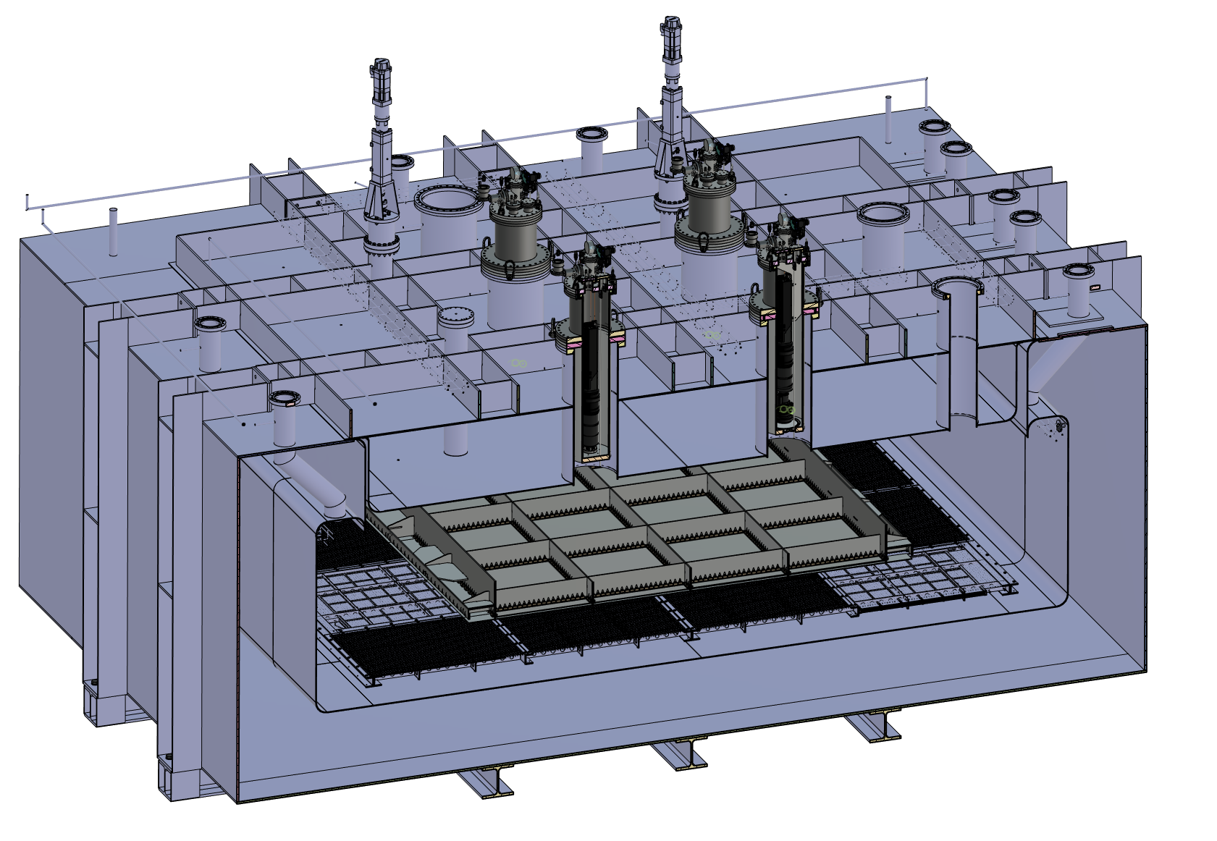
ARIADNE⁺: Cryostat Optical Configuration
TPX3 Camera
Assembly (1 x VUV)
TPX3 Camera
Assembly (3 x visible)
Large scale test of ARIADNE optical readout principle for dual-phase LArTPCs.
Four Timepix3 based cameras, each covering 1m x 1m readout area.
Three cameras detect visible light (wavelength shifter installed above THGEMs)
One camera directly detects VUV.
Light Readout Plane (LRP)
Cathode

Slide 13
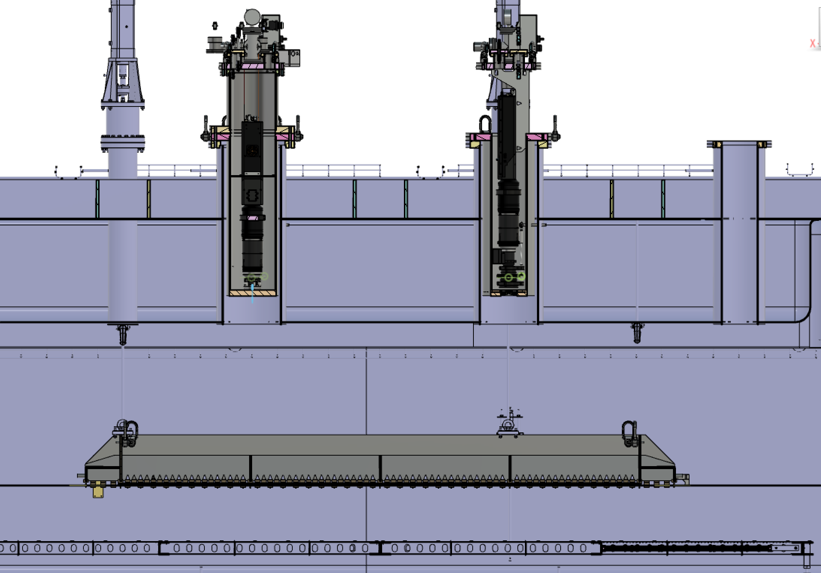
ARIADNE⁺: Cryostat Optical Configuration
Re-entrance viewports, cameras in gas nitrogen
20 cm electron drift

Slide 14
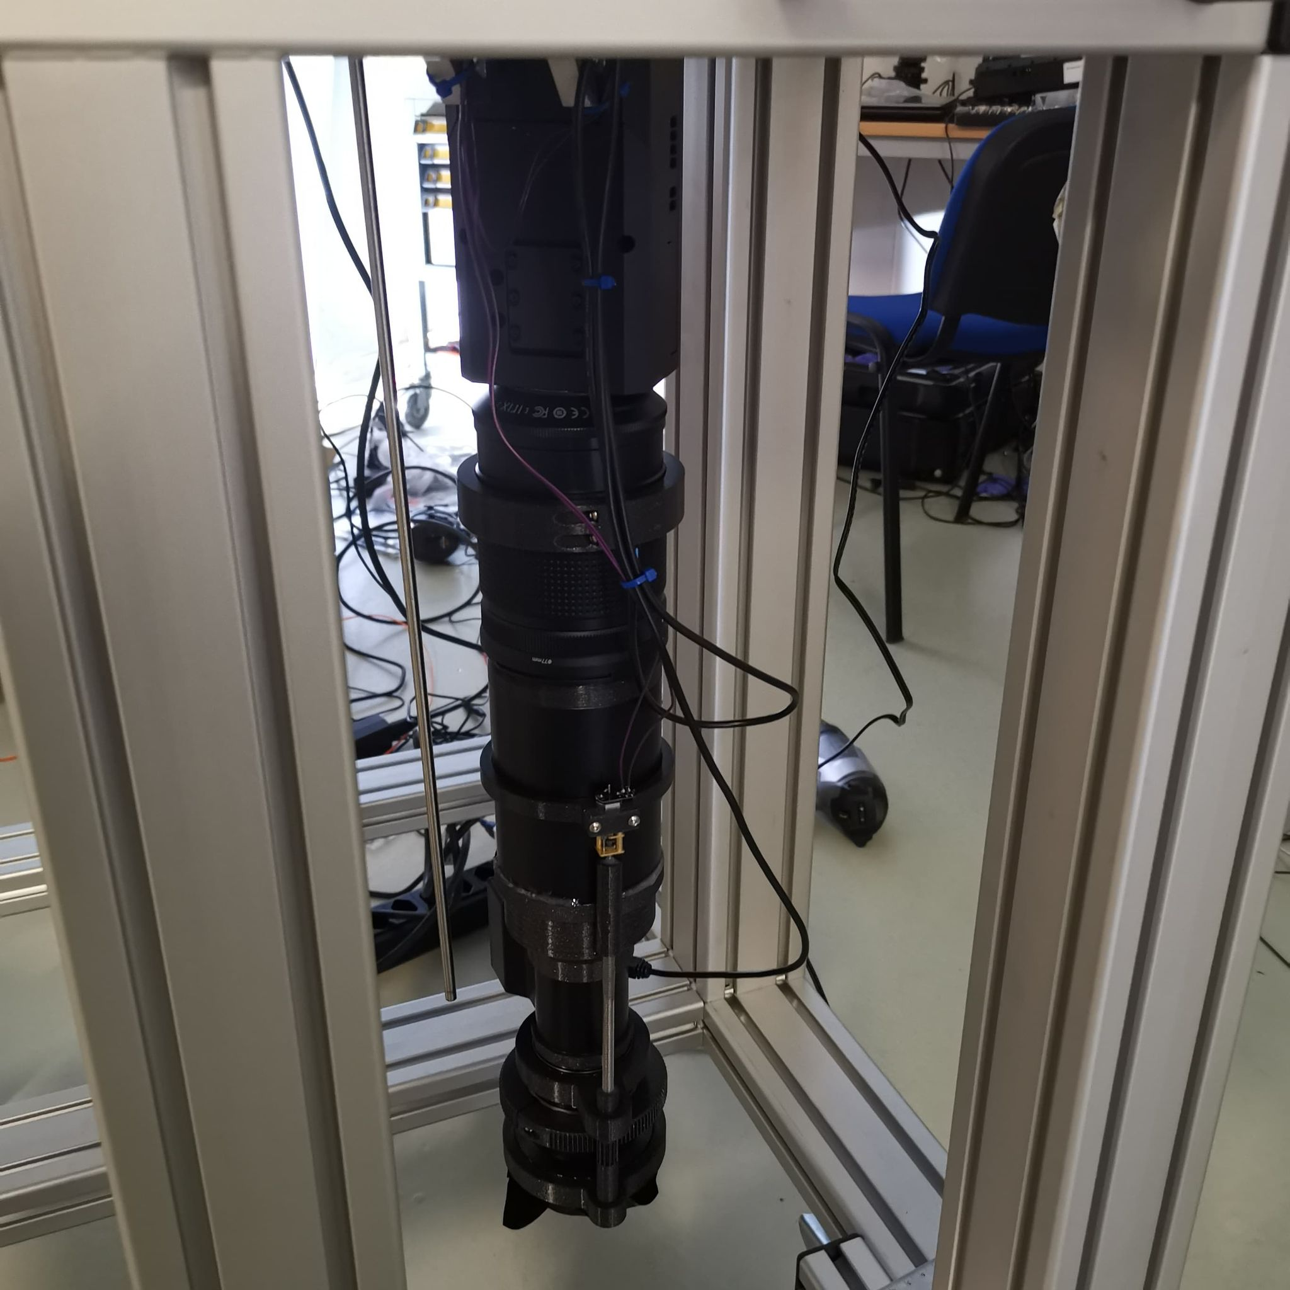
TPX3 Camera System
Timepix 3 Camera
Relay optics
Image intensifier
Objective lens

Slide 15
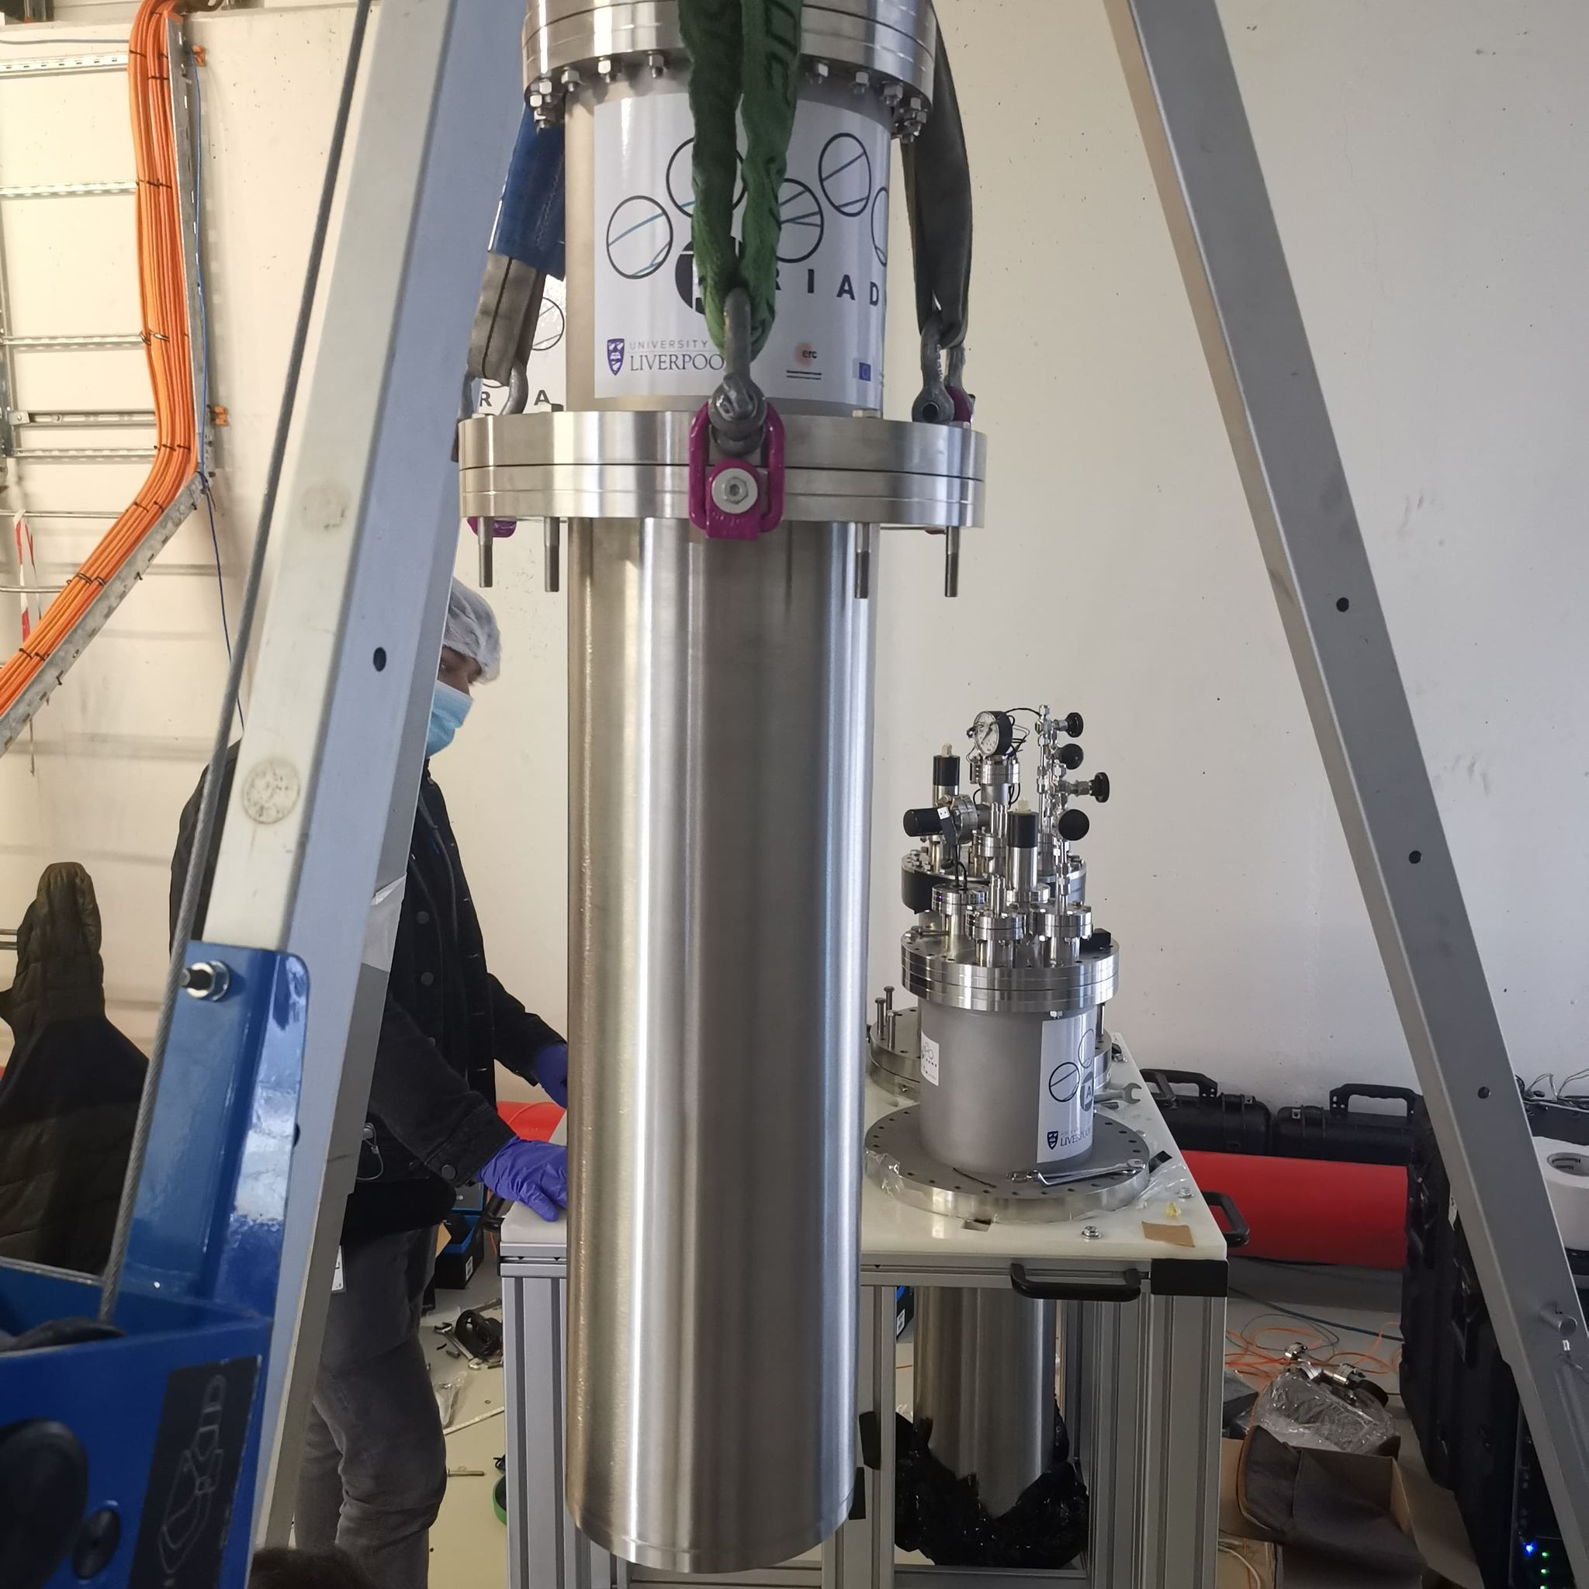
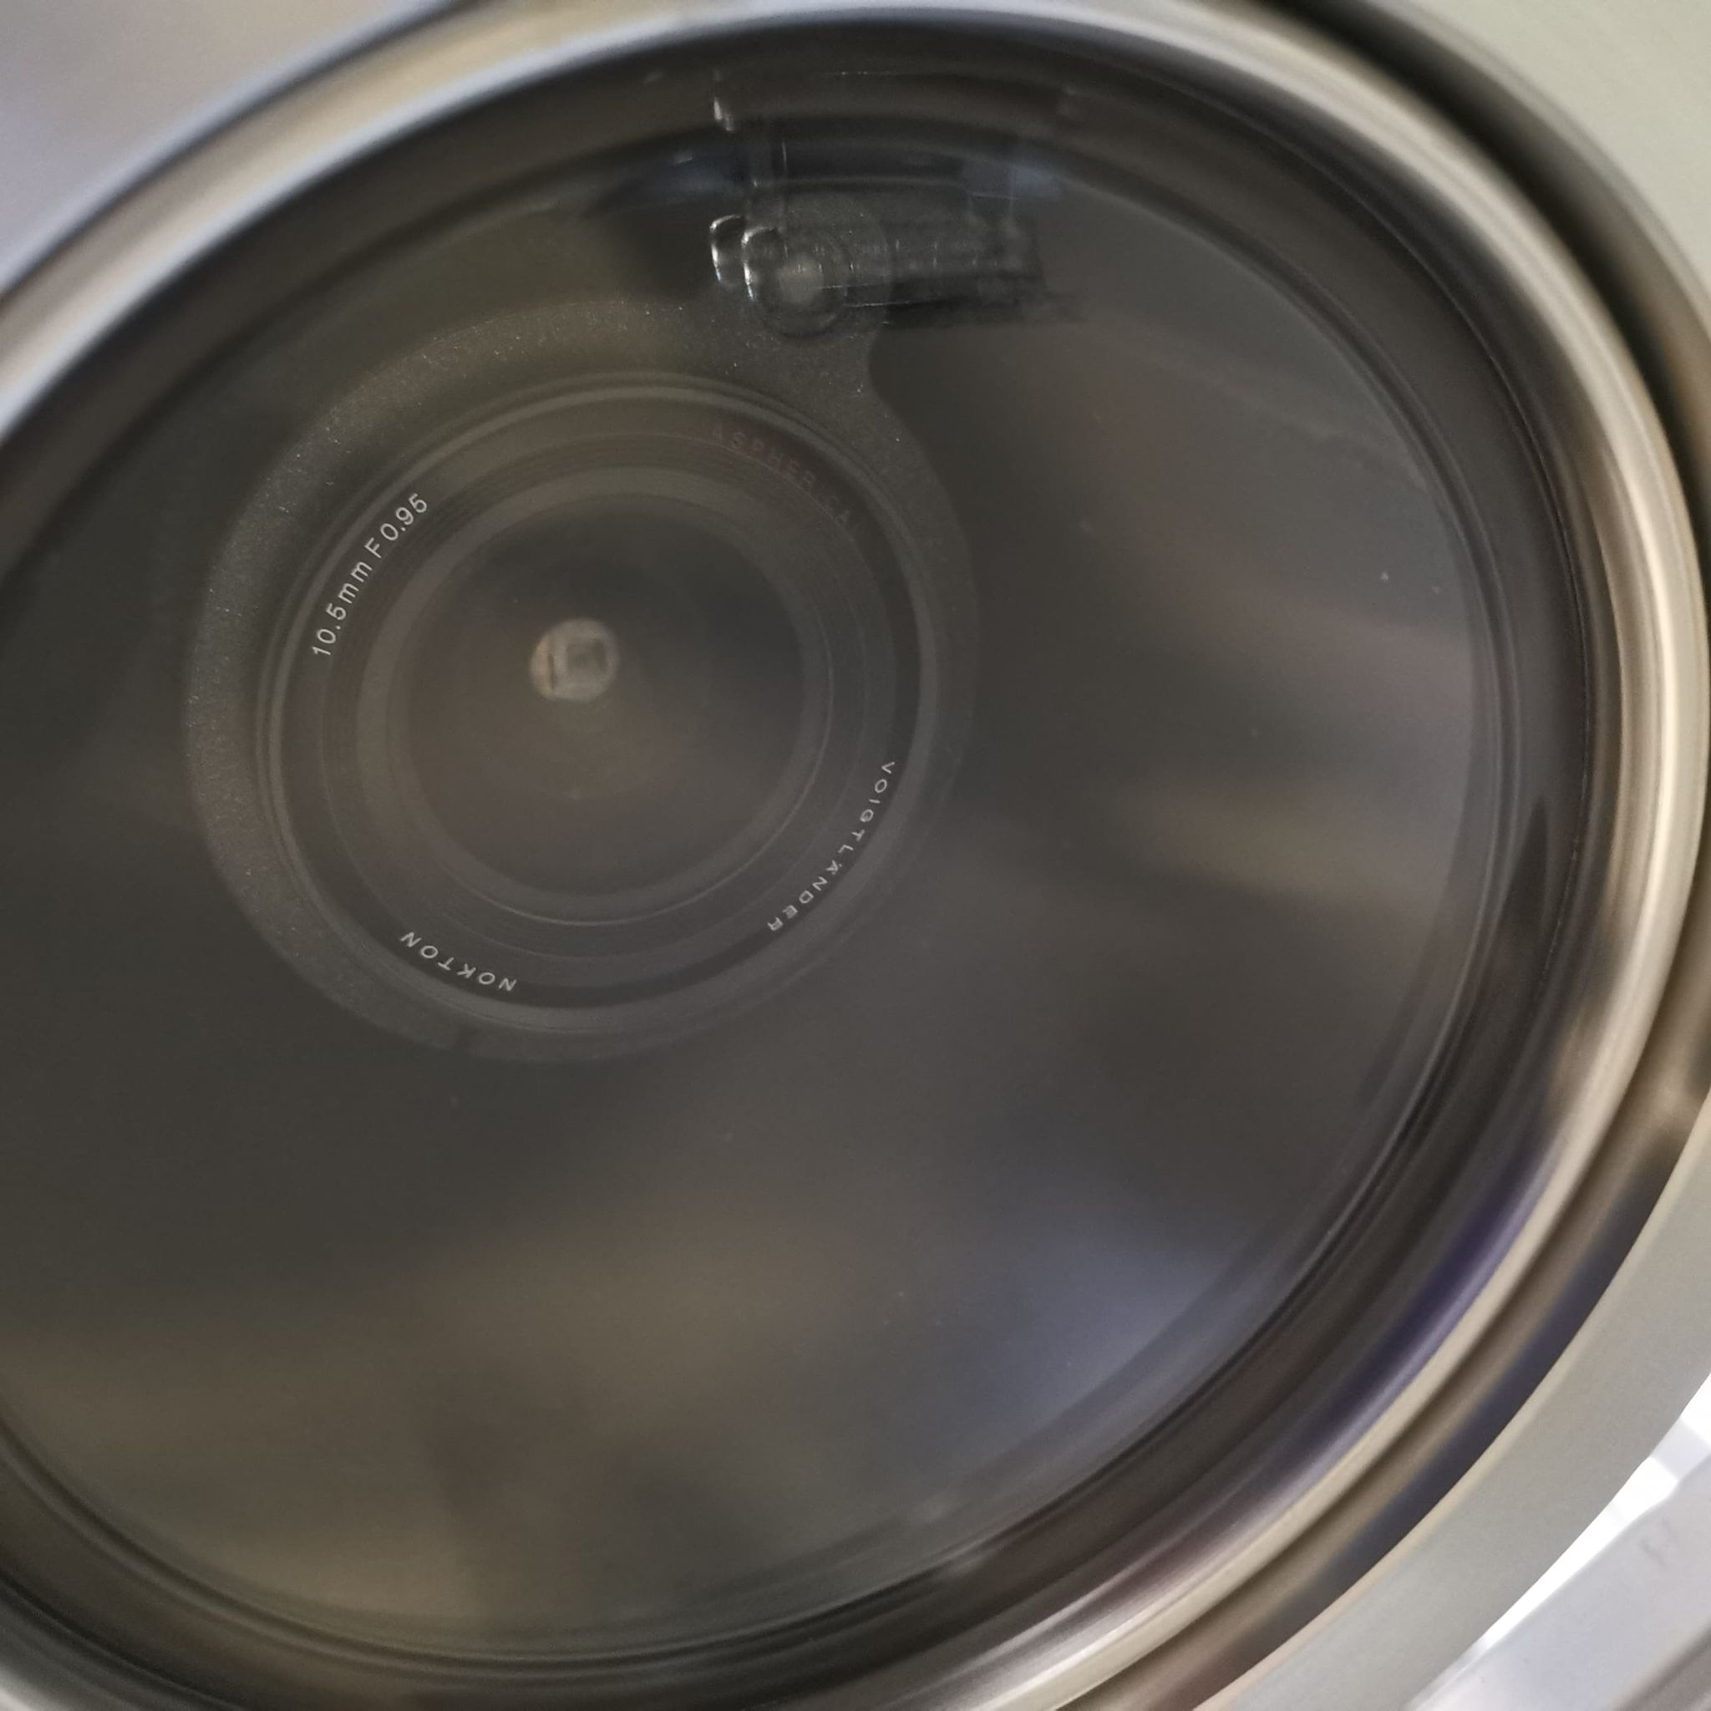
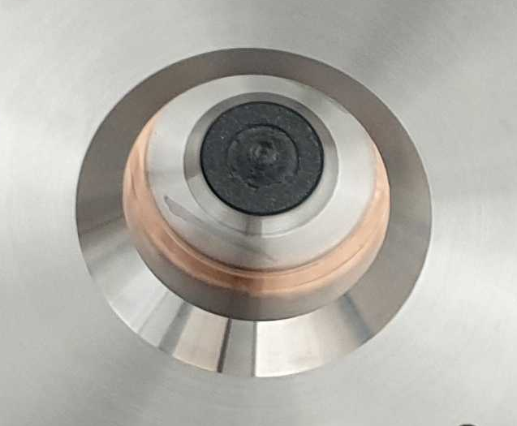
Re-entrance Viewport
Visible lenses (f0.95, 10.5 mm)
Custom made VUV MgF₂ Lens (f3, 11mm, 5mm diameter)

Slide 16
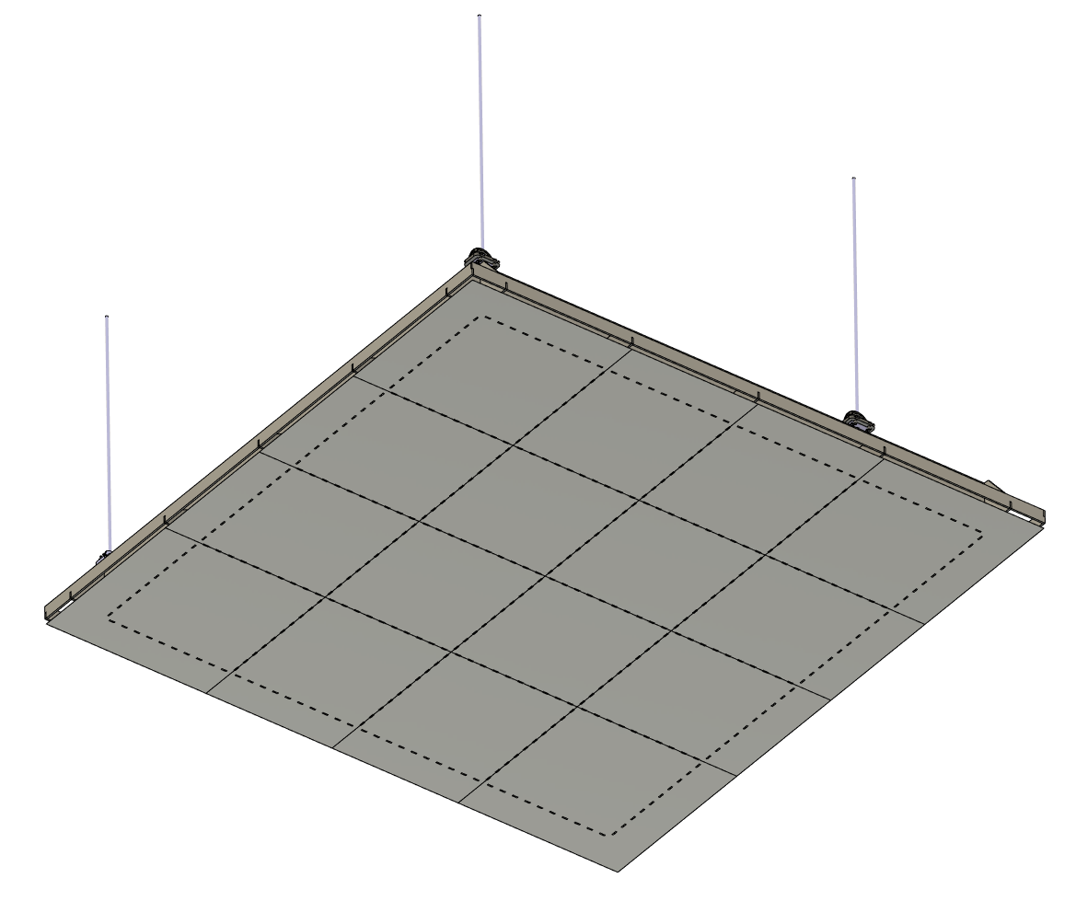
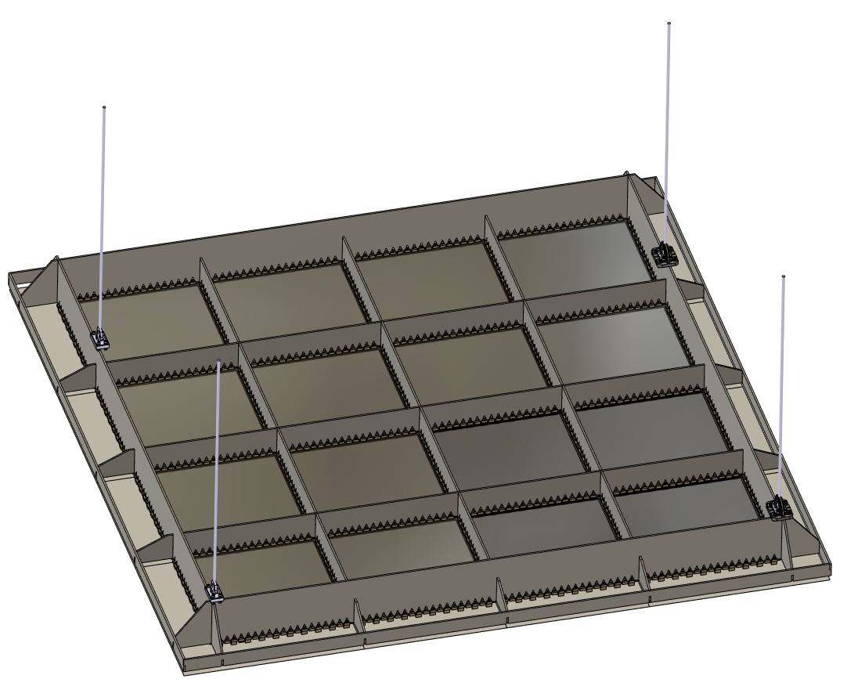
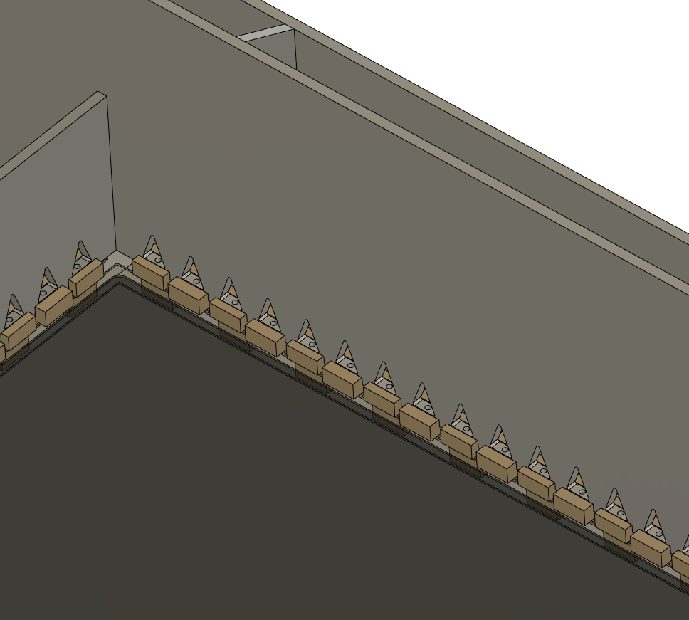
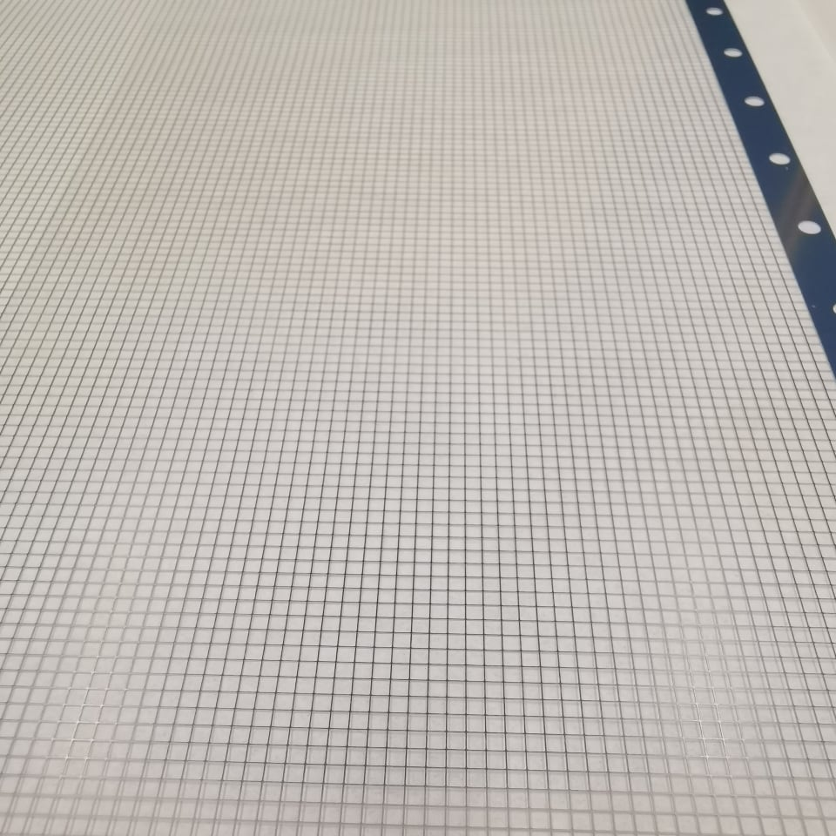
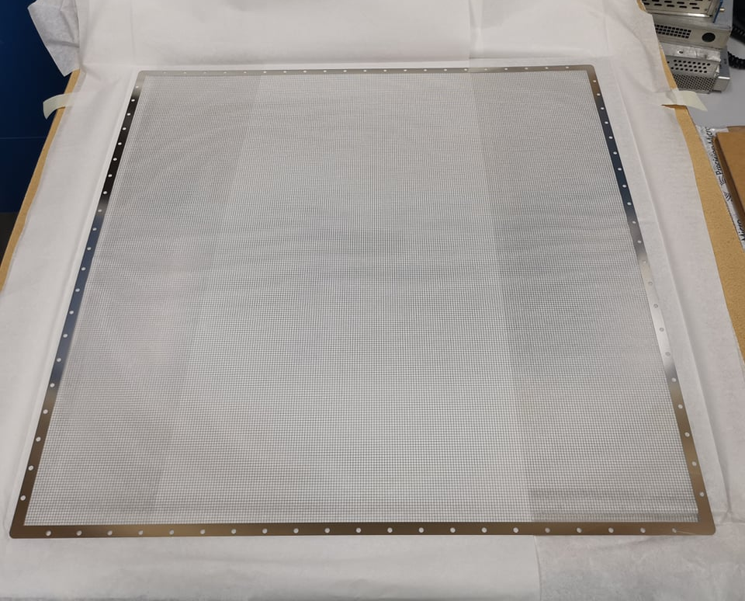
Light Readout Plane (LRP) Design
Modular design and can be applied directly to a DUNE module
Bottom view
Welded Invar structure (Uniquely low coefficient of thermal contraction)
16x 50cm square G-THGEMs
2.3m
Photochemically etched extraction grids
THGEMs/Extraction grids supported by PEEK Spacers

Slide 17
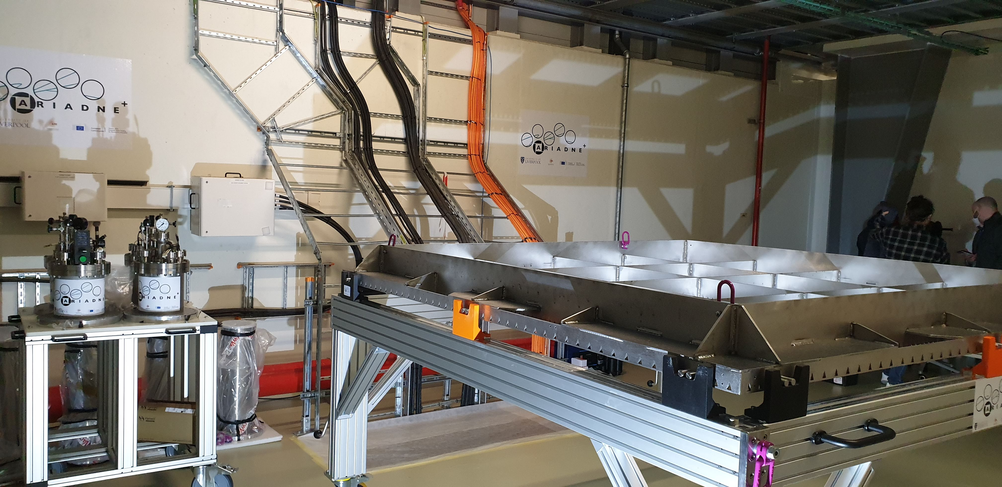
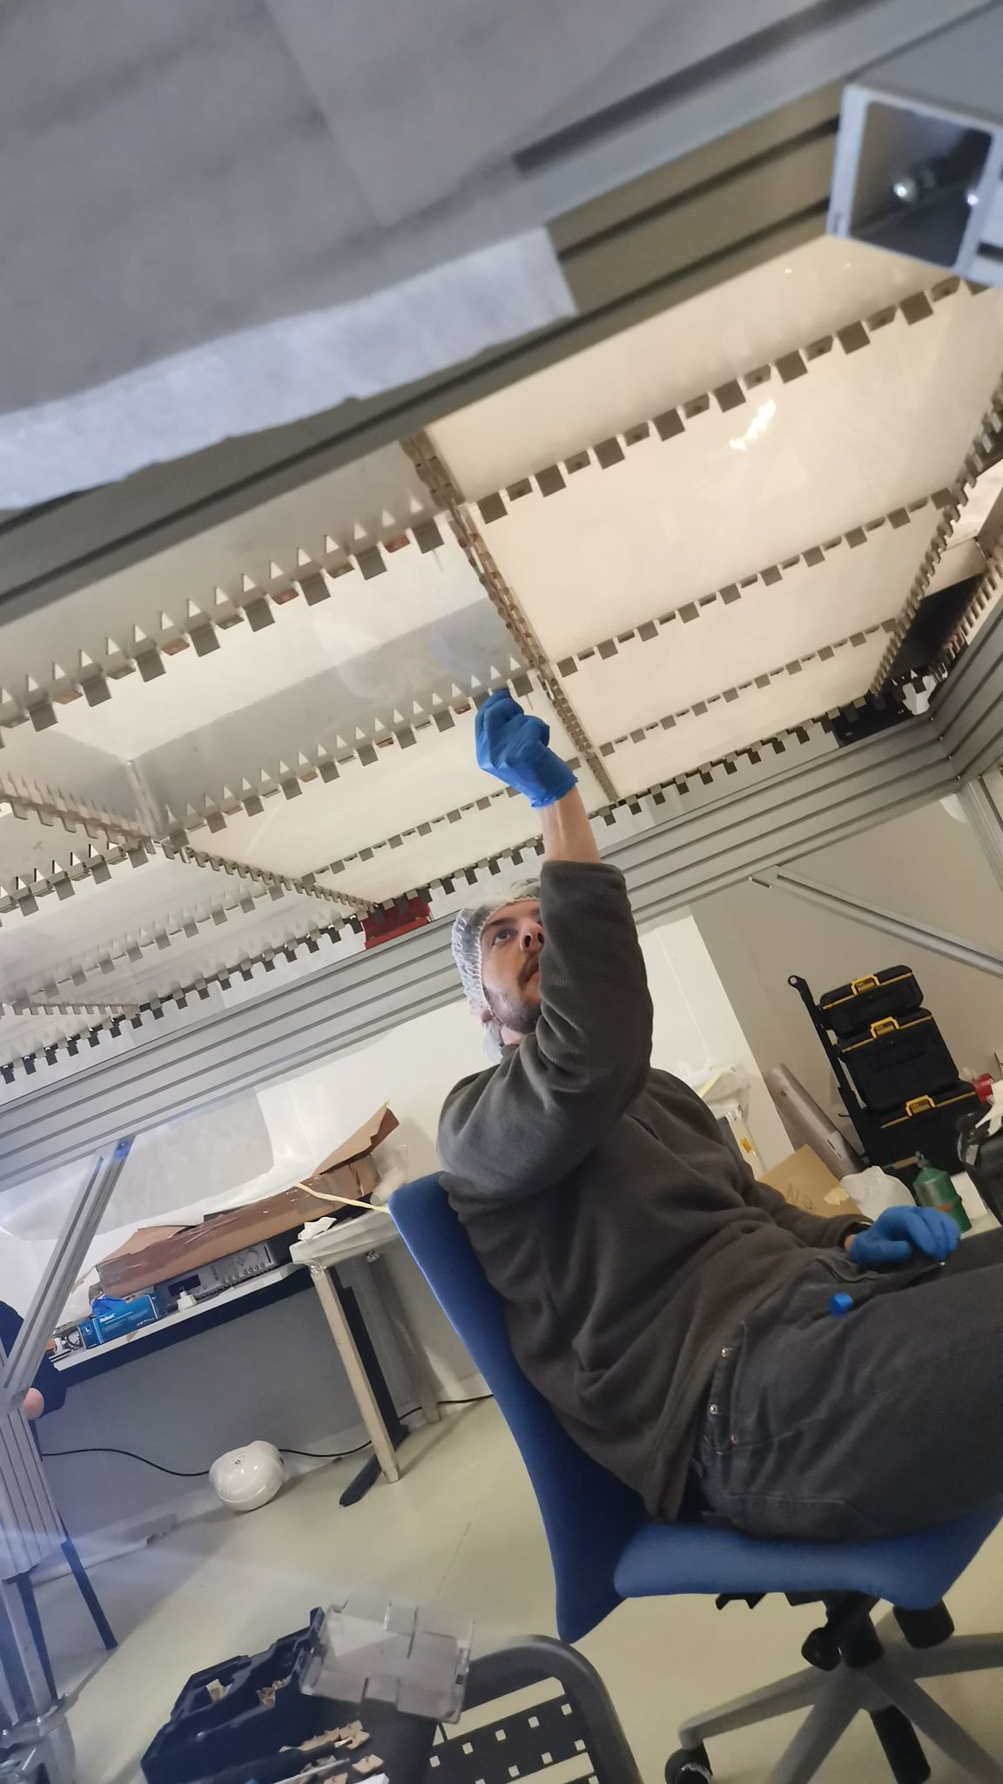
Light Readout Plane (LRP)
LRP assembly at CERN

Slide 18
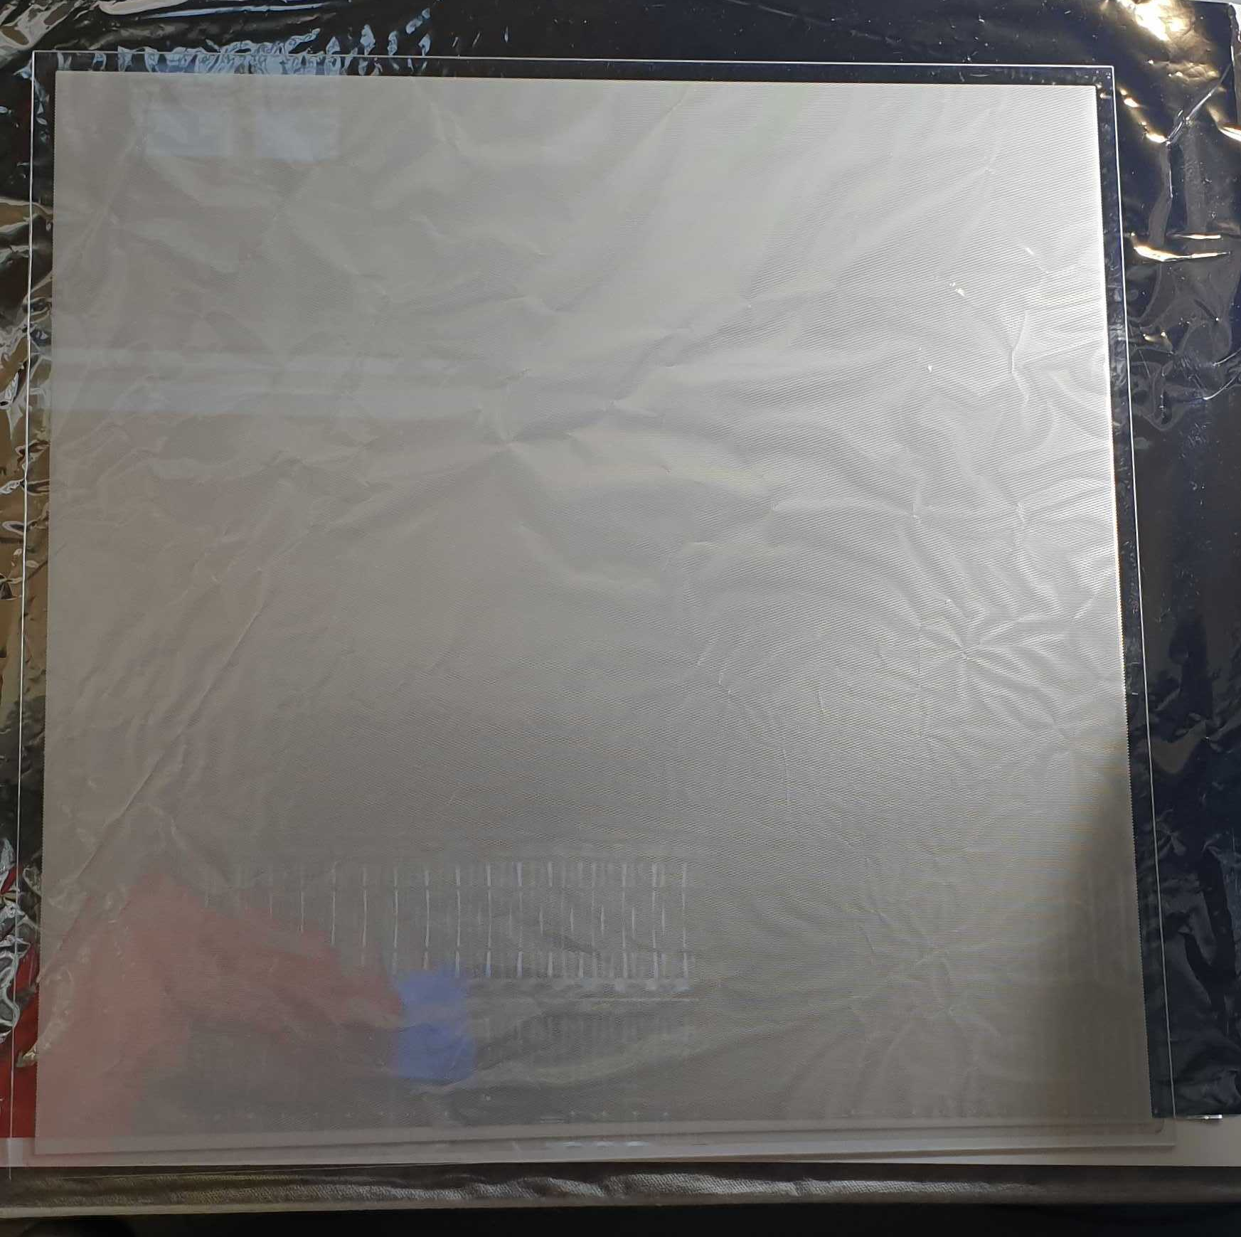
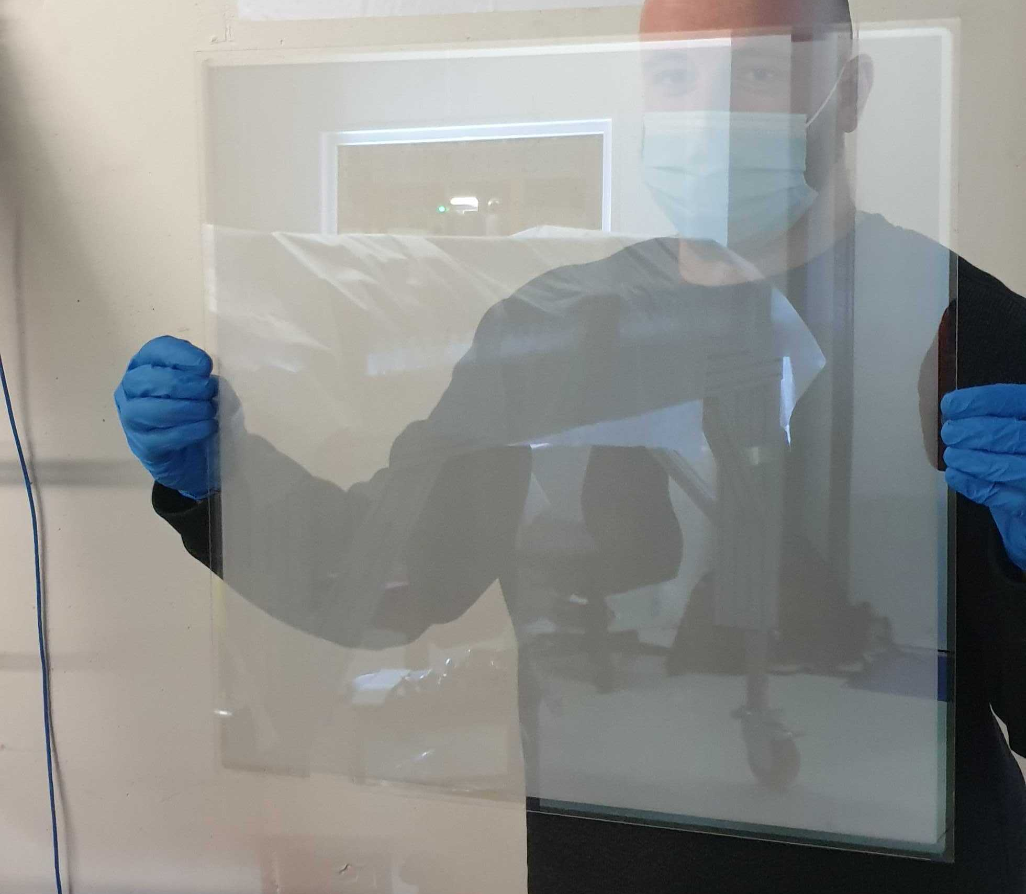
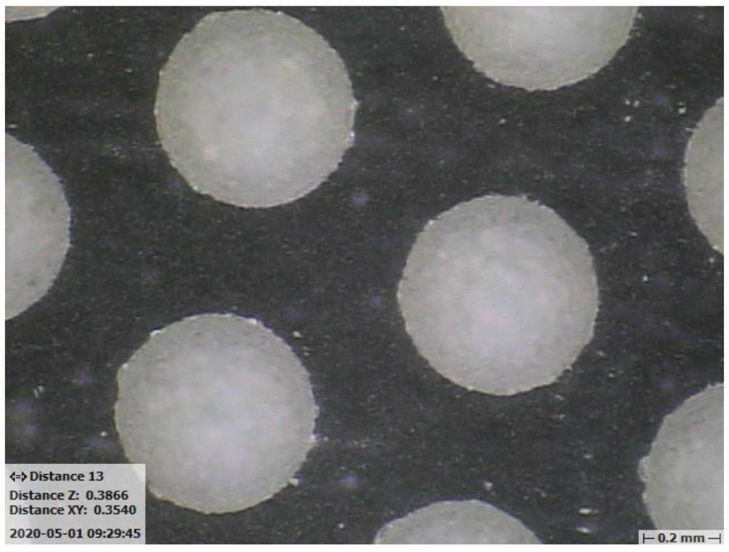
50cm Glass THGEMs
Novel Glass THGEMs developed at Liverpool (Patent accepted GB2019563.2)
Sixteen 50cm x 50cm glass THGEMs
1.1mm thick,
500μm ID holes,
800μm pitch hexagonal array
See for more details:
https://www.mdpi.com/2076-3417/11/20/9450

Slide 19
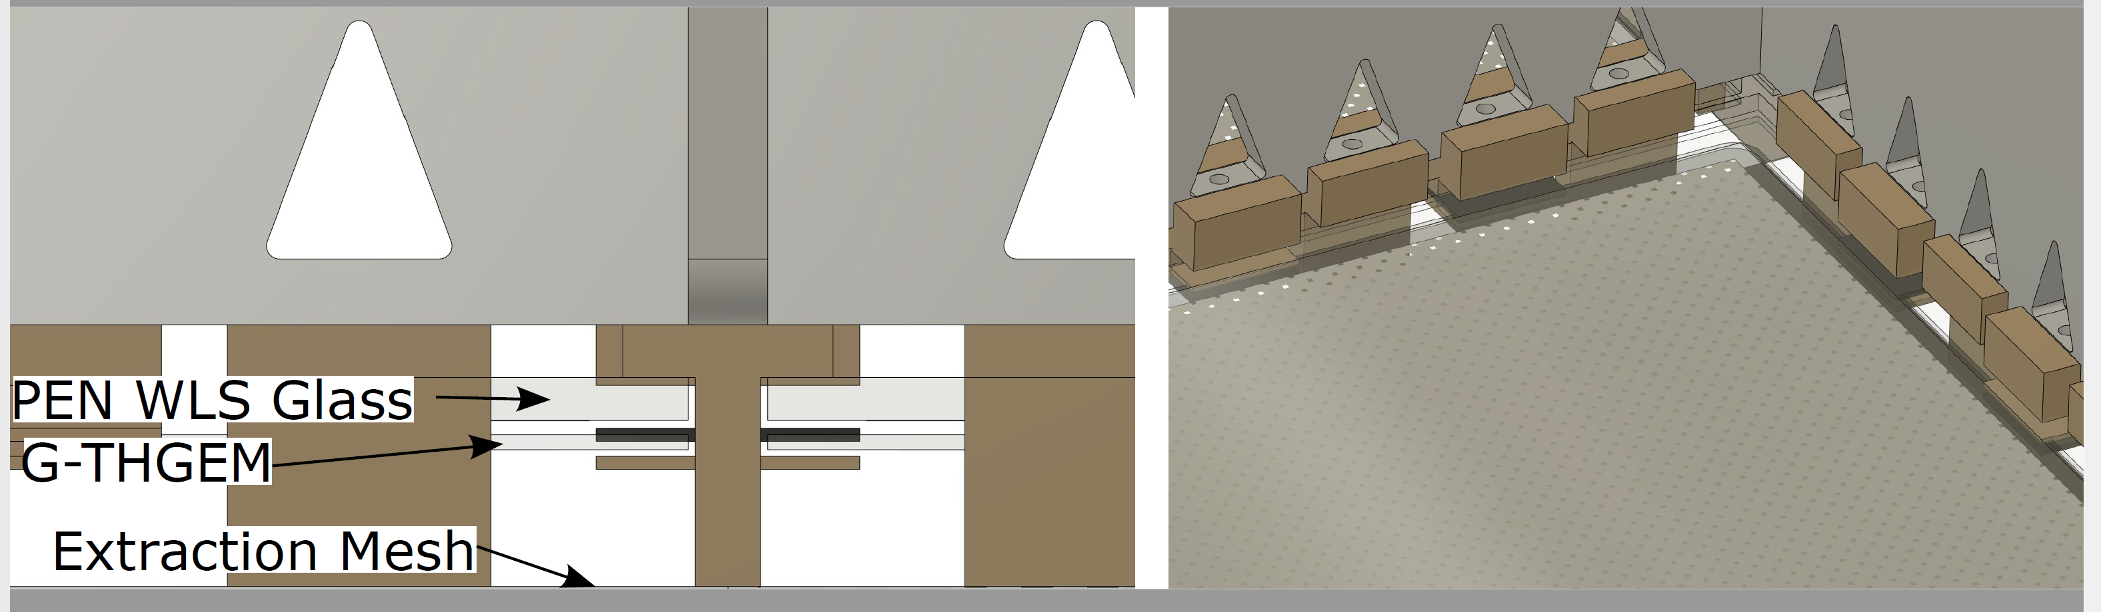
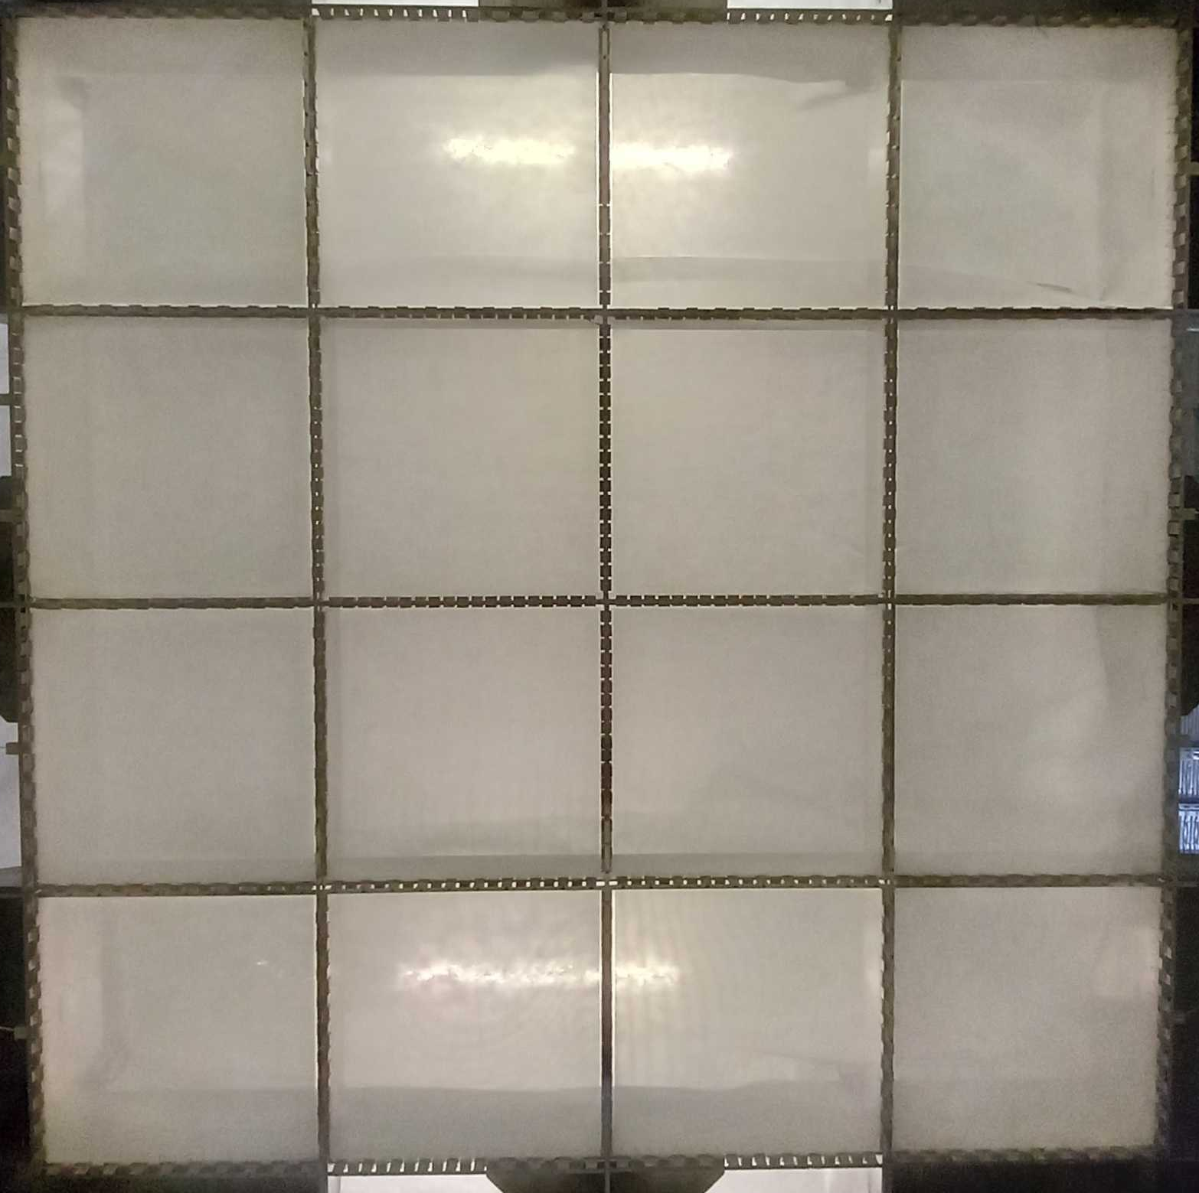
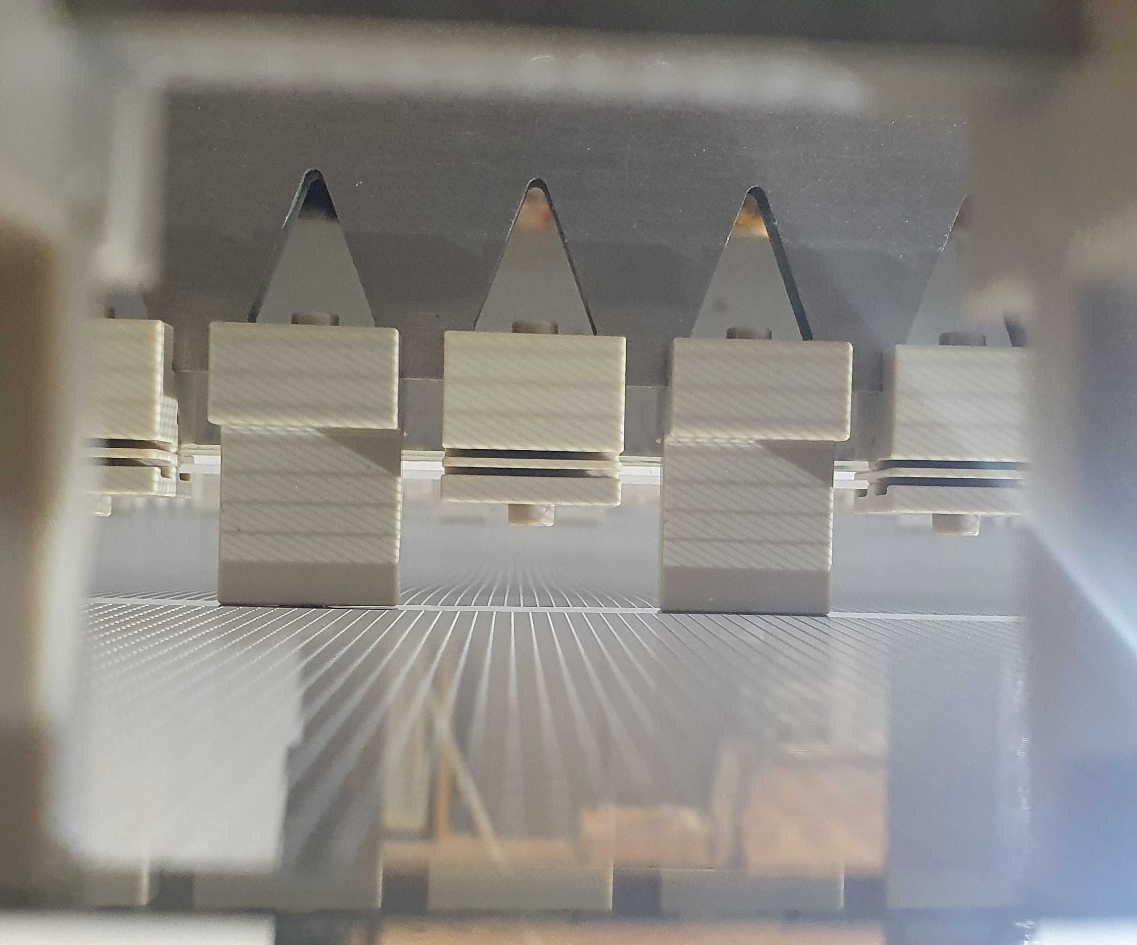
Light Readout Plane
LRP CAD
LRP grids, G-THGEMs and WLS
2x2m LRP G-THGEMs from underneath
The 15mm modular extraction region provided a very stable extraction field!

Slide 20
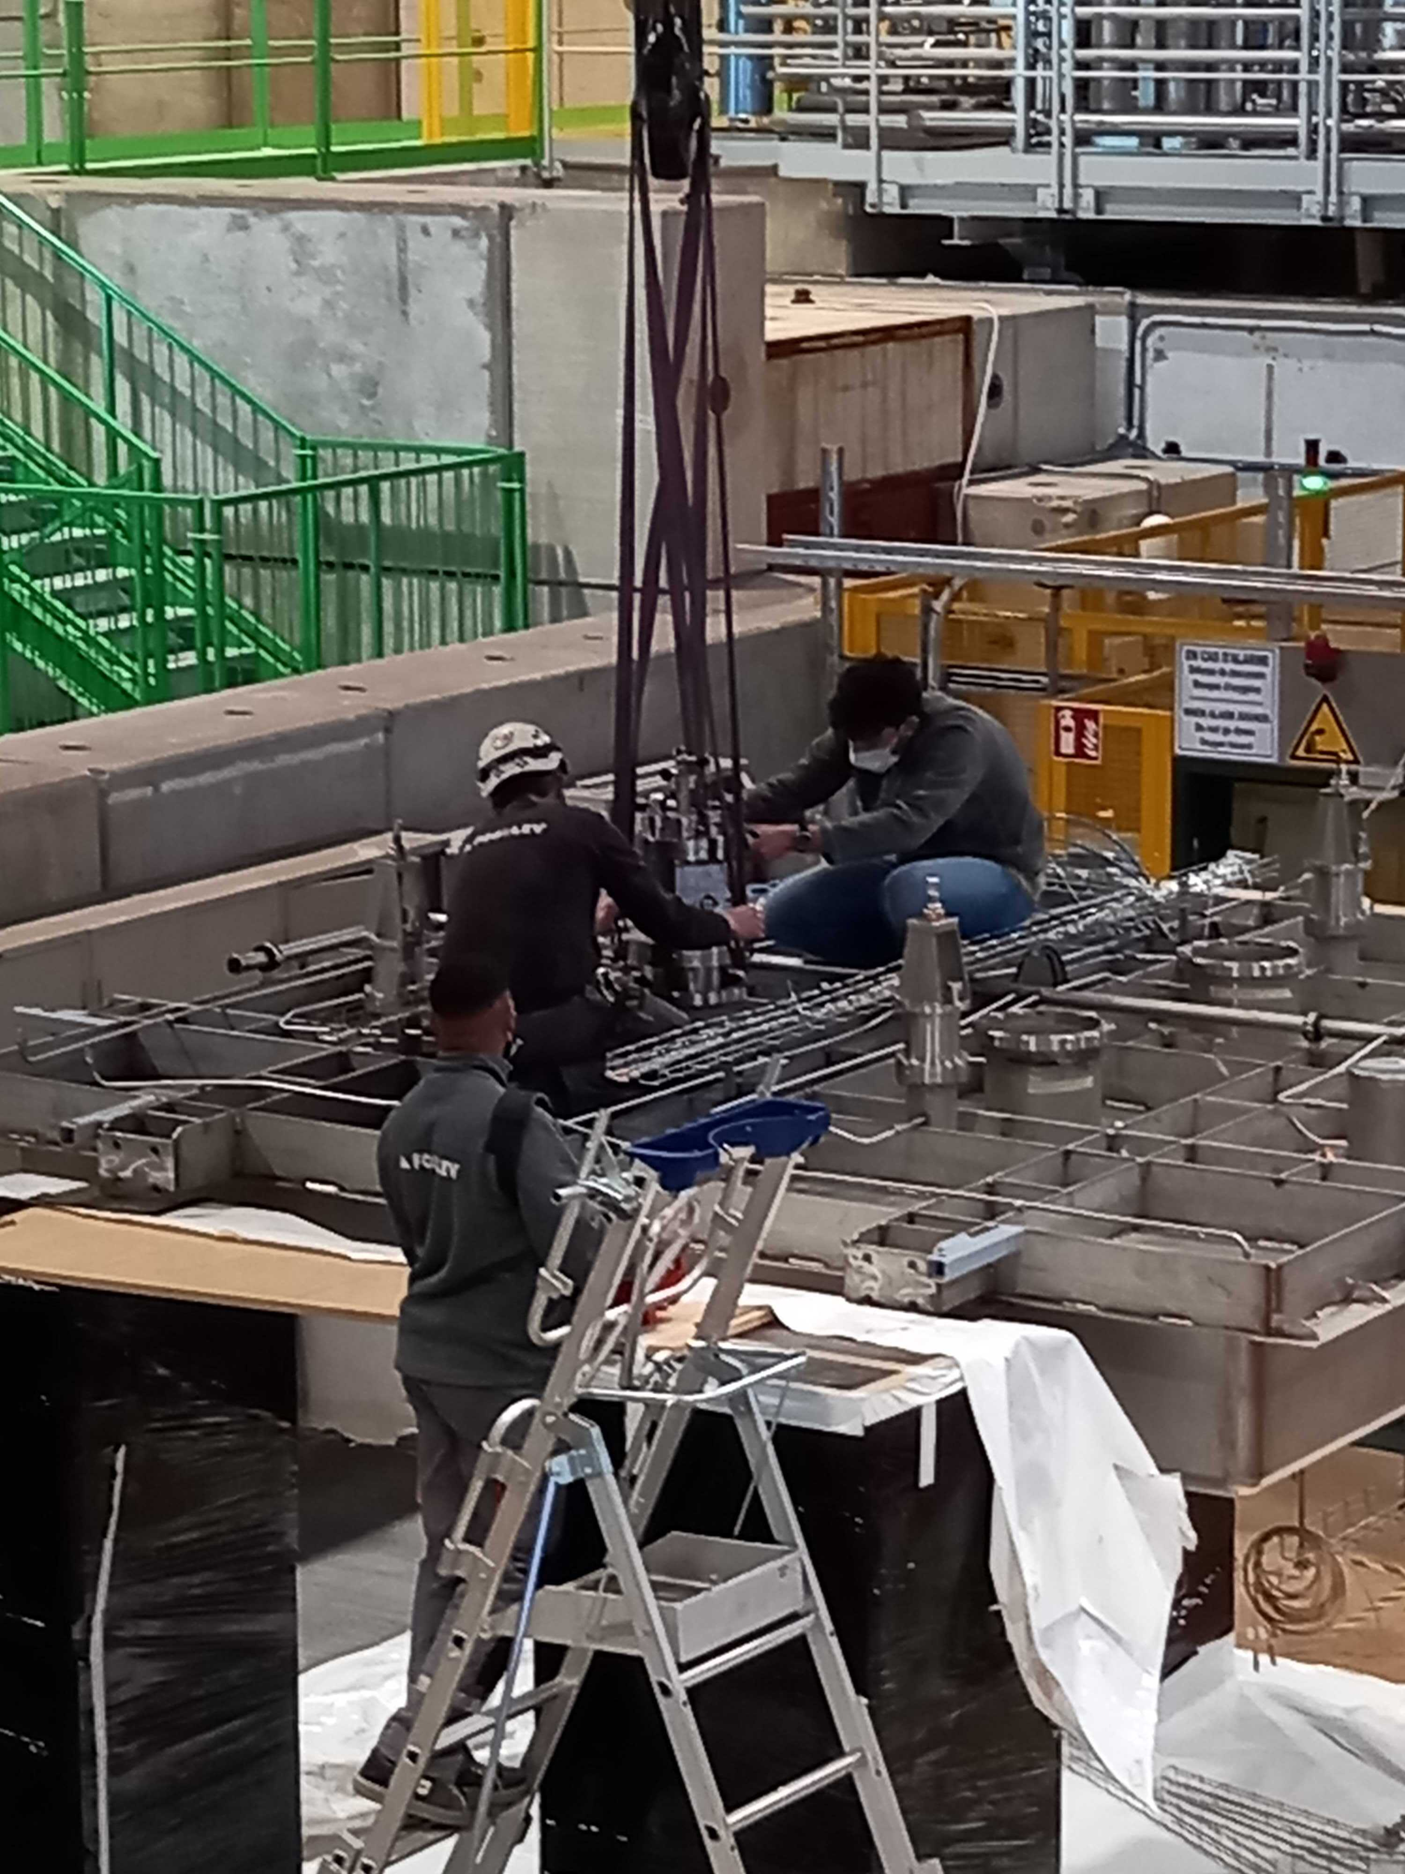
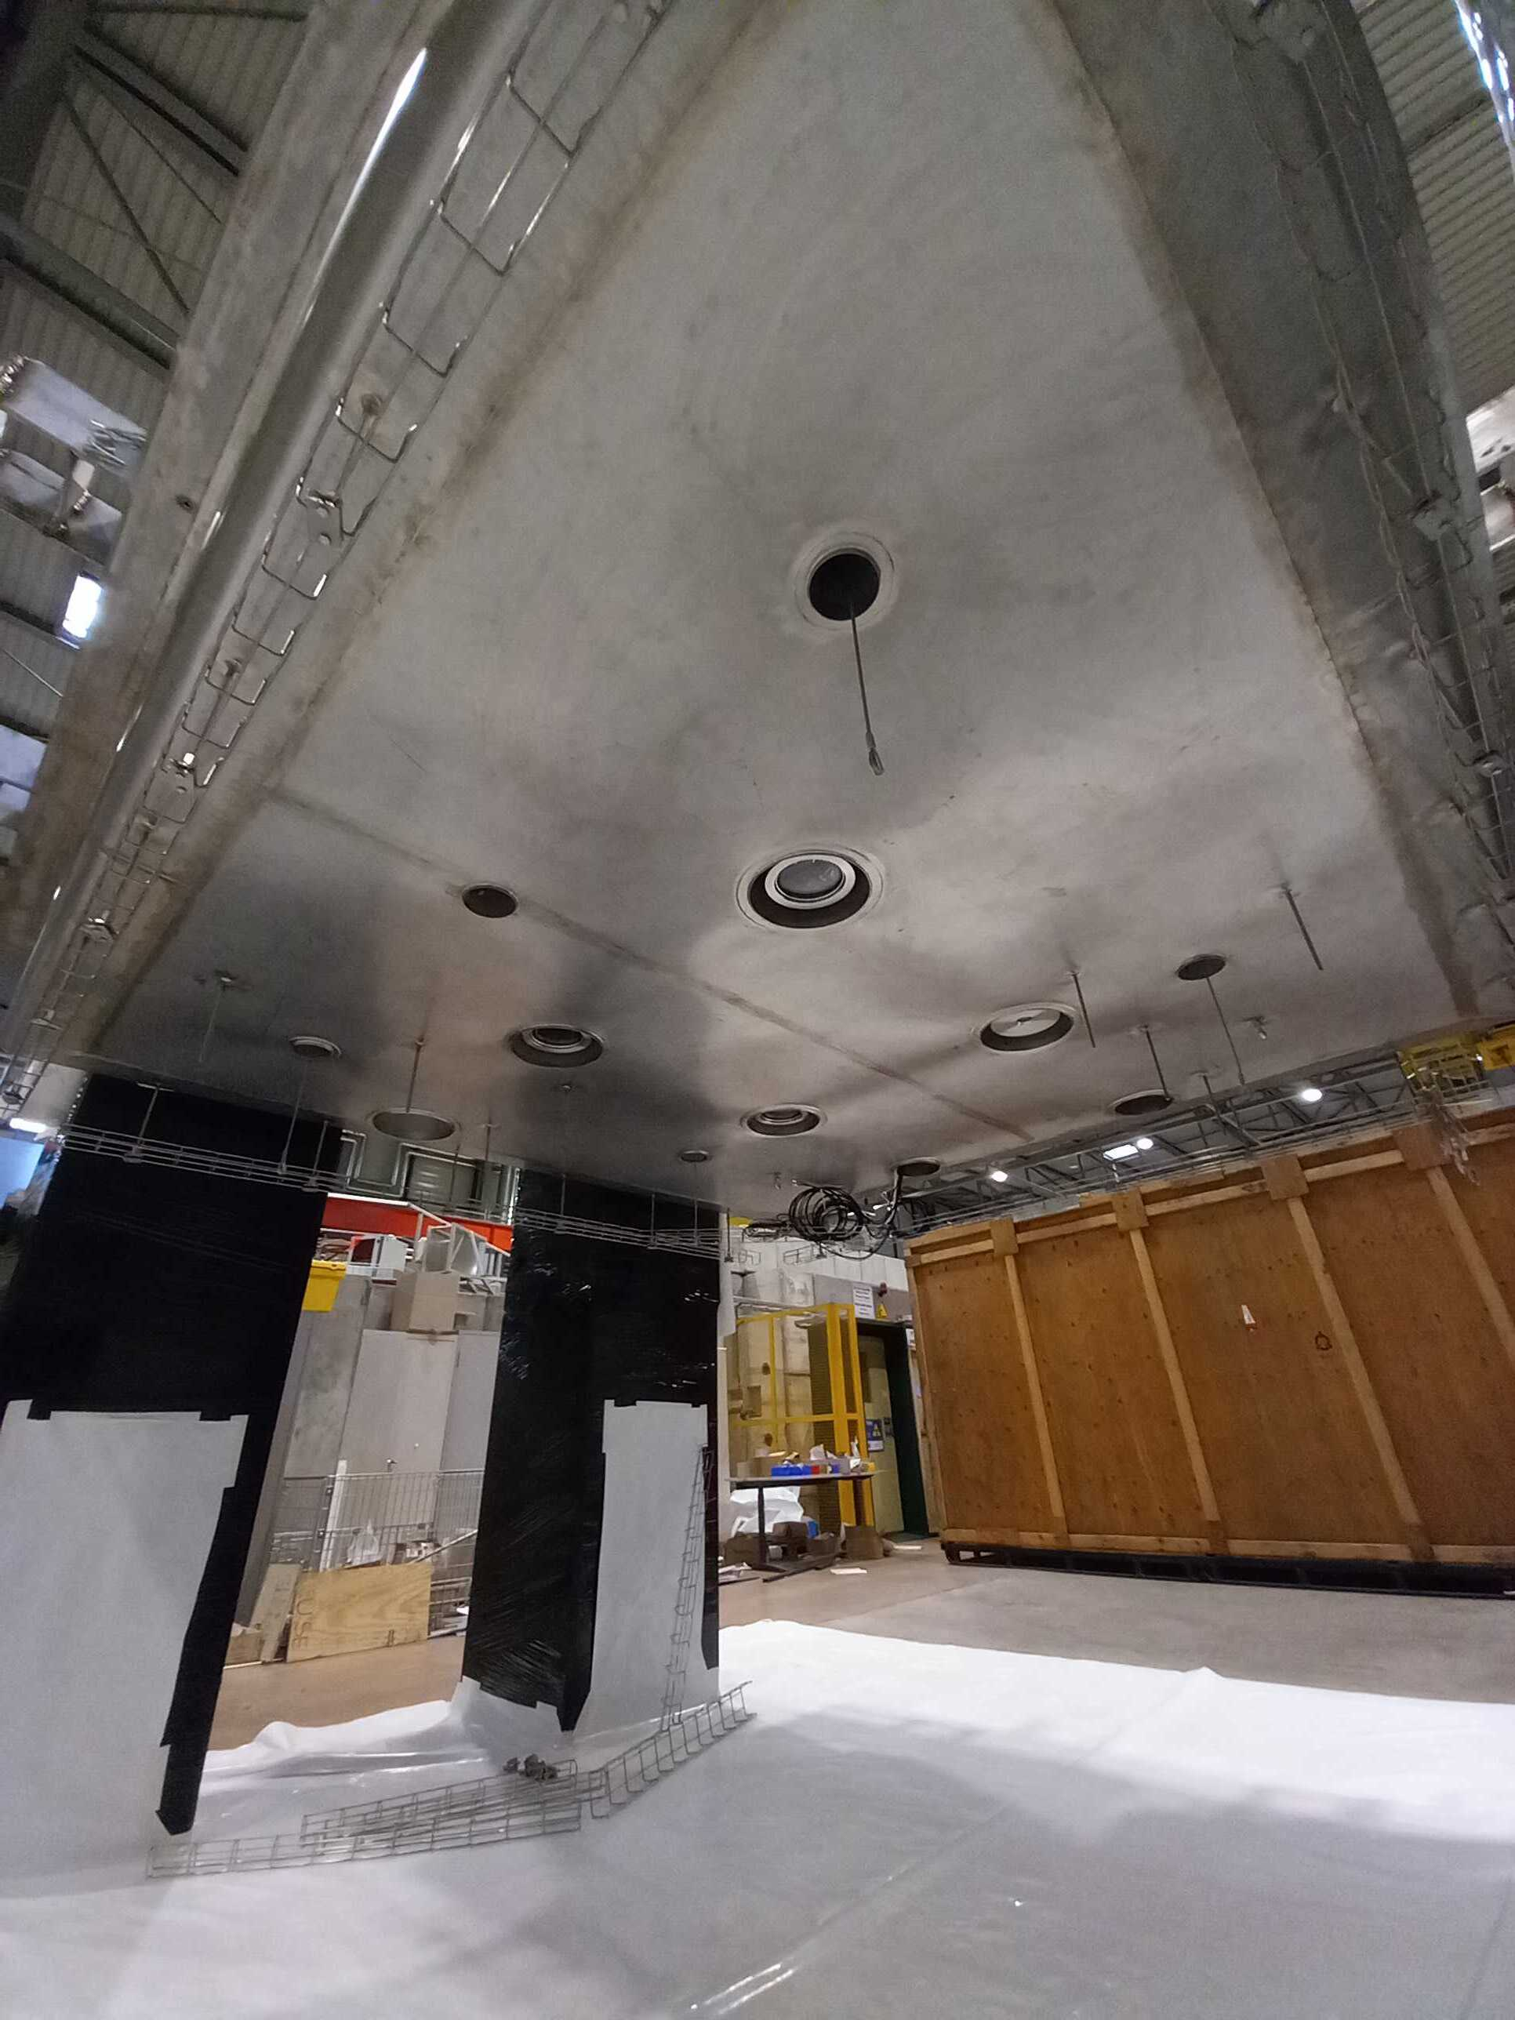
Cold box Integration

Slide 21
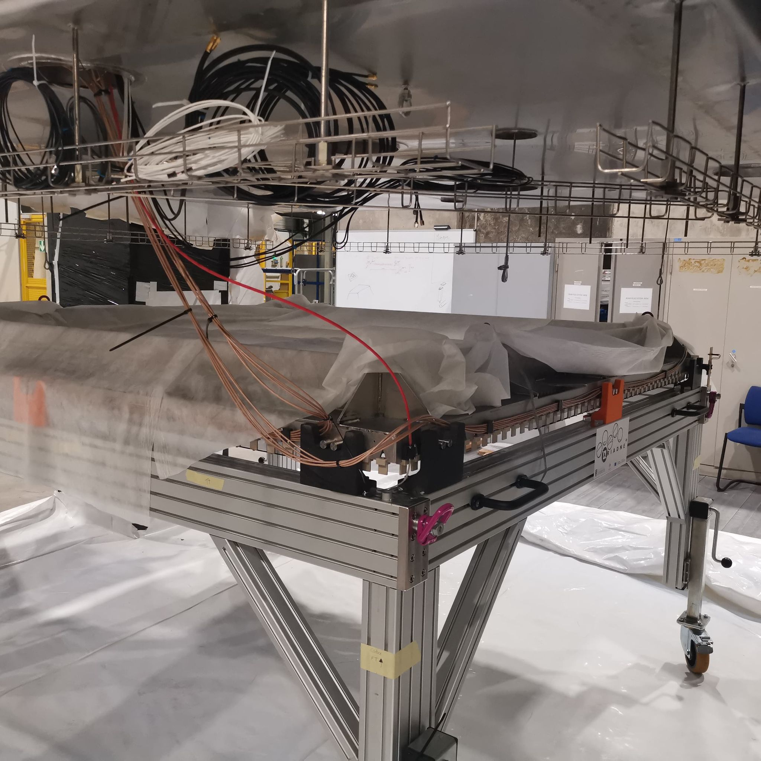
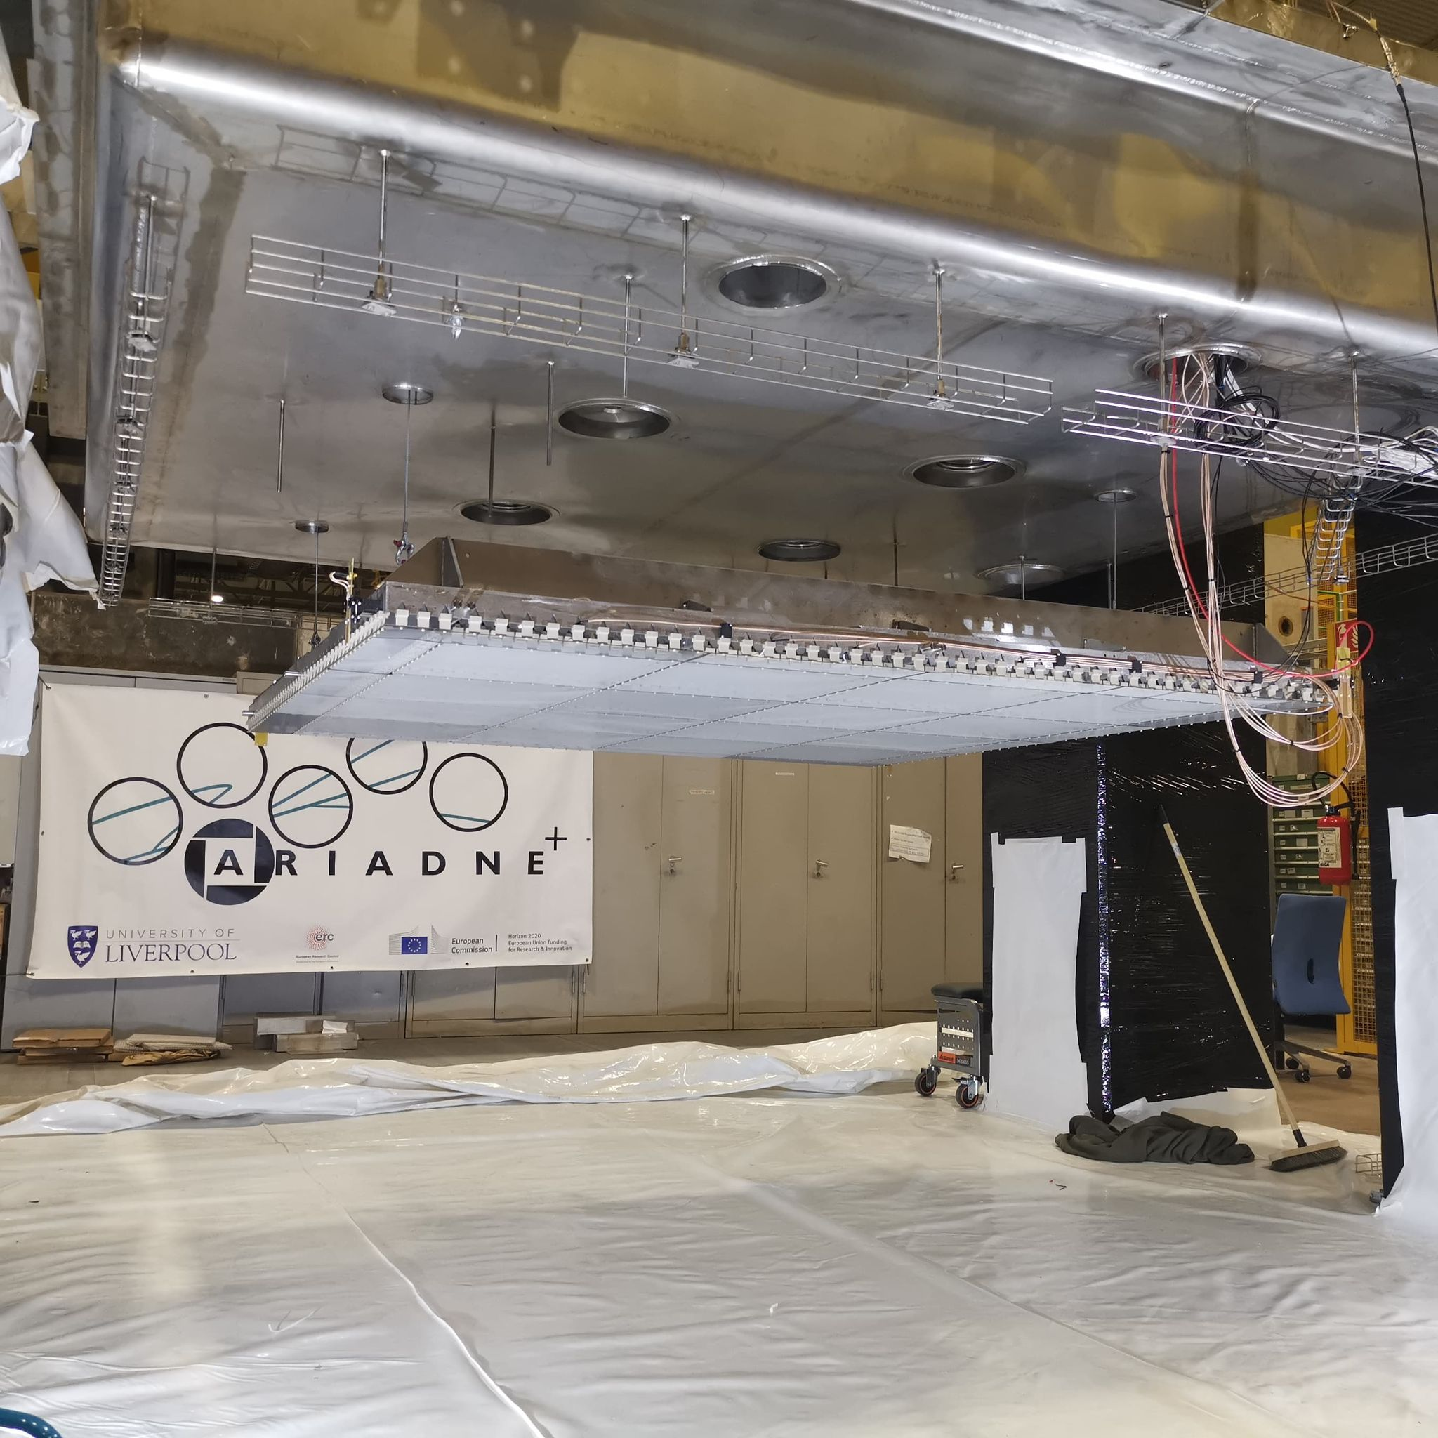
Cold box Integration

Slide 22
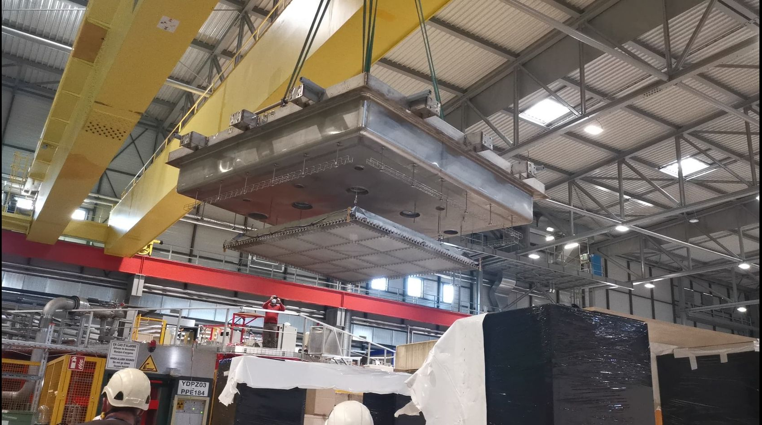
Closing the Detector

Slide 23
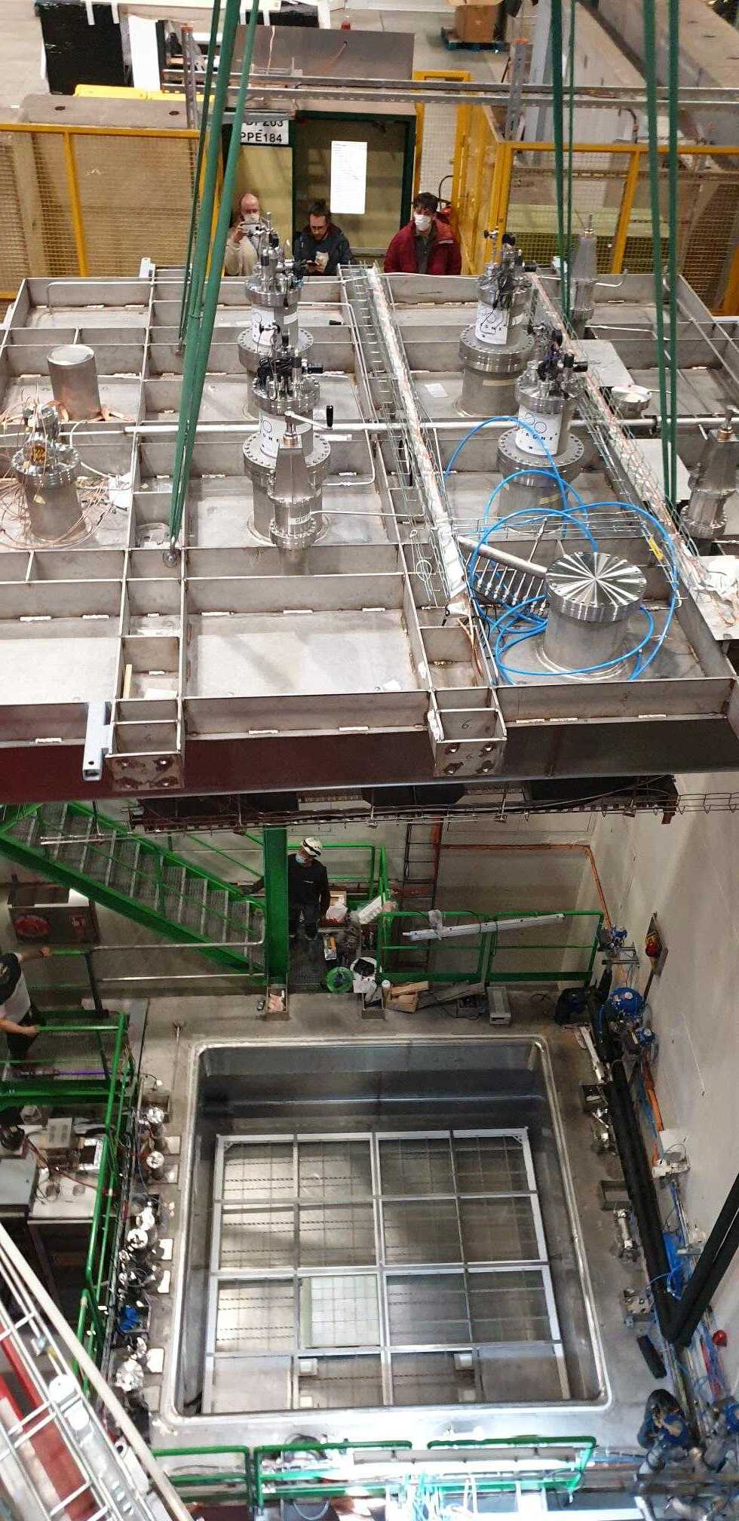
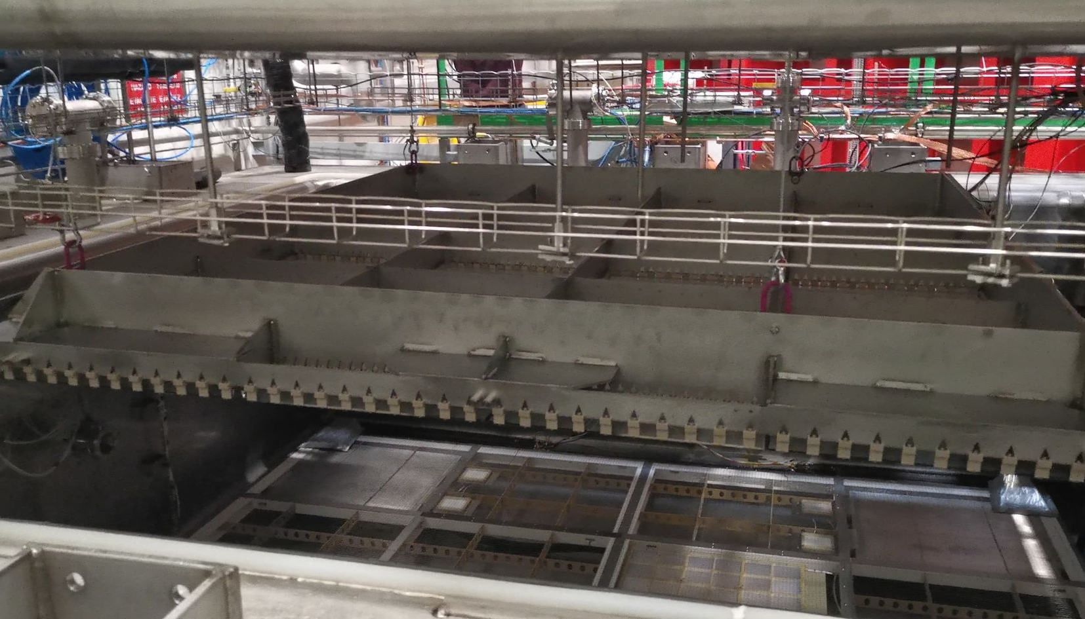
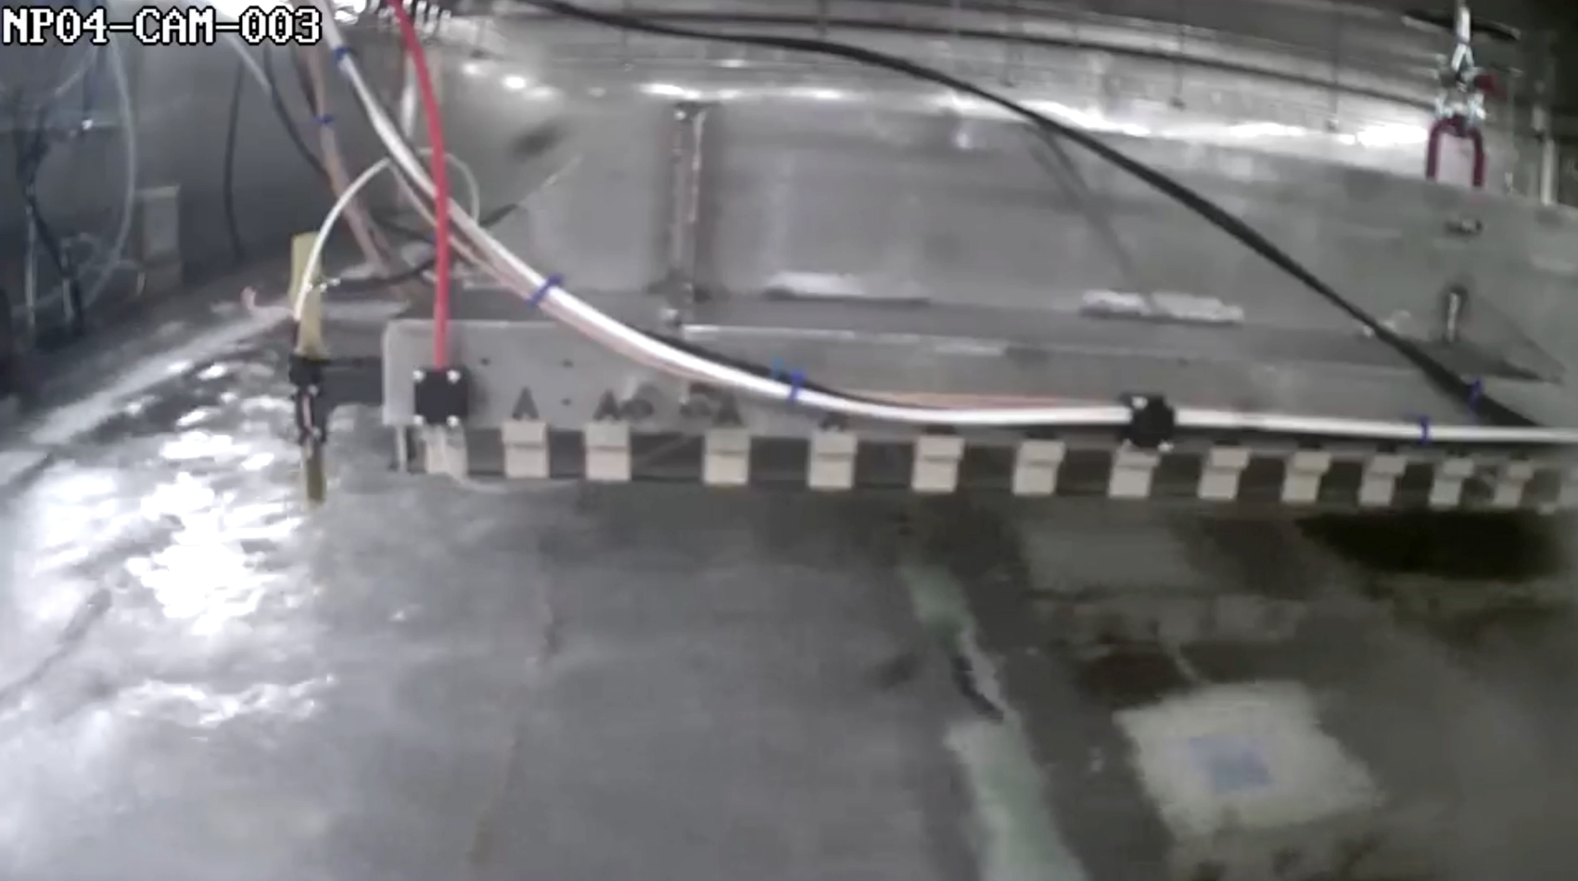
Closing the Detector
X-Arapuca

Slide 24
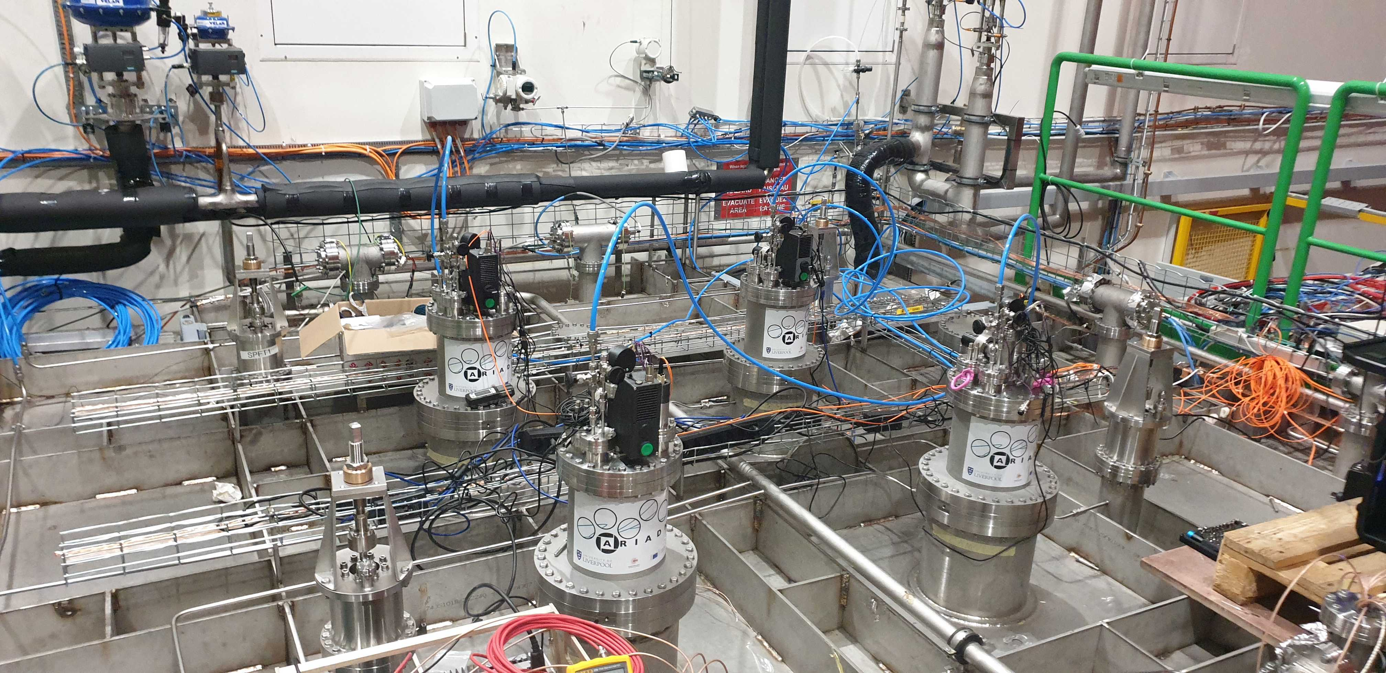
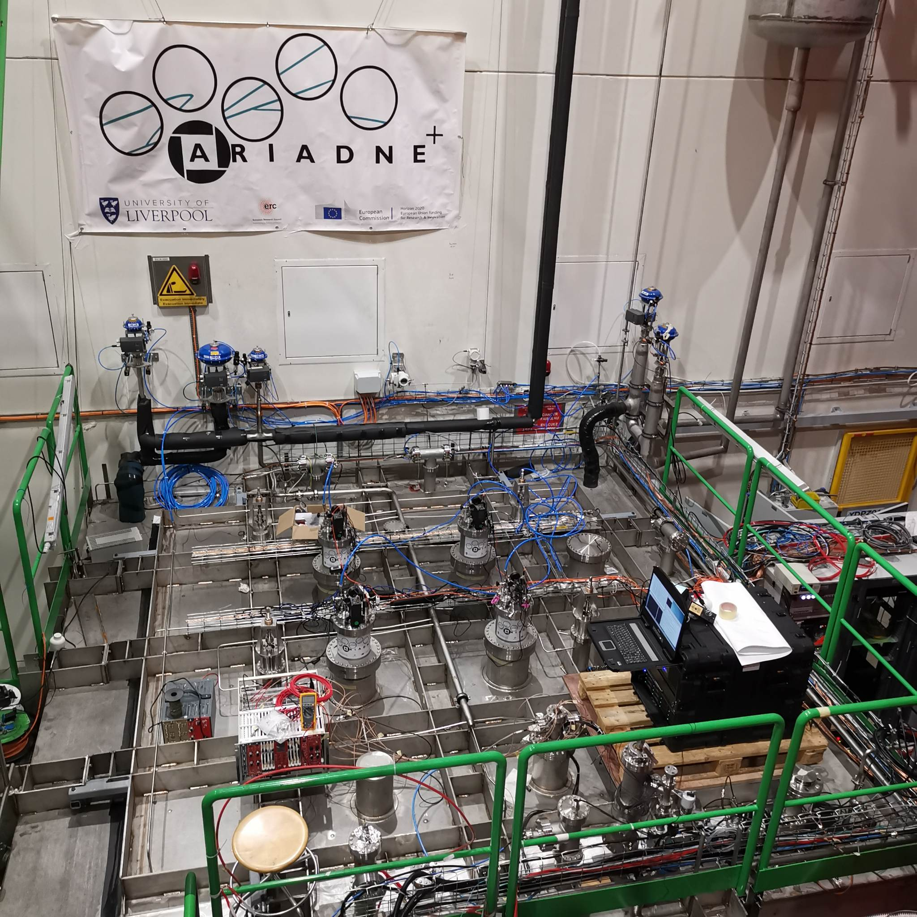
Detector Closed/Running
Very stable cryogenic operation thanks to the CERN team
Argon purity was approximately 0.5 msec
Three weeks of data collection refilled twice

Slide 25


Glass THGEM Light Gain Study
Visible Intensifier
VUV Intensifier

Slide 26


30 Seconds Integral Cosmics
Visible cosmics
VUV cosmics
(vignetting effect needs correction)

Slide 27


Sample Events
Successful imaging of LAr interactions from Cosmics
Visible image intensifier
VUV image intensifier
4 mm Resolution

Slide 28
Energy Calibration and Resolution
Track fitting to through going muons (Through THGEM and greater than 19 cm depth)
Energy conversion : 199.10 ± 1.73 ADU / MeV
Energy resolution : 16.73 ± 0.16 %
https://arxiv.org/pdf/2301.02530v2.pdf
Preliminary
Preliminary

Slide 29



X-ARAPUCAS S1&S2 signals
USC collected data using the X-ARAPUCAS embedded within the cathode of the cold box. - Powered via LASER worked nicely.
Combined camera and X-Arapucas -progress on analysis
As seen by X-Arapucas
As seen by TPX3 Cam
Cosmic Muon
S1
S2
X-ARAPUCAS

Slide 30
ARIADNE+ Conclusions
Optical readout achieved with stable detector conditions has been demonstrated at the same scales as that for vertical drift tests (CERN Neutrino Platform Cold Box)
Dual phase extraction region very stable at large scale!
TPX3 and Glass THGEM technology is ready for deployment now
TPX3Cam TPC Benefits
Raw data is natively 3D
Huge readout rates possible (80 MHits/s)
Zero suppressed readout (approx. few kbytes per event)
Technology | Physics enables | TRL (For DUNE) | Cost (DUNE 12mx60m FD) | R&D plans
TPX3 CAM | Very low energy threshold & excellent tracking | 9 | 7.2M (1 cam/m², 4mm/pix) | Lens and image intensifier testing
LRP (GTHGEM Array) |  | 7-8 | 10M (assumes 14k/m², mass production cost reduction is not included) | Larger scale tests (protoDUNE)
TPX4 CAM | Improved time & energy resolution | 7 | 3.2M (0.6 cam/m², 3mm/pix) | Full characterization
High resolution with approx. 1 mm per pixel
Easy access for swapping in/out technologies
Same readout is possible for dual phase or gas TPCs
Comparatively low cost to other readout methods
ProtoDUNE will be the natural platform to perform the next essential step

Slide 31


Using ProtoDUNE dual phase to test optical readouts for Neutrinos and DM; TPX3Cams, DarkSide PDUs & X-Arapucas
Proposal to SPSC:
TPX Cameras

Slide 32

ProtoDUNE dual phase instrumentation with optical readout
Darkside PDUs, along the beam line
TPX3 Cams in the existing cryostat ports
X-ARAPUCAs
Two LRPs with glass THGEMs, similar to the ARIADNE cold box test
Modify partially existing field cage, with embedded X-ARAPUCAS in H shape profile. Low energy threshold S1 (Flavio’s talk)
Cathode at the bottom for larger drift volume

Slide 33

TOP VIEW Optical protoDUNE
12 Darkside-20k PDUs produced in the UK
In dark green shade is the FoV of the TPX cameras(1mx1m) using the current cryostat ports
TPX3Cams ports
Space to test more optical sensors for very low energy thresholds such as Darkside20k SiPMs
X- Arapucas will be used to cover the field cage (sides only and retain the rest of the field cage). X-Arapucas in the Field cage are of high importance to correlate S2/S1 signals for DM
X-ARAPUCAs
Cathode moves at the bottom creating about 5 m drift

Slide 34

Design effort -LRP
One LRP to contain 6x5 Glass THGEMS (very similar design concept as the ARIADNE cold box test)
Made out of Invar
Similar size to a vertical drift CPR
Will hang from four top cryostat ports and will be able to move up down using the existing levelling motors
The LRP structure will take the weight of the cathode panel
CAD Models By George Stavrakis

Slide 35

Design Effort -Assembly
Field cage support structure (hangs from cryostat ports)

Slide 36

Design Effort -Assembly
First LRP installation (independently hangs from cryostat ports)

Slide 37

Design Effort -Assembly
Second LRP (hangs also independently)

Slide 38

Design Effort -Assembly
Cathode planes hangs from LRPs

Slide 39

Design Effort -Assembly
Field cage installation (mixture of the old and new)

Slide 40
Coordination (in progress)
Major TPC Component | Coordinator | Institutes | Notes
LRP | Kostas M | Liverpool,..
TPX Cameras assembly | Adam R | Liverpool,..
Field Cage Modification | Flavio C, Mike Wilking(?) | Fermi, CERN, Stony Brook(?),..
Cathode Modification |  |  | Minimum effort re-use
X-ARAPUCAS (cathode & LRP) |  | Fermi,..
HV FT | Francesco P | CERN,… | If there is interest could test a 500kV PS!
DarkSide SiPMs | Adam R & Guiliana? | Naples, Liverpool,..
DAQ | Krish M,.. | Liverpool,..
Working group meeting took place
Many opportunities to get involved, obtain funding and test new ideas
Aim to Run the detector around 2025/26 after the vertical drift run finishes
Start drafting the LoI for SPSC
Aim to finish the LoI by end summer 2023
Overleaf link:
https://www.overleaf.com/project/643f115114b3bed07feb178f

Slide 41



Coming Soon -New ARIADNE 1-ton Run
Preparations are ongoing in Liverpool for a new ARIADNE run to test some of the proposed instrumentation for protoDUNE.
Three TPX cameras will be installed, with the remaining ¼ of the detector dedicated to Darkside SiPMs.
Measure the response of Darkside SiPMs to varying THGEM bias and determine the correct gain for ProtoDUNE operation
Install new glass THGEM and extraction grid
Two different types of intensifier - one previously used on ARIADNE and the new intensifier on ARIADNE+
One camera mounted at the same distance from the THGEM as on ARIADNE+ for making direct comparisons
Using TPB coated glass for WLS instead of PEN - assessing difference in light quantity
New streaming DAQ for PMTs (better correlation with TPX)
To dope at the end of the run with 15ppm Isobutylene (Joseph’s Zennamo proposal photosensitive dopants)
Very Happy to accommodate in ARIADNE new ideas that will help towards the new protoDUNE run

Slide 42
Proposed Timeline
Today
2024
2025
2026
Testing of Darkside SiPMs in ARIADNE
Design of LRPs/TPC for protoDUNE
Submit proposal to SPSC
Facility at Liverpool for GTHGEM production
Finalise all design and start procurement
Installation of TPC components in ProtoDUNE
Start Run

Slide 43

Thank you
The A. Team

Slide 44
Extra Slides

Slide 45


TPX3 -> TPX4

Slide 46


THGEM S2 light production
VUV (126nm) light produced through de-excitation of Argon gas.
TPB Wavelength shifter above THGEM converts to 430nm.
At low field (<2kV/cm), S2 light production is linearly proportional to THGEM field. No charge gain. Very stable operation without discharges. No ion production.
At higher fields, electron multiplication occurs (Townsend avalanche).
Exponentially increasing S2 light production -> Improved sensitivity/threshold
Simulation

Slide 47




Novel G-THGEM Production
G-THGEM: https://www.mdpi.com/2076-3417/11/20/9450
FR4 THGEM with Copper electrodes and holes formed by mechanical drilling.
Borofloat 33 substrate G-THGEM
G-THGEM with ITO electrodes and holes formed by abrasive machining.
Abrasive machining vs drilled holes with chemically etched rims.

Slide 48



G-THGEM Characterisation
THGEM charging behaviour
Bi-conical holes lead to “upwards” charging over time.
Straight wall holes lead to “downwards” charging over time
The charging behaviour of fused silica THGEMs results in greater light production for the same applied field.
All circle hole glass THGEMs produced more light than the equivalent FR4 THGEM.
THGEM bias scan
https://www.mdpi.com/2076-3417/11/20/9450

Slide 49


PEN WLS
Two grades of TEONEX PEN foil investigated Q51 and Q53.
Thinner PEN consistently found to have a better conversion efficiency than thicker sheets (surface interaction).
Q51 consistently found to have a better conversion efficiency than Q53.
50cmx50cm Q51 25μm PEN film glued on glass panel

Slide 50





Focusing VUV Intensifier using GAr TPC
Alphas from Am-241 in 1100mb pure argon
+1mm
+2mm
Spacer rings
MgF₂ objective lens position is fixed into viewport.
Spacers change focal length position between objective lens and intensifier photocathode.
+2mm found produce sharpest image (in GAr).
+3mm
Intensifier photocathode QE

Slide 51

ProtoDUNE optical Run open side

Slide 52

ProtoDUNE cathode, X-ARAPUCAS

