Slide 1
Power Over Fiber PoF
DUNE FD3 Mini-Workshop Toward a Combined Photon Detection and Field Cage System
June 26-28th 2023
William Pellico

Slide 2
PoF
Heard about successful use of PoF (Cold Box, FNAL, University Partners)
  Low Noise
  Isolation
  Most components had no failures after install completed – operated trouble free
    Had damaged Pof fibers due to handling process – nothing indicative of PoF fiber issue
  No heating – bubbles
  Significant performance improvements achieved over the past 3+ years
University Partners
  Development of a cryo rated GaAs photo voltaic
  A potential new product that can play a role in HEP and other cold science
  Extensive testing of PoF system to ensure viability and suitability
Completion of present PoF designs for VD2 detector
  Certification of higher efficiency GaAs units at required power
  No insulating jacket needed
  Fanout and redundancy options
Now about VD3 roadmap based upon present knowledge/plans

Slide 3
PoF R&D Status & Roadmap for VD2
2020:
Cold box Proof of Principle Si PoF
Certified
2021:
Resolve Issues from CB1
Final Design Delivery with Installation Plan
2023:
Ramp up PoF Large Scale Layout and Tests
2018:
PoF Initiation – Prototyping
FY22:
CB
GaAs PoF
Certified

Slide 4
PoF – Present and VD3 – Building Upon Success
Designing for the baseline plan but looking for flexibility and optimization
  Fibers
  Improved performance of cryogenic fiber distribution system
  Lasers
  Complete a design that is simple and meets the long-term operations
  We have tested 977nm, 808nm and could use 1480nm to significantly reduce photon noise risk
  Photovoltaic
  Now at 56 % with Goal of >60 % - Theoretical 75% in GaAs Units may be realized
  Goal of power total loss less than .5 W/unit at 1+ W input achieved – but will be improved in VD3
    High power use is not required – but should have similar efficiencies to low powers (several Watts)
  Redundancy – 100% is very feasible but probably not necessary
    Usable lifetime is >20 years for PC and lasers
    We will have time to demonstrate longevity testing – runs of 1 year possible and at higher power
    Built in overhead will allow PoF to meet power needs
  Expansion of PoF feasibility as a power source for other electrical systems
  Build a relationship with FNAL/Universities/Vendor to expand knowledge and performance
    Known materials such as epoxies used
    Known semiconductor model that matches performance
    Known/approved manufacturing process – packaging

Slide 5
VD3 Fiber
The fiber for VD2 has been chosen.
  Has met the VD2 engineering and physis requirements
  Preparations for bulk orders, testing and installation plan
Fiber for VD3 will look to build upon success and knowledge
  (The fiber chosen delivers low light loss and power handling capabilities but……)
  The fiber jacket is rugged but uses so called ‘everlasting’ materials and now a concern by many over their environmental impact.
  The fiber jacket has a Coefficient of thermal expansion that results in compression loss
VD3 Fiber will look to remove the PFAS material
VD3 Fiber will look to remove the compression power loss
Working with our fiber vendors – we will explore several options
Si jacketing looks to be the most promising – deliver higher performance
Just ordered our first Si jacketed fibers

Slide 6
Fibers – Chosen after Testing
Bulk orders (key aspects)
Jacket choice
  Black PFA
  Black PVDF
  Black PTFE
  Black ETFE
    Acrylate
    Polyimide
  Silicon
62.5 nm/.27 NA
105 nm/.22NA
Low-OH core
Doped Silica Clad
Acrylate coating
Polyimide coating
Nearly a dozen fibers have been investigated
Light Leak
Bending Radius
Thermal parameters
Cost
Long term data in cold
Long term data with 1+ W power use
Fiber | Length M | Delivery | Certification
62.5 | 400 | 16 W | Complete | PVDF
105 | 200 | 18 W | Partial | ETFE/Polyimide
105 | 200 | 18 W | Lab Test Only | PFA/Acrylate
105 | 100 | 18 W | Lab Test Only | PFA/Polyimide

Slide 7
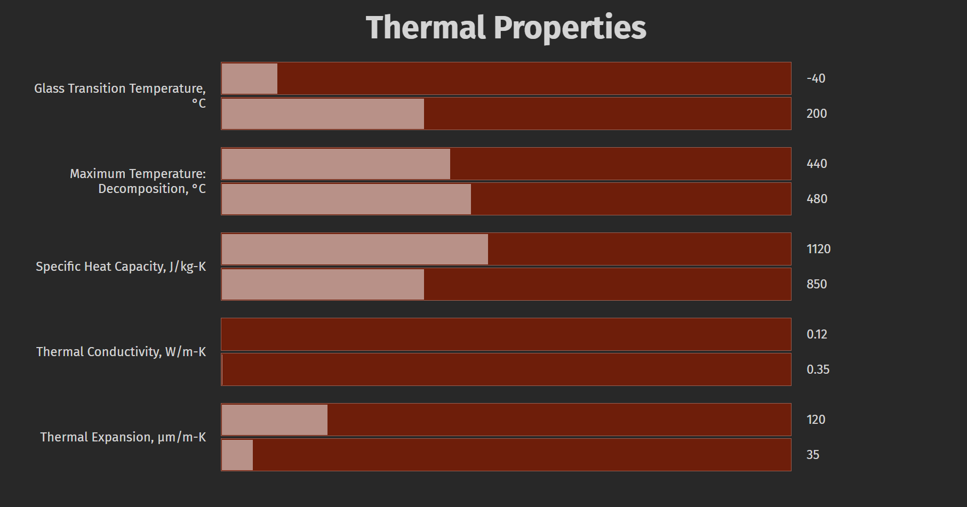
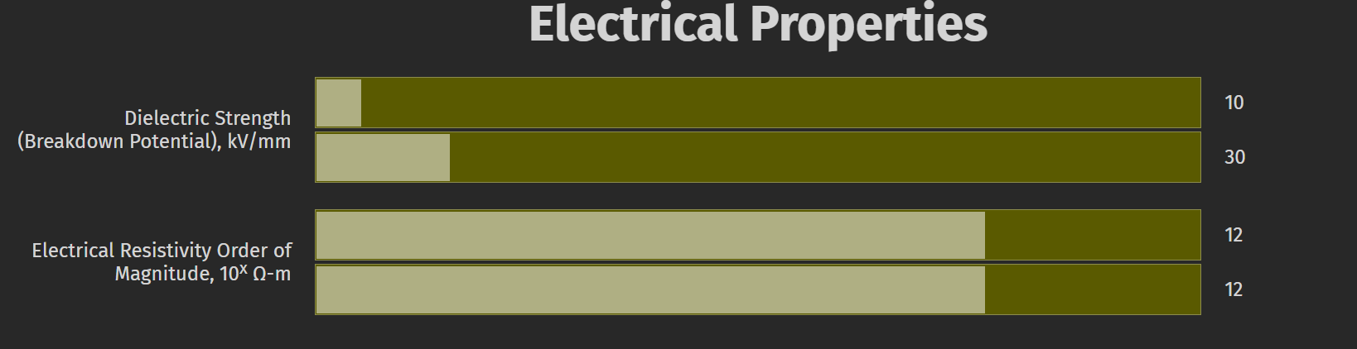
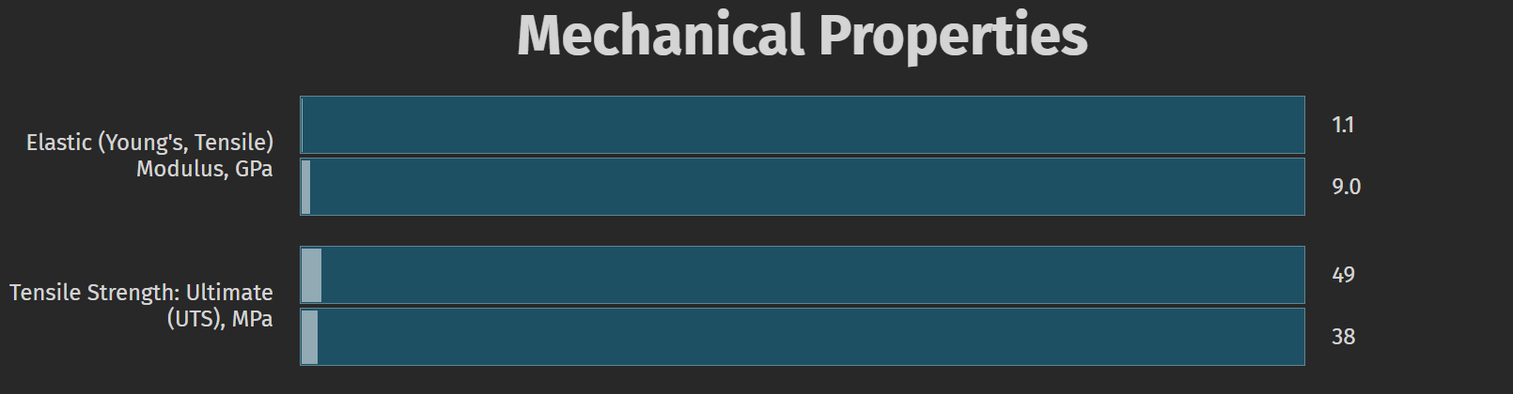
VD3 Fiber
Limited R&D Needed
The investigation into jacket material (Si option, and 105 um core will be fully vetted).
This is suspected to be critical for cryo PoF fiber power loss

Slide 8
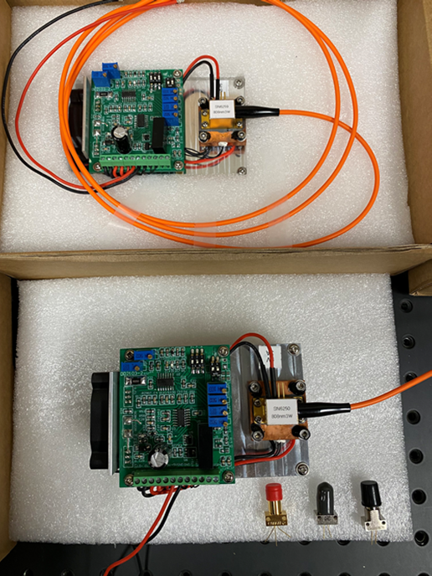
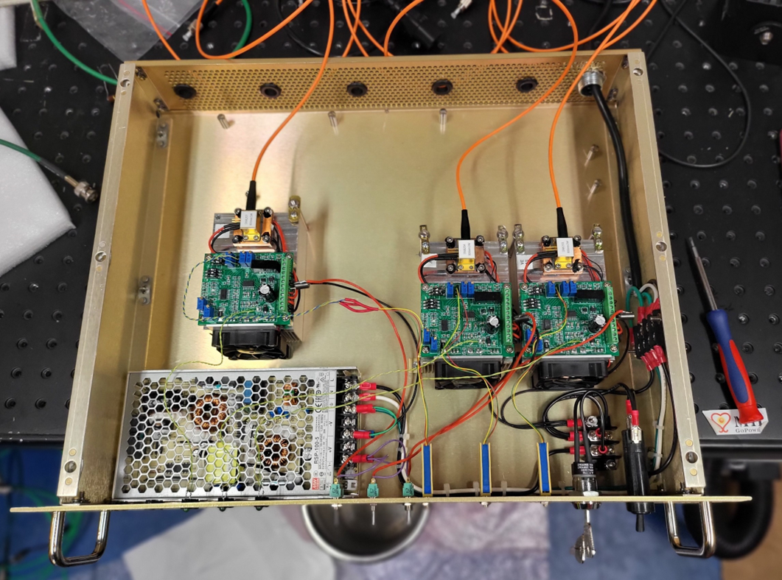
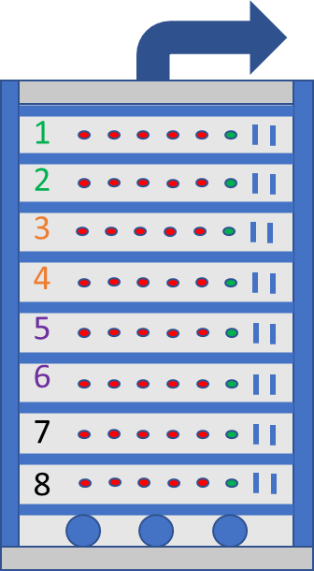
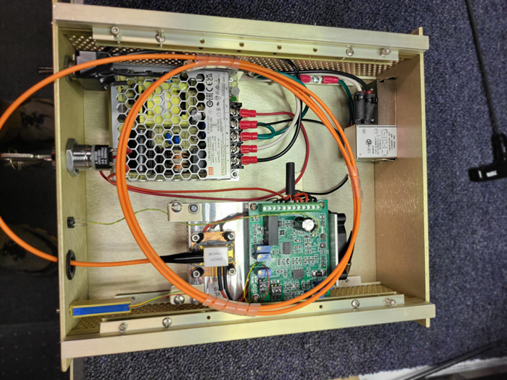
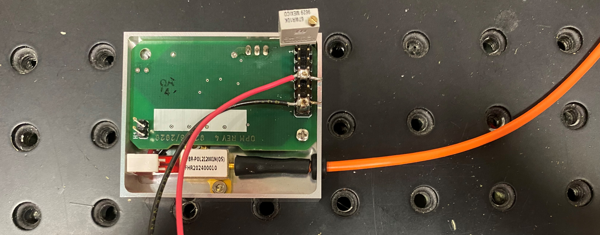
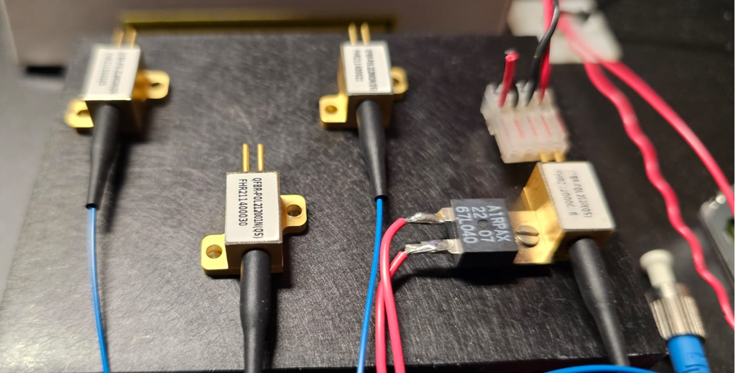
Laser Modules (808nm) 3 units tested
Converging on final laser package:
Fit in rack(s) at DUNE
Meet Safety
Controls and Monitoring
Accessible/Repairable
Laser light fidelity
Laser Safety Unit
Compact laser housing
Containing 8 lasers for VD2

Slide 9
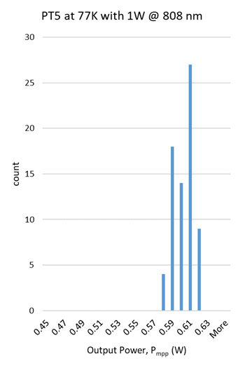
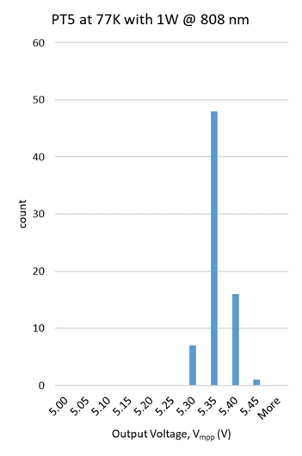
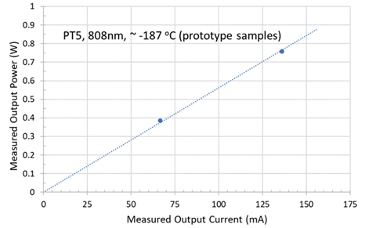
OPC Batch Testing – 70 units (Q&A)

Slide 10
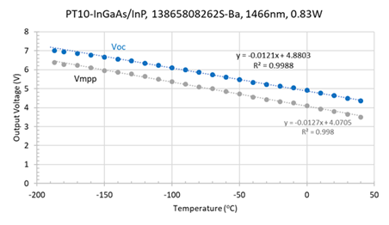
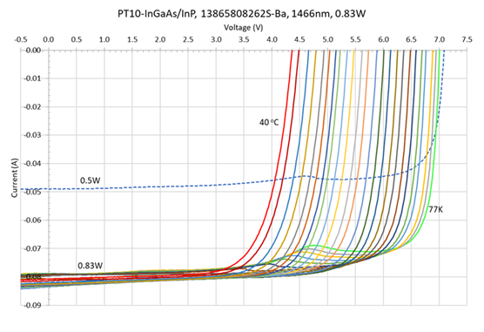
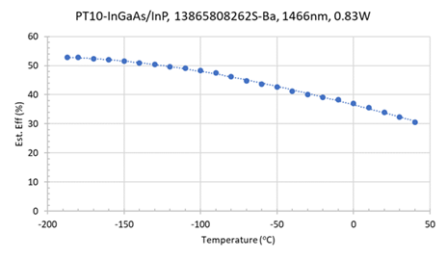
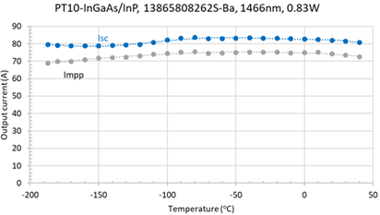
InGaAs Option
If we felt light leakage was the most critical issue, we wanted to address, we could compete the InGaAs field testing.
Wafers of the PT10, 1480nm, OPC that could be immune to light pollution:

Slide 11
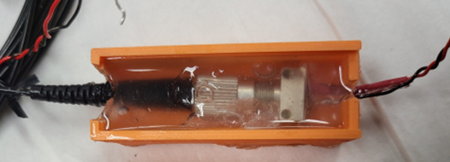
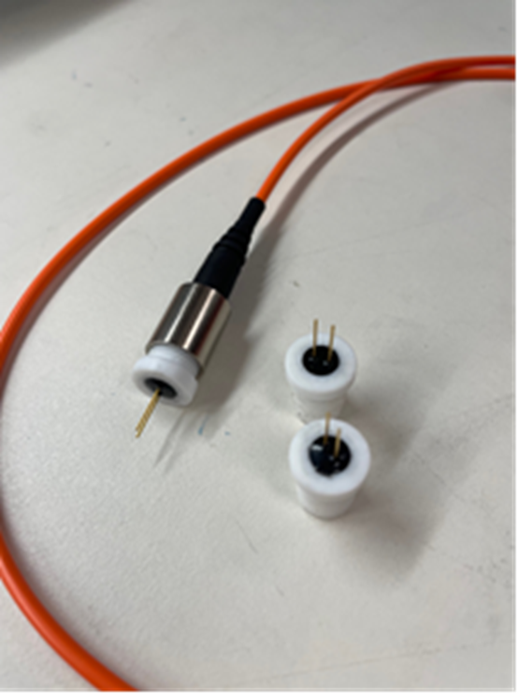
PoF Photovoltaic (OPC) VD2 present
Certification of Si is complete
Certification of base GaAs is complete – multiple staged improvements completed
  All units are from Broadcom
    Tested off the shelf standard ‘unhoused’ unit
    One is a unit that has been modified by Broadcom by replacing metal housing with Teflon
    Tested higher power Broadcom off the shelf OPC
  All units have passed cyro tests but did not achieve desired power-eff
Plan
Would like to test 800 + units (Broadcom)
FNAL Completes the VD2 OPC bulk purchase and testing
Utilize UIUC design to reach closer to theoretical limits
UIUC delivers wafer(s) for packaging test units

Slide 12
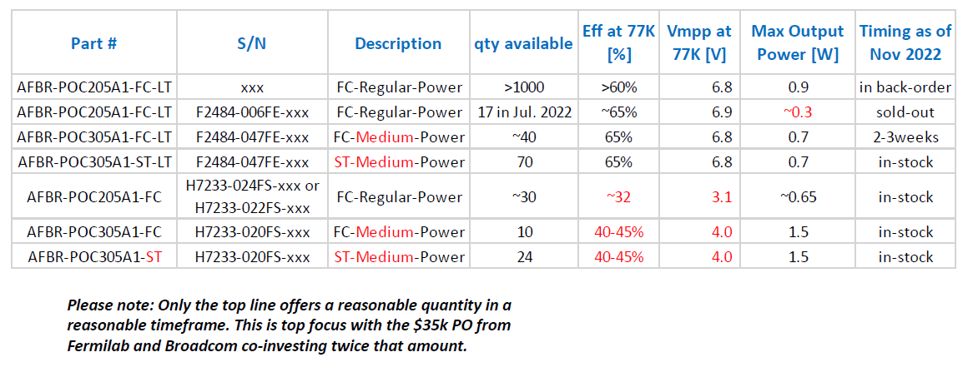
VD2 Effort – Looking for Small Upgrade Path
We have tested a number of Broadcom units these past 3+ years that have provided insight into cryo operations. This knowledge will be used to set a reasonable R&D strategy to achieve an optimum cryogenic OPC.

Slide 13
Xtra – Fiber coating
The advantages of the acrylate material is that it can be selected for strip-ability and is fairly soft which makes the fiber more flexible. Its disadvantages are that acrylates tend to have low temperature ratings (usually around 85C although some are available that are rated as high as 200C) and it is a well-known out gasser.
Polyimide has been used successfully for coating space grade optical fiber and it comes with the advantage of a 125C temperature rating. Polyimide will tend to make the fiber seem stiffer than an acrylate coated fiber and the difficulties associated with stripping polyimide. Polyimide coating can be stripped chemically, with hot sulfuric acid, or mechanically, using a hot tweezers. Users find hot sulfuric acid to be dangerous and non-portable. Mechanical stripping methods are not recommended for flight cable assemblies because they have the capacity to introduce surface flaws to the glass fiber, compromising long term reliability.
Reference: https://photonics.gsfc.nasa.gov/tva/meldoc/cabass/coating.htm

Slide 14
Xtra – OPC Notes
OPC “GaAs” even when it is optimized for 808nm, or 830nm typically has some aluminum, or even other elements, in additional layers. These layers, often referred to as back-surface-field layers, serve to tweak the QE peak to shorter wavelengths. However, these seem to have some, yet poorly understood, behavior as the temperature is drastically reduced. We are now using what Broadcom calls ‘PT5’. They have modified their OPS product to what they say is the ‘purest’ or simplest version of our OPCs with a minimum, possible none, of these additional tweaking layers.
With a more extensive effort, it might be possible to truly design in special layers for top performance at 77K, but this would involve a multitude of epi-runs, each costing a money and followed by the necessary fab into chips. In the just completed effort, Broadcom had been ‘lucky’ in that several years ago, a particular epi-run went sideways. That resulted in the first ‘flavor’ of PT5 which maintained efficiency at 77K but were not capable of more than 300mW output. To increase the power, we then had to reconstitute to repeat in a controllable manner to increase the power while the conversion efficiency was maintained. That’s the most recent effort which resulted in the PT5s.
Wafers of the PT10, 1480nm, OPC that could be immune to light pollution:
  These are already at our Canada facility for singulation into chips
  Preliminary testing show good results at 77K albeit with lower conversion efficiency
  Chips will be assembled into FC housing starting mid-April:
    A smaller quantity to take place in the San Jose area and might be ready before mid-May
    A larger quantity at our CM in Taiwan and should be completed by mid-June as we need to outfit the CM with proper laser for testing

Slide 15
PoF V3
Characterization of PoF R&D
Item | Goal | TRL (VD3 focus) | Cost Est | Time | Benefits
Fiber | Reduce power loss by a factor of 2 | 5 to 7 | 95 k | 1 year | Improved S/N
PoF | Increase Efficiency from 55 to 70 % | 3 to 7 | 145 k | 2 year | Fewer Units
Laser | No significant change
Longevity | No significant change
Safety | Lower loss & higher eff reduces laser pwr

Slide 16
PoF: VD2 to VD3 (FY23-FY24)
Until R&D Funds are available – Essential Work
We will complete the implementation of an efficient GaAs PC unit. (FY23)
  Final TDR using PT5 units rated for 55% efficiency @800 mW
  Long Term Stability Testing Completed
  Final Laser electronics and housing unit design and prototypes built and tested
We will move to VD3 R&D (FY24)
  Use the tests (USDSM & FNAL & SB) to document the cryo performance of PoF
    IEEE and Optics Journals
  Roadmap path to higher power and efficient PoF units
    UIUC partnership
    Broadcom partnership
  Testing of Si cladded PoF Fibers
Commissioning of FNAL cryo test stand
Initial investigation of 1480 nm fiber PoF capabilities at FNAL

Slide 17
PoF Stretch R&D
There are several paths that could be investigated that offer benefits:
A stable & tunable PoF system that would allow for SiPM voltage adjustments.
  This would require a system power stability of a few percent to meet the SiPM voltage stability needs of < .25%.
  No need for LDO chip in cryo for SiPM operations
Running multiple fibers cores in a single jacket.
  Fewer fibers and feedthroughs
A PoF powered RF communication cryo data pipeline

