Slide 1



Cryogenic operation of
GaAs laser power converters
Bora Kim^{1,2}, Mijung Kim^{1,2}, Brian Li^{1,2}, Ryan Hool^{2,3}, and Minjoo Larry Lee^{1,2}
¹Electrical and Computer Engineering, University of Illinois Urbana-Champaign
²Nick Holonyak Micro and Nanotechnology Laboratory, University of Illinois Urbana-Champaign
³Materials Science and Engineering, University of Illinois Urbana-Champaign
Acknowledgments
1

Slide 2
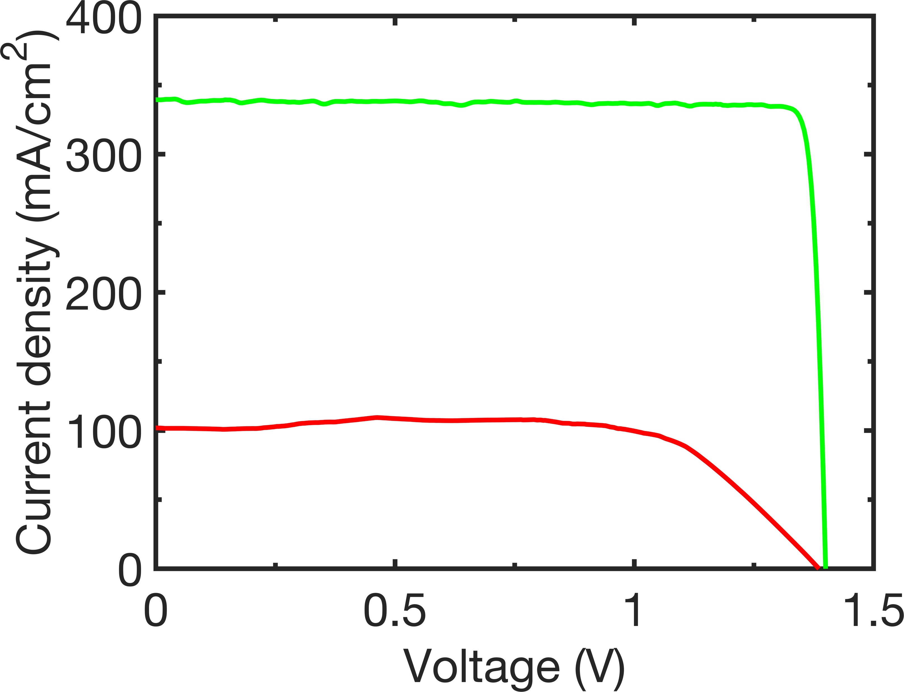
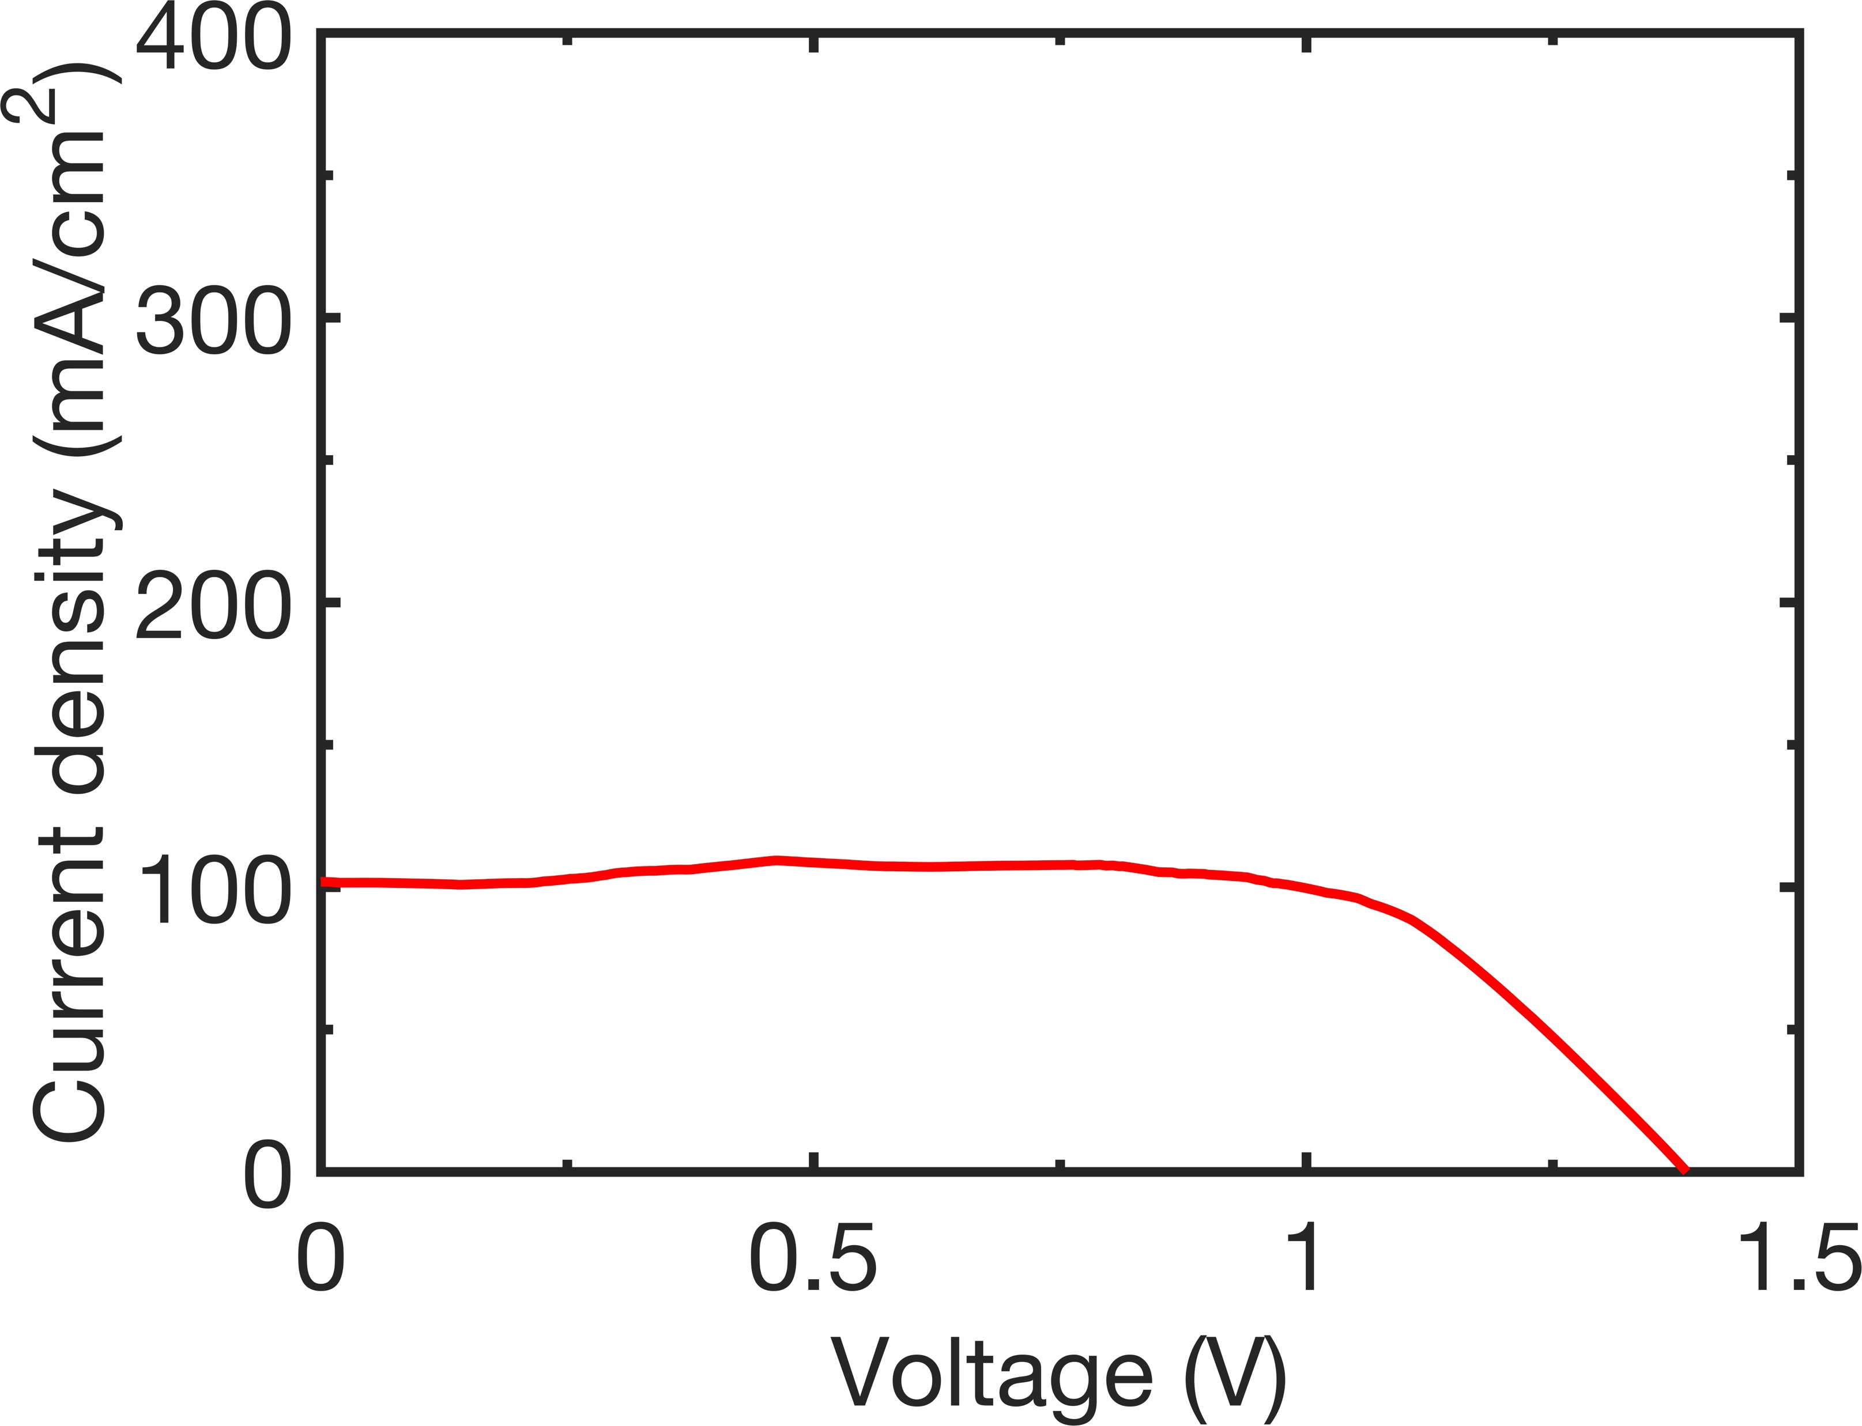
Outline
Motivation and background
Cryogenic 1J-GaAs LPC results
  Effect of carrier freeze-out on band diagrams
  Strategies for T-invariant R_{S}
  Improved LPC performance at low-T
  Towards 70% low-T efficiency
  Conclusions
High majority hole barrier, T=83K
w/ low barrier+DLARC
E_{C}
p-GaAs
Base
p-InGaP
BSF
+
E_{F}
E_{V}
w/ high barrier
w/ high barrier
T=83K
T=83K
Low majority hole barrier, T=83K
E_{C}
ID | P_{In, density} (W/cm²) | FF (%) | Efficiency (%)
High barrier | 0.27 | 74.4 | 39.1
Low barrier | 0.71 | 93.3 | 62.1
p+GaAs
Base
p+AlGaAs
BSF
ID | P_{In, density} (W/cm²) | FF (%) | Efficiency (%)
High barrier | 0.27 | 74.4 | 39.1
+
E_{V}
E_{F}

Slide 3
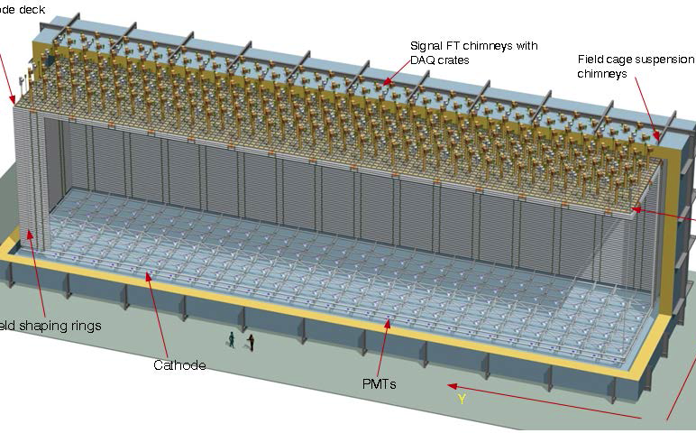

Cryogenic power-over-fiber
Inaccessible environment
Power-over-fiber (PoF)
  Suitable in harsh environment due to spark-free operation
Transmitter unit
Receiver unit
Optical fiber
Laser driver
Laser diode
Electronic
circuits
LPC
PoF in deep underground neutrino experiments
  Convey power to electronics embedded in high voltage (V=300kV) and LAr (T=83-89K)
Readout electronics
Anode
[1]
$$\vec{E}$$
Cathode (V=−300 kV)
Liquid Argon (LAr), 83-90K
Neutrinos
from
Fermi lab
PMTs
[1] B. Abi et al., JINST 15, T08008 (2020).

Slide 4
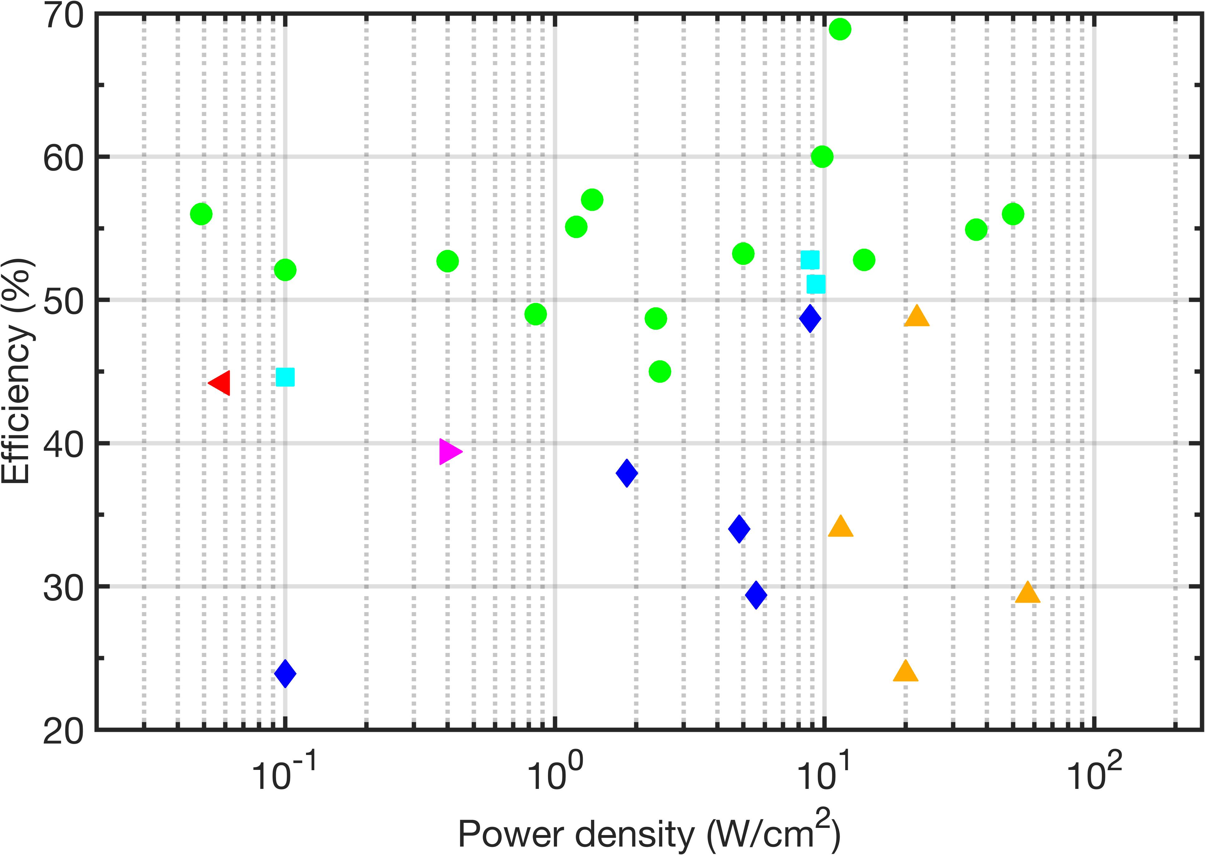
LPC material selection
GaAs-based LPC
  High efficiency>50%
  Highest efficiency: 68.9%[1] with thin-film, back-surface reflector
GaAs or GaAs/AlGaAs
Si
InGaP
GaSb
Single junction
T = 298K
InGaAs
InGaAsP
w/ thin-film
& back surface reflector
[1] H. Helmers et al., Phys. Status Solidi RRL 15, 2100113 (2021).

Slide 5
Laser wavelength (𝜆) selection
Zero transmittance loss in LPCs with E_{photon}>E_{g}
E_{photon}<E_{g}
Transmittance loss
Conduction band
E_{C}
E_{g}
E_{photon}
E_{V}
+
Valence band

Slide 6
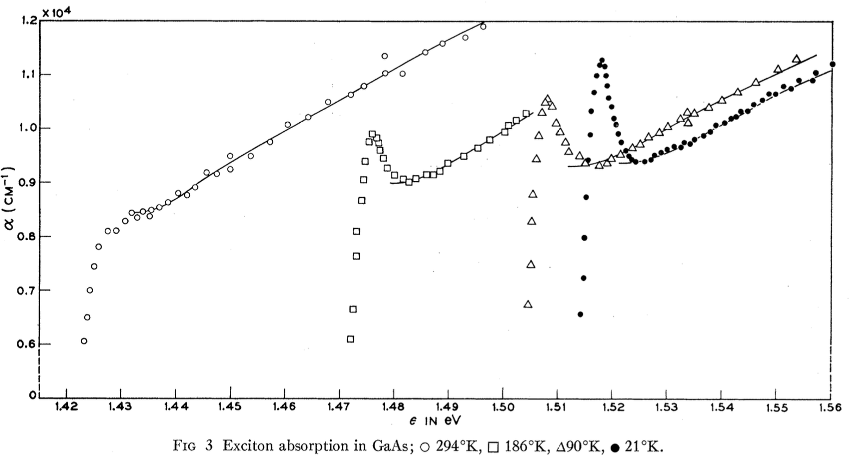
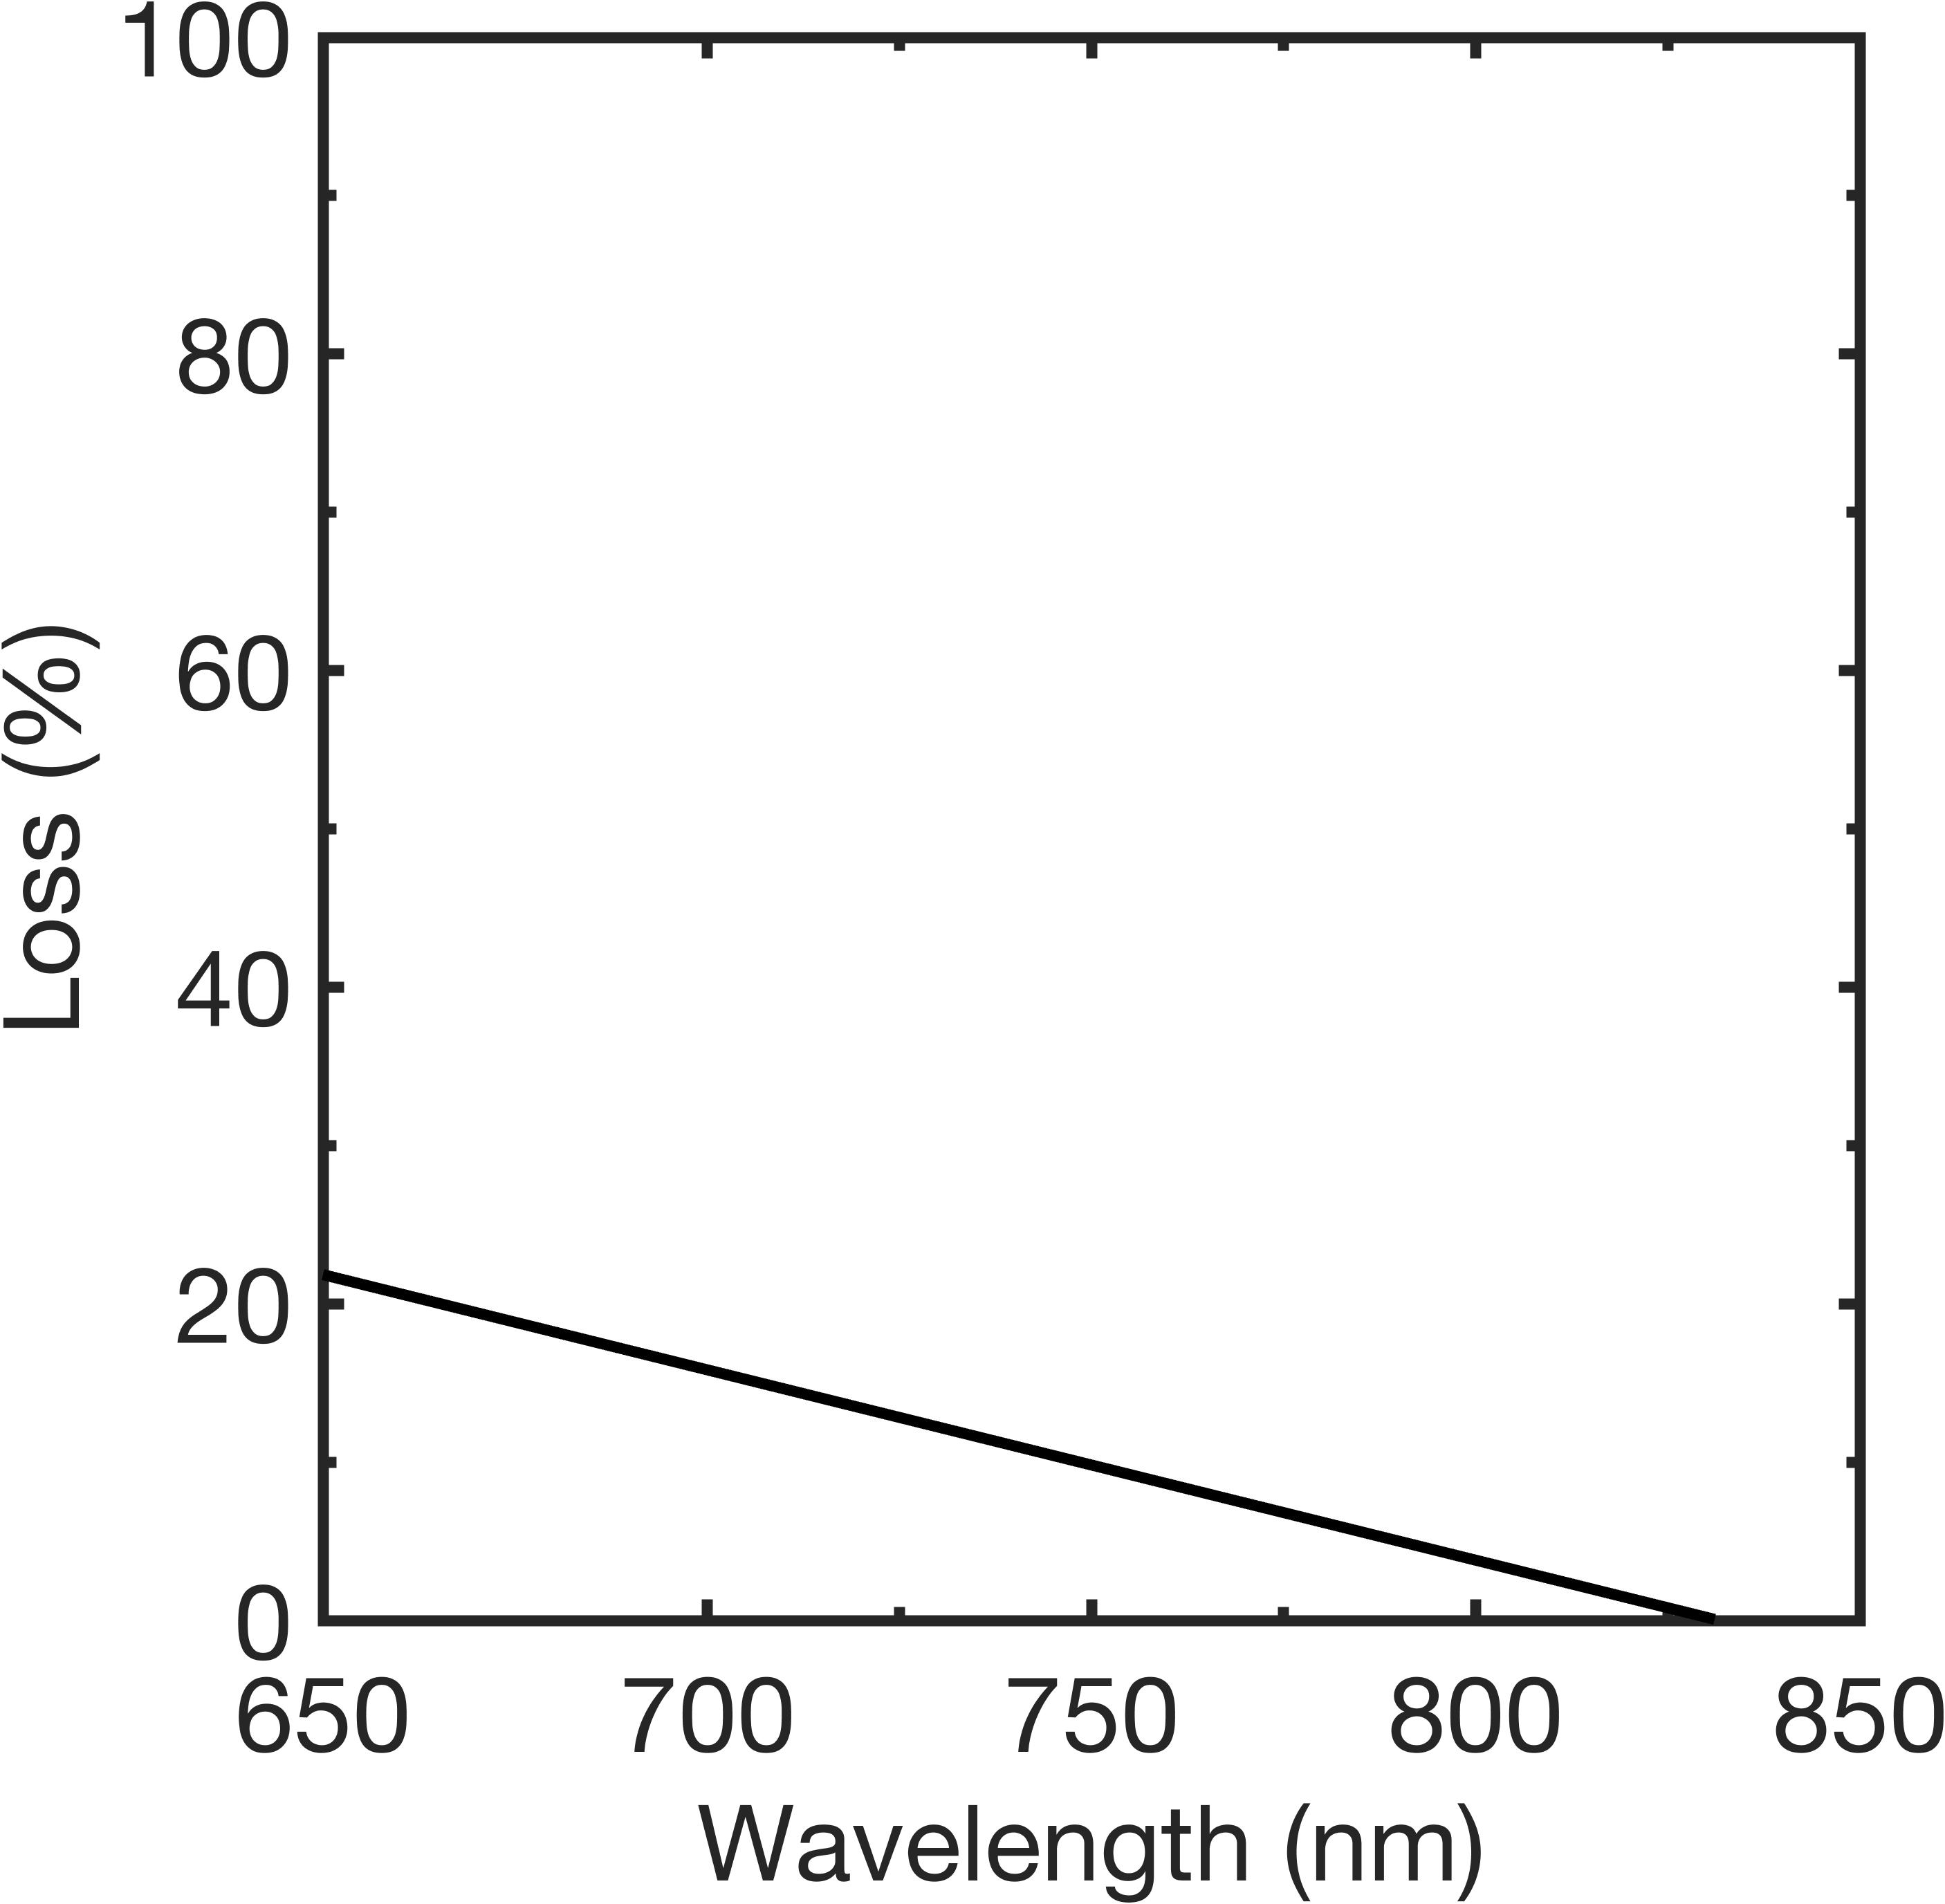
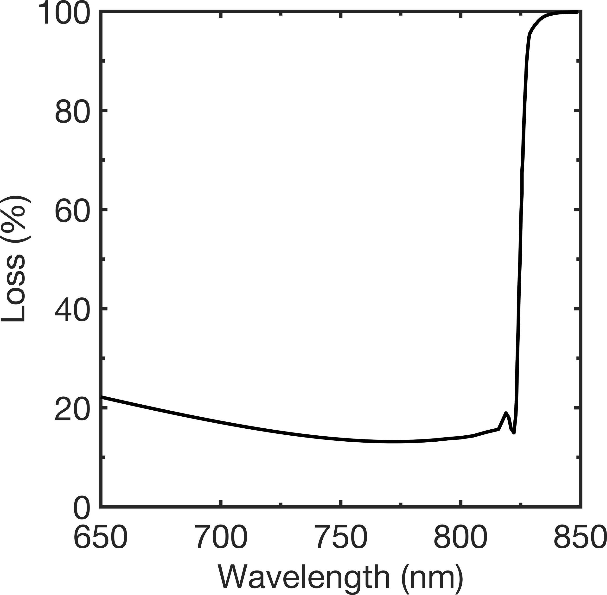
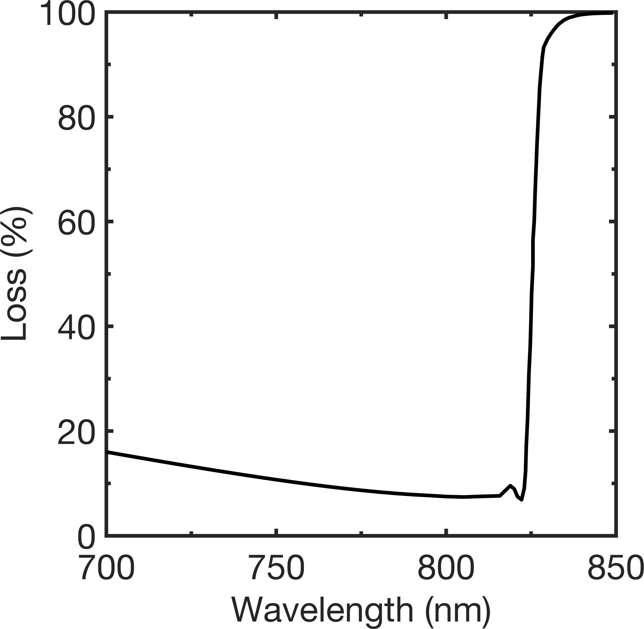
Laser wavelength (𝜆) selection
Zero transmittance loss in LPCs
Trade-off between thermalization and incomplete absorption losses
  Coupled with 808 nm laser
E_{photon}>E_{g}
T=83K-90K
Absorber thickness=2.08 um
Thermalization loss
Incomplete absorption loss
x10⁴
[1]
808 nm
1.2
Thermalization loss
Conduction band
Thermalization loss
-
Lattice heat
Incomplete absorption loss [1-3]
-
1.0
E_{C}
𝛼 (cm⁻¹)
E_{g}
0.8
E_{photon}
Minimal 𝛴loss
+
E_{V}
0.6
+
GaAs, 90K
Valence band
827
816
805
795
Wavelength (nm)
[1] M. D. Sturge et al., Phys. Rev. 129, 2835 (1963).
[2] O. D. Miller et al., IEEE J. Photovolt. 2, 303-311 (2012). [3]. F. Urbach, Phys. Rev. 92, 1324 (1953).

Slide 7
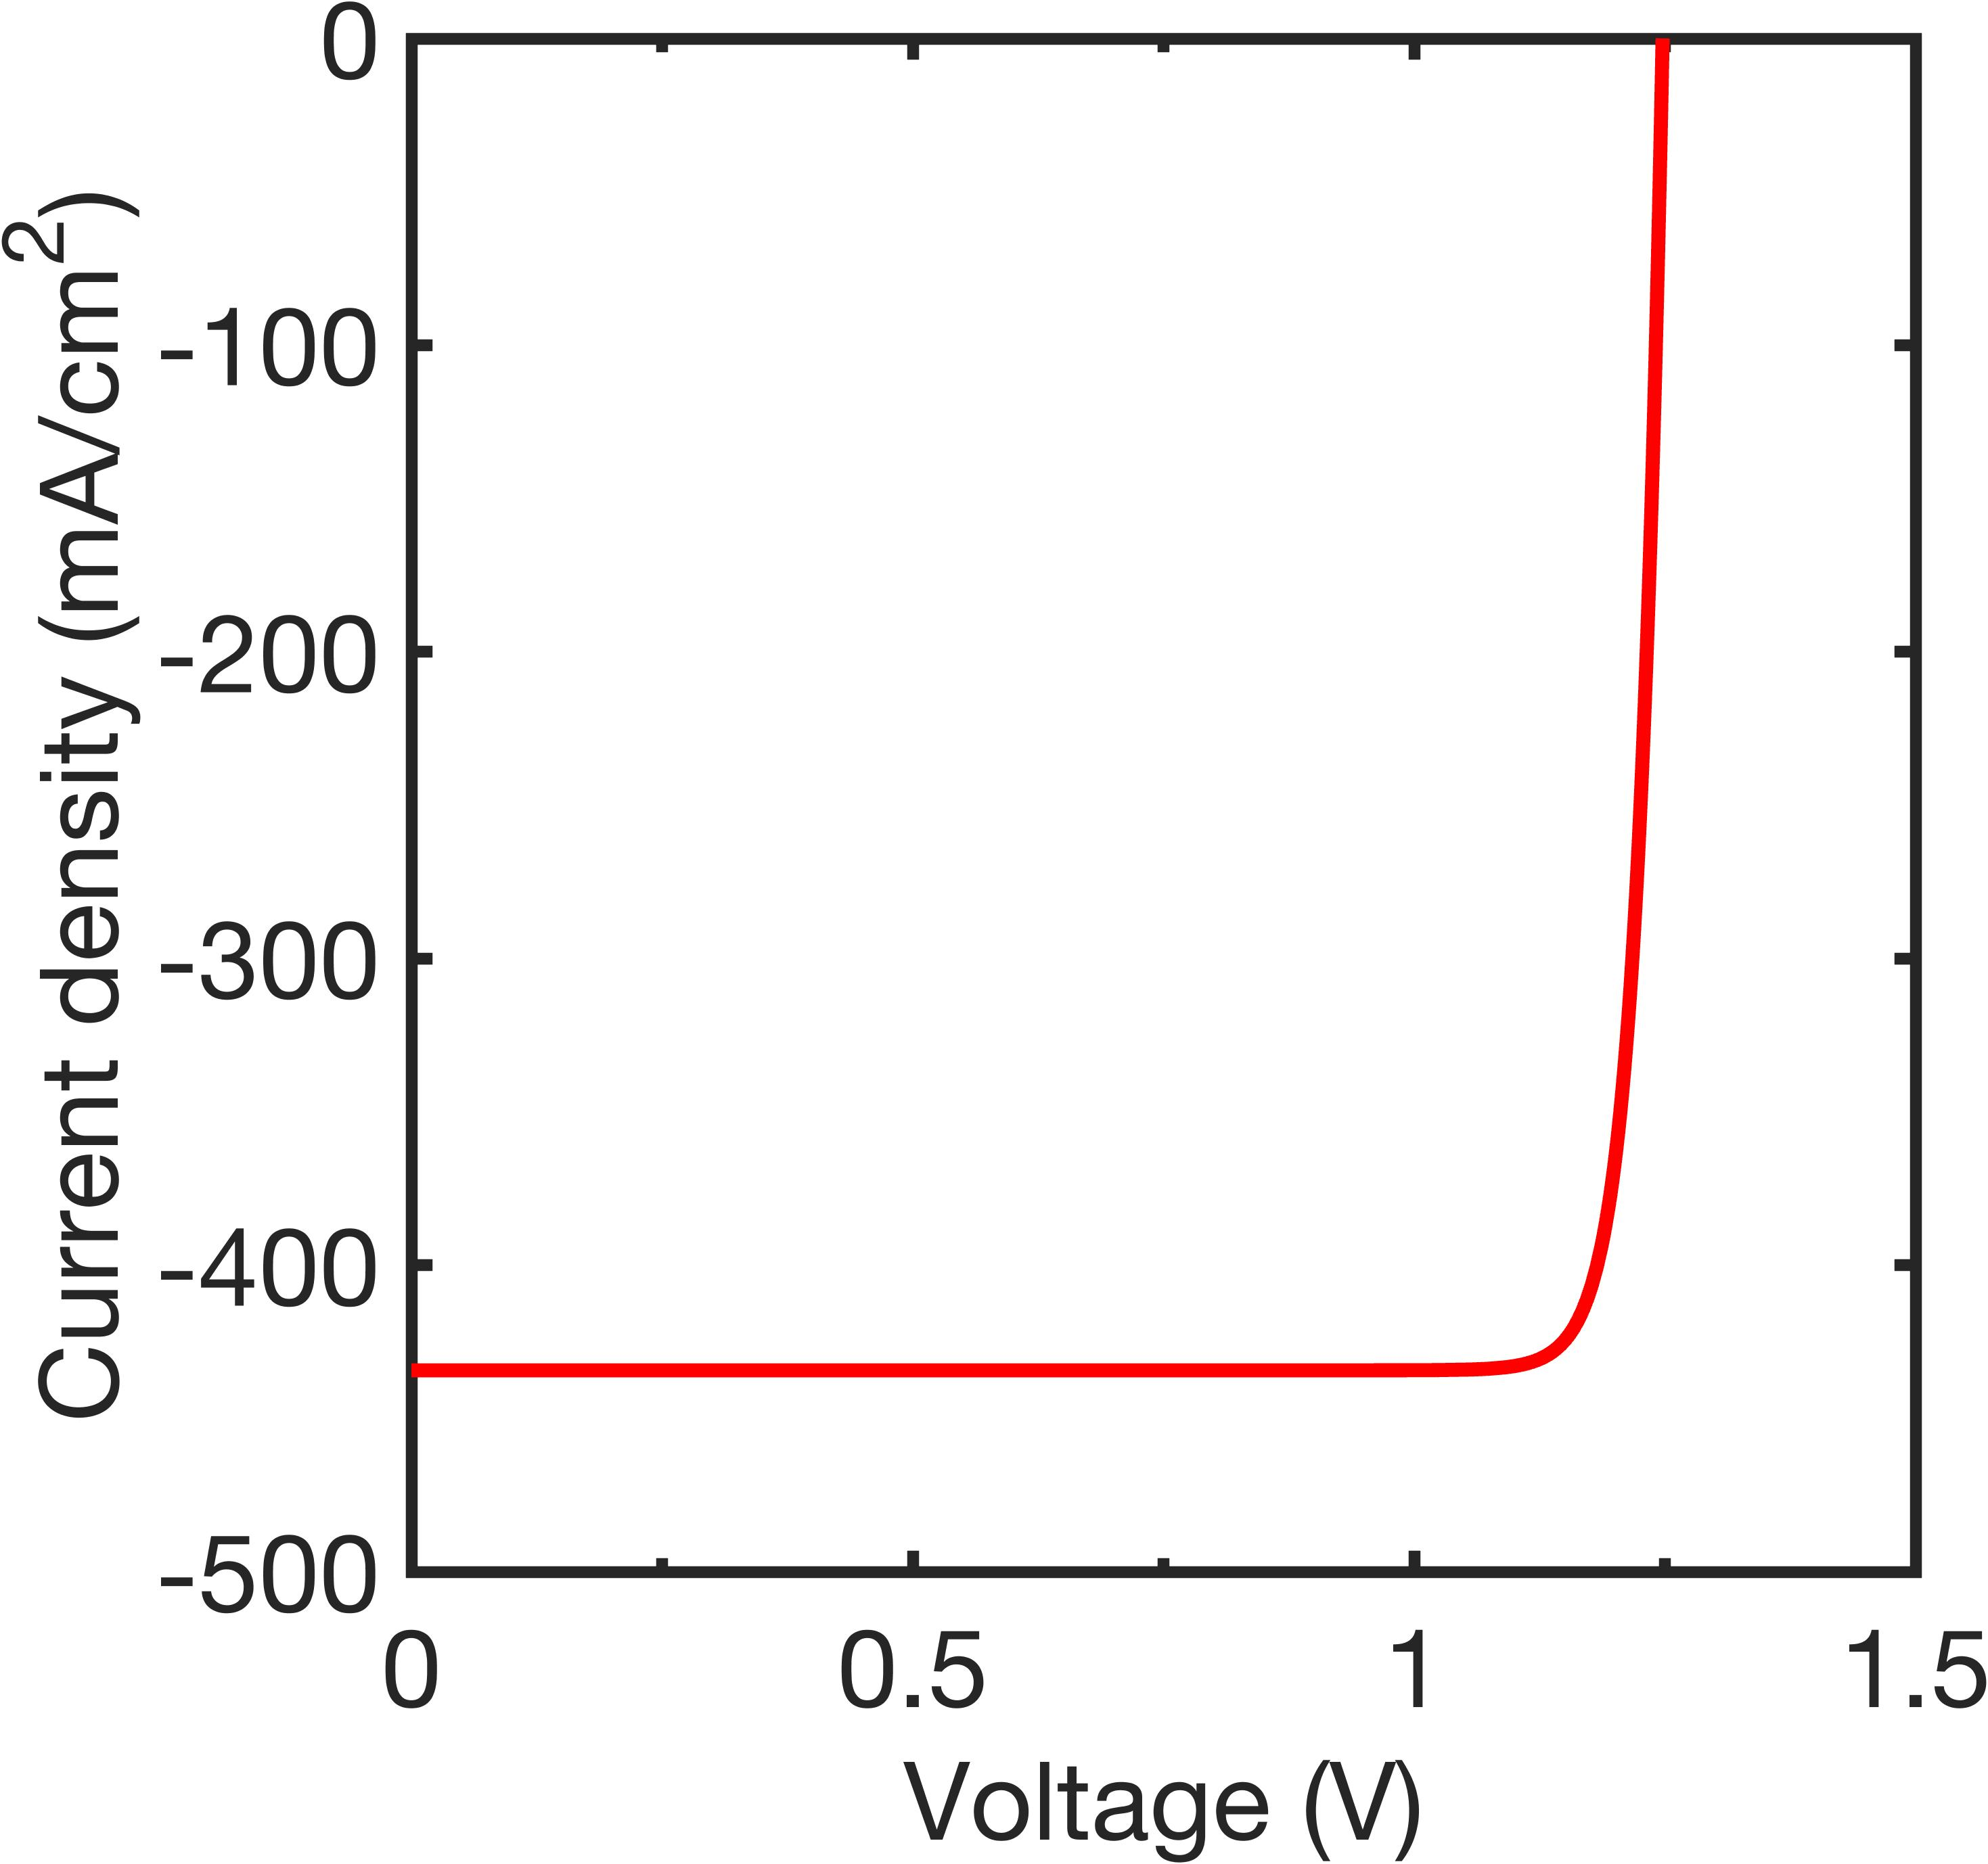
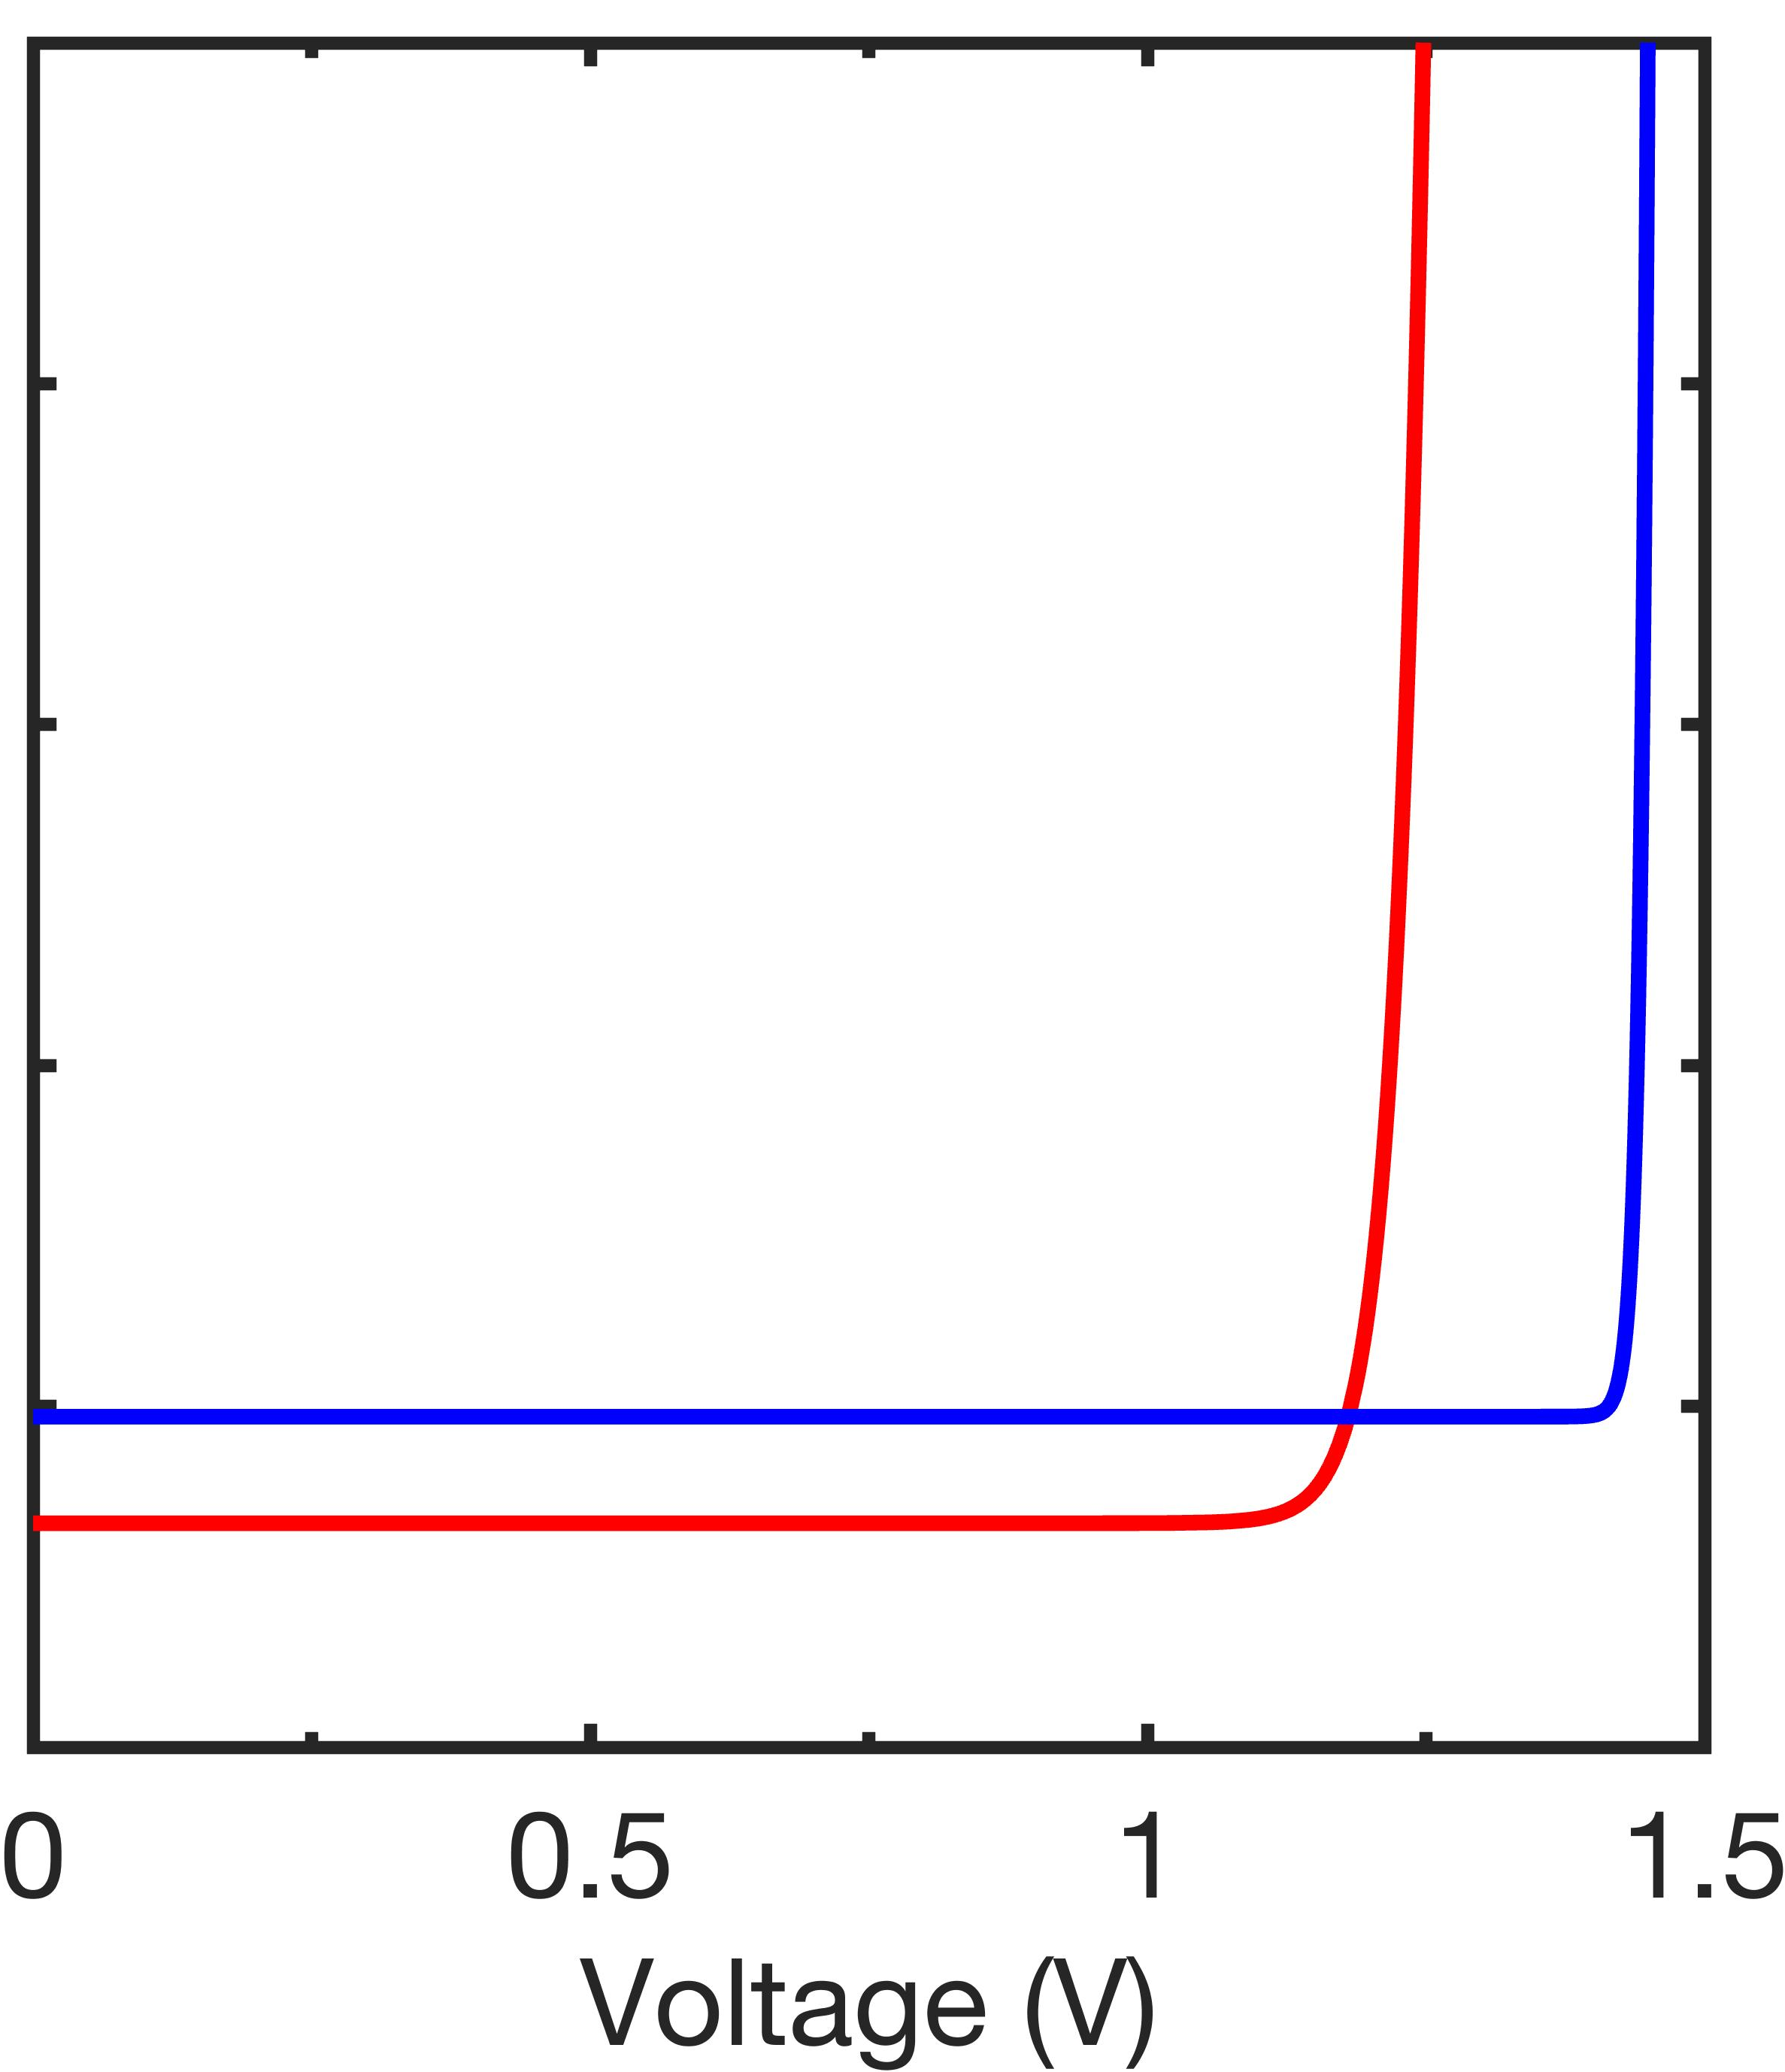
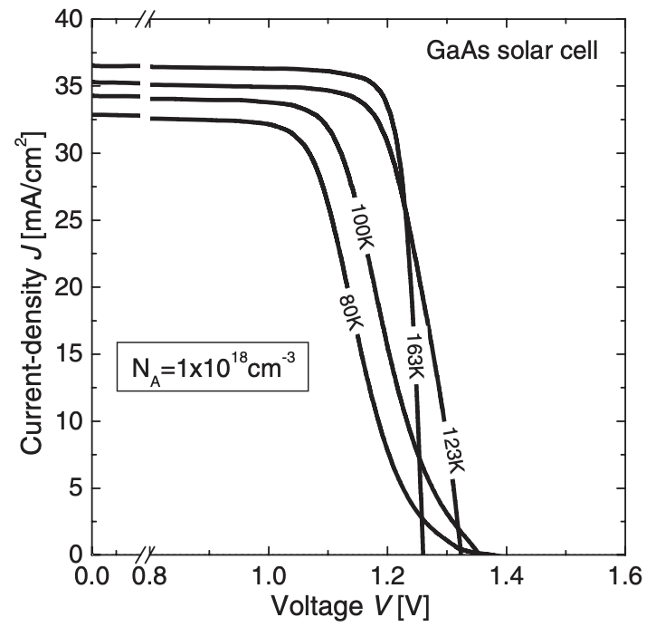
Effect of operating temperature
Theoretical IV
Experimental IV
In theory,
  T ↓ → 𝜂 ↑ (J_{SC} ↓, V_{OC} ↑, FF ↑)
  Radiative limit efficiency increased from 69.8% (298K) to 80.8% (83K)
  In practice, FF can decrease at low-T
T↓ → V_{OC} ↑
[1]
High R_{S}
V_{OC}
298K
298K
GaAs solar cell
83K
30
163K
123K
100K
Current density (mA/cm²)
20
80K
T↓ → J_{SC} ↓
10
J_{SC}
0
0
0.8
1.0
1.2
1.4
Voltage (V)
Simulation conditions
Absorber thickness=2.08 um
𝜆=808 nm
Power density=0.7W/cm²
T (K) | J_{SC} (A/cm²) | V_{OC} (V) | FF (%) | η (%)
298 | 0.434 | 1.248 | 90.1 | 69.8
83 | 0.403 | 1.449 | 96.9 | 80.8
R_{S} ↑ as T ↓
→ FF ↓
[1] R. Hoheisel et al., IEEE J. Photovolt. 2, 398-402 (2012).

Slide 8
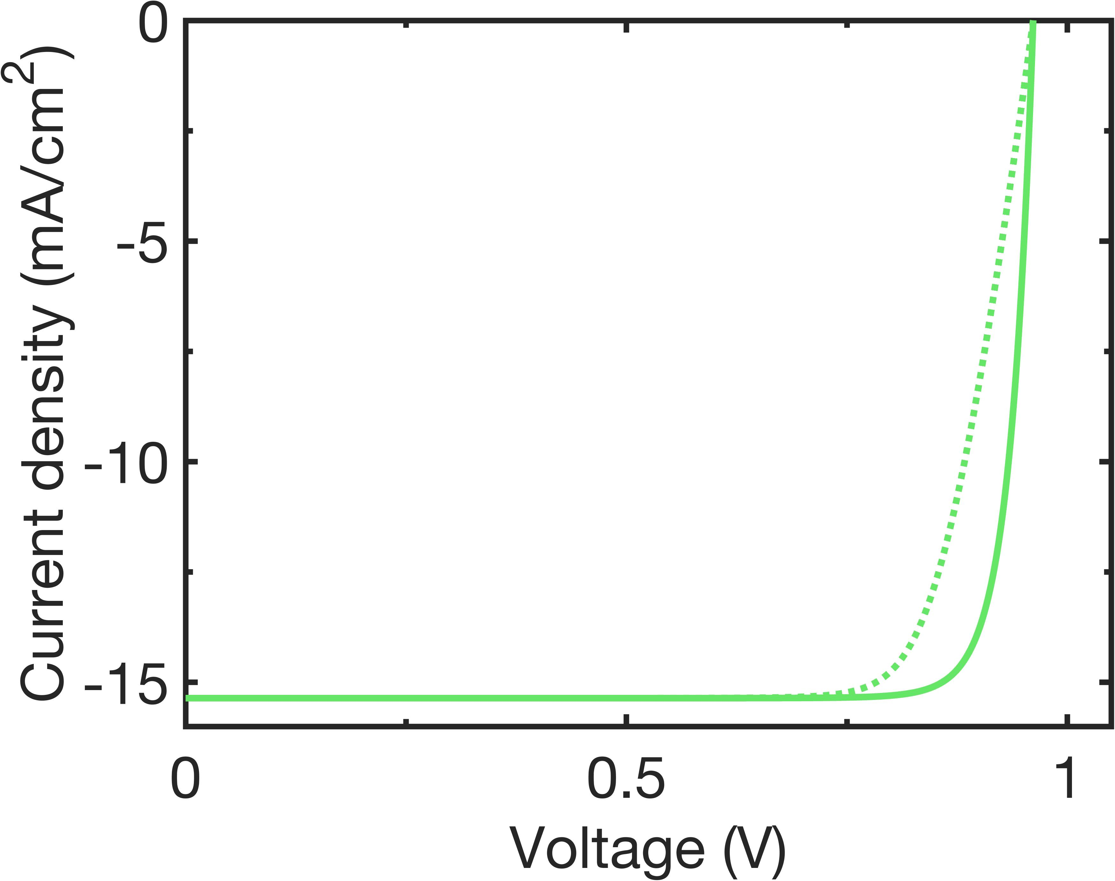
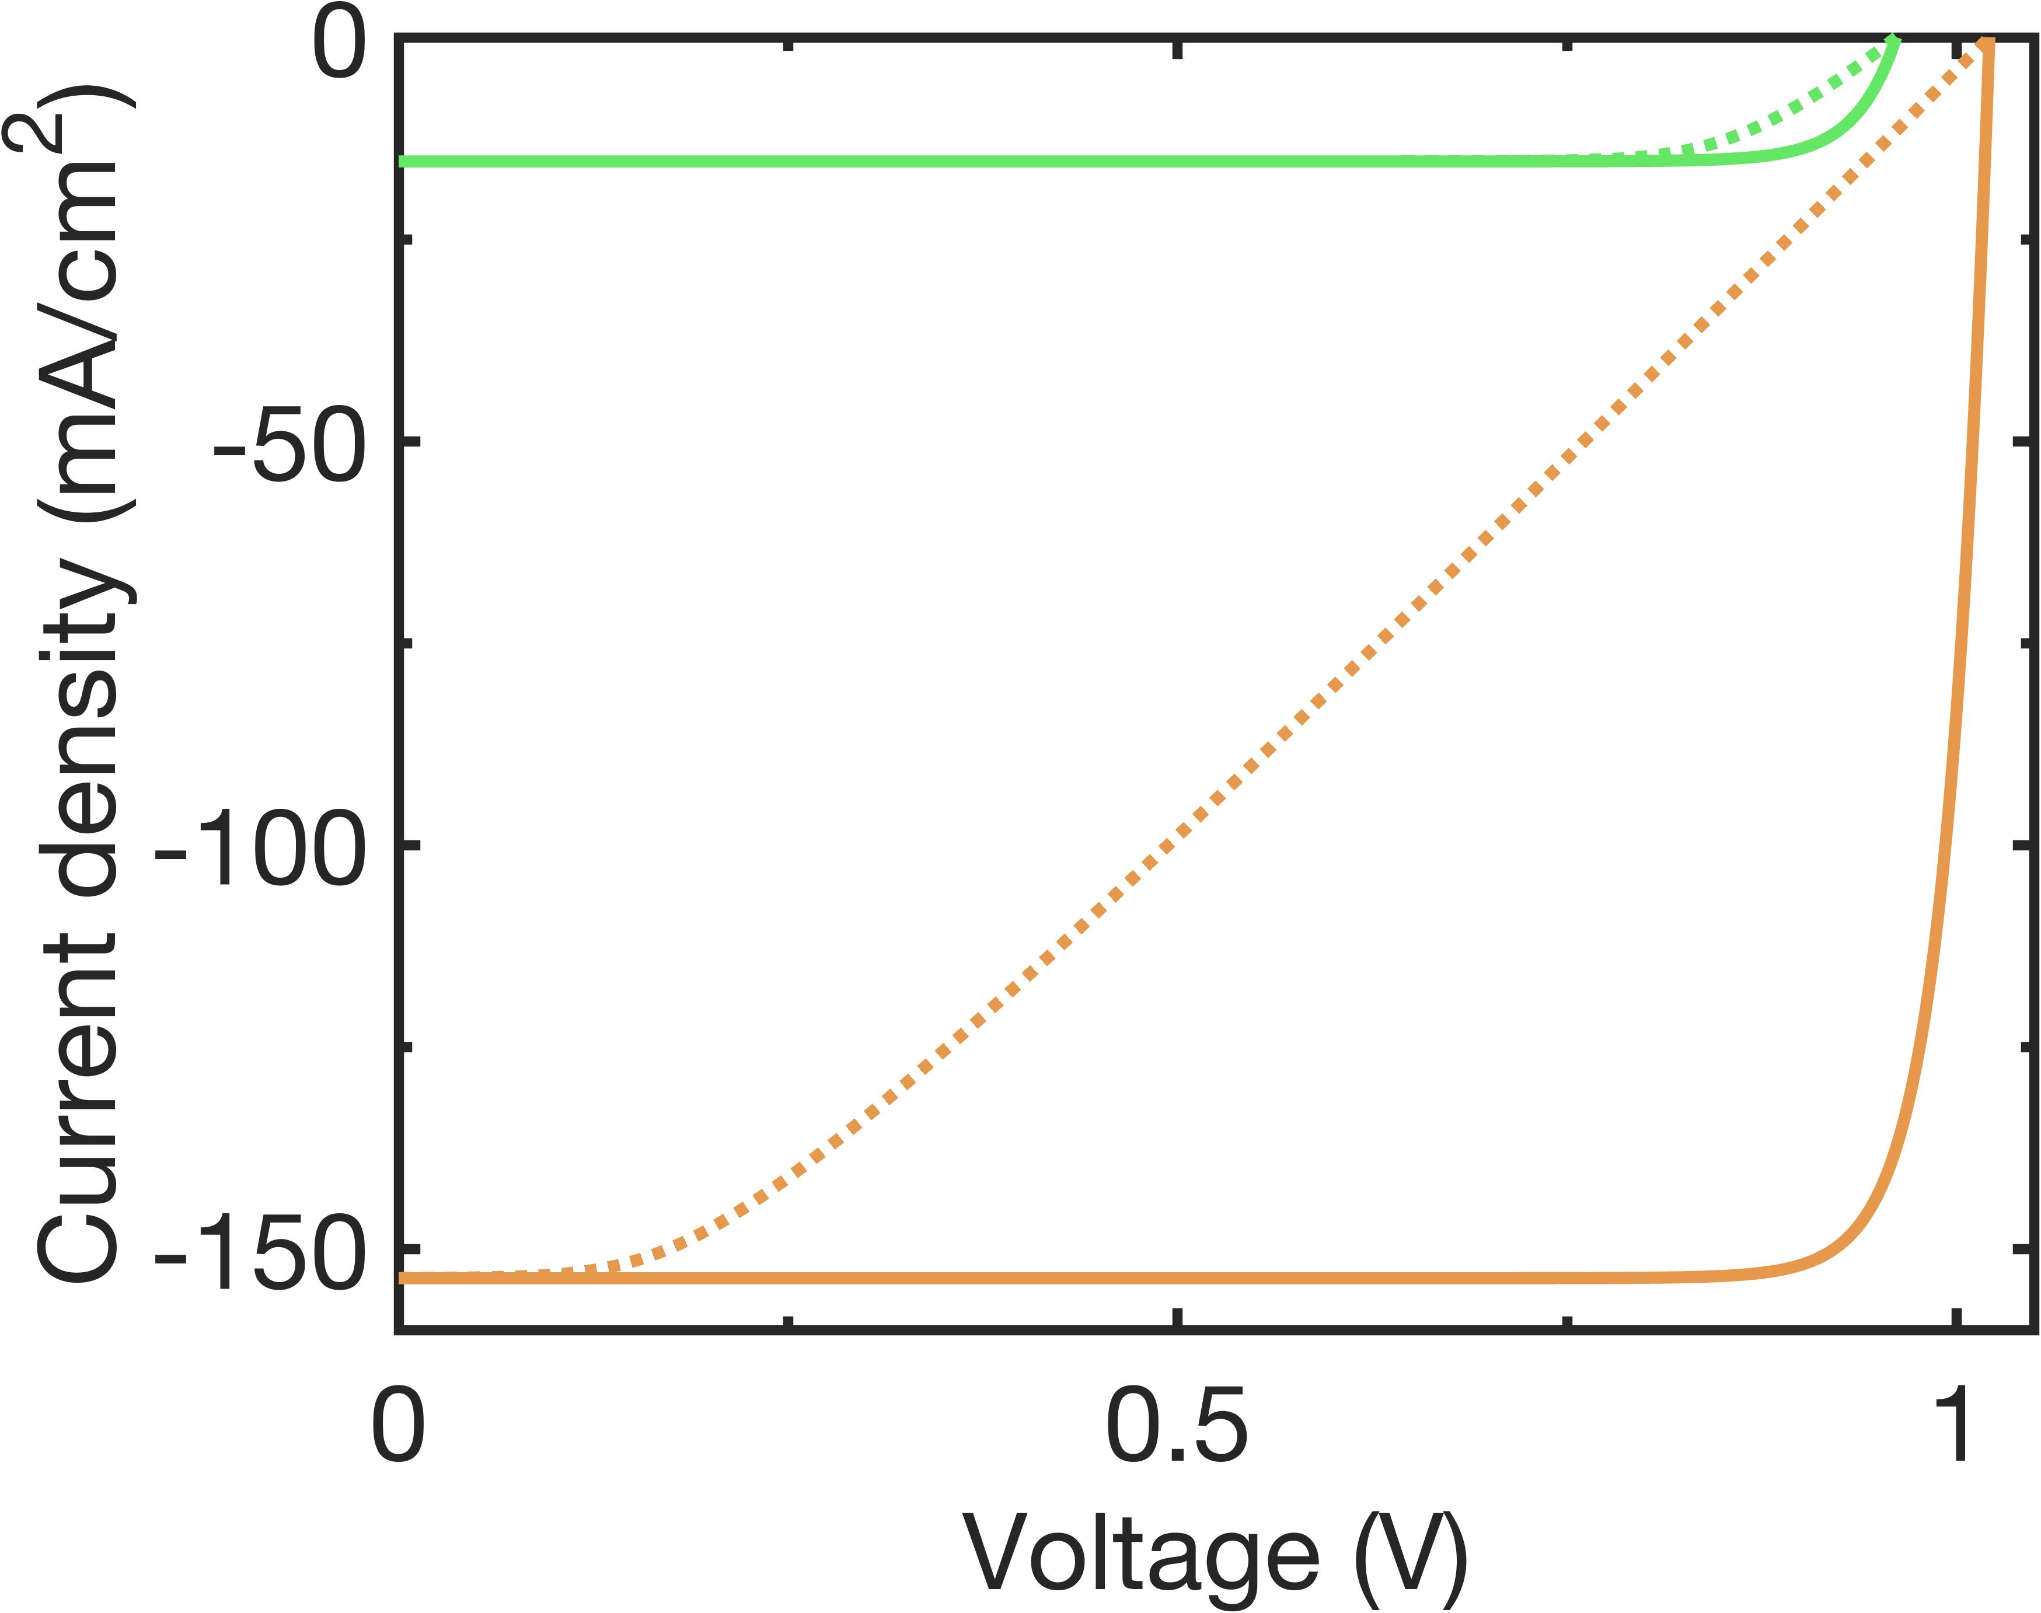
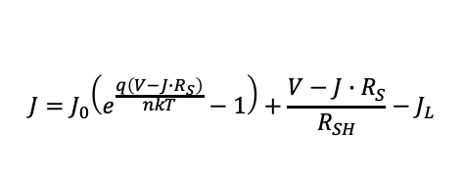
Effect of R_{S} on IV characteristics
R_{S}
R_{S}: Induce voltage drop itself and dissipate power as heat
FF ↓ as R_{S} ↑
Impact of R_{S} significantly ↑ as light intensity ↑
h𝜈
J
$$J=J_{0}\left(e^{\frac{q\left(V−J∙R_{S}\right)}{nkT}}−1\right)+\frac{V−J∙R_{S}}{R_{SH}}−J_{L}$$
J_{L}
J_{d}
R_{SH}
V
Low R_{S}
High R_{S}
Low R_{S}
Low Illumination
High R_{S}
Increasing R_{S}
→ FF ↓
High Illumination
[1] C. Algora et al., Joule, 6, 340-368 (2022). [2] M. D. Sturge et al., Phys. Rev. 129, 2835 (1963).
[3] O. D. Miller et al., IEEE J. Photovolt. 2, 303-311 (2012). [4]. F. Urbach, Phys. Rev. 92, 1324 (1953).

Slide 9
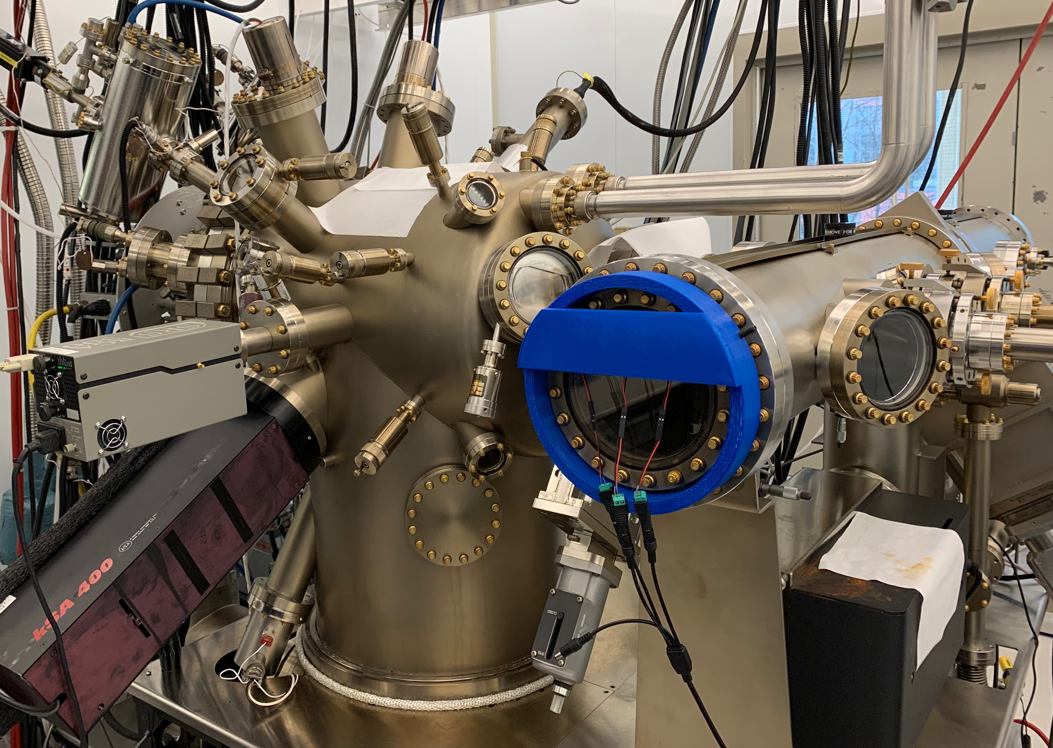
LPCs growth and characterization
Solid-source molecular beam epitaxy (MBE)
  Sources: Al, Ga, In, As, P
  Dopants: Si, Be
  T_{Sub}: 460˚C-610˚C
[1] S. Lu et al., Nanoscale Res. Lett. 6, 576 (2011). [2] S. T. Hwang et al., Sol. Energy Mater. Sol. Cells, 155, 264-272 (2016).

Slide 10
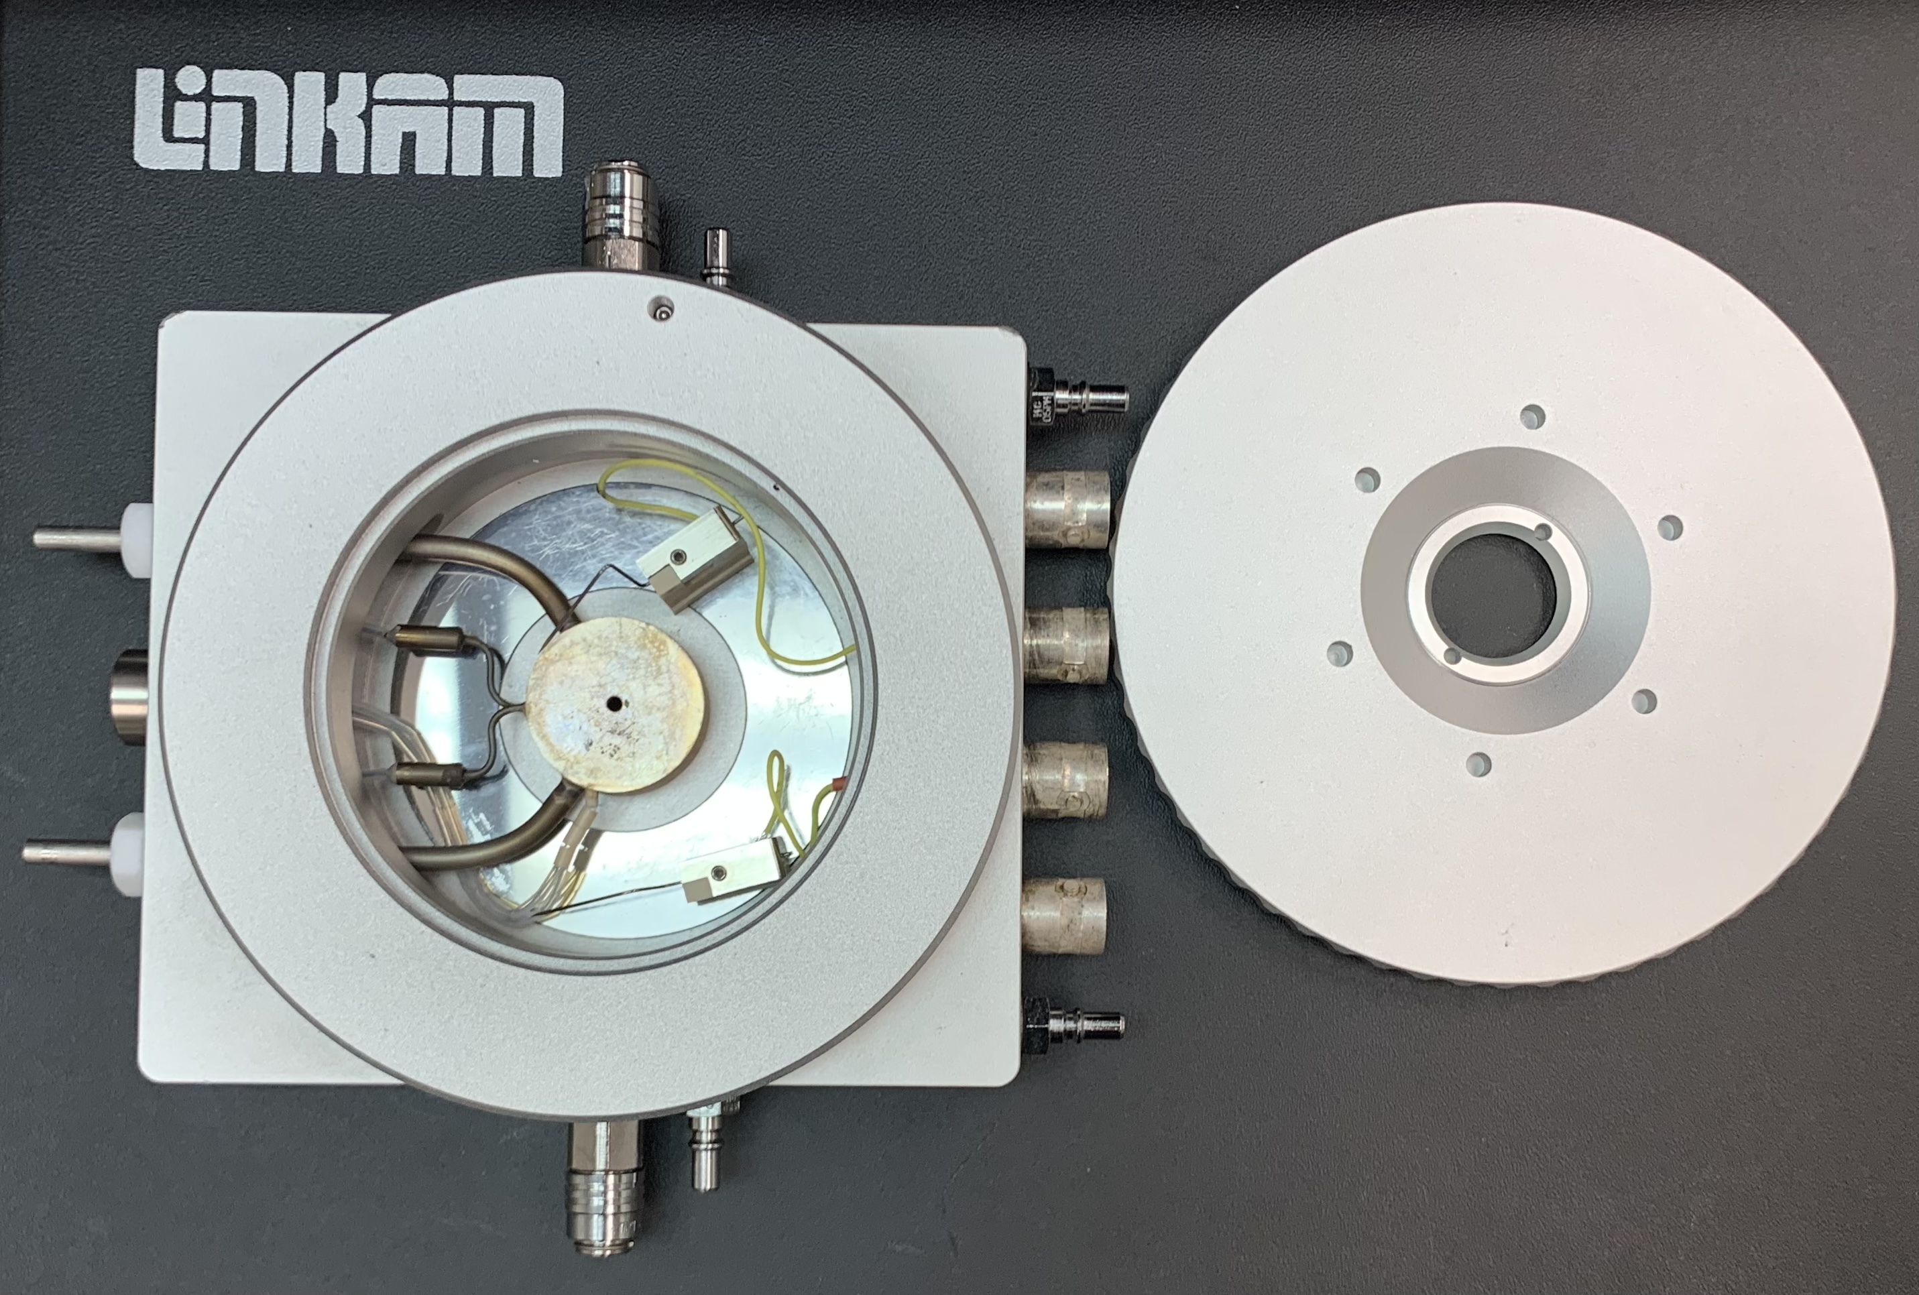
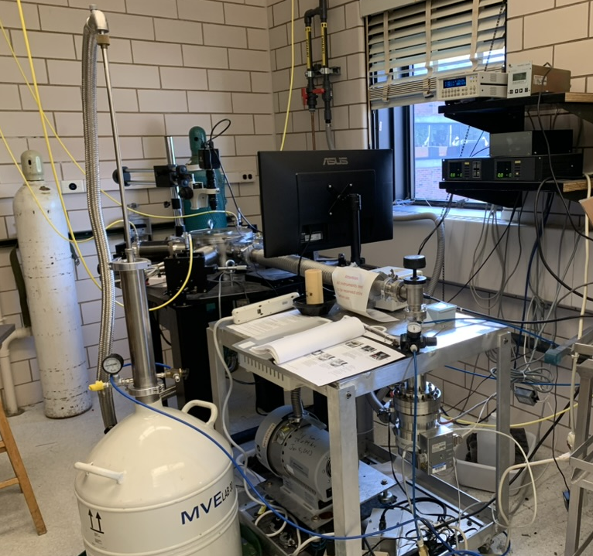
LPCs growth and characterization
Solid-source MBE growth
  Sources: Al, Ga, In, As, P
  Dopants: Si, Be
  T_{Sub}: 460˚C-610˚C
  DLARC only on structure C
Structure A
Typical solar cell design^{[1-2]}
p-InGaP; 98% Be deactivation
Structure B
Control cell
No heterointerface blocking
Structure C
Low R_{S} targeted at 83K
p-Al_{0.1}GaAs; minimal deact.
Contact (6e18) n-GaAs 250 nm
Contact (6e18) n-GaAs 20 nm
Contact (6e18) n-GaAs 250 nm
Window (1e18) n-AlInP 20 nm
Emitter (3e18) n-GaAs 80 nm
Window (8e18) n-InGaP 500 nm
Emitter (1e18) n-GaAs 50 nm
Emitter (1e18) n-GaAs 80 nm
Base (1e17) p-GaAs 2 um
Base (1e17) p-GaAs 1 um
Base (1e17) p-GaAs 2 um
Base (2e18) p-GaAs 50 nm
BSF (0.1~3e18) p-GaAs 100 nm
BSF (0.1~7e18) p-GaAs 100 nm
BSF (1e18) p-InGaP 50 nm
BSF (6e18) p-AlGaAs 100 nm
Buffer (7e18) p-GaAs 200 nm
Buffer (3e18) p-GaAs 400 nm
Buffer (7e18) p-GaAs 400 nm
p-GaAs Substrate
p-GaAs Substrate
p-GaAs Substrate
T-dependent characterizations
  EQE, DIV, 808nm-IV, TLM
  with two types of cryostats
    T range=83K-298K
Sliver sample stage
sample stage
N₂
Electrical tester
LN₂
LN₂
Electrical tester
Vacuum
P<1e-5 Torr
[1] S. Lu et al., Nanoscale Res. Lett. 6, 576 (2011). [2] S. T. Hwang et al., Sol. Energy Mater. Sol. Cells, 155, 264-272 (2016).

Slide 11
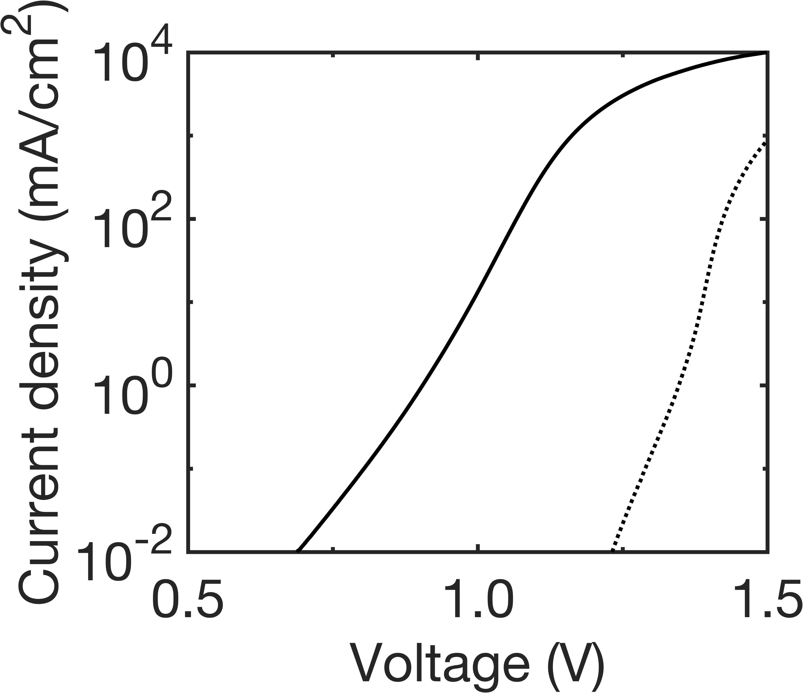
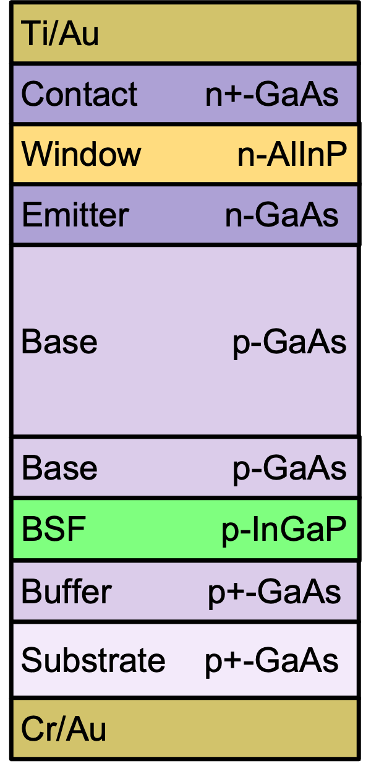
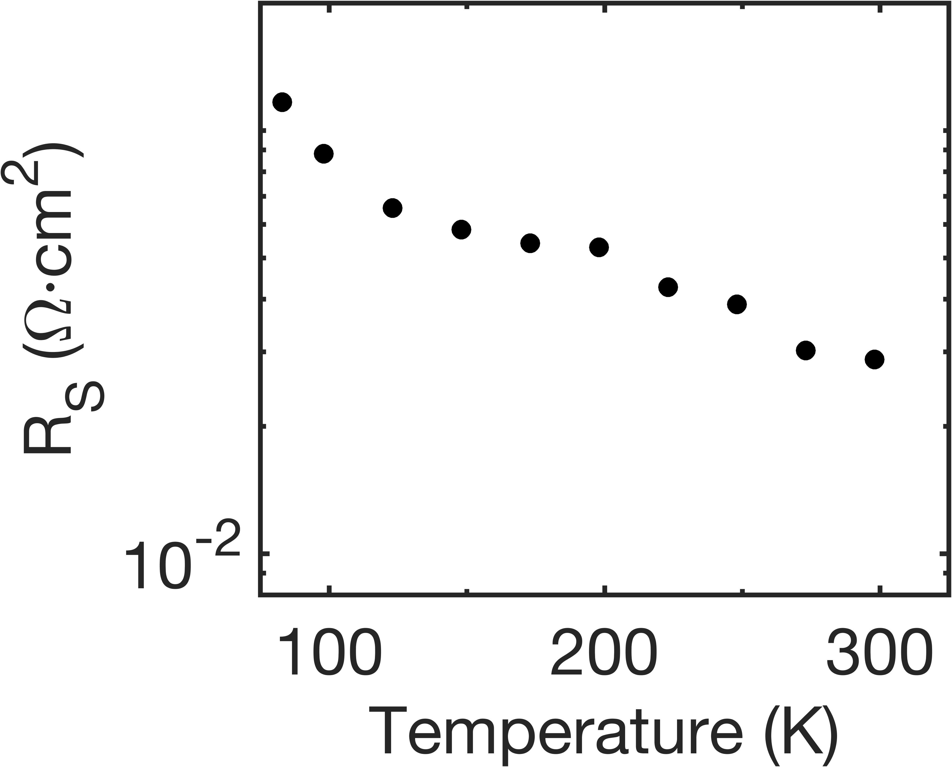
Structure A
: T-dependent R_{S} analysis
R_{Int}
Structure A
  Increasing R_{S} with decreasing T
Dark diode Structure A
R_{C}
𝛴R_{Bulk}
10⁰
R_{C}
10⁰
Ti/Au
298K
83K
298K
10⁻¹
83K
Contact n+-GaAs
R_{S}
10⁻¹
  No change in ∑R_{bulk} or R_{C}
  Thus, R_{Int} is main cause
10⁻²
Window n-AlInP
10⁻²
R_{S}
Emitter n-GaAs
10⁻³
R_{S}
298K
83K
10⁻³
R_{Bulk}
Base p-GaAs
10⁻⁴
10⁻⁴
 | 83K | 298K
R_{S} | 1.17e-1 | 2.88e-2
𝛴R_{Bulk} | 5.78e-4 | 6.98e-4
R_{C} | 1.06e-4 | 8.94e-5
R_{int} _{(estimated)} | 1.16e-1 | 2.80e-2
R_{Int}
1
 | 83K | 298K
R_{S} | 1.17e-1 | 2.88e-2
𝛴R_{Bulk} | 5.78e-4 | 6.98e-4
R_{C} | 1.06e-4 | 8.94e-5
Base p-GaAs
BSF p-InGaP
Buffer p+-GaAs
Substrate p+-GaAs
Cr/Au

Slide 12
Structure A
: T-dependent band diagram analysis
Structure A
Contact (6e18) n-GaAs
Window (1e18) n-AlInP
Emitter (1e18) n-GaAs
Base (1e17) p-GaAs
Severe carrier deactivation in p-type
Moderately doped p-InGaP shows 98% carrier deactivation
Structure A
  High majority carrier blocking at p-GaAs/p-InGaP heterointerface
    Due to partial carrier freeze-out in p-InGaP BSF layer
Base (2e18) p-GaAs
BSF (1e18) p-InGaP
Buffer (7e18) p-GaAs
p-GaAs Substrate
298K
E_{C}
298K
298K
p-GaAs Base
p-InGaP
BSF
77K
77K
+
E_{F}
E_{V}
Tunneling-dominated
83K
E_{C}
+
E_{F}
E_{V}
InGaP
Thicker tunneling barrier

Slide 13

Structure B & C
: T-dependent band diagram analysis
Structure B
Control cell
No heterointerface blocking
Structure C
Low R_{S} targeted at 83K
p-Al_{0.1}GaAs; minimal deact.
Contact (6e18) n-GaAs
Contact (6e18) n-GaAs
Emitter (3e18) n-GaAs
Window (8e18) n-InGaP
Emitter (1e18) n-GaAs
Base (1e17) p-GaAs
Base (1e17) p-GaAs
BSF (0.1~3e18) p-GaAs
BSF (0.1~7e18) p-GaAs
Structure B
  No majority/minority blocking
Structure C
  No majority blocking
  Sufficient minority blocking
BSF (6e18) p-AlGaAs
Buffer (3e18) p-GaAs
Buffer (7e18) p-GaAs
p-GaAs Substrate
p-GaAs Substrate
298K
E_{C}
298K
p-GaAs Base
p+GaAs BSF
p-GaAs Base
p+GaAs BSF
p+AlGaAs BSF
E_{F}
+
E_{V}
+
83K
E_{C}
83K
E_{C}
E_{F}
E_{V}
E_{F}
E_{V}
+
+

Slide 14
T-dependent R_{S} analysis
Structure A
  Increasing R_{S} with decreasing T
Structure A
Structure A
Structure B
Structure B
Structure C
Structure C
  No change in ∑R_{bulk} or R_{C}
  Thus, R_{Int} is main cause
High
R_{S}
  Structure B and C
    T-invariant R_{S}
      At 83K, 10-14x smaller than that of structure A
298K
83K

Slide 15
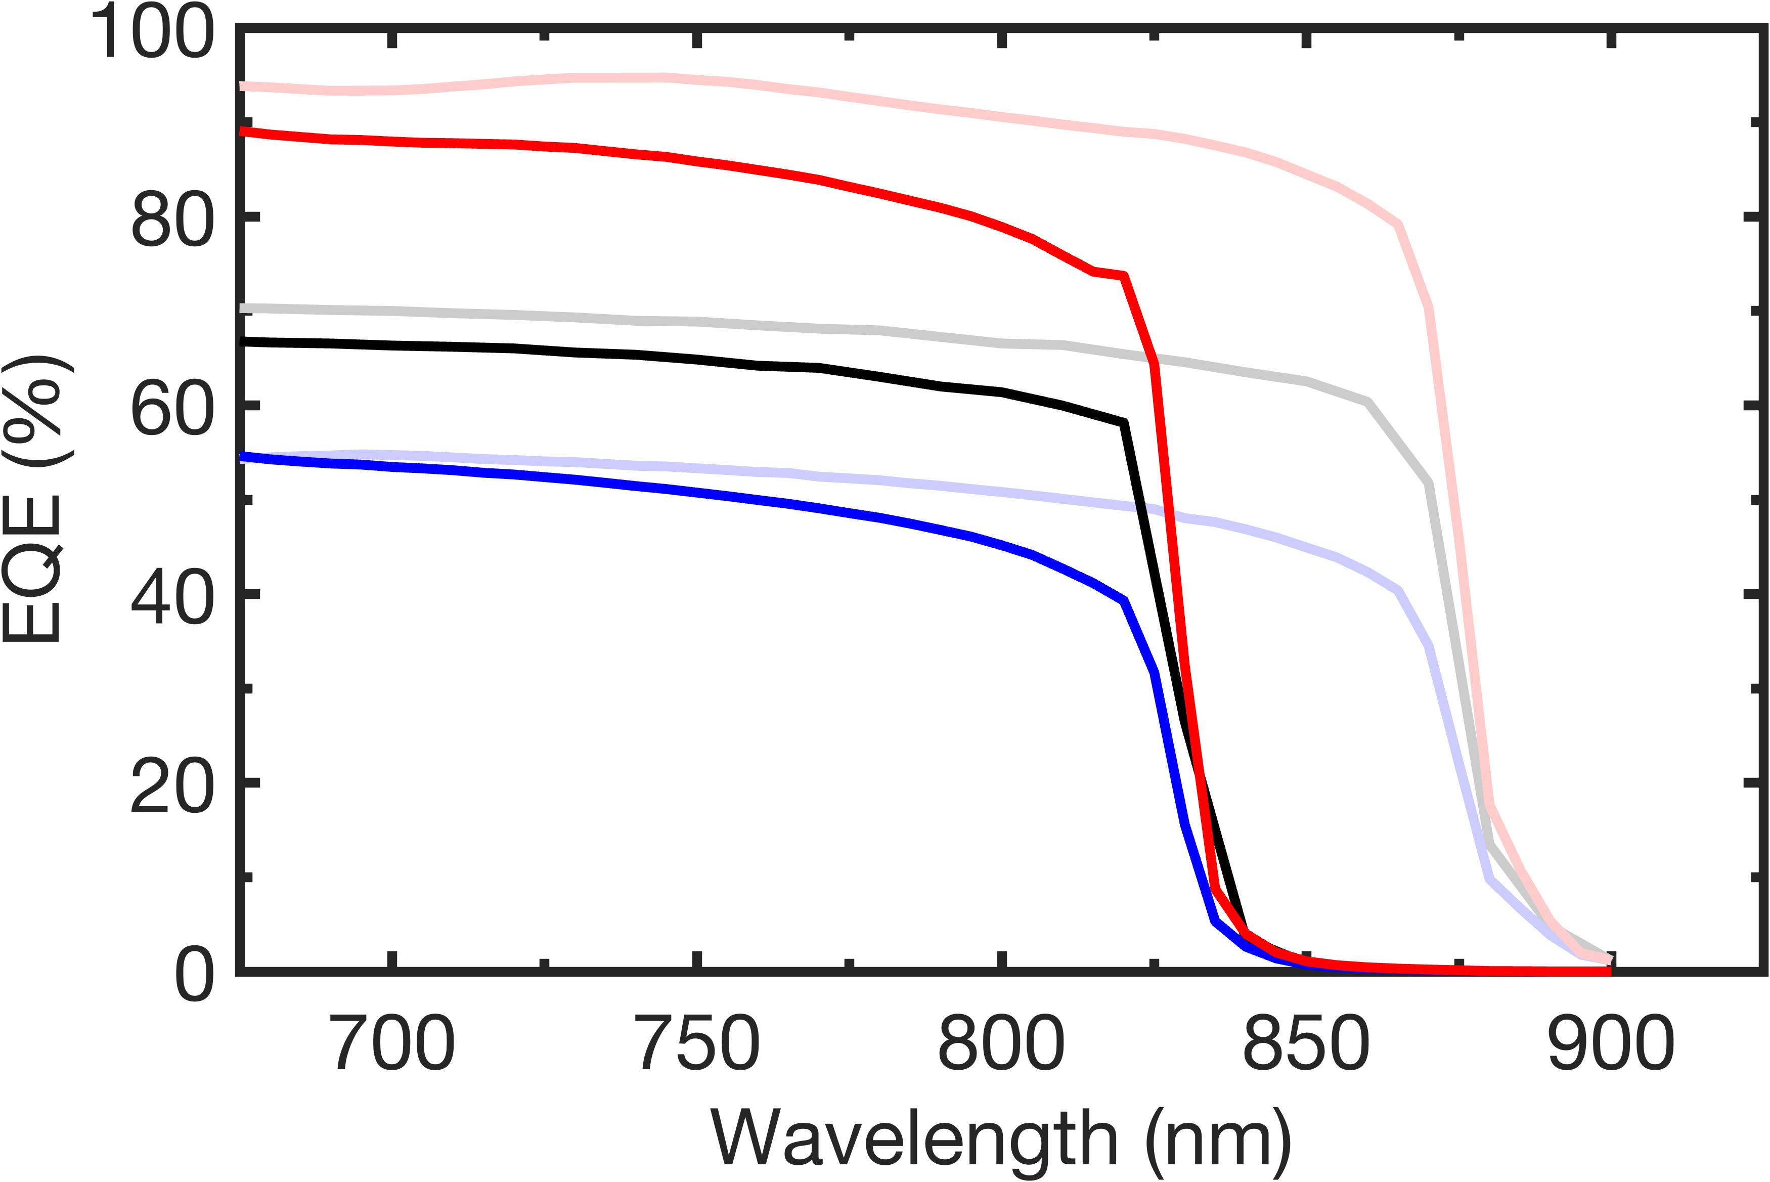
QE comparison
298K
At 298K, IQE_{808 nm} of structure A ≈ structure C >> structure B
91.3%
92.6%
74.0%
Structure A
At 83K, decrease in EQE_{808 nm} due to
  Decrease in minority carrier diffusion length
  Decrease in absorption coefficient at 808nm
  EQE_{808 nm}~76.6% in structure C+DLARC
Structure B
Structure C
808 nm
Structure C+DLARC
83K
298K
Structure A
76.6%
62.2%
Structure B
43.3%
808 nm

Slide 16
808-IV comparison
T=83K
FF decreases in structure A with increasing power density due to high R_{S}
Structure C + DLARC
Structure B
  FF in structure C > FF in structure B
Structure A
    Peak 𝜂 of 62.1% in structure C under power density of 0.7W/cm²
Structure C + DLARC
Structure A
Structure B

Slide 17
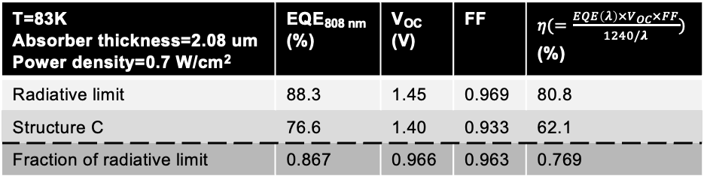
Roadmap to 70% LT efficiency
Need to improve EQE (J_{SC})
T=83K Absorber thickness=2.08 um Power density=0.7 W/cm² | EQE_{808 nm} (%) | V_{OC} (V) | FF | 𝜂$(=\frac{EQE\left(λ\right)×V_{OC}×FF}{1240/λ})$ (%)
Radiative limit | 88.3 | 1.45 | 0.969 | 80.8
Structure C | 76.6 | 1.40 | 0.933 | 62.1
Fraction of radiative limit | 0.867 | 0.966 | 0.963 | 0.769
  Strategy: increase absorption of photons
    DBR, back surface mirror
Light
photon
GaAs absorber
+
-
Absorption
GaAs absorber
+
-
Radiative recombination
GaAs substrate
Incomplete absorption
GaAs substrate

Slide 18
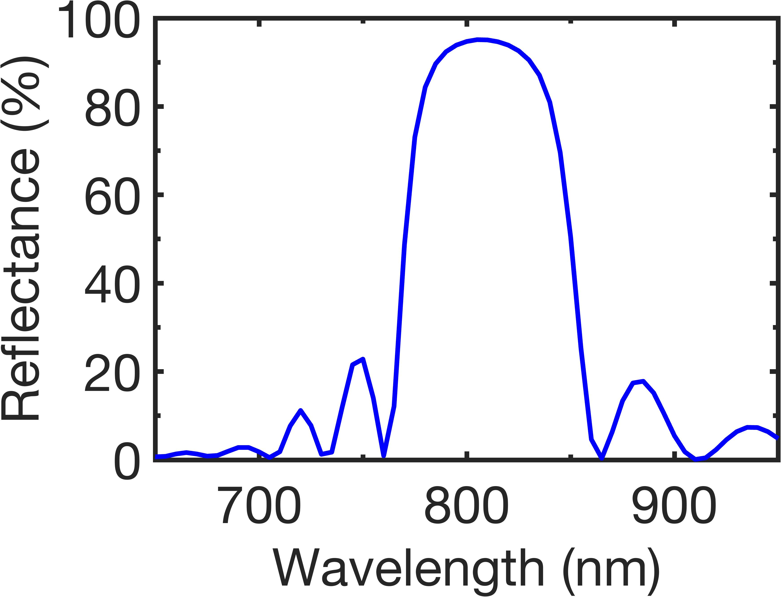
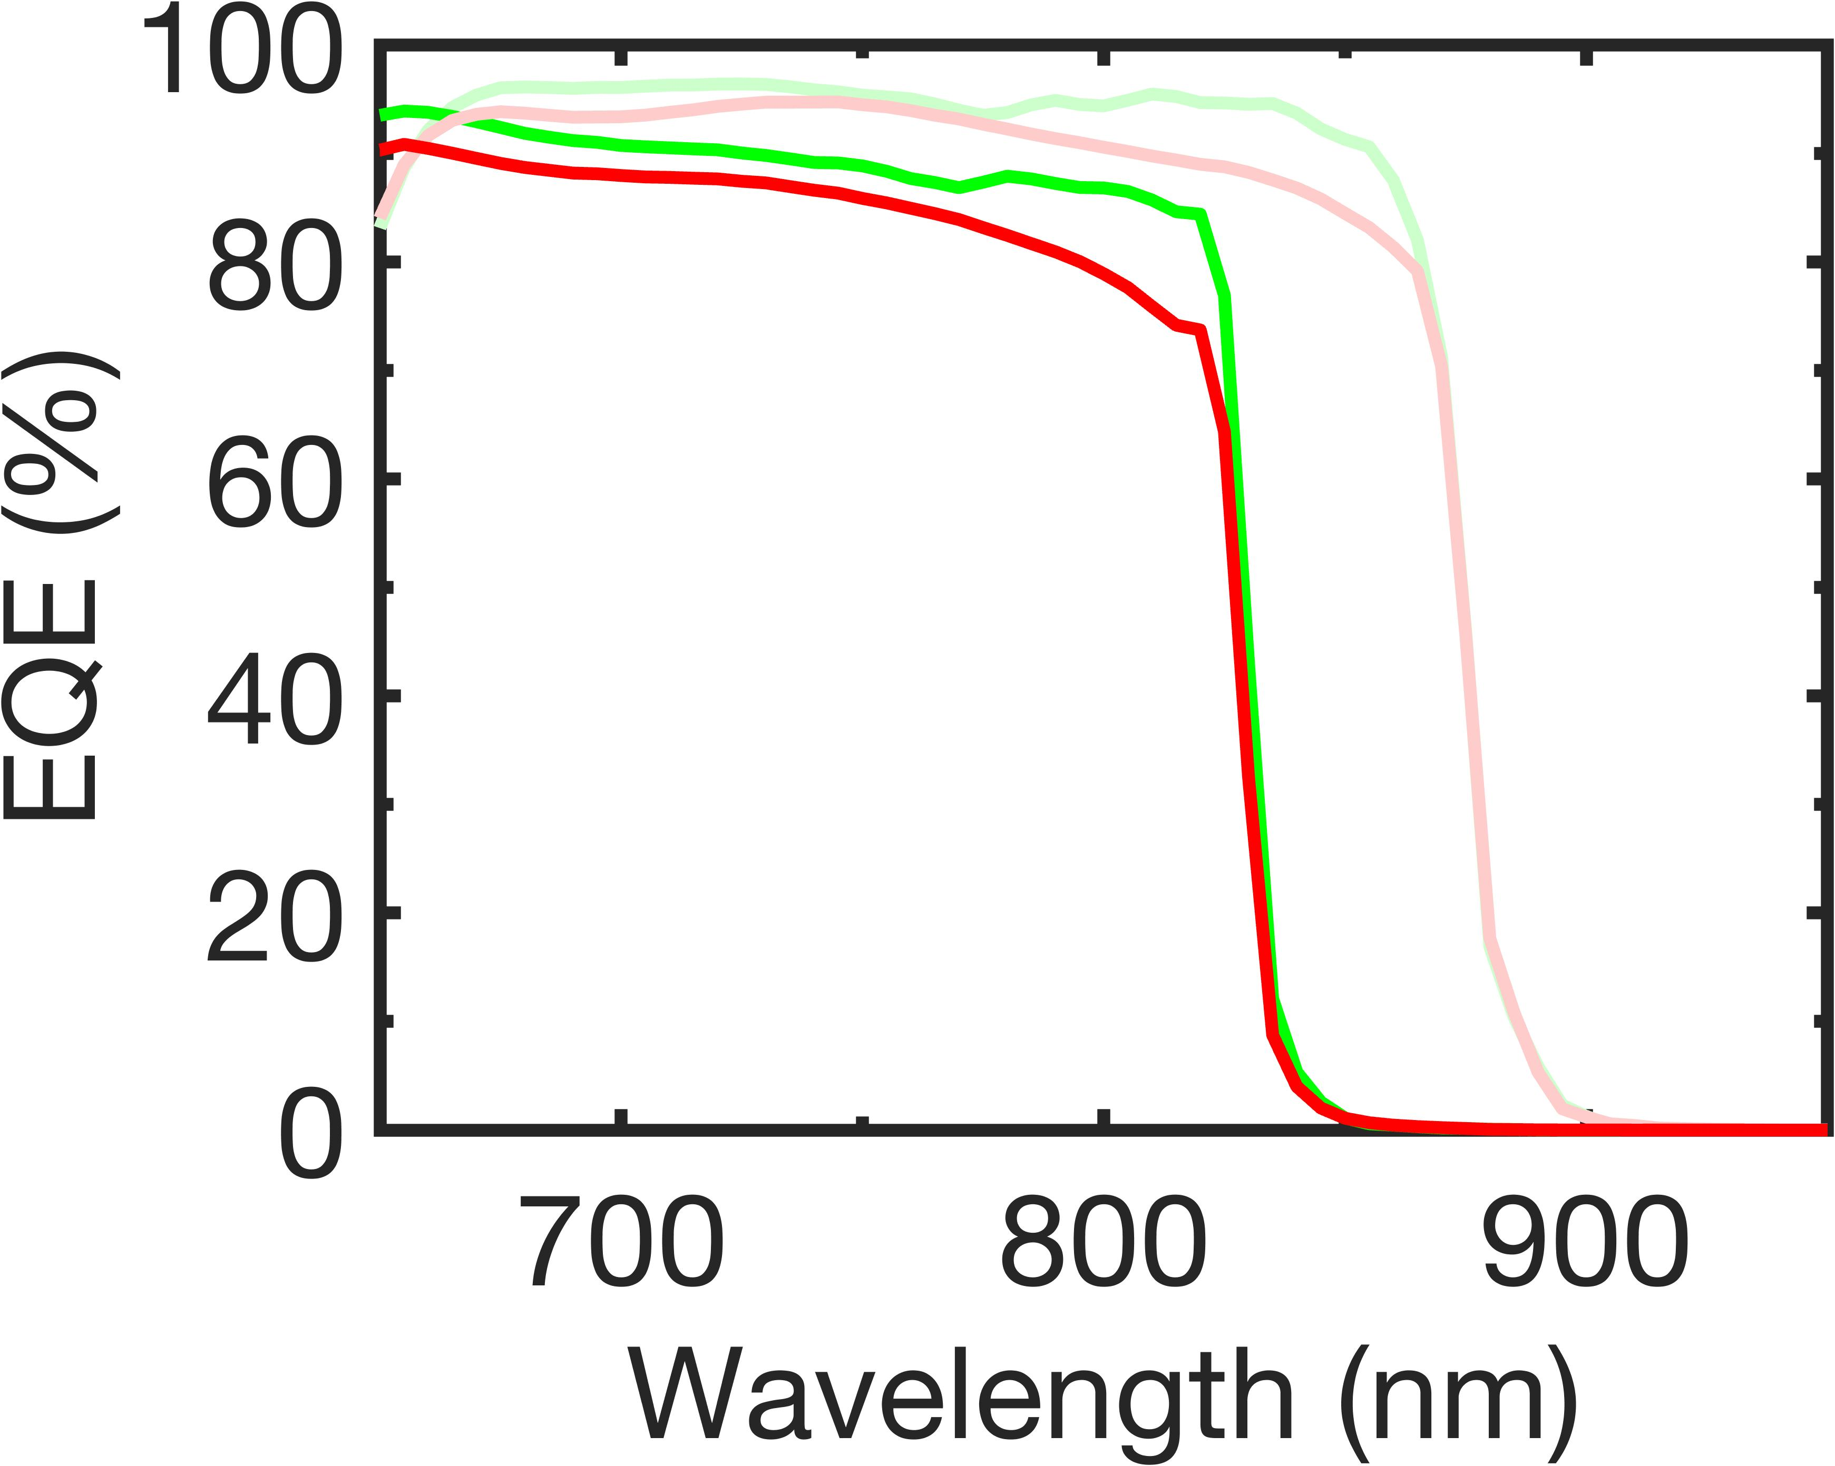
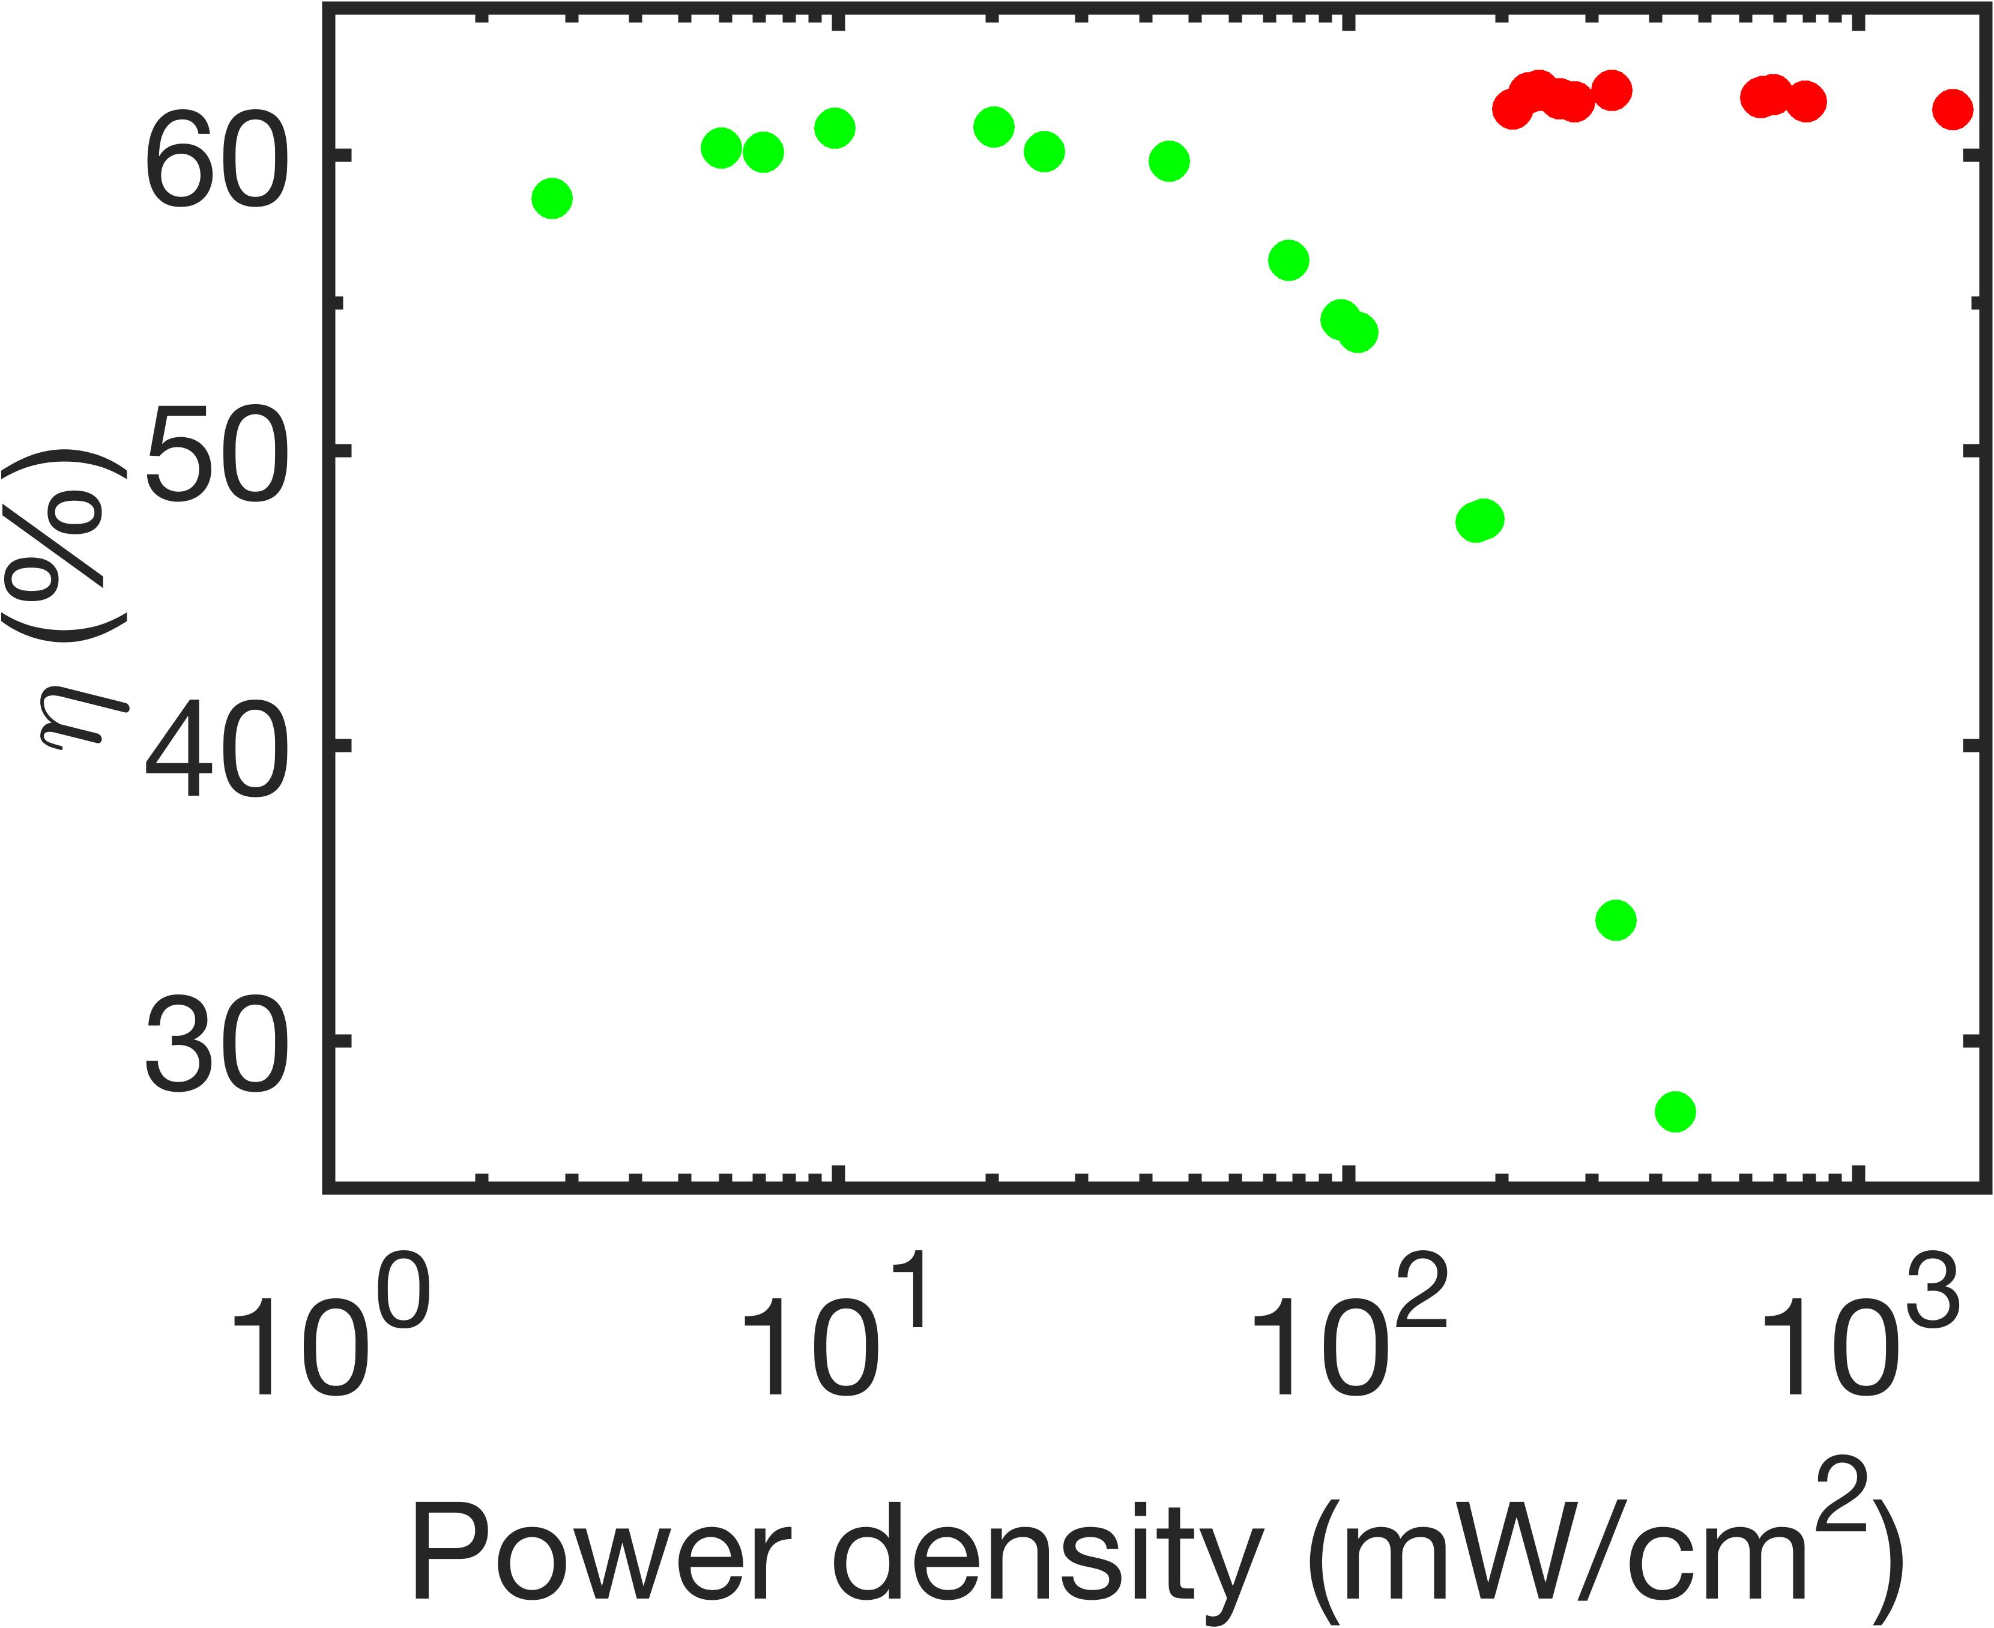
Roadmap to 70% LT efficiency – (1) DBR
808 nm
Need to improve EQE (J_{SC})
GaAs absorber
+
-
95%
  Strategy: increase absorption of photons
    DBR, back surface mirror
Reflection
DBR
GaAs substrate
86.0% EQE_{808 nm} with DBR
  73.2% 𝜂 expected
83K
298K
86.0%
w DBR
w/o DBR
76.6%
  However, high R_{S} and low FF due to carrier deactivation
  Other DBR structures under investigation
w DBR
w/o DBR
808 nm

Slide 19
Roadmap to 70% LT efficiency – (2) BSR
(c) Metal-metal bonding by thermo-compression
Need to improve EQE (J_{SC})
Handle wafer (Si)
(e) 2 step Photolithography
  Strategy: increase absorption of photons
    DBR, back surface mirror
(b) Back contact metallization
(d) Etch GaAs substrate
(a) MBE-grown inverted epilayers
Back contact
Back contact
Back contact
Handle wafer (Si)
Epilayers
Inverted epilayers
Inverted epilayers
Inverted epilayers
Back contact
GaAs substrate
GaAs substrate
GaAs substrate
Back contact
Handle wafer (Si)
Additional advantage
  Photon recycling
Back contact
Back contact
Inverted epilayers
  However, low yield and high R_{S} due to non-optimized fabrication techniques
Total internal reflection
Escape cone
GaAs absorber
+
-
+
-
Reabsorption
Reflection
Back surface reflector/metal contact

Slide 20
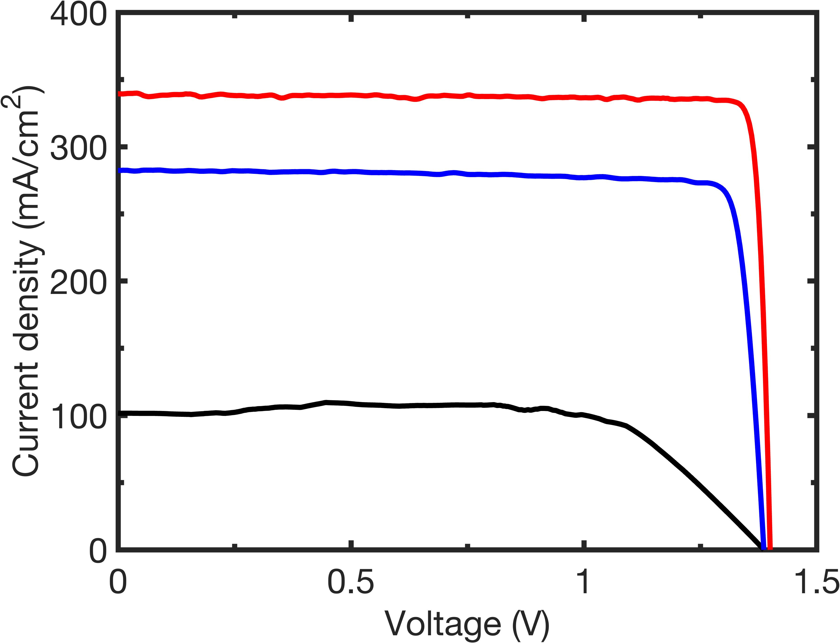
Conclusion
Majority hole blocking acted as a strong performance-limiting factor in cryogenic LPCs
By selecting proper barrier material with high doping and minimal freezeout
  FF>90% and peak efficiency of 62.1% were measured
Structure C + DLARC
Structure B
Structure A
ID | EQE_{808 nm} (%) | P_{In, density} (W/cm²) | J_{SC} (A/cm²) | V_{OC} (V) | FF (%) | η_{Max} (%)
A | 62.2 | 0.27 | 0.102 | 1.385 | 74.4 | 39.1
B | 43.3 | 1.05 | 0.282 | 1.387 | 89.2 | 33.2
C | 76.6 | 0.71 | 0.339 | 1.400 | 93.3 | 62.1

