Slide 1
Cryogenic Digital SiPMs for DUNE
Farah Fahim, David Christian
FNAL
June 27, 2023

Slide 2
Digital SiPM concept
HV
Analog SiPMs – requires either
  -Cold ADC
  -Analog Signal over fiber transmission
Digital SiPM - Well established concept (SPAD integrated in CMOS process)
Active or passive quenching circuit can control the quench time
Can provide added position resolution and/or timing resolution if needed
Collaborate with industry (GF/Tower) and academic groups (e.g EPFL/ U.Sherbrooke, University of Washington)
Amplify and A/D converter
SPAD = Single Photon Avalanche Diode
HV
Quenching circuit
Quenching circuit
Quenching circuit
Quenching circuit
Digital SOF
Photonics
Micro-ring resonator
+
+
+
CMOS

Slide 3
SiPMs are great, but...
• There is a limit to the number of SiPMs that can be passively ganged together that is associated with their capacitance.
  • S/N for a single SiPM is very large
  • S/N decreases as more SiPMs are ganged
• Several technologies exist now in which CMOS SPADs can be realized
• Could eliminate the scaling of noise with the number of pixels.
• CMOS SPAD devices may allow a much larger active photodetection area to be read out on a single channel with essentially zero noise.

Slide 4
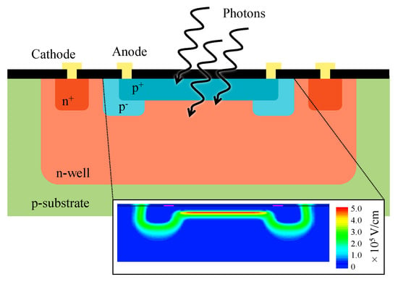
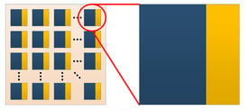
Frontside SPADs for blue light (490 nm wavelength)
Electronics
SPAD
10.3390/s21020598
Limited in-pixel electronics consisting of active quenching circuit, comparator and adder
Fill factor is not a major concern. Low power, cryogenic performance is critical

Slide 5
Digital SiPMs with integrated Photonics
~32 mm
Frontside SPADs optimized for blue wavelength
Maximize pixel SPAD area
Low power photon counting
Passive/Active quenching
Low power inverter- based comparator for digitization
Optimized adders to provide total number of counts
Number of output bits used would depend on expected occupancy
SPAD
SPAD
SPAD
SPAD
SPAD
SPAD
Peripheral circuits
~8 mm
Digital signal on fiber
SPAD array with minimal pixel electronics (100 x 500)
SPAD
SPAD
SPAD

Slide 6
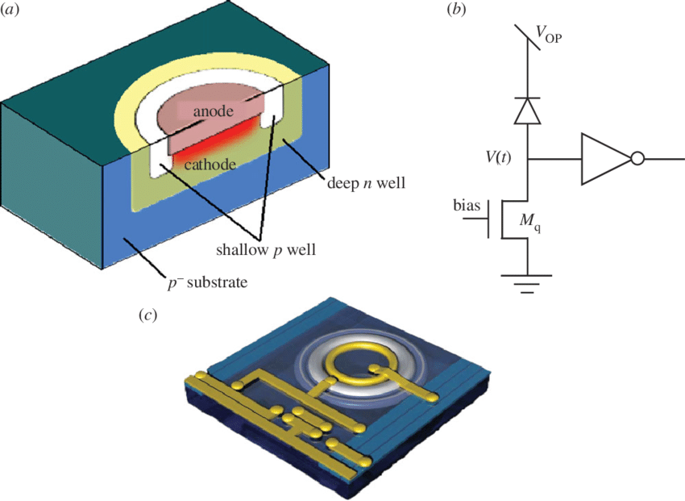
Readout
Simple low power readout circuit
SPAD Pixel
HV
O/P
Comparator
Vth
Quenching circuit
reset

Slide 7
SPAD Chip Readout
Module
Power & Clock
Output (from previous chip e.g. 16b)
Added Output (to next chip e.g. 16b)
+
SPAD chip
SPAD chip
SPAD chip
Total count
Photonic readout
Clock (10 MHz)
SoF
4b
H-tree adder path
Power: Photonic driver
+
Reset path (after data is latched)
Avoid clock distribution across the chip
Other peripheral functions such as picosecond TDC can be added
Each SPAD chip could have a laser driver circuit; only the last chip in the daisy chain would have this circuit powered.
Output could be by silicon photonics, either integrated or in a separate chip.
Photonic driver
+
3b
+
Signal transmission on fiber
(only activated for the last chip in the module)
2b
+
+
+
+
1b
1
0
0
1
1
0
0
0
Pixel array with photon hits

Slide 8
CMOS SPADs can be optimized for DUNE
• Each pixel would contain a very low power discriminator & reset circuit.
• Pixel readout could consist of an “adder tree” and an output latch (12-16b) resulting in the number of hit pixels in a given period of time
• Readout of a large number of SPAD chips could be done using two pipeline steps.
• Step 1: count the number of hit pixels in each chip in period N
• Step 2: add the number of hits in period N-1 in all chips & reset the pixels that were hit in period N.
• The readout bandwidth required for a group of SPAD chips would depend on the length of the integration period.
• Example: An integration period of 100ns would imply 160 Mbps if the output consisted of a 16-bit number. This would provide a huge dynamic range. The time resolution would be 100ns/root(12) = 29ns.

Slide 9
Preliminary power estimates and feasibility
400mW for 80 SiPMs –size is 6 mm x 6 mm: Current POF capability
Estimate single pixel size of 60 µm x 60 µm; total no. of pixels: 80 x 100 x 100
20b photon counting performance
Power per pixel – (400 mW to 1.6 W)/ (80x100x100) = (0.5 – 2) uW per pixel(feasible)
SPAD quenching (passive) ; Comparator + clockless combinatorial adder architecture + data transfer
Ultra low CMOS leakage power due to cryogenic operation
Power for quenching circuits and data transfer – similar to standard SiPMs
Minimize power by eliminating cold ADC by developing digital SiPMs
Compare power and performance vs. analog Signal over fiber

Slide 10
Global Foundries
Two options; will depend on GF partnership and interest; meeting scheduled to estimate costs and feasibility
45 RF CLO – fully integrated SPAD + CMOS processing + Silicon Photonics
Pros: fully integrated solution
Cons: No cryogenic demonstration, unsure of SPAD development and performance; process is huge demand – risk of low priority for DOE HEP
GF 55 nm – integrated cryogenic SPAD + CMOS processing; additional photonics chip
Pros: Proven cryogenic operation of SPADs; similar to bulk CMOS 65 nm technology characterized for DUNE
Cons: Integrated Photonic solution is not available

Slide 11
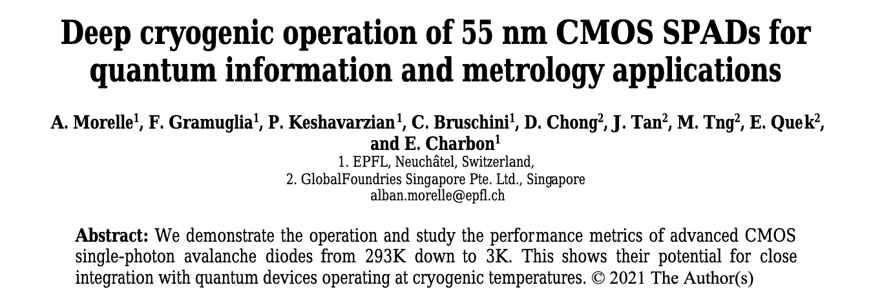
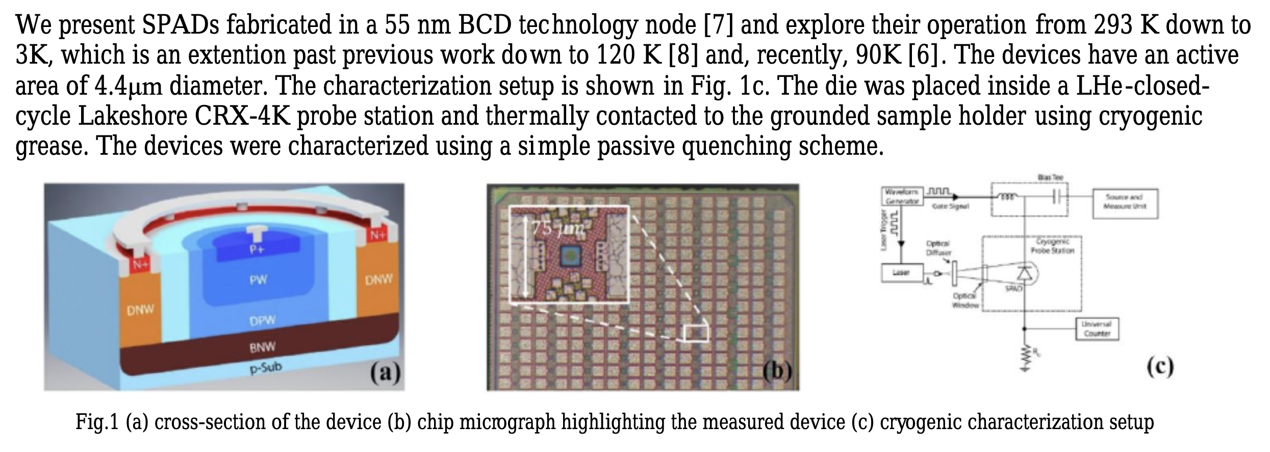
GF cryo SPAD development

Slide 12
Tower semiconductor
Generally lower cost than Global Foundries
TPSCo 65nm – integrated SPAD + CMOS processing; additional photonics chip
Pros: Demonstration of high quality SPADs in this process; closest to bulk CMOS 65 nm technology characterized for DUNE. Established relationship with foundry for HEP specific developments. Previous experience in the process. Stitching available for larger form factors e.g. ~1 cm x 24 cm chips
Cons: Cryogenic performance is unknown, Photonic chip coupling is required

Slide 13
Open Questions
What control is required and how should it be implemented?
  Clock: an external clock would ensure system synchronization
  Individual pixel kill: It might be necessary to disable noisy pixels
Should an optical receiver be integrated into the CMOS SPAD chip?

