Slide 1
Digital Readout: From VD to FD3
Jonathan Eisch
DUNE FD3 Mini-Workshop
June 27, 2023

Slide 2
Overview
Digital readout concept
Current R&D status
Next steps
Further refinement
Advanced usage and optimization

Slide 3
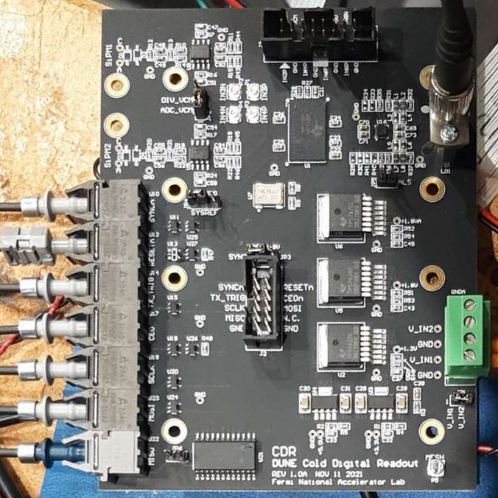
Cold Digital Readout Concept
Objective: Low part-count digital ADC solution compatible with cryogenic operation.
Cold Digital Readout Operation
A single low-power ADC clocked by a free-running oscillator continuously digitizes multiple input-channels.
The samples are transmitted over a single optical fiber using the deterministic-latency JESD204B subclass 2 protocol.
An FPGA in the warm recovers the transmission/sampling clock and decodes the samples for multiple digitizers.
A thought: Continuous digitization has a relatively flat power draw, which is a good match for power over fiber. Triggered processing at the edge does not pay off as well here.

Slide 4
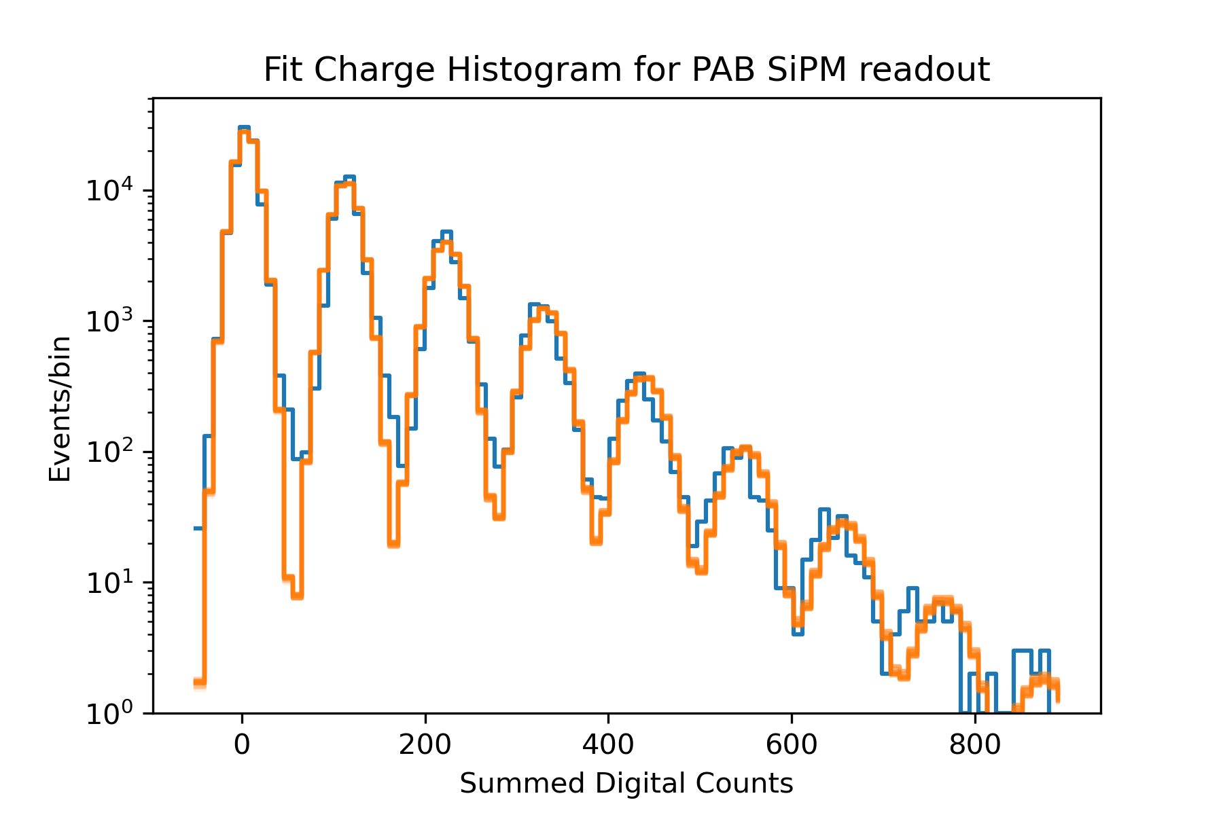
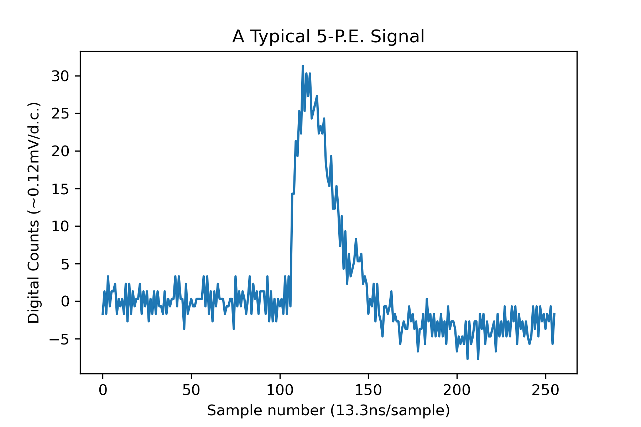
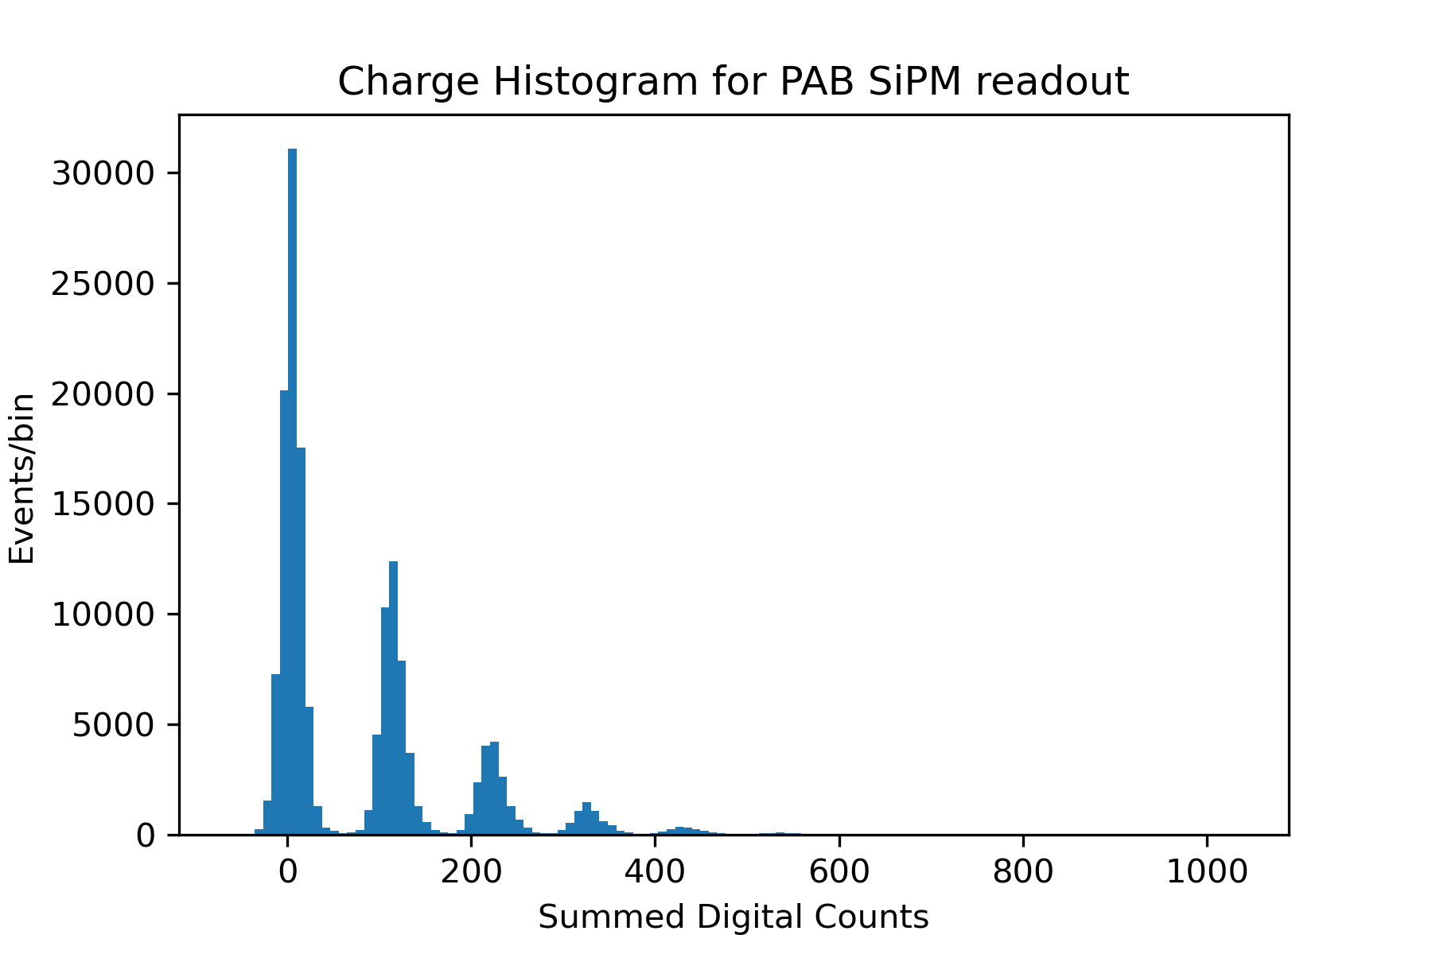
Cold Performance at Fermilab
Best fit results
Pedestal: 5dc
Pedestal RMS: 11.2dc
SPE: 109dc
SPE RMS: 7.7dc
Average SPE/trigger: 0.59
Crosstalk Probability: 0.15
14-bit digitization at 75MHz, (slightly outside of the datasheet specification)
The Cold Digital Readout board operates reliably at both lab temperatures and in liquid Argon/Nitrogen without any configuration changes.
Fitting the charge spectrum with a combined Poisson and SiPM crosstalk model allows measuring the crosstalk probability directly.
(Can measure based on the dark-noise spectrum alone)

Slide 5
Prototype overview (Version 1, for reference)
Analog front-end
X10 gain, copied from analog design
Could use multiple gains.
ADC and Laser Driver
Unique to this design
(laser diode shared with analog design)
Control and timing
LED-based signaling over plastic optical fiber, stable at DC levels and multiple MHz in liquid argon.
Power
Linear regulators chosen from existing cryo designs.
5V (Analog front end and controls)
3.3V Laser driver and Oscillator
1.8V digital and analog for ADC
75MHz free-running crystal oscillator with CMOS output.

Slide 6
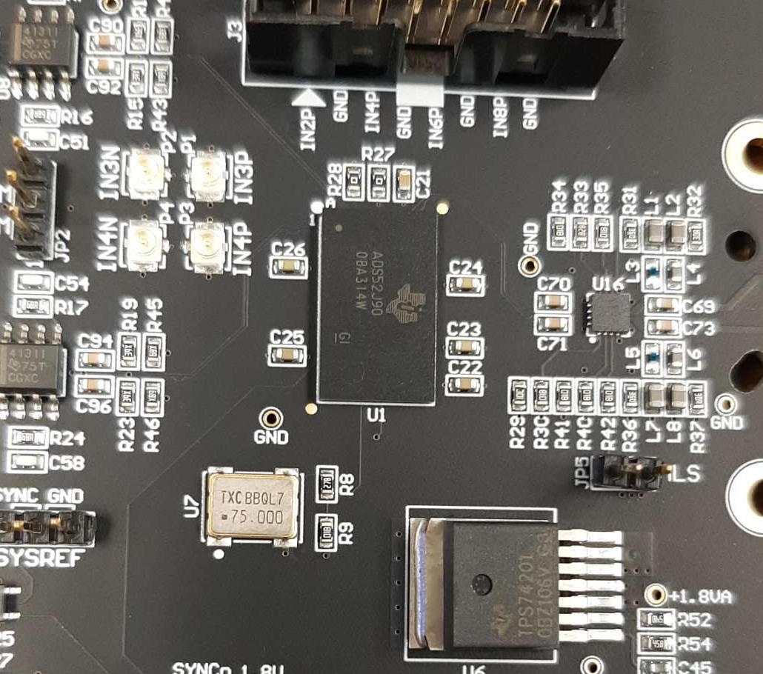
ADC Chip
Version 1: TI ADS52J90
  14-bit 16-channel ADC with 5Gbps JESD204B serial output
  Chosen from experience with cold operation in LBNL-Fermilab CryoDAQ targeting Liquid He operation.
  Supports up to 32 differential input channels (configurable) over 2 fibers
  Total power ~30mW/ch at 40MSPS (16ch) Requires 2 fibers.
Version 2: ADI AD9656
  16-bit 4-channel ADC with 8Gbps JESD204B serial output
  Successfully tested in Liquid Argon at Fermilab.
  Defaults to 4-channels over 1 fiber at startup, only requires standard JESD204b signals.
  Total power as low as 100mW/ch at 40MSPS (per datasheet)
So far untested: TI ADS52J65
  16-bit 8-channel ADC with 12.8Gbps JESD204B serial output
  38mW/ch at 40MSPS (8-ch). Would only require 1 fiber.
Best efficiency when many channels can be utilized.

Slide 7
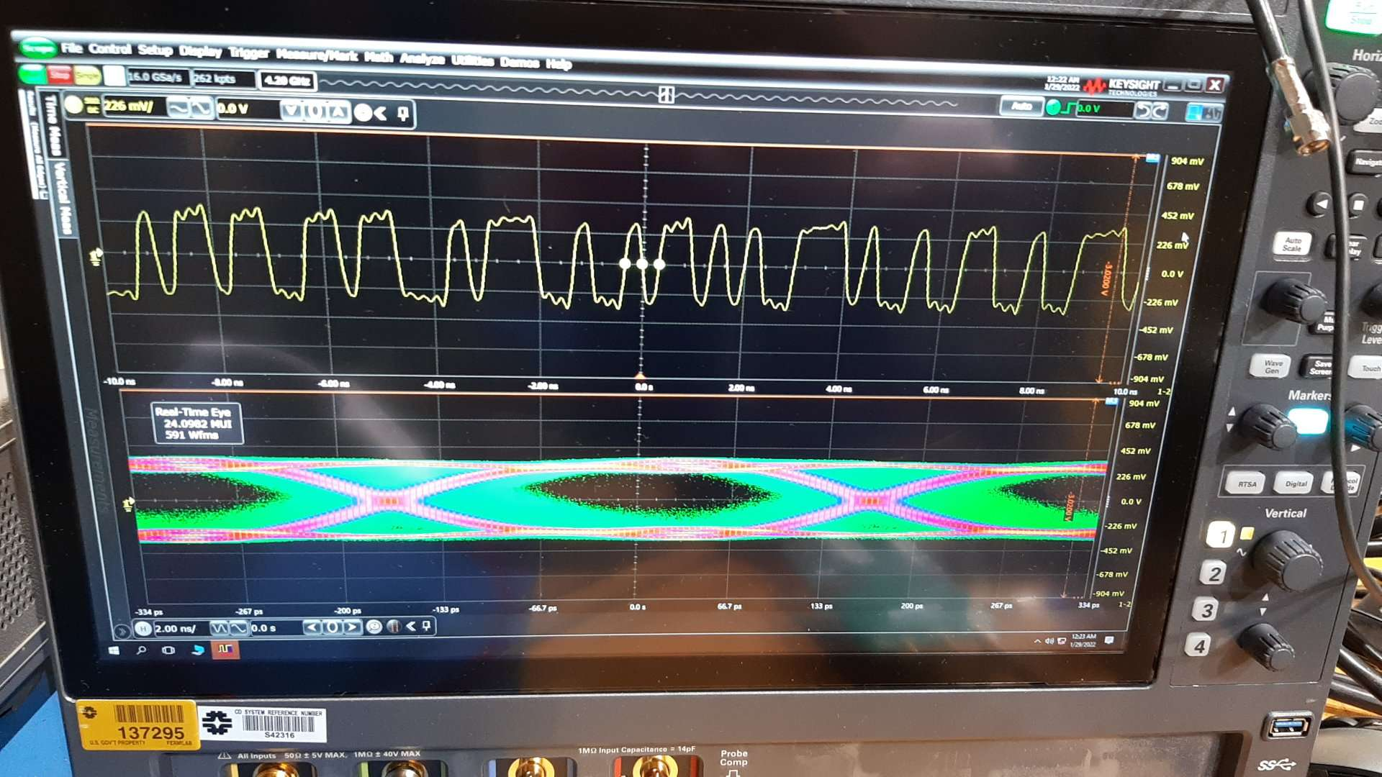
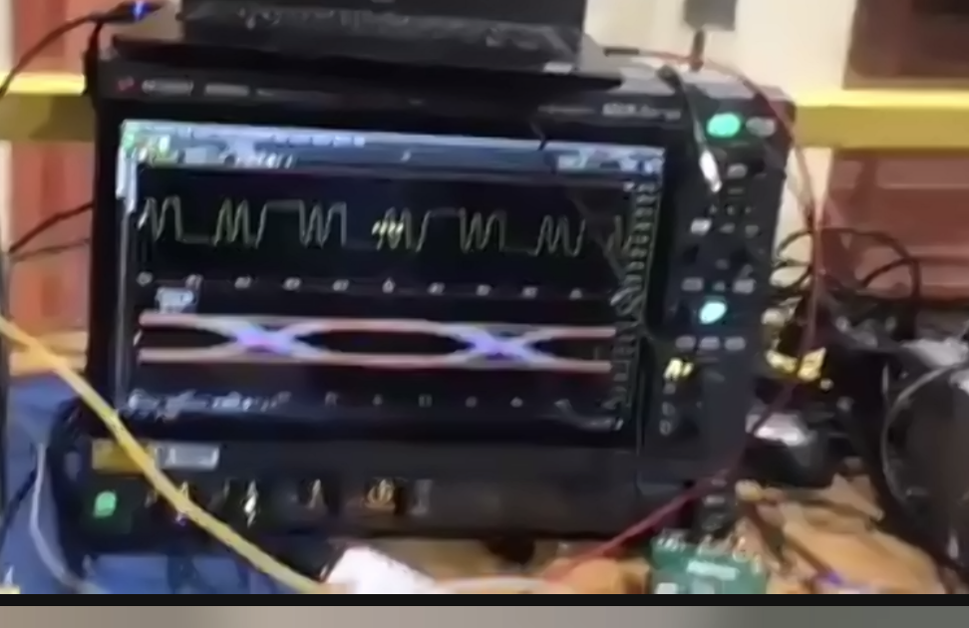
Laser and Laser Driver
Laser bias and modulation settings optimized and set with onboard resistors.
Reliable operation at 5gbps (higher datarates not yet tested)
FC coupled lasers worked in shallow liquid argon, but quickly flooded.
“Sealed” pigtail lasers operated at depth in liquid argon, but eventually flooded.
New, “unfocused” lasers available to solve the flooding problem.
Signs that the laser driver can operate reliably at lower voltages.
Before optimizing:
After optimizing:
(3gbps)

Slide 8
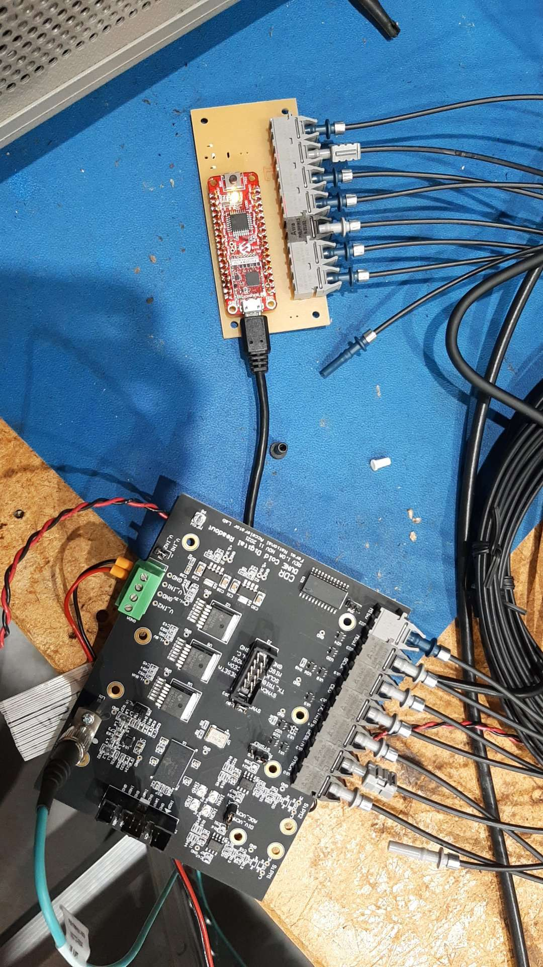
Control signals
ADS52J90 ADC requires several registers to be configured and multiple reset and sync signals. Prototypes used plastic optical fibers with LED transmitters.
Two prototypes deployed to the coldbox at CERN.
Both prototypes had significant issues with the optical slow-control fibers.
  Difficult to keep track of 7 identical fibers through the cryostat penetration.
  The requirement of being able to send DC signals (active high reset, resynchronization signal, etc.) meant using receivers sensitive to DC light levels, so termination and coupling problems caused communications failures.
An onboard active controller device (ASIC, FPGA, Microcontroller) would greatly simplify the design, eliminating the need for most control.

Slide 9
Power delivery
Existing designs used:
  5.0V for Analog front end opamps
  3.3V for laser driver
  1.8V supplies for analog and digital ADC.
PoF supplied ~6V, so >2/3 of the power was lost to the linear power regulars.

Slide 10
Next Steps:
Immediately available:
  New ADC available: TI ADS52J65, lower total power and reasonable channel count.
  New laser available: Test the new unfocused laser diodes
Straightforward:
  Improve efficiency of voltage regulation, perhaps with switch-mode regulators.
  Optimize power of analog front end.
  Could use an ADC channel to monitor input voltage modulate the input Power over Fiber.
Needed:
  Simple automatic or remotely-controllable configuration (FPGA, ASIC or microcontroller).
  May want to provide external clock to simplify operation.
The big questions:
  Can we make use of multiple ADC channels to make the power/channel competitive with FD2 analog designs?
  Does digital signal transmission provide a benefit that isn’t otherwise available?

Slide 11
Backup slides

Slide 12
Digital readout concept
Minimal digital electronics in the cold to minimize analog conversation steps.
Flexible choices for input/output channels.
Simplified electronics outside the cryostat (only digital)
Analog front-end amplifier/filter and Power over Fiber same as analog design
Laser Driver and laser tested working at 5Ghz
Control over Plastic Optical Fiber with LED based transmitters/receivers
Free-running crystal oscillator
FPGA board
SFP+
FPGA
SFP+
SFP+
SFP+
Feed-through
amp
ADC
Laser Driver
amp
Laser
Control
Power

Slide 13
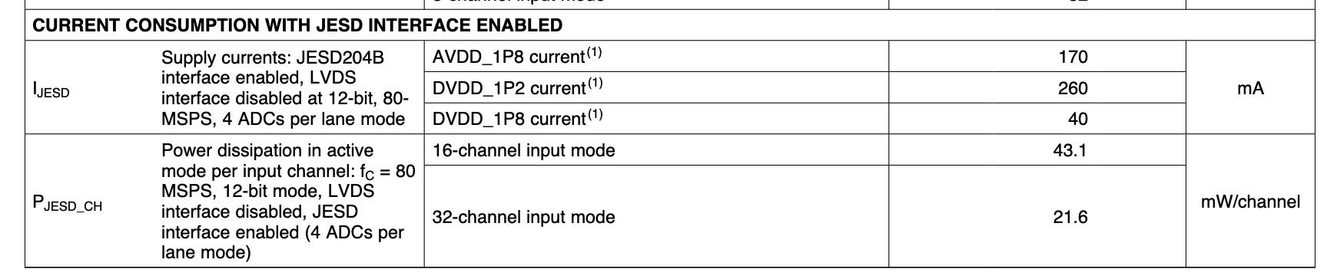
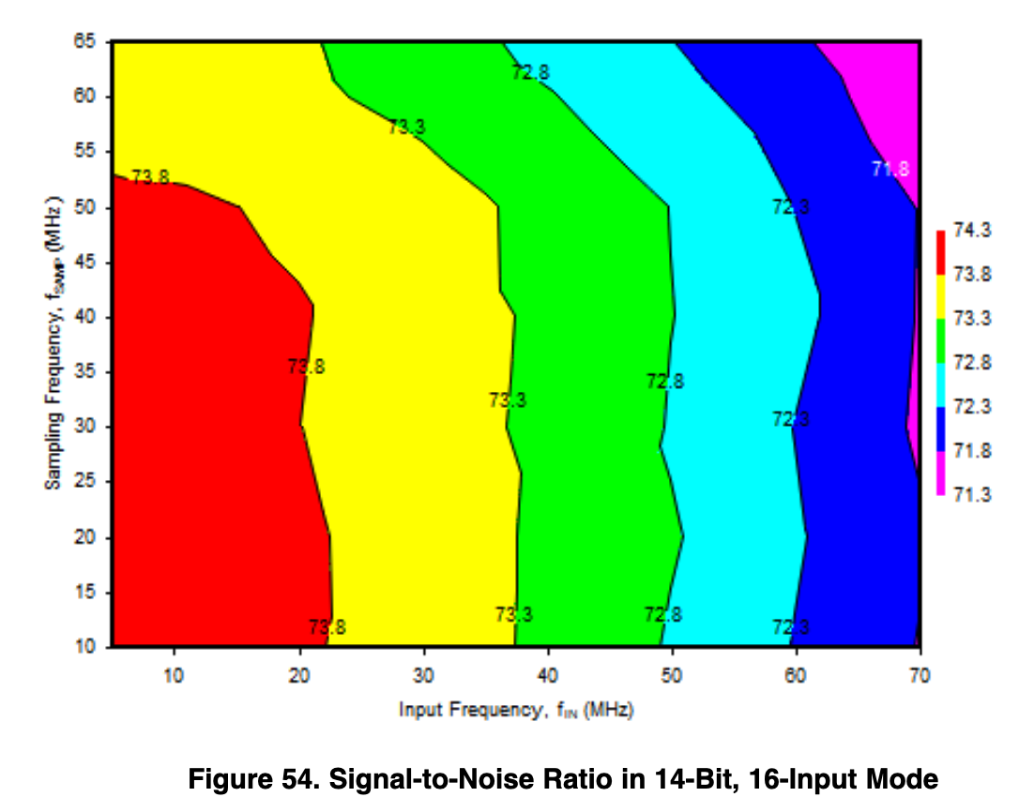
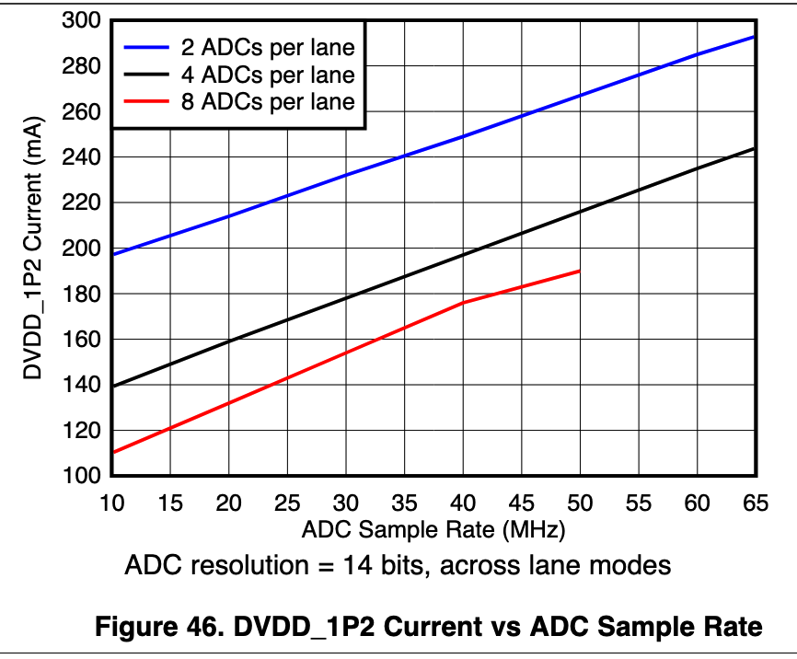
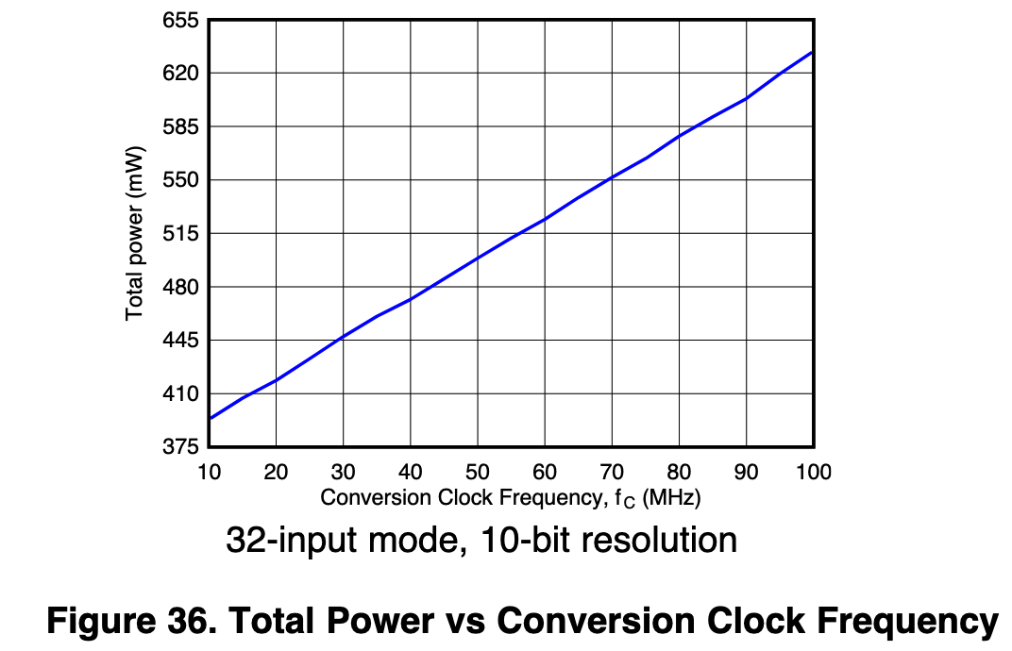
Additional plots from ADS52J90 Datasheet

