Slide 1
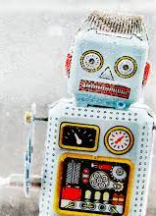
FNAL Cold Box Test Area
DUNE FD3 Mini-Workshop Toward a Combined Photon Detection and Field Cage System
W. Pellico
FNAL
6/27/2023

Slide 2
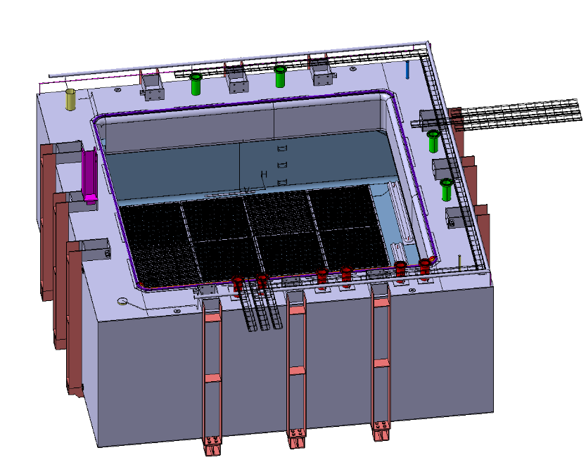
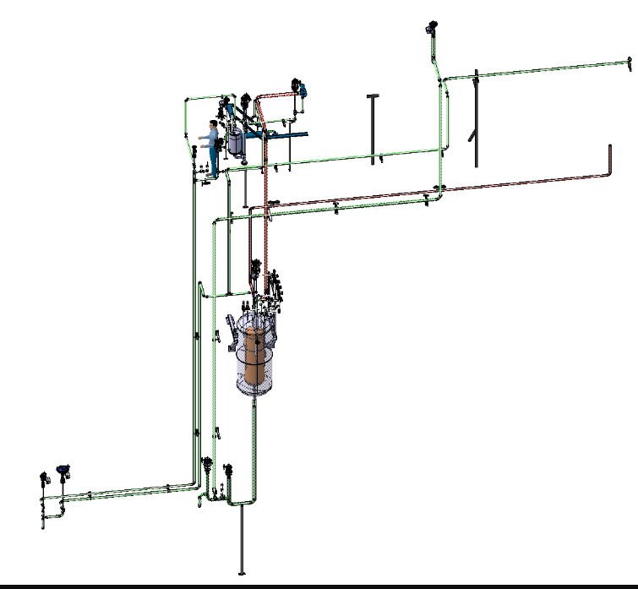
IERC Building
Fermilab has just completed a new state of the art engineering building. The intent is to bring emerging technologies and space for engineering teams to collaborate on projects efforts.
FNAL is committed to meeting the needs of the projects and understood the need for the new IERC facility.
Because of CERN Cold Box Envy – I put forth the need to have a similar facility to improve our DUNE cold electronics testing.

Slide 3
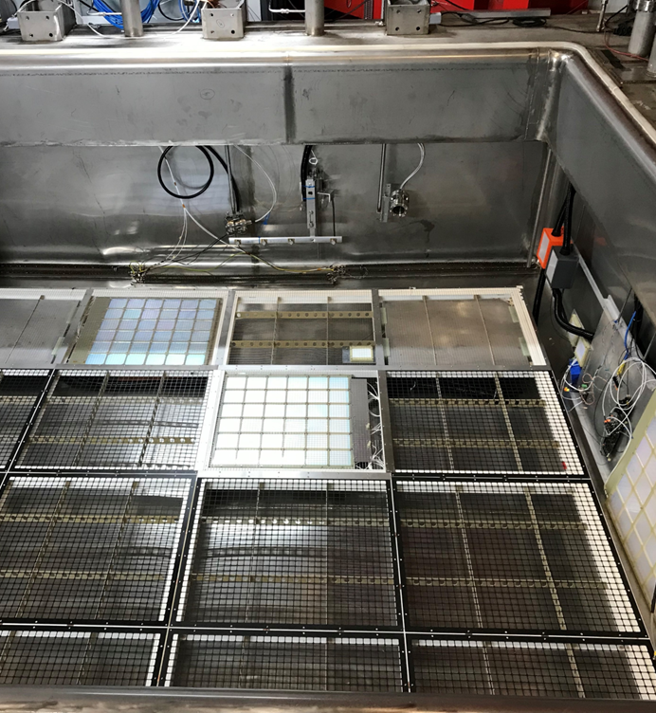
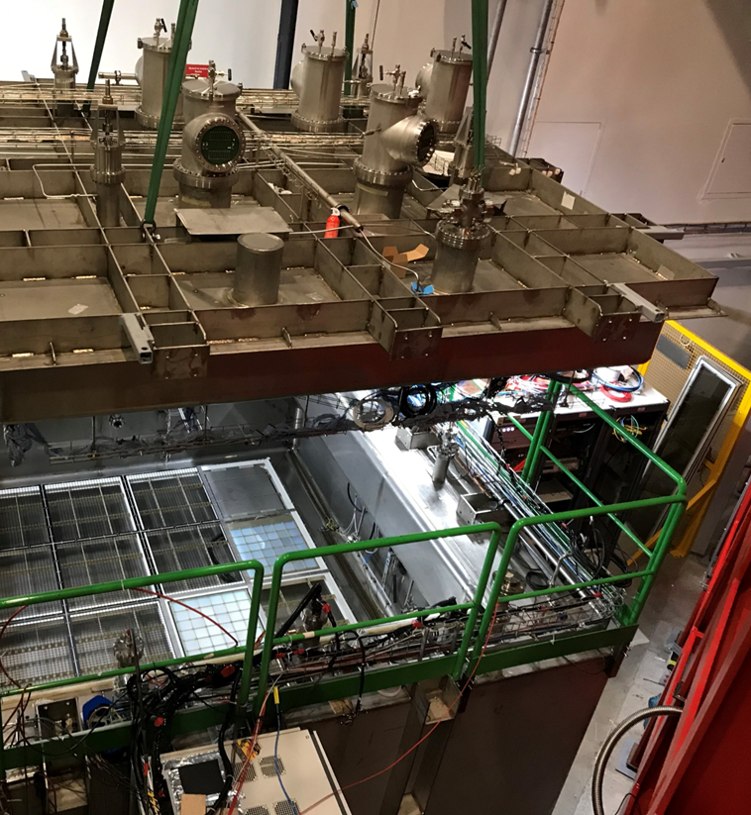
CERN COLD BOX – GOOD but ‘room’ for improvement

Slide 4
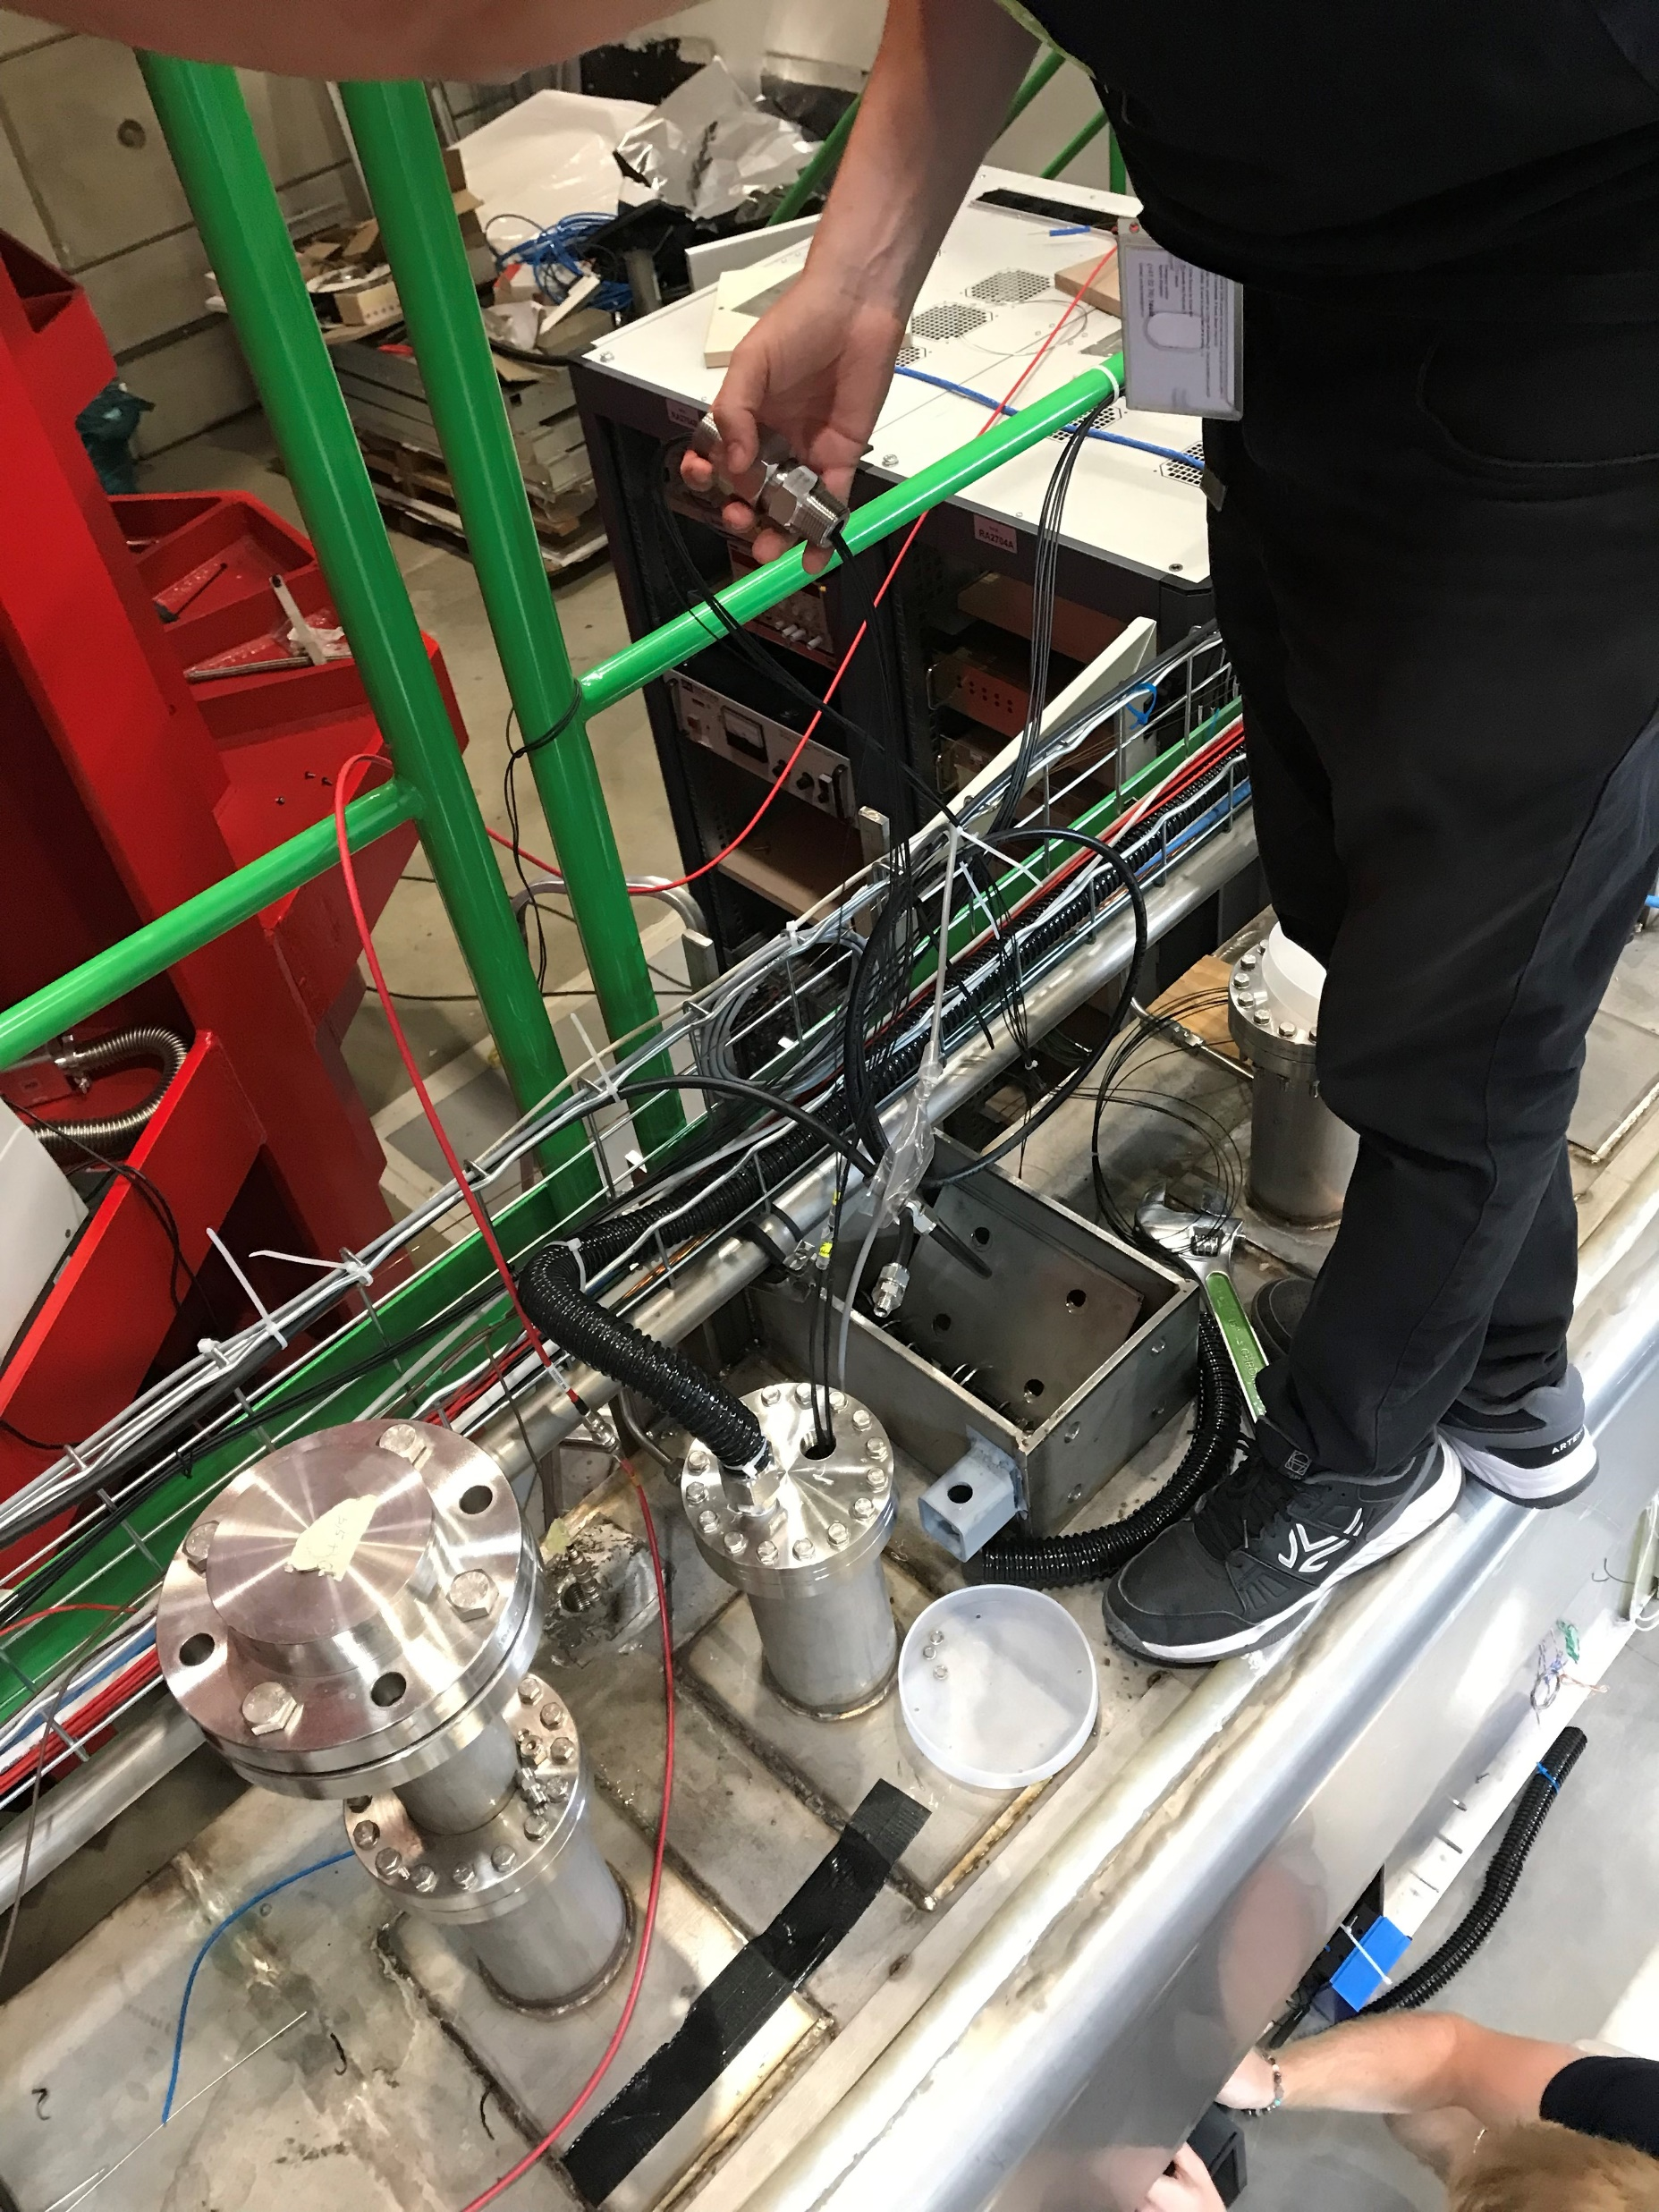
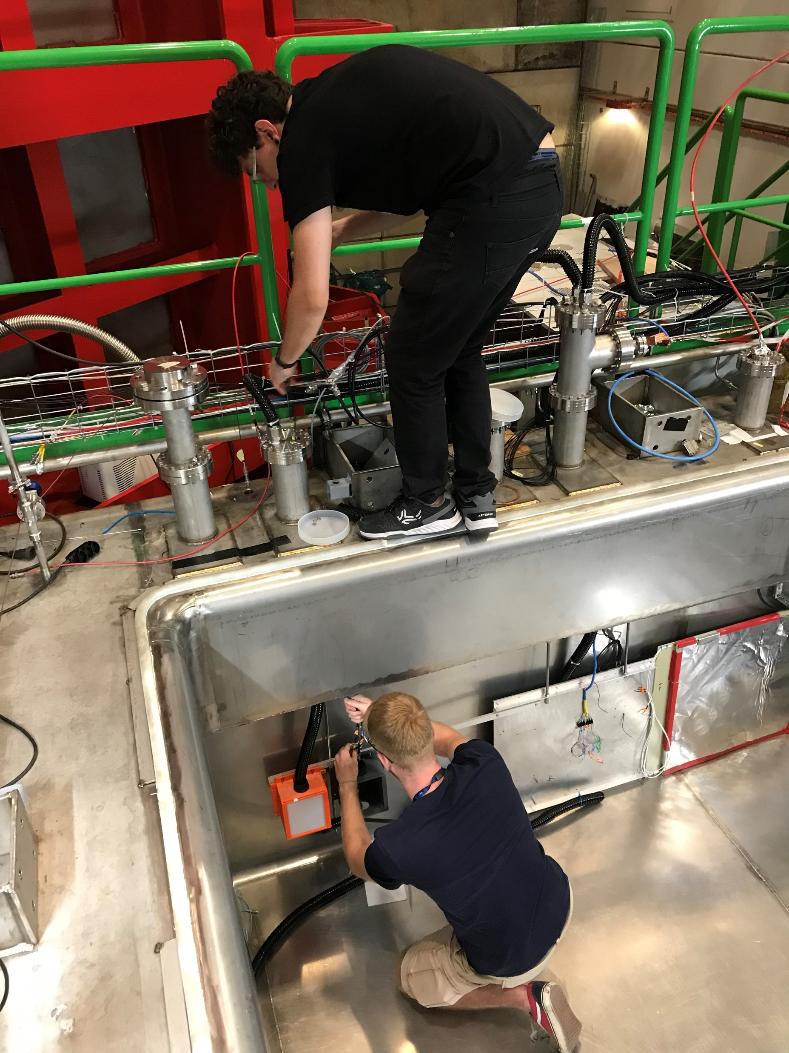
Trying to Avoid –
Lessons Learned
Space around the edge
Access to the feedthroughs
Edge Sealing
Storage for Top cap
Lighting
Access to benches and tools
Faster turnaround

Slide 5
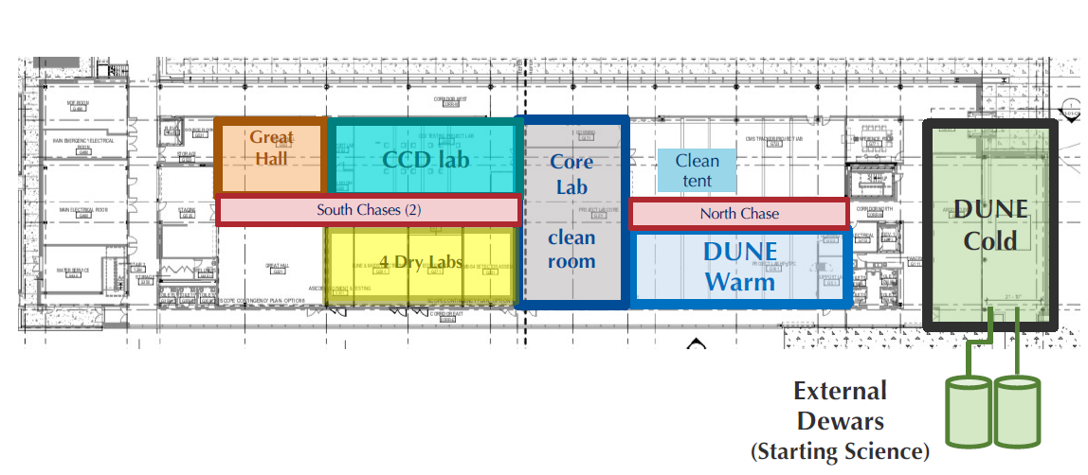
Ground Floor of IERC

Slide 6
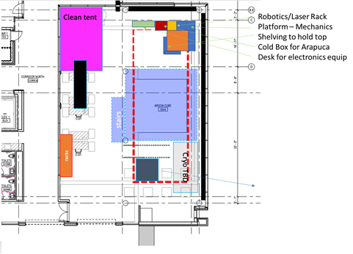
Arapuca
Assembly
This is a shared area and after months of negotiations an agreed upon layout has been approved.
Primary Users:
DUNE Near Detector Module Assembly and Test Facility (MATF)
Robotic – cryogenic capabilities lab
DUNE Far Det Cold Electronics Testing

Slide 7
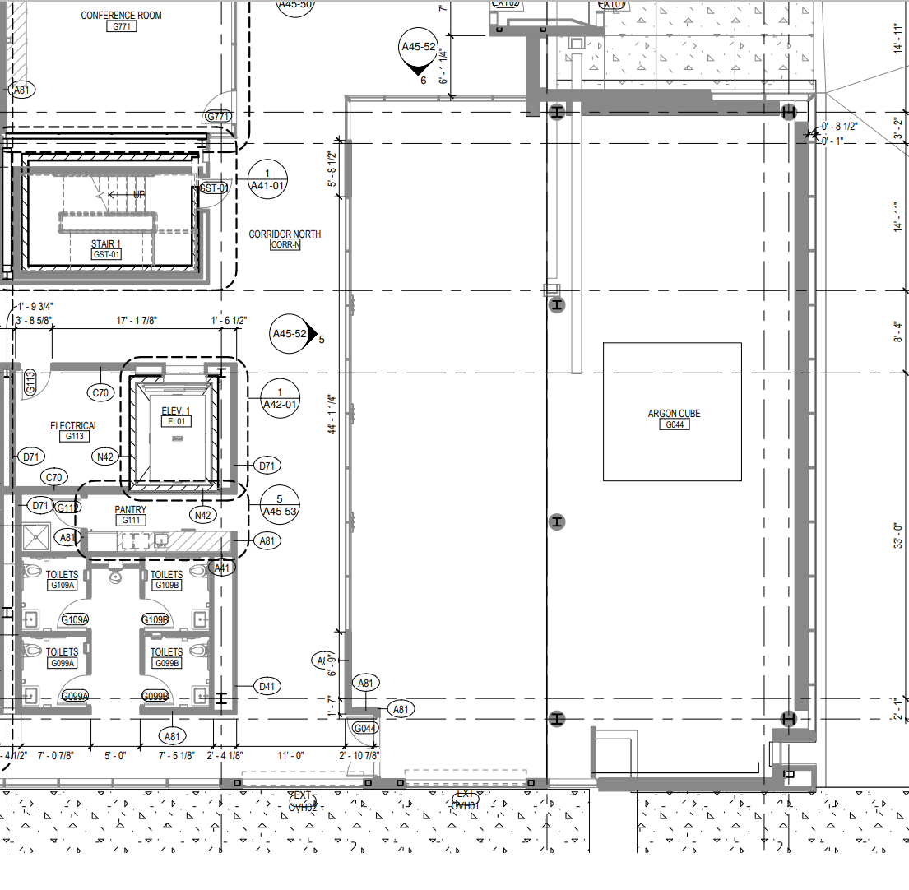
DUNE COLD AREA
Still working on clean room spacing needs
Lab desk spacing – access to power, cryogenics, and lab grade gas
Building ground and Power layout – carefully done for clean power
Potential area to build a cold box:
Need to negotiate space and use near the planned ‘pit’ area.
This area will have the necessary ODH, cryo plumbing and space for racks and test equipment.
However – a shared area will always have limitations.
We would like to have a space where collaborators working on harsh (cold) environment robotics can come and work.
A showcase for this shared effort –
Universities, DOE labs, and NASA
Clean Room
Lab Desk
Area

Slide 8
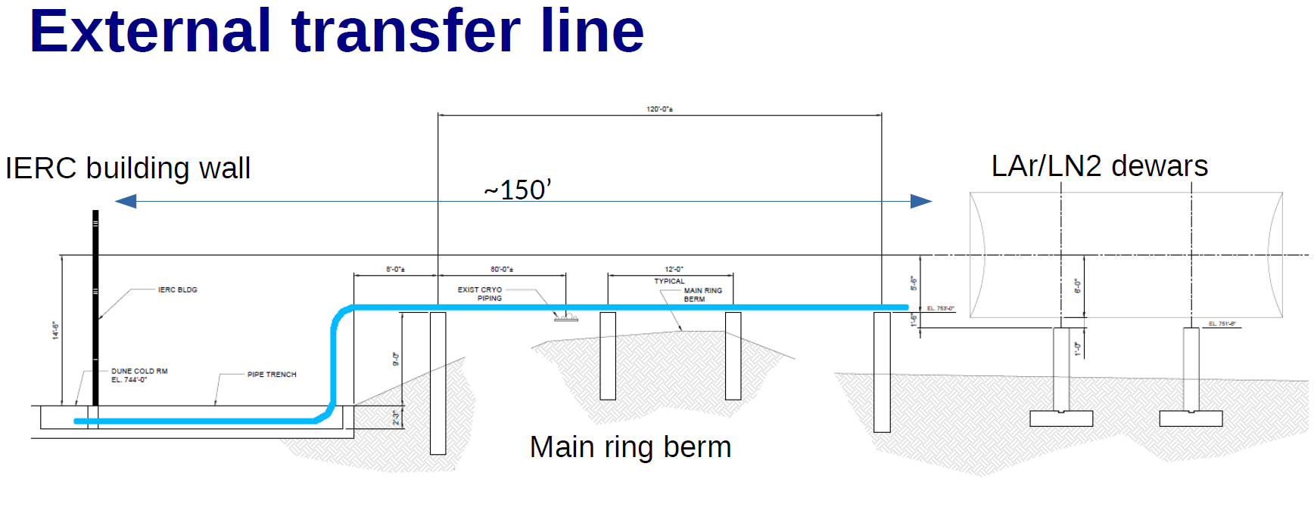
When will we fill and start testing –
When the cryo lines are done –
Next Spring

Slide 9
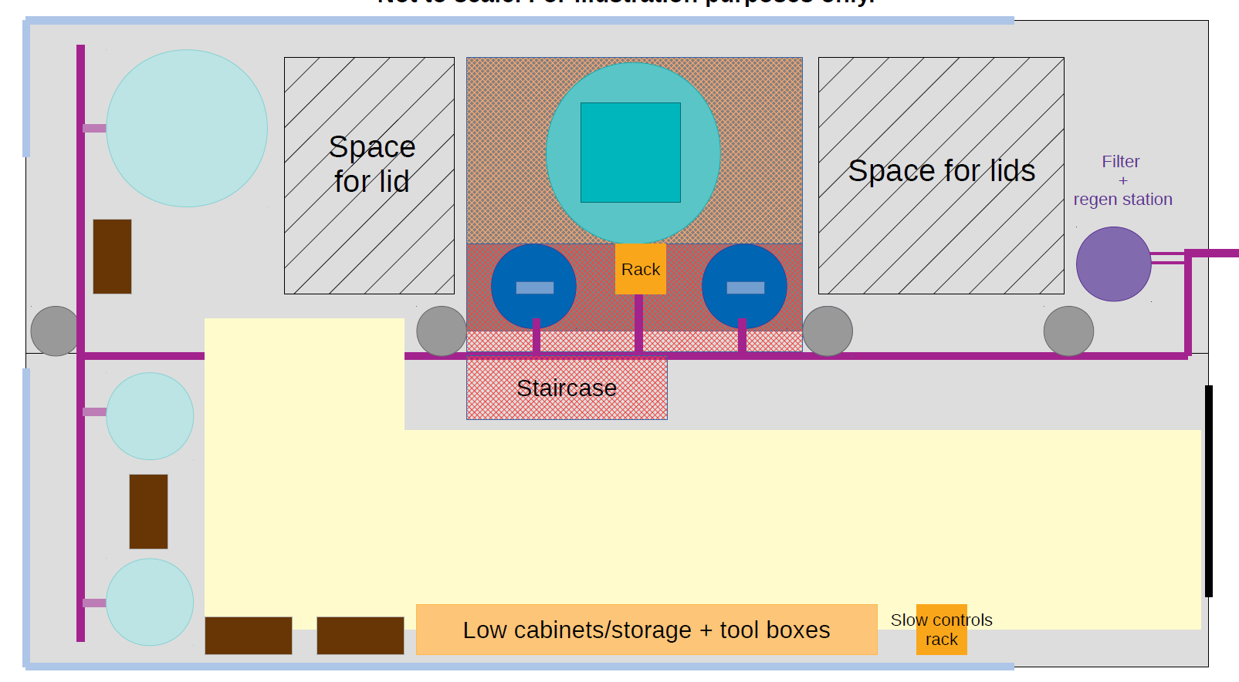
The Argonaut Cold Box
Needed to accommodate IERC Needs:
Near Detector Cube Work
Clean Room
Assembly Area
Cryo Lines
Power Troughs
Crane Use
Looked at this area
Pit
Argonaut
Cold Box

Slide 10
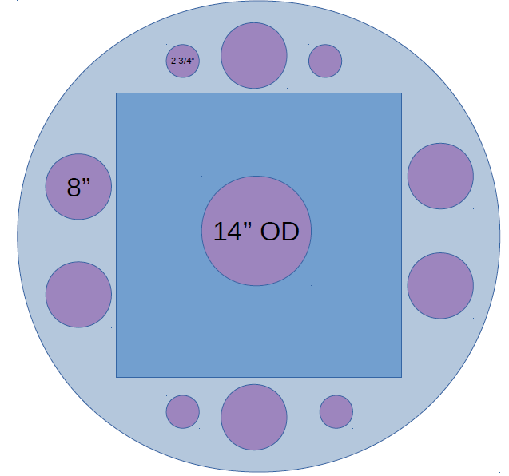
● Generic design to maximize usefulness
● On utility lid (usually not removed)
● Flanges for experiments: up to 5x 8” flanges
● 1x 8” flange for purity monitor
● 4x 2 3/4” flanges for instrumentation (sampling lines, RTDs, level meter, pressure gauge,heater, etc)
● On physics lid:
● 1x 14” OD flange
→ window, future TPC, HV FT, etc.
● On both lids: bolts/rods to allow attaching mechanical supports for devices that need to hang from the lid.
Removable Lid

Slide 11
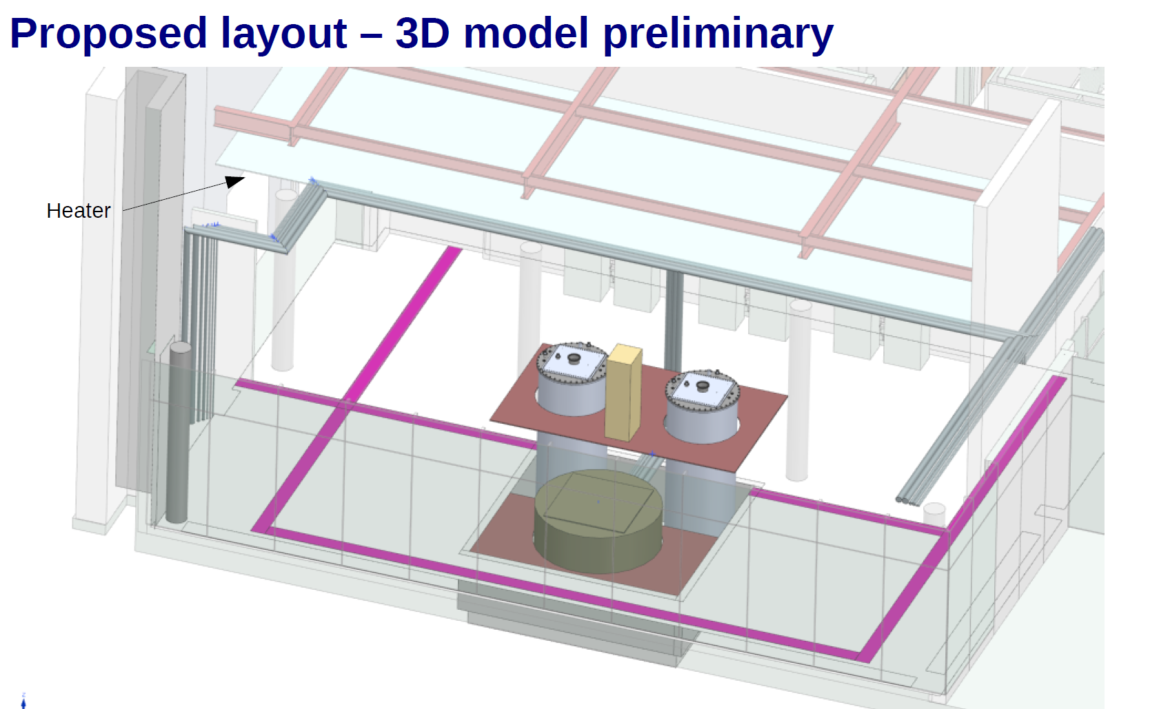
The design will allow easy and safe access around the vessel for connections.
The design will have fill lines from the south end near the cryo plumbing.
Initially nitrogen – but capable in the future of argon fill.

Slide 12
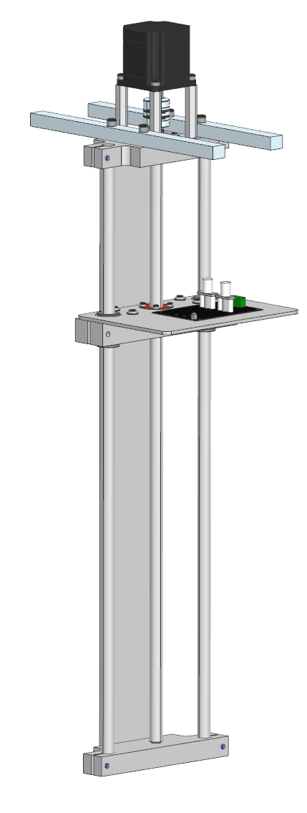
Mechanical Highlights
Liquid Level
Liquid Level
The system is being designed to operate with two guide rods attached to a membrane wall/floor. The drive motor will not be in cryo but in the gas phase near the top of the detector. Ideas presented by members of TD cryo offer several suitable arrangements/locations for such a motor placement. The spooling of fiber will also be located at the top. There are options for the spooling that allow for placement in both vertical or horizontal arrangement.
The platform can accommodate two camera systems, RF detector and all the required digitizing hardware.
The weight is not an issue and will require a small motor with some tension wires to assist in cable guidance and movement.
Uses two PoF to deliver 1.5 Watts
Uses FPGA – to digitize

Slide 13
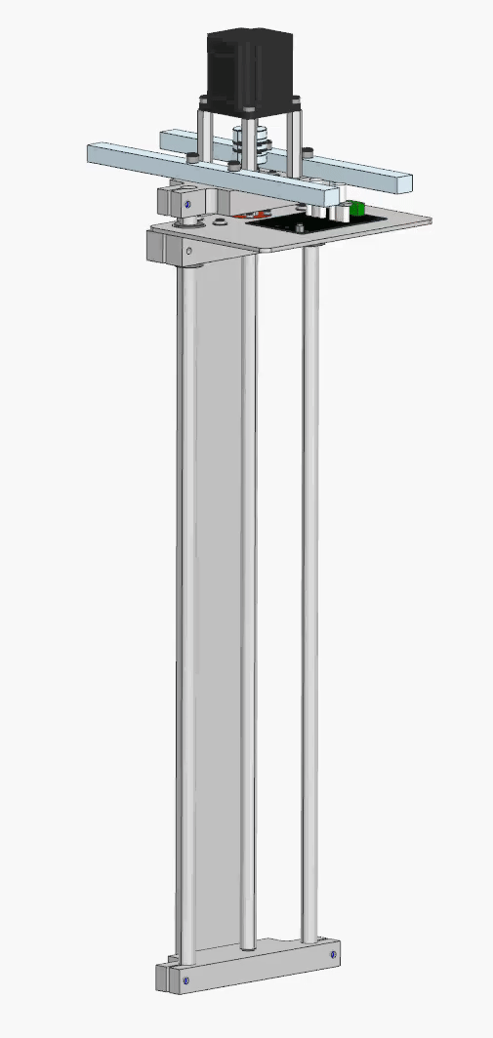
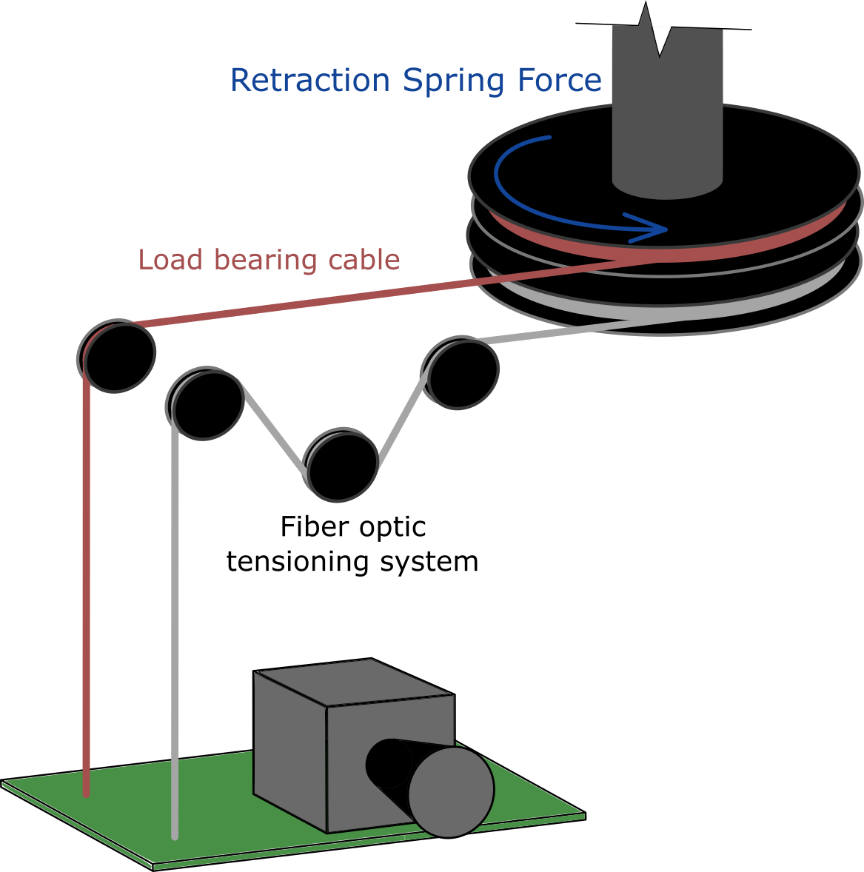
Mechanical Motion
Soon To be tested in a small 2 Meter setup (fiber and platform and electronics on hand)

Slide 14
Initial diagnostics –
Camera and RF detector
We are still working towards a cold cmos sensor suitable to run without heating or housing
  Two vendors: Sony and Teledyne have interesting cmos sensors
  Teledyne has been more receptive to discussing our needs.
    We are looking at a low power option
    Using our FNAL tested digital to fiber communication (recently at CERN)
      750 mW – is high but the system is not optimized – inefficient DCDC and other items need work – goal of .5 W
    Simple pi and nano cameras – have been tested
      Current too high, components not well match to cryo (caps are not npo, clock osc tunes out of range etc….
      Could redesign and swap components or build from ground up – so we are doing both (two different groups
  RF noise – expected to develop via voltage breakdown – help shutdown system prior to arc.
    A dipole antenna is being designed to cover a broad spectra -

Slide 15
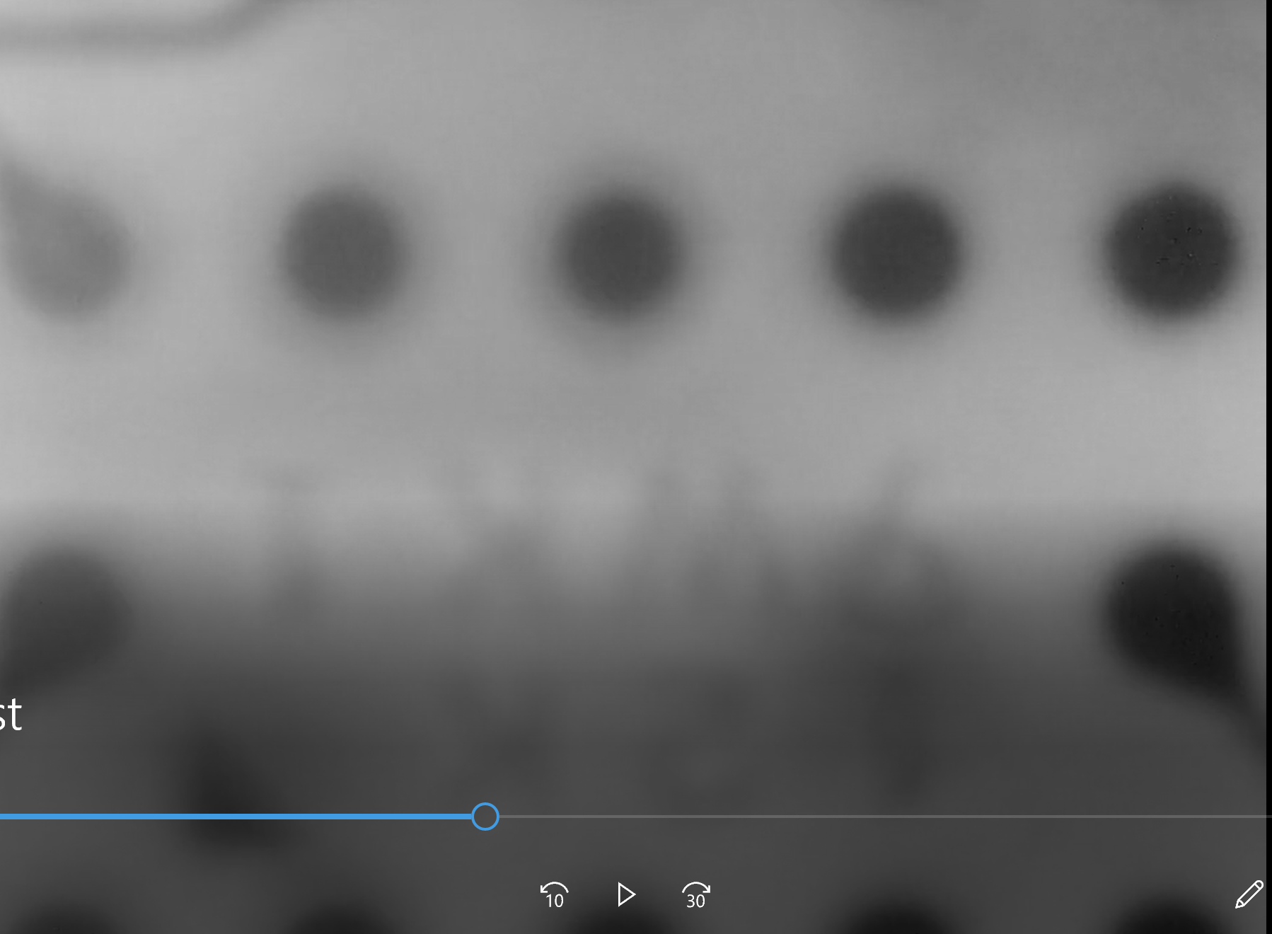
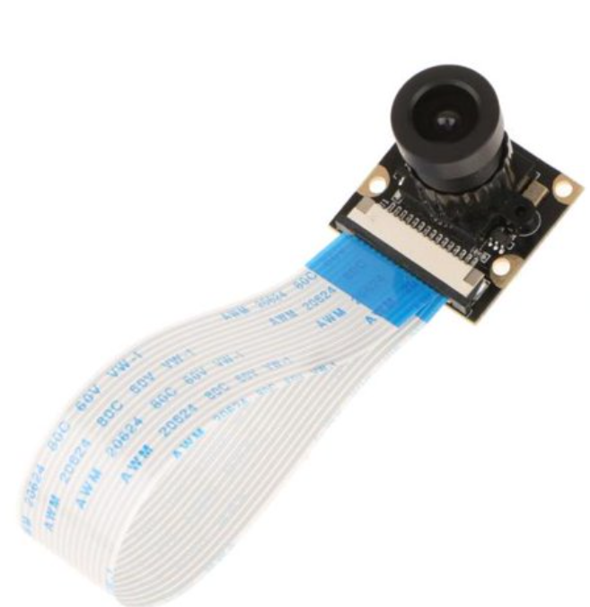
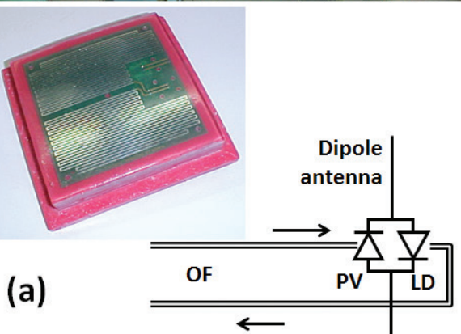
Initial Diagnostics
Camera had several components replaced – still not working as needed but making progress
A video frame of cold camera
Camera struggled to stay in sync
But clearly operated at cryo temp after some changes in components

Slide 16
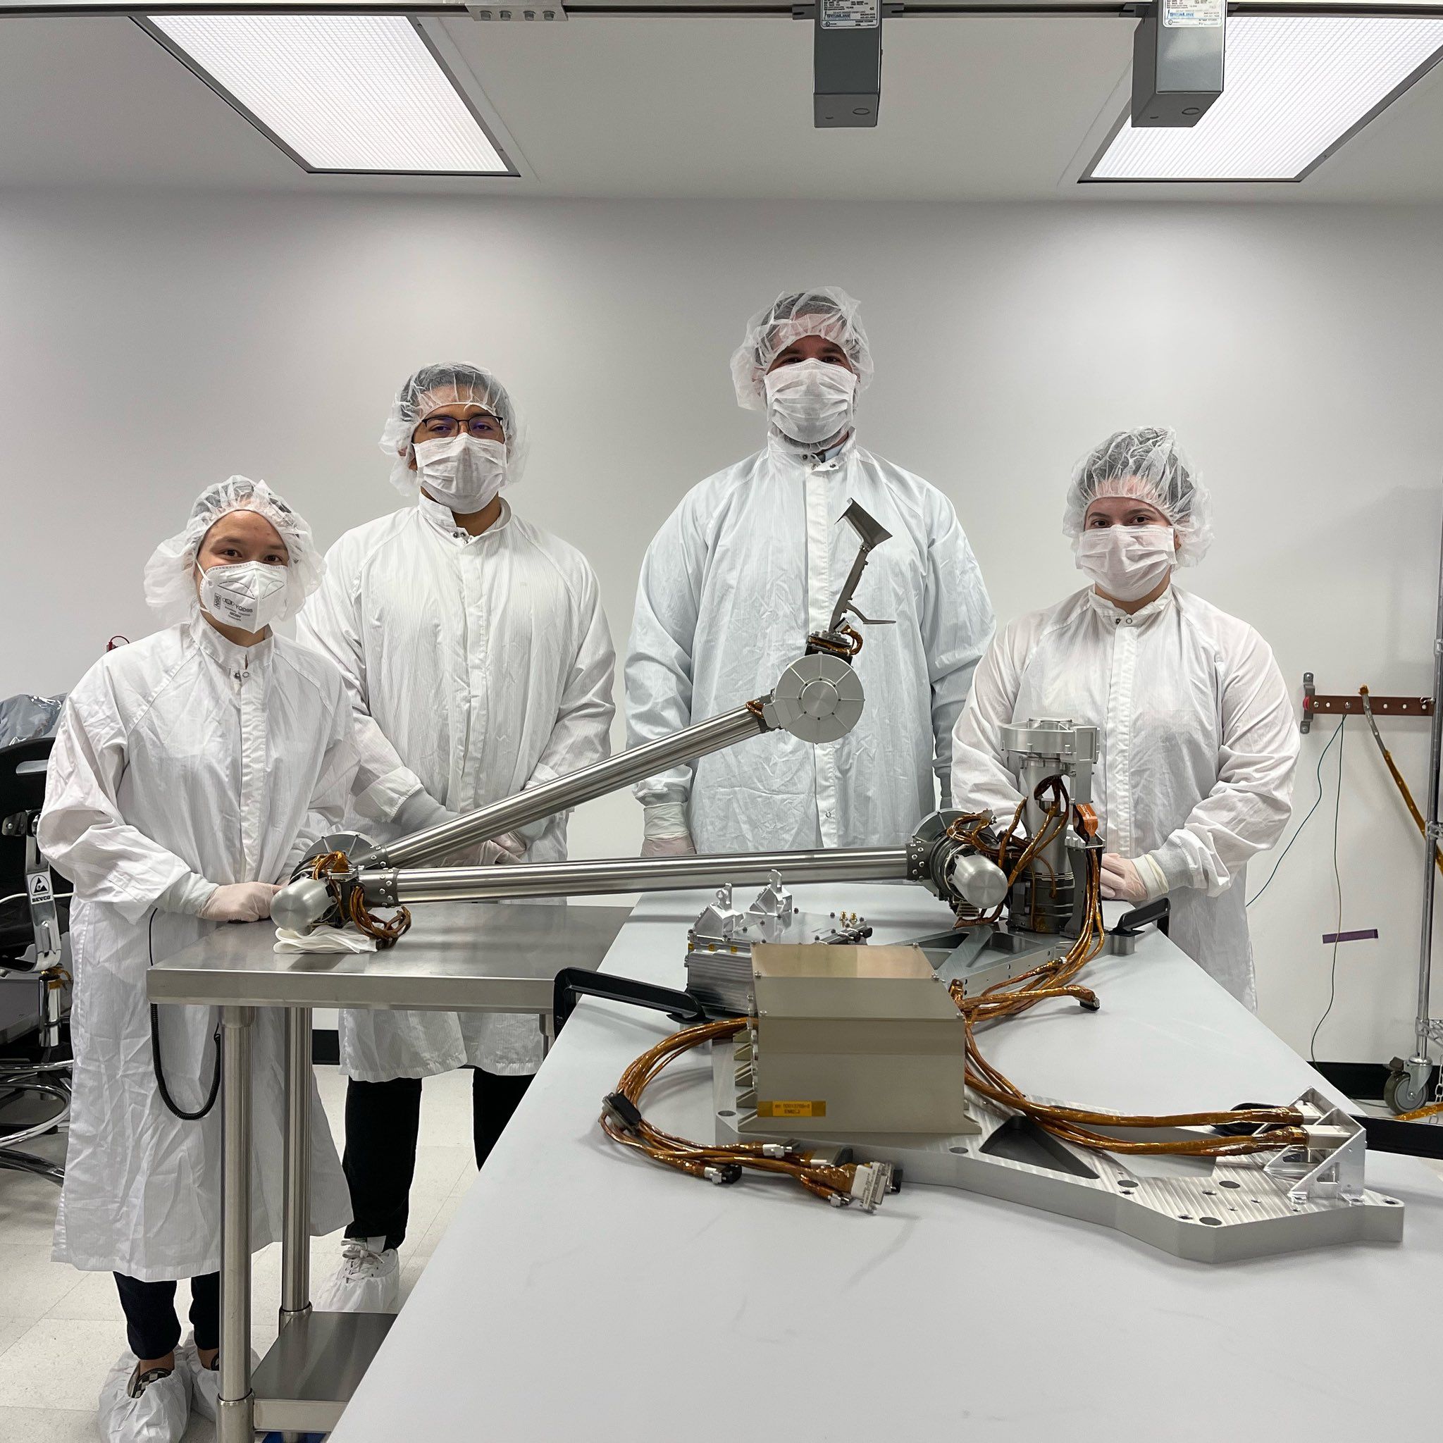
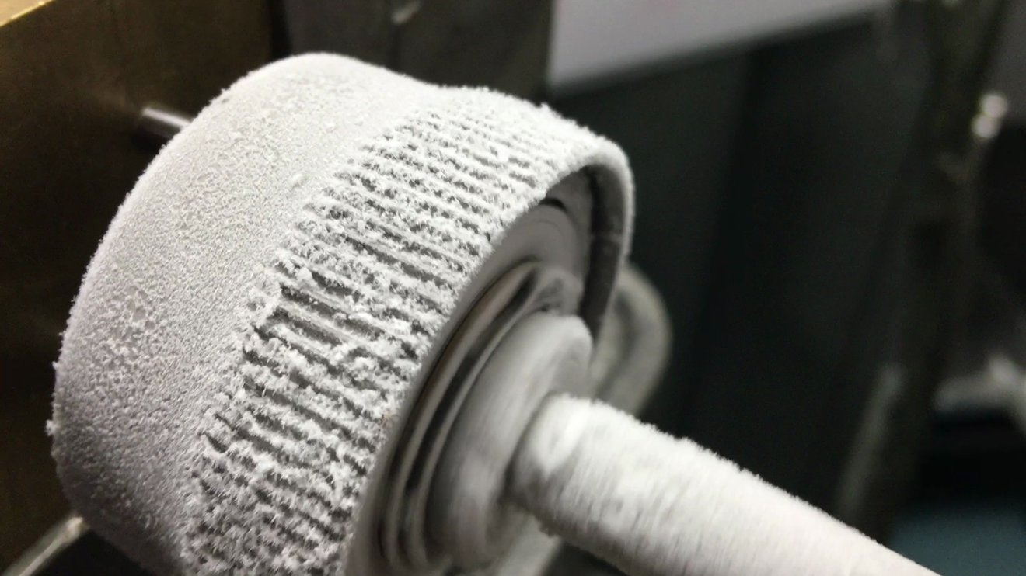
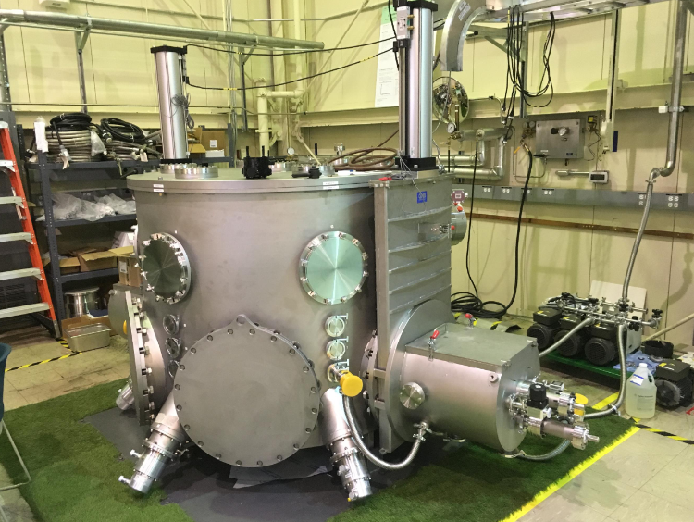
Sample of Recent Partner Cryo-Capable Investiments
COLDArm
  Developed under NASA’s return to the moon program (Artemis).
  Capable of operating at <100 K using custom motor controllers and actuators
Bulk Metallic Glass (BMG) Gears
  Can be run cold and dry (no lubricants)
  Do not become brittle in cryo environments
CITADEL
  Short-term cryo-vac test chamber
  Enables testing on icy simulants
  2 DOF manipulator arm inside
COLDArm
BMG Gears
CITADEL

Slide 17
extra

Slide 18
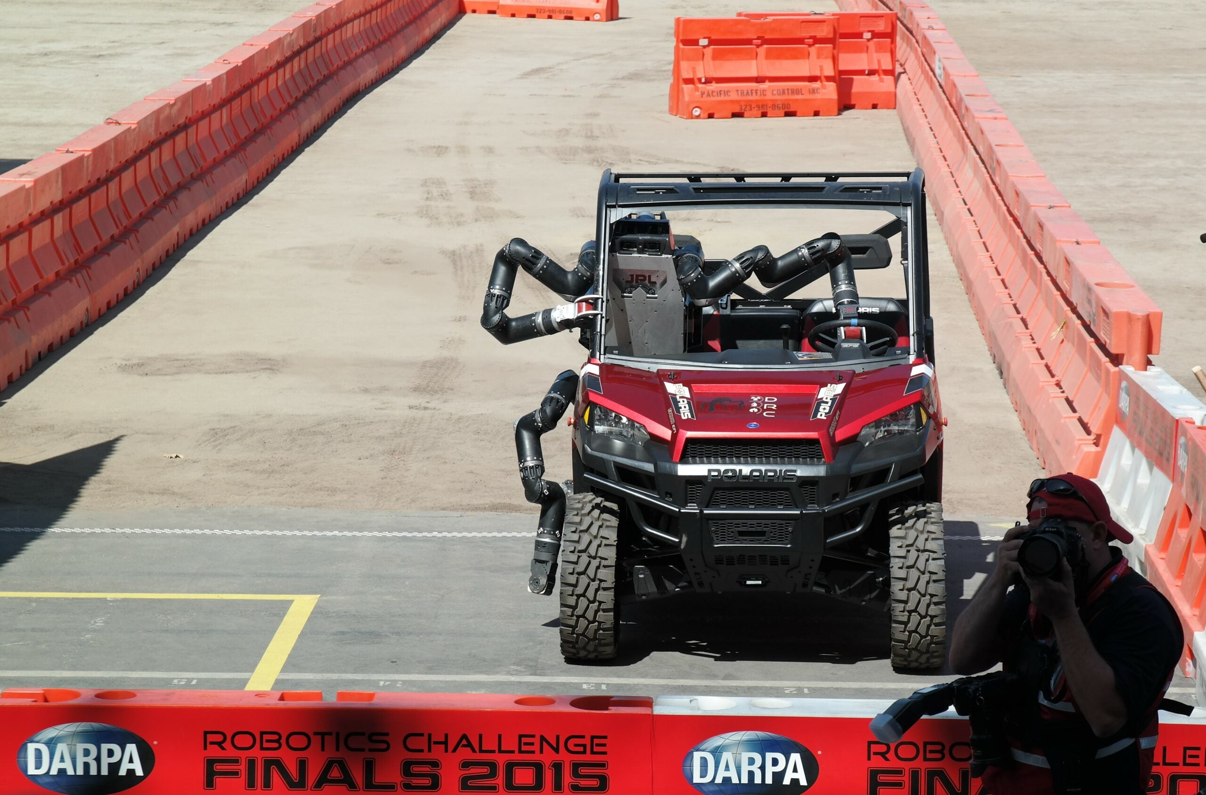
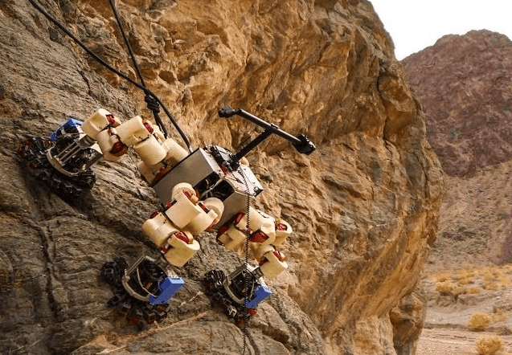
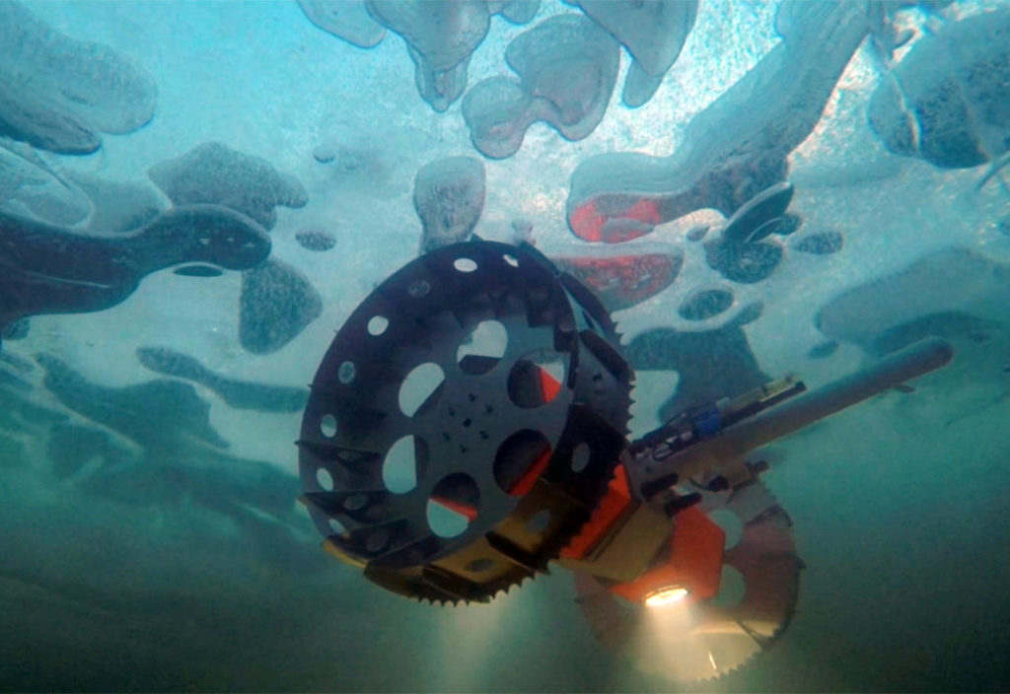
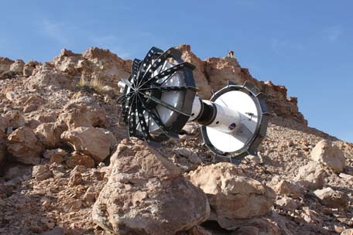
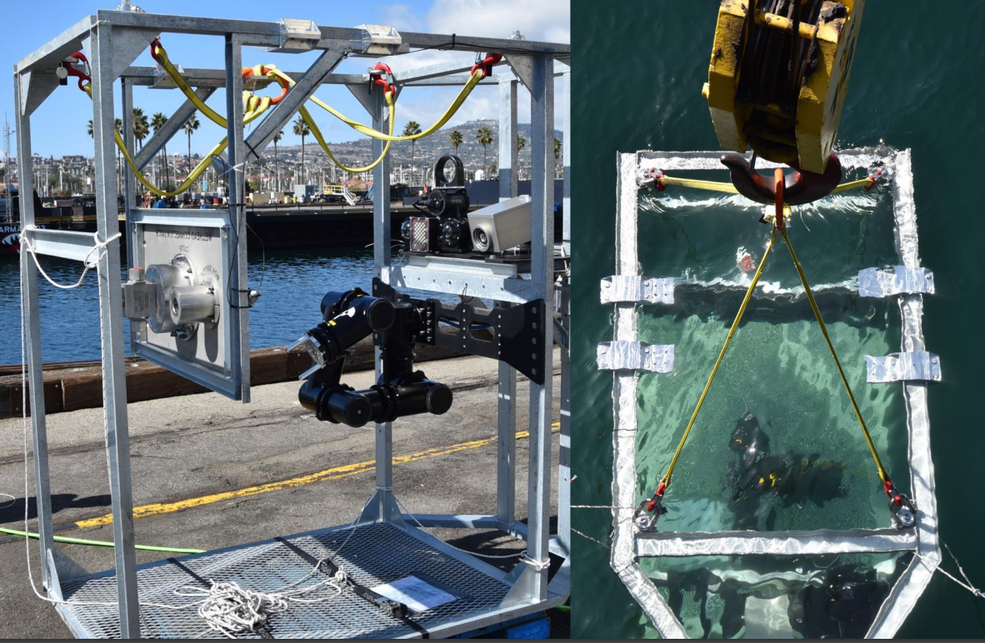
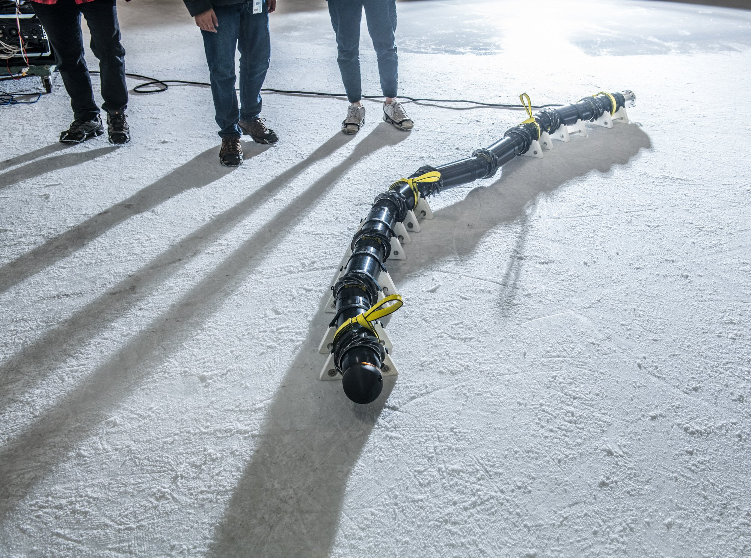
JPL Robotics Overview
JPL has a rich history of providing first-of-their-kind ground-robotic systems, including: Surveyor 1-7 lunar landers, Viking 1-2 Mars landers, Sojourner Mars rover, Mars Exploration Rovers (Spirit & Opportunity), Phoenix Mars lander, Curiosity Mars Rover, InSight Mars Lander, Perseverance Mars Rover. In addition to its flight successes, JPL has developed many research robotic platforms that will enhance NASA’s future exploration capabilities; a sample of these robots surround this text.

Slide 19
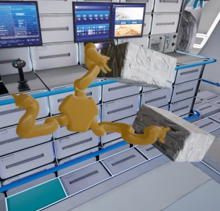
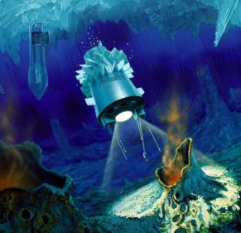
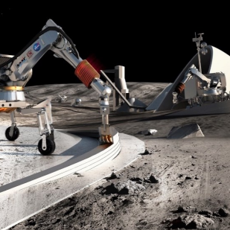
Identified Technology Development Needs for this Decade
Resilient robotic technologies are needed to support both intra- and extra-vehicular activity, inspection, and maintenance of assets and habitable volumes
Fault-tolerant, fail-operational robotic systems are required for high-tempo, deep space missions
Lunar robotic systems are needed to tolerate multiple day/night cycles and survive in permanently shadowed regions (<100 K)
Contamination control

Slide 20
Future - Plans
Once we know the cost – we will know what we can purchase for hardware.
Once we have a vendor start to build, we will have a fixed cold box and can complete our mechanical structures to match.
Once we have a usable space – we will look to ramp our partnerships.
  JPL visited IERC and we talked about options.
  Mechanical arms that could work in the space.
  Others who might join in the testing.

