Slide 1
Pulsed Neutron Source (PNS) for Photon Detector System (PDS) calibration
Ajib Paudel (On behalf of the PNS calibration group)
DUNE Far Detector 3 Mini-workshop: Toward a Combined Photon Detection and Field Cage System
June 28, 2023

Slide 2
Outline
Photon Detector System(PDS) as an energy calorimeter
Pulsed Neutron Source (PNS) for PDS calibration
Prior developments in PNS calibration:
More details in:
  Jingbo Wang's DUNE collaboration meeting talk
  Walker Johnson's Dune Collaboration meeting talk
  Nicholas Carrara's DUNE collaboration meeting talk
Deploying PNS in ColdBox Module 1 run
Summary

Slide 3
PDS as a calorimetric tool:
Liquid Argon detectors have predominantly used PDS for event time (t0) reconstruction
SoF and PoF technology → better PDS coverage → improved uniformity in Light collection
We are now more prepared to use PDS for energy reconstruction
In addition to realistic simulation, we need a standard candle for energy scale determination
Next few slides will describe why Pulsed Neutron source could be a practical calibration source for PDS system like DUNE-FD2 and same applies for FD3
Fig: Energy resolution as a function of deposited energy for DUNE-FD2 simulation using PDS system

Slide 4
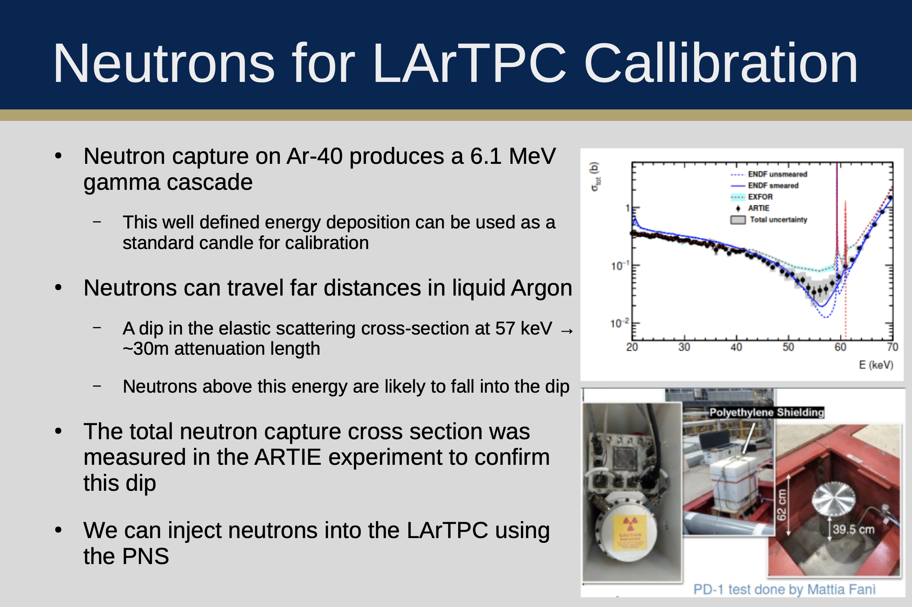
Slide from Walker Johnson

Slide 5
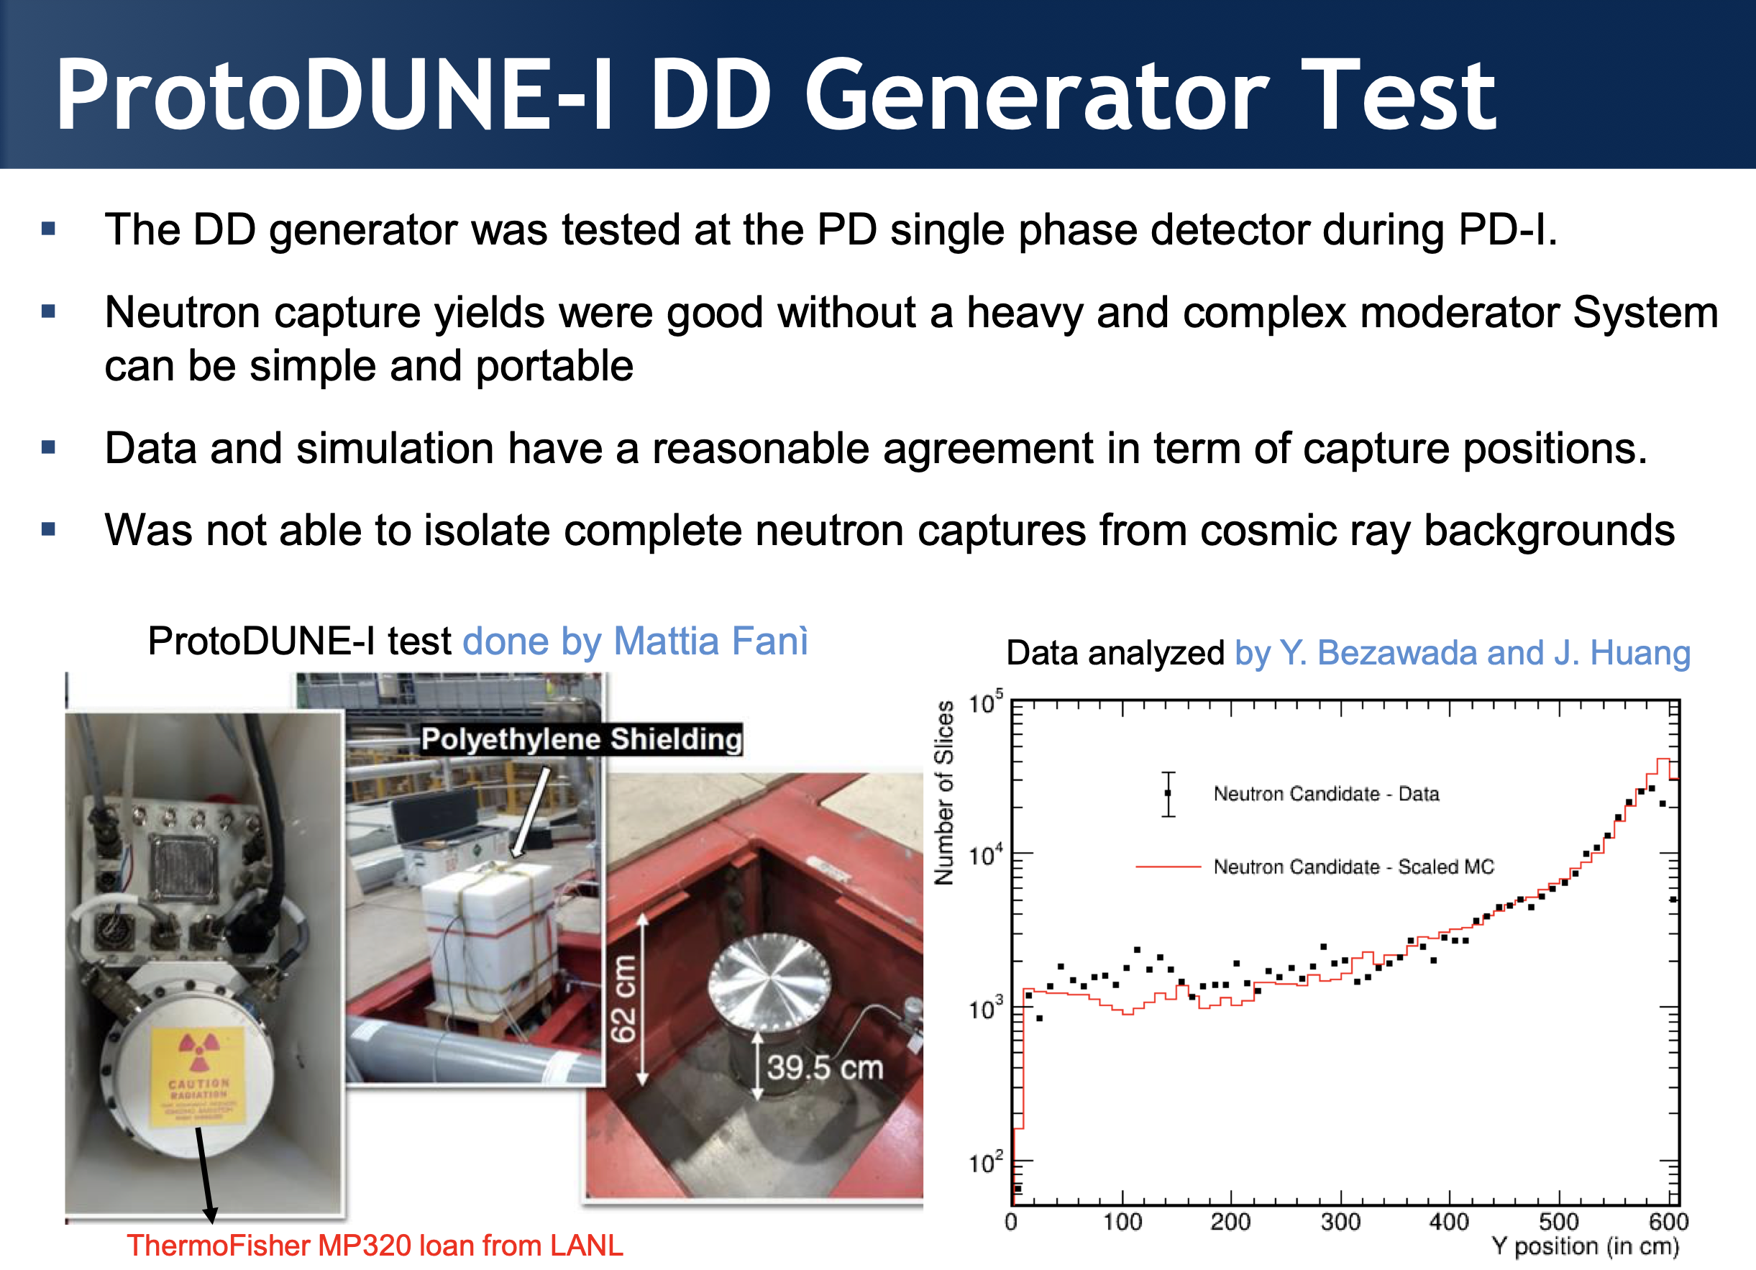
Slide from Jingbo Wang

Slide 6
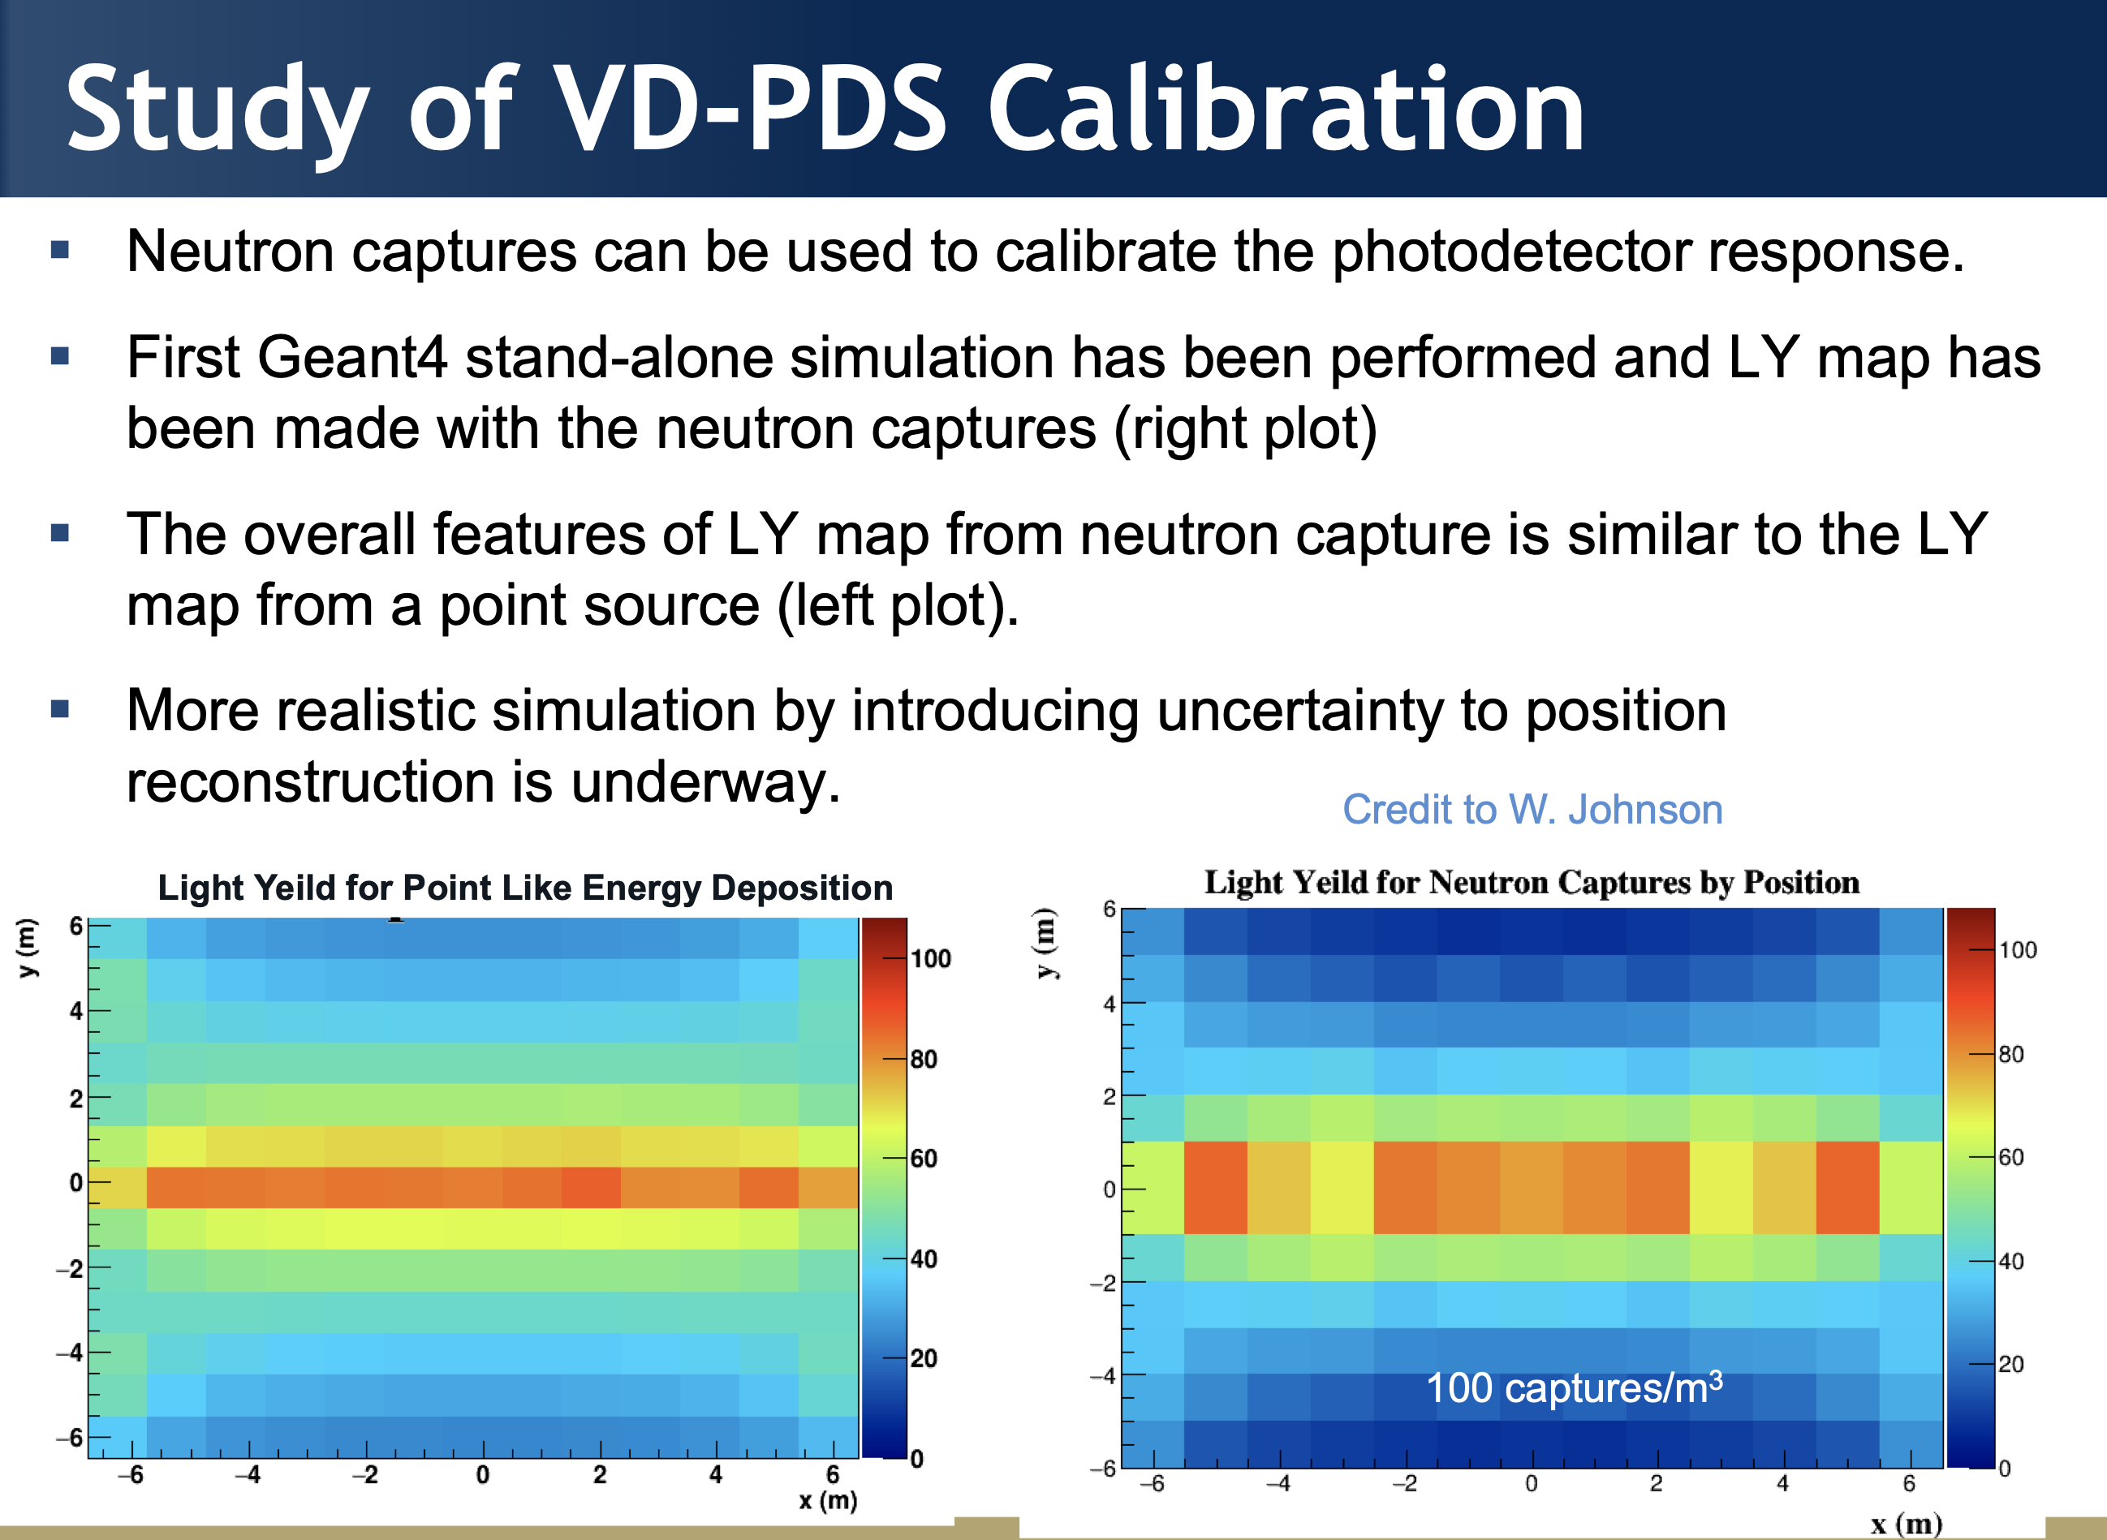
[Note: It’s not the latest stand-alone simulation, just showing to compare the LY from point source and neutron capture]
Credit to Laura, Franciole

Slide 7
Next Steps + Ongoing studies [PNS VD-ColdBox run]:
Geometry file for VD ColdBox at CERN available (for first coldbox run)
Photon simulation (in LArSoft) was also carried out to study Light Yield
However, there have been a many changes to the PDS configuration since the first run
Work is undergoing to modify the geometry file to reflect the configuration planned for module 1 run
Simulate neutron captures to obtain a light yield map
Use the neutron generator to take experimental data
Compare data-simulation (will validation simulation parameters and a major step forward)

Slide 8
PNS run in ColdBox:
Neutron generator used for ProtoDUNE-SP (I) is at SDSMT and additionally a new neutron generotor have been procured recently
Need more discussion on the detailed run plans
As the cold box is on surface isolating neutron capture events from cosmic ray contamination will be challenging. However, it will be interesting to see if we can exploit PDS’s excellent timing resolution capability to isolate neutron capture events with high purity.

Slide 9
Summary:
PNS can be a viable tool for calibrating photon detectors (simulation and proposed coldbox run will give more insight)
A physics calibration run is very important to understand the detector performance and will be a big step forward to understand our detector capability
Combining PDS and CRP data for the study will be ideal. However, only PDS data will also give a lot of information.
We have a slack channel to discuss the PNS-PDS calibration, which is a good platform to bring up discussion (vdpdscalibration).
THANK YOU

Slide 10
BACK UP SLIDES

Slide 11
