Slide 1
Noise in electron bunches
Preliminary data taken on 04/25/2023
Jinhao Ruan, Randy Thurman-Keup, Andrea Saewert
Analysis by Sergei Nagaitsev

Slide 5
Signal dependence with different filters

Slide 6
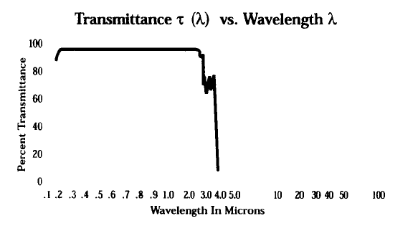
Light transport from the OTR screen to photodiode
2 Al parabolic mirrors
1 Al flat mirror
5 Silver flat mirrors
Vacuum viewport: SiO2 (fused silica) glass

Slide 7
Filters on hand; Product type: rectangle 10mm x 10mm
770 nm: https://opticalfiltershop.com/shop/bandpass-filter/nir-bandpass-700nm-to-1100nm/nir-bandpass-filter-770nm-fwhm-100nm/
840nm: https://opticalfiltershop.com/shop/specialty-filters/lidar/nir-bandpass-filter-840nm-fwhm-100nm/
960 nm: https://opticalfiltershop.com/shop/bandpass-filter/nir-bandpass-700nm-to-1100nm/nir-bandpass-filter-960nm-fwhm-100nm/
1070 nm: https://opticalfiltershop.com/shop/specialty-filters/lidar/nir-bandpass-filter-1070nm-fwhm-125nm/
1180nm: https://opticalfiltershop.com/shop/bandpass-filter/swir-bandpass-filters-1-1um-to-3-0um/swir-bandpass-filter-1180nm-fwhm-120nm/
1361 nm: https://opticalfiltershop.com/shop/bandpass-filter/swir-bandpass-filters-1-1um-to-3-0um/swir-bandpass-filter-1361nm-fwhm-75nm/
1424 nm: https://opticalfiltershop.com/shop/bandpass-filter/swir-bandpass-filters-1-1um-to-3-0um/swir-bandpass-filter-1424nm-fwhm-80nm/
1575 mn: https://opticalfiltershop.com/shop/specialty-filters/lidar/swir-bandpass-filter-1575nm-fwhm-75nm/
1700 nm: https://opticalfiltershop.com/shop/bandpass-filter/swir-bandpass-filters-1-1um-to-3-0um/swir-bandpass-filter-1700nm-fwhm-85nm/

Slide 8
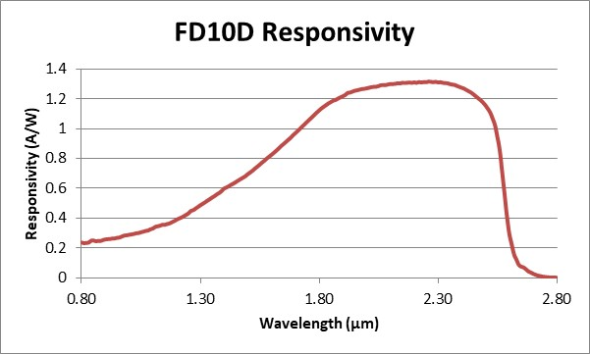
Amplifier circuit
From Andrea’s calibration data it looks like the effective capacitance is actually 3 pF

Slide 9
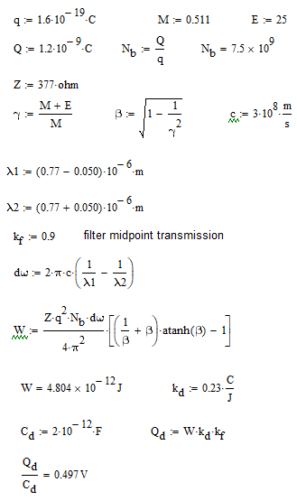
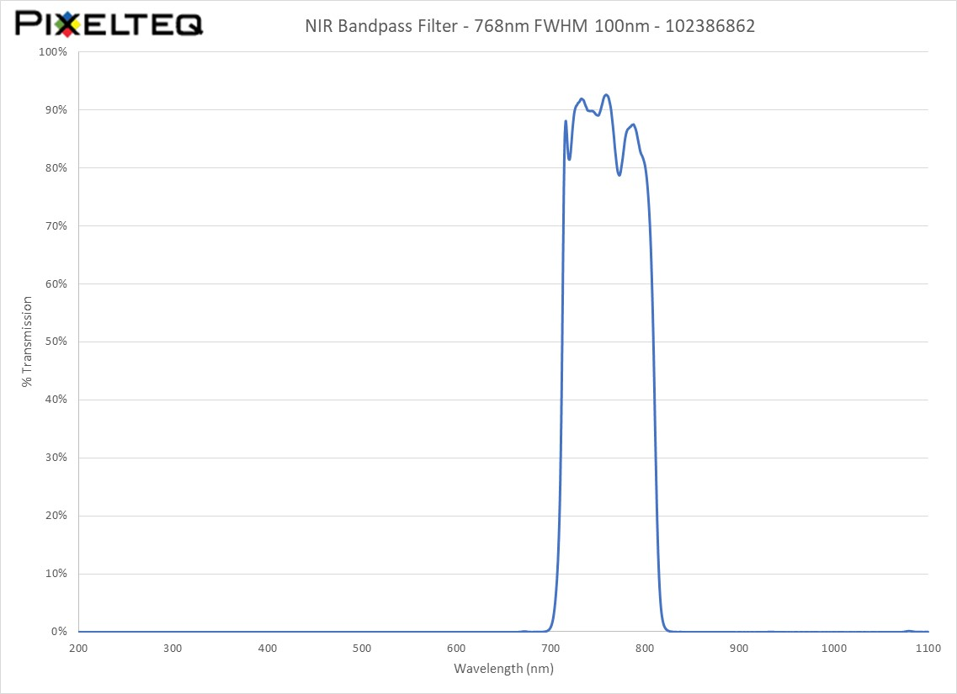
At 770 nm

Slide 10

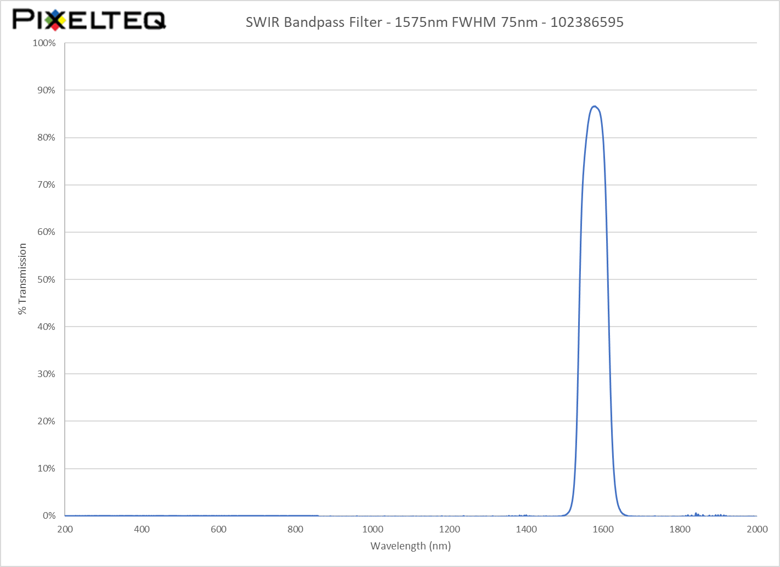
At 1575 nm

