Slide 1
2x2 Network and Computing Status
Geoff Savage
04 June 2023

Slide 2
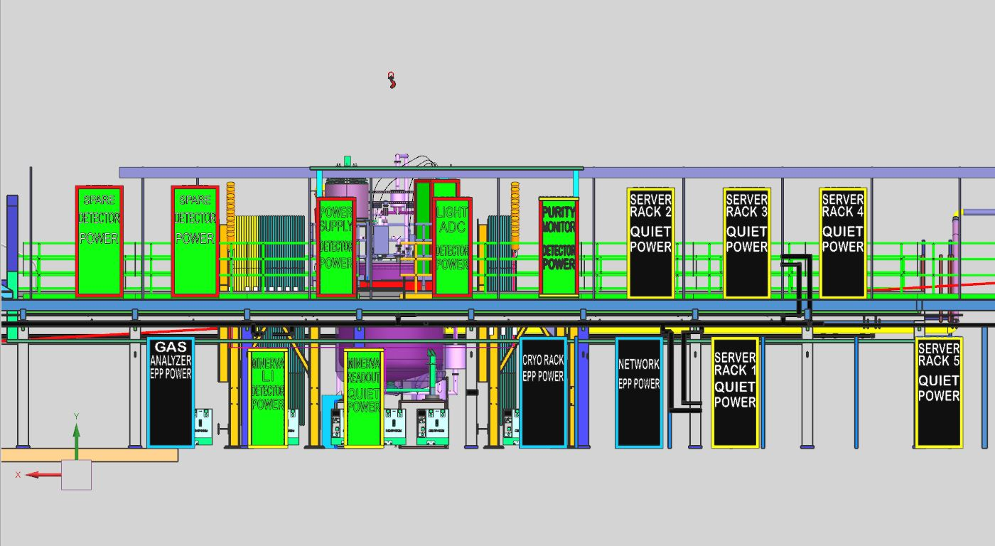
2x2 Rack Locations – Final???
Beam Direction

Slide 3
2x2 Rack Locations
Platform rack hidden behind light adc rack in this view.
Beam Direction
Not all racks in the image are scheduled to be installed for the initial phase of 2x2.

Slide 4
Rack List
Electronics
Purity Monitor
Light ADC
Power Supply
HV Filter and Light VGA (on platform)
Server Racks
Server 1,2,3 for 14 Linux servers
Server 1 rack – 48-port 1 Gb copper switch for all Linux servers
Server 2+3 racks have no network switches
Server 4+5 racks are for expansion if needed
Electrical outlets will be installed but not used right away
Network rack
Main switch (router) – 48 port SFP+
Cryo rack
Minerva
Light Injection (LI)
Readout

Slide 5
2x2 Rack Locations
Beam Direction

Slide 6
2x2 Rack Locations
Beam Direction

Slide 7
Upper Wire Way Outlets
L6-20-R Outlet
not 30A

Slide 8
Outlets Over Network Rack

Slide 9
Overview
Minerva readout is working (Server 1 rack)
Two gateway servers
Two DAQ servers – connect to Minerva VME readout crate
24-port network switch installed in server 1 rack (borrowed)
Network fuse panels in Minerva LI rack are on the network
2x2 Networking
Switches are here
Ordered 17-Oct-2022
PO 693151
Most cabling is in hand
RITM1635011 - Cabling for 2x2 demonstrator network installation in Minos underground
What we are missing has been ordered by Networking
Transceivers are available
Installation
Only have power for the Network and Server 1 racks
Requested installation of the router and 1 Gb switch sometime in the the first two weeks of June
Not sure of the status with the safety stand down and illness of group leader
2x2 Computing
Servers are on site
2x2 DAQ (5) – 4 DAQ and 1 slow controls
Minerva DAQ (3) – One used for nearline
Operations (4) – new gateways and remote desktops
Already have two gateways installed in Server 1 rack

Slide 10
Cabling (not to scale)
Electrical Requirements:
Fiber separates grounds.
No copper between racks on different power.
Fibers from racks go
back to Network Rack.
Within each rack copper
from 12-port switch to
each device.
Cryostat
Platform Rack
Detector Power
48-port managed switch
Light ADC has
independent network.
x4 for
light
Power Supply
Detector Power
12-port managed switch
Light ADC
Detector Power
12-port managed switch
Purity Monitor
Detector Power
12-port managed switch
Server2
Quiet power
AC2x2 DAQ servers
Server3
Quiet power
AC2x2 DAQ servers
Key:
10Gb copper
x9 for
light
1Gb copper
fiber
catwalk
Trunk
Fiber
Minerva LI
Quiet power
copper from server 1 rack
Minerva Readout
Quiet power
no network devices
Cryo Rack
EPP power
Computer
UPS
Network
EPP power
48-port router
SFP+ ports
UPS
Server1
Quiet power
Minerva DAQ servers, gateways
48-port managed switch 1 Gb copper
MND 102
No Power

Slide 11
2x2 Demonstrator Network (Logical)
Network Rack
(Router)
Server 1 Rack
2x2 Private
(1Gb)
2x2 Public
(10 Gb)
2x2 Private
(10Gb)
Light Readout
(10 Gb)
LRO VME (x9)
2x2 DAQ (x4)
Light ADC Rack
Server 2 Rack
Slow Controls
Light ADC
Server 3 Rack
Power Supply
Minerva (x3)
Uplinks
Server 1 Rack
Purity Monitor
Operations (x4)
Platform
Server 3 Rack
Server 1
Slow controls
IPMI

Slide 12
Tasks
Phase 1
Limited AC power – Network rack and Server 1 rack
In the short term install the router in the network rack and the 1Gb switch in the Server 1 rack
New Minerva DAQ servers in the Server 1 rack
pORC for each rack
Partial Operational Readiness Clearance (for one rack)
Network
Server 1 (updated)
I'm working with Linda on the rack protection and UPS for the network rack.
In the short term we can connect the network switches directly to the duplex outlets in the wire way to get the network equipment installation started.
Develop a plan to install the new Minerva DAQ servers in the Server 1 rack while keeping the Minerva readout working.
New servers will have a different operating system.
Phased approach?

Slide 13
Linux Server Purchase Goals
Support the software used at Bern for module testing
High disk write rates during testing light readout
Modernize Minerva readout servers
Computing for underground operations
Eventually support DUNEDAQ but not immediately
Some servers not included locally
Network file system servers
Database servers
Use NFS and DB from Fermilab central services

Slide 14
2x2 DAQ Server
CPU = AMD, mid-range, single socket, 32 cores
RAM = 128GB
Mirrored system disks
~20TB Hardware RAID10
Quad 10GB copper
Dual 10GB SFP+ - for light readout
Fully unlocked IPMI features
5 year warranty
Dual power supplies
Works with latest version of Fermi Linux
Count = 5
4 2x2 DAQ
1 Bern slow controls
Test all 4 modules at the same time

Slide 15
Minerva DAQ Server
CPU = mid-range, single socket, 16 cores
RAM = 64GB
Mirrored system disks
~20TB Hardware RAID 10
Quad 10GB copper
PCI 32 bit 33 MHz for CAEN A2818 card (5V or 3.3V)
https://www.caen.it/products/a2818/
Mechanical – half size form factor, 106.65 mm x 167.65 mm (HxL)
Serial port
Fully unlocked IPMI features
5 year warranty
Dual power supplies
Works with latest version of Fermi Linux
Count = 3
1 DAQ
1 Nearline
1 DAQ/nearline spare

Slide 16
Operations Server
CPU = AMD, mid-range, single socket, 16 cores
RAM = 64 GB
Mirrored system disks
Quad 10GB copper
Fully unlocked IPMI features
5 year warranty
Dual power supplies
Works with latest version of Fermi Linux
Count = 4
2 gateways
2 operations and ignition

Slide 17
Space In HV Filter / Light VGA rack
This rack is on the platform
Distance from the platform surface to the top of the cryostat is ~13 inches (see picture in next slide)
Front of the rack faces the cryostat to minimize cable distances
I don’t remember which cables
What is the distance from the cryostat to the front of the rack in a birds eye view?
Looks like the space for a 48-port network switch in this rack falls below the level of the cryostat top and will not be accessible
1U for switch
1U for cable management
Reviewed the situation with Jack and Tom last Friday at LArTF
Can the rack be supported above the platform with a riser?
Stability
Interference with crane
Interference with ???

Slide 18
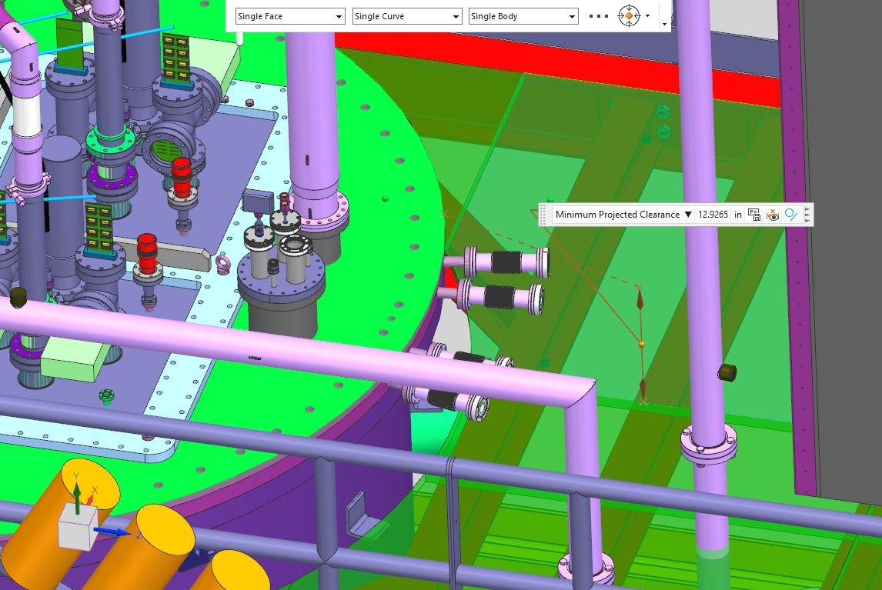
Distance from Platform to Cryostat Top = 13 inches

