Slide 1
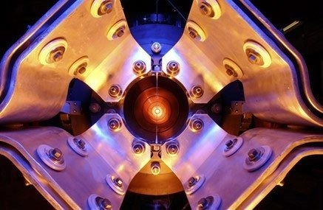
Overview of Flux Predictions and Measurements
(Accelerator Physics Perspective)
Katsuya Yonehara
NuINT 2024
April 16 2024

Slide 2
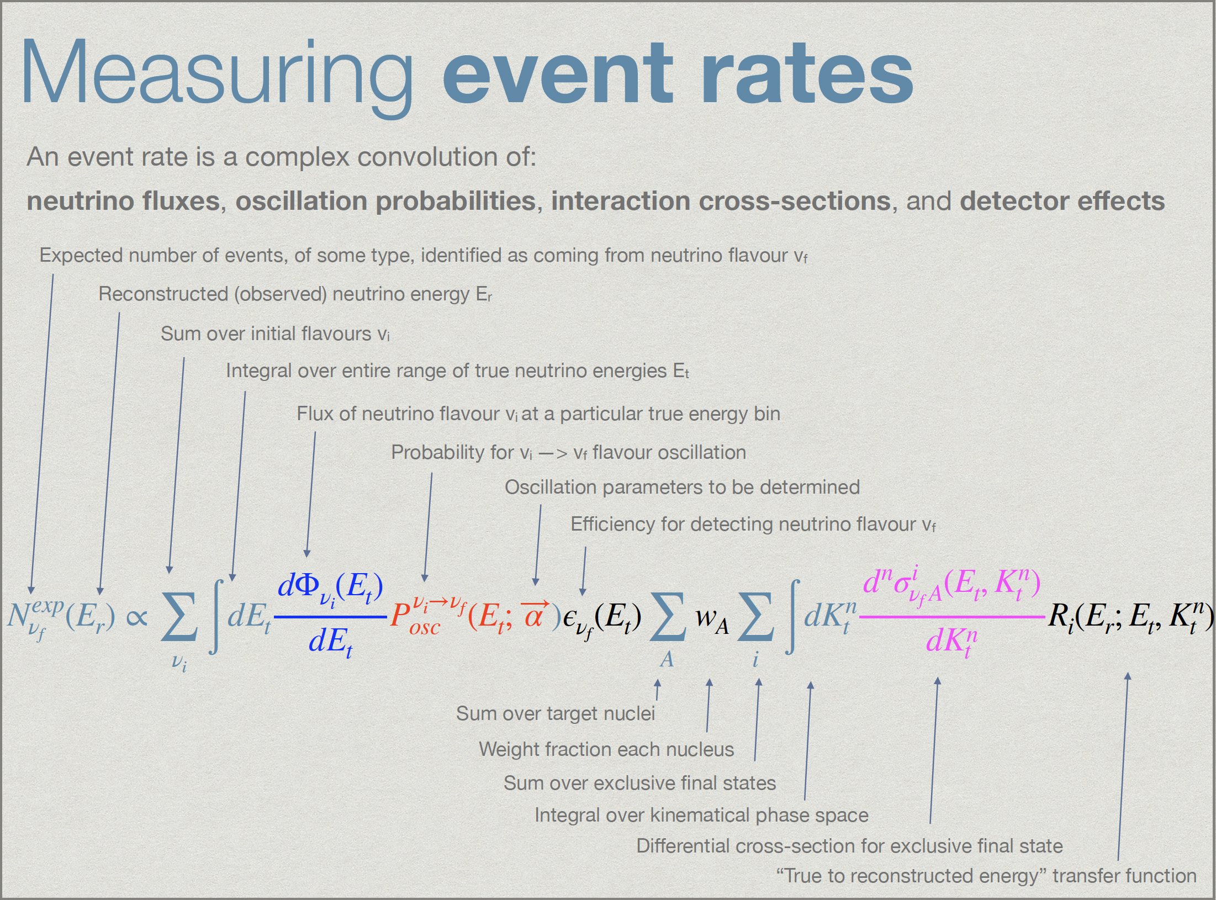
Scope of the session
Determining initial neutrino flux (source) and precisely measuring neutrino flux (detector) are crucial for the neutrino oscillation experiments
Courtesy by
Costas Andreopoulos
Link here

Slide 3
Scope of the session
Determining initial neutrino flux (source) and precisely measuring neutrino flux (detector) are crucial for the neutrino oscillation experiments
Predicting initial neutrino flux in simulation is hard because
  Hadron production model introduces uncertainty
  Geometric uncertainty exists in the dimension of beam-intercepting materials and the distribution of electric and magnetic fields
Measuring neutrino flux is also challenging because neutrinos are an elusive particle
We will be updated on the progress of these studies in various neutrino experiments during this session!

Slide 4
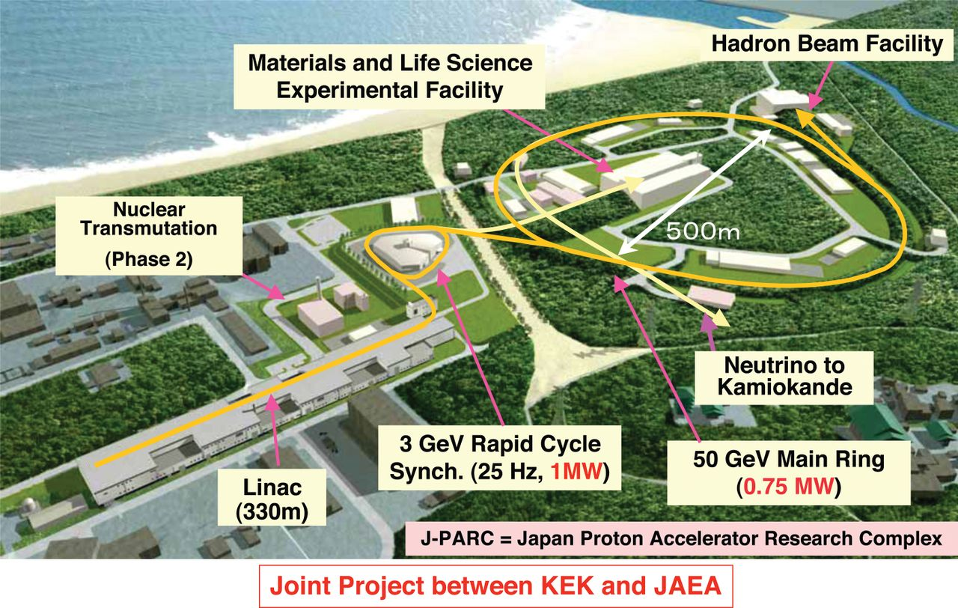
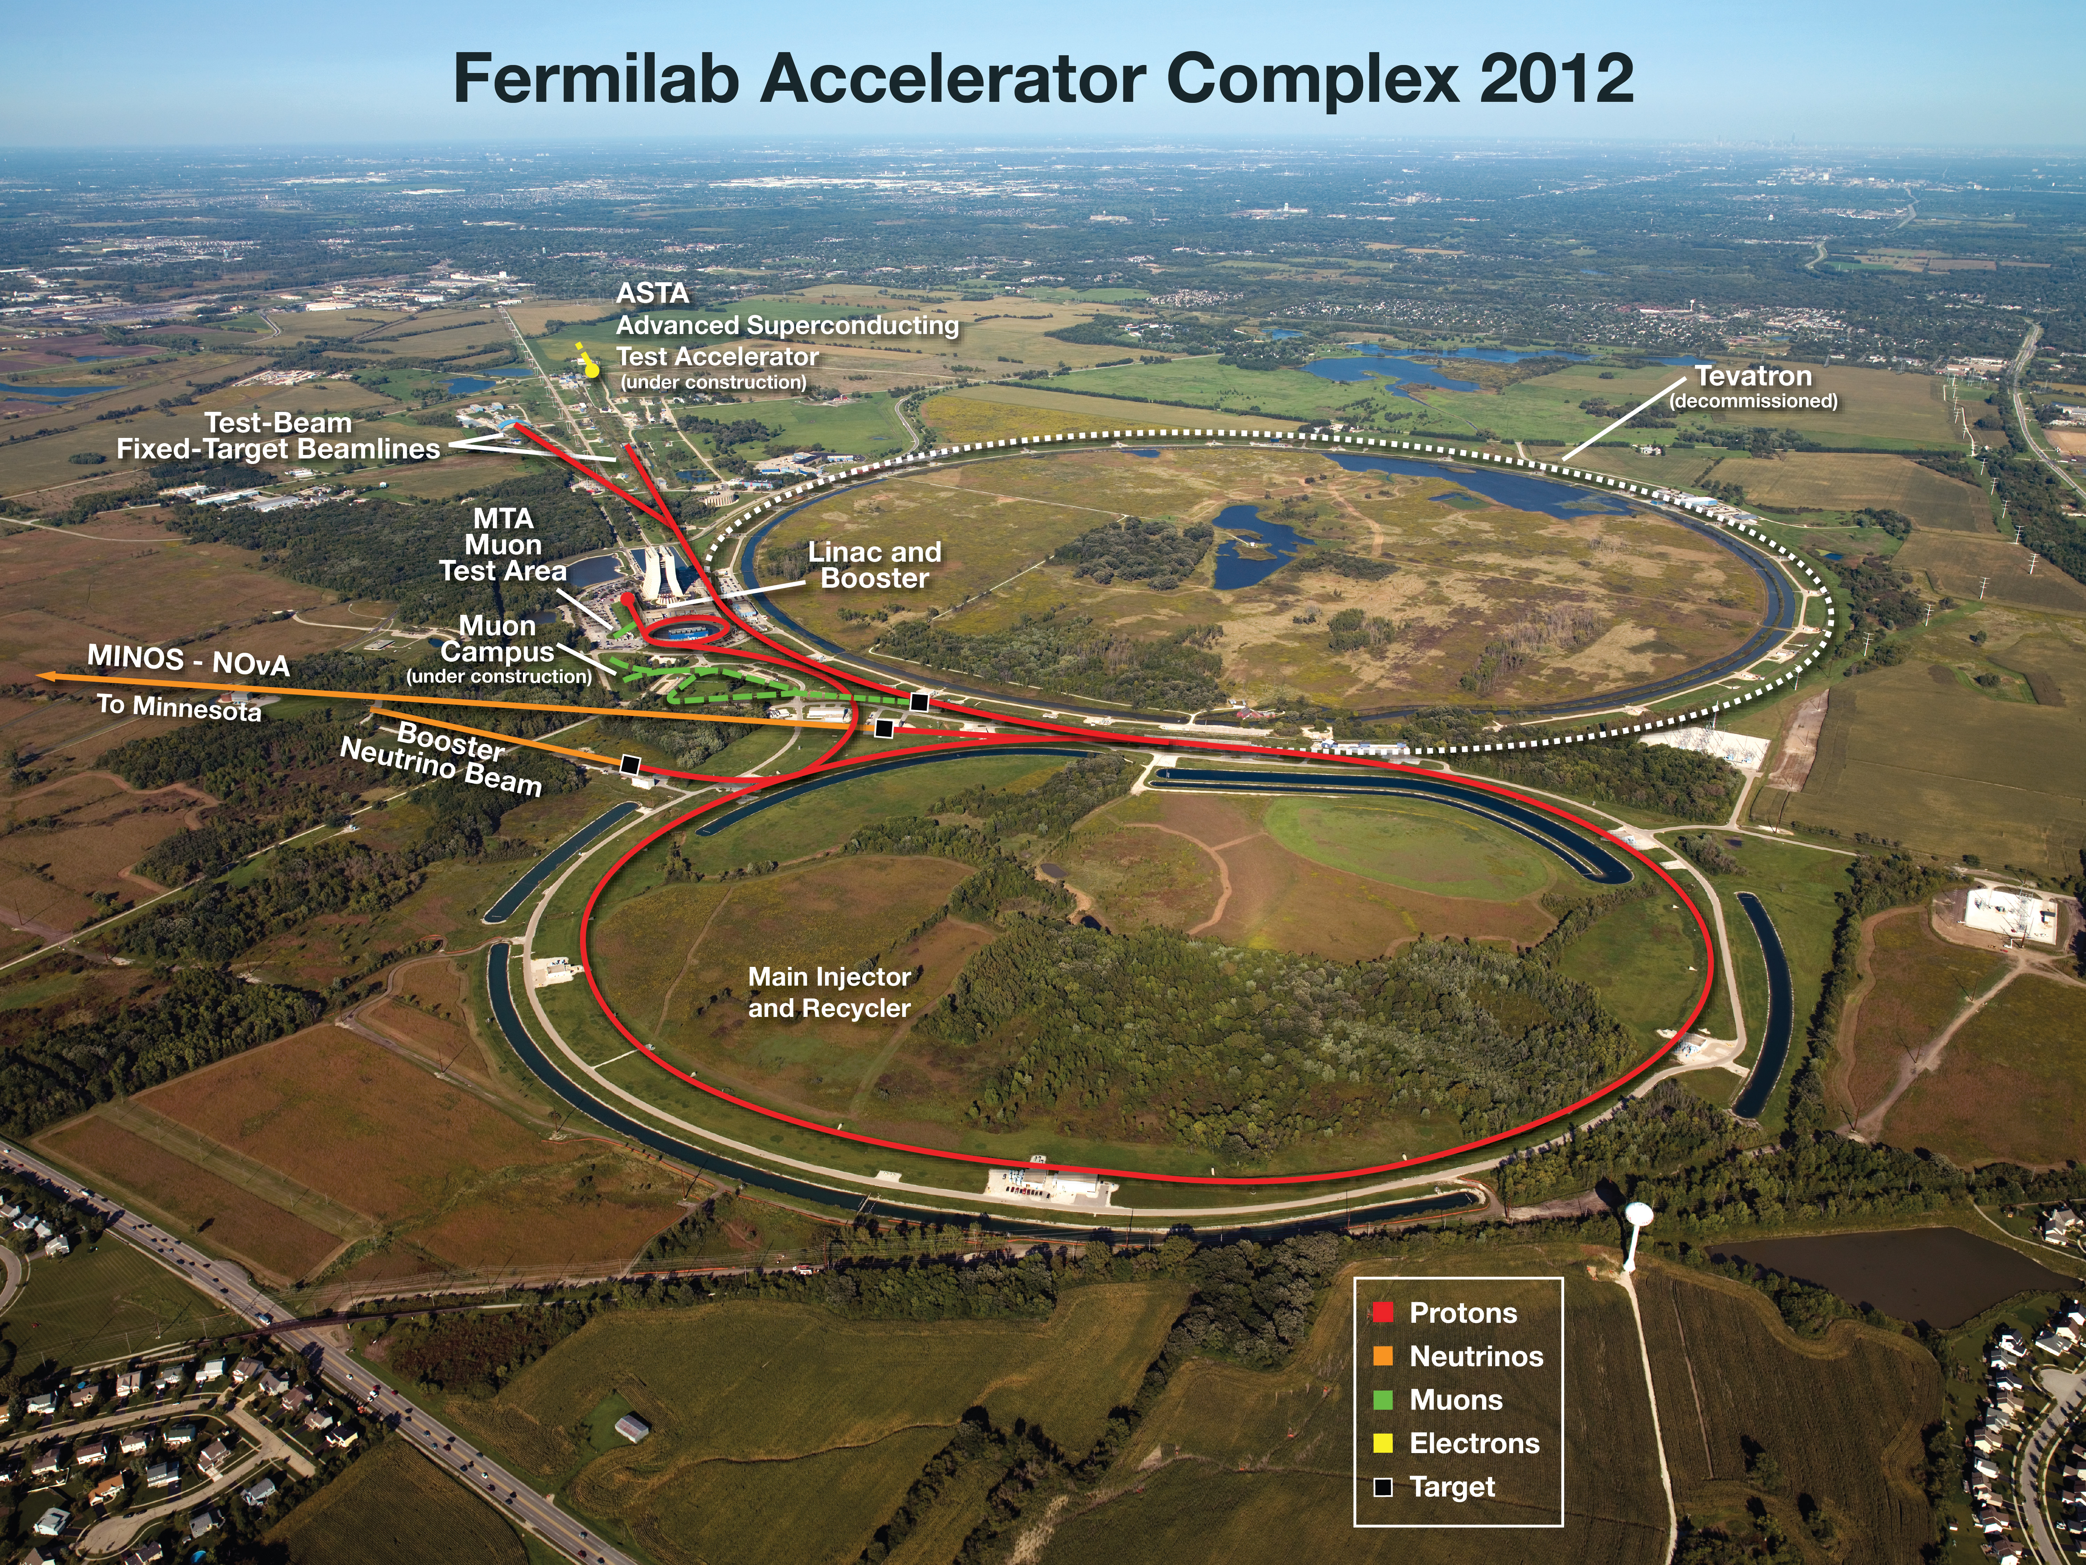
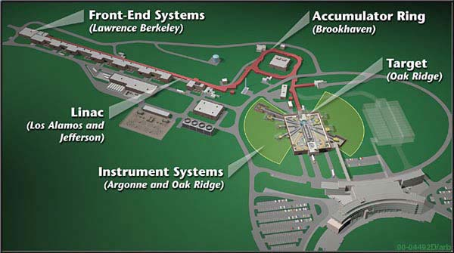
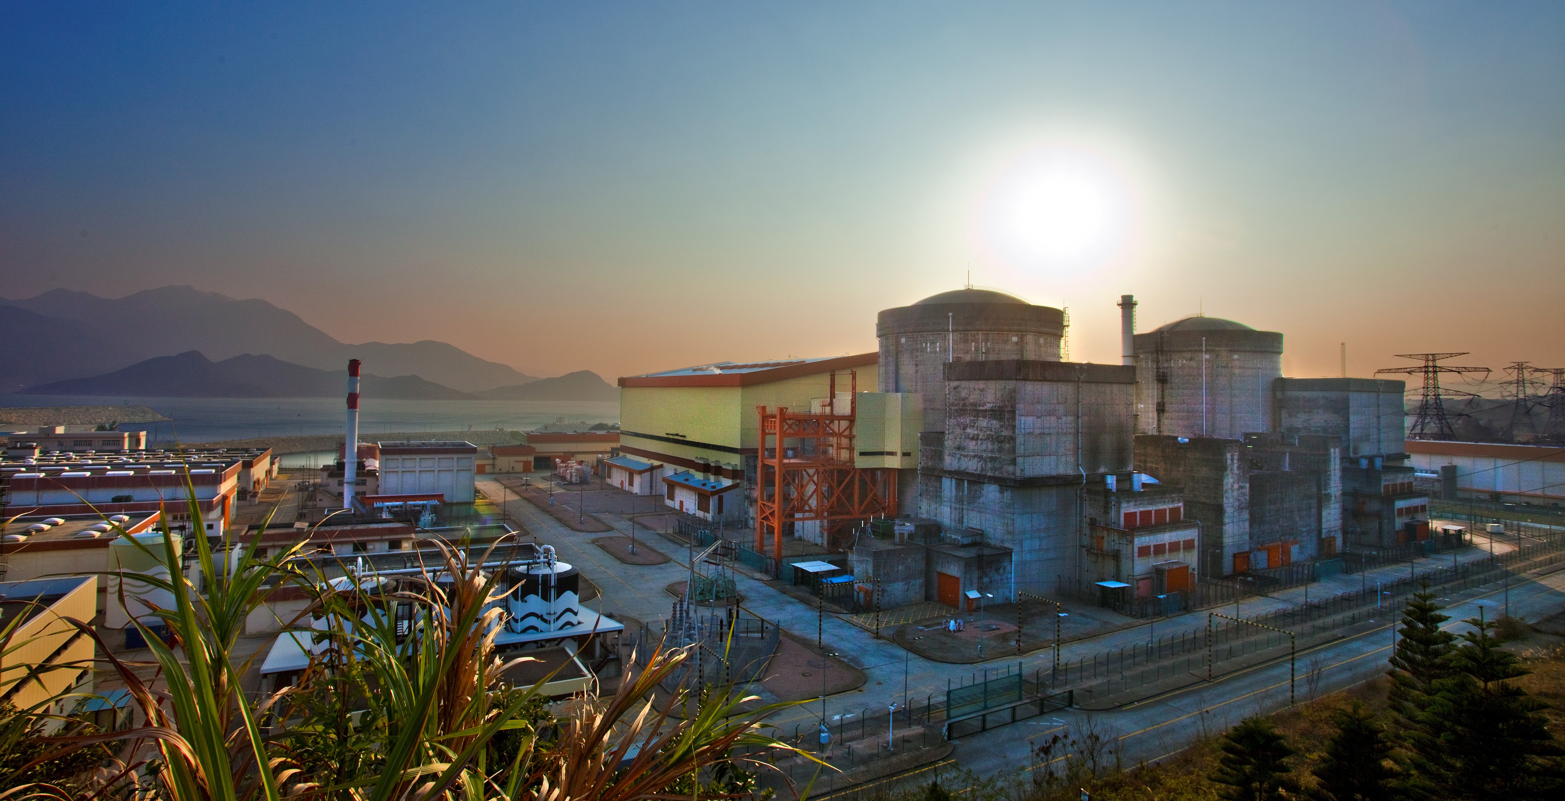

Neutrino Energy
See Lucas’ talk
J-PARC
$$E\left(ν\right)$$
1 GeV
Accelerator based neutrinos
100 MeV
See Zarko’s talk
10 MeV
Spallation neutrinos
Fermilab
Reactor neutrinos
See Yuri’s talk
Daya Bay
SNS (stopped pion)

Slide 5
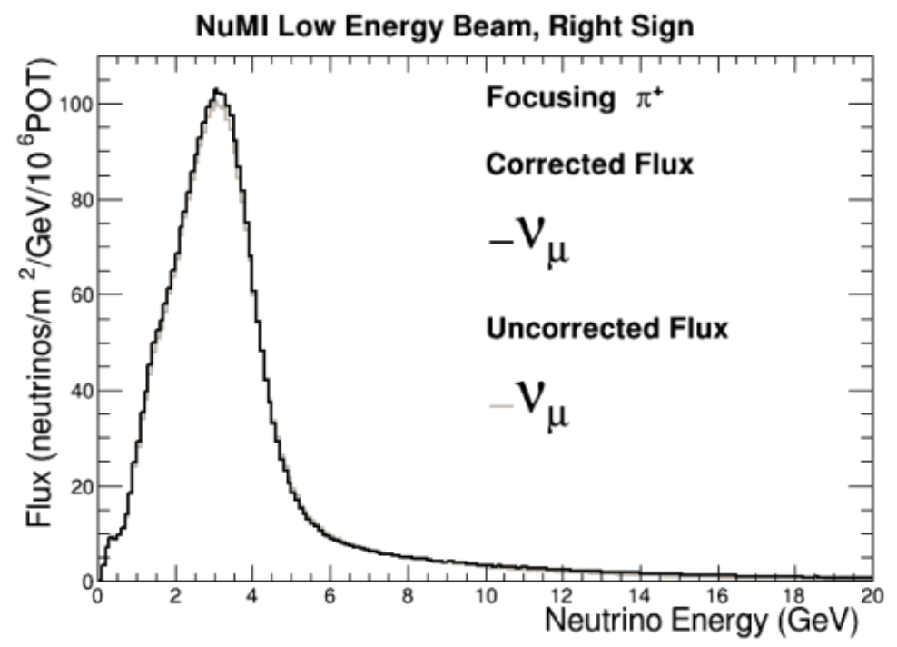
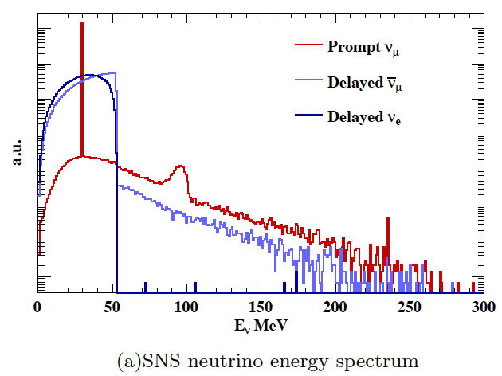
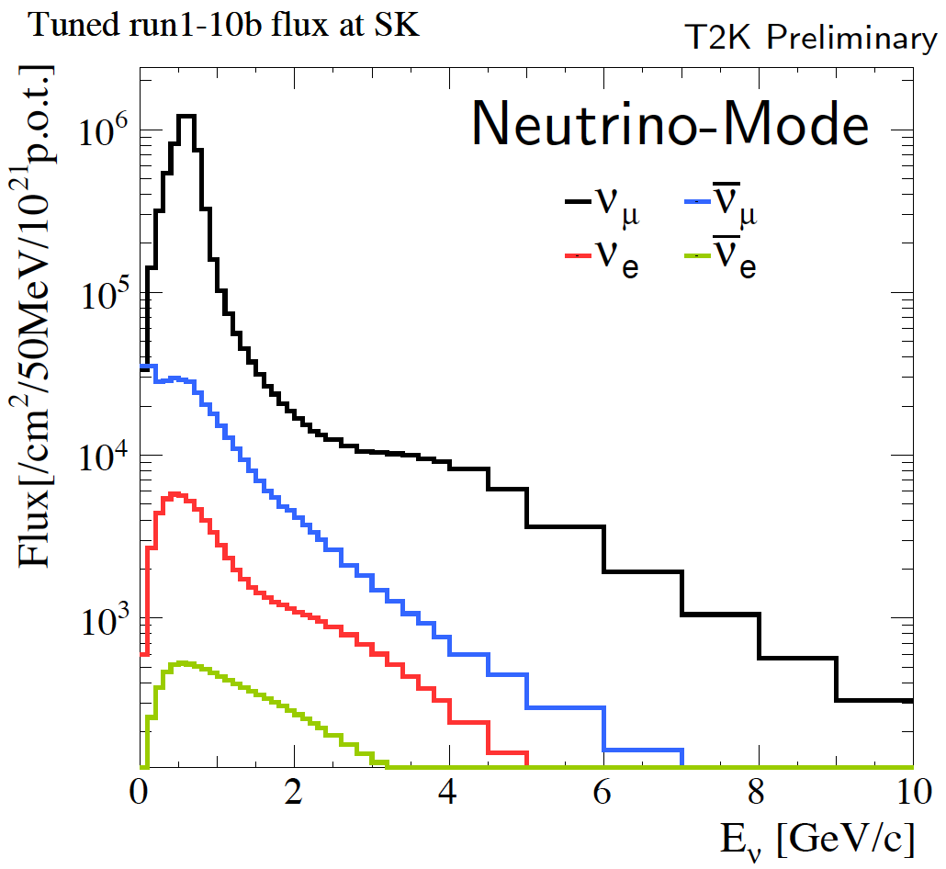
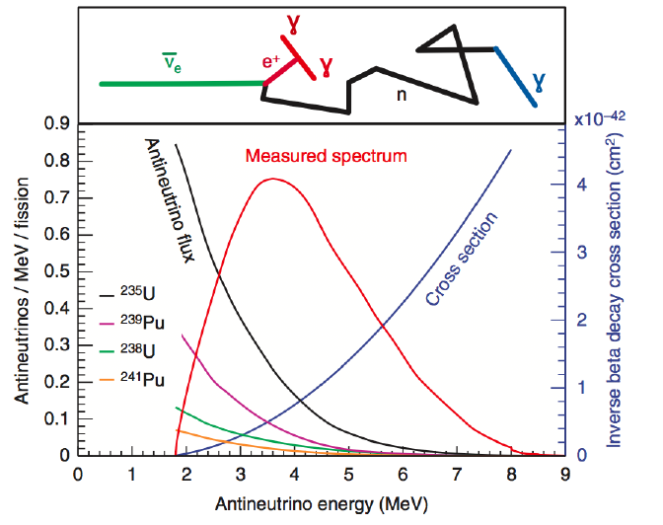
Neutrino Energy Spectrum
MINERvA (on axis)
$$E\left(ν\right)$$
COHERENT
1 GeV
Accelerator based neutrinos
100 MeV
T2K (off axis)
10 MeV
Spallation neutrinos
Reactor neutrinos

Slide 6
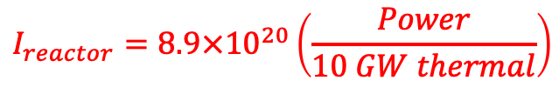
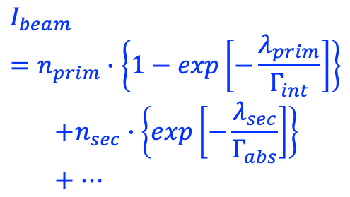
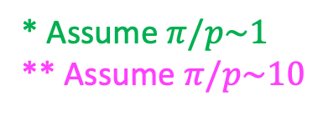
Source Intensity vs Neutrino Energy
Intensity [s⁻¹]
* Assume $π/p\sim 1$
** Assume $π/p\sim 10$
$$I_{reactor}=8.9×{10}^{20}\left(\frac{Power}{10 GW thermal}\right)$$
10²⁰
Giga Watt
Fission
$$I_{beam}=n_{prim}∙\left\{1−exp\left[−\frac{λ_{prim}}{Γ_{int}}\right]\right\}$$
  $$+n_{sec}∙\left\{exp\left[−\frac{λ_{sec}}{Γ_{abs}}\right]\right\}+…$$
Sub-Mega Watt
Stopped pion*
Pion decay
in flight**
10¹⁰
Mega Watt
Secondaries
Horn
Primary
Target
Energy
1 MeV
1 GeV
1 TeV

Slide 7
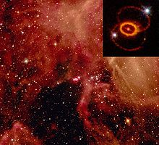
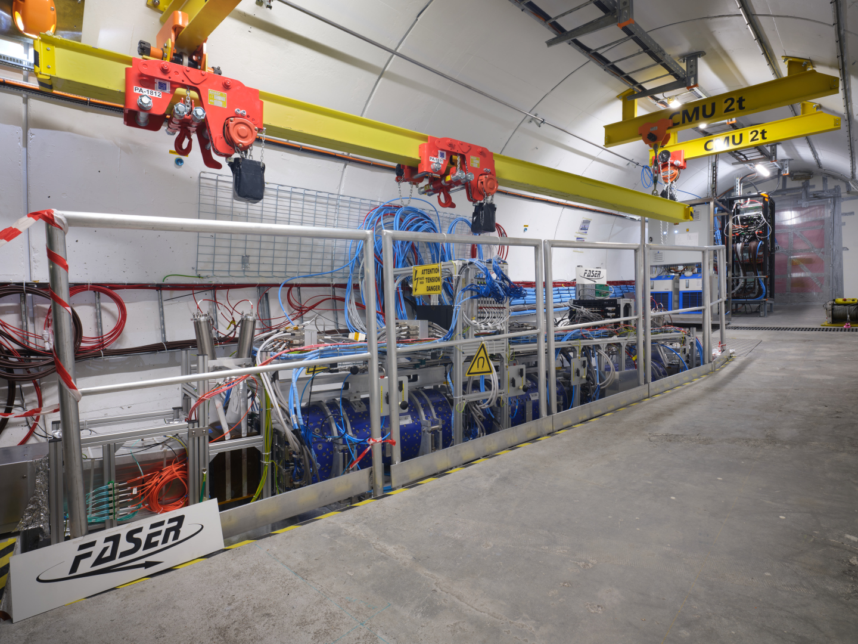
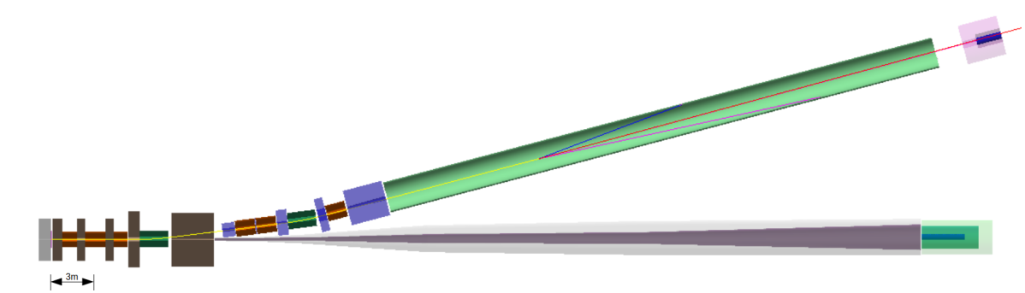
Source Intensity vs Neutrino Energy
Intensity [s⁻¹]
Super Nova
* Assume $π/p\sim 1$
** Assume $π/p\sim 10$
10²⁰
Giga Watt
Fission
Sub-Mega Watt
Stopped pion*
Pion decay
in flight**
10¹⁰
Mega Watt
See Andrei’s talk
ENUBET
FASER
Energy
1 MeV
1 GeV
1 TeV
Tagging muons in K or π decays

Slide 8
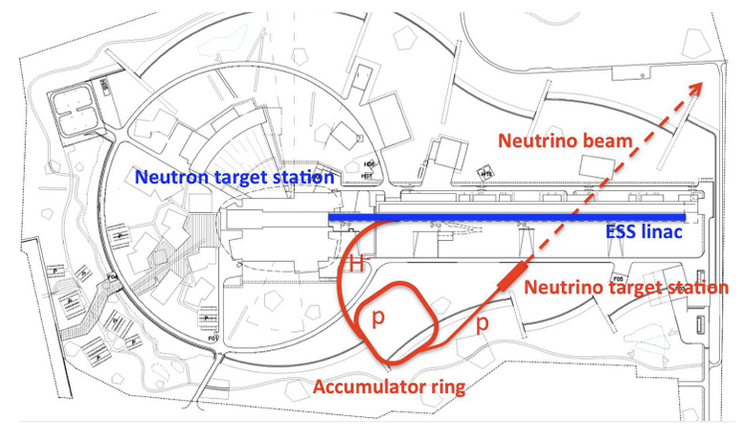
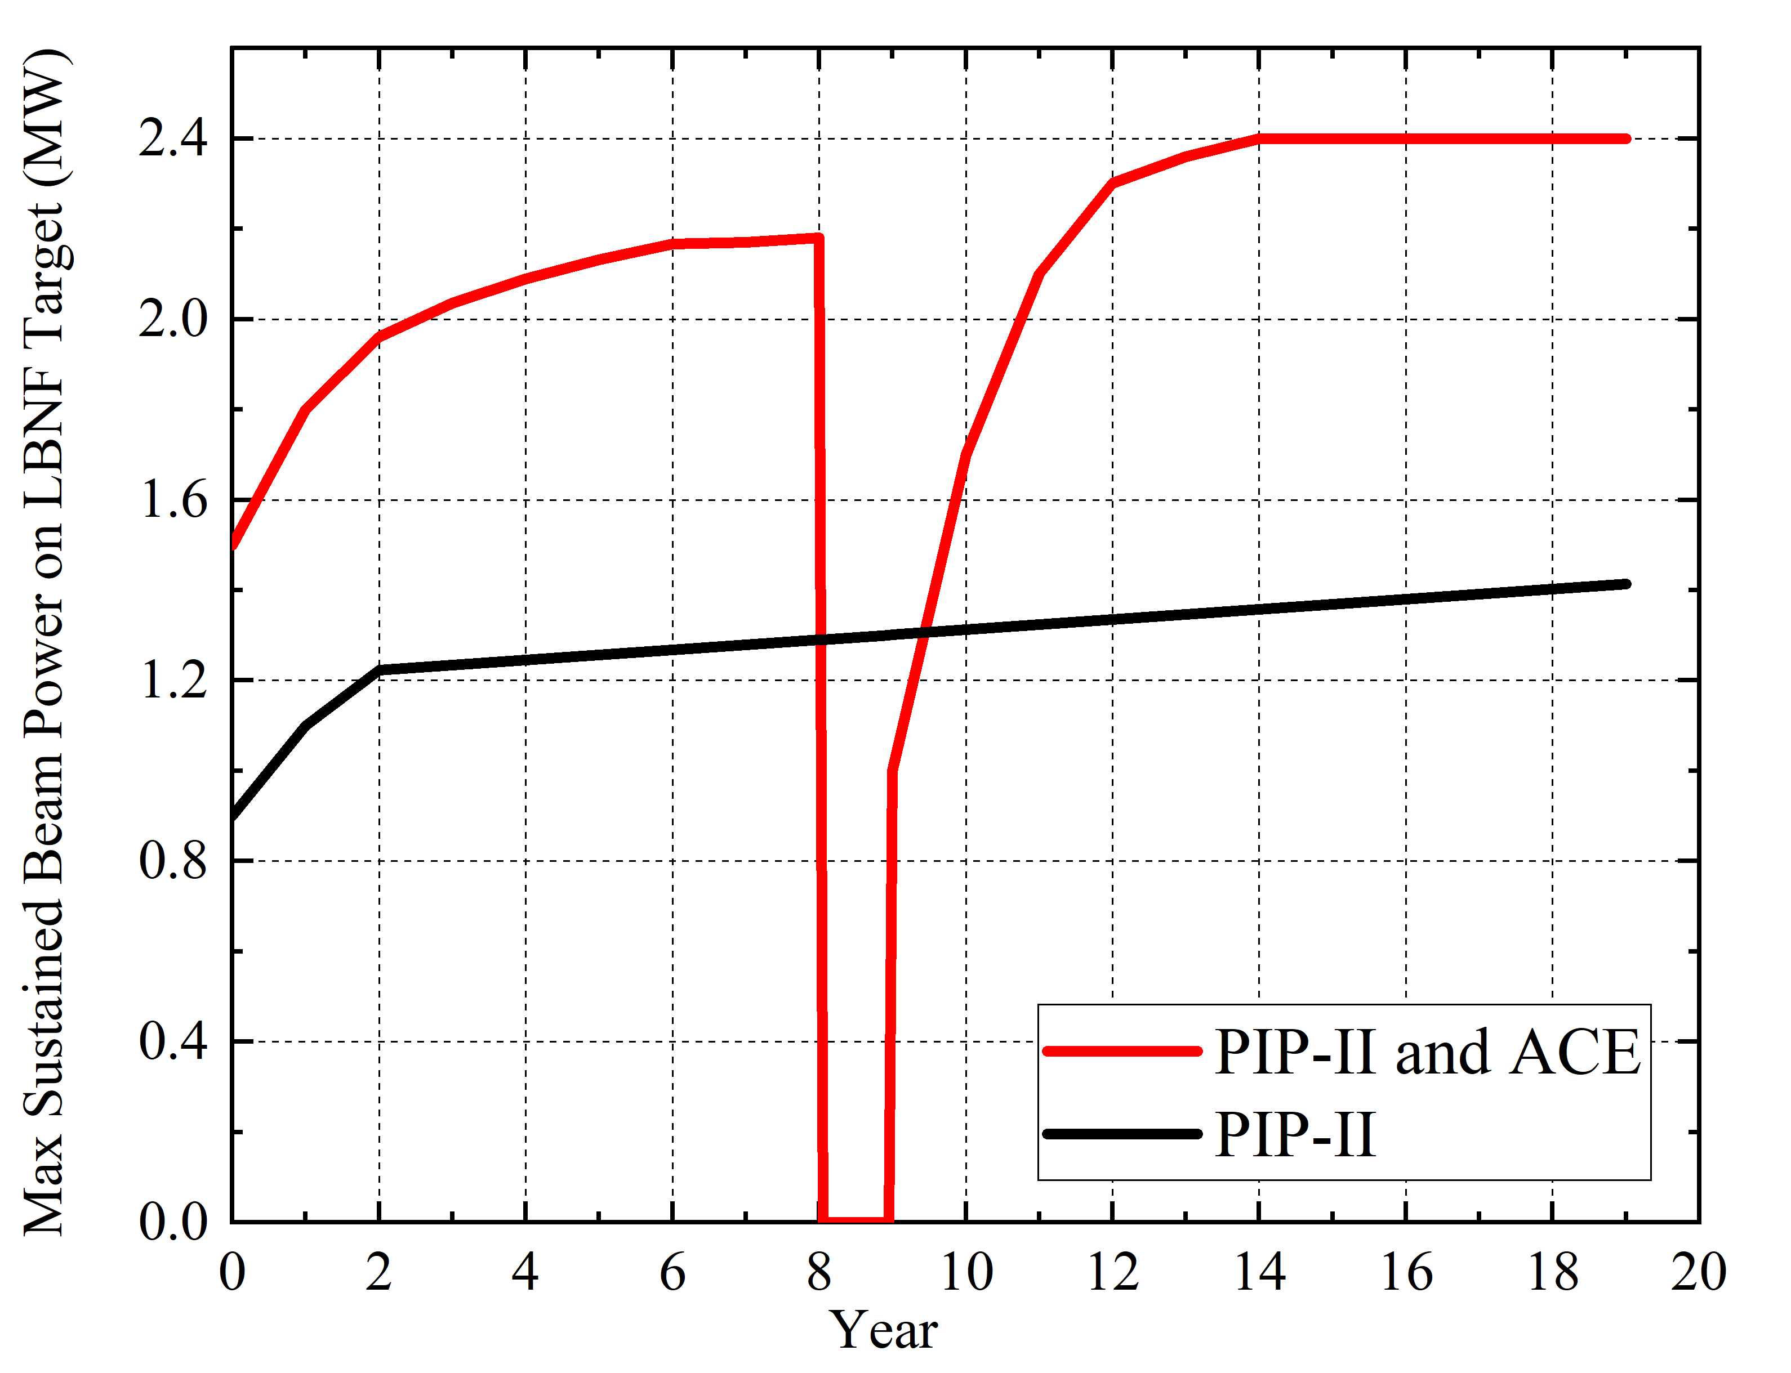
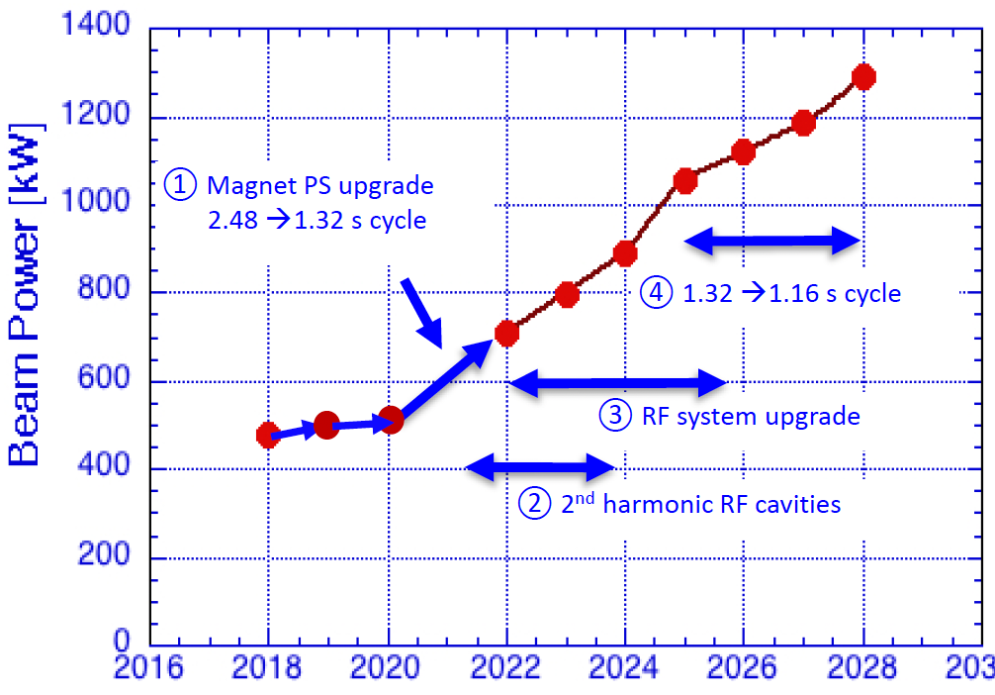
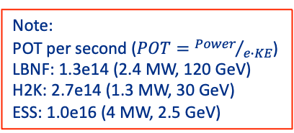
Source Intensity vs Neutrino Energy
Intensity [s⁻¹]
Future multi-MW accelerator facilities
will provide more intense neutrinos
H2K, LBNF, ESS, and SNS
10²⁰
Giga Watt
Fission
ESS
10¹⁰
Accelerator Complex Evolution at Fermilab
Beam power upgrade plan at J-PARC
Note:
POT per second ($POT={Power}/{e∙KE}$)
LBNF: 1.3e14 (2.4 MW, 120 GeV)
H2K: 2.7e14 (1.3 MW, 30 GeV)
ESS: 1.0e16 (4 MW, 2.5 GeV)
Energy
1 MeV
1 GeV
1 TeV

Slide 9
Study of Hadron Interactions
Monte Carlo simulation codes are a vital tool for designing neutrino sources and analyzing neutrino experiments
Geant4, FLUKA, PHITS, MARS are a standard code for an event generator
The physics generator is model dependence, it introduces an uncertainty
  Uncertainty will be enhanced during multiple hadronic process (error propagations & missing correlations)
Model is often parametrized to fit the experimental result
Demonstrate two hadron interaction measurements in this session
  Thin target vs Thick target to involve propagations and correlations

Slide 10
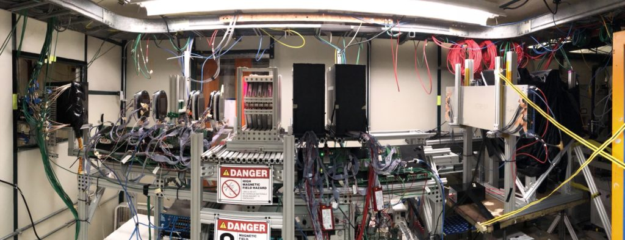
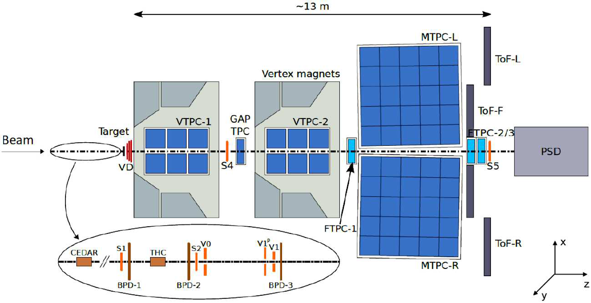
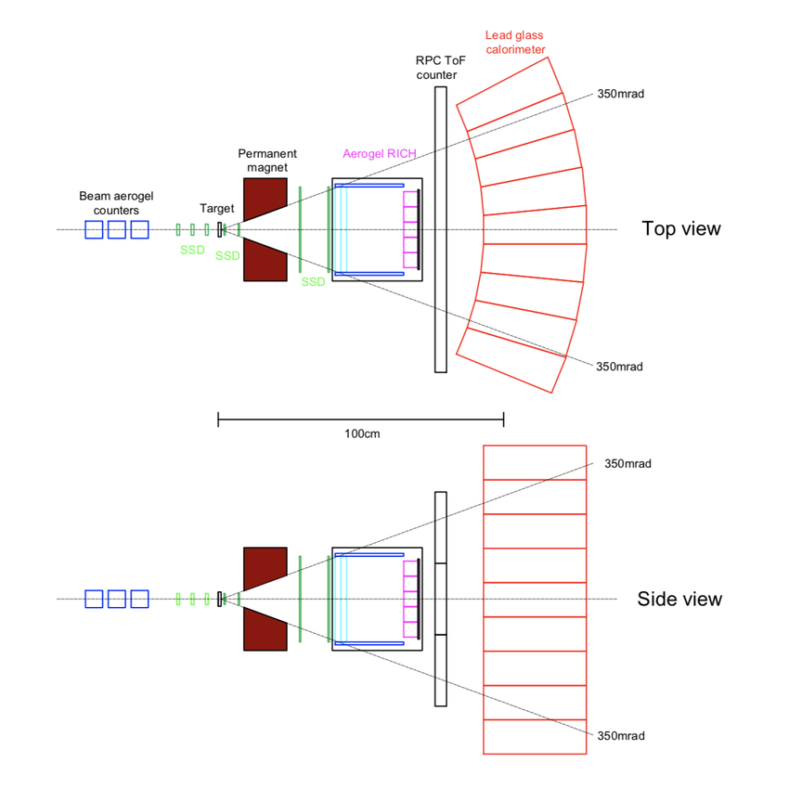
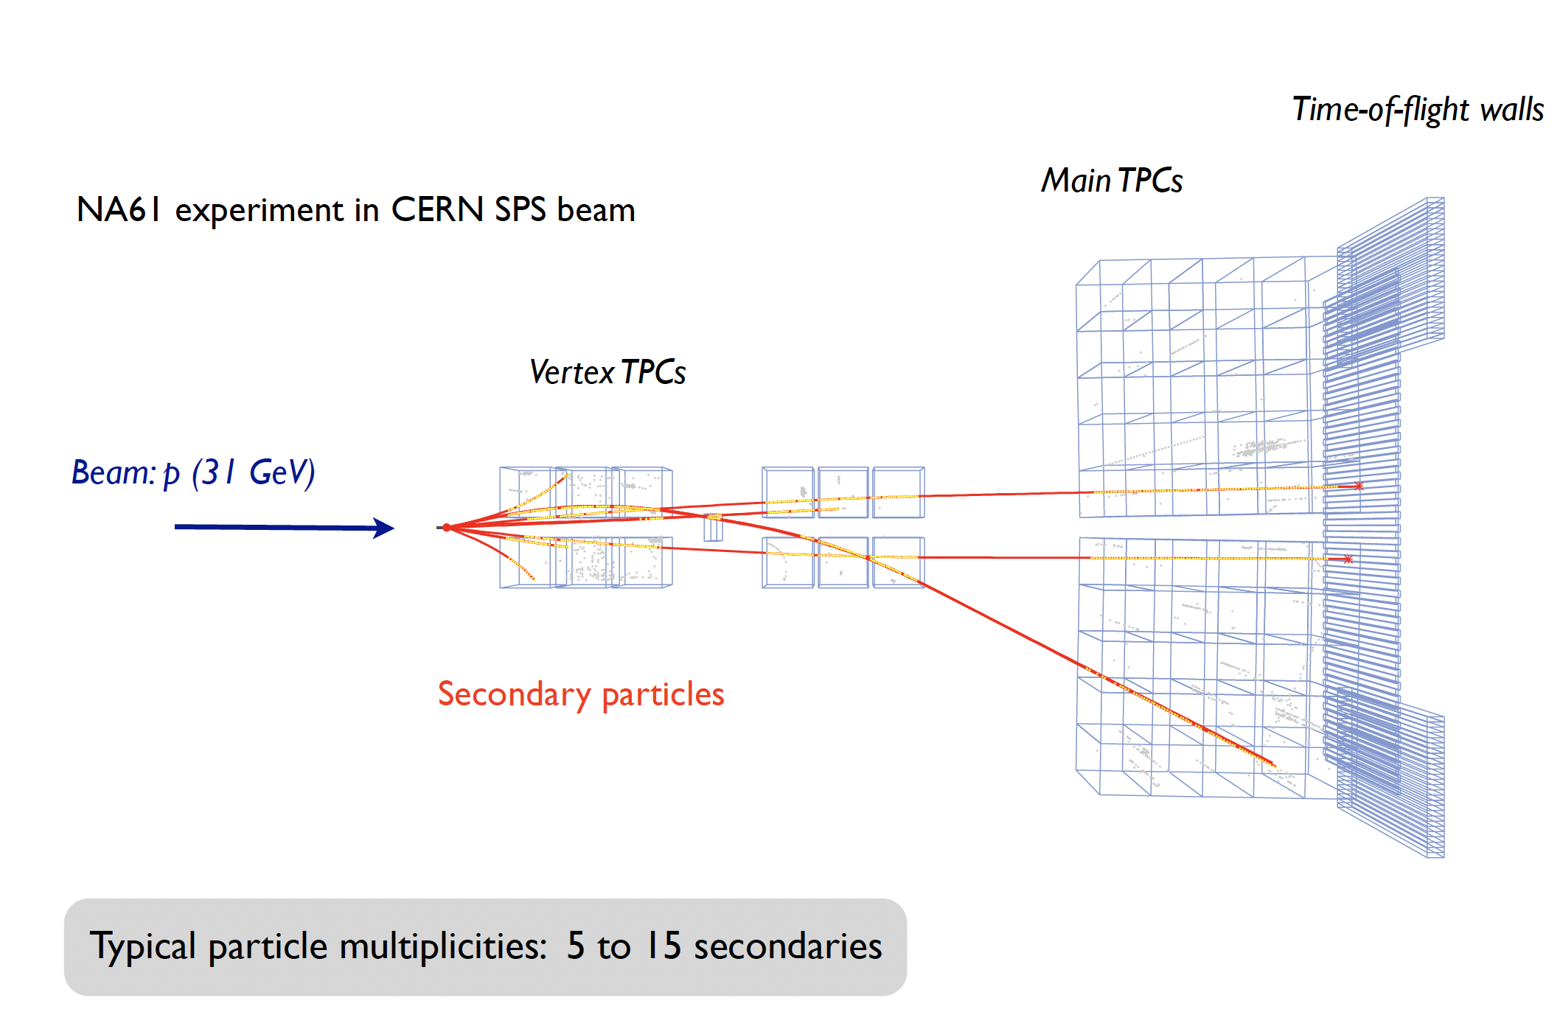
Two hadron measurements updated in the session
Layout of EMPHATIC
Layout of NA61 and simulated event
See Leo’s talk
See Andrew’s talk

Slide 11
Accelerator Complex at Fermilab and Neutrino source

Slide 12
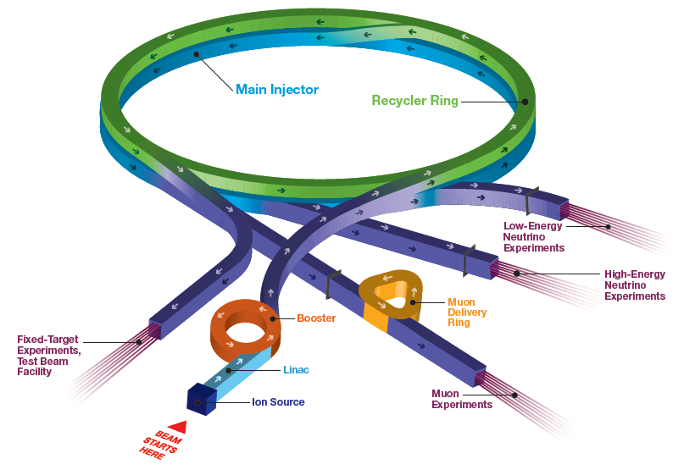
Accelerator Complex at Fermilab
Short Baseline Neutrino:
ICARUS, ANNIE, SBND
SwitchYard120:
test beam (FTBF),
SpinQuest
Long Baseline Neutrino:
NOvA
Muon Campus:
g-2 (completes this year), Mu2e (commissioning)
Irradiation Test Area (ITA) in Linac

Slide 13
Accelerator Complex Evolution plan at Fermilab
Increase protons on target to DUNE Phase I detector by
  Shortening the Main Injector cycle time to increase beam power
  Upgrading target systems for up to 2.4 MW
  Improving reliability of the Complex
Establish a project to build a Booster replacement to
  Provide a robust and reliable platform for the future of the Accelerator Complex
  Ensure high intensity for DUNE Phase II CP-Violation measurement
  Enable the capability of the complex to serve precision experiments and searches for new physics with beams from 1-120 GeV
  Create the capacity to adapt to new discoveries
  Supply the high-intensity proton source necessary for future multi-TeV accelerator research
Previously referred to as PIP-III

Slide 14
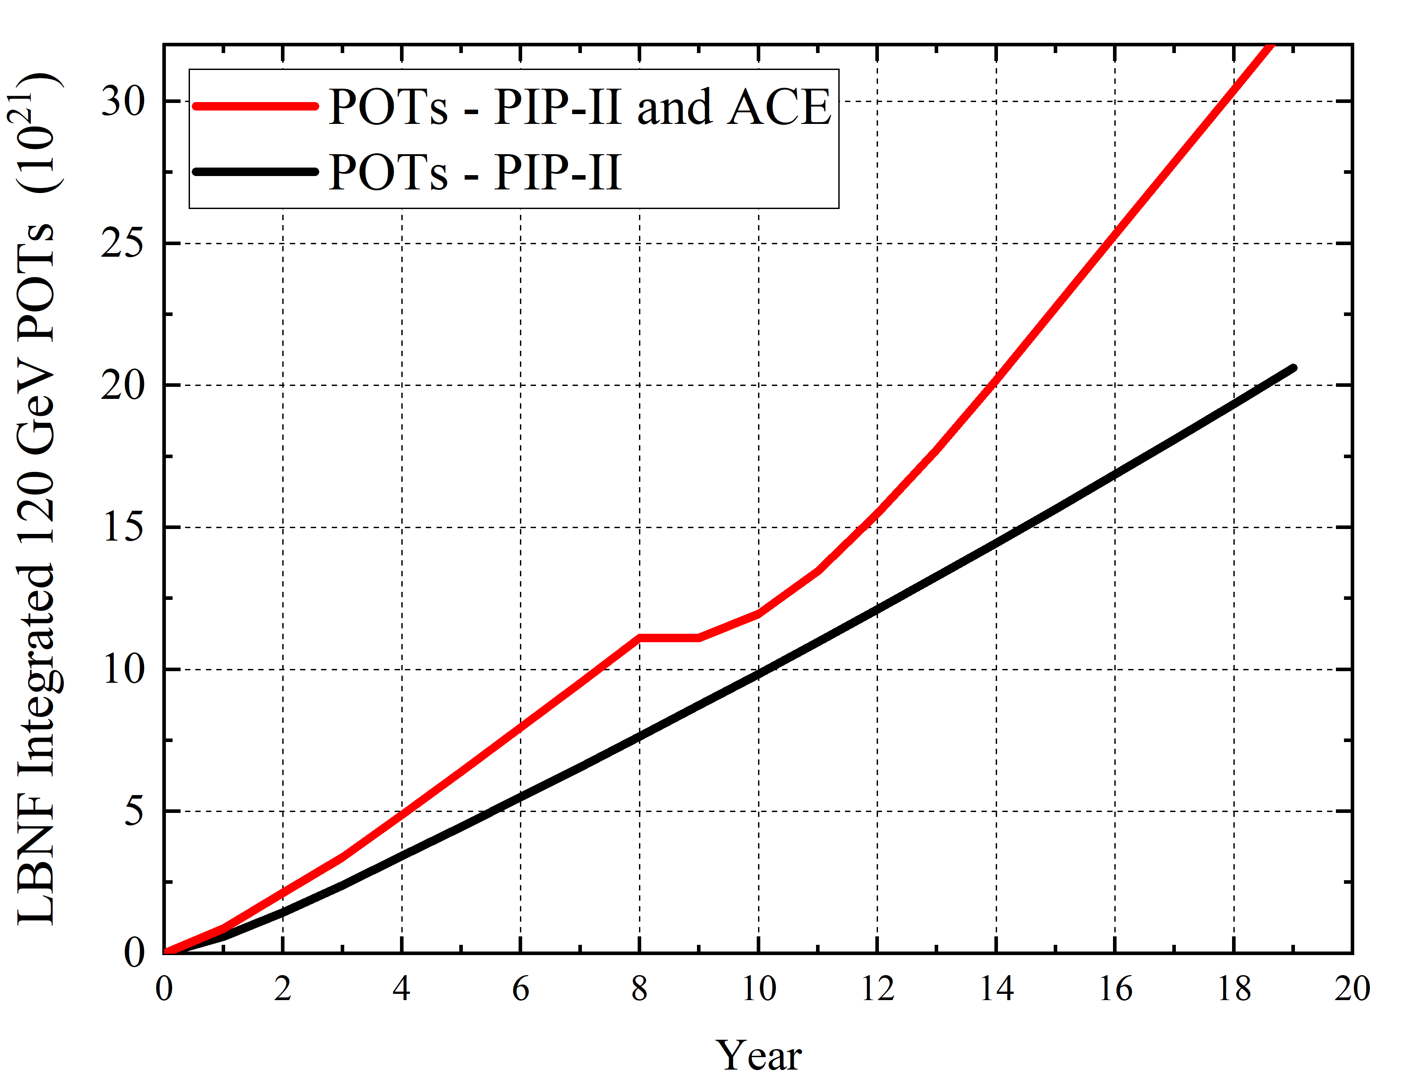
DUNE power and POT implications
Booster replacement
Mu2e complete in 2033
(Mu2e restarts 2029)
ACE-MERT (MI upgrade and high power Target) can provide 2-MW class beam to LBNF earlier than the original plan

Slide 15
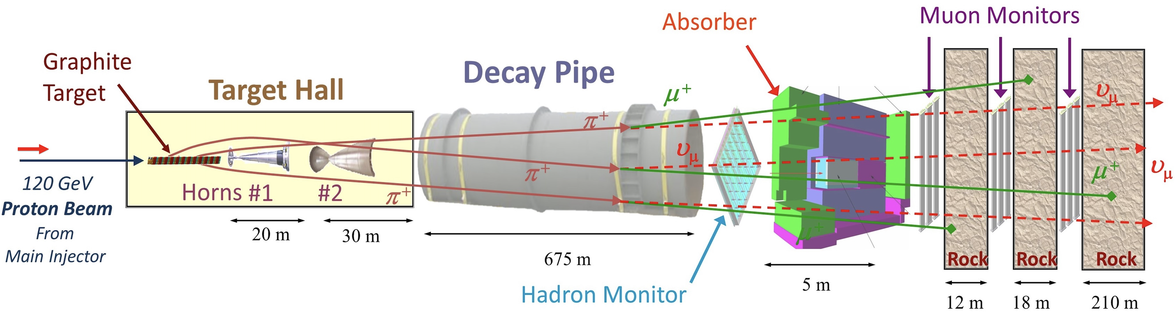
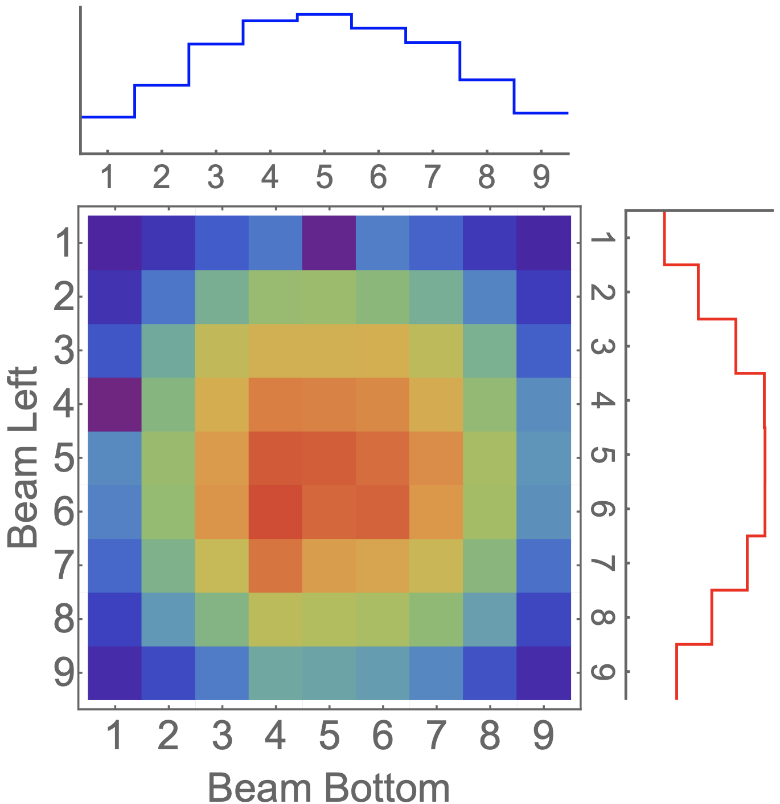
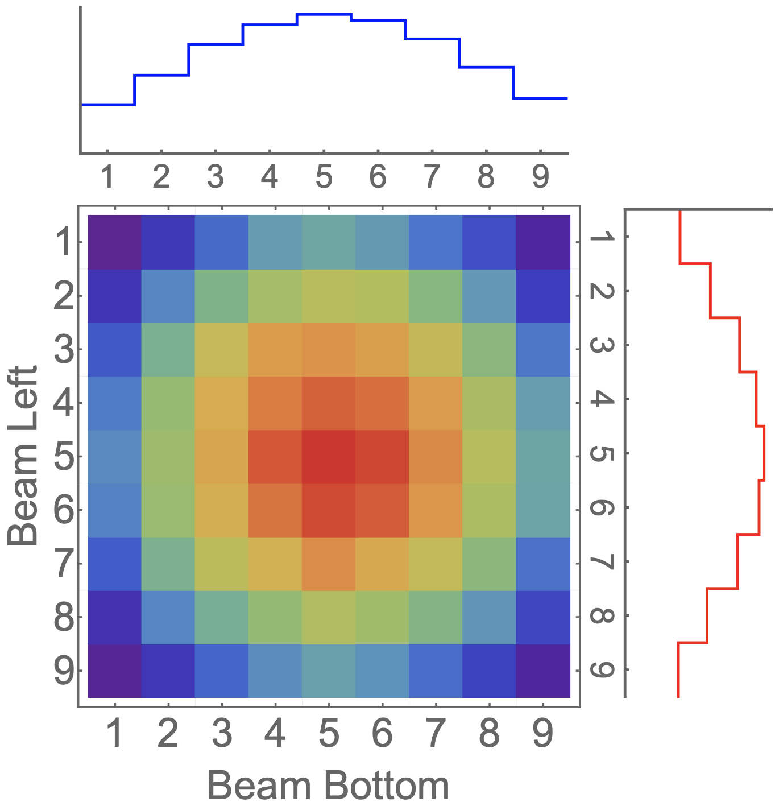
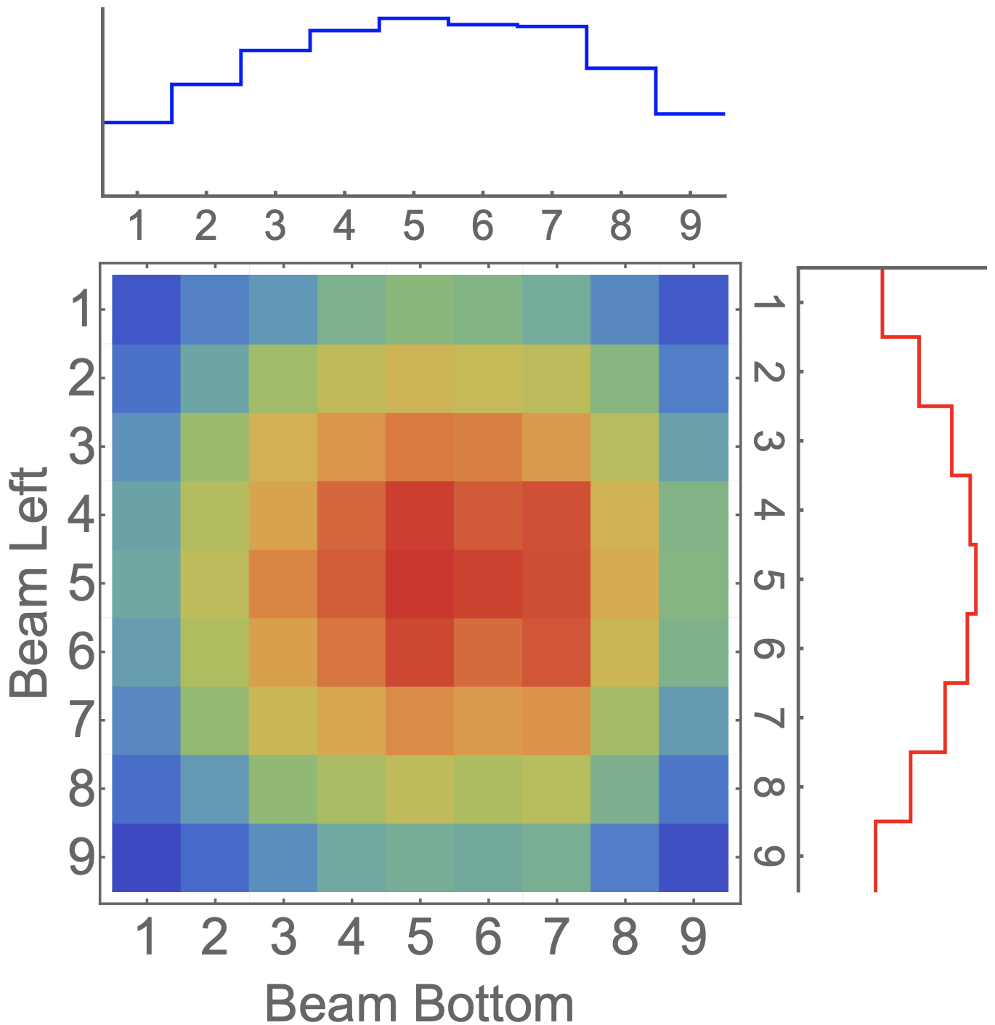
Study of beam-related systematic uncertainty
MM1: muon monitor 1 (Cut off energy ~4 GeV)
MM2: muon monitor 2 (Cut off energy ~10 GeV)
MM3: muon monitor 3 (Cut off energy ~20 GeV)
Raw signal from MM1
Raw signal from MM2
Raw signal from MM3
Monitor signal is linearly responded to the beam intensity
Each monitor samples muons with a different energy range
Thus, each monitor behaves differently when the beam parameter is changed

Slide 16

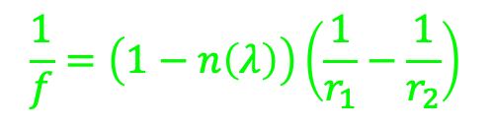

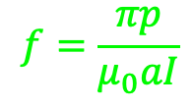
Magnetic Horn Model as Optical Lens
For simplify, two horns are
combined into one horn
Paraxial approximation
Ray trace for light
Optical lens
focal point
$$\frac{1}{f}=\left(1−n\left(λ\right)\right)\left(\frac{1}{r_{1}}−\frac{1}{r_{2}}\right)$$
$$f_{r}>f_{g}$$
Chromaticity aberration
because refractive index depends on wavelength
Ray trace for
charged particle
Magnetic horn
focal point
$$f_{r}<f_{g}$$
$$f=\frac{πp}{μ_{0}aI}$$
Chromaticity aberration
because focal length is proportional to momentum

Slide 17
Magnification of muon image on muon monitors
arXiv:2305.08695
Observed muon beam centroid vs proton beam position at target
Positive slope →
High energy muons shown in muon monitor 3 are underfocused by horns
Zero slope →
Medium energy muons shown in muon monitor 2 are on focused by horns
Negative slope →
Low energy muons shown in muon monitor 1 are overfocused by horns
Slope size shows a magnification factor of the lens

Slide 18
Study of Magnetic Horn Chromaticity
arXiv:2305.08695
Slope is changed by the horn current and the change is unique for each monitor.
Muon monitor 2 will be the most sensitive monitor for the horn current because the slope is deviated from zero.
Intersection of curves may indicate the effective beam axes of low, medium, and high energy muons (study is on going).

Slide 19
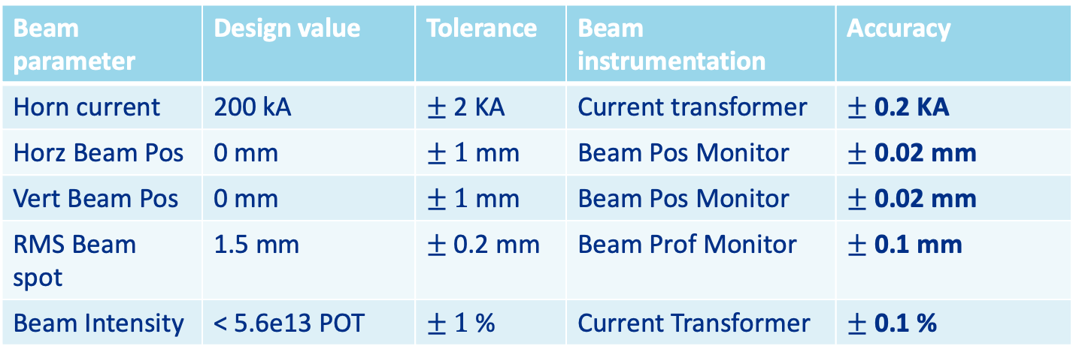
Reducing Uncertainty of Beam Measurement
Combine the conventional beam instrumentation and muon monitor data, we can realize high accuracy beam parameter measurement
Beam parameter | Design value | Tolerance | Beam instrumentation | Accuracy
Horn current | 200 kA | $±$2 KA | Current transformer | $±$0.2 KA
Horz Beam Pos | 0 mm | $± 1$ mm | Beam Pos Monitor | $±$0.02 mm
Vert Beam Pos | 0 mm | $± 1$ mm | Beam Pos Monitor | $±$0.02 mm
RMS Beam spot | 1.5 mm | $±$0.2 mm | Beam Prof Monitor | $±$0.1 mm
Beam Intensity | < 5.6e13 POT | $± 1$ % | Current Transformer | $±$0.1 %

Slide 20
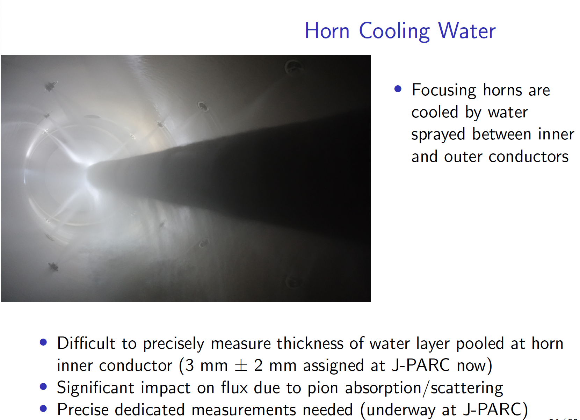
COURTECY M. FRIEND, Neutrino 2022

Slide 21
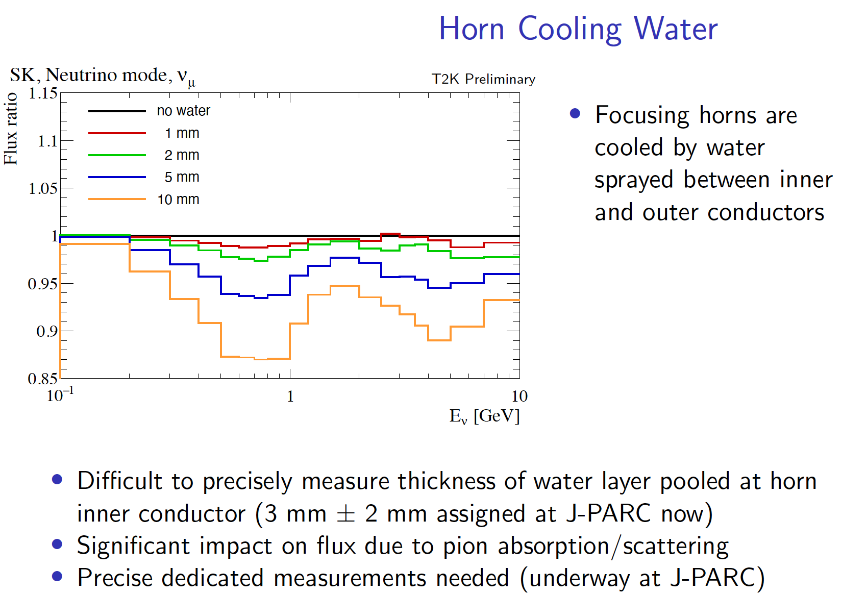
COURTECY M. FRIEND, Neutrino 2022

Slide 22
Summary
Map out various neutrino experiments as functions of neutrino energy, source intensity and neutrino spectrum
  Each measurement has a unique physics goal (Stay tuned in the session to hear the goal)
Focus on neutrino source at the NuMI target system
  Explain how to prepare neutrino
  Demonstrate the NuMI beam instrumentation to be high accuracy beam parameter measurement

