Slide 1
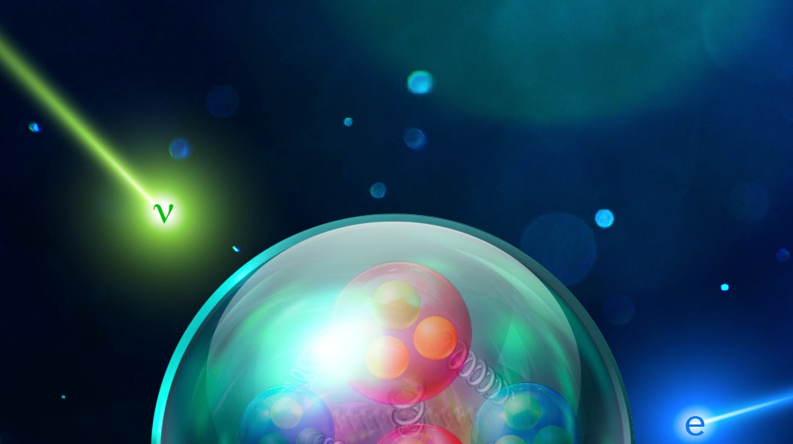



Electrons for Neutrinos
Julia Tena Vidal at Tel Aviv University
on behalf of the e4nu and CLAS collaborations

Slide 2
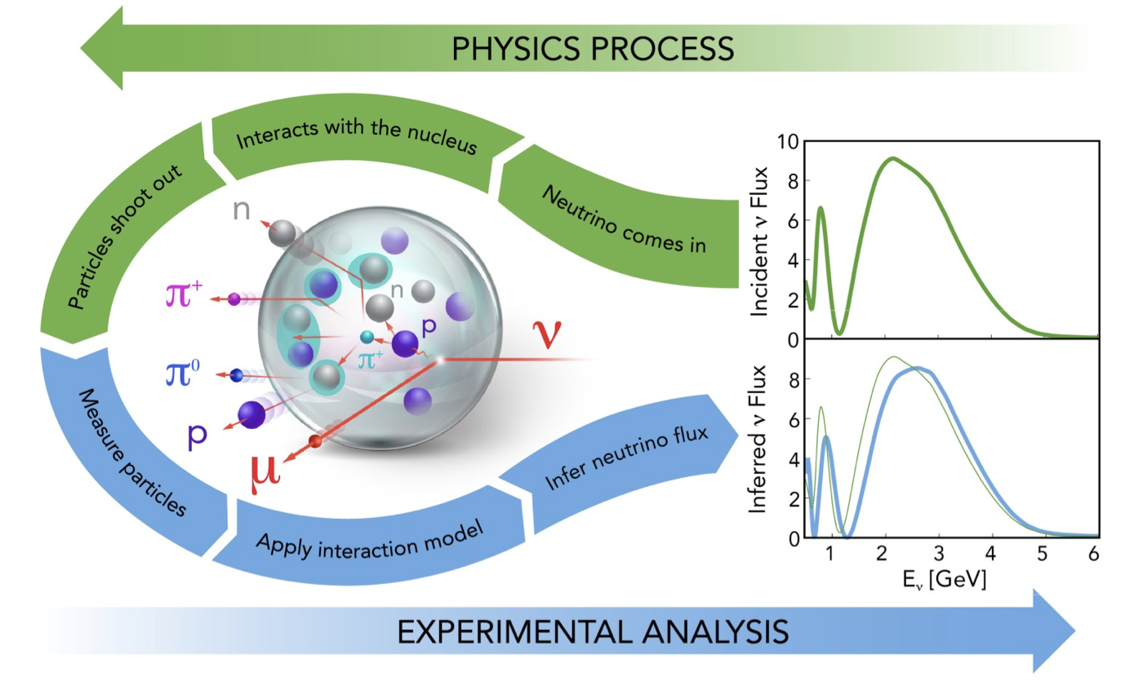
Introduction
Global effort to improve lepton-nucleus scattering models for oscillation experiments
Unprecedented accuracy in cross section models required by next generation neutrino oscillation experiments

Slide 3
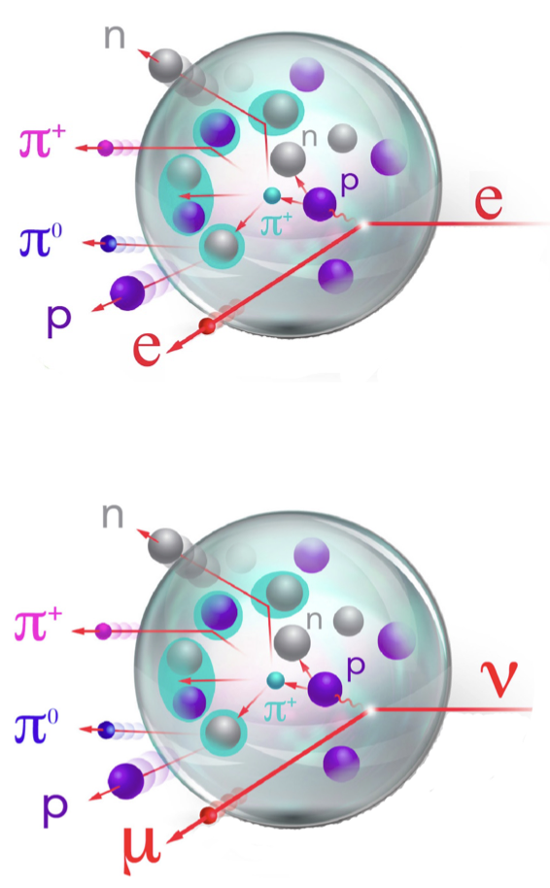
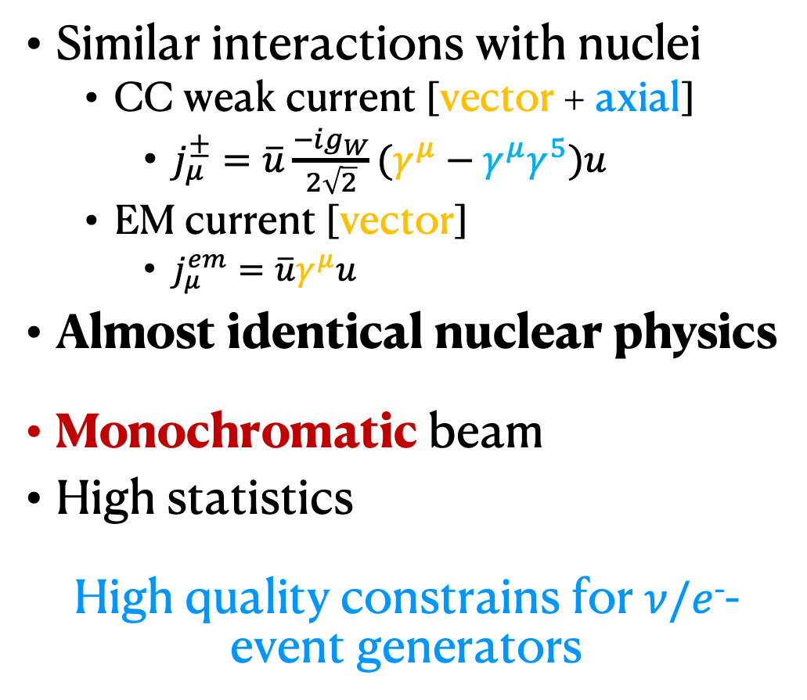
Electrons for neutrinos
Similar interactions with nuclei
  CC weak current [vector + axial]
    $j_{μ}^{±}=\overline{u}\frac{−ig_{W}}{2\sqrt{2}}(γ^{μ}−γ^{μ}γ^{5})u$
  EM current [vector]
    $j_{μ}^{em}=\overline{u}γ^{μ}u$
Almost identical nuclear physics
Monochromatic beam
High statistics
High quality constrains for $ν/e$⁻-event generators

Slide 4
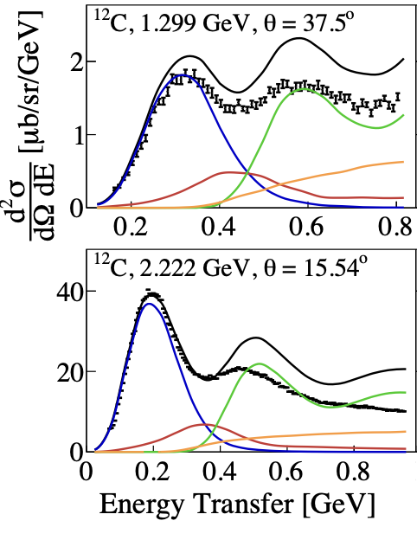
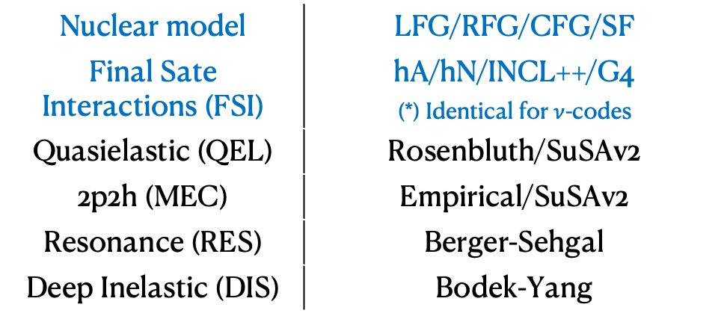

GENIE http://tunes.genie-mc.org
  GEM21_11a (SuSAv2), e-¹²C data
$ν$-A, $l^{±}$-A and $h$-A event generator
  MeV to PeV, all targets
Full description for electrons
  Common code for $ν$-A, $e^{−}$-A processes
  Many models available
QE
RES
MEC
DIS
Nuclear model | LFG/RFG/CFG/SF
Final Sate Interactions (FSI) | hA/hN/INCL++/G4 (*) Identical for $ν$-codes
Quasielastic (QEL) | Rosenbluth/SuSAv2
2p2h (MEC) | Empirical/SuSAv2
Resonance (RES) | Berger-Sehgal
Deep Inelastic (DIS) | Bodek-Yang
PhysRevD.103.113003
A. Papadopoulou et. al.

Slide 5
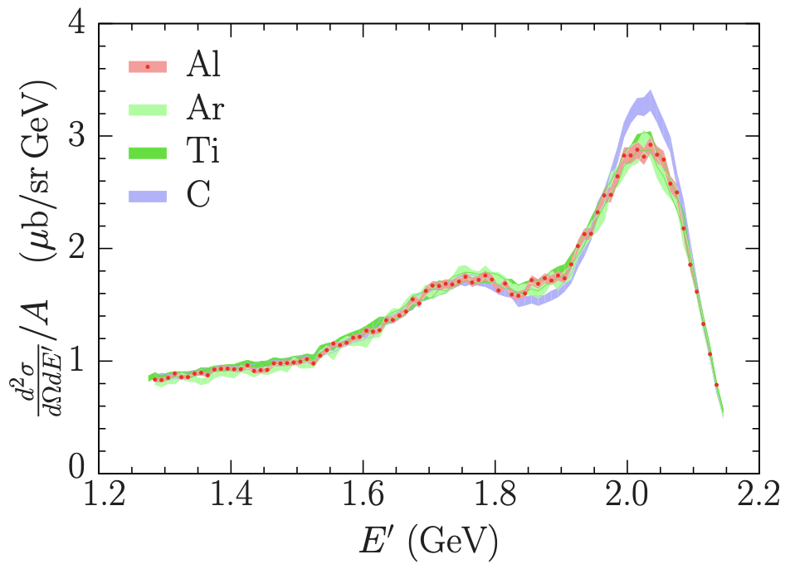
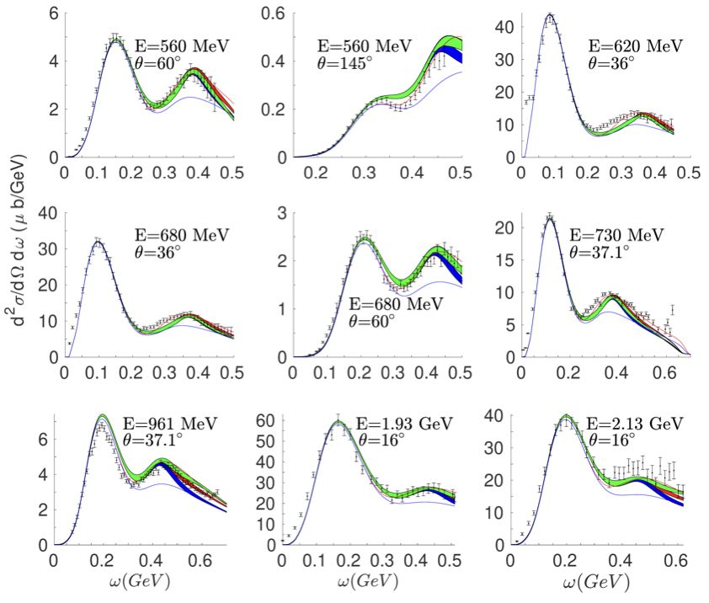
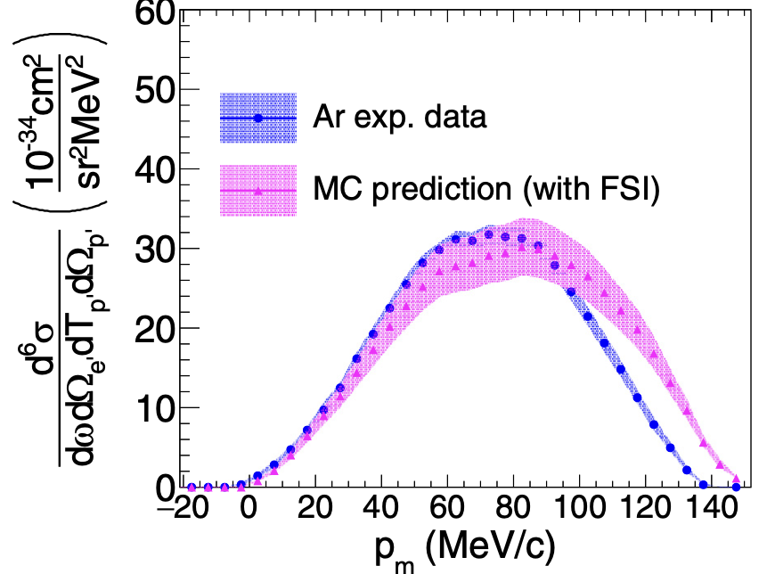
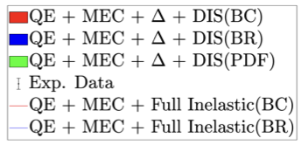

Inclusive measurements
The Jefferson Lab Hall A Collaboration
@ PhysRevC.100.054606 (2019)
@ PhysRevC.100.054606 (2019)
@ PhysRevC.99.054608 (2019)
Most electron-scattering measurements are inclusive
Exclusive measurements are limited to specific kinematics
Lacking exclusive hadron production measurements
@ PhysRevC.98.014617 (2018)
@ PhysRevC.98.014617 (2018)
(e,e’)
SuSAv2 model extension to inelastic regime
2.222 GeV, $θ_{e}$=15.54°◦
@ PhysRevC.103.034604 (2021)
@ PhysRevD.105.093009
(e,e’p)
e-¹²C @O. Benhar et.al.
2.222GeV, $θ_{e}=21.5∘$
$θ_{p}=−50∘$, 0<E_{m} <27MeV

Slide 6
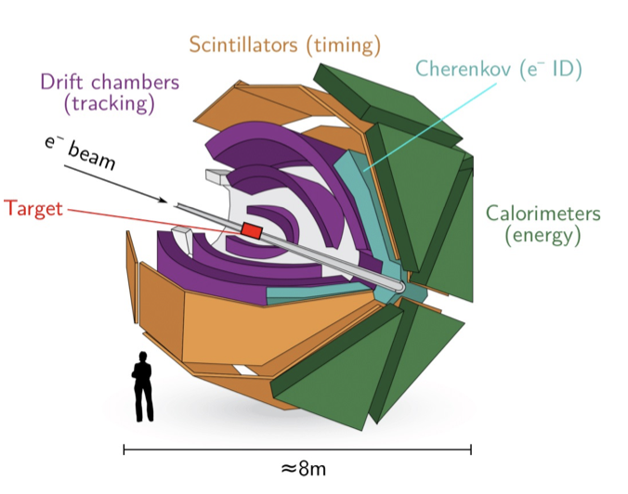
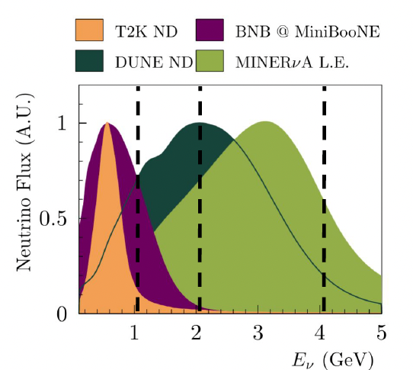
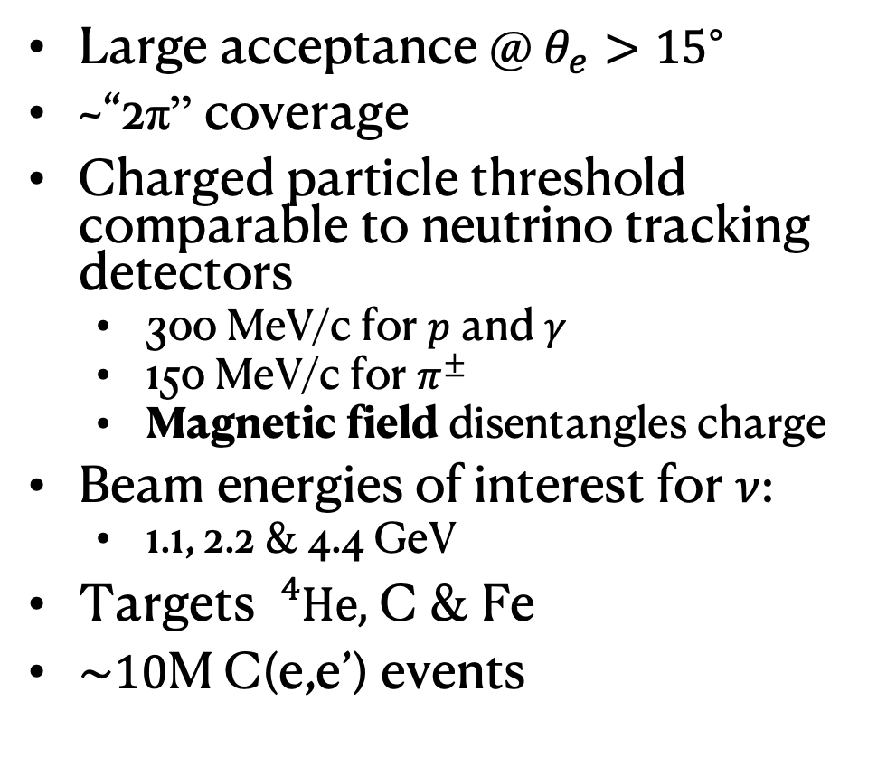
Hadron production with CLAS6
Large acceptance @ $θ_{e}>{15}^{∘}$
~“2π” coverage
Charged particle threshold comparable to neutrino tracking detectors
  300 MeV/c for $p$ and $γ$
  150 MeV/c for $π^{±}$
  Magnetic field disentangles charge
Beam energies of interest for $ν$:
  1.1, 2.2 & 4.4 GeV
Targets${}_{}^{4}{He},$ C & Fe
$\sim 10$M C(e,e’) events

Slide 7
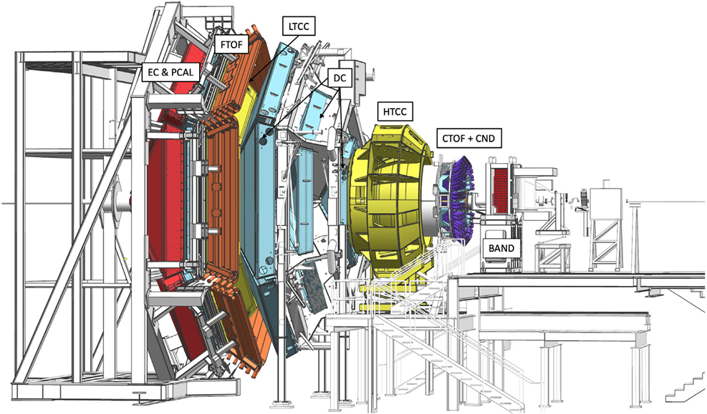

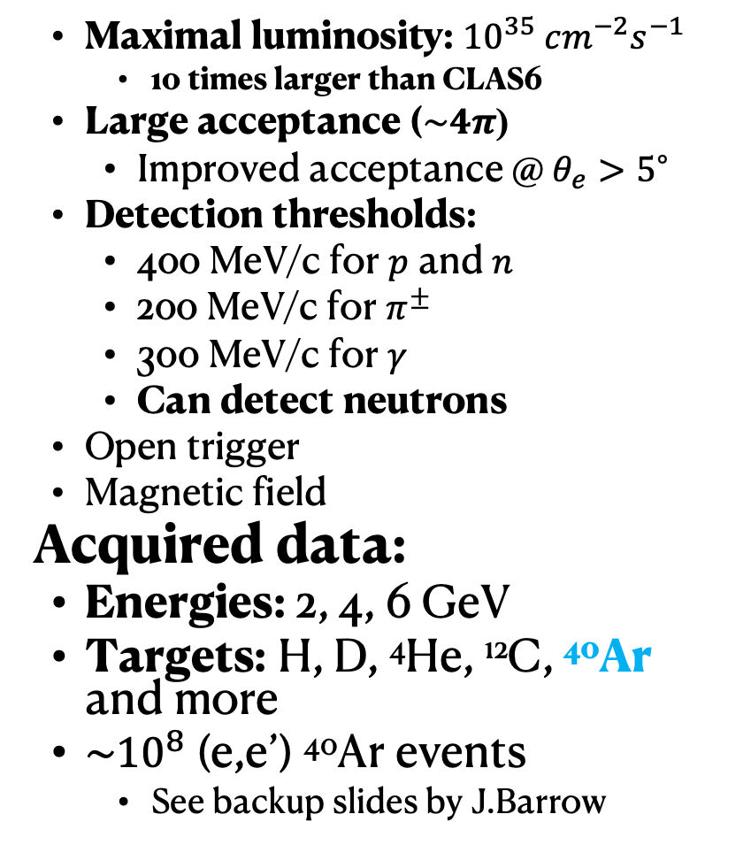
The CLAS12 detector
Forward Detector (FD)
Maximal luminosity: ${10}^{35} {cm}^{−2}s^{−1}$
  10 times larger than CLAS6
Large acceptance ($\sim 4π$)
  Improved acceptance @ $θ_{e}>5^{∘}$
Detection thresholds:
  400 MeV/c for $p$ and $n$
  200 MeV/c for $π^{±}$
  300 MeV/c for $γ$
  Can detect neutrons
  Open trigger
  Magnetic field
Acquired data:
Energies: 2, 4, 6 GeV
Targets: H, D, ⁴He, ¹²C, ⁴⁰Ar and more
$\sim {10}^{8}$ (e,e’) ⁴⁰Ar events
  See backup slides by J.Barrow
Central Detector
Beam
https://doi.org/10.1016/j.nima.2020.163419

Slide 8
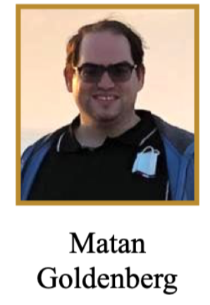
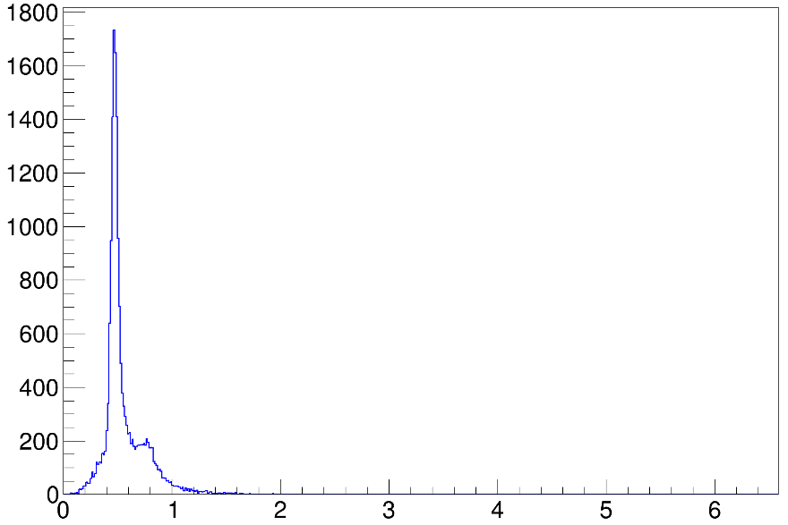
Inclusive (e,e’) at multiple angles and targets
²H at 6GeV
$θ_{e}∈$[10.5, 39.5]° with 1° steps
CLAS 12 data
PRELIMINARY
Event Rate
Energy transfer [GeV]

Slide 9
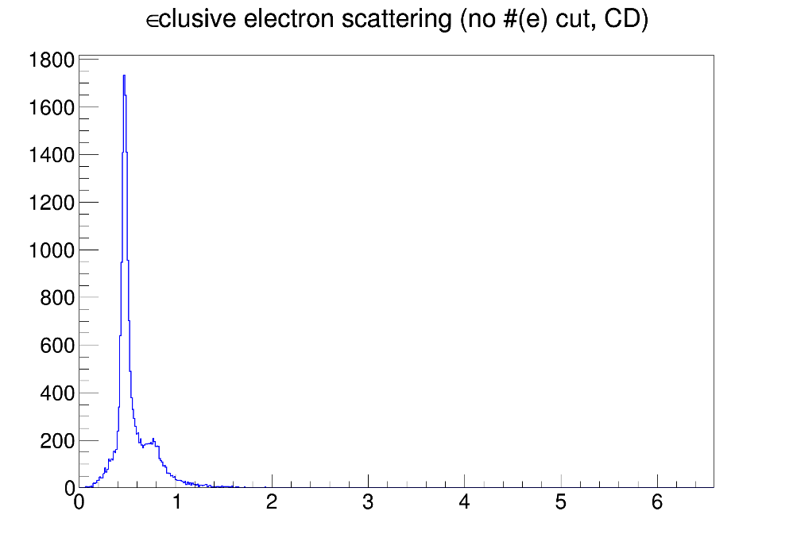
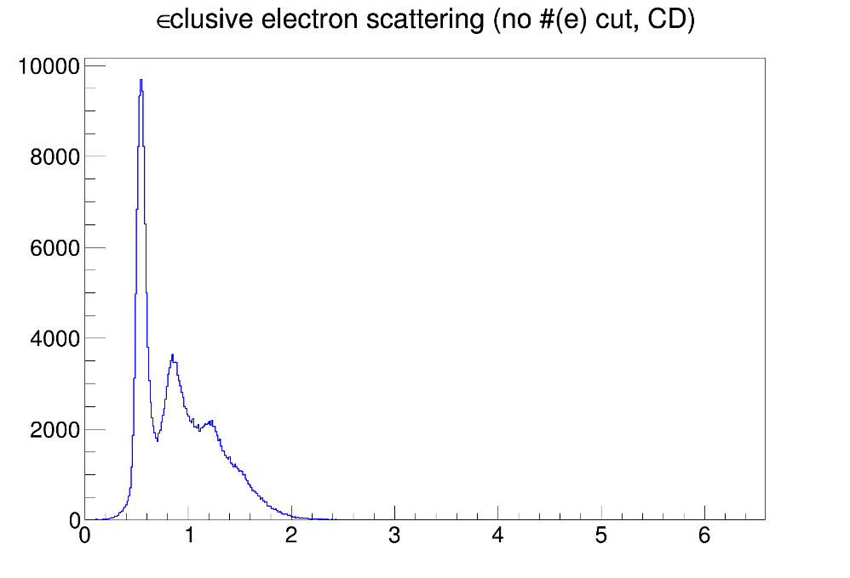
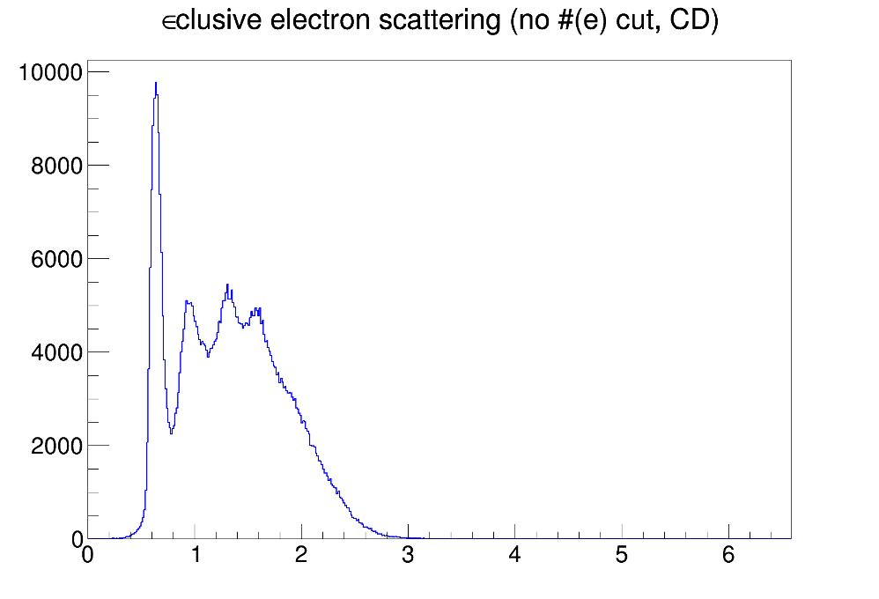
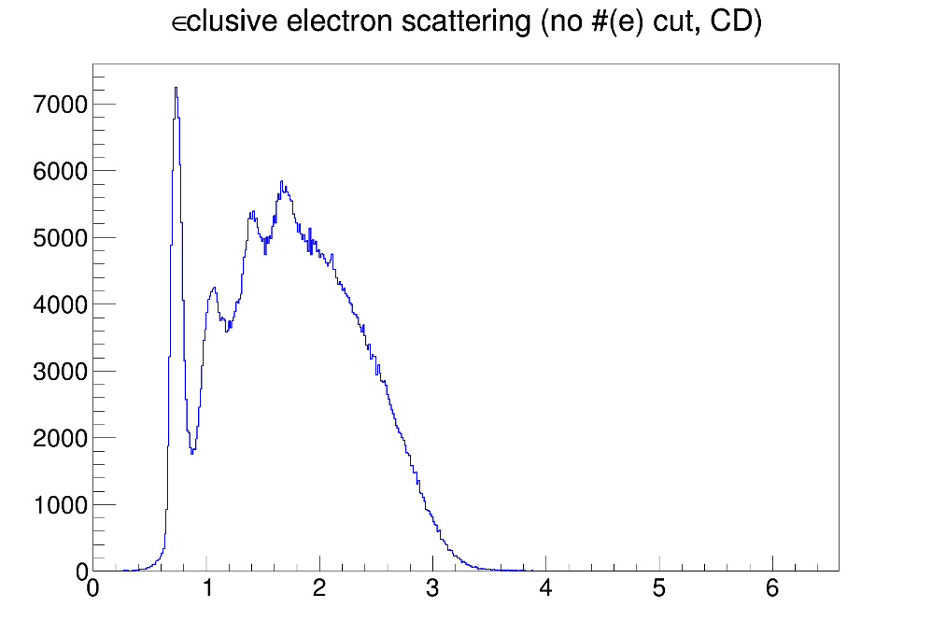
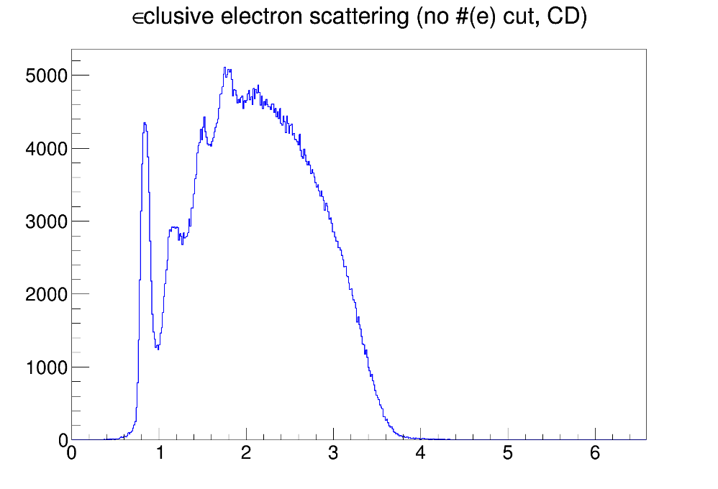
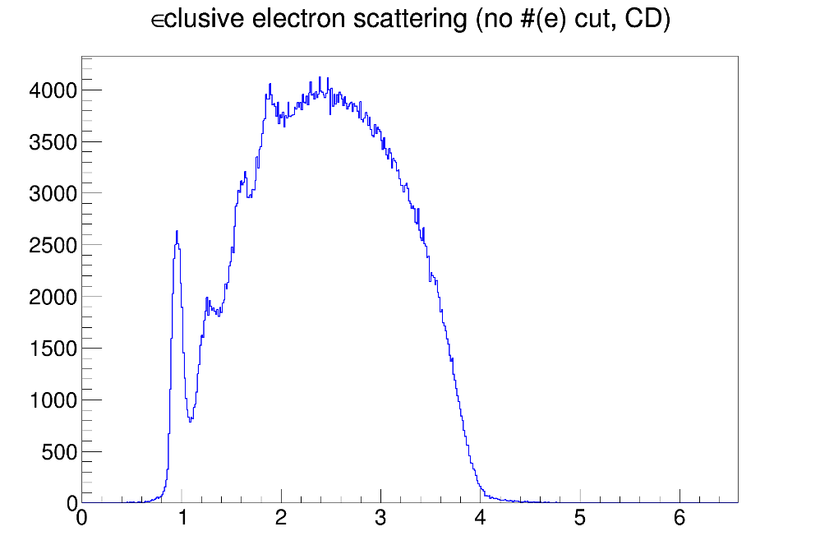
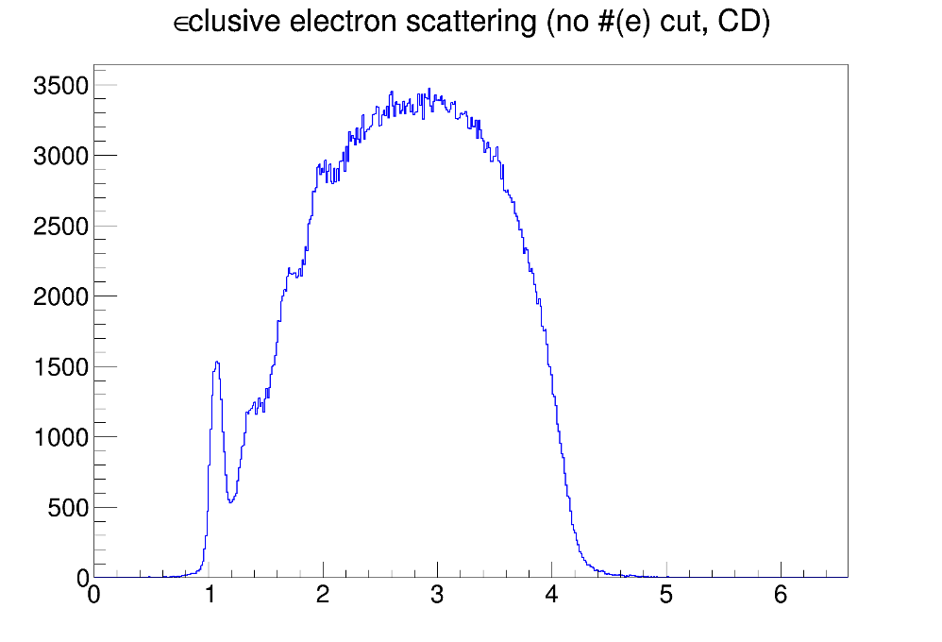
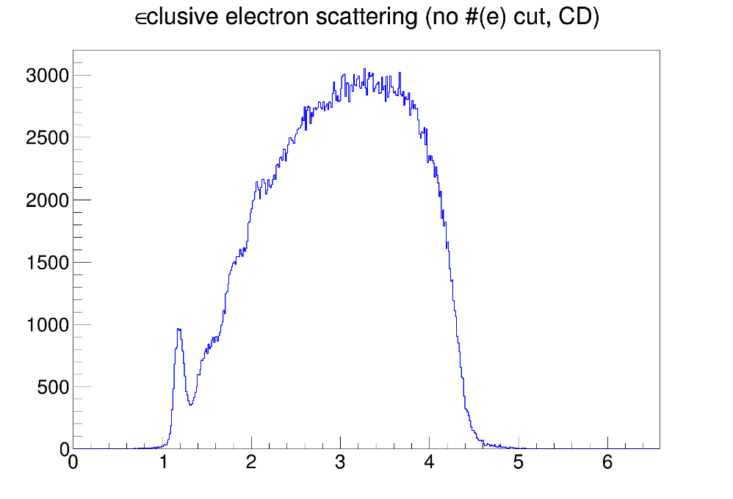
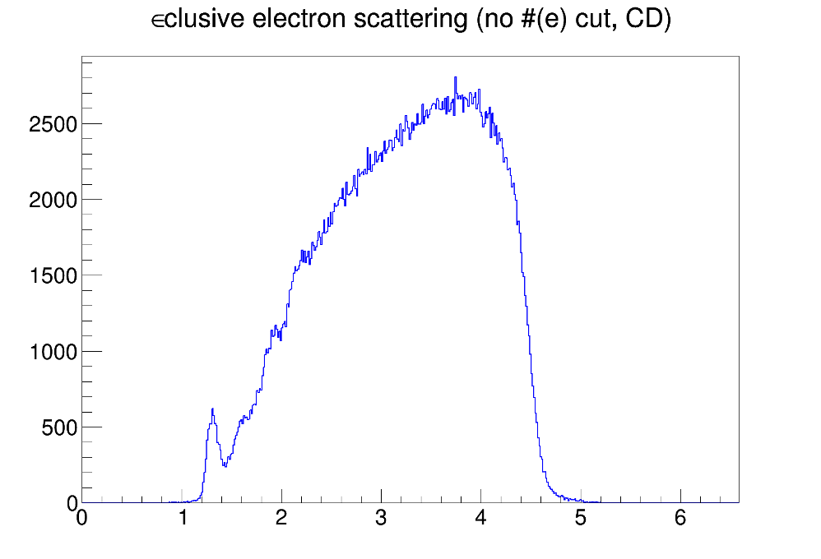
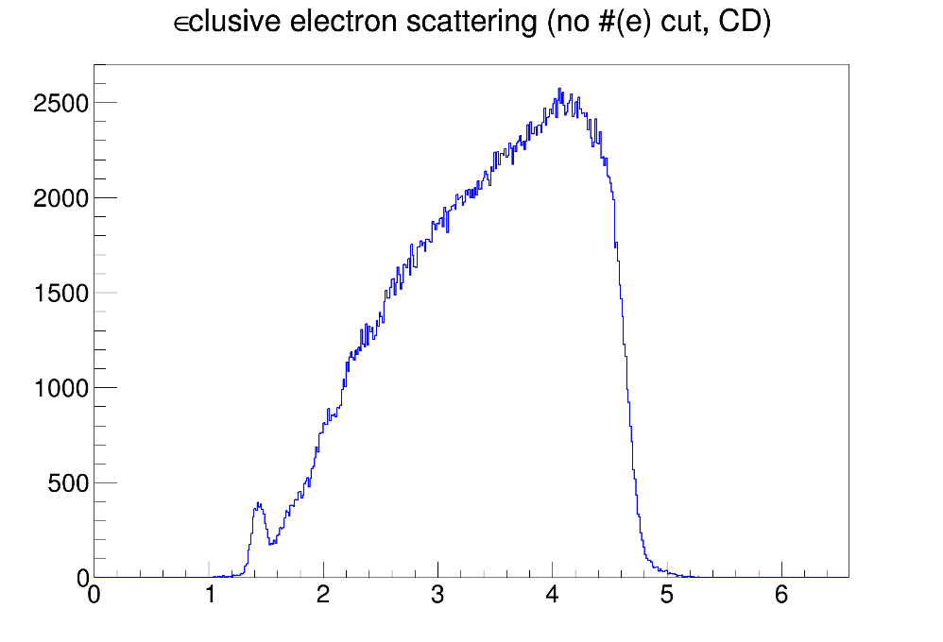
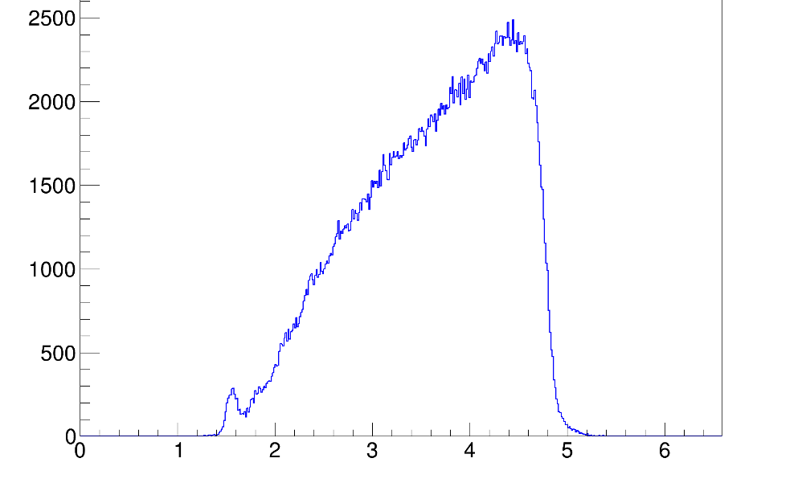
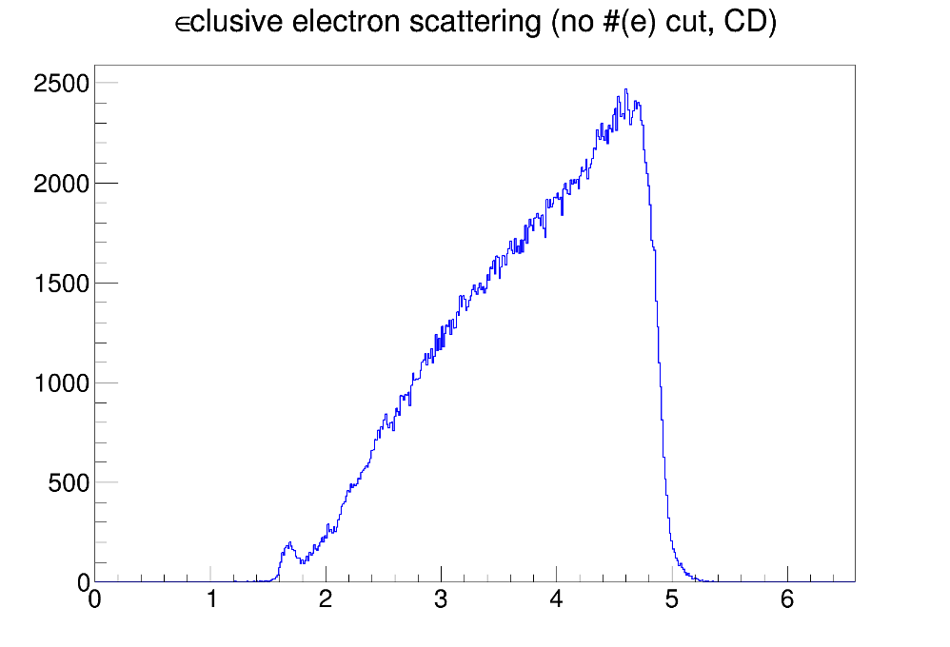
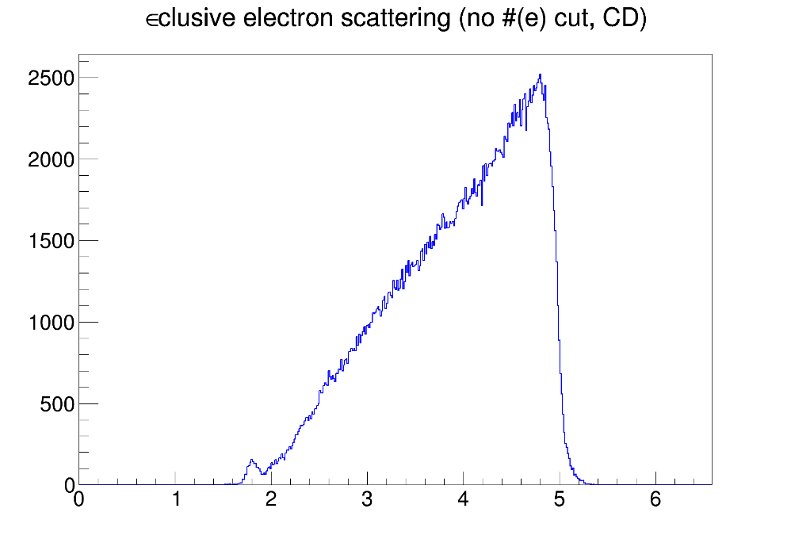
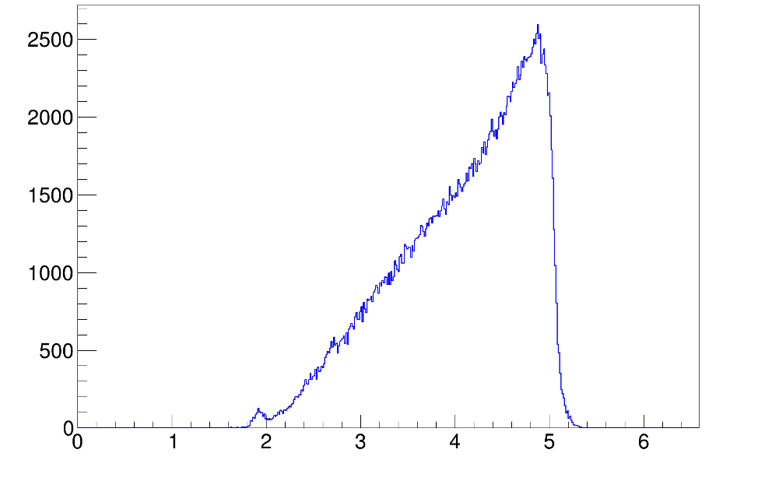
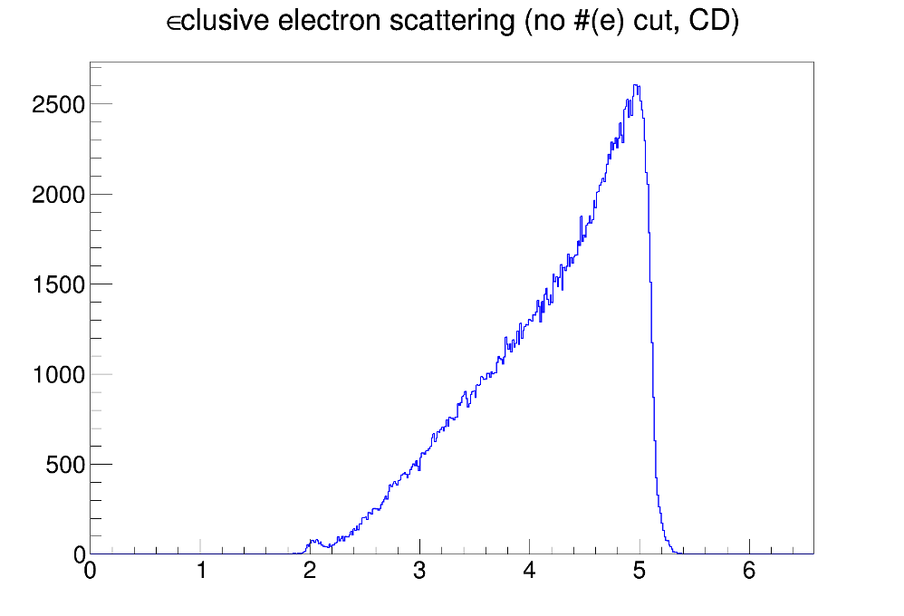
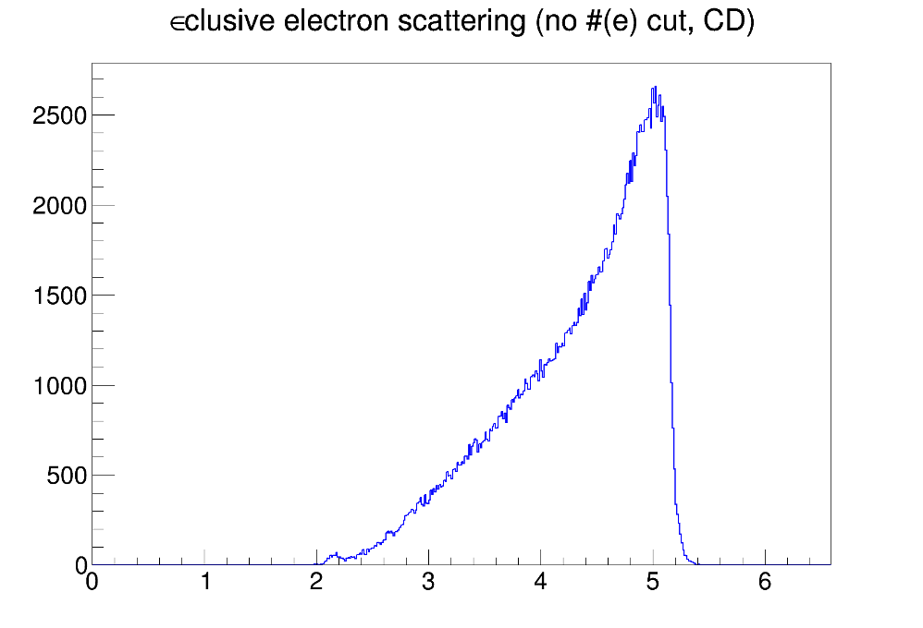
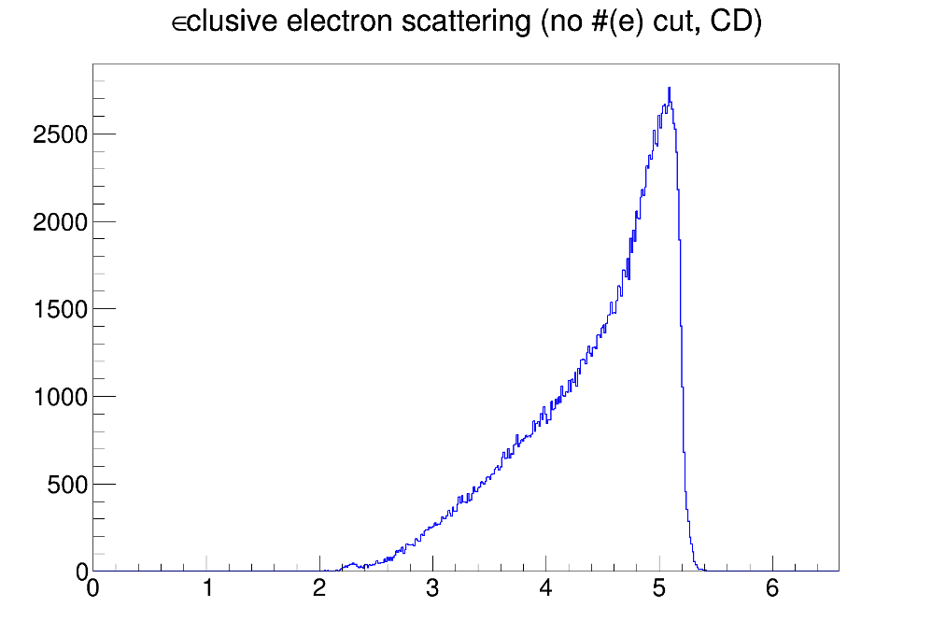
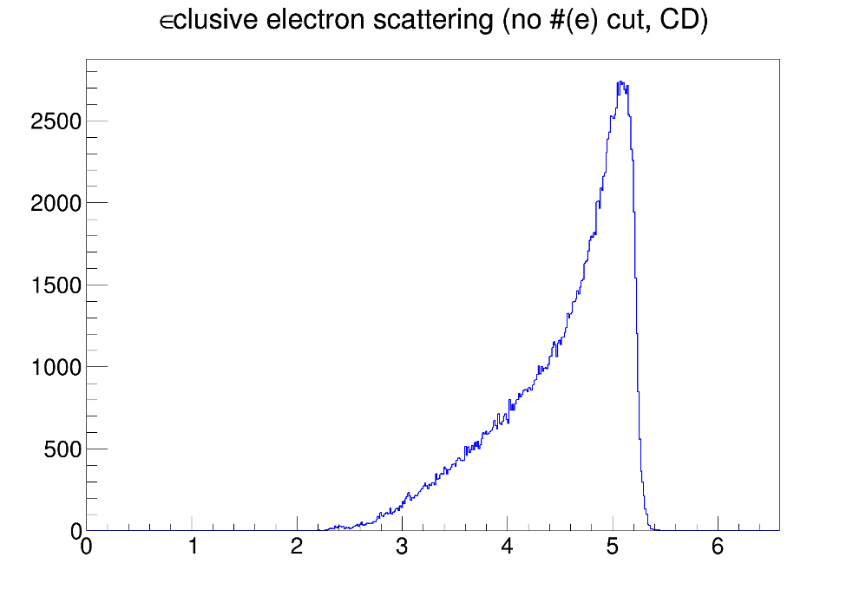
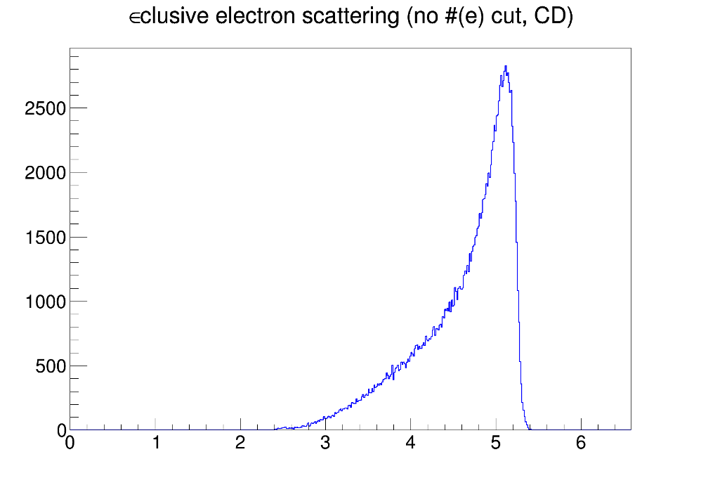
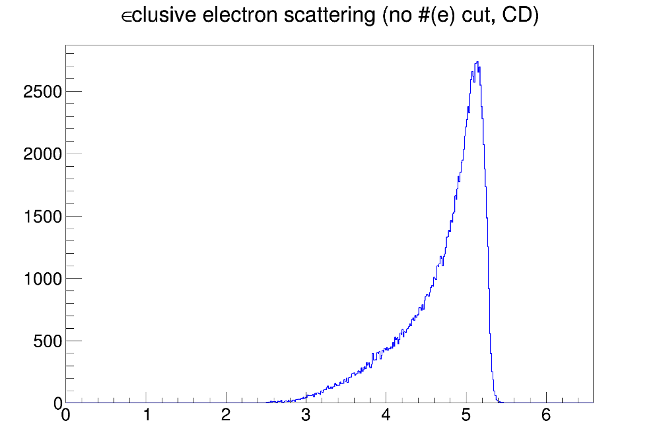
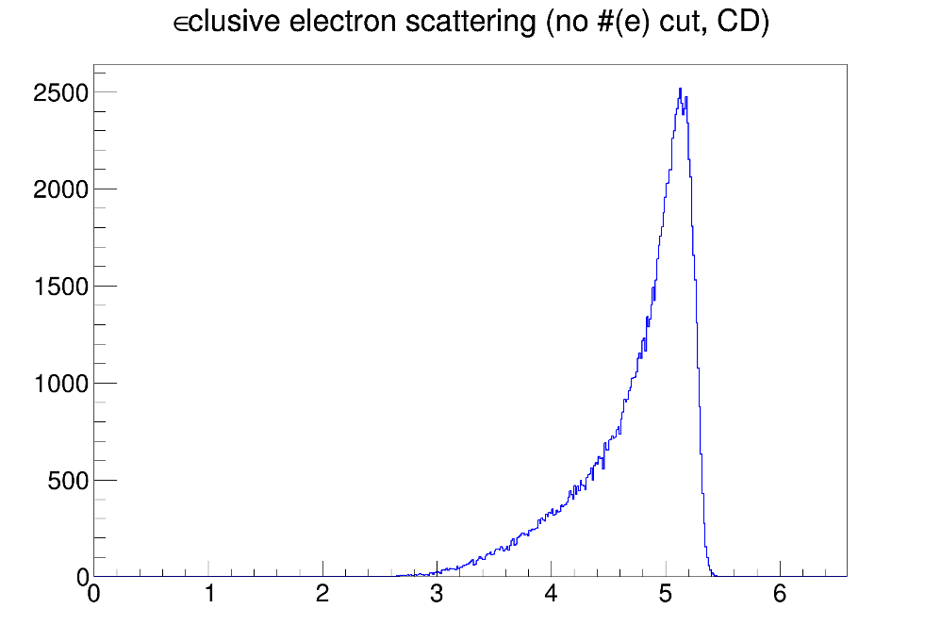
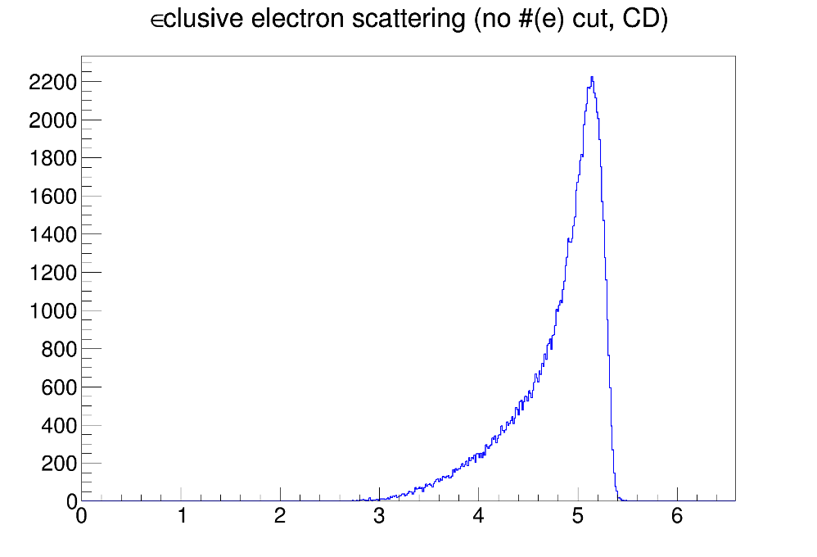
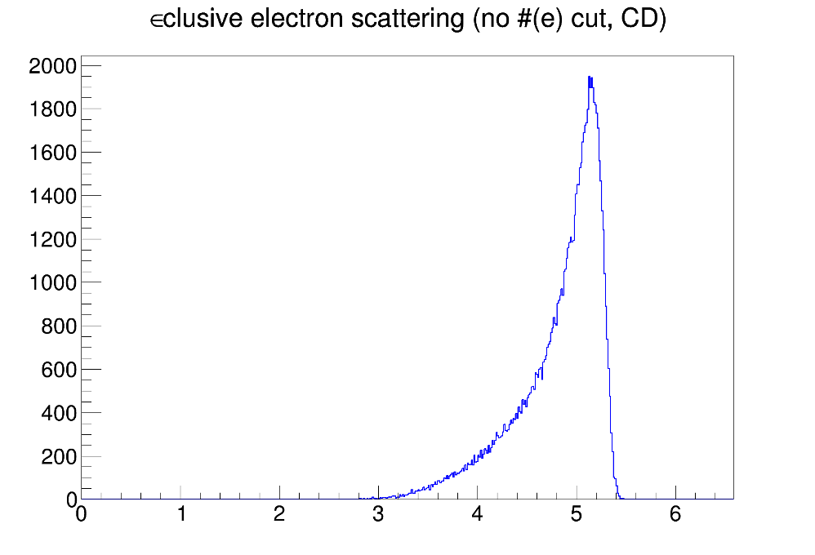
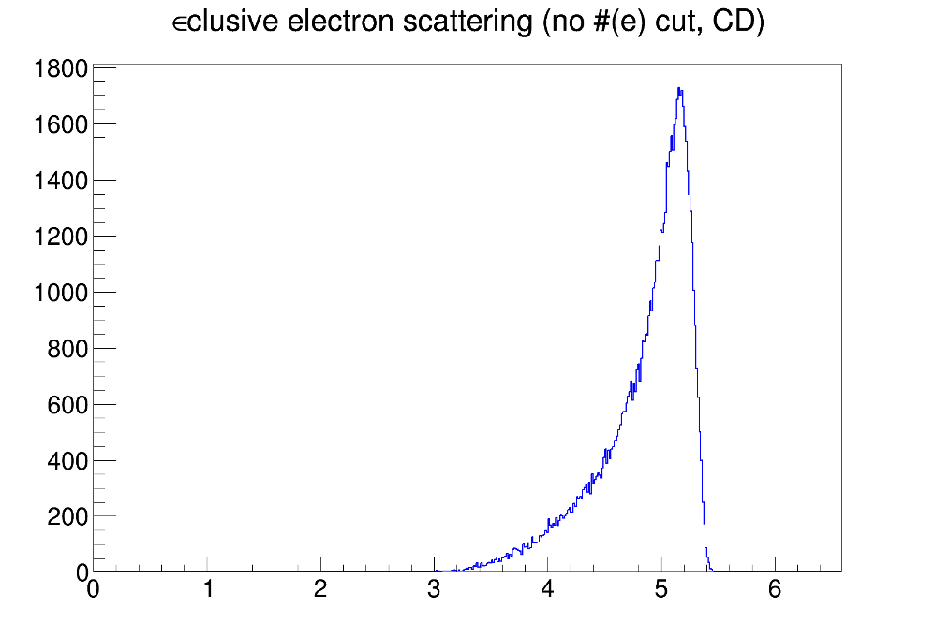
























Inclusive (e,e’) at multiple angles and targets
Can choose kinematics to focus on specific reaction mechanisms
$θ_{e}∈$[8.5,9.5]°
$θ_{e}∈$[9.5,10.5]°
$θ_{e}∈$[10.5,11.5]°
$θ_{e}∈$[11.5,12.5]°
$θ_{e}∈$[12.5,13.5]°
$θ_{e}∈$[13.5,14.5]°
QEL
RES
PRELIMINARY
PRELIMINARY
PRELIMINARY
PRELIMINARY
PRELIMINARY
PRELIMINARY
$θ_{e}∈$[14.5,15.5]°
$θ_{e}∈$[15.5,16.5]°
$θ_{e}∈$[16.5,17.5]°
$θ_{e}∈$[16.5,17.5]°
$θ_{e}∈$[17.5,18.5]°
$θ_{e}∈$[17.5,19.5]°
PRELIMINARY
PRELIMINARY
PRELIMINARY
PRELIMINARY
PRELIMINARY
PRELIMINARY
Event Rate
$θ_{e}∈$[18.5,19.5]°
$θ_{e}∈$[19.5,20.5]°
$θ_{e}∈$[20.5,21.5]°
$θ_{e}∈$[21.5,22.5]°
$θ_{e}∈$[22.5,23.5]°
$θ_{e}∈$[23.5,24.5]°
PRELIMINARY
PRELIMINARY
PRELIMINARY
PRELIMINARY
PRELIMINARY
PRELIMINARY
$θ_{e}∈$[24.5,25.5]°
$θ_{e}∈$[25.5,26.5]°
$θ_{e}∈$[26.5,27.5]°
$θ_{e}∈$[27.5,28.5]°
$θ_{e}∈$[28.5,29.5]°
$θ_{e}∈$[29.5,30.5]°
DIS
PRELIMINARY
PRELIMINARY
PRELIMINARY
PRELIMINARY
PRELIMINARY
PRELIMINARY
Energy transfer [GeV]

Slide 10
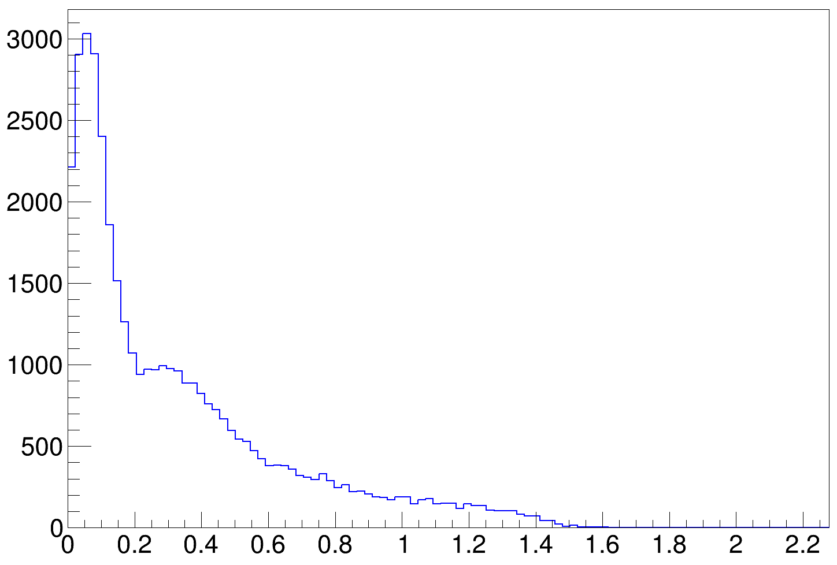
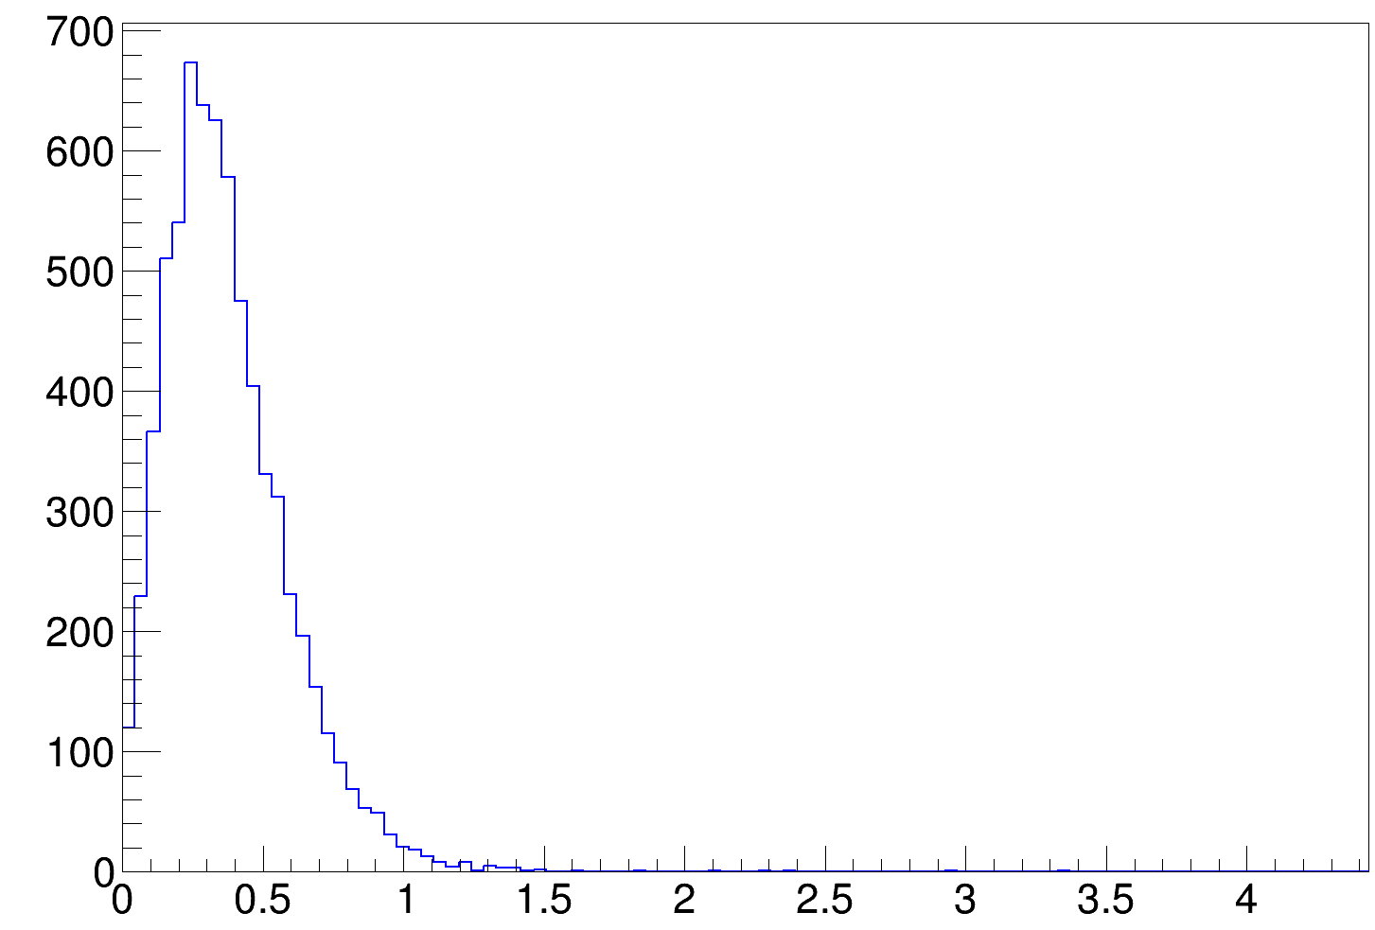

Inclusive (e,e’) at multiple angles and targets
⁴⁰Ar
2 GeV
4 GeV
CLAS 12 data, $θ_{e}∈$[6.5, 37.5] °
CLAS12 data, $θ_{e}∈$[9.5, 46.5] deg°
PRELIMINARY
PRELIMINARY
Event Rate
Event Rate
Energy transfer [GeV]
Energy transfer [GeV]

Slide 11
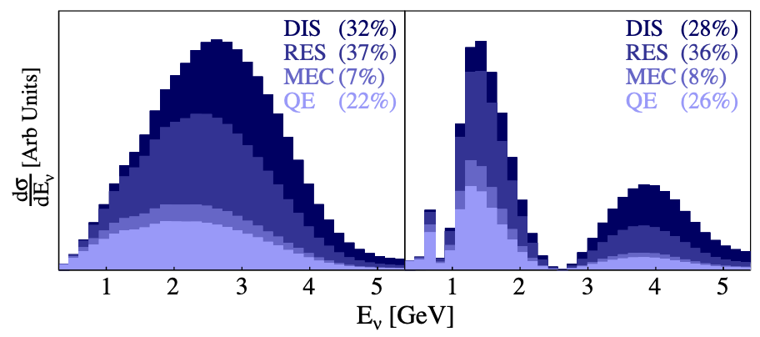




Pion production dominated era
DUNE will be dominated by pion production events
Near Detector flux
Far Detector flux
$$π$$
$$π$$
$$π$$
QE
QE
$$π$$
New precise data crucial to validate and improve models

Slide 12
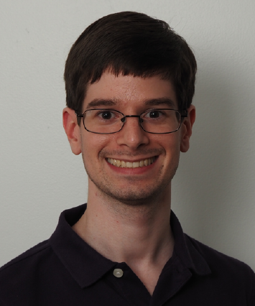




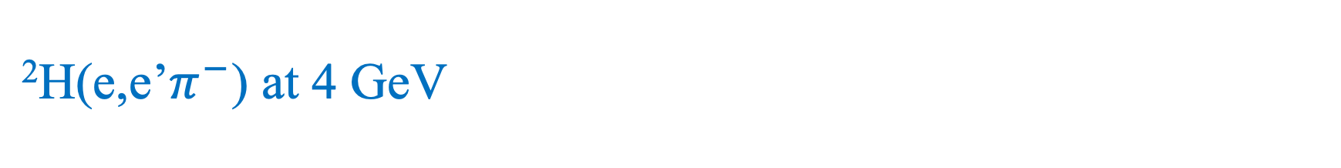







²H(e,e’$π^{−}$) at 4 GeV
0.7 < Q² < 1 GeV²
More Q² slices available
⁴⁰Ar measurement to come
$θ_{πq}$<6°
$6{≤θ}_{πq}$<10°
$10{≤θ}_{πq}$<20°
$20{≤θ}_{πq}$<30°
$30{≤θ}_{πq}$<40°
$40{≤θ}_{πq}$<50°
by Caleb Fogler
PRELIMINARY
PRELIMINARY
PRELIMINARY
PRELIMINARY
PRELIMINARY
PRELIMINARY
$2{≤P}_{π}$<3.3 GeV
CLAS12 data
PRELIMINARY
PRELIMINARY
PRELIMINARY
PRELIMINARY
PRELIMINARY
PRELIMINARY
$1.5{≤P}_{π}$<2 GeV
Uncorrected cross-section [mb/GeV]
PRELIMINARY
PRELIMINARY
PRELIMINARY
PRELIMINARY
PRELIMINARY
PRELIMINARY
$0.9{≤P}_{π}$<1.5 GeV
PRELIMINARY
PRELIMINARY
PRELIMINARY
PRELIMINARY
PRELIMINARY
PRELIMINARY
$0.6{≤P}_{π}$<0.9 GeV
PRELIMINARY
PRELIMINARY
PRELIMINARY
PRELIMINARY
PRELIMINARY
PRELIMINARY
$0.3{≤P}_{π}$<0.6 GeV
W [GeV]

Slide 13





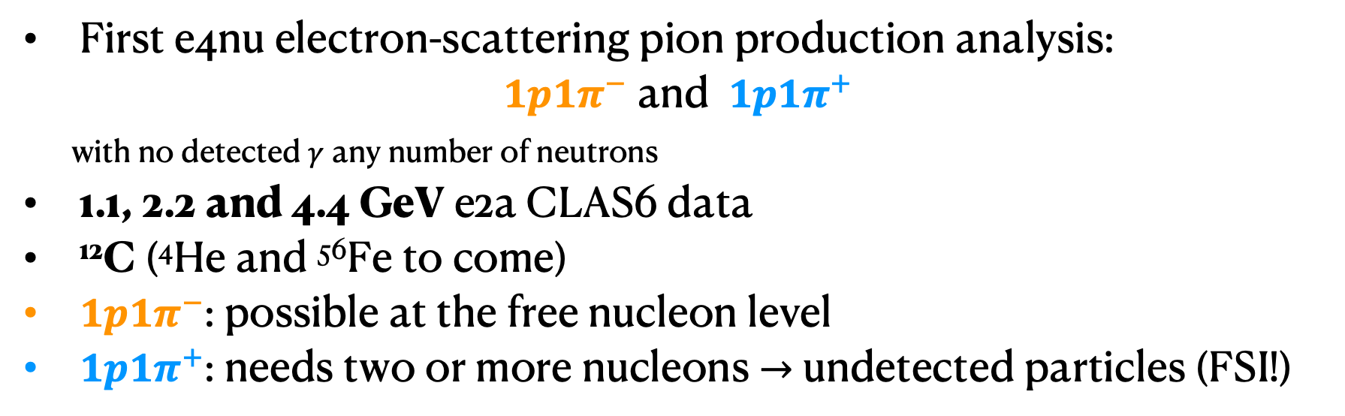






Exclusive pion production
First e4nu electron-scattering pion production analysis:
$1p1π^{−}$ and $1p1π^{+}$
with no detected $γ$ any number of neutrons
1.1, 2.2 and 4.4 GeV e2a CLAS6 data
¹²C (⁴He and ⁵⁶Fe to come)
$1p1π^{−}$: possible at the free nucleon level
$1p1π^{+}$: needs two or more nucleons $→$ undetected particles (FSI!)
$$π^{−}$$
$$π^{+}$$
$$∆^{0}$$
$$∆^{0}$$
$$π^{−}$$
$$e^{−}$$
$$γ$$
$$e^{−}$$
$$γ$$
$$p$$
$$p$$

Slide 14
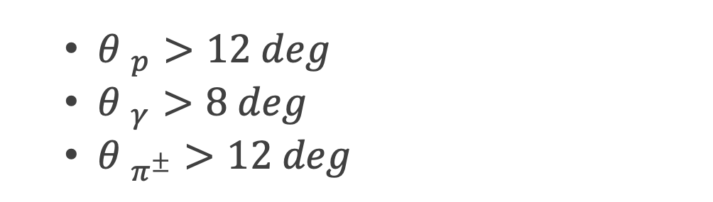
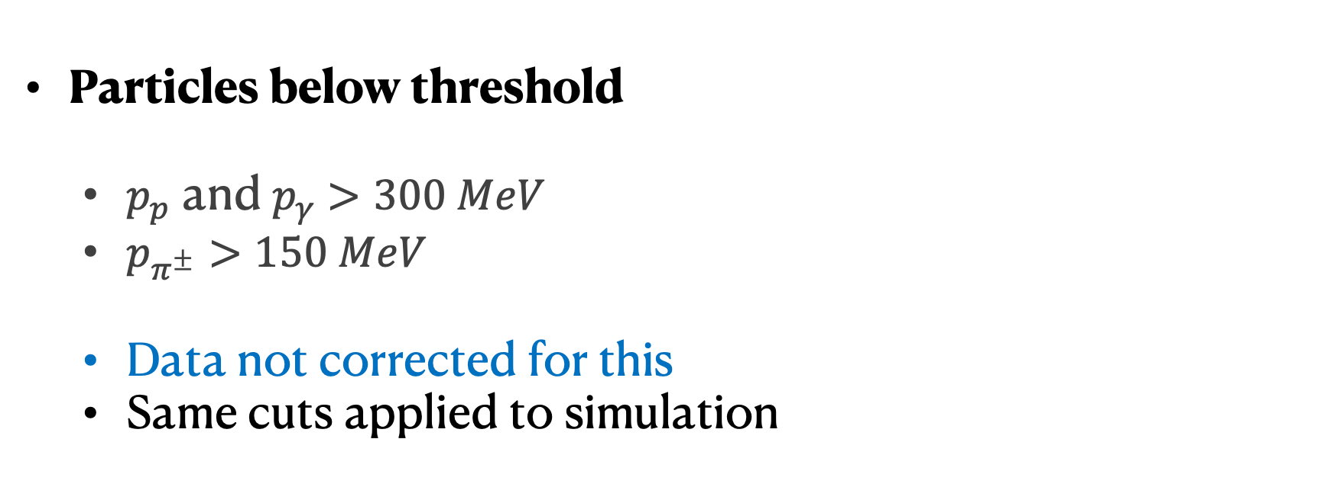

1p$1π^{±}$analysis: background contamination
Particles below threshold
  $p_{p}$ and $p_{γ}$ $>300 MeV$
  $p_{π^{±}}>150 MeV$
  Data not corrected for this
  Same cuts applied to simulation
  ${θ }_{p}>12 deg$
  ${θ }_{γ}>8 deg$
  ${θ }_{π^{±}}>12 deg$

Slide 15





1p$1π^{±}$analysis: background contamination
~50% of “4π” coverage
Not full “4π” coverage
  Gaps between the sectors
  Gaps within a sector
  “Data driven” background subtraction
    Multi-particle correction
$$π^{−}$$
$$p$$
$$π^{+}$$

Slide 16



C(e,e’1p$π^{−}$)
1.1 GeV
Shape-only comparison
  GENIE normalized to data
  Using GEM21_11a
  QEL+2p2h: SuSAv2
  RES: Berger-Sehgal
  SIS+DIS: Bodek-Yang
  FSI: hA
Data corrected for bkg. events, e/p/$π^{±}$acceptance and detection eff.
  Not radiative corrected yet
  Only statistical errors
No FSI
PRELIMINARY
Events/Bin width
GENIE
PRELIMINARY
$$∆$$
SIS
Other RES
W [GeV]

Slide 17




C(e,e’1p$π^{−}$) – Pion momentum
$$π^{−}$$
$$p$$
1.1 GeV
2.2 GeV
4.4 GeV
PRELIMINARY
PRELIMINARY
PRELIMINARY
Shape well described by GENIE
FSI needed

Slide 18

C(e,e’1p$π^{−}$) – Pion angle
$$π^{−}$$
$$p$$
1.1 GeV
2.2 GeV
4.4 GeV
PRELIMINARY
PRELIMINARY
PRELIMINARY
Angular shape in good agreement with GENIE

Slide 19

C(e,e’1p$π^{−}$) – Proton momentum
$$π^{−}$$
$$p$$
1.1 GeV
2.2 GeV
4.4 GeV
PRELIMINARY
PRELIMINARY
PRELIMINARY
Low momentum protons are not described by MC
Sensitive to FSI

Slide 20


C(e,e’1p$π^{−}$) – Proton angle
$$π^{−}$$
$$p$$
1.1 GeV
2.2 GeV
4.4 GeV
PRELIMINARY
PRELIMINARY
PRELIMINARY
PRELIMINARY
Angular shape in good agreement with MC
High $θ_{p}$ possible only due to FSI

Slide 21



C(e,e’1p$π^{−}$) – Transverse boosting angle
$$π^{−}$$
$$p$$
1.1 GeV
2.2 GeV
4.4 GeV
PRELIMINARY
PRELIMINARY
PRELIMINARY
$δα_{T}$ is sensitive to mostly FSI
Excellent shape description

Slide 22


C(e,e’1p$π^{+}$) – Proton angle
$$π^{+}$$
$$p$$
1.1 GeV
2.2 GeV
4.4 GeV
PRELIMINARY
PRELIMINARY
PRELIMINARY
FSI crucial to describe data
Most events due to FSI

Slide 23

C(e,e’1p$π^{+}$) - proton momentum
$$π^{+}$$
$$p$$
1.1 GeV
2.2 GeV
4.4 GeV
PRELIMINARY
PRELIMINARY
PRELIMINARY
Good shape description

Slide 24










Beam energy reconstruction
2.2 GeV on Carbon
[Nature 599, 565-590 (2021)]
1p$0π$
1p${1π}^{−}$
1p${1π}^{+}$
PRELIMINARY
PRELIMINARY
  $E_{Cal}=E_{e′}$+ $T_{p}$+$ε_{p}$
  $E_{Cal}=E_{e′}$+ $E_{π}$ + $T_{p}$+$ε_{p}$
  $E_{Cal}=E_{e′}$+ $E_{π}$ + $T_{p}$+$ε_{p}$
Peak reconstructed if measured particles are full final state
Tail due to missing particles, not well described

Slide 25

Proton transparency
New proton transparency measurement on ⁴He, ¹²C and ⁵⁶Fe
  Probability that a struck proton leaves the nucleus without significant re-scattering
  Study proton FSI similarly to neutrino scattering
All previous transparency analysis measure (e,e’p)exp/(e,e’p)_{PWIA}
Define a more data driven transparency analysis informed by theory
T_{A} = N(e,e’p)0π /${\text{N}\text{(}\text{e}\text{,}\text{e}\text{’)}}_{QE}$
N(e,e’p)0π: selected 1p0π events from CLAS6
  Background subtracted, radiative, acceptance and efficiency corrections
${\text{N}\text{(}\text{e}\text{,}\text{e}\text{’)}}_{QE}$: inclusive QEL event rate
  Use GENIE to determine QE dominated regions

Slide 26



Proton transparency
¹²C
⁵⁶Fe
PRELIMINARY
PRELIMINARY
Compatible with previous data

Slide 27



Proton transparency
⁴He
¹²C
⁵⁶Fe
PRELIMINARY
PRELIMINARY
PRELIMINARY
First transparency measurement on ⁴He
Transparency flat in p_{p} decreases with A
Data to MC differences larger at small p_{p}, grow with A
  MC very sensitive to nuclear structure models
Publication soon!

Slide 28

First 2p and 1n1p knockout analysis
Alon Sportes
CLAS12 ¹²C 6GeV data
Selecting 1n1p or 2p events with no visible pions in the final state
  6 GeV on Carbon
  $N_{(e,e^{′}2p)}\sim 50k, N_{(e,e^{′}1n1p)}\sim 30k$
  Will repeat analysis:
    2, 4 and 6GeV
    Argon target
PRELIMINARY
PRELIMINARY
PRELIMINARY
PRELIMINARY

Slide 29

Conclusions
e4nu provides important input for $ν$-A interactions
  Huge increase in data base for hadron electroproduction
  New sensitivity to nuclear structure/FSI
  Significant improvement to event generators
Many channels available for 1-6 GeV electrons (e.g. carbon, argon)
  Unprecedented wide kinematic coverage for inclusive scattering
  New and unique pion-proton coincidence data studies FSI, $∆$(1232)
  New proton transparency data studies FSI and nuclear structure
  New 1n1p/2p electroproduction gives new sensitivity to reaction mechanisms
  Many other channels available for new collaborators

Slide 30










e4nu at NuINT24
Thank you
New collaborators are welcome!
Caleb Fogler
Adi Ashkenazi
Steven Dytman
Matan Goldelberg
Larry Weinstein
Noah Steinberg
Julia Tena Vidal
Josh Barrow
Alon Sportes
Brandon Eberly
Minerva Betancourt
Steven Gardiner
Afroditi Papadopoulou

Slide 31
Backup slides

Slide 32

C(e,e’1p$π^{+}$) – Transverse boosting angle
$$π^{+}$$
$$p$$
1.1 GeV
2.2 GeV
4.4 GeV
PRELIMINARY
PRELIMINARY
PRELIMINARY
GENIE with FSI predicts correct rise

Slide 33

Acceptance correction per sector
Not used
Not used
Not used

Slide 34



Pion production analysis - Raw data
PRELIMINARY
PRELIMINARY
PRELIMINARY
Delta dominated
Multi-pion production
Higher W resonances

Slide 35



1p$1π^{±}$analysis: background contamination
“Data driven” background subtraction
  Rotate detected background event N times around $\vec{q}$
    Compute probability to be detected as signal ($Ρ_{signal}$)
    Add pseudo-event weighted by $Ρ_{signal}$
    1% $φ_{\vec{p}∙\vec{q}}$-dependence on cross-section
$$π$$

Slide 36




Background subtraction
Calculate the probability of the event to be reconstructed as
  i.e. 2p1$π$, 1p2$π$ and 1p1$π$
  We add a pseudo-event with weight $w$ and the new particle content after rotation
  $N_{mf}$: number of counts with $m_{f}<m_{i}$
  $w_{i}$: initial event weight
$$p$$
  $$w=−\frac{N_{mf}}{N_{mi}}w_{i}$$
$$π$$

Slide 37

Background subtraction
Repeat for lower multiplicity events
  i.e. 2p1$π$ and 1p2$π$
Calculate the weight for the event to be reconstructed as
  1p1$π$ (our signal definition)
  $w=+\frac{M_{mf′}}{M_{mf}}\frac{N_{mf}}{N_{mi}}$ $w_{i}$
  Repeat until we only have signal events
$$p$$

Slide 38

Background subtraction
The method can be easily generalized to any signal definition
We classify events given their multiplicity:
  Number of signal particles in the event
We calculate the weight for every event with $m>m_{signal}$
  All permutations considered by the algorithm
  Correct weight assigned to each event
The initial multiplicity is configurable

Slide 39


Background subtraction
PRELIMINARY
PRELIMINARY
PRELIMINARY

Slide 40

Correct for detector acceptance
We must correct the data for detector effects to obtain a detector-independent cross-section measurement
We use MC simulations to compute the acceptance correction
  MC simulation without detector effects
    “True MC”
  MC simulation with detector effects and no background events
    “True reconstructed MC”
We apply an overall per-bin scaling factor to the data:
$α_{acc, i}=\frac{True MC events ith−bin}{True Reconstructed MC events ith−bin}$

Slide 41


Detector acceptance maps
Depending on momentum and directionality, we assign an extra MC weight to account for detector acceptance effects
(*) Re-used from previous analysis

Slide 42

Radiative corrections
MC simulation does not account for radiative effects
We add radiative effects the same way as Jefferson Lab SIMC event generator
  Data correction factor
Implementation generalized for all interaction mechanisms
This is ongoing work; it is not included in the results shown in this talk

Slide 43



CLAS12 – acceptance
4/7/24
43
Electron
$ε_{eff}\left(θ_{e},φ_{e}\right)$ in $(e,e′)$
FD protons
$ε_{eff}\left(θ_{p},φ_{p}\right)$ in $(e,e′)$
Leading FD neutron
$ε_{eff}\left(θ_{n},φ_{n}\right)$ in $(e,e′)$
FD acceptance:
Polar angle: $5°≤θ≤35°$ (up to $45°$ in some sub-systems)
Azimuthal angle: from $50\%$ at $θ=5°$ to $90\%$ at $θ=40°$
CD acceptance:
Polar angle: $35°≤θ≤125°$
Azimuthal angle: full range
$$ε_{eff}\left(θ,φ\right)=\frac{Observed}{Expected}$$
Leading FD neutron = the neutron with the highest momentum magnitude in the FD
¹²C simulation at $E_{beam}≃6$ GeV

Slide 44

CLAS12 – sub-systems in the FD and CD
4/8/24
44
Forward Detector (FD):
High Threshold Cherenkov Counter (HTCC)
Drift Chambers (DC)
Low Threshold Cherenkov Counter (LTCC)
Forward Time-Of-Flight detector (FTOF)
Ring Imaging Cherenkov detector (RICH)
Electromagnetic Calorimeters (EC & PCAL)
Central Detector (CD):
Central Vertex Tracker (CVT)
Central Time-Of-Flight (CTOF)
Central Neutron Detector (CND)
Back Angle Neutron Detector (BAND)
https://doi.org/10.1016/j.nima.2020.163419
Back to:
The CLAS12 detector

Slide 45

CLAS12 statistics
J.Barrow

Slide 46

CLAS12 ⁴⁰Ar statistics
J.Barrow

Slide 47

CLAS12 ⁴⁰Ar statistics
J.Barrow

Slide 48

CLAS12 ⁴⁰Ar statistics
J.Barrow

