Slide 1
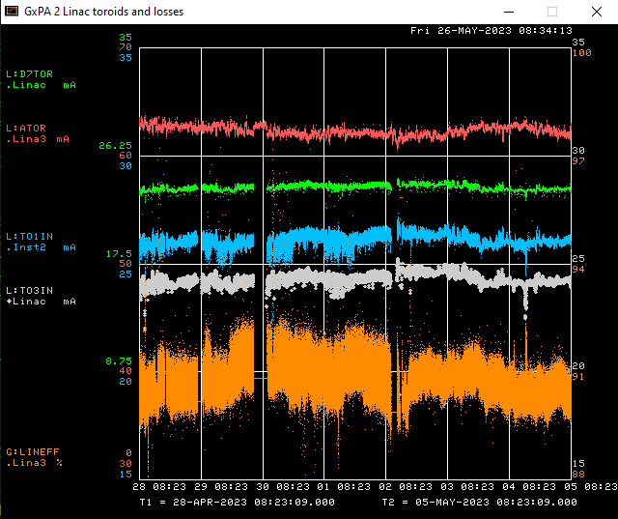
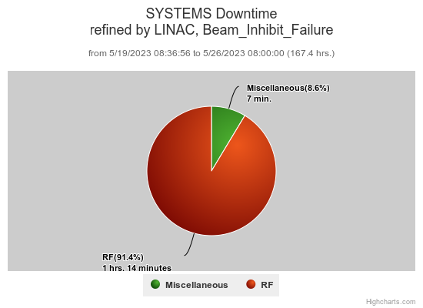
Preacc/Linac Weekly Performance
Tuesday: FPGA fuse blown out at DTL Station 2

Slide 2
Current Conditions/Plans
Source A – 58 mA
Linac input – 26 mA
Linac output – 23.7 mA
Opportunistic Tunnel Access ~30 min

