Slide 1
RR/MI status
Rob Ainsworth
9am ops meeting
26 May 2023

Slide 2
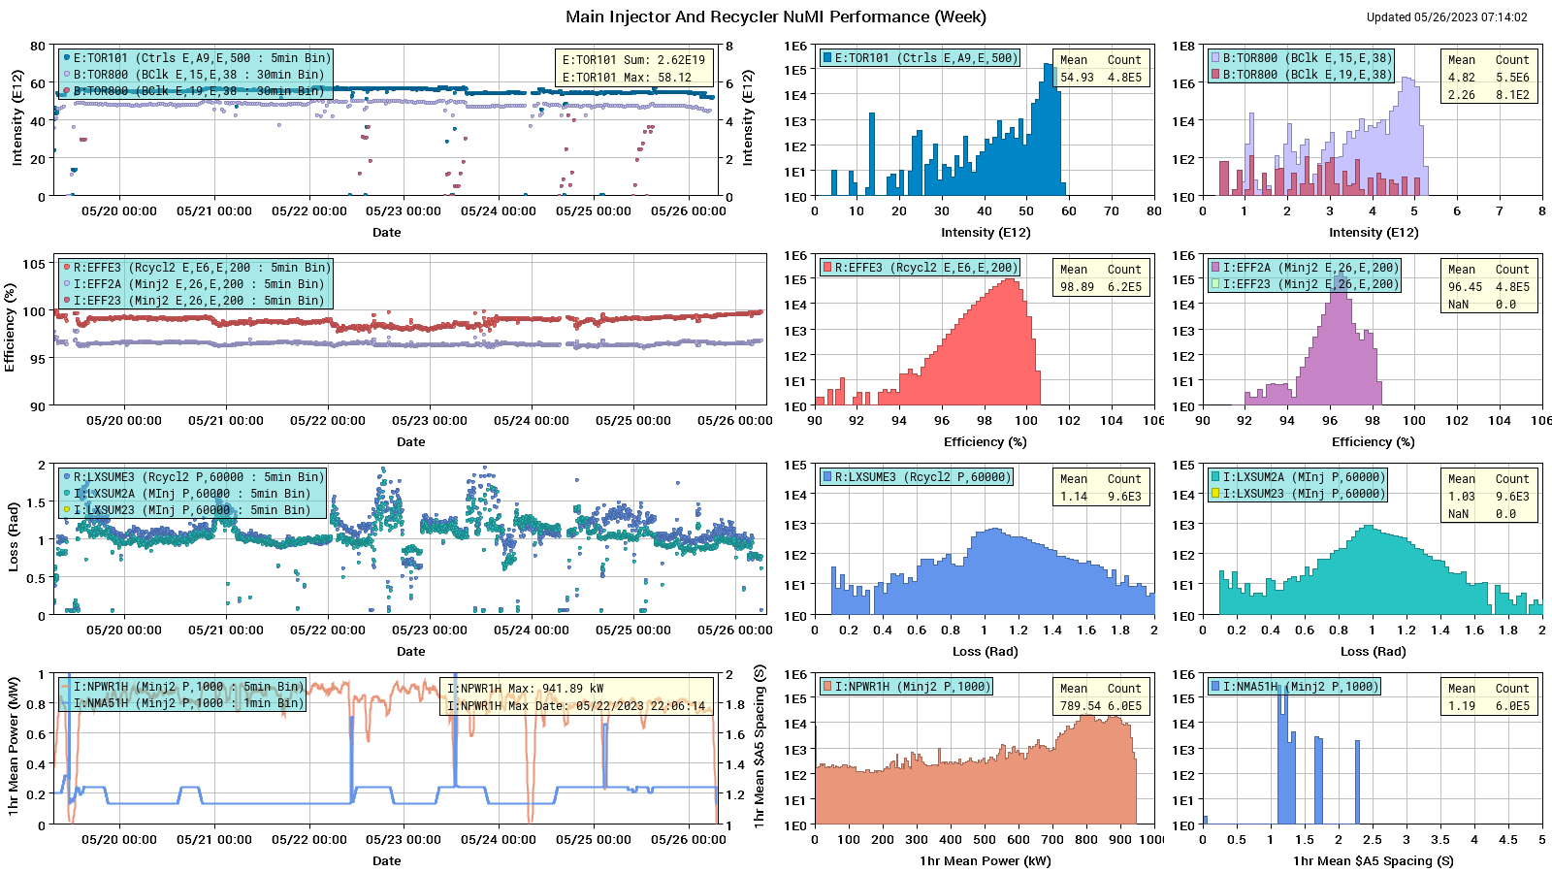
NuMI

Slide 3
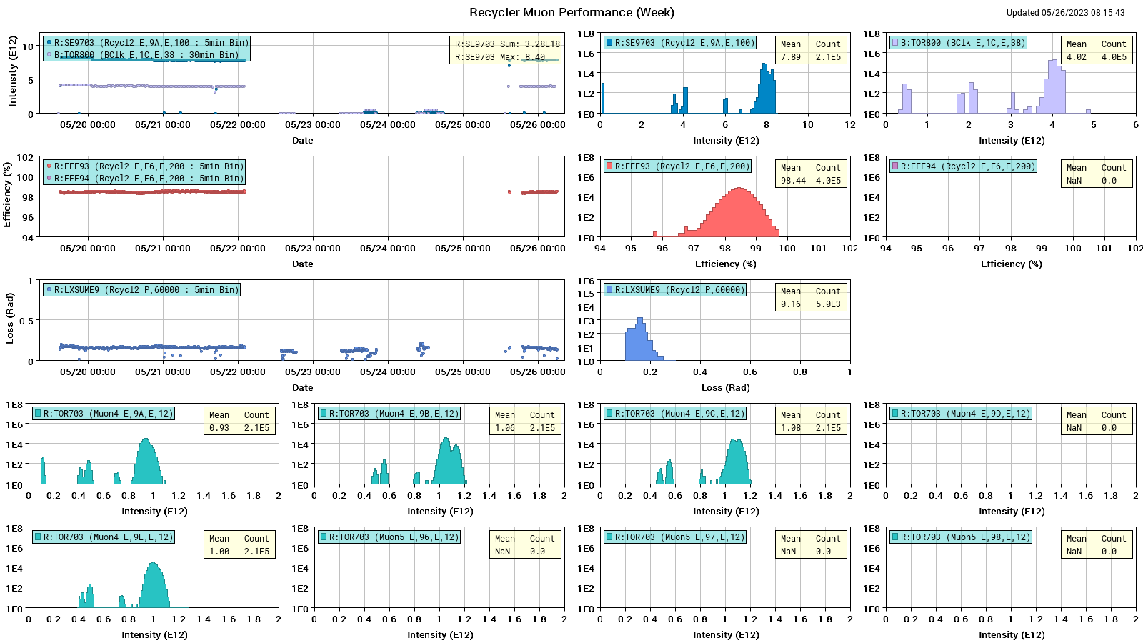
Muon

Slide 4
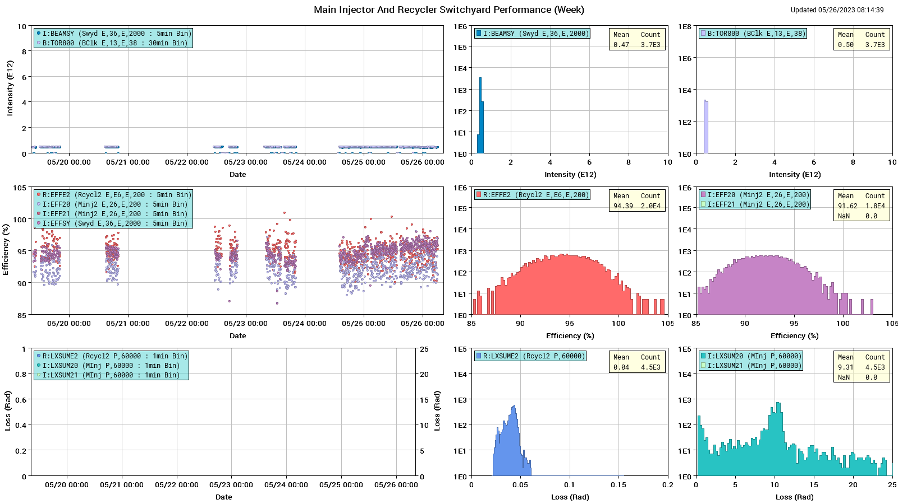
SY

Slide 5
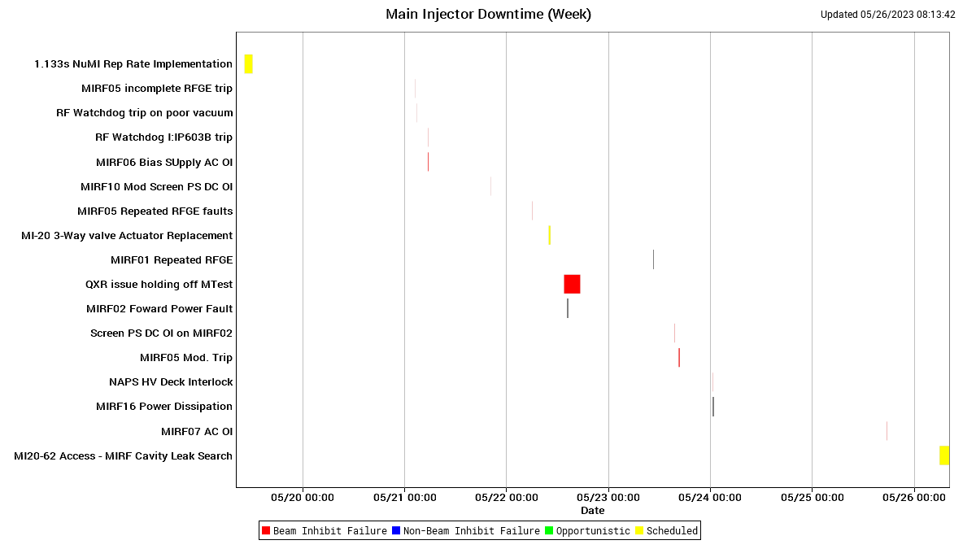
MI downtime

Slide 6
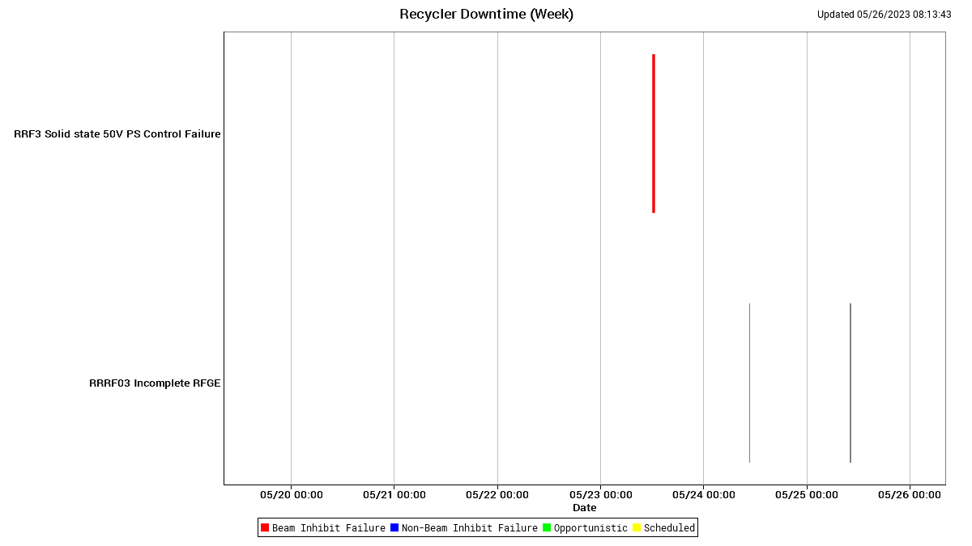
RR downtime

Slide 7
Weekly summary and requests
New 1 hour power record
960 kW
1.067s ramp implementation
Shooting for 1st week in July
Studies requests
$E0 and $E1 under the $20

