Slide 1
Study of simulation methods for atom interferometry sequences
MAGIS-100 Science and Simulation meeting
14 June 2023
Noam Mouelle

Slide 2
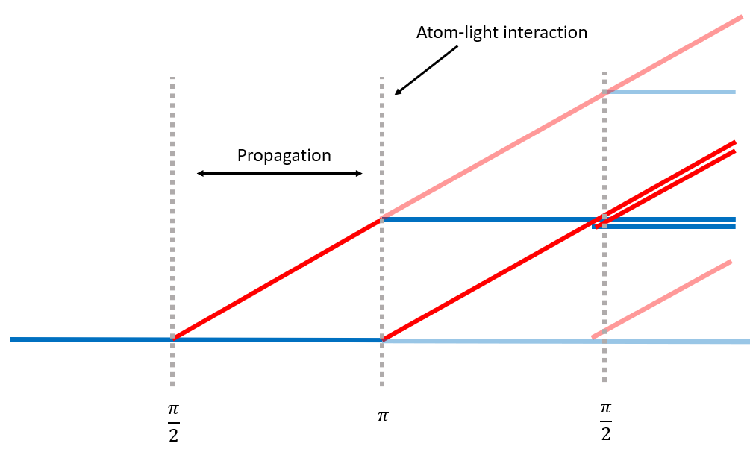
Introduction
Goal:
Finding a framework able to simulate realistic ultra-cold atom clouds undergoing A.I. sequences
Scope:
Free propagation of the quantum system
Interactions of the system with the laser pulses

Slide 3
Contents
Fully numerical propagation: split-step method
Beam-splitting scheme: ttt-scheme
Multiparticle simulation
Some results
Future plans

Slide 4
Fully numerical propagation
Split-step method

Slide 5
Fully numerical propagation: split-step method
Main approach is to use a wave-packet to represent an atom, allowing the use of the semi-classical approximation [1]:
$$|\left.ψ\left(t\right)\right\rangle =e^{\frac{iS_{cl}}{ℏ}}|\left.ψ(t_{0})\right\rangle$$
however:
Not exact beyond quadratic potentials
A priori, solutions to S.E. in a trap are not Gaussians. A more general method is needed.
[1] P. Storey, C. Cohen-Tannoudji. Journal de Physique II, 1994, 4 (11), pp.1999-2027.

Slide 6
Fully numerical propagation: split-step method
For a general Hamiltonian of the form
$$\hat{H}=\frac{{\hat{p}}^{2}}{2m}+V(\hat{r})$$
Then, for any wavefunction
$$|\left.ψ\left(t+Δt\right)\right\rangle =\exp\left(−\frac{iV\left(\hat{r}\right)Δt}{2ℏ}\right)\exp\left(−\frac{i{\hat{p}}^{2}Δt}{2mℏ}\right)\exp\left(−\frac{iV\left(\hat{r}\right)Δt}{2ℏ}\right)\left|\left.ψ\left(t\right)\right\rangle \right.+O(Δt^{3})$$
position-only
momentum-only
position-only

Slide 7
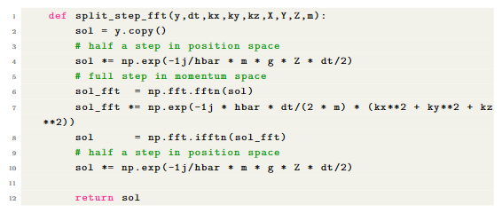
Fully numerical propagation: split-step method
Momentum-only propagation can be done in Fourier space efficiently with FFT
Limited by position grid resolution:
$$λ_{DB}=\frac{h}{p}→Δx≤\frac{h}{2p}≲{10}^{−9}m$$

Slide 8
Beam-splitting scheme
ttt-scheme

Slide 9
Beam-splitting scheme: ttt-scheme^{[2]}
Goal: model laser pulses accounting for
Detuning
Finite pulse duration
External fields
Position-dependent laser amplitude/phase
Working with Hamiltonian
$$\hat{H}=\left(\frac{\hat{p}}{2m}+V\left(\hat{r}\right)\right)⊗\hat{1}+\hat{1}⊗ℏω_{0}\left|\left.e\right\rangle \right.\left\langle \left.e\right|\right.−ℏΩ_{0}\cos\left(ωt−k⋅\hat{r}+φ\right)⊗(\left|\left.e\right\rangle \right.\left\langle \left.g\right|\right.+\left|\left.g\right\rangle \right.\left\langle \left.e\right|\right.)$$
external dof
internal dof
laser pulse
[2] C. Antoine, C. J. Bordé, Appl. Phys. B 84, 585–597 (2006)

Slide 10
Beam-splitting scheme: ttt-scheme^{[2]}
Key is to remove the internal and external parts by going in the interaction picture
$$\left.|ψ(t)\right\rangle →\exp\left(\frac{i}{ℏ}\left({\hat{H}}_{ext}+{\hat{H}}_{int}\right)(t−t_{1})\right)\left.|ψ(t)\right\rangle$$
And to remove explicit time-dependence by going in the rotating frame
$$\left.|ψ\right\rangle →\left(e^{−i\hat{Φ}\left(t,t_{1}\right)}\left|\left.e\right\rangle \right.\left\langle \left.e\right|\right.+\left|\left.g\right\rangle \right.\left\langle \left.g\right|\right.\right)\left.|ψ\right\rangle$$
$$\hat{Φ}\left(t,t_{1}\right)=ω−ω_{0}−k⋅\hat{R}\left(t,t_{1}\right)+φ$$
arbitrary time
[2] C. Antoine, C. J. Bordé, Appl. Phys. B 84, 585–597 (2006)

Slide 11
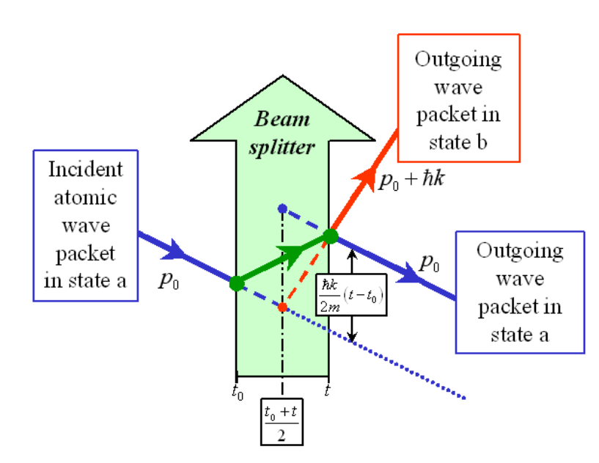
Beam-splitting scheme: ttt-scheme^{[2]}
Effects of these operators can be easily calculated for Gaussian wavepackets. Effectively we have
$$t_{0}$$
propagation
$$t_{1}$$
propagation
$$t$$
Effective intereaction (splitting+phase shift+ translation)
Laser turns off
Laser turns on
[2] C. Antoine, C. J. Bordé, Appl. Phys. B 84, 585–597 (2006)

Slide 12
Beam-splitting scheme: ttt-scheme^{[2]}
Rotating frame transformation:
Extension: position-dependent phase
$$\hat{Φ}\left(t,t_{1}\right)=δω−k⋅\hat{R}\left(t,t_{1}\right)+φ$$
If $φ→φ(\hat{r})$, we can expand it around the position of the atom
0th order:
$$φ\left(\hat{r}\right)=φ\left(r_{0}\right)+O(\left|\hat{r}−r_{0}\right|)$$
$\hat{Φ}(t,t_{1})$ becomes
$$δω−k⋅\hat{R}\left(t,t_{1}\right)+φ(r_{0})$$
$$\left.|ψ\right\rangle →\left(e^{−i\hat{Φ}\left(t,t_{1}\right)}\left|\left.e\right\rangle \right.\left\langle \left.e\right|\right.+\left|\left.g\right\rangle \right.\left\langle \left.g\right|\right.\right)\left.|ψ\right\rangle$$
[2] C. Antoine, C. J. Bordé, Appl. Phys. B 84, 585–597 (2006)

Slide 13
Beam-splitting scheme: ttt-scheme^{[2]}
1st order:
$$φ\left(\hat{r}\right)=φ\left(r_{0}\right)+\left(\hat{r}−r_{0}\right)∇φ\left(r_{0}\right)+O\left({\left|\hat{r}−r_{0}\right|}^{2}\right)$$
$\hat{Φ}(t,t_{1})$ becomes
$$δω−\left(k−∇φ\left(r_{0}\right)\right)⋅\hat{R}\left(t,t_{1}\right)+φ\left(r_{0}\right)−r_{0}∇φ(r_{0})$$
$$δω−k′⋅\hat{R}\left(t,t_{1}\right)+φ′$$
i.e. scattering + phase shift
wavefront
[2] C. Antoine, C. J. Bordé, Appl. Phys. B 84, 585–597 (2006)

Slide 14
Beam-splitting scheme: ttt-scheme^{[2]}
Notes on implementation:
Terms in phase shift, like $ω$ are $O\left({10}^{15}\right)$ and require precision of $O({10}^{−4})$. Quadruple precision is required (128 bits)
Currently have a prototype implementation in Python which does not include:
Wavefront aberration scattering
Evolution of laser wavefront
[2] C. Antoine, C. J. Bordé, Appl. Phys. B 84, 585–597 (2006)

Slide 15
Multi-particle simulations

Slide 16
Multiparticle simulations
single-particle states
General multi-particle wavefunction (no-interaction)
$$\left.|α_{1},…,α_{N}\right\rangle =\frac{1}{\sqrt{N!∏n_{α}!}}\sum_{P}{{\left(±1\right)}^{P}}\left.|α_{P1}\right\rangle ⊗…⊗\left.|α_{PN}\right\rangle$$
The resulting probability distribution contains ${N!}^{2}$ terms
Approximation must be made
+1/-1 for bosons/fermions
sum over all permutations

Slide 17
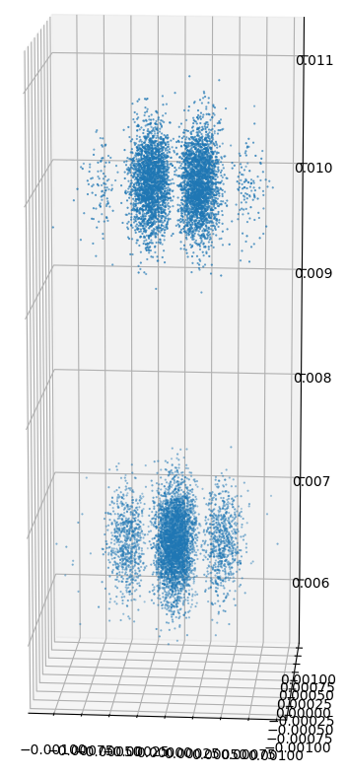
Multiparticle simulation
Naive approach:
one cloud = many Gaussian wavepackets
This holds as long as the wavepackets do not overlap.
The condition is therefore
$$w{\left(t\right)}^{3}≪σ{\left(t\right)}^{3}/N$$
wave-packet width
cloud width

Slide 18
Multiparticle simulation
We have
$w\left(t\right)=\sqrt{w_{0}^{2}+{\left(\frac{ℏt}{2mw_{0}}\right)}^{2}}$ and $σ\left(t\right)=\sqrt{σ_{0}^{2}+\frac{k_{B}T}{m}t^{2}}$
So the conditions are
$w_{0}^{3}≪\frac{σ_{0}^{3}}{N}$ and $w_{0}≫\frac{ℏ}{2\sqrt{mk_{B}T}}$
Or
$${\left(\frac{ℏ}{2\sqrt{mk_{B}T}}\right)}^{3}≪\frac{σ_{0}^{3}}{N}$$
i.e. thermal cloud
coherence length $L$

Slide 19
Multiparticle simulation
Is this applicable to MAGIS-100?
Parameters of [3]: $N=4×{10}^{6}, {3σ}_{0}=200μm, T=50nK$
Give:
$\frac{L^{3}N}{V}≲1$
[3] A Sugarbaker, S M. Dickerson, J M. Hogan, D M. S. Johnson, M A. Kasevich.
Phys. Rev. Lett. 111, 113002 – Published 10 September 2013

Slide 20
Some results

Slide 21
Some results
1s
$$V\left(r\right)=mgr−\frac{1}{2}mΓr^{2}$$
Simulation of a 3 pulse sequence with a thermal cloud (wavepackets)
Interference scheme:
Combine overlapping wavepackets
Sample
prop
prop
prop
$${\left|A_{i}\right|}^{2}+{\left|A_{j}\right|}^{2}+2A_{i}A_{j}\cos{(δφ_{ij}+\overline{p}r_{ij})}$$
Wave-packet params (128bits):
Amplitude
Phase
Position
Momentum
Width params
$$\frac{π}{2}$$
$$π$$
$$\frac{π}{2}$$

Slide 22
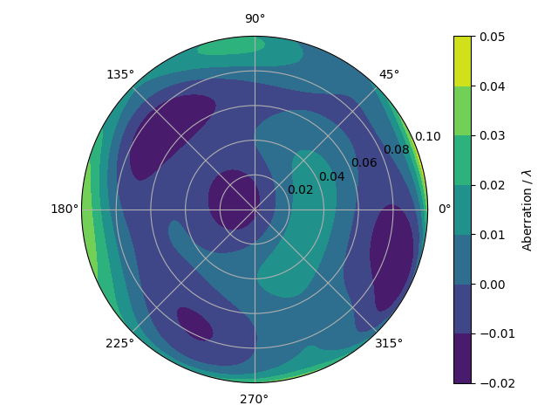
Some results
Code based on aisim^{[4]}
Randomly generated wavefront (36 Zernike coefficients)
Propagation using quadratic Hamiltonian (ABCD)
Parameters:
$$N={10}^{4}, T=15nK, σ_{0}=1cm$$
[4] https://github.com/bleykauf/aisim/tree/master

Slide 23
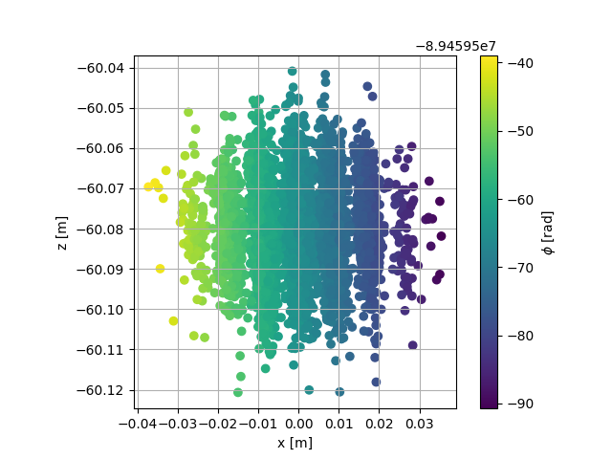
Some results
no phase shear
phase shear

Slide 24
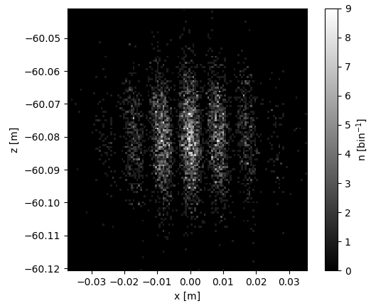
Some results
Binning to emulate imaging

Slide 25
Future plans

Slide 26
Future Plans
Investigating methods allowing simulations beyond the thermal regime
Develop faster implementations (C++)
Test against experiment

Slide 27
Thank you Questions?

