Slide 1
Safety Pause Exercise
Safety Pause
31 May 2023

Slide 2
Why are we here
On Thursday, May 25, a worker on the PIPII Linac construction site fell 25 feet to the concrete floor.
They suffered severe injuries, and they remain hospitalized.
This is the worst injury at Fermilab in decades.
As a result of this, laboratory leadership determined a site-wide standdown was appropriate. This is not a PIP-II event nor a subcontractor event.
This is a Fermilab event. We are all in this together.
This Photo by Unknown Author is licensed under CC BY-SA-NC

Slide 3
Why are we here
All involved responded heroically to this tragic event to help our colleague.
A nearby worker immediately called 630-840-3131 from their cell phone.
REMEMBER – from a non-lab phone you must dial 630-840-3131
From a lab phone you can dial x3131
Fermilab’s Security Operations Center immediately dispatched the Fermilab Fire Department and called for off-site ambulance support, and the Fermilab Fire Department immediately called for a medical helicopter.
The individual was transported via helicopter to a level 1 trauma center.
The purpose of the standdown is to ensure that no other events occur while responding to this one and that we could all take a few moments pause to reflect and collect ourselves (like taking a deep breath) to prevent future events.
This event is a lab-wide opportunity to review, revise and react to ensure we prevent future incidents.
Nothing is more important than executing our mission safely.
This Photo by Unknown Author is licensed under CC BY-SA-NC

Slide 4
Safety Pause Process
Teams/ Users/ Subs
All employees/ users/affiliates meeting
ALD/SD/PM
The safety pause is intended to bring departments or groups together to discuss the following slides. The goal is to create discussion and improve safety for everyone at the lab.
Wednesday, 5/31/2023
The format will be similar to January’s safety pause. Cascading meetings will occur throughout the day. Directorates should schedule make-up sessions for future weeks to ensure all personnel are reached.
Read through the following slides as a team. Encourage discussion for the scenarios and exercises. Plan for 90 minutes.
Feedback is welcome and strongly encouraged! Please send your feedback to your organization’s head.
Notes: ​
Subcontractors, TM/CC/SCs will be invited to follow a similar process​
Next week – All-supervisor meeting (open to anyone who directs work)​

Slide 5
Safety Pause Process
Hands-on work has been stopped.
Only office work is approved except specific ALD/Senior Director approved tasks to maintain safe work environment.
ALDs, Senior Directors and Project Directors will submit completion to the COO, then lab management will then notify the release back to work, except work at heights.
Work at 4 feet or higher remains stopped. Additional instructions will be provided.
Includes any work being performed where your feet are 4+ feet above the ground or floor level, including utilizing step ladders or lifts of any kind (scissor or aerial). Activities that require the use of passive or active fall protection systems to prevent a fall are prohibited.
Acqua Alle Funi

Slide 6
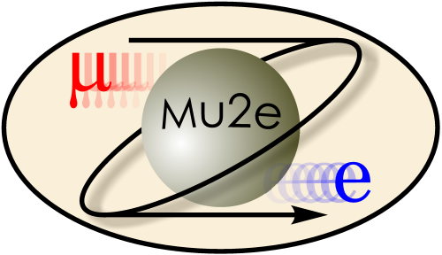
Safety Pause Agenda
Work Planning and Control – best practices that really work
Questioning attitude – what does this mean and how does it help
Team Engagements in the Workplace
Open discussion

Slide 7
Work Planning and Control – Best Practices Accelerator Directorate Boot Camp Talks
The Accelerator Directorate manages an annual maintenance shutdown, 10-12 weeks, each summer.
Hundreds of jobs are planned and coordinated prior to the start of the shutdown (current count – 750).
Boot camp talks are hosted throughout the month prior to start of shutdown, everyone is welcome to attend.
Boot camp talks are presented by SMEs, on topics relevant to shutdown work. It is not training, but an opportunity to reinforce training and requirements and ask clarifying questions.

Slide 8
Work Planning and Control – Best Practices Mu2e Installation Work Planning Overview - SHAPE
Mu2e is a large project to design, fabricate and install equipment for the Mu2e experiment
Multiple Lab Directorates executing complex work in a shared space
Communication essential for safe execution of work
Mu2e Integration Team authorizes and coordinates work
Multidisciplinary team of scientists, engineers, technicians, safety professionals
Weekly meeting with installation task leaders
SCOPE - requests for work authorization for the upcoming week
HAZARDS - discuss issues and required work planning (IMPACT when necessary)
AUTHORIZE - approve work
coordinate space conflicts, equipment availability, hazardous occupancy limiting work such as pressure tests
PERFORM - TV screen at entrance lists online schedule of work authorized for week
Description of work, location of work to be performed, contact leading work
EVALUATE - reports on work accomplished during the past week
Opportunity to share issues that may impact others and lessons learned
Floor Manager provides on-site coordination and support, regular ESH coordinator walkthroughs
Mu2e Cryo Installation Team example
Actively participate in the above process
In addition, daily 8 AM Toolbox meeting at job site (daily oversight walkthrough)
Daily communication is essential for safety
Engineers meet with technicians, additional experts such as ESH and scientists invited as required
Review work performed during previous day
Discuss safety and technical aspects of work for upcoming day
Extended Toolbox meetings when necessary for longer term work planning

Slide 9
Questioning Attitude
What is a questioning attitude? And how can it help?
[When individuals’ mindsets are tuned to] avoid complacency and continuously challenge existing conditions and activities in order to identify discrepancies that might result in error or inappropriate action. (Nuclear Regulatory Commission)
When individuals maintain vigilant situational awareness toward surrounding working conditions to detect error-likely situations, unsafe or hazardous working conditions, or otherwise unusual conditions; not proceeding in the face of uncertainty and basing decisions on facts. (DOE Human Performance Handbook)
Elements of our Safety Culture:
VALUES:
Safety as a priority is demonstrated by all, including line management
Quality of work and discipline to following processes is demonstrated by all, including line management
BELIEFS:
Absolutely safe environments do not exist
Human beings are fallible
People want to do a good job
Human error is normal
ATTITUDES:
Uneasiness toward human fallibility
Questioning attitude
Conservative approach
Avoiding unsafe attitudes
How can a questioning attitude help us avoid unwanted situations?
What are examples of demonstrating a questioning attitude?
How have you demonstrated a questioning attitude in the past?

Slide 10
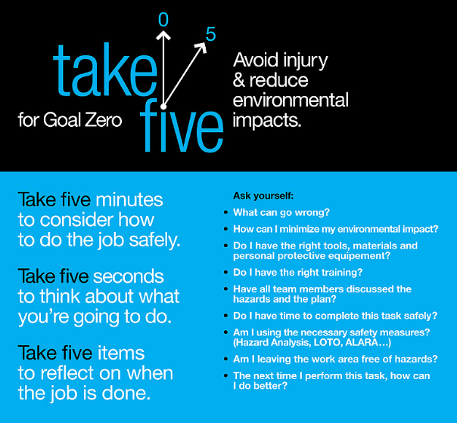
Questioning Attitude
Take Five for Goal Zero
Take five minutes before a job to consider how to do it safely;
Take five seconds before each step to think about what you’re going to do before you do it;
Take five things to reflect on after the job is done.
This simple exercise will help all of us avoid the issues that arise when we act too quickly. It also serves as a mechanism for our talented technical staff to provide feedback into work processes and make them better.
These are important WPC concepts!
Remember this from 2013? If you do, share the concepts with your colleagues who have joined since then.

Slide 11
Questioning Attitude
Did you know that you have the right to stop unsafe work? Did you know that you have the responsibility to stop unsafe work?
Stopping or pausing work is a way to help keep people safe. Because we care.
If someone stops you, do not get mad, listen to the concern and adjust if needed.
If a person is not responsive to your concern, call your supervisor or Division Safety Officer for support.
Scenario 1:
You are an office professional who is not trained in ladder use. Near your office a worker is performing work above the ceiling tiles. They are standing on the top step of a ladder, and you cannot see the top half of their body. What would you do?
Scenario 2:
You are working with a small crew of technicians and engineers to secure a load of materials and transport them by forklift out of a high bay area. The high bay is a busy area where people often walk. People keep walking through the area without regard to the work your team is performing. What do you do?

Slide 12
Team Engagements in the Workplace
Scope
What are we doing, when and where?
Hazards
What can hurt us? What can go wrong?
Authorize
Explicit approval from those in charge
Perform
Do the work according to the approved plan
Evaluate
Review how it went, what went well and what can improve?
We work as teams and across teams every single day.
We must ensure we engage together so that everyone on the team and all impacted stakeholders understand the plan, and work the plan as agreed upon.
Developing and following a plan is very critical to safety, quality and reliability.
This is true for all work – from office work to high hazard work.
Supervisors, managers and individuals in charge of activities have an obligation to make sure work is being implemented according to the plan or that the plan is appropriately adjusted to factor in new information.
The following slides provide a common understanding for what Management Walkthroughs should be.

Slide 13
Workforce Engagement – Management Walkthroughs
MANAGER/SUPERVISOR SLIDE
Workforce Engagement
Why walkthroughs are important
Support teams and lab mission to engage with people at their work location
Helps continuous improvement, safety and incorporation of lessons learned
Enables communication
Aids in personal growth and development of professional/leadership competencies
Management Involvement
Organizational Learning
Employee Engagement

Slide 14
Workforce Engagement – Management Walkthroughs
MANAGER/SUPERVISOR SLIDE
These questions are designed to simply start the conversation and get the person to know you are interested in their work, find out what they value and if they have good ways of getting their problems addressed. Employees should feel free to raise issues or problems without fear of reprisal. Don’t try to solve problems in the moment but listen carefully and ask what their ideas or options are. They will open up and tell you things you need to hear when they know you are listening.
General questions you can ask:
Can you tell me about your job or what you are working on?
How do you know you are doing this work correctly?
What parts of your process are working particularly well?
Are there things that can be done to increase the quality or the work?
What do you do if you have a problem?
What isn’t working well and what do you need from me to help improve the situation?
Pick 2 questions

Slide 15
Workforce Engagement – Management Walkthroughs
MANAGER/SUPERVISOR SLIDE
These questions are designed to find out about workplace hazards and if we know how those risks and hazards are managed. Most mistakes are the result of rushing or taking short cuts. Managers sometimes reward efficiency and expediency without knowing they may be reinforcing the wrong behavior if the employee is taking unnecessary or dangerous risks. Most people know about unaddressed safety issues in their workplace but either overlook them, adapt to them or think they are under control.
Safety questions you can ask:
What dangers do you face?
Are these dangers under control?
Are any safety issues not dealt with?
Do you or others feel you need to take short cuts?
What would have to be different in order for you to feel more comfortable about safety in your workplace?
Ergonomics: Are there any work tasks that are causing you pain or discomfort? Have you taken Ergonomics Training or had a workstation evaluation?
Pick 2 questions

Slide 16
Workforce Engagement – Management Walkthrough Guidance
MANAGER/SUPERVISOR SLIDE
Go where the people are.
Walkarounds are not about doing workplace safety inspections. They are about conversations that lead to increased safety and improved work processes.
Ask good questions to learn what’s going on.
Employees want to be acknowledged for their contributions and want to succeed. They welcome an opportunity to have you help them to be successful.
Every encounter is a touch point – make it positive.
Your employees should welcome your visits and look forward to seeing you, not run away when they see you coming down the hall. Do not use these opportunities for correction or performance evaluations. Use them to engage in meaningful conversations about the work.
Start with safety but go beyond.
After you ask questions to find out about their work it is important to talk about safety and establish that you care about their welfare. If the first thing you talk about is cost or schedule, that’s what they think is the most important issue on your mind.
Don’t walk past a mistake.
When you do not address an unsafe behavior or condition it implies you condone it. Also, make it a personal commitment to pick up litter in your path. When you intervene in constructive ways it gives others “permission” to do the same.

Slide 17
Workforce Engagement – Management Walkthrough Guidance
MANAGER/SUPERVISOR SLIDE
If you find something wrong – don’t get mad, get curious.
Try to find out why they thought it was right at the time. No one comes to work each day trying to figure out ways they can deliberately screw up. If you introduce anger or irritation, you may never find out the real cause of the problem. When you engage in “empathic inquiry” you engage your employee in partnership.
Cross walk with other managers.
Fresh eyes lead to important discoveries. Help each other to be skillful at doing effective walkarounds.
Don’t try to solve the problem in the moment.
Only the simplest of problems can be solved in the moment and many problems are more complex to solve than they first appear. Trying to solve problems in the moment may shut off conversation before the real issues are known.
When you get feedback or suggestions, get back to them (quickly).
Even if you have to tell someone that their idea was considered but not adopted, they are more willing to accept that they were listened to than ignored. If they feel they were ignored you will not likely get any more suggestions. Also, if you didn’t use their idea, give them a reason - it will verify that their idea was at least evaluated.

Slide 18
Team Engagements in the Workplace
Error Precursor – Imprecise communication habits
Mitigations for imprecise communication
Communication habits or means that do not enhance accurate understanding by all members involved in an exchange of information.
Self-checking
Peer-checking
Three-way communication
Reviews and approvals
Supervisory oversight
EXERCISE:
Ask for one volunteer to be “the speaker”. Everyone else will be “the listeners” and will need a sheet of paper and pen/pencil.
Ask the speaker to describe the geometrical image (pick one from backup slides) in detail. The listeners will attempt to draw the image on their paper based upon the instructions. After 5 minutes review the drawings compared to the original.
Discuss. Did the drawings turn out like the original? What worked about the speaker’s instructions? What did the speaker or listeners do to reduce misunderstanding? How can you apply this to your work?

Slide 19
Team Engagements in the Workplace
Error Precursor – Time Pressure
Mitigations for time pressure
Urgency or excessive pace required to perform action or task. May be manifested by shortcuts, being in a hurry, or an unwillingness to accept additional work or to help others. No spare time.
Identify if time pressure exists (real or perceived). Ask: Do you have enough time to complete safely and correctly? Under what conditions would you stop work? Do you feel comfortable requesting an extension?
If time pressure exists – address it directly by adjusting the plan or raising the issue to the supervisor/department head/division head/ALD or Senior Director.
Scenario 1:
You are a new technician at the lab on a team that is responsible for rigging and relocating a one-of-a-kind component that should have been delivered weeks ago. The component weighs 20 tons. You notice just before the job begins that the bridge crane that will be used is rated for 15 tons.
What would you do? And what should have been done to avoid this situation?
Scenario 2:
You are an engineer responsible for the construction and installation of a top priority piece of equipment. You speak to the crew building the equipment once a week by Zoom. Today you learn of a problem that might put you behind schedule, but your slides for the DOE review were due to your boss yesterday. What do you do?

Slide 20
Open Discussion
Safety doesn’t and shouldn’t just happen at work.
Watch video (must be on network) https://eshq.fnal.gov/atwork/safeatalltimes/
Have you or someone you know ever had a similar experience?
How do the safety and work planning principles used at work help at home?

Slide 21
Safety Pause Conclusion
Thank you for your time and engagement throughout this safety pause.
Please send feedback through your line organization.
YOU are the lab’s most important resource. If you know of equipment, tools, systems that would make the lab a safer place, please let us know in your feedback.
There is nothing more important than your safety.
Nothing is more important than your safety.

Slide 22
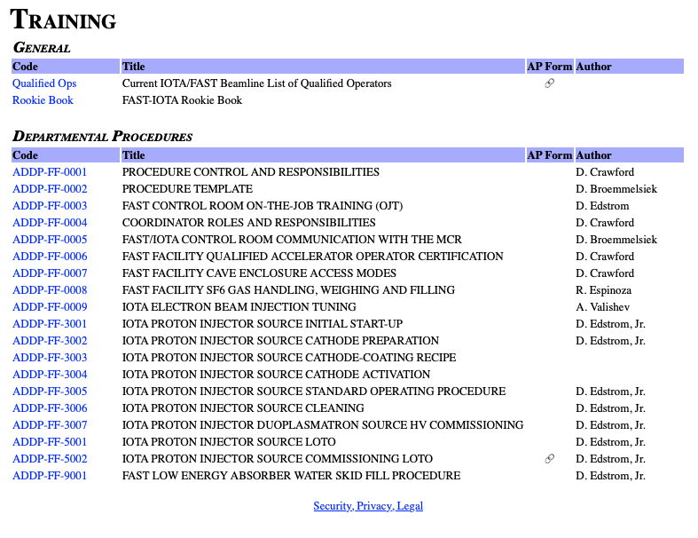
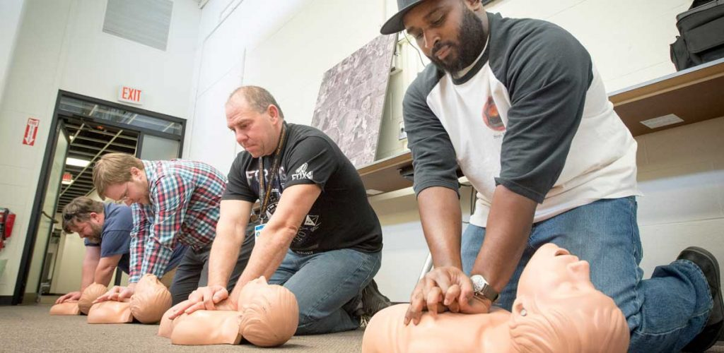
Hands-on Work Pause is an opportunity to:
Review our FAST Department procedures
Do you plan to be at FAST? These apply…
https://fast.fnal.gov/?a=fast/procedures.shtml
Complete your training
Do you have any outstanding ITNA training due?
https://www-esh.fnal.gov/pls/default/itp.html
Review work plans and hazard analyses
Before doing any work do a HA:
Mental analysis of hazards for short easy jobs
“Take 5”
HA write up through IMPACT Tool for complicated jobs
https://www-esh.fnal.gov/pls/apex/f?p=129

Slide 23
Slide 18 exercise

Slide 24
Slide 18 exercise

Slide 25
Slide 18 exercise

