Slide 1
LQXFA01, TC1 Magnetic Measurements Update
07 June 2023
J. DiMarco

Slide 2
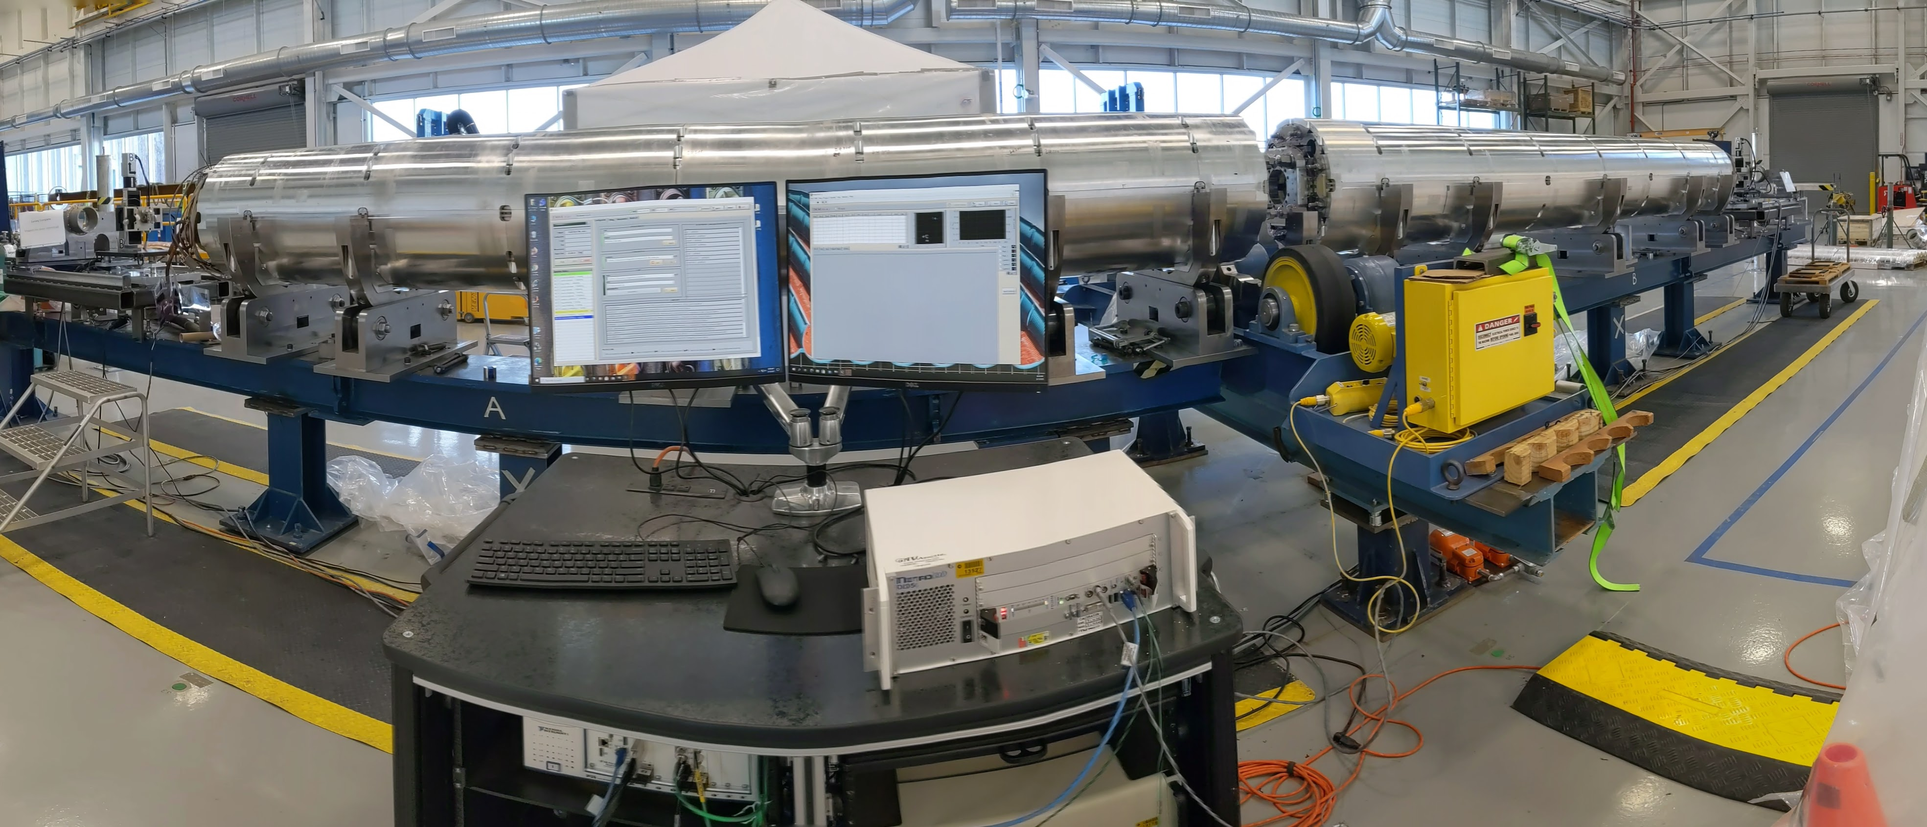
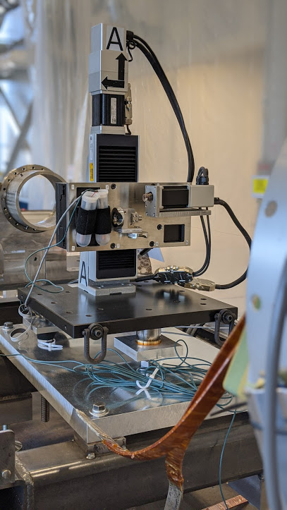
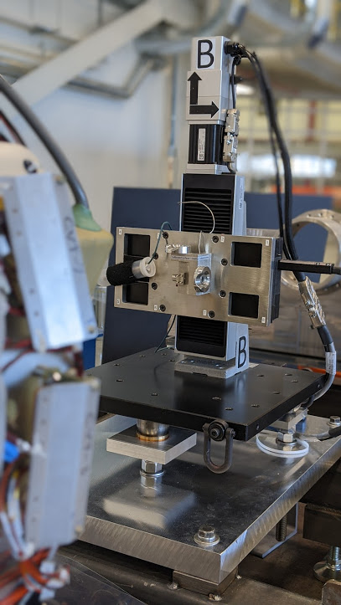
Single Stretched Wire Alignment of MQXFA03 – MQXFA04 During Fabrication
MQXFA04
MQXFA03
~11 m
Z=0

Slide 3
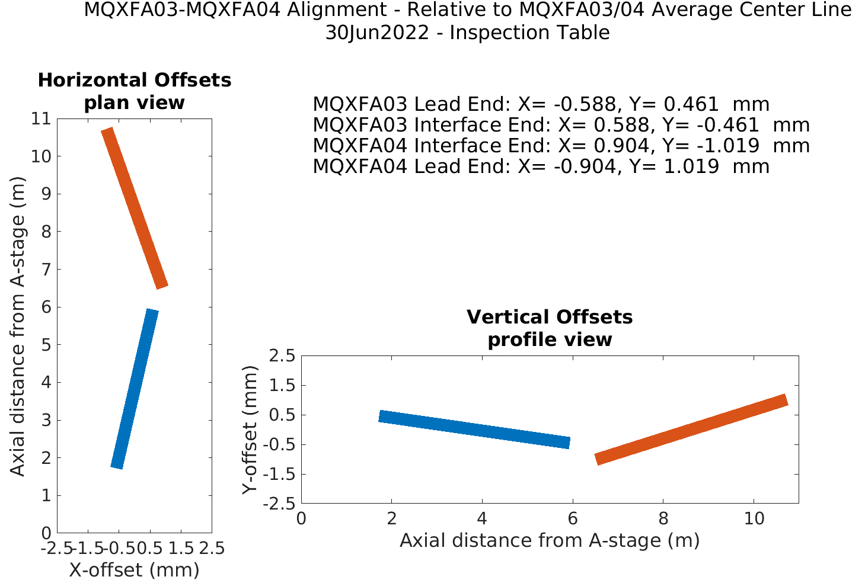
, before cryostatting
A03 roll angle = 1.80 mrad
A04 roll angle = -0.34 mrad
Delta angle = 2.14 mrad
Ave angle = 0.73 mrad
A03 Z-dist A-stage to magnetic center = 3.8284 m
A04 Z-dist B-stage to magnetic center = 3.5201 m
Z-dist A03 to A04 = 4.7892 m (Lw=12.1378)
Uncertainty in measuring ends is about 100um

Slide 4
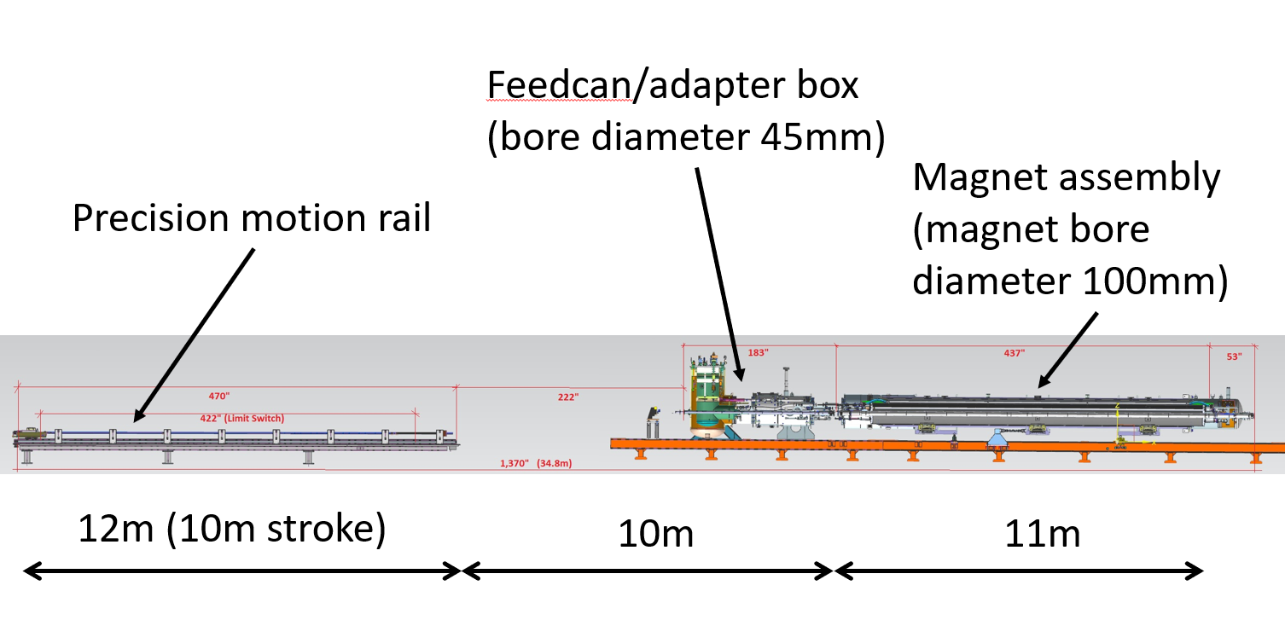
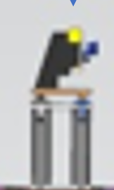
Stage A
Stage B
18m
A second SSW system is used for the measurements on the cold stand.
Measurements on cryo test stand are significantly more challenging:
18m-long wire
Wire motion constrained to be within 100mm Warm Bore Tube but the WBT steps down to ~44mm at the feedcan
The available wire motions are further reduced by any misalignment of the cold mass on the stand
Additional mechanical and electrical noise
WBT diameter transition

Slide 5
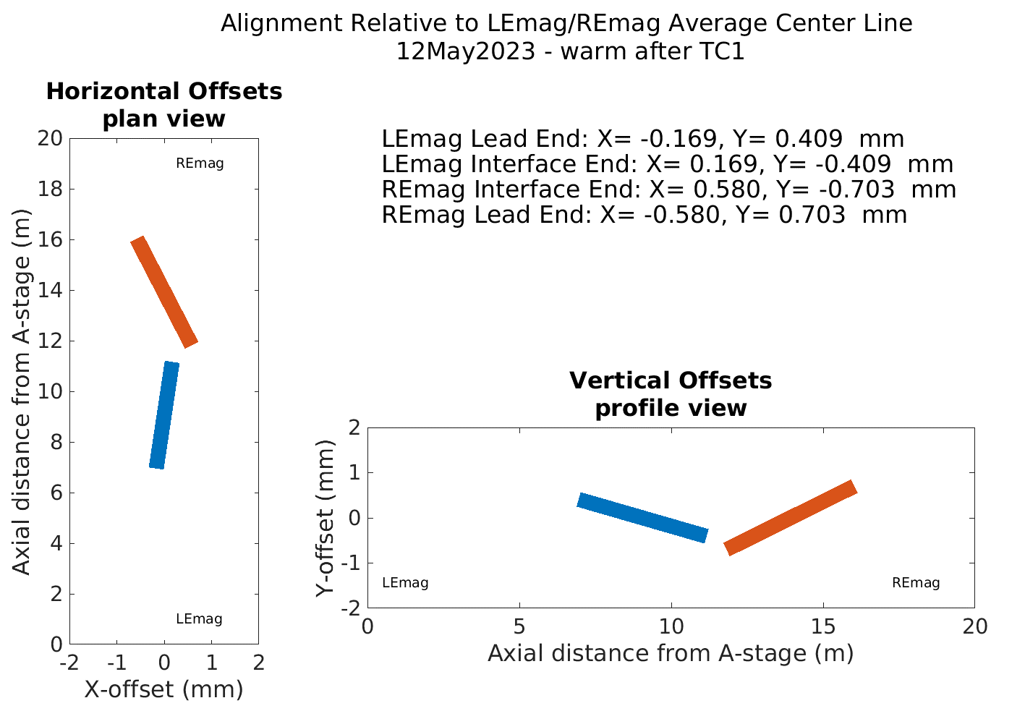
LEmag roll angle = 4.61 mrad
REmag roll angle = 1.94 mrad
Delta angle = 2.68 mrad
Ave angle = 3.28 mrad
LEmag Z-dist A-stage to magnetic center = 9.05 m
REmag Z-dist B-stage to magnetic center = 4.29 m
Z-dist LEmag to REmag = 4.87 m (Lw=18.2097)

Slide 6
ICBA measurements (SSW_A1)
IB1 measurements (SSW_A2)
Z-distance between magnets as determined by SSW may be useful only as a relative measure because of stray field effects.
Final Z-distance determination will be based on the rotating coil tests

Slide 7
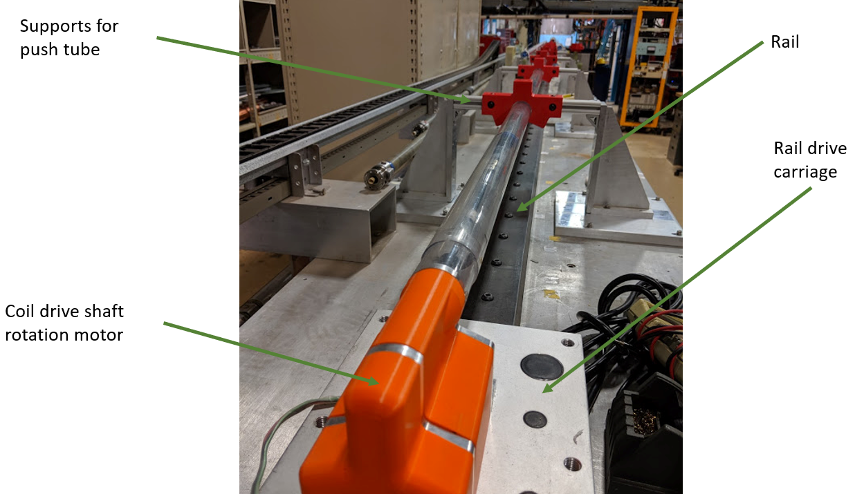
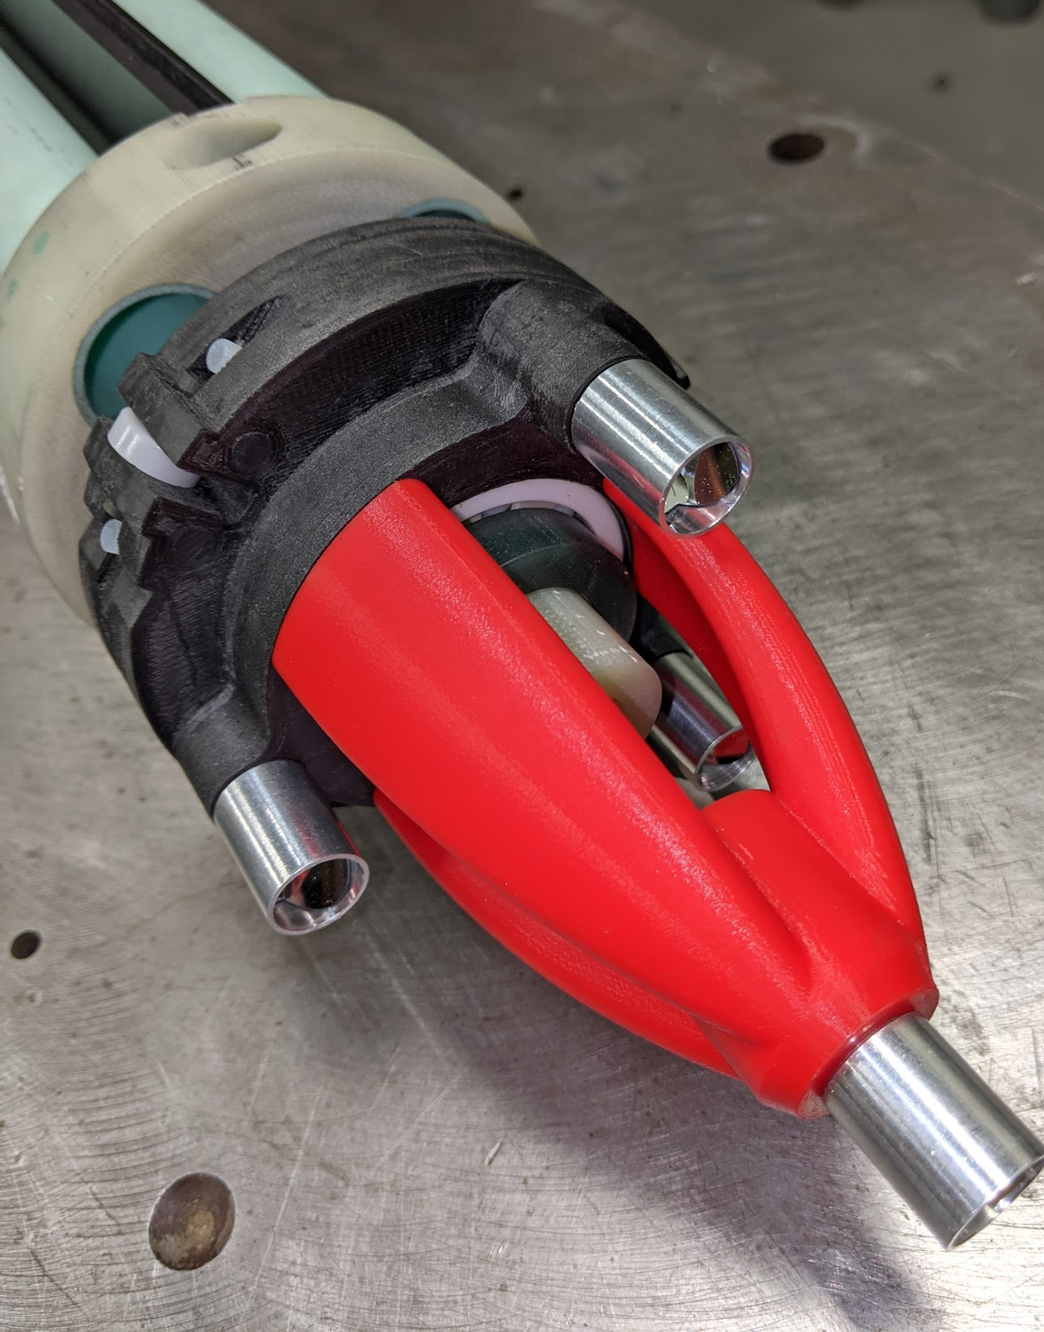
Rotating coil checkout scan was done during cooldown
Probe has 436mm-long winding and two ‘back-to-back’ 109mm-long windings.
Local encoder and slipring
PCB probes stiffened with carbon fiber
Laser tracker targets visible from non-drive end
22m-long carbon fiber rotating drive shaft and polycarbonate push-tube

Slide 8
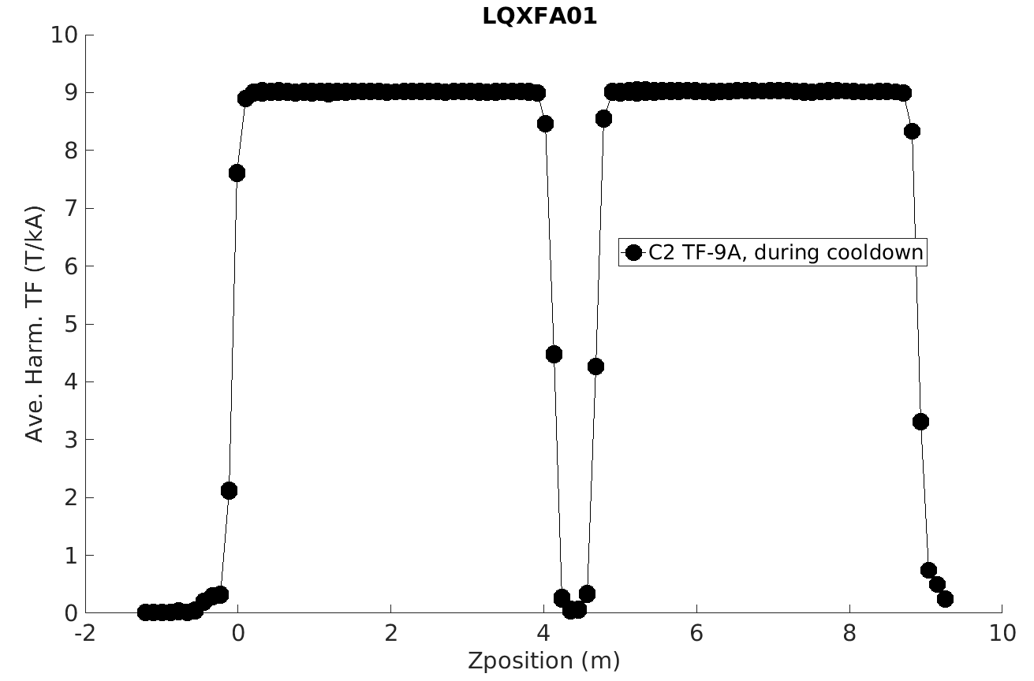
These data are from one of the two 109mm probes
Just starting to look at these data…

Slide 9
Summary
Alignment measurements have been performed warm on the horizontal test stand for LQXFA01 with uncertainty in magnet end position of 100um and of average center position of 20um.
The relative alignment of the magnets is consistent with the last measurements before cryostatting.
The alignment values are close to requirements (ends within 0.5mm of average common axis)
Roll angle of the magnet on the test stand is about 3mrad. The relative roll is about 2.14 mrad during assembly but was measured at 2.68 mrad on stand 4 – stage orthogonality calibration needs to be checked.
The z-center separation measured by SSW on the horizontal test stand is NOT consistent with what seen in the assembly measurements - this is also being looked into (e.g. different contributions by leads/stray fields may account for this)

