Slide 1


LQXFA/B01 Horizontal Test Status and Preliminary Results
Guram Chlachidze
Jun. 6, 2023

Slide 2
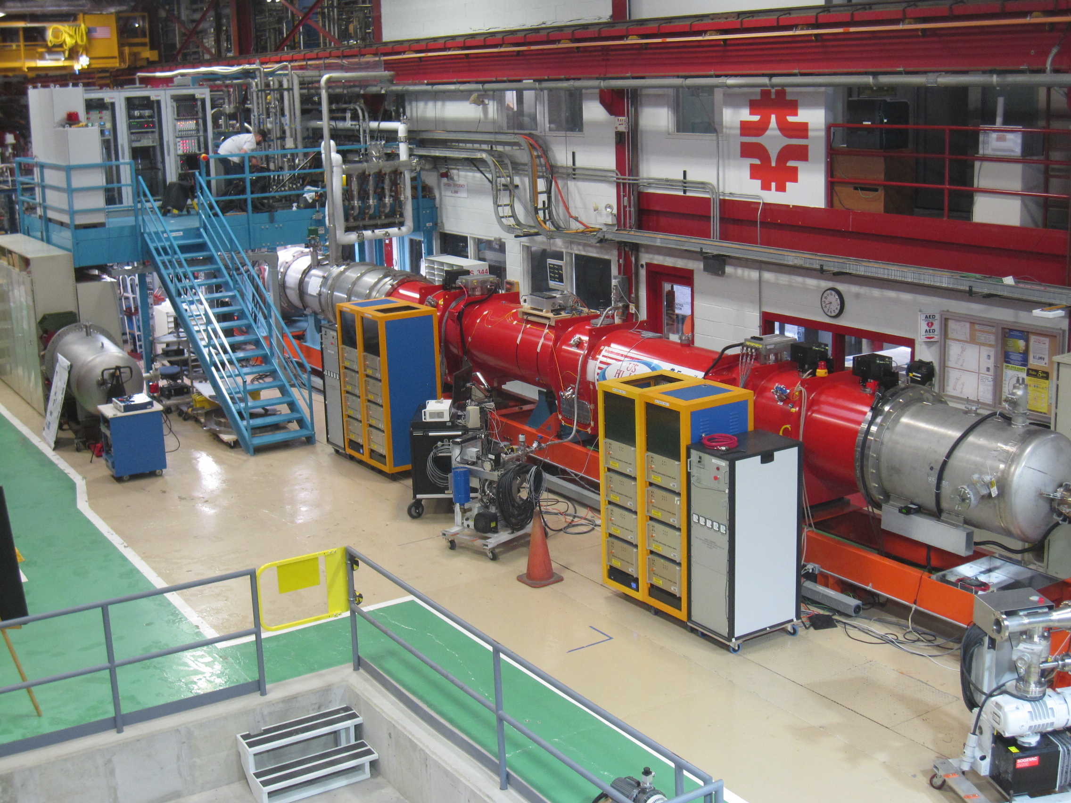
LQXFA/B01 Test Status
Lead End
MQXFA03 (B)
MQXFA04 (A)

Slide 3
Initial Electrical Checkouts
Cryo-assembly was received at the test facility with one open heater (YT223 in MQXFA03) and one open voltage tap EE152
Room temperature insulation (Hipot) tests: no failures
  Coil-to-structure at 2.5 kV for Top plate leads (3) w/o magnet
  Coil-to-ground at 368 V
  Quench heater-to-coil at 460 V

Slide 4
LQXFA/B01 controlled cooldown
19 days of cooldown: Mar 15 - Apr 3
  About 5 days of downtime due to various issues
  First week running with the 50 K temperature difference requirement
  GHe mass flow rate varied from 5 g/s to 18 g/s
Platinum RTDs 505/506 are installed on the CM end plates

Slide 5
LQXFA/B01 Controlled cooldown (2)
ΔT requirement between the GHe supply and the CM RE changed from 50 K to 80 K
  Delta T (meas) - difference between the temperature readings of the RTD sensors 505/506 located on the cold mass end plates
  Delta T (calc) is based on the magnet resistance measurements

Slide 6
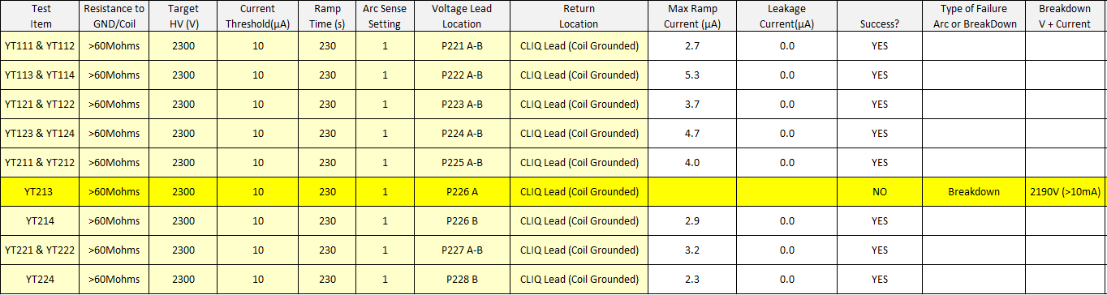
Cold Electrical Checkouts
Coil-to-ground at 1840 V
Quench heater-to-coil Hipot at 2300 V
MQXFA03: YT213A/B heater failed the Hipot test around 2190 V
No dead short to coil or ground, small current leakage at 200 V
Currently using dummy load instead of YT213

Slide 7
Preliminary Test Results
Preliminary TC1 results were released on May 8th
  Manual trips at 1000 A and 6000 A
  Ramp 1: Cu/SC leads in the feed box tripped at 15387 A (no quench origin in magnets)
    Due to low LHe level above Lambda-plate
  Ramp 2: SC leads trip at 16388 A (no quench origin in magnets)
    Motion related voltage spike in SC leads
  Ramp 3: Holding 16530 A for 30 min
  Ramp 4: High ramp rate test. 5 min at 16230 A, ramp up/down 30 A/s
  Ramp 5: Endurance test at 16530 A: trip after 32 min at flattop (no quench origin in magnets)
    Dump switch voltage dropped below the limit and initiated slow ramp down
  Ramp 6: Ramp to 16530 A. Quench at 16386 A
    Quench in MQXFA04 negative half-coil, coil 113 (Q2) or 206 (Q3)
  Ramp 7: Repeated test: Holding 16530 A for 30 min
  Ramp 8: Repeated High ramp rate test: 5 min at 16230 A, ramp up/down 30 A/s
  Ramp 9: Endurance test at 16530 A: trip after 85 min at flattop (no quench origin in magnets)
    Due to sudden drop of LHe level above Lambda-plate
  Ramp 10: Demonstrating level of training: 5 min at 16530 A
  Ramp 11: Temperature dependence study at 4.2 K: 30 min at 16230 A
  Next step: Thermal cycle

Slide 8
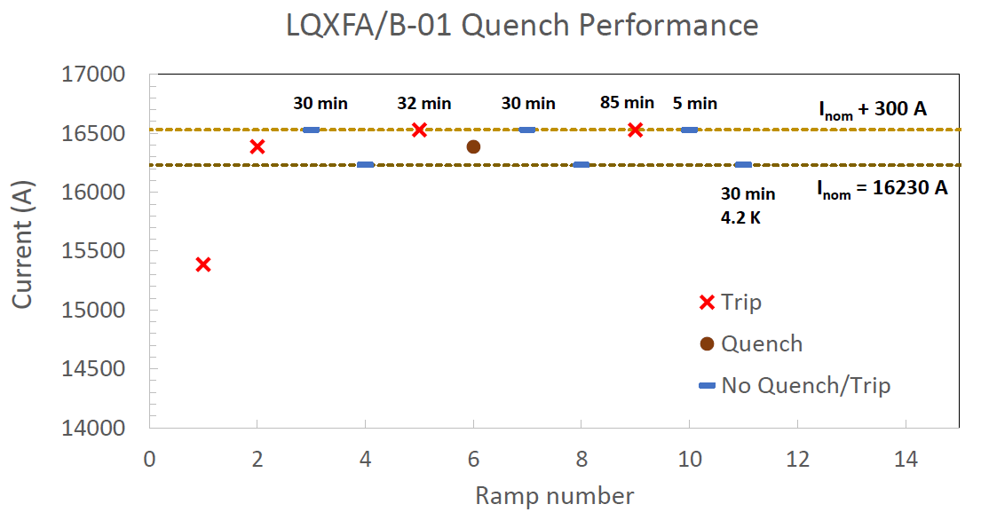
LQXFA/B01 Quench Performance in TC1
High ramp rate tests only at 30 A/s. To be repeated in TC2
Two attempts of the endurance (holding current) test
  First trip at Inom+300 A=16530 A caused a minor detraining
  85 min is the longest run. In total Inom+300 A was held for 3+ hours

Slide 9
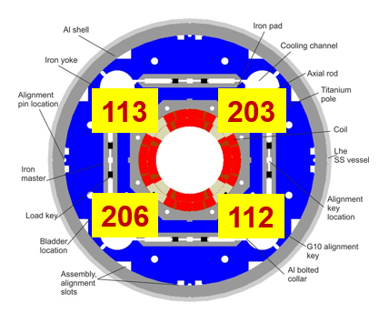
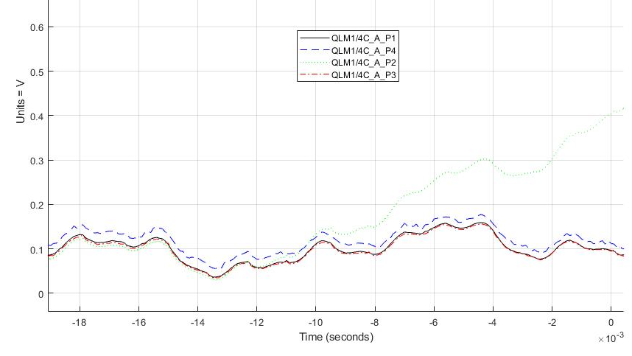
Preliminary Test Results (2)
Only one spontaneous quench in magnets
  Quench at 16386 A, in MQXFA04 (Magnet A), coil 113 (P2)
  Quench Integral ~27 MIITs (no external energy extraction)
(P2+P3) - (P1+P4)
P2

Slide 10
Splice measurements
Two additional splices were made in LQXFA/B01 to add extra length for testing at Fermilab (and CERN)
  Lead length w/o the additional splice is sufficient for the tunnel installation at CERN
Additional splices
in LQXFA/B01

Slide 11
Splice measurements (2)
Splice measurements were made at 1.9 K for currents up to 5 kA
  8-channel MUX system based on Keithley 2182A Nanovolt Meter
Two-splice segments are measured ~0.7±0.1 nΩ, and single splice
segments - less than 0.3±0.1 nΩ
More measurements at higher
currents are possible

Slide 12
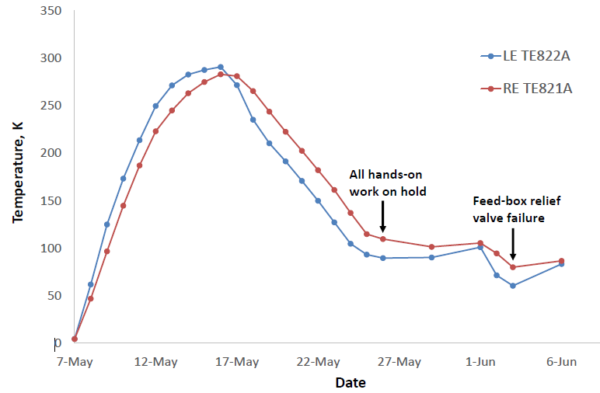
Warmup and cooldown for TC2
Controlled warmup from May 8 to 16
  No cooldown since May 26
Cernox RTDs TE821/822 installed in the CM shell openings

Slide 13
Cooldown in TC1 and TC2
First cooldown used for optimizing the controlled cooldown parameters
  Two weeks are expected for 1.9 K cooldown. Further improvement requires upgrade of the heat exchanger in the Helium return line
Cernox RTDs TE821/822

Slide 14
Next Steps
Currently replacement of the relief valve in progress
  Magnets are floating at around 85 K
Complete cooldown to 1.9 K and continue test according to the Run Plan
  Electrical checkouts
  Endurance (holding current) Test
  High ramp rate test
  Repeat the temperature dependence test
  Magnetic measurements

Slide 15
Backup Slides

Slide 16
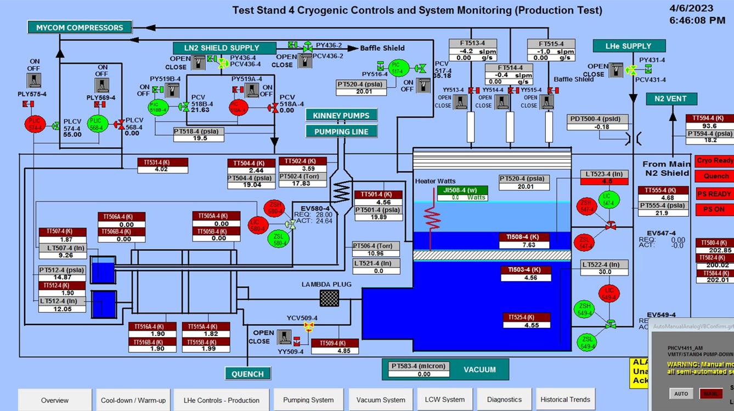
LQXFA/B01 Test Status (2)
On Apr. 6, LQXFA/B01 was cooled down to 1.9 K
Test Stand overview screen

