Slide 1
BCC Stands Review
Introduction
Brian Hartsell
06 June 2023

Slide 2
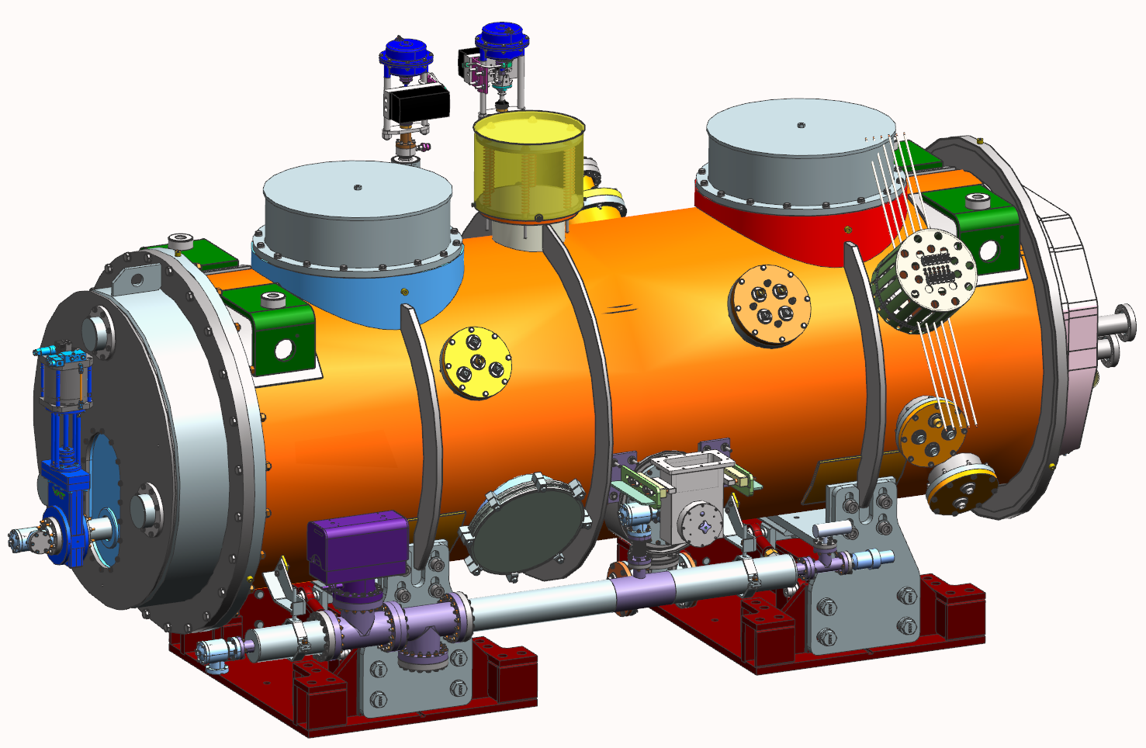
What is the BCC?
Part of a new injector for the LCLS-II-HE beamline at SLAC. The design re-uses components from the LCLS-II and LCLS-II-HE cryomodule designs and also combines some PIP-II cryomodule elements.

Slide 3
1.3 GHz LCLS-II Cryomodule for Comparison

Slide 4
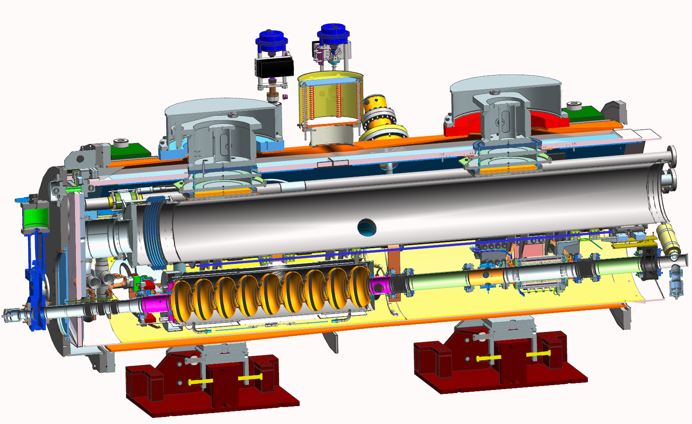
Similarities
1.3 GHz LCLS-II/HE cavity, BPM, downstream gate valve, upstream upper cold mass, support systems, cryo piping and valves are all similar to LCLS-II-HE.

Slide 5
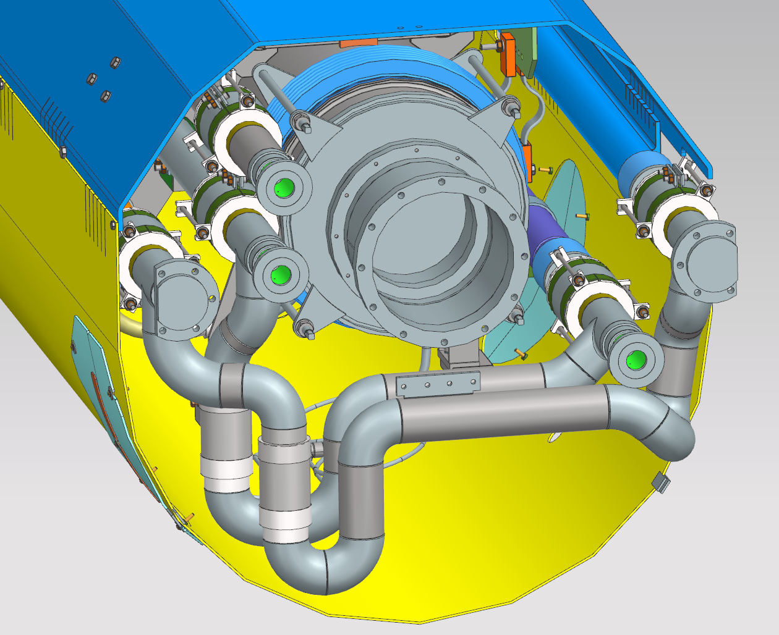
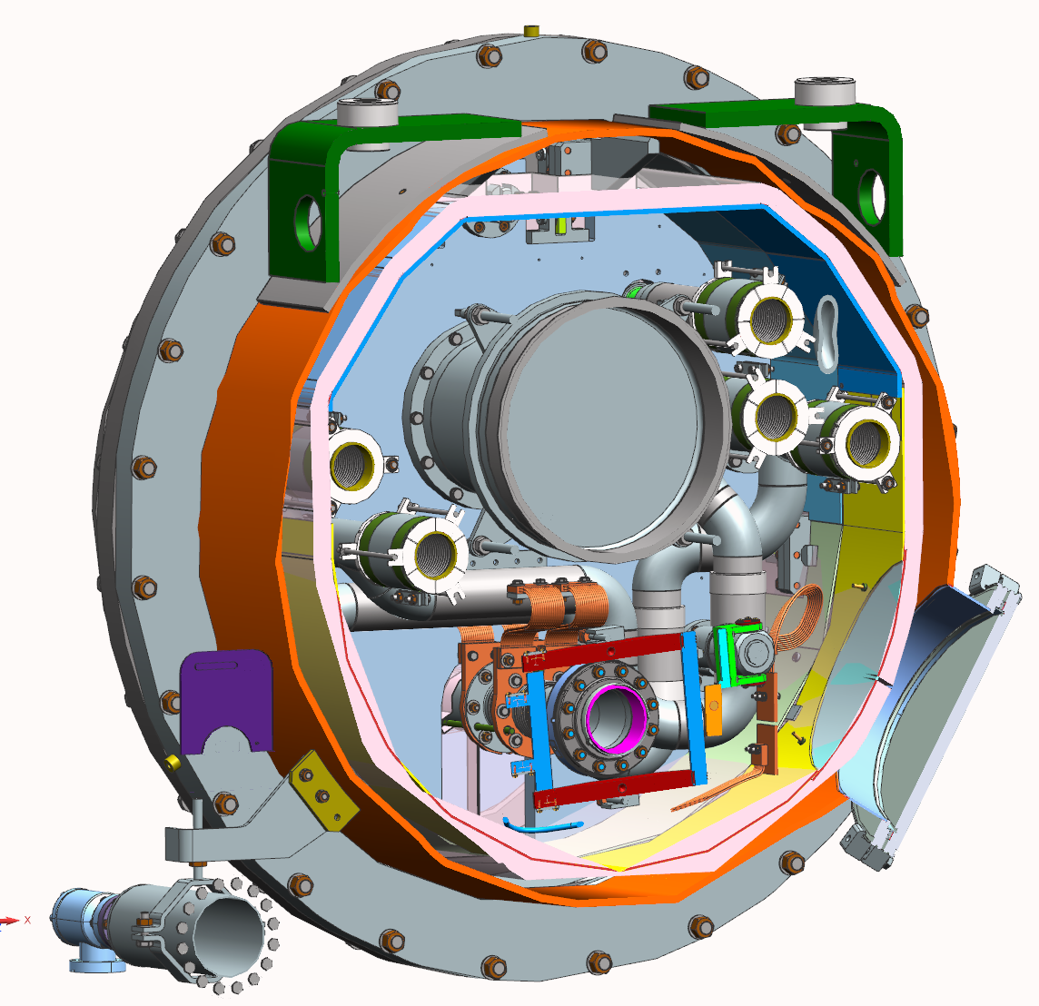
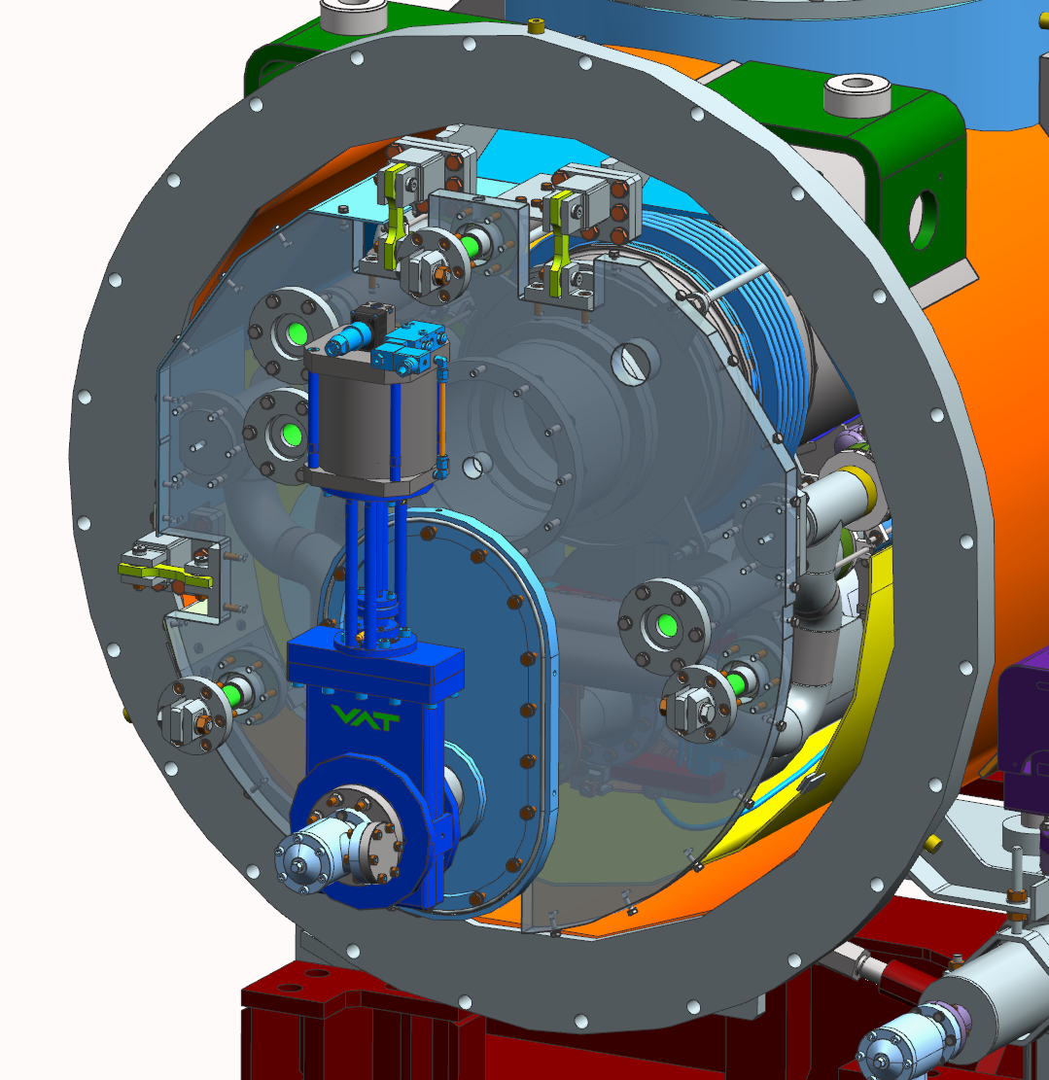
Differences
For LCLS-II/HE 1.3 GHz CMs the cryogenic lines flowed straight through. BCC integrates a turnaround with an intermediate 50K plate. Solenoid magnet in the BCC has a different design than the quadrupole magnet in the 1.3 GHz CMs

Slide 6
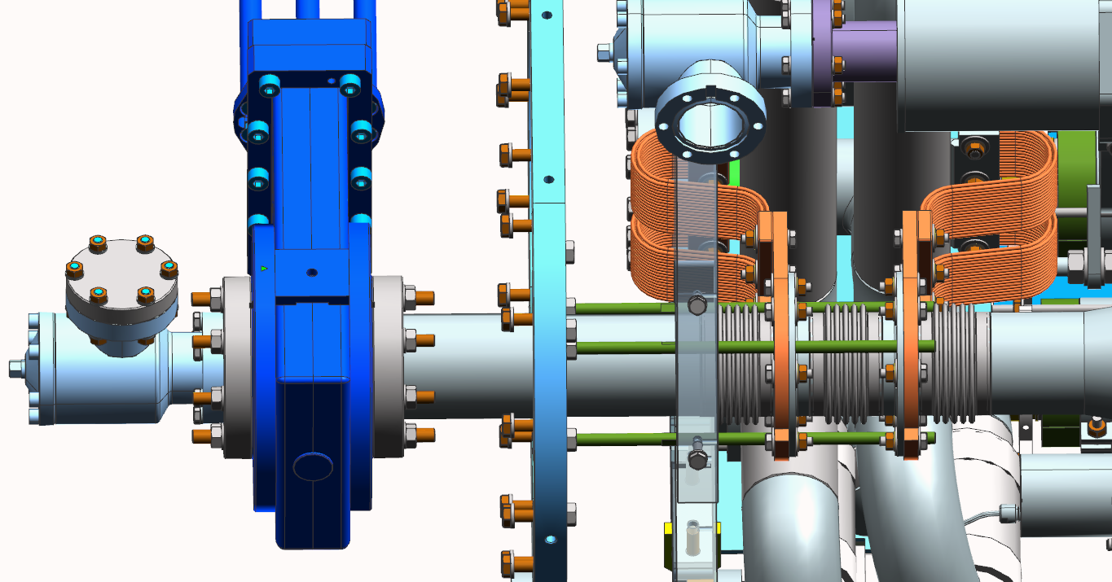
Differences
The end cap uses a warm gate valve design that transitions through three thermally strapped bellows to minimize heat loss. The bellows are anchored to the end cap for stability.

Slide 7
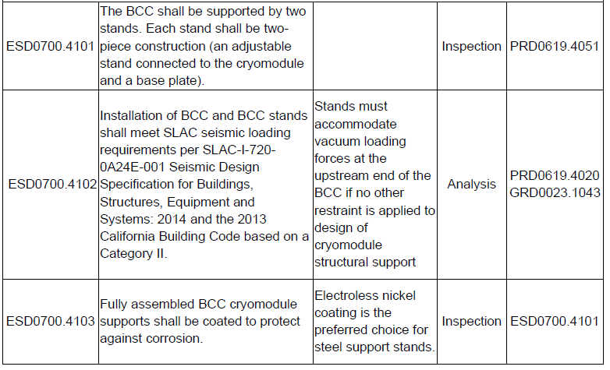
Stand design - Requirements

Slide 8
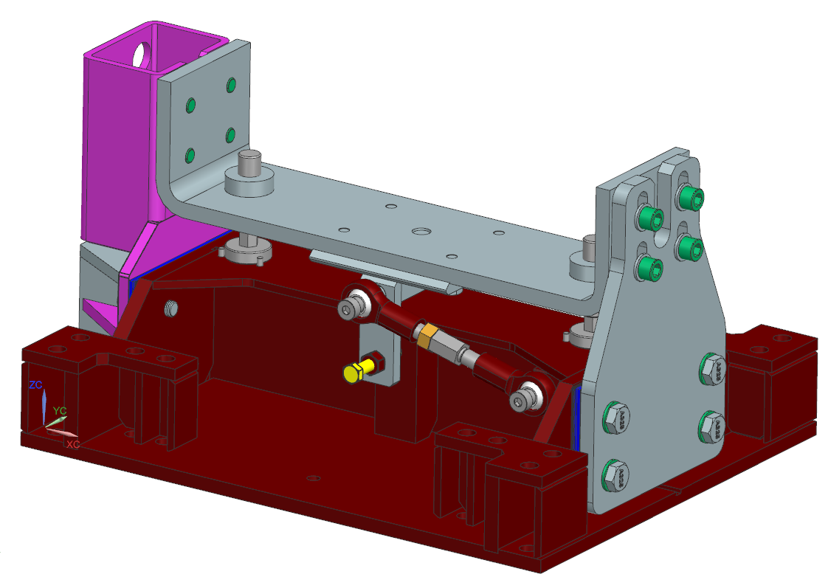
Stand Design - Adjustment
X axis (beam left/right) adjustment is done via the turnbuckle and shim package to seismic restraints.
Y axis (beam up/down) via cryomodule feet.
Z axis by yellow bolt (present on both sides).

Slide 9
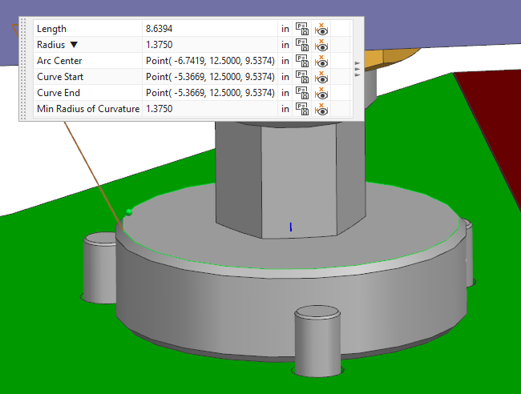
Adjustment
Axis | Limit | Resolution
X Translation | Shims - +/- ½” | 1/32” (0.031”) or 0.8 mm
Y Translation | Seismic restraint slots, +/- 0.75” | 15° rotation of M36x2 is 0.08mm or 0.003”
Z Translation | Pad radius 1-3/8”, +/- ~0.75” | 15° rotation of ¾”-10 is 0.004” or 0.1mm
Rotation about X | Seismic restraint slots
Rotation about Y | Shims | 1/32” over 1492mm is 0.03° or 0.5mrad
Rotation about Z | Seismic restraint slots

Slide 10
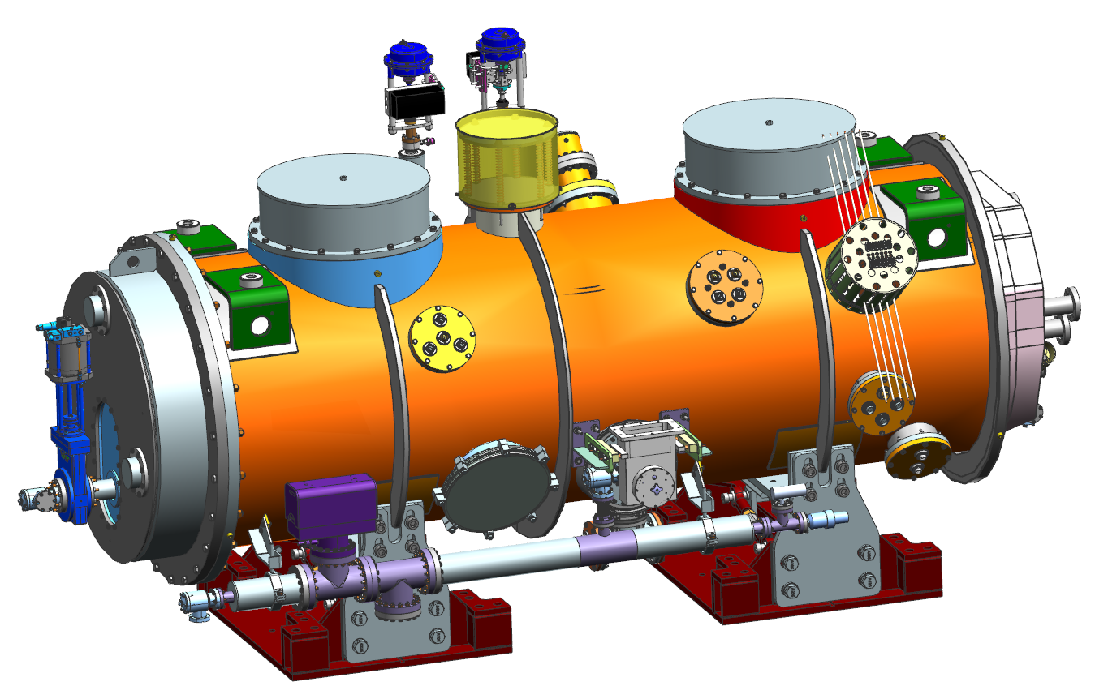
Fixed vs Sliding
Sliding stand – allows sliding movement along beamline axis
Fixed stand

Slide 11
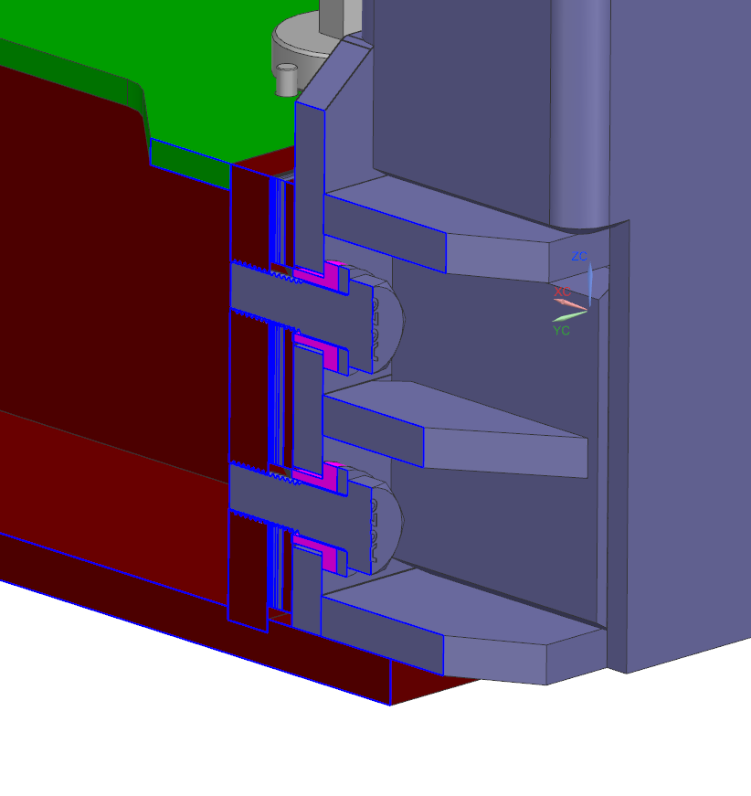
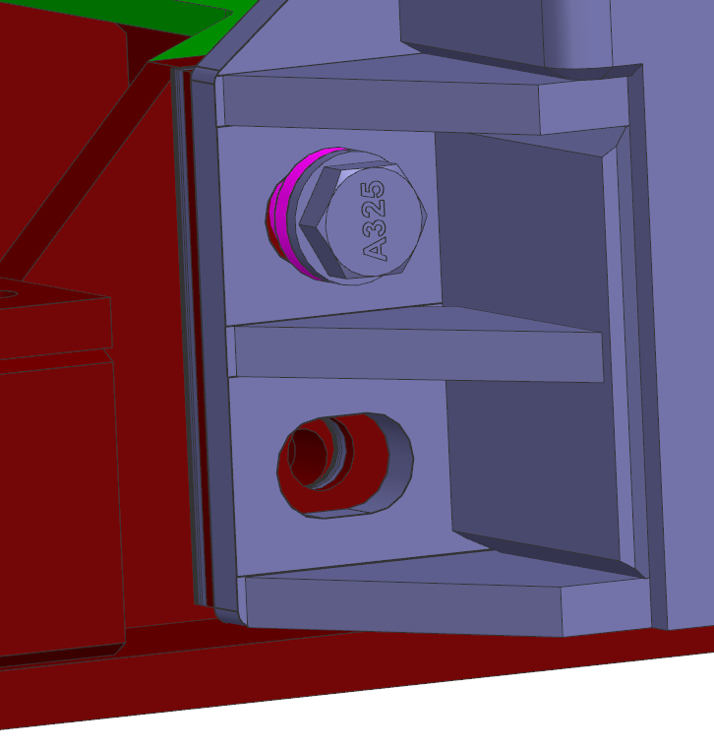
Fixed vs Sliding
On the sliding stand, collars (magenta) are inserted in the seismic restraint to base plate shim interface and the screws are tightened against these collars. The seismic restraint is slotted in the beamline axis.

Slide 12
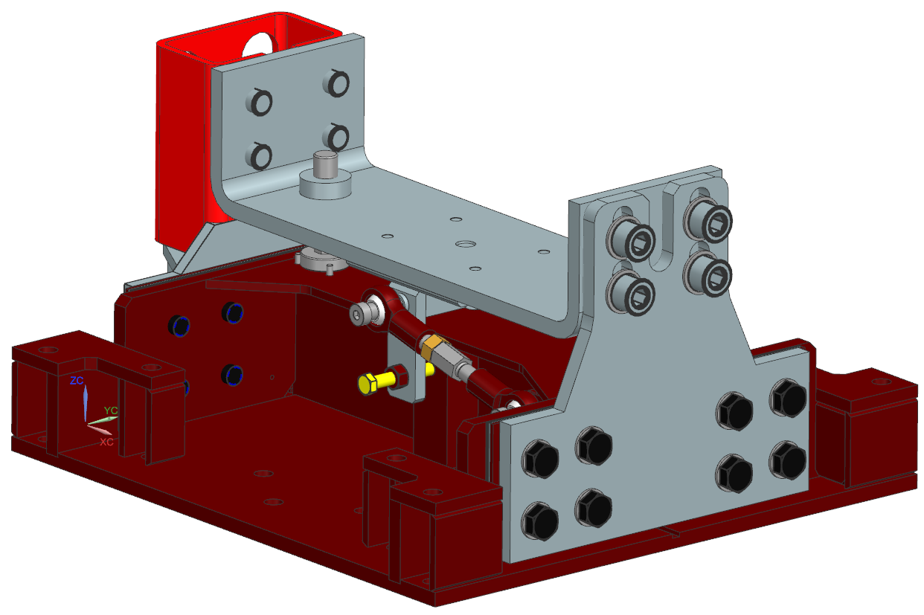
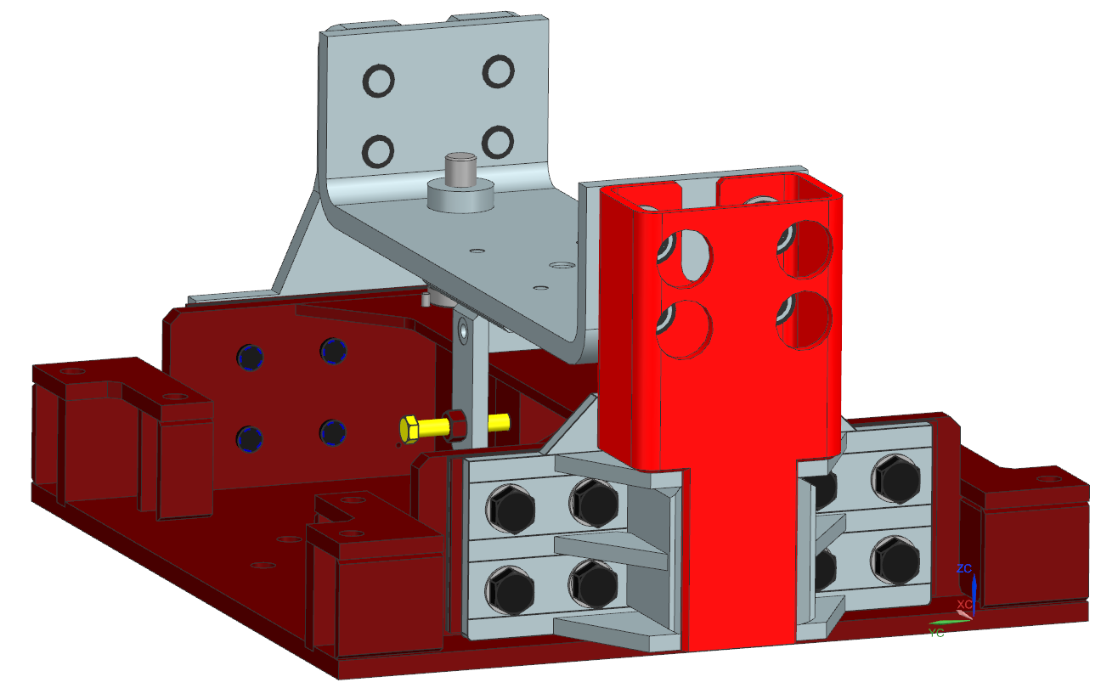
Final Design
Colin will present the analysis that led us here.
Screws holding the seismic restraint plate to the CM were increased in size and flange width increased to prevent tearout. The screws holding the seismic restraint plate to the base plate were increased in size and number. Shear anchors increased in number and size, and tension anchors increased in size.

Slide 13
To Do
Create a simple sheet metal cover plate over the seismic restraint plate screws.
Also need to create a warning label attached to the cover plate indicating the unique nature of this stand and bolts should not be loosened without having insulating vacuum and cyrogenic piping at atmospheric pressure.
Anchorage to be verified by SLAC building office.

