Slide 1
LCLS-II-HE BCC Stands Engineering Peer Review
Colin Narug
6/6/2023

Slide 2
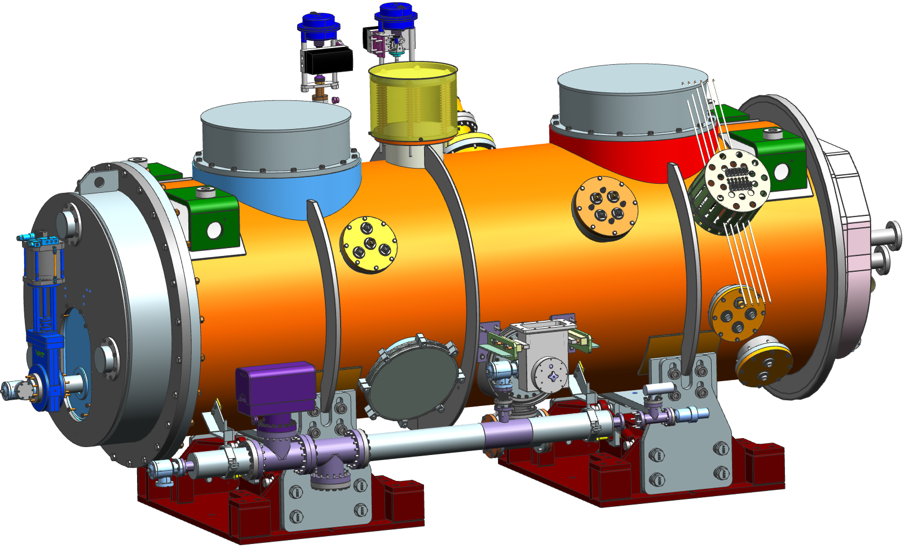
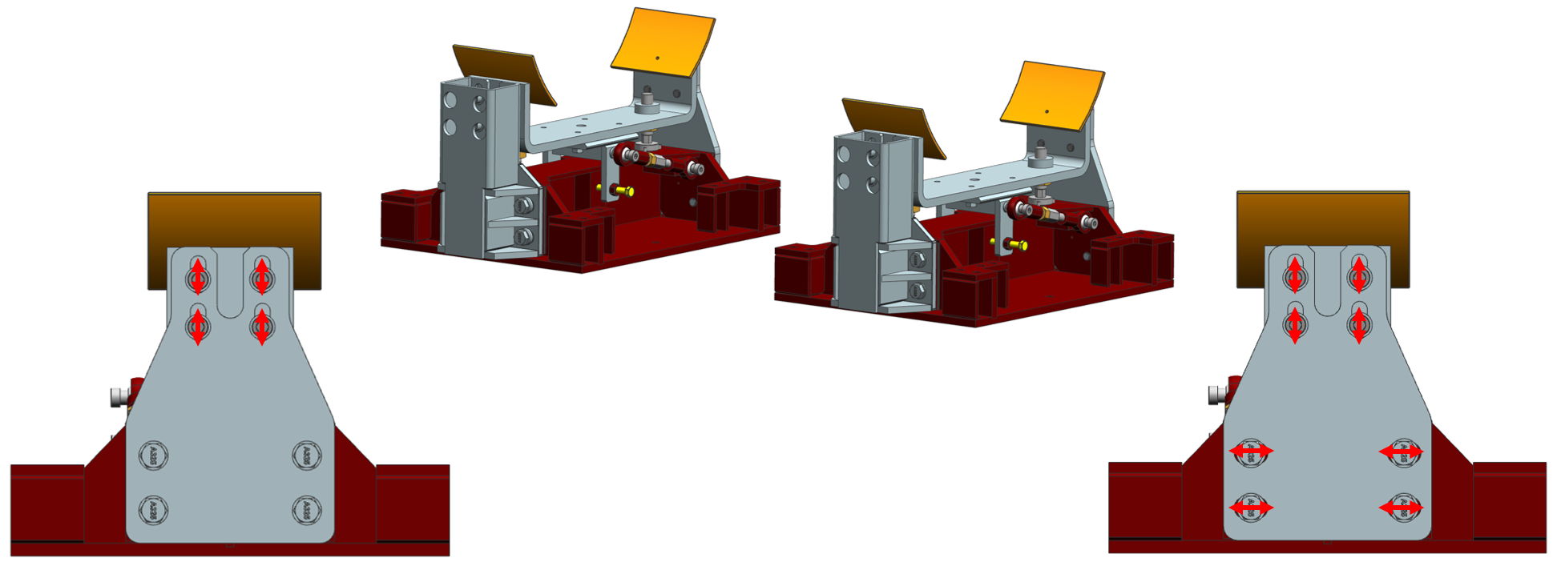
Introduction
BCC Cryomodule will be supported on two stands updated from the ones used to the support the LCLS-II cryomodules.
Front support fixed design, back support allowed to slide
Required to support cryomodule during seismic operations while additionally resisting pressure loads during operations.

Slide 3
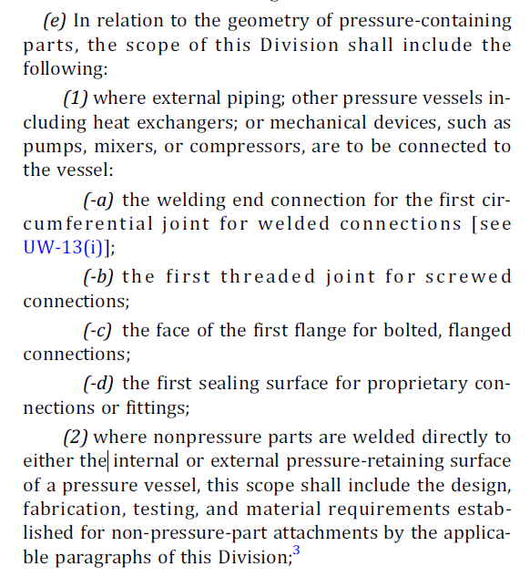
Design Methodology
Exact methods to evaluate stand design is difficult due to non traditional features.
Outside of scope of BPVC as per VIII-2,U-1(e)(2)
AISC 360 Advanced Analysis Methods are more for beam line elements than solid body, detailed components.
A combination of methods will be employed
Manual AISC/ASCE/Traditional calculations
FEA verification to ASME BPVC
Weld with joint efficiency = 1 due to compressive welds
FESHM Safety not explicitly required for vacuum vessels
Div. 1 vessels have a loading factor of 3.5

Slide 4
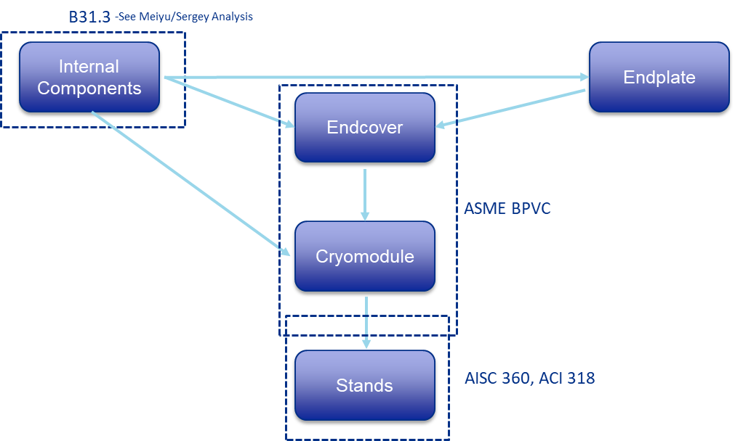
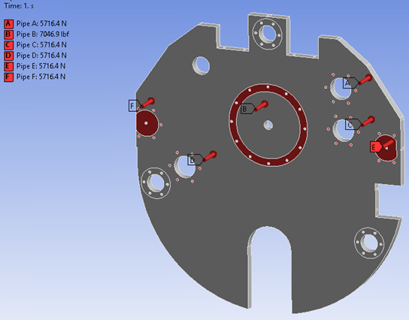
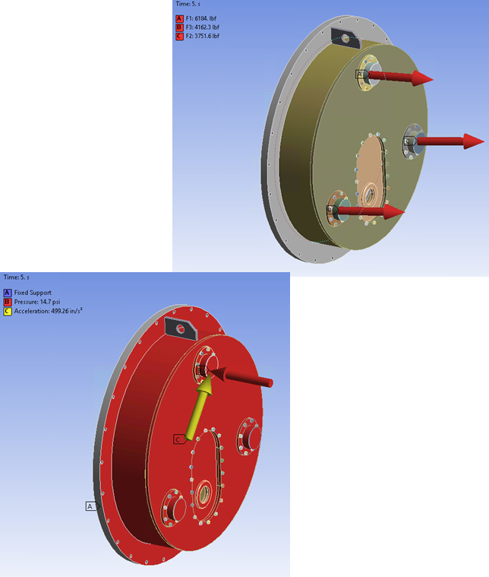
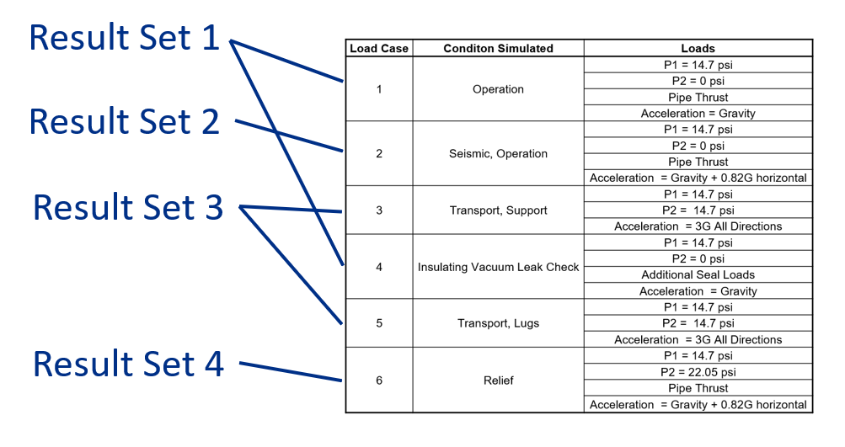
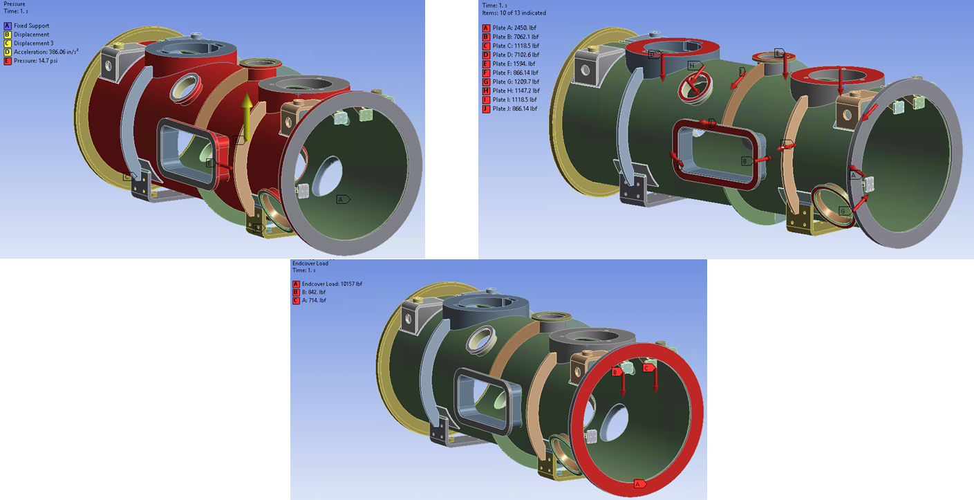
Design Methodology cont.
Design of stands is based on the analysis of the cryomodules:
Exact details outside of the scope of this review
End Cover/Internal Components
Cryomodule Analysis
Stand Analysis

Slide 5
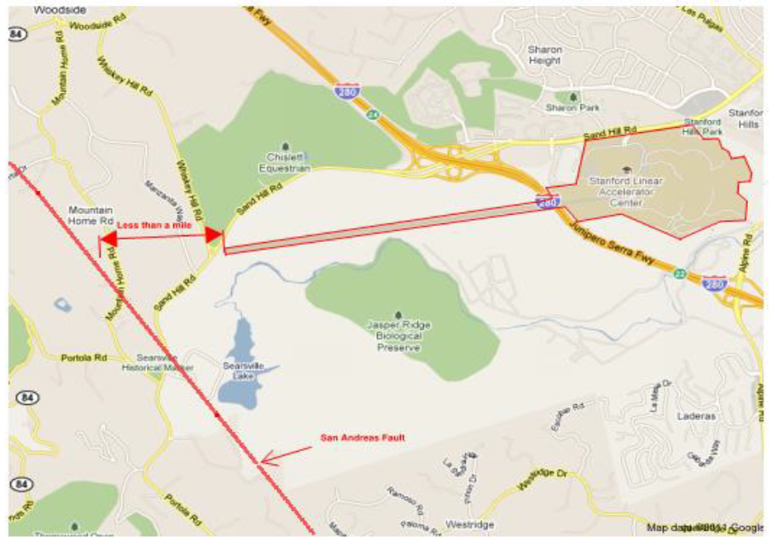
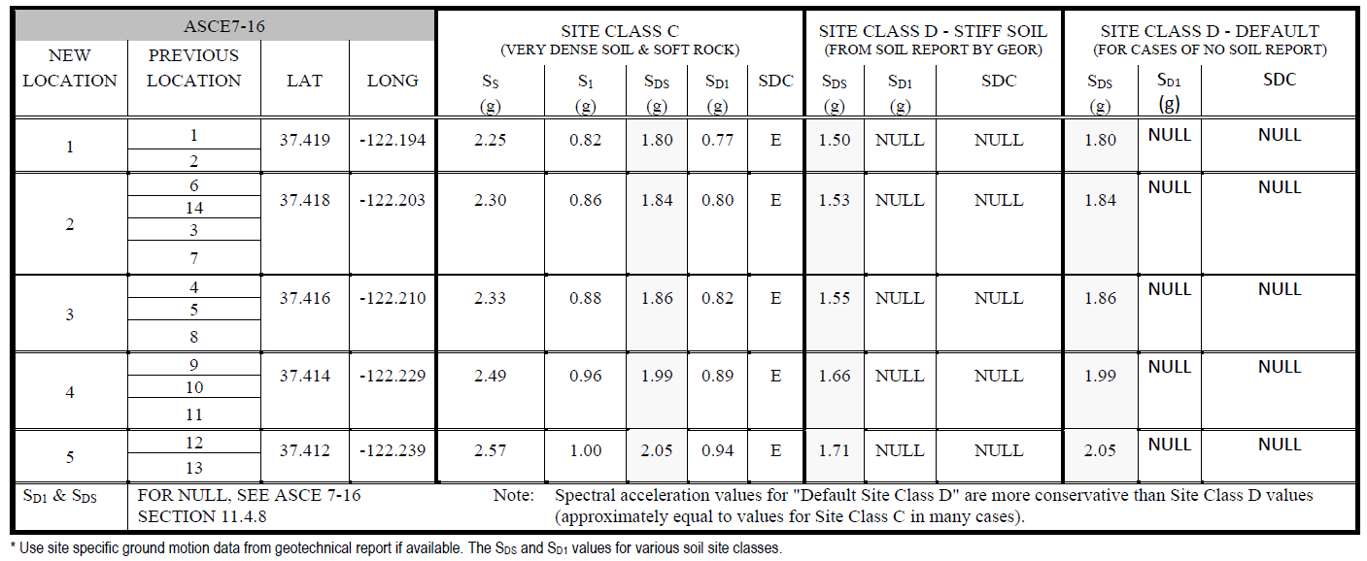
Seismic Parameters

Slide 6
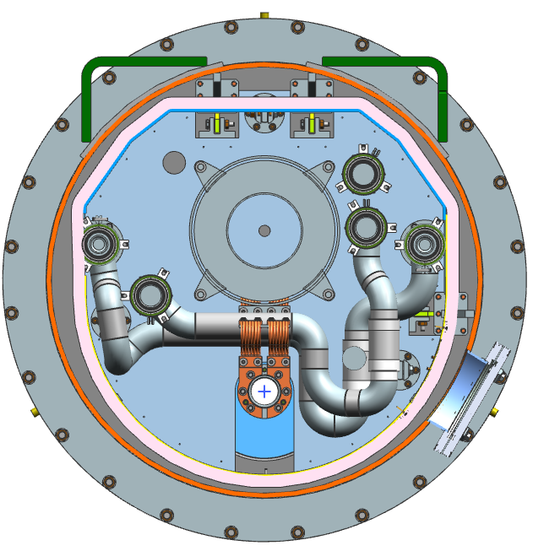
Pipe Loading
B
A
F
C
E
D
Pipe | Description | Pressure (psi) |  | Apx. Thrust Loads (lbf)
 |  | Operating | Design | Operating | Design
A | 2.2 K Supply Line | 3 | 20 | 192.8 | 1285.1
B | Helium Gas Return | 0.031 | 4.1 | 53.3 | 7046.9
C | 4.5 K Supply Line | 3 | 20 | 192.8 | 1285.1
D | 5.5 K Return Line | 2.8 | 20 | 179.9 | 1285.1
E | 35 K Supply Line | 3.7 | 20 | 237.7 | 1285.1
F | 55 K Return Line | 2.7 | 20 | 173.5 | 1285.1
G | 2-Phase He Line | 0.031 | 4.1 | 5.7 | 747.3
H | Cool Down Warm Up Line | 3 | 20 | 94.2 | 627.8
 |  | Net Force (lbf): |  | 1129.8 | 14847.3

Slide 7
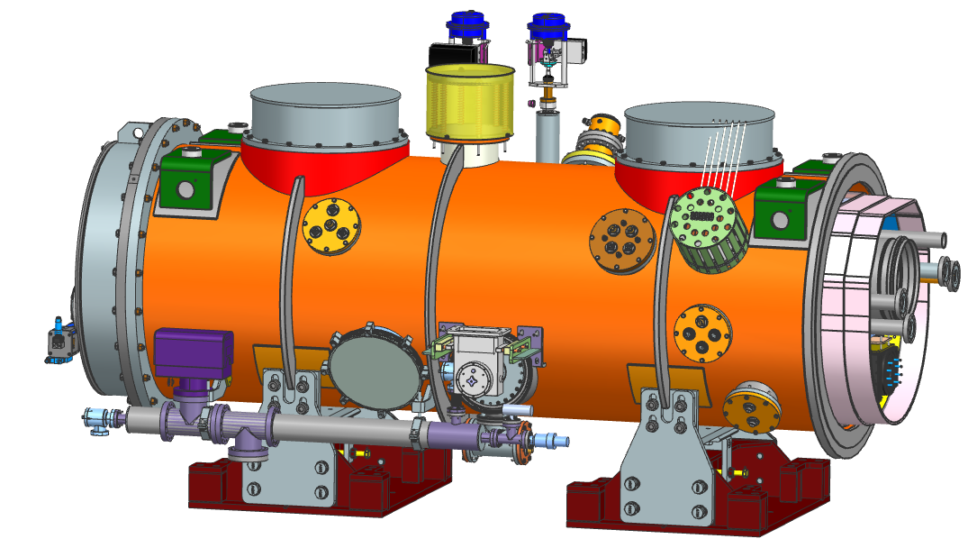
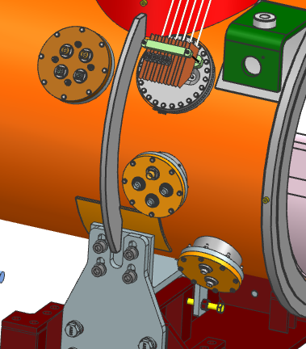
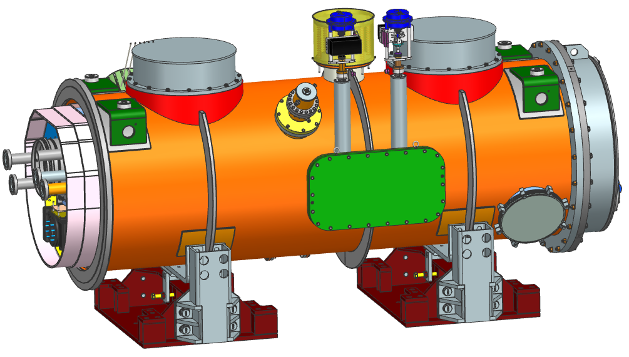
Pipe Flange Loads
E
D
H
F
Port | Diameter (mm) | Area (in²) | Force (lbf)
A | 370 | 166.7 | 2449.9
B | N/A | 480.4 | 7062.1
C | 250 | 76.1 | 1118.5
D | 630 | 483.2 | 7102.7
E | 298.5 | 108.4 | 1594.0
F | 220 | 58.9 | 866.1
G | 260 | 82.3 | 1209.7
H | 253.2 | 78.0 | 1147.2
I | 250 | 76.1 | 1118.5
J | 220 | 58.9 | 866.1
K | 220 | 58.9 | 866.1
I
G
A
J
C
K
A
B

Slide 8
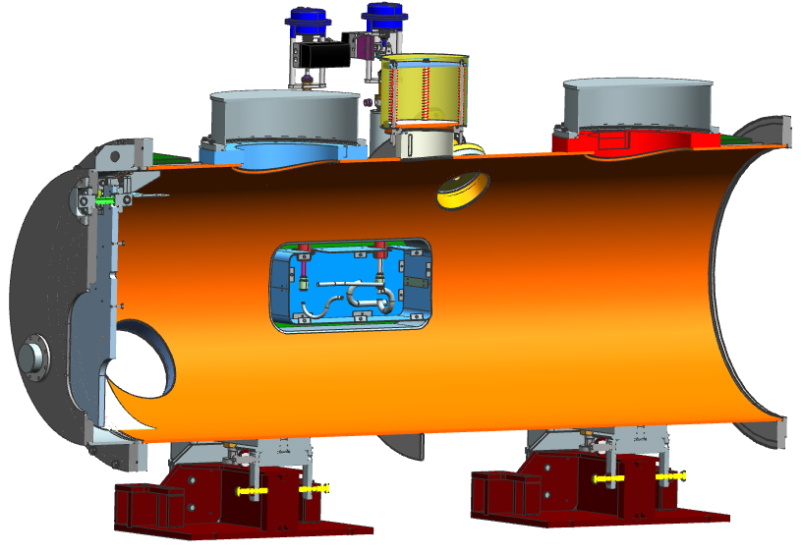
Cryomodule Load Conditions
Load Case | Conditon Simulated | Loads
1 | Operation | P1 = 14.7 psi
 |  | P2 = 0 psi
 |  | Pipe Thrust
 |  | Acceleration = Gravity
2 | Seismic, Operation | P1 = 14.7 psi
 |  | P2 = 0 psi
 |  | Pipe Thrust
 |  | Acceleration = Gravity + 0.82G horizontal
3 | Transport, Support | P1 = 14.7 psi
 |  | P2 = 14.7 psi
 |  | Acceleration = 3G All Directions
4 | Insulating Vacuum Leak Check | P1 = 14.7 psi
 |  | P2 = 0 psi
 |  | Additional Seal Loads
 |  | Acceleration = Gravity
5 | Transport, Lugs | P1 = 14.7 psi
 |  | P2 = 14.7 psi
 |  | Acceleration = 3G All Directions
6 | Relief | P1 = 14.7 psi
 |  | P2 = 22.05 psi
 |  | Pipe Thrust
 |  | Acceleration = Gravity + 0.82G horizontal
P1
P2
Material | Tensile Strength (ksi) | Yield Strength (ksi) | Allowable Strength (ksi) | Elastic Modulus (psi) | Poisson's Ratio | Density (lbf/in^3)
ASTM A516 Steel, Grade 60 | 60 | 32 | 17.1 | 2.94E+07 | 0.3 | 0.28
ASTM A36 Steel | 58 | 36 | 16.6
304 Stainless Steel | 75 | 30 | 20 | 2.83E+07 | 0.31 | 0.29
304L/316L Stainless Steel | 70 | 25 | 16.7

Slide 9
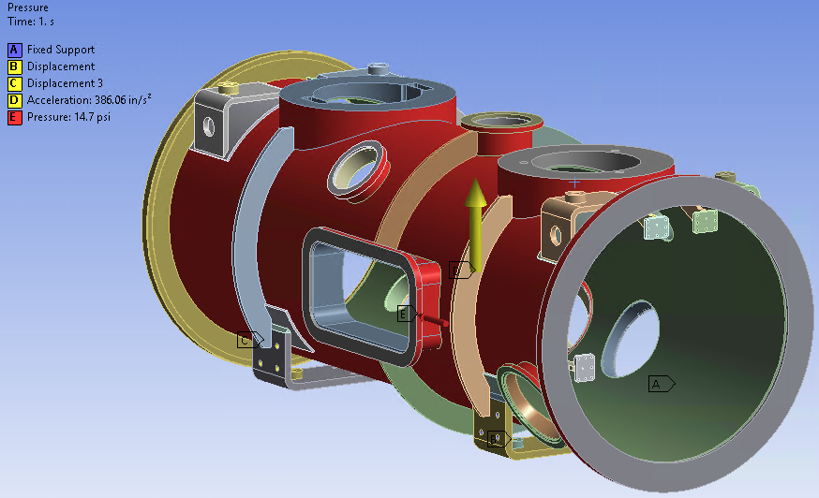
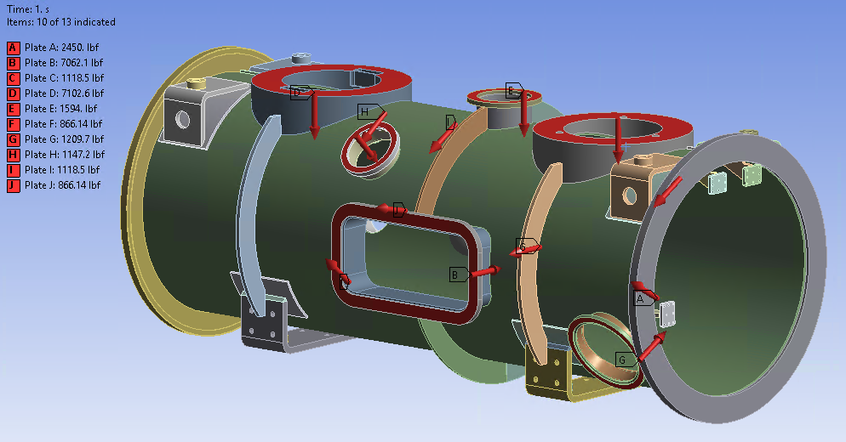
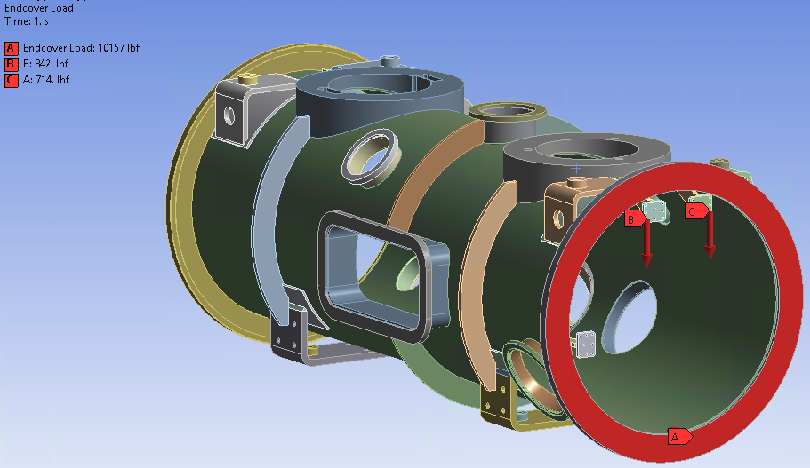
Cryomodule Loading Conditions

Slide 10
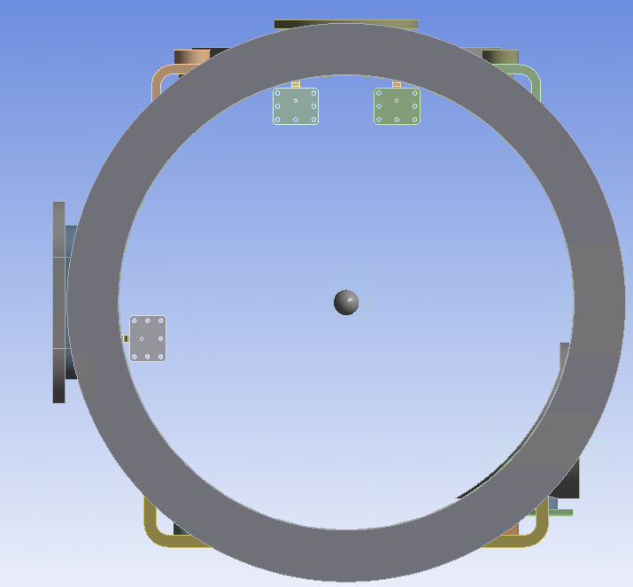
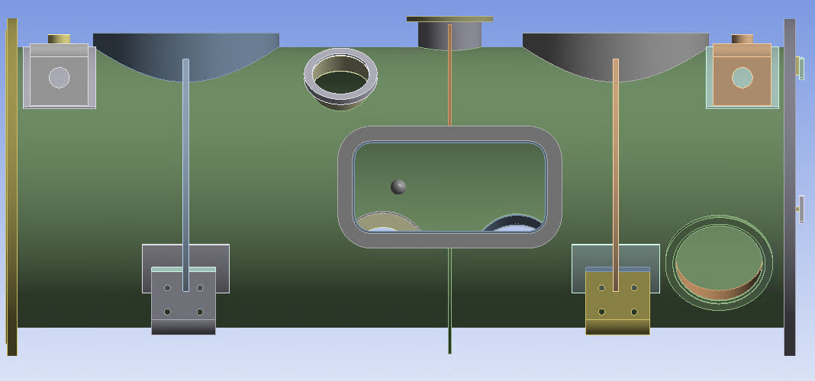
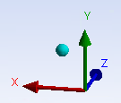
Input Loading
Using the force reactions from the cryomodule the stand will be modeled at the supports:
1
2
Load Case | Loading Condition | Force Reaction (lbf) |  |  |  |  |  |  |  |  |  |  |  |  |  |  |  | Moment Reaction (lbf in)
 |  | Fixed Support |  |  |  |  |  |  |  | Sliding Support |  |  |  |  |  |  |  | Fixed Support |  |  |  |  |  |  |  | Sliding Support
 |  | Side Support 1 |  |  |  | Side Support 2 |  |  |  | Side Support 1 |  |  |  | Side Support 2 |  |  |  | Side Support 1 |  |  |  | Side Support 2 |  |  |  | Side Support 1 |  |  |  | Side Support 2
 |  | X | Y | Z | Total | X | Y | Z | Total | X | Y | Z | Total | X | Y | Z | Total | X | Y | Z | Total | X | Y | Z | Total | X | Y | Z | Total | X | Y | Z | Total
1 |  | -1545.7 | -6243.1 | 1501.6 | 6604.566 | 1130.6 | -6651.0 | 951.2 | 6813.14 | -1455.2 | -5931.5 | -49.866 | 6107.601 | 1542.4 | -6271.6 | 56.803 | 6458.73 | -7079.6 | 1283.2 | -4075.3 | 8268.942 | -1924.2 | -1922.7 | 3138.8 | 4153.479 | 4919.7 | -1570.0 | -3156.8 | 6052.581 | 758.8 | 2160.7 | 2972.3 | 3752.185
2 | 1 | -2743.0 | -10018.0 | 1547.4 | 10501.0 | 2284.8 | -10661.0 | 898.9 | 10941.0 | -2373.2 | -9328.4 | -59.3 | 9625.7 | 2471.3 | -9429.4 | 67.8 | 9748.1 | -9643.4 | 2327.0 | -6397.8 | 11804.0 | -4967.4 | -2953.7 | 5346.1 | 7872.8 | 6506.7 | -2116.7 | -4984.3 | 8465.2 | 1473.2 | 2810.2 | 4648.6 | 5628.2
 | 2 | -342.7 | -2473.8 | 1457.7 | 2891.7 | -29.6 | -2648.9 | 999.3 | 2831.3 | -549.3 | -2555.7 | -40.4 | 2614.4 | 624.9 | -3132.3 | 45.5 | 3194.4 | -4591.0 | 292.2 | -1763.0 | 4926.6 | 1045.2 | -927.9 | 946.3 | 1687.9 | 3386.0 | -1052.8 | -1366.8 | 3800.2 | 98.8 | 1534.4 | 1334.8 | 2036.1
 | 3 | -2331.7 | -6855.6 | -5589.6 | 9147.7 | 2169.6 | -8393.3 | -6120.0 | 10612.0 | -897.2 | -5335.3 | 32.9 | 5410.3 | 795.3 | -4528.6 | 99.9 | 4598.9 | -14899.0 | 3695.9 | -4546.2 | 16010.0 | -9554.7 | -4832.1 | 4594.6 | 11651.0 | -691.5 | -945.1 | -2523.9 | 2782.4 | -2337.0 | 1043.0 | 1870.7 | 3169.9
 | 4 | -737.8 | -5615.5 | 8603.1 | 10300.0 | 61.9 | -4889.2 | 8010.3 | 9384.7 | -2010.5 | -6527.9 | -132.9 | 6831.8 | 2292.7 | -8017.5 | 14.0 | 8338.9 | 754.7 | -1171.8 | -3572.0 | 3834.3 | 5574.4 | 940.9 | 1646.7 | 5888.2 | 10566.0 | -2208.0 | -3790.4 | 11440.0 | 3939.2 | 3309.9 | 4080.3 | 6566.7
 | 5 | -2486.4 | -1533.3 | -1780.9 | 3421.2 | -1161.1 | -11003.0 | 4263.9 | 11857.0 | -4887.3 | -6032.9 | 109.2 | 7764.9 | -2772.6 | -6046.7 | -129.7 | 6653.3 | -3091.7 | 3697.2 | -1489.1 | 5044.4 | -8961.0 | 249.3 | 5099.5 | 10313.0 | -2222.6 | -4811.3 | -3975.7 | 6625.3 | 3260.3 | -47.6 | 1736.9 | 3694.4
 | 6 | -577.3 | -10649.0 | 4854.8 | 11717.0 | 3454.5 | -2153.3 | -2441.0 | 4746.5 | 1918.3 | -5706.8 | -201.7 | 6023.9 | 5780.9 | -6280.2 | 236.3 | 8539.1 | -10704.0 | -1256.2 | -6682.6 | 12681.0 | 5391.8 | -4012.2 | 1381.4 | 6861.3 | 11858.0 | 1584.4 | -2547.3 | 12232.0 | -1992.0 | 4224.5 | 4445.8 | 6448.2
3 | 1 | -4306.1 | -13612.0 | 147.3 | 14278.0 | 4159.3 | -14536.0 | -168.2 | 15121.0 | -3303.5 | -12216.0 | -29.9 | 12655.0 | 3253.6 | -11358.0 | 35.4 | 11815.0 | -8654.8 | 3425.1 | -8317.1 | 12482.0 | -11087.0 | -3678.2 | 8068.5 | 14197.0 | 5105.4 | -1847.1 | -6651.2 | 8585.8 | 2294.4 | 2222.4 | 6158.6 | 6937.7
 | 2 | 2833.9 | 10804.0 | -173.7 | 11171.0 | -2689.8 | 11334.0 | 173.1 | 11650.0 | 3722.7 | 12857.0 | 36.8 | 13385.0 | -3732.3 | 12389.0 | -47.7 | 12939.0 | 5492.5 | -2425.9 | 6276.4 | 8685.9 | 6238.8 | 2557.1 | -5976.3 | 9009.9 | -7823.8 | 2147.7 | 7173.8 | 10830.0 | -4403.5 | -2767.3 | -6864.1 | 8611.9
 | 3 | -2758.3 | -2256.2 | -26001.0 | 26244.0 | 3574.2 | -6171.4 | -25804.0 | 26771.0 | 2134.3 | 2348.3 | 299.1 | 3187.4 | -2674.2 | 6320.8 | 163.6 | 6865.1 | -28712.0 | 8763.7 | -1688.8 | 30067.0 | -27665.0 | -10527.0 | 5068.1 | 30031.0 | -20220.0 | 2175.2 | 2332.2 | 20470.0 | -11150.0 | -3970.0 | -3960.2 | 12481.0
 | 4 | 3009.3 | 2411.5 | 26039.0 | 26323.0 | -3846.5 | 6334.5 | 25766.0 | 26810.0 | -2032.6 | -2288.0 | -299.8 | 3075.1 | 2588.0 | -6262.3 | -162.9 | 6777.9 | 28681.0 | -8972.4 | 1955.3 | 30115.0 | 27774.0 | 10616.0 | -5406.0 | 30221.0 | 20188.0 | -2190.9 | -2211.5 | 20427.0 | 11234.0 | 4006.8 | 3837.5 | 12530.0
 | 5 | -4139.4 | 17481.0 | -12546.0 | 21912.0 | -8153.7 | -16858.0 | 12691.0 | 22622.0 | -14512.0 | -2136.9 | 693.6 | 14685.0 | -17371.0 | 1911.8 | -812.4 | 17495.0 | 15282.0 | 9849.6 | 8930.3 | 20256.0 | -26648.0 | 9028.8 | 6157.0 | 28802.0 | -26130.0 | -11210.0 | -3985.4 | 28712.0 | 8162.9 | -7729.2 | -6247.8 | 12861.0
 | 6 | 3794.3 | -17073.0 | 12599.0 | 21555.0 | 8486.4 | 17235.0 | -12770.0 | 23068.0 | 14417.0 | 2217.1 | -696.3 | 14603.0 | 17489.0 | -1824.0 | 815.5 | 17602.0 | -14441.0 | -9402.2 | -8908.3 | 19399.0 | 29003.0 | -9785.9 | -6276.8 | 31247.0 | 24744.0 | 10482.0 | 3900.8 | 27154.0 | -9255.4 | 8328.7 | 6206.3 | 13912.0
4 |  | -2632.1 | -7606.5 | -10924.0 | 13569.0 | 2632.1 | -9044.7 | -10645.0 | 14215.0 | -731.0 | -4383.8 | -3.5 | 4444.3 | 387.8 | -3682.9 | 2.4 | 3703.3 | -16328.0 | 5249.6 | -5094.2 | 17892.0 | -13188.0 | -6006.1 | 5307.9 | 15433.0 | -1841.1 | -596.8 | -2248.6 | 2966.8 | -2998.1 | 452.7 | 1549.6 | 3405.1
6 | 1 | -1685.6 | -4141.0 | -10895.0 | 11776.0 | 2217.2 | -4925.1 | -11063.0 | 12311.0 | 543.8 | -476.4 | 6.0 | 723.0 | -118.3 | 1531.4 | -3.7 | 1535.9 | -10895.0 | 3794.0 | -2409.5 | 11786.0 | -12208.0 | -4832.9 | 3246.4 | 13525.0 | -5015.4 | 843.2 | 235.1 | 5091.2 | -5176.9 | -366.8 | -387.4 | 5204.3
 | 2 | -2825.6 | -7830.2 | -10861.0 | 13684.0 | 3319.7 | -8871.6 | -11104.0 | 14596.0 | -357.2 | -3807.6 | -2.2 | 3824.3 | 765.3 | -1567.1 | 6.0 | 1744.0 | -13448.0 | 4793.2 | -4626.3 | 15008.0 | -15354.0 | -5896.0 | 5403.0 | 17312.0 | -3643.5 | 354.0 | -1564.5 | 3980.9 | -4529.6 | 239.0 | 1277.2 | 4712.3
 | 3 | -529.1 | -446.1 | -10935.0 | 10957.0 | 1098.1 | -967.5 | -11018.0 | 11115.0 | 1433.4 | 2843.3 | 13.9 | 3184.2 | -995.2 | 4623.2 | -13.5 | 4729.1 | -8623.4 | 2908.8 | -184.9 | 9102.7 | -9262.1 | -3862.4 | 1076.8 | 10093.0 | -6368.1 | 1329.2 | 2022.4 | 6812.5 | -5796.4 | -967.2 | -2046.6 | 6222.7
 | 4 | -2410.5 | -4747.2 | -17984.0 | 18755.0 | 3153.4 | -6588.5 | -18135.0 | 19550.0 | 1134.4 | 174.5 | 88.0 | 1151.1 | -844.9 | 3254.0 | 40.9 | 3362.1 | -18589.0 | 6148.9 | -2825.8 | 19783.0 | -19614.0 | -7704.4 | 4581.4 | 21565.0 | -10493.0 | 1428.2 | 879.9 | 10627.0 | -8195.0 | -1446.5 | -1462.1 | 8449.2
 | 5 | -887.3 | -3490.8 | -3798.5 | 5234.6 | 1202.6 | -3214.1 | -4001.5 | 5271.5 | -43.3 | -1125.3 | -76.2 | 1128.7 | 608.7 | -192.1 | -48.1 | 640.1 | -3236.1 | 1464.6 | -1911.7 | 4033.9 | -4823.1 | -2001.8 | 1819.6 | 5529.9 | 484.9 | 249.7 | -407.4 | 680.8 | -2126.4 | 724.7 | 687.6 | 2349.3
 | 6 | -2744.4 | 359.7 | -14061.0 | 14331.0 | -63.3 | -9314.7 | -7862.4 | 12189.0 | -2842.3 | -611.1 | 154.7 | 2911.4 | -4313.8 | 1594.9 | -179.0 | 4602.7 | -7237.6 | 6361.4 | 19.3 | 9635.9 | -19686.0 | -3051.1 | 5065.7 | 20555.0 | -11843.0 | -2315.9 | -481.1 | 12077.0 | -2486.4 | -2343.9 | -1699.0 | 3816.1
 | 7 | -588.2 | -8567.0 | -7739.9 | 11561.0 | 4471.0 | -477.1 | -14257.0 | 14949.0 | 3871.0 | -386.1 | -143.8 | 3892.9 | 4120.4 | 1448.4 | 171.7 | 4370.9 | -14963.0 | 1552.4 | -4781.8 | 15785.0 | -5032.5 | -7004.8 | 1380.2 | 8734.9 | 1829.3 | 3896.0 | 899.9 | 4397.2 | -7880.1 | 1681.5 | 952.5 | 8113.6

Slide 11
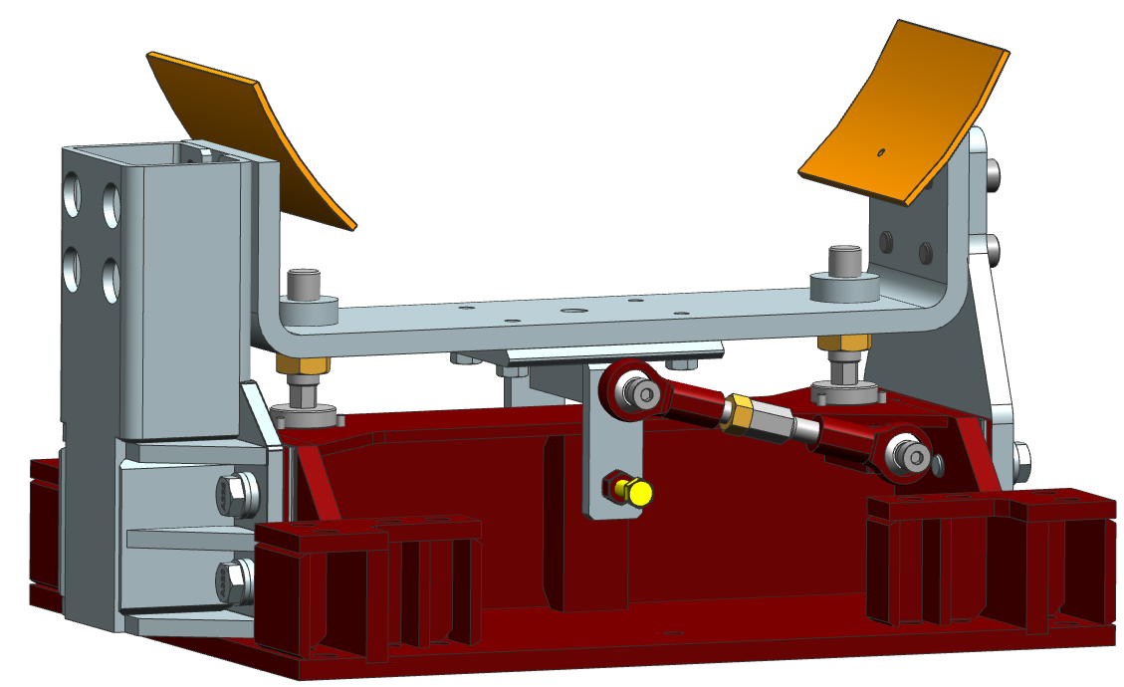
Maximum Forces/Moments
Converting all of the Forces/Moments to maximum conditions…
Largest Combined Force/Moment:
26,810.0 lbf of force
31,247.0 lbf-in of moment
Force (lbf) |  |  | Moment (lbf-in)
X | Y | Z | X | Y | Z
17,489 | 17,481 | 26,039 | 29,003 | 11,210 | 8,930.3
Y
Z
X

Slide 12
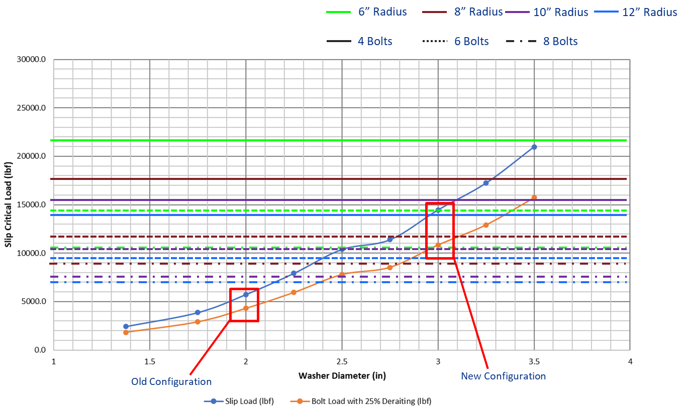
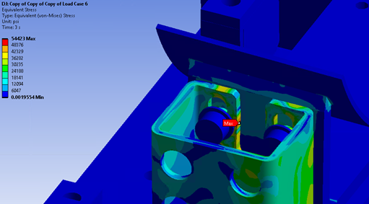
Initial Assessment
Initial assessments indicated that the assembly would not be able to withstand loading.
Bolts would exceed slip critical conditions
Anchors overloaded without considering effects of friction
Bolt tear-through occurred on FEA models at anchors and at the attachment points of the stand

Slide 13
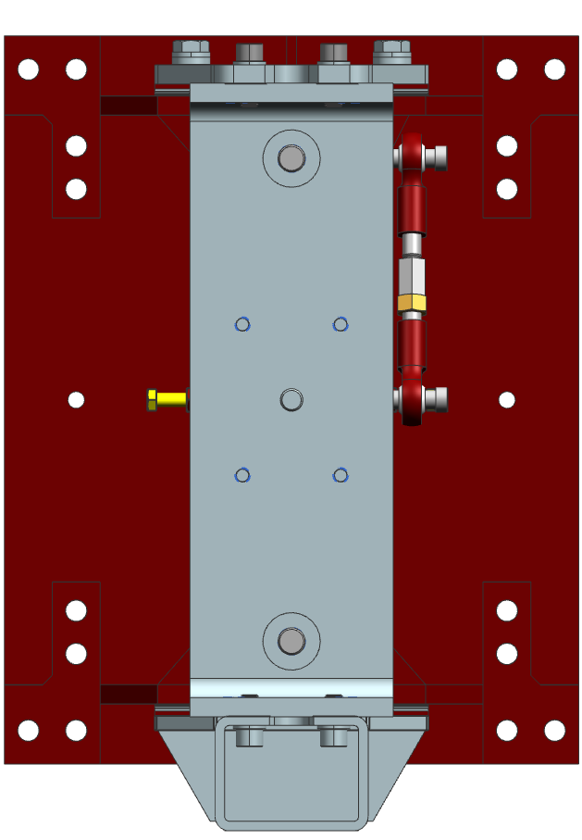
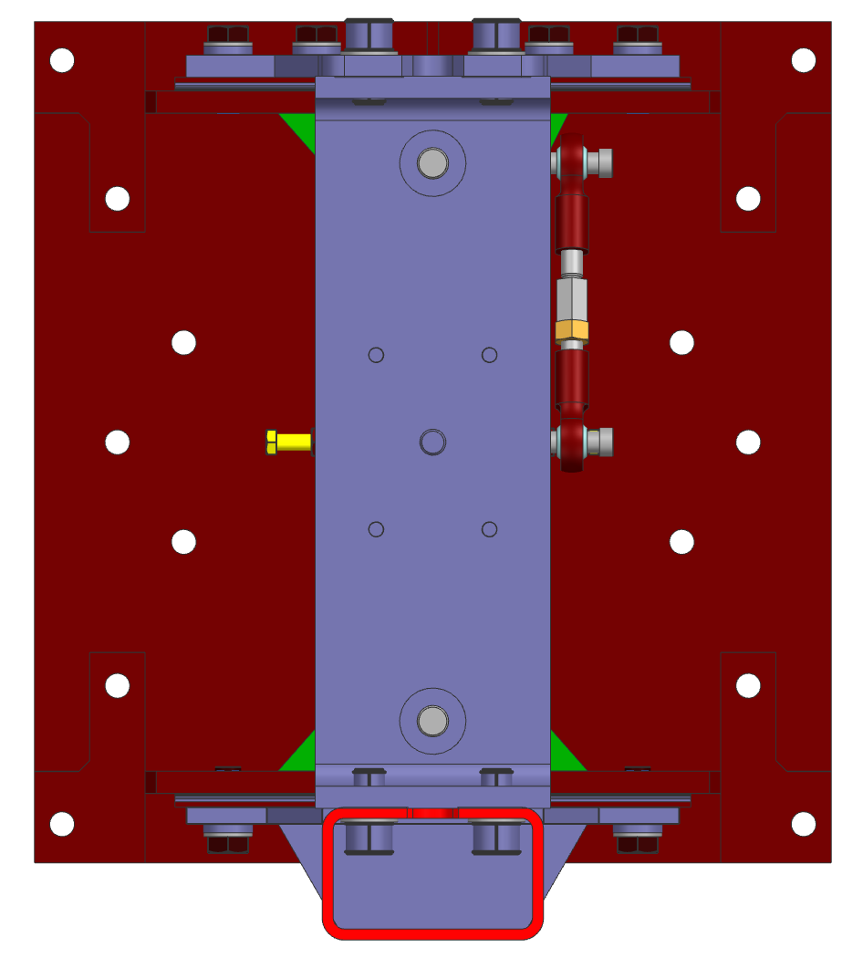
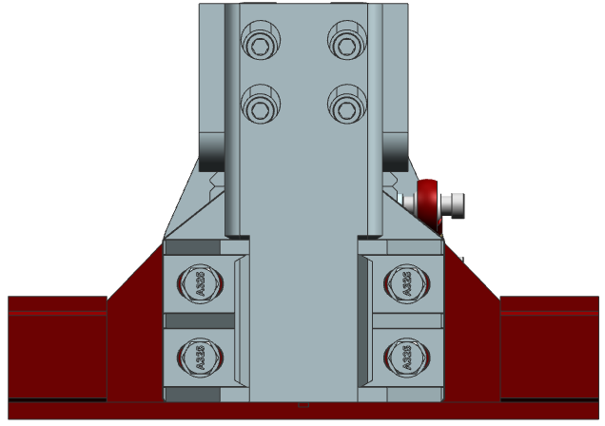
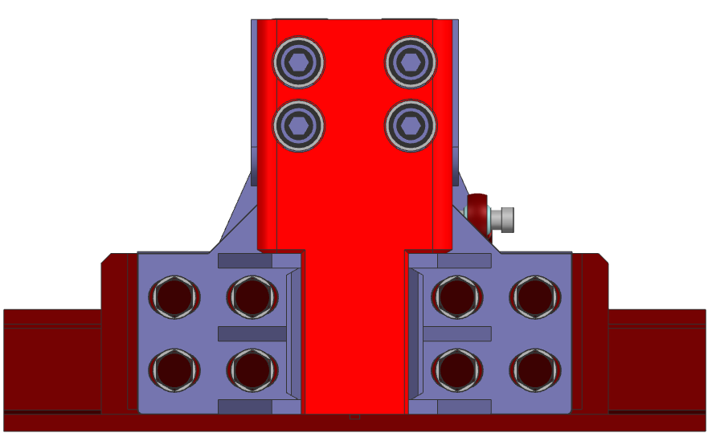
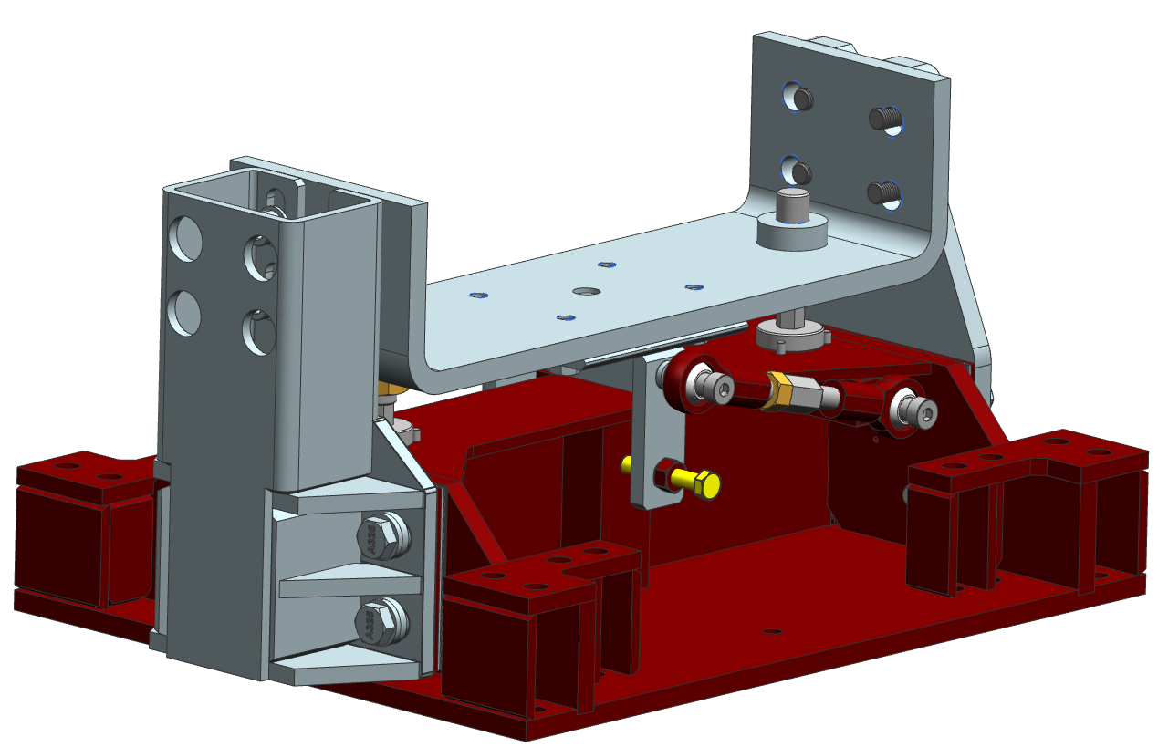
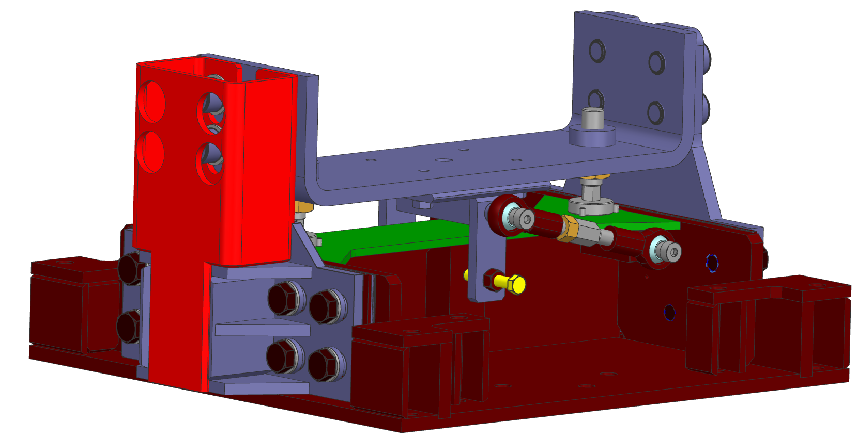
Design Changes

Slide 14
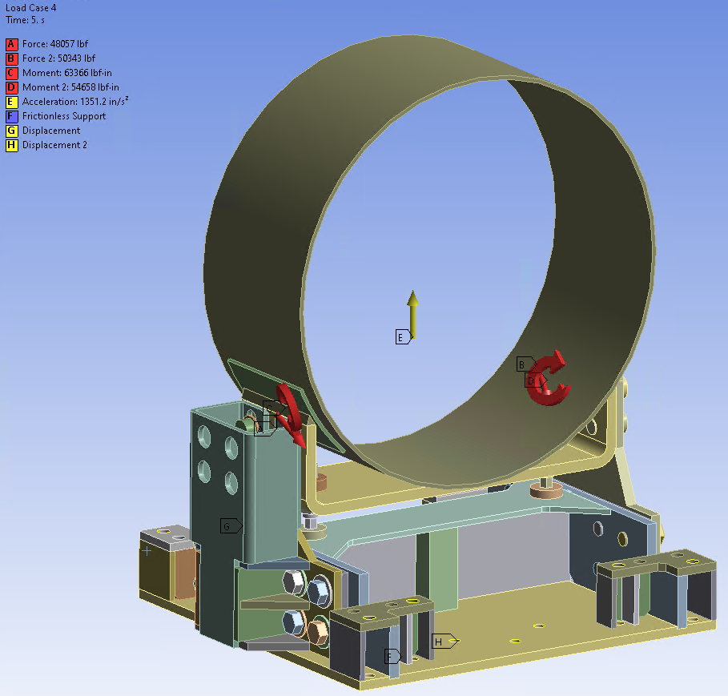
Simulation Setup
Load Step | Load Scaler | Purpose
1 | 0 | Gravity
2 | 1 | Initial Loading
3 | 1.7 | Local Failure
4 | 2.4 | Div. 2 Plastic Collapse
5 | 3.5 | Div. 1 Plastic Collapse

Slide 15
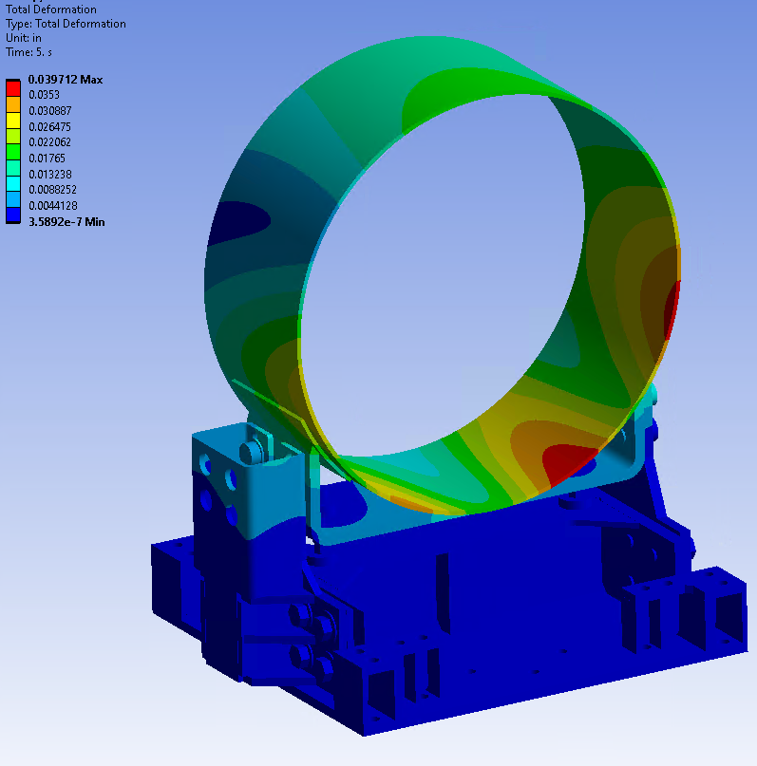
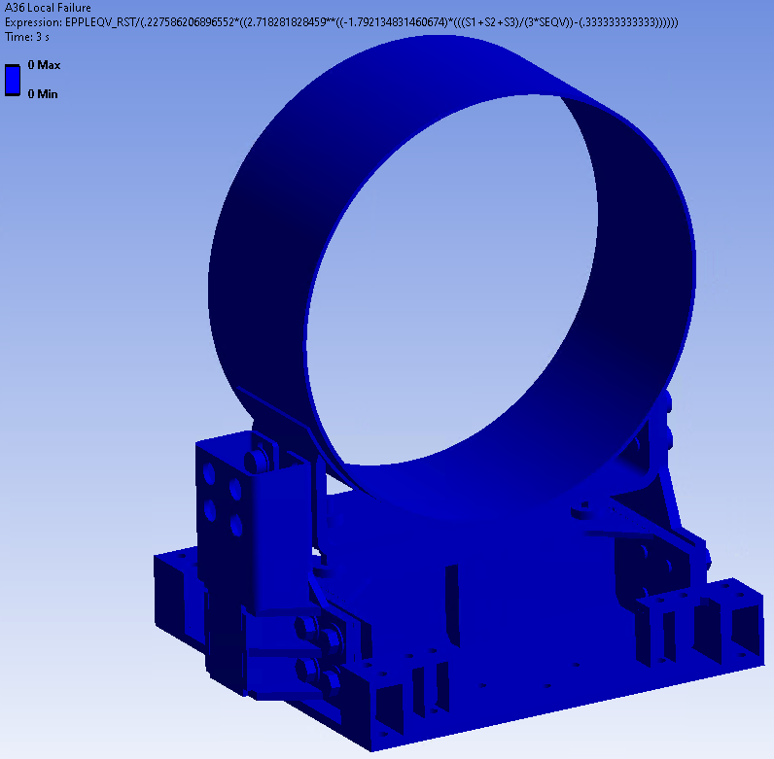
Load Case 1

Slide 16
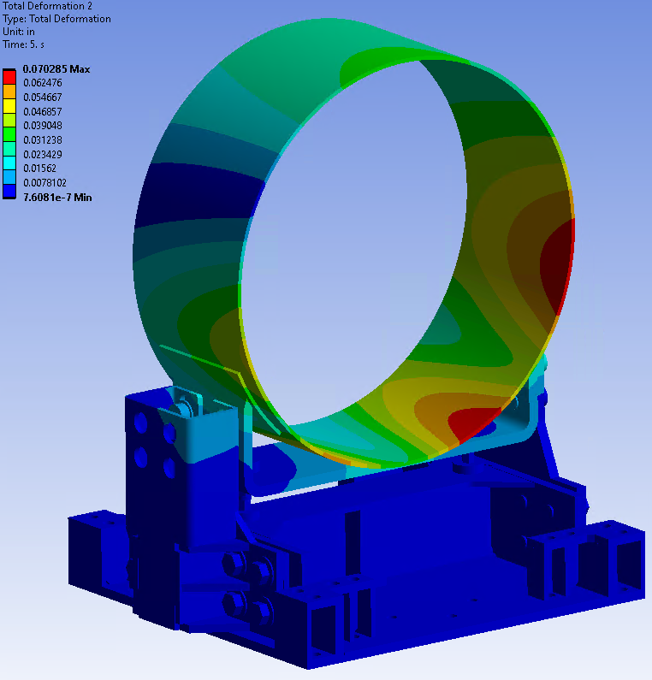
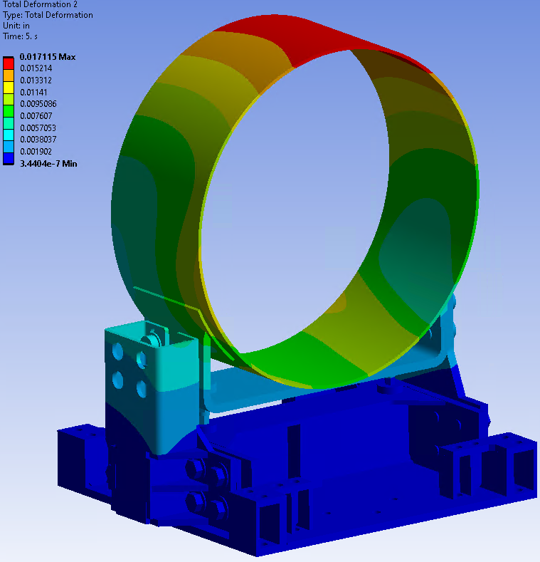
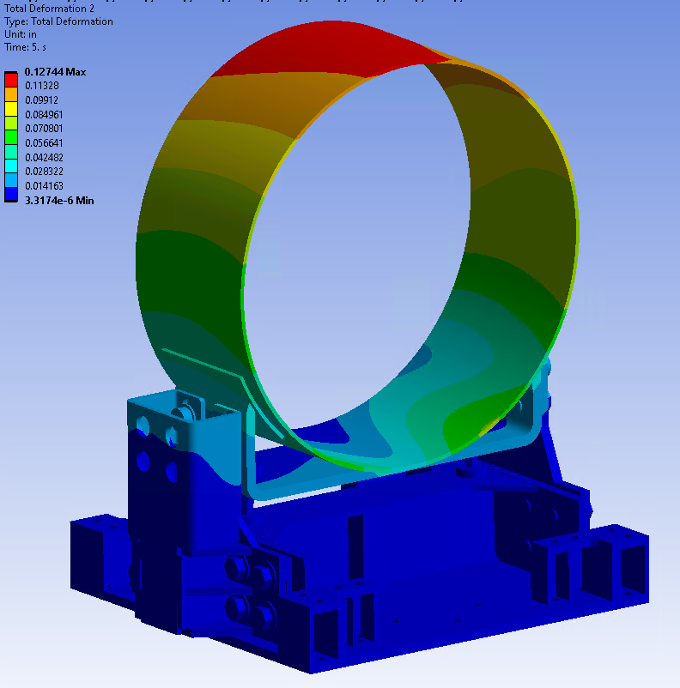
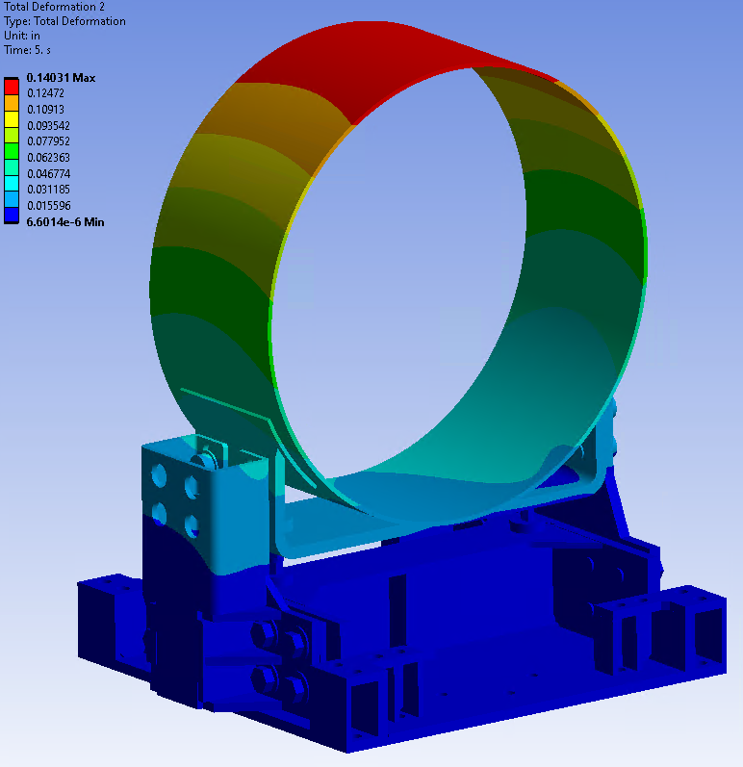
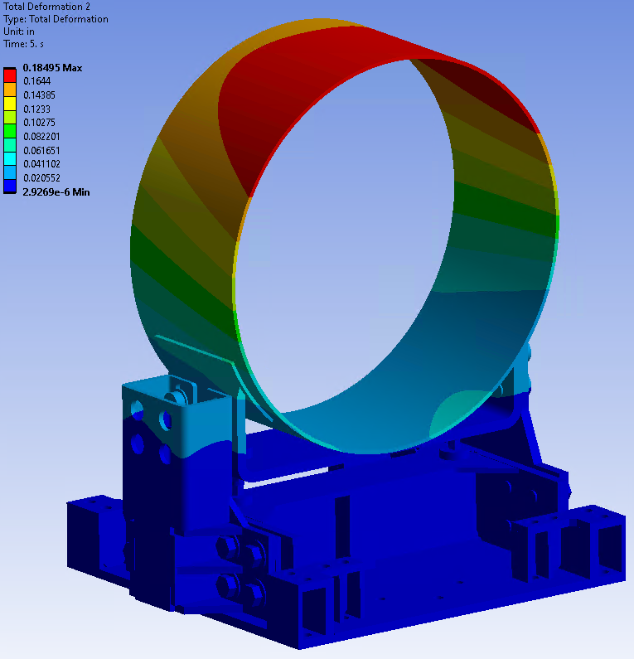
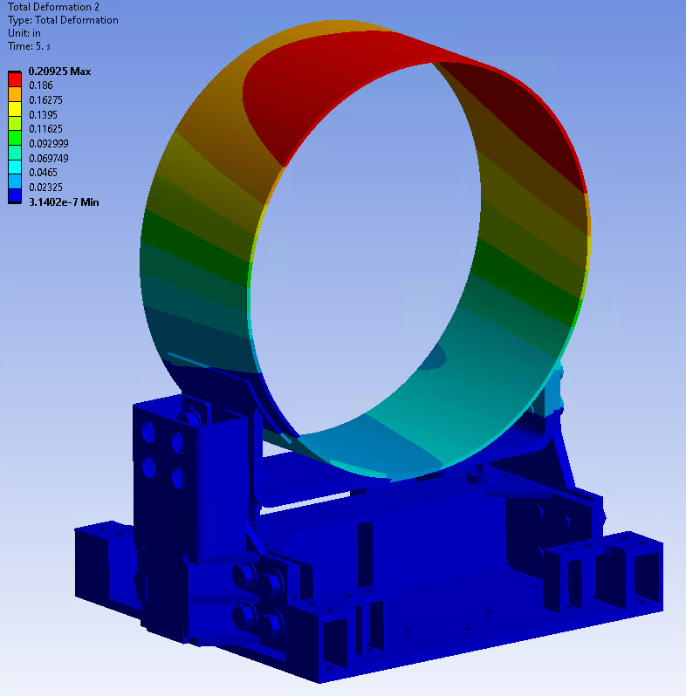
Load Case 2 Plastic Collapse
LC1
LC2
LC3
LC4
LC5
LC6

Slide 17
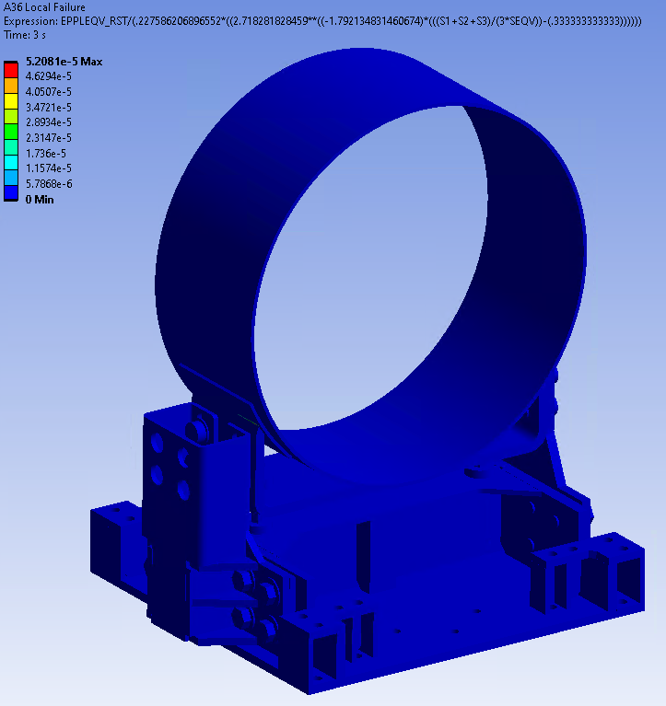
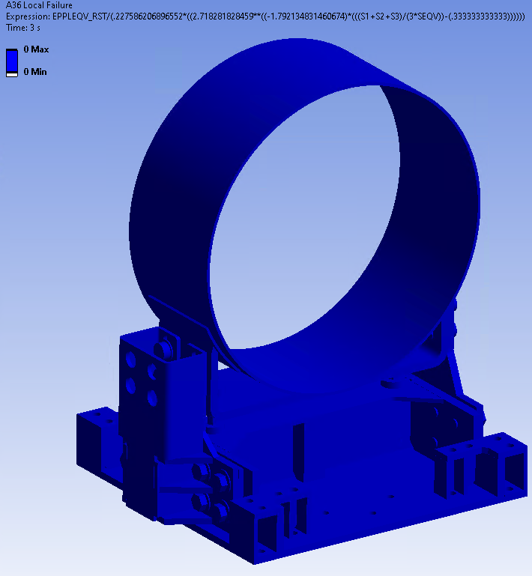
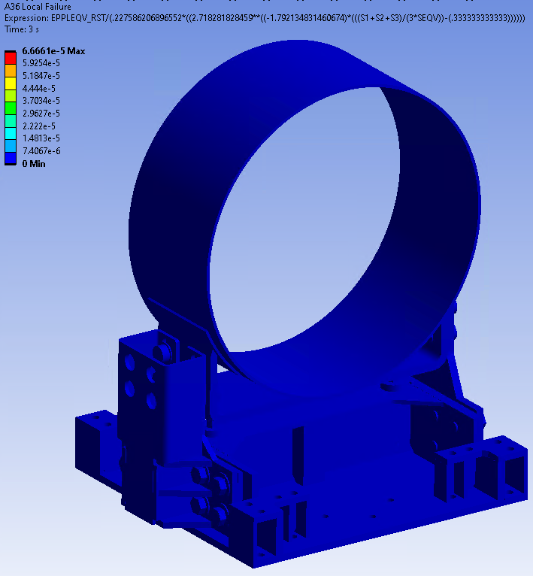
Load Case 2 Local Failure
LC1
LC2
LC3
LC4
LC5
LC6

Slide 18
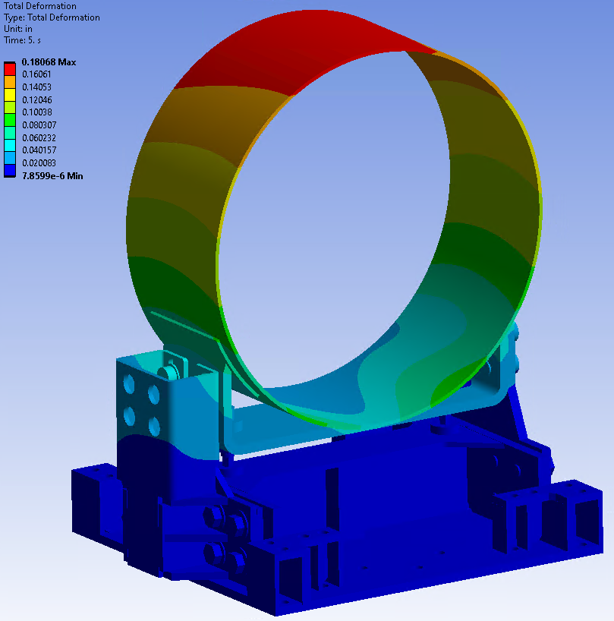
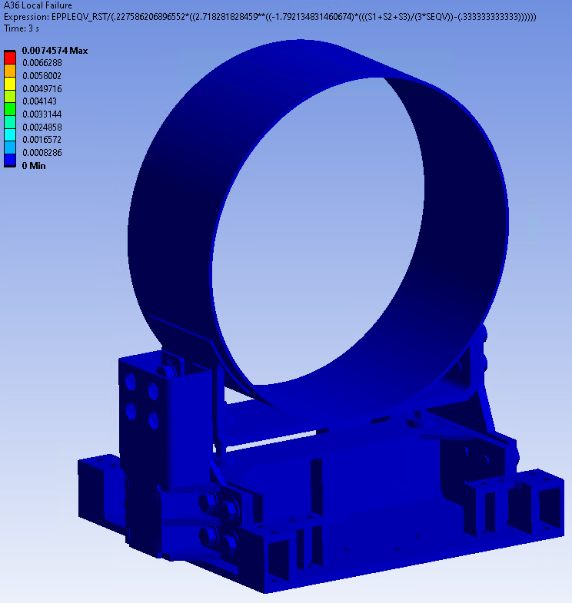
Load Case 4

Slide 19
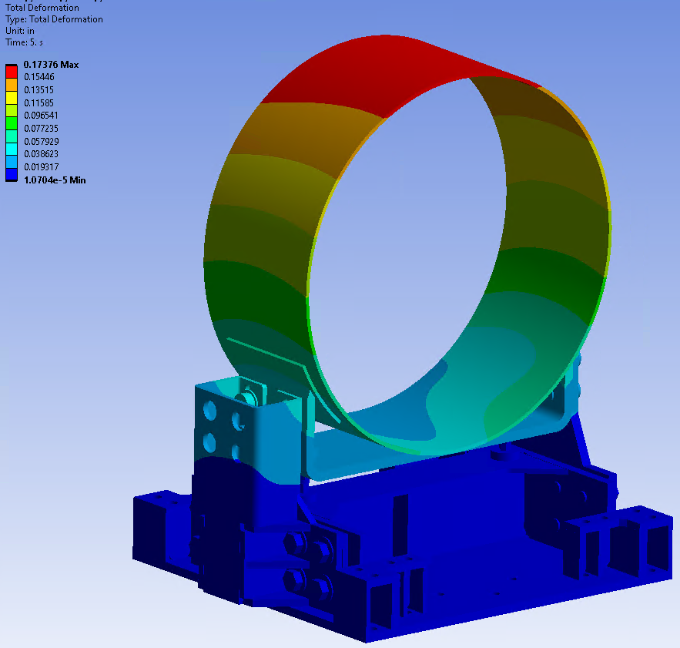
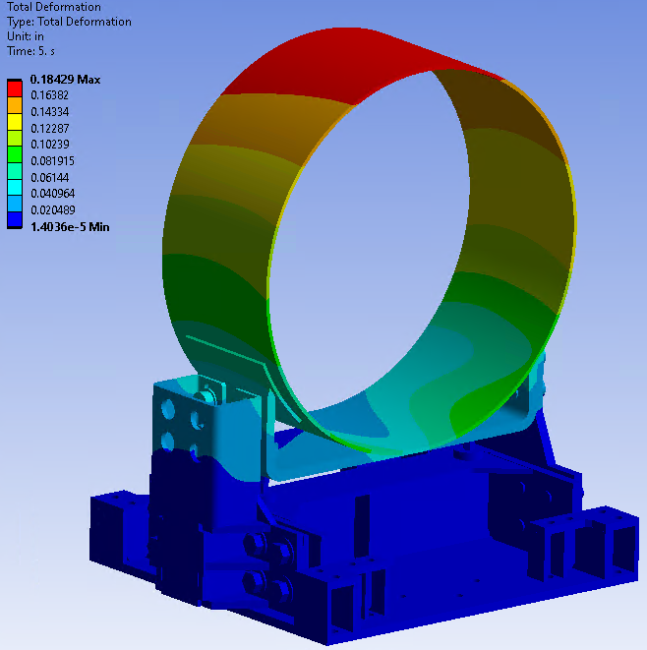
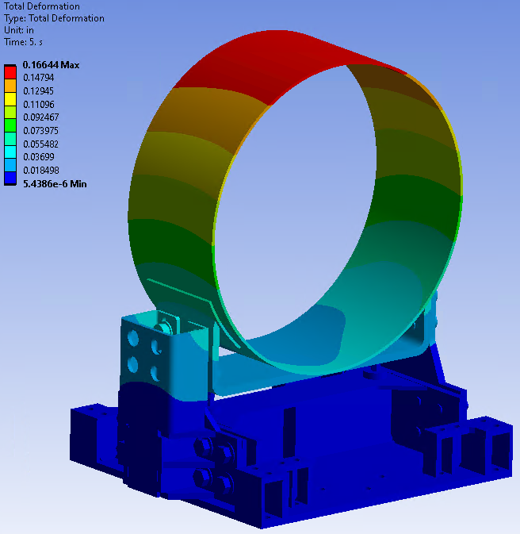
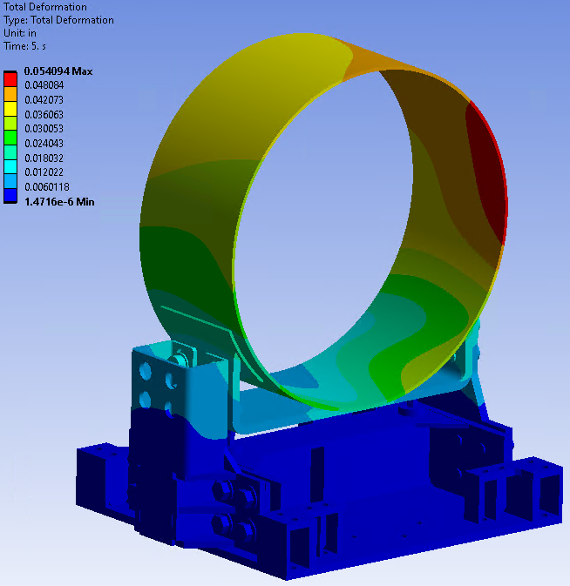
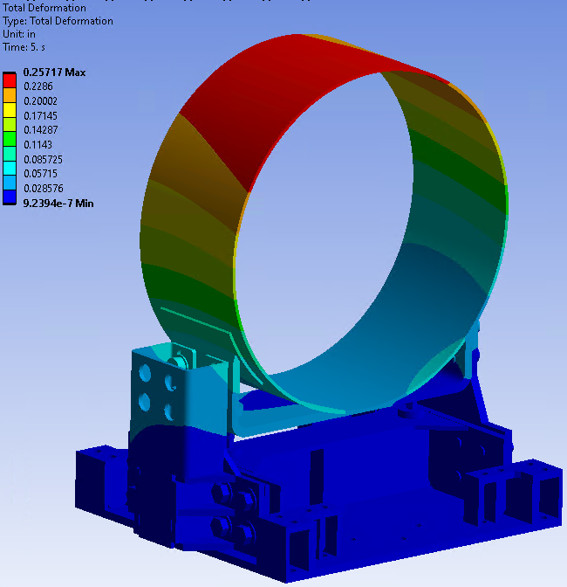
Load Case 6 Plastic Collapse
LC1
LC2
LC3
LC4
LC5
LC6

Slide 20
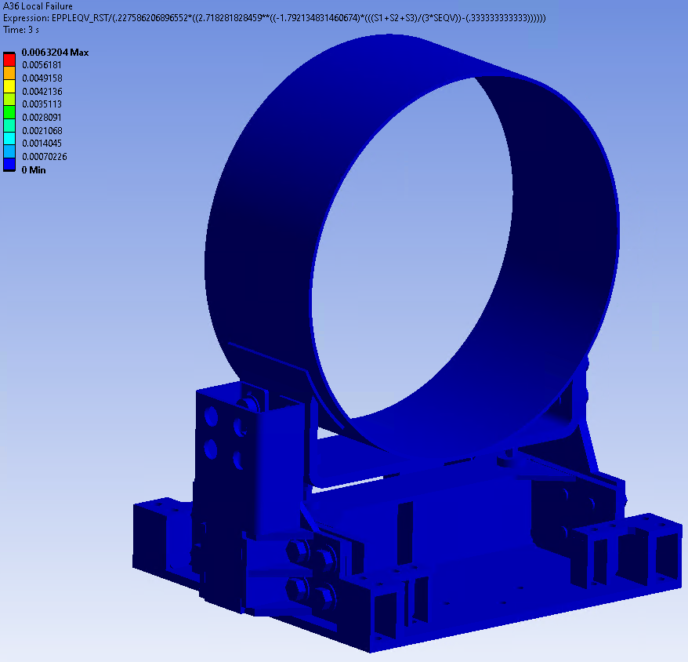
Load Case 6 Local Failure
LC1
LC2
LC3
LC4
LC5
LC6

Slide 21
Load Case 6, Condition 7

Slide 22
Conclusions
Design of stands have been validated using FEA using ASME BPVC Design by Analysis methods.
Manual Calculations have also been performed to validate the design of the components.
Details can be seen in backup slides.
Results show that the design will be able to withstand all relevant loading conditions
Stands have been updated to be made wider to account for

Slide 23
Backup Slides

Slide 24
First-Order Stand Reactions to Vacuum Loading:
58.7488”
1
Assume radius of 22.8”
Pressure of 14.7 psi
F = 24,080 lbf
32.5922”
3
2
Assume center of connection is center of fixed stand
Generated Moment at anchorage center = 784,820 lbf-in
Force at other stand will help balance out
Will occur even without anchors
Force = 13,359 lbf for 100% absorption

Slide 25
Stand Component Flexure
Simplified Cross Section:
2 Rectangular Bars
Ix: 54.1218 in^4
Iy: 0.7217 in^4
Y
Parts made of A36 Steel
Em = 29e6 psi
Ys = 36 ksi
Yt = 58 ksi
8.66”
X
Simplified Cross Section:
Hollow Tube
Wall Thickness: 0.5”
Ix: 113.0833 in^4
Iy: 71.0833 in^4
1”
Simplified Cross Section:
Rectangular Bar
Ix: 43.7965 in^4
Iy: 0.6725 in^4
6”
8.07”
8”
1”

Slide 26
Stand Flexure Calculations
$$P_{n}∗l{=M}_{n}=F_{y}Z=F_{y}\frac{I}{c}⇒P_{n}=\frac{F_{y}\frac{I}{c}}{l}$$
Y
$$Φ=0.9;P_{a}=ΦP_{n}$$
X
X-Axis Force
Moment Arm (l): 20.3”
Iy: 0.6725 in^4
c = 0.5”
$P_{n}$=2,385.2 lbf
Y-Axis Force
Moment Arm (l): 20.3”
Ix: 43.7965 in^4
c = 4.035”
$P_{n}$= 19,249 lbf
X-Axis Force
Moment Arm (l): 8.5433”
Iy: 0.7217 in^4
c = 0.5”
$P_{n}$/2= 6,082.2 lbf
Y-Axis Force
Moment Arm (l): 8.5433”
Ix: 54.1218 in^4
c = 4.33”
$P_{n}$/2= 52,670 lbf
X-Axis Force
Moment Arm (l): 20.25”
Iy: 71.0833 in^4
c = 3”
$P_{n}$= 42,123 lbf
Y-Axis Force
Moment Arm (l): 20.25”
Ix: 113.0833 in^4
c = 4”
$P_{n}$= 50,259 lbf
$P_{a}=17,324.1$ lbf
Combined, all sections should have a combined $P_{a}$of 51,004.8 lbf the X axis Direction and 157,363.2 lbf in the y axis direction
Limit of forces is 26,810 lbf, combined stands can reset moments
Assumptions: Find Max Load Part can hold assuming maximum possible bending moment (x-Axis force) or half the width of the part (y-Axis force) as per AISC 360 Section F7

Slide 27
Bolt Limits
Three Sets of Bolts hold the stand together
Two in slip critical conditions, one just withstanding vertical loads.
SHCS M24 x 3 Class 8.8
SF-568M
Proof Load: 212 kN - 233 kN
Proof Load: 47.7klbf – 52.4 klbf
M36 x 2 Connection
SF-568M (for M36x4)
Proof Load: 184 kN - 792 kN
Proof Load: 41.4 klbf – 178 klbf
HHCS 1”-8
SA-325
Proof Load: 51.5 klbf – 55.8 klbf

Slide 28
Bolt Moment Reactions pt. 1
F = F’+F’’
$F^{′}=\frac{V}{n}$
V = Shear Force
N = # of bolts
$F^{′′}=\frac{M}{4r}$
M = Applied Moment
R = Distance from Center
F = ____
Bolt Shear = $τ=\frac{F}{A}$
A = bolt area
$τ=$____
Bearing Area Stress = $σ=\frac{F}{A_{b}}$
$σ=\text{____}$
F = F’+F’’
$F^{′}=\frac{V}{n}$
V = Shear Force = 26,039 lbf
N = # of bolts
$F^{′′}=\frac{M}{4r}$
M = Applied Moment = 29,003 lbf-in
R = Distance from Center
F = 9,174.3 lbf
Bolt Shear = $τ=\frac{F}{A}$
A = bolt area = 0.7012
$τ=$13,084 psi
Bearing Area Stress = $σ=\frac{F}{A_{b}}$
$A_{b}=$Bearing Area = 0.945 in²
$σ=$ 9,708 psi
69.4709 mm
41.275 mm
55.88 mm
318.8792 mm
141.5993 mm
47.625 mm
133.35 mm

Slide 29
Base Force Reactions
To transfer the forces to the bottom set of bolts:
Moment loading will transfer.
For the sake of being conservative, it will be assumed to be additive.
P = 26,039 lbf, x = 12.5543 in
M_r = 326,900 lbf-in
Combined Moment Reaction of 355,900 lbf-in
Reaction Force of 26,810 lbf
M
P
F
M
M_r

Slide 30
Bolt Moment Reactions pt. 2
F = F’+F’’
$F^{′}=\frac{V}{n}$
V = Shear Force = 26,810 lbf
N = # of bolts
$F^{′′}=\frac{M}{4r}$
M = Applied Moment = 355.9 klbf-in
R = Distance from Center
F = 22,663 lbf
Bolt Shear = $τ=\frac{F}{A}$
A = bolt area = 0.7854
$τ=$28,855 psi
Bearing Area Stress = $σ=\frac{F}{A_{b}}$
$A_{b}=$Bearing Area = 1 in²
$σ=$ 22,663 psi
F = F’+F’’
$F^{′}=\frac{V}{n}$
V = Shear Force = 26,039 lbf
N = # of bolts
$F^{′′}=\frac{M}{4r}$
M = Applied Moment = 29,003 lbf-in
R = Distance from Center
F = 9,174.3 lbf
Bolt Shear = $τ=\frac{F}{A}$
A = bolt area = 0.7012
$τ=$13,084 psi
Bearing Area Stress = $σ=\frac{F}{A_{b}}$
$A_{b}=$Bearing Area = 0.945 in²
$σ=$ 9,708 psi
69.4709 mm
41.275 mm
55.88 mm
318.8792 mm
141.5993 mm
47.625 mm
133.35 mm

Slide 31
Slip Critical Conditions
To determine if the connection will hold, slip critical bolt calculations will be performed as per J3-4 and J3-5a using LRFD methods.
$${R_{a}=φR}_{n}=φμD_{u}h_{f}T_{b}n_{s}$$
Where
$φ$= 0.7, $D_{u}=1.13$, $T_{b}$= proof load of fastener, $n_{s}$=number of slip plains (1), $μ$ = 0.3
$h_{f}$= factor for fillers (1.0 for SHCS, and 0.85 for HHCS in this configuration)
The Bolts can hold:
SHCS = 11,309 lbf per bolt (45,238 lbf for 4 bolts)
- 25% pretension from SHCS issues, 8,482 lbf per bolt, 32,550 lbf for 4 bolts.
HHCS = 10,388 lbf per bolt (39,989 lbf for 4 bolts)

Slide 32
Slip Critical Condition Maintained
The slip critical condition of the side plate is not able to maintain a slip critical condition during the highest load case. If the plate is in contact with the bottom of the plate.
Moment needs to resist ~355.9 klbf-in
Reaction force of 49,776 lbf needed.
Cross section area of apx. 7.925 in² at the reaction location
~6,281 psi of shear stress.
Within limits of material
All of these assumptions are if contact can be made
Otherwise bolts can slip
355.9 klbf-in
7.15 in
49,776 lbf

Slide 33
Base Reactions
Component is held to ground through 6 anchor bolts.
Maximum Loads:
Shear Anchors
Resist F_x, F_z, My
Moment Anchors
Resist F_y, M_x, M_z
Will assume all loads will combine
Assuming no friction.
Force Reaction (lbf) |  |  |  | Moment Reaction (lbf-in)
X | Y | Z | Total | X | Y | Z | Total
7,991.4 | 20,679 | 36,119 | 37,863 | 38,204 | 116,550 | 152,640 | 183,300
Force Reaction (lbf) |  |  | Moment Reaction (lbf-in)
X | Y | Z | X | Y | Z
4,692.1 | 9,469.7 | 6,517.1 | 17,967.1 | 5,452.4 | 5,301.2
11.5496 in
Z
X
Y
6.2667 in
17.2667 in

Slide 34
Anchor Reactions
Shear Anchors
Tension Anchors
F = F’+F’’
$F^{′}=\frac{V}{n}$
Fxz = Shear Force = 36,992 lbf
N = # of bolts
$F^{′′}=\frac{M}{2r}$
My = Applied Moment = 116,550 lbf-in
R = Distance from Center
F = 23,542 lbf
Bolt Shear = $τ=\frac{F}{A}$
A = bolt area =
$τ=$
Bearing Area Stress = $σ=\frac{F}{A_{b}}$
$A_{b}=$Bearing Area =
$σ=$
F = F’+F’’
$F^{′}=\frac{V}{n}$
Fy = Tension Force = 20,679 lbf
N = # of bolts
$F^{′′}=\frac{M}{4r}$
Mx = Applied Moment = 38,204 lbf-in
R = Distance from Center = 11.5496 in
$F^{′′′}=\frac{M}{4r}$
Mz = Applied Moment = 152,640 lbf-in
R = Distance from Center = 15 in
F = 8,540.7 lbf
Bolt Tension = $σ=\frac{F}{A}$
A = Anchor Area =
$σ=$

Slide 35
Design Changes
Slip critical and Anchor Loading was exceeded in calculations
To ensure that the components will withstand loading, modifications will be made.
Calculations that will be examined are:
SHCS M24 X3 Class 8.8
SF-568M
HHCS 1”-8
SA-325
Anchor Bolts
Will use HILTI HVU2 Anchors
Anchor_PTG_21 final.pdf (hilti.com)
6 1” Dia. Shear Anchors => ~7,847.3 lbf per anchor
8 Tension Anchors with current design => ~4,270.4 lbf per anchor
Connection significantly overdesigned, but room to reduce number if SLAC team needs to reduce anchorage
Their design decision.

Slide 36
HHCS Considerations
6” Radius
8” Radius
10” Radius
12” Radius
4 Bolts
6 Bolts
8 Bolts
Old Configuration
New Configuration

Slide 37
Bolt Design Design
To increase the slip critical loading of the bolted connections:
SHCS should be switched to M30x3.5
Will have a proof load of 17,978 lbf per bolt and 71,912 lbf for the set
FEA switched to M36x4.0 to 26,140 lbf per bolt and 104,560 lbf for the set
HHCS will require more design changes
Largest bolt load is 20,977.3 lbf for 1 1/2 -6 bolt
HHCS connection will be designed for
1 1/4 -7 Bolt
Slip load of 14,462.2 lbf per bolt
57,849 lbf for full set

Slide 38
Anchorage Design
Anchorage design is complex and relates a lot to SLAC design parameters.
If stand is larger, design effort and their requirements should be handled by SLAC.
Updated Design
6, 1” Dia. Shear Anchors => ~7,847.3 lbf per anchor
Total of 47,083.8 lbf total
May need 1-2 more to exceed 54,368.08 lbf as per ASCE 7-16 base shear
If friction is allowed to be used, this is not an issue.
8, Tension Anchors with current design => ~4,270.4 lbf per anchor
Calculations based on old ones, will be lower
Connection significantly overdesigned, but room to reduce number if SLAC team needs to reduce anchorage

