Slide 1
9am Meeting
Jeff Eldred
Monday, June 5th, 2023
Huddle

Slide 2
Current Plan for This Week
Heights Safety Training
- New training offered everyday this week, required for work at heights.
- If you have the training, work can proceed with normal approvals.
NuMI/MSD
- Braze work plan for QD118 leak repair in place, repair taking place today.
Switchyard
- Sump pumps 1&2 failure in Enclosure C high water level.
- ODH fan issues, cryo coordinator verified experiment change-over okay.
Chilled water Leak at MI-8 Serving Building – we’ll discuss more..
- Chill water shortage impacting Muon & MI/RR.
Muon Campus
- Cryo issues with muon g-2, will ramp-up today (or after chill water?).
Proton Source Studies
- Current understanding is that Booster can run to dump during MI-8 work.
- Scheduled for this Wed 6/7, overlap with chilled water downtime.
- Cons will cover RunCo duties for Jeff on Wed.
.

Slide 3
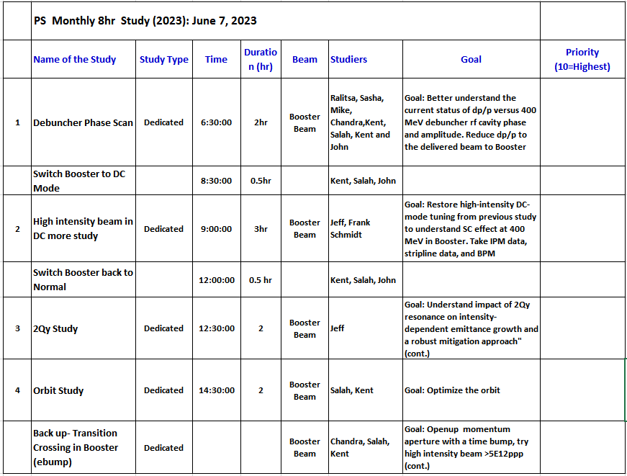
Proton Source Studies

Slide 4
Outlook
May Proton Source Study Day
-- Scheduled for June 7th, Cons will cover RunCo duties.
June “ACORN Month”
-- Please help ACORN group understand control systems.
June International Booster Studies
-- Scheduled for week of June 26-30th
-- Tentative schedule half-shift on 6/26 & 6/30, day-shifts 6/27, 6/28, 6/29
Shutdown “Beam Off” Date: July 9th

