Slide 1


Introduction and Charge
Sandor Feher – Fermilab
L2 Manager for Q1/Q3 Cryo-Assembly Fabrication
HL-LHC AUP Series Production Readiness Review – August 23, 2023

Slide 2
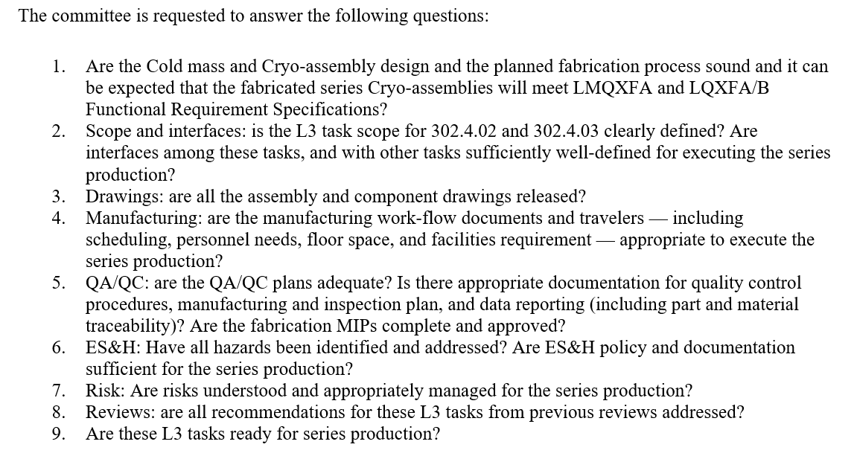
Charges for the series Production Readiness Review

Slide 3
Outline
Scope
Interfaces
Organization
Functional Requirements Specifications
Acceptance Criteria
QA/QC
ES&H
Risks
Previous Review Recommendations
Summary

Slide 4
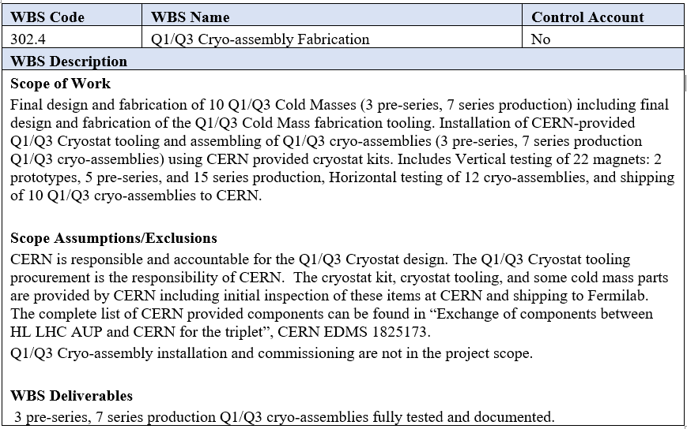
WBS 302.4: Scope
Scope is defined in the WBS dictionary - US-HiLumi-doc-39

Slide 5
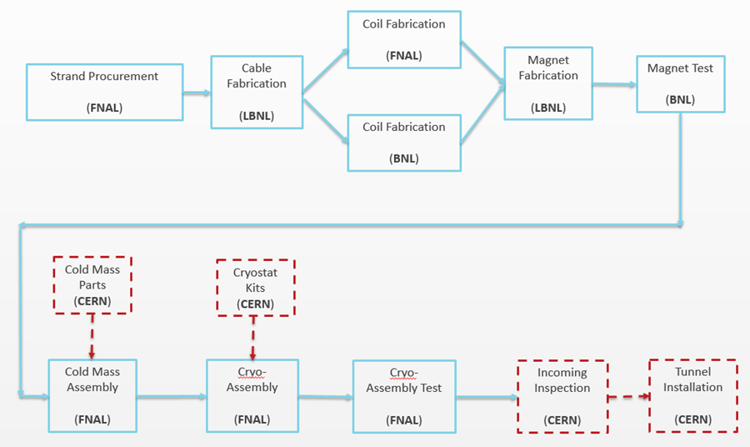
Production Plan
Operational (in production)
(US-HiLumi-doc-138)
Vertical Test Stand
(BNL)
Manufacturing Flow
Coil Parts (FNAL)
Part of the this Review
Test Stand 4
(FNAL)

Slide 6
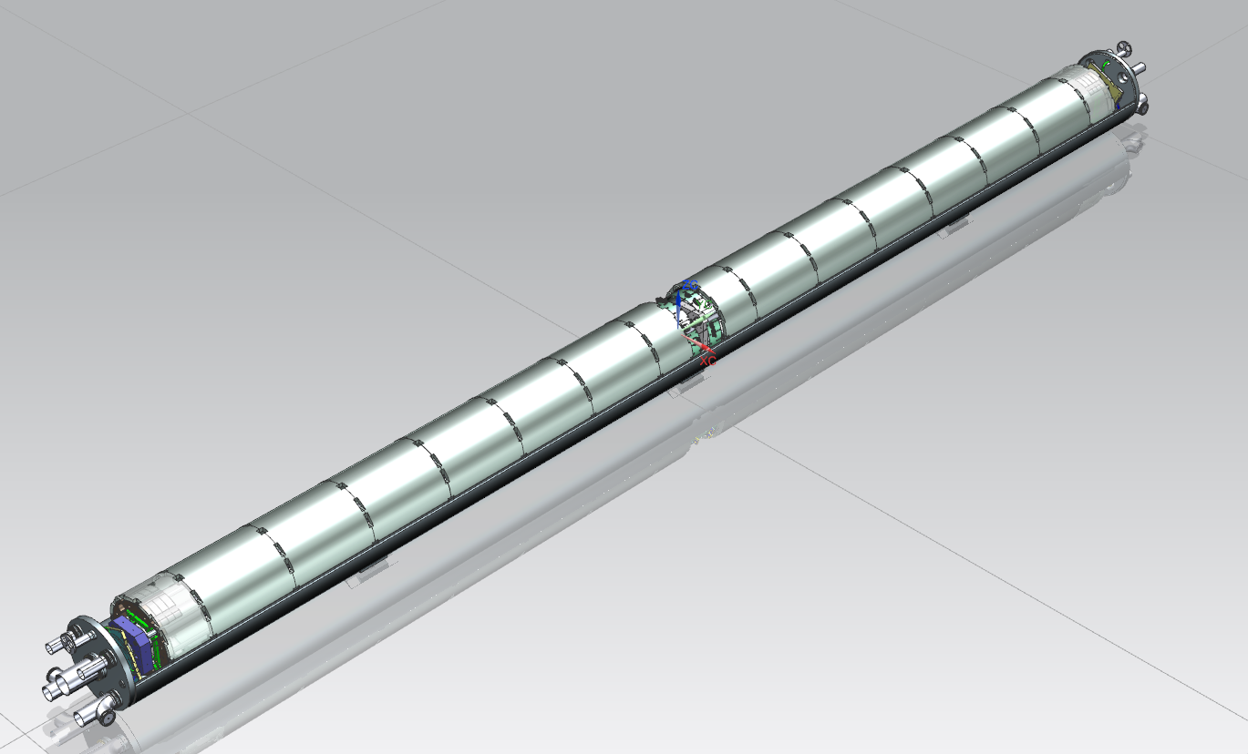
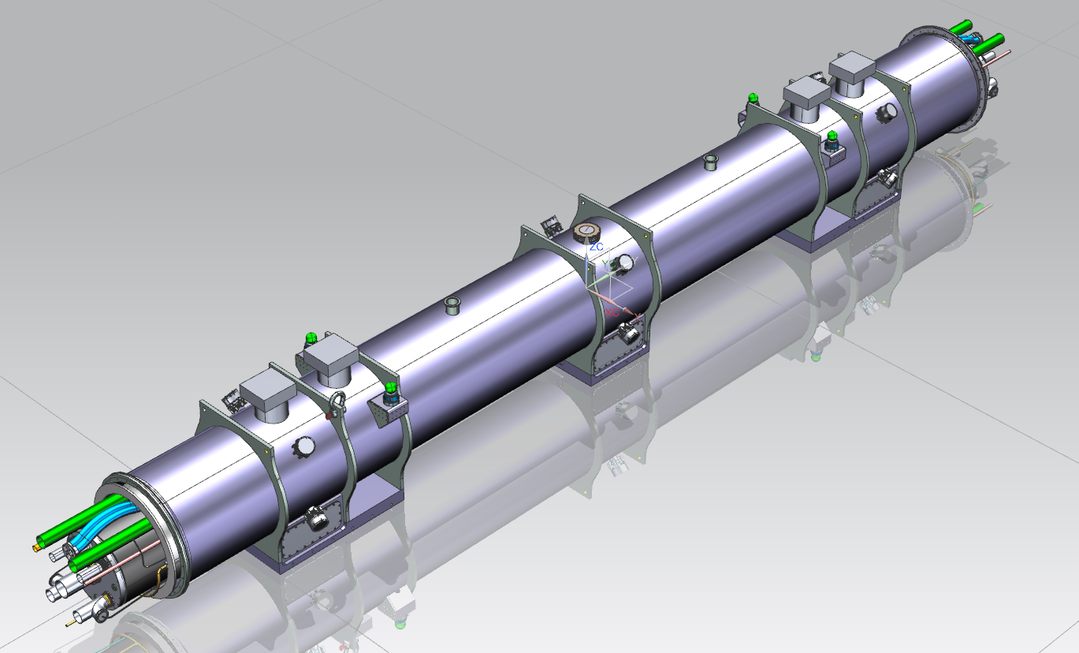
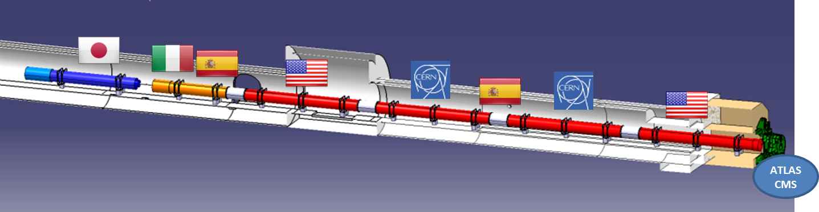
302.4 Scope
Magnet
(MQXFA)
Magnet
(MQXFA)
12 Q1/Q3 Cryo-Assemblies
  3 pre-series
  7 series production
  Re-work of two Cryo-Assembly assumed
Cold Mass
(LMQXFA)
Cryo-assembly
(LQXFA/B)
HL-LHC AUP IPR DOE/SC Review– Jan 14-16, 2020
HL-LHC AUP CD-2/3b Director’s Review – July 2018
6
6

Slide 7
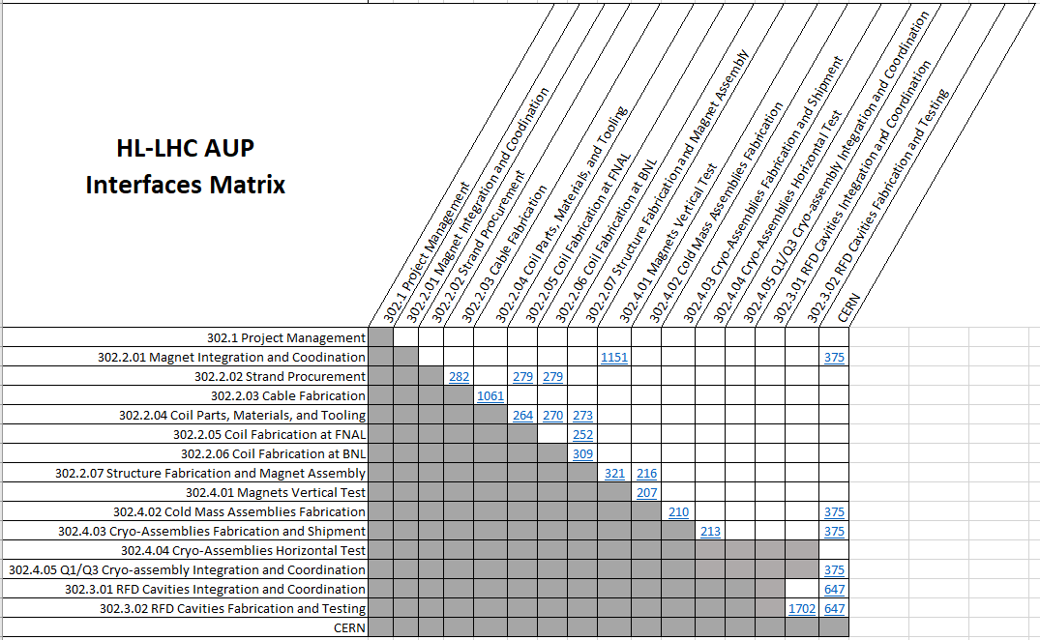
WBS 302.4: Interfaces
  Q1/Q3 Cryo-Assembly Interface Control Matrix
  Reference to Interface Control Document for each interface
  In each ICD we have identified and list all the interfaces
Interface Matrix US-HiLumi-doc-219
Interfaces description in the talks and a summary in Tom’s talk

Slide 8
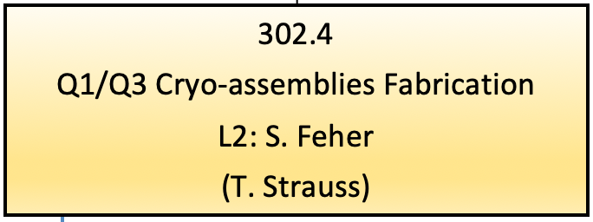
302
US HL-LHC Accelerator Upgrade Project
Project Manager: G. Apollinari
Deputy Project Manager: R. Carcagno
302.1
Project Managment
L2: G. Apolinari (R. Carcagno)
CAM: R. Carcagno
302.2
MQXFA Magnets Fabrication
L2: G. Ambrosio
(M. Baldini, P Ferracin)
302.3
RFD Dressed Crab Cavities Fabrication
L2: L. Ristori
(P. Berrutti)
302.4
Q1/Q3 Cryo-assemblies Fabrication
L2: S. Feher
(T. Strauss)
302.1.01
Project Office Management
L3: R. Carcagno
302.1.02
BNL Management
L3: K. Amm
302.1.03
LBNL Management
L3: S. Prestemon
302.2.01
Magnets Integration and Coordination
L3/CAM: G. Ambrosio
(M. Baldini)
302.2.04
Coil Parts, Materials and Tooling Procurement
L3/CAM: M. Yu (A. Nobrega)
302.2.05
Coil Fabrication at FNAL
L3/CAM: A. Nobrega (M. Yu)
302.2.06
Coil Fabrication at BNL
L3/CAM: J. Schmalzle
(M. Anerella)
302.2.07
Structure Fabrication and Magnets Assembly
L3/CAM: S. Prestemon
(D. Cheng)
302.2.03
Cable Fabrication
L3: I. Pong (E. Lee)
CAM Dep: I. Pong (M. Naus)
302.2.02
Strand Procurement
L3: L. Cooley (V. Lombardo)
CAM: V. Lombardo
302.3.01
RFD Cavities Integration and Coordination
L3/CAM: L Ristori (P. Berrutti)
302.3.02
RFD Cavities Fabrication and Testing
L3/CAM: L. Ristori (P. Berrutti)
302.4.02
Cold Mass Assemblies Fabrication
L3/CAM: A. Nobrega (A. Vouris)
302.4.03
Cryo-Assemblies Fabrication
L3/CAM: A. Nobrega (R. Rabehl)
302.4.04
Cryo-Assemblies Horizontal Test
L3/CAM: G. Chlachidze
(S. Stoynev)
302.4.04.01
Cryo-Mechanical Horizontal Test Stand Upgrade
L4: R. Rabehl
302.4.04.02
Instrumentation and Mechanical Horizontal Test Stand Upgrade
L4: G. Chlachidze (S. Stoynev)
302.4.04.03
Horizontal Test Stand Operations
L4: G. Chlachidze (S. Stoynev)
302.3.02.01
Procurement of Services
L4: L. Ristori
302.3.02.02
Materials and Bare Cavity Procurement
L4: M. Narduzzi
302.3.02.03
Bare Cavity Qualification
L4: P. Berrutti
302.3.02.04
Dressed Cavity Procurement
L4: M. Narduzzi
302.3.02.05
Dressed Cavity Qualification
L4: P. Berrutti
302.4.01
Magnets Vertical Test
L3: P. Joshi (A. Yahia)
CAM: P. Joshi
302.4.05
Q1/Q3 Cryo-assembly Integration and Coordination
L3/CAM S. Feher (T. Strauss)
302.4.04.99
L3 Management Cryo-assemblies Horizontal Test
L3: G. Chlachidze (S. Stoynev)
302.1.04
Deliverables Transportation Management
L3: C. Orozco
L3 Managers/Deputies and CAMs are Experienced Engineers and Scientists
Experienced floor/production manager with skilled techs
Getting the right support from the Home laboratories
Part of the review

Slide 9
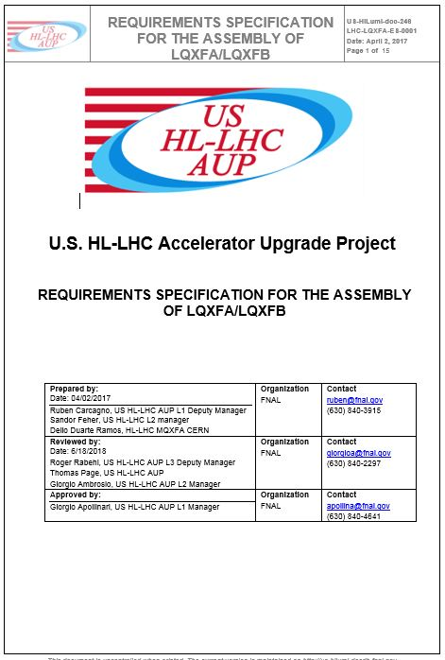
Performance Requirements
US-HiLumi-doc-64
Cold Mass Functional Requirement Specifications (FRS)
  CERN approved – EDMS No 1686197 under revision control
  AUP accepted
Requirements Specifications for the Assembly of QQXF_SC
  CERN approved – EDMS No 1828585 under revision control
  AUP accepted
US-HiLumi-doc-246

Slide 10
Requirements
Cold Mass and Cryostat Assembly
  Requirements are classified into two groups:
    Threshold requirements (CM 27; Cryostat 20) are requirements that contain at least one parameter that the project must achieve.
    Objective requirements (CM 4; Cryostat 1) are challenging requirements that the project should achieve and will strive to achieve.
All requirements are traceable

Slide 11
Acceptance criteria
(US-HiLumi-doc-1127)
Cryo-Assembly acceptance criteria has been developed approved by CERN (EDMS no 2323981) CERN.
It is based on Requirements documents:
  Every individual requirement is separately addressed
  Verification plan was developed for each requirement

Slide 12
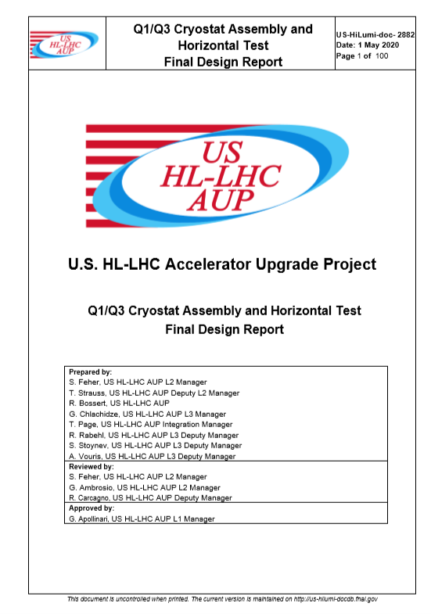
Final Design Report
(US-HiLumi-doc-2882)
Final Design Report is available on Review indico-site.
Details will be presented by L3s.
The FDR summarizes the design and has all the references to find the detailed description of the design, design specifications, design drawings, design analysis, interfaces, QA and ES&H documents.
Drawings are accessible through the HiLumi document database.
The model can be shown by request on the Q&A session.

Slide 13
Final Design Specifications – Models and Drawings
The design specifications were developed to meet the Cold Mass and Cryo-Assembly requirements.
We have developed Stand 4 Horizontal Test Facility to be able to cold test the Cryo-Assembly – perform most of the tests that are described in the Acceptance Criteria.
The design carefully chosen materials that are approved by CERN (EMDS 1868473; US-HiLumi-doc-2890).
Cold Mass final design drawings are released.
Cryostat final design drawings are released.

Slide 14
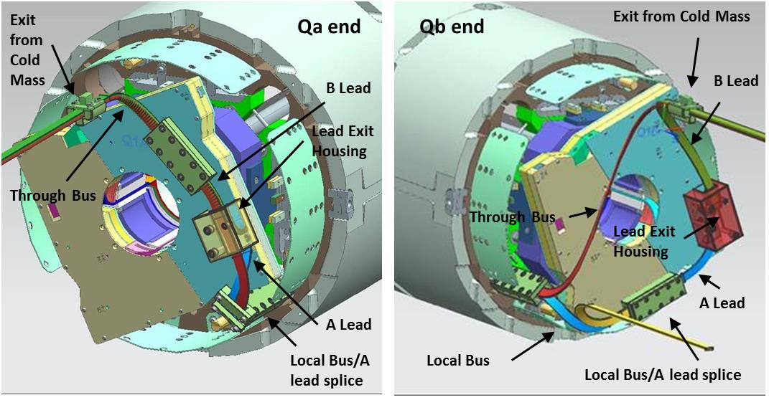
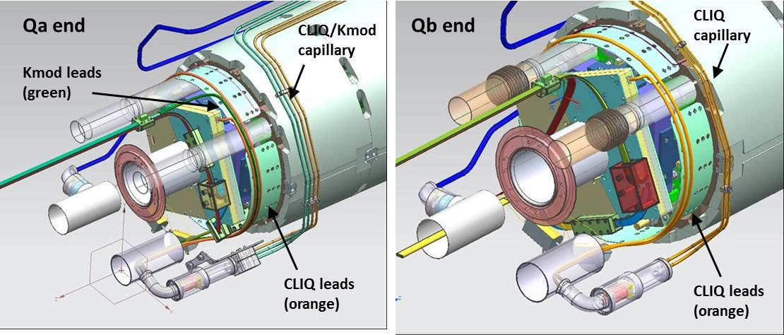
Cold Mass Design
Two MQXFA Magnets
Two half shells
End cover – five penetrations:
  Beam tube
  Heat exchangers
  Bus ports
Bus work
  Through bus
  Local bus
  Expansion loops
  Splices
CLIQ leads
kMod (trim) leads
Instrumentation
  V-taps
  Temp sensors
Supports
(See T. Vouris’s and R. Bossert’s talk)

Slide 15
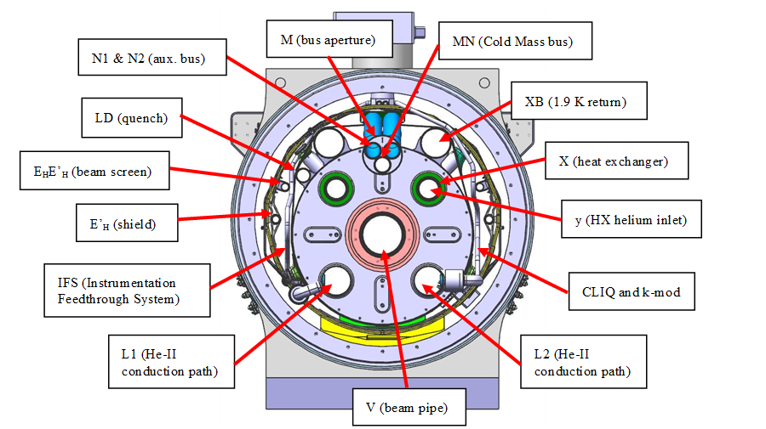
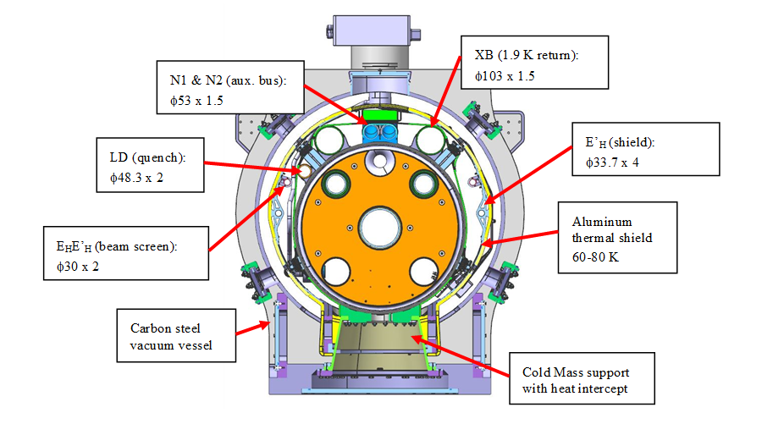
Cryostat Design
Cryostat design has a lot of similarity with LHC magnets; main difference:
  Cold Mass size
  Thermal shield Temperature increase
Relevant design analysis have been performed (see FDR)
Several critical design specifications have been verified during the successful cold test of CA01
(See R. Rabehl’s talk)

Slide 16
QA/QC
Cold Mass Manufacturing and Inspection Plan (MIP) with holding points has been approved by CERN
Cold Mass travelers have been released:
  Q1/Q3 Cold Mass Assembly Traveler 464525
  HL-LHC Magnet Bus Traveler 464507
  LH-LHC AUP MQXFA incoming inspection and QA Traveler 464574
Cryostat work MIP has been developed and released
Cryostat traveler has been developed based on the CERN one and all the lesson learned has been incoorporated

Slide 17
ES&H
AUP Hazard Analysis Report (HAR) in US-HiLumi-doc-303
CERN created a PED Compliance Technical Note:
  Compliance with Pressure Equipment Directive (PED-2014/68/EU) essential safety requirements - US-HiLumi-doc-850 (EDMS 1891856)
  This was used to develop the Cold Mass design
Cold Mass tooling has been designed to have a safe usage
  Hazard Analysis Reports have been written for each of the workstations and include the bus soldering procedure as well as the stainless-steel pressure washing
The cryostat design, assembly, and accompanying documentation complies with the project safety agreements as well as the Fermilab ES&H Manual (FESHM)
  Cryostat components provided by CERN are in compliance with FNAL FESHM requirements
  The cryostat tooling has met the FESHM requirements and received operational readiness clearance (ORC)

Slide 18
Risks
RI-ID | Title | Proba-bility | Cost impact | Schedule impact | P*impact
Cold Mass Assemblies Fabrication
RT-302-4-02-002 | CERN fails to supply cold mass components for production on schedule | 30% | 30 – 60 k$ | 6-12 months | 14 k$
RT-302-4-02-002-COVID | CERN fails to supply cold mass components for production on schedule | 25% | 30 – 60 k$ | 6-12 months | 11 k$
RT-302-4-02-005 | Severe damage to CM or CA during assembly requires major rework | 10% | 328 – 5201 - 8591 k$ | 1 – 12 – 12 months | 471 k$
Cryo-assemblies Fabrication
RT-302-4-03-004 | Cryo-assembly fails to meet specifications and needs rework | 50% | 678 – 1228 k$ | 4-12 months | 477 k$
RT-302-4-03-009 | Unforeseen design and interface changes to Cryo-Assemblies after CD3 | 10% | 967 k$ | 2 months | 97 k$
RT-302-4-03-004-COVID | Cryo-assembly fails to meet specifications and needs rework | 10% | 678 – 1228 k$ | 4-12 months | 95 k$
RT-302-4-03-001 | More effort than anticipated to meet FNAL's cryostat safety requirements | 20% | 24 k$ | 1 months | 5 k$
RT-302-4-03-002-COVID | CERN fails to supply a complete cryostat kit for the production on schedule | 25% | 10 – 20 k$ | 2 – 6 months | 4 k$
RT-302-4-03-002 | CERN fails to supply a complete cryostat kit for the production on schedule | 10% | 10 – 20 k$ | 2 – 6 months | 2 k$

Slide 19
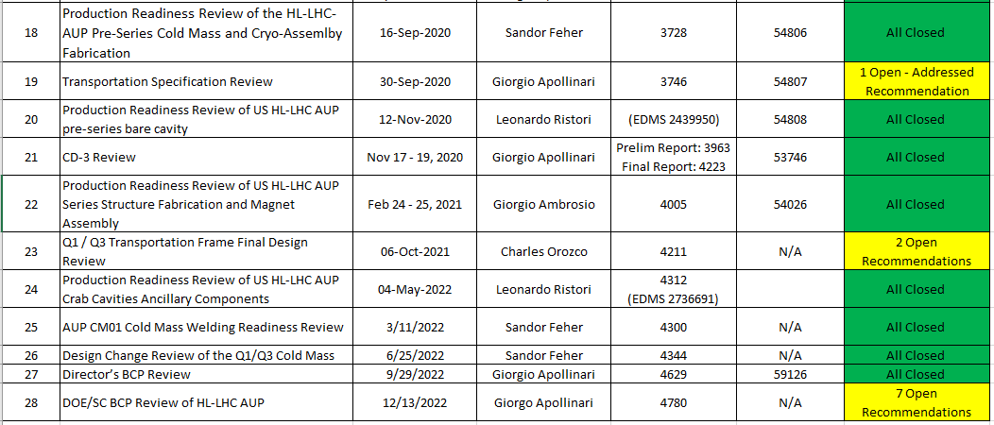
Previous Review Recommendations
Recommendations are kept in US-HiLumi-doc-1322
No open recommendations under my name (CM&Cryo)

Slide 20
Summary
Cryo-Assembly final design has been updated with lesson learned form the first pre-series successful fabrication and test
Design is well documented FDR is the center piece document with 90 references that describe the final designs in great detail
Interfaces have been identified and described in ICDs
MIP plans have been used successfully as the basis for QA
Traveler has been updated and released to reflect lesson learned from CA01 fabrication and test
Risks have been identified and actively managed
No open recommendations from previous reviews
The design is sound, the tooling and the fabrications plan is in place. We are ready to proceed with the CM and Cryo-assemblies series production

