Slide 1
Cold Mass Production
Antonios Vouris - Fermilab
HL-LHC AUP Series Production Readiness Review– September 06, 2023

Slide 2
Outline
Scope, FRS, Acceptance Criteria
Organization
Codes and Standards
Final Design Specifications – models and drawings
Interfaces
Cold Mass Pre-Series Fabrication Validation
Fabrication Plan – traveler
ES&H
QA/QC
Summary

Slide 3
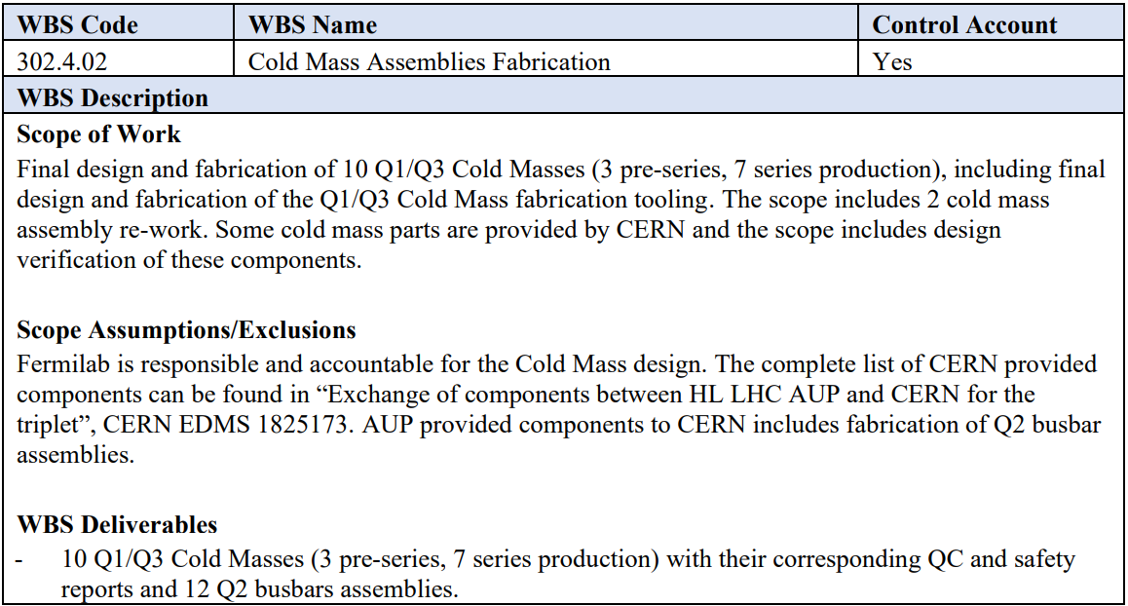
WBS 302.4.02: Scope
Scope of work includes Final Design and Fabrication
10 Q1/Q3 Cold Masses - 3 pre-series, 7 series production
2 Cold Mass assembly re-work
Design & Fabrication of Cold Mass Tooling
Design & Fabrication of 12 Q2 Busbar assemblies
WBS Deliverables include 10 Q1/Q3 Cold Mass assemblies with QC & Safety
Reports and 12 Q2
Busbar assemblies
See WBS Dictionary:
US-HiLumi-doc-39

Slide 4
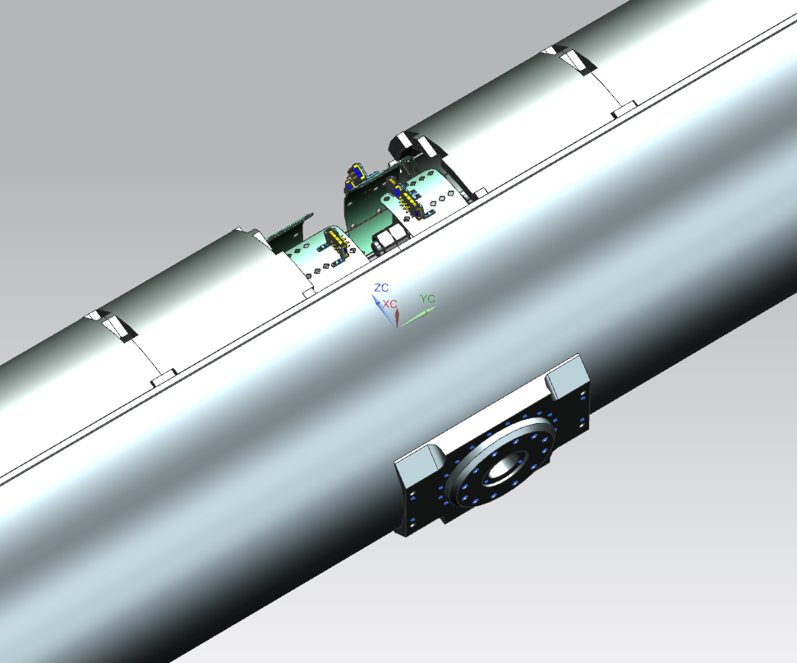
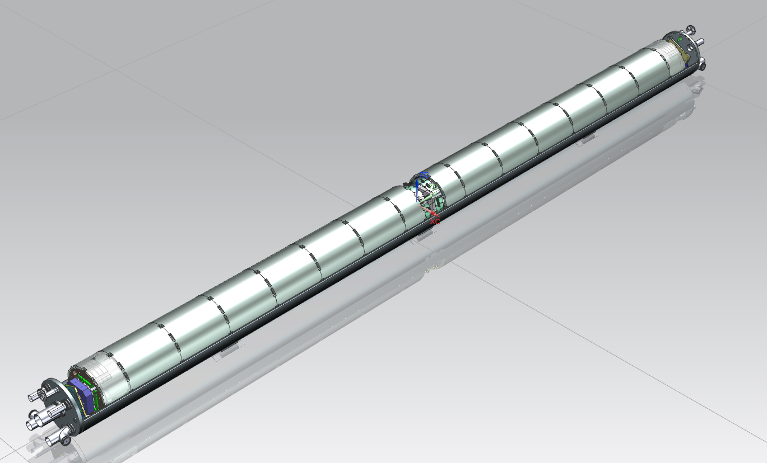
WBS 302.4.02: Scope
The LMQXFA Cold Mass is the He pressure vessel assembly containing 2 MQXFA magnets
MQXFA Magnets
Cold Mass Supports
End Cover
Heat Exchangers
Cold Mass Supports
The Bus & Instrumentation design see Rodger Bossert’s talk
Beam Tube
IFS Port
CLIQ/K-Mod Port

Slide 5
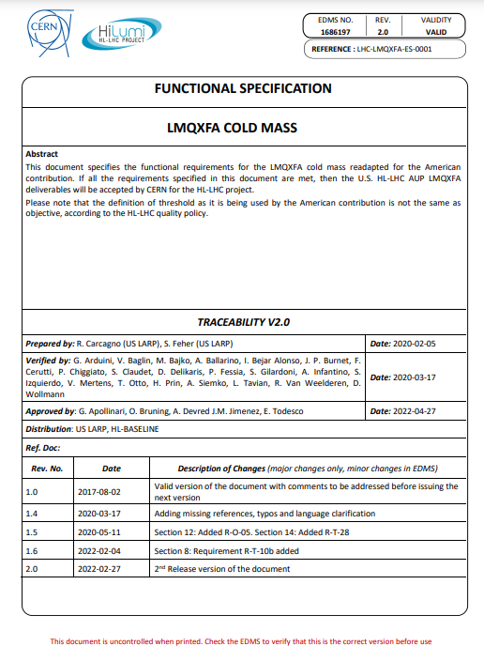
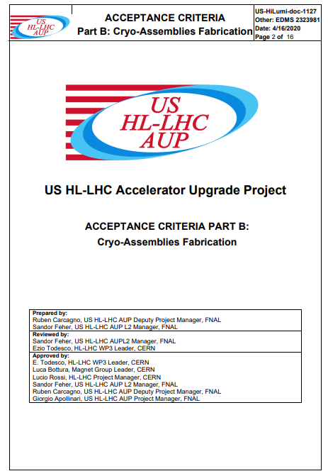
WBS 302.4.02: Functional Requirements and Acceptance Criteria
LMQXFA Cold Mass Functional Requirement Specification (FRS) identifies 27 “Threshold” Requirements & 4 “Objective” Requirements. These documents are located at US-HiLumi-doc-64 for the FRS and at US-HiLumi-doc-1127 for the Acceptance Criteria Part B

Slide 6
WBS 302.4.02: Organization
302.4
Q1/Q3 Cryo-assemblies Fabrication
L2: S. Feher
(T. Strauss)
302.4.02
Cold Mass Assemblies Fabrication
L3/CAM: A. Nobrega (A. Vouris)
302.4.03
Cryo-Assemblies Fabrication
L3/CAM: A. Nobrega (R. Rabehl)
302.4.04
Cryo-Assemblies Horizontal Test
L3/CAM: G. Chlachidze
(S. Stoynev)
302.4.01
Magnets Vertical Test
L3: P. Joshi (A. Yahia)
CAM: P. Joshi
302.4.05
Q1/Q3 Cryo-assembly Integration and Coordination
L3/CAM S. Feher (T. Strauss)
Experienced Team:
A. Nobrega
A. Vouris – Lead Engineer
R. Bossert (Engr)
L. Martin (Engr)
A. Lake (Tech Supervisor)
S. Klema (Tech)
M. Larson (Tech)
M. Jamison (Tech)
R. Diamond (Tech)
D. Davis (Tech)
O. Madera (Tech)
T. Fisk (Welder)

Slide 7
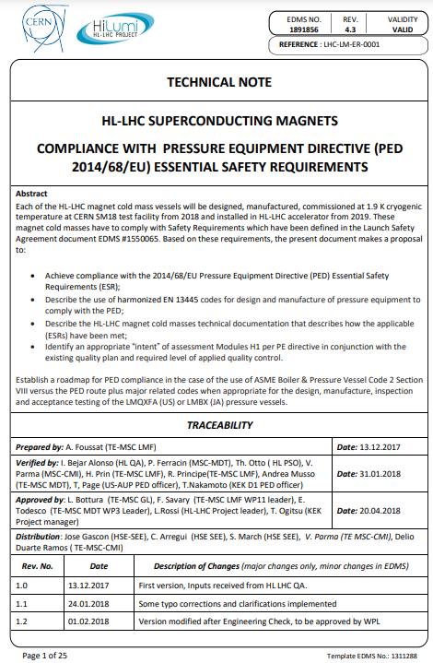
Codes and Standards
The LMQXFA Cold Mass is tested in Industrial Building 1 Test Stand 4 and thus must comply with Fermilab’s Environment, Safety & Health Manual (FESHM) chapter 5031 in order to be pressurized and tested
FESHM Chapter 5031 defaults pressure vessel design and construction to comply with ASME Boiler & Pressure Vessel Code Section VIII
According to Functional Requirement Specification “Threshold requirement R-T-26: The LMQXFA cold mass assembly must comply with CERN’s Launch Safety Agreement (LSA) for IR Magnets” and the Agreement recognizes ASME B&PVC Section VIII Div.2 as a compatible design & construction code with a few following modifications:
ASME B&PV Code Section VIII div.2 is applied to meet the Design by Analysis method requirements per R-T-07
Harmonized materials shall be used: have an EN 10204:2004 3.1 product control
Welding procedures qualifications shall be in accordance to ASME Section IX with additional testing and acceptance requirements per the LSA.
100% NDE shall be performed on all shell longitudinal and circumferential closure welds using Phased Array Ultrasonic Testing in lieu of Radiography
Pneumatic test pressure is per ASME Section VIII div.2 with the exception that it is 1.25 x design pressure
US-HiLumi-doc-850

Slide 8
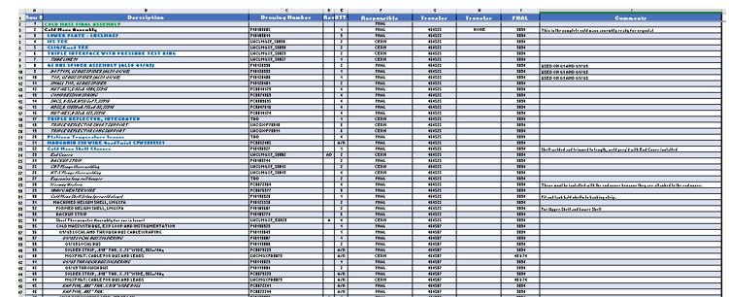
Final Design Specs – Models & Fab Drawings
Design models complete, assembly and component drawings are complete and continuously maintained for updates
A drawing tree has been created in a spread sheet form and uploaded to US-HiLumi-doc-3010
The Cold Mass Model and drawings are structured into assembly steps leading up into the upper level final cold mass assembly
Cold Mass Drawing Tree US-HiLumi-doc-3010

Slide 9
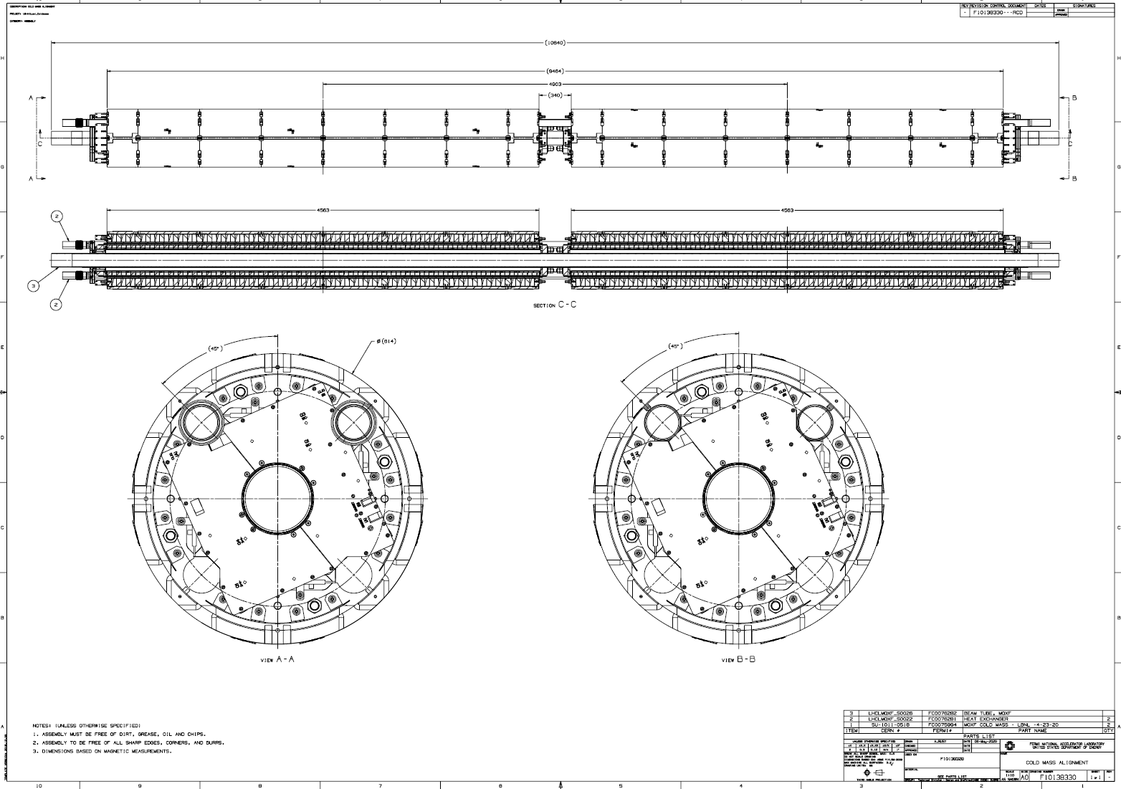
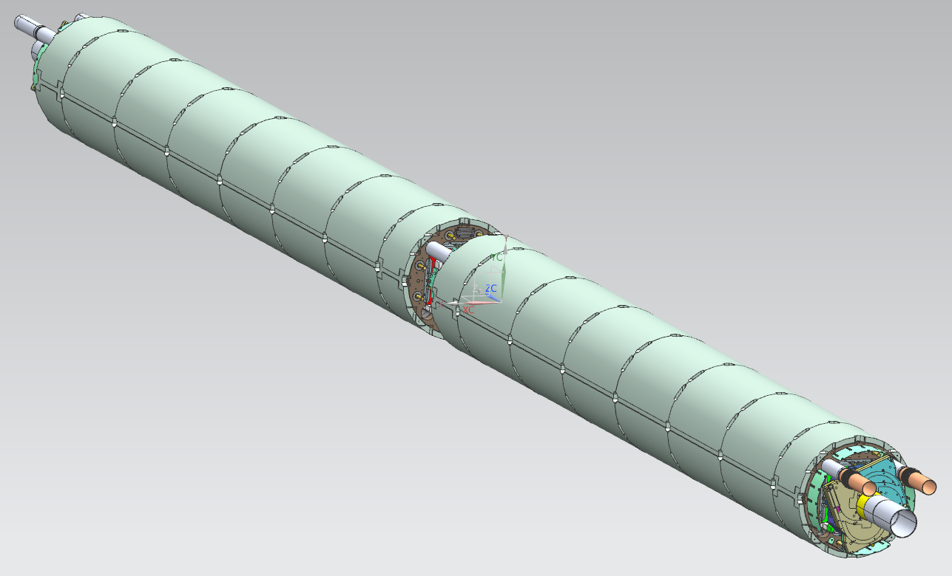
Final Design Specs – Models & Fab Drawings 1st step: Cold Mass Alignment F10138330
Magnets received & inspected per receiving traveler; tack blocks installed & alignment begins prior to installing heat exchangers & Beam Tube
R-T-04 Bus assembly installed without obstructions
R-T-05, 2 identical MQXFA magnets connected in series with same polarity
R-T-06 Maintain 4806 +/-5mm between nodal points at RT

Slide 10
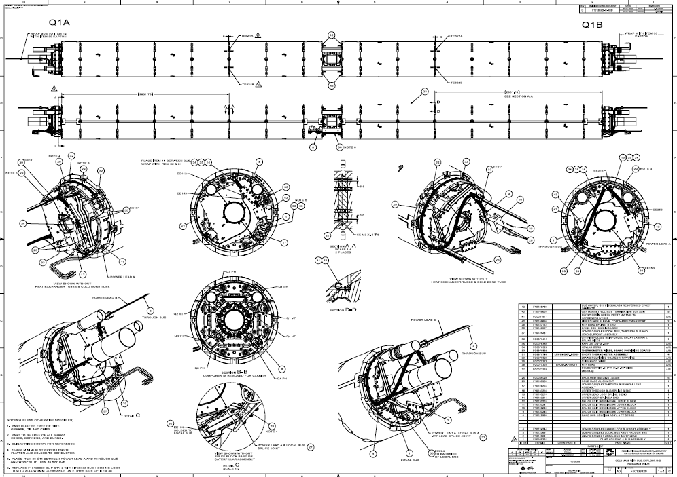
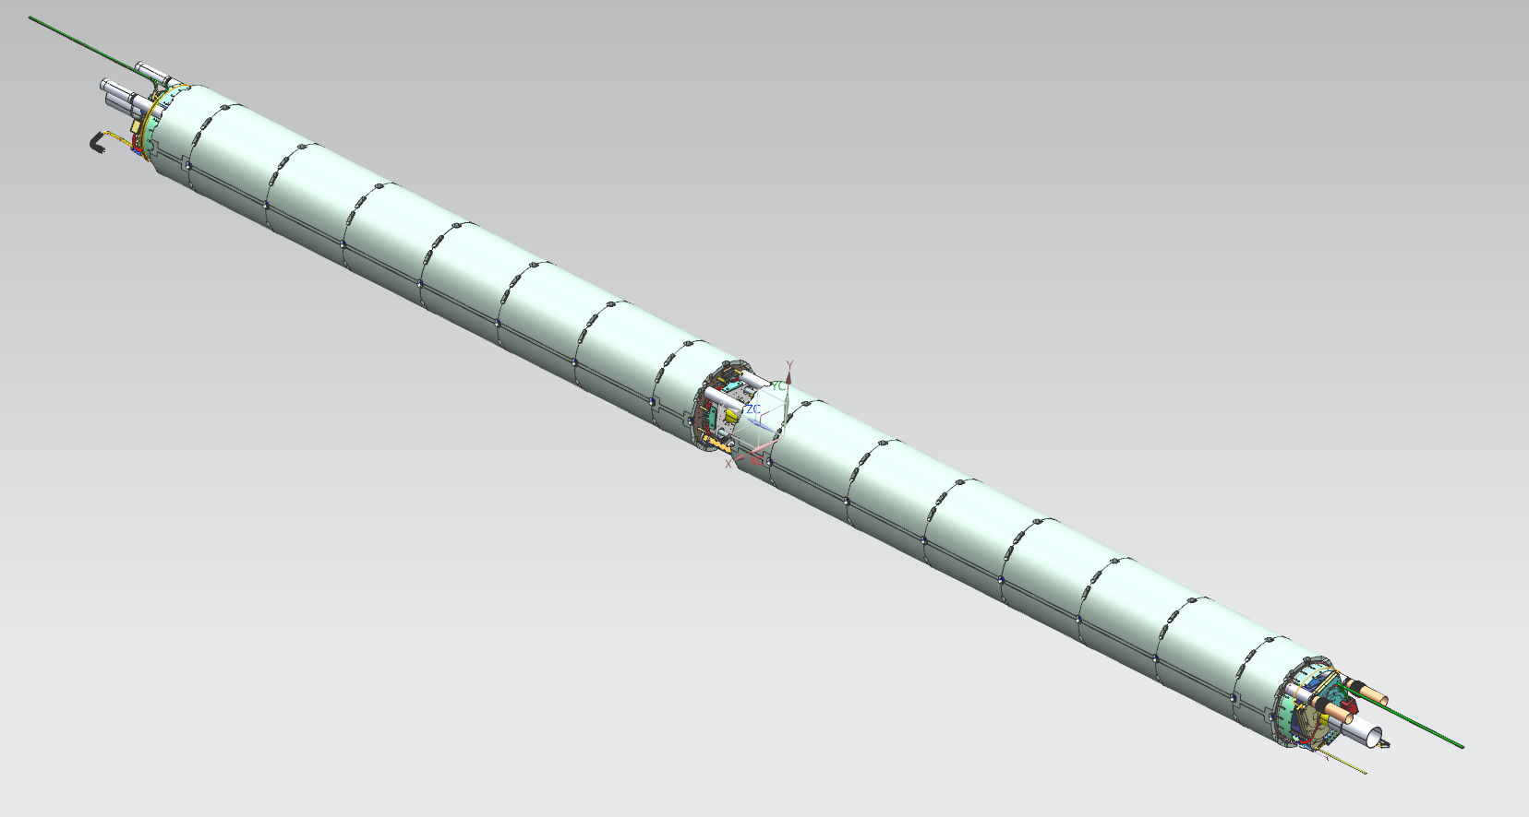
Final Design Specs – Models & Fab Drawings 2nd step: Install Bus & instrumentation F10138329
Bus assembly assembled and installed into the aligned magnet pair finish instrumentation and bus loops (See Bossert’s Talk)
R-T-04 Bus assembly to be
installed clear of obstructions

Slide 11
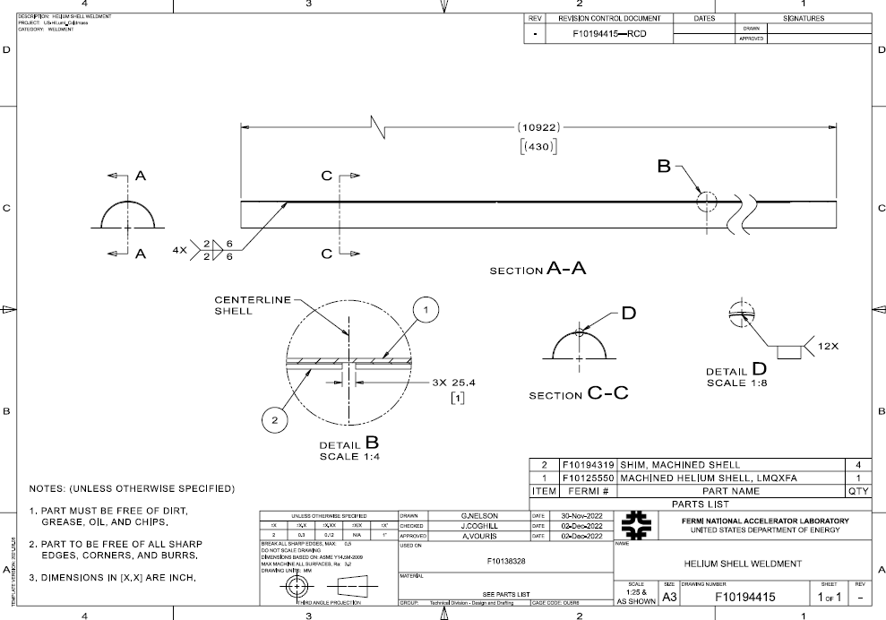
Final Design Specs – Models & Fab Drawings 3rd step: Inspect-Prepare Half Shells F10194415
Stainless shell is cleaned, inspected & fit/tacked with shim
Arc length and profile is verified

Slide 12
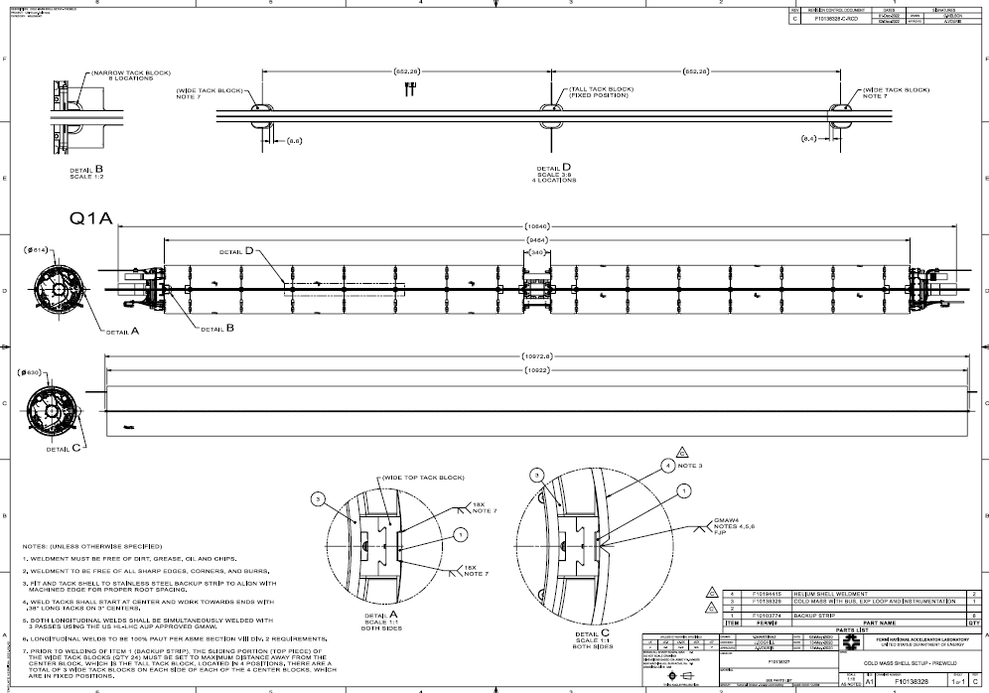
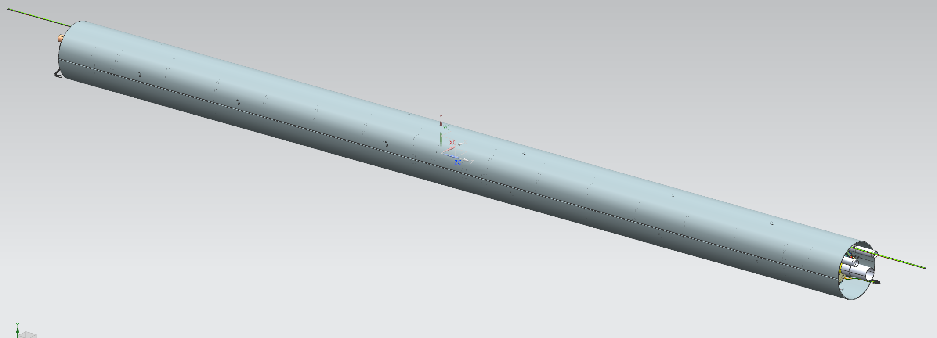
Final Design Specs – Models & Fab Drawings 3rd step: Fit & Tack Half Shells F10138328
Stainless shell gets fit, tacked in place one half at a time with shell ends left long for trimming square after longitudinal welding
R-T-02 Outer Diameter including
tolerances does not exceed 630mm

Slide 13
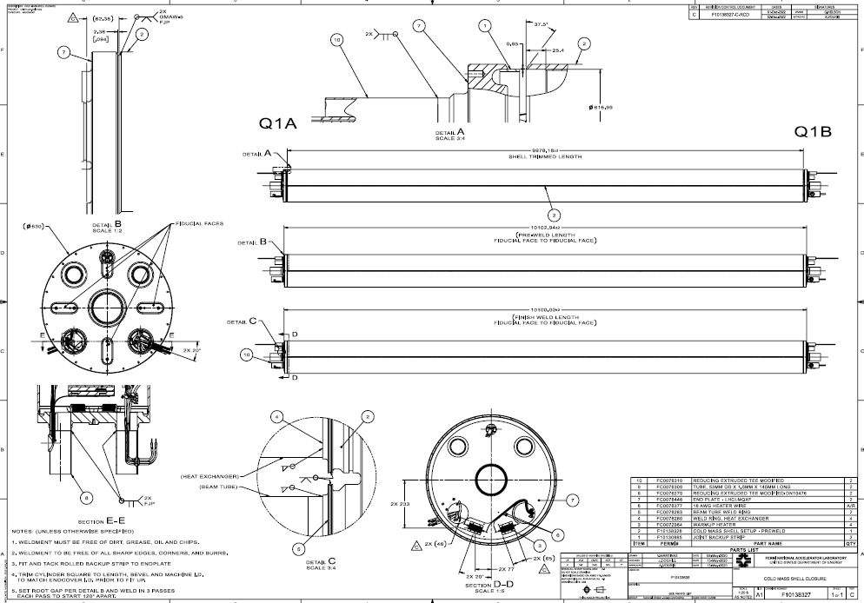
Final Design Specs – Models & Fab Drawings 4th step: Fit, tack & weld End Covers F10138327
Stainless End Covers get fit, tacked & welded in place one end at a time after long shell is trimmed beveled and ID boring to match End Cover ID
R-T-01 Maximum overall length not to exceed 10100 mm

Slide 14
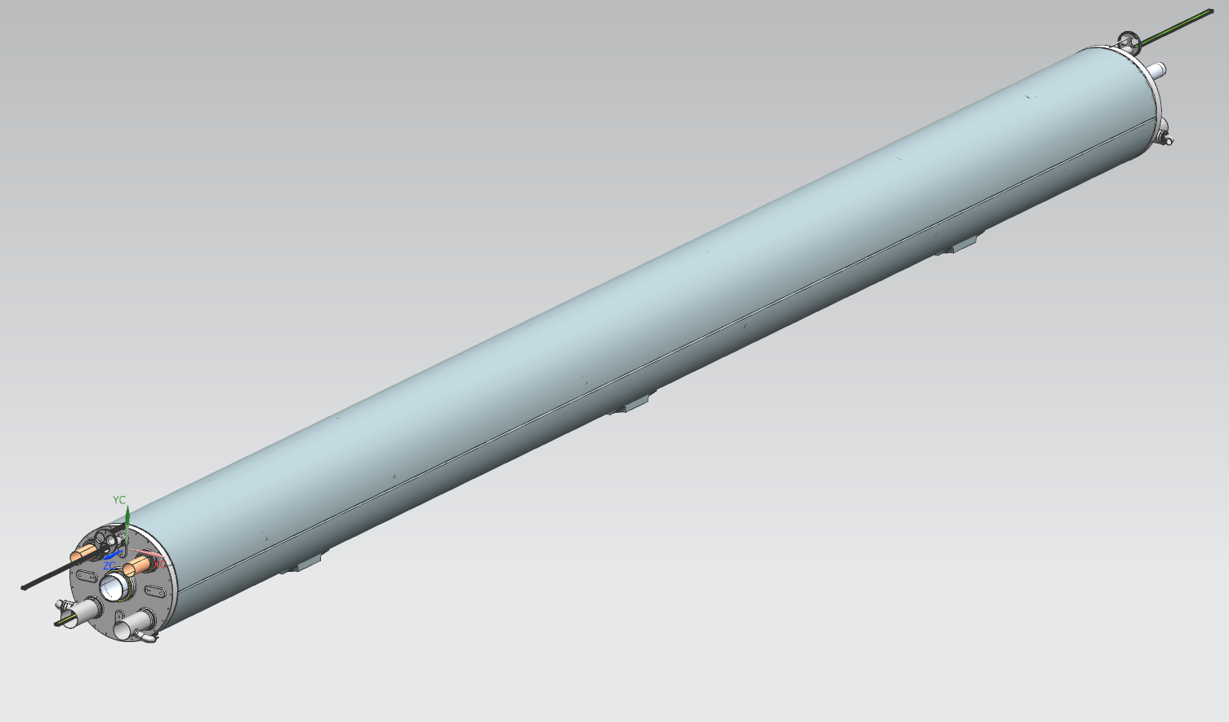
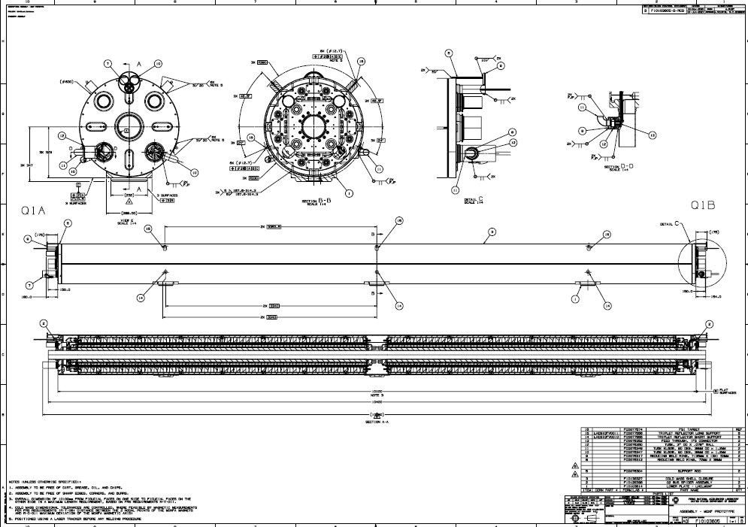
Final Design Specs – Models & Fab Drawings 5th step: Fit/weld beam tube, heat exchanger, IFS, CLIQ leads, and lower support - F10103605
Beam Tube, Ht-X’s are centered and welded in place with flare flanges.
Find vertical centerline, index with tooling and weld lower plates. Locate & weld mirror targets (R-T-21).

Slide 15
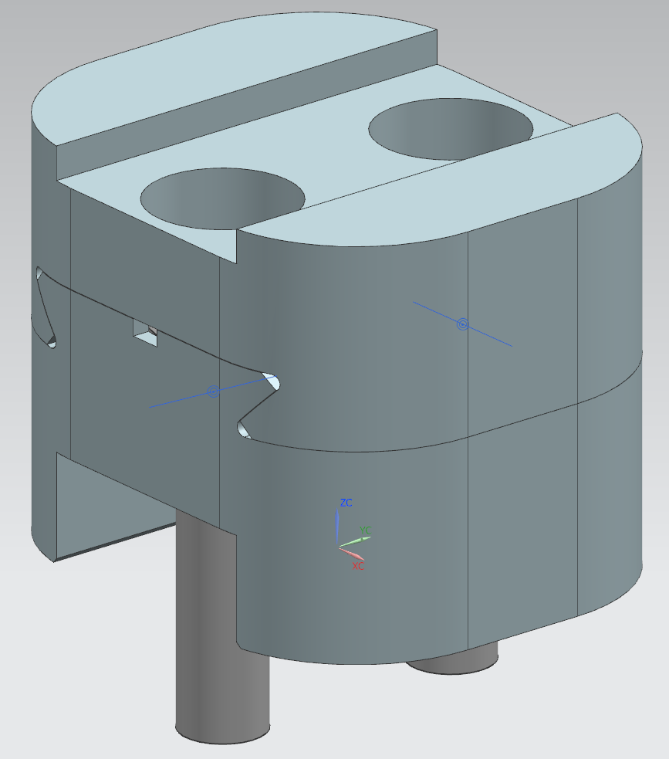
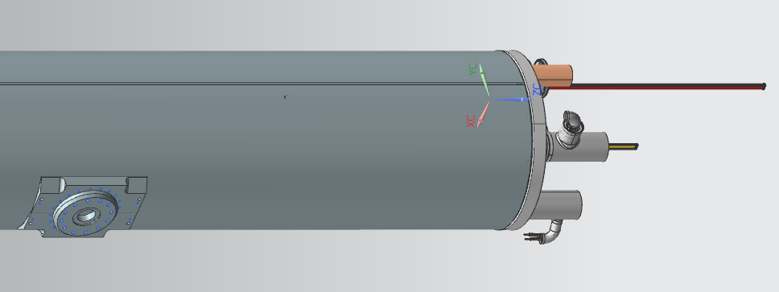
Interfaces
OD
Openings for
Alignment Tooling
OPENINGS FOR
TACK BLOCKS
For Shell
Welding/Attachment
End Cover
Ports
Magnet openings
Beam Tube
HT-X
Bus
Lower Plate
Cryostat Interface

Slide 16
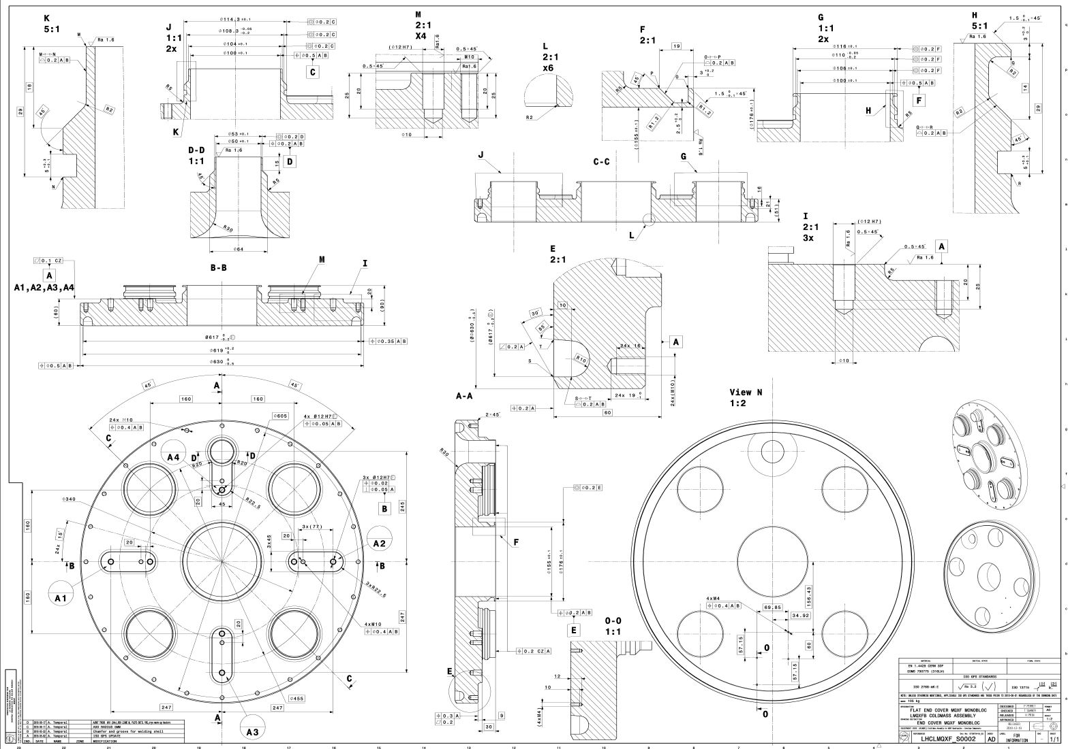
Interfaces
LHCLMQXF_S0002, End Cover designed to align piping interfaces per R-T-03 with magnet features & CERN connections

Slide 17
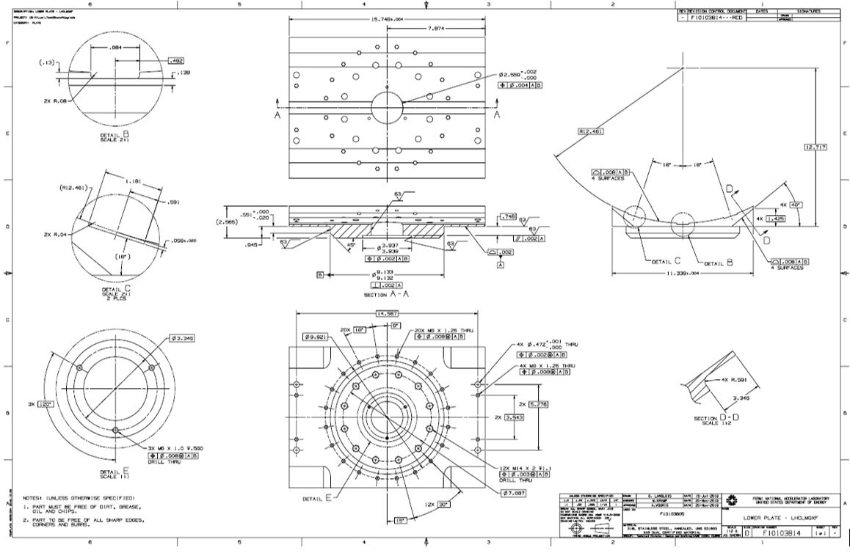
Interfaces
F10103814, Lower Plate is designed to interface with the CERN Cryostat and with Fermi designed shipping posts

Slide 18
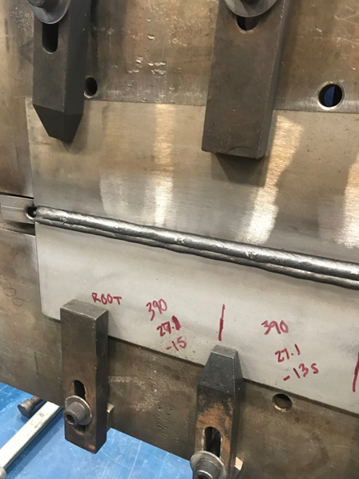
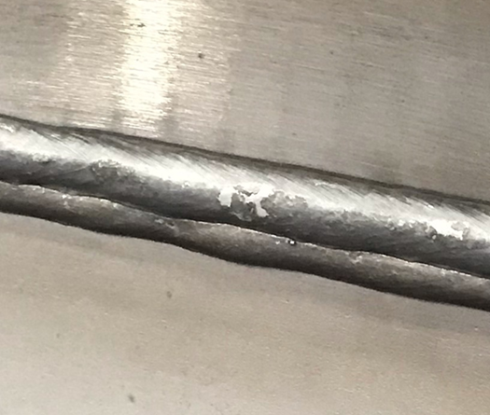
Weld & Welder Qualification Tests
Filler Rod Successfully used according to the revised Safety Agreement changes dated May 2021, CERN incorporated the 317L (mod) filler rod as the recommended filler
Samples had been completed and sent out for testing prior to CM-02 and CM-03 welding and passed all prescribed CERN tests including but not limited to Charpy & Fracture tests at 4.2K
Circumferential weld coupons were made in the flat position and passed to qualify weld procedures (WPS)
Material used: 8 mm thk, 316LN SS material from actual CM drops pressure vessel shells.
As of March 2023, three FNAL welders passed in horizontal (longitudinal position) for welder performance qualifications (WPQ)
317L (mod) – ASN 5-IG (Si)
98% Ar – 2%CO2

Slide 19
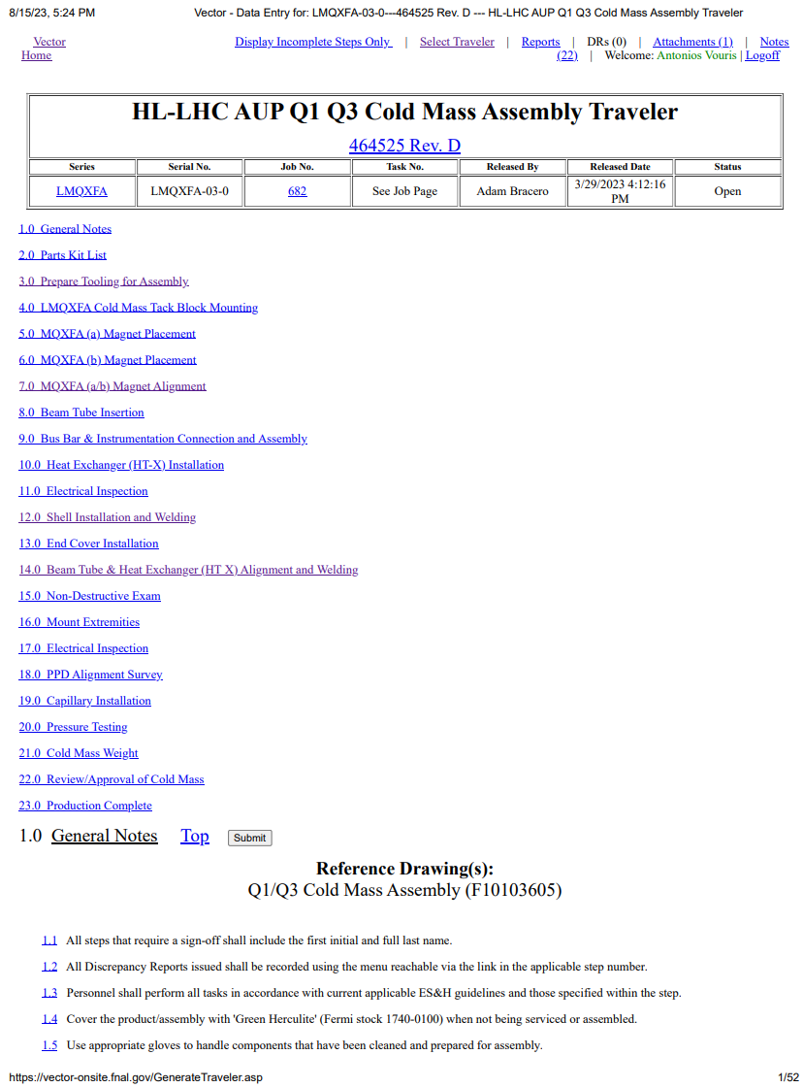
Fabrication Plan – traveler
3 travelers have been released for the fabrication of the LMQXFA . A Manufacturing and Inspection Plan is approved by CERN.
464574 HL-LHC AUP MQXFA Incoming Inspection and QA Traveler will be used for MQXFA receiving process. Receiving Inspection and test reports will be uploaded to this traveler and accessible through Vector software
464507 HL-LHC Magnet Bus Traveler will be used to guide personnel through the assembly process of the Q1/Q2 bus assembly. Includes all steps for in-process inspection and testing (See Rodger Bossert’s talk).
464525 HL-LHC AUP Q1 Q3 Cold Mass Assembly Traveler identifies the parts lists, maintain material traceability for each LMQXFA cold mass unit and provides fabrication steps for the Cold Mass as identified by the drawing sub-assemblies. In-process inspection, testing and verification identified.
Cold Mass Alignment per F10138330:
survey and stretch wire measurements of magnets to verify alignment/Install of beam tube & HT-X’s
Install Bus & instrumentation F10138329:
Fab expansion loops on both ends and install instrumentation & Install tack blocks
Fit & Tack Half Shells F10194415 & F10138328:
Weld backing strip to tack blocks
Inspect, clean and fit/tack shims to shells
Fit/tack 1st half shell to backing strip, roll cold mass & Fit/ tack 2nd half shell
prep/move to longitudinal welding workstation & eld longitudinal seams (GMAW)
Fit, tack & weld End Covers F10138327
Prep & lift welded Cold Mass back to alignment table, trim shell ends square to length
Bore ID of SS shell to match End Cover ID and bevel outside edge to weld prep requirements
Tack backing strip to end cover and fit/tack end cover to Cold Mass (both ends)
Weld end cover (start stops shift 120 deg for each pass) – Repeat for 2nd end cover
Fit ferrules & weld to Beam tube/End Cover (repeat for both ends)
Fit ferrules & weld to Ht-X/End Cover (repeat for both ends)
Determine cold mass center to ground using magnetic measurements and roll Cold Mass to align perpendicular w/ table surface
Mount Indexing clamps to align with reference brackets mounted on stations
Fit/weld beam tube, heat exchanger, IFS, CLIQ leads, and lower support - F10103605:
Fit/align lower plates per F10103804 to mounting posts on table and transport Cold Mass to inspection table
Lower Cold Mass gently, align indexing clamps with bracket slots. Verify fit & weld lower supports
Locate and weld mirror targets & external pipe supports

Slide 20
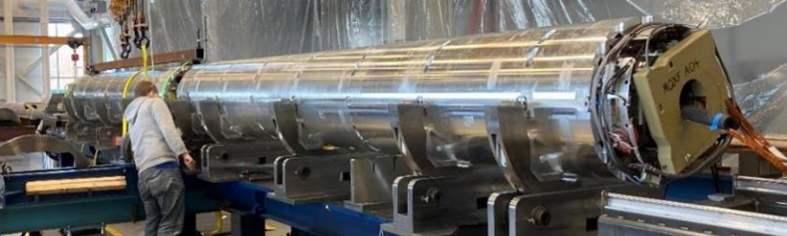
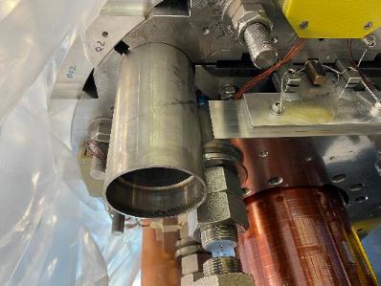
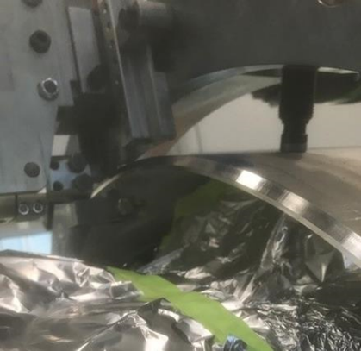
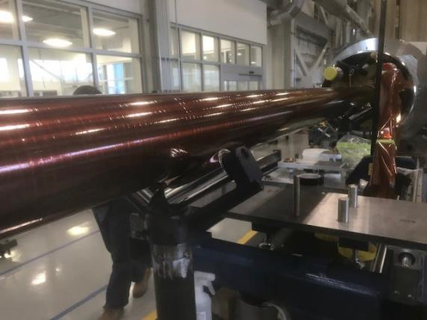
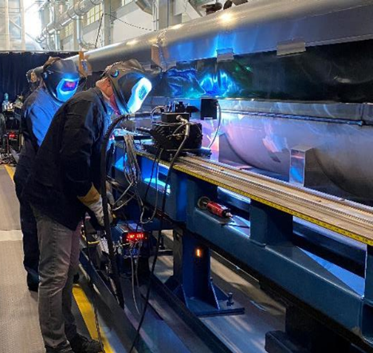
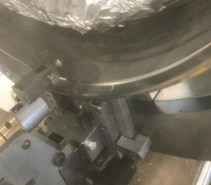
Pre – Series Fabrication
Magnet Pair Alignment
Heat Exchanger Installation
Beam Tube Installation
Shell Longitudinal Seam Welding
Orbital Cutting, Boring
& Weld beveling

Slide 21
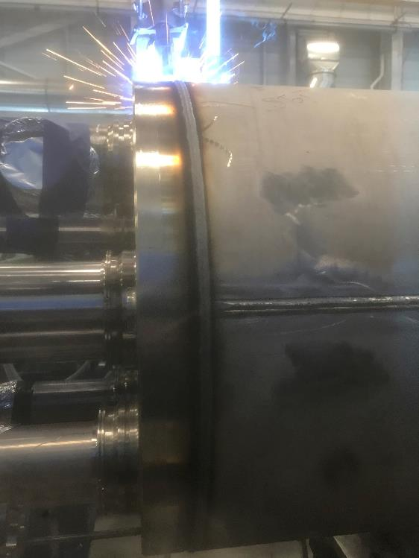
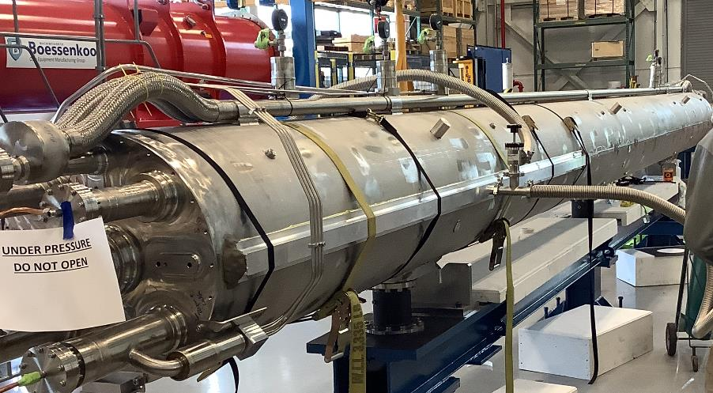
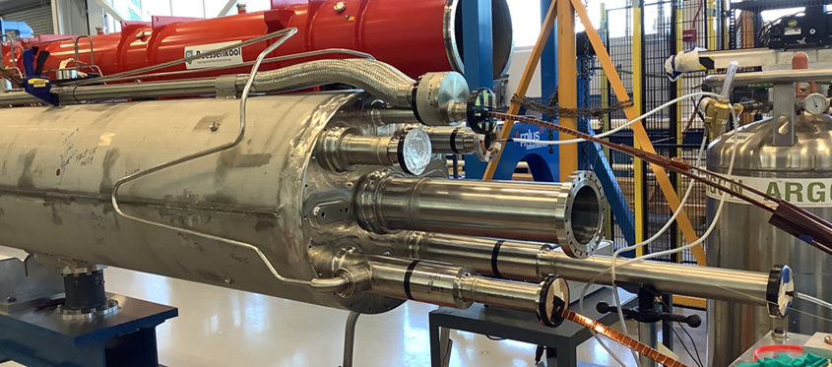
Pre – Series Fabrication
Pressure/Leak Test
End Cover Welding
Nozzles & Extensions for Testing

Slide 22
ES&H
ES&H coordinator is Amy Pavnica
Operational hazards during Cold Mass assembly include Mechanical, Electrical, Welding and Pressure hazards
The risk categories of identified hazards are summarized in US-HiLumi-doc-1121
Main Hazards
Use of overhead crane and lifting fixtures
High voltage tests
Welding: burns, UV flashing and Hexavalent Chrome inhalation
Documents:
AUP Hazard Analysis Report (HAR)
CERN’s Launch Safety Agreement (LSA) for IR Magnets (WP3) (see US-HiLumi-doc-234)
Document with CERN completed: Agreement on Compliance with the CERN Safety Regulation for Mechanics (SR-M) including Pressure Equipment Directive (PED-2014/68/EU) of LMQXFA Magnets from the US HL-LHC-AUP
FNAL pressure vessel FESHM chapter 5031 is addressed through ASME Section VIII Div. 2 Analysis

Slide 23
QA/QC
This L2 sub-project follows HL-LHC AUP Quality Assurance Plan.
Project Quality Assurance Plan is described in US-HiLumi-doc-80.
A Manufacturing and Inspection Plan (MIP) is developed to monitor quality control and acceptance testing. The MIP documents critical inspection points and level of inspection.
QC is incorporated into the production of the Cold Mass through the released travelers. The travelers include in-process inspections points and management hold points per the FNAL and CERN approved MIP.
Test and Inspection reports for the Cold Mass will be upload to the traveler as identified in the traveler steps and can easily be accessed when required.

Slide 24
Summary
Design is complete
FRS requirements and CERN Safety Agreement are addressed
Fabrication Travelers are created and released with each unit.
Manufacturing & Inspection Plan (MIP) approved by CERN
Procedures for various steps have been released to identify critical work processes
Interfaces are defined and actively managed
Three Pre-Series Assemblies have been fabricated and/or tested

Slide 25
Back-up Slides

Slide 26
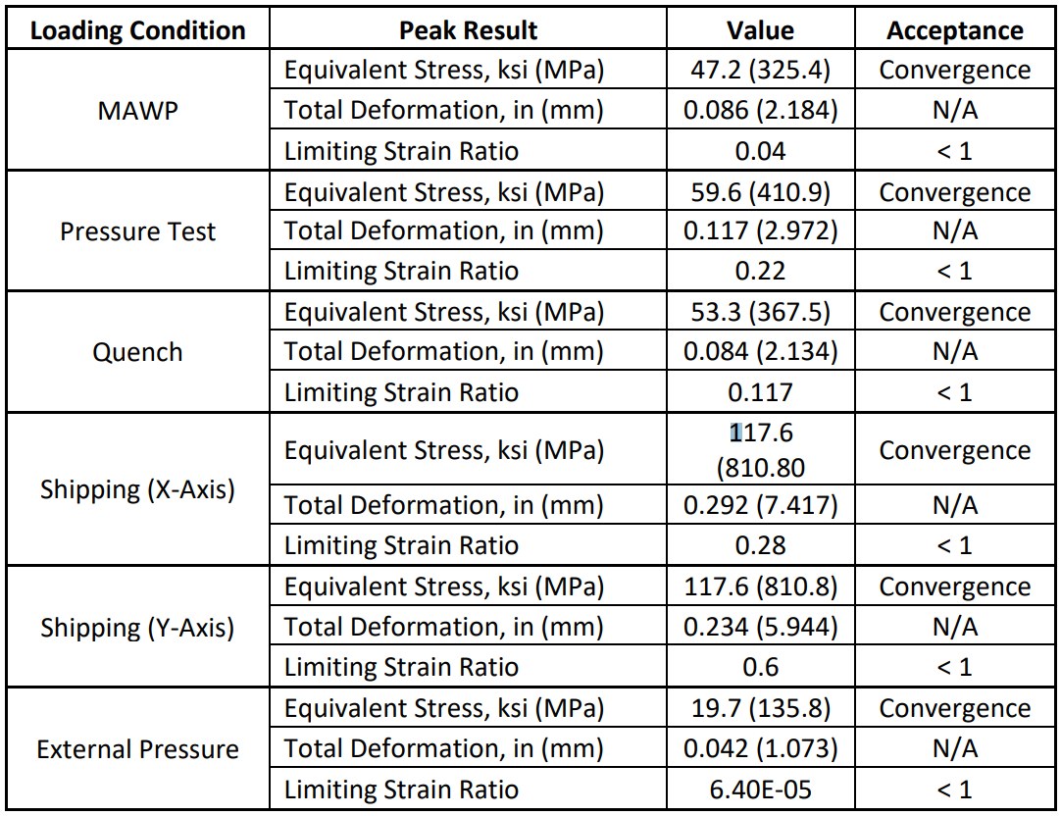
Design Analysis
ASME Pressure Vessel Note per R-T-07: US-HiLumi-doc-2934
Analysis use a Maximum Allowable Working Pressure (MAWP) of 20 bar differential pressure at 1.9 K He as per FRS requirement R-T-10.
The Cold Mass was analyzed under MAWP conditions, pressure test conditions at 25 bar, quench conditions, shipping conditions, and under external pressure to meet the FRS R-T-09.

Slide 27
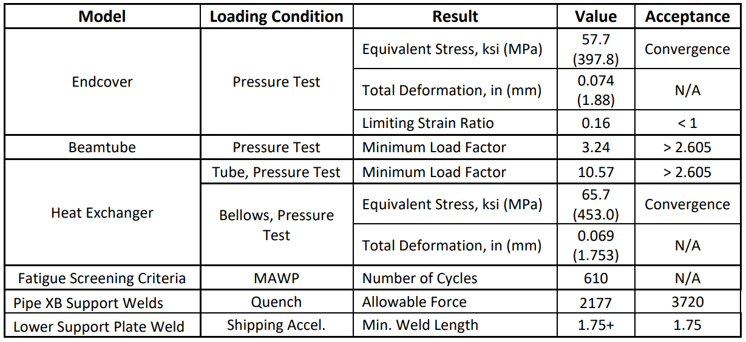
Design Analysis
ASME Pressure Vessel Note: US-HiLumi-doc-2934
Additional analysis was performed on sub-models of the assembly to determine if individual components would fail, buckle, and to determine the minimum number of operational cycles.

Slide 28
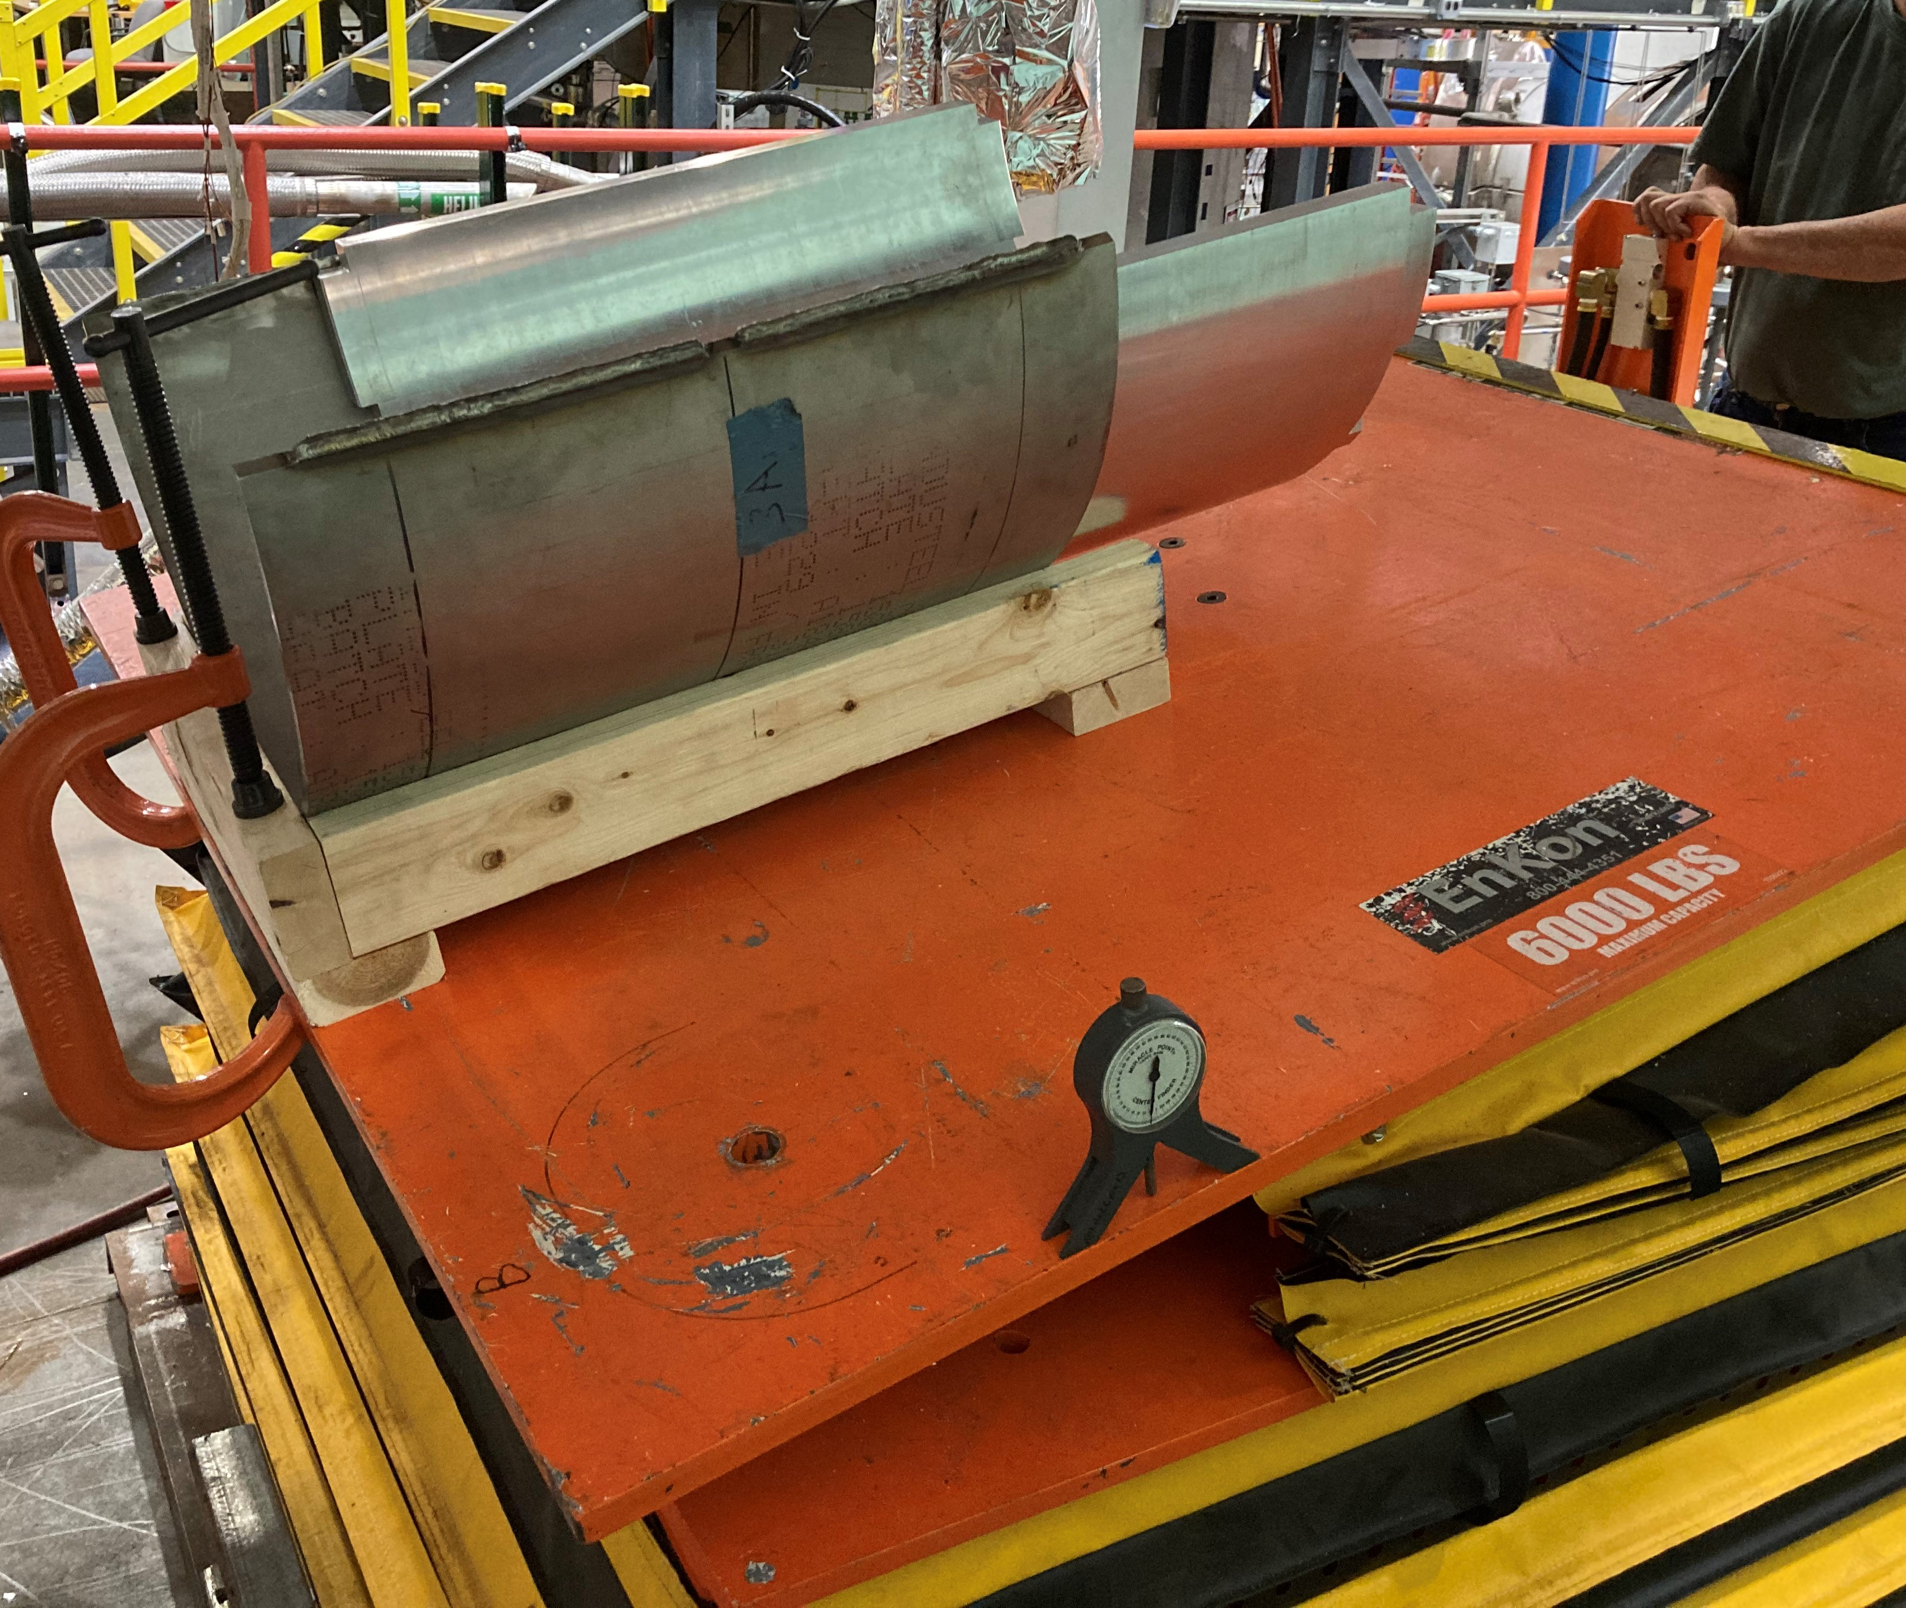
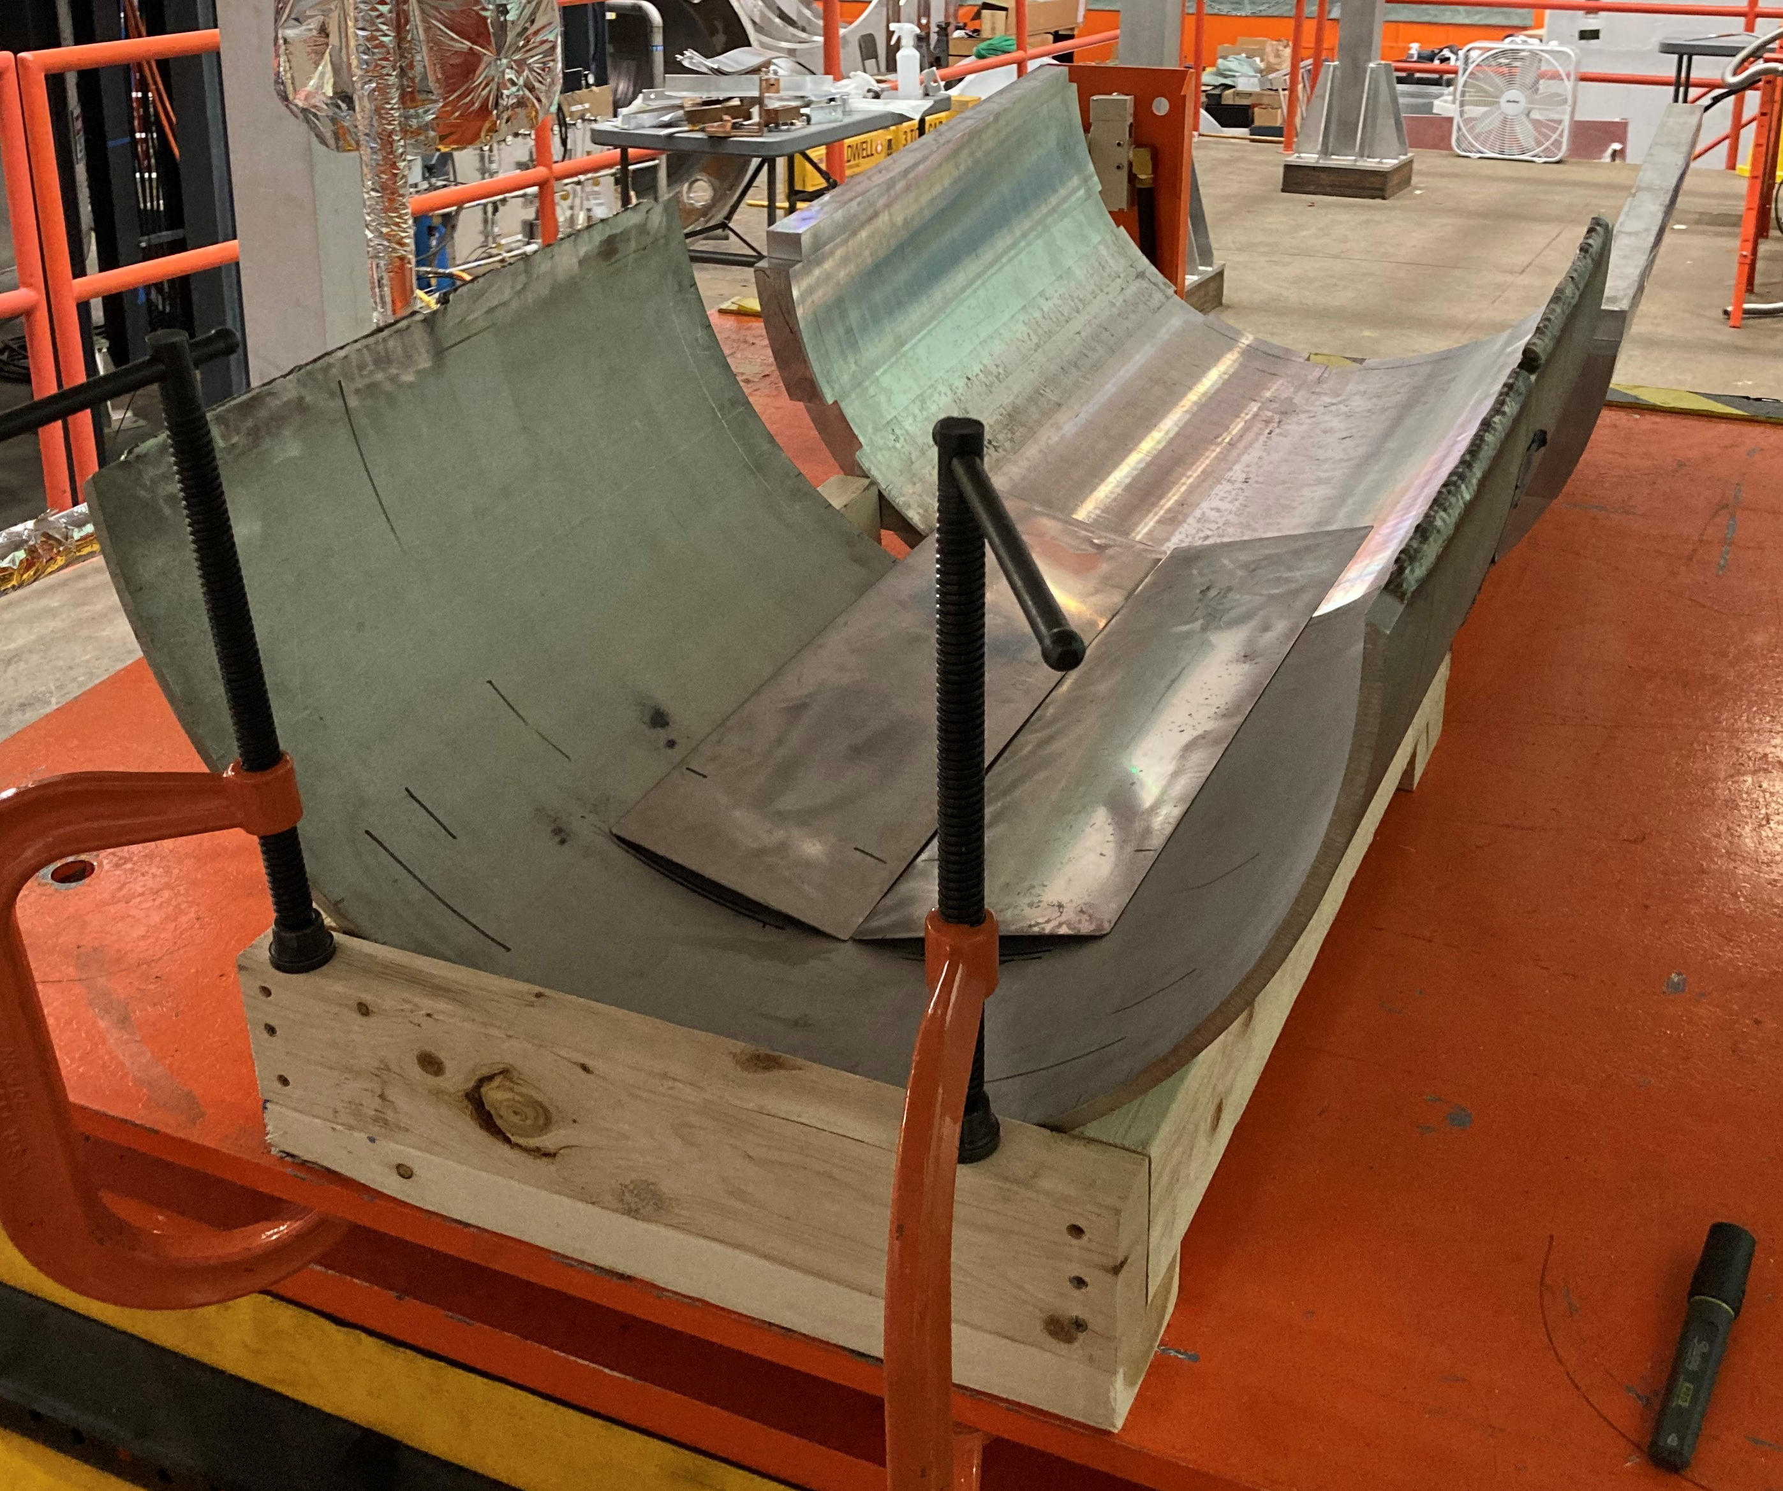
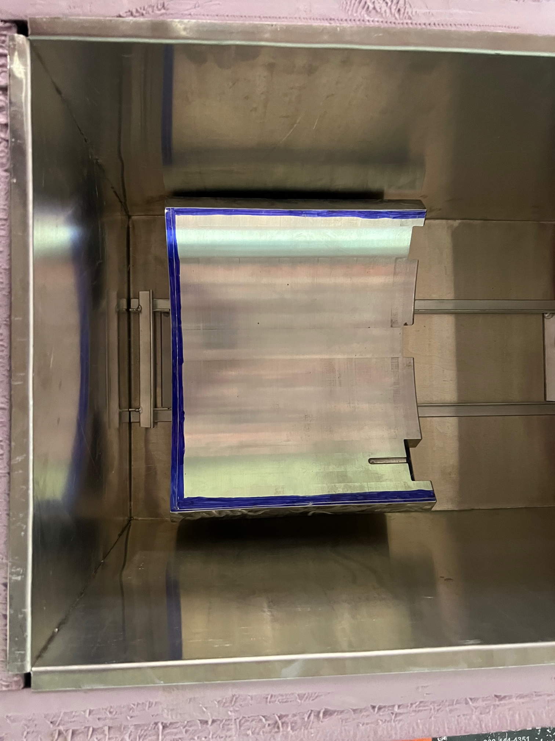
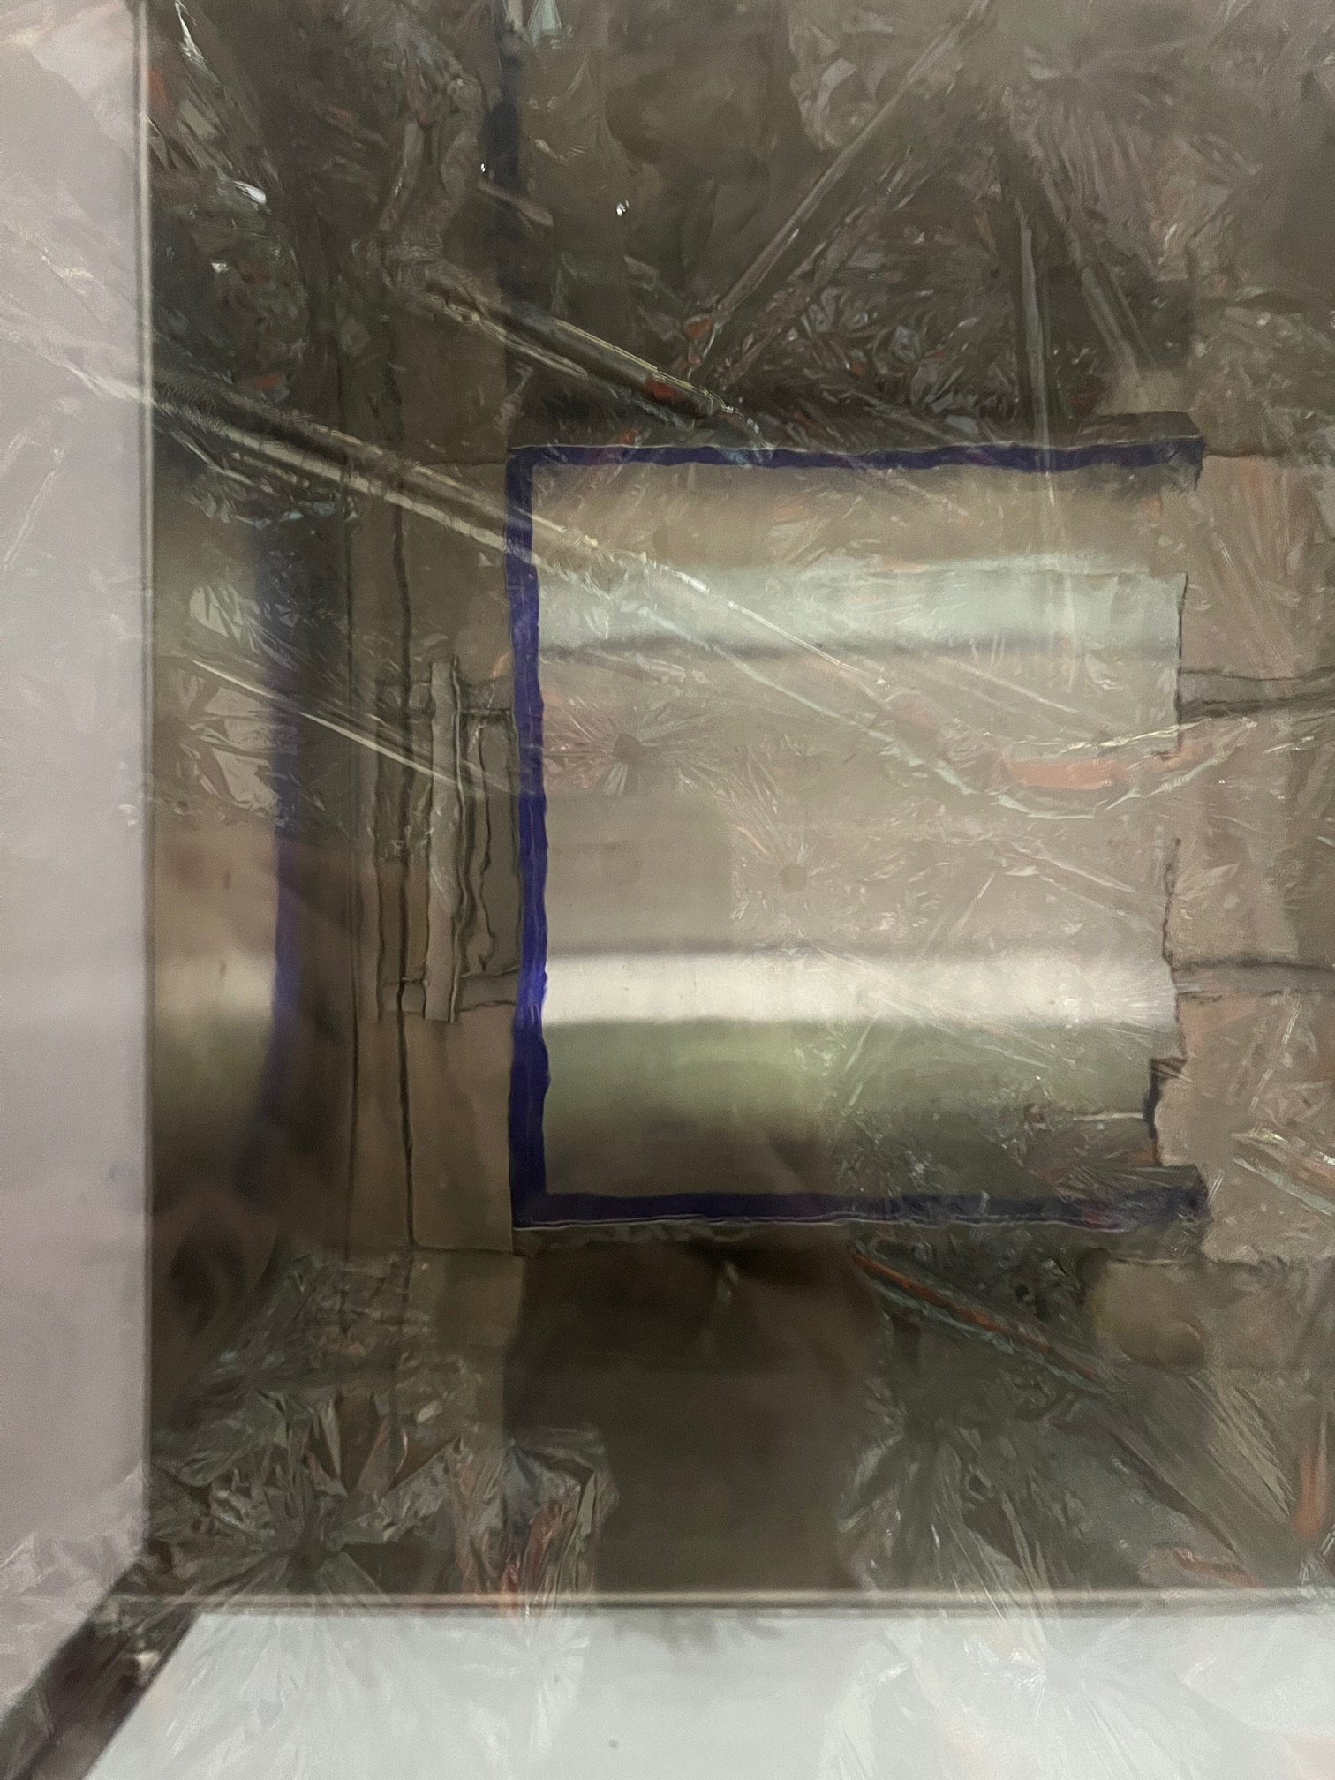
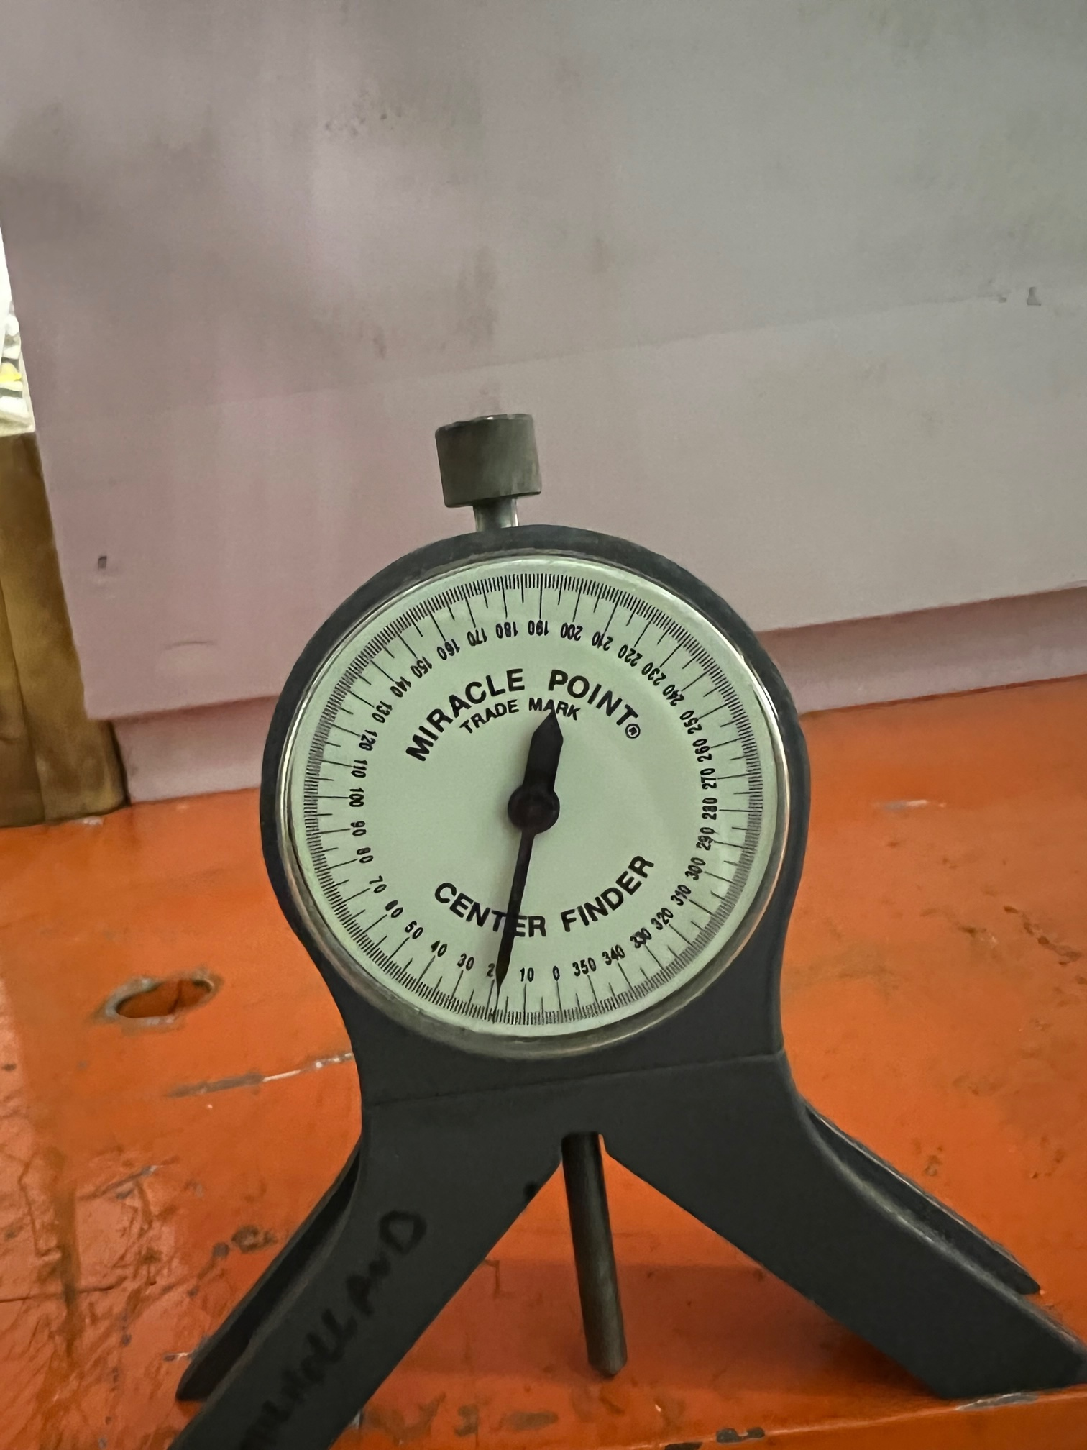
Shell Friction Coefficient Proof Test
Original Test: Verified friction coefficient by sliding 2 samples on a tilt table to determine the angle where sliding begins:
Aluminum Shell of MQXFA Magnet & SS He Shells
SS Shims placed between Aluminum MQXFA Shell and SS He shell
Aluminum MQXFA Shell on a fixed SS Shim.
Follow Up Friction Coefficient Test: Verified the Friction Coefficient between the Aluminum Shell of the MQXFA Magnet & SS He Shell at 80K (LN2) temp.
Room temperature test repeated (3x) prior to introducing the LN2 bath for reference of smaller samples with possible change
The difference between the cold and warm was measured
Orig. Test Set-up
New Tests in LN2 bath
28

Slide 29
Shell Friction Coefficient Proof Test
 | Delta angle = Cold - Warm
 | Trial #1 | Trial #2 | Trial #3 | Avg | Friction
Alum to SS He Shell | 1° | 3° | 4° | 2.6° | 0.03
Second test concludes that difference between room temperature and 80K has negligible differences; the friction is getting slightly larger at 80 K
29

Slide 30
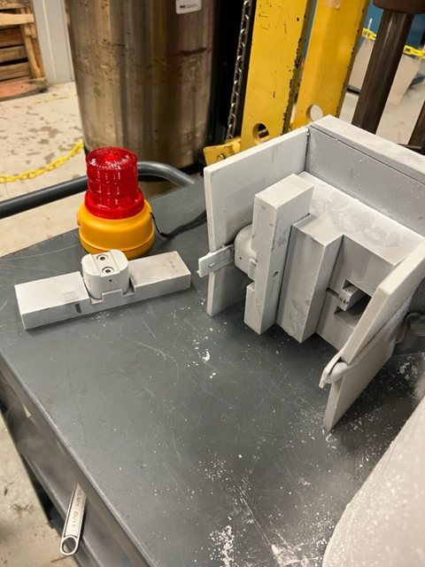
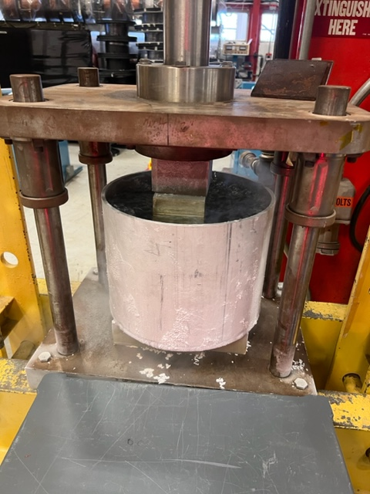
Cold Tack Block Bolt Shear Tests
LN2 Bath Bolt Shear strength Mock-up tests:
The original fixture was machined to fit the ARMCO Iron inserts provided by LBNL. The inserts were then milled to match the profile of the tack block seat with 2x M8 threaded holes on both faces to mount the tack blocks. Tack blocks were fastened to the ARMCO Iron and fit, welded with the backing strip and shell plates.
The Mock up fixture was set in a dewar and filled with LN2 until it cooled down to 80K.
The IB3 press was used for this test also raising the load incrementally in 5-10 kN at a time with 30 sec. hold time between steps until failure occurred.
30

