Slide 1


Bus Bar and Instrumentation
Rodger Bossert
Fermi National Accelerator Laboratory v2
HL-LHC AUP Series Production Readiness Review– September 6, 2023

Slide 2
Outline
Scope, Acceptance Criteria
Final Design Specifications – models and drawings
Interfaces
Design Validation
Fabrication plan – Traveler
ES&H
QA/QC
Summary

Slide 3
Q1/Q3 Busbar, Exp Loop and Instrumentation Scope
Requirements can be found in the Requirements specification document US-HiLumi-docdb-64, Sections 11.1 and 11.2. Summaries are listed below:
11.1 Busbars Scheme and Requirements
R-T-11: The LMQXFA cold mass will have two main superconducting leads on each side going through the busbar line connection. An additional pair of resistive leads (trim) are required to have current unbalance up to 35 A between the two magnets during operation. The additional leads exit the cold mass through the helium vessel connection. Four additional resistive leads (CLIQ, two per magnet) are required for protection system.
R-T-12: The 18 kA busbars will be made with the same Nb-Ti cable used for the connections of the magnet.
R-T-13: The busbars must include expansion loops, to be contained within the end cover section and able to accommodate up to 30 mm of axial movement due to differential thermal expansion/contraction. The maximum force allowed for a 30 mm displacement is 500 N.
R-O-03: The busbars will include maximum four internal splices. Each splice resistance target value must be less than 1.0 nΩ at 1.9 K. A target value at room temperature will also be specified after the completion of the prototype program. An acceptance threshold will be defined after the completion of the short model program. There are CERN requirements for the splice resistance as well as the solder and flux used for these splices:
R-T-14: Splices are to be soldered with CERN approved materials.
11.2 Electrical/ Instrumentation Requirements
R-T-16: In each cold mass, two temperature sensors will be installed. These sensors are the short type thermometer assembly (36 mm x 12 mm x 10 mm) typically used by CERN and specified in [10]. The location is chosen to minimize the radiation dose and to give the most reliable information for both magnets. Two sensors in the same positions are used for redundancy. The thermometer assemblies will be calibrated and supplied by CERN.
R-T-17: The LMQXFA cold mass assembly includes a minimum of 16 voltage taps. The Quench Detection voltage taps should follow MQXFA redundancy requirement (see [1] R-T-15).
R-T-18: Instrumentation wires type, preliminary quantity and function are given in Table 2 of the FDR.
R-T-19: The LMQXFA instrumentation wiring must exit the cold mass assembly through the helium vessel connection. Instrumentation of each magnet will exit the cold mass on opposite sides.

Slide 4
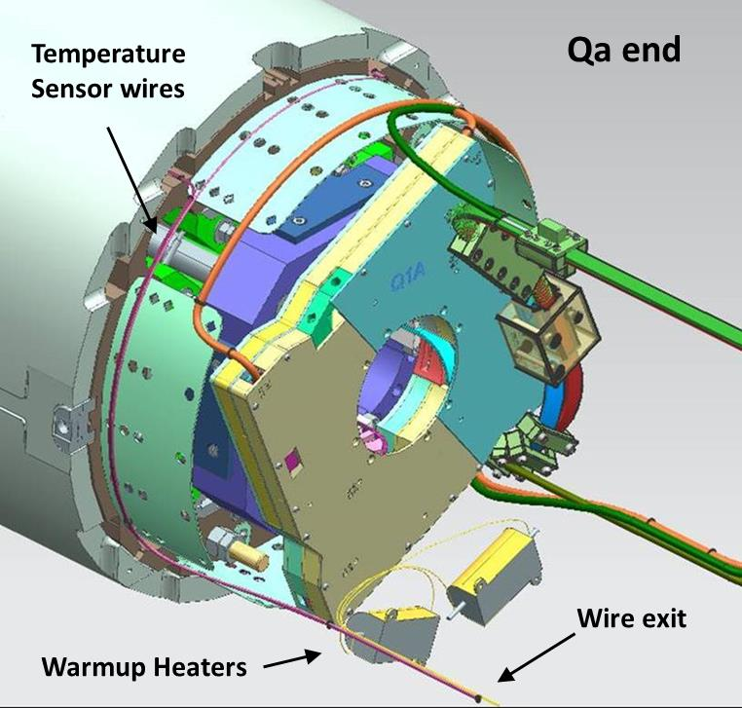
Q1/Q3 Bus Bar, Exp Loop and Instrumentation Scope
List of items in scope of Bus, Expansion loops and Instrumentation:
Bus assembly with housing
Upper and Lower Expansion loops
Lead and expansion loop hold-down parts
Splices from “A” lead to local bus
Kmod (Trim Leads)
CLIQ lead routing
Instrumentation
  Cryo Heaters (Warmup Heaters)
  Temperature Sensors
  MTF temperature sensors
  Quench Detection Voltage Taps
  Coil Voltage Tap Routing
  Coil Protection Heater wire routing

Slide 5
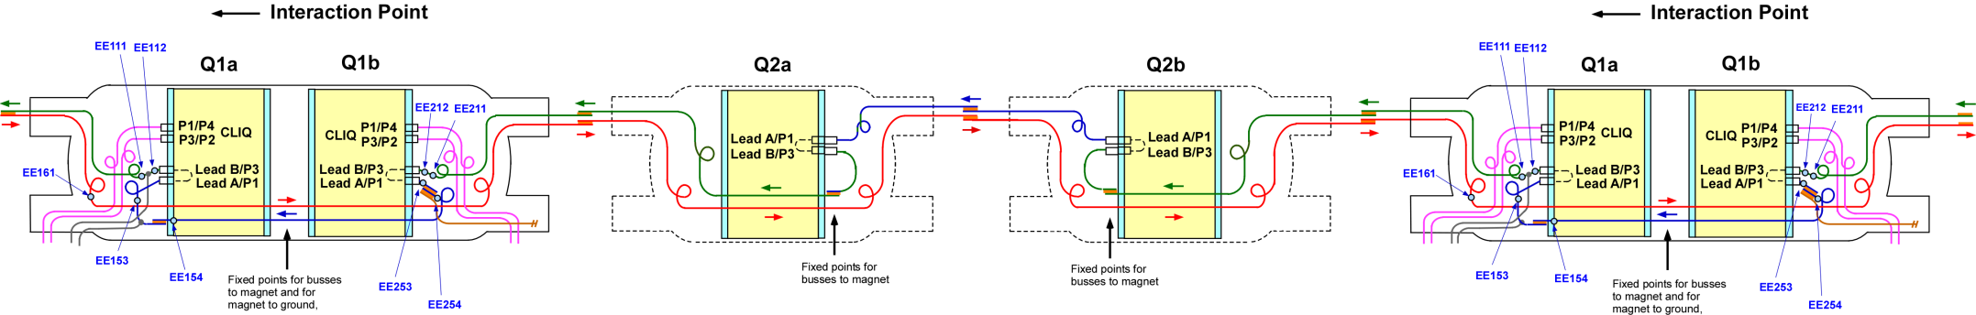
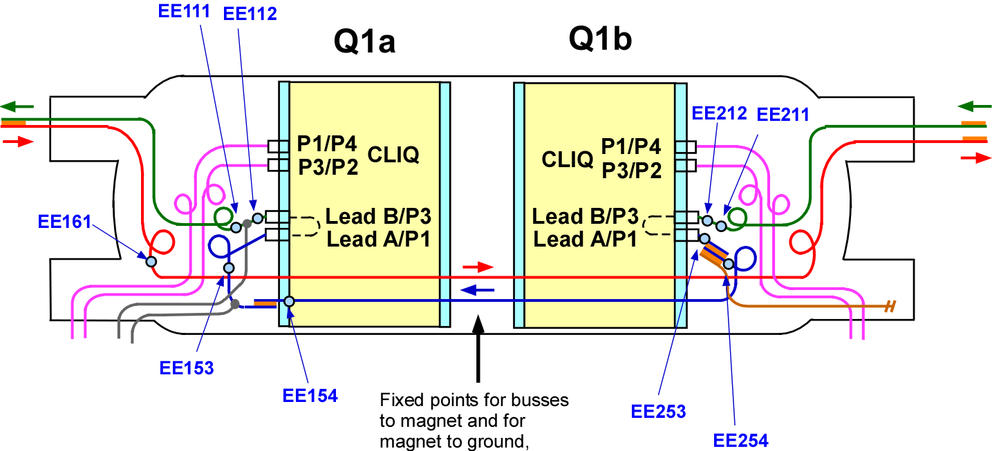
Bus and Expansion loop Final Design Specifications
The bus and expansion loop system for the entire triplet is shown in the illustration below. A Q1/Q3 is shown in the lower illustration (area in dotted rectangle). This system is consistent with the CERN electrical schematic LHCLMQXF E000.

Slide 6
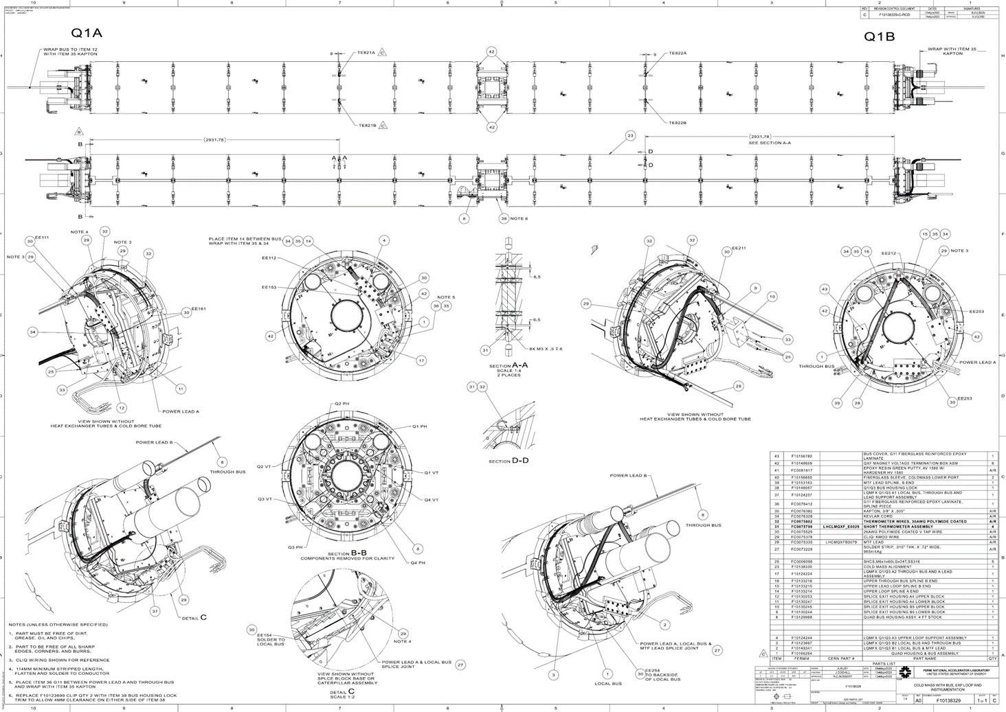
Q1/Q3 Bus and Expansion loop Final Design Specifications
Cold Mass sub-assembly drawing F10138329 (shown below) includes the bus, expansion loop and instrumentation. Exceptions are the warm-up heaters and the MTF temperature sensors, which are included on the cold mass shell closure assembly, drawing F10138327, and the cold mass alignment drawing F10138330 respectively. .

Slide 7
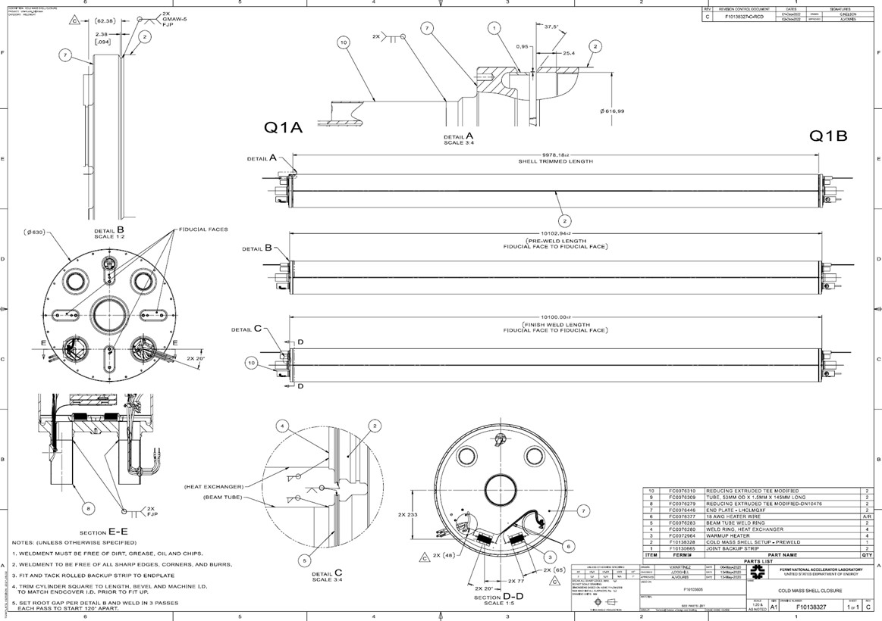
Q1/Q3 Bus and Expansion loop Final Design Specifications
Cold Mass shell closure assembly, drawing F10138327, which includes the warmup heaters.

Slide 8
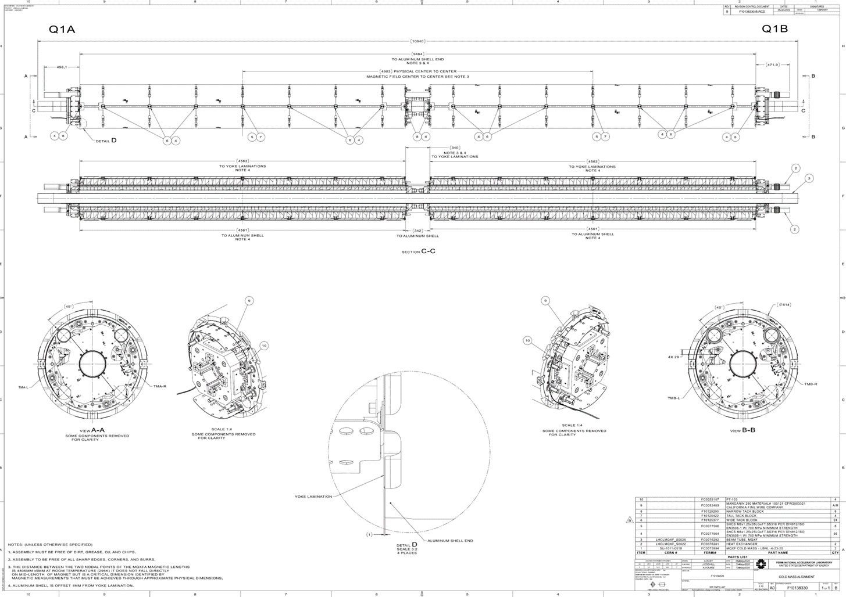
Q1/Q3 Bus and Expansion loop Final Design Specifications
Cold Mass alignment drawing F10138330, which includes the MTF temperature sensors.

Slide 9
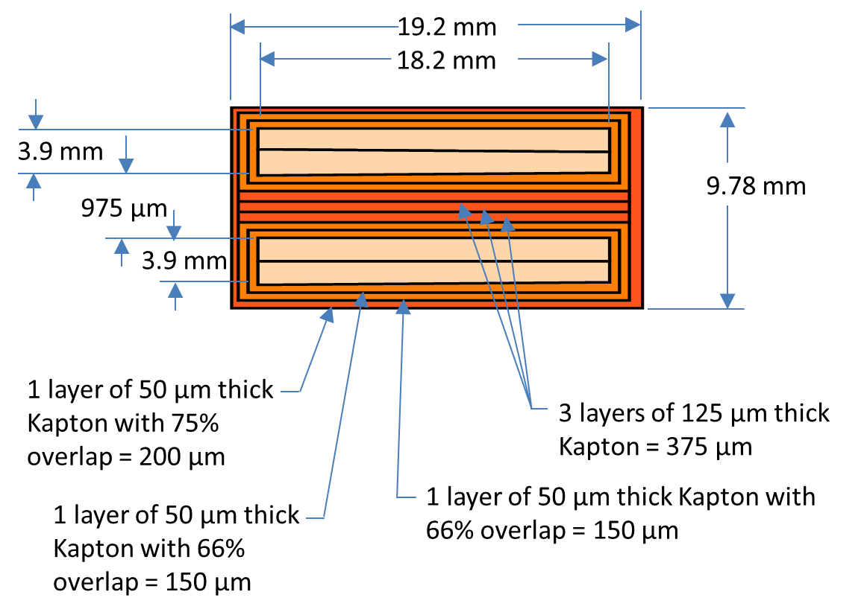
Bus and Expansion loop Final Design Specifications
Q1/Q3 and Q2 Bus Assembly
The through bus is similar to the design used for the MQXB (LHC IR triplet) magnets in the current IR triplet. It consists of two pairs of special rectangular NbTi cable used for busses and coil leads as (CERN drawing number LHCMQXFB0079), consistent with requirement R-T-12. Each pair is soldered together and wrapped with Kapton. The pair are wrapped together as shown and placed into a bus housing made of G-11 The assembly drawing of the bus is FNAL #F10119849.
The amount of kapton between each bus is 995 um. 50 um (2 mil) kapton will withstand 6100V/mil. 125 um (5 mil) kapton will withstand 3900 V/mil. The bus insulation can therefore withstand a total electrical resistance of 131kV, which far exceeds the High Voltage withstand requirement of 4600 V (at room temperature).
1 layer of 50 µm Kapton with 66% overlap = 150 µm

Slide 10
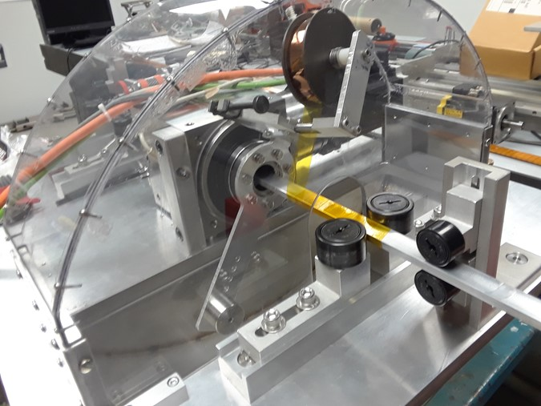
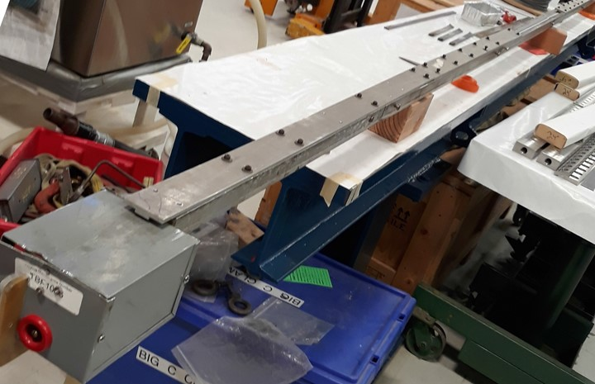
Bus and Expansion loop Final Design Specifications
Q1/Q3 and Q2 Bus Manufacturing
Solder used for the busses as well as the splices consists of flat strips of 96% tin/4% silver, the materials approved by CERN (R-T-14). Two pieces of solder strip are placed between the cables and enclosed in a full-length fixture (dwg F10119961), then heated to 240 degrees C for approximately 10 minutes. The flux used is Solder Gel MOB 39 (specified by CERN). The solder joint for the busses and splices were tested in a short model and implemented in the first cold mass tested in IB1.
Busses are wrapped with layers of 50 µm thick Kapton. Wrapping is done on a device designed at Fermilab for this purpose (FNAL assembly drawing #F10095440).

Slide 11
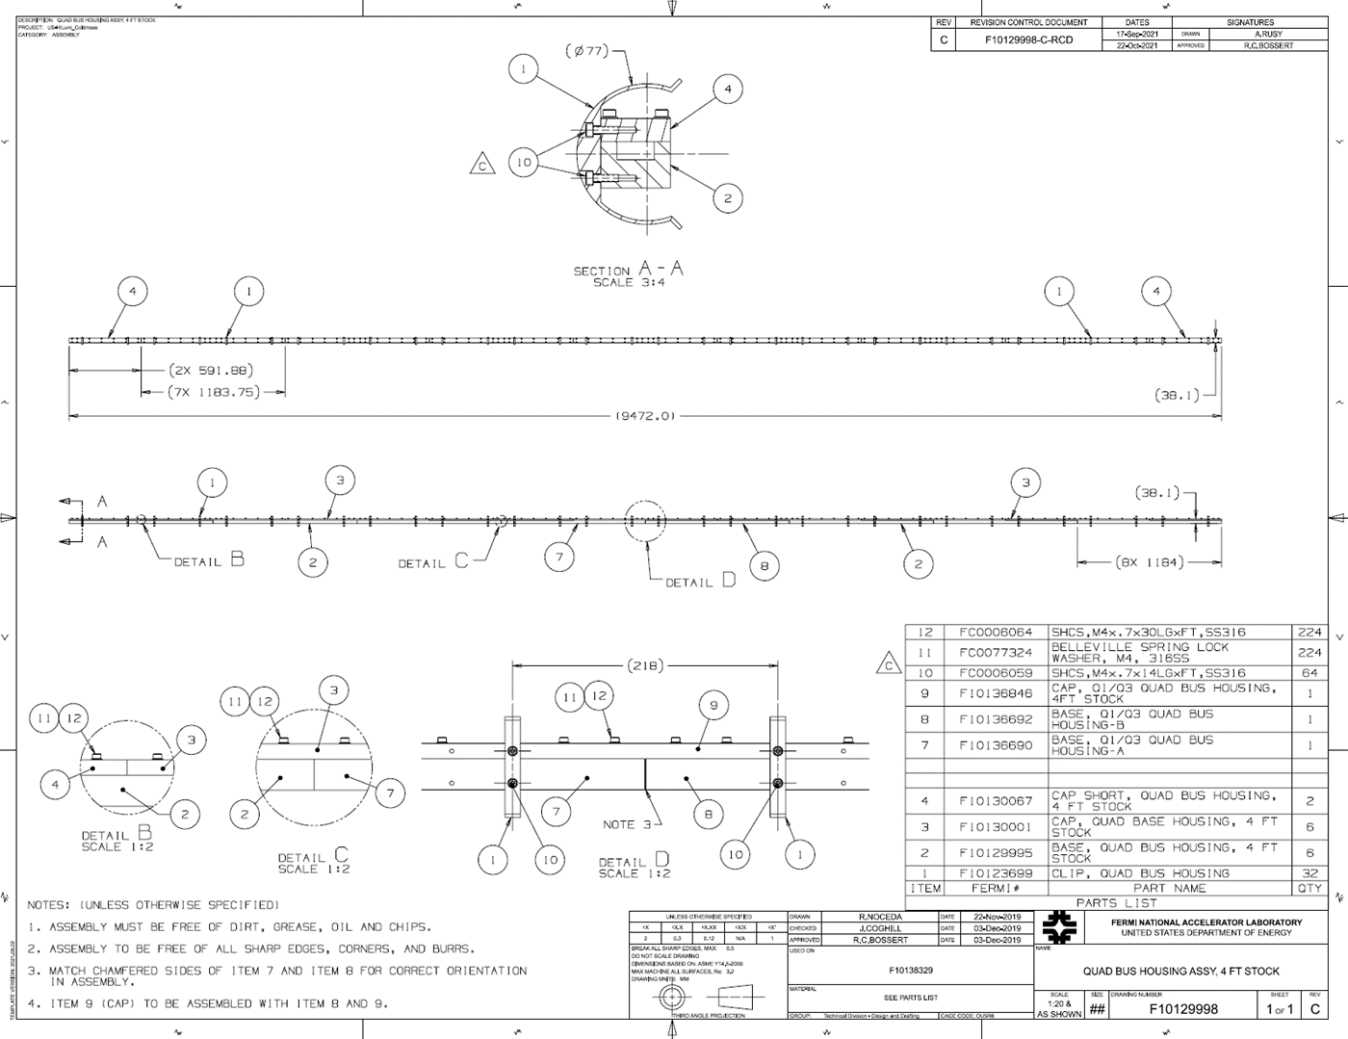
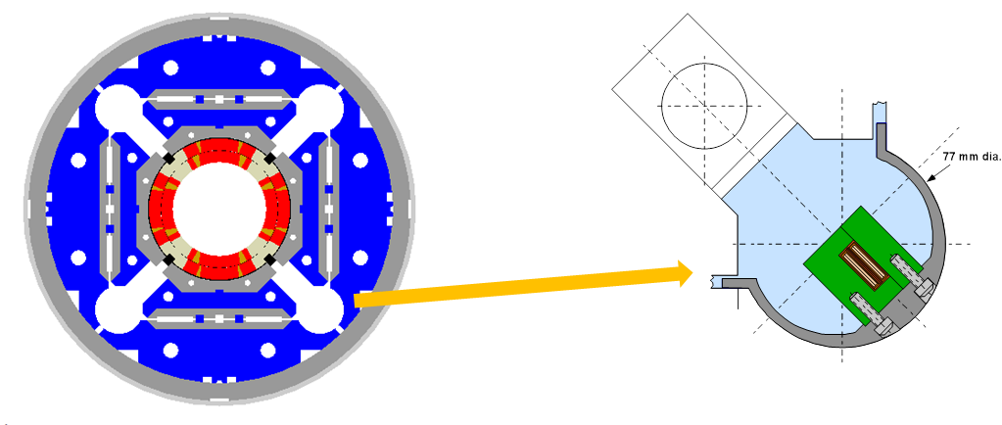
Bus and Expansion loop Final Design Specifications
Q1/Q3 and Q2 Bus Housing
The bus is enclosed by a full-length G-11 bus housing drawing F10129998 (Q1/Q3 shown) and placed within the designated bus port. The housing is supported by aluminum clips at fixed positions within the bus port. The housing assembly is designed to withstand the magnetic forces on the bus and still stay within the minimum flow requirements for the LMQXF cold mass. Three Q1/Q3 bus assemblies with housings have been manufactured and the entire production run of 12 Q2 bus assemblies are ready to ship to CERN.

Slide 12
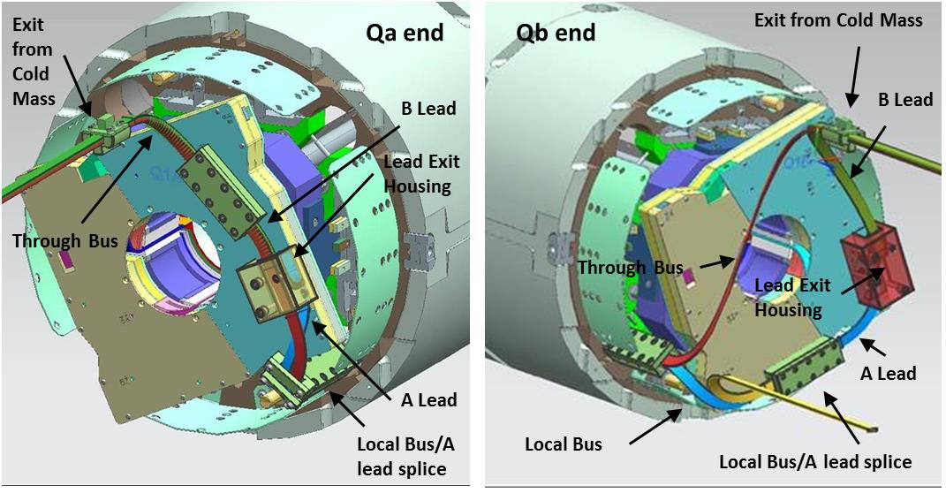
Bus and Expansion loop Final Design Specifications
Q1/Q3 Expansion Loops
Configuration of Q1/Q3 expansion loops and supporting fixtures are shown shown below.
Since the magnets are “flipped horizontally” within the cold mass, the bus ports are on the opposite sides when viewed from the end.

Slide 13
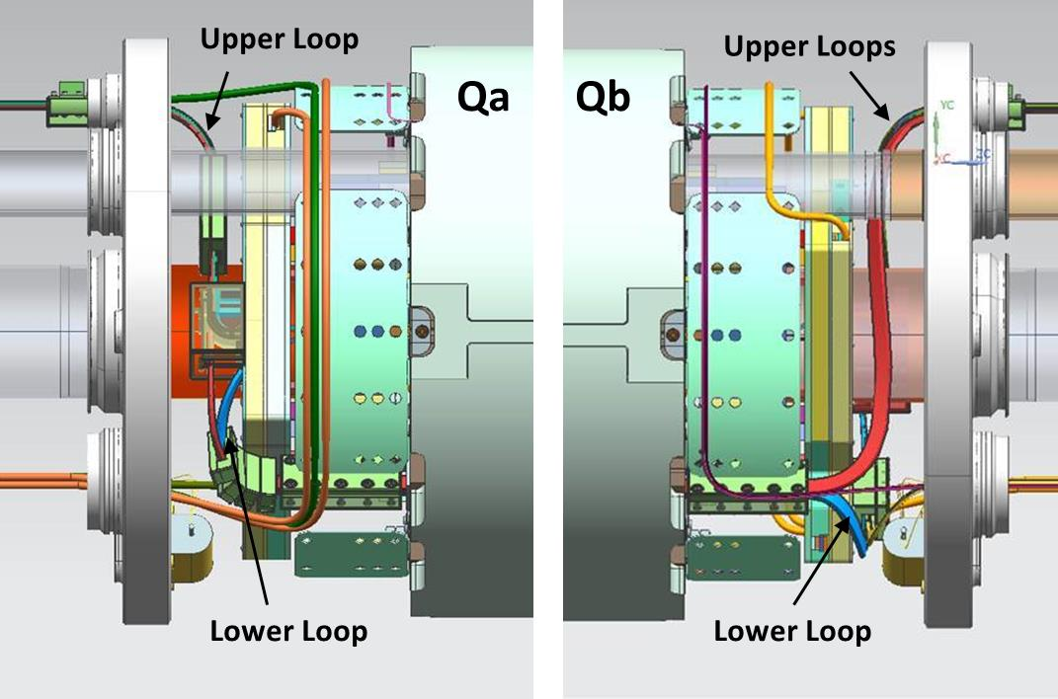
Bus and Expansion loop Final Design Specifications
Q1/Q3 Expansion Loop Travel
The space between the splice box and the inside surface of the end cover is 75mm +/- 1mm. To allow for thermal expansion, the upper expansion loops need to have +/- 18mm of travel while the lower loops need +/-7mm. Expansion loop calculations are given in US-HiLumi-doc-3208. Loops were tested on a full-scale mockup and meet the requirements.
The “home” or room temperature position of the loops is in the approximate center of the space allowed, as shown in the figure above.

Slide 14
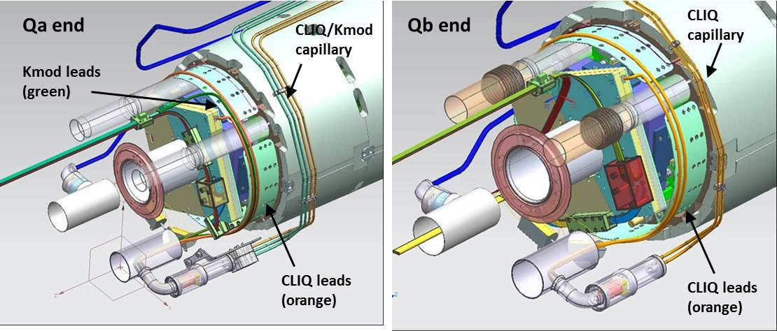
Bus and Expansion loop Final Design Specifications
CLIQ and Kmod (Trim) Leads
Two CLIQ leads exit the splice box on each end of the magnet, and exit through the CLIQ/Kmod capillary (designed and supplied by CERN). Kmod (trim) leads are soldered to the magnet leads and exit on only the Qa end through the CLIQ/Kmod capillary. They are 35A copper cables (not superconducting) with a 10mm² cross section.
Cable used for the CLIQ and Kmod leads is identical and is supplied by CERN. The cable specification is available at US-Hilumi-doc-998.

Slide 15
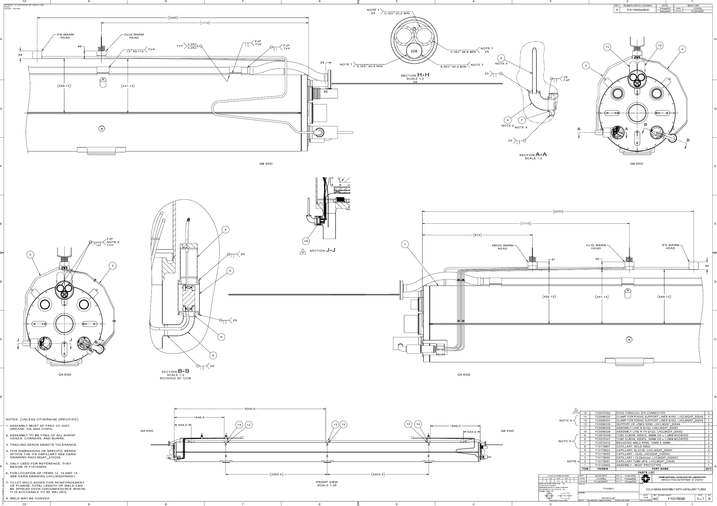
Q1/Q3 Bus and Expansion loop Final Design Specifications
CLIQ and Kmod capillary tubes which route wires from the cold mass to the “warm head” are shown in drawing F10178090 rev. A.

Slide 16
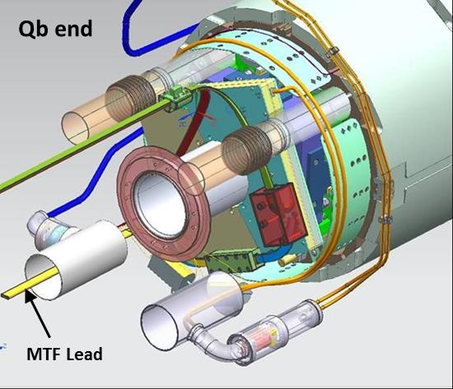
Bus and Expansion loop Final Design Specifications
MTF Lead
One special lead is added to allow either the Qa or the Qb to be tested separately on the horizontal stand at the Fermilab Magnet Test Facility.
The MTF lead is soldered to the A lead and local bus and will not be used after testing. It will be cut and capped before the Cryo-assembly is shipped to CERN,

Slide 17
Q1/Q3 Instrumentation
The Cold Mass is instrumented with temperature sensors, warm up heaters and voltage taps. In addition there are Quench protection heater wires and several other voltage taps that are mounted on the MQXFA magnet coils that will be routed out of the cold mass through the instrumentation port to the IFS capillary (R-T-19). The table below consists of a list of the all instrumentation wires which exit the end dome (R-T-18). The instrumentation wiring diagram is shown CERN drawing number LHCLMQXF E0001
Lead or Wire | Qty per end | Exit port | Notes
Quench Protection Heater Wires | 16 | IFS Capillary | From the quench protection heaters bonded to the coils Total of 4 wires from each coil. Jumpered on the return end of magnets during magnet construction. 18 AWG polyimide coated wire.
Magnet Voltage Taps | 16 | IFS Capillary | Voltage taps which extend from the end of the coils. 4 taps from each coil. 26 AWG polyimide coated wires.
Cold Mass Voltage Taps | 4 or 5 | IFS Capillary | 5 on Qa end and 4 on Qb end. 26AWG polyimide coated wires.
Temperature Sensor Wires | 8 | IFS Capillary | Four wires from each temperature sensor. 30AWG polyimide coated wire.
Cryo Heater Wires (Warmup Heaters) | 4 | IFS Capillary | Two wires from each Heater. 18 AWG polyimide coated wire.
Temperature Sensor for Wires on Horizontal Test Stand | 2 | IFS Capillary | Two wires from each temperature sensor. 36AWG quad-twist polyimide + Tefzel single strand wire, used only for MTF testing.

Slide 18
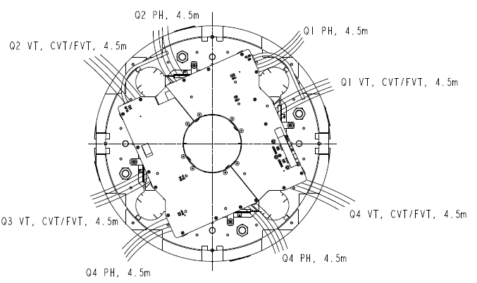
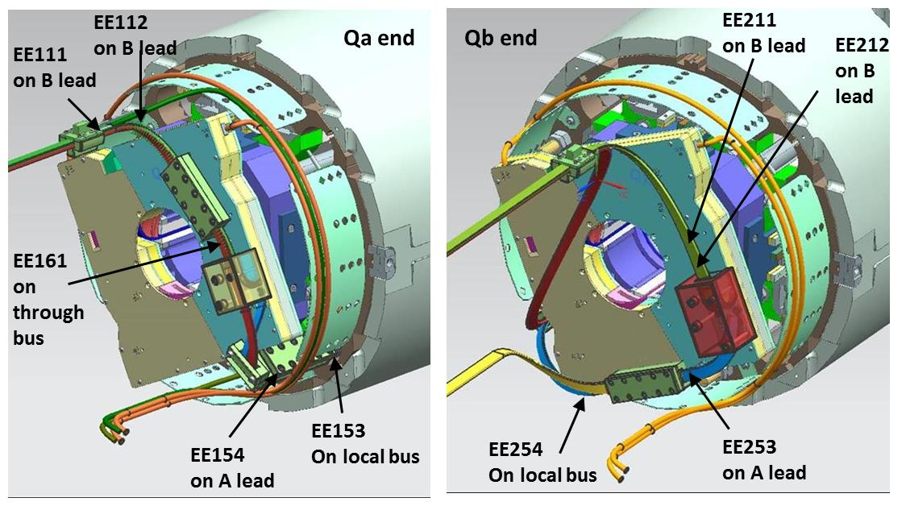
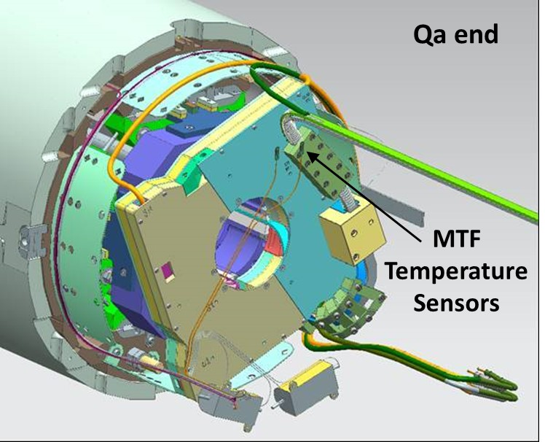
Q1/Q3 Instrumentation Wire Exit
Wires from various sensors are shown as they exit the cold mass
Protection heater and coil voltage taps
Quench Protection Voltage taps
Warmup Heater and Temperature sensor Wires
MTF Temperature Sensor Wires

Slide 19
Final Design Specs – Models & Fab Drawings
Cryo-assembly F10139011
Cold Mass w/ Capillaries F10178090
Cold Mass Assy F10103605
Shell Closure F10138327
Shell Setup Pre-weld F10138328
Alignment F10138330
Bus + Expansion Loops F10138329
Cryo-assy for Testing in IB1 F10111033
The complete drawing tree structure as well as pdfs of the drawings for the cold mass is located at US-HiLumi- doc-3094.
A brief flowchart of the major subassemblies of the cold mass, including those related to the Bus, Expansion Loop and Instrumentation, is shown to the right.
Pressure Test Cold Mass Assy
F10172809

Slide 20
Bus and Instrumentation Interfaces.
Relevant Interfaces to the Q1/Q3 Bus, Exp Loop and Instrumentation System design:
Quantity of NbTi bus cable needed for Q1/Q3 (with CERN through Miao Yu) – p8.
Leads for local and through busses need to be of sufficient length to reach the splices of the next element in line at CERN and able to be accommodated by the vertical test facility at BNL. (with CERN and Fermilab/BNL coil manufacturing groups) – p.11.
CLIQ lead, PH wire and coil voltage tap wire connection with magnets (with LBNL) – p.16.
Connection of lead exit housings to splice boxes (with LBNL) – p.11.
Magnet physical length and space for Expansion Loop (with LBNL and CERN) – p.12.
Thermometer, warmup heaters and associated wires (supplied by CERN) – p.17-18.
Wire number identification for instrumentation wiring from BNL and LBNL for magnet and from CERN for interface with IFS and CLIQ/Kmod capillaries – 15-17.
Instrumentation system must be consistent with CERN schematic – p.5.
Pipe connection to IFS and CLIQ/Kmod capillaries and thermal sensor installation, with Cryostat group at Fermilab – p.14 and 15.
Position and length of “MTF Lead” with horizontal test facility at Fermilab - p.16.

Slide 21
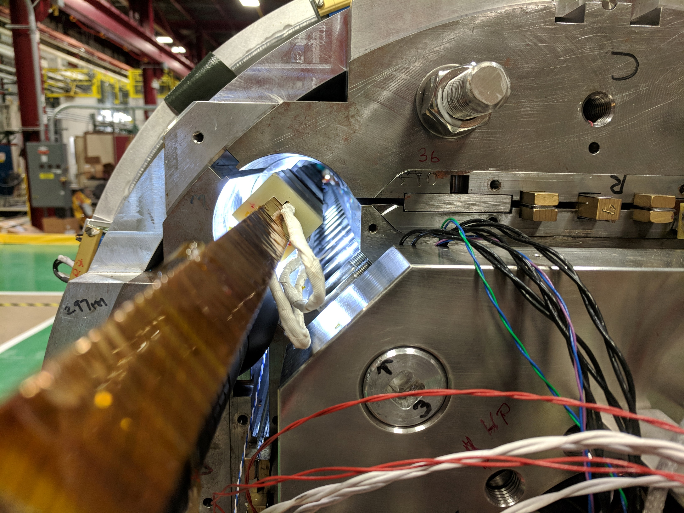
Design validation
A demonstrator bus has undergone complete testing at temperature and field in a short model MQXFS1e (See “Characterization of NbTi busbar for LMQFXA cold masses” Hi-Lumi doc 2314 by Maria Baldini). Insertion of bus was completed successfully.
In addition, one Q1/Q3 cryoassembly and one Q2 cryoassembly has been tested at Fermilab and CERN respectively, with completed bus and expansion loop assemblies. The bus and expansion loops operated as expected.

Slide 22
Fabrication plan – Traveler
  Four travelers are relevant to the Q1/Q3 Bus and Instrumentation –
  464574 HL-LHC AUP MQXFA Incoming Inspection and QA Traveler
  464507 HL-LHC Magnet Bus Traveler
  464525 HL-LHC AUP Q1 Q3 Cold Mass Assembly Traveler
  464720 HL-LHC AUP Capillary Tube Installation Traveler.
  A brief summary of the assembly steps:
  Incoming electrical inspection of all instrumentation on both magnets.
  After coils are aligned, insert previously fabricated bus/housing assembly.
  Install bus housing lock.
  Make local bus-to-A-lead splices and install splice housings.
  Install lead exit support fixtures.
  Form expansion loops on both Qa and Qb ends.
  Install all expansion loop hold-down fixtures
  Solder Kmod leads in the appropriate places.
  Route CLIQ and Kmod leads.
  Add quench detection voltage taps.
  Verify expansion loop travel on both ends.
  Install thermometers and route coil voltage taps and protection heater wires.
  After horizontal shell weld, install warm-up heaters and temperature sensors for horizontal test.
  Add IFS and CLIQ/Kmod capillary tubes.
  Final physical and electrical inspections.
  Note: electrical inspections are done during assembly when appropriate, as designated in traveler. Spreadsheet for input of electrical inspection data can be found at HiLumi doc 3966.

Slide 23
ES&H
ES&H coordinator is Amy Pavnica
Operational hazards during Bus and Instrumentation Assembly include Mechanical and Electrical hazards.
The risk categories of identified hazards are summarized in US-HiLumi-doc-1121
Main Hazards
  Use of overhead crane and lifting fixtures
  High voltage tests
  Work with soldering – elevated temperatures and fumes.
  Pinch points for cable wrapper
Documents:
  AUP Hazard Analysis Report (HAR) US-HiLumi doc 303.
  Document with CERN completed: Agreement on Compliance with the CERN Safety Regulation for Mechanics (SR-M) including Pressure Equipment Directive (PED-2014/68/EU) of LMQXFA Magnets from the US HL-LHC-AUP
Operation Readiness Clearance (ORC) for soldering and bus wrapping tooling has been completed.

Slide 24
QA/QC
This L2 sub-project follows HL-LHC AUP Quality Assurance Plan.
Project Quality Assurance Plan is described in US-HiLumi-doc-80.
A Manufacturing and Inspection Plan (MIP) is developed to monitor quality control and acceptance testing. The MIP documents critical inspection points and level of inspection.
QC is incorporated into the production of the cold mass through the released travelers. The travelers include in-process inspection points and management hold points per the FNAL and CERN approved MIP.
Test and Inspection reports for the cold mass are uploaded to the traveler as identified in the traveler steps and can easily be accessed when required.

Slide 25
Summary
Q1/Q3 Bus, Expansion Loop and Instrumentation design is complete, 3 have been built, and one has undergone cryogenic testing in a pre-series cryo-assembly.
All production Q2 busses have been fabricated. One completed Q2 bus assembly has been installed into a cryo-assembly.
Fabrication Travelers are created and released with Manufacturing and Inspection plan (MIP) approved by CERN.
Interfaces are defined and actively managed.
Task is ready for series production.

Slide 26
Backup Slides

Slide 27
Design Analysis
Structural, magnetic, and physical analysis has been done on the bus and interconnect system. A list of the documents:
  Bus Soldering Fixture Temperature and Testing – US-HiLumi-doc-3256
  Expansion Loop Thermal Contraction Calculations. – US-HiLumi- doc-3208
  Q1 Q3 Flow area – US-HiLumi-doc-3214
  Q1 Q3 Bus housing structural and magnetic analysis – US-HiLumi -doc-3211
  Bus solder fill tests – US-HiLumi-doc-3286
  Q1 Q3 Mockup Report – US-HiLumi-doc-3289
  Bus Strand Temperature Tests – US-Hilumi doc – 3685
  Magnetic Analysis of forces on expansion loops – US-Hilumi doc 3689

Slide 28
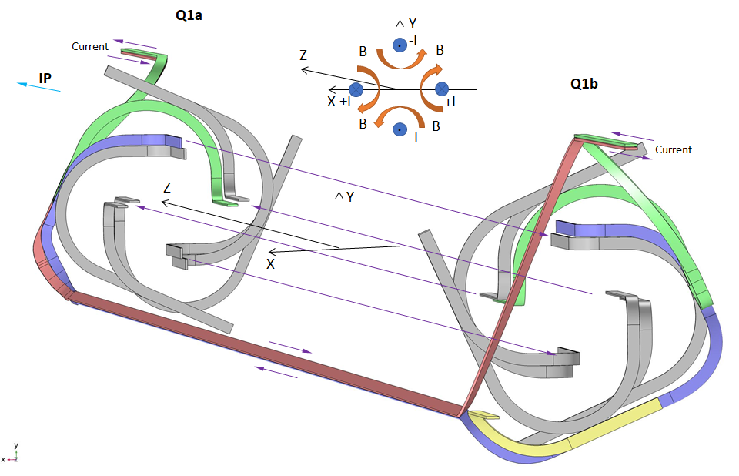
Design validation tests
Magnetic analysis was performed to understand forces on the expansion loops. The full results are available at US-HiLumi-doc-3286.

Slide 29
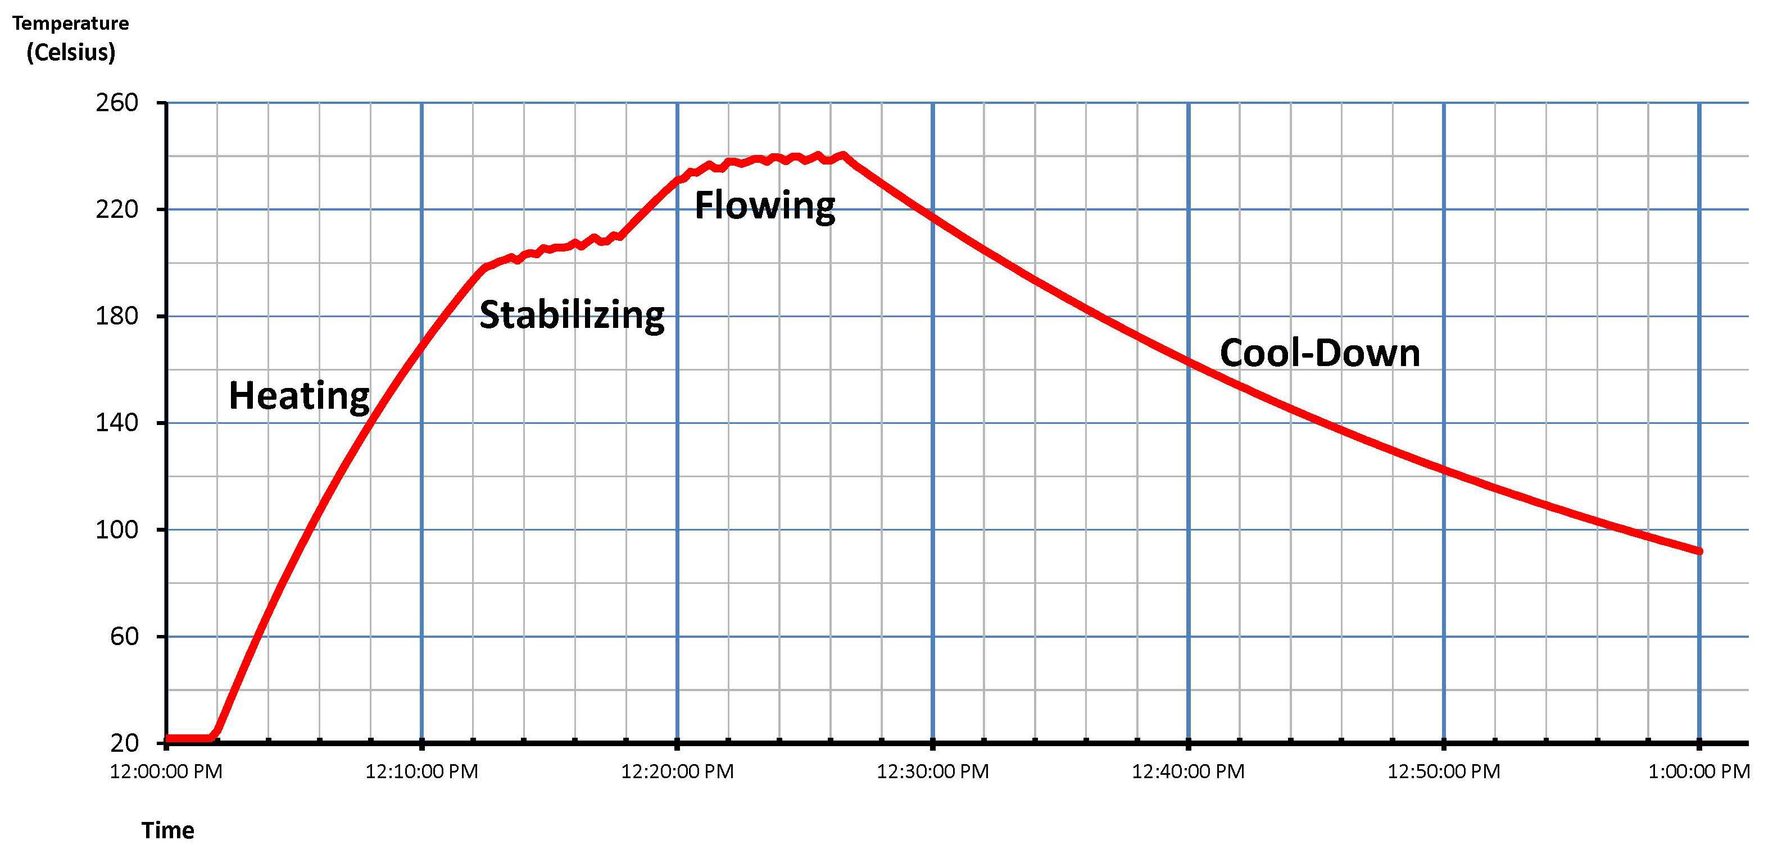
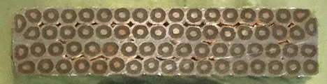
Design validation tests
Temperature cycle of bus soldering fixture was tested and verified. Details are at US-HiLumi-doc-3256.
Bus solder fill tests were completed. The full results are available at US-HiLumi-doc-3286.
Complete busses have been installed in 3 Q1/Q3 cold masses and one Q2 cold mass. One complete Q1/Q3 cryoassembly and one complete Q2 cryoassemby have been tested successfully with these busses and operated as expected. .

Slide 30
Electrical Testing
Electrical inspection is done at various points in the assembly. Data is input to a spreadsheet (HiLumi doc 3966).
  464574 HL-LHC AUP MQXFA Incoming Inspection and QA Traveler
    4.9 hold point for visual inspection
    6.3 Electrical inspection
  464507 HL-LHC Magnet Bus Traveler
    8.2 resistance check of bus
    8.3 hiopt of bus
    10.11 hipot of bus assembly (with housing)
  464525 HL-LHC AUP Q1 Q3 Cold Mass Assembly Traveler
    8.4 Beam Tube hipot to ground
    8.10 Beam Tube hipot to coil, heaters
    11.0 complete electrical inspection of all components, including all instrumentation and hipots, before shell welding.
    13.15 electrical inspection of all components, of the combined magnets and busbars after longitudinal shell welding.
    13.20 electrical inspection of all components, of the combined magnets and busbars after end cover welding.
    17.0 electrical inspection of all components, of the combined magnets and busbars after beam tube, heat exchanger, extremities, N lines, and Fsi target mounts have been installed.
  464720 HL-LHC AUP Capillary Tube Installation Traveler.
    3.3, 4.3 Perform an electrical check on all the instrumentation wires.
    3.18, 4.18 Perform a continuity check on instrumentation wires.
    3.23, 4.23 Post capillary tube electrical check on instrumentation wires.
    5.10 Perform electrical checks on CLIQ wires
    5.11.3.12 Perform continuity checks on CLIQ splices
    5.13 perform electrical tests on both CLIQ lines
    6.14 Perform continuity and resistance checkouts of CLIQ and kmod splices..
    6.17 Perform electrical tests of CLIQ and kmod lines

Slide 31
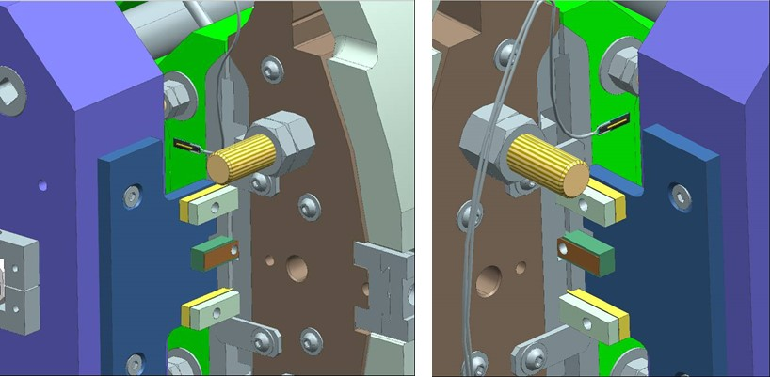
MTF Temperature Sensors

Slide 32
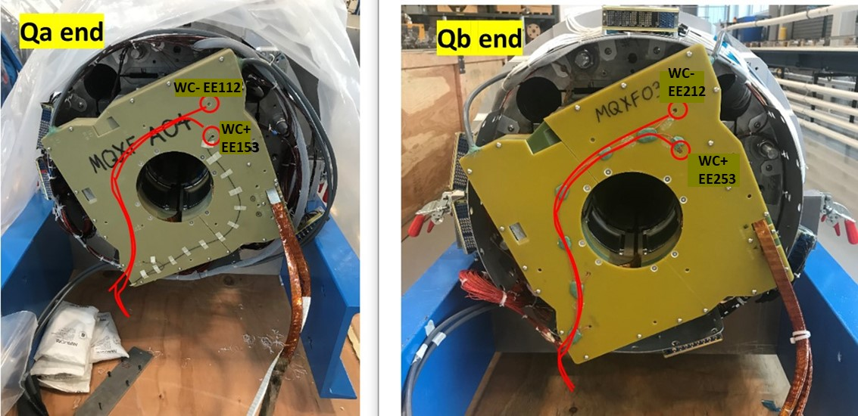
Voltage taps from Splice Box

