Slide 1
Q1/Q3 Cryostat Design
Roger Rabehl – Fermilab
HL-LHC AUP Series Production Readiness Review – September 6, 2023

Slide 2
Outline
Scope, FRS, Acceptance Criteria
Interfaces
Models and Drawings
Organization and Personnel
Manufacturing
QA/QC
ES&H
Summary

Slide 3
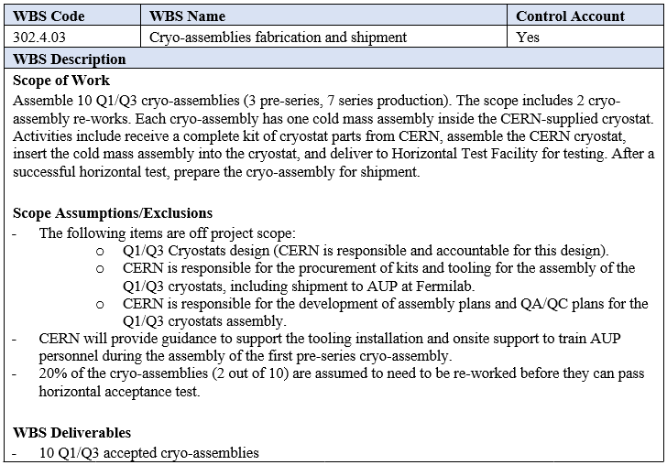
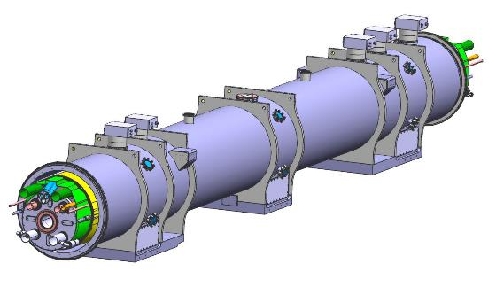
Scope, FRS, Acceptance Criteria
WBS Dictionary:
US-HiLumi-doc-39
Functional requirements specification FRS (US-HiLumi-doc-246) and acceptance criteria (US-HiLumi-doc-1127) address:
Physical dimensions, weight
Pressure ratings, pressure loads
Leak tightness
Hipot performance, quench performance
Alignment

Slide 4
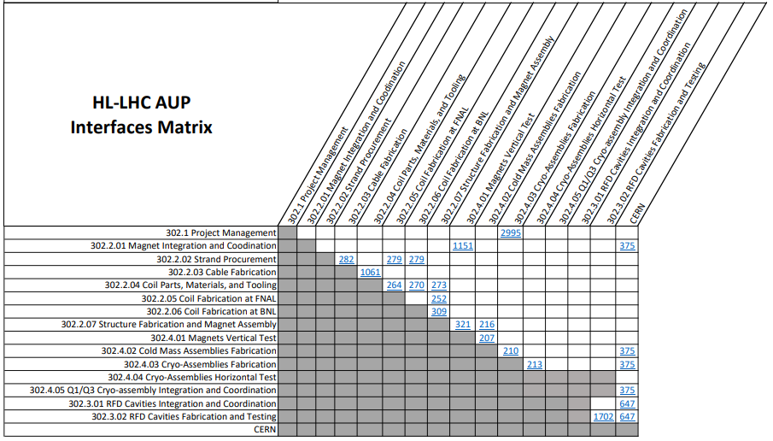
Interfaces
There are approved internal Interface Control Documents between
Cold Mass Assemblies Fabrication and Cryo-Assemblies Fabrication
Cryo-Assemblies Fabrication and Cryo-Assemblies Horizontal Test
There is an approved external Interface Control Document between Cryo-Assemblies Fabrication and CERN.
They can be accessed at:
US HiLumi-doc-210, 213, and 375
Interface Matrix US-HiLumi-doc-219

Slide 5
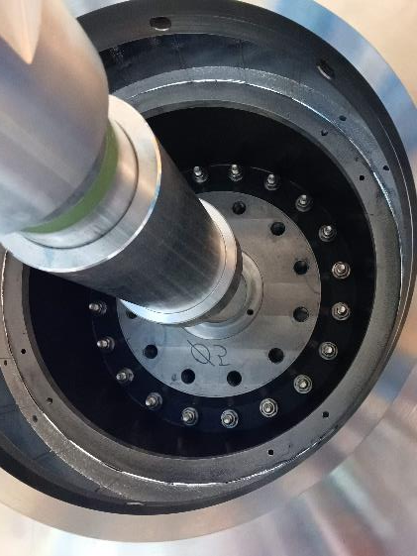
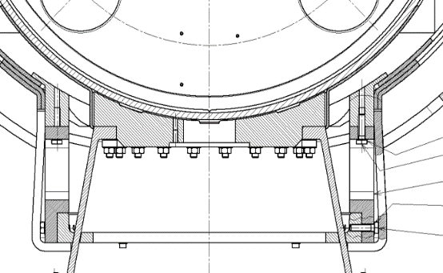
Interfaces
Cold Mass to Cryo-Assembly
Mounting of GFRE support post to Cold Mass support
Defined by the CERN-provided Q1/Q3 3-D model

Slide 6
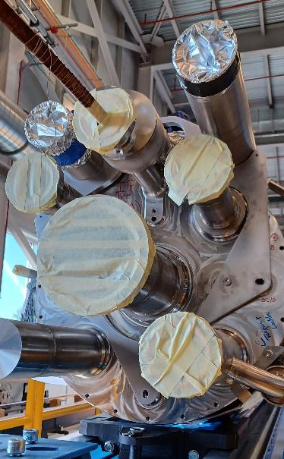
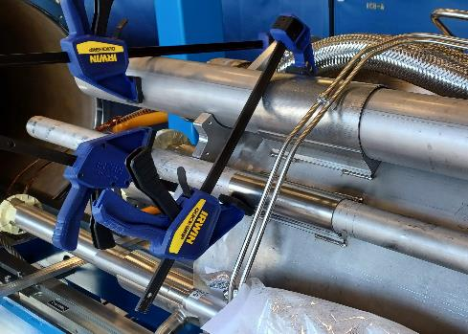
Interfaces
Cold Mass to Cryo-Assembly
Mounting of pipe brackets to Cold Mass
Defined by the 3-D model, managed by the assembly traveler and the CERN-provided positioning tooling

Slide 7
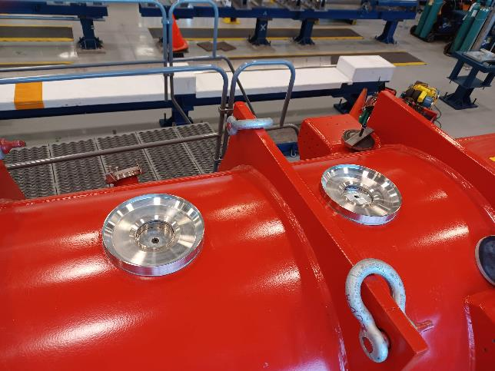
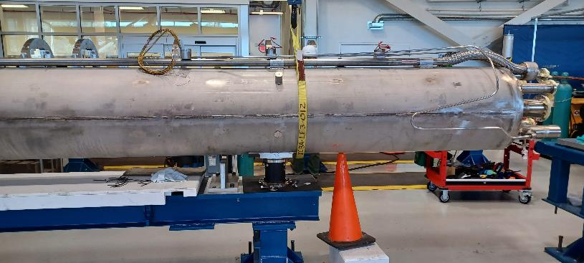
Interfaces
Cold Mass to Cryo-Assembly
CLIQ/KMOD/IFS warm heads
Defined by the 3-D model, managed by the assembly traveler

Slide 8
Models and Drawings
The LQXFA Cryo-Assembly is the Cold Mass, thermal shield, and cryogenic piping installed in the cryostat.
Vacuum vessel
9345 mm (30 ft 8 in) long
1055 mm (3 ft 6 in) wide
1389 mm (4 ft 7 in) high
Cryo-Assembly
21,769 kg (48,000 lbf) (CA-01 measured weight)

Slide 9
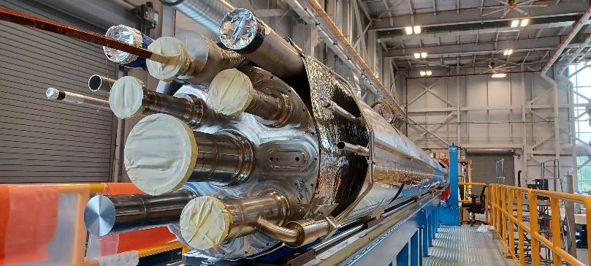
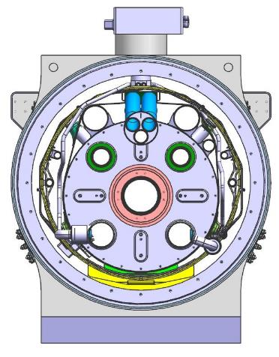
Models and Drawings
The LQXFA Cryo-Assembly is the Cold Mass, thermal shield, and cryogenic piping installed in the cryostat.
Interface box for CLIQ/IFS/k-mod (qty. 5)
1.9 K pumping line (qty. 2)
Quench/cool-down line
Thermal shield/beam screen supply (qty. 2)
Thermal shield
Thermal shield cooling flow (qty. 2)
Vacuum vessel
Cold Mass

Slide 10
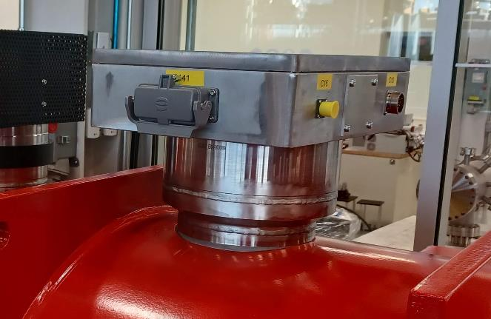
Models and Drawings
The 3-D model is complete and is the basis for all drawings.
Final Design Report is found at US HiLumi-doc-2882.
All Cryo-Assembly detail and assembly drawings have been released with the exception of IFS drawings, for which seven drawings are shown as either “Ready for Approval” or “In Work” in EDMS.

Slide 11
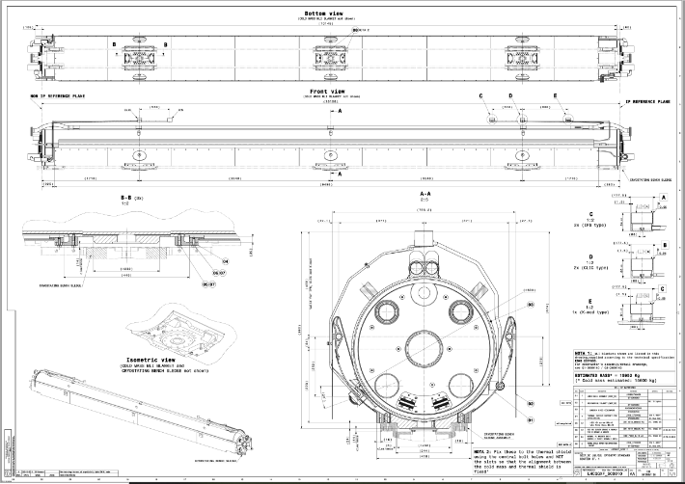
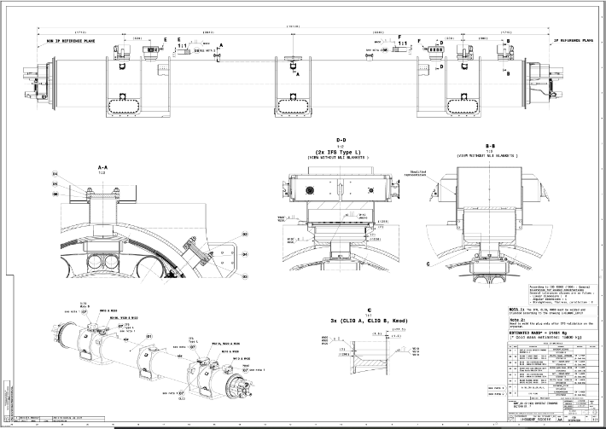
Models and Drawings
The Cryo-Assembly assembly process is detailed in seven CERN assembly drawings, all of which are released.

Slide 12
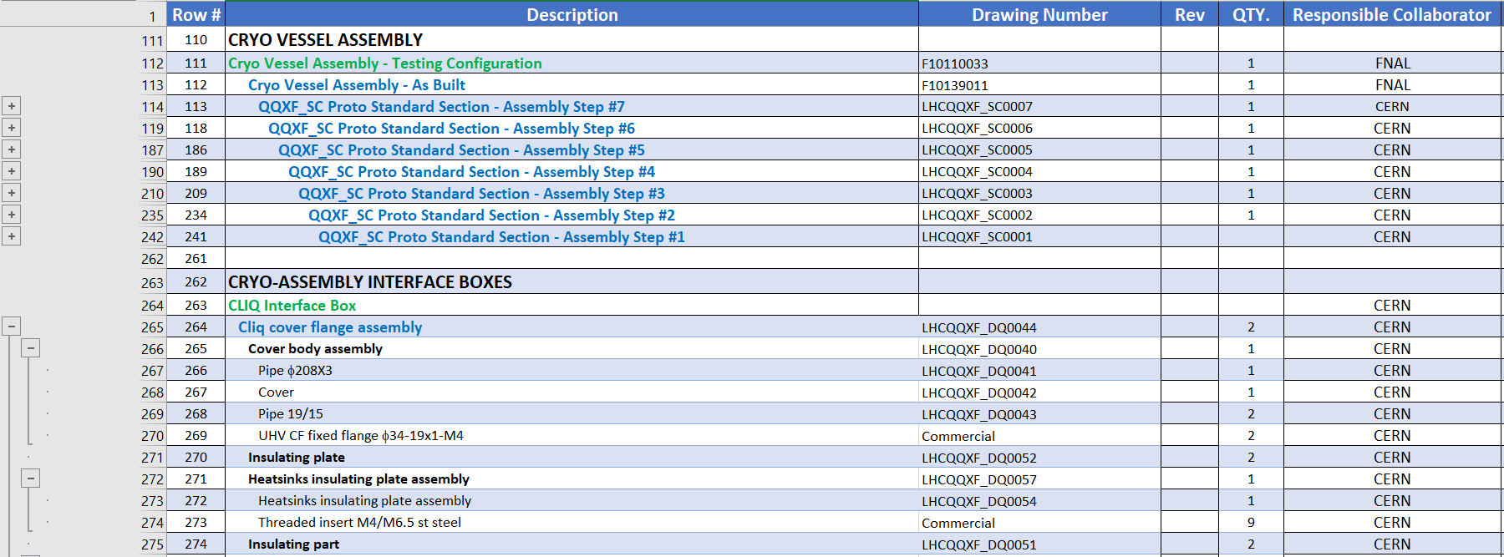
Models and Drawings
A drawing tree spreadsheet is found in US-HiLumi-doc-3010.
The latest revisions of CERN Cryo-Assembly drawings are found in US-HiLumi-doc-3001.

Slide 13
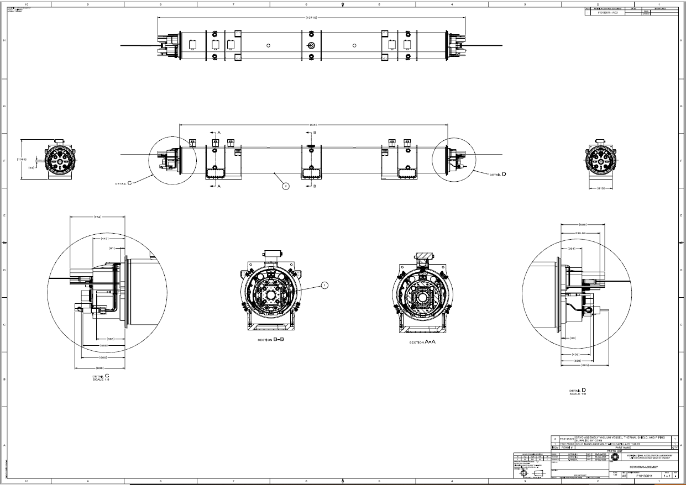
Models and Drawings
F10139011 is the Cryo-Assembly model/drawing.
Fermilab Cold Mass
CERN vacuum vessel, thermal shield, and Cryo-Assembly piping
Cryo-assembly F10139011
Cold Mass w/ Capillaries F10178090
Cold Mass Assy F10103605
Shell Closure F10138327
Shell Setup Preweld F10138328
Alignment F10138330
Bus + Expansion Loops F10138329

Slide 14
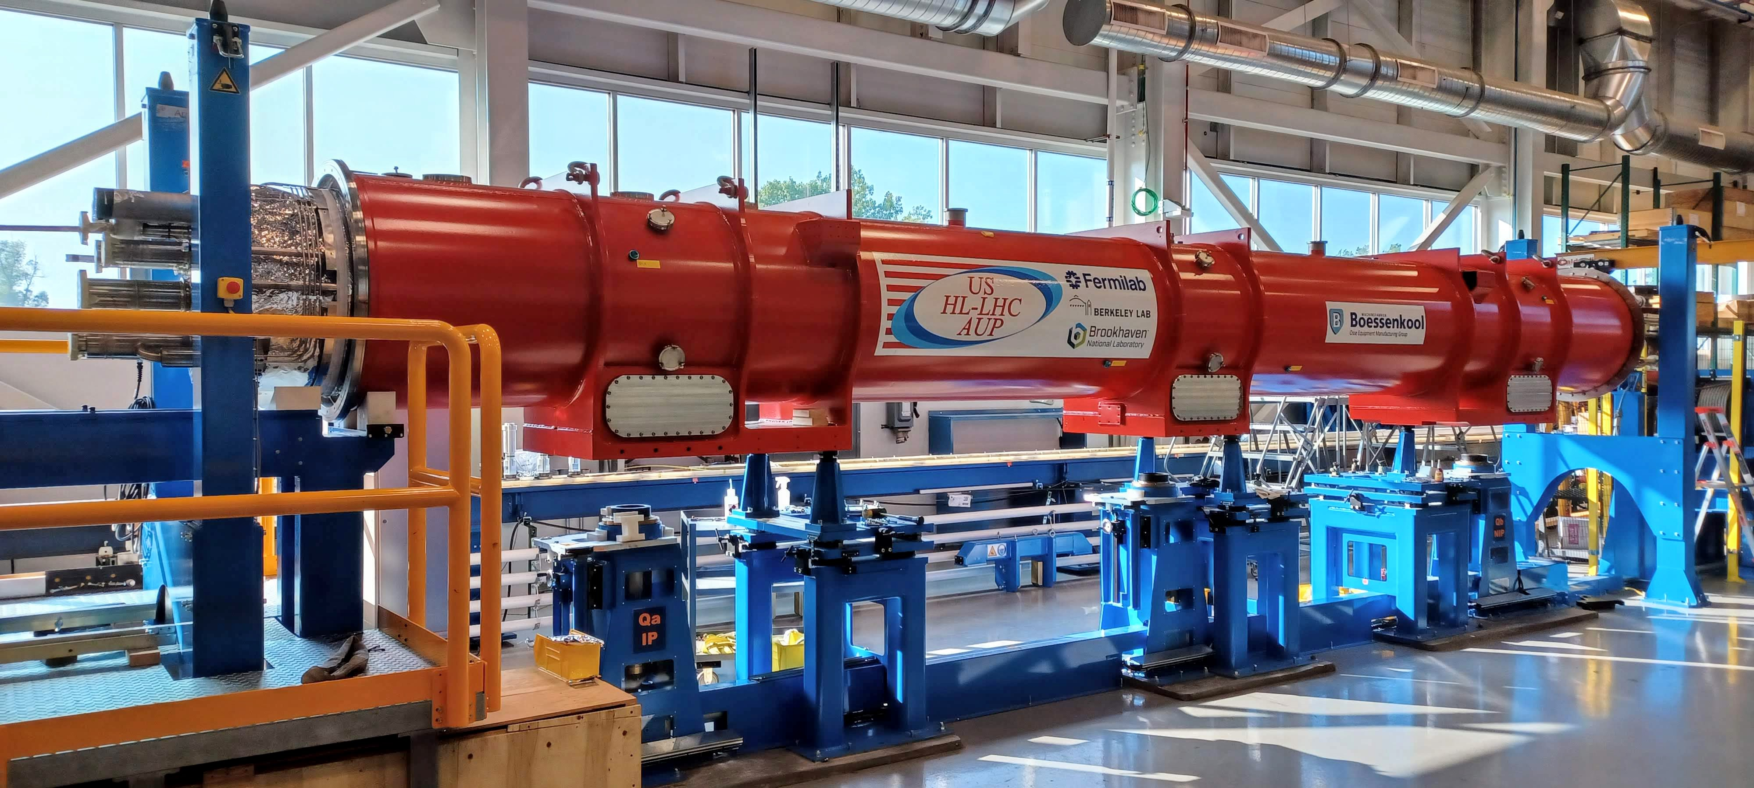
Validation
The first Pre-Series Cryo-Assembly LQXFA01 has met all required mechanical and thermal requirements.
Weight (48,000 lbf (21,769 kg) ≤ 22,500 kg)
Alignment of Cold Mass within the vacuum vessel (Dimensional Inspection Report)
Heat load

Slide 15
Organization and Personnel
302.4
Q1/Q3 Cryo-assemblies Fabrication
L2: S. Feher
(T. Strauss)
302.4.03
Cryo-Assemblies Fabrication
L3/CAM: A. Nobrega (R. Rabehl)
302.4.04
Cryo-Assemblies Horizontal Test
L3/CAM: G. Chlachidze
(S. Stoynev)
302.4.01
Magnets Vertical Test
L3: P. Joshi (A. Yahia)
CAM: P. Joshi
302.4.05
Q1/Q3 Cryo-assembly Integration and Coordination
L3/CAM S. Feher (T. Strauss)
302.4.02
Cold Mass Assemblies Fabrication
L3/CAM: A. Nobrega (A. Vouris)
Engineers: R. Rabehl
Tech Floor Supervisor: A. Lake
S. Klema
M. Larson
D. Davis
M. Jamison
A. Coon (Oct)
P. Fox (Oct)
R. Diamond (C)
O. Medera (C)
T. Fisk (welder)
US-HiLumi-doc-104

Slide 16
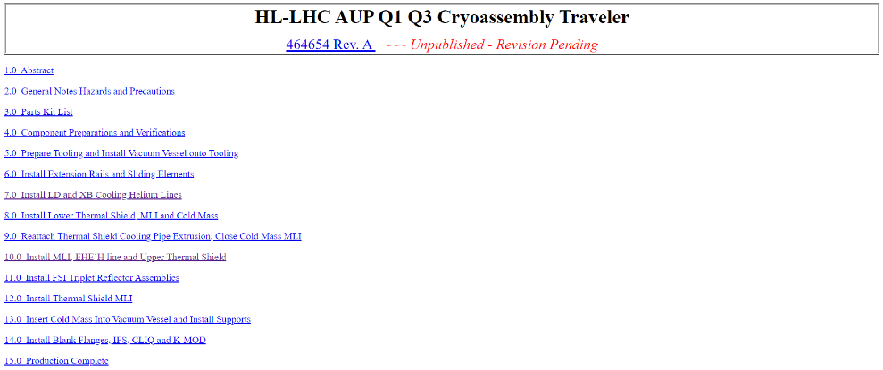
Manufacturing
Cryostating first assembly procedure (EDMS 2681264) was released and used for assembly of the first Cryo-Assembly.
This CERN procedure is the basis for Fermilab Vector traveler 464654-A (release in progress) to be used for the remaining Cryo-Assemblies.

Slide 17
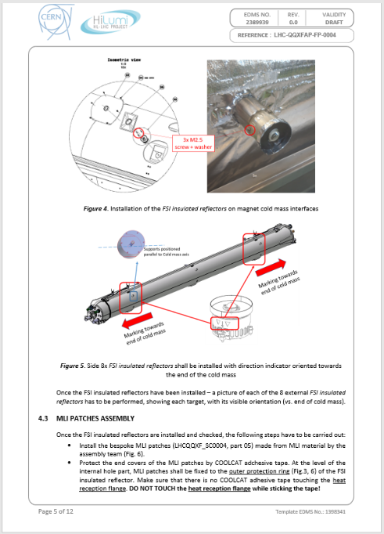
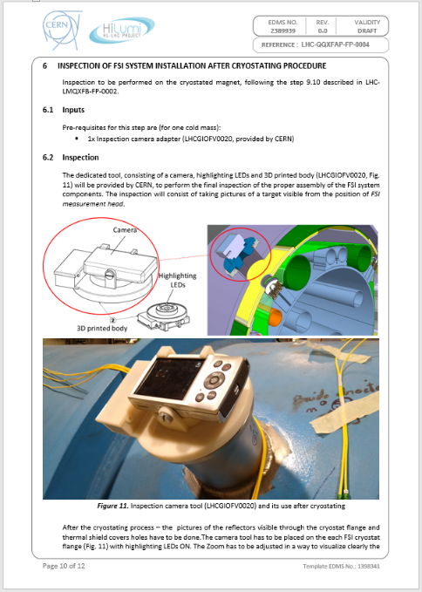
Manufacturing
Installation and positioning of FSI Cold Mass position monitoring system (EDMS 2389939) is Released.

Slide 18
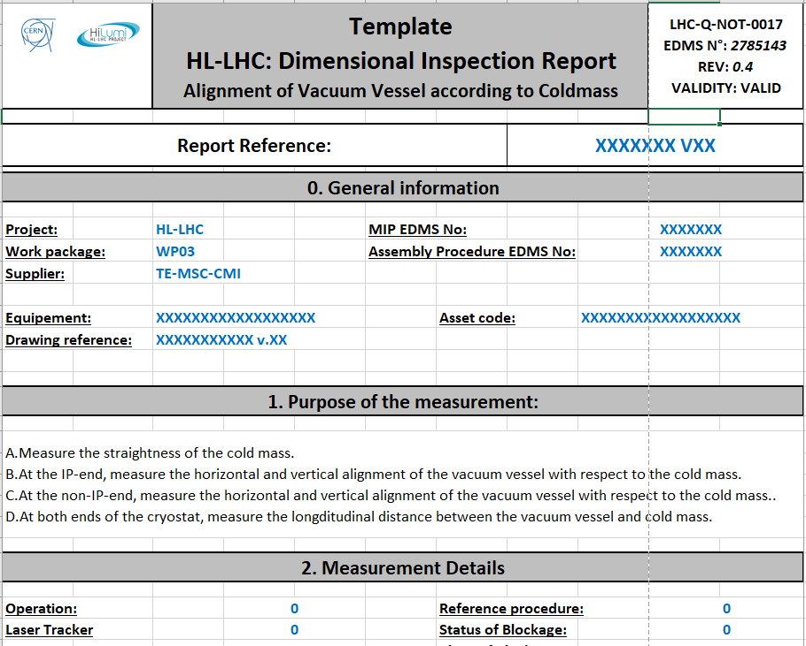
Manufacturing
Dimensional Inspection Report for alignment of the cold mass inside the cryostat (EDMS 2785143) is Released.

Slide 19
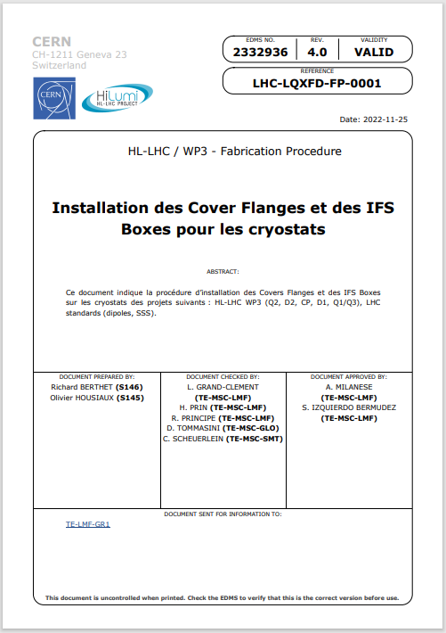
Manufacturing
IFS box and cover flange installation procedure (EDMS 2332936) is Released.

Slide 20
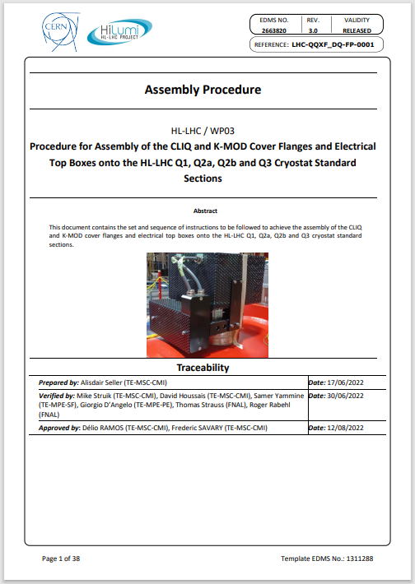
Manufacturing
CLIQ and KMOD box and cover flange installation procedure (EDMS 2663820) is Released.

Slide 21
QA/QC
The QC steps are captured in the traveler (Vector 464654), which verifies the cold mass meets the electrical and mechanical specifications at each step of the assembly process as the cold mass is integrated into a cryo-assembly.
Mechanical tests
Dimensions and location of cryo-assembly components
Leak check of the CLIQ/KMOD/IFS warm head welds to the vacuum vessel
Electrical tests
Hipot tests
Temperature sensor four wire measurements
Voltage-tap continuity measurements

Slide 22
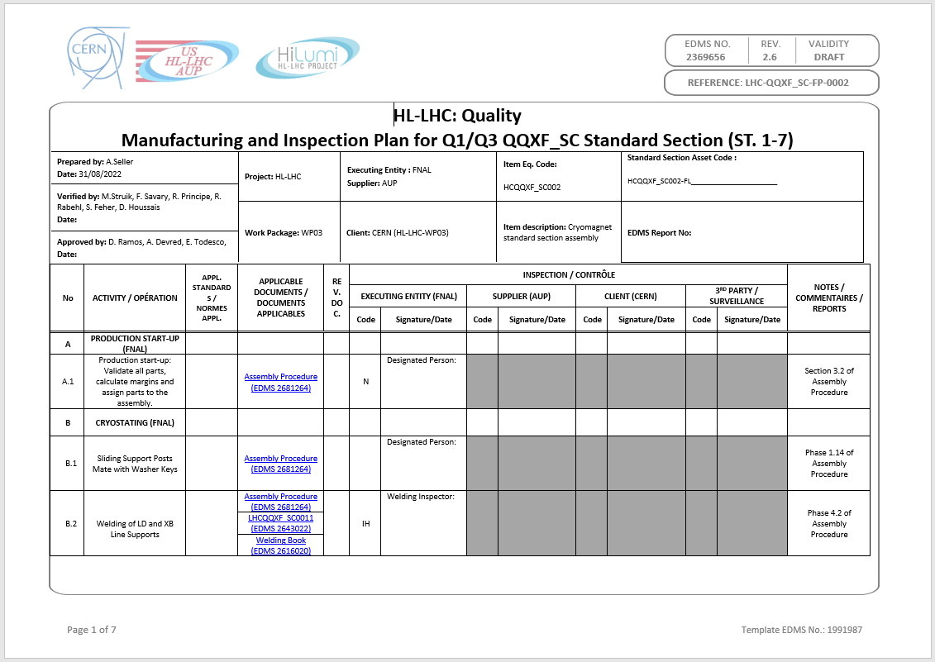
QA/QC
The QA plan is the CERN Manufacturing & Inspection Plan, which is referenced by the Fermilab Vector traveler 464654-A.
The changes in going from the Pre-Series MIP to the Series MIP are
No longer any FSI-related hold points
On-site measurement/validation of the FSI system by CERN personnel was required for only the first Cryo-Assembly.
CERN EDMS 2369656 is in the release process (v. 2.6).

Slide 23
ES&H
Risk categories have been identified and assessed in the Hazard Analysis Report (HAR) US-HiLumi-doc-1121.
Hazards of Cryo-Assemblies Fabrication
Material handling
Use of overhead crane and lifting fixtures
Manual material handling
Vehicles
Hazardous materials
Compressed gases and cryogens for purging and welding
Solvents and resins
Mechanical hazards
Grinding tools, power tools, and assembly tooling
Radiation hazards
UV light from welding
Electrical hazards
High voltage tests
Fire hazards
Welding, soldering

Slide 24
Summary
The cryo-assembly model is complete
Other than the CERN IFS drawings, all drawings have been released.
Manufacturing team is in place.
Fermilab assembly traveler has been released.
CERN manufacturing and inspection plan is being released.
ES&H hazards have been identified and are addressed through the project Hazard Analysis Report.
The project and the team are ready for Series Cryo-Assembly production.

