Slide 1
Cold Mass & Cryo-assembly Series Production Plan
Fred Nobrega, L3/CAM
HL-LHC AUP CA Series Production Readiness Review – September 6, 2023

Slide 2
Outline
Cold Mass & Cryo-assy Series Production Plan
Scope
Organization
Travelers & Assembly Drawings
Schedule
ES&H
QA/QC
Summary

Slide 3
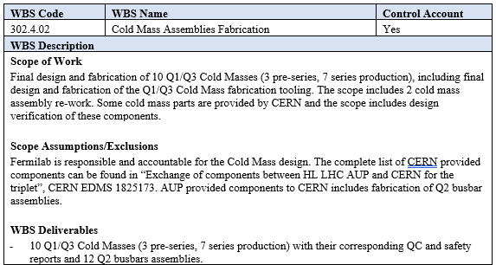
WBS 302.4.02: Scope
Scope of work includes Final Design and Fabrication
10 Q1/Q3 Cold Masses - 3 pre-series, 7 series production
2 Cold Mass assembly re-work
Design & Fabrication of Cold Mass Tooling
Design & Fabrication of 12 Q2 Busbar assemblies
WBS Deliverables include 10 Q1/Q3 Cold Mass assemblies with QC & Safety
Reports and 12 Q2
Busbar assemblies
See WBS Dictionary:
US-HiLumi-doc-39

Slide 4
WBS 302.4.03: Scope, FRS, Acceptance Criteria
Scope of work for Cryo-assemblies fabrication
10 Q1/Q3 cryo-assemblies, 3 pre-series, 7 series production
2 cryo-assemblies re-works
CERN supplied cryostat kits
Deliver to Horizontal Test Facility for testing
Ship tested cryo-assembly to CERN
WBS Deliverables: 10 accepted Q1/Q3 cryo-assemblies
See WBS Dictionary: US-HiLumi-doc-39
WBS Code | WBS Name | Control Account
302.4.03 | Cryo-assemblies fabrication | Yes
WBS Description
Scope of Work Assemble 10 Q1/Q3 cryo-assemblies (3 pre-series, 7 series production). The scope includes 2 cryo-assembly re-works. Each cryo-assembly has one cold mass assembly inside the CERN-supplied cryostat. Activities include receive a complete kit of cryostat parts from CERN, assemble the CERN cryostat, insert the cold mass assembly into the cryostat, and deliver to Horizontal Test Facility for testing. After a successful horizontal test, prepare the cryo-assembly for shipment. Scope Assumptions/Exclusions The following items are off project scope: Q1/Q3 Cryostats design (CERN is responsible and accountable for this design). CERN is responsible for the procurement of kits and tooling for the assembly of the Q1/Q3 cryostats, including shipment to AUP at Fermilab. CERN is responsible for the development of assembly plans and QA/QC plans for the Q1/Q3 cryostats assembly. CERN will provide guidance to support the tooling installation and onsite support to train AUP personnel during the assembly of the prototype cryo-assembly. 20% of the cryo-assemblies (2 out of 10) are assumed to need to be re-worked before they can pass horizontal acceptance test. WBS Deliverables 10 Q1/Q3 accepted cryo-assemblies
Functional requirements specification FRS and acceptance criteria (US-HiLumi-doc-3133):
Physical dimensions, weight of Cryo-Assembly
Positioning performance and capabilities
Allowable traction forces
Allowable accelerations
Operator controls
Support post installation

Slide 5
Project Organization
302.4
Q1/Q3 Cryo-assemblies Fabrication
L2: S. Feher
(T. Strauss)
302.4.02
Cold Mass Assemblies Fabrication
L3/CAM: A. Nobrega (A. Vouris)
302.4.03
Cryo-Assemblies Fabrication
L3/CAM: A. Nobrega (R. Rabehl)
302.4.04
Cryo-Assemblies Horizontal Test
L3/CAM: G. Chlachidze
(S. Stoynev)
302.4.01
Magnets Vertical Test
L3: P. Joshi (A. Yahia)
CAM: P. Joshi
302.4.05
Q1/Q3 Cryo-assembly Integration and Coordination
L3/CAM S. Feher (T. Strauss)
Control Account
Engineers: R. Bossert, L. Martin, A. Vouris, R. Rabehl
Tech Floor Supervisor: A. Lake
S. Klema
M. Larson
D. Davis
M. Jamison
A. Coon (Oct)
P. Fox (Oct)
R. Diamond (C)
O. Medera (C)
T. Fisk (welder)

Slide 6
Approval of Costs, Scope
Handover between accounts
AUP CM+CA Project Org Chart
Details, Procedures, Approval of Materials
Schedule
L2 Manager
S. Feher
L3 Fred Nobrega
L2 - deputy
Thomas Strauss
Instrumentation
Luke Martin
BusBar
Rodger Bossert
Cryostating + Test
Roger Rabehl
Cold Mass
Antonios Vouris
Technician
Work hours
Monday - Friday
7:00 - 15:30
Floor Supervisor
Anthony Lake
Scott Klema
Matt Larson
Marlon Jamison
Marc Vallejo
Welder
Thea Fisk
Robert Diamond
Oscar Madera
Deonte Davis
Pat Fox

Slide 7
Cold Mass Series Production
LMQXFA Cold Mass fabrication consist of 5 workstations & tooling:
Alignment workstation
Longitudinal welding workstation
Inspection workstation
Rework workstation (Configured as Alignment WS)
Bus wrapping and Soldering workstation
The Alignment Workstations has additional tooling for End cover/Beam Tube fit up and welding
3 various lifting fixtures are used during Cold Mass assembly
WACHS Cutter with boring bar adapter

Slide 8
Cryo-assembly Series Production
MQXFA Cryo-assembly workstation
The assembly table is for the cold mass thermal shield, piping, and MLI assembly steps.
The cryostat support tables support the cryostat for all assemblies & disassembly steps.
Motorized winches pull completed cold mass assembly into or out of the cryostat.
Synchronized jacks place the cold mass onto the cryostat. Also used for installation & removal of the shipping posts.
Stabilizers used to prevent the cold mass from tipping when only supported by the synchronized jacks.

Slide 9
ICBA Cryo-assembly Series Production
Work Station Layout
Cryostat Staging
Cryostat Staging
Alignment
Longitudinal Welding
Incoming magnet inspection
Shipping
Inspection
Alignment/Rework
Cryostating
Bus Wrapping & Soldering

Slide 10
Travelers
Well developed and released.
Technicians and engineers sign off as steps are completed.
Hold points for inspection and review of data
Discrepancy reports used for nonconformities & discrepancies written against traveler steps.
464574 HL-LHC AUP MQXFA Incoming Inspection and QA Traveler
464525 HL-LHC AUP Q1 Q3 Cold Mass Assembly Traveler
464507 HL-LHC AUP LMQXFA Bus Bar Traveler
464720 HL-LHC AUP Q1 Q3 IFS, CLIQ, Kmod Capillary Assemblies Traveler
464654 HL-LHC AUP Q1 Q3 Cryo-assembly Traveler

Slide 11
Assembly Drawings & Procedures
Design models complete
Assembly & component drawings released
Procedures released
Cryo-assembly F10139011
Cold Mass w/ Capillaries F10178090
Cold Mass Assy F10103605
Shell Closure F10138327
Shell Setup Preweld F10138328
Alignment F10138330
Bus + Expansion Loops F10138329
Cryo-assy for Testing in IB1 F10111033
Pressure Test Cold Mass Assy
F10172809
DocDB | Title
#3067 | AUP Lifting Fixtures Procedure
#3278 | HL LHC Inner triplet magnets metrological controls & measurements
#3284 | FSI support assembly on the cold mass
#3755 | Ultrasonic Phased Array Examination of Welds
#3966 | Electrical Checks of AUP
#4018 | Q1/Q3 Bus insertion, expansion loop and instrumentation placement
#4191 | Magnet prework procedure before LMQXFA cold mass
#4286 | Adding plug, sleeve and color coding to Q1/Q3 cold mass wires
#4612 | He Shell Cleaning Procedure
#4615 | Cold Mass Shell Welding Plan and Execution Procedure
#4616 | He Shell Post Weld WACHs Cutting
#4618 | Beam Tube & Heat Exchanger Installation
#4621 | HL-LHC AUP LMQXFA HMSLD Leak Testing Procedure
#4623 | Cold Mass Pressure Testing
#4624 | SSW measurement

Slide 12
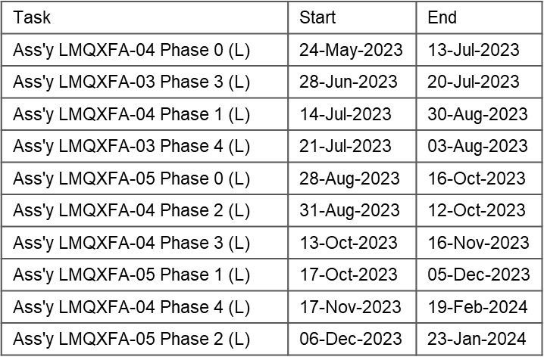
Cold Mass 6 Month Schedule
Cold mass assembly (39 wks) is split into 5 phases, 0-4.
P6 schedule from WAD (US-HiLumi-doc-1235)

Slide 13
Cold Mass Tasks
464574 HL-LHC AUP MQXFA Incoming Inspection and QA Traveler
1.0 Abstract
2.0 General Notes Hazards and Precautions
3.0 Supporting Documentation
4.0 Visual Inspection
5.0 Mechanical Test
6.0 Electrical Measurements
7.0 Review/Approval by the L2
8.0 Production Complete
464525 HL-LHC AUP Q1 Q3 Cold Mass Assembly Traveler
1.0 General Notes
2.0 Parts Kit List
3.0 Prepare Tooling for Assembly
4.0 LMQXFA Cold Mass Tack Block Mounting
5.0 MQXFA (a) Magnet Placement
6.0 MQXFA (b) Magnet Placement
7.0 MQXFA (a/b) Magnet Alignment
8.0 Beam Tube Insertion
9.0 Bus Bar & Instrumentation Connection and Assembly
10.0 Heat Exchanger (HT-X) Installation
11.0 Electrical Inspection
12.0 Shell Installation and Welding
13.0 End Cover Installation
14.0 Beam Tube & Heat Exchanger (HT X) Alignment and Welding
15.0 Non-Destructive Exam
16.0 Mount Extremities
17.0 Electrical Inspection
18.0 PPD Alignment Survey
19.0 Capillary Installation
20.0 Pressure Testing
21.0 Cold Mass Weight
22.0 Review/Approval of Cold Mass
23.0 Production Complete
(0)
(1)
464507 HL-LHC AUP LMQXFA Bus Bar Traveler
1.0 General Notes
2.0 Parts Kit List
3.0 Manufacture Local Bus
4.0 Through Bus
5.0 Wrap Local Bus
6.0 Wrap Through Bus
7.0 Final Wrap of Bus Assembly (F10119849)
8.0 Inspections
9.0 Place the bus in a PVC pipe and store for future use.
10.0 Assembly of Bus into Bus Housing
11.0 Storage
12.0 Production Complete
(2)
(3)
(4)
464720 HL-LHC AUP Q1 Q3 IFS, CLIQ, Kmod Capillary Assemblies Traveler
1.0 Abstract
2.0 General Notes Hazards and Precautions
3.0 IFS Capillary Tube Installation Qa End
4.0 IFS Capillary Tube Installation Qb End
5.0 CLIQ Assembly Installation
6.0 CLIQ/Kmod Assembly Installation
7.0 Production Complete

Slide 14
Cryo-assembly 6 Month Schedule & Tasks
Cryostat assembly duration is 9 wks
P6 schedule from WAD (US-HiLumi-doc-1238)
464654 HL-LHC AUP Q1 Q3 Cryo-assembly Traveler
1.0 Abstract
2.0 General Notes Hazards and Precautions
3.0 Parts Kit List
4.0 Prepare Tooling and Install Vacuum Vessel onto Tooling
5.0 Install Extension Rails and Sliding Elements
6.0 Install Lower Thermal Shield, MLI and Cold Mass
7.0 Install LD and XB Cooling Helium Lines
8.0 Install MLI, EHE’H line and Upper Thermal Shield
9.0 Install FSI Triplet Reflector Assemblies
10.0 Install Thermal Shield MLI
11.0 Insert Cold Mass Into Vacuum Vessel and Install Supports
12.0 Install Blank Flanges, IFS, CLIQ and K-MOD
13.0 Production Complete

Slide 15
ES&H
ES&H coordinator is Amy Pavnica
Operational hazards during Cold Mass assembly include Mechanical, Electrical, Welding and Pressure hazards
The risk categories of identified hazards are in
US-HiLumi-doc-1121
Main Hazards
Hazardous materials: solvents, resins, cryogens
Power tools: grinding, drilling, sanding
Use of overhead crane and lifting fixtures
High voltage tests
Welding: burns, UV flashing and Hexavalent Chrome inhalation

Slide 16
Summary
Production team is fully staffed.
Travelers are detailed and mature.
Drawings and procedures are released
The production plan uses the assembly travelers and P6 schedule.
The fabrication teams are successfully using the workstations, tooling, travelers, and process procedures to assemble the pre-series cold masses and cryo-assemblies.
The production assembly team is ready for Series Cold Mass and Cryo-Assembly production.

Slide 17
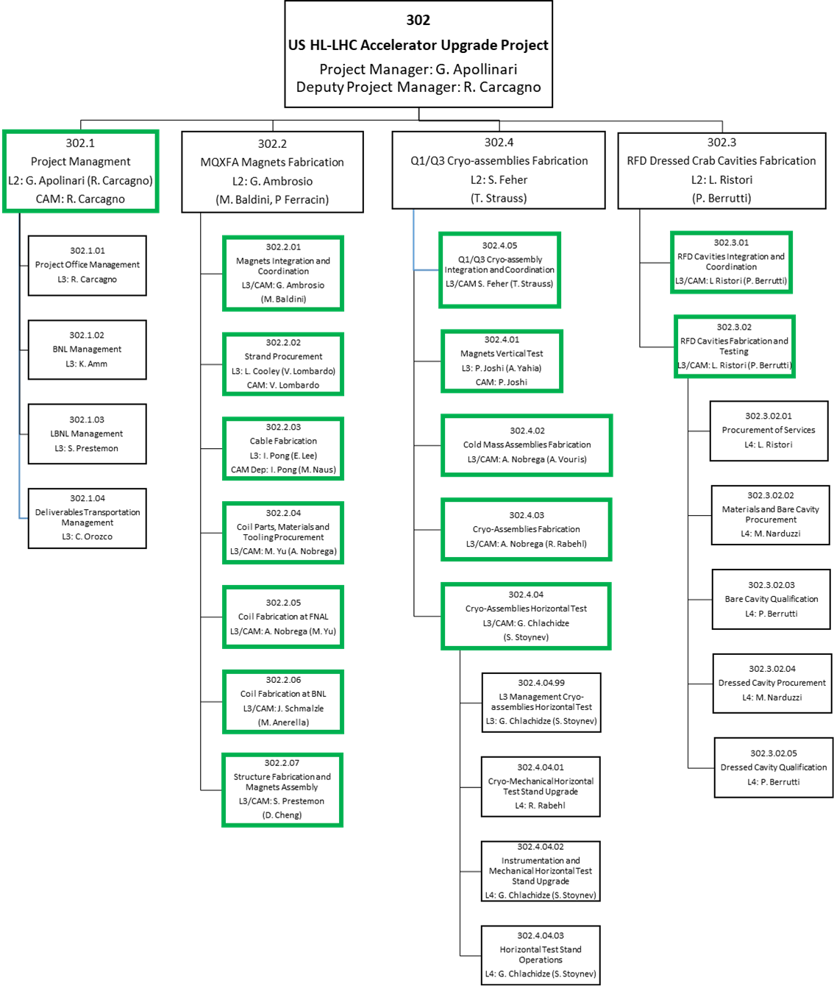
Project Organization

