Slide 1
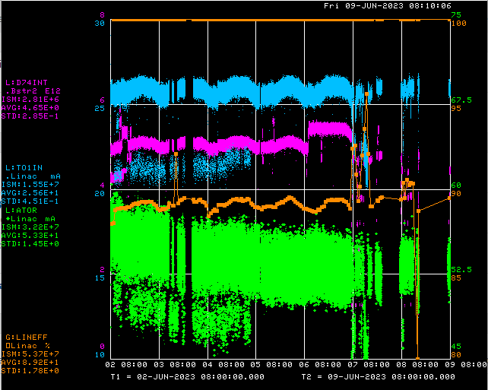
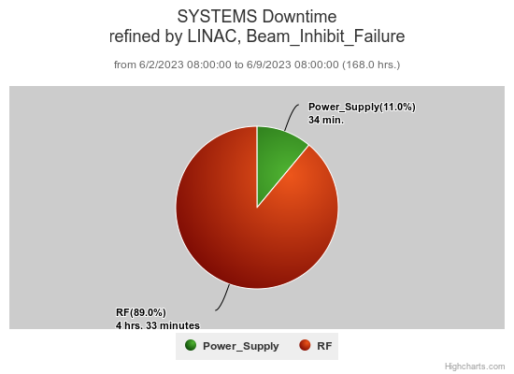
Preacc/Linac Weekly Performance
No Preacc
Downtime
Weekend LRF3 driver anode fuse/interlock failure
Monday LRF4 LLRF reboot
Wednesday DeBuncher phase scans
LEBT horizontal study
Replaced QPS228
Thursday Replaced penetration chipmonk
SCL 4-1 BPM troubleshooting
PMT filter test
All week:
KRF2, 5 CS faults
QPS228

Slide 2
Current Conditions/Plans
Source A – 53 mA
Linac input – 26 mA
Linac output – 23 mA, 4E12 /pulse
1 hr. enclosure access to retrieve PMT filter

