Slide 1
Radiation Safety – Weekly Update
ES&H RPO Department
06/09/2023 9am Ops Meeting

Slide 2
Enclosure Briefings
Enclosures with local High Radiation Areas and/or Contamination Areas continue to require enclosure access briefings, for either Controlled Access or Supervised Access.
Contact RSO is you are unable to attend scheduled briefing.
Daily briefings for non-AD available on access days.
+ means Contamination Area
* means High Radiation Area
% means only when shield blocks removed
Current List:
MTA +
Booster *+
8 GeV *+
BNB *
MI-20—MI-62 *+
NuMI Pre-Target / Target Hall *+%
NuMI Absorber Hall *+
Muon Campus US/DS +

Slide 3
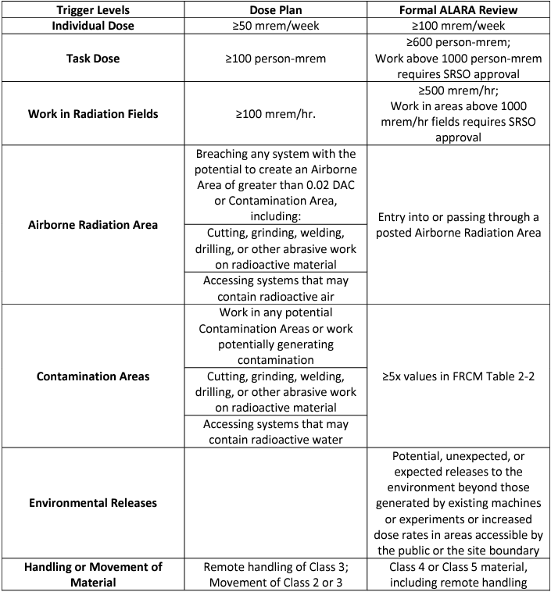
Shutdown ALARA and Dose/Job Plans
Shutdown is coming up, make sure all relevant jobs are reviewed by Radiation Safety. Triggers for a Dose Plan and a Formal ALARA Review are on the right, and a link to the review spreadsheet is below.
http://esh-docdb.fnal.gov/cgi-bin/RetrieveFile?docid=1316

Slide 4
Shutdown ALARA and Dose/Job Plans
Job | Location | Worklist | Rad Safety Requirement
Ring wide vacuum leak check | Booster | 22859 | RCT/RWP/ALARA
MP02 ion pump replacement | Booster | 22855 | RCT/RWP/ALARA
Decon Collimator Region | MI-8 | 23683 | RCT/RWP/ALARA
MI RF Cavity LCW Upgrades | Main Injector | 22956 | RCT/RWP/ALARA
Summer 23 Linac tank 5 repair (if needed) | linac | 22947 | RWP/RCT/ALARA

Slide 5
Contacting your RSO!
If you’re unsure which RSO is responsible for your area, or need to reach a wider audience of RSOs, we have a group email.
ESH_RSO@FNAL.GOV
If you’re curious who your assigned RSO is, please use the link below or go to the ESH website, click on Radiological Protection, then click RSO Coverage and Contact Info on the right hand column:
https://esh-docdb.fnal.gov:440/cgi-bin/ShowDocument?docid=3846

